Slide 1
Update Physics Data Processing
David Groep
Nikhef staff meeting
15 October 2021

Slide 2
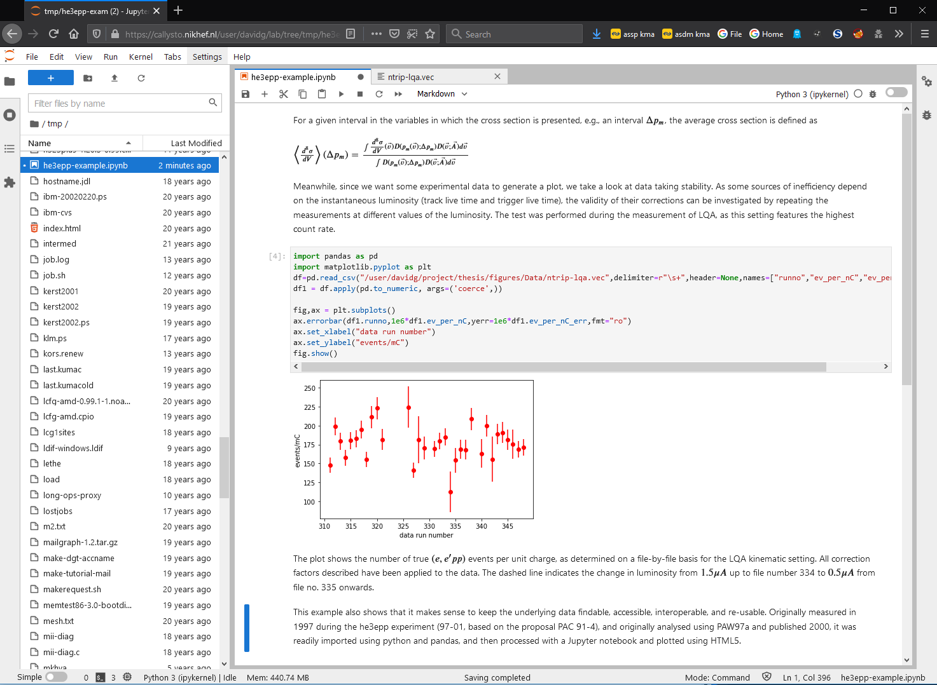
Today news: Callysto
Notebooks for (python) interactive analysis
pre-production service
comparable to stbc-i*
with your own home, project, data & dcache
64 EPYC AMD cores
basis for ‘cloud’ analysis
co-creation = innovation
use on-site network or eduVPN IA (see https://wiki.nikhef.nl/ct/EduVPN)
and go to https://callysto.nikhef.nl/
service will contain rough edges and, yes, the login experience will improve soon ☺

Slide 3
But such easy access is … ‘for your eyes only’
We have to protect our key assets, like $HOME, software on /project, or ‘/dcache’
and we join in exercises to see what happens if we, Nikhef, deny key assets to others … ☺
‘How we organize large-scale DDoS drills in the Netherlands’
at the NCSC One Conference
https://nationalespeeltuin.nl/
image sources: NCSC One Conference 2021, https://emagazine.one-conference.nl/2021/keynotes-and-webinars/

Slide 4
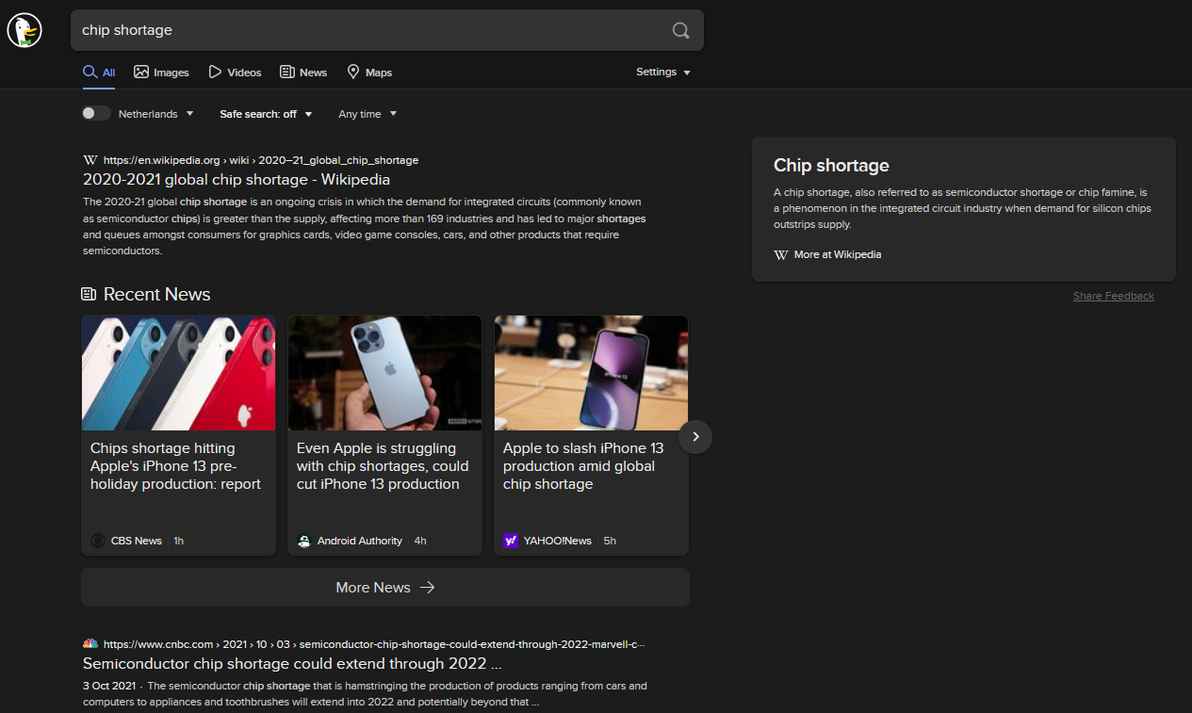
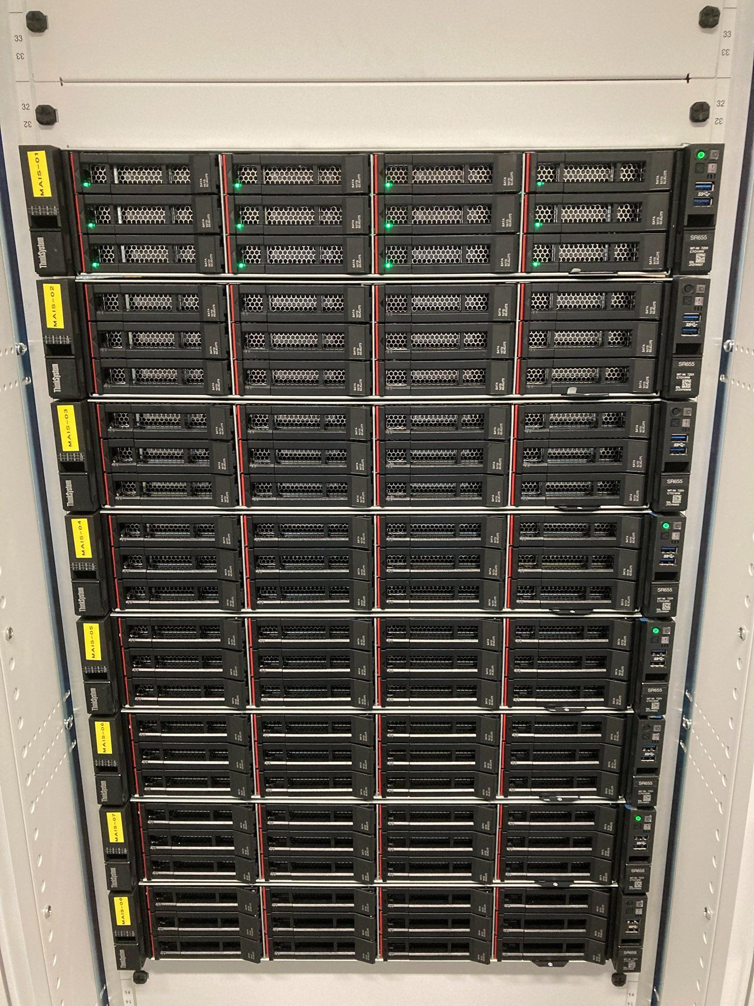
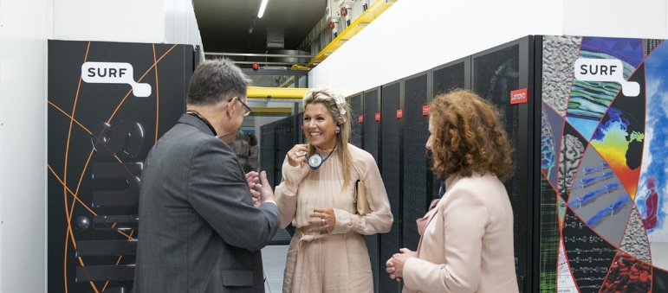
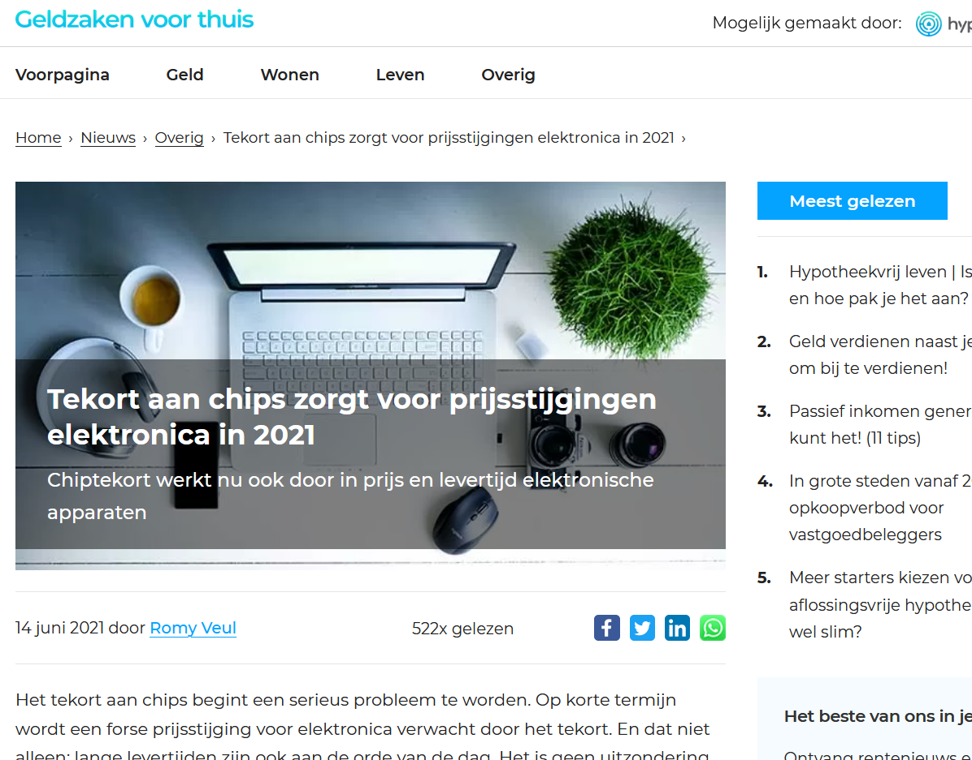
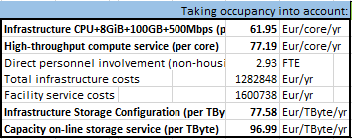
+ 1.6 PiB … + 2176 cores …
‘My name is Snellius – EPYC Snellius’
image sources: https://www.hypotheek.nl/nieuws/overig/prijzen-elektronica-2021-omhoog/ Search engine results from duckduckgo.com
TCO for the NDPF HTC and HTS services cost for production year 2022

Slide 5
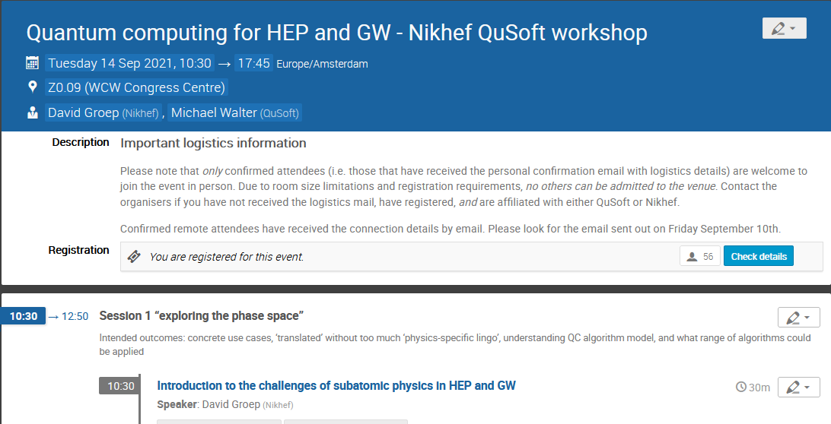
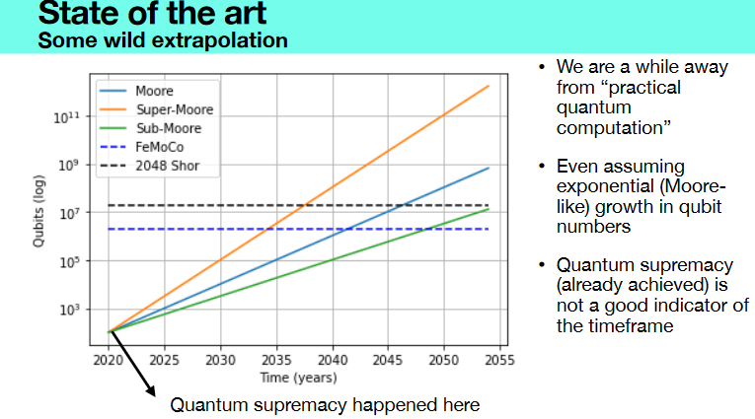
But even that won’t get us to 2035+
Slides thanks to: Jonas Helsen (CWI & QuSoft) Ronald de Wolf (QuSoft, CWI and UvA)
https://indico.nikhef.nl/e/qchepgw-0914

