Slide 1
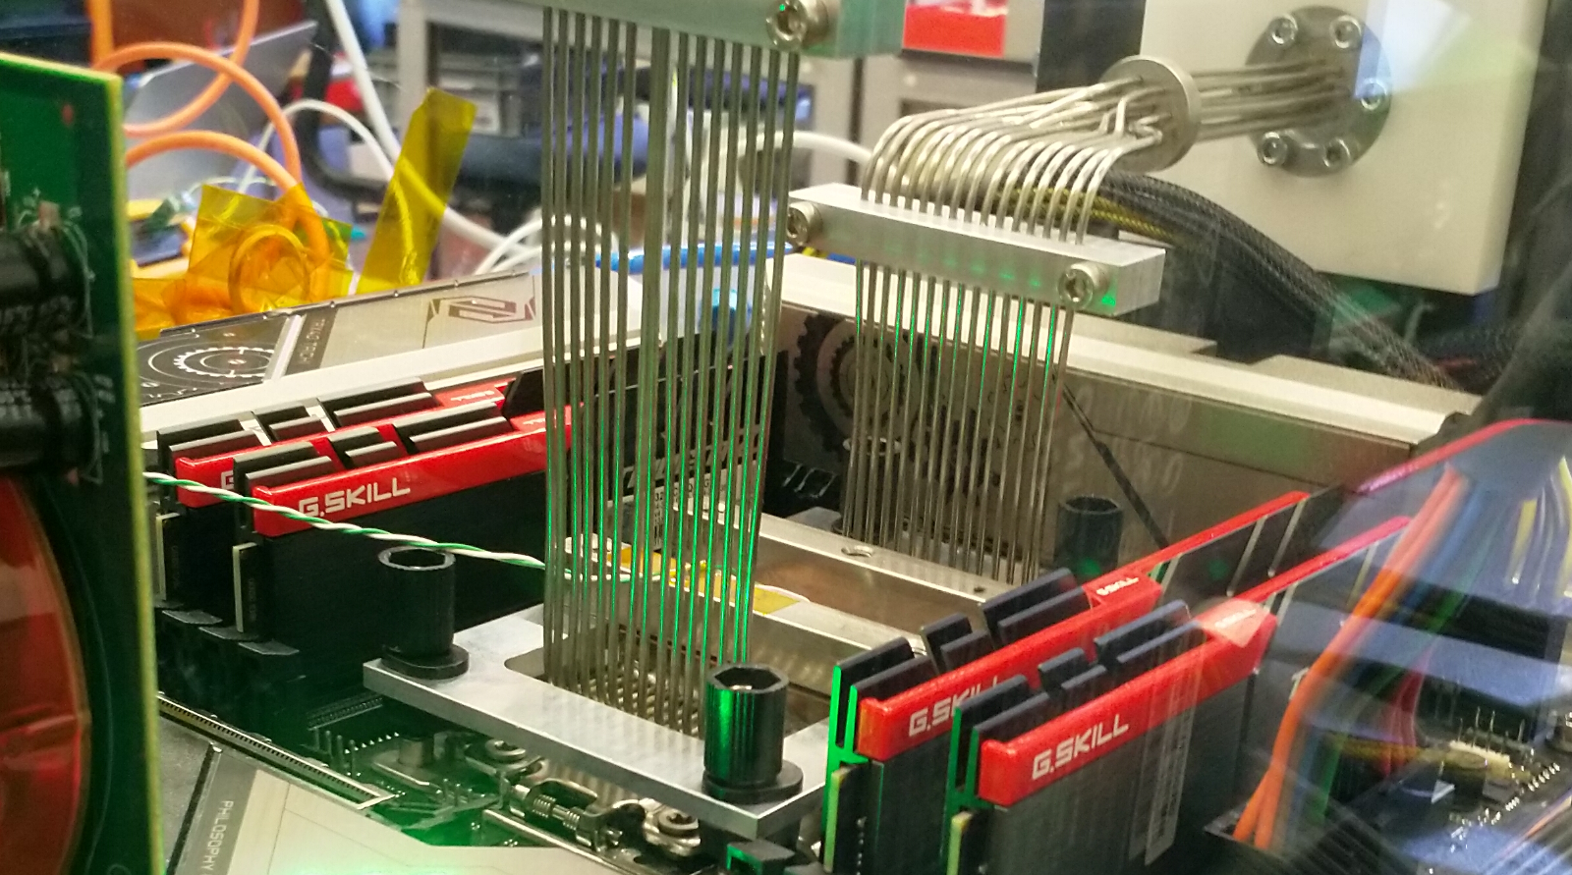
Physics Data Processing accelerating ‘time to science’ through computing and collaboration
scientific platform meeting January 2026
David Groep

Slide 2
David Groep - PDP Gerhard Raven - {LHCb, PDP} Jeff Templon - PDP Mary Hester - CT-PDP Roel Aaij - PDP Ronald Starink - CT-.*
Today with a joint PDP-CT-PDP attendance

Slide 3
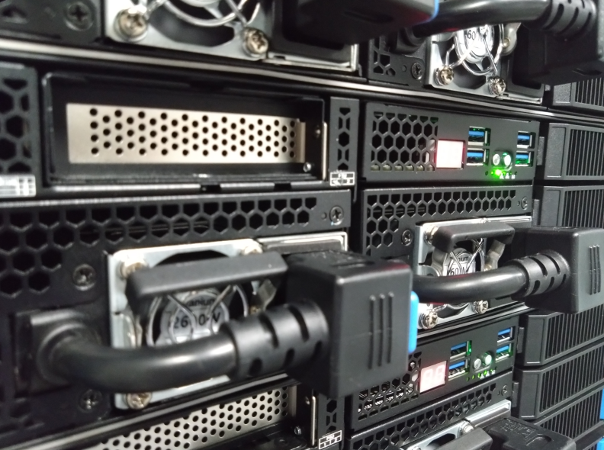
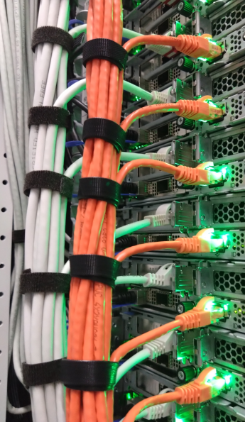
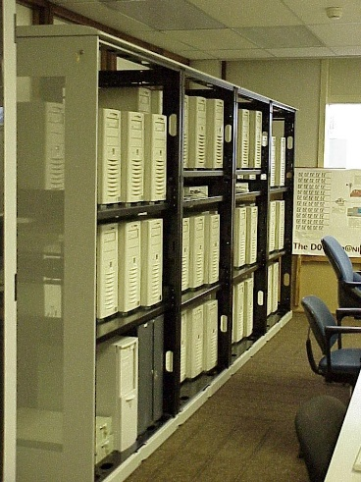
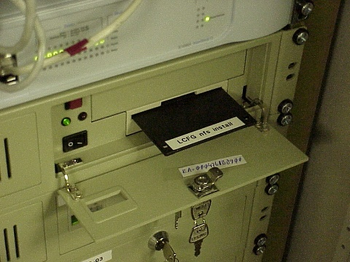
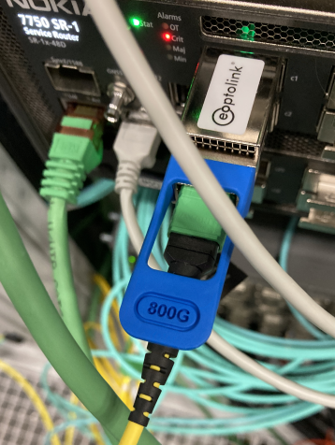
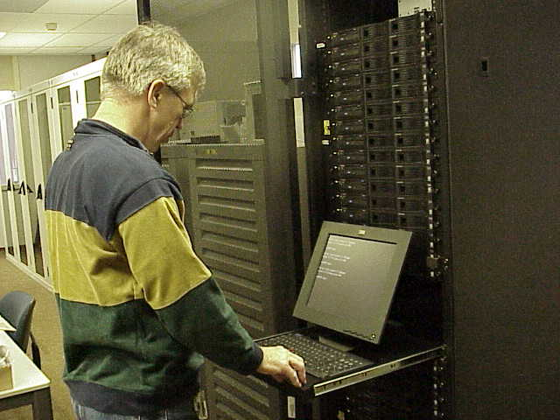
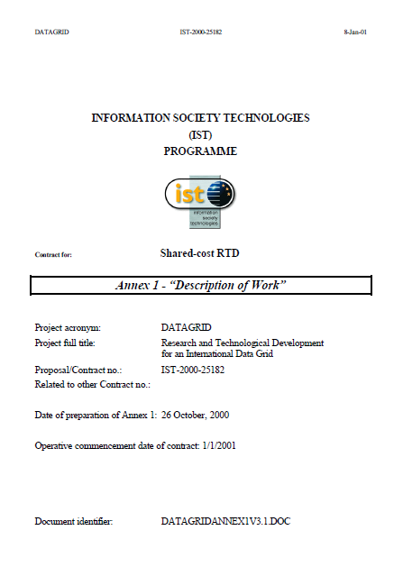
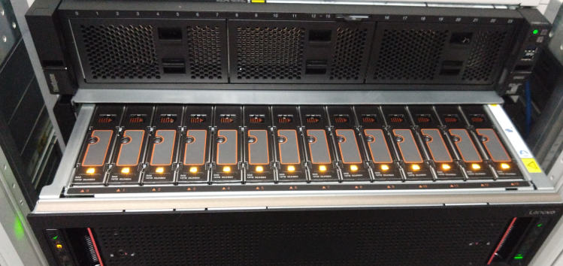
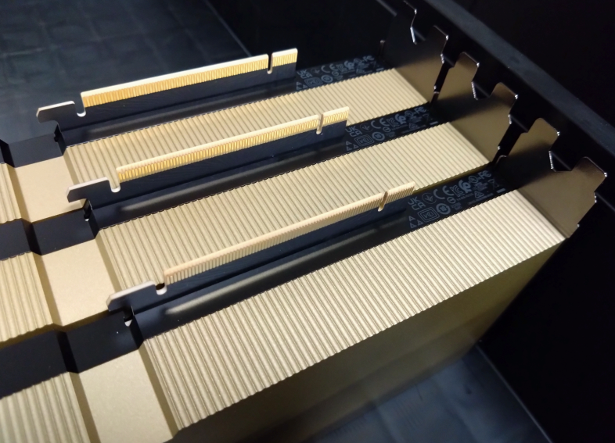
25 years of European data driven computing at Nikhef
1-1-2001 … 1-1-2026
+ 2 years of WTCW Virtual Laboratory!

Slide 4
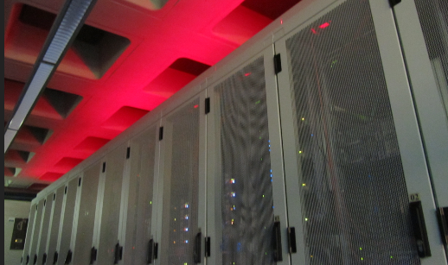
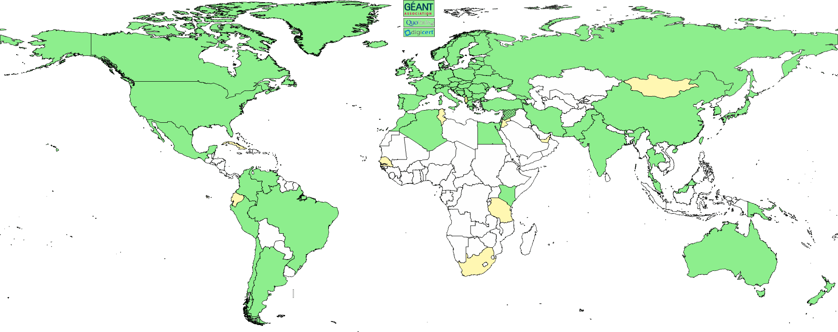
The pillars of Physics Data Processing
Algorithmic design patterns and software
GPU & accelerator software, algorithms, heterogeneous processors optimisation
algorithmic design R&D
Infrastructure, network & systems co-design R&D
building ‘research IT facilities’ co-design & development
data science at volume scale
research on IT infrastructure
Infrastructure for trusted collaboration
trust and identity for enabling communities
managing complexity of collaboration mechanisms
securing the infrastructure of our open science cloud
Infrastructure for scalable ML in HEP & APP
Inference optimisation for data throughput, HTC/HEP and HPC/AI-factory convergence, hybrid workflows “walking the ‘staircase’ for analysis and scheduled processing”
T&I, Federation, Research Infra Commons

Slide 5
Means and purpose of processing
Accelerate time to results with efficient use of computing through algorithmic design, novel software methods, and optimisation of data driven workflows and models
exploit new systems design and integration: heterogeneous architectures, innovative vendors, faster networks
ensure physics access to the broadest range of science services with ease
Meanwhile
ensure our computing capacity is sustainable … as we fund it to a large extent from non-HEP/APP sources, and have a commitment to open science and collaboration
continue push for generic access of services … important to keep individual RIs aligned
move more of our experiments to generic computing infrastructure … so we can contribute compute more effectively, cheaper, better to our physics programmes

Slide 6
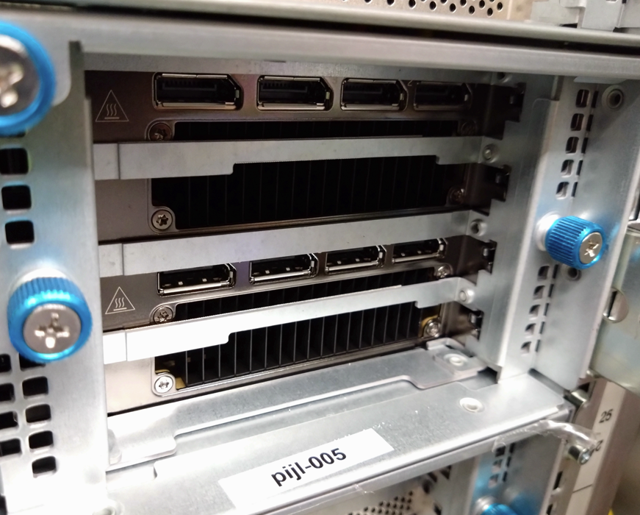
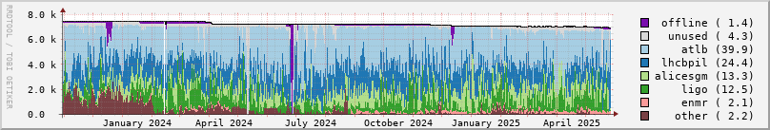
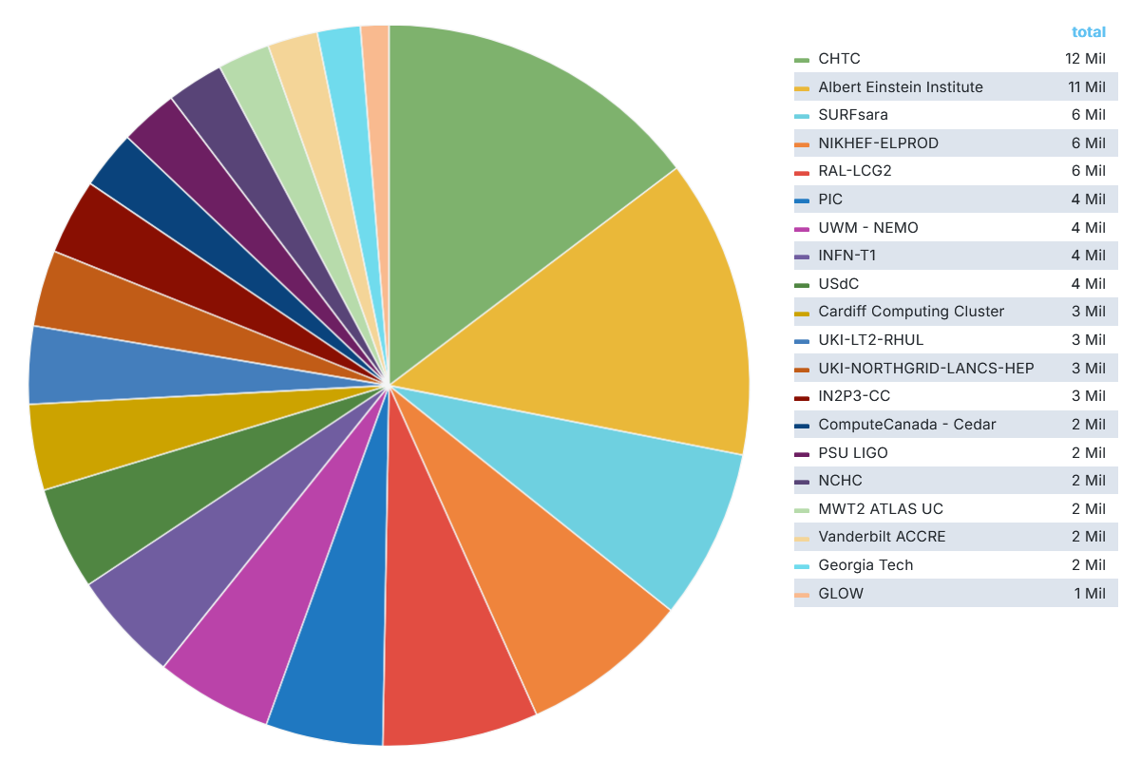
Some computing, engineering and trust highlights
seeing significantly increased use of GPUs in our analysis facility and for AI/ML
Completely migrated to HTCondor for both local analysis and federated facility
continued 94% occupancy of our NL-federated Tier-1
‘NL-T1’ compute for IWGN now >15% of global capacity*
Faster networks & more packets with ‘interesting’ effects
Security and risk management for EOSC EU Node
AARC architecture (G080) and trust framework (PDK) and with tokens for more than just IGWN and WLCG
* Netherlands as a whole is NIKHEF-ELPROD + SARA-MATRIX, 16Mcore-hrs
Data: occupancy data for Nikhef NDPF NL-T1 and DNI compute (https://www.nikhef.nl/pdp/doc/stats/ndpf-prd-grisview-year). IGWN data: OSG Gracia portal, whole of 2025: Nikhef 7.5% + SURF 7.5% https://gracc.opensciencegrid.org/d/9u1-Q3vVz/cpu-payload-jobs?orgId=1&var-ReportableVOName=ligo&var-Project=All&var-Facility=All&var-Probe=All&var-interval=1d&from=1735689600000&to=1765756800000&viewPanel=9

Slide 7
Last year’s SAC observations
The PDP group has an ambitious remit, ranging from developing and supporting the use of modern algorithms on modern hardware, to the facility deployment at Nikhef (together with Nikhef Computing Technology), and essential collaborative infrastructure for scientific computing in international projects.
The team has established good relationships with the physics teams locally and at the university partners and has a focus on training and help-desk support for software issues.
As software is clearly critical (and frequently under-supported) across the institute’s physics activities, we find the team size to be quite small for this role. Growing links to research software engineering teams at the university partners may be a means to broaden the support base for software and help address important issues of sustainability. Due consideration of software lifecycles should be given and new software technologies pursued. In particular, growing use of AI/ML is being observed and this means that the PDP group should also play an important role in both resource provisioning and skills training for new ML-based software techniques.
Resource delivery for international projects benefits hugely from stressing common interfaces and solutions, which we commend. Keeping in-house resources reduces risks and maintains vital expertise.
Report of the Nikhef Scientific Advisory Committee Meeting June 5-6, 2025

Slide 8
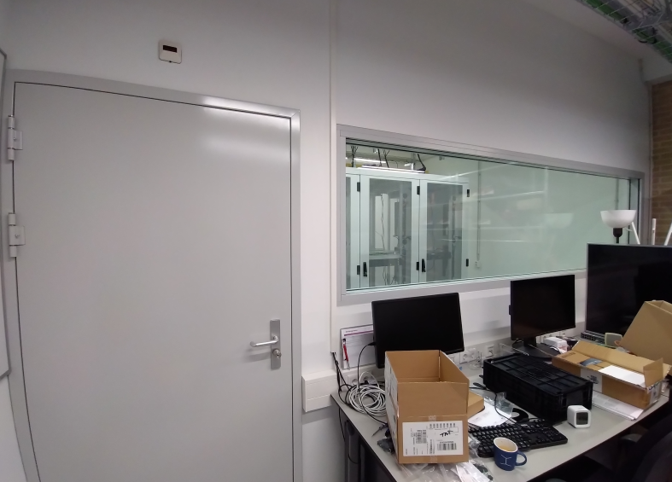
‘Keeping in-house resources…’
We need our operational capability to be relevant* in the ecosystem
we are the ‘staircase model’ put into practice: scaling from STBC to DNI national and global resources – and influencing these by example Naturally aligned with the Research Infrastructure Commons
we provide the ‘rapid-response’ capability of the innovation platforms and the (national) ‘Experimental Technologies Platform’ for SURF
outsourcing (or even off-site co-location) of facilities would jeopardize that role in innovation – and be detrimental to our talent case …
But we (cannot) do not do this alone
MERGE proposal explicitly includes the Commons as mechanism to import and export expertise on AI/ML and infrastructure usage
* thanks Wennink ☺

Slide 9
‘… benefits hugely from stressing common interfaces & solutions’
Systems design for exploitation of scalable resources for scheduled processing and chaotic analysis: a combination of research & development + operations & support
In acquisition and real-time acceleration for 4D
FASTTRACK accelerated R&D facility (WP5.1), and algorithmic work in the experiments themselves for WP5.2
Jointly with SURF ETP innovation collaboration
In making HPC resources (and AI factories) a better fit for data intensive HEP/APP
with SURF: workflows on Snellius preparing for ‘Lorentz’ tender – leveraging ATLAS & Alice
EuroHPC Federation and the Tier-1→Tier-0 transition: systems design, AAI, Interfaces to Architecture Testbeds
and alsi just the basics: helping promote the NWO ‘Rekentijd’ granting scheme
In developming a smooth transition ‘staircase’ path
TDCC NES project on JupyterHub alignment Stoomboot and Snellius
OSNL project on reproducible software at scale (with 4TU, TUDelft, NLeSC)

Slide 10
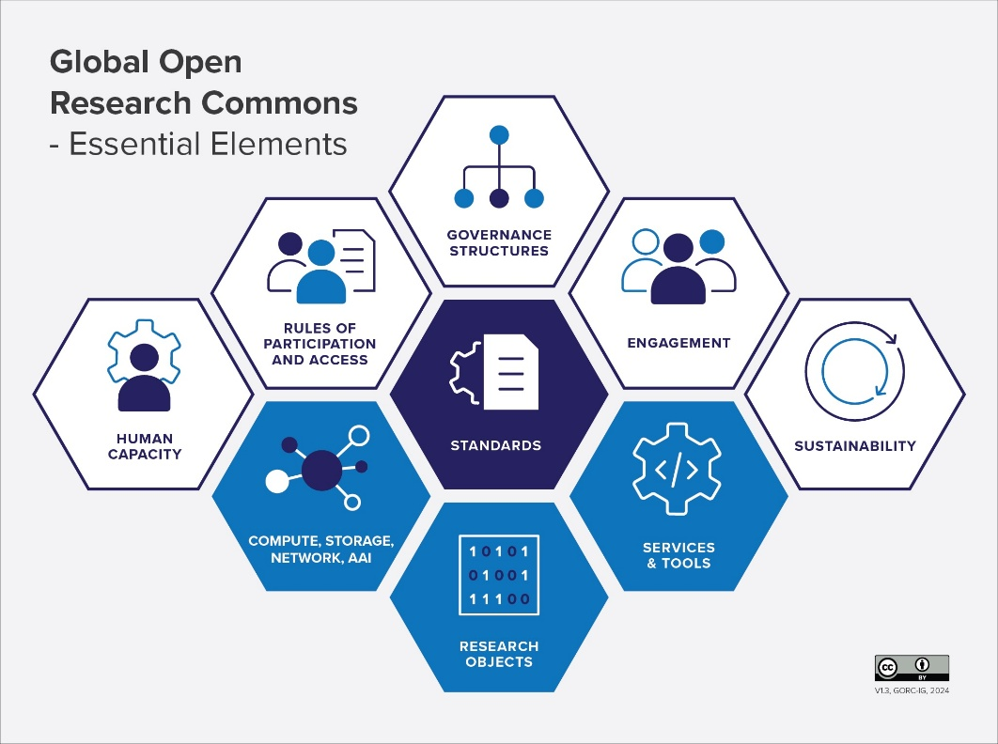
Ecosystem approach to sustainability and resourcing
For our sustainability and impact
aim to be present in each element of the Commons with a non-trivial contribution
choose control-point elements to mitigate relatively small size
to ensure Nikhef can benefit from both national and global community resources.
‘Large users’ like us have a real impact on this global ecosystem!
GORC IG: Typology and Definitions, https://doi.org/10.15497/RDA00087

Slide 11
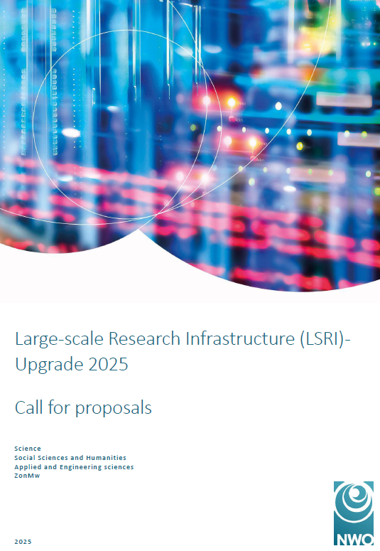
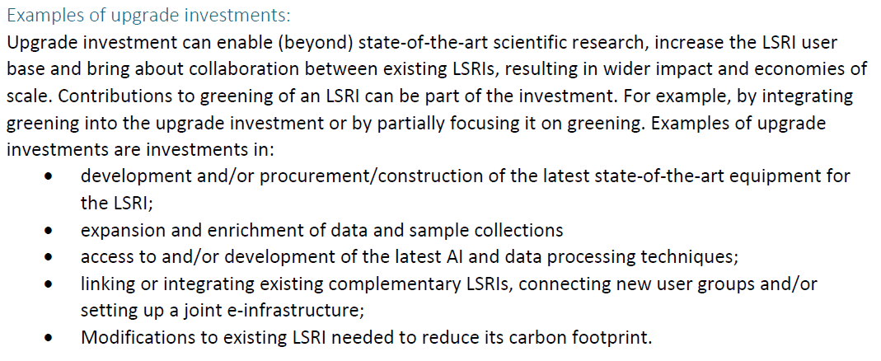
Innovation: ‘… growing use of AI/ML is being observed’ …
New AI/ML R&D group brings activities together in both the experiments and for PDP
links the ‘data, physics, workflows, and facilities in the 2040s’ role of PDP with stronger complement in the physics programmes on (AI/ML) software
R&D on infrastructure extensions for AI/ML and accelerated compute generally
We will be evolving
the physics staff and PoC hardware will be available starting mid-2026
facility for inference (MERGE) still under review
While other aspects remain as relevant in the future
systems R&D and our role as a ‘Tier-1’ facility for HEP/APP
in a complex, multi-stakeholder world, mixing long and short term ‘political’ objectives
accelerating time to results from 4D fast timing close to the detectors to the final plots ☺

Slide 12
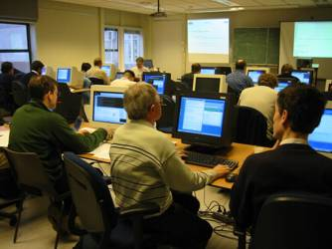
Balancing training & support with innovation R&D
The pathway to practical impact is via training and hands-on support … with infinite demand and always limited capacity ☺
computing courses need investment from two sides
getting specific AI/ML workflows to run on both locally and on ‘scale-up’ systems from STBC → Snellius → LUMI → hopefully our federated HTC / Tier-1 in 2028+
and also RDM and FAIR ‘digital research process’ courses
Here we lack the ‘sweet spot’ for trainers: it is beyond the helpdesk expertise, and then our next layer is > level-3 engineering researcher support … … but it’s nice to be able to give training and see the effect of your R&D efforts!

Slide 13






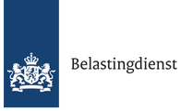
















AI/ML
Pathways via projects and collaborations
MERGE
Infrastructure R&D and systems co-design
Accelerating
computing
New initiatives and projects
strengthen the strategic areas
ensure continuity of research and infrastructure
ETF
future project pathways planned: MERGE, SHAKE, …
Public partner R&D engagement AMD, Nokia/Cerebras, NL-ix, AmsIX… Dutch national government
Infrastructure for Collaboration

Slide 14
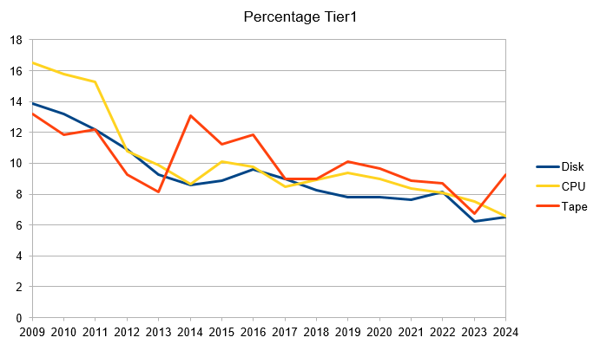
Weaknesses, threats … and mitigation scenarios
Weaknesses
Continuity as ‘cross-domain Tier-1 hub’ based on project, not institutional, funding → fiche ‘digital infrastructure’, NWO-SURF report ‘Reken er maar (niet meer) op’ … MERGE is only a stopgap measure for this, as, again, it is an upgrade project
Threats
Market developments in semicon ☹ → phased and deferred acquisition, market research, and vendor engagement/co-innovation to get better conditions is the best we can do – but likely not enough for 2026-2027
Divergence of HEP/HTC and EuroHPC/AI factories → co-design of new Tier-1 systems and ensure ‘Lorentz’ as national facility, collaborate to instigate change in EuroHPC (SURF, EuroCC, SHAKE)
Balancing operations, support and research as algorithms (and AI) become more important → engage physics groups in software engineering (as per the SAC2025 report), more ‘project’ software engineering and computing/AI/ML training capacity in CT-PDP
Risk of divergence WLCG from most ‘others’, even in our own domain, remains significant → invest in control points such as HPC CoEs and in AAI, policy, and ‘OpSec’
‘the true effect of flat budget’

Slide 15
And some resource-centric ones … no realistic mitigation?
Weaknesses
We provide a lot of research services, of all kinds, but disinvesting is not usually an option → we possible we can join up with others (SURF, OSG, other GWIs in the Commons, maybe NWO-I), but these in turn look back to us …
Threats
Lack of people on the CT-(PDP) side in the longer term: with FASTTRACK, MERGE, and AI/ML the demand keeps growing. → the requested ‘matching’ engineering resources, esp. FASTTRACK, need to become available in CT
Too many SPOFs, esp. in I4C, ‘open science’, and policy activities → ‘dakpan Jeff’ needs to take care of anchoring our ‘horizontal’ knowledge as well – makes for a very challenging job indeed!

Slide 16
Opportunities and strength … (no mitigation scenarios ☺)
Strength
Impact in our chosen focus areas: Accelerated computing, Infrastructure, Trust & Identity, → we are seen and proactively asked to partake in projects, and seen as trusted and active partner
Opportunities
Acceleration advances and ML help us exploit new systems → alignment with EuroHPC (and AI factories) for HEP/APP use cases as the EuroHPC Federation forms
Design of next gen national Tier-1 (‘Lorentz’ ?) facility and (to some extent) AI factory → improve suitability for HEP use cases through design choices
Cross-programme AI/ML activity raises profile of computing in our programmes → may get us the audience awareness for the importance of computing and algorithms
Heterogeneous and energy-efficient computing → more ‘physics output per unit of .*’
National Plan for Research Digitalisation (‘fiche’) → if granted, we can leverage far broader ecosystem at the institute and partner universities!

Slide 17
Physics Data Processing towards results unconstrained by computing

Slide 18
Re-strengthening the PDP in 2026
‘working on the interface between systems research for AI/ML, data processing infrastructure for high-throughput computing, and accelerated computing - combining hands-on systems operation, direct engagement with user-physicists, combined with long-term strategic vision …’
‘The new colleague will play an important part in designing and determining how Nikhef will continue to engage with and strengthen our national, European, and global computing ecosystems.
Key elements of the position include also the liaison with our national partners and our international collaborations at a strategic level, the acquisition of funding and management of projects, and shaping the ‘computing systems aspects’ driving the machine learning and AI/ML activities at Nikhef.
The candidate has a PhD in experimental sub-atomic physics or a very closely related field and extensive experience in the organization and use of data-intensive computing in large physics experiments. Systems operation experience in (at least one aspect of) high-throughput computing, data management systems, or networking, is expected.’

Slide 19
800G link Nikhef & SURF to CERN

Slide 20
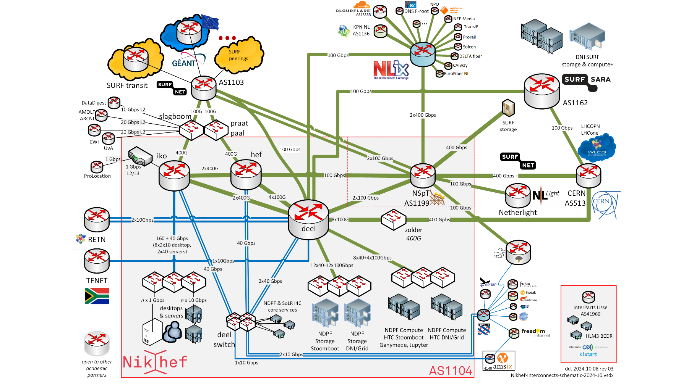
Next Gen networks – connecting our data and people

Slide 21
Foundational Principles for Digitalisation at Nikhef
Still needs explanation – despite digital sovereignty discussions. For both research and ‘enterprise’ ICT.
And ‘if they are many, they are not principles’, so we set only four:
Institutional strategy and mission directs ICT decision making ICT decisions are assessed based on the Nikhef strategic themes
Collaboration as a core value Nikhef stands for the whole of the Dutch community in (astro)particle physics and its European and global collaborations
Shared public values and responsible technology Nikhef employs, develops, and shapes technologies that preserve autonomy, justice and humanity, that builds on our academic sovereignty and integrity
Digitalisation reflects the continuity in our research programmes With research horizons measured in decades, ICT reflect this continuity in its choice of infrastructure, services, and information management, and in its human expertise

Slide 22
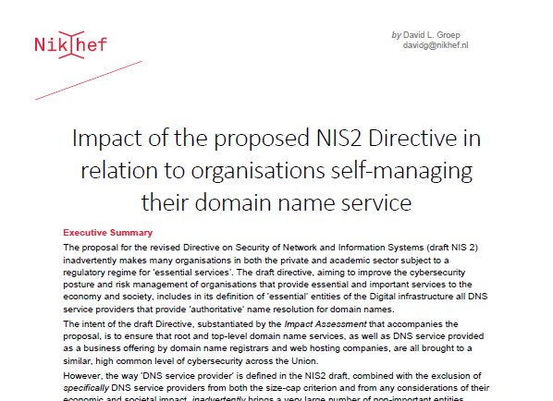
Policy development in ICT and our collaborative values
Our Research Infra (and Open Science) needs a collaborative ‘values framework’
frequently threated by increasingly ‘corporate’ approach to ICT services
continuous remedial action needed at many levels: from European Commission and EP, down to even our ‘own’ centralized national institutes organization …
Continued vigilance on IT infra is part of PDP programme to keep our research ICT infrastructure open, e.g. through:
watch carefully and continuously NWO’s push to ‘corporate IT’ and its impact on academic integrity & freedom;
promote trustworthy federated access via AARC (globally), SRAM (our SURF national scheme), promote trust & identity with our university partners
Digital sovereignty white papers advocating ‘relevant’ Netherlands & Europe
build scalable security solutions rather than pay corporate ‘ISO tick-box’ providers
luckily many times in collaboration with GEANT, JISC, STFC, EGI, and our peer institutes in NL
https://doi.org/10.5281/zenodo.4629136

Slide 23
Because we can … does not mean it’s the scalable way ☺
LCO2 cooling of an AMD Ryzen Threadripper 3970X [56.38 °C] at 4600.1MHz processor (~1.5x nominal speed) sustained, using the Nikhef LCO2 test bench system (https://hwbot.org/submission/4539341) - (Krista de Roo en Tristan Suerink)

