Slide 1
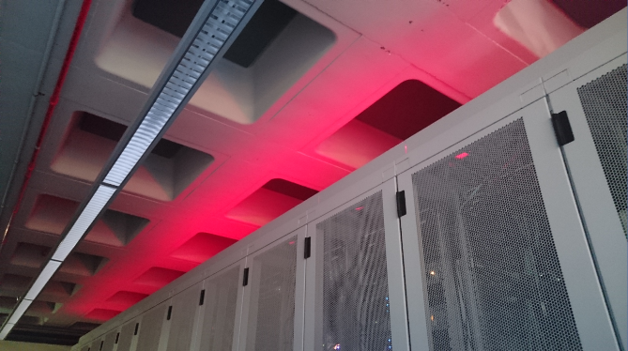
Physics Data Processing, Engineering and Computing accelerating ‘time to results’ through computing and collaboration
Nikhef SEP panel visit November 2023
David Groep
Roel Aaij
Ronald Starink
Karol Popławski
Osama Karkout

Slide 2
Physics Data Processing
& ‘CT-PDP’ engineering
David Groep | PL Physics Data Processing

Slide 3
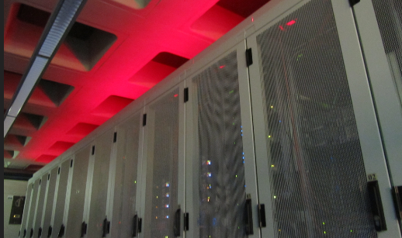
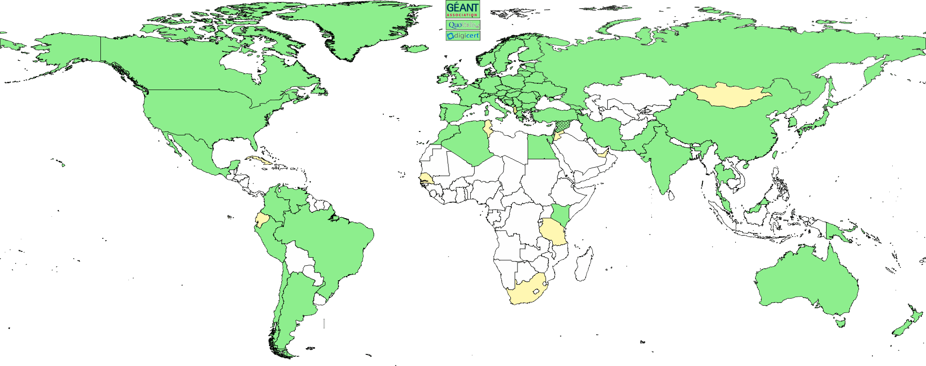
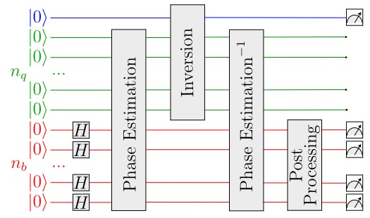
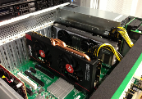
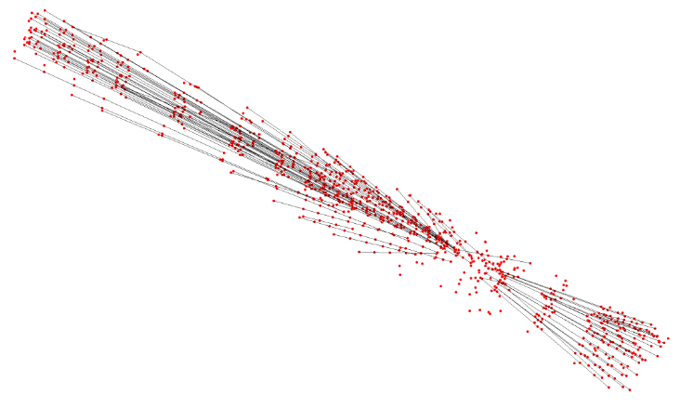
PDP: Computing as research and instrumentation
validated through our real-life applications
Physics Data Processing programme lines
infrastructure, network & systems research
  building ‘research IT facilities’ through co-design & development
  big data science innovation: research next gen IT infrastructure
infrastructure for trusted collaboration
  trust and identity for enabling communities
  managing complexity of collaboration mechanisms
  securing the infrastructure of our open science cloud
algorithmic design patterns - more in Roel’s introduction
  GPU accelerated computing, Quantum Computing, AI and Machine Learning
Images: H234b data centre; IGTF trust map; plofkip.nikhef.nl; Davide Nicotra, Maastricht and Nikhef, arXiv:2308.00619v2 quant-ph for JInst.

Slide 4
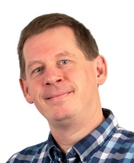
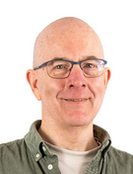
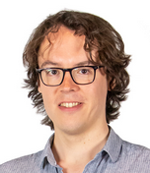
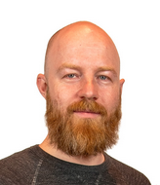
Physics Data Processing and CT-PDP engineering effort
2.5 staff (David Groep, Roel Aaij, Jeff Templon)
1 postdoc (Maarten van Veghel)
~ 11 engineers: DevOps, research software, RDM, Collaboration / Trust & Identity
with organic embedding in the Computer Technology engineering group
With wide range of activity leads, including for example LHCb RTA Reco convener,
SURF innovation expert group chair, EOSC Security Coordinator, AEGIS Trust and Identity policy lead, Interoperable Global Trust Federation chair, Dutch National Infrastructure Executive, lead for the Thematic DCC Natural and Engineering Sciences, and members in board & committees for the (global) e-Infrastructure landscape: GEANT GCC, PC-GWI, CieDO…

Slide 5
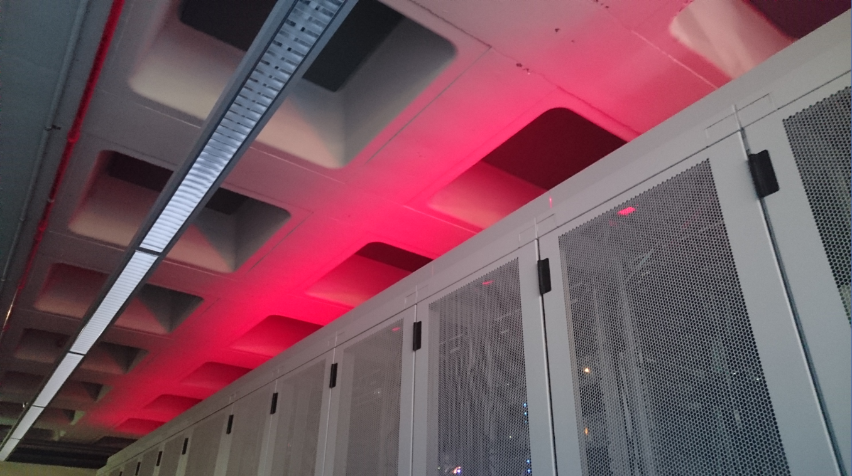
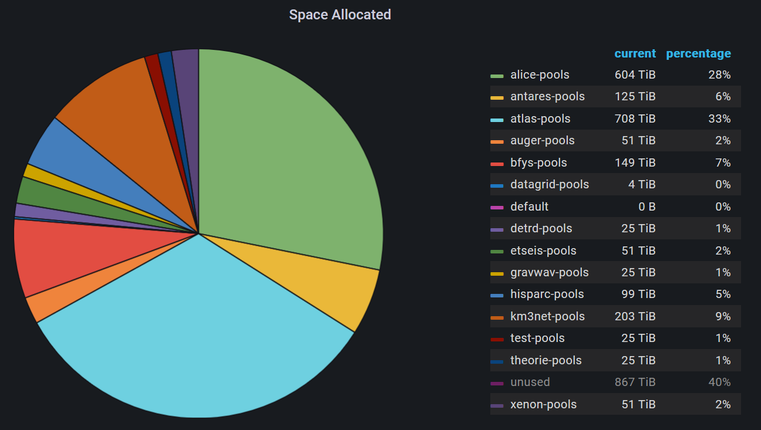
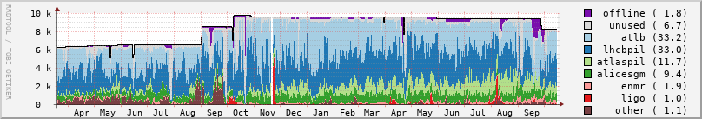
Infrastructure for Research
KM3NeT
Alice
High-Through Compute (HTC) + HT Storage
National e-Infrastructure coordinated by SURF
LHC NL-T1, IGWN, KM3NeT, Xenon, DUNE, WeNMR, MinE ...
‘Stoomboot’ local analysis facility + IGWN cluster & ‘submit node’
~ 12 000 cores (total), 13 PByte storage – very competitive w.r.t. commercial cloud
LHCb
Antares
Atlas
Occupancy: NDPF DNI processing facility in the period March 2021 .. October 2022. Top-right: storage capacity allocated in DNI Nikhef segment

Slide 6
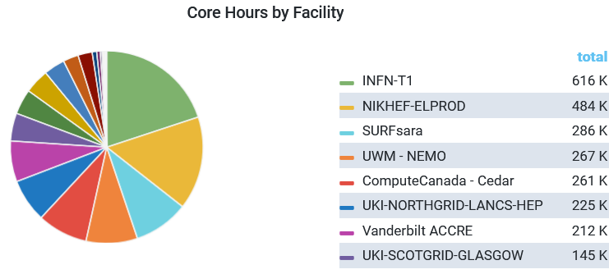

Common solutions are essential for our ‘national’ facility
IGWN use of
NL DNI infrastructure at NIKHEF & SURF 4-11 April, 2023
Alignment of common e-Infrastructure
and shared use by experiments
(LHC, GW, KM3NeT, DUNE, Xenon, ...)
common solutions, since bespoke systems
for each experiment do not scale for Nikhef (or NL)
efficient sharing of both hardware and DevOps effort
synergy with other domains helps sustainable funding
NL DNI
Nikhef + SURF
Continuation of our long-term strategy - from EU DataGrid in 2000 onwards:
drives collaborative efforts we work with for identity management and common protocols globally:
ACCESS-CI and CILogon (US) – key players for LIGO, DUNE, and US-ATLAS
common processing framework development (e.g. together with KM3NeT in its INFRADEV project)
Data on Tue April 11th 2023 from the OSG accounting for the LIGO VO for past week (with also SURFsara fully in production)
https://gracc.opensciencegrid.org/d/9u1-Q3vVz/cpu-payload-jobs?orgId=1&var-ReportableVOName=ligo&var-Project=All&var-Facility=All&var-Probe=All&var-interval=1d&from=1680566400000&to=1681257600000

Slide 7
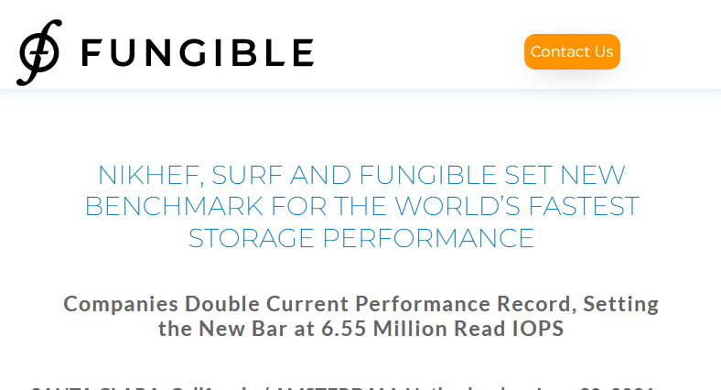
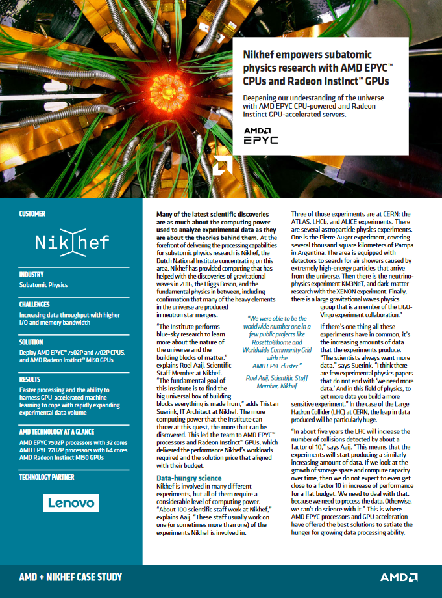
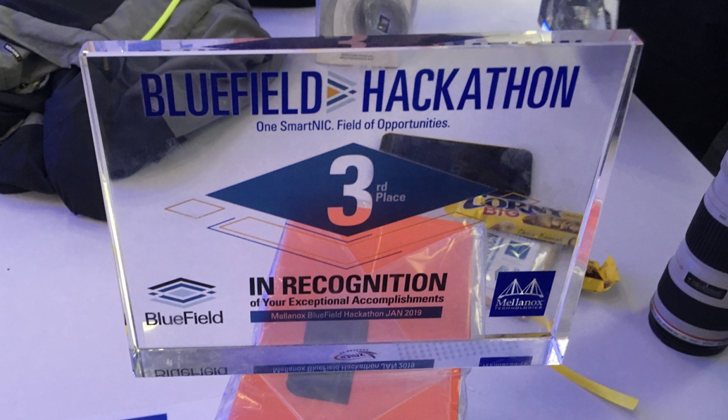
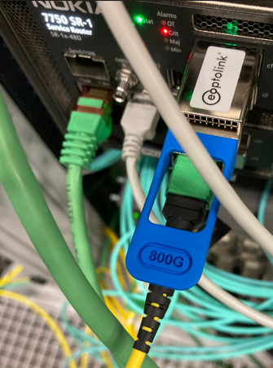
Innovation on infrastructure
Network-to-systems integration
Storage throughput & parallelism
Systems integration design and tuning
early engineering engagement with vendors
to build us suitable systems
co-design of our national HPC systems (‘Snellius’)
data-intensive compute with DPUs, or on-NIC FPGAs?
networks > 800Gbps, >1 Bpps (today: 400G to CERN)
Image: Minister of Economic Affairs M. Adriaansens launched the Innovation Hub with Nikhef, SURF, Nokia and NL-ix, January 2023. Composite image from https://www.surf.nl/nieuws/minister-adriaansens-lanceert-testomgeving-voor-supersnelle-netwerktechnologie; Bluefield Hackathon by Nvidia/Mellanox; abbreviations: DPU: Data Processing Unit; on-NIC FPGAs: on-network interface card field programmable gate arrays; pps: packets per second

Slide 8
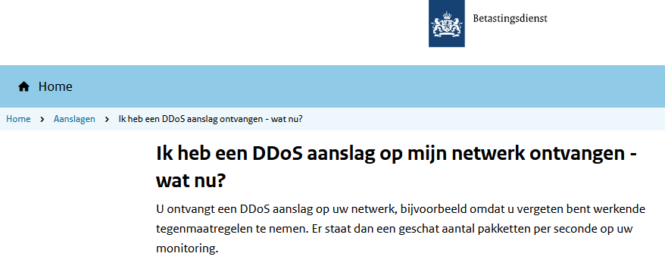
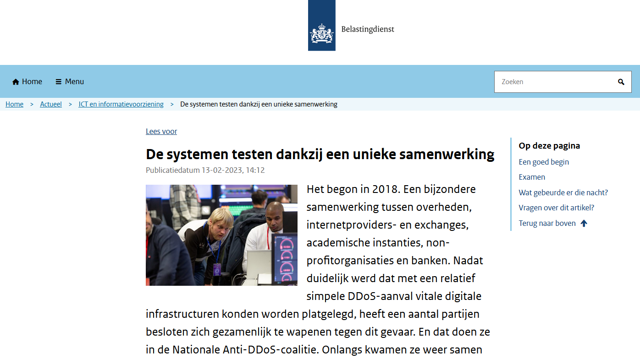
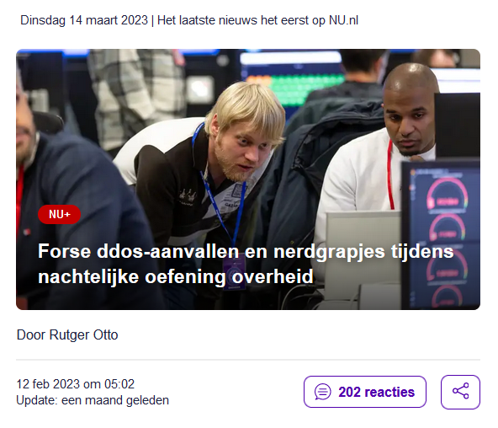
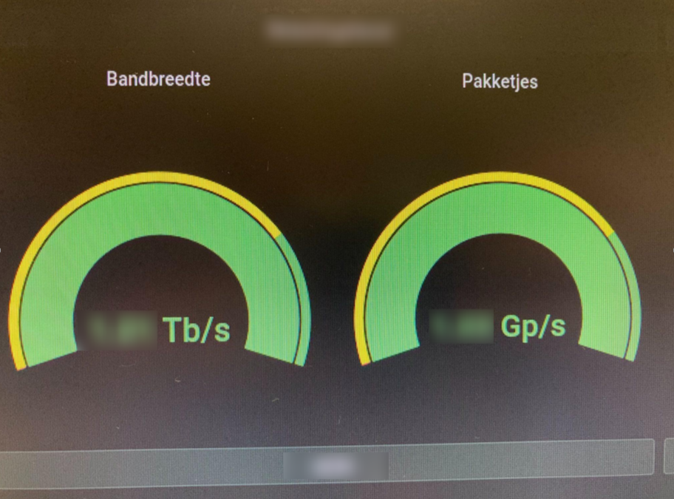
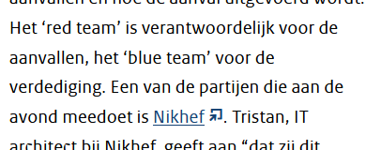
Our science data flows are somebody else’s DDoS attack
Image sources: belastingdienst.nl, rws.nl, nu.nl, werkentegennederland.nl

Slide 9
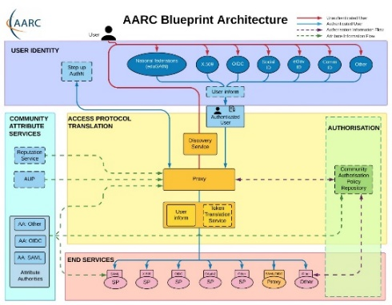

Infrastructure for Collaboration
Target impactful areas in architectures for ‘AAI’ & ‘OpSec’
authentication & authorization for research collaboration
  AARC project & community: GEANT Framework projects, R&E federation,
  identity and credentialing services, EOSC Future, …
  recently awarded: EOSC Core security and AARC-TREE
  policy frameworks for interoperability for data protection and global seamless service access
  continuous technical evolution driving IGWN, WLCG in line with AARC and global AAI architecture
embedding data processing needs of our experiments in the (EOSC) landscape
  EOSC Interoperability Framework: Security Baseline, AAI Architecture
  eduGAIN Operational Security for the global R&E inter-federation service
  EGI Advanced computing for research federation, GEANT community
AAI: Authentication and Authorization Infrastructure; OpSec: Operational Security (incident response); AARC: Authentication and Authorisation for Research Collaboration community and projects; EOSC: European Open Science Cloud; EGI and GEANT:
pan-European e-Infrastructure and network collaborations; IGWN: International Gravitational Waves Observatory Network;

Slide 10
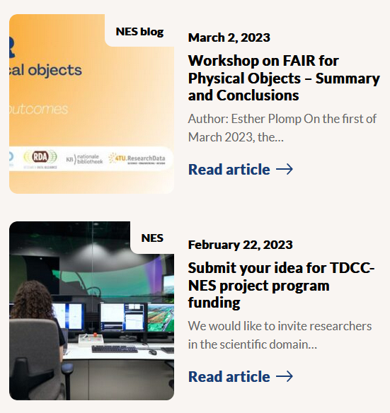
Collaboration: Research Data Management beyond ‘FA’
FAIR for live data, in large volumes, from ‘FA’ towards the ‘I’ and ‘R’
not that many disciplines with really voluminous data
  so nationally join forces with those who do: ASTRON (SRCnet), KNMI (earth observation, seismology), &c
work with those who care about software to bring data to life on infrastructure
  NLeSC, 4TU.RD/TUDelft, CWI, and with those who ensure the infrastructure: SURF
for our own analyses and the local (R&D) experiments we work
towards continuous deposition of re-usable data and software:
  Thematic Digital Competence Centre for the Natural and Engineering Sciences
  co-develop Djehuty RDM repository software link ‘Stoomboot’ analysis cluster storage

Slide 11





















PDP strategic projects mechanism
Infrastructure R&D and system
co-design
Join initiatives and projects that
strengthen the strategic areas
ensure continuity of
research and infrastructure
Research Software & Acceleration
BDSI
project pathways include
SURF innovation, GN5-*, AARC-TREE, EOSC Core, LHC4D (planned), …
Public partner R&D engagement
AMD, Nokia, Nvidia/MLNX, NL-ix, …
Dutch national government
Infrastructure for Collaboration

Slide 12
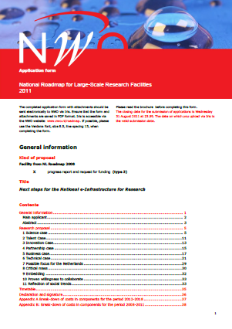
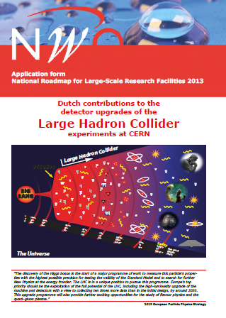

Sustained infrastructure for advanced computing?
Data processing: a persistent need for all our experiments. And ‘we’ are not alone!
many disciplines: ESCAPE (our experiments plus astronomy), bio-informatics, health, SSH, …
need infrastructure to exploit the collected data with long-term ICT capabilities
project-based funding for ‘upgrades’ of infrastructure not the appropriate way of
funding persistent requirements … but only thing we have at the moment:
…?
2003
2007
2011
2015
2020
timeline: ICES-KIS, BIG and GWI projects for computing capacity, by submission date

Slide 13
Algorithms and Acceleration
Roel Aaij | Senior Scientific Researcher PDP

Slide 14
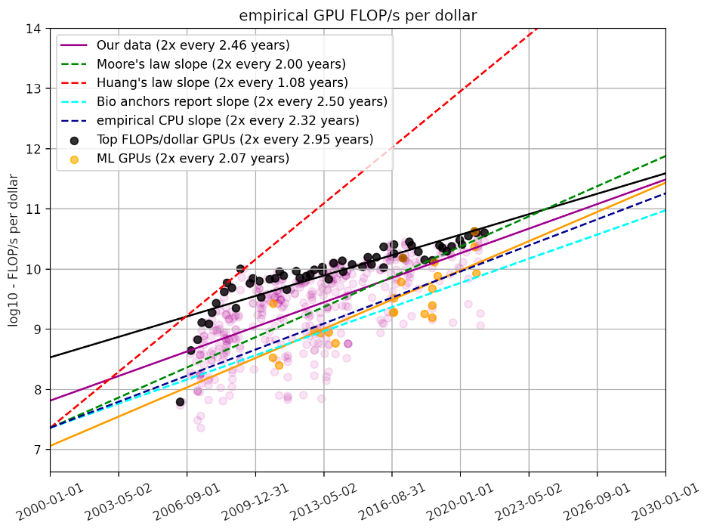
Efficient and Scalable Computing For HEP
CPU-only is not going to be affordable;
In other words: compute accelerators offer
more physics for less money
Most mature compute accelerators: GPUs
How to program?
How to optimize at algorithm and system level?
How to integrate in frameworks and infrastructure?
How to do this efficiently in terms of people’s time?
How to maintain?
What will future (compute) accelerators look like?
How to provide career perspective to people who focus on (accelerated) software?
https://epochai.org/blog/trends-in-gpu-price-performance

Slide 15
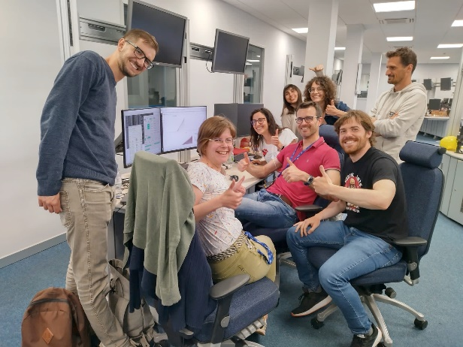
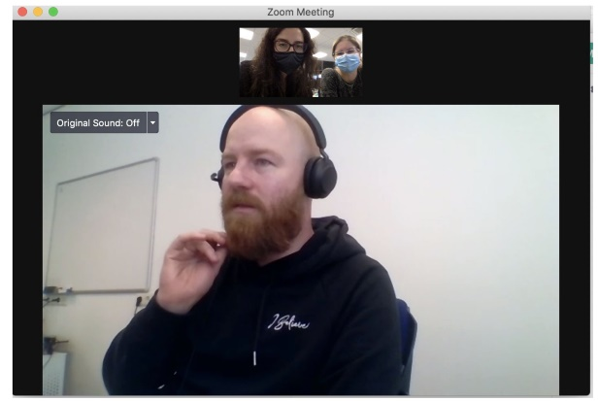
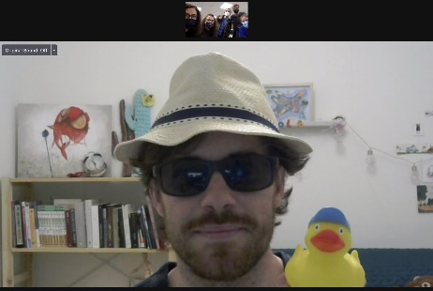
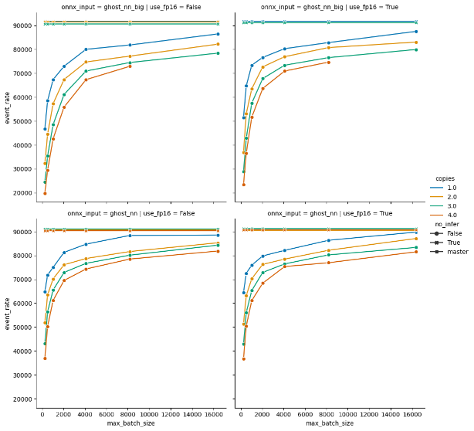

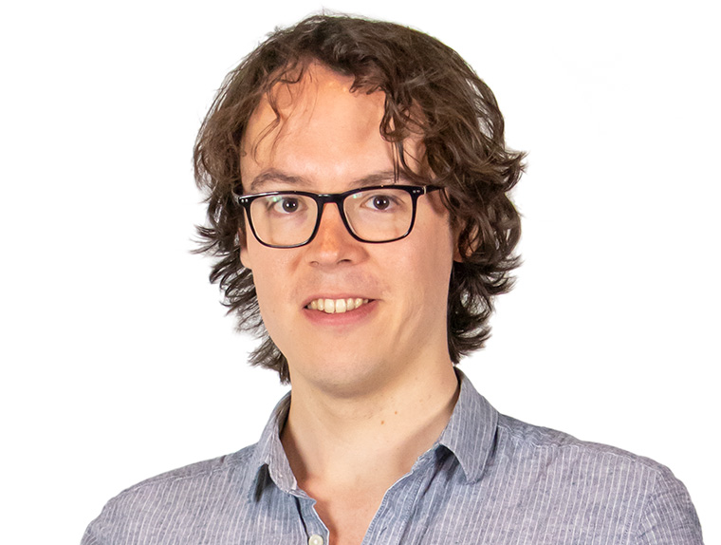
Efficient and Scalable Computing For HEP
LHCb’s first-stage GPU trigger (Allen)
- Bespoke application with all-custom kernels
- 4 TB/s of detector data on 400 GPUs
- Nominal luminosity next year
- Focused on integration (DAQ, LHCb stack, etc.)
- From idea to R&D to production in 5 years
With NLeSC: fast ML inference
- Using standard format (ONNX) and libraries
User (software) support for GPUs (AMD and NVIDIA)
FASTER: computing for HL-LHC & ‘4D’ reconstruction
https://github.com/LHC-NLeSC/run-allen-run

Slide 16
Computing group at Nikhef
Ronald Starink | TGL Computing Technology

Slide 17
CT organisation
CT-PDP: dedicated support for the PDP programme
  Software & infrastructure innovation
  Staff: 11
  (→ presentations DG and RA)
CT-B: system administration & service desk
  General support for ICT, end user support
  Staff: 7
CT-PO: support for projects by experiments
  Software engineering: slow controls, data acquisition, analysis framework support
  Staff: 6
  (→ presentation KP)

Slide 18
Challenges
General: recruitment in a competitive labour market
CT-B: balance flexibility ↔ standardization
CT-PO: matching resource with experiments’ needs (time, expertise)

Slide 19
Project engineering & support
Karol Popławski | Software Engineer CT-PO

Slide 20




KP – Software, Controls and more
Barrel Alignment | DAQ of ~5800 channels
MDT DCS Module | 1200 chambers: T, B-field, electronics monitoring & configuration
SciFi tracker | FEE configuration with DB, granularity up to 1.5mln thresholds
Scrum Master | MT, ET, R&D

Slide 21



CT-PO
Henk | FELIX
 | MDM firmware
Ton | SciFi FEE calibration
 | PTOLEMY
Kostis | Future 4D tracking with White Rabbit

Slide 22
How I use stoomboot
Osama Karkout | happy ATLAS & stoomboot user

Slide 23
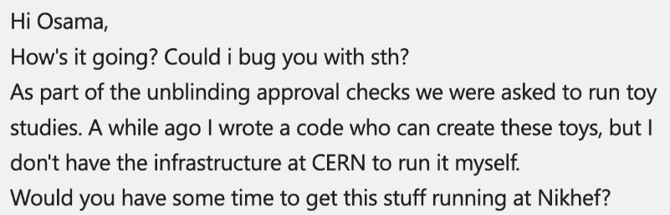
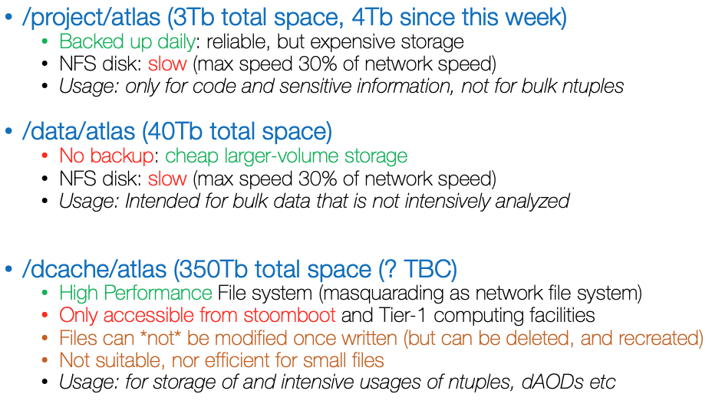
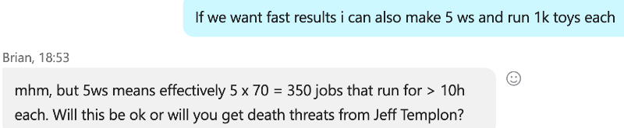
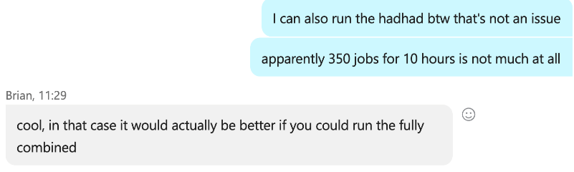
Data Analysis
designed for data analysis: economic & efficient

Slide 24
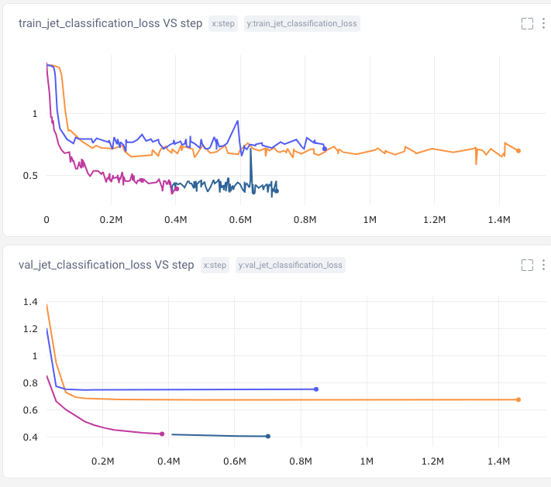
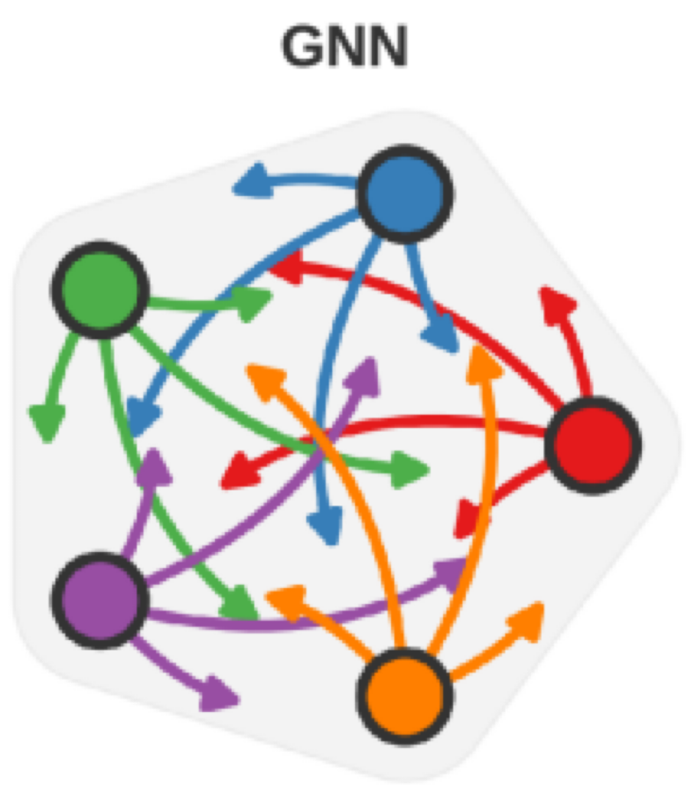
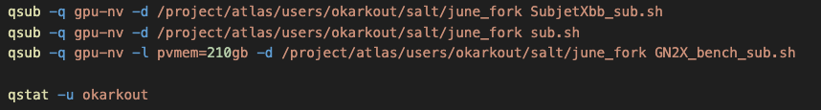
Physics Data Processing towards results unconstrained by computing
Neural Network training: ATLAS GNNs and Transformers

Slide 25
Data centre visit and networks
Arjen van Rijn
David Groep

Slide 26
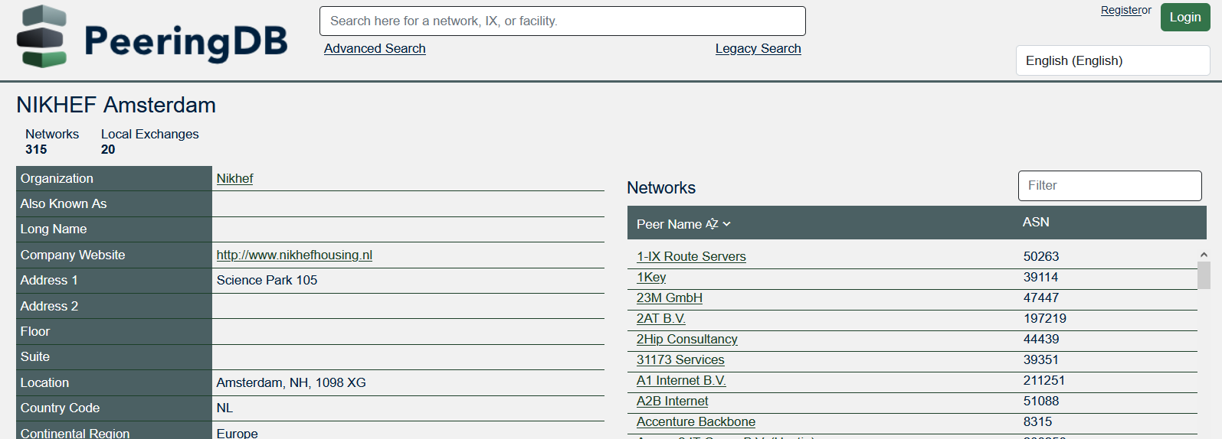
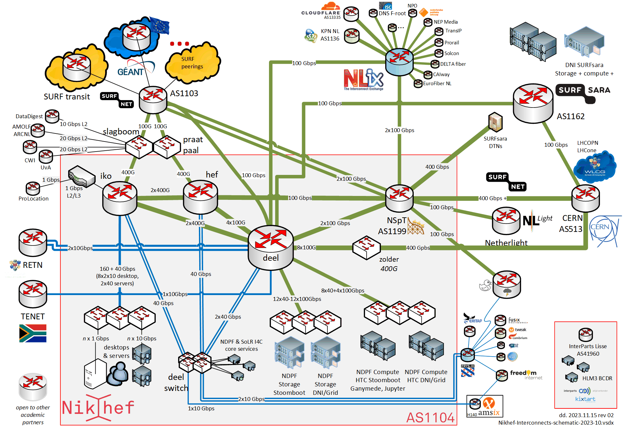
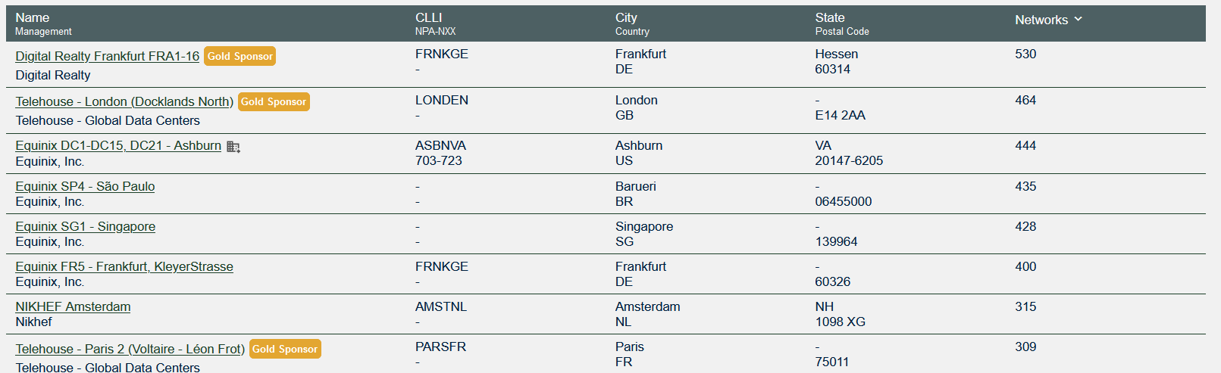
Our datacenter is all about connectivity
#7 on the worldwide peering list

Slide 27
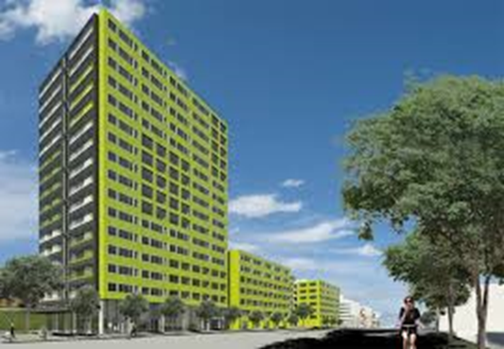
Summary data of our datacentre
Maximum power: 2,7 MW
Power Usage Efficiency (PUE): 1,3
Residual heat used for:
Nikhef building
Amsterdam University College
Student housing
Room | Purpose | # racks max | IT power average per rack (kW) | IT power total (kW) | IT power currently (kW)
H234b | Scientific computing | 47 | 6,25 | 300 | 180
H140 | Nikhef Housing | 282 | 1,9 | 660 | 528
H142 | Nikhef Housing (extension) | 112 | 4,0 | 540 | 10
Financial figures (annually):
Turnover currently ~5 M€; will grow to about 6,5 M€;
Running costs will grow to 3 – 3,5 M€ (energy costs!);
Depreciation of extension: 1 M€ annually until end 2028;
Net result: 2 – 3 M€
Aandacht voor duurzaamheid:
overtollige warmte gebruiken we zelf en geven we aan de studentenhuisvesting aan de overkant (~1,5 GWh/jr)

Slide 28
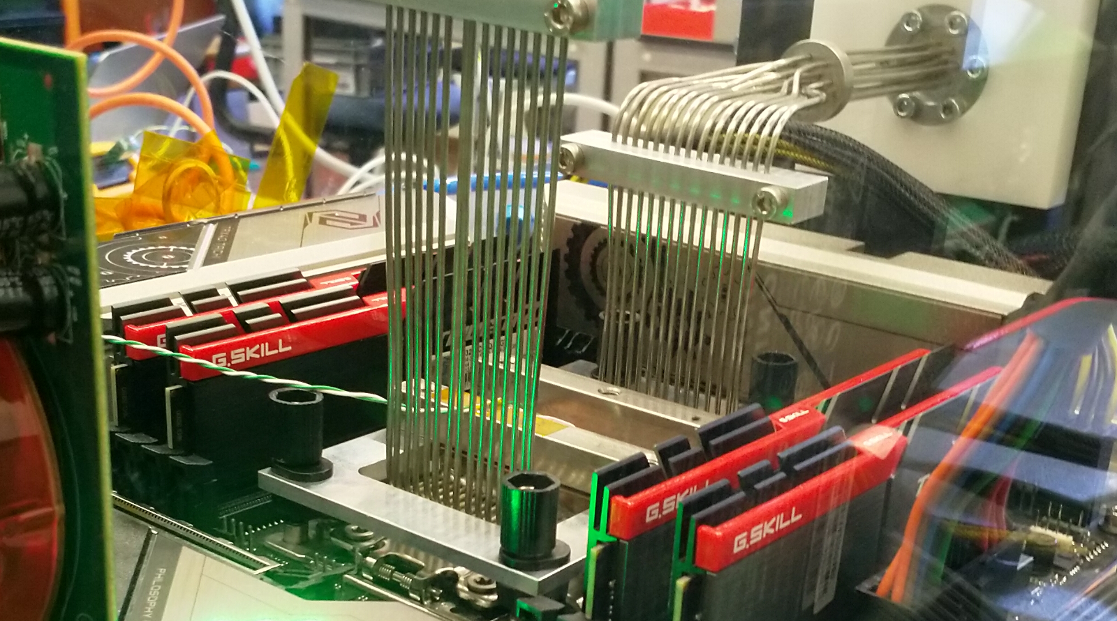
Because we can … does not mean it’s the scalable way ☺
LCO2 cooling of an AMD Ryzen Threadripper 3970X [56.38 °C] at 4600.1MHz processor (~1.5x nominal speed) sustained,
using the Nikhef LCO2 test bench system (https://hwbot.org/submission/4539341) - (Krista de Roo en Tristan Suerink)

Slide 29
Supplementary materials

Slide 30
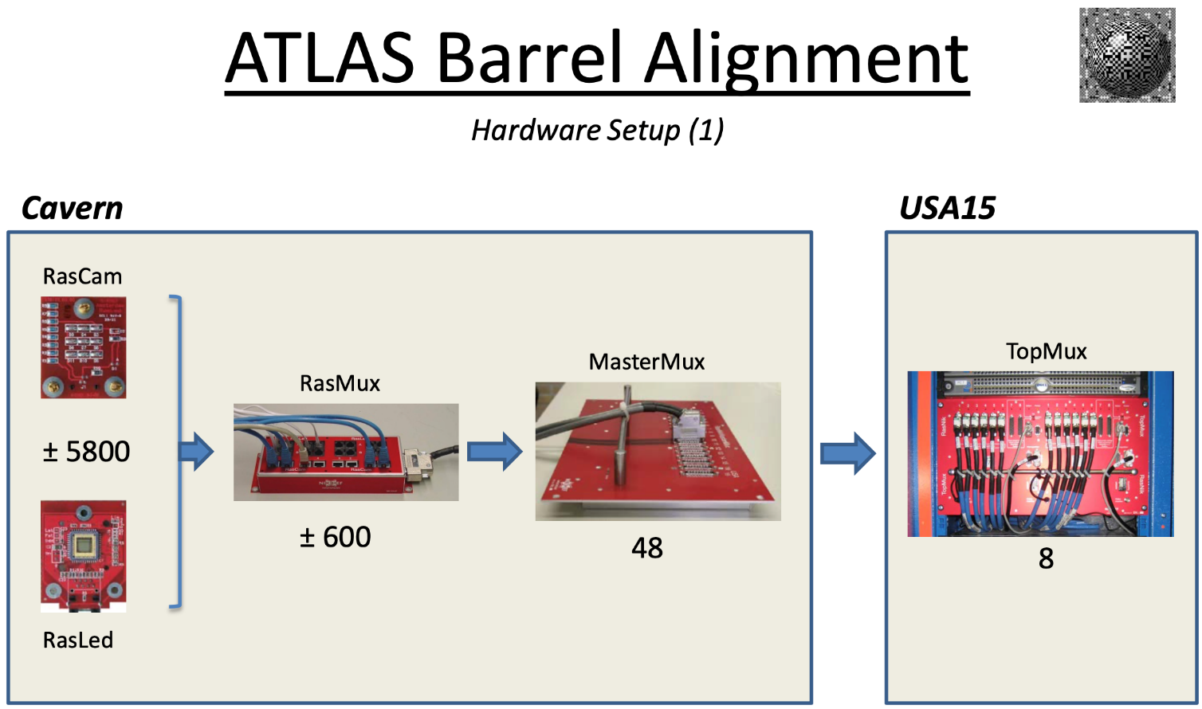
Backup – Balign
Source: Future Barrel Alignment by Robert Hart

Slide 31
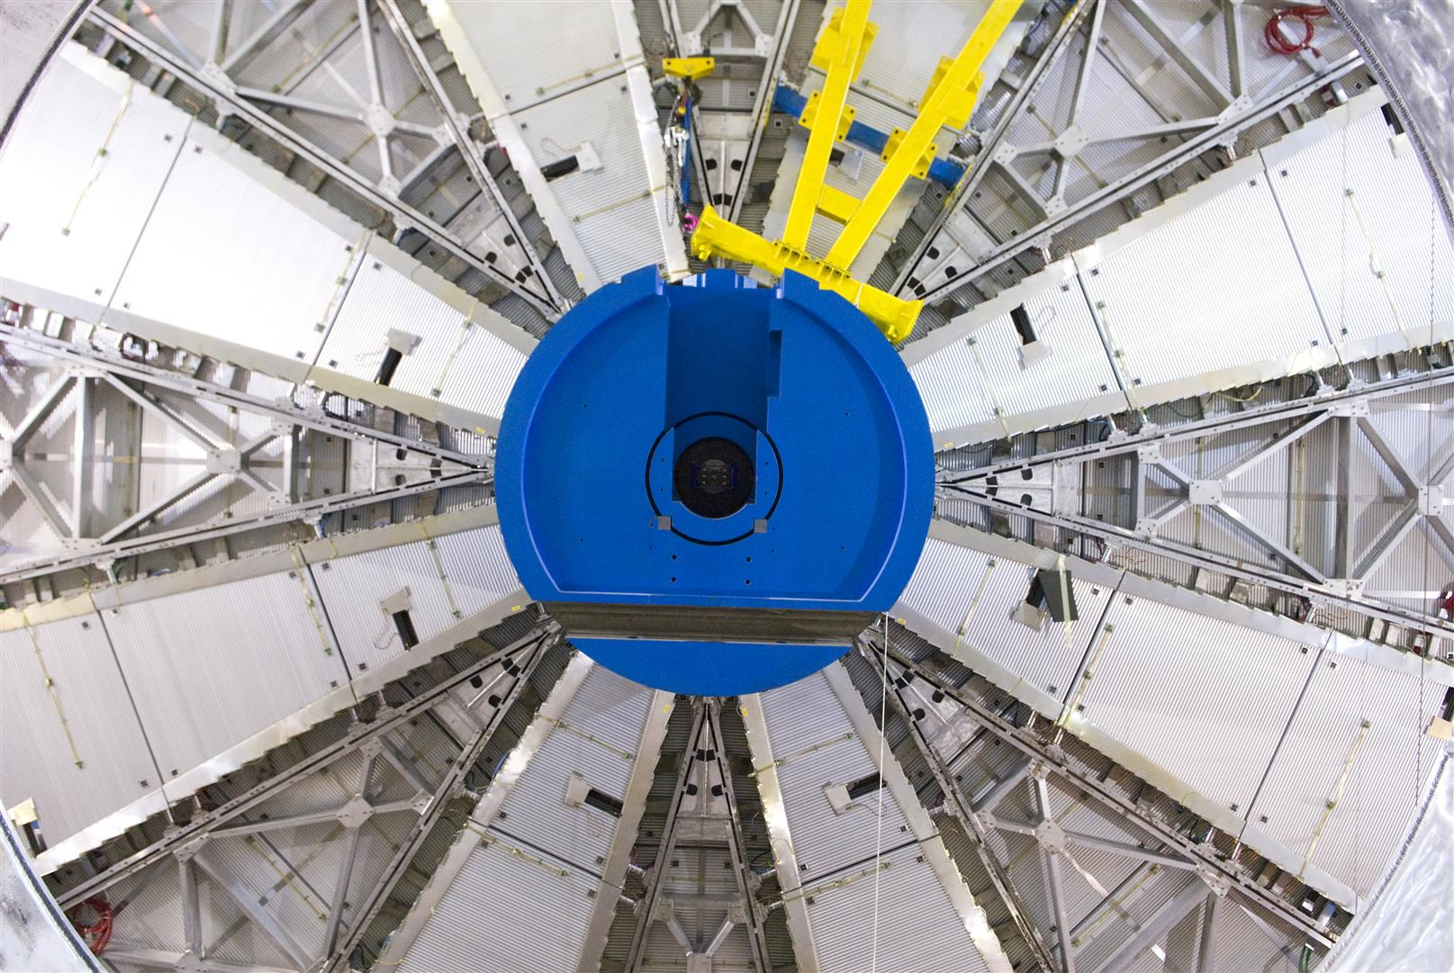
Backup – MDM
1,171 chambers with total 354,240 tubes (3 cm diameter, 0.85-6.5 m long)
Tube resolution 80 μm
Source: https://atlas.cern/Discover/Detector/Muon-Spectrometer

Slide 32
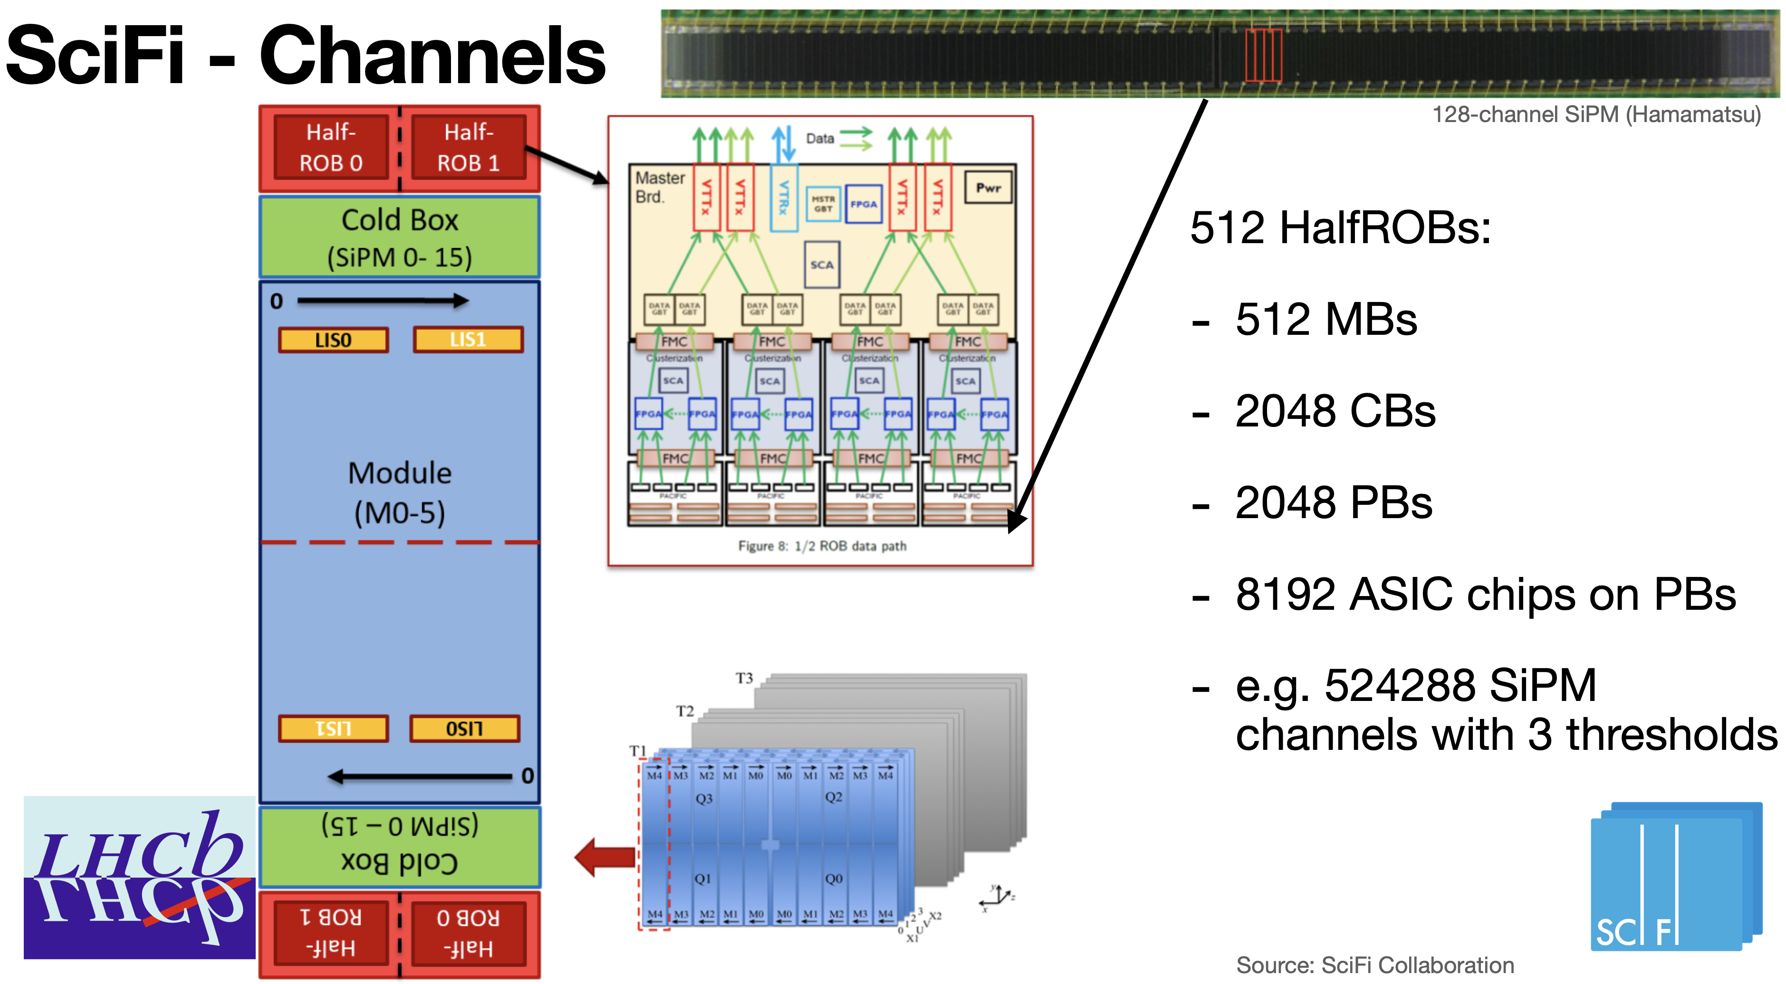
Backup – SciFi

