Slide 1
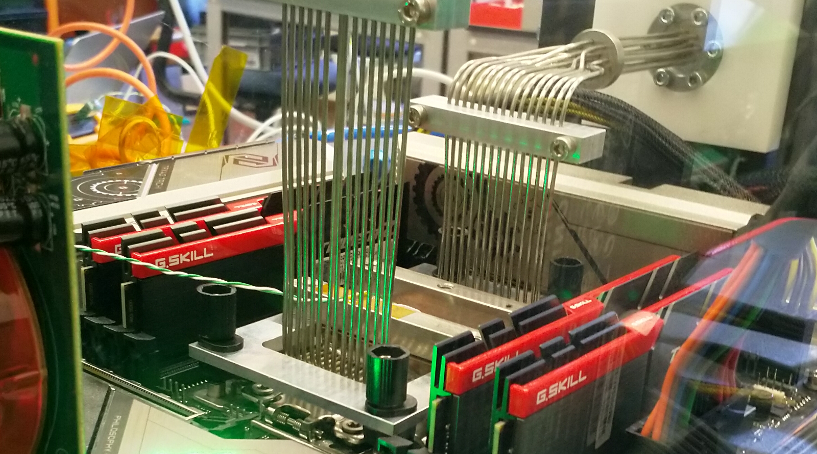
Physics Data Processing accelerating ‘time to science’ through computing and collaboration
Nikhef SAC April 2023
David Groep

Slide 2
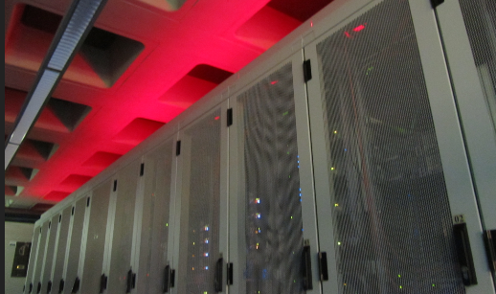
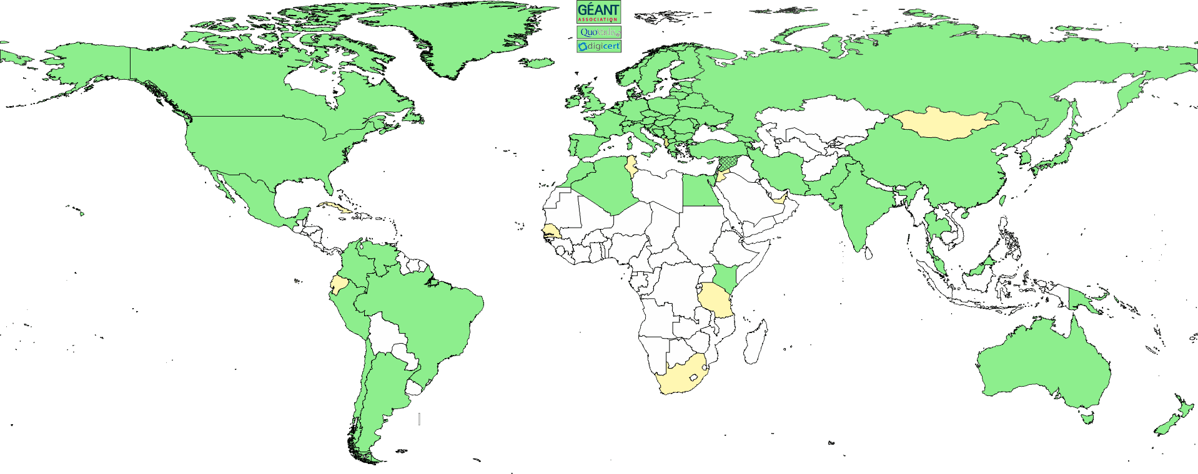
The three pillars of Nikhef Physics Data Processing
Algorithmic design patterns and software
designing software for (GPU) accelerators, new algorithms,
high-performance processors
software design patterns for workflow & data orchestration
Infrastructure, network & systems co-design R&D
building ‘research IT facilities’
co-design & development
big data science innovation
research on IT infrastructure
Infrastructure for
trusted collaboration
trust and identity for
enabling communities
managing complexity of collaboration mechanisms
securing the infrastructure
of our open science cloud
people: 3.6 FTE (2.6 staff + 1 postdoc)
+ ~ 7.5 FTE DevOps and research engineers from the Nikhef computing technology group

Slide 3
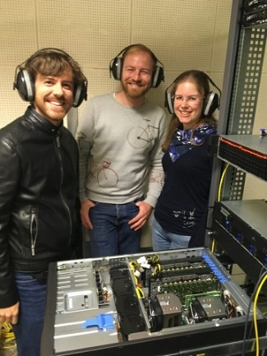
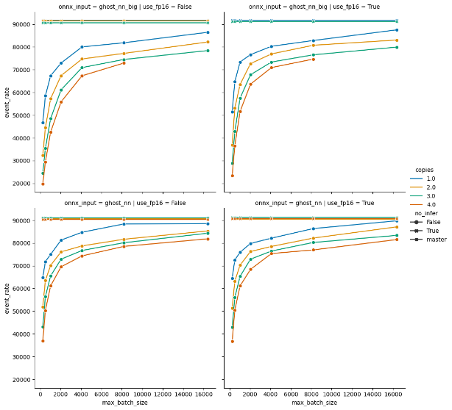
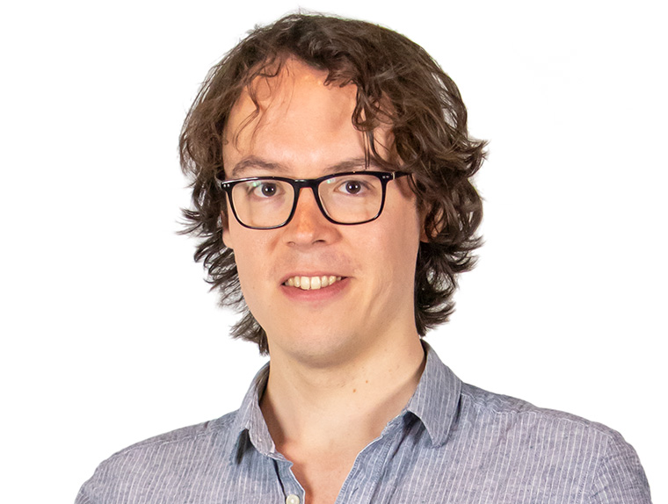

Efficient computing and ‘accelerated results’
FASTER: computing for HL-LHC & ‘4D’ reco
LHCb’s Allen full-GPU trigger for HLT1
- now adding HLT2 and CPU NN implementations
NLeSC GPU acceleration in LHCb
and parallel inference with ONNX+tensor ML libraries
R&D roadmap for hybrid computing
  link to infrastructure innovation & engineering with vendors
  alternative architectures: non-x86, watercooling, GPU+FPGA, hybrid dies
  ‘scaling and validation’, collaboration with computer science (SLICES-RI) & ML algorithms (@UM + RU)
For the long term: Quantum Computing algorithms exploration
in collaboration with our experiments (notably LHCb and GW), QuSoft (CWI, UvA, et al.), SURF, and IBM (Zürich) via Maastricht
personal expectation: ‘production’ use far away (>2035?), but work on algorithms, even if ultimately not QC, very interesting anyway
Image: LHCb’s Allen team: Daniel Campora (Nikhef & UM), Roel Aaij (Nikhef), Dorothea vom Bruch (LPNHE) (source: LPNHE). Graphs: Allen inference event rate vs batch size (NLeSC)
https://github.com/LHC-NLeSC/run-allen-run

Slide 4
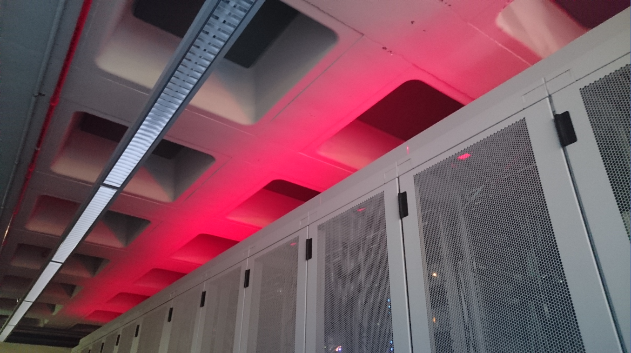
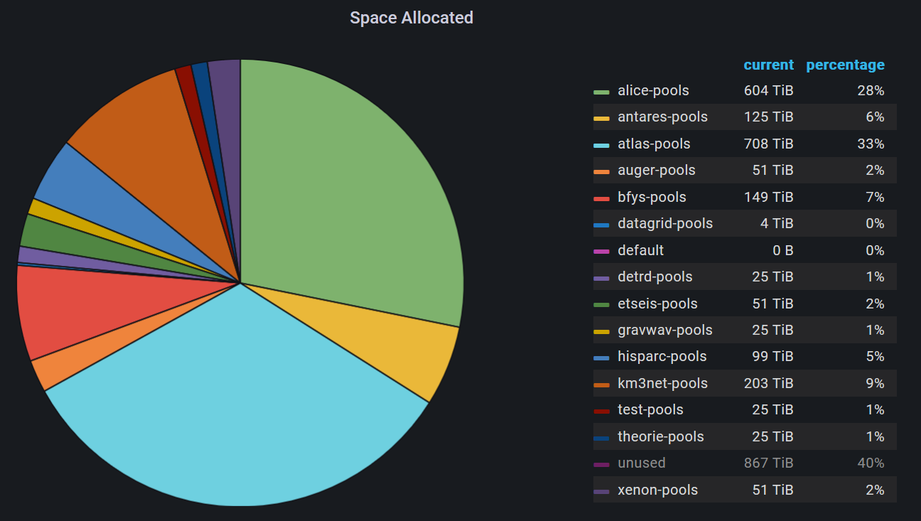
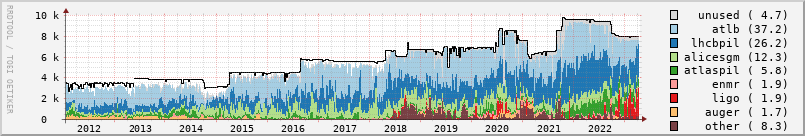
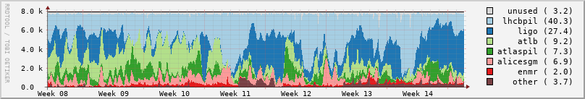
Infrastructure for Research
High-through compute (HTC) + HT storage
National e-Infrastructure coordinated by SURF
NL-T1, IGWN, KM3NeT, Xenon, DUNE
+ WeNMR, MinE, …
‘Stoomboot’ local analysis facility + IGWN cluster & ‘submit node’
~ 12 000 cores, 13 PByte storage installed, with pretty competitive TCO!
Occupancy: NDPF DNI processing facility. Faster processors (AMD Rome) allows processing in fewer cores using less power

Slide 5
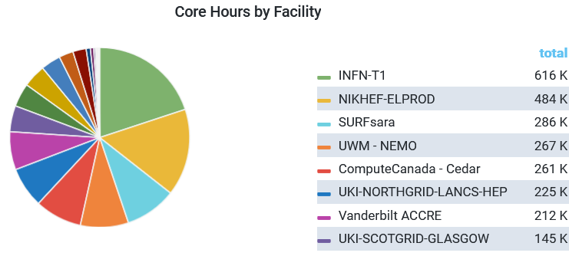

Common solutions are essential for our ‘national’ facility
We promote alignment of general purpose
e-Infrastructure and use by experiments
(LHC, GW, KM3NeT, DUNE, Xenon, ...)
common solutions since bespoke systems for each experiment do not scale for Nikhef (NL)
needed for both efficient resource sharing
and importantly: for our DevOps people
IGWN use of
NL DNI infrastructure at NIKHEF & SURF 4-11 April, 2023
NL DNI
Nikhef + SURF
Continuation of our long-term strategy - from EU DataGrid onwards:
drives collaborative efforts we work with for identity management and common protocols:
ACCESS-CI and CILogon (US) – which are key players for LIGO, DUNE, and US-ATLAS
common processing framework development (e.g. together with KM3NeT in its INFRADEV project)
Data on Tue April 11th 2023 from the OSG accounting for the LIGO VO for past week (with also SURFsara fully in production)
https://gracc.opensciencegrid.org/d/9u1-Q3vVz/cpu-payload-jobs?orgId=1&var-ReportableVOName=ligo&var-Project=All&var-Facility=All&var-Probe=All&var-interval=1d&from=1680566400000&to=1681257600000

Slide 6
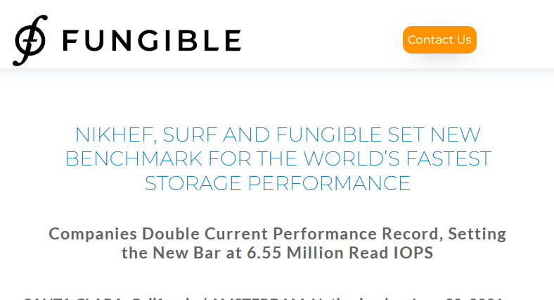
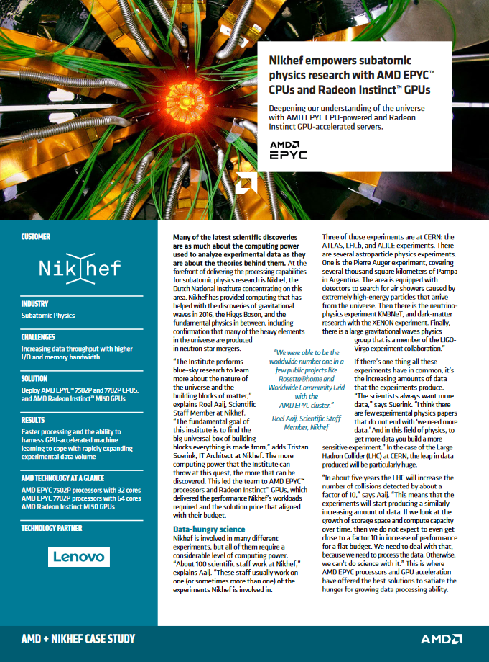
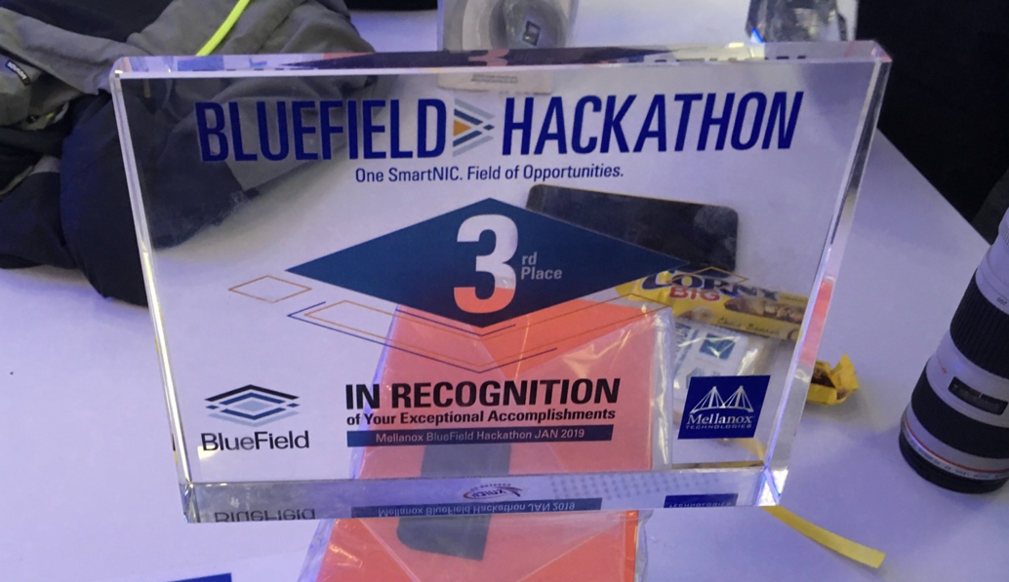
Innovation on infrastructure
Network – systems integration
Storage throughput & DPUs
Systems design and tuning
early engineering engagement with vendors
to build us suitable systems
co-design of our national HPC systems (‘Snellius’)
data-intensive compute with DPUs. Or on-NIC FPGAs?
next-gen networks: >800Gbps (and 400G to CERN)
Image: Minister of Economic Affairs M. Adriaansens launched the Innovation Hub with Nikhef, SURF, Nokia and NL-ix, January 2023. Composite image from https://www.surf.nl/nieuws/minister-adriaansens-lanceert-testomgeving-voor-supersnelle-netwerktechnologie

Slide 7
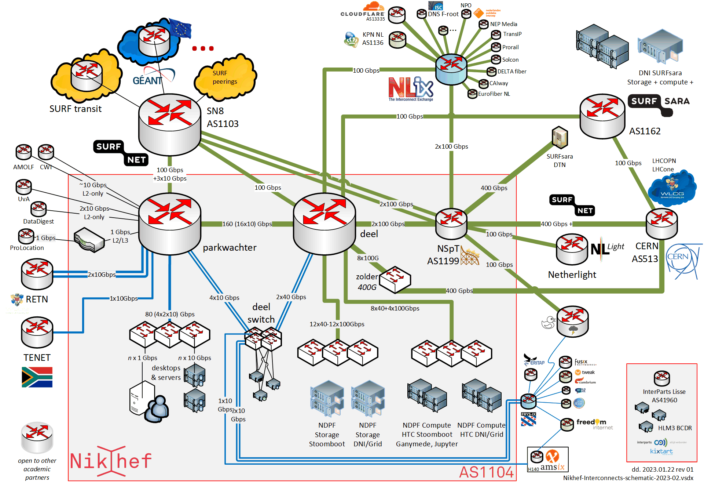
Next Gen networks – connecting our data and people

Slide 8
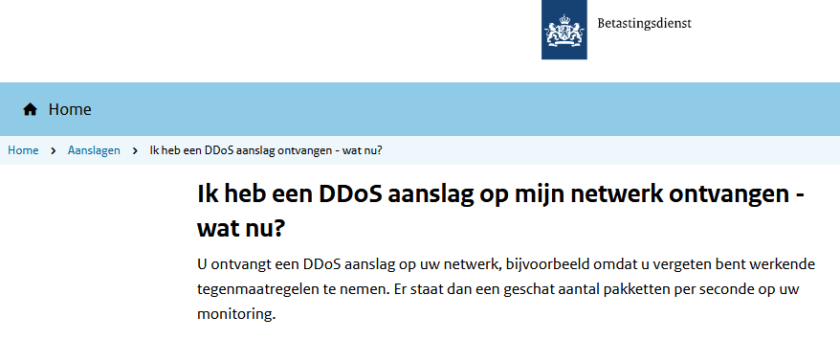
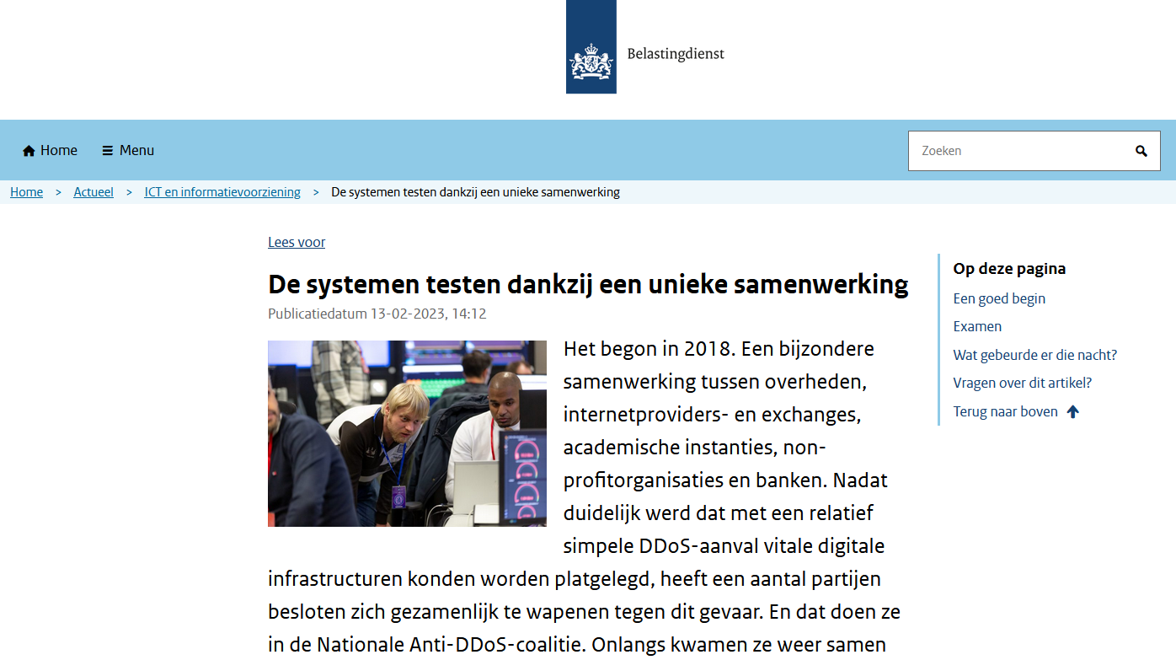
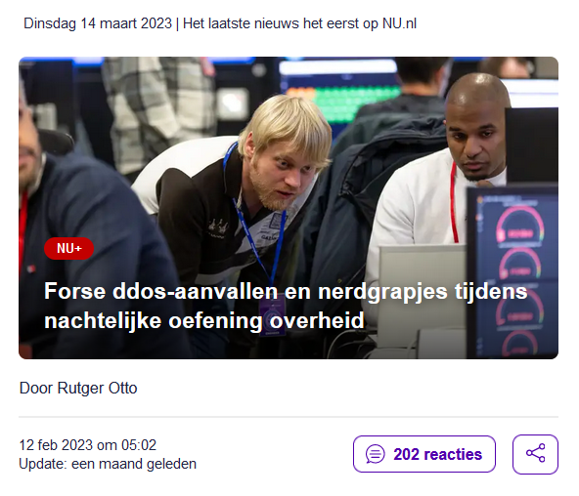
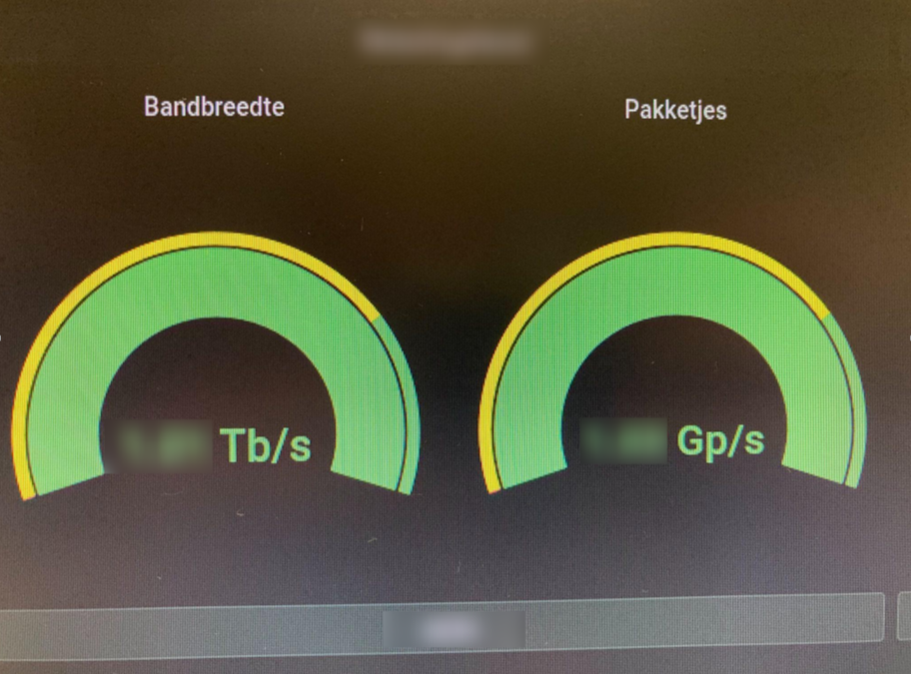
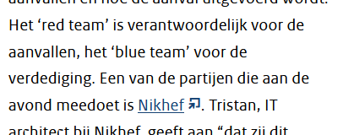
Our science data flows are somebody else’s DDoS attack
Image sources: belastingdienst.nl, rws.nl, nu.nl, werkentegennederland.nl

Slide 9
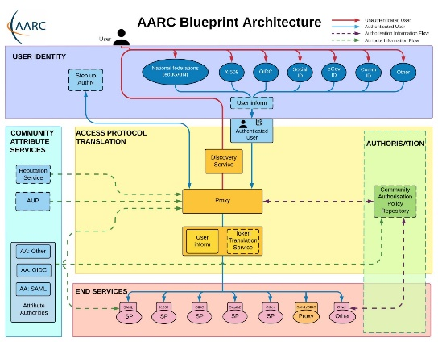
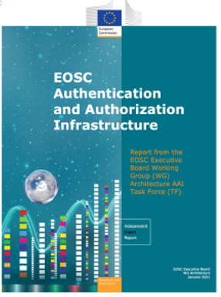
Infrastructure for Collaboration
Target high-impact specialized areas,
bridging policy & technical architecture for ‘AAI’ & ‘OpSec’
authentication & authorization for research collaboration
  AARC project & community, GEANT GN5, REFEDS & eduGAIN,
  EOSCFuture, TCS & RCauth.eu, …
  and planned: EOSC Core, AARC-TREE, EOSC-Q, …
  policy for interoperability for data protection, seamless service access, single-click acceptable use
  continuous technical evolution driving IGWN, WLCG in line with the AARC BPA and global RIs
embedding of data processing needs of our experiments in the EOSC landscape
  EOSC Interoperability Framework
  EOSC-A (AAI-TF), EGI, GEANT community

Slide 10
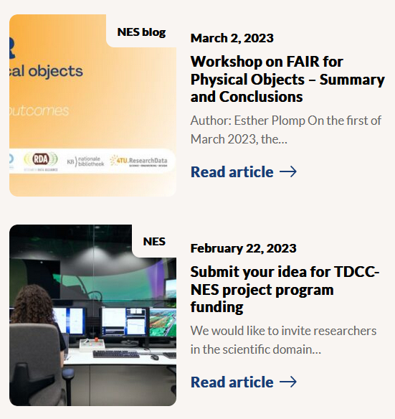
Collaboration: Research Data Management beyond ‘FA’
FAIR for live data and large volumes, shifting gears towards the “I” and “R”’
not that many disciplines with really voluminous data
  so nationally join forces with those who do: ASTRON (SRCnet), KNMI (earth observation, seismology)
work with those who care about software to bring data to life:
  NLeSC, 4TU.RD/TUDelft, CWI, and with those who ensure the infrastructure: SURF
for our own analyses and the local (R&D) experiments we work
towards continuous deposition of re-usable data and software
  NWO Thematic Data Competence Centre for the Natural and Engineering Sciences
  develop Djehuty RDM repository software link to ‘Stoomboot’ analysis cluster storage
  research data management is ‘just’ part of a good science workflow

Slide 11






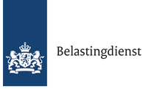














Infrastructure R&D and system
co-design
PDP strategic directions and
their supporting projects
New initiatives and projects
strengthen the strategic areas
ensure continuity of
research and infrastructure
Research Software & Acceleration
BDSI
planned project pathways include
GN5-*, AARC-TREE, EOSC-Q,
EOSC Core, LHC4D Roadmap, …
Public partner R&D engagement
AMD, Nokia, NVidia/MLNX, IBM, NL-ix, …
Dutch national government
Infrastructure for Collaboration

Slide 12
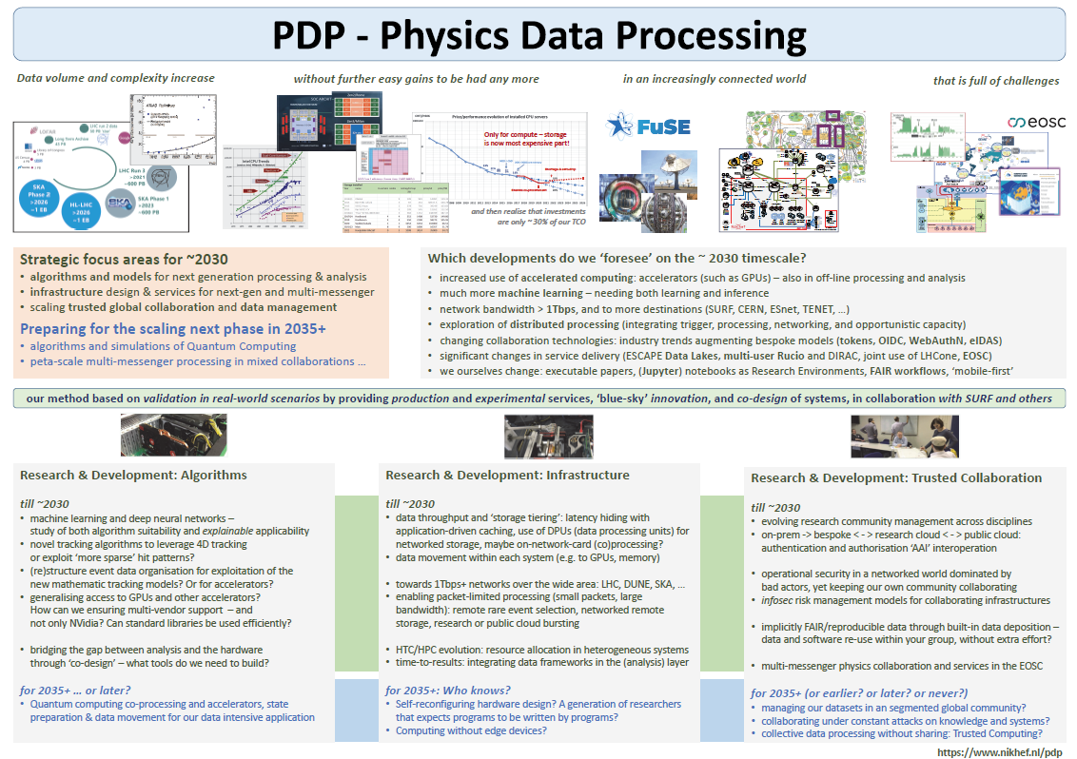
Where do we plan to go from here?
Strategic focus areas for ~2030
algorithm design patterns for processing & analysis
infrastructure design for multi‐messenger
trusted global collaboration and data management
on this ‘near term’ timescale
accelerators (such as GPUs and hybrid computing) – also in off‐line processing and analysis
much more machine learning – needing both learning and inference
network bandwidths > 1Tbps, and to more destinations (SURF, CERN, ESnet, TENET, …)
exploration of distributed processing (integrating trigger, processing, networking, and opportunistic capacity)
changing collaboration technologies: industry augmenting our bespoke models
significant changes in service delivery (‘data lakes’, multi‐user workflow systems, science networks, EOSC)
and in due course, we ourselves and as a community will change
executable papers, ‘notebooks’ for all Research Environments, ‘beyond’-Open-Science workflows, ‘mobile‐first’ research computing, and who knows what’s more to come?
Vista 30

Slide 13
Because we can … does not mean it’s the scalable way ☺
LCO2 cooling of an AMD Ryzen Threadripper 3970X [56.38 °C] at 4600.1MHz processor (~1.5x nominal speed) sustained,
using the Nikhef LCO2 test bench system (https://hwbot.org/submission/4539341) - (Krista de Roo en Tristan Suerink)

Slide 14
Physics Data Processing towards results unconstrained by computing

Slide 15
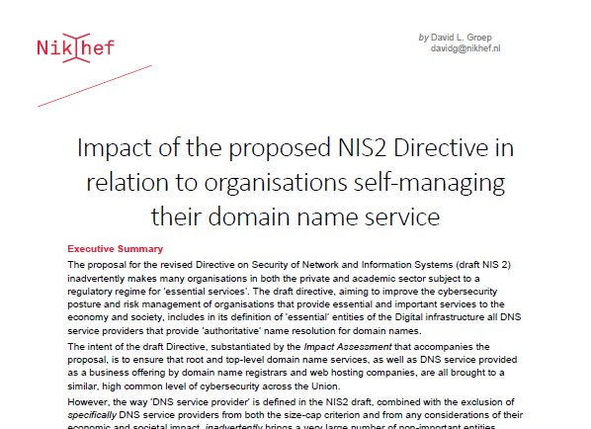
Policy development in ICT and our collaborative values
Our Research Infra (and Open Science) needs a collaborative ‘values framework’
frequently threated by increasingly ‘corporate’ approach to ICT services
continuous remedial action needed at many levels: from European Commission and EP, down to even our ‘own’ centralized national institutes organization …
Continued vigilance on IT infra is part of PDP programme
to keep our research ICT infrastructure open, e.g. through:
reviewed & improved NIS2 directive, with our Opinion taken up by the EP;
watch carefully and continuously NWO’s push to ‘corporate IT’
and its impact on academic integrity & freedom;
promote trustworthy federated access via AARC (globally), SRAM (our
SURF national scheme), promote trust & identity with our university partners
build scalable security solutions rather than pay corporate ‘ISO tick-box’ providers
luckily many times in collaboration with GEANT, JISC, STFC, EGI, and our peer institutes in NL
https://doi.org/10.5281/zenodo.4629136

