Slide 1
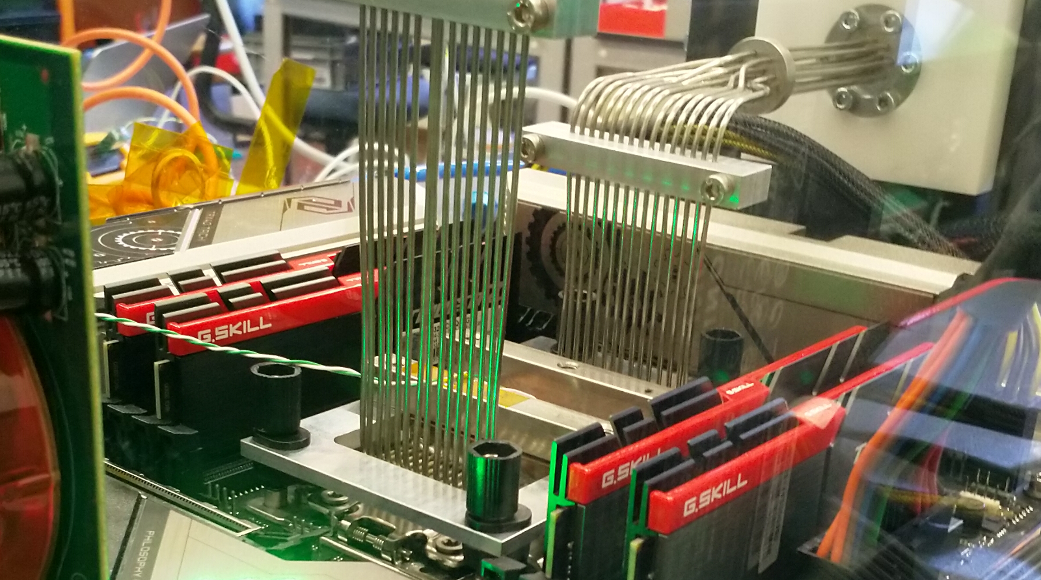
Physics Data Processing accelerating ‘time to science’ through computing and collaboration
Nikhef SAC June 2025
David Groep

Slide 2
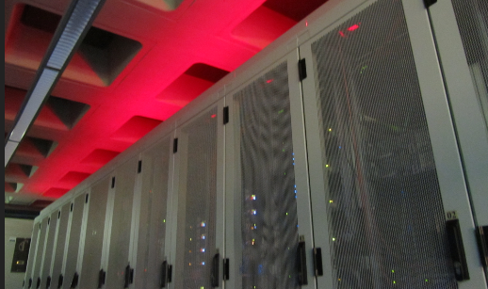
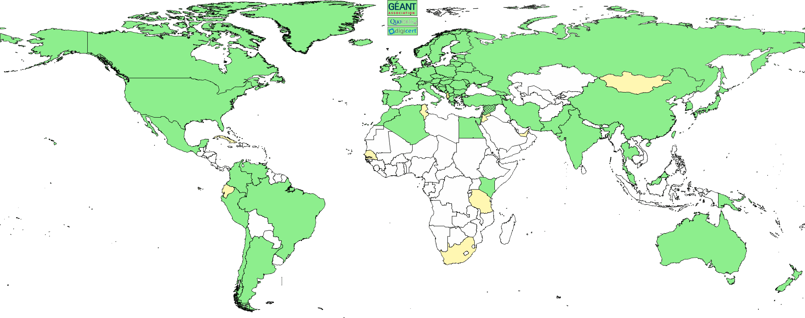
The three pillars of Nikhef Physics Data Processing
Algorithmic design patterns and software
designing software for (GPU) accelerators, algorithms &
high-performance processors
design patterns for
workflow & data orchestration
Infrastructure, network & systems co-design R&D
building ‘research IT facilities’
co-design & development
big data science innovation
research on IT infrastructure
Infrastructure for
trusted collaboration
trust and identity for
enabling communities
managing complexity of collaboration mechanisms
securing the infrastructure
of our open science cloud

Slide 3
Ambitions and execution
Accelerate time to results with efficient use of computing
exploit new systems design and integration:
different architectures, innovative vendors, faster networks
ensure our users access to the broadest range of services with ease
Meanwhile
ensure our computing capacity is sustainable
we fund it to a large extent from generic, non-subatomic-physics sources
continue push for generic access of services
important to keep individual RIs like WLCG in line with (access to) generic infrastructures
divergence puts our NL-T1 funding model (2.7M€ per year for WLCG alone) in jeopardy
move more of our experiments to generic computing infrastructure so we can contribute more effectively, cheaper and faster, like we invested in IGWN and KM3NeT

Slide 4
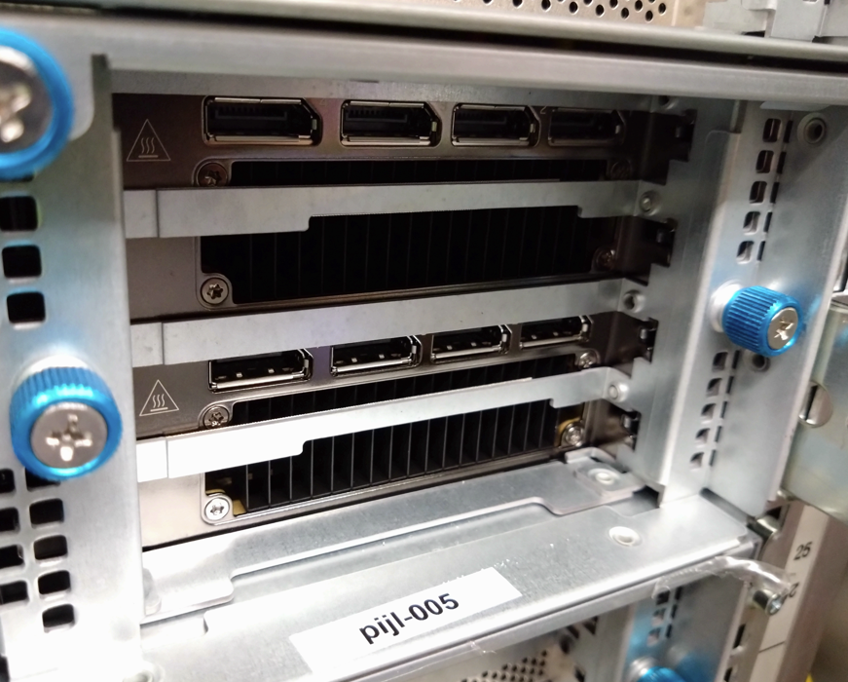
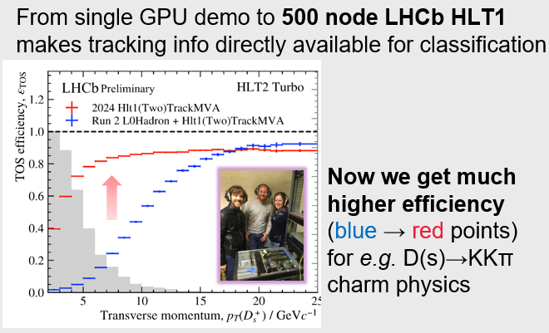
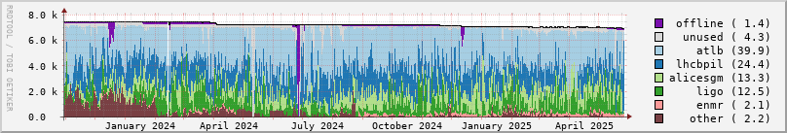
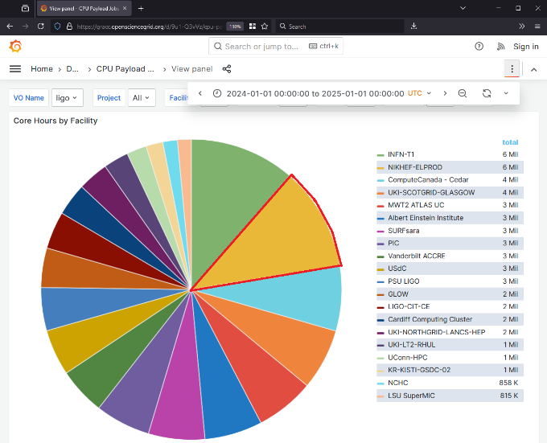
Some computing, engineering and trust highlights
significantly increased
use of GPUs
not only with Allen
but also in our analysis facility
94.3% occupancy of our NL-federated Tier-1 facility
Nikhef compute for IWGN now >11% of global capacity*
800 Gbps coherent long-distance AMS-GVA network
Security and risk management for EOSC EU Node
new AARC architecture and trust framework
with tokens for more than just IGWN and WLCG
* Netherlands as a whole provides
17% of OSG accounted LIGO+ resources
Data: occupancy data for Nikhef NDPF NL-T1 and DNI compute (https://www.nikhef.nl/pdp/doc/stats/ndpf-prd-grisview-year). IGWN data: OSG Gracia portal, whole of 2024: Nikhef 11.1% + SURF 6.1% https://gracc.opensciencegrid.org/d/9u1-Q3vVz/cpu-payload-jobs?orgId=1&var-ReportableVOName=ligo&var-Project=All&var-Facility=All&var-Probe=All&var-interval=1d&from=1704067200000&to=1735689600000&viewPanel=9

Slide 5
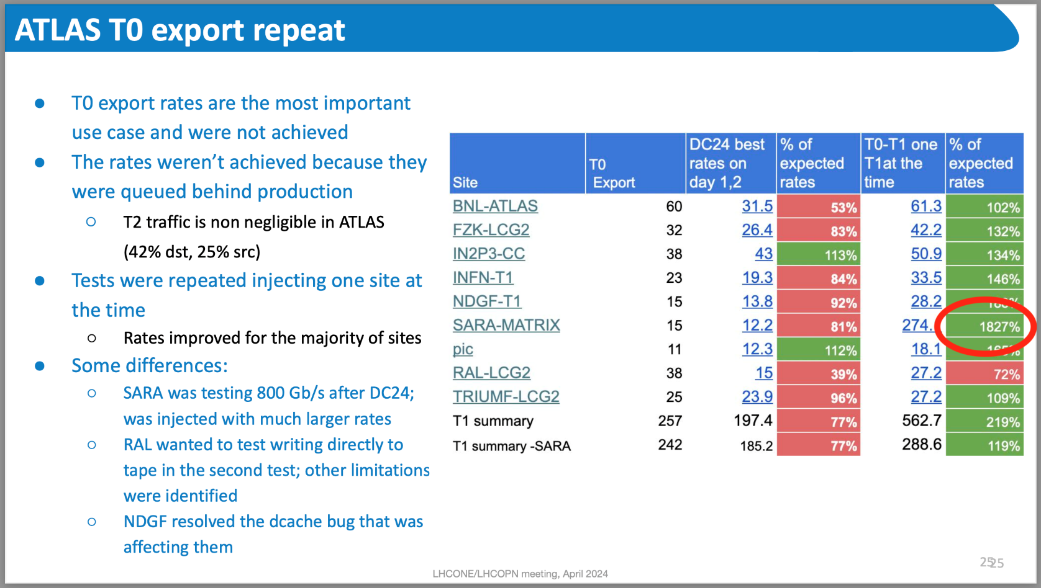

800Gbps in practice
From: Katy Ellis (STFC RAL): DC24 report, LHCOPN meeting, Catania, IT, April 2024 https://indico.cern.ch/event/1349135/#6-dc24-report

Slide 6
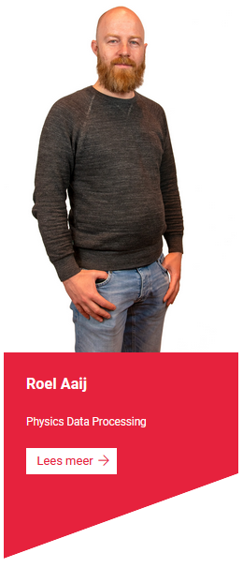
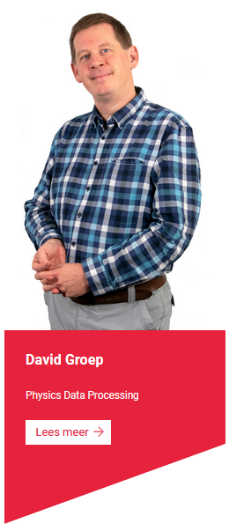
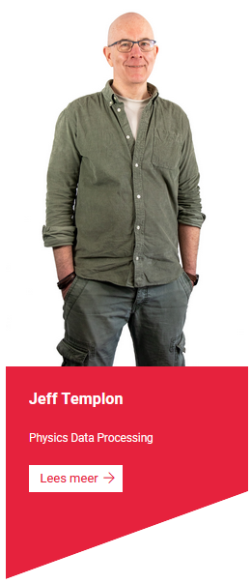
A compact programme backed by computing technology
People: 2.1 FTE (spread over 3 staff)
our one postdoc got a permanent position (LHCb)
at Maastricht University since July 1st
But: rely can on ~ 6.5 FTE from Nikhef Computing Technology
~ 3 FTE (nominally) infrastructure operations
for both our Tier-1 (co-funded by SURF) and Tier-3
while also providing researcher engagement & support
~ 1.5 FTE infrastructure for collaboration and cross-domain security
(funded by GEANT, EGI, and other EC contracts)
~ 2 FTE innovation, accelerated processing and next-gen networks
(mostly funded by SURF), doubling with support for advanced infra operations
Activities on accelerated computation, ML (and QC) spread across all programmes, with PDP participation,
to ensure proper sustained embedding of their results in the programmes

Slide 7






















Pathways via projects
and collaborations
Infrastructure R&D
and systems
co-design
Accelerating
computing
New initiatives and projects
strengthen the strategic areas
ensure continuity of
research and infrastructure
BDSI
future project pathways planned:
FASTTRACK, AI/ML Upgrade, …
Public partner R&D engagement
AMD, Nokia, NVidia, NL-ix, AmsIX…
Dutch national government
Infrastructure
for Collaboration

Slide 8
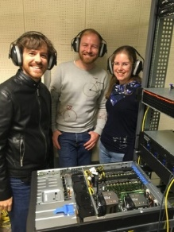
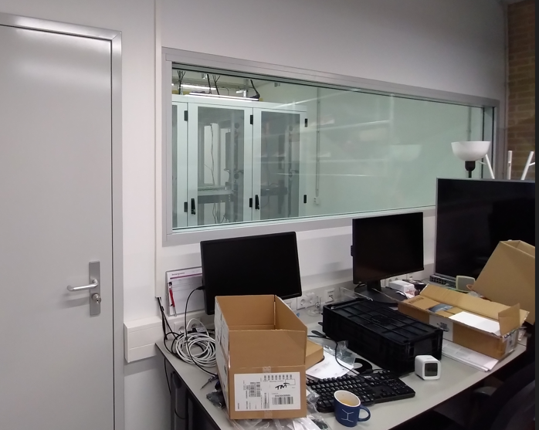
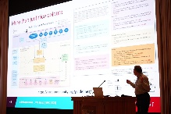
Next to operations and innovation, we push ahead!
Drive change in analysis and re-processing with accelerators to become ‘the default’:
we have GPU accelerator expertise with Allen for LHCb’s … on to a FASTER FASTTRACK
there is already large embedded effort on AI & ML across the Nikhef portfolio
as a T1 have fast access to data, and have a GPU-heavy national HPC system at SURF
strong and coherent CompSys research in CS, and the AI coalition across Dutch academia
Push the high-throughput system integration boundaries
dedicated ‘lab’ data centre for Tbps+ networks, energy & cooling, novel architectures
excellent links with SURF, public sector, and vendor ecosystem
Make collaboration easier across domains
keep our field connected to AAI in R&E space, evolving our federated access
building on the foundations we brought and bring
to eduGAIN/GEANT, EOSC, EGI, SURF, and the trust and identity federations
executable papers, research workflows, ‘beyond’-Open-Science workflows, Open Scholarly Infrastructure

Slide 9
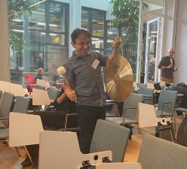
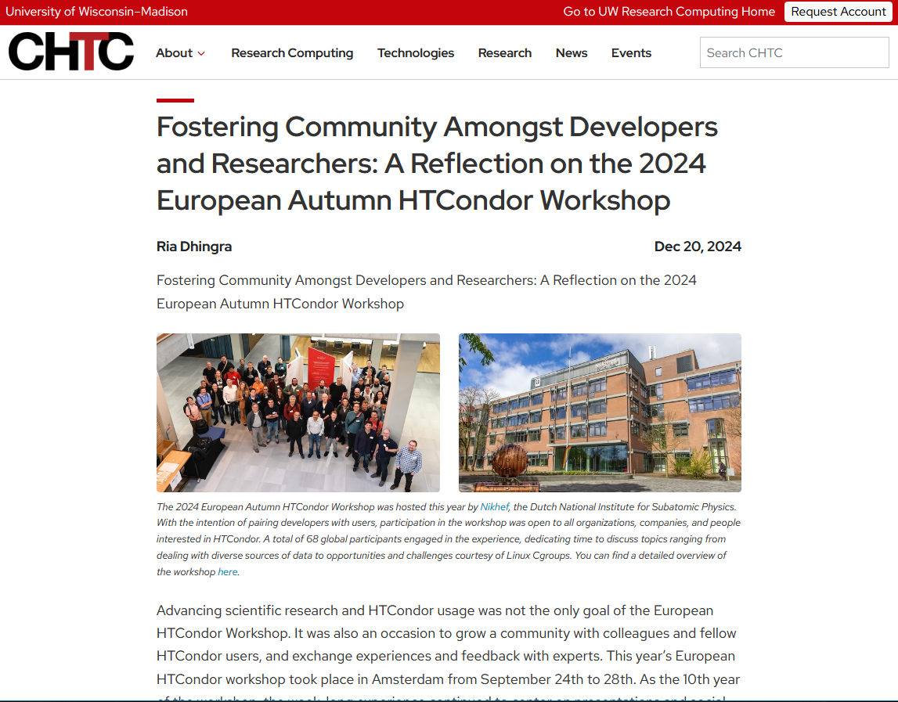
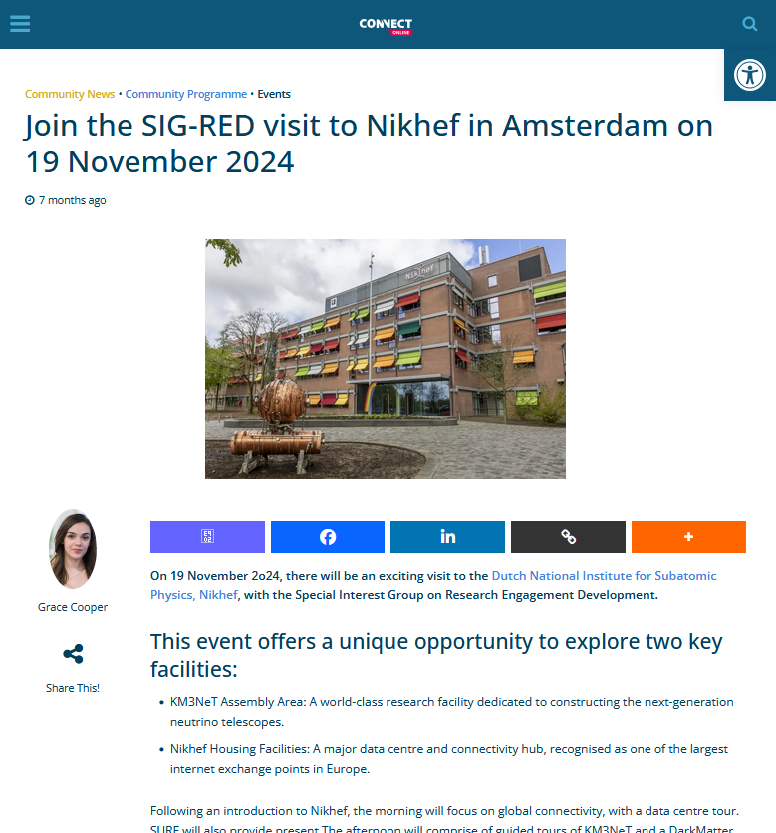
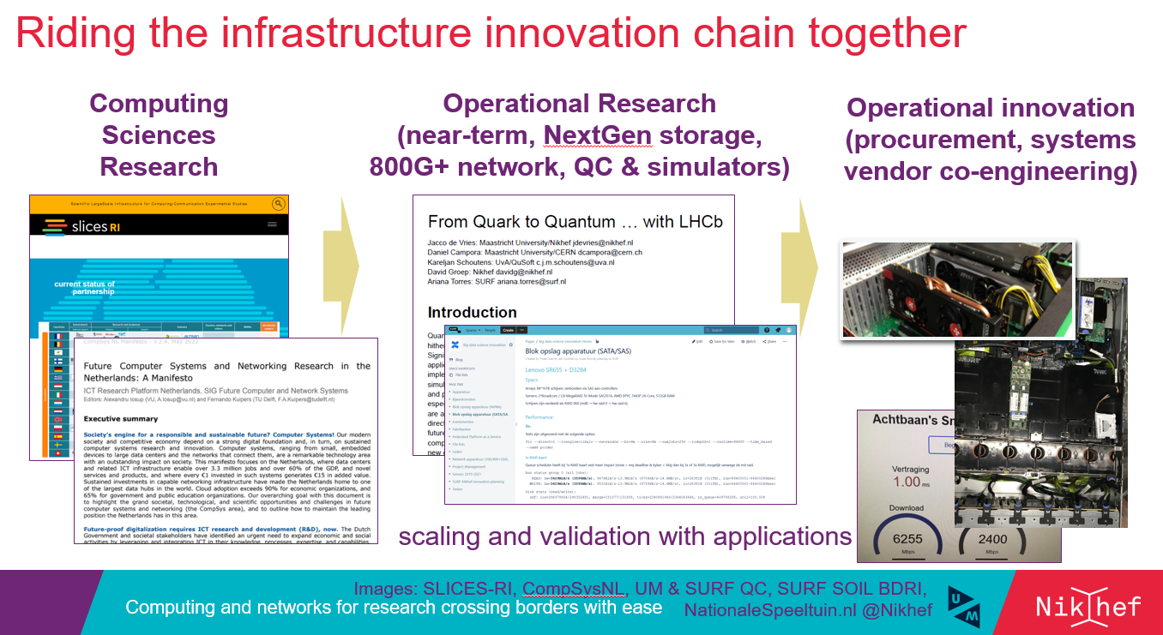
Coherence and alignment – within and outside
Data processing across all of Nikhef
Per-programme algorithmic collaboration
from compiler flags to restructuring algorithms
Computing Office Hours
from printing to vectorisation, all in one go
… and across the national and global landscape

Slide 10
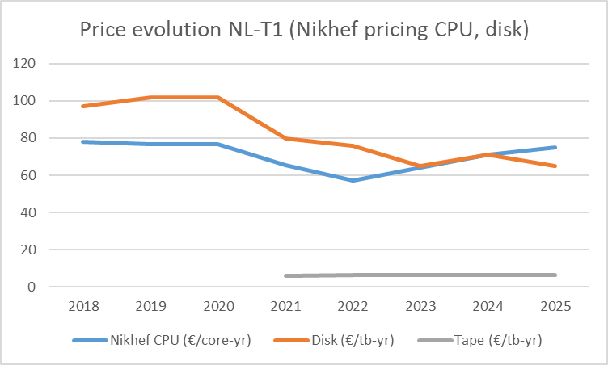
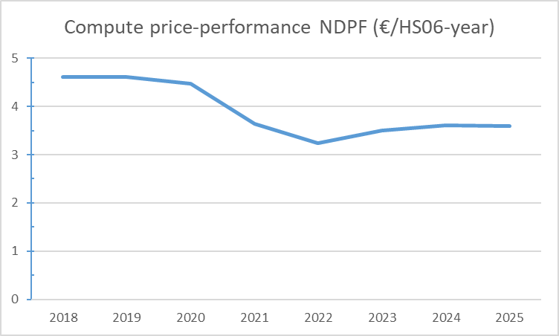
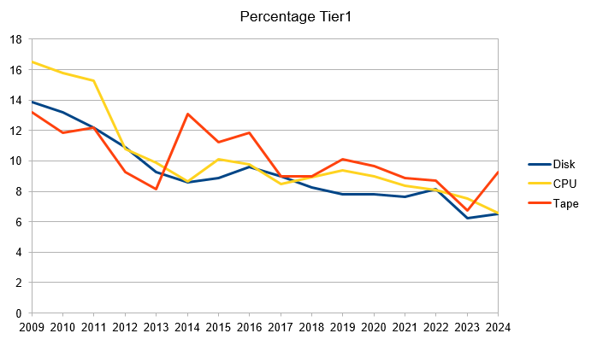
Challenges and opportunities
Computing operations and funding for capacity
are a continuous challenge
energy and personnel costs are dominating factors
‘AI bubble’ actually works against us for hardware pricing
Dutch funding model with emphasis on short-term competition
assumes operations are ‘just’ funded from institutional basis
reliance on generic funding means we must remain aligned!
But we can also help and make an impact at the same time
large users like us improve efficiency of whole ecosystem
acceleration advances and ML help us exploit new systems,
and allow us to do more with the resources we do get
innovation programme aids on procuring national systems that fit also our future needs
corrected for the (slight) performance increase per core
‘the true effect of flat budget’
Nikhef Data Processing Facility TCO data. Percentage (WLCG) Tier-1 data: SURF, 2024

Slide 11

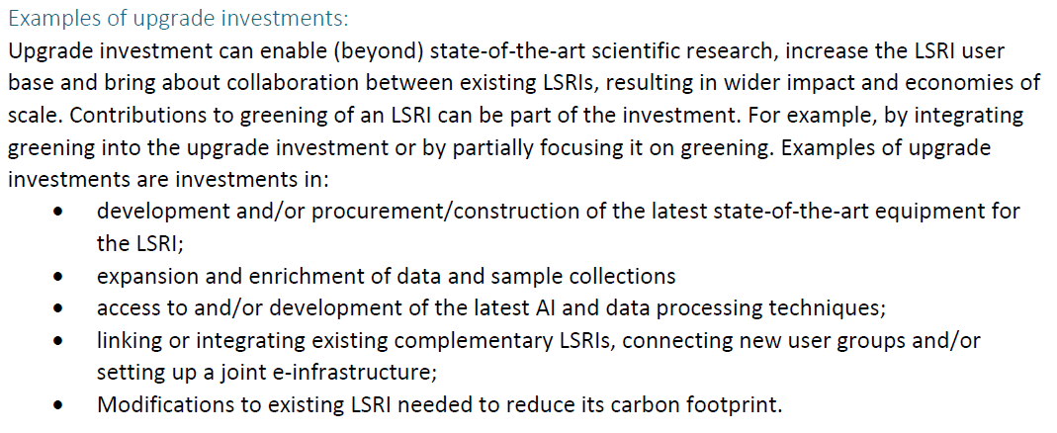
Continuity for capacity and an ‘AI/ML’ upgrade
Opportunities can actually be found in funding landscape
Large-Scale Research Infrastructure upgrade call specifically mentions as eligible examples
‘joint e-Infrastructure’ and ‘access to and development of the latest AI and data processing techniques’
we can build on BIGLHC (2013) and KM3NeT 2.0 (2019)
GPU heavy extensions both for AI/ML and accelerated compute
ensuring all types of data are available for training (and validation)
which can complement other funding opportunities
that are available to Nikhef for AI/ML

Slide 12
Physics Data Processing towards results unconstrained by computing

Slide 13
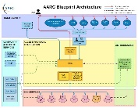
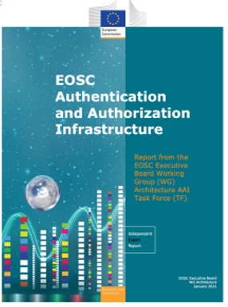
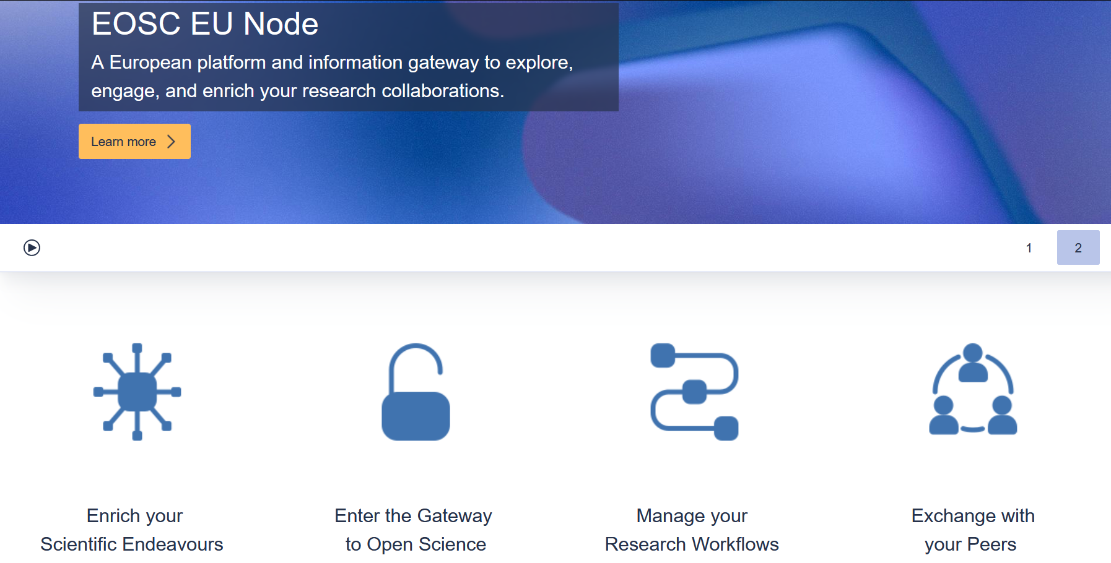
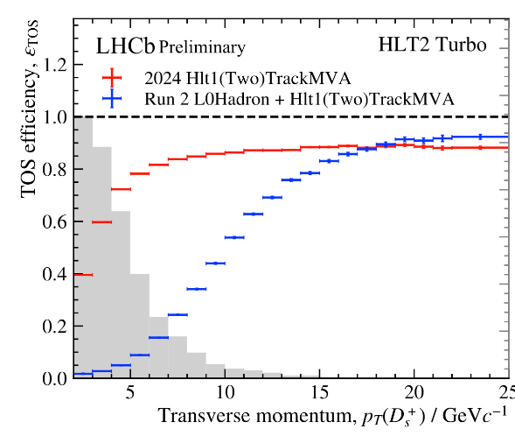
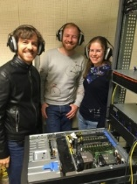

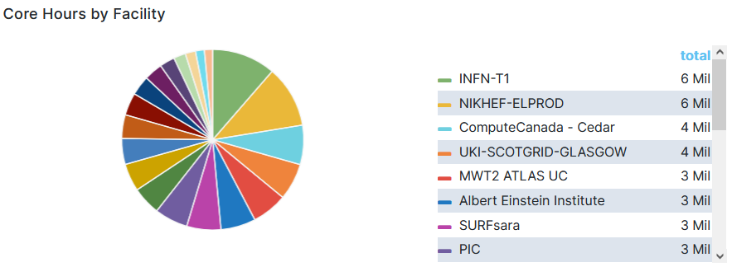
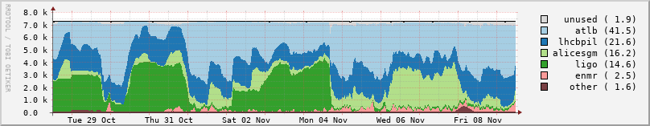
Pushing computing boundaries, some examples
From single GPU demo to 500 node LHCb HLT1
makes tracking info directly available for classification
Providing Security and
Risk Management for the European Open Science Cloud “EU Node” core services (procured EC service, delivered with )
Now we get much higher efficiency (blue → red points) for e.g. D(s)→KKπ charm physics
and next-gen trust & identity for LSRIs with
AARC TREE and eduGAIN security
LIGO (+ Virgo) global distributed compute
all of 2024
Nikhef Data Processing Facility in our ederated Dutch e-Infrastructure:
WLCG Dutch Tier 1, Auger, KM3NeT
gravitational waves … but also
e.g. WeNMR structural biochemistry
Image sources: EOSC EU Node https://open-science-cloud.ec.europa.eu/; IGWN utilisation from OSG GRACIA https://gracc.opensciencegrid.org/ and https://edu.nl/tr79b; LHCb HLT1: Roel Aaij (Nikhef), Daniel Campora (Nikhef & UM), Dorothea vom Bruch (LPNHE), photo: LPNHE; Run3 to Run2 comparison: https://lbfence.cern.ch/alcm/public/figure/details/3837; EOSC AAI Architecture: publications office of the European Union; AARC blueprint: https://aarc-community.org/; DNI: https://www.nikhef.nl/pdp/doc/stats/

Slide 14
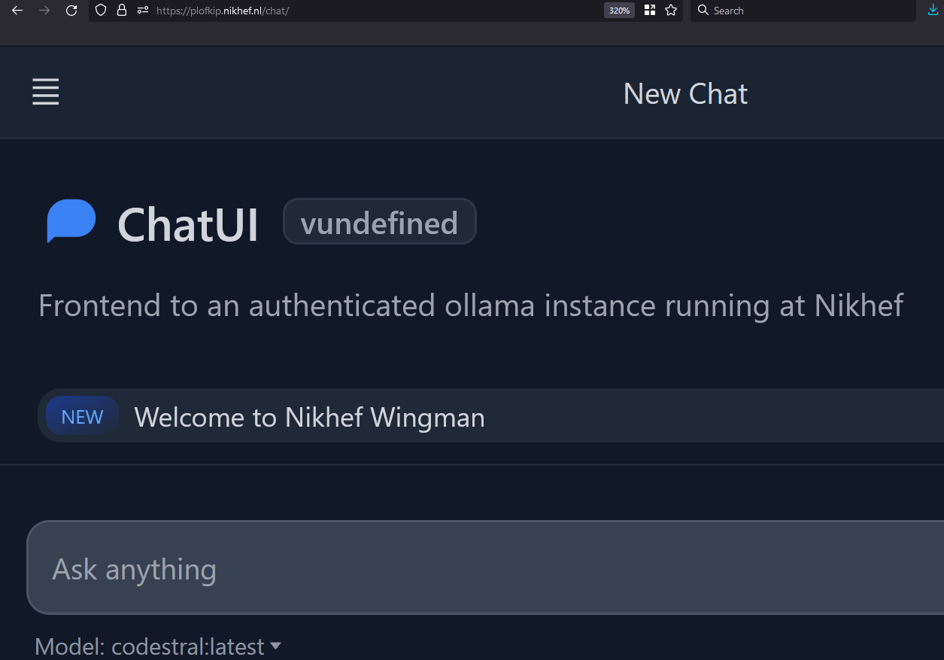
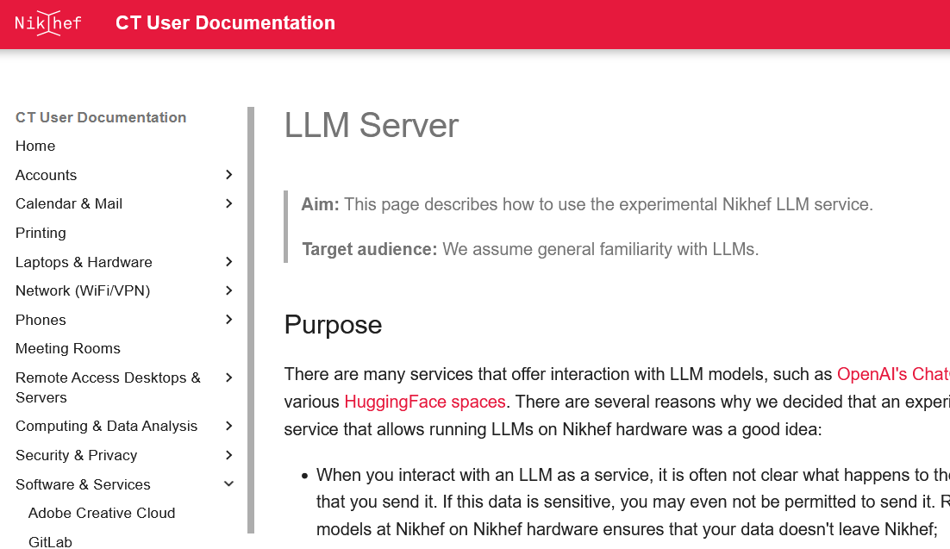
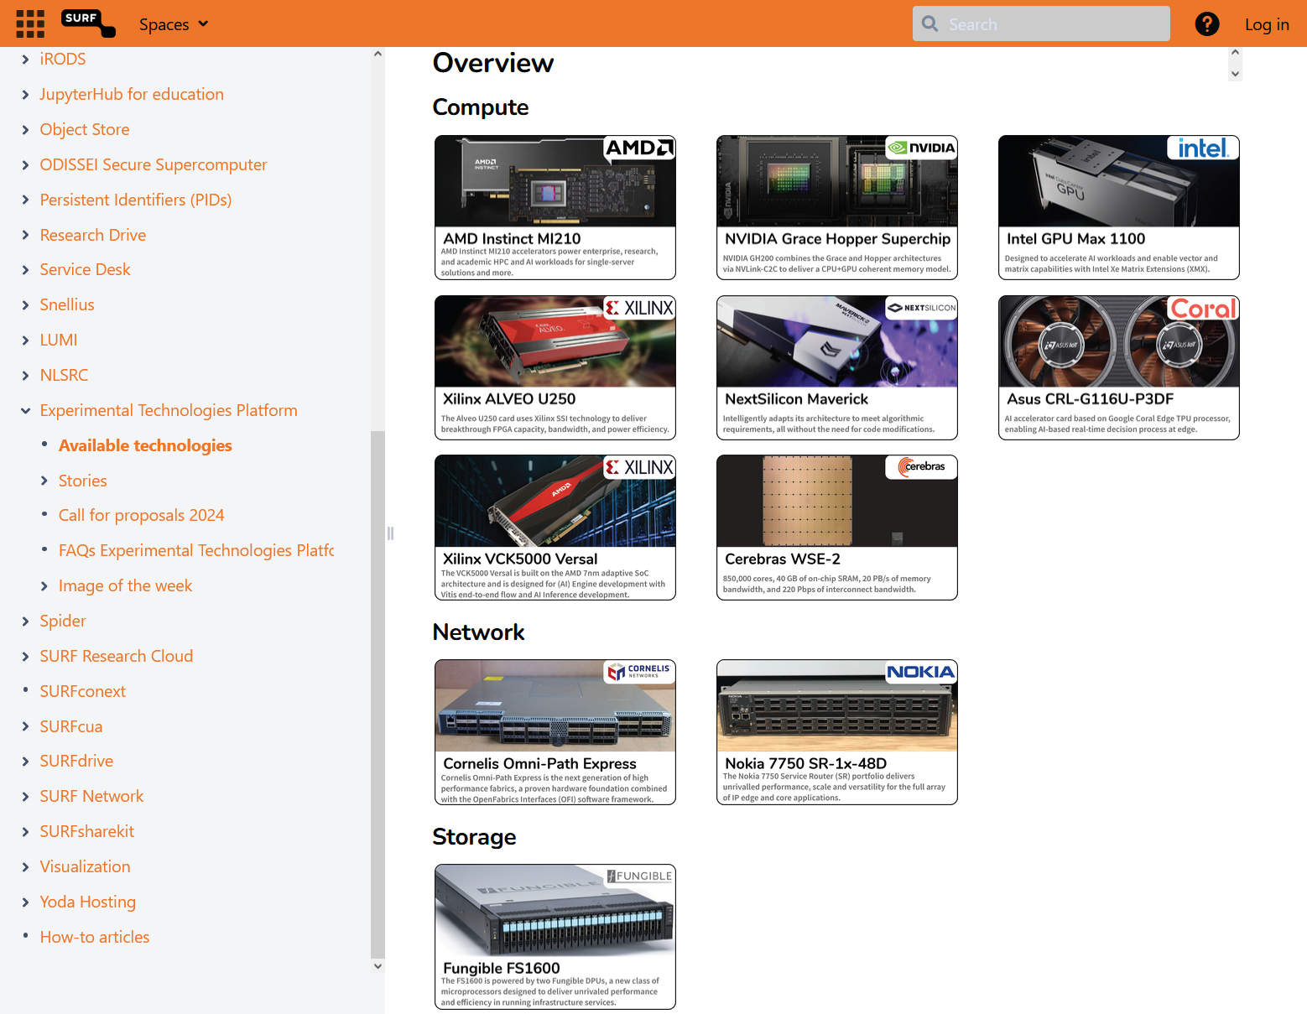
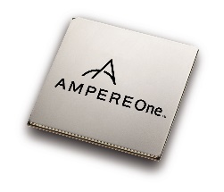
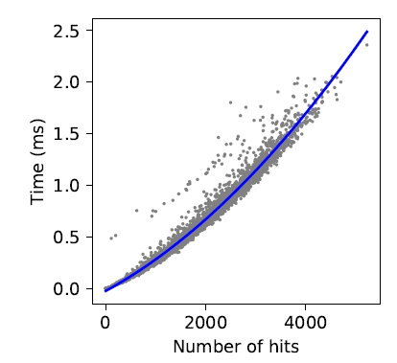


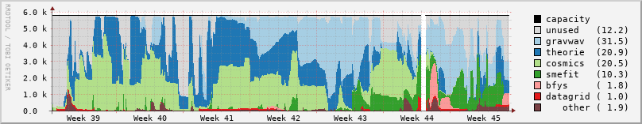
Jumping over our computing boundaries
Efficient and accelerated computing
accelerators, such as GPU- and hybrid-computing
– extending its scope to last trigger stage, to off‐line processing and to analysis
more machine learning, for tracking and physics event classification
efficient architectures: ARM systems (with our SURF Experimental Platform)
exploration of quantum computing, for future gains in algorithmic complexity
Networking, both physical link and collaborative networks
network bandwidths over 800 Gbps to CERN, and to more destinations
evolving and aligning global collaboration technologies (unified tokens):
authentication & authorization for WLCG, Gravitational Waves, SKA, DUNE,
… and the European Open Science Cloud
Open Science at scale, with data for today’s and tomorrow’s science
new forms of service delivery with Analysis Facilities and ‘data lakes’
practical Open Science for data-intensive systems (with 4TU.RD/TUDelft)
– with a new Institutional Data Repository using Djuhuty open source software,
linked to our local analysis facility, adding re-usable science software
LLM service: https://plofkip.nikhef.nl/chat, services: kb.nikhef.nl/ct, AmpereOne SURF ETP ARM experimental platform pauperbak.nikhef.nl; scatter plot shows compute time per event estimated for ATLAS at the HL-LHC with the current processing model (from: FASTER ENW-XL); Djehuty open source Data repository: archive.nikhef.nl, data.4tu.nl, Catharina Vaendel (Nikhef) and Roel Jansen et al. (TUDelft).

Slide 15
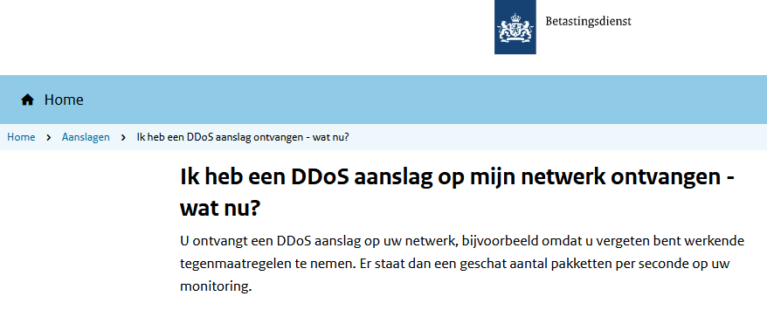
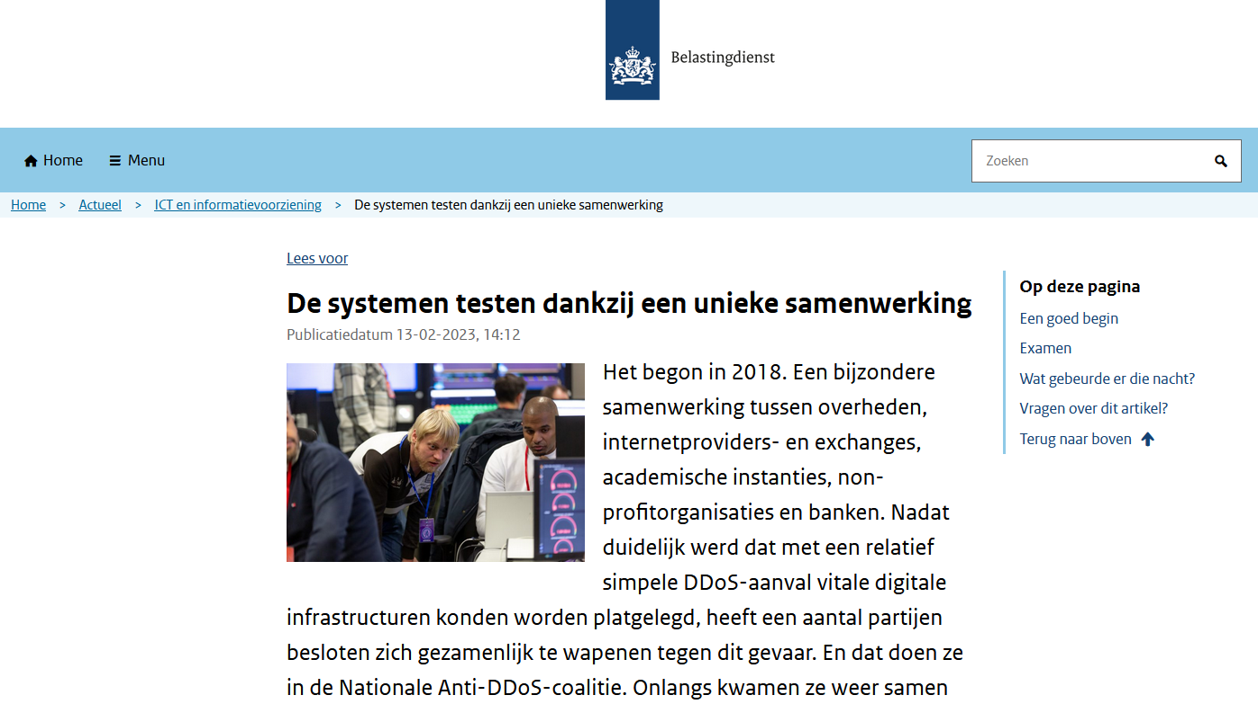
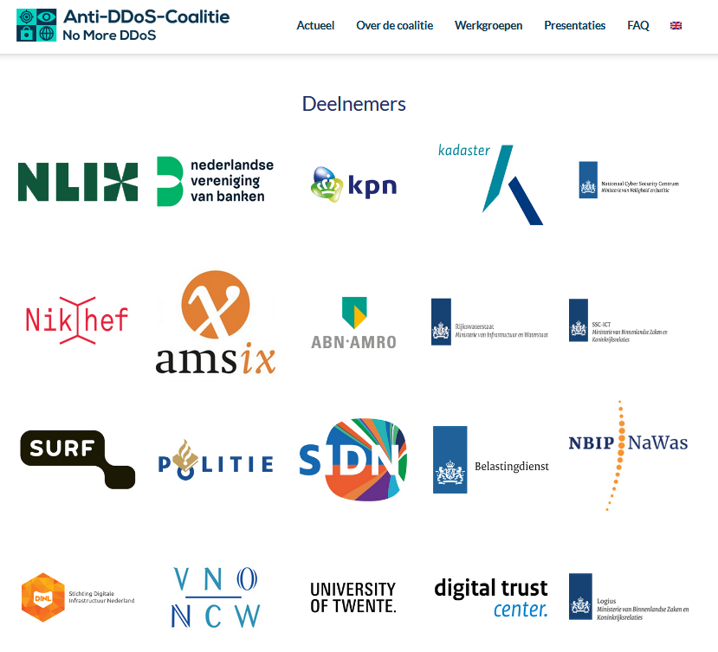
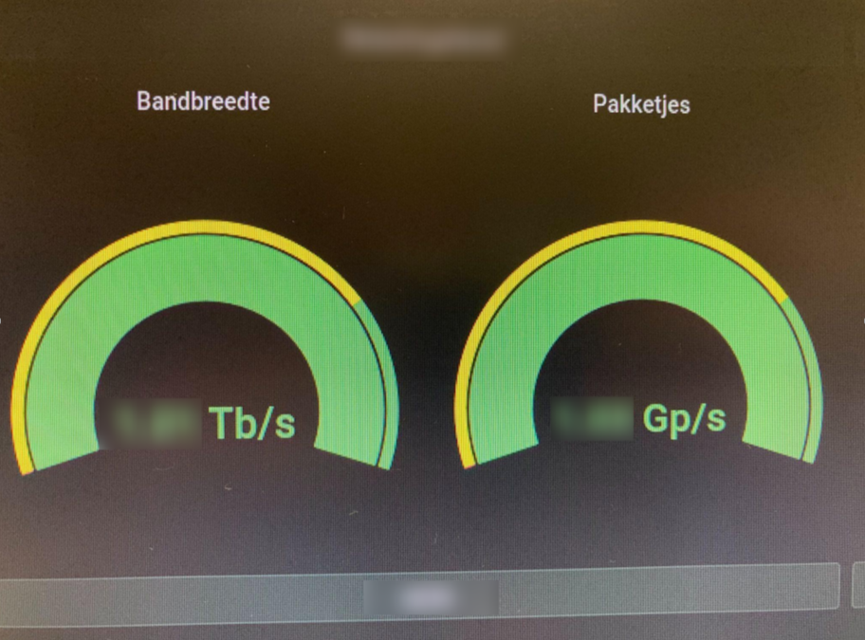
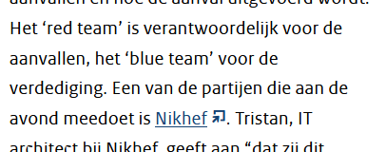
Our science data flows … are somebody else’s DDoS attack
Bandwidth for the HL-LHC, WLCG, and the trigger data streams can also ‘exercise’ our Dutch national critical infrastructure
Image sources: belastingdienst.nl, rws.nl, werkentegennederland.nl, https://www.nomoreddos.org/deelnemers/

Slide 16
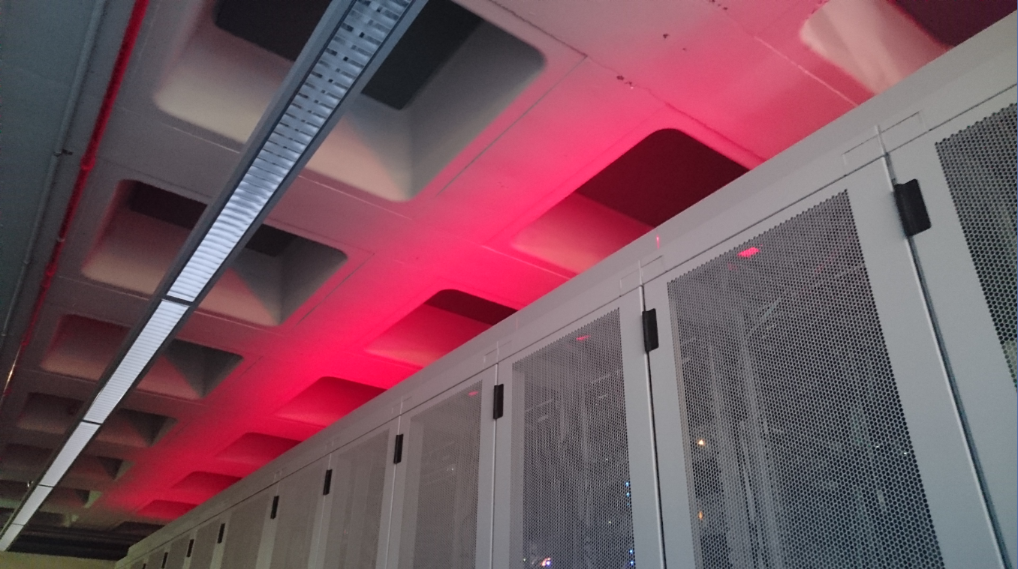
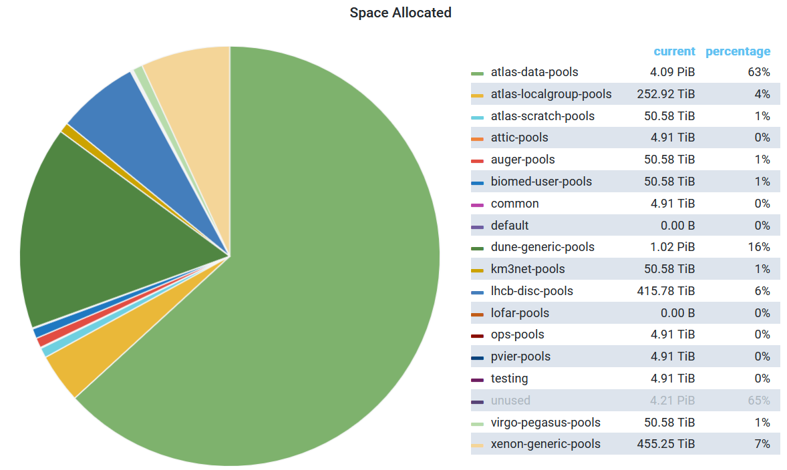
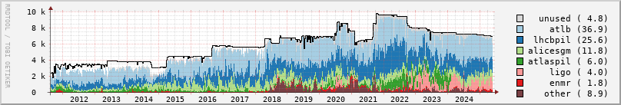
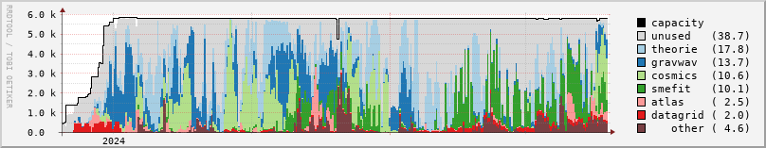
Infrastructure for Research
High-through compute (HTC) + high throughput storage
provided by the national e-infrastructure
coordinated by SURF
WLCG NL-T1, IGWN, KM3NeT, Xenon, DUNE
+ other science domains WeNMR, Tropomi, project-MinE, …
‘Stoomboot’ local analysis facility
~ 11 000 cores, 16 PByte storage installed, with pretty competitive TCO
Occupancy: NDPF DNI processing facility. Faster processors (AMD Rome and Bergamo) allows processing in fewer cores and using less power
Storage data: https://steker.nikhef.nl:3000/d/c8fA5P0Wk/dcache-grid?orgId=1&refresh=5m&viewPanel=37 as of May 25, 2025

Slide 17
800G link Nikhef & SURF to CERN

Slide 18
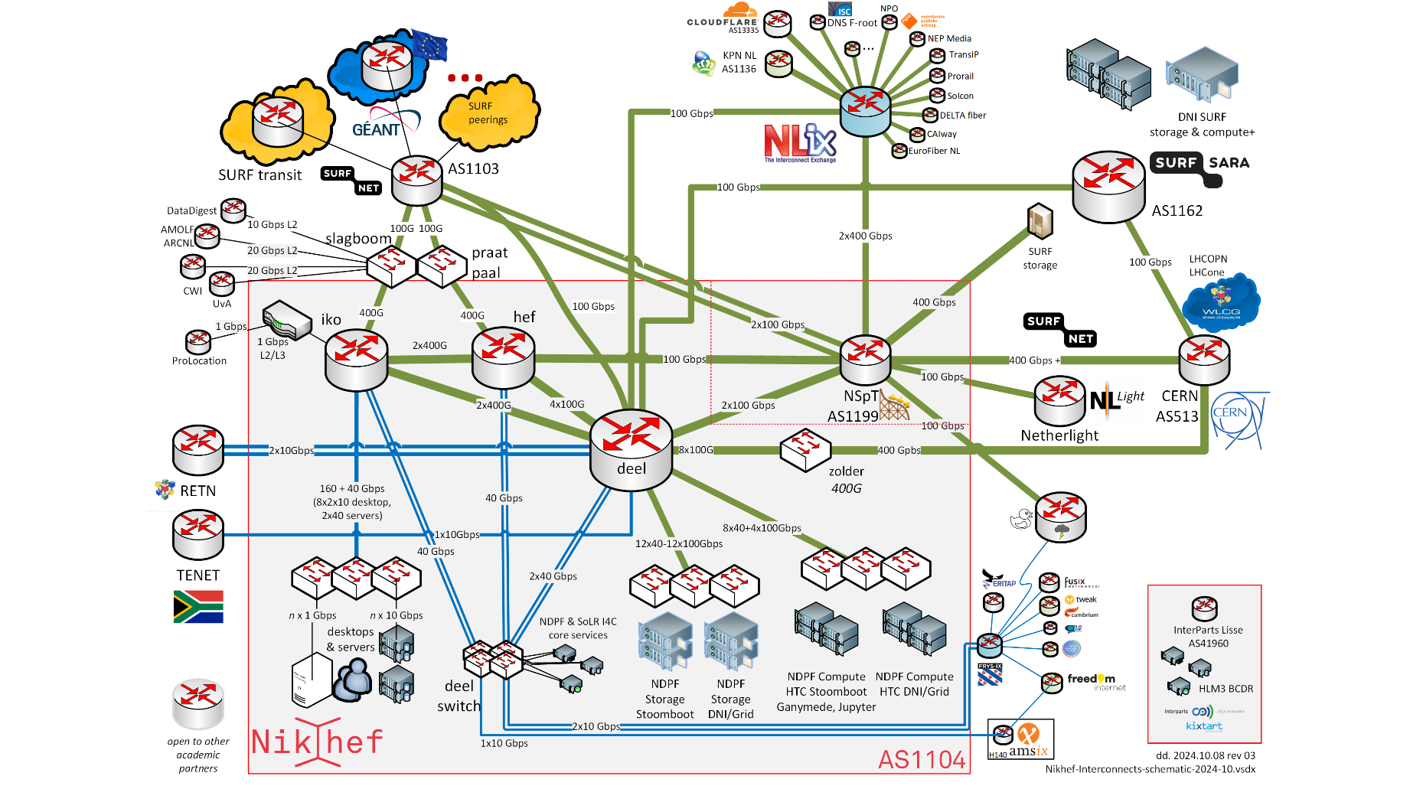
Next Gen networks – connecting our data and people

Slide 19
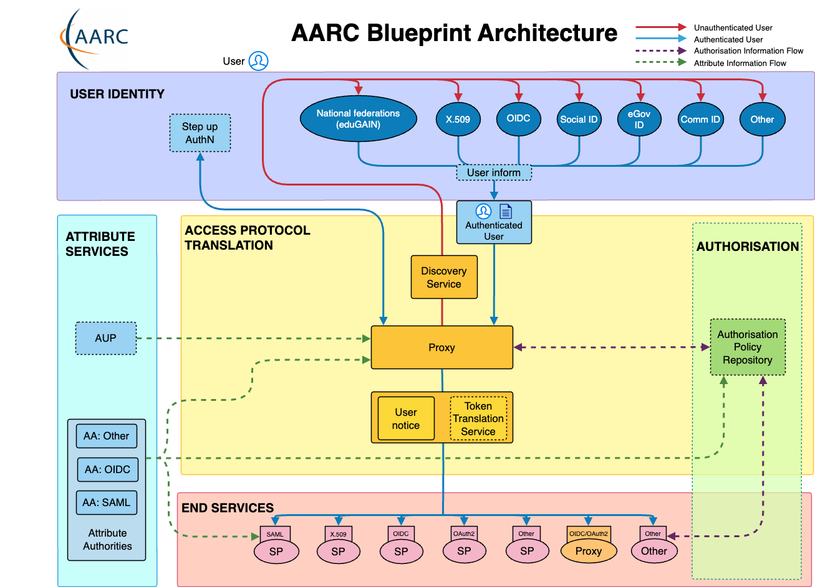
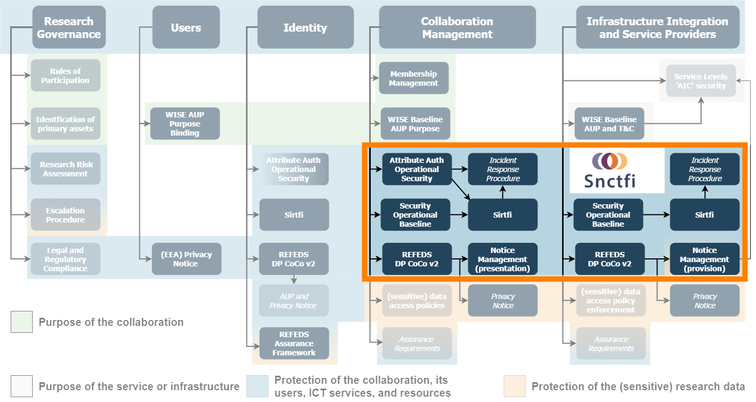
Infrastructure for Collaboration
Target high-impact specialized areas,
bridging policy & technical architecture for ‘AAI’ & ‘OpSec’
authentication & authorization for research collaboration
  AARC project & community, GEANT GN5, REFEDS & eduGAIN,
  TCS & RCauth.eu, AARC TREE, EOSC
  policy for interoperability for data protection,
  seamless service access, single-click acceptable use
  continuous technical evolution in line with the AARC BPA and global RIs
embedding of data processing infrastructure
of our programmes in the EOSC landscape

Slide 20
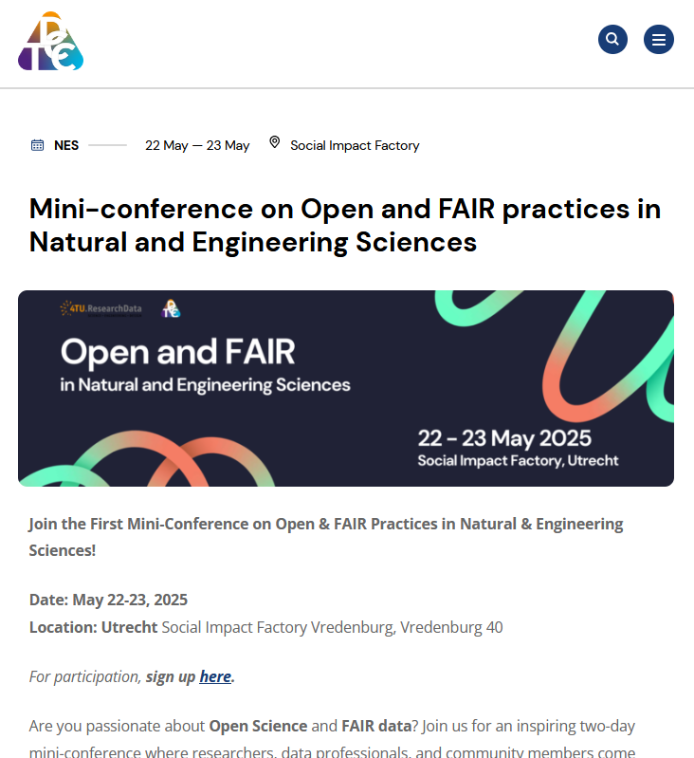
Collaboration: Research Data Management beyond ‘FA’
FAIR for live data and large volumes, shifting gears towards the “I” and “R”’
not that many disciplines with really voluminous data
  so nationally join forces with those who do: ASTRON (SRCnet), KNMI (earth observation, seismology)
work with those who care about software to bring data to life:
  NLeSC, 4TU.RD/TUDelft, CWI, and with those who ensure the infrastructure: SURF
for our own analyses and the local (R&D) experiments we work
towards continuous deposition of re-usable data and software
  NWO Thematic Data Competence Centre for the Natural and Engineering Sciences
  develop Djehuty RDM repository software link to ‘Stoomboot’ analysis cluster storage
  research data management is ‘just’ part of a good science workflow

Slide 21
Foundational Principles for Digitalisation at Nikhef
Still needs explanation – despite digital sovereignty discussions. For both research and ‘enterprise’ ICT.
And ‘if they are many, they are not principles’, so we set only four:
Institutional strategy and mission directs ICT decision making
ICT decisions are assessed based on the Nikhef strategic themes
Collaboration as a core value
Nikhef stands for the whole of the Dutch community in (astro)particle physics and its European and global collaborations
Shared public values and responsible technology
Nikhef employs, develops, and shapes technologies that preserve autonomy, justice and humanity, that builds on our academic sovereignty and integrity
Digitalisation reflects the continuity in our research programmes
With research horizons measured in decades, ICT reflect this continuity in its choice of infrastructure, services, and information management, and in its human expertise

Slide 22
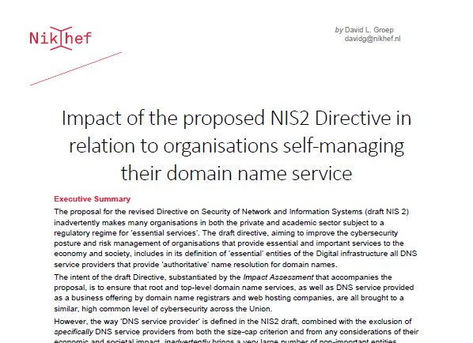
Policy development in ICT and our collaborative values
Our Research Infra (and Open Science) needs a collaborative ‘values framework’
frequently threated by increasingly ‘corporate’ approach to ICT services
continuous remedial action needed at many levels: from European Commission and EP, down to even our ‘own’ centralized national institutes organization …
Continued vigilance on IT infra is part of PDP programme
to keep our research ICT infrastructure open, e.g. through:
reviewed & improved NIS2 directive, with our Opinion taken up by the EP;
watch carefully and continuously NWO’s push to ‘corporate IT’
and its impact on academic integrity & freedom;
promote trustworthy federated access via AARC (globally), SRAM (our
SURF national scheme), promote trust & identity with our university partners
build scalable security solutions rather than pay corporate ‘ISO tick-box’ providers
luckily many times in collaboration with GEANT, JISC, STFC, EGI, and our peer institutes in NL
https://doi.org/10.5281/zenodo.4629136

Slide 23
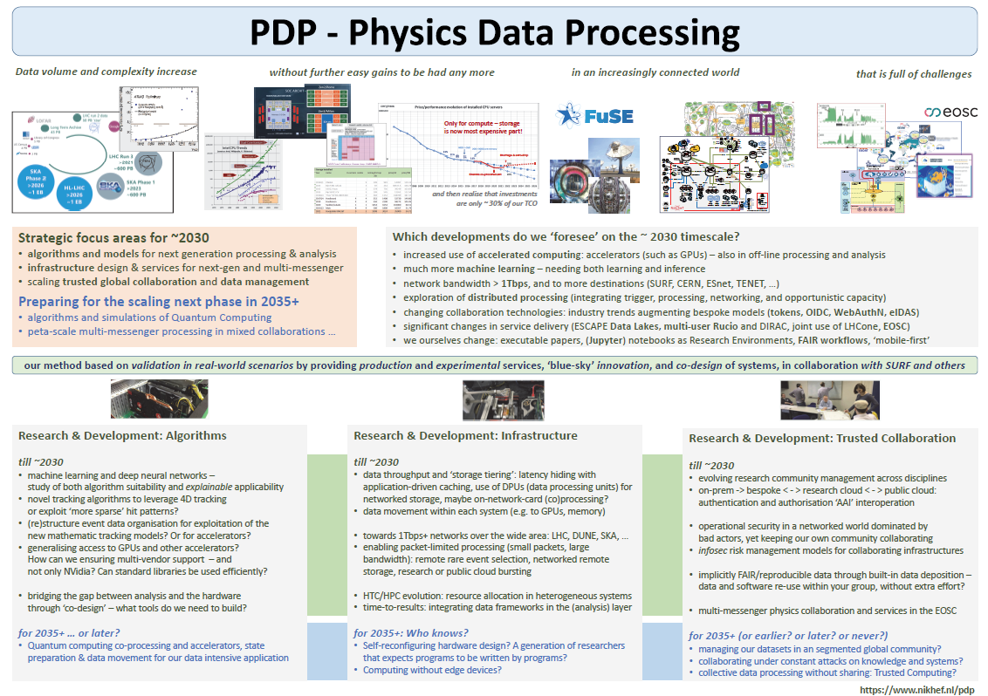
Where do we plan to go from here?
Strategic focus areas for ~2030
algorithm design patterns for processing & analysis
infrastructure design for multi‐messenger
trusted global collaboration and data management
on this ‘near term’ timescale
accelerators (such as GPUs and hybrid computing) – also in off‐line processing and analysis
much more machine learning – needing both learning and inference
network bandwidths > 1Tbps, and to more destinations (SURF, CERN, ESnet, TENET, …)
exploration of distributed processing (integrating trigger, processing, networking, and opportunistic capacity)
changing collaboration technologies: industry augmenting our bespoke models
significant changes in service delivery (‘data lakes’, multi‐user workflow systems, science networks, EOSC)
and in due course, we ourselves and as a community will change
executable papers, ‘notebooks’ for all Research Environments, ‘beyond’-Open-Science workflows, ‘mobile‐first’ research computing, and who knows what’s more to come?
Vista 30

Slide 24
Because we can … does not mean it’s the scalable way ☺
LCO2 cooling of an AMD Ryzen Threadripper 3970X [56.38 °C] at 4600.1MHz processor (~1.5x nominal speed) sustained,
using the Nikhef LCO2 test bench system (https://hwbot.org/submission/4539341) - (Krista de Roo en Tristan Suerink)

