Slide 1
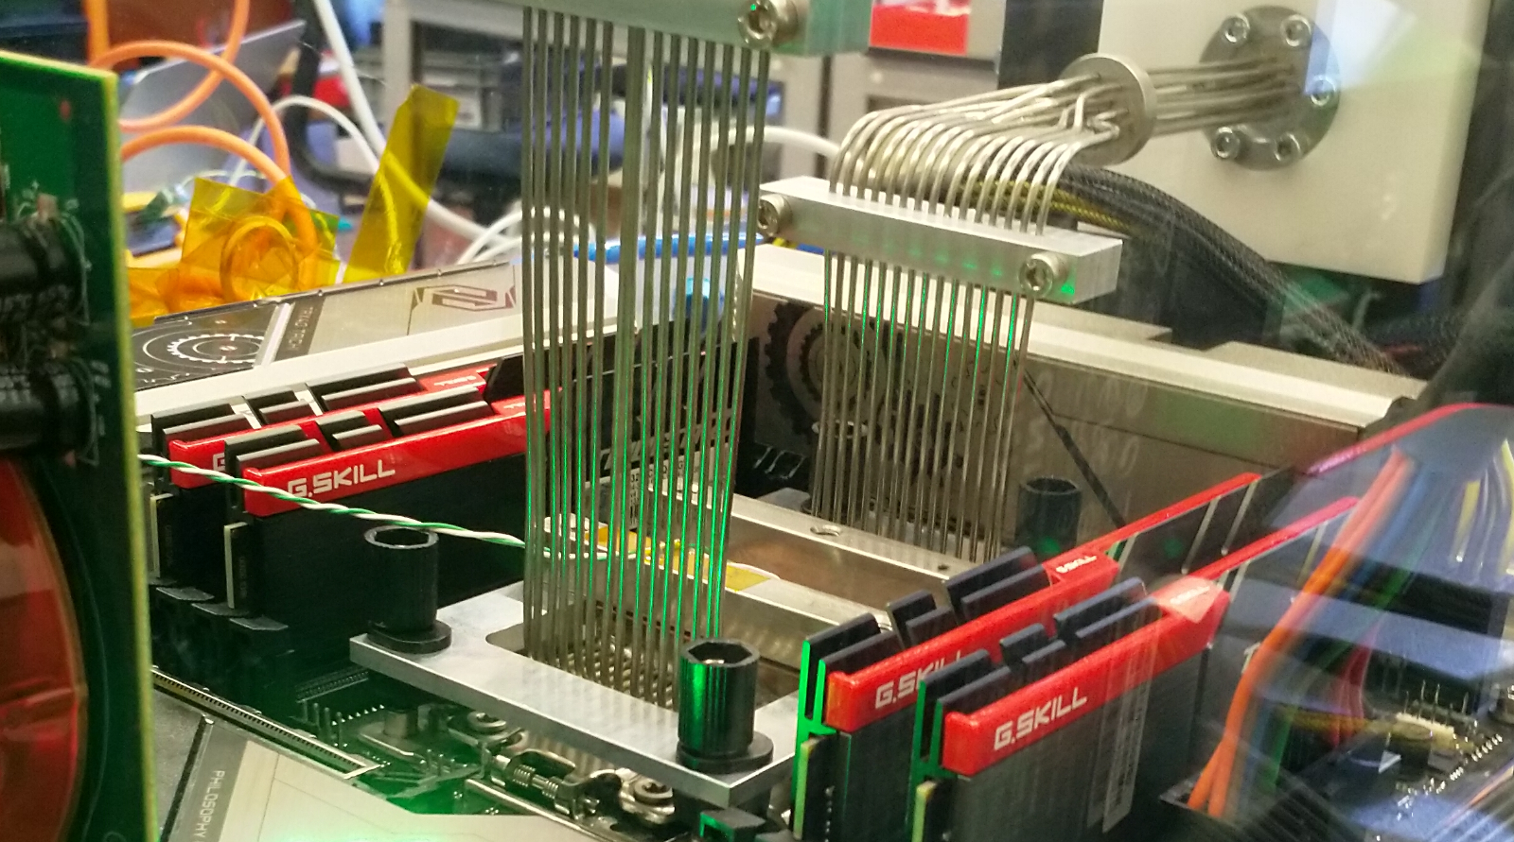
Physics Data Processing accelerating ‘time to science’ through computing and collaboration
Nikhef SAC February 2026
David Groep

Slide 2
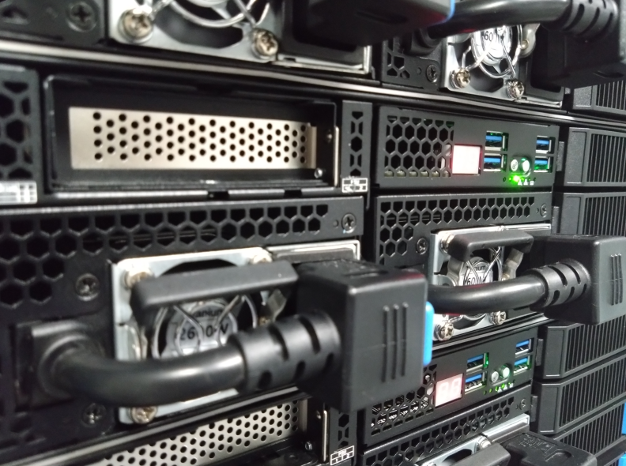
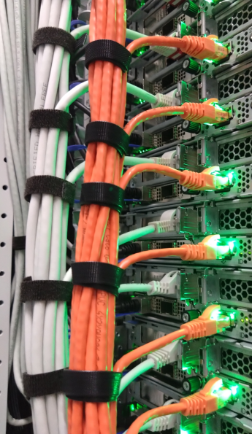
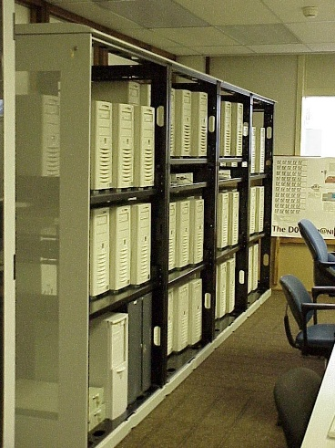
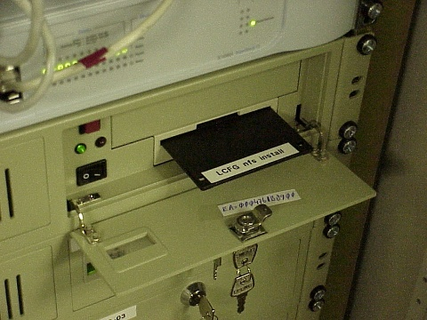
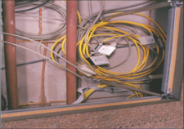
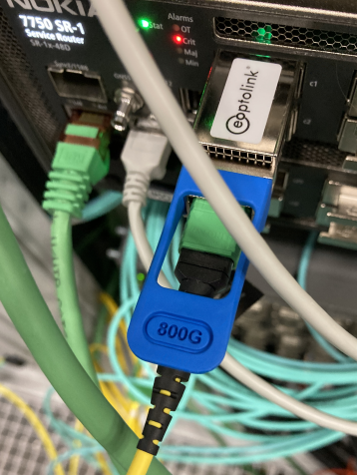
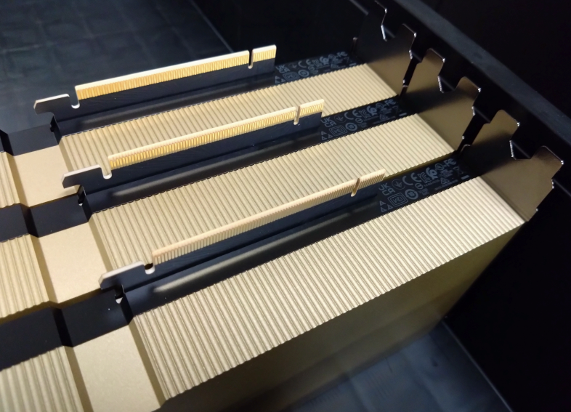
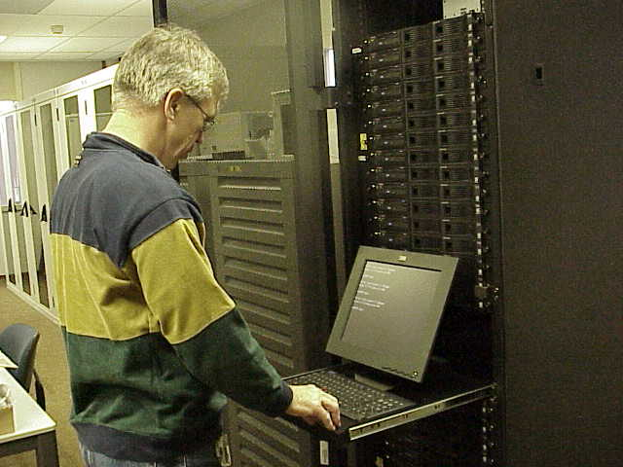
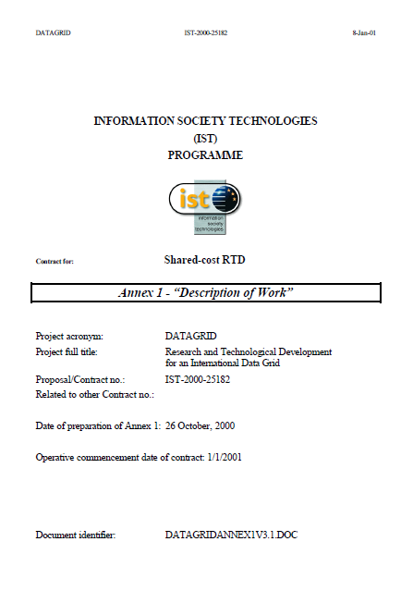
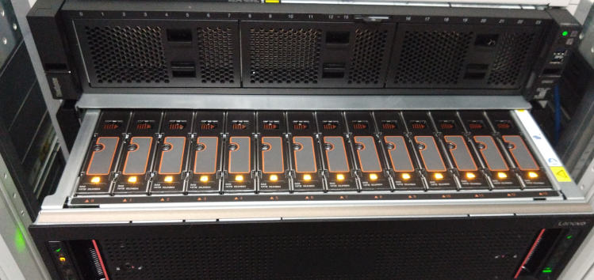
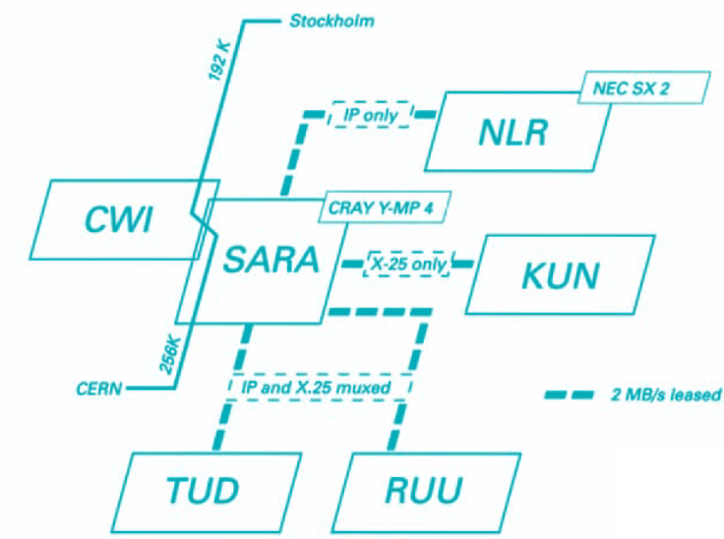
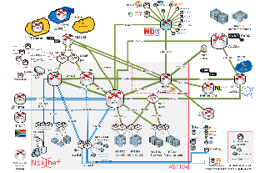
Fourty years of data driven computing at Nikhef (almost)
$ whois nikhef.nl
Domain name: nikhef.nl
Status: active
Creation Date: 1987-01-07
2001
1996
2026
1990
plus WTCW Virtual Laboratory, DAS-2,
Virtual Lab for eScience, BiGGrid, since 1999

Slide 3
‘Means and purpose’ of processing
Accelerate time to results with efficient use of computing
through algorithmic design, novel software methods,
and optimisation of data driven workflows and models
exploit new systems design and integration for efficiency and scalability
with heterogeneous architectures, innovative vendors, faster networks
ensure physics access to the broadest range of science services with ease
while operationally
ensure our computing capacity is sustainable … as we fund it to a large extent from non-HEP/APP sources, and have a commitment to open science and collaboration
continue push for generic access of services … important to keep individual RIs aligned
move more of our experiments to generic computing infrastructure …
so we can contribute compute more effectively, cheaper & better to our physics programmes

Slide 4
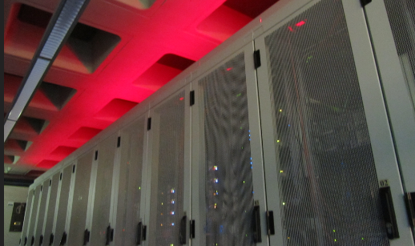
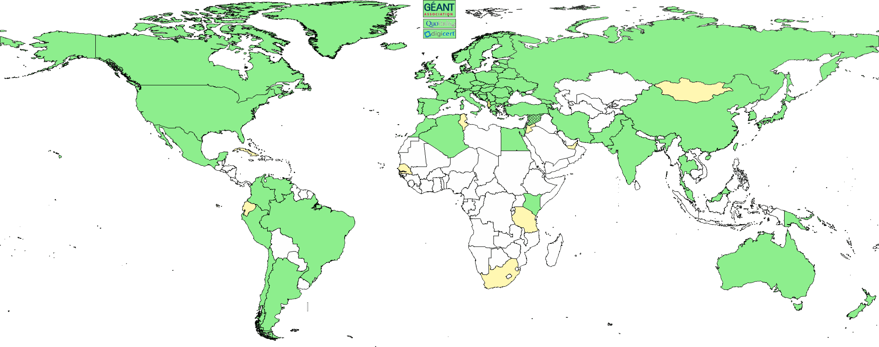
The pillars of Physics Data Processing
Algorithmic design patterns and software
GPU & accelerator software, algorithms, heterogeneous processors optimisation
algorithmic design R&D
Infrastructure, network & federated systems R&D
building ‘research IT facilities’
& federated access for RIs
data science at volume scale
research on IT infrastructure
Infrastructure for
trusted collaboration
community trust and identity
managing complexity of collaboration mechanisms
securing the infrastructure
of our open science cloud
scalability of policy negotiation
Infrastructure for scalable ML in HEP & APP
Inference optimisation for data throughput,
HTC/HEP and HPC/AI-factory convergence, hybrid workflows
“scaling data processing from local to national to AI factories”
T&I, Federation, Research Infra Commons

Slide 5
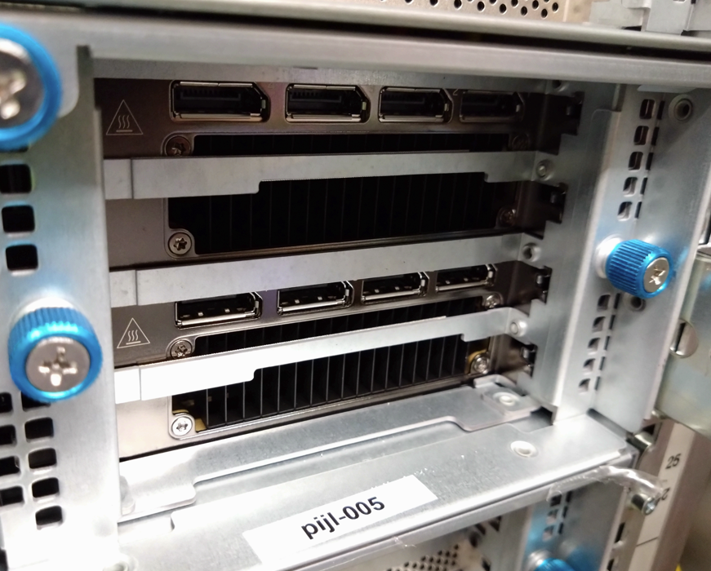
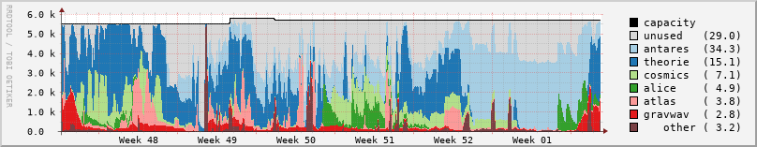
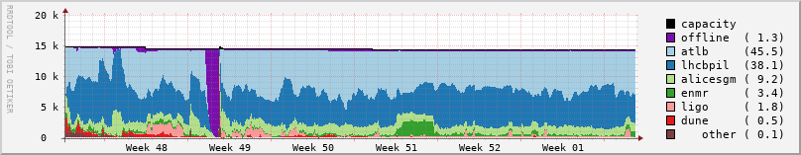
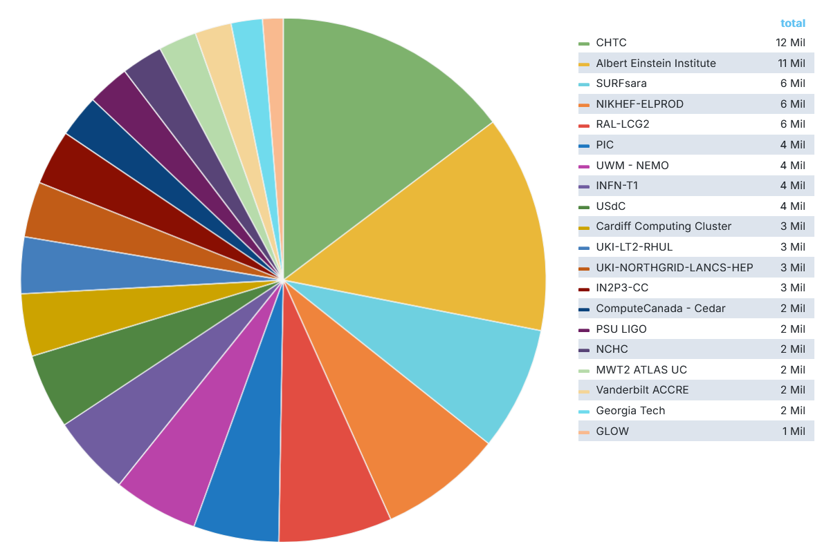
Some computing, engineering and trust highlights
seeing significantly increased use of GPUs
in our analysis facility for AI/ML
consolidated migration to HTCondor for
both local analysis and our federated facility
– improved 98% occupancy of our NL-federated Tier-1
‘NL-T1’ compute for IGWN now >15% of global capacity*
faster networks & more packets with ‘interesting’ effects
security and risk management for EOSC EU Node
new AARC architecture & trust framework delivered
tokens, OpenID Federation, and review of EU ID Wallets
* Netherlands as a whole is NIKHEF-ELPROD + SARA-MATRIX, 16Mcore-hrs
Data: occupancy data for Nikhef NDPF NL-T1 and DNI compute (https://www.nikhef.nl/pdp/doc/stats/ndpf-prd-grisview-year). IGWN data: OSG Gracia portal, whole of 2025: Nikhef 7.5% + SURF 7.5% https://gracc.opensciencegrid.org/d/9u1-Q3vVz/cpu-payload-jobs?orgId=1&var-ReportableVOName=ligo&var-Project=All&var-Facility=All&var-Probe=All&var-interval=1d&from=1735689600000&to=1765756800000&viewPanel=9

Slide 6






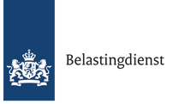
















AI/ML
Pathways via projects
and collaborations
MERGE
Infrastructure and
systems R&D
Accelerating
computing
New initiatives and projects
strengthen the strategic areas
ensure continuity of
research and infrastructure
ETP
future project pathways planned:
MERGE, SHAKE, …
FAIR-4-AI
Public partner R&D engagement
AMD, Nokia/Cerebras, NL-ix, AmsIX…
Dutch national government
Infrastructure
for Collaboration

Slide 7
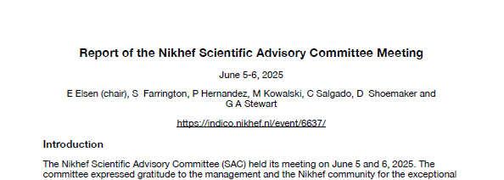
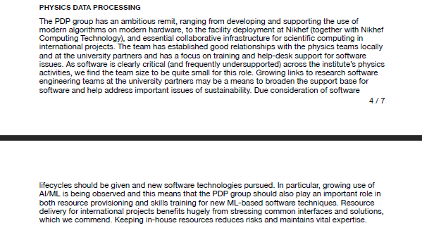
From the SAC’s last year observations
Looking back and forwards
‘Keeping in-house resources…’
‘… benefits hugely
from stressing common interfaces & solutions’
‘… growing use of AI/ML is being observed’
‘… an ambitious remit …’
…
Report of the Nikhef Scientific Advisory Committee Meeting June 5-6, 2025

Slide 8
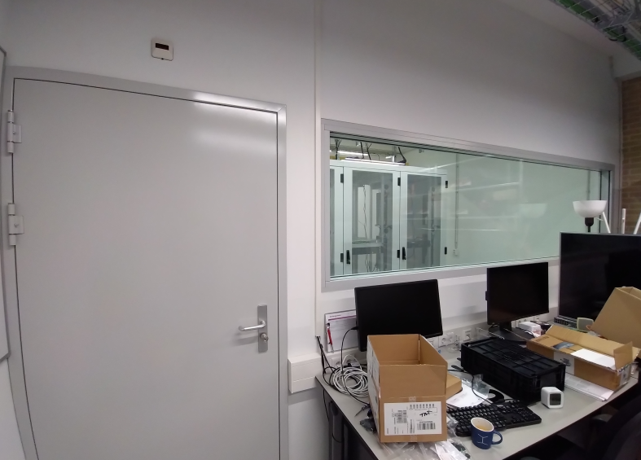
‘Keeping in-house resources…’
We need our operational capability to be relevant* in the ecosystem
we are the ‘staircase model’ put into practice: scaling from ‘Stoomboot’ to our federated ‘DNI’ national and global resources – and influencing these by example
Naturally aligned with the Research Infrastructure Commons
we provide the ‘rapid-response’ capability of
the innovation platforms and the (national)
‘Experimental Technologies Platform’ (ETP) for SURF
Outsourcing (or even off-site co-location) of facilities would jeopardize
that role in innovation – and be detrimental to our talent case …
But we (cannot) do not do this alone
MERGE proposal explicitly includes the Commons as mechanism
to import and export expertise on AI/ML and infrastructure usage
* aligns well with the Dutch Wennink report on national relevance and innovation

Slide 9
‘… benefits hugely from stressing common interfaces & solutions’
Designing for exploitation of resources for scheduled processing and chaotic analysis: a combination of research & development + operations & support
In acquisition and real-time acceleration for 4D
FASTTRACK accelerated R&D facility (WP5.1),
and algorithmic work in the experiments themselves for WP5.2
Jointly with SURF ETP innovation collaboration
In making HPC resources (and AI factories) a better fit for data intensive HEP/APP
with SURF: workflows on Snellius preparing for ‘Lorentz’ tender – leveraging ATLAS & Alice
EuroHPC Federation and the Tier-1→Tier-0 transition:
systems design, AAI, Interfaces to Architecture Testbeds
and also just the basics: helping promote the NWO ‘Rekentijd’ granting scheme
In developing a smooth transition ‘staircase’ path for both software and resulting data sets
NWO Thematic Centre (TDCC) NES project on JupyterHub alignment of Stoomboot & Snellius
OpenScienceNL project on reproducible software at scale (with 4TU, TUDelft, NLeSC)

Slide 10
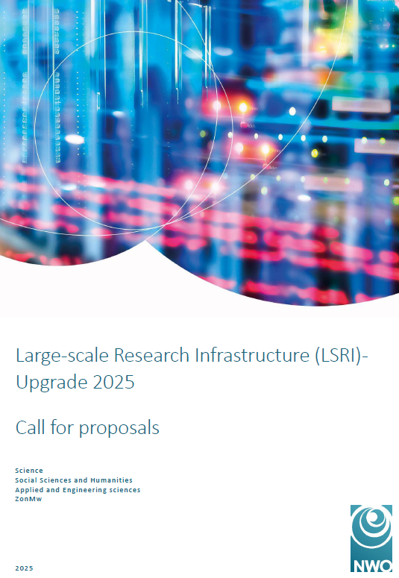
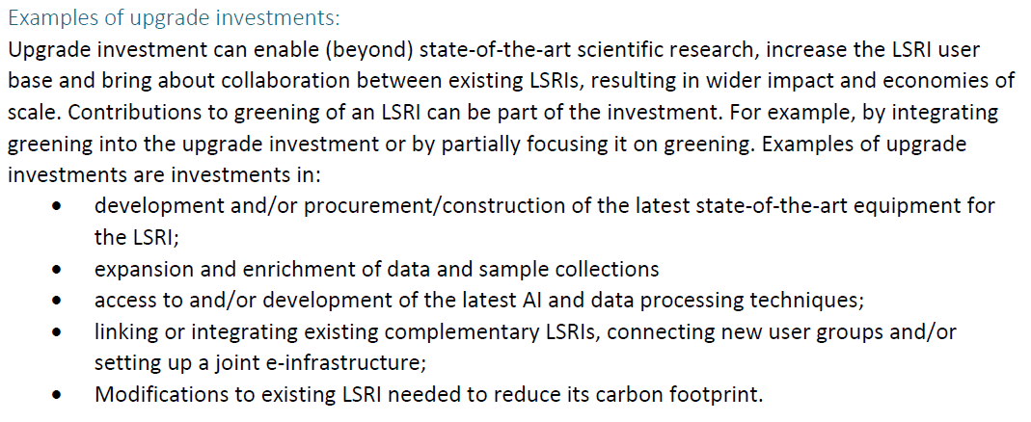
Innovation: ‘… growing use of AI/ML is being observed’ …
New AI/ML R&D group brings activities together in both the experiments and for PDP
links strong physics programmes on AI/ML
with the ‘data, physics, workflows, and infrastructure research’ role of PDP
R&D on infrastructure extensions for AI/ML and accelerated compute generally
We will be evolving
the physics staff and PoC hardware will be available starting mid-2026
transformative facility for inference (MERGE, under funder’s review)
While other aspects remain as relevant in the future
systems R&D and our role as a ‘Tier-1’ facility for HEP/APP
in a complex multi-stakeholder world, where mixing long and short term objectives is non-trivial
accelerating time to results from 4D fast timing, from close to the detectors to the final plots ☺

Slide 11
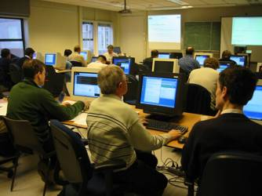
Balancing training & support with innovation R&D
‘seeing significantly increased use of GPUs in our analysis facility for AI/ML‘
Pathway to practical impact and efficient use is via training and
tutoring … with infinite demand but always limited capacity
computing courses need investment from two sides
getting scalable AI/ML workflows:
  locally and on ‘scale-up’ systems
  from Stoomboot → Snellius → LUMI* → our federated HTC / Tier-1 in 2028+
plus the research data management, FAIR ‘digital research process’ training, ‘regular’ computing, software engineering, knowledge safety, computer security …
*LUMI: EuroHPC pre-exascale system in which NL has a share, as we do also in the Jules Verne consortium

Slide 12
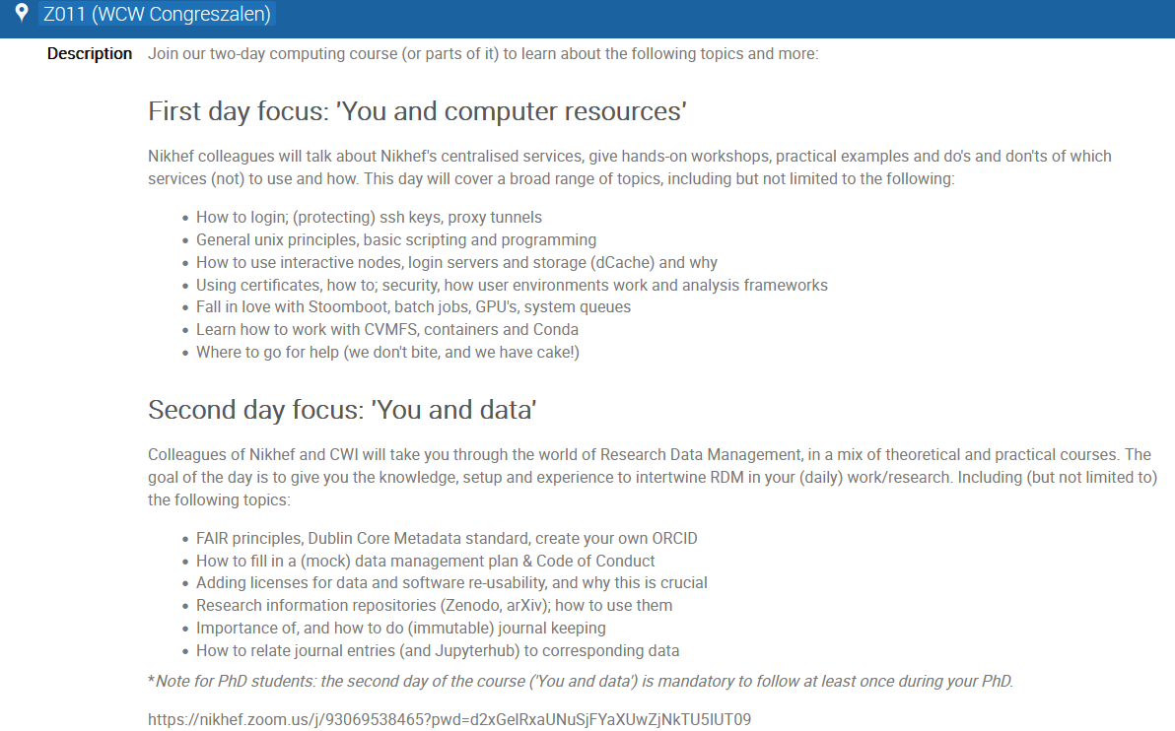
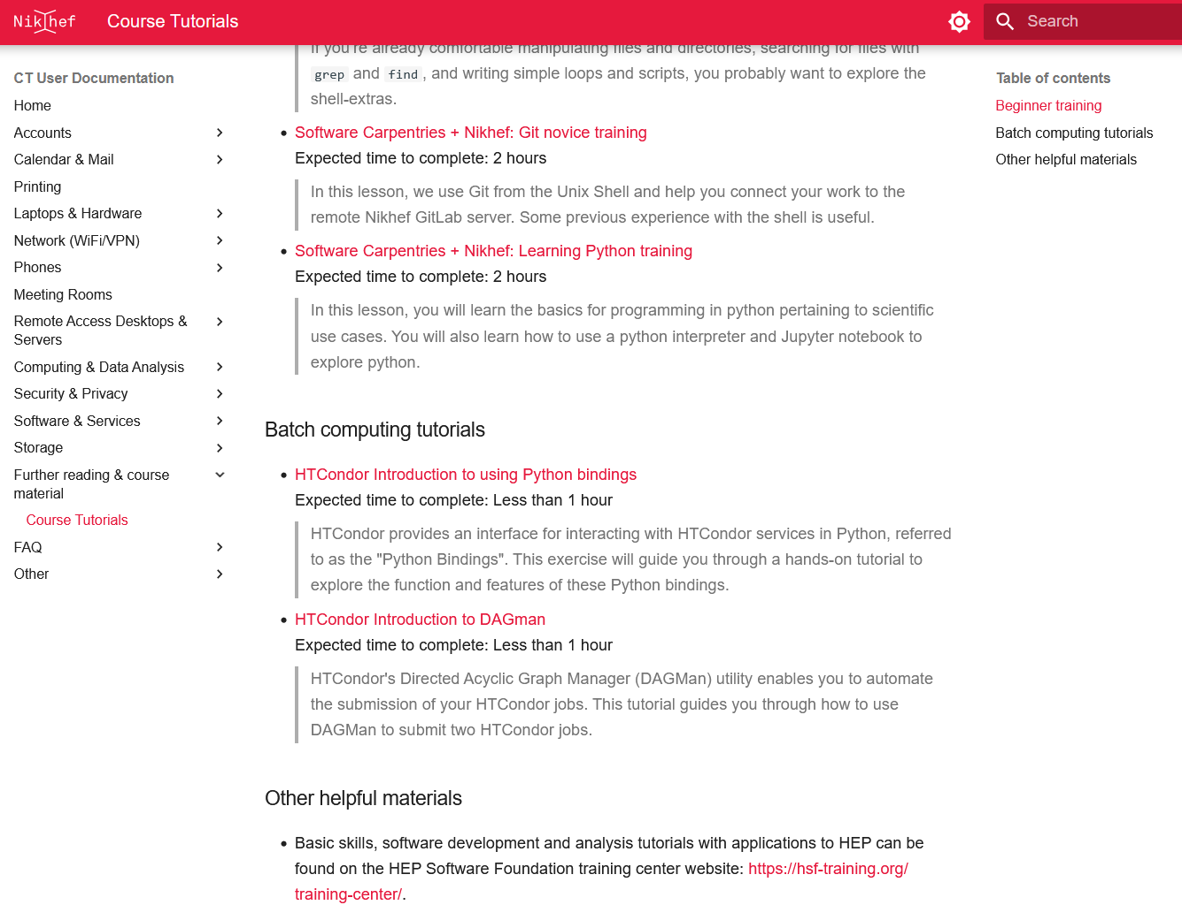
Collaborative training & support for our physics programs
We lack a ‘sweet spot’ in trainers: it is beyond the helpdesk expertise, but our next layer
is level-3+ engineering researcher support … and although it’s really nice to be able to give trainings and lectures, and see the effect of your R&D efforts, time is always limited.
‘computing courses need investment from all sides’
  Allowing time to partake in the trainings: long term benefit vs short term time investment
  Help making courses scalable: a trainee-to-trainer programme for PhD & postdocs?
Course development as a collaborative exercise
  Use - and co-develop where needed - contextualised trainings
  Carpentries, NWO-I DCC, TDCC NES, HSF Training hub is there, but need ‘local flavour’ to be attractive
Giving the courses requires people, and is resource intensive
  emerging AI group at Nikhef helps raise awareness and importance: more interest in getting trained
  would giving formal recognition (e.g. in terms of certificates) for trainers help after their time @Nikhef? We can recognise their contribution internally (and do!), but people tend to move ☺
  - Recognition & Rewards (SFDORA) relatively strong in NL and Europe, but not (yet) much elsewhere …
https://kb.nikhef.nl/ct/Course_Tutorials.html

Slide 13
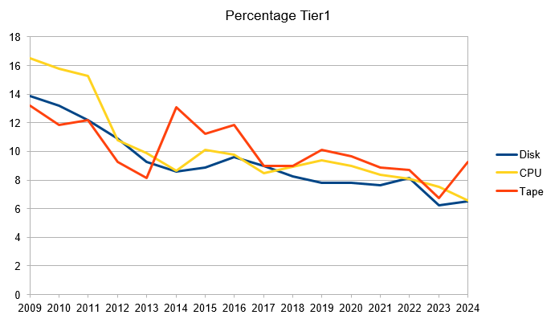
Weaknesses, threats … and mitigation scenarios
Weaknesses
Continuity as ‘cross-domain Tier-1 hub’ based on project, not institutional, funding
→ fiche ‘digital infrastructure’, NWO-SURF report ‘Reken er maar (niet meer) op’
… MERGE is only a stopgap measure for this, as, again, it is an upgrade project
Threats
Market developments in semicon ☹
→ phased and deferred acquisition, market research, and vendor engagement/co-innovation
to get better conditions is the best we can do – but likely not enough for 2026-2027
Divergence of HEP/HTC and EuroHPC/AI factories
→ co-design of new Tier-1 systems and ensure ‘Lorentz’ as national facility,
collaborate to instigate change in EuroHPC (SURF, EuroCC, SHAKE)
Balancing operations, support and research as algorithms (and AI) become more important
→ engage physics groups in software engineering (as per the SAC2025 report),
more ‘project’ software engineering and computing/AI/ML training capacity in CT-PDP
Risk of divergence WLCG from most ‘others’, even in our own domain, remains significant
→ invest in control points such as HPC CoEs and in AAI, policy, and ‘OpSec’
‘the true effect of flat budget’

Slide 14
And some resource-centric ones … no realistic mitigation?
Weaknesses
We provide a lot of research services, of all kinds, but disinvesting is not usually an option
→ we possible we can join up with others (SURF, OSG, other GWIs in the Commons, maybe NWO-I),
but these in turn look back to us …
Threats
Lack of people on the CT-(PDP) side in the longer term: with FASTTRACK, MERGE, and AI/ML the demand keeps growing.
→ the requested ‘matching’ engineering resources, esp. FASTTRACK, need to become available in CT
Too many SPOFs, esp. in collaboration infrastructure, ‘open science’, and policy activities
→ ‘dakpan Jeff’ needs to take care of anchoring our ‘horizontal’ knowledge as well
– makes for a very challenging job indeed!

Slide 15
Opportunities and strength … (no mitigation scenarios ☺)
Strength
Impact in our chosen focus areas: Accelerated computing, Infrastructure, Trust & Identity,
→ we are seen and proactively asked to partake in projects, and seen as trusted and active partner
Opportunities
Acceleration advances and ML help us exploit new systems
→ alignment with EuroHPC (and AI factories) for HEP/APP use cases as the EuroHPC Federation forms
Design of next gen national Tier-1 (‘Lorentz’ ?) facility and (to some extent) AI factory
→ improve suitability for HEP use cases through design choices
Cross-programme AI/ML activity raises profile of computing in our programmes
→ may get us the audience awareness for the importance of computing and algorithms
Heterogeneous and energy-efficient computing
→ more ‘physics output per unit of .*’
National Plan for Research Digitalisation (‘fiche’)
→ if granted, we can leverage far broader ecosystem at the institute and partner universities!

Slide 16
Physics Data Processing towards results unconstrained by computing

