Slide 1
Computing for the 50s!
50
PDP – Physics Data Processing
David Groep
Nikhef Jamboree 2025
From when computing was scarce … and back again

Slide 2
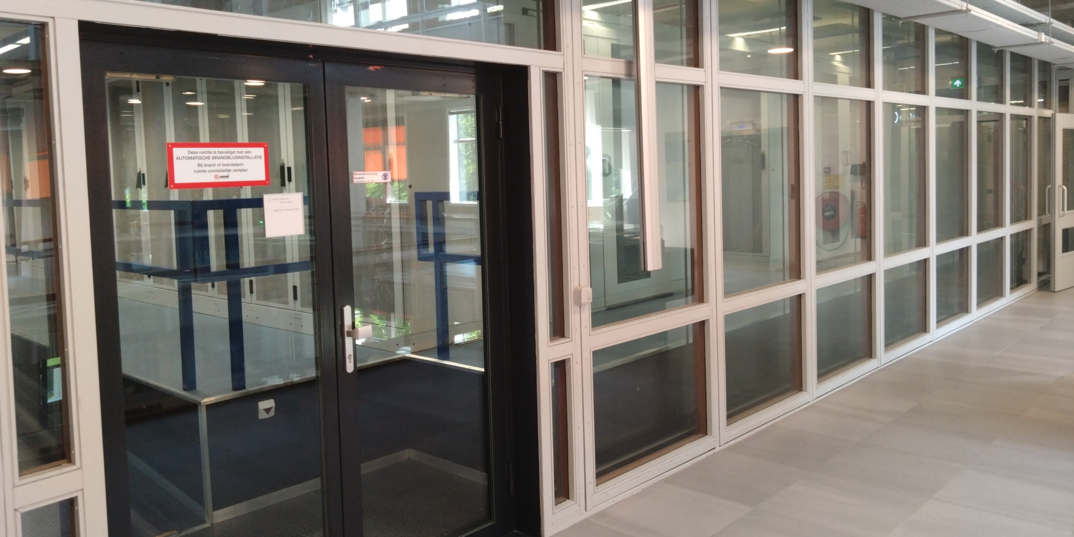
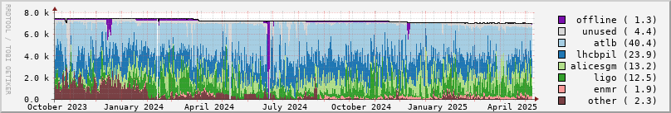
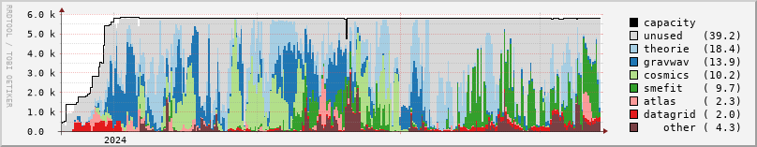

Slide 3
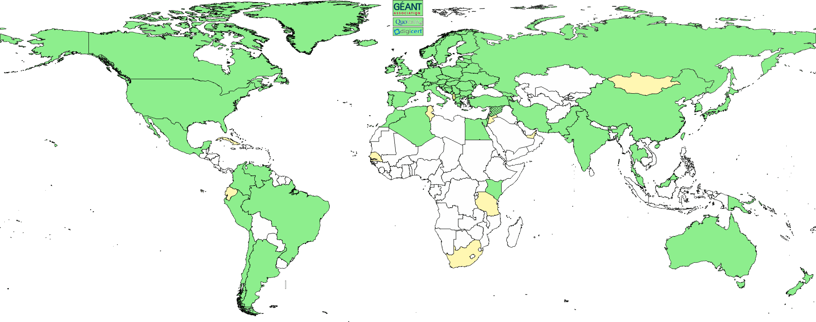
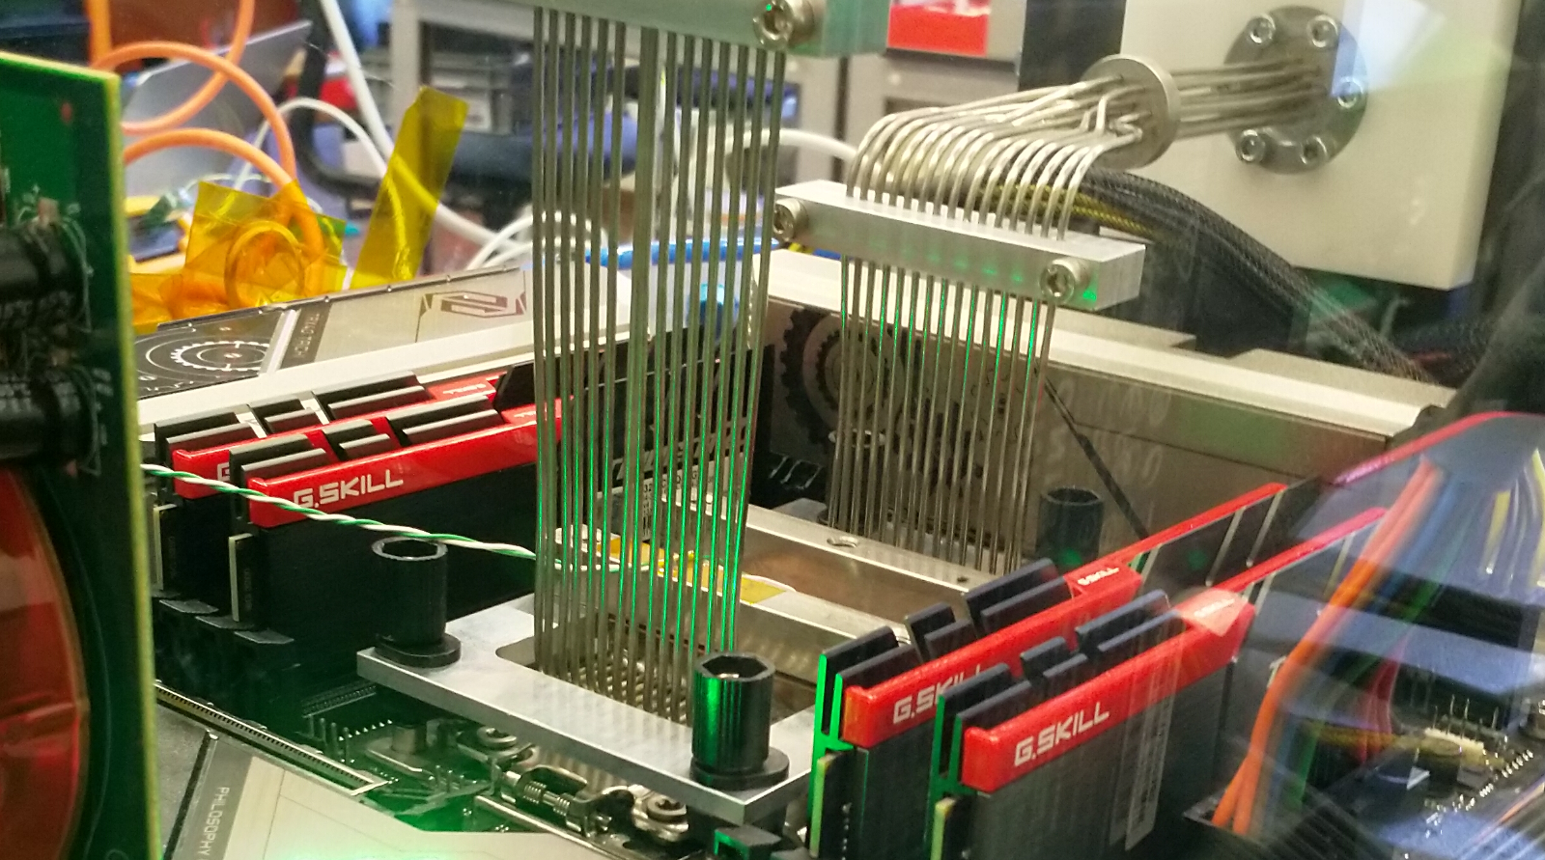
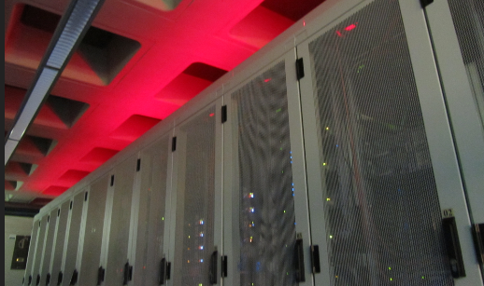
‘Pillars’ of Nikhef Physics Data Processing
Infrastructure for
trusted collaboration
trust and identity (‘SSO’) for
enabling communities
managing complexity of collaboration mechanisms
securing infrastructure for
science, today & tomorrow
Algorithmic design patterns and software
designing software for (GPU) accelerators, new algorithms,
high-performance processors
software design patterns for workflow & data orchestration
Infrastructure, network & systems co-design R&D
building ‘research IT facilities’
co-design & development
big data science innovation
research on IT infrastructure

Slide 4
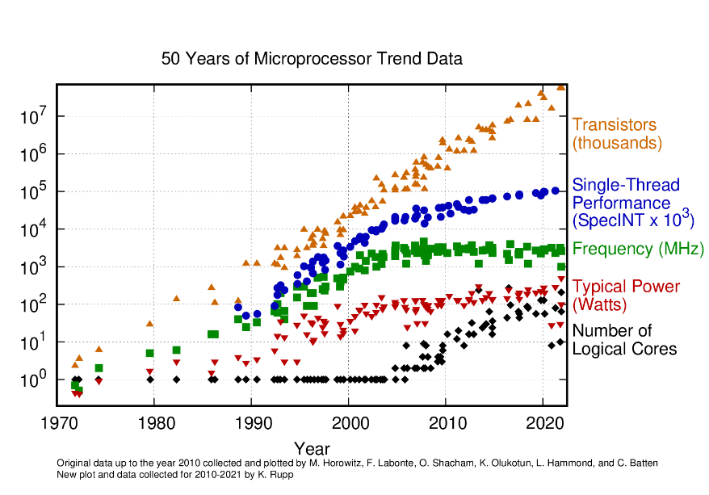
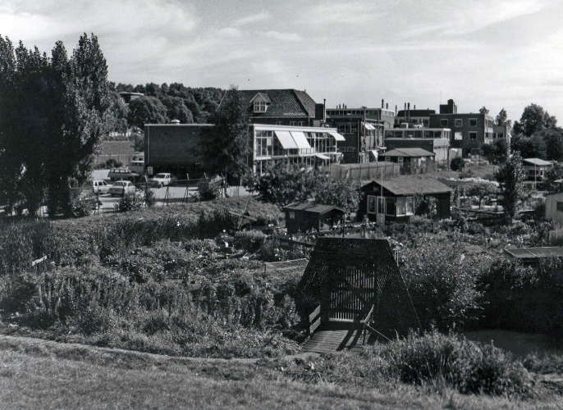
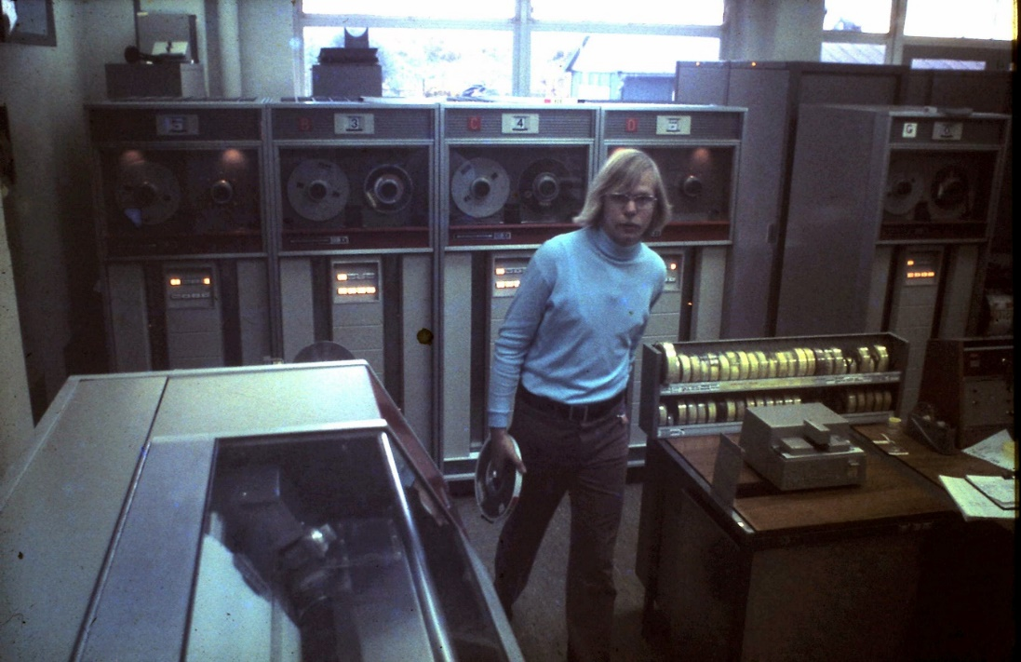
From when efficient computing was absolutely vital …
computing at Nikhef, ca. 1975
Image processor trend data: https://github.com/karlrupp/microprocessor-trend-data, by K.Rupp et al., CC-BY-4.0

Slide 5
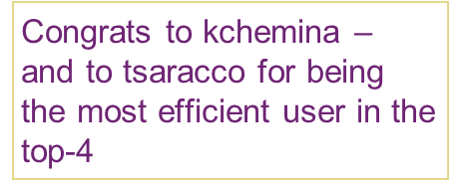
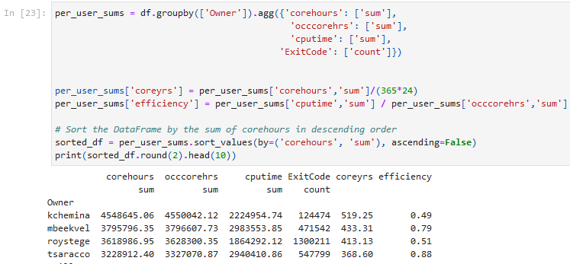

Stoomboot still is mostly CPU, but it’s accelerating!
and you can also use CPU processing very effectively
Stoomboot usage May 2024 – May 2025, analysis: Jeff Templon
See also https://www.nikhef.nl/pdp/stats/stbc/intern/stbc_summ_plots
Notes:
Top 1,2,3:
Beste multicore gebruiker:
top-3 multicore: user jobcount CPU time Wall time cpuwallratio

Slide 6
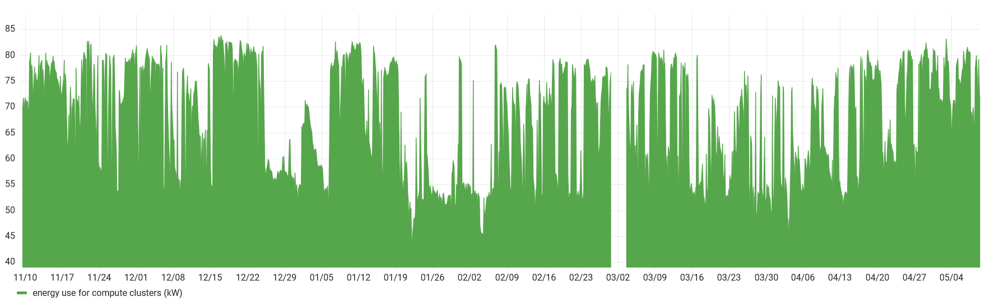
But who is the most energy efficient?
someone discovered an empty Stoomboot on New Years day ☺
Data: aggregate energy use of all compute clusters (stoomboot + grid) at Nikhef from November 2024 till May 2025.
data from steker.nikhef.nl: sum(ipmi_dcmi_power_consumption_watts)/1000
See also https://go.nikhef.nl/stbc-energy for just the Stoomboot usage

Slide 7
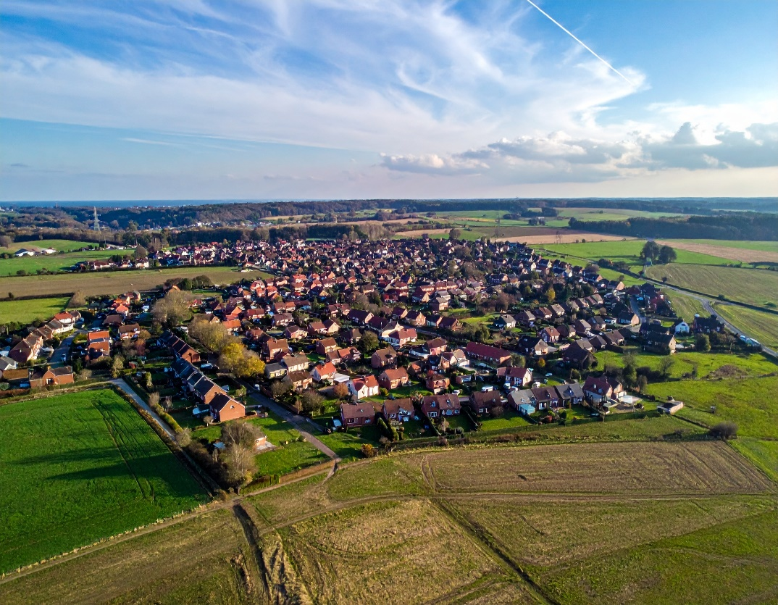
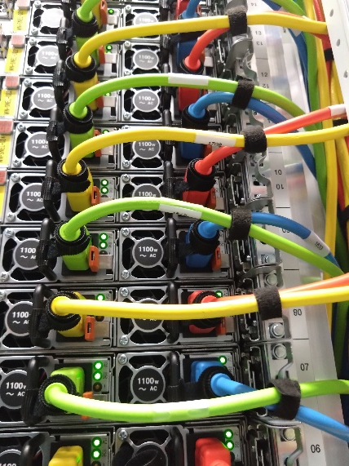
The real cost of computing
This ~65 kW average for computing
is the equivalent of 235 households
Compute only, all of NDPF (DNI-HTC and Stoomboot). Sources:
https://www.milieucentraal.nl/energie-besparen/inzicht-in-je-energierekening/gemiddeld-energieverbruik/ - 2420kWh/yr per household
Adobe Firefly: “a village with 235 houses, some of which are semi-detached, some council housing, and a scattering of villas, surrounded by fields and nature, with one overhead H/T power line running towards the village” – generating 4 images takes ~20Wh (charging a smartphone 4 times, https://www.technologyreview.com/2023/12/01/1084189/making-an-image-with-generative-ai-uses-as-much-energy-as-charging-your-phone/

Slide 8

Which is an expensive exercise …
And you have to cool the heat away from H234b, adding +30% (“PUE 1.3”)
so 65 → 84.5 kW
cost is ~ 15 ct/kWh
so just the cluster compute alone is 111 033 €/year
and you will need data from disk, which is equally power-hungry
the typical load of our science data centre is 175kW, or 230 000 €/year
15ct/kWh: WCW rolling average energy pricing 2023-2025 including marginal grid connection costs and taxes
banknote image: https://pxhere.com/nl/photo/1327791

Slide 9
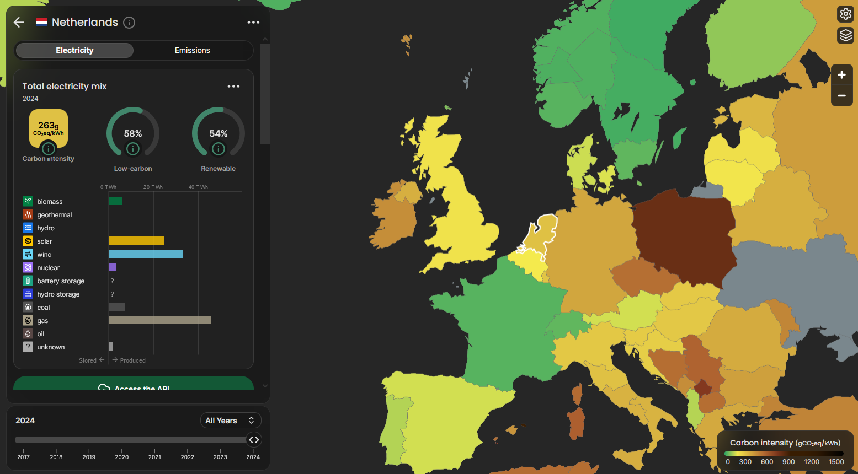
Now we do procure 100% green electricity at Nikhef …
Actual effective electricity mix different from the zero-emission we buy
Dutch average source mix
270 gr CO2e per kWh
(scope-1)
Infographic: https://app.electricitymaps.com/zone/NL/all/yearly
GHG data from Methodiek CO2 emissiefactoren elektriciteit, MilieuCentraal, https://co2emissiefactoren.nl/media/sources/240214-Notitie-CO2emissiefactoren-elektriciteit-pdf.pdf, data for 2023 (last year again better)
banknote image: https://pxhere.com/nl/photo/1327791

Slide 10
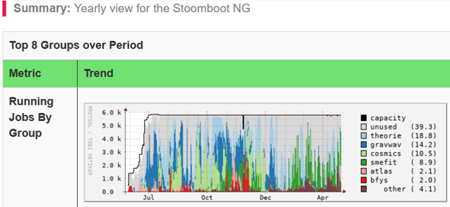
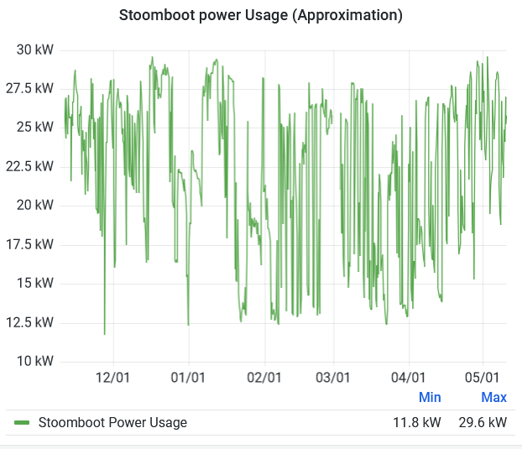
Let’s look at stoomboot, since that is where you can help
https://go.nikhef.nl/stbc-energy
Stoomboot is not always full, by design, since otherwise you wait too long for your results (we see queueing complaints regularly …)
The grid side is more efficient, since it is 96% full all the time

Slide 11
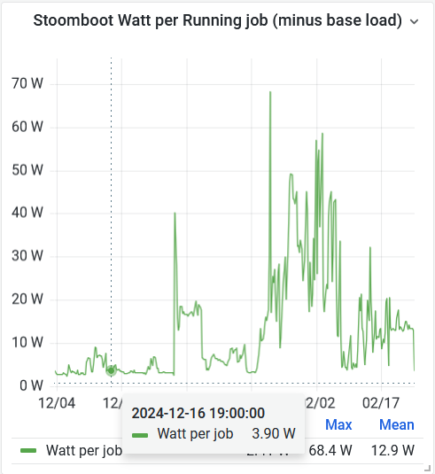
The impact of the stoomboot
Emily's power plot for Stoomboot shows 11.8 kW idle, with PUE 1.3 makes 103 MWh per year
at 15ct/kWh, this costs 20158 €/year just for energy to start with…
with 270g CO2e/kWh this is 36282 kgCO2e
to put that in context: AMS-GVA is 171.3 kgCO2e
so save at least 106 return trips for enjoying having stoomboot ☺
But peak usage power is 29.6 kW
that is where you can help maximize the physics return thereof
power used in jobs 29.6-11.8 = 17.8 kW for 5774 cores * 1.3 (PUE)
computing you initiate takes 4 W/core
100 jobs of 4 cores for 8 hours 3.46 kg CO2e (and costs 2 € extra)
put that in context, that is a 120 minute hot shower (at 29 gCO2e/minute)
Pricing: WCW 2023-2025, GHG data MilieuCentraal, flight emission data https://curb6.com/footprint/flights/ https://www.bbva.es/en/general/sostenibilidad/soluciones-para-personas/huella-de-carbono-personas/repositorio/ducharse-a-diario.html gives 90-200g/5min, so on average 145/5 = 29 gCO2 per minute. Stoomboot energy use: Emily Kooistra, https://go.nikhef.nl/stbc-energy

Slide 12
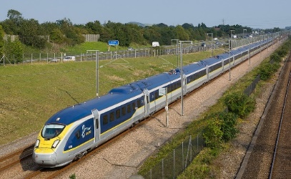
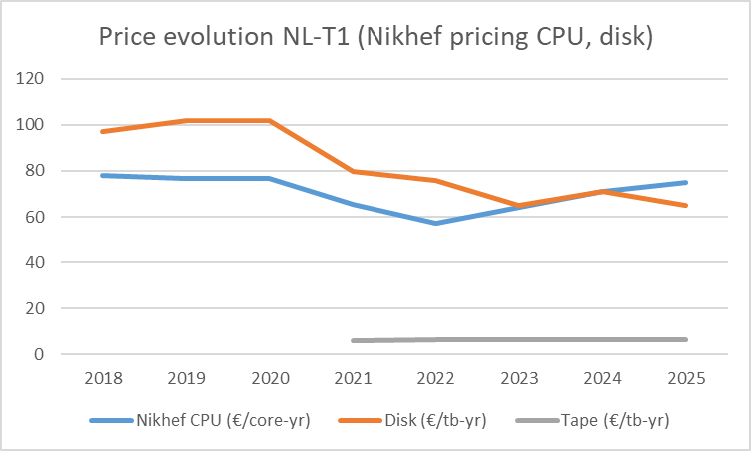
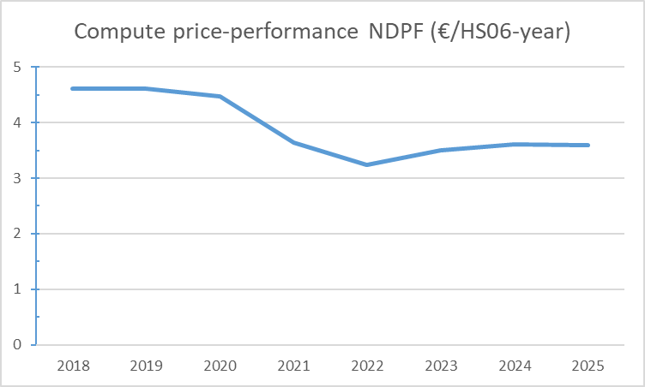
So you want to be more efficient!
So: by thinking before submitting you can … shower longer?
or if you take the train for your longer trips …
why not also use that time to optimize your code?
or do you want to stand a chance for the future data rates?
corrected for the (slight) performance increase per core
Image: Wikimedia. Price evolution: NDPF TCO NLT1-Nikhef-price-evolution-2018-2025 Effective TCO for stoomboot 156 €/used-core-year (due to 56% occupancy and support components)

Slide 13
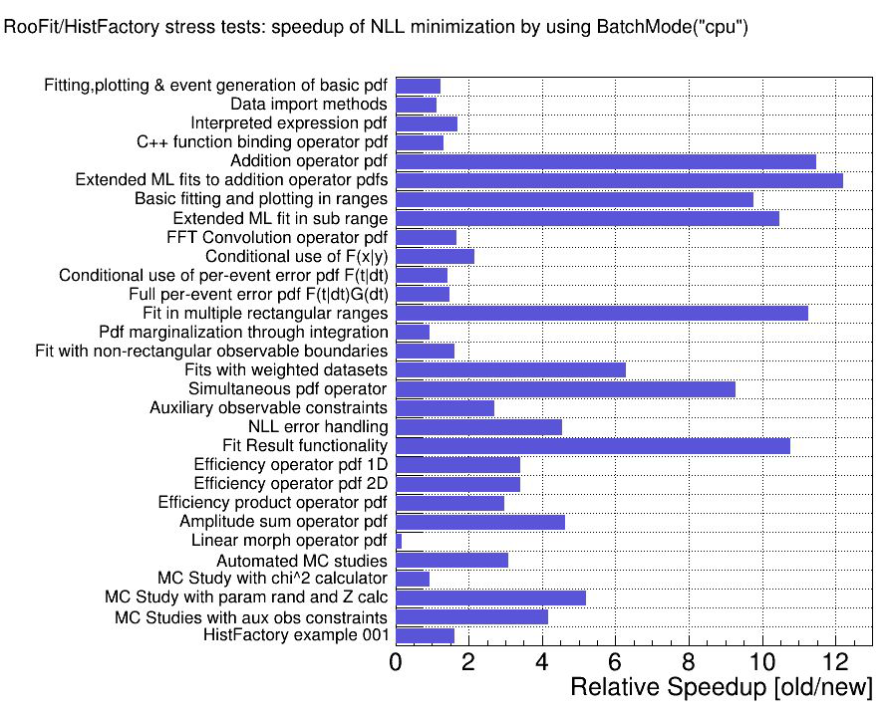
There are quick wins …
If some cases it is Really Simple™ …
+ simple code optimisation gave additional 14% gain*
And use the proper ROOT version (6.32+)
for your processing, where vectorisation is the default
-march=x86-64-v3
15% improvement*
Efficient use of scarce resources
More sustainable in every sense (money and environment)
Faster physics results!
* for the same amount of energy. optimised arch and code for Finesse library SuiteSparse KLU by Emily Kooistra.
Speedup graph: https://indico.cern.ch/event/1484669/contributions/6456378/attachments/3061358/, Jonas Rembser at the HSF workshop ’25. Speedup measured with Root 6.28.04, see CHEP2023

Slide 14


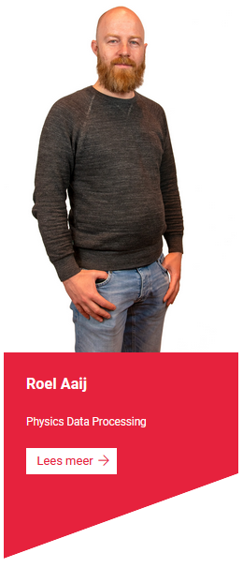
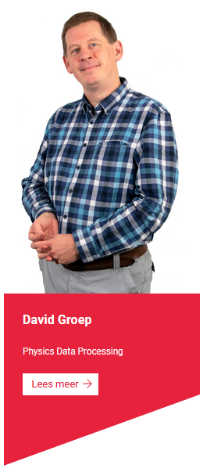


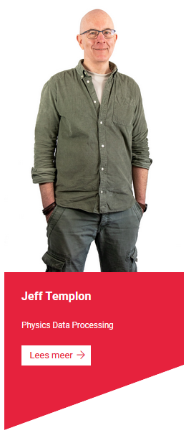

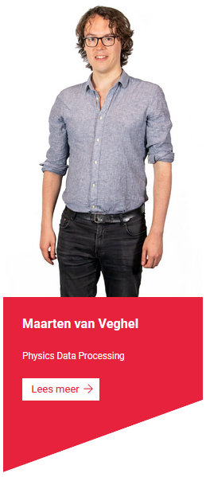






PDP-CT – all about collaboration, so help us to help you!
PDP and CT-PDP – meet us in Amsterdam at the science data centre, or at the Office Hours on the 1st Thursday of the month!

Slide 15
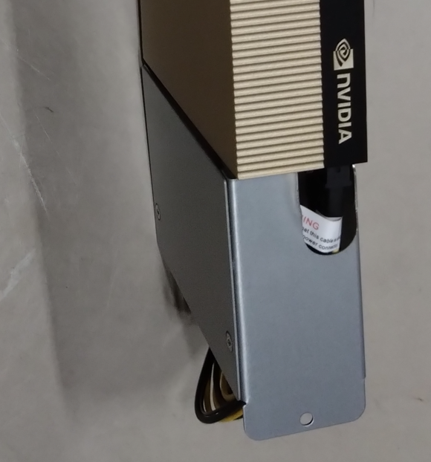
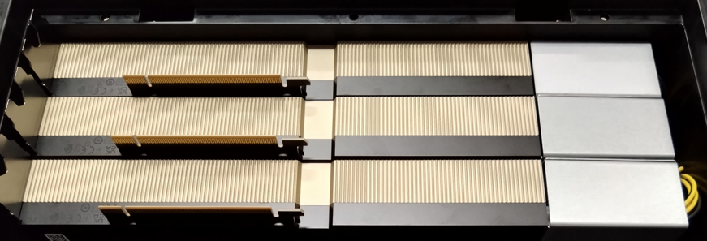
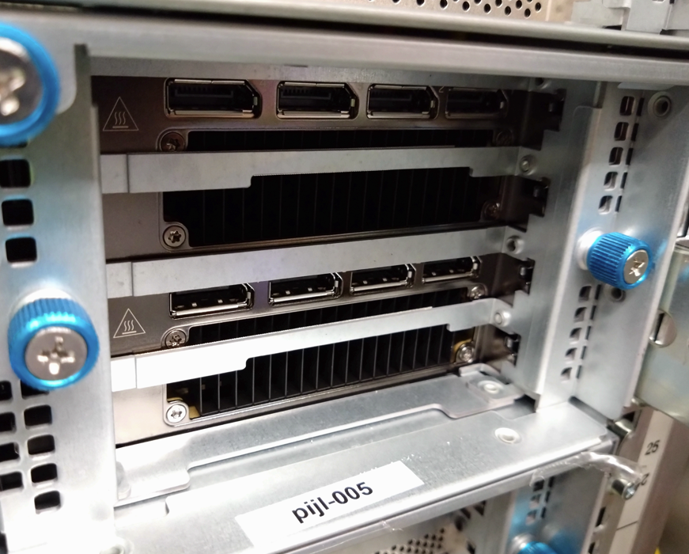
GPUs are more efficient as well … supported by MT & CT
Thank Stan Heijnen for getting you safe GPU computing
(and prevent potential ‘true positive’ fire alarms from H234b)

Slide 16
Next up
Maarten van Veghel
Keeping it real (time): impact of PDP on LHCb

