Slide 1
“Zie ginds weer de Stoomboot”
PDP – Physics Data Processing
David Groep
Nikhef Jamboree 2024
“See Santa’s Ship Sail again ! “

Slide 2
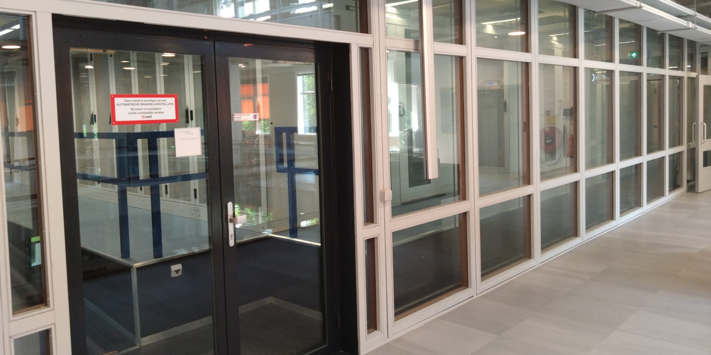
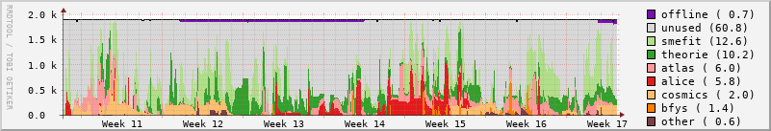

Slide 3
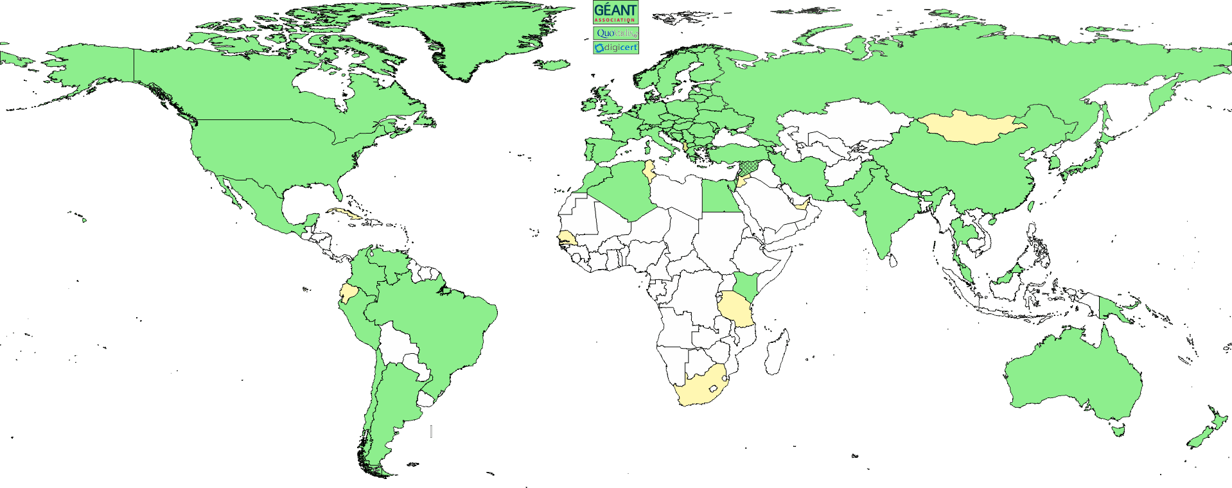
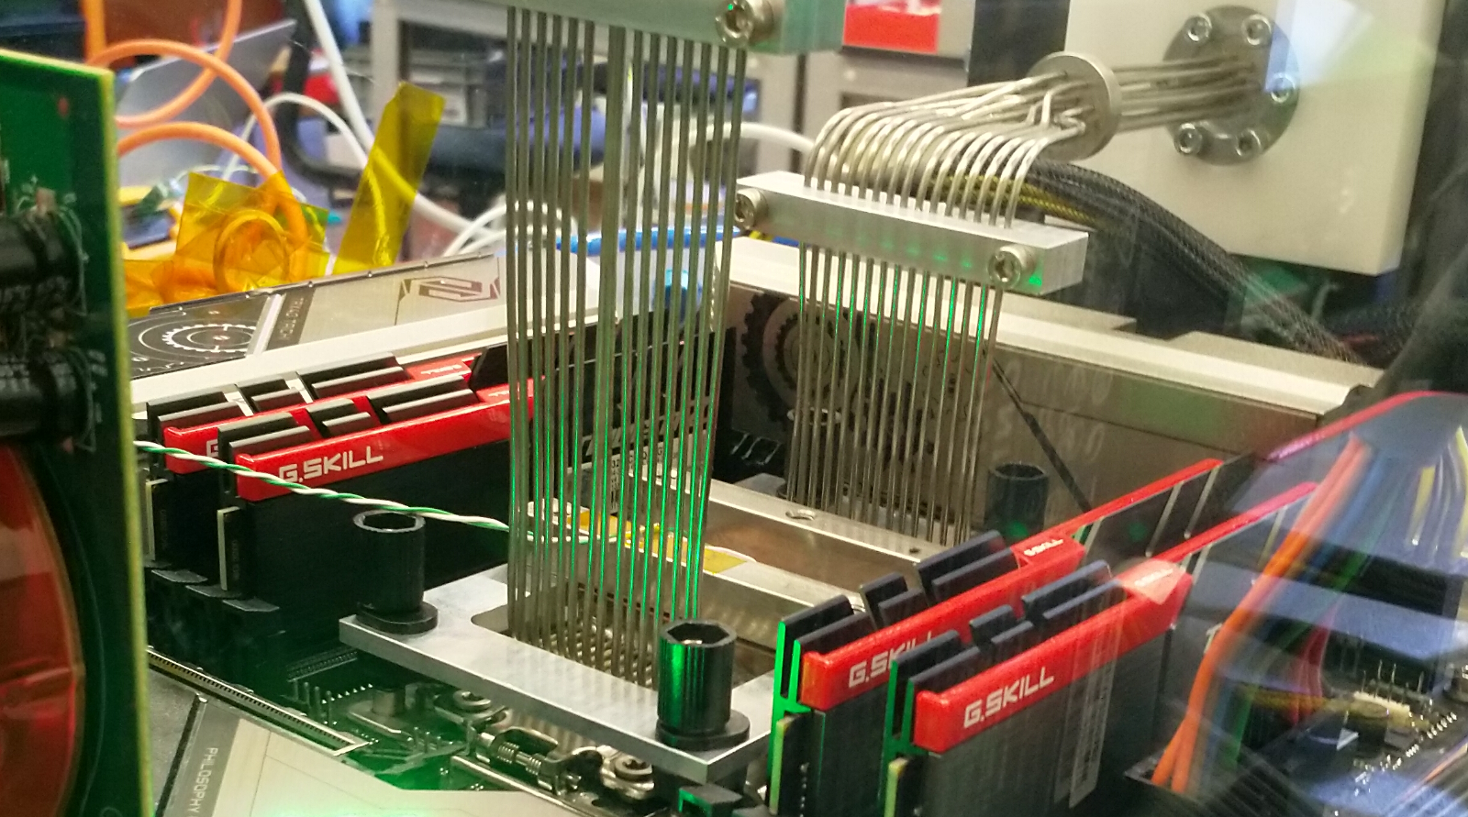
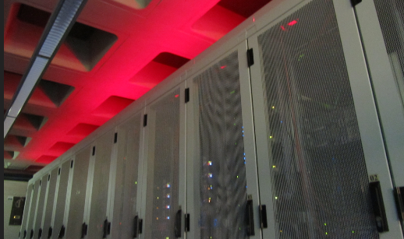
‘Pillars’ of Nikhef Physics Data Processing
Infrastructure for
trusted collaboration
trust and identity (‘SSO’) for
enabling communities
managing complexity of collaboration mechanisms
securing infrastructure for
science, today & tomorrow
Algorithmic design patterns and software
designing software for (GPU) accelerators, new algorithms,
high-performance processors
software design patterns for workflow & data orchestration
Infrastructure, network & systems co-design R&D
building ‘research IT facilities’
co-design & development
big data science innovation
research on IT infrastructure

Slide 4
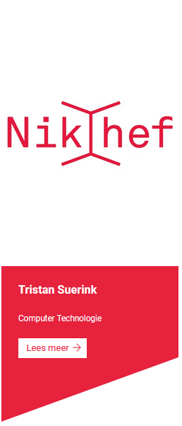

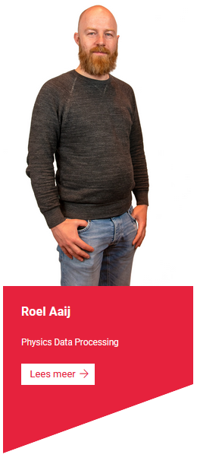
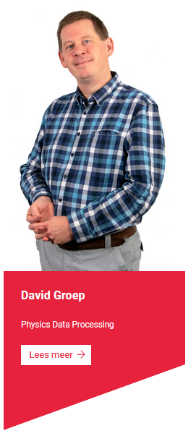
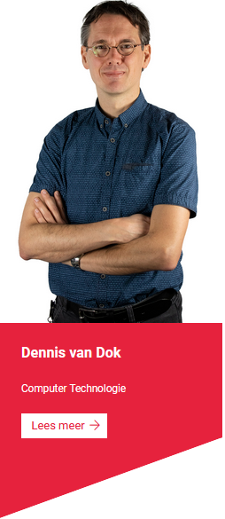
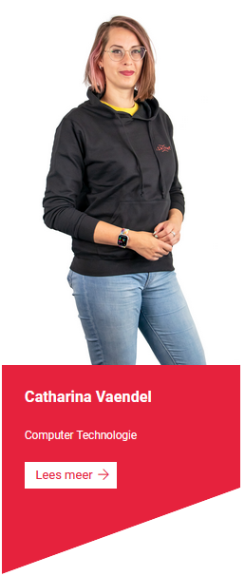
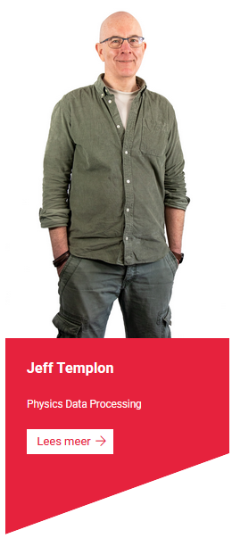

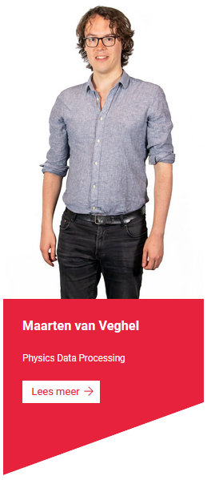



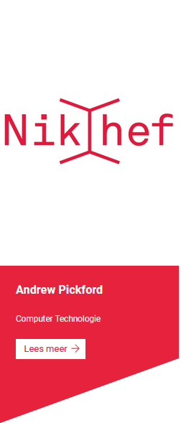


PDP-CT itself is also a collaboration!
PDP and CT-PDP – “most of whom cannot be seen”. But you can soon find out – join the Office Hours every 1st Thursday of the month!

Slide 5
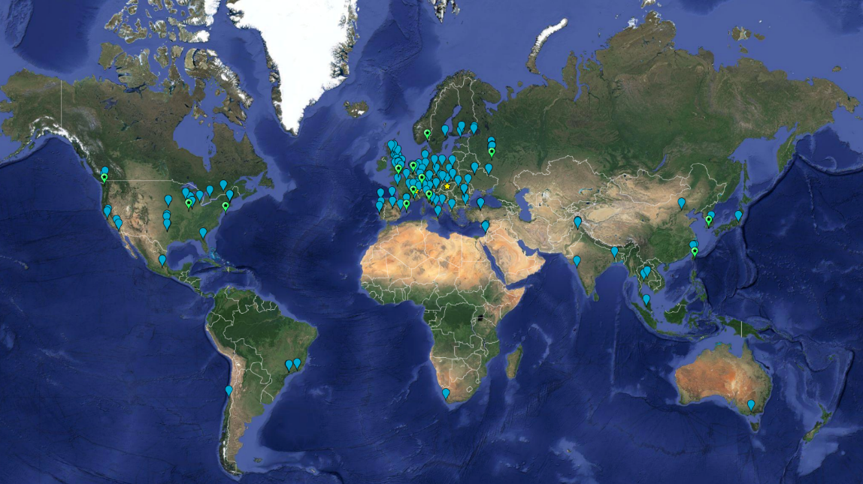
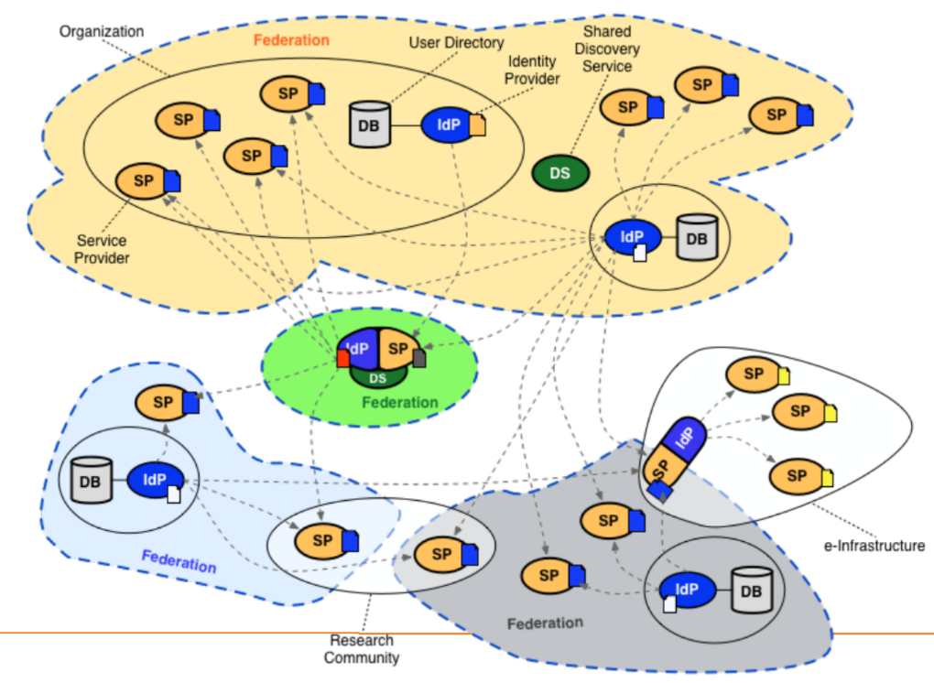



Scalable Multi-domain services: Infrastructure for Collaboration
Sites map: EGI Federation, WLCG; multi-federation image by Lukas Hammerle, SWITCH; AARC Community: https://aarc-community.org/

Slide 6
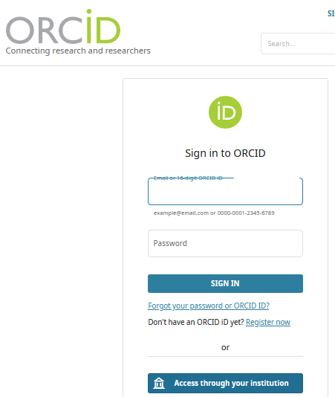
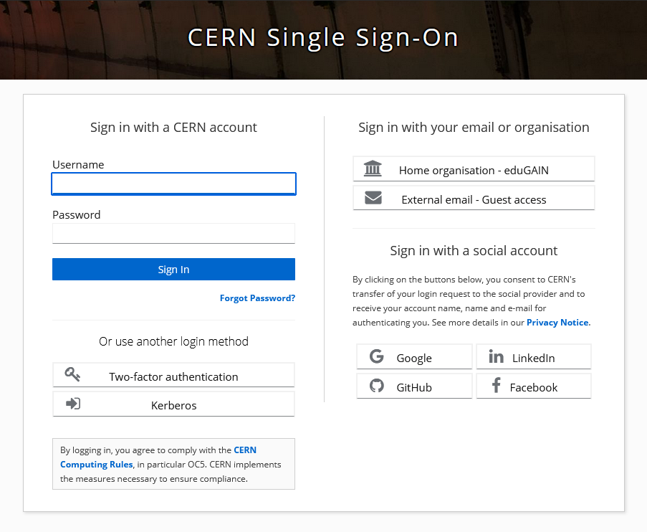
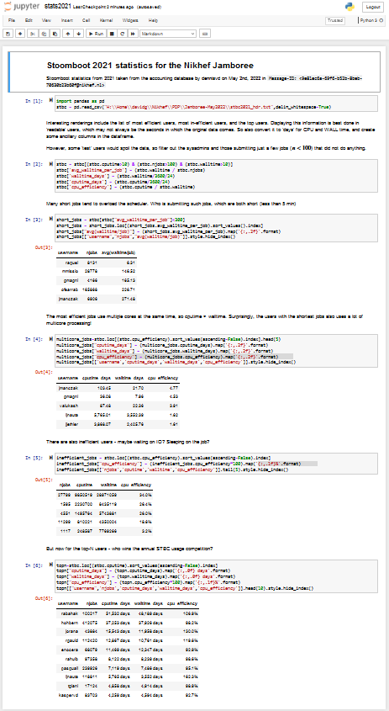
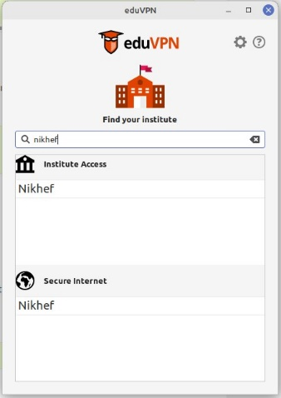
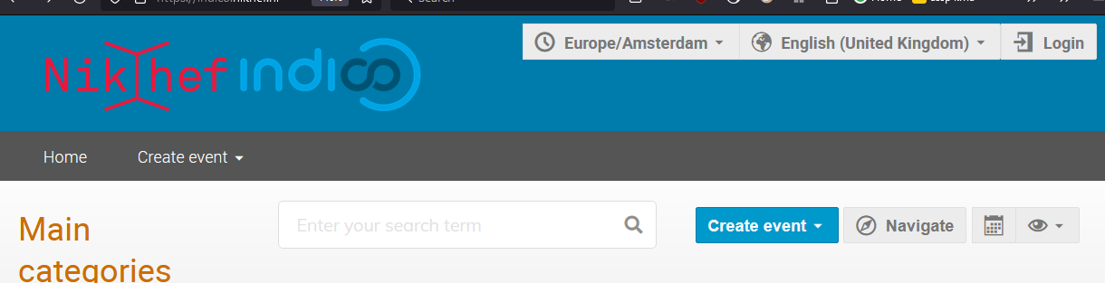
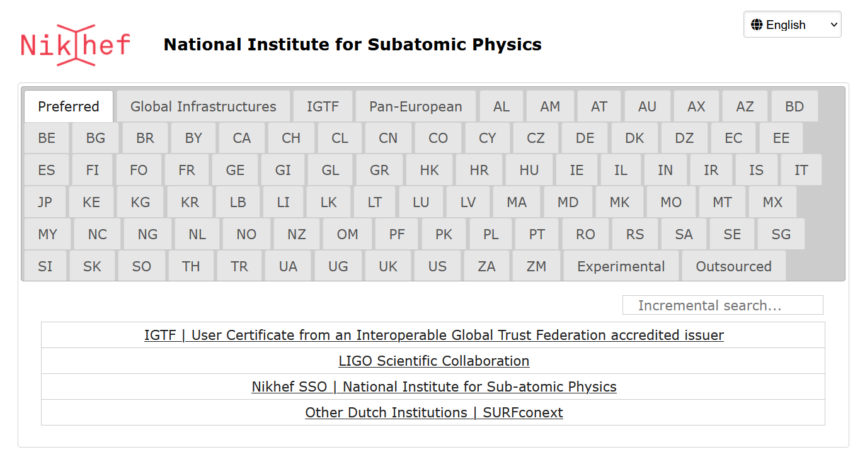
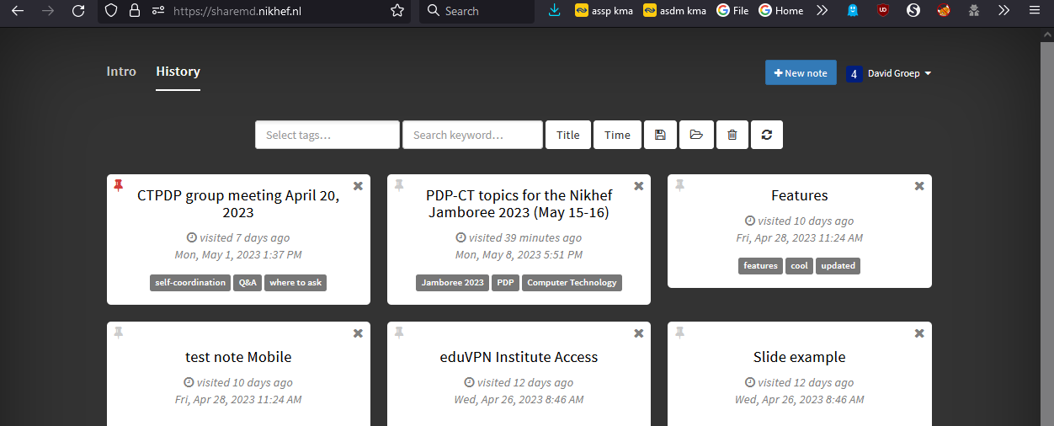
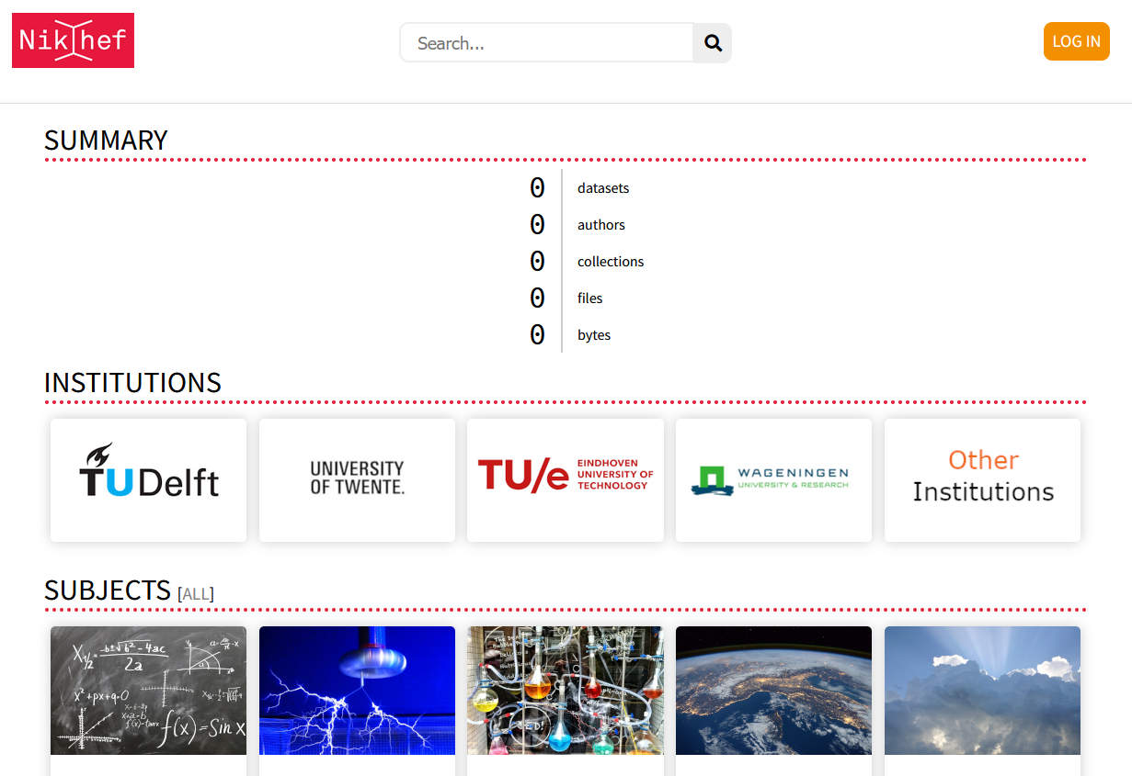
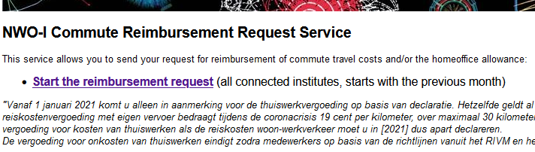
Some services you may already use …
CERN: login with eduGAIN
Nikhef (and CERN Indico): global federated login
eduVPN: securely access Callysto and your home
eVA, SURFdrive, and FileSender to collaborate
Callysto: JupyterHub with $home and SSO
Experimental services: ShareMD, NWO-I commute, …
But do read https://www.nikhef.nl/pdp/doc/experimental-services before using experimental services ...

Slide 7
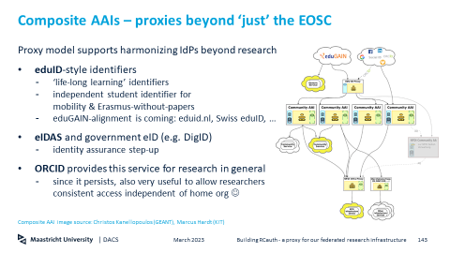

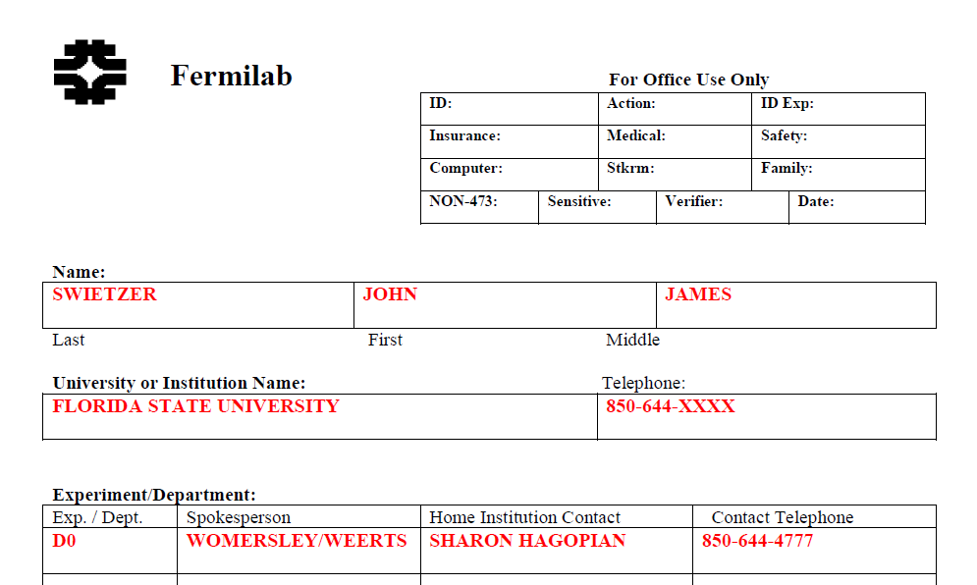
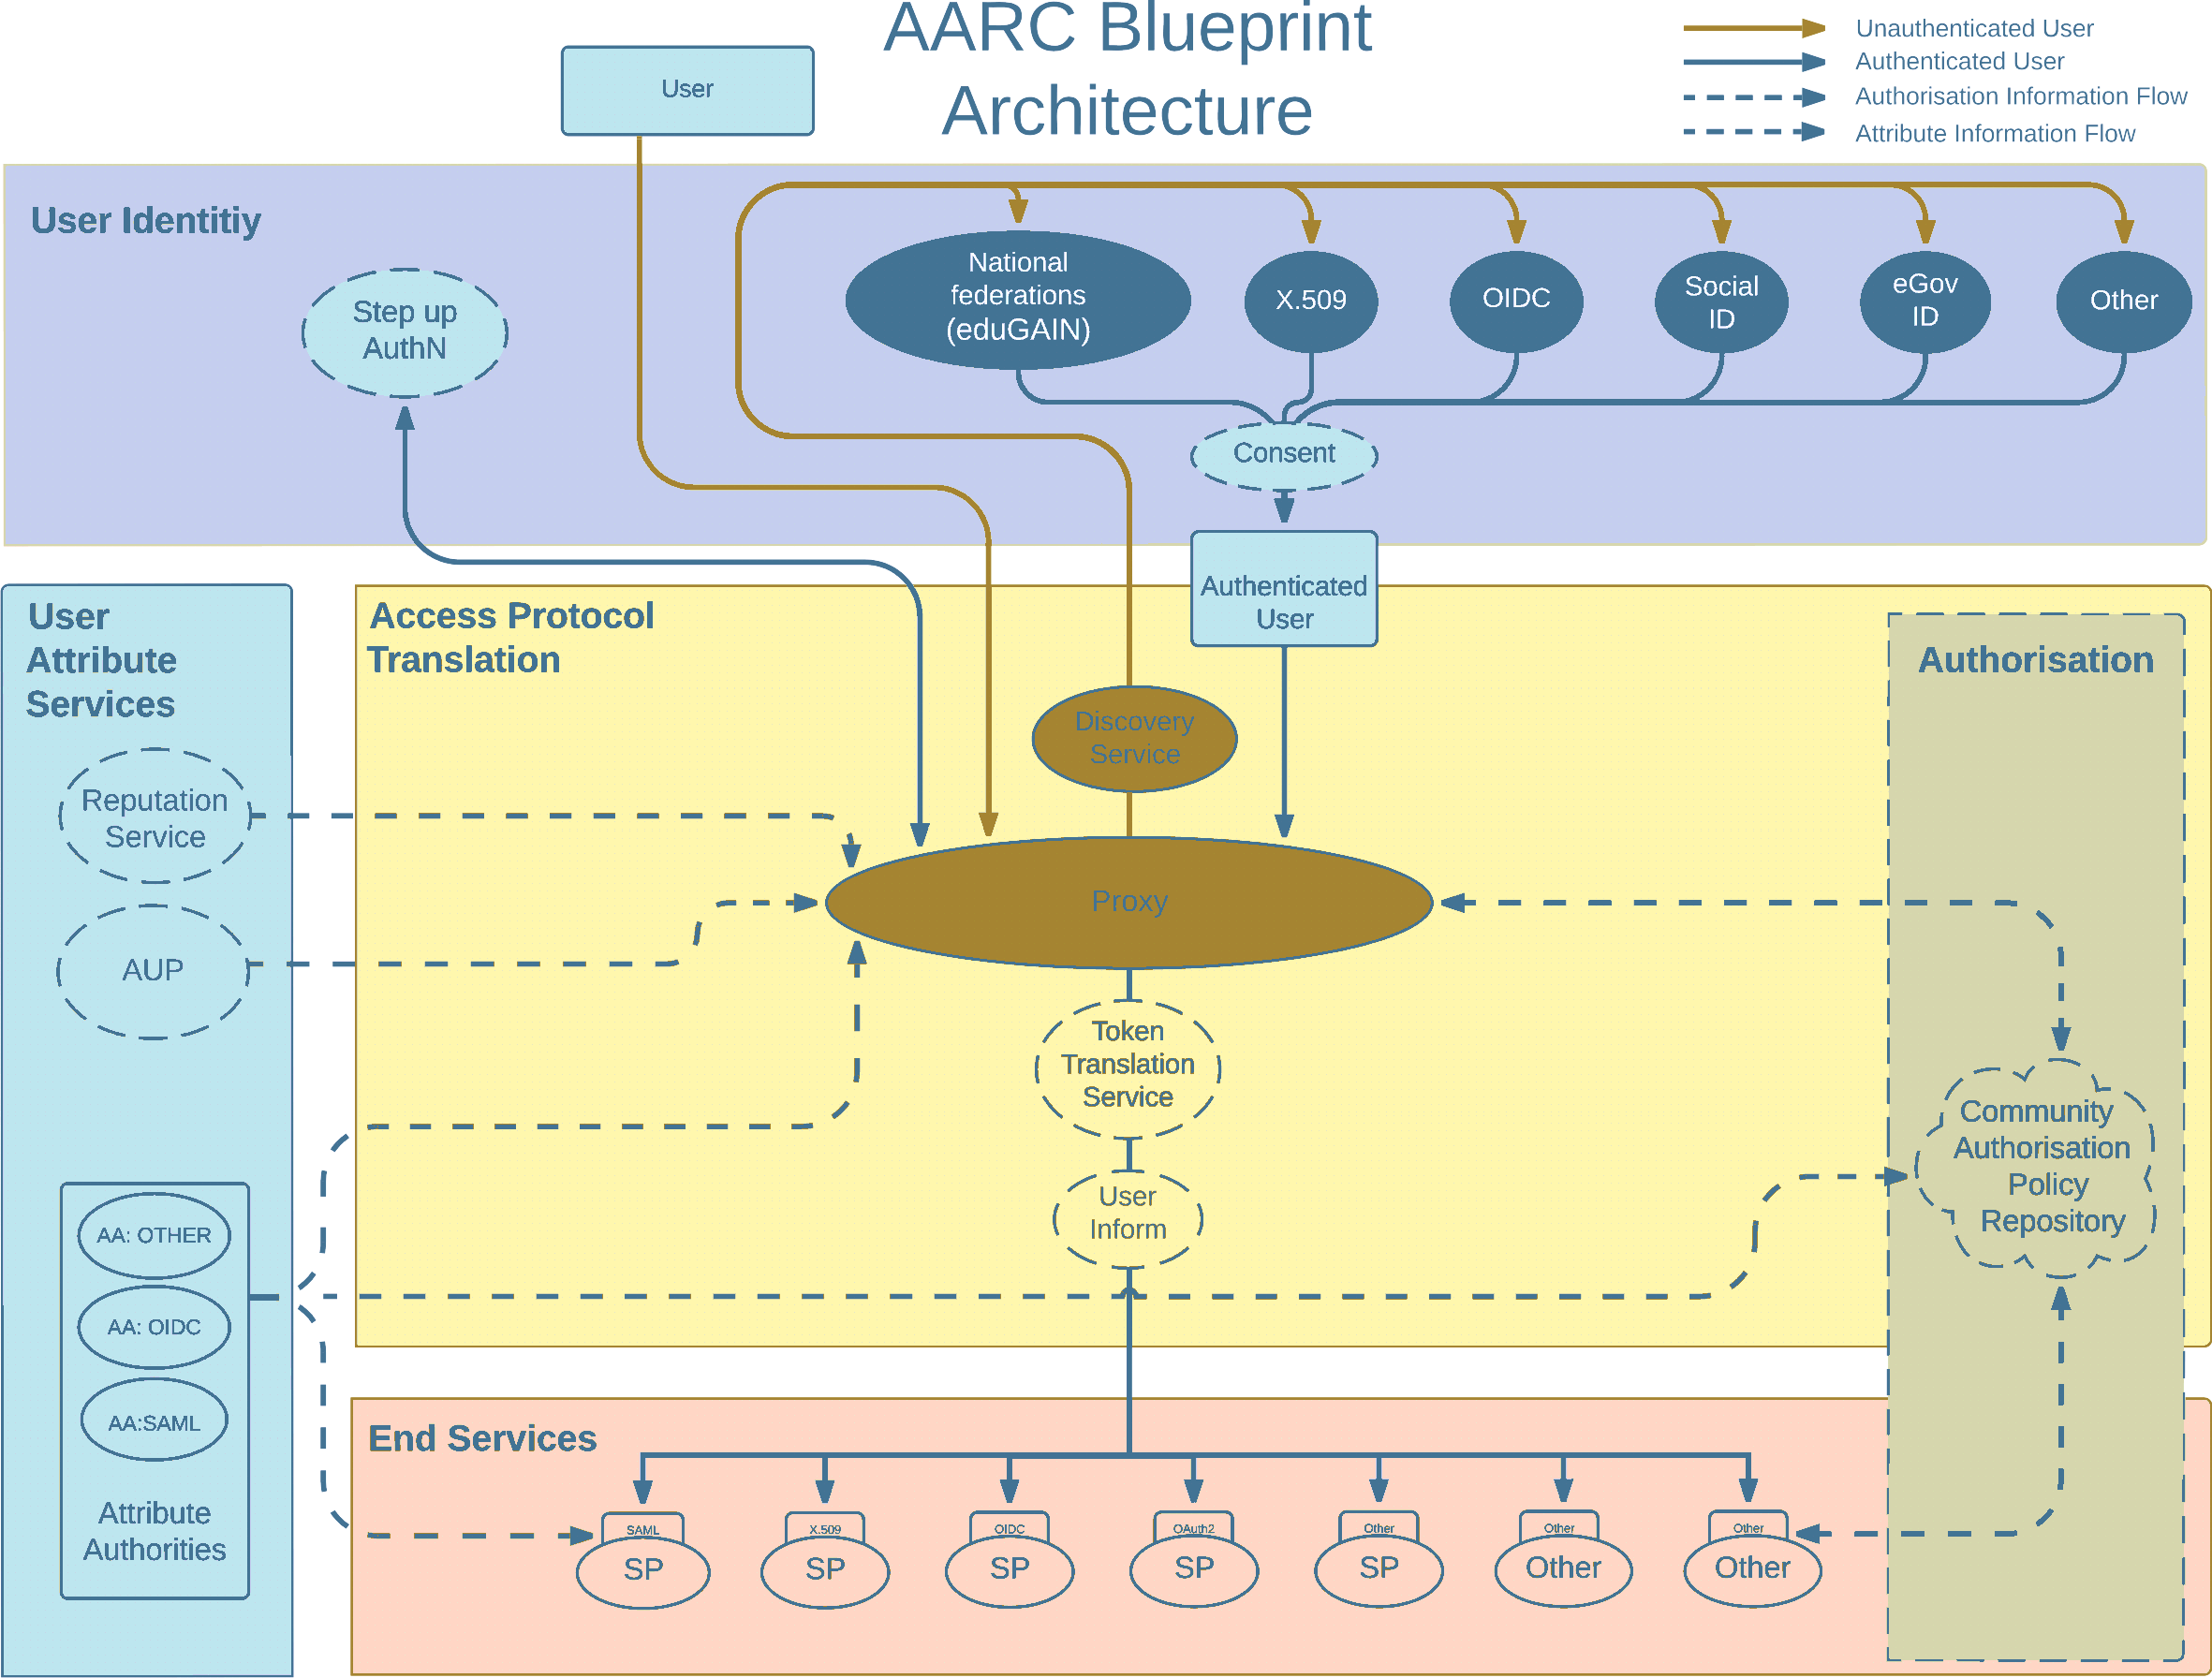
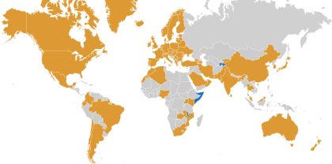
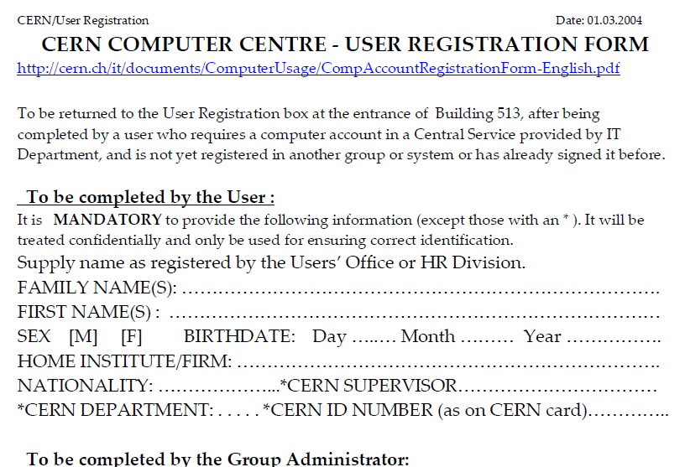
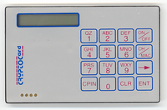

Infrastructure for Collaboration – under an AARC TREE
Architectures, protocols, and good practice guidelines for global, ‘seamless’, and secure collaboration
building cross-domain global compute facilities
collaboration on open, ‘FAIR’ global data
joining and moving around in your experiment
with services across Research Infrastructures
See also https://doi.org/10.2777/8702, https://rcauth.eu/, https://aarc-community.org/

Slide 8
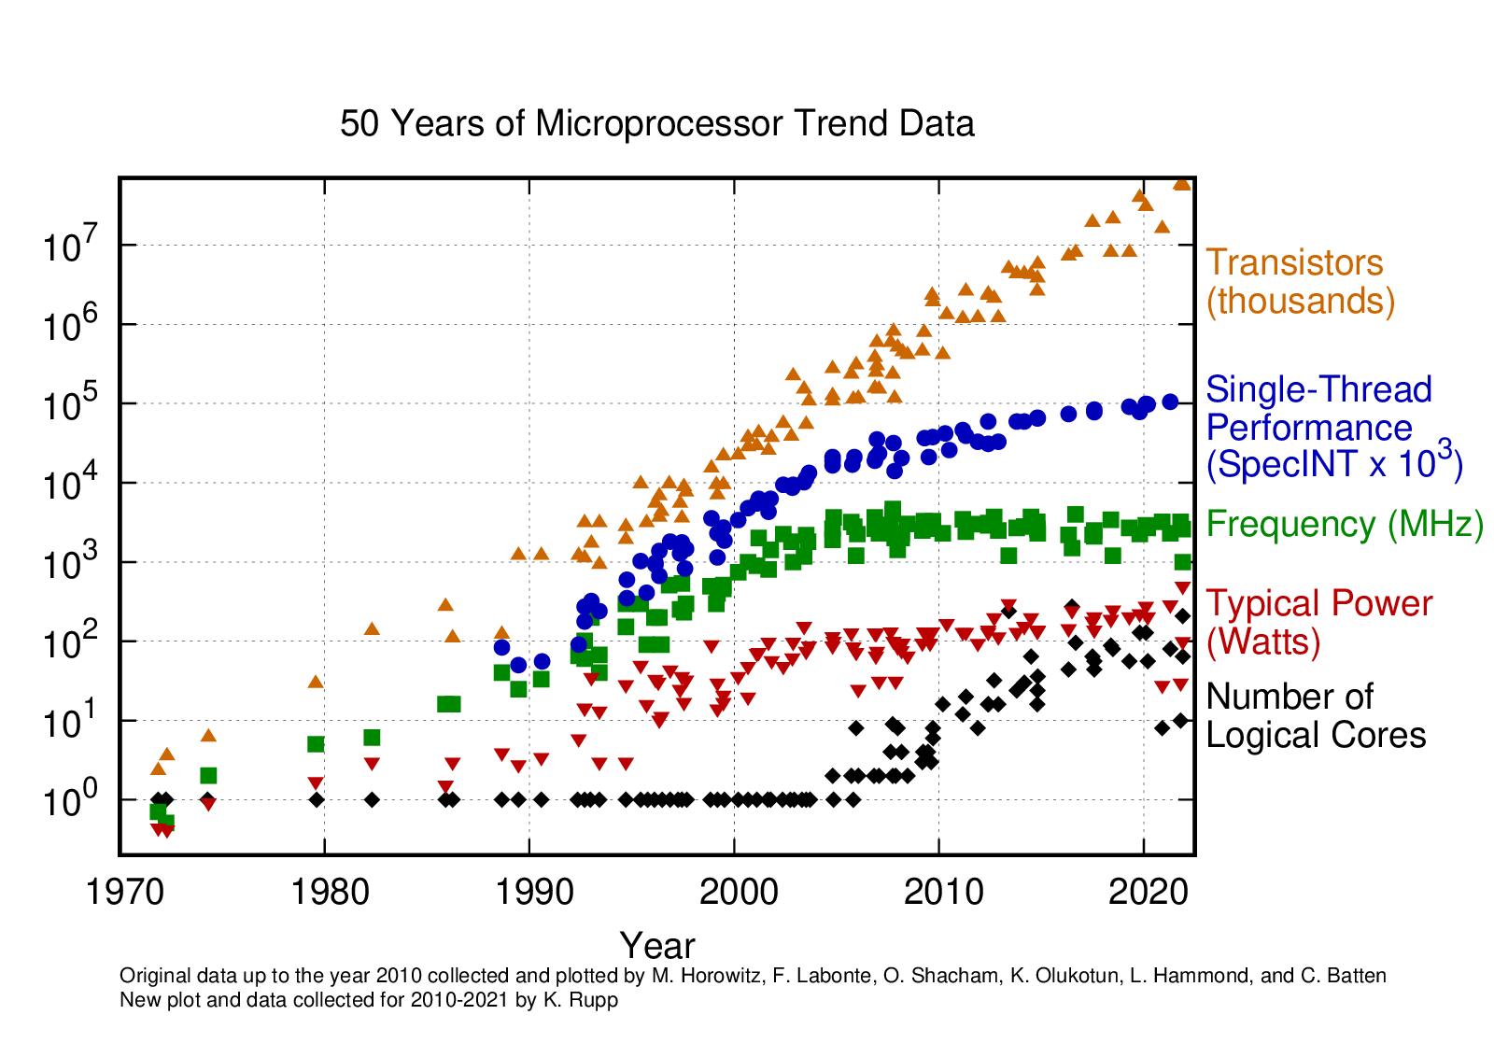
Need4Speed, Need4Scale, Need4Thought? Or all of these?
‘More of the same’ is not enough
co-design of detectors, readout and processing: optimize performance, keep (energy) cost under control
we must move to accelerators
also in re-processing and ‘off-line’: FASTER, LHC4D, …
and we must be more clever as well ☺
driven by ‘need for speed’, but also by energy limitations (watt/cm² and total power)
Image processor trend data:
https://github.com/karlrupp/microprocessor-trend-data, by K.Rupp et al., CC-BY-4.0

Slide 9
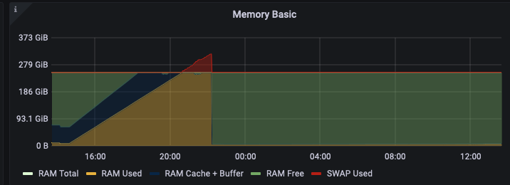
On data structures and scalability
A Python ‘dictionary’ is almost never
the suitable representation of your
cumulative event collection …
The OOM Killer will come to hunt you down …

Slide 10
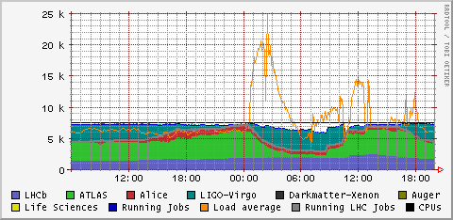
Need4Scale – with great power …
[root@wn-pep-002 ~]# top
top - 09:40:47 up 71 days, 12:17, 2 users, load average: 110.38, 101.43, 106.3
Tasks: 700 total, 7 running, 666 sleeping, 0 stopped, 27 zombie
%Cpu(s): 17.0 us, 2.0 sy, 0.0 ni, 81.0 id, 0.0 wa, 0.0 hi, 0.0 si, 0.0 st
KiB Mem : 39462902+total, 23514457+free, 10406320 used, 14907812+buff/cache
KiB Swap: 67108860 total, 66841340 free, 267520 used. 37964784+avail Mem
PID USER PR NI VIRT RES SHR S %CPU %MEM TIME+ COMMAND
82661 expt000 20 0 5618756 396356 924 R 360.0 0.1 5:14.43 mksquashfs
72615 expt000 20 0 5626336 248516 816 R 90.0 0.1 5:44.11 mksquashfs
83257 expt000 20 0 5611608 219300 852 S 90.0 0.1 1:17.66 mksquashfs
...
User doing mass creation of containers, rebuilding their python ‘virtual env’ for each job, running on >> 4000 cores
June 28th, 2023, data from Nikhef NDPF stats & cricket (top),

Slide 11
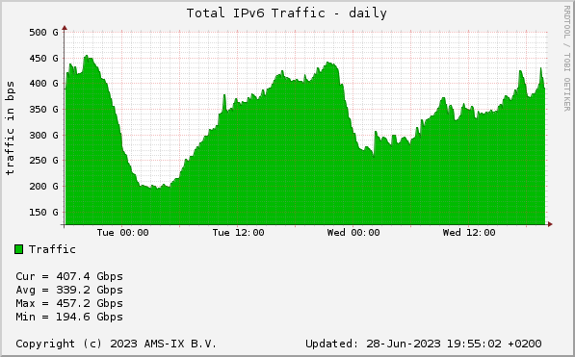

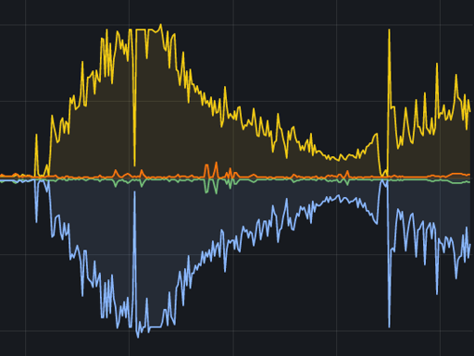

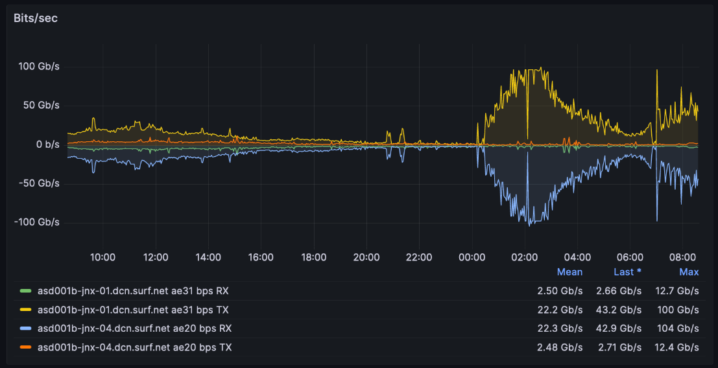
… comes great responsibility!
1/4th of all IPv6 traffic
that night at the NL Amsterdam Internet Exchange was from this one user @NDPF
Pulling the python packages at line rate and downloading public python repositories ultimately will flood SURFnet (and suck up Cloudfare’s IPv6)
June 28th, 2023,
asd001b-jnx-01 to asd001b-jnx-04 (left),
AMS-IX SFlow https://stats.ams-ix.net/sflow/index.html (bottom)

Slide 12
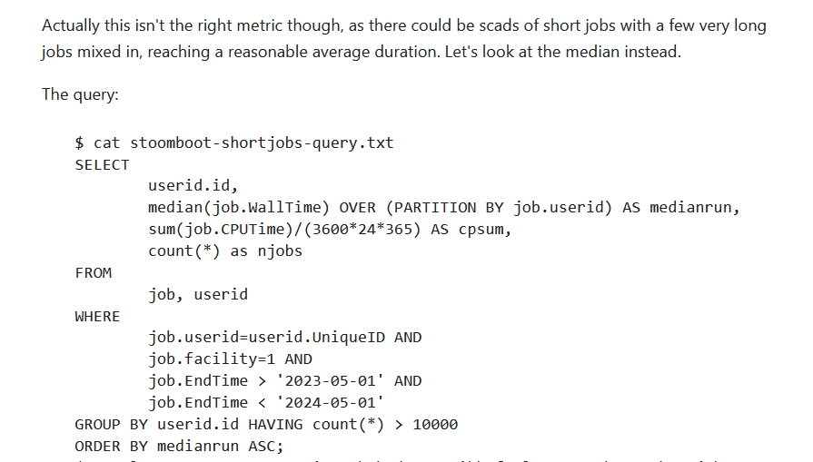
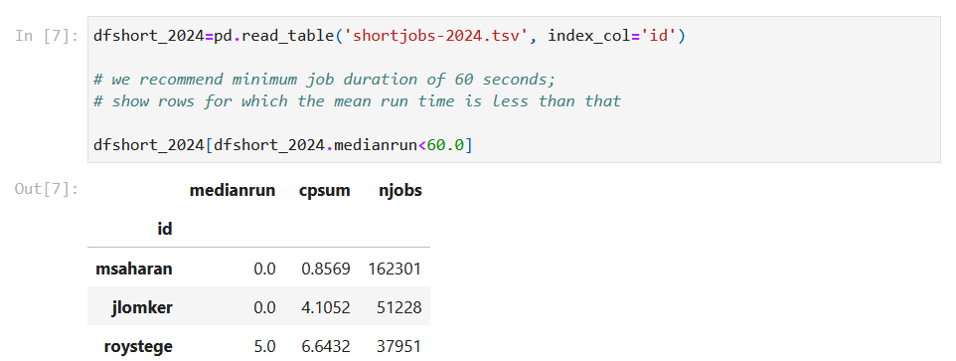
Other ways to ‘exercise’ a cluster:
jobs for which life came to an unfortunate, premature end
https://www.nikhef.nl/pdp/stats/stbc/intern/stbc_summ_plots.html

Slide 13
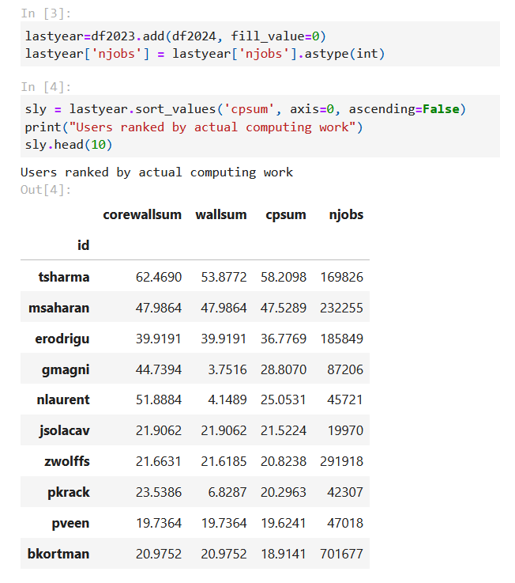
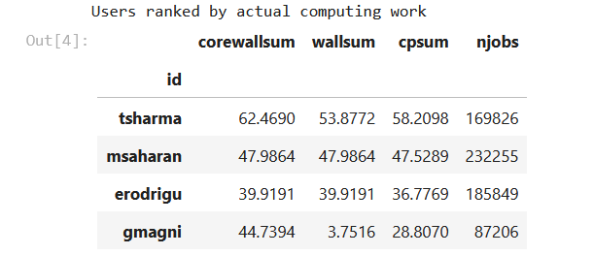
And this year, the stoomboot
winner is …
Congrats to Tanishq (theory), Mohit (cosmics), Efren (LHCb), and Giacomo (theory)
[years]
[years]
[years]
Stoomboot usage May 2023 – May 2024, analysis: Jeff Templon
See also https://www.nikhef.nl/pdp/stats/stbc/intern/stbc_summ_plots
Notes:
Top 1,2,3:
Beste multicore gebruiker:
top-3 multicore: user jobcount CPU time Wall time cpuwallratio

Slide 14
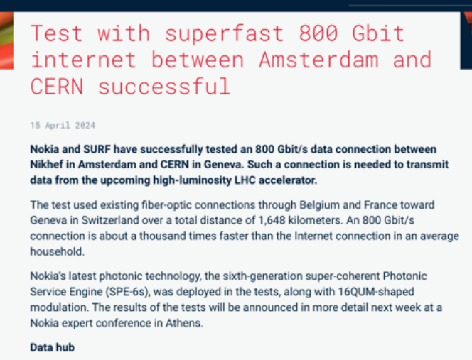
In time for the HL HLC (and more besides)

Slide 15
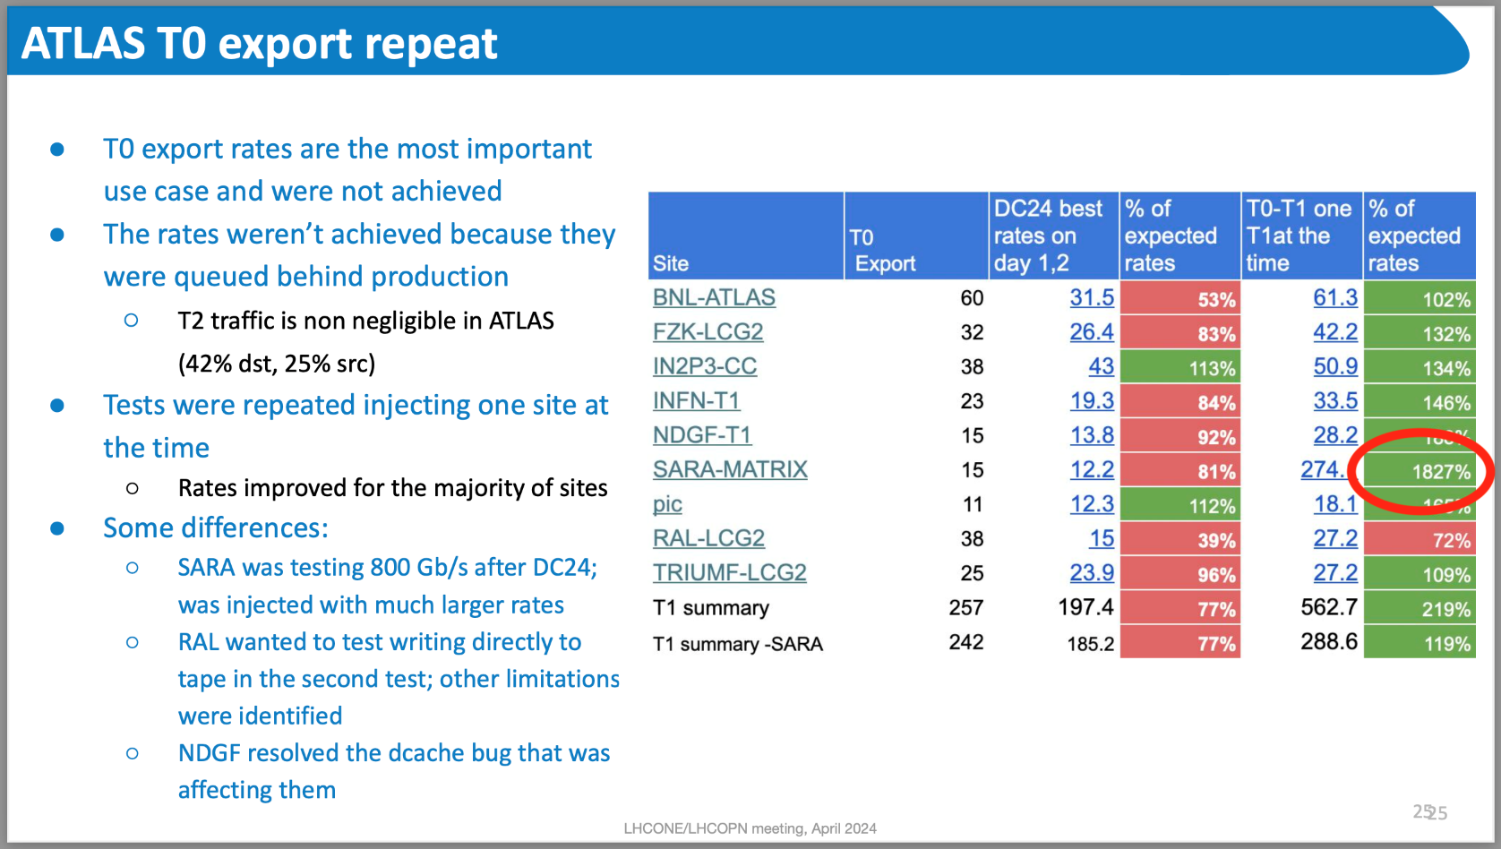

800Gbps in practice
From: Katy Ellis (STFC RAL): DC24 report, LHCOPN meeting, Catania, IT, April 2024 https://indico.cern.ch/event/1349135/#6-dc24-report

Slide 16
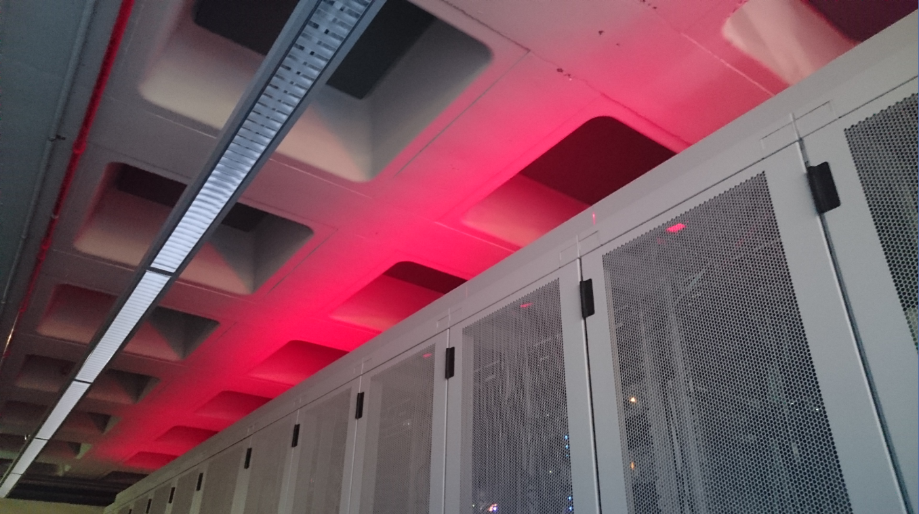
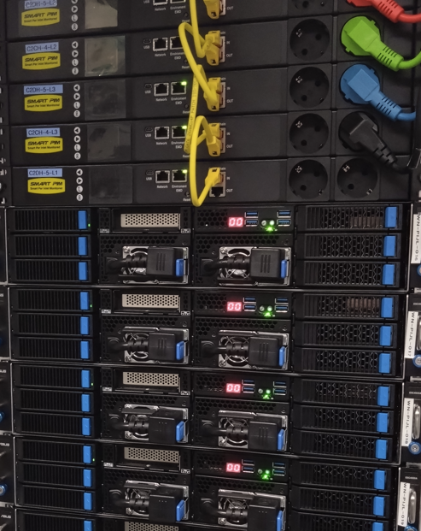
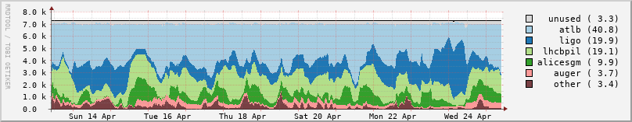
… towards tomorrow!
But why not get results faster on our next-gen clusters?
+30% HEPscore performance
and ‘containerise’ your work
better access to GPUs on stoomboot
automatically done on our newer hardware like ‘vuurpijl’
prepare for data analysis preservation and good research data management
Screenshot: AMD EPYC Genoa architecture, VO GRIS view https://www.nikhef.nl/pdp/doc/stats/stbc-grisview-short

Slide 17
Next up
Condor and Containers Dennis van Dok
“Scavenging Containers fallen off the Stoomboot?”

Slide 18
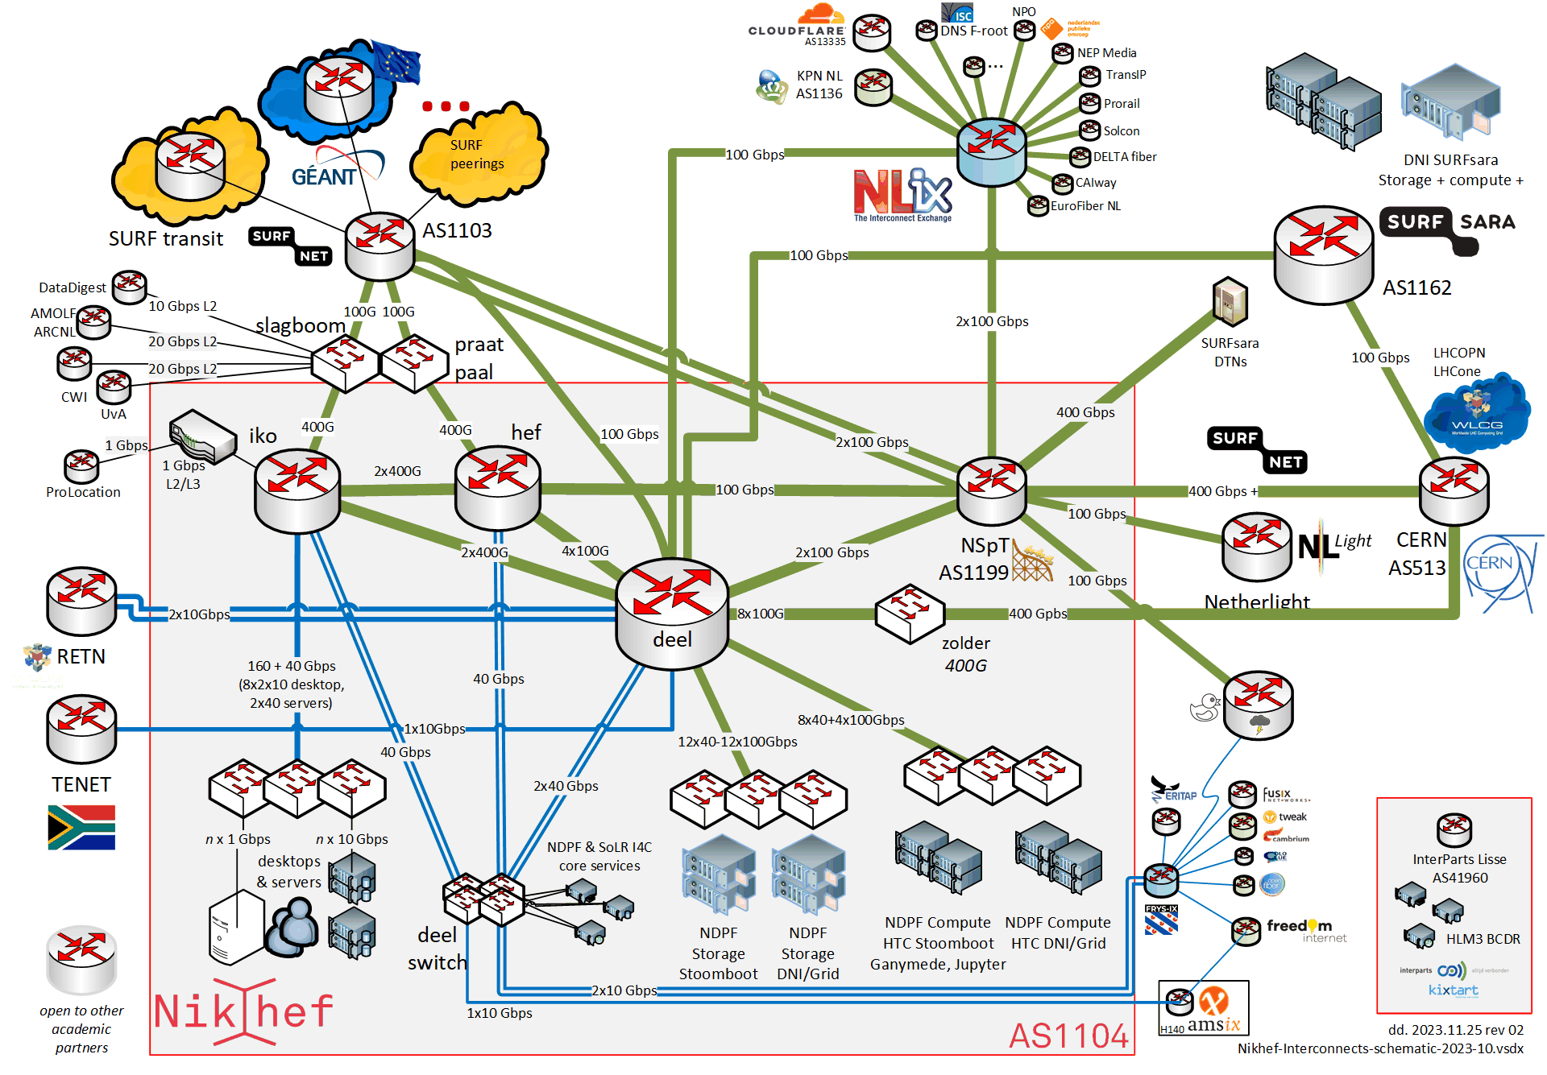
Networks can make an image with many tracks as well!
Nikhef ‘Autonomous System’
AS1104
internal network
and private peerings
Time for some track finding?
Curious about your way home?
From home, use
traceroute -A myip.nikhef.nl

