Slide 1
Fancy a (peta)?b(y|i)te …
Physics Data Processing and Computing Technologies
David Groep
Nikhef Jamboree 2023

Slide 2
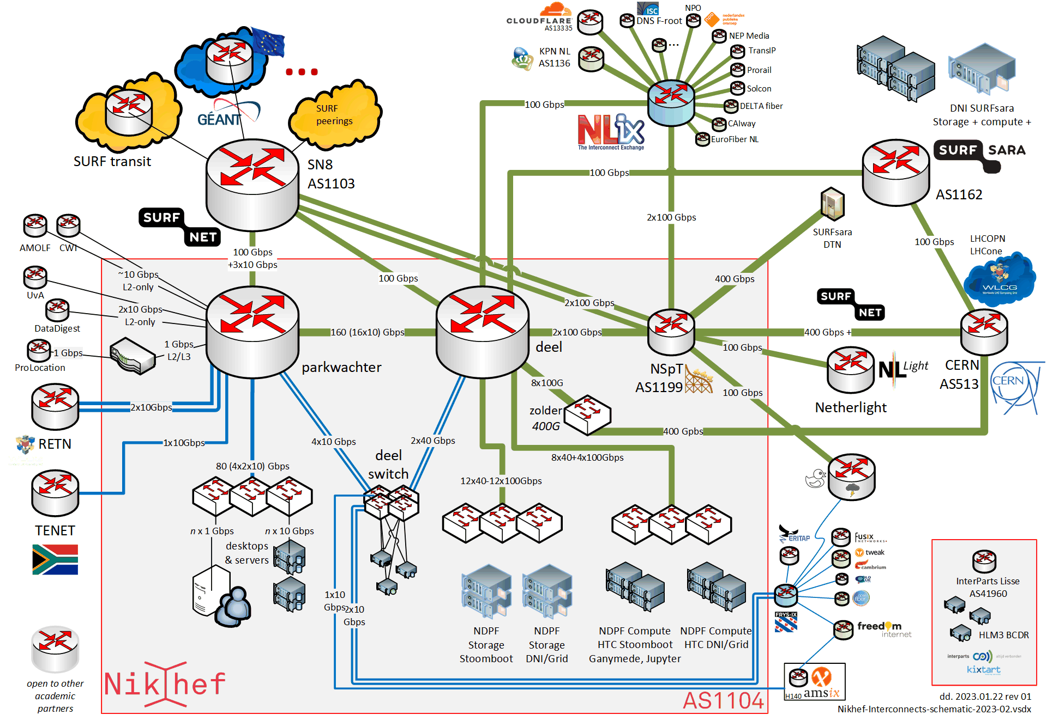
Computing can make an image with many tracks as well ☺


Nikhef AS1104 internal network and private peerings
Time for some track finding!
Curious about your way home? From home, use
traceroute -A myip.nikhef.nl


Slide 3
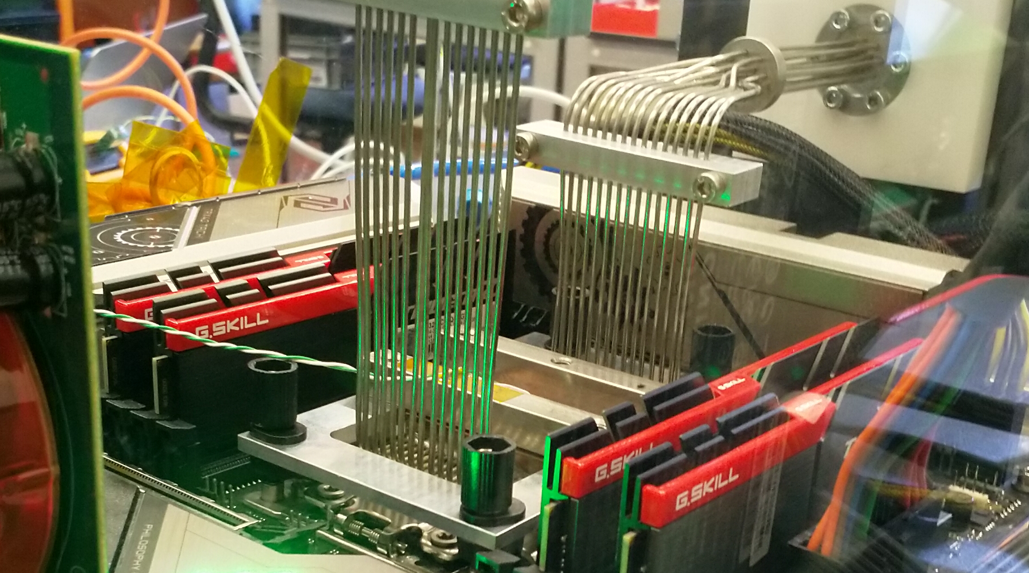
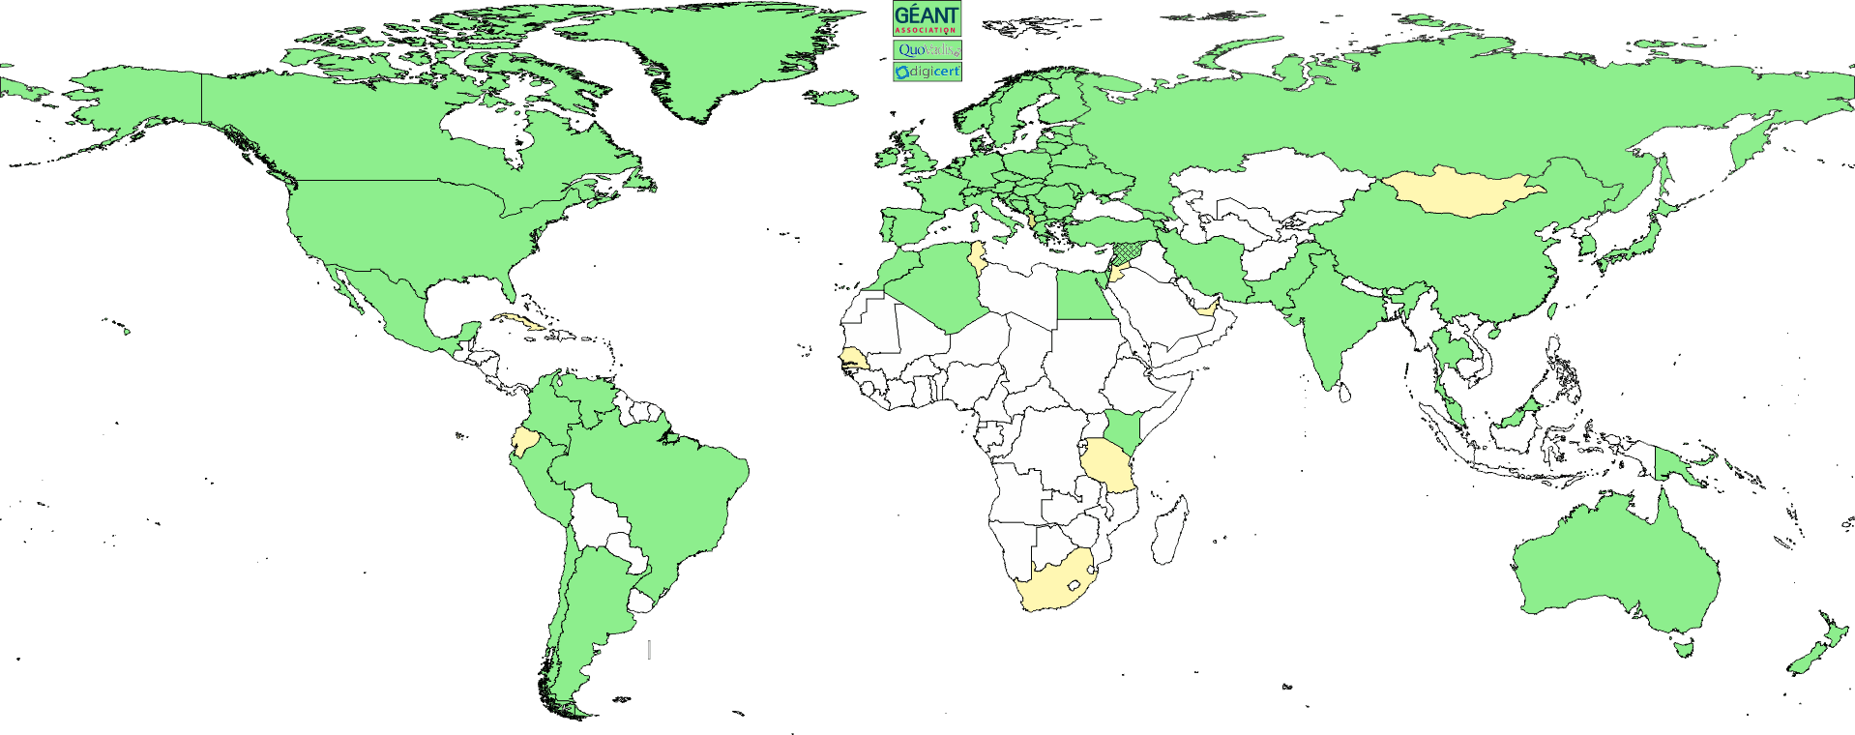
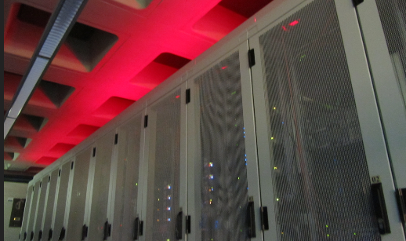
The three pillars of Nikhef Physics Data Processing
Algorithmic design patterns and software
designing software for (GPU) accelerators, new algorithms, high-performance processors
software design patterns for workflow & data orchestration
Infrastructure for trusted collaboration
trust and identity (‘SSO’) for enabling communities
managing complexity of collaboration mechanisms
securing the infrastructure of our open science cloud
Infrastructure, network & systems co-design R&D
building ‘research IT facilities’
co-design & development
big data science innovation
research on IT infrastructure

Slide 4
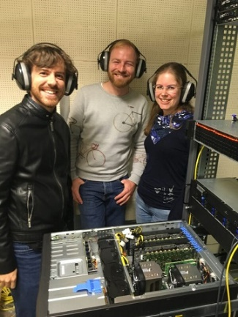
Towards heterogeneous computing at scale
Allen for LHCb’s GPU-based HLT1 commissioned
Roadmap for more hybrid computing
alternative architectures: non-x86/ARM, GPU+FPGA hybrid dies
For the long term: Quantum Computing algorithms exploration
in collaboration with our experiments (notably LHCb and GW), QuSoft, SURF, IBM, …
personal expectation: ‘production’ use far away (>2035?), but work on algorithms, even if ultimately not QC, very interesting anyway
Image: LHCb’s Allen team: Daniel Campora (Nikhef & UM), Roel Aaij (Nikhef), Dorothea vom Bruch (LPNHE) (source: LPNHE)

Slide 5
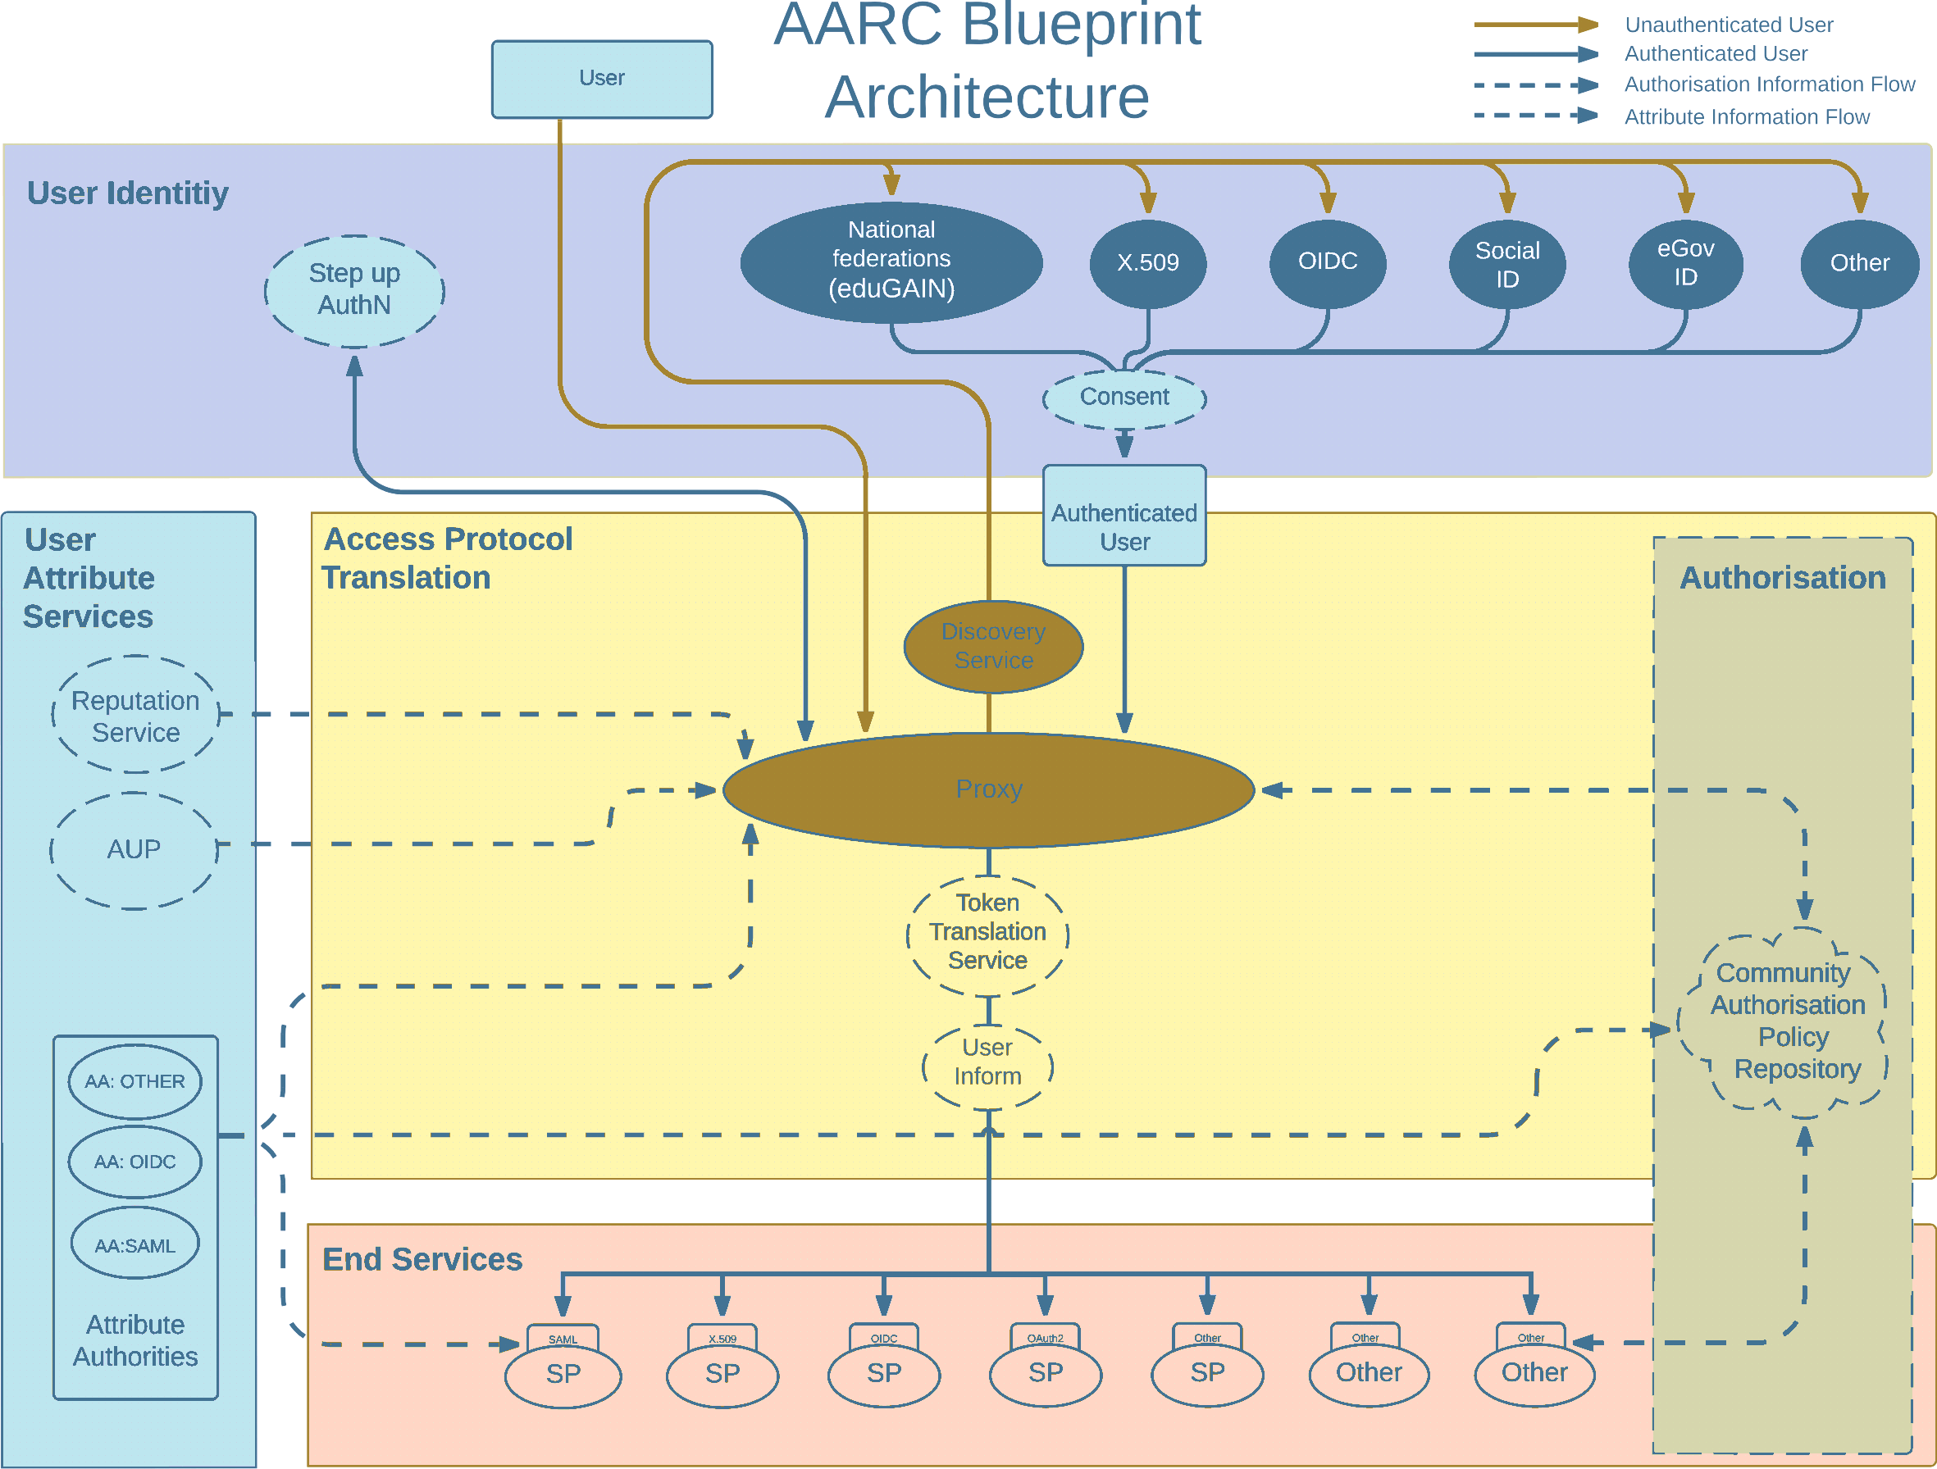
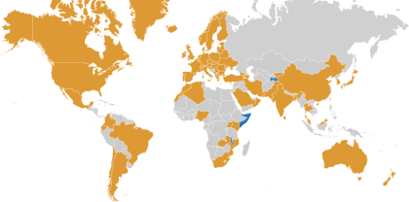
Global trust: from AARC Blueprint to EOSC and RCauth.eu
See https://doi.org/10.2777/8702, https://rcauth.eu/

Slide 6
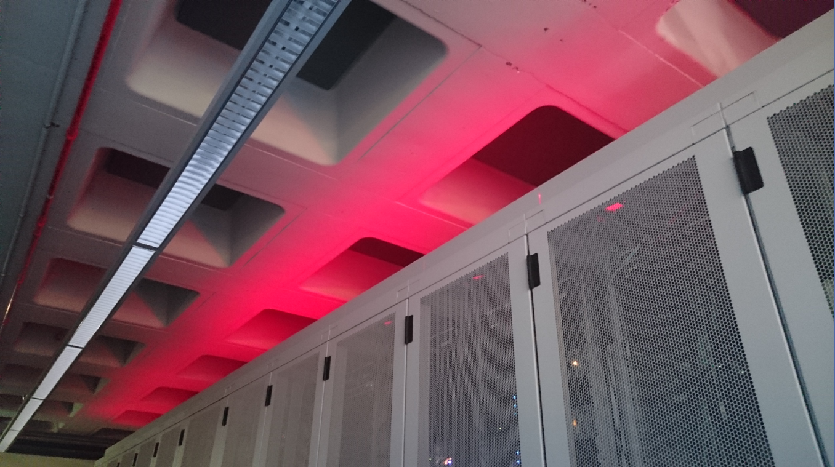
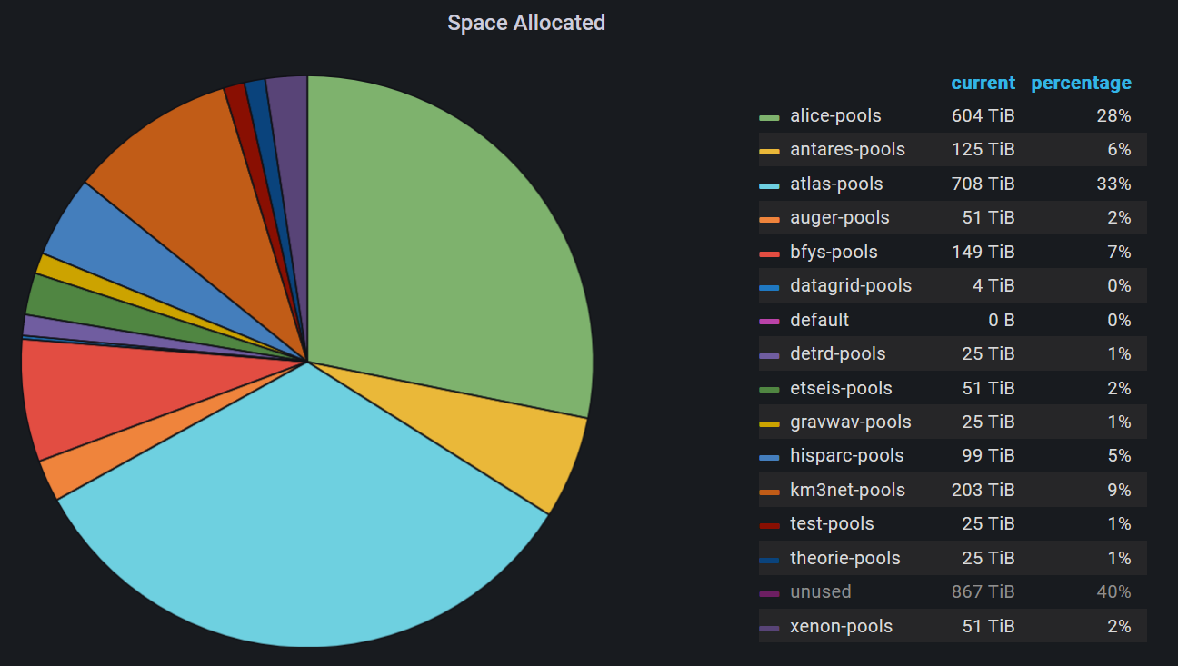
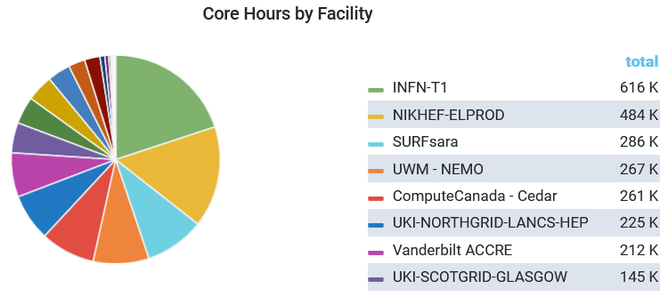
ATLAS + Alice + KM3NeT= ~2/3
Infrastructure for Research
Data Processing Facility High-Throughout Compute & Storage
National Infra (NL-T1, IGWN, KM3NeT, Xenon, DUNE, WeNMR, MinE, …)
and Stoomboot (Nikhef users)
now ~ 12 000 cores, 13 PByte storage
IGWN use of NL DNI infrastructure at NIKHEF & SURF 4-11 April, 2023
NL DNI Nikhef + SURF
Occupancy: NDPF DNI processing facility. Dip in mid-2022 shows migration of IGWN nodes back to HTcondor

Slide 7
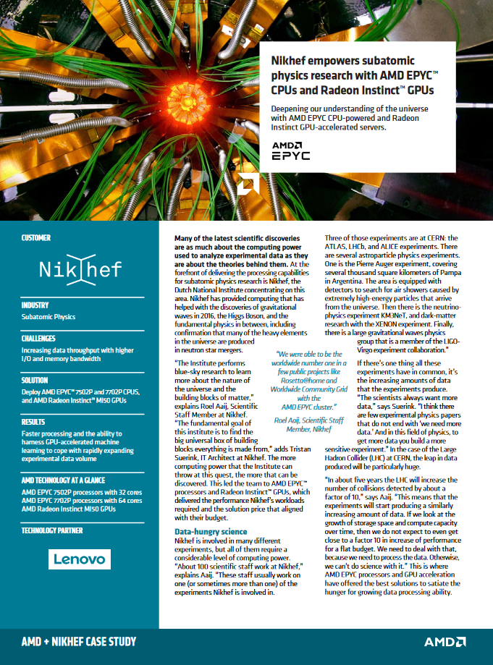
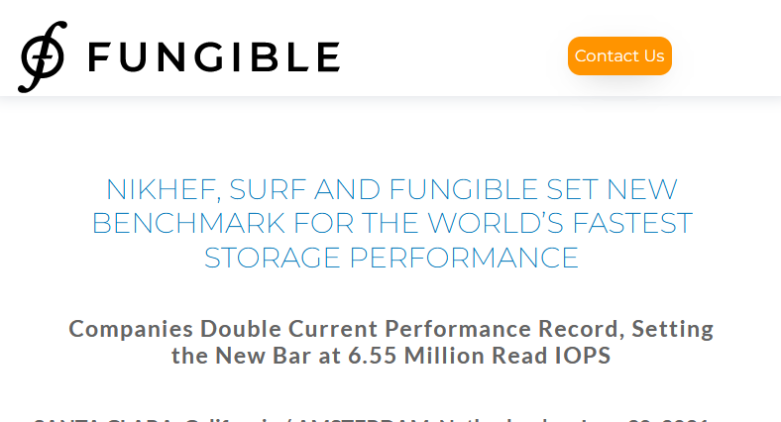
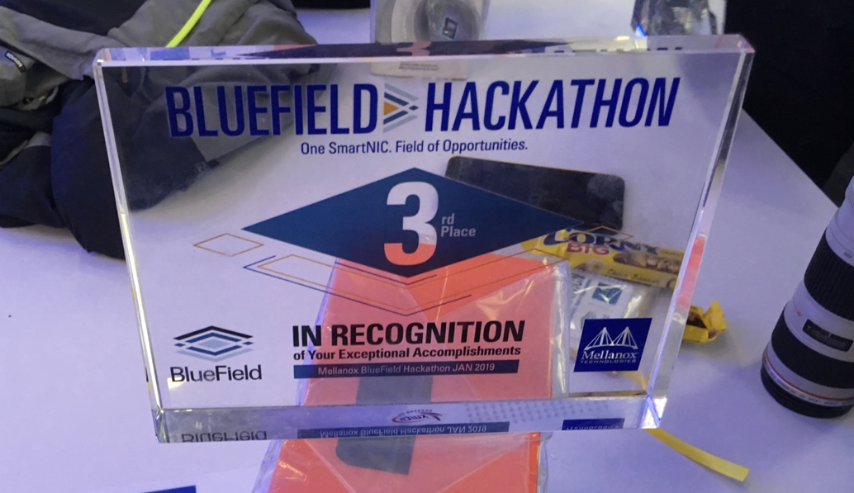
Innovation on infrastructure
Image: Minister of Economic Affairs M. Adriaansens launched the Innovation Hub with Nikhef, SURF, Nokia and NL-ix, January 2023. Composite image from https://www.surf.nl/nieuws/minister-adriaansens-lanceert-testomgeving-voor-supersnelle-netwerktechnologie

Slide 8
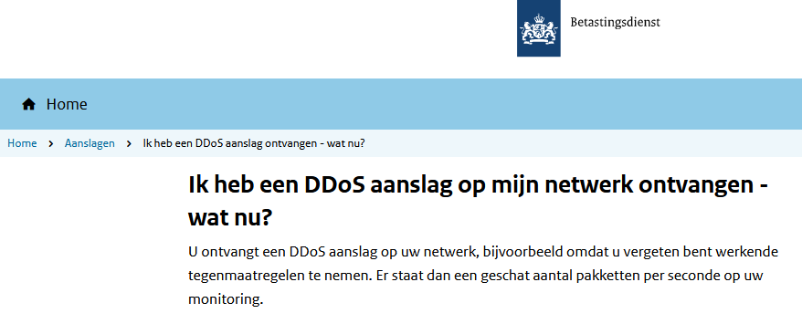
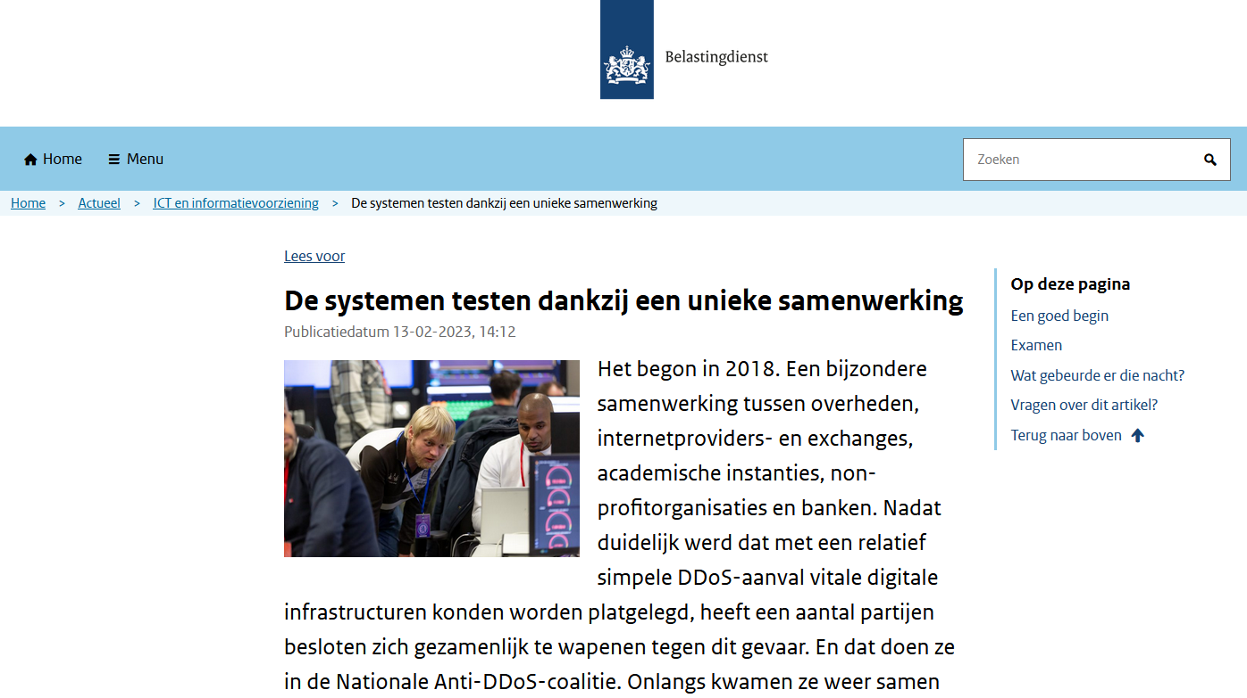
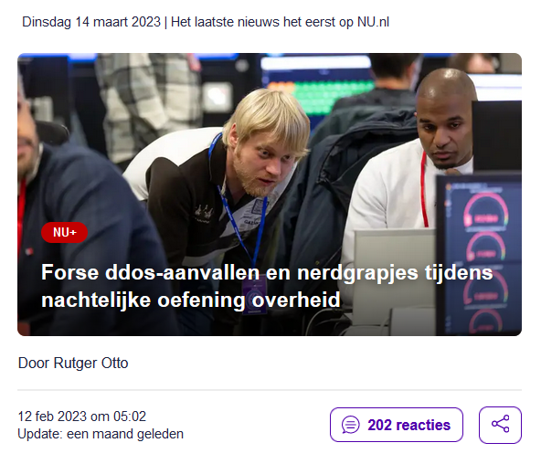
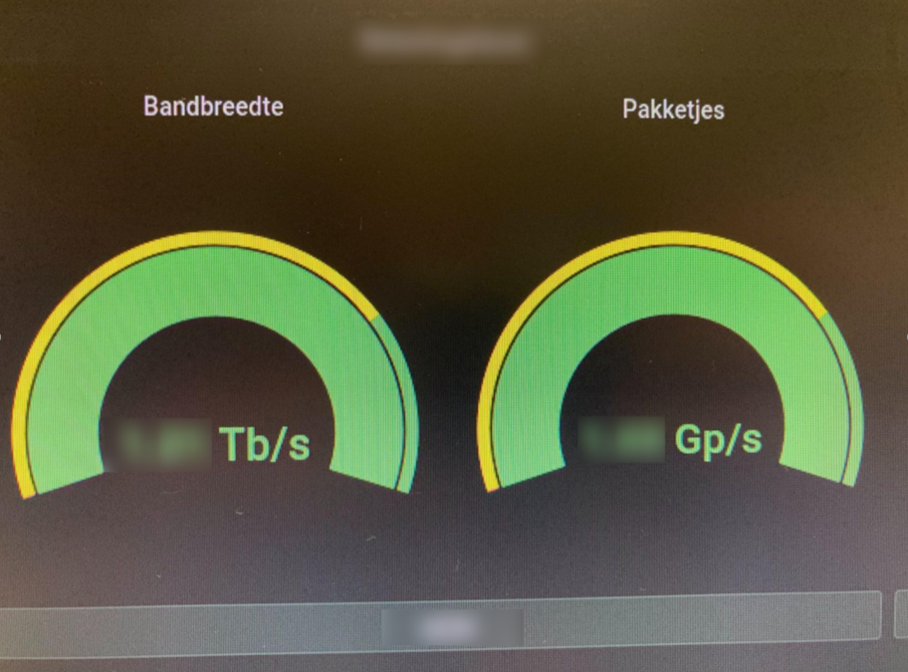
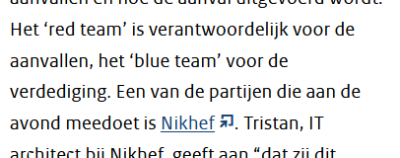
Our science data flows are somebody else’s DDoS attack
Image sources: belastingdienst.nl, rws.nl, nu.nl, werkentegennederland.nl

Slide 9
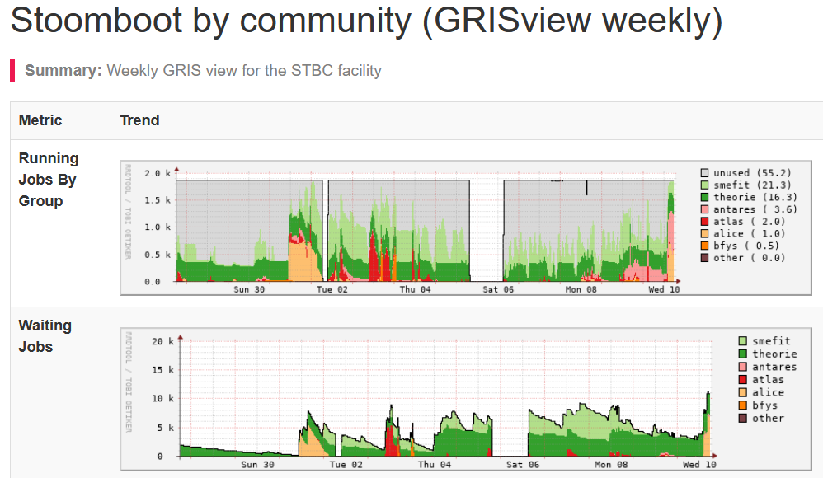
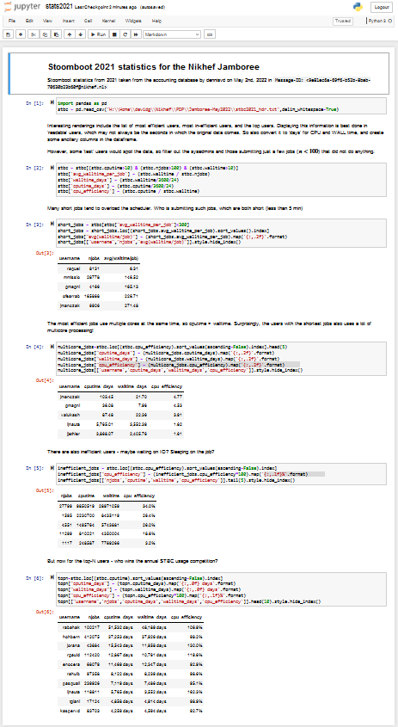
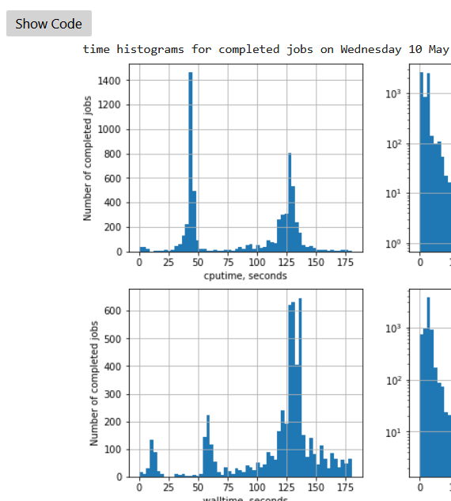
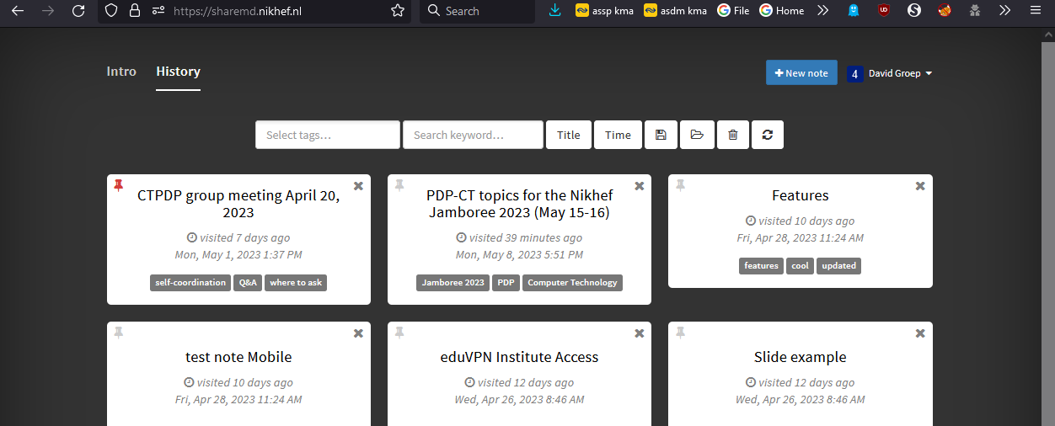
Some services you use today …
Stoomboot: ~2000 cores and ~3 PByte dCache
Callysto: JupyterHub with $home and SSO login
eduVPN: securely access Callysto and your home
Mattermost’s ‘STBC-users’ channel to talk & ask
eVA, SURFdrive, and FileSender to collaborate
Experimental services: ShareMD, Commute, …
But do read https://www.nikhef.nl/pdp/doc/experimental-services before using experimental services ... Stoomboot statistics: https://www.nikhef.nl/pdp/doc/stats/stbc-grisview-week, https://www.nikhef.nl/pdp/stats/stbc/intern/stbc_summ_plots

Slide 10
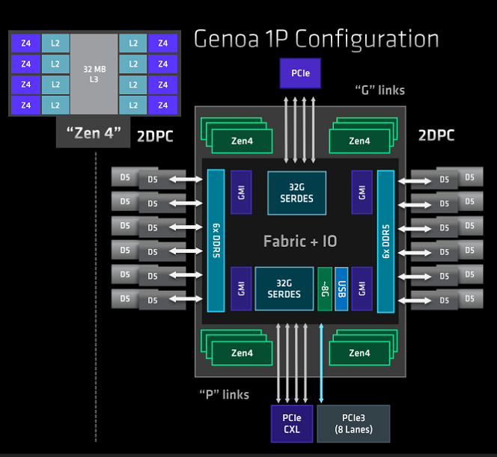
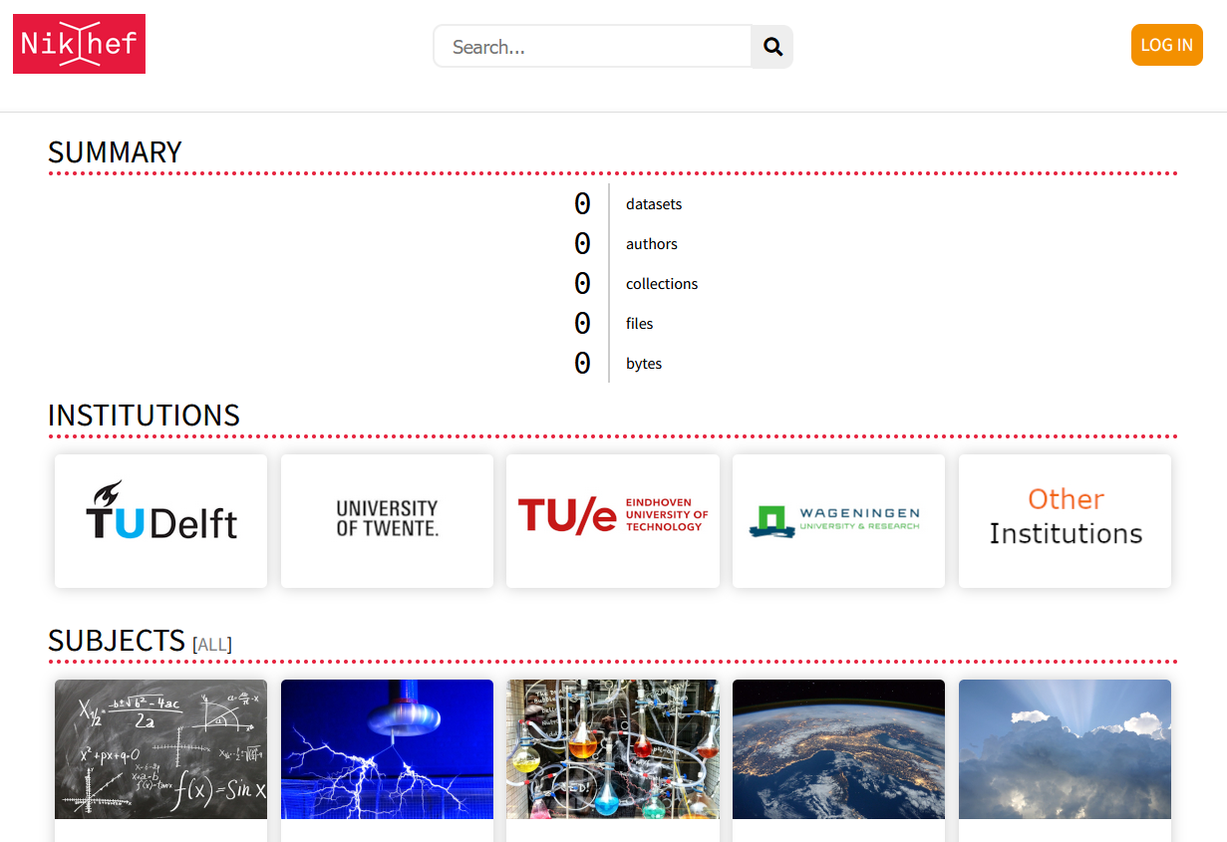
… towards ~ tomorrow
But why not get results faster on our next-gen clusters?
new clusters likely by the end of 2023 …
today’s Genoa already +30% HEPscore performance
although … why is nobody using stbc-iexp?
And containerise your work in the future!
better access to GPUs on stoomboot
run on newer hardware that will use Rocky 8 or 9
prepare for data analysis preservation and good research data management when we link Stoomboot dCache to our institutional Research Data Management

Slide 11
And this year, the stoomboot winner is …
Animation: Dennis van Dok, source: https://gitlab.nikhef.nl/pdp/stoomboot-animation
Notes:
Top 1,2,3:
bkortman Bryan Kortma
njsolacav Josep Sola Cava
jasperw: Jasper Westbroek
Beste multicore gebruiker:
pkrack Peter Krack
top-3 multicore: user jobcount CPU time Wall time cpuwallratio
63 maaikeb 241 192.489942 8.762731 21.966888
60 ksphukon 64 1247.389271 159.864016 7.802815
94 pkrack 5655 3263.190324 463.634282 7.038285
ksphukon == Khun Sang Phukon

Slide 12
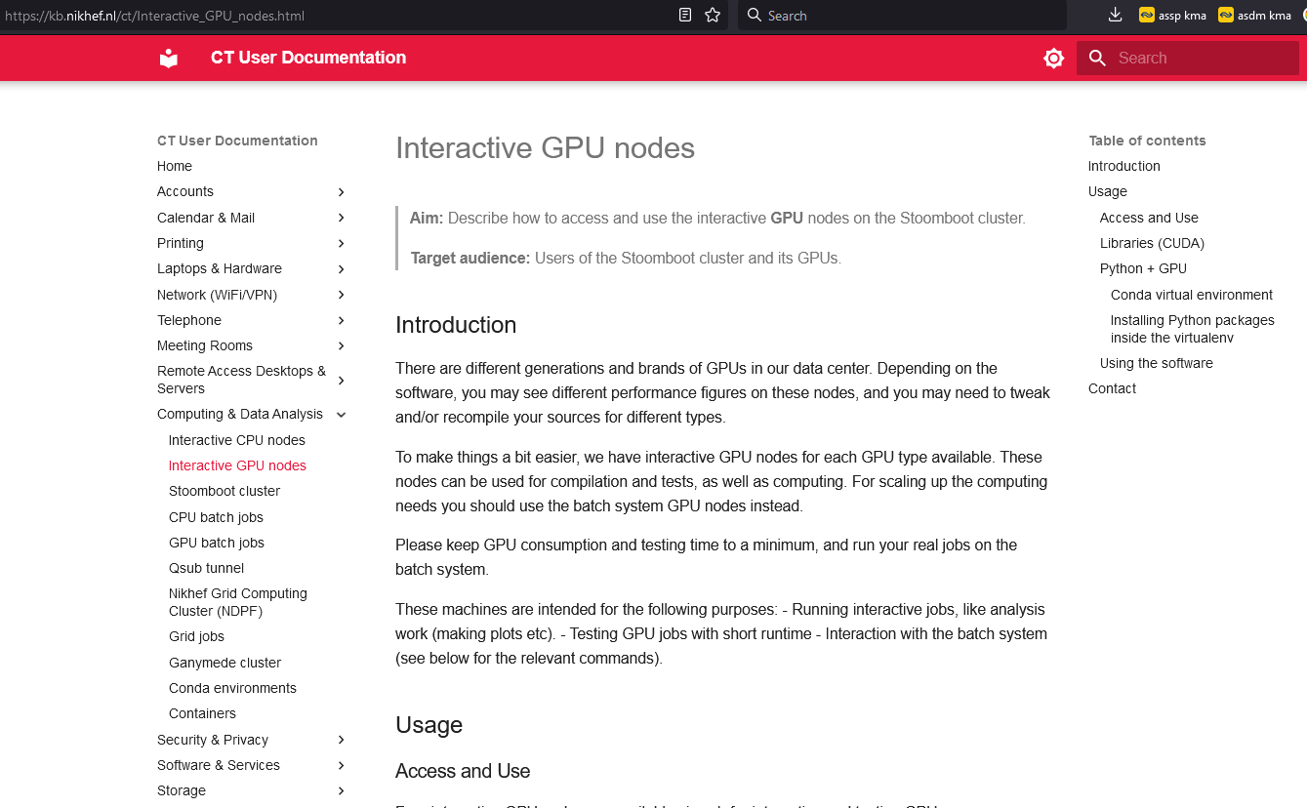
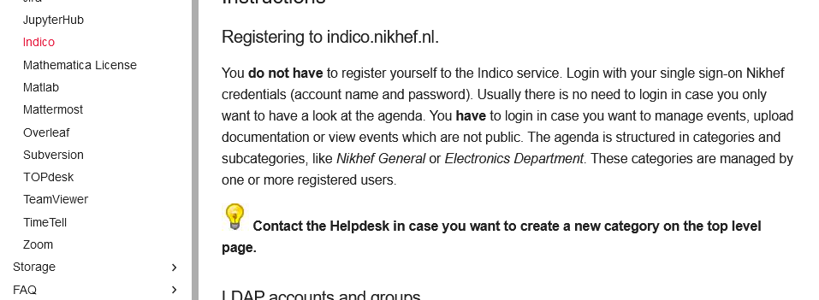
Your new knowledge base starts here, on kb.nikhef.nl/ct

Slide 13
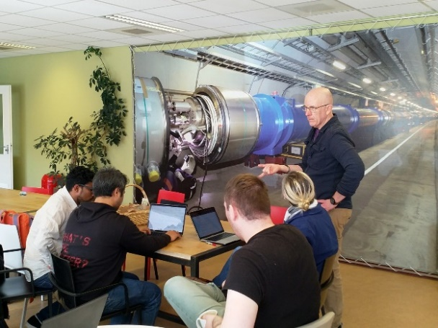
Fancy cake?
Meet at the Computing Office hours – ‘ask us anything’
1300-1500, first Thursday of every month
SP110 ‘Spectrum Noord’
slice of cake with every question
Join the Nikhef Computing Course for a structured learning approach
https://www.nikhef.nl/pdp/computing-course/
materials at https://indico.nikhef.nl/e/computingcourse2022

Slide 14
Next up “A tour of Italian CPUs, and our speedy road south” (Erik Kooistra)

