Slide 1
The Security Baseline – in EOSC and the AARC PDK
‘for loosely connected services and infrastructure’
David Groep
AARC Policy Area coordinator
Nikhef Physics Data Processing (PDP) programme
EUGridPMA 53
2021.09.27

Slide 2
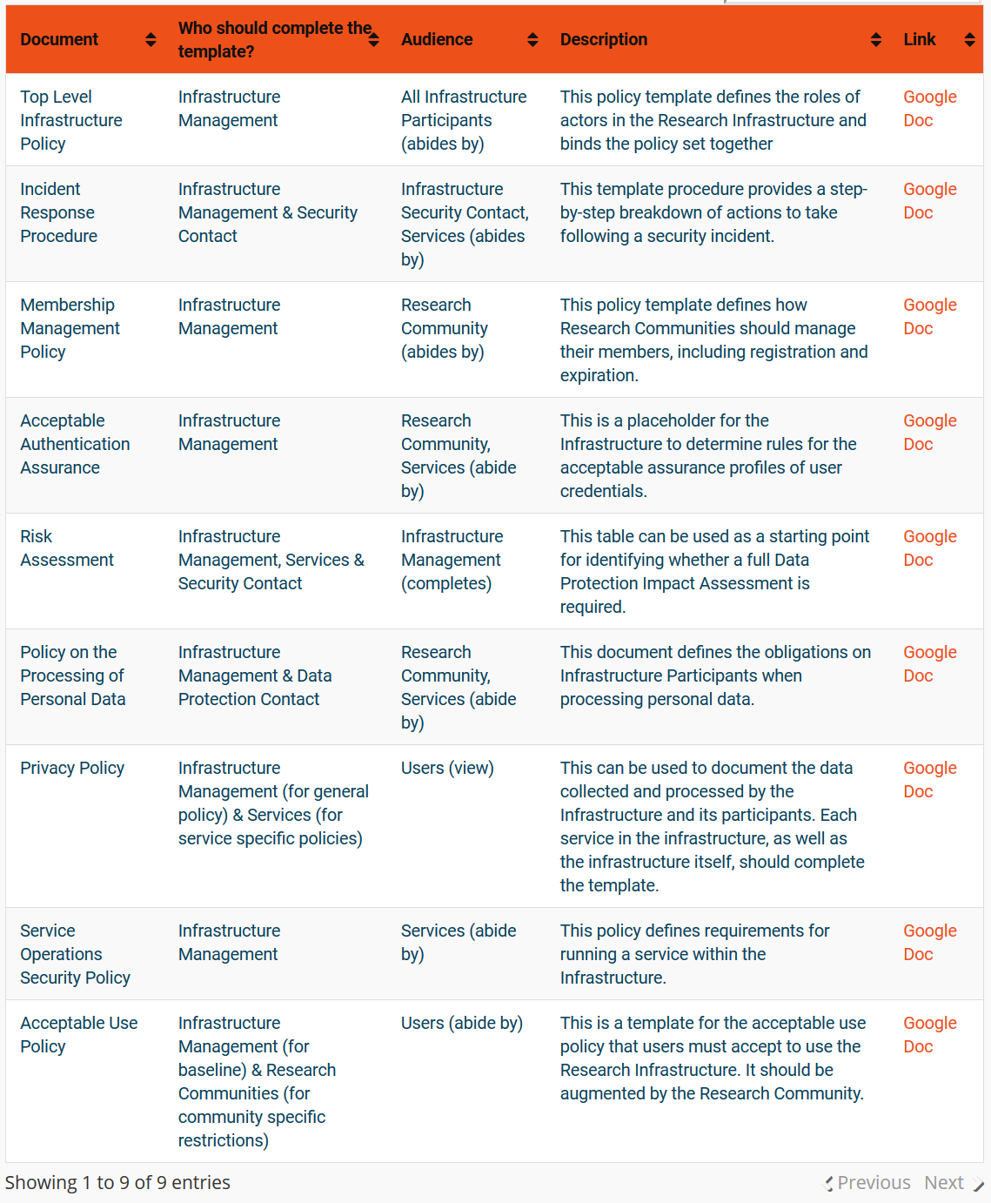
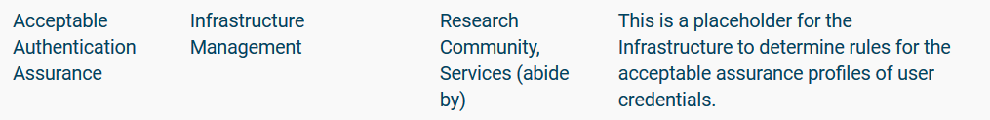

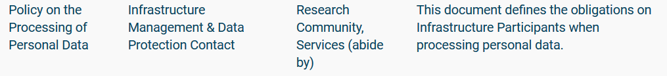
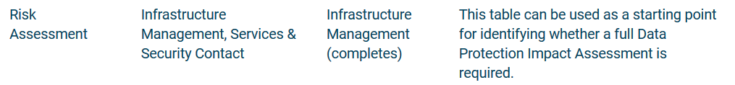
AARC Policy Development Kit - Service-centric policies
https://aarc-project.eu/policies/policy-development-kit/

Slide 3
PDK “Service Operations” development
AARC Policy Development Kit “Service Operations” policy was rather specific
addressed also some ‘service-internal’ operations and software
embedded in the PDK ecosystem and did not work well as a ‘stand-alone’ document
had a built-in assumption of a coherent and coordinated infrastructure
Developed by UK-IRIS to be
more stand-alone
better implementable by adding references and notes (‘best practice’, or an ‘FAQ’)
In the EOSC ecosystem, original assumptions also no longer hold
services provided are less coherent, and much more autonomous then every before
need to accommodate providers with varying maturity levels - and different intentions!

Slide 4
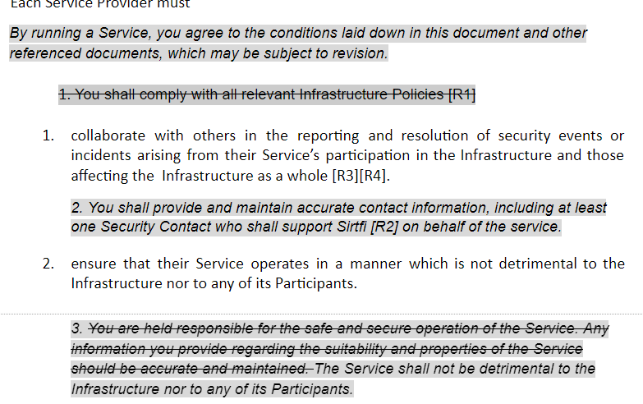
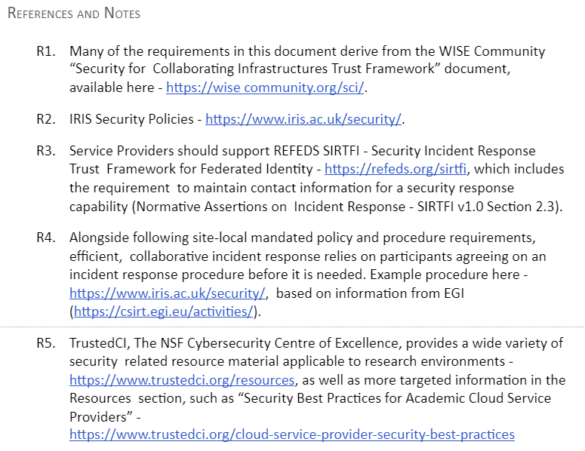
The UK IRIS improvements

Slide 5
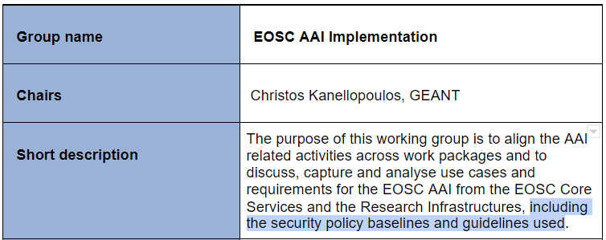
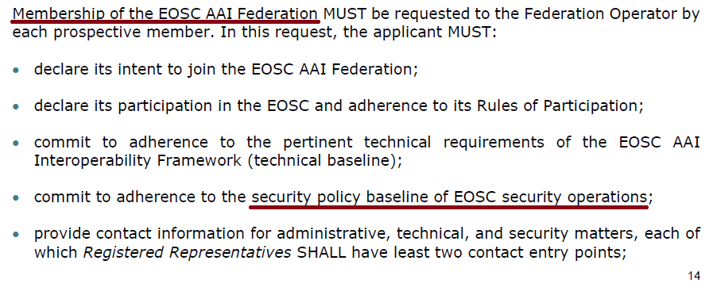
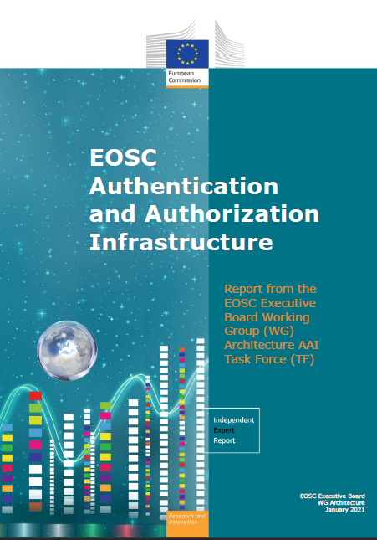
Towards a Baseline instead of a single policy
Not all services are created equal
EOSC primarily about user experience & research success: security there to support this goal
Services are composable – and thus interdependent
Premise: do no harm!
Security Baseline
prerequisite for connecting to the Core Infra Proxy
connection requirement for the EOSC AAI
may evolve over time
Additional elements can be added to augment trust
through service level agreements
by maturity grading (‘WISE SCI’ peer assessments)

Slide 6
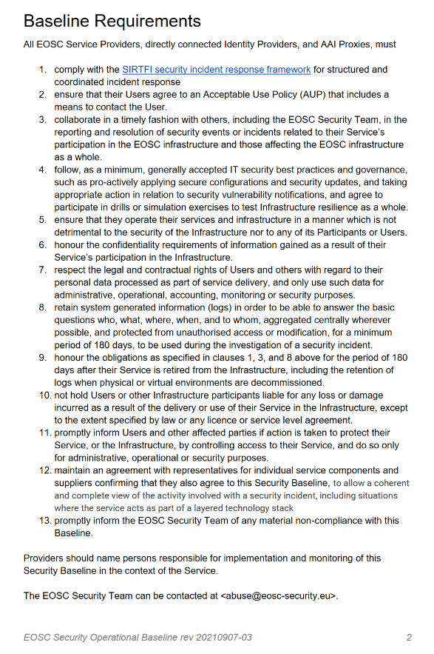
Baseline Process
Co-development of EOSC Future & AARC Policy Community
version based on UK-IRIS evolution of the AARC PDK
specifically geared towards the looser EOSC ecosystem
mindful of urgent need for collective coherent response
AARC Policy team consultation – 1st round just finished
13 itemised points - https://edu.nl/avfv4
complemented by an ‘FAQ’ with guidance and refs
(no new standards, there is enough good stuff out there)
leverages Sirtfi framework
connects to the Core Security Team
https://wiki.eoscfuture.eu/x/Q4sb

Slide 7
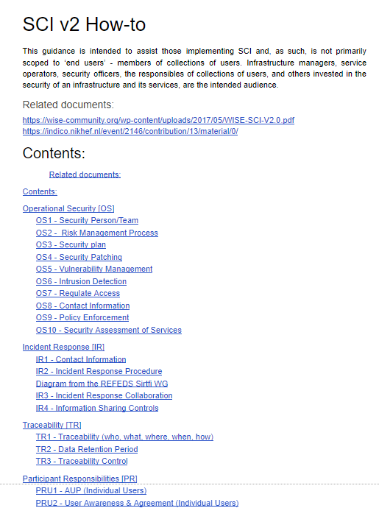
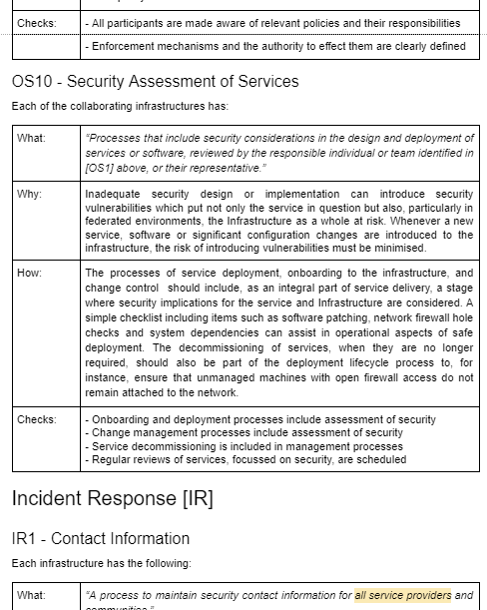
Complementing elements
SCI maturity assessment model
WISE Risk Assessment Templates
EOSC Future Core Security Team
Contact information
Response processes and guidance
…

Slide 8
EOSC Security Operational Baseline (rev 20210908-03)
https://docs.google.com/document/d/1a8TQAfOnB0CADo_n5nn7-DQX6jV7Iz-2i90hBAzMgGY
Development location(s): to be discussed now
FAQ for now at
https://wiki.eoscfuture.eu/display/EOSCF/EOSC+Security+Operational+Annotated+Baseline

Slide 9
davidg@nikhef.nl
this work is co-supported by the EOSC-Future project, the GN4-3 project, EGI-ACE, UK-IRIS, and SURF

