Slide 1
On Multi-User Pilot Jobs
Recovering control in an obfuscated world

Slide 2
Overview
Grid participants
Workload models
  user workload management and multi-user pilot jobs
  impact on traceability and incident handling
Recovering control
  policy actions and liability; containing mechanisms
gLExec
  sources and early deployments
  controls and security audits
  system interactions
Deployment on clusters
  site-wide access control,
Towards integrated authorization

Slide 3
Overview
Multi-domain Distributed Grid and
the Grid Participants
Security model
Late binding and pilot jobs
Multi-user pilot jobs (MUPJ): VO overlay networks
Portals and gateways versus the LCG MUPJs
What if this goes wrong?
  Response to major incidents
  Suspicions
  Regulatory requirements and woking with multiple National Legal Areas

Slide 4
Overview
Recovering control
  Policy on Multi-User Pilot Jobs
  VO Portal Policy
  Preventing back-compromises, worms and user hiding
Implementations
  Unix level sandboxing: uids and gids, LCAS/LCMAPS
  Sandboxing in ‘conventional’ submission (GT gatekeeper, Unicore TSI, CREAM/sudo)
  Adjusting control points to the late-binding model
  gLExec on the worker node

Slide 5
Overview
gLExec on the worker node
  gLExec, the mini-gatekeeper
  Configuration and installation
  Protections and paranoia (minuid checks, ...)
  Security audits of gLExec
  Deployment modes – and the back-compromise trick
  Meeting policies (DoE/FNAL, traceability, ..., NNPT?!)
Managing credentials across multiple nodes
  Centralizing control
  SCAS: LCAS/LCMAPS in the distance
  Additional controls: banning services and Argus

Slide 6
Overview
Towards managed authorization
  The red button for the grid
  Site-central banning and policy control:
  extending SCAS to other services
  Grid-wide banning and incident response:
  Argus and the OSCT ban-list service
  Availability and migration paths:
  joint Argus and SCAS deployments

Slide 7
Job submission models
Traditional submission and brokering models
User-based job management
Multi-user pilot jobs

Slide 8
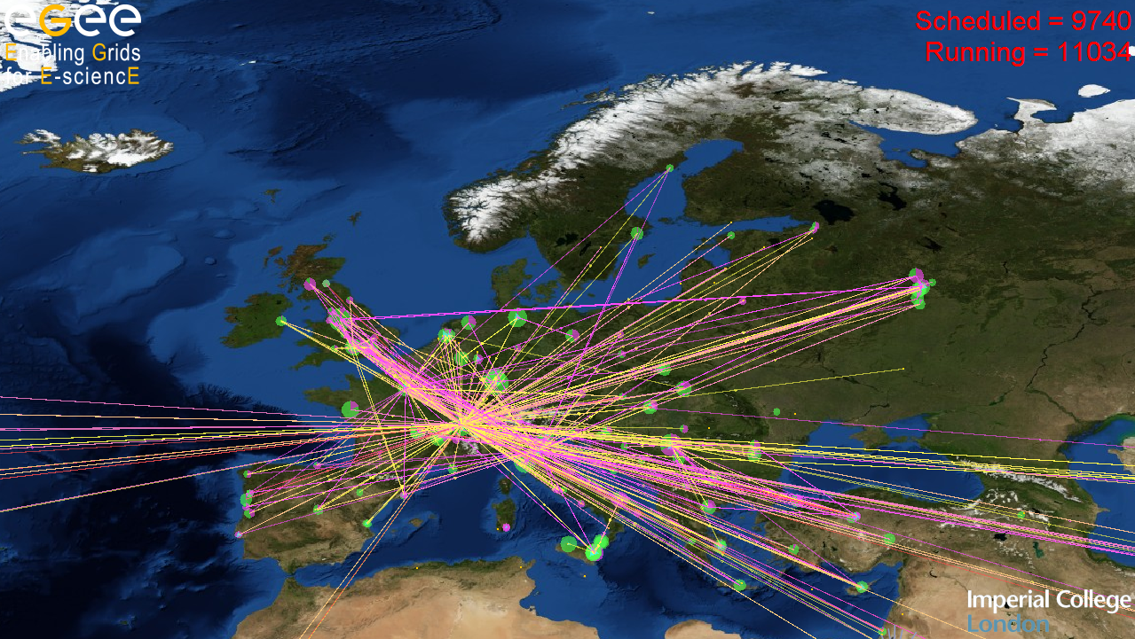
Multi-domain Grids

Slide 9
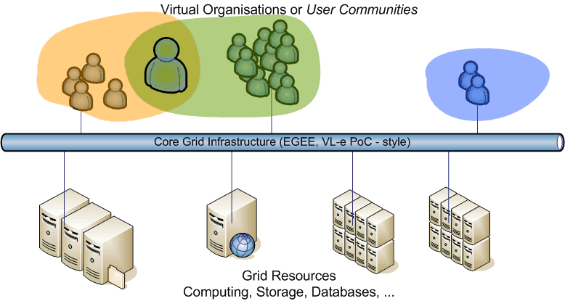
e-Infrastructure model for Grid
Users and user communities de-coupled from the sites
Policy Coordination: User and VO AUPs, operations, trust
Facilitating negotiation: VO meta-data, SLAs, op. environment

Slide 10
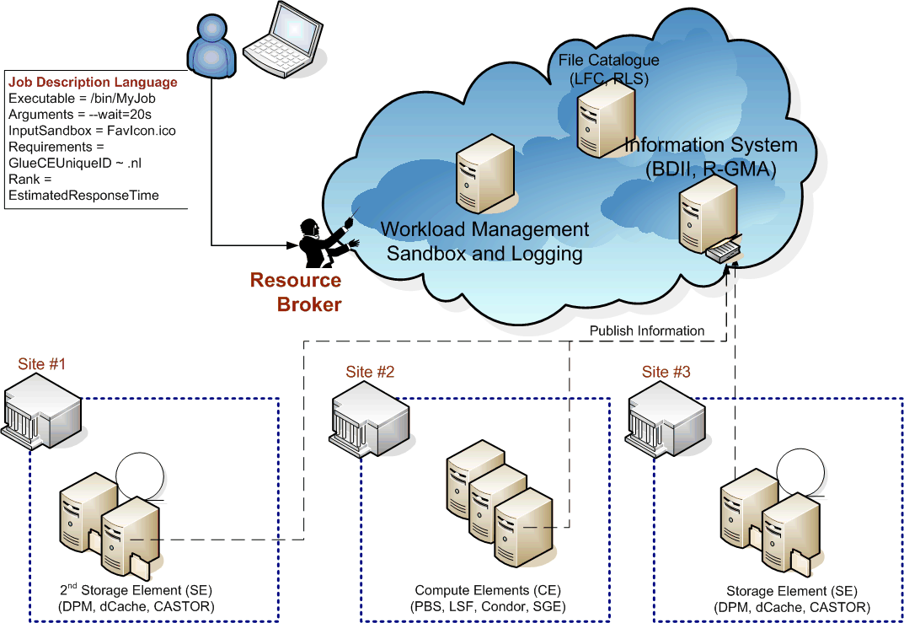
Job Submission Scenario

Slide 11
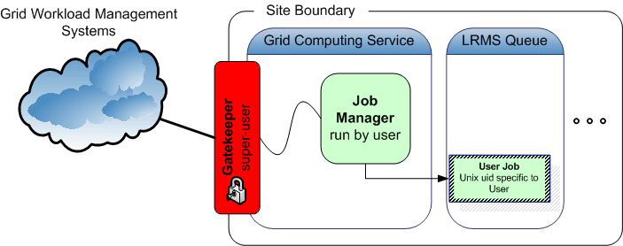
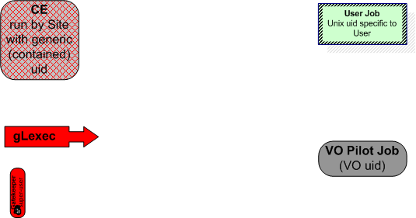
Inside the site: traditional model
Colour coding:
Site controlled service,
running with ‘generic’ uid
Real User Job
(with uid matching actual workload being run)
Site controlled,
running as super-user
Site controlled
super-user daemon
VO-run process
(generic VO uid, or generic VO pool)

Slide 12
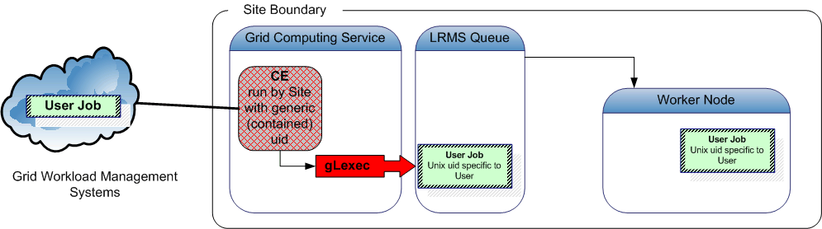
Classic job submission models
In the submission models shown, submission of the
user job to the batch system is done
with the original job owner’s mapped (uid, gid) identity
grid-to-local identity mapping is done only on the front-end system (CE)
  batch system accounting provides per-user records
  inspection shows Unix process on worker nodes and in batch queue per-user

Slide 13
Late binding: pilot jobs
Job submission gets more and more intricate …
Late binding of jobs to job slots via pilot jobs
some users and communities develop and prefer to use
proprietary, VO-specific, scheduling & job management
  ‘visible’ job is a pilot: a small placeholder
  that downloads a real job
  first establishing an overlay network,
  subsequent scheduling and starting of jobs is faster
  it is not committed to any particular task on launch
  perhaps not even bound to a particular user!
this scheduling is orthogonal to the site-provided systems

Slide 14
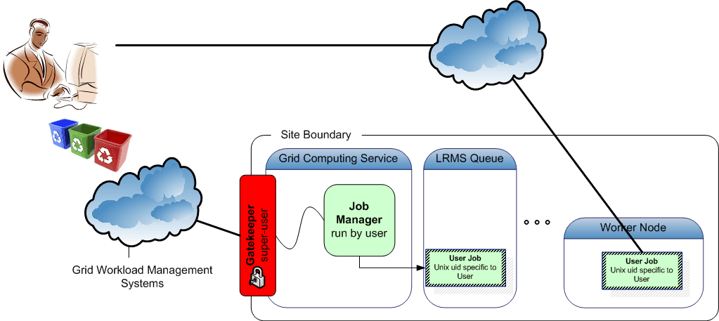
Every user a pilot

Slide 15
Pilot job pros and cons
Some Pros:
Worker node validation and matching to task properties
Intra-VO priorities can be reshuffled on the fly
without involving site administrators
Avoid jobs sitting in queues when they could run elsewhere
From: https://wlcg-tf.hep.ac.uk/wiki/Multi_User_Pilot_Jobs
For any kind of pilot job:
  Frameworks such as Condor glide-in, DIRAC, PANDA, … or Topos, are popular, because they are ‘easy’ (that’s why there are so many of them!)
  Single-user pilot jobs are no different than other jobs
  when you allow network connections to and from the WNs
  Of course:
  any framework used to distribute payload gives additional attack surface

Slide 16
Multi-user pilot jobs
All pilot jobs are submitted by a single (or a few) individuals from a user community (VO)
  Creating an overlay network of waiting pilot jobs
VO maintains a task queue to which people
(presumably from the VO) can submit their work
Users put their programs up on the task queue
Pilot jobs on the worker node looks for work from that task queue to get its payload
Pilot jobs can execute work for one or more users in sequence, until wall time is consumed

Slide 17
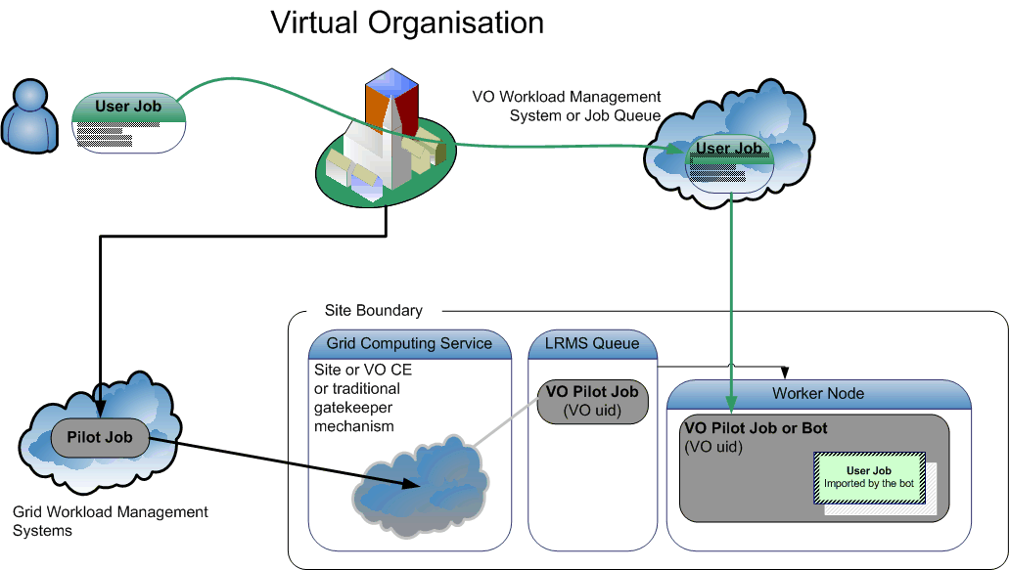
VO overlay networks: MUPJ

Slide 18
Pros and Cons of MUpilot jobs
In current ‘you only see the VO pilot submitter’ model:
Loss of control over scheduling/workload assignment, e.g.
  site admin cannot adjust share of specific user overloading e.g. the Storage Element (only the pilots are seen by the batch system) and might need to:
  ban entire VO instead of user from the SE and/or CE, or
  reduce the entire VO share
  Is that acceptable in case of a non-confirmed incident?
Traceability and incident handling issues
Advantages
you only see & need to configure a single user
It’s not complicated, and no software/config is needed
Extensive summary of technical issues (pros and cons):
https://wlcg-tf.hep.ac.uk/wiki/Multi_User_Pilot_Jobs

Slide 19
Traceability and compromises
In case of security incidents:
  Complete & confirmed compromise is simple: ban VO
  In case of suspicion: to ban or not to ban, that’s the question
    There is no ‘commensurate’ way to contain compromises
    Do you know which users are inside the VO?
    No: the list is largely private
    No: it takes a while for a VO to respond to ‘is this user known’?
    No: the VO will ban user only in case they think (s)he is malicious – that may be different from your view, or from the AIVD’s view, or ...
    So: the VO may or may not block
    The site is left in the cold: there is no ‘easy’ way out except blocking the entire VO, which then likely is not ‘acceptable’

Slide 20
Traceability and compromises
Protecting user payload, other users, and the pilot framework itself from malicious payloads
  To some extent a problem for the VO framework, not for the site
  Not clear which payload caused the problem: all of them are suspect
  User proxies (when used) can be stolen by rogue payloads
  … or the proxy of the pilot job submitter itself can be stolen
  Risk for other user to be held legally accountable
Helps admins understand which user is causing a problem
Sites may need proof of the identity of who was
(or is about to!) use the resources at any time,
in particular the identities involved in any ongoing incidents
  Information supplied by the VO may be (legally) insufficient or too late
  Privacy laws might hamper the flow of such information

Slide 21
Recovering control

Slide 22
Recovering control: policy
Policy on MUPJ
  https://edms.cern.ch/document/855383
  Implemented to varying degrees
  Actual policy requires use of fine-grained control tools
Document-based reviews of LHC VO frameworks
  A wLCG working group reviewed the LHC VO frameworks based on documents (or slideware where no document was available)
  No actual code review was done
  Some frameworks are likely good (security was taken as part of design considerations), others unknown (but trivial exploits closed down after public demonstrations)

Slide 23
wLCG MUPJ Policy 1.0
1. Before submitting pilot jobs to a Site the VO must have approval from the Grid and from that Site.
2. Each pilot job must be the responsibility of one of a limited number of authorised and registered members of the VO. The VO is responsible for implementing a process for authorising pilot job owners and ensuring that they accept the conditions laid down here. The pilot job owner and the VO on behalf of whom the job is submitted are held responsible by the Grid and by the Site for the safe and secure operation of the pilot job and its associated user job(s).
3. The pilot job must only execute user jobs belonging to registered and authorised members of the VO.
4. The pilot job framework must meet the fine-grained monitoring and control requirements defined in the Grid Security Traceability and Logging policy. The use of gLexec in identity switchingmode is one solution that meets these needs.
5. The pilot job must use the approved system utility to map the application and data files to the actual owner of the workload and interface to local Site authorization, audit and accounting services. The owner of the user job is liable for all actions of that user job.
6. The pilot job must respect the result of any local authorisation and/or policy decisions, e.g. blocking the running of the user job.
7. The pilot job must not attempt to circumvent job accounting or limits placed on system resources by the batch system, for example the execution of more parallel jobs than allowed.
8. The pilot job framework must isolate user jobs from one another, including any local data files created during execution and any inter-process communication.
9. When fetching a user job and credentials into the worker node, the pilot job must use means at least as secure as the original pilot job submission process.
10. The Grid and/or the Sites reserve the right to terminate any pilot jobs and associated user jobs that appear to be operating beyond their authorisation and/or are not in compliance with this policy. Other possible consequences include blacklisting of users or the VO as a whole.
11. The VO and/or pilot job owner must produce and keep audit logs, as defined in the Grid Security Traceability and Logging policy, and must assist Grid Security Operations in security incident response.
12. The VO must make a description of the architecture, the security model and the source code of their pilot job system available to Grid Security Operations and/or Sites on request.

Slide 24
Liabilities
General statements on liability are hard to make
  Dutch law is purposefully vague
  Artikel 54a WvS today may provide some protection:
  ”Een tussenpersoon die een telecommunicatiedienst verleent bestaande in de doorgifte of opslag van gegevens die van een ander afkomstig zijn,
  wordt als zodanig niet vervolgd indien hij voldoet aan een bevel van de officier van justitie, na schriftelijke machtiging op vordering van de officier van justitie te verlenen door de rechter-commissaris, om alle maatregelen
  te nemen die redelijkerwijs van hem kunnen worden gevergd om de gegevens ontoegankelijk te maken.“
  but we still don’t know whom to block to prevent it from re-occuring
  and it covers data, but not the offering of compute or network services
  And then that is not the only relevant piece of text ...
    are we doing enough for ‘due diligence’ ?
    are we able to control and restrict illegal use of resources?
    even when its illegal just in,e.g., NL, FR, DE, but fine elsewhere?

Slide 25
Recovering control: mechanisms
Unix-level sandboxing
  POSIX user-id and group-id mechanisms for protection
  Enforced by the ‘job accepting elements’:
    Gatekeeper in EGEE (Globus and lcg-CE), TeraGrid and selected HPC sites
    Unicore TSI
    gLite CREAM-CE via sudo
VM sandboxing
  Not widely available yet
... a slight technical digression on (1) follows ...

Slide 26
Submission via a Gatekeeper
Traditional job submission scenario, model ‘gatekeeper’
change of credentials at the site edge
networked service (‘gatekeeper’) with super-user privileges
job management in a per-user account (be it for single or multiple jobs)

Slide 27
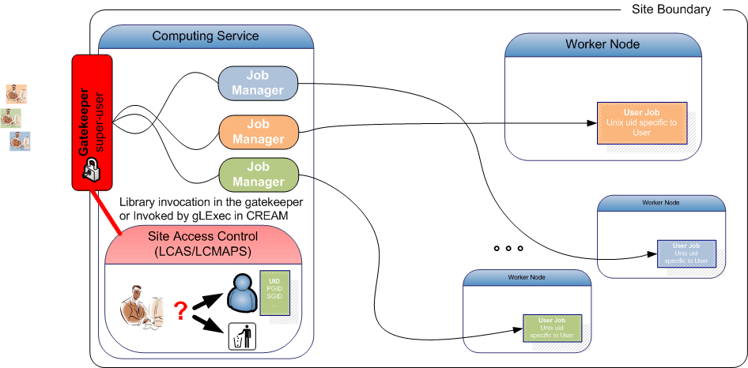
Implementing mapping: LCMAPS

Slide 28
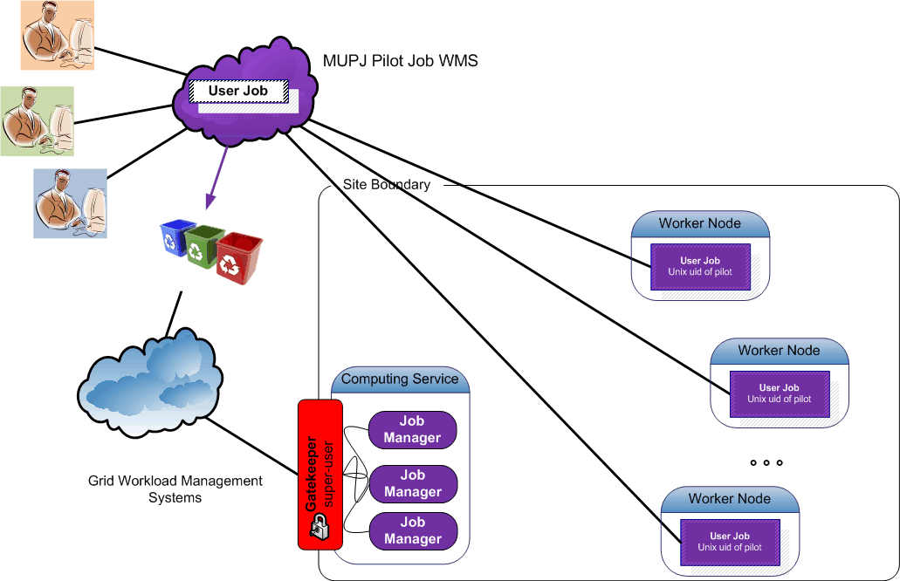
Pushing access control downwards
Multi-user pilot jobs hiding in the classic model

Slide 29
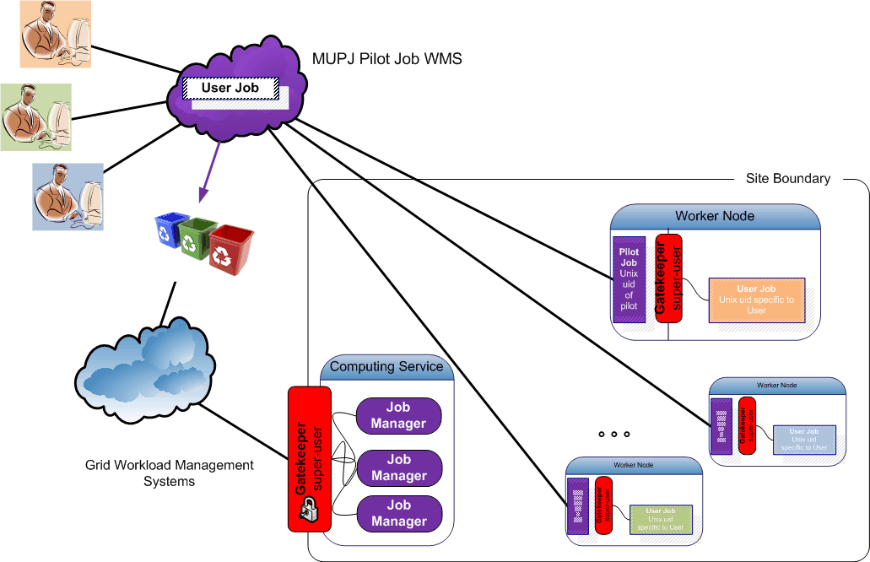
Pushing access control downwards
Making multi-user pilot jobs explicit with distributed
Site Access Control (SAC)
- on a cooperative basis -

Slide 30
Recovering Control
Make pilot job subject to normal site policies for jobs
VO submits a pilot job to the batch system
  the VO ‘pilot job’ submitter is responsible for the pilot behaviour
this might be a specific role in the VO, or a locally registered ‘special’ user at each site
  Pilot job obtains the true user job,
  and presents the user credentials and the job
  (executable name) to the site (glexec) to request a decision on a cooperative basis
Preventing ‘back-manipulation’ of the pilot job
  make sure user workload cannot manipulate the pilot
  project sensitive data in the pilot environment (proxy!)
by changing uid for target workload away from the pilot

Slide 31
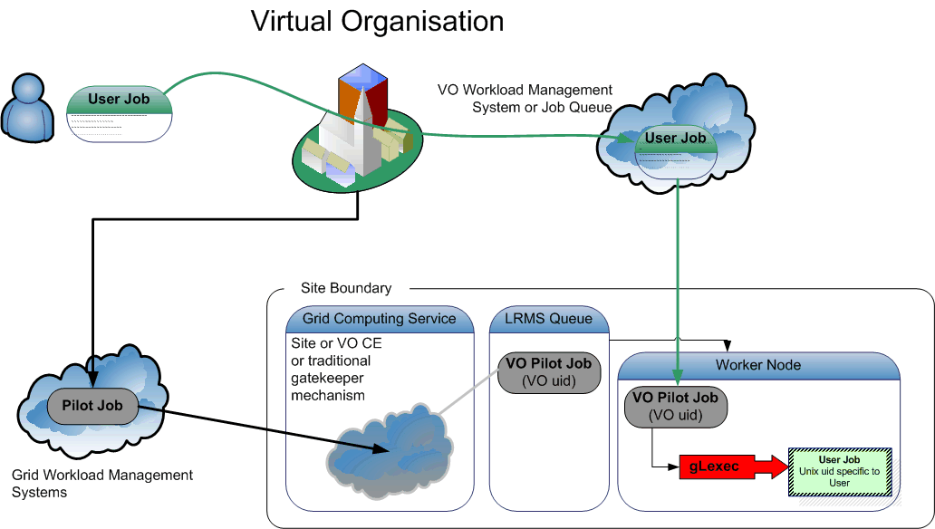
Recovering control: gLExec

Slide 32
gLExec

Slide 33
What is gLExec?
gLExec
a thin layer
to change Unix domain credentials
based on grid identity and attribute information
you can think of it as
‘a replacement for the gatekeeper’
‘a griddy version of Apache’s suexec’
‘a program wrapper around LCAS, LCMAPS or GUMS’

Slide 34
What gLExec does …
User grid credential
(subject name, VOMS, …)
command to execute
current uid allowed to execute gLExec
cryptographically protected
by CA or VO AA certificate
gLExec
Authorization (‘LCAS’)
check white/blacklist
VOMS-based ACLs
is executable allowed?
…
Credential Acquisition
voms-poolaccount
localaccount
GUMS, …
‘do it’
LDAP account
posixAccount
AFS, …
LCMAPS
Execute command with arguments
as user (uid, pgid, sgids … )

Slide 35
Sources of gLExec
A History of gLExec
  Taken from apache suexec(8)
  Modified for certificate parsing and LCMAPS
  Added more restrictions to execution environment
    Start with minimal permissions
    On request of end-users, review each requested feature
    Like allowing execution of symlinks (or /bin/sh does not work on a linux system ...)
  Early alpha code-reviewed by UW-Madison MIST team
    Asset-based review, looking for exploitable code
    By the time they finished, the root-exploitable vulnerabilities found has already disappeared ...
  Additional source review by PSNC (Poznan) people

Slide 36
gLExec, early deployments
Deployed in Autumn 2008 at FNAL
  Driven by urgent need to comply with DoE regulatory constraints
  Resulted in lots of interoperability and code testing
  Deployed on productions systems since end 2008
EGEE PPS and production deployment
  Nikhef, IN2P3 Lyon, FZK, various T2s in UK
  Focus in install-ability – but picked on purpose widely varying sites (including one where the system administrators did not have root access ...)

Slide 37
Built-in controls (1)
Configuration and start-up
  Configuration file must be protected
  $PATH is reset regardless, to compiled-in default
  All environment is cleaned, except for designated variables TZ,X509_USER_PROXY, GLEXEC_* and those specified in config
On invocation
  Invoking ruid and rgid must be registered users
  Invoking ruid must be in white list (from config file) or must be member of compiled-in access group
  Invoking user must have a valid proxy cert
  Uses privilege separation (also for reading source files)

Slide 38
Built-in controls (2)
Identity switching
  New uid and gids must be larger than compiled-in minimum
  Regardless of mapping source, target uid must not be 0
  Target username and group must be reasonable and must exist
Installing the proxy cert of the target user
  Write with target credentials
  Does not write to symlinks
  Only re-writes proxy files as the target user itself
  (switches euid/egids before writing)
  Permissions on target proxy are always 0600

Slide 39
Built-in controls (3)
Invocation of payload
  Target proxy must either exist and be owned by target user, or directory must be owned by target uid
  Neither CWD nor target program must not be writable by others, and target program must not be setuid
  CWD and program must be owned by either invoker or target user, or by root
  Glexec can linger around to manage process, or just execve it (but then you do not get usage statistics at the end)

Slide 40
gLExec deployment modes
Identity Mapping Mode – ‘just like on the CE’
  have the VO query (and by policy honour) all site policies
  actually change uid based on the true user’s grid identity
  enforce per-user isolation and auditing using uids and gids
  requires gLExec to have setuid capability
Non-Privileged Mode – declare only
  have the VO query (and by policy honour) all site policies
  do not actually change uid: no isolation or auditing per user
  the gLExec invocation will be logged, with the user identity
  does not require setuid powers – job keeps running in pilot space
‘Empty Shell’ – do nothing but execute the command…

Slide 41
Pieces of the solution
VO supplied pilot jobs must observe and honour
  the same policies the site uses for normal job execution
  (e.g. banned individual users)
Three pieces that go together:
glexec on the worker-node deployment
  the mechanism for pilot job
  to submit themselves and their payload to site policy control
  give ‘incontrovertible’ evidence of who is running on which node at any one time (in mapping mode)
    gives ability to identify individual for actions
    by asking the VO to present the associated delegation for each user
  VO should want this
    to keep user jobs from interfering with each other, or the pilot
    honouring site ban lists for individuals may help in not banning the entire VO in case of an incident

Slide 42
Pieces of the solution
glexec on the worker-node deployment
keep the pilot jobs to their word
  mainly: monitor for compromised pilot submitters credentials
  process or system call level auditing of the pilot jobs
  logging and log analysis
gLExec cannot to better than what the OS/batch system does
  ‘internal accounting should now be done by the VO’
    the regular site accounting mechanisms are via the batch system, and these will see the pilot job identity
    the site can easily show from those logs the usage by the pilot job
    accounting based glexec jobs requires a large and unknown effort
  time accrual and process tree remain intact across the invocation
    but, just like today, users can escape from both anyway!

Slide 43
Installation
Actually only identity mapping mode really helps
  Otherwise
  back-compromise (and worm infections) remain possible
  attributing actions to users on WN is impossible
  (that needs a uid change)

Slide 44
Starting and Killing Jobs
The batch system performs the following basic functions
Job Submission
Job Suspend/Resume
Job Kill
CPU time accounting
does not yet address enforcing sanity and user compliance
from the test description of Ulrich Schwickerath

Slide 45
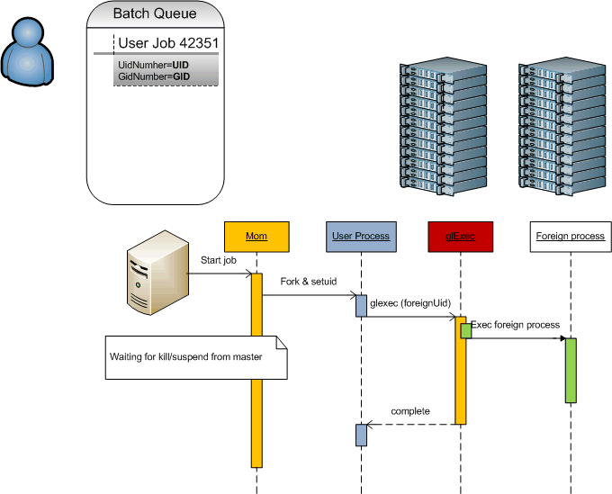
Starting and Killing Jobs

Slide 46
Testing it
Can batch system suspend/kill the gLExec’ed processes?
Test using gLExec itself
  Most ‘true’ tests
  Requires installation of gLExec and all dependencies
Test using the sutest mini programme
  Same logic, but a stand-alone small (50-line) C programme
  No dependencies
  A few hard-coded constants to be set before compilation
  Trivial to test

Slide 47
Session Preservation
$ date && ps --forest -eo pid,ppid,sess,user,uid,euid,cmd
Fri Feb 8 14:02:41 CET 2008
PID PPID SESS USER UID UID CMD
3294 1 3294 root 0 0 /usr/sbin/pbs_mom
18668 3294 18668 davidg 502 502 \_ -bash
18713 18668 18668 davidg 502 502 \_ /bin/sh …/jobs/33.tbn05.ni.SC
18715 18713 18668 nobody 99 99 \_ /project/sutest /bin/sleep 120
18716 18715 18668 nobody 99 99 \_ /bin/sleep 120
...
... and Torque will kill all processes in the tree:
$ date && qsub -q test tmp/tt.pbs
Fri Feb 8 14:02:21 CET 2008
33.tbn05.nikhef.nl
tbn05:~:1018$ cat tmp/tt.pbs
#! /bin/sh
date
/project/sutest /bin/sleep 120
date
All vanishes after a ‘qdel 33’ …

Slide 48
CPU accounting
No change with respect to current behaviour of jobs
Times are accumulated on wait and collated with the gLExec usage

Slide 49
Forcing havoc on yourself
$ ( date && ./sutest /bin/sleep 60 && date )
Fri Feb 8 16:41:24 CET 2008
Notice: identity changed to uid 99
...
7508 1 7508 root 0 /usr/sbin/sshd
32122 7508 32122 root 0 \_ sshd: davidg [priv]
32124 32122 32122 davidg 502 | \_ sshd: davidg@pts/0
32126 32124 32126 davidg 502 | \_ -bash
17001 32126 32126 davidg 502 | \_ -bash
17003 17001 32126 nobody 99 | \_ ./sutest /bin/sleep 60
17004 17003 32126 nobody 99 | \_ /bin/sleep 60
# kill -9 17001
Killed
17003 1 32126 nobody 99 99 ./sutest /bin/sleep 60
17004 17003 32126 nobody 99 99 \_ /bin/sleep 60

Slide 50
Cleaning up files
File cleanup: what do sites use today?
Check for files owner by users not currently running a job?
  Who ‘is running’ becomes ill defined
  Need a ‘back-mapping’ tool that can trawl log files or a state dir
tmpwatch(8) for old files?
  Change of uid does not influence this solution
Transient TMPDIR facilities (PBSPro, Torque 2+)?
  Runs with root privileges anyway
  TMPDIR is inherited by the gLExec’ed child
  And is thus unaffected by gLExec
  will be cleaned as intended

Slide 51
Pruning stray processes
Killing stray user processes
‘not owned by a user with a currently running process’
  E.g. used at CERN/LSF
  Need a ‘back-mapping’ tool that can trawl log files or a state dir
  But: is not trustworthy to begin with on multi-job-slot machines!
Kill processes that are ‘too old’
  Will run as root anyway
  Unaffected, but is not trustworthy either
Kill processes not ‘parented’ in a batch job
  gLExec will preserve the process tree, and thus this will work
  Will also slaughter daemonizing jobs today … a Good Thing™

Slide 52
Pruning User Processes
https://www.nikhef.nl/grid/sysutils/prune_users/
For Torque in perl (simple migration to other systems)
Kill processes that are not a child of a registered pbs_mom
Uses the momctl command on the node
Caveats
  Will usually not kill processes with a uid < 99
  May optionally preserve top-level sshd sessions (beware of MPI)
  Does not protect against fork bombs

Slide 53
Deployment on a Cluster

Slide 54
Deploying on a Cluster
Let’s assume you make it setuid. Fine. Where to map to:
To a shared set of common pool accounts
  Uid and gid mapping on CE corresponds to the WN
  Requires SCAS or shared state (gridmapdir) directory
  Clear view on who-does-what
To a per-WN set of pool accounts
  No site-wide configuration needed
  Only limited (and generic) set of pool uids on the WN
  Need only as many pool accounts as you have job slots
  Makes cleanup easier, ‘local’ to the node
Or something in between ... e.g. 1 pool for CE other for WN

Slide 55
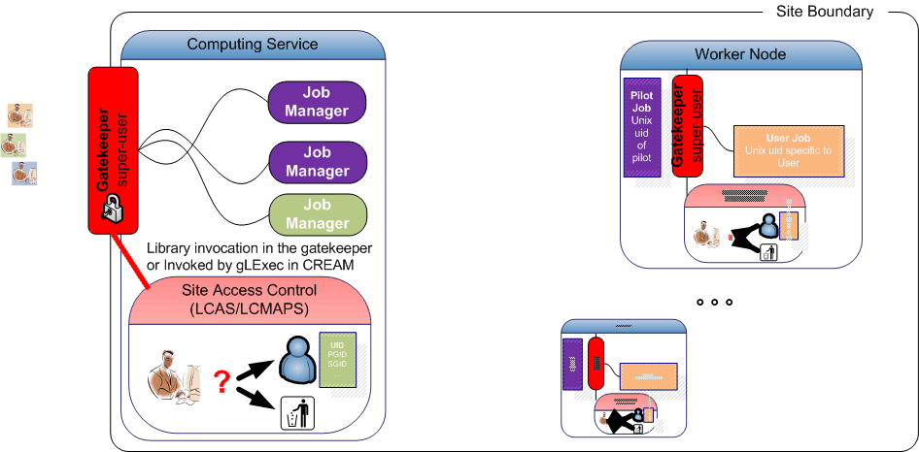
Node-local access control
PRO no single points of failure
well defined number of pool accounts (as many as there are job slots/node)
containment of jobs (no cross-WN infection)
CON need to distribute the policy through fabric management/config tools
no cross-workernode mapping (e.g. no support for pilot-launched MPI)

Slide 56
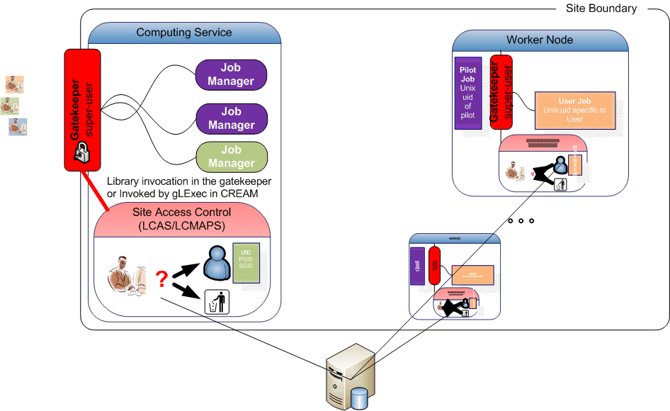
WN-coordinated access control
PRO single unique account mapping per user across whole farm, CE, and SE
transactions database is simple (implemented as an NFS file system)
communications protocol is well tested and well known
CON need to distribute the policy through fabric management config tools
coordination only applies to the account mapping, not to authorization

Slide 57
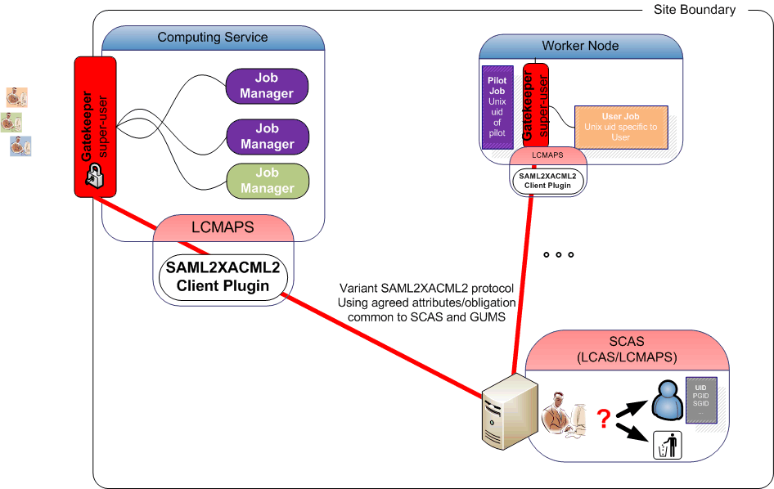
Site-central access control
PRO single unique account mapping per user across whole farm, CE, and SE*
can do instant banning and access control in a single place
protocol profile allows interop between SCAS and GUMS (but no others!)
CON replicated setup for redundancy needed for H/A sites
still cannot do credential validation (formal issues with the protocol)
* of course, central policy and distributed
per-WN mapping also possible!

Slide 58
Centralizing decentralized SAC
Supporting consistent
policy management
mappings (if the are not WN-local)
banning
via the
Site Central Authorization Service SCAS
  network wrapper around LCAS and LCMAPS
  it’s a variant-SAML2XAML2 client-server
  it is itself access controlled

Slide 59
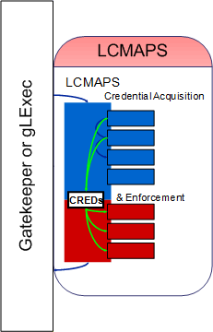
Local LCMAPS
Linked dynamically or statically to application
does both credential acquisition
- local grid map file
- VOMS FAQN to uid and gids
and enforcement
- setuid
- krb5 token requests
- AFS tokens
- LDAP directory update
LCAS is similar is use and design, but makes the basic Yes/No decision

Slide 60
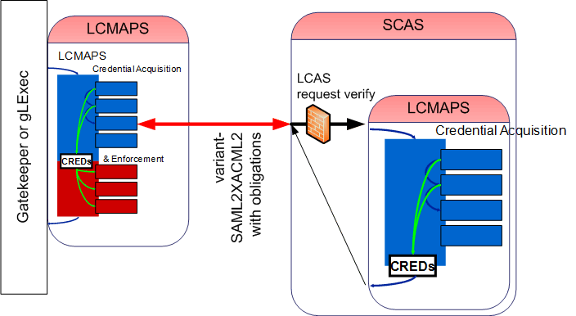
SCAS: LCMAPS in the distance
Application links LCMAPS dynamically or statically, or includes Prima client
Local side talks to SCAS using a variant-SAML2XACML2 protocol
- with agreed attribute names and obligation between EGEE/OSG
- remote service does acquisition and mappings
- both local, VOMS FAQN to uid and gids, etc.
Local LCMAPS (or application like gLExec) does the enforcement

Slide 61
Talking to SCAS
From the CE
  Connect to the SCAS using the CE host credential
  Provide the attributes & credentials of the service requester, the action (“submit job”) and target resource (CE) to SCAS
  Using common (EGEE+OSG+GT) attributes
  Get back: yes/no decision and uid/gid/sgid obligations
From the WN with gLExec
  Connect to SCAS using the credentials
  of the pilot job submitter
  An extra control to verify the invoker of gLExec
  is indeed an authorized pilot runner
  Provide the attributes & credentials of the service requester, the action (“run job now”) and target resource (CE) to SCAS
  Get back: yes/no decision and uid/gid/sgid obligations
The obligations are now coordinated between CE and WNs

Slide 62
Supported services
SCAS communicates based on a few standards and the joint “Authorization Interoperability” profile
  Supported by Globus, gLite 3.x, VDT, OSG
  Defines common naming of obligations such as uid/gid
Compatible software
  Globus gatekeepers, lcg-CE
  gLExec (on WNs and on CREAM-CEs)
  dCache > 1.9.2-4
  GT GridFTP
  GT4.2 WS-GRAM, GRAM5

Slide 63
Towards managed authorization

Slide 64
Central banning
EGEE (and EGI) Operational Security teams will be maintaining a list of all ‘banned’ users
  Rapid reaction (preferably within 6 hrs)
  When consistently deployed, will help contain incidents
Implementations
  Usually done (easily) via standard fabric management
  using service-native tools (LCAS, GACL for WMSes, DB entries for DPM, SAZ via gPlazma where configured)
  For SCAS-enabled services: can be done in one place on the site
  Grid-wide banning without site intervention is not trivially possible today (but could be scripted)

Slide 65
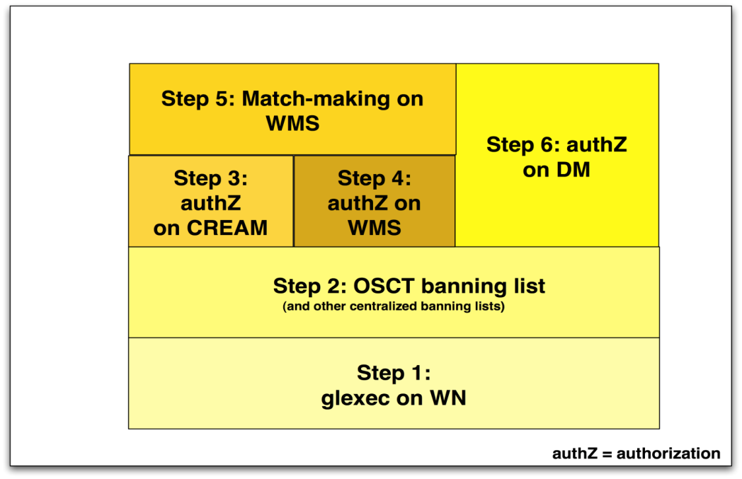
Next? Argus
Creating a homogeneous authZ interface: Argus
  For the moment specific to gLite
  Not in production yet –
  and you really ought to wait for release >= 1.1
  which is due to start certification on Jan 15th, 2010
  Supports distributed policy administration and automatic propagation of the ban list
  Phased deployment foreseen
Deployment
scheduled
for EGEE-III

Slide 66
Deployment options
Argus and SCAS can be deployed ...
  As alternatives (when Argus is complete)
  In parallel, at the service side
  In sequence, with SCAS fronting it
For the moment, though, Argus is only certified for the gLExec-on-WN use case

Slide 67
Conclusions

Slide 68
Conclusions
Grid access model has changed fundamentally with the introduction of MUPJs
  Both benefits and drawbacks to the new situation
  But this reality cannot be ignored, nor banned
There are good reasons to retain control
  Ability to react commensurately
  Implementation of site-local or national controls
  Systems-operational reasons
Regaining control through both of:
  Policy: JSPG MUPJ policy document, reviews
  Systems tooling: gLExec-on-WN in mapping mode
  Monitoring: compliance verification of VO
Deployment: locally, site-centralised, or ...

Slide 69
Questions?

