Slide 1

Distributed Access Management
Recovering control over compute
in the wake of community-run scheduling services
David Groep, Nikhef

Slide 2
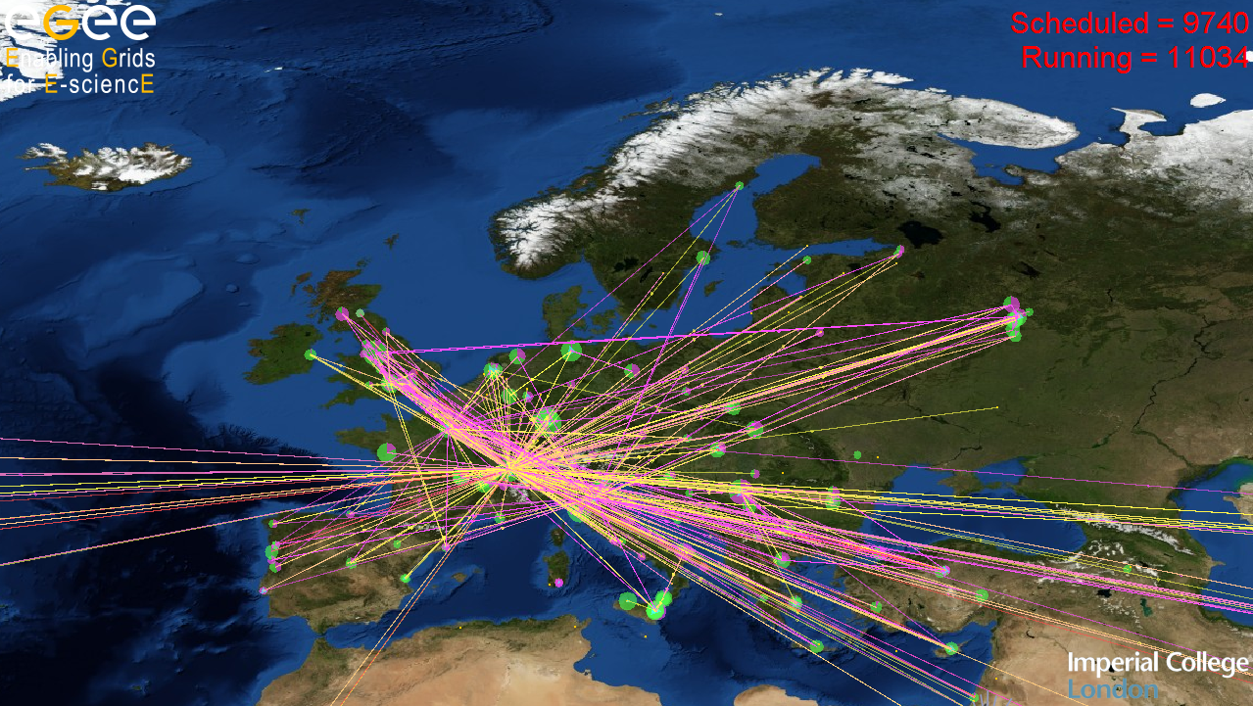
Overview
Grid ‘infrastructure’ view
Workload model are changing
  ‘traditional’ job submission models and brokering
  VO-centric workload management and multi-user pilot jobs
  impact on traceability and incident handling
Recovering control
  policy actions and liability; containing mechanisms
  Distributing your control point: gLExec
  sources and early deployments
Towards integrated authorization – choices to make

Slide 3
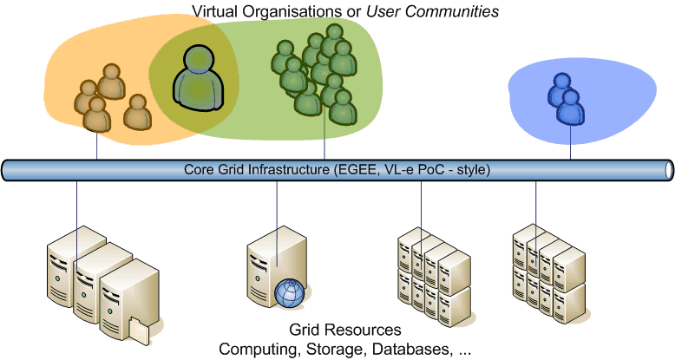
e-Infrastructure model for Grid
Users and user communities, sites and resources
where do you schedule your work?
Policy Coordination: User and VO AUPs, operations, trust, enabling AAA
Access negotiation: VO meta-data, ACLs, operational environment needs
Submitting work: user pushes work to the resource selected

Slide 4
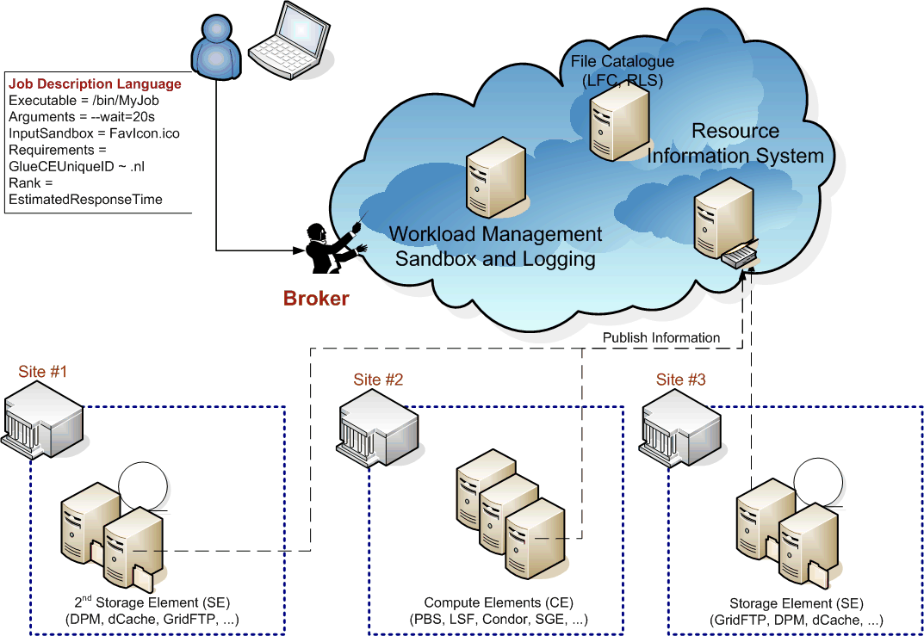
Job Submission Scenario

Slide 5
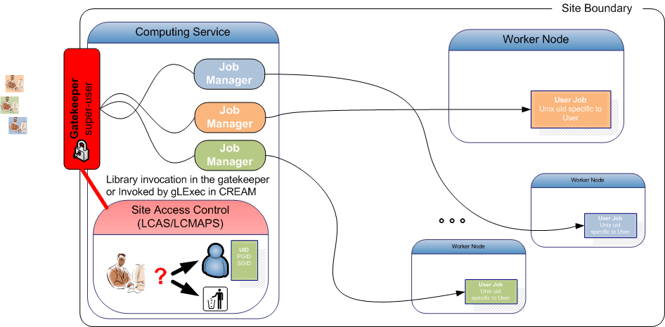
Securing the entrance
Resource boundary –
Enforcing access control
Graphics:
OGSA 1.0 GFD
Frank Siebenlist, Globus and ANL

Slide 6
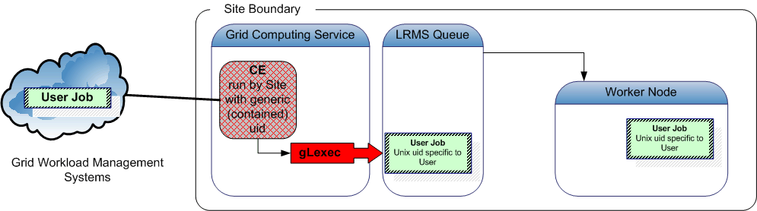
Classic job submission models
In the submission models shown, submission of the
user job to the batch system is done
with the original job owner’s mapped (uid, gid) identity
grid-to-local identity mapping is done only on the front-end system (CE)
  batch system accounting provides per-user records
  inspection shows Unix process on worker nodes and in batch queue per-user

Slide 7
Late binding: pilot jobs
Job submission gets more and more intricate …
Late binding of jobs to job slots via pilot jobs
some users and communities develop and prefer to use
proprietary, VO or user specific scheduling & job management
  ‘visible’ job is a placeholder that downloads a real job
  the placeholders first establish an overlay network
  subsequent scheduling and starting of jobs is faster
  placeholder is not committed to any particular task on launch
  perhaps not even bound to a particular user!
Scheduling within this overlay is orthogonal to site-provided systems

Slide 8
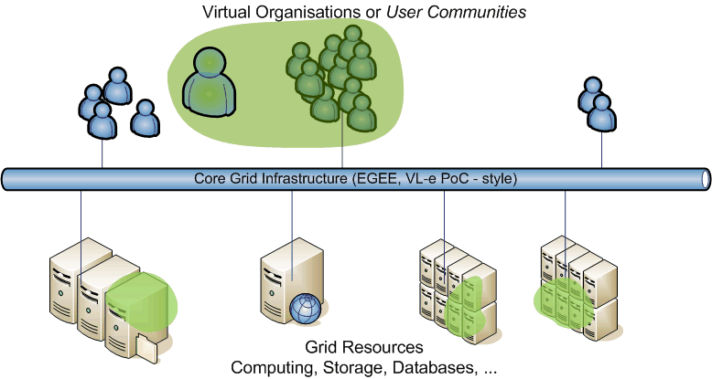
User or VO overlay network

Slide 9
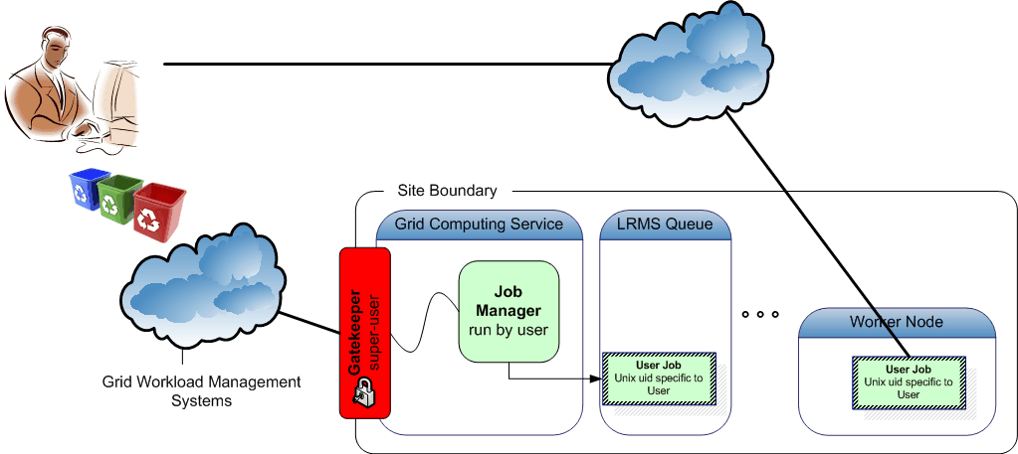
Every user a pilot: nothing really new
‘User WMS’
This is happening today if you allow (outbound) network connections!
Indistinguishable from ‘apparent’ use of your resources
But does introduce additional attack surfaces (the user WMS)

Slide 10
Pilot job incentives
Some Pros:
Worker node validation and matching to task properties
Intra-VO priorities can be reshuffled on the fly
without involving site administrators
Avoid jobs sitting in queues when they could run elsewhere
From: https://wlcg-tf.hep.ac.uk/wiki/Multi_User_Pilot_Jobs
For any kind of pilot job:
  Frameworks such as Condor glide-in, DIRAC, PANDA, … or Topos, are popular, because they are ‘easy’ (that’s why there are so many of them!)
  Single-user pilot jobs are no different than other jobs
  when you allow network connections to and from the WNs
  Of course:
  any framework used to distribute payload gives additional attack surface

Slide 11
Multi-user pilot jobs
All pilot jobs are submitted by a single (or a few) individuals from a user community (VO)
  Creating an overlay network of waiting pilot jobs
VO maintains a task queue to which people
(presumably from the VO) can submit their work
Users put their programs up on the task queue
Pilot jobs on the worker node looks for work from that task queue to get its payload
Pilot jobs can execute work for one or more users in sequence, until wall time is consumed

Slide 12
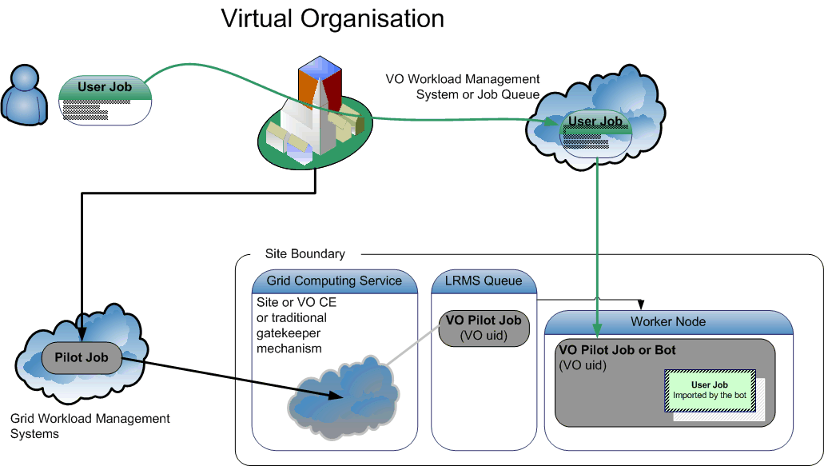
VO overlay networks: MUPJ

Slide 13
Pros and Cons of MUpilot jobs
In current ‘you only see the VO pilot submitter’ model
Loss over control on who gets to use your site
Loss of control over scheduling/workload assignment,
  site admin cannot adjust share of specific user overloading e.g. the Storage Element (only the pilots are seen by the batch system) and might need to:
  ban entire VO instead of user from the SE and/or CE, or
  reduce the entire VO share
  Is that acceptable in case of a non-confirmed incident?
Traceability and incident handling issues
Also some apparent advantages for providers
you only see & need to configure a single user
Needs no software or config – since the VO does that ...
Extensive list of technical issues (both pros and cons)
https://wlcg-tf.hep.ac.uk/wiki/Multi_User_Pilot_Jobs

Slide 14
Traceability and compromises
Post-factum: in case of security incidents:
  Complete & confirmed compromise is simple: ban VO
  In case of suspicion: to ban or not to ban, that’s the question
    There is no ‘commensurate’ way to contain compromises
    Do you know which users are inside the VO?
    No: the list is largely private
    No: it takes a while for a VO to respond to ‘is this user known’?
    No: the VO will ban user only in case they think (s)he is malicious – that may be different from your view, or from the AIVD’s view, or ...
    So: the VO may or may not block
    The site is left in the cold: there is no ‘easy’ way out except blocking the entire VO, which then likely is not ‘acceptable’

Slide 15
Traceability and compromises
Ante-factum requirements
Sites may need proof of the identity of who was
(or is about to!) use the resources at any time,
in particular the identities involved in any ongoing incidents
Information supplied by the VO may be (legally) insufficient or too late
Privacy laws might hamper the flow of such information back and forth
  c.f. the German government’s censorship bill, with the list of domains that
  a DNS server must block, but which cannot be published by the enforcing ISP
  Or other government requirements or ‘requests’ that need to be cloaked

Slide 16
Traceability and compromises
Protecting user payload, other users,
and the pilot framework itself from malicious payloads
  To some extent a problem for the VO framework, not for the site
  Not clear which payload caused the problem: all of them are suspect
  User proxies (when used) can be stolen by rogue payloads
  … or the proxy of the pilot job submitter itself can be stolen
  Risk for other user to be held legally accountable
  Cross-infection of users by modifying key scripts and environment of the framework users at each site
  compromise of any user using the MUPJ framework ‘compromises’ the entire framework
Seeing distinguished users helps site administrators
to understand which user is causing a problem and remedy

Slide 17
Recovering Control
Policy
Cooperation
Tools

Slide 18
Recovering control: policy
Draft a Policy and try to ensure compliance
  E.g. in EGEE https://edms.cern.ch/document/855383
  Implemented to varying degrees
  Actual policy requires use of fine-grained control tools
Collaboration with the VOs and frameworks
You cannot do without them!
  Vulnerability assessment of the framework software
  Work jointly to implement and honour controls
  Where relevant: ‘trust, but verify’
Provide middleware control mechanisms
  Supporting site requirements on honouring policy
  Support Vos in maintaining framework integrity
  Protect against ‘unfortunate’ user mistakes

Slide 19
Recovering control: mechanisms
Unix-level sandboxing
  POSIX user-id and group-id mechanisms for protection
  Enforced by the ‘job accepting elements’:
    Gatekeeper in EGEE (Globus and lcg-CE), TeraGrid and selected HPC sites
    Unicore TSI
    gLite CREAM-CE via sudo
VM sandboxing
  Not widely available yet
  Only helps either the VO or the site, but not both
  since VMs cannot (yet) be nested
... a slight technical digression on (1) follows ...

Slide 20
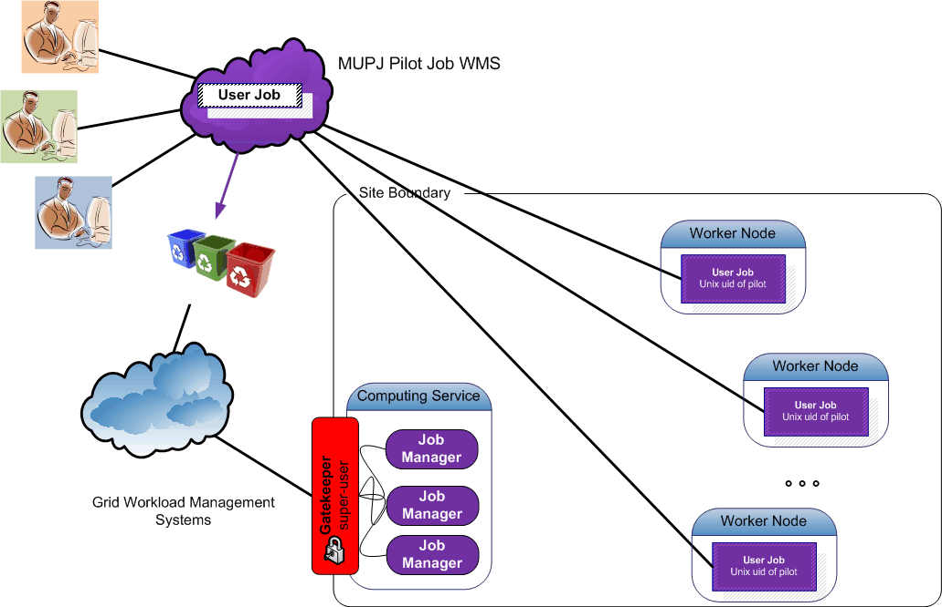
Pushing access control downwards
Multi-user pilot jobs hiding in the classic model

Slide 21
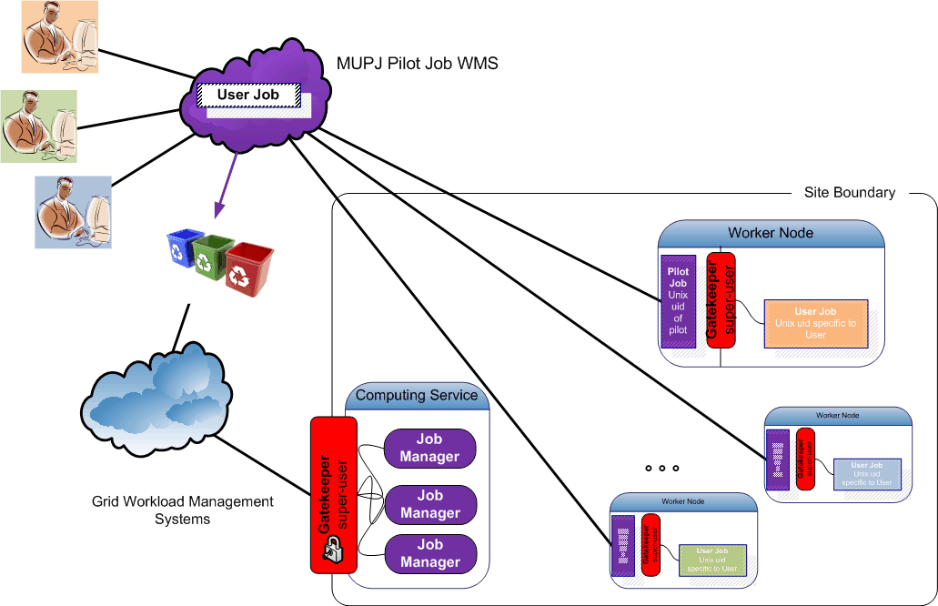
Pushing access control downwards
Making multi-user pilot jobs explicit with distributed
Site Access Control (SAC)
- on a cooperative basis -

Slide 22
Recovering Control
Make pilot job subject to normal site policies for jobs
VO submits a pilot job to the batch system
  the VO ‘pilot job’ submitter is responsible for the pilot behaviour
this might be a specific role in the VO, or a locally registered ‘special’ user at each site
  Pilot job obtains the true user job,
  and presents the user credentials and the job
  (executable name) to the site (glexec) to request a decision on a cooperative basis
Preventing ‘back-manipulation’ of the pilot job
  make sure user workload cannot manipulate the pilot
  project sensitive data in the pilot environment (proxy!)
by changing uid for target workload away from the pilot

Slide 23
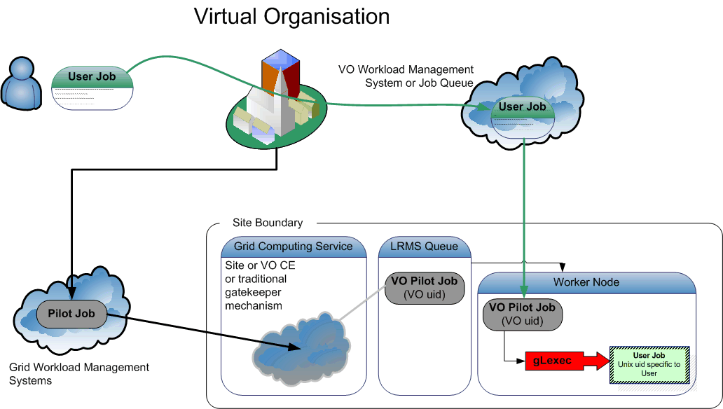
Recovering control: gLExec

Slide 24
What is gLExec?
gLExec
a thin layer
to change Unix domain credentials
based on grid identity and attribute information
you can think of it as
‘a replacement for the gatekeeper’
‘a griddy version of Apache’s suexec’
‘a program wrapper around LCAS, LCMAPS or GUMS’

Slide 25
What gLExec does …
User grid credential
(subject name, VOMS, …)
command to execute
current uid allowed to execute gLExec
cryptographically protected
by CA or VO AA certificate
gLExec
Authorization (‘LCAS’)
check white/blacklist
VOMS-based ACLs
is executable allowed?
…
Credential Acquisition
voms-poolaccount
localaccount
GUMS, …
‘do it’
LDAP account
posixAccount
AFS, …
LCMAPS
Execute command with arguments
as user (uid, pgid, sgids … )

Slide 26
Pieces of the solution
VO supplied pilot jobs must observe and honour
  the same policies the site uses for normal job execution
  (e.g. banned individual users)
Three pieces that go together:
glexec on the worker-node deployment
  the mechanism for pilot job
  to submit themselves and their payload to site policy control
  give ‘incontrovertible’ evidence of who is running on which node at any one time (in mapping mode)
    gives ability to identify individual for actions
    by asking the VO to present the associated delegation for each user
  VO should want this
    to keep user jobs from interfering with each other, or the pilot
    honouring site ban lists for individuals may help in not banning the entire VO in case of an incident

Slide 27
Pieces of the solution
glexec on the worker-node deployment
keep the pilot jobs to their word
  mainly: monitor for compromised pilot submitters credentials
  process or system call level auditing of the pilot jobs
  logging and log analysis
gLExec cannot to better than what the OS/batch system does
  ‘internal accounting should now be done by the VO’
    the regular site accounting mechanisms are via the batch system, and these will see the pilot job identity
    the site can easily show from those logs the usage by the pilot job
    accounting based glexec jobs requires a large and unknown effort
  time accrual and process tree remain intact across the invocation
    but, just like today, users can escape from both anyway!

Slide 28
gLExec deployment modes
Identity Mapping Mode – ‘just like on the CE’
  have the VO query (and by policy honour) all site policies
  actually change uid based on the true user’s grid identity
  enforce per-user isolation and auditing using uids and gids
  requires gLExec to have setuid capability
Non-Privileged Mode – declare only
  have the VO query (and by policy honour) all site policies
  do not actually change uid: no isolation or auditing per user
  Pilot and framework remain vulnerable
  the gLExec invocation will be logged, with the user identity
  does not require setuid powers – job keeps running in pilot space
‘Empty Shell’ – do nothing but execute the command…

Slide 29
Installation
Actually only identity mapping mode really helps
  Otherwise
  back-compromise (and worm infections) remain possible unless you change ID or sandbox the payload
  attributing actions to users on WN is impossible
  (that needs a uid change)
  Interesting back-compromises of the entire framework are possible: (.bashrc or .curlrc infections, &c)
But a setuid installation triggers other worries
  Stability and security of the tool itself
  Integration with the scheduling systems
Which choice would you make??

Slide 30
Conclusions
Grid access model changed fundamentally with introduction of MUPJs
  Both benefits and drawbacks to the new situation
  But this reality cannot be ignored, nor banned
There are good reasons to retain control
  Ability to react commensurately
  Implementation of site-local or national controls
  Systems-operational reasons
Regaining control through both of:
  Policy: JSPG policy document, reviews of VO workload management systems
  Systems tooling: gLExec or like tools in strict sandboxing mode
  Monitoring: compliance verification of VO
All the options are there – how do you react to the changed world?

