Slide 1
More resources with fewer clicks!
Notice management by AARC BPA proxies
David Groep
AARC Policy WG
Nikhef and Maastricht University
ACAMP I2 TechEx 2024
December 2024

Slide 2
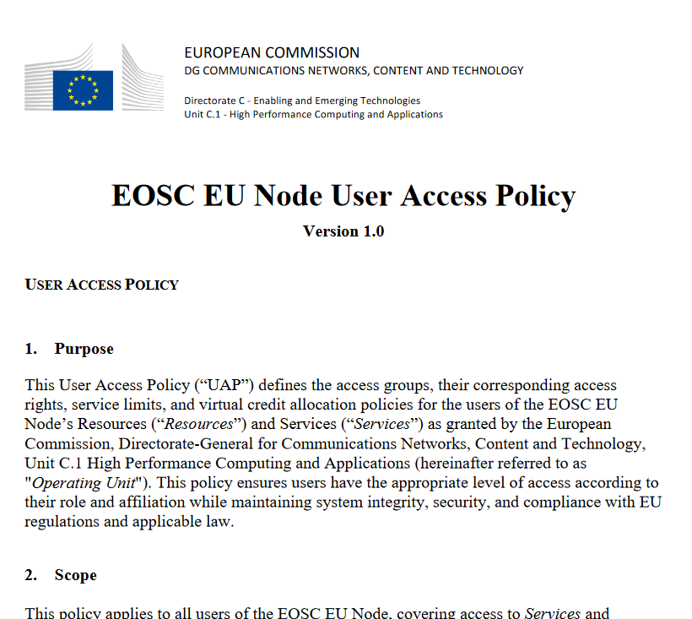
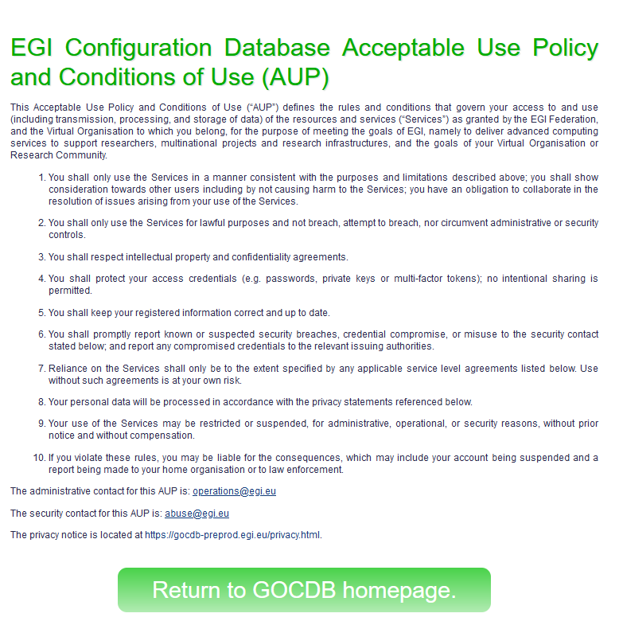
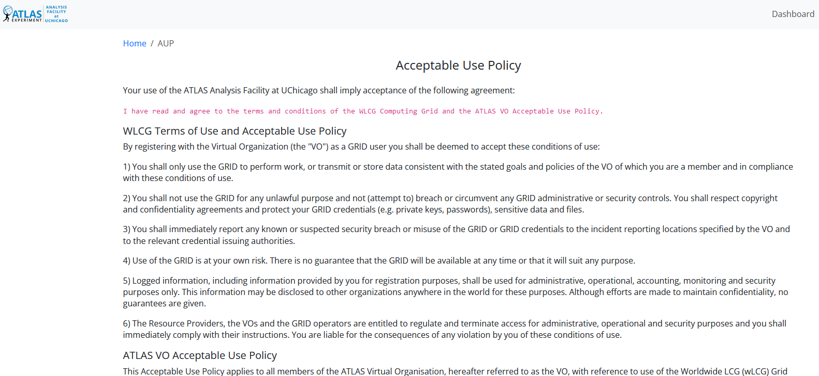
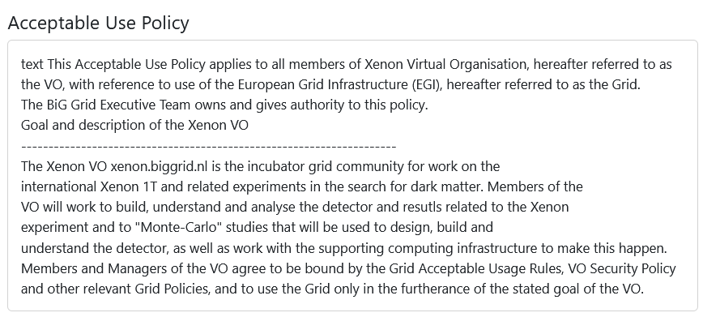
How many of these?

Slide 3

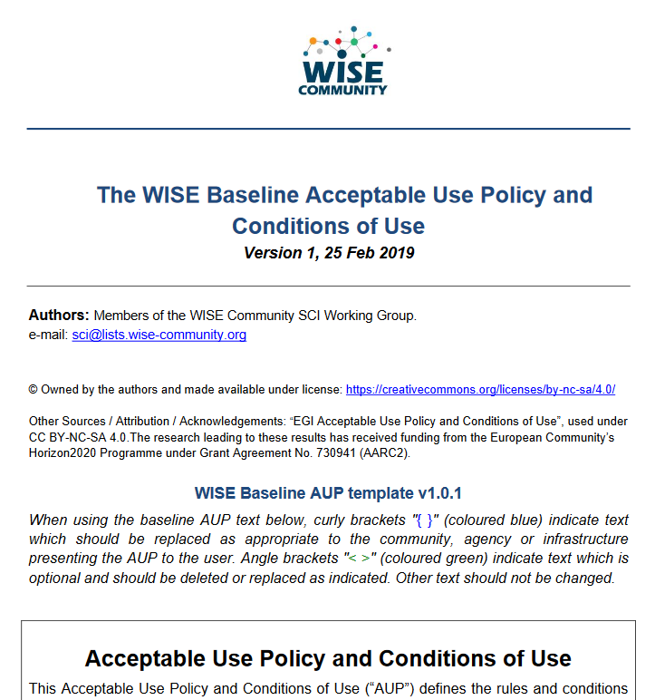
WISE Baseline AUP
Template for a common and cascading AUP and T&C notice
by intent focusses primarily on acceptable use
do not dwell on unintended use
guarantee and service levels are T&Cs, not acceptable use interoperability
Placeholder model for
scope of the AUP (purpose binding)
– mirrored in Service Security operational baseline
10 commandments
placeholder for additional T&Cs
privacy notice references and authority

Slide 4
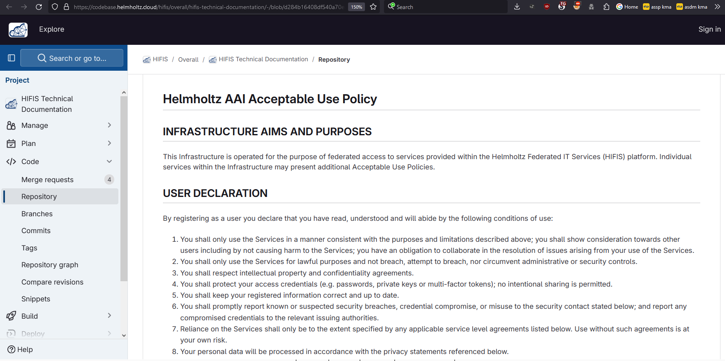
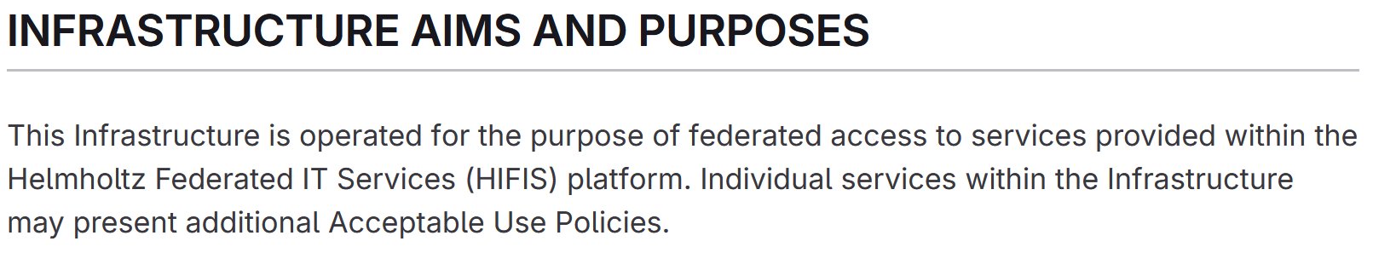
Example: HIFIS AUP

Slide 5

Proxies have more challenges as well: AUPs, T&Cs, Privacy notices, …
For large ‘multi-tenant’ proxies
some subset users in some communities use a set of services –
how to present their Terms and Conditions and their privacy policies, so that users
  only see the T&Cs and notices for services they will access
  this does not to need to be manually configured for each community
  is automatically updated when services join
For community and dedicated proxies
when new (sensitive) services join, who needs to see the new T&Cs?
can we communicate existing acceptance of T&Cs to downstream services?
What is an acceptable user experience in clicking through agreements?
What is effective in exploiting the WISE Baseline AUP? What do researchers need?
‘with fewer clicks to more resources’
beyond AARC-G040

Slide 6
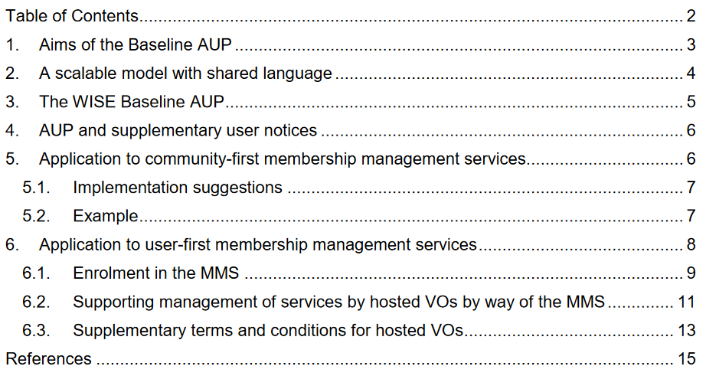
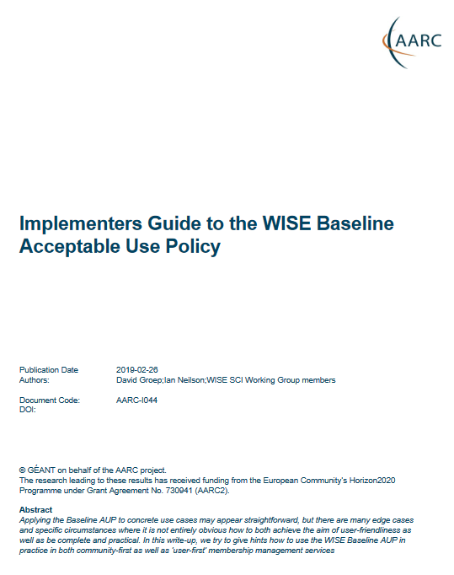
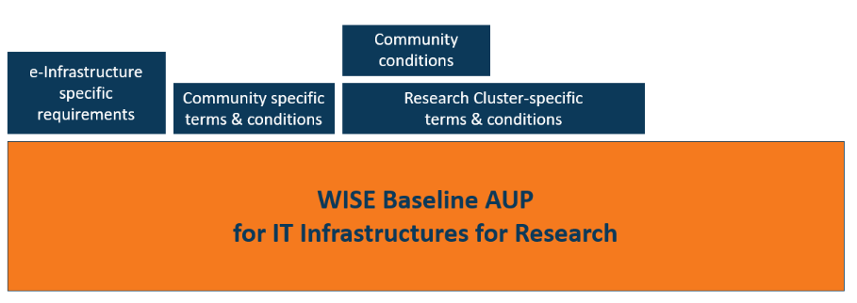
Prior WISE AUP construction guidance: AARC I044
Notice combined in a single document all AUP, terms and conditions, and purpose binding on behalf of both community, infrastructure, and services

Slide 7
Limits to the I044 and G040 model
The introduction of multi-community and multi-tenancy proxies has changed that premise in two ways:
the proxy does not equate the community, with multiple communities being hosted on the same proxy instance, or individuals registering first with the proxy in a generic mode (without specifying the community) and subsequently registering with one or more communities; and
the proxy and the controller (as meant in the EEA GDPR) of access personal data (elaborated below) are not the same entity, and the role of the proxy operator may change over time even for the same user (as the user takes on different roles duing the registration life cycle in the proxy).

Slide 8
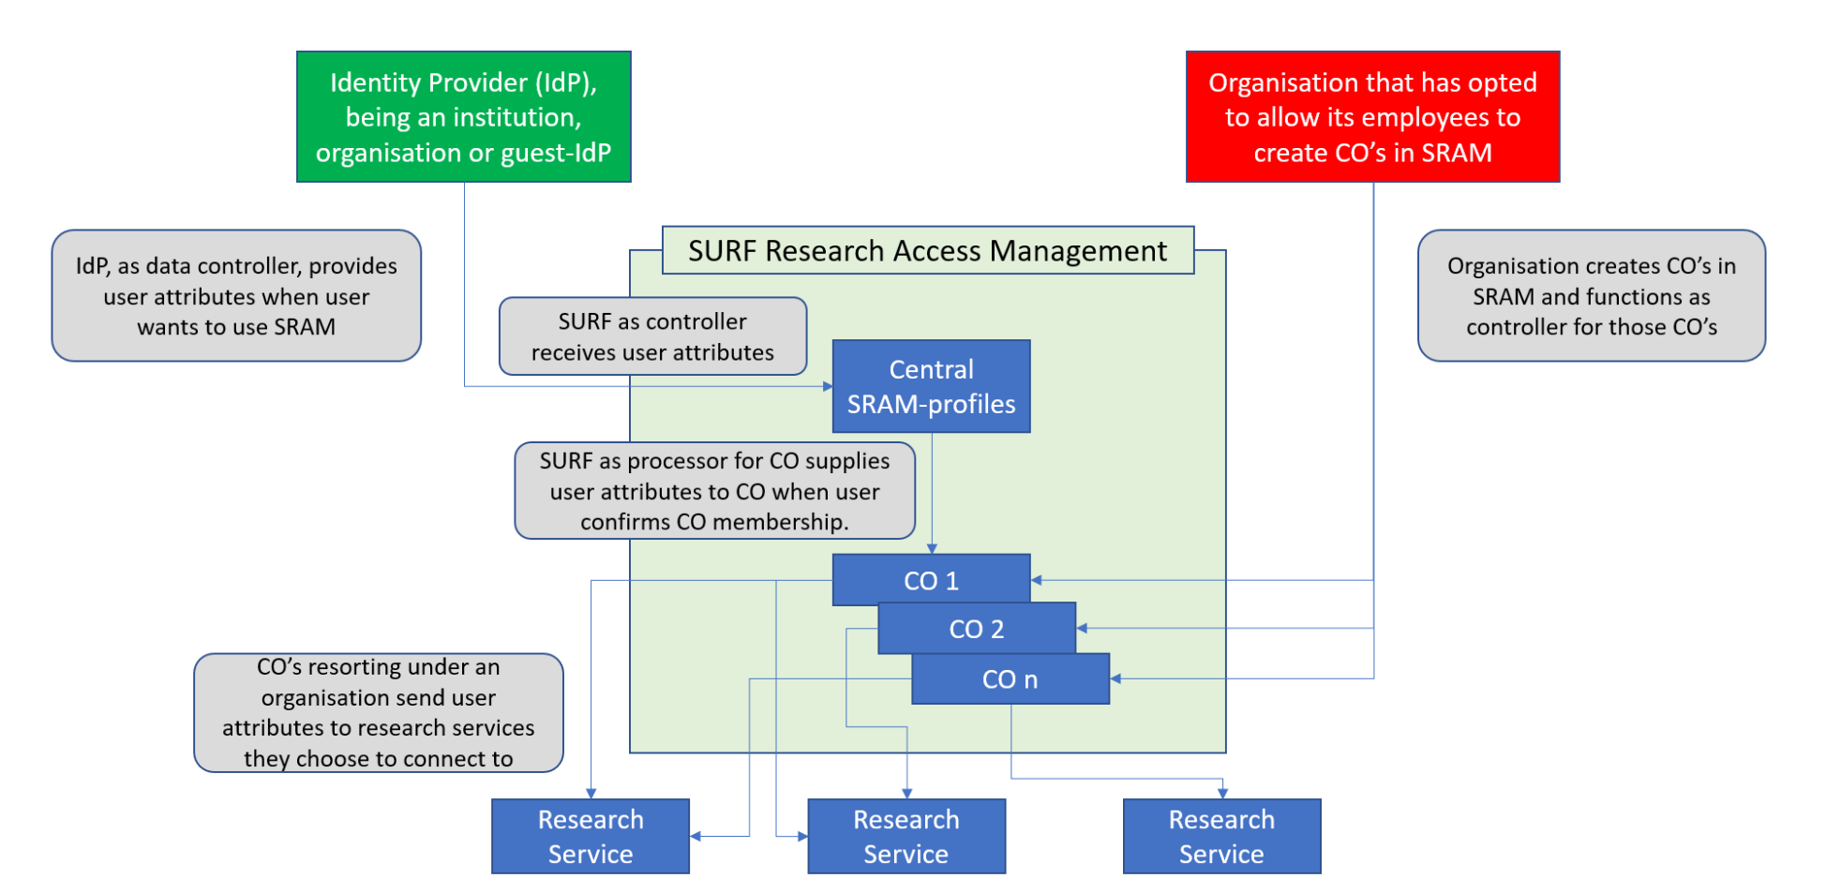
SURF SRAM multi-tenancy proxy and GDPR role assignments

Slide 9
Constraints on the notice management, depending on connected services?
Offline access and non-interactive (brokered) workflows
Activities that occur or continue to execute without user presence may require specific notices to be presented to the user to prevent abuse and unintended consequences. This in particular applies to OIDC flows that use the offline_access scope for requesting refresh tokens, as defined in the OpenID Connect Core specification section 11 (https://openid.net/specs/openid-connect-core-1_0.html#OfflineAccess).
In these cases, the OP (including a proxy) either MUST or SHOULD have explicitly received or have consent for offline access, depending on the application type as stated in the OIDC Core specification. To ensure the user does not need to be presented with an interstitial consent page, this request for explicit consent MUST be presented as part of the initial set of notices if the user workflow(s) are, or likely are, requiring offline access.
The service provider or proxy requiring offline access that is capable of presenting notice meta-data should signal this requirement in that way, and any service or proxy may (in lieu of or in addition) signal this by out-of-band mechanisms (e.g. in explicit agreements) for single common notice and cascading notice points in upstream proxies.

Slide 10

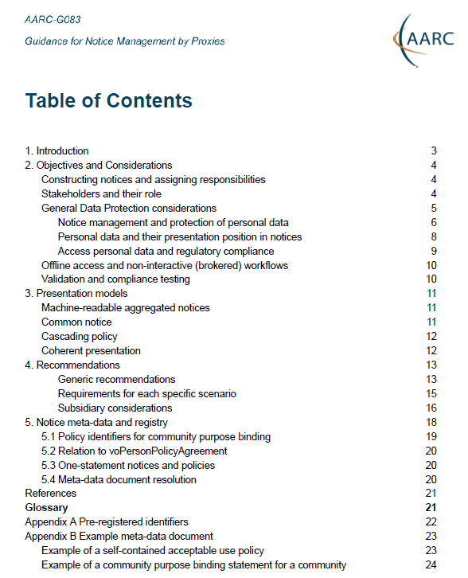
AARC G082 Notice Management by Proxies!
Four presentation models. In order of preference
machine-readable aggregated notice
common notice (single common authority domain)
cascading notices (assume responsibility for underlings)
coherent presentation: you show what you need (but not more)
Generic recommendations
use the WISE Baseline AUP composition model, record what and when
user confirmed acceptance, and be able to confirm this downstream
plus a machine-actionable model to
construct notices based on a hierarchy of proxies
sufficient to build you a comprehensive WISE Baseline AUP
and a set of privacy notices (for those GDPR encumbered)
plus a namespace inspired by RFC6711’s LoA registry
https://aarc-community.org/guidelines/aarc-g083/

Slide 11
Recommendations – generic and per presentation model
use of the WISE Baseline AUP is RECOMMENDED
the notice presentation component MUST record, collect and retain time-stamped information related to notice presentation
a notice presentation component that records logs about notice presentations SHOULD collect and retain necessary user contact information
a service provider or proxy that is intentionally connected up-stream to an AARC BPA proxy MUST inform all accepted and acknowledged upstream proxy operators

Slide 12
But how to prevent duplicate presentation of ‘already confirmed’ notices?
List of machine-readable policies MUST be the same for all users of the service and there SHOULD be one location to retrieve policy notice information per proxy, service/data provider
(we know this is a limitation, but will catch 80+% of the use cases)
When sending claims or attribute assertions towards downstream connected services and proxies, the proxy MUST include identifiers of all the policies to which the user has agreed, using the assigned policy identifiers and send that via the voPersonPolicyAgreement AVA or vo_person_policy_agreeement claim (multivalued)
When a service or proxy keeps persistent state about a user, and as part of a transaction receives a voPersonPolicyAgreement identifier from a trusted party, it SHOULD associate this information with the user state, and MUST NOT present notices that are (according to that receiving service provider or proxy) materially equivalent to notices that the user has already received.

Slide 13
Can we construct all of the WISE Baseline AUP at the proxy?
Four elements are needed:
the purpose binding for everything the user is going to experience
the 10 commandments (or materially equivalent)
aggregate of the terms and conditions for the proxy and the services behind it to which the user will (or may!) have access
including limits on personal data processing for data held within the service or data provider
list of privacy notices for connected services (‘two clicks away’)
plus the source(s) of authority for this combined notice

Slide 14
Mechanisms
‘meta-data’ for notice information at a well known endpoint
voPersonPolicyAgreement signalling downstream on a per-user bases
aggregation rules for included and augmenting notices
notice types in line with the WISE Baseline AUP (purpose, acceptable-use, conditions, sla, privacy)
where privacy notices are those for ‘access personal data’ as meant in REFEDS CoCo v2
and:
include state information on validity, acceptance period, refresh period, and version
multi jurisdiction (EEA and others) and multi-language are needed

Slide 15
Automatically constructing notices? Will that work? We can at least try!
{ "id": "urn:doi:10.60953/68611c23-ccc7-4199-96fe-74a7e6021815", "aut": "https://www.nikhef.nl/", "aut_name": "Nikhef", "valid_from": 1649023200, "ttl": 604800, "contacts": [ "helldesk@nikhef.nl", "information-security@nikhef.nl" ], "security_contacts": [ "abuse@nikhef.nl" ], "privacy_contacts": [ "privacy@nikhef.nl" ], "policy_class": "acceptable-use", "notice_refresh_period": 34214400, "includes_policy_uris": [ "https://documents.egi.eu/document/2623" ], "policy_uri": "https://www.nikhef.nl/aup/", "description#nl_NL": "Deze Gebruiksvoorwaarden betreffen het gebruik van netwerk en computers bij Nikhef. Iedere gebruiker van deze middelen of diensten wordt geacht op hoogte te zijn van deze voorwaarden en deze na te leven.", "description": "This Acceptable Use Policy governs the use of the Nikhef networking and computer services; all users of these services are expected to understand and comply to these rules." }
{ "id": "https://operations-portal.egi.eu/vo/view/voname/xenon.biggrid.nl", "aut": "https://xenonexperiment.org/", "aut_name": "Xenon-nT collaboration", "valid_from": 1311890400, "ttl": 31557600, "contacts": [ "grid.support@nikhef.nl", ], "security_contacts": [ "vo-xenon-admins@biggrid.nl" ], "policy_class": "purpose", "augments_policy_uris": [ "https://wise-community.org/wise-baseline-aup/v1/" ], "policy_uri": "https://operations-portal.egi.eu/vo/view/voname/xenon.biggrid.nl", "description": "detector construction and experiment analysis for the search of dark matter using Xenon detectors" }

Slide 16
Identifying notices for composition
Identifiers registered under this guideline require to:
Be in the form of a URI,
Be assigned a name, being a string uniquely and unambiguously identifying the notice for use in human presentation, and in protocols where URIs are not appropriate, and
Include a resolvable http or https informational URL pointing to a JSON document containing additional structured information.
And:
it SHALL NOT be used for identity assurance levels: we have RFC6711 for that
but it does establish a registry for notices (and a resolver) akin to the IANA one for LoA’s

Slide 17
id (required, single-value): string containing the URI of the identifier for the policy
aut (recommended, single-value): URI identifying the authority governing this policy. It is recommended to use identifiers assigned by a recognised naming agency (such as a LEI-based URN) or long-term stable URL to the main web presence of an organisation. For privacy notices as meant in the EU GDPR (policy_class: “privacy#eu”), this SHOULD identify the data controller.
aut_name (required, single-value): plain-text human-readable and disambiguating name of the authority (used in the WISE Baseline AUP preamble)
valid_from (recommended, single-value): time from which this policy is in effect. This is expressed as Seconds Since the Epoch. When present, this value MUST increment whenever there is a minor change to the policy referring to this informational document. Note that major material changes SHOULD be assigned a new policy URI (id). Minor and major are defined discretionarily by the authority for the policy.
ttl (optional, single-value): the time period after which this document SHOULD be retrieved again by consumers. This is expressed in seconds. In absence of this key, the document SHOULD NOT be retrieved more often than once a day; should be cached.

Slide 18
contacts (required, multi-value),
security_contacts (recommended, multi-value),
privacy_contacts (recommended, multi-value): JSON arrays with one or more strings representing contact persons at the Entity. These MAY contain names, e-mail addresses, descriptions, phone numbers, etc. (incorporated from OpenID Federation 1.0) (used in the WISE Baseline AUP postscript)
policy_class (required, single-value):
string from the limitative enumeration: ‘purpose’, ‘acceptable-use’, ‘conditions’, ’sla’, ’privacy’.
The value ‘privacy’ MAY be qualified with a jurisdiction (e.g. ‘privacy#eu’). Jurisdictions SHALL use IANA ccTLD identifiers where possible. The jurisdiction value “eea” MAY be used to indicate the European Economic Area (e.g. “privacy#eea” will indicate a privacy policy in accordance with Regulation (EU) 2016/679 ‘GDPR’). Assigned subdomain names under the .int TLD MAY be used to indicate international organisations holding their own jurisdiction (e.g. “privacy#cern.int” will indicate a policy in accordance with CERN’s OC11).
The policy_class ‘privacy’ applies to privacy policies governing service access data only (i.e. data used for enabling access, as meant in the REFEDS Data Protection Code of Conduct). Policies regarding privacy of the data processed in the service or in services connected to the proxy MUST be expressed in a ‘conditions’ policy_class.

Slide 19
notice_refresh_period (optional, single-value): number of seconds after which this same notice has to be presented again to the same user, regardless of any earlier acceptance. Used to trigger periodic re-acceptance of e.g. acceptable use policies.
includes_policy_uris (optional, multi-value): JSON array of policy URIs that are included in this policy and therefore implicitly fulfilled. Those policy URIs SHOULD be listed in the registry (which is machine-readable, but machine-readable only) . This list MAY include also policies that are superseded by this policy, if the material content of deprecated policies is fully subsumed in this policy.
augments_policy_uris (optional, multi-value): JSON array of policy URIs that are augmented by this policy, e.g. the WISE Baseline AUP itself. A presenting application MAY merge the presentation of this policy and any policies this policy augments.
policy_uri (recommended, single-value): URL of the documentation of conditions and policies in human-readable form (incorporated from OpenID Federation 1.0)
description (recommended): shortest plain-text human-readable description of the policy to be used for presentation in composite notices (used in the WISE Baseline AUP preamble)
All human-readable keys (aut_name, description) MAY be postfixed with a hash-sign followed by a locale code in RFC 4646 format (example: aut_name#nl_NL: “nationaal instituut”).

Slide 20
5.4 Meta-data document resolution
The resolution mechanism for meta-data JSON documents SHOULD be left to the AARC Architecture working group. The resolution set MAY be of the form of a HTTP GET request for a document at https://nr.aarc-community.org/resolv/v1/<URL-encoded-URI>. This URL MUST result in a 301 “Moved Permamently” response, and include a HTTP response “Location” header indicating the URL of the JSON meta-data document.
For the prior example …
It might potentially then be retrievable from https://nr.aarc-community.org/resolv/v1/https%3A%2F%2Foperations-portal.egi.eu%2Fvo%2Fview%2Fvoname%2Fxenon.biggrid.nl
Following AARC-G069, the identifier could have been auto-completed, once a namespace has been defined for BiG Grid communities. In that case, the identifier would have been “urn:geant:nikhef.nl:projects:biggrid:group:xenon”, with associated resolver URL https://nr.aarc-community.org/resolv/v1/urn%3Ageant%3Anikhef.nl%3Aprojects%3Abiggrid%3Agroup%3Axenon

Slide 21
It can (should) still be refined!
https://aarc-community.org/guidelines/aarc-g083/
and we need your input on these. Both on the four representation types and
on the meta-data json document format/schema
and, no, there is no formal schema yet, just the textual description and the examples
and we know that voPersonPolicyAgreement needs a small update (URL->URI)

Slide 22
davidg@nikhef.nl

