Slide 1

Research Data Management
  and the Nikhef Policy Draft
WAR meeting
David Groep
PDP
07 December 2017 davidg@nikhef.nl

Slide 2
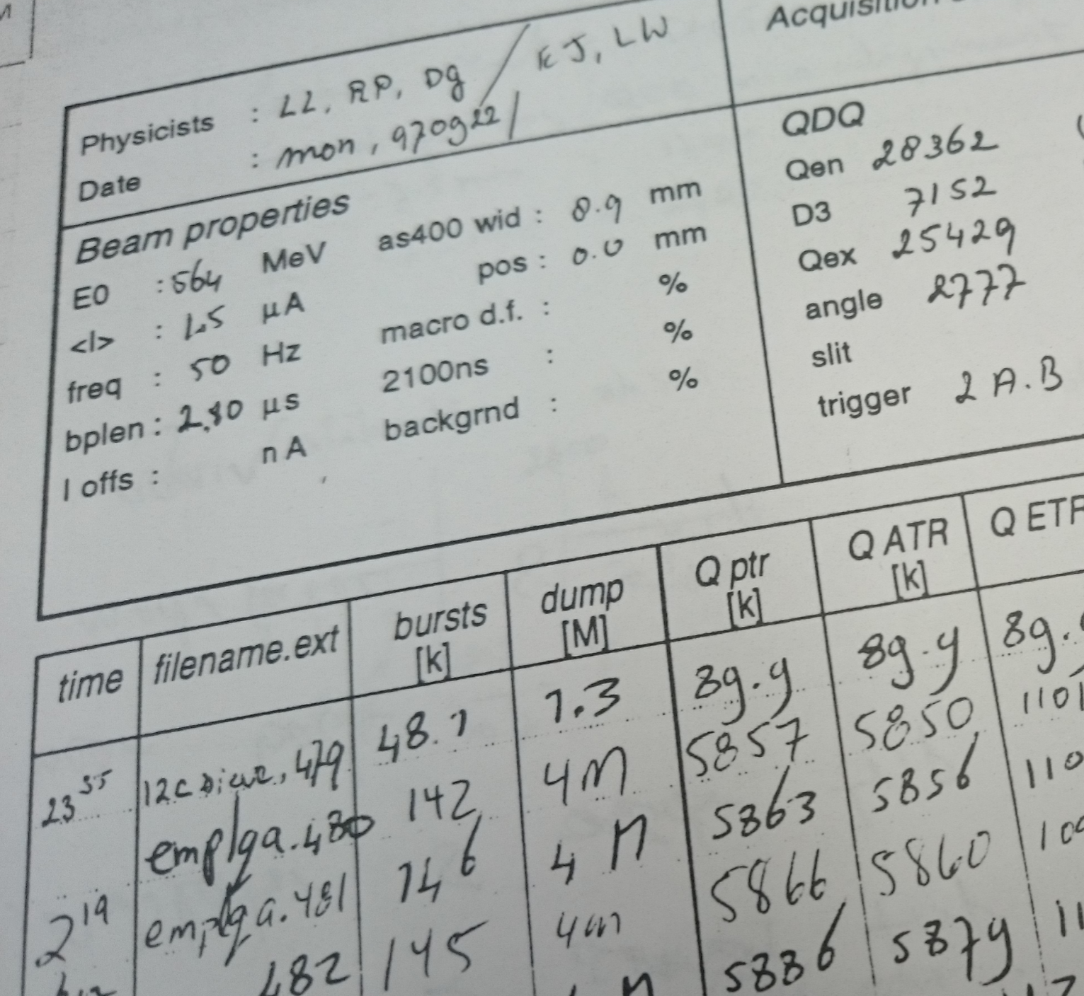
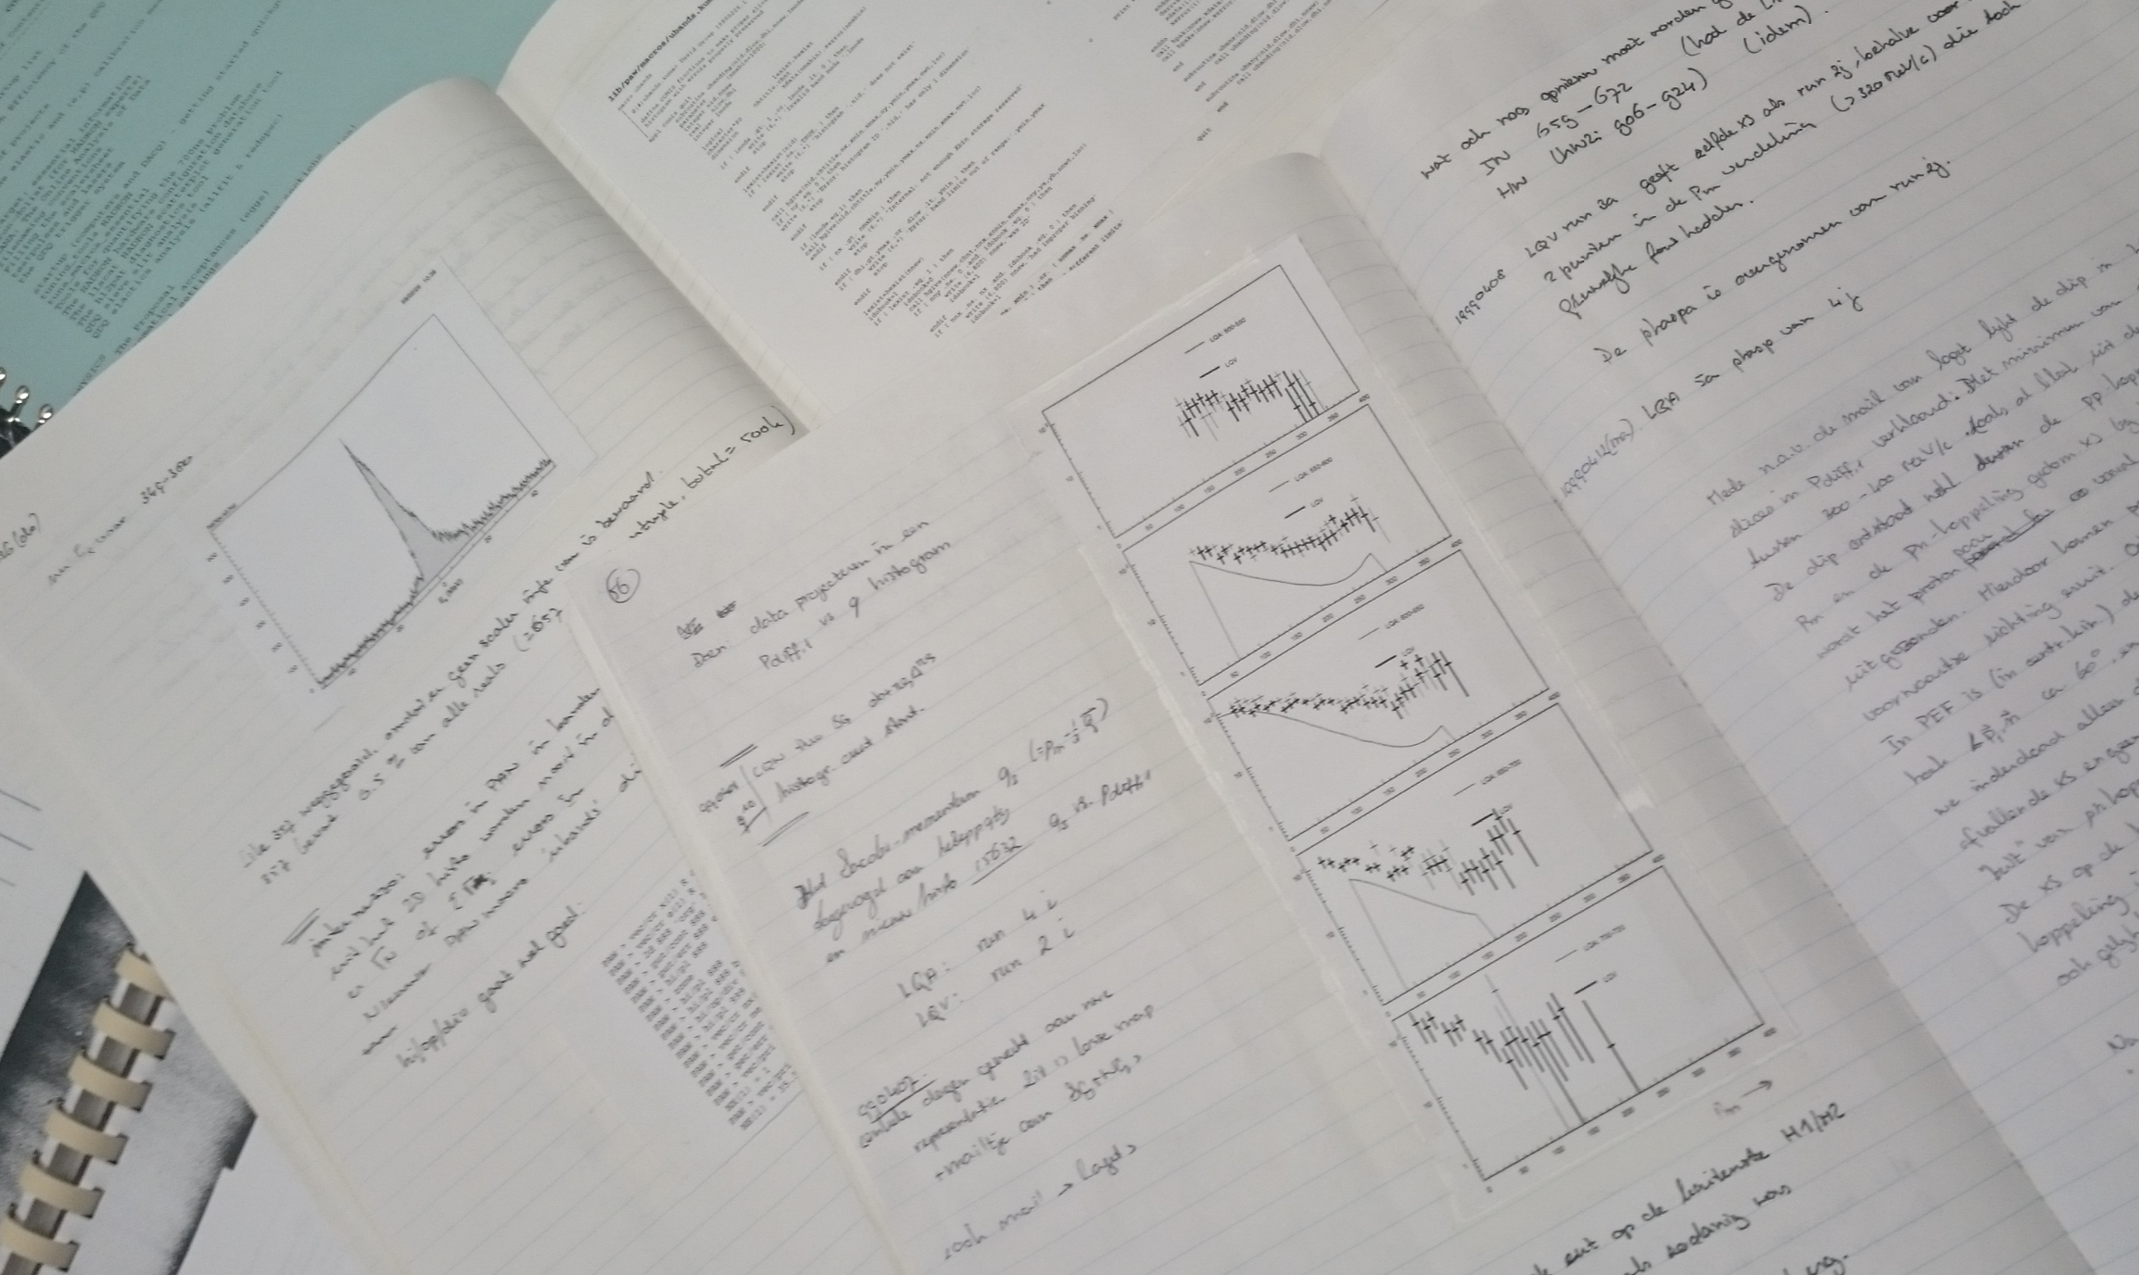
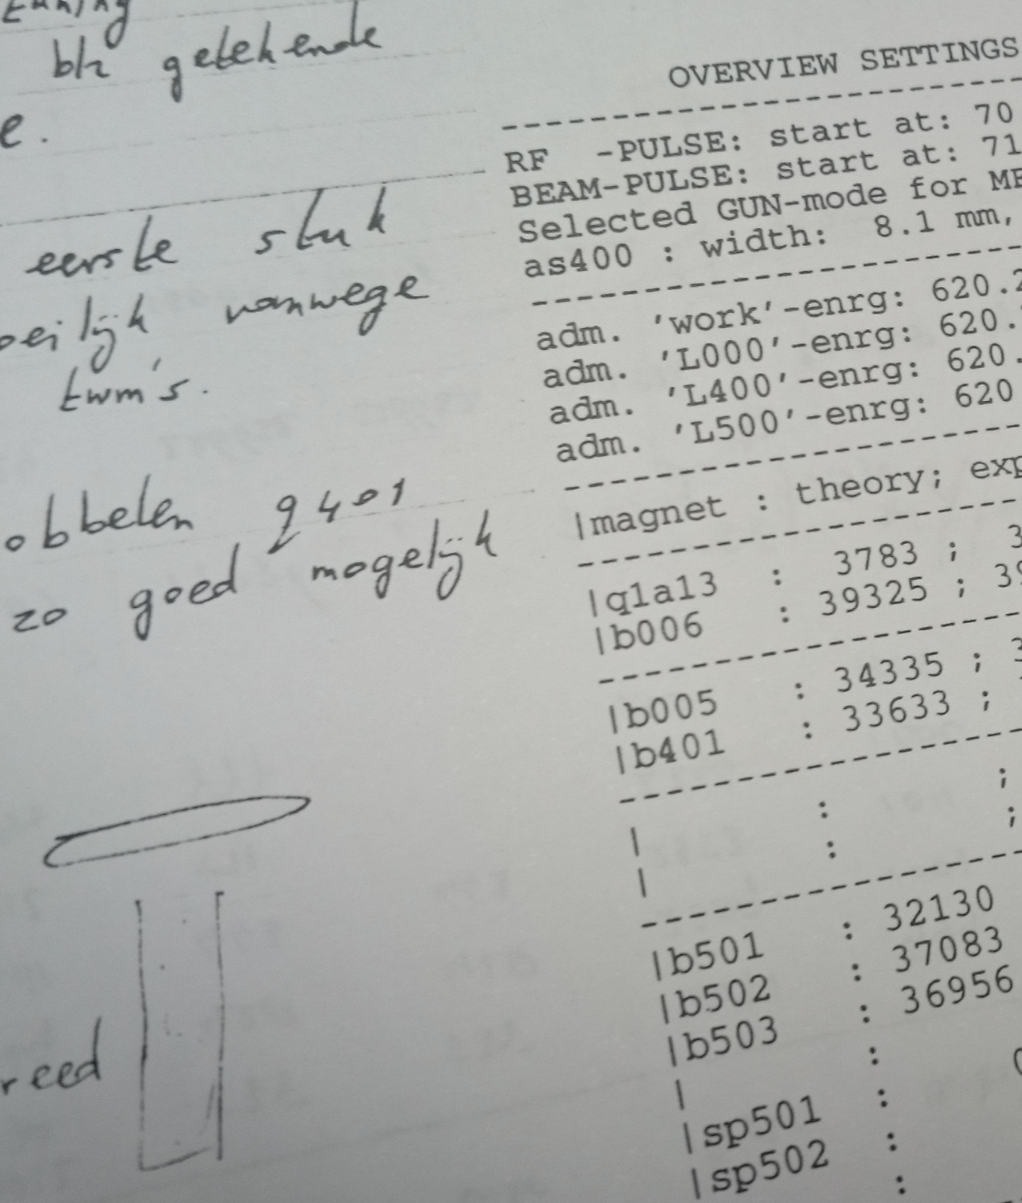
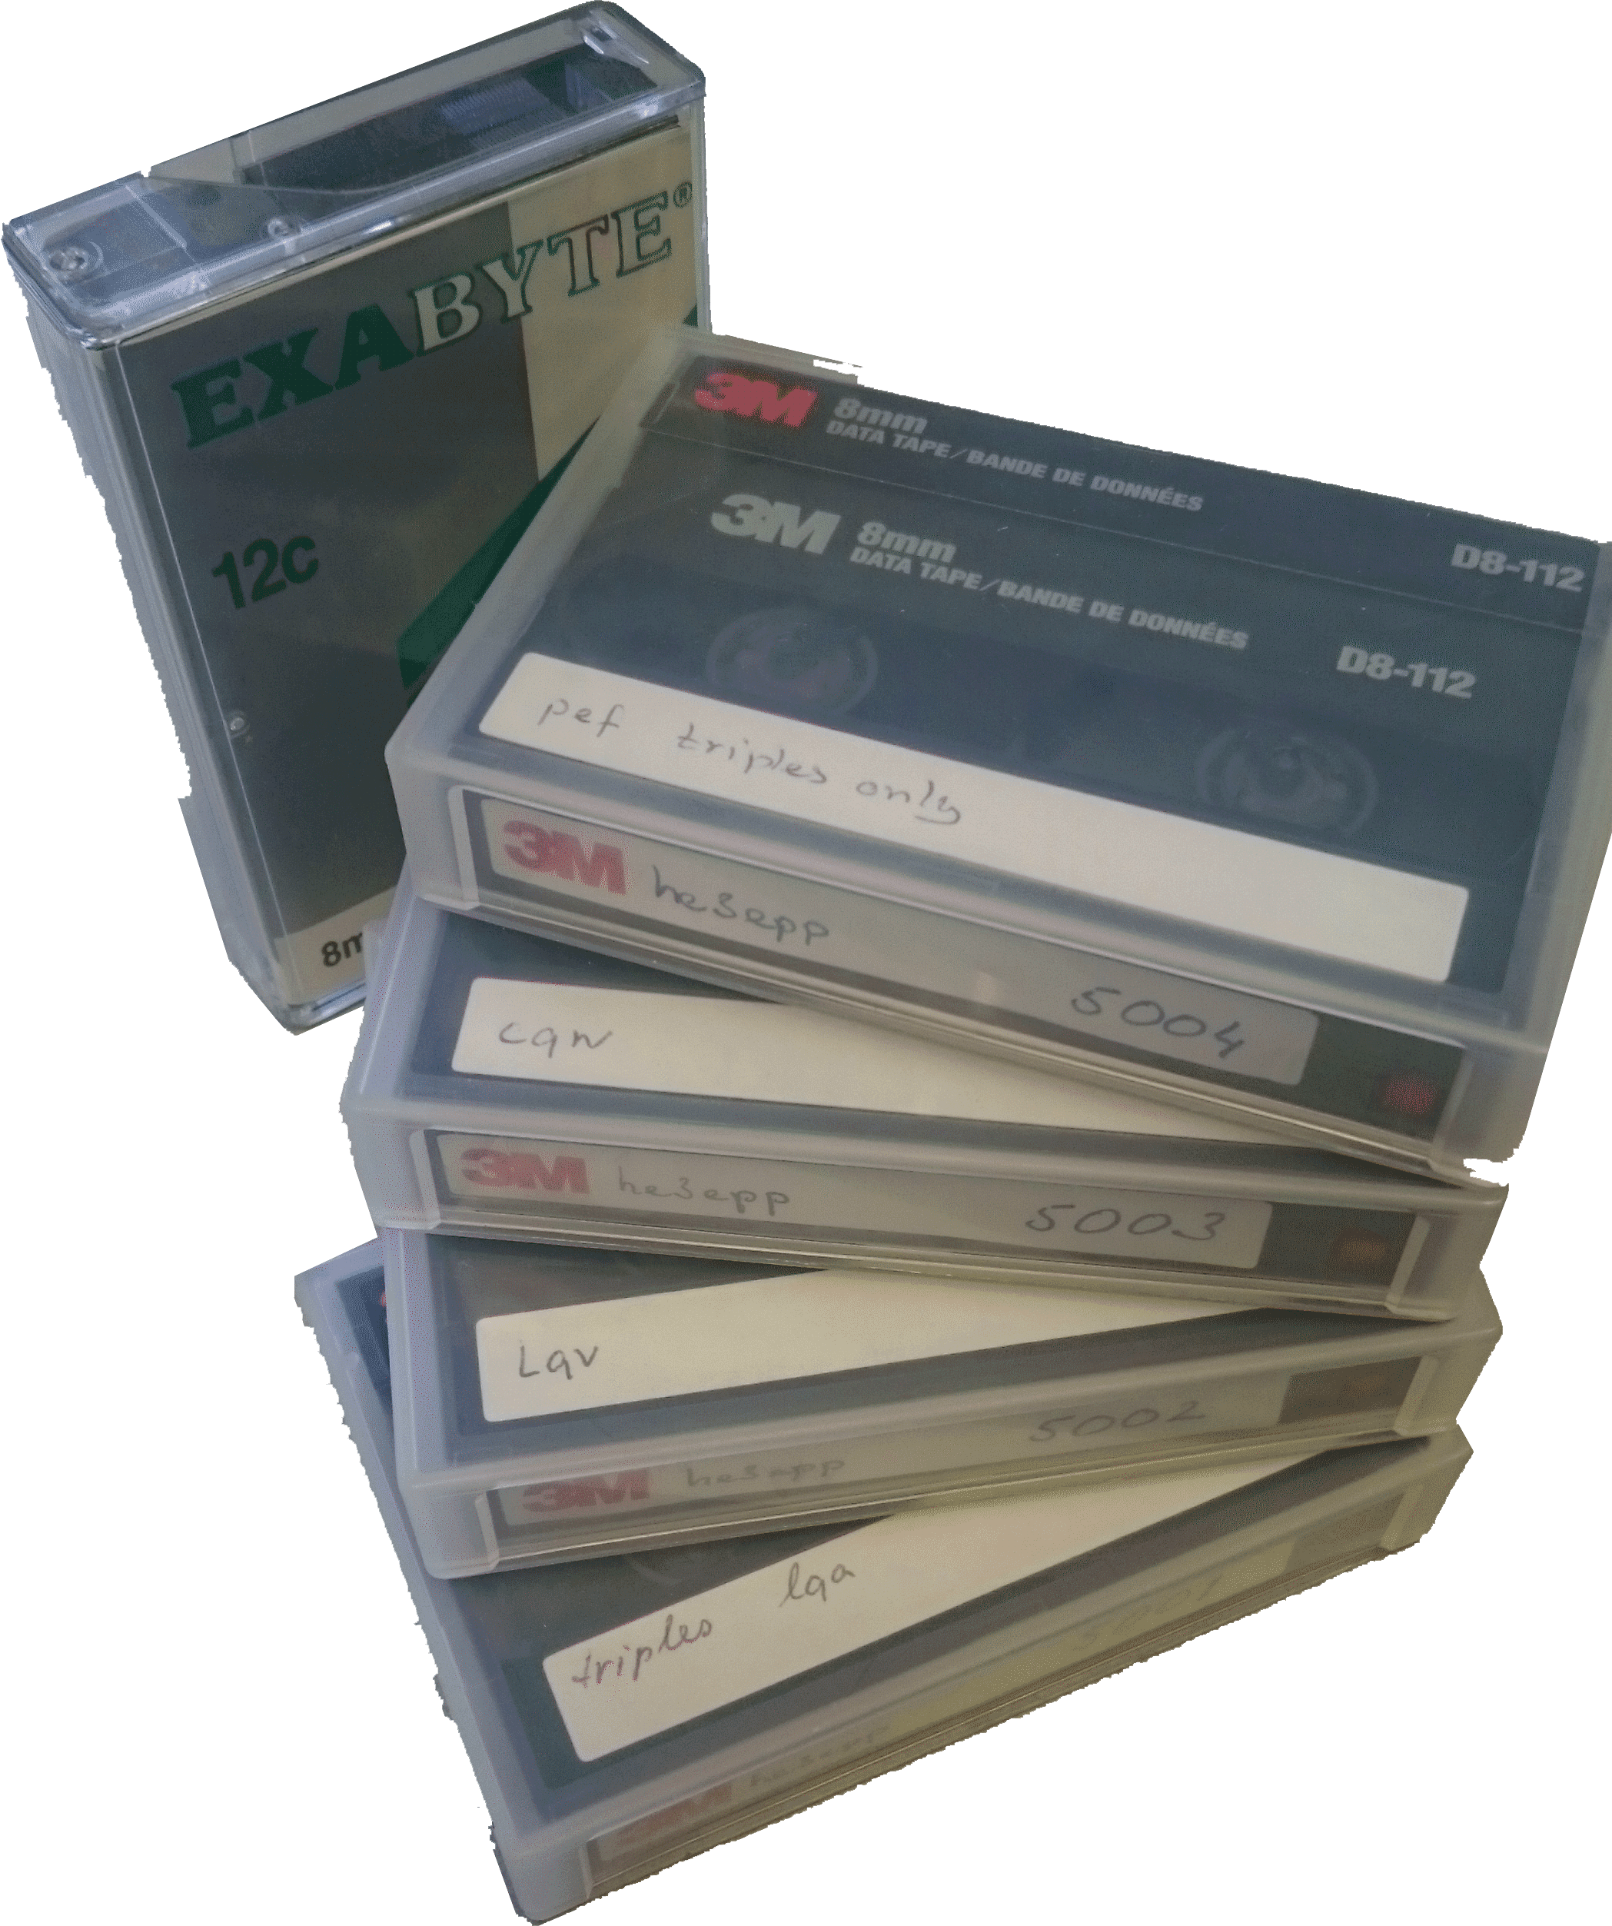
Research Data Management
Towards long-term data preservation
and re-use for research at Nikhef
Introduction
Research Data Management & ‘FAIR’
NWO Policy Framework Requirements
Our own Data Preservation tradition
Discussion
Nikhef Data Management Policy terms
Principles
Practice Guidance
excepts from data archive and logbooks of experiment 97-01 He³(e,e′pp)

Slide 3
Why Research Data Management?
RDM in support of the proper research process
implementing the VSNU/NWO Code of Conduct* – ‘verifiability’ criterion
“Open Science” & “Open Access” policy aims
conventional re-use for our own purposes (“where was that dataset again??”)
but there may be subsidiary aims for RDM
re-use in different domain: complex here, but not uncommon for societal challenges
citizen science: e.g. “Hanny's Voorwerp” [J094103.80+344334.2] in astronomy
reuse of results for industry, civil society and general public – it’s in our mission ☺
http://www.vsnu.nl/files/documenten/Domeinen/Onderzoek/Code_wetenschapsbeoefening_2004_(2012).pdf

Slide 4
The “FAIR” Principles
… since ‘open access’ ‘open data’ is basis for (funding) agenda OCW/NWO/KNAW/EC …
pick a name for the effort that is ‘hard to disagree with’ …
FAIR
Findable - data & metadata are easy to find by humans & computers
Accessible – standard download method & ‘protocols’ for access explicit
Interoperable - they can be automatically combined with other data
Reusable - sufficiently well described to be replicated or combined
but this is easier said than done, and implementation domain specific
Wilkinson et al. The FAIR Guiding Principles for scientific data management and stewardship doi:10.1038/sdata.2016.18

Slide 5
FAIR – a ‘slight’ LS bias
To be Findable:
F1. (meta)data are assigned a globally unique and persistent identifier
F2. data are described with rich metadata (defined by R1 below)
F3. metadata clearly and explicitly include the identifier of the data it describes
F4. (meta)data are registered or indexed in a searchable resource
To be Accessible:
A1. (meta)data are retrievable by their identifier using a standardized communications protocol
A1.1 the protocol is open, free, and universally implementable
A1.2 the protocol allows for an authentication and authorization procedure, where necessary
A2. metadata are accessible, even when the data are no longer available

Slide 6
FAIR – more microstatements
To be Interoperable:
I1. (meta)data use a formal, accessible, shared, and broadly applicable language for knowledge representation.
I2. (meta)data use vocabularies that follow FAIR principles
I3. (meta)data include qualified references to other (meta)data
To be Reusable:
R1. meta(data) are richly described with a plurality of accurate and relevant attributes
R1.1. (meta)data are released with a clear and accessible data usage license
R1.2. (meta)data are associated with detailed provenance
R1.3. (meta)data meet domain-relevant community standards
‘let’s really think that you can replace researchers with automated systems’

Slide 7
The NWO DM Protocol
The “FAIR” principles inspired the NWO DM Protocol,
and the H2020 Open Data guidance, and ERC requirements
Based on the DM Protocol, there is also an
NWO Institute Data Management Policy Framework
Endorsed August 2016, now needs to be implemented soon(ish)

Slide 8

For ‘us’ RDM is not new
last big e⁺e⁻ machine closed years ago,
and e.g. LEP, or HERA, data is not re-measurable today …
DPHEP (2008 – ICFA-DPHEP Study Group, 2013+ DPHEP MoU)
  preserve experimental data and its software environment
  study group, repository development (Zenodo), software curation
http://dphep.org/

Slide 9

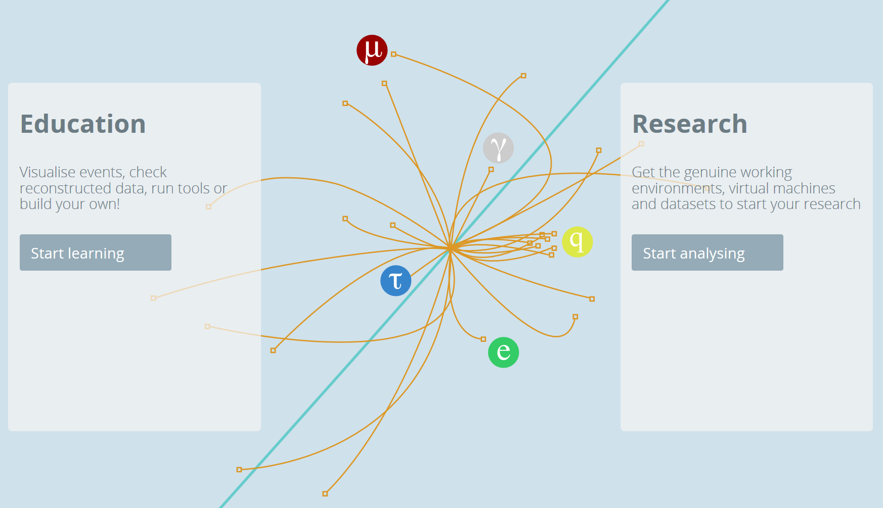
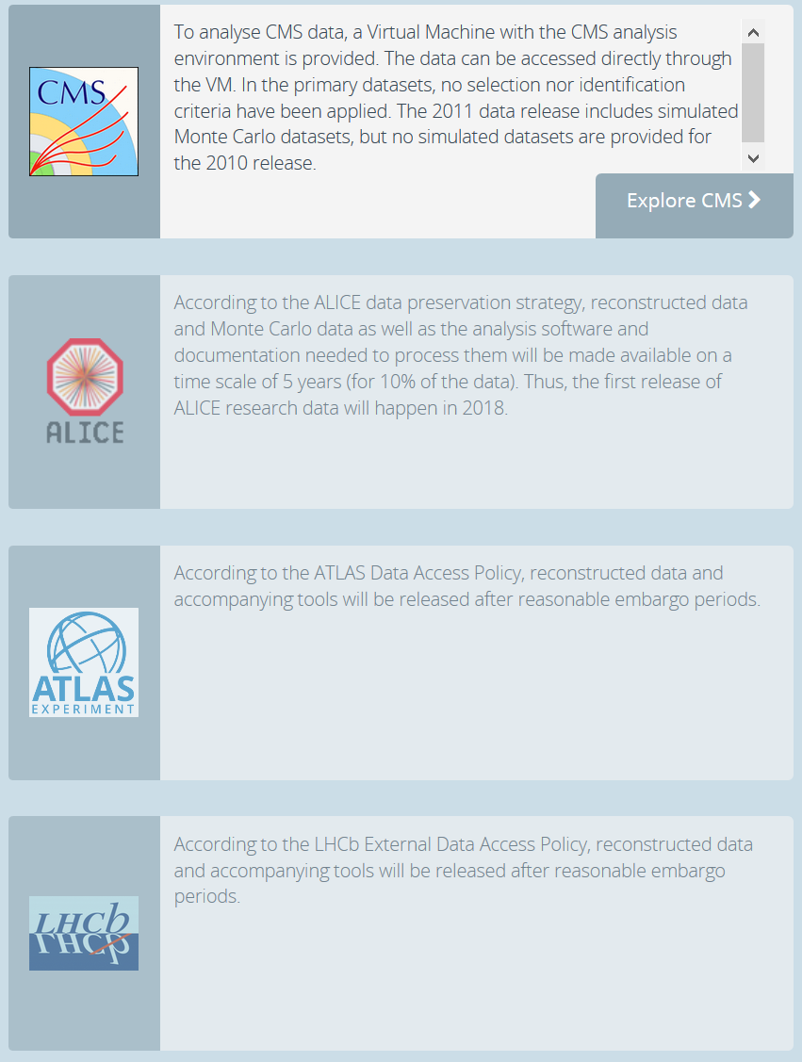
opendata.cern.ch

Slide 10
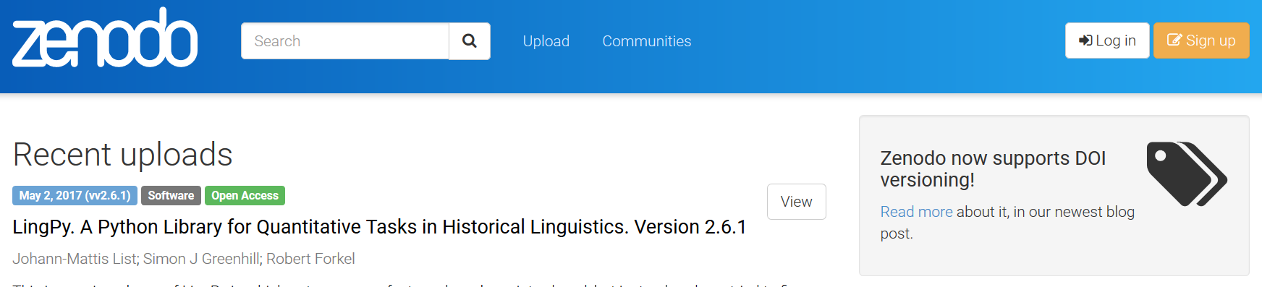
We have tradition here!
DPHEP
HEPForge
HepData
CERN OC3
INSPIRE-HEP (‘SPIRES’)
and we ‘spread the word’ through general-purpose services
Zenodo
https://www.nikhef.nl/grid/nikhef/dmp/

Slide 11
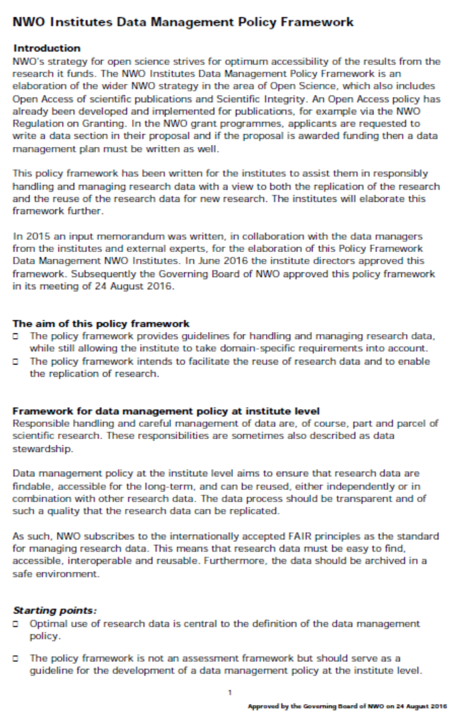
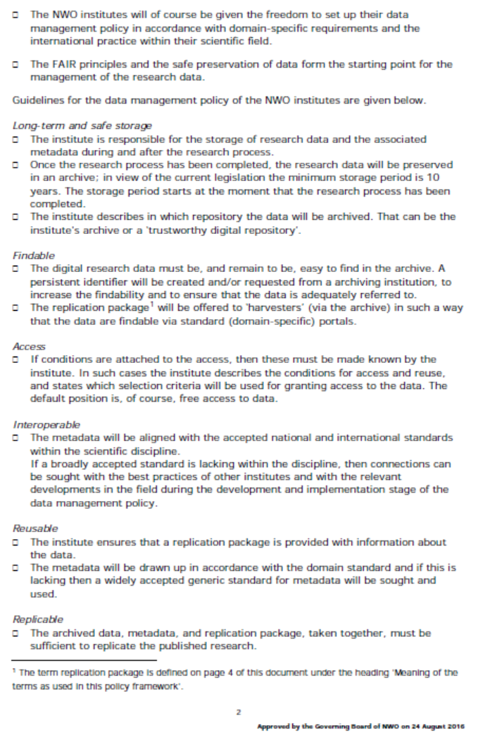
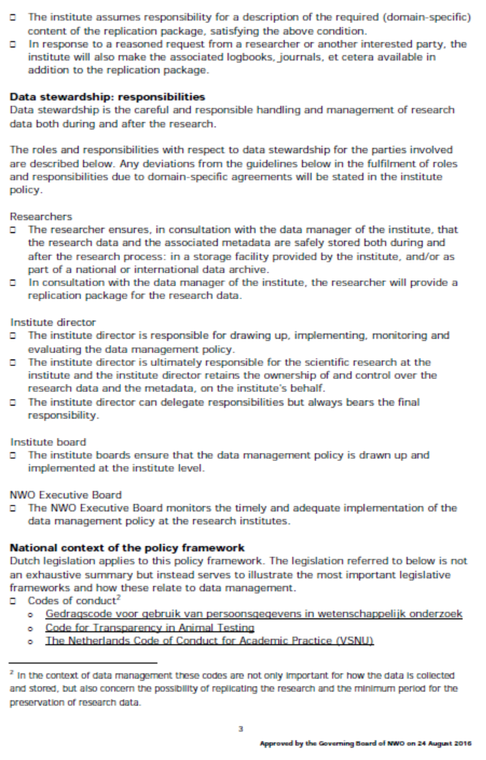
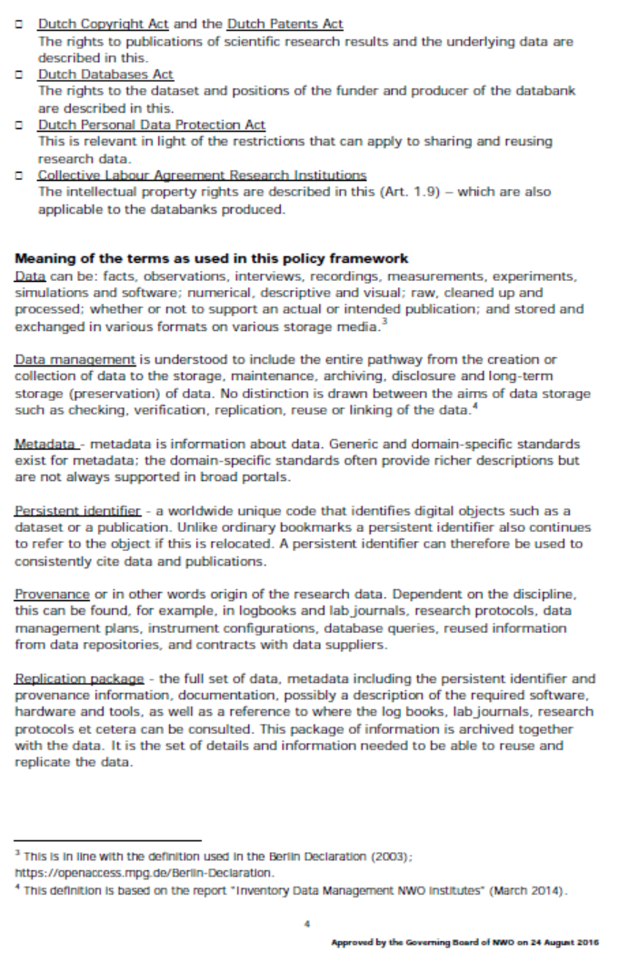
NWO-I DM Policy Framework
Implement (by ~1 Sep 2017)
the NWO-I DM Policy Framework
only 4 pages (good …)
binding (unlike NWO Protocol)
Institute Data Managers
were consulted beforehand
Leaves us freedom of implementation, but does
require specific elements
like the Replication Package
https://www.nikhef.nl/grid/nikhef/dmp/NWO-Institutes-Data-Management-Policy-Framework.pdf

Slide 12
Nikhef RDMP ToR
must implement the NWO-I DM Framework and NWO Protocol
not undermine any past or future data management customs already in use in the sub-atomic physics domains (HENP & others)
leverage as much as possible international efforts (such as DPHEP)
minimal impact on PhD students and their time
limit impact also for staff members as much as possible
not incur unnecessary costs or liabilities

Slide 13

The Document ...

Slide 14
Terms used from RFC 2119
MUST
This word, or the terms "REQUIRED" or "SHALL", mean that the definition is an absolute requirement of the specification.
SHOULD
This word, or the adjective "RECOMMENDED", mean that there may exist valid reasons in particular circumstances to ignore a particular item, but the full implications must be understood and carefully weighed before choosing a different course.
RFC219 (BCP 14) - https://www.ietf.org/rfc/rfc2119.txt

Slide 15
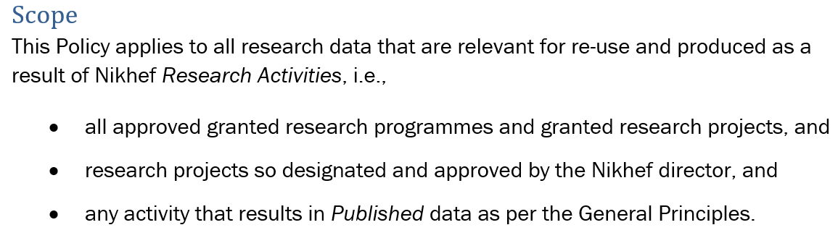
Scope
defines Research Activities and re-usable data
non-reusable data (e.g. collected when building tools/components) need not be subject to the policy
but most data usually is

Slide 16
but there are exclusions
specific agreements & treaties take precedence (e.g. CERN)
we exclude contract work –
the responsibility in that case is with the third party
software as a product in itself (like FORM, or control software)
physical detectors & components (but archive the design drawing)
personal “GDPR” data – you really ought to think why you need it!
administrativa
you can obviously still be following the policy, but it will not be as absolutely mandatory

Slide 17
RDM Policy Principles
Encompasses all kinds of Data: raw, derived, published, logs & settings
Implement NWO Protocol & NWO-I DM Framework
Be legal, yet use of released data not our concern (beware of law & NWO)
Each Activity should have a Data Management Plan “DMP”
(already required for NWO, H2020, ERC)
– or at least implement the ‘default’ guidance in the Policy
At least outline of DMP in proposal phase - already now for NWO/H2020
DMP should follow current best practice ‘for our domain’

Slide 18
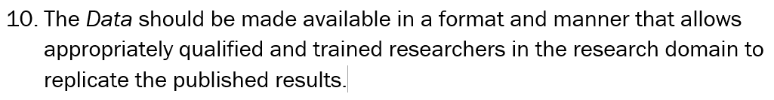
Open Data Principle
Data should become public in 6 months following publication
  unless otherwise agreed (e.g. for the LHC experiments)
  or if access should be limited to ensure patents, or first publication, or protection of individuals, ethical things, or other good reasons
  –these reasons to be stated in the DMP
Data should be replicatable and there must be a ‘replication package’

Slide 19
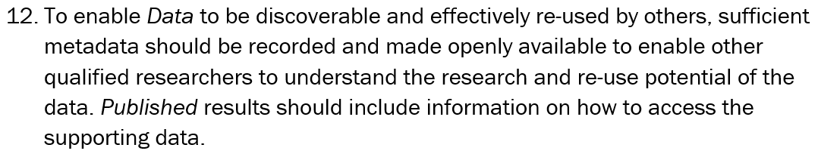
Data needs Metadata
Comes out of the FAIR principles
Is strongly emphasized in the NWO protocol and policy framework
The ‘qualified’ researcher is there for a reason – we do not anticipate citizen science here, but target domain-trained physicists
… or the meta-data should be infinitely detailed and un-doable …

Slide 20
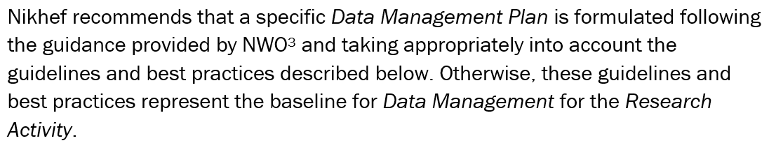
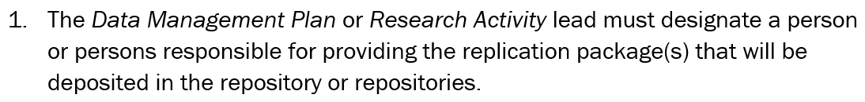
The Data Management Plan
The specific plan implements the policy – or take the default and take the time to understand what it means for your case:

Slide 21
Nikhef DM Plan Guidance
guidelines for writing the DMP for each activity
or
the baseline if you do not write an activity-specific DMP

Slide 22
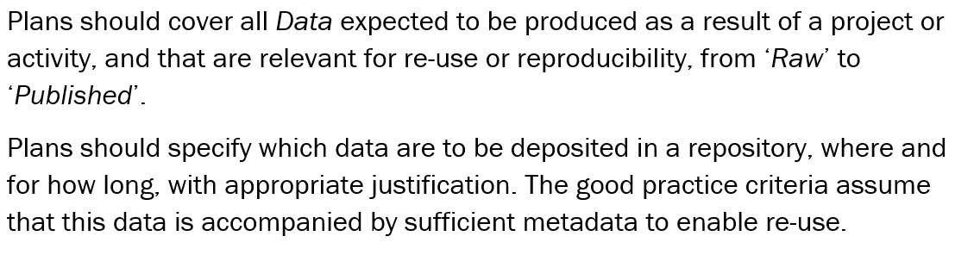
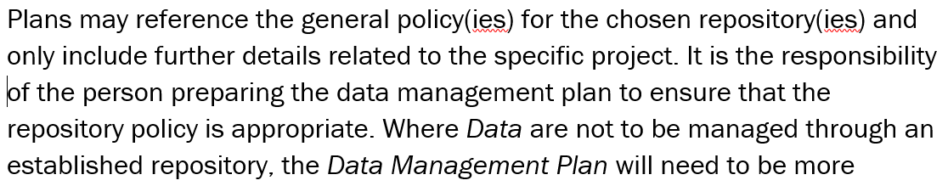
Describe what will be stored
but keep costs in mind, and don’t store re-createable intermediates

Slide 23
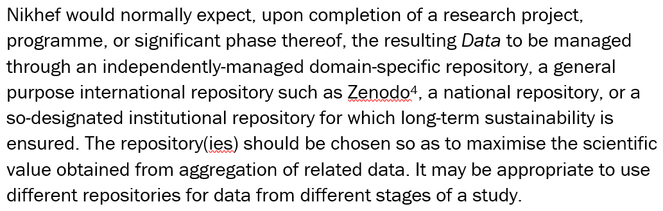
Dumping a replication package
off-load the curation to an established (non-Nikhef) place
it’s at least a lot cheaper than setting up your own ☺
just your own DOI assignment costs €8500/yr for DataCite membership – or €4.50 per DOI @mEDRA

Slide 24
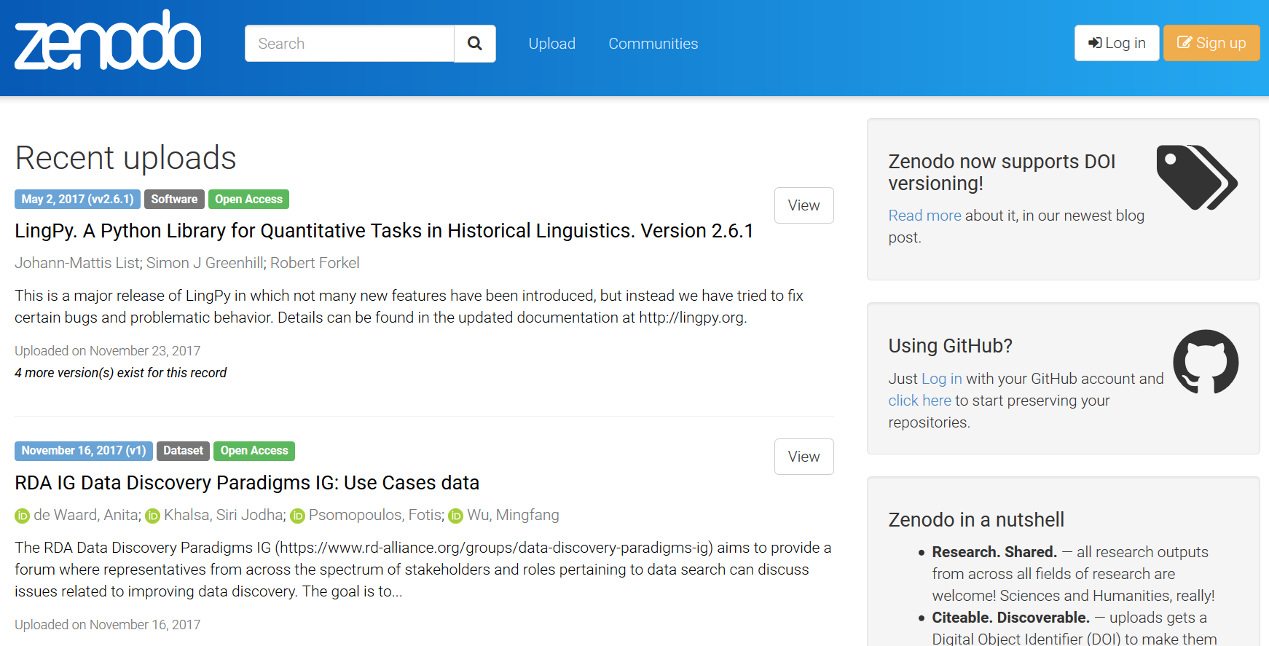
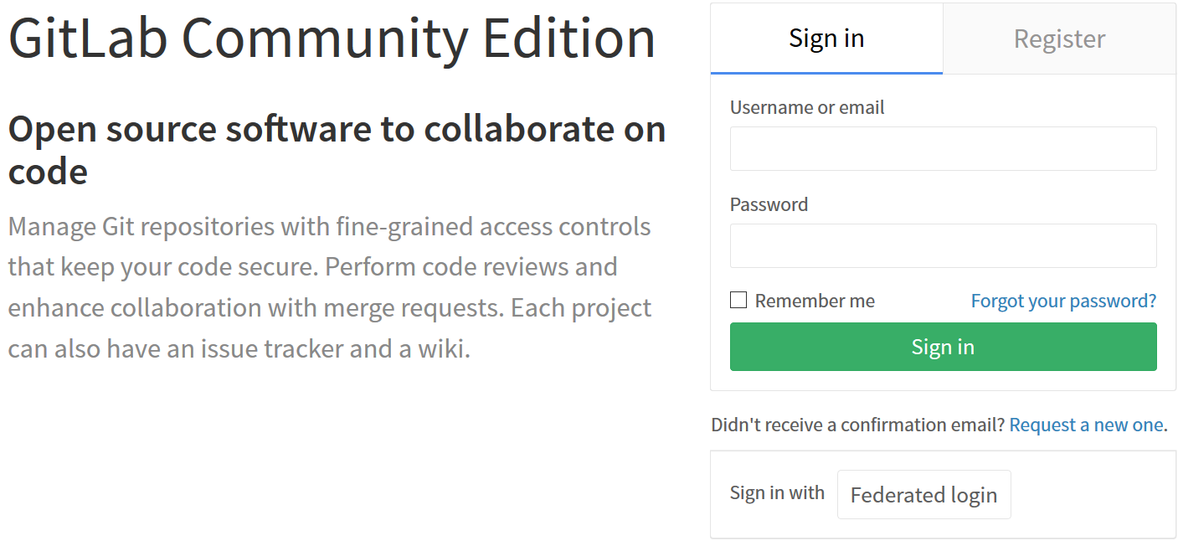
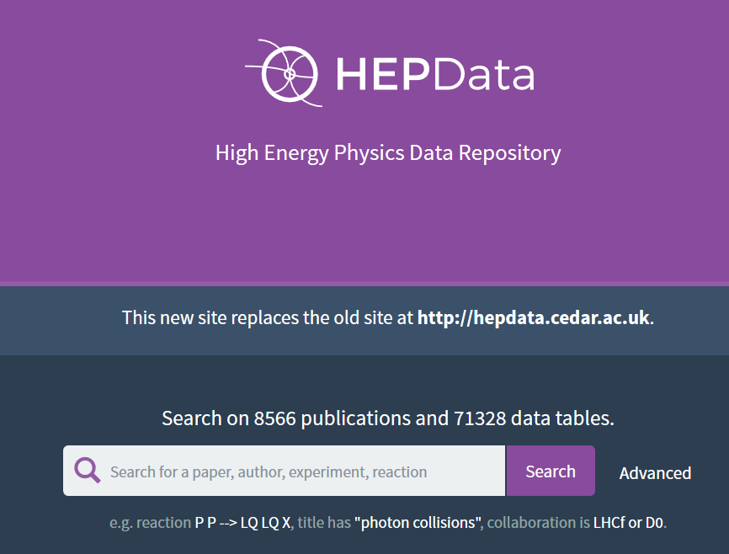
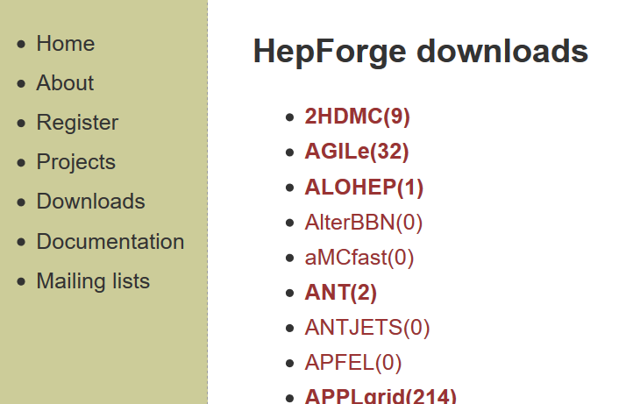
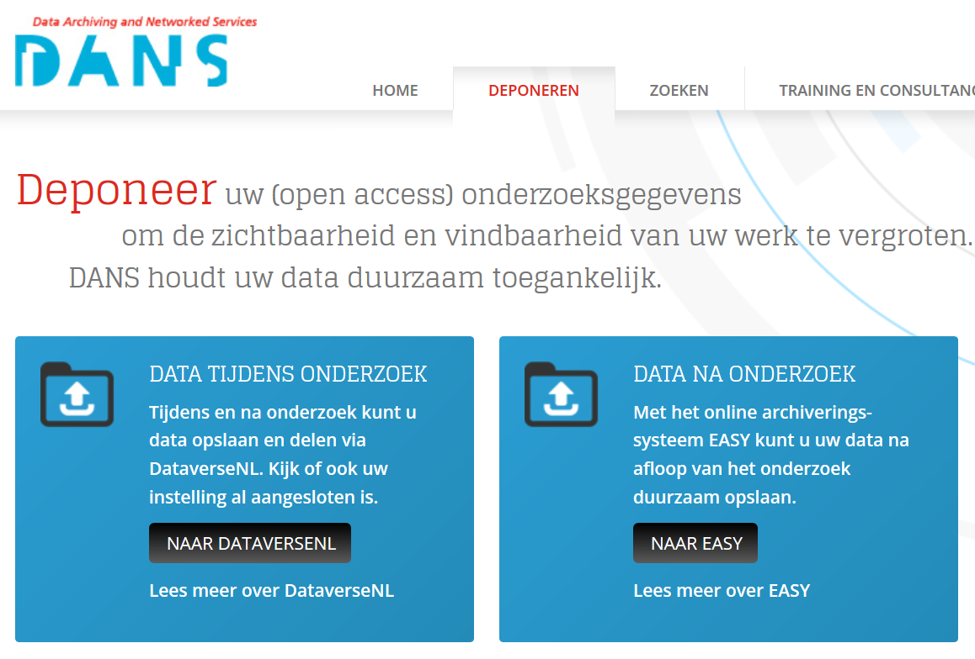
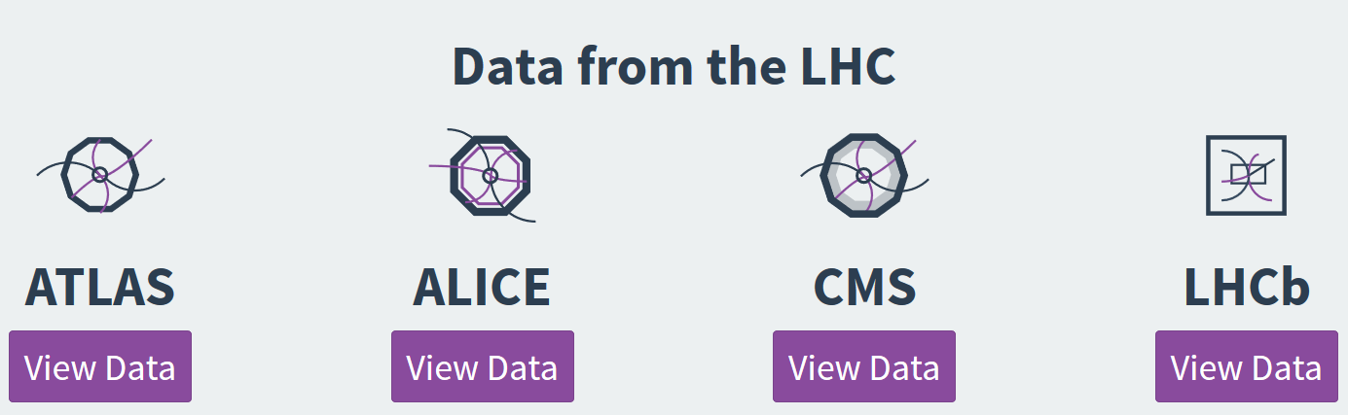
Repositories

Slide 25
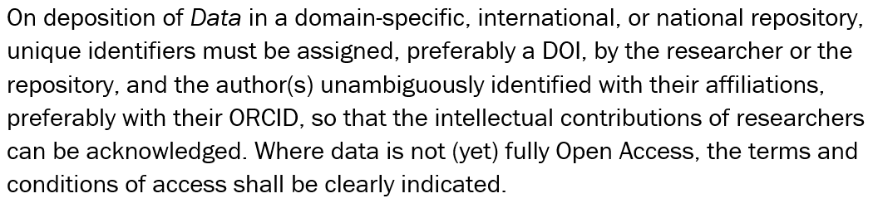
Findable – a persistent ID
Get a DOI (a URL is not usually persistent)
Link your ORCID to it (bi-directional)
Nikhef cannot assign DOIs itself, we do give URNs, OIDs, and ISBN
The repositories will do this for you (Zenodo, DANS, FigShare)
just your own DOI assignment costs €8500/yr for DataCite membership – or €4.50 per DOI @mEDRA

Slide 26
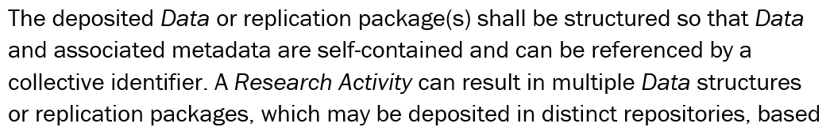
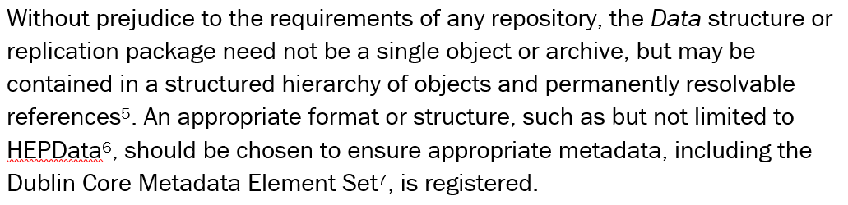
Packaging data
Related data stick together

Slide 27
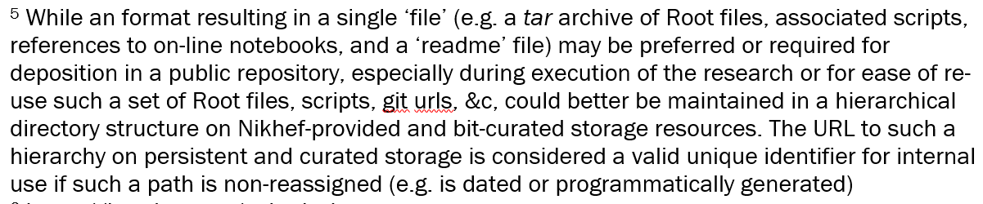
Archive or file hierarchy?
Submission to a repository usually is in a single file
But in the Nikhef repository, it might be more useful as a directory
as long as it contains the meta-data and description
this should be on backed-up, CT managed, so-designated storage!

Slide 28



Meta-data format
Remember the ‘rich’ meta-data and machine-based research?
Ensure at least minimally useful meta-data is there!
https://hepdata.net/submission
https://guidelines.openaire.eu/en/latest/data/index.html
http://dublincore.org/documents/dces/

Slide 29
Not that complicated a set
Identifier
Creator
Title
Publisher
PublicationYear
Subject (key words)
Contributor
Date
Language
ResourceType
AlternateIdentifier
RelatedIdentifier
Size
Format
Version
Rights
Description
GeoLocation

Slide 30
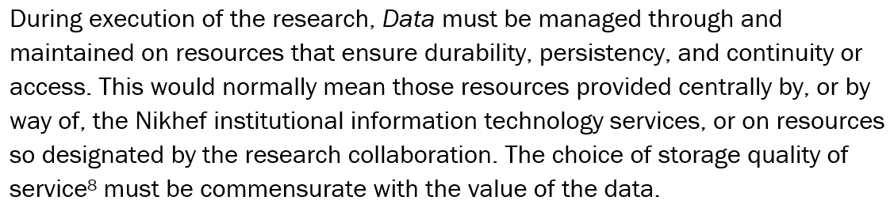
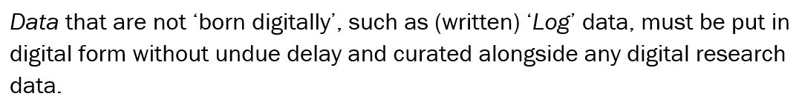
Pick the right path!
Not all storage is created equal – ask the CT for the QoS
and scan paper log books and notes

Slide 31
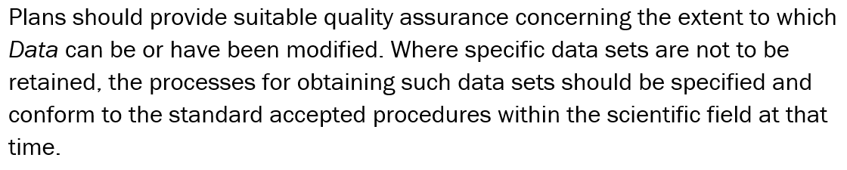
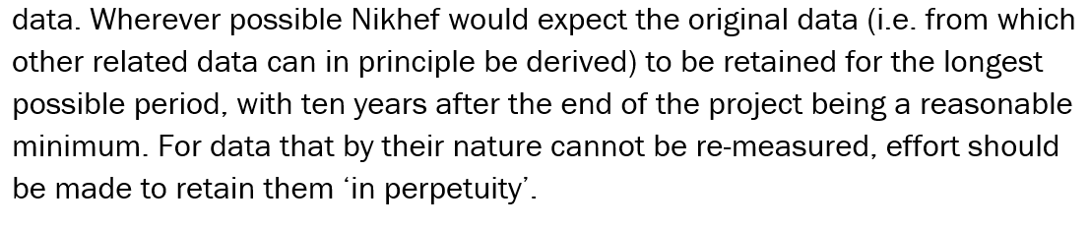
Immutable results: integrity
This is a basic property of the required replication package

Slide 32
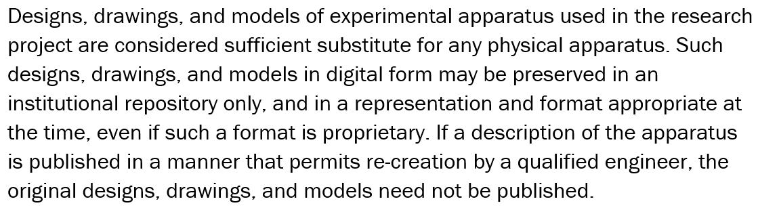
Don’t overload the MT
“managing NX TeamCenter and COMSOL is already complex and both retain traceability”

Slide 33
In Practice
Every research activity will need a responsible person
Think about what needs to be in the replication package
Decide if the results can be public – then select the proper repository
Zenodo takes 50 GBytes/dataset, but unlimited # of datasets ☺
HEPData takes and assesses data submissions – conforming to ‘FAIR’
For ‘local’ and proprietary data – CT should be making available
space for this (with a QoS like /project) – don’t modify content there
We do need a registry for research output in our local repo
(and need that anyway for the Annual Report and reviews)
Indicate Nikhef as publisher, and you as creator – and include your ORCID

Slide 34
In Practice
Review the Computing Course training on research data
Jeff gave one on Nov 27th
Use DMP copy-pasting from https://www.nikhef.nl/grid/nikhef/dmp/
Ask the CT/PDP team for help [rdm-support@nikhef.nl]
  if you have to cook up a DMP for NWO
  if you want to re-use a stock DMP for the LHC experiments
  if you need some GDPR guidance (but: IANAL!)
This policy and practice needs to evolve and will change, but for now
Sit back, relax, and enjoy your data!

Slide 35
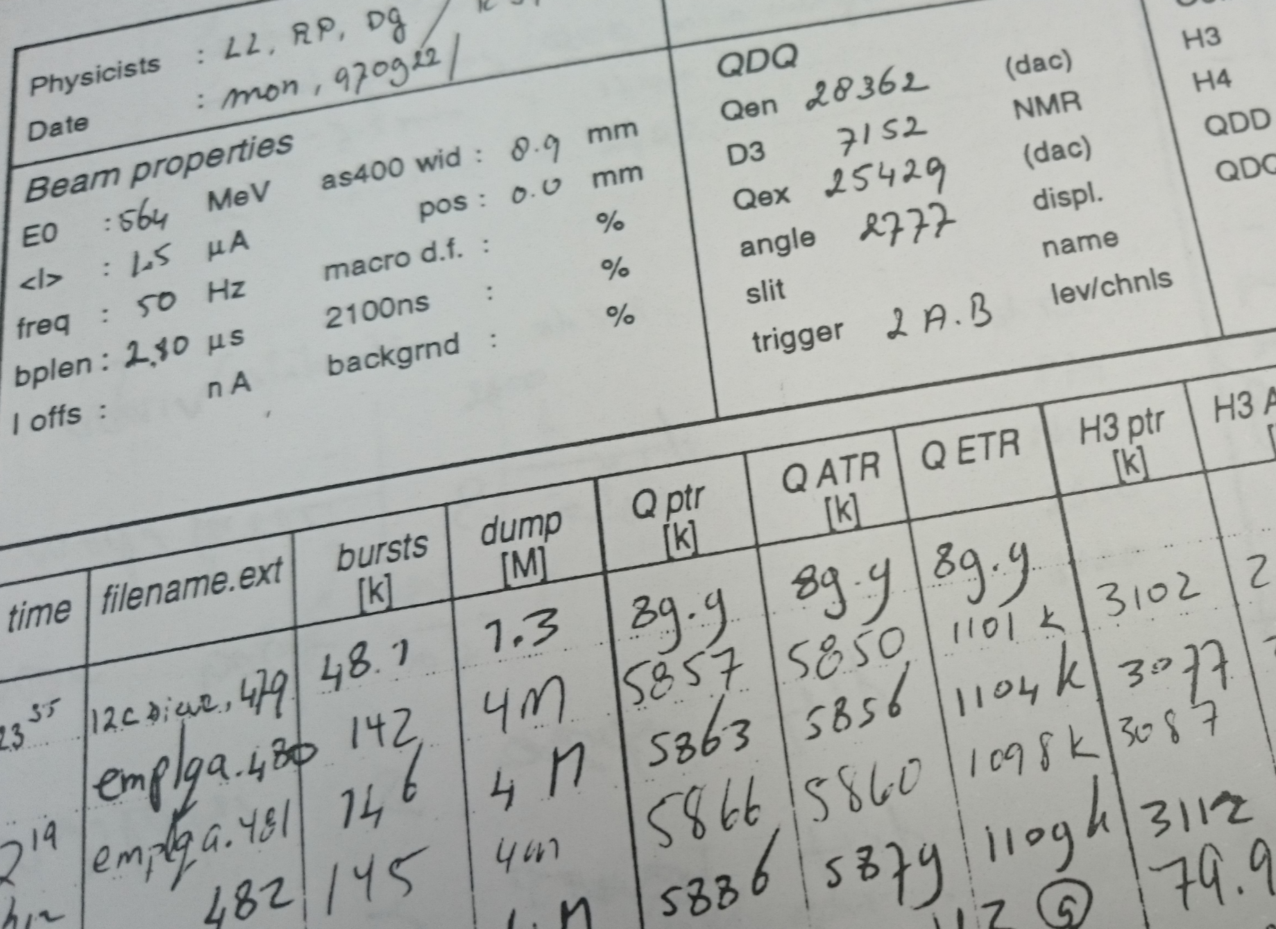
Questions?
David Groep
davidg@nikhef.nl
https://www.nikhef.nl/~davidg/presentations/
https://orcid.org/0000-0003-1026-6606

