Slide 1
From Iron to Service, a glimpse at the Nikhef computing and Data Processing infrastructure
David Groep,
October 2024

Slide 2
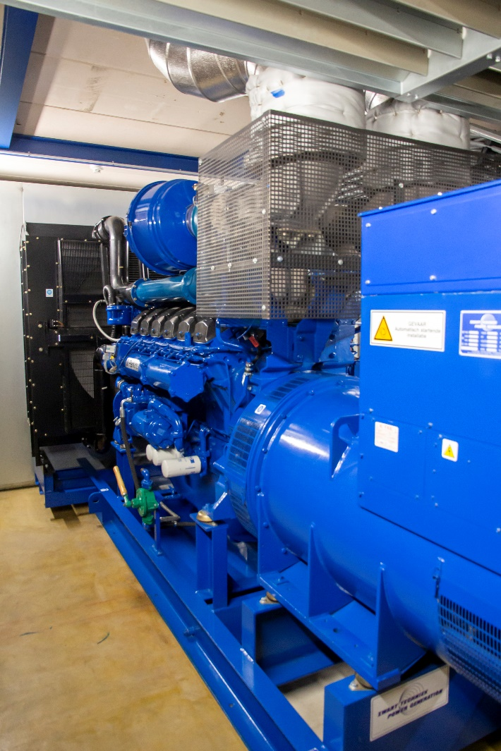
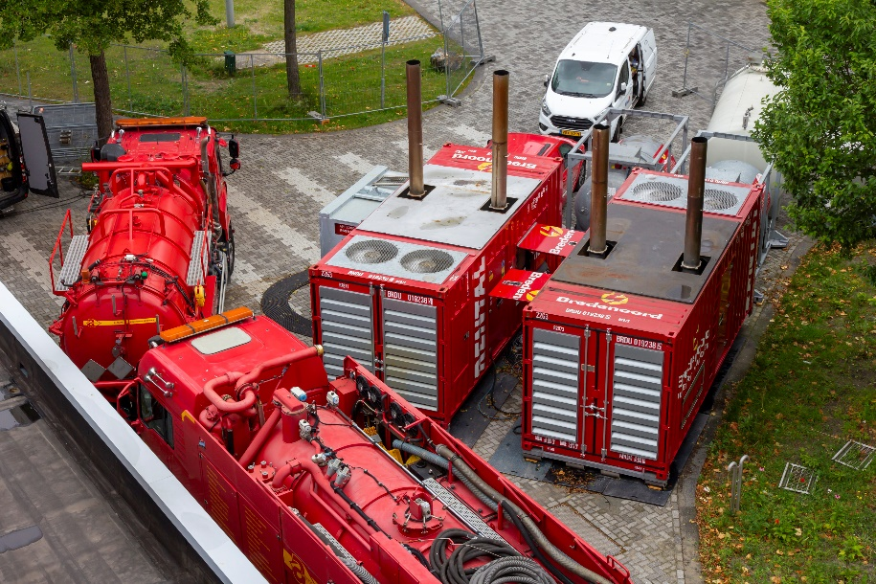
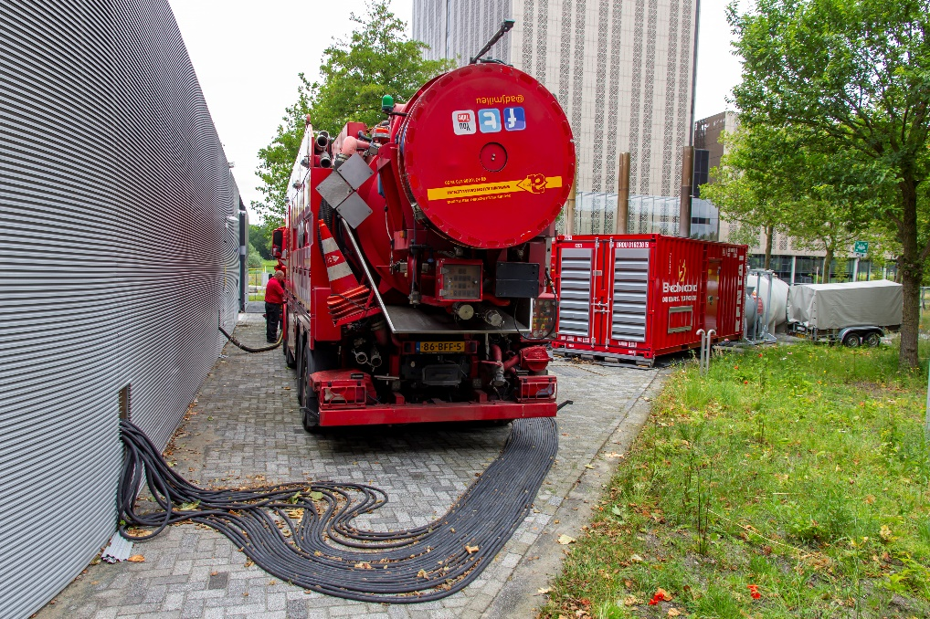
Starting with the basics …

Slide 3
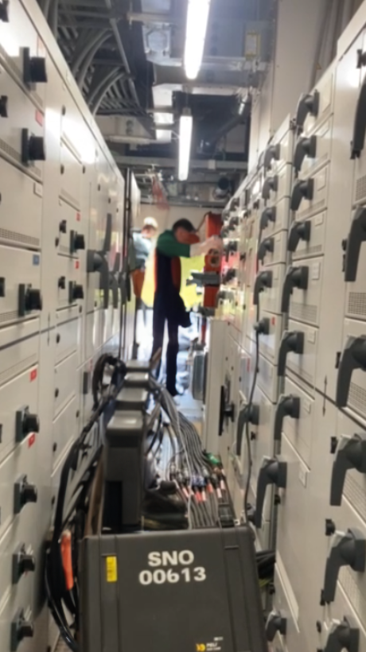
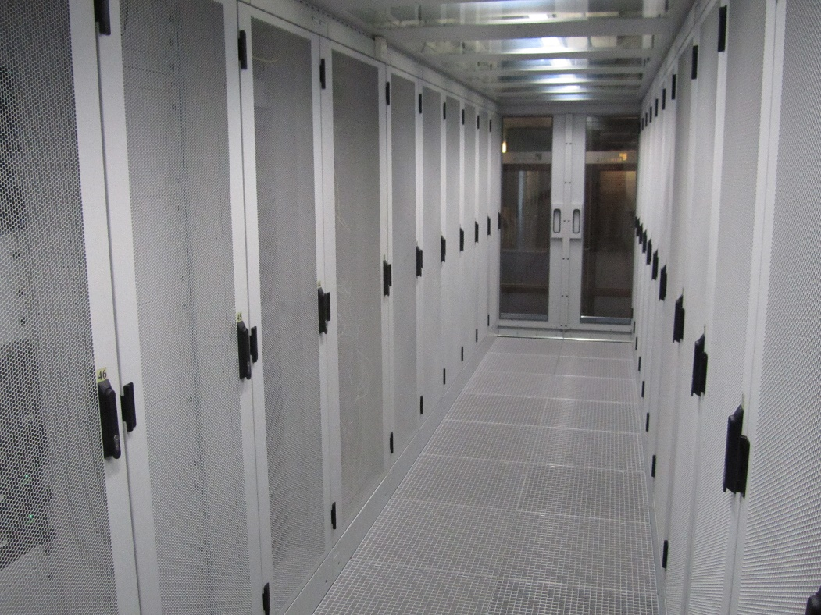
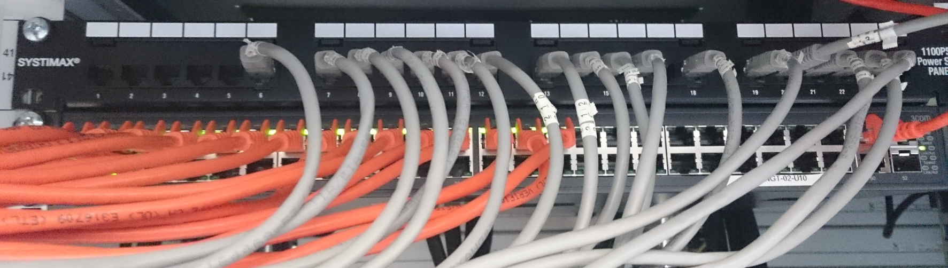
DC infrastructure: power, cooling, racks, and organisation
Left-side image: frame from a movie by Anton Mors, people replaced by … Adobe Firefly (and this was its best result ☹)

Slide 4
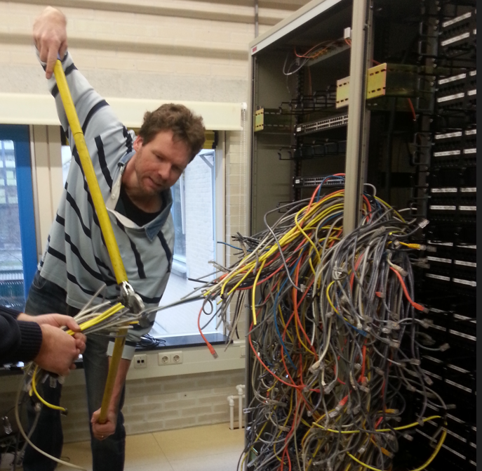
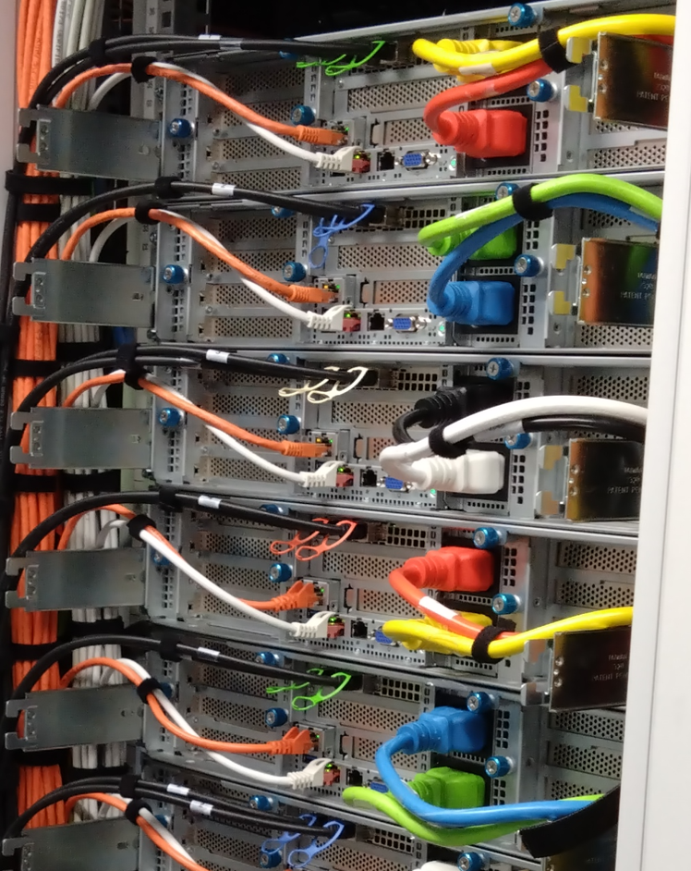
the art of infrastructure construction: beyond spaghetti

Slide 5
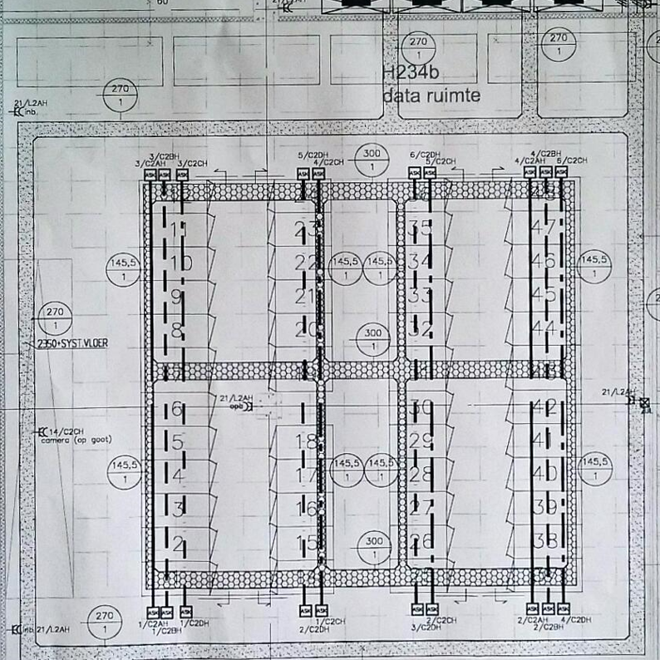
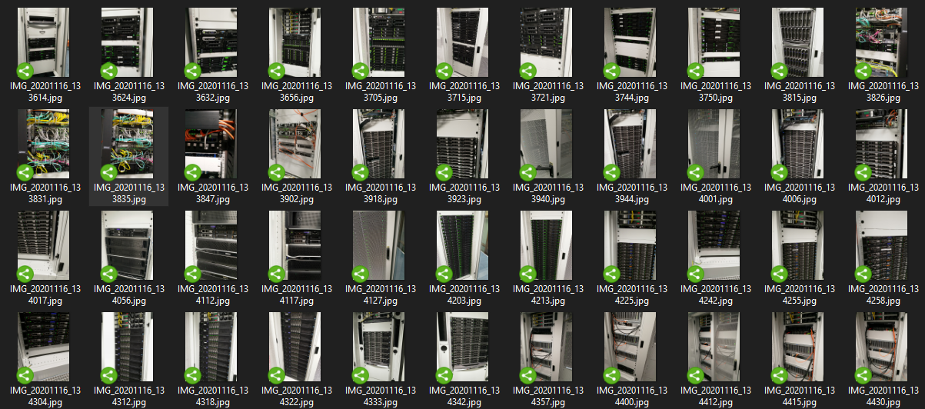
Data Centre: layout and floor plans

Slide 6
Systems physical grouping by functional & security zone

Slide 7
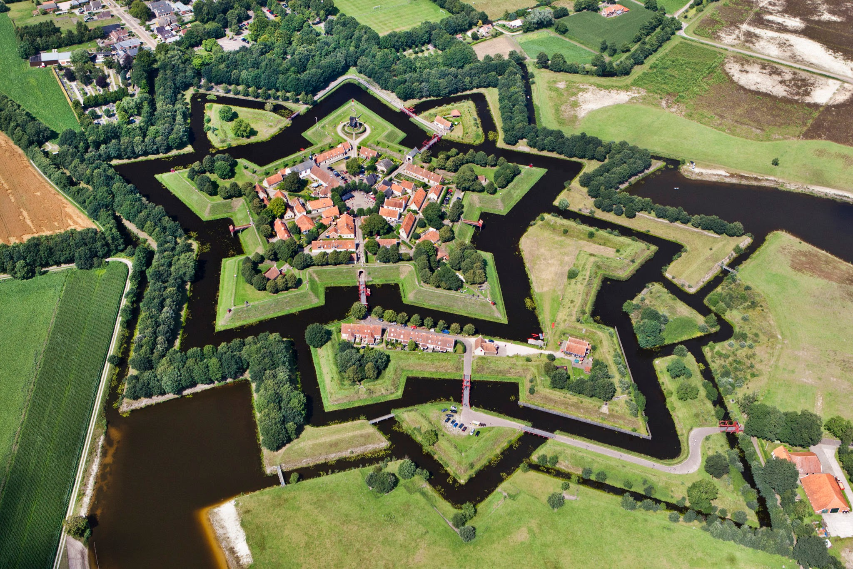
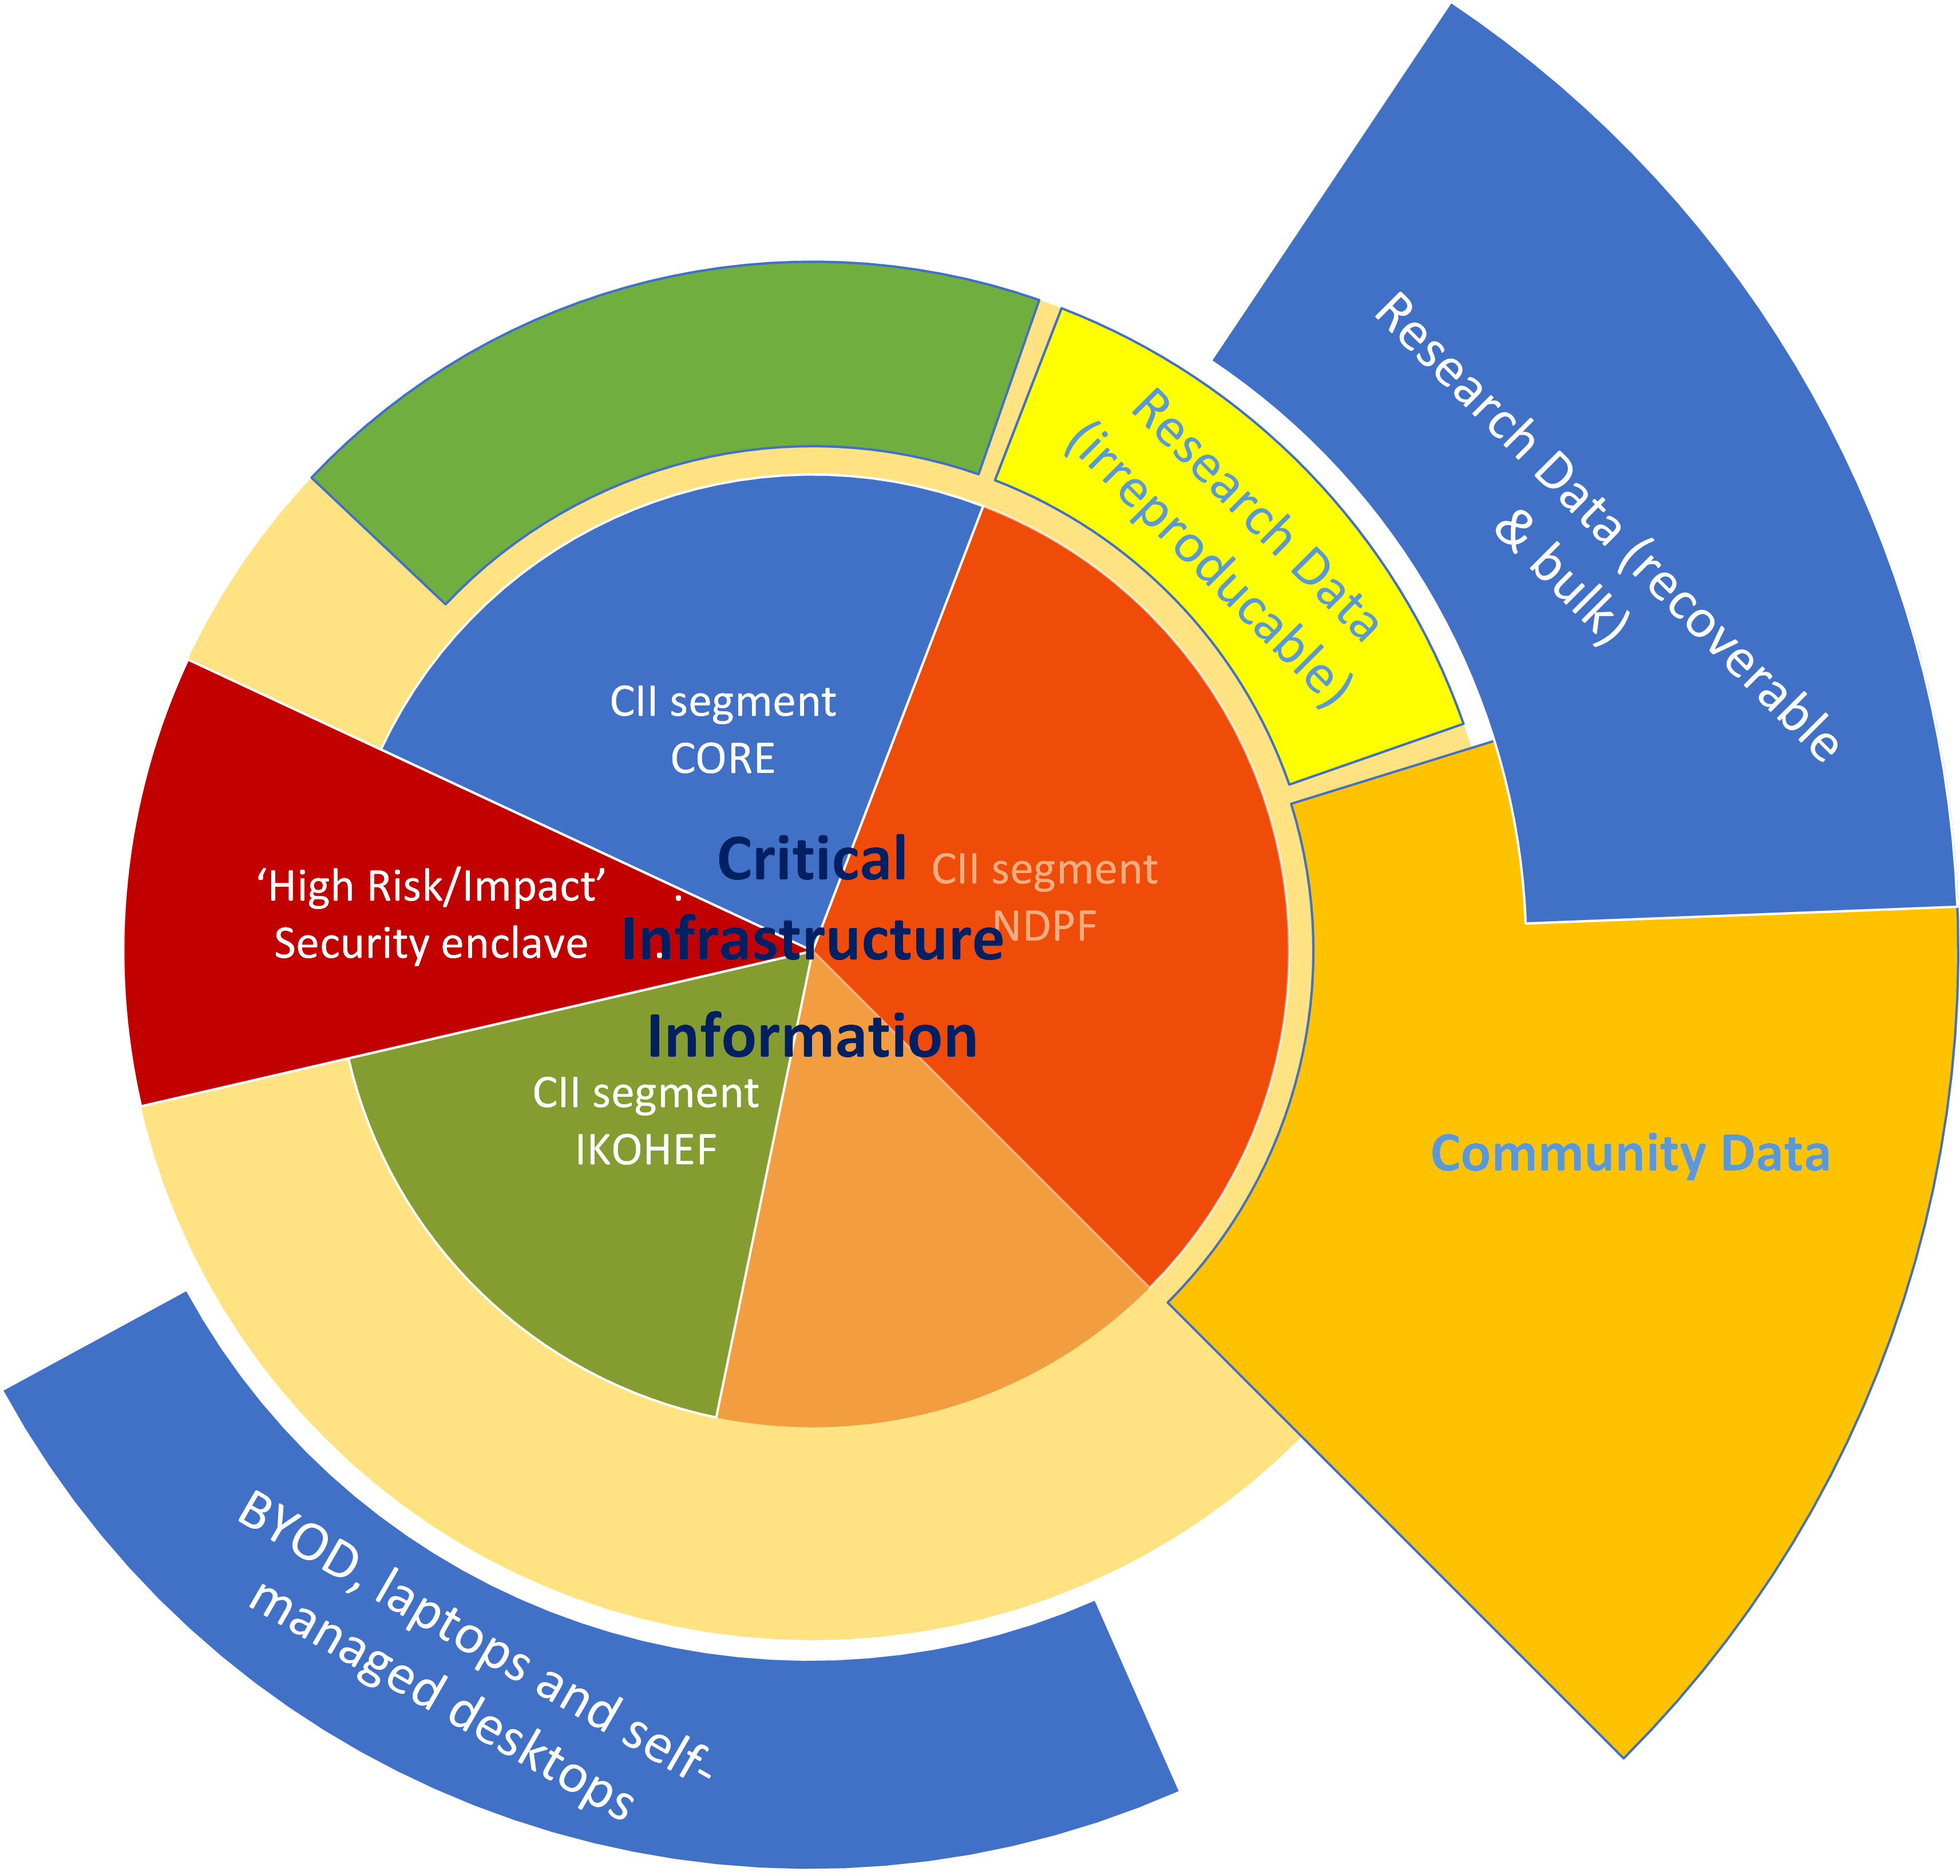
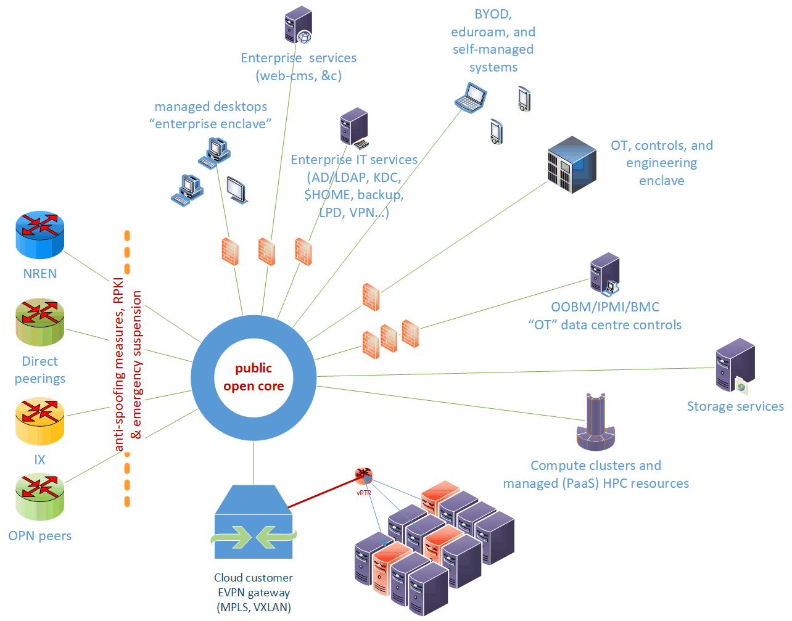
Network structure design: logical and topological view
segmentation: a research network with office enclaves
achtergrondbeeld: Vesting Bourtange

Slide 8
Segmentation by access class and function
Assignments from RIPE LIRs nl-fom and SN-LIR and their subclassing in AS1104

Slide 9
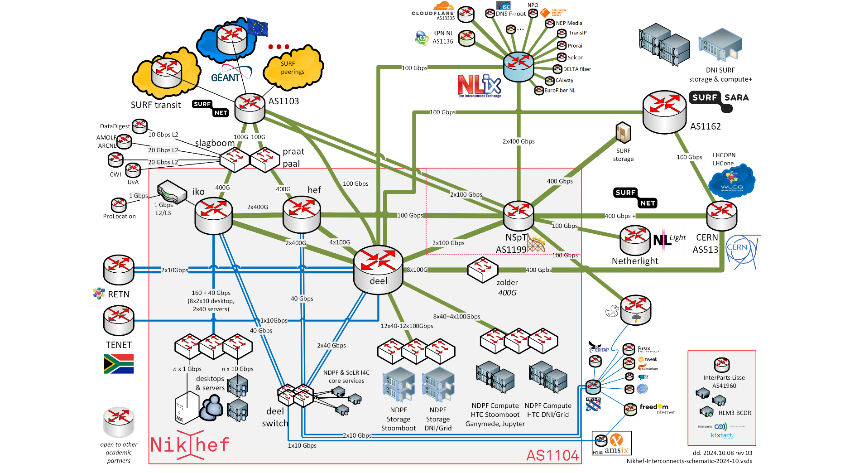
Connectivity view
AS1104 and adjacent systems
in October 2024

Slide 10
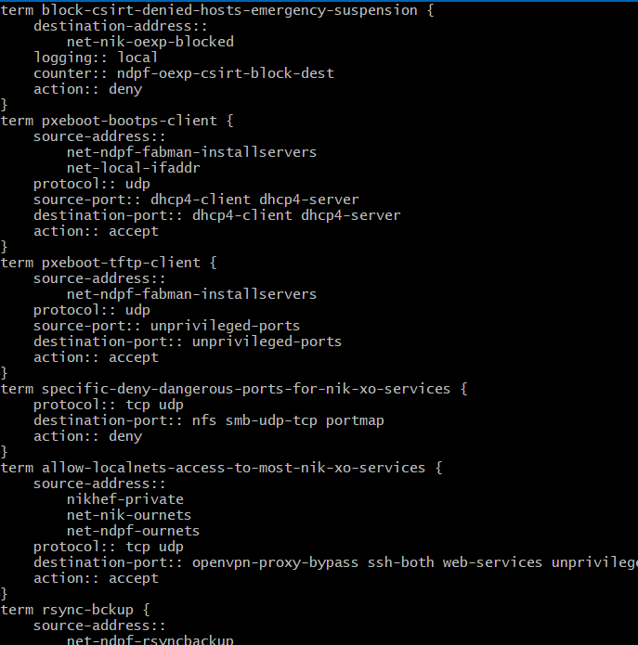
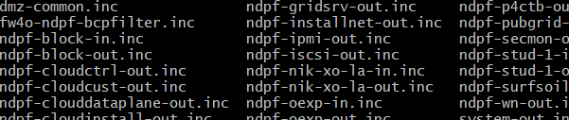
Capirca – vendor agnostic rule expression
Capirca extended for SROS by synnack (https://github.com/synnack/capirca), forked from https://github.com/google/capirca

Slide 11
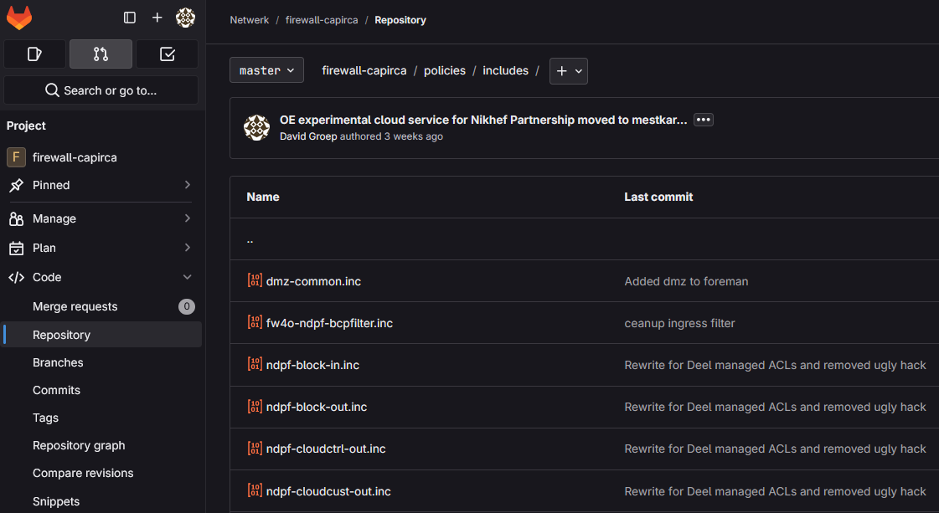
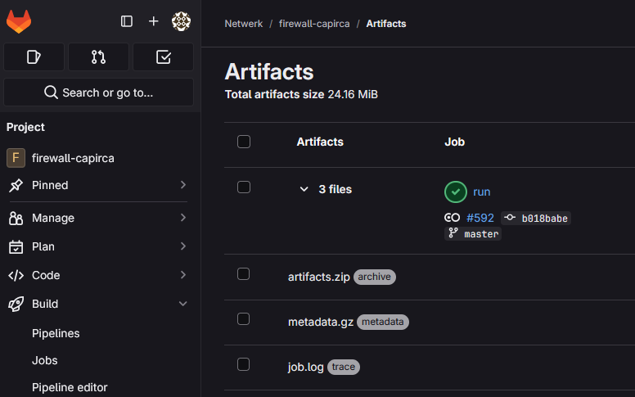
Managed systems … managed networks
Capirca ACL generation for most network
vendor languages (JunOS, Cisco, &c)
https://github.com/google/capirca
Nokia SROS support by WilcoBH (synnack):
https://github.com/synnack/capirca

Slide 12
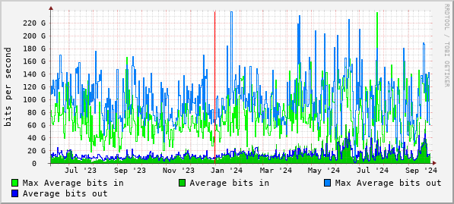
Networks at scale: bandwidth to compute and storage
Compute-storage-transit traffic DeelQFX aggregate (data volume as measured by harbours)

Slide 13
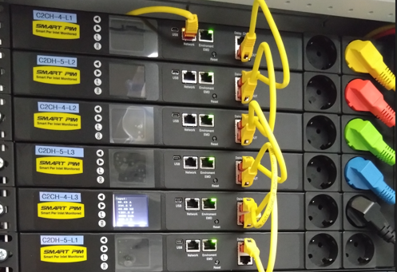

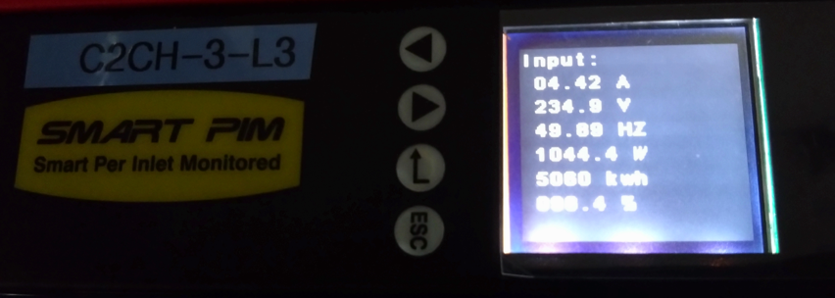
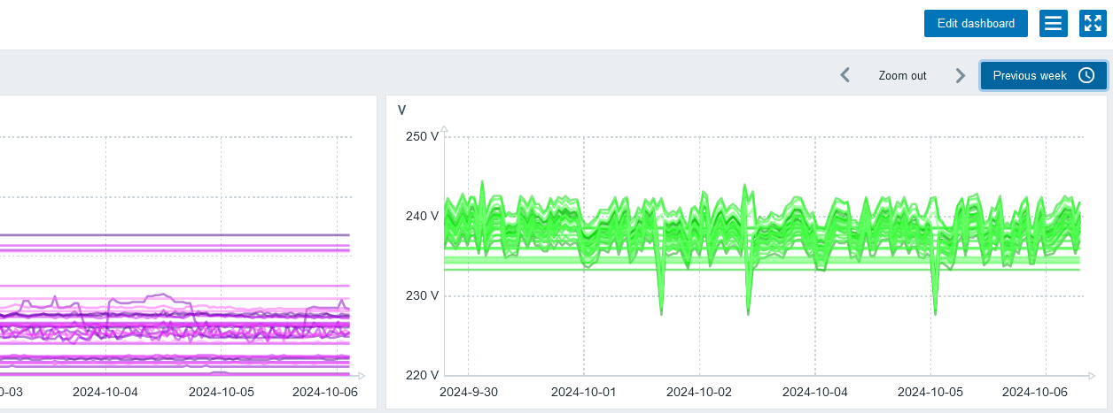
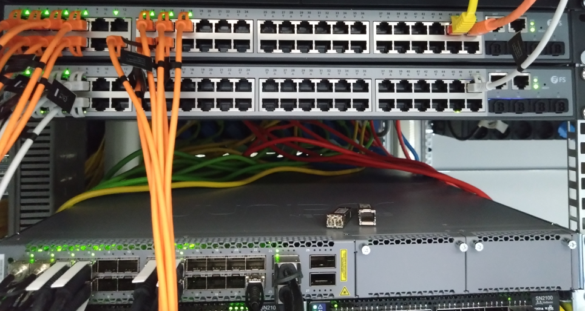
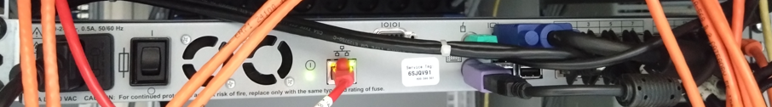
Basic infrastructure:
‘every rack should have one’
Each rack comes with a couple of ‘standard’ elements
remotely monitored PDUs
temperature sensor(s)
VGA+HID+RS232 switch access
1x OOBM GigE ‘dumb’ switch
1x GigE installnet (managed)
1-2x 10/25/100G
data + storage networks
Shown: H234b C06 ‘SOC’ cabinet, C08 rKVM

Slide 14
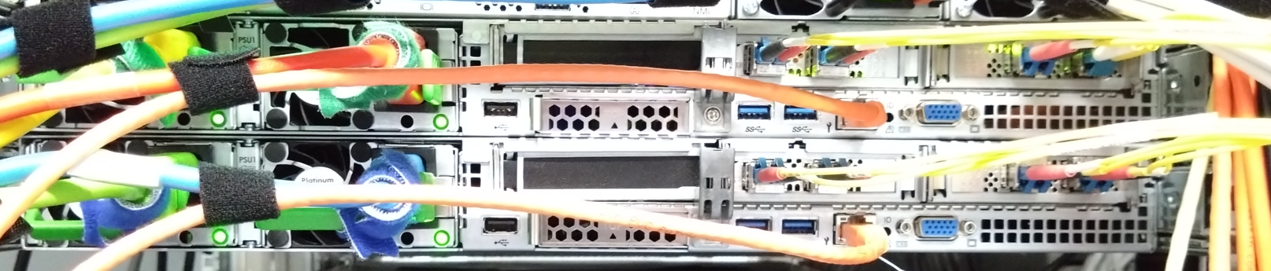
Service clusters: ‘minimally redundant operations basis’
‘Typical’ node has some CPU and limited local system disk, plus:
2x 10/25G VM data net 802.3ad LACP config
2x 10/25G storage network iSCSI with 2 independent fabrics
3x 1000BASE-T install/management 1x for initial install, 2x in 802.3ad
1x OOBM IPMI & Redfish, rKVM and remote media
Nikhef H234bC08: orkestbak OEXP VM service pair. Other service clusters (GSP) are similar. FabMan and PMASec may have local-store only.

Slide 15
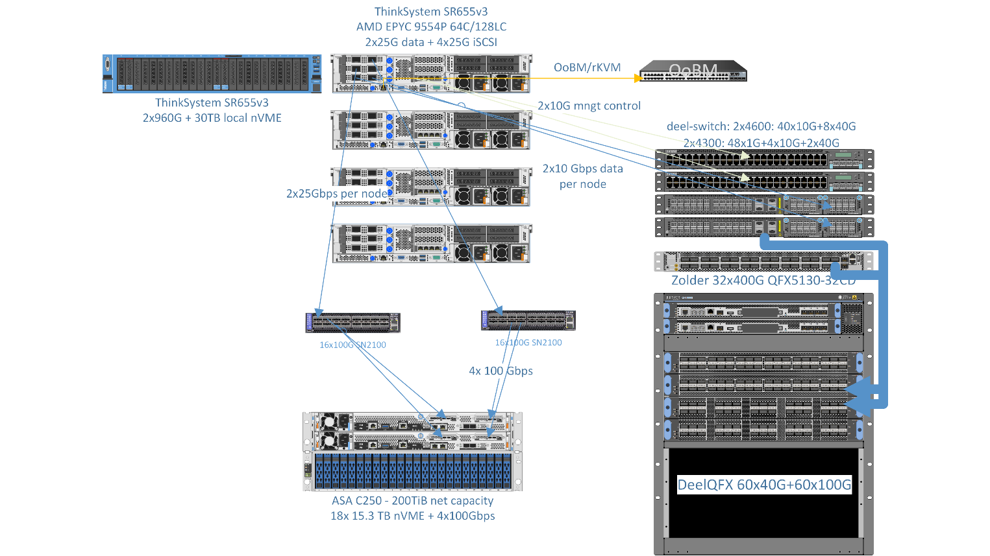
Example: GSP ‘Koning’ en ‘Prinsjes’ (2024 edition) …
NetApp ASA C250 200TB all-flash 4x100Gbps iSCSI, 4x (Lenovo SR655 EPYC 9554P 128 logical + 30TB local ‘ephemeral’ NVME storage + 1100GiB DDR5 4800MHz)

Slide 16
Managing the NDPF and SoLR inventory

Slide 17
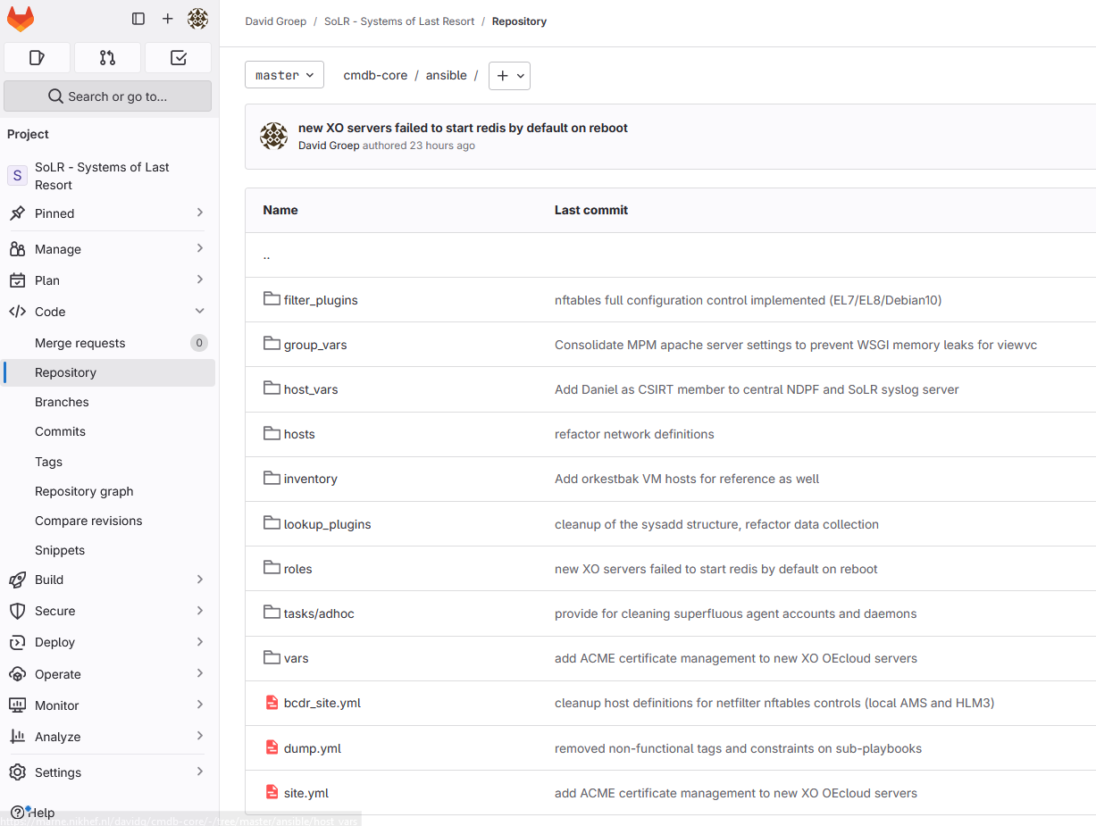
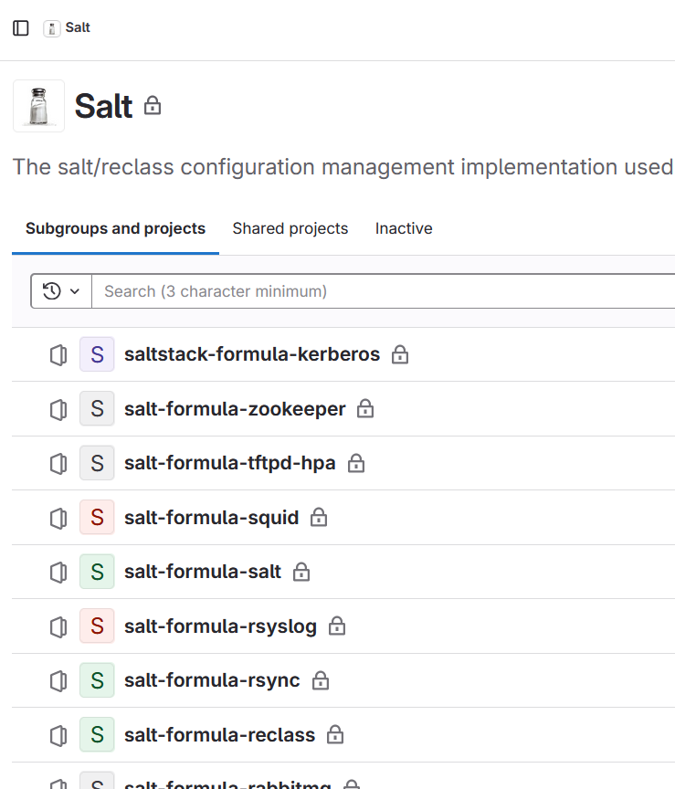
But more importantly … (re)creating and managing them
SoLR systems inventory and site definition (Ansible)
and the NDPF SaltStackj

Slide 18
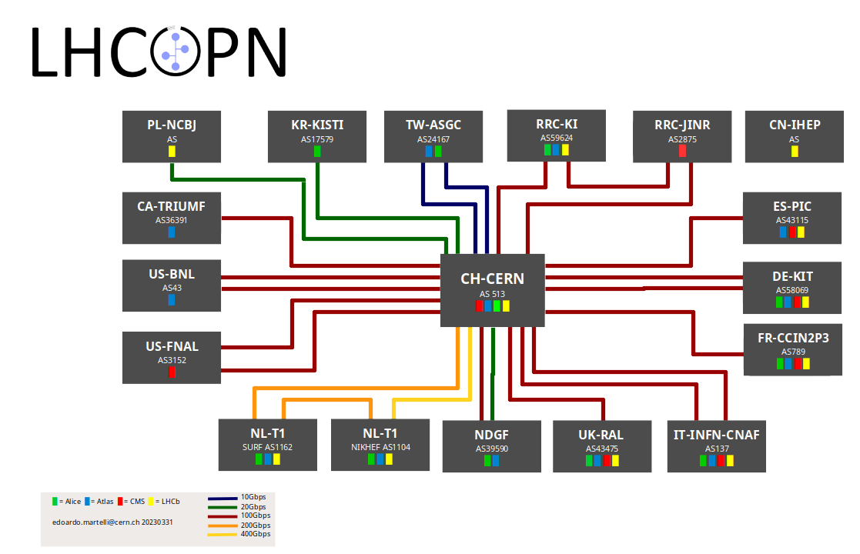
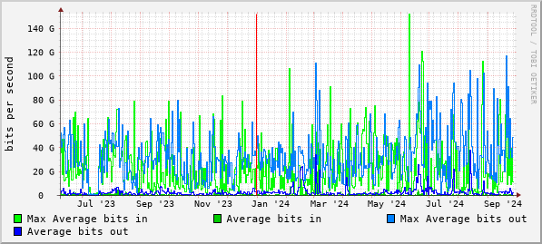
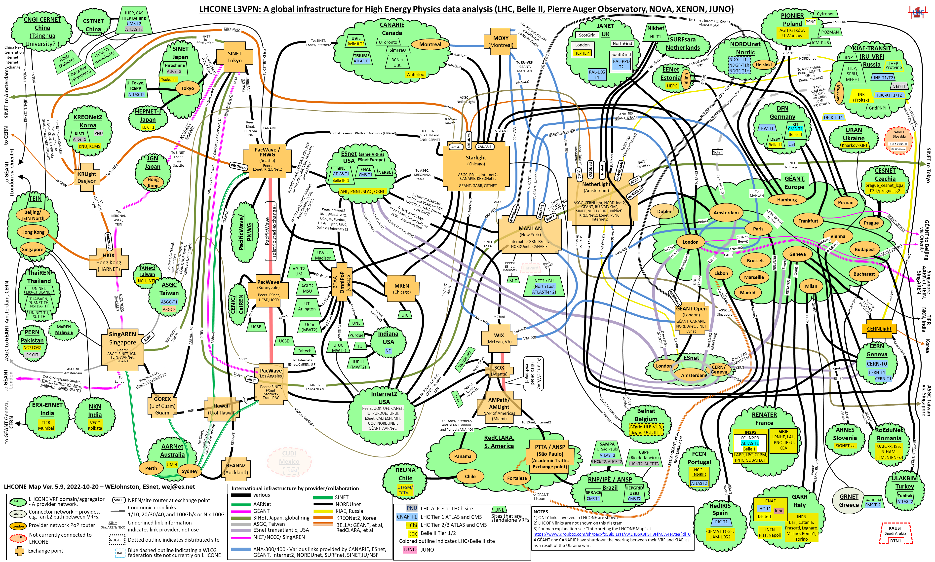
Zolder: 400G access LHCOPN/LHCOne CERN link
ae10: CERN via asd001b-a96-08-6-3 – daily averages; https://cricket.nikhef.nl/ target /zolder.ipmi.nikhef.nl/ae10

Slide 19
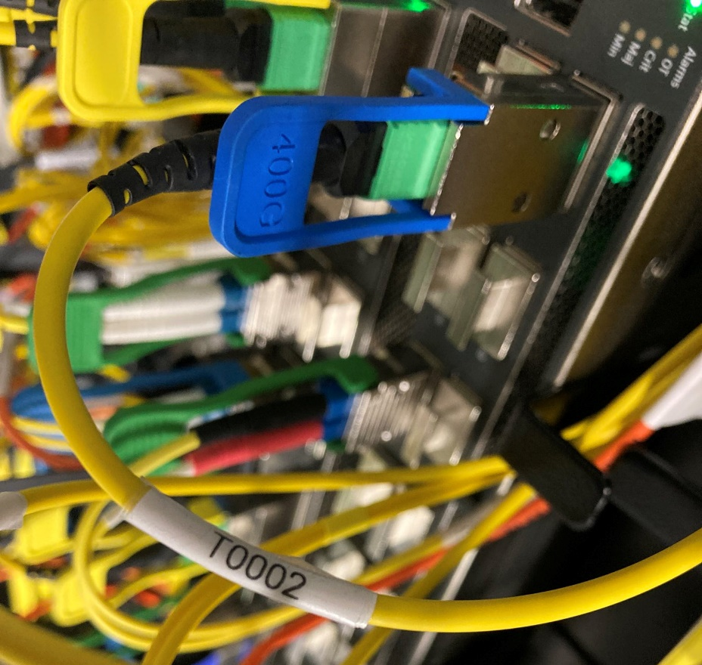
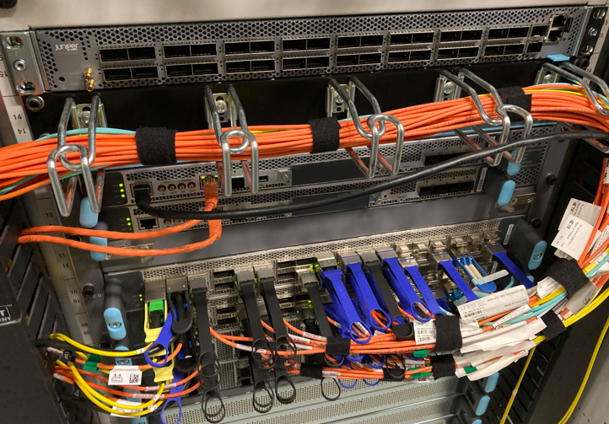
Physical view … QFX5130 400G switch ‘zolder’ top-up
Nikhef H234bC07 – foto’s Tristan Suerink

Slide 20
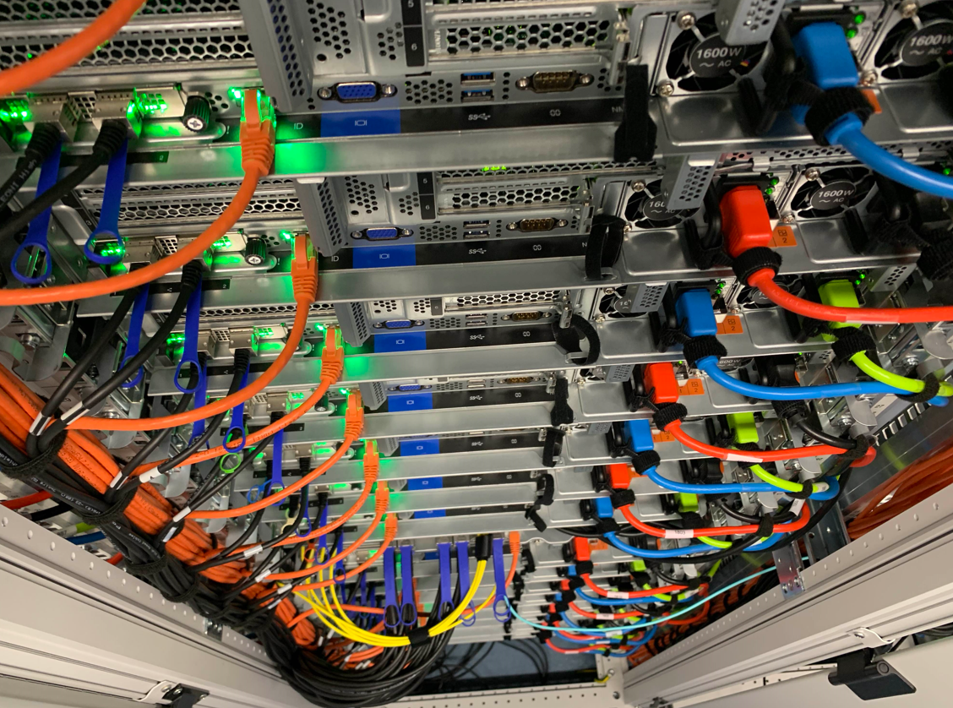
Clusters: high throughput compute and storage service
Data-driven workloads (like WLCG, SKA, WeNMR) need more than ‘just’ compute:
balanced features for node throughput:
CPU, storage, memory bandwidth
& latency, NIC & network speed
single-socket multicore systems are fine,
typical: 64-128 cores per system
network: 2x25Gbps (+ ‘out of band’ management)
memory: 8 GiB/core (so ~ 1 TiB/node)
local disk: 16TB+ NVME PCIe Gen4 x4
add GPUs depending on use case
favour inference-optimized APUs in future
Image: Cluster ‘Lotenfeest’ at the Nikhef NDPF, acquired March 2020. Lenovo SR655 with AMD EPYC 7702P 64-Core single-socket

Slide 21
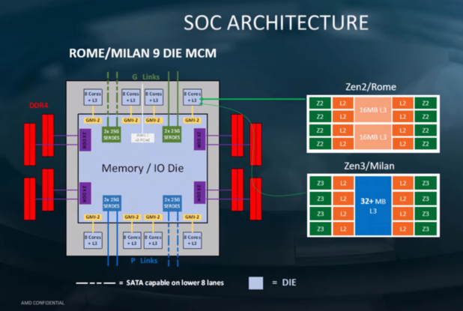
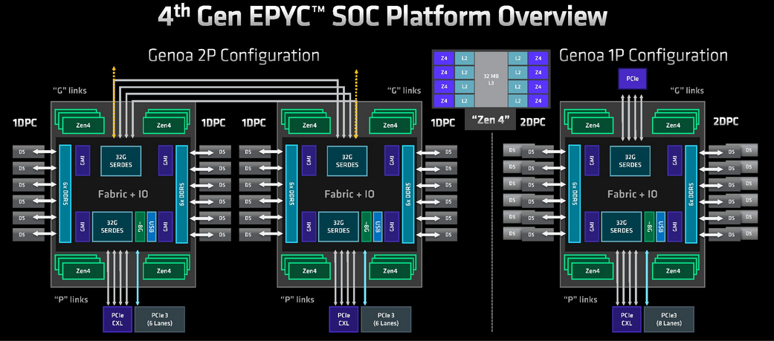
Balanced systems design: from global to local performance
Example: AMD EPYC CPUs
and their influence on systems design
!! not all ‘upgrades’ relevant to all applications
(Rome>Milan hardly improved HTC throughput)
AMD, retrieved from https://m.hexus.net/tech/news/cpu/135479-amd-shares-details-zen-3-zen-4-architectures/ and https://www.semianalysis.com/p/amd-genoa-detailed-architecture-makes

Slide 22
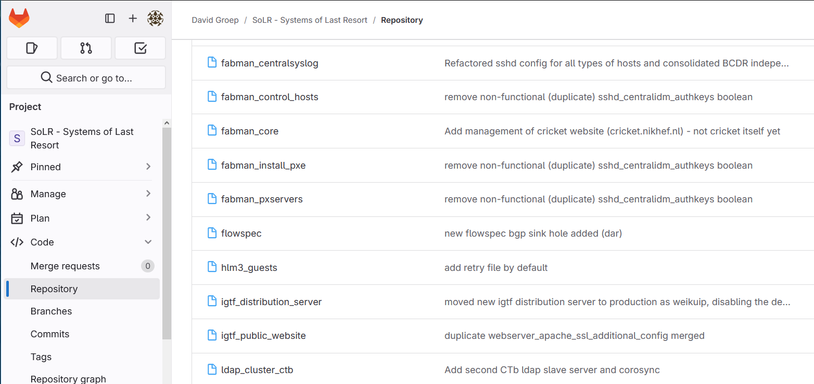
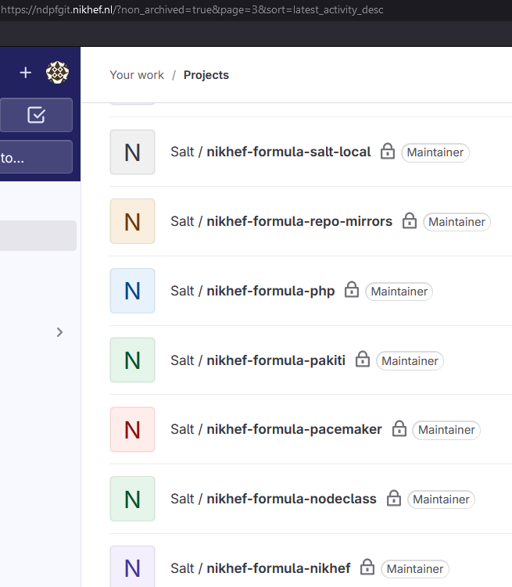
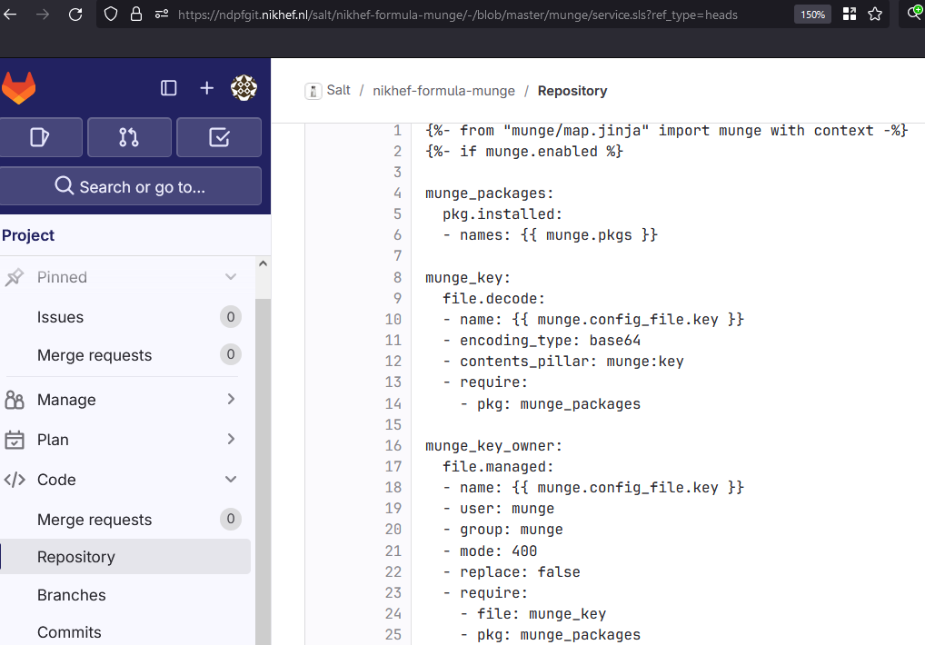
More than one system:
Fabric Management
Managed nodes
Software Servers
http
SW package
Manager (SPMA)
cache
nfs
packages
RPM, PKG
packages
SWRep
(RPM, PKG)
Different modalities are fine as long as all ‘production’ systems are managed and monitored
(yet this does not apply – for a reason - to the experimental technologies platform and Nationale Speeltuin)
ftp
Installed software
kernel, system, applications..
Install server
System services
AFS,LSF,SSH,accounting..
Vendor
System installer
RHEL*, Solaris,
Fedora,…
nfs/http
Node Configuration
Manager (NCM)
CCM
base OS
dhcp
Node
(re)install
Install Manager
pxe
Nikhef NDPF Salt & Reclass (Dennis van Dok, Andrew Pickford, Mary Hester); Quattor: https://en.wikipedia.org/wiki/Quattor); SoLR Ansible
(s)CDB

Slide 23
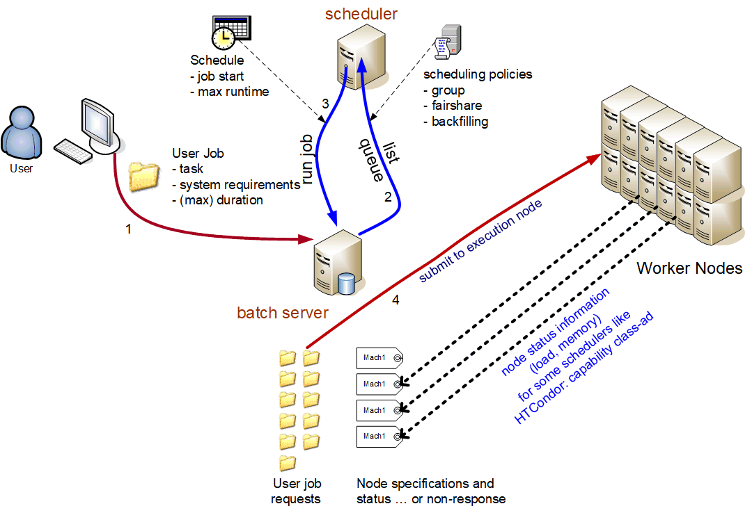
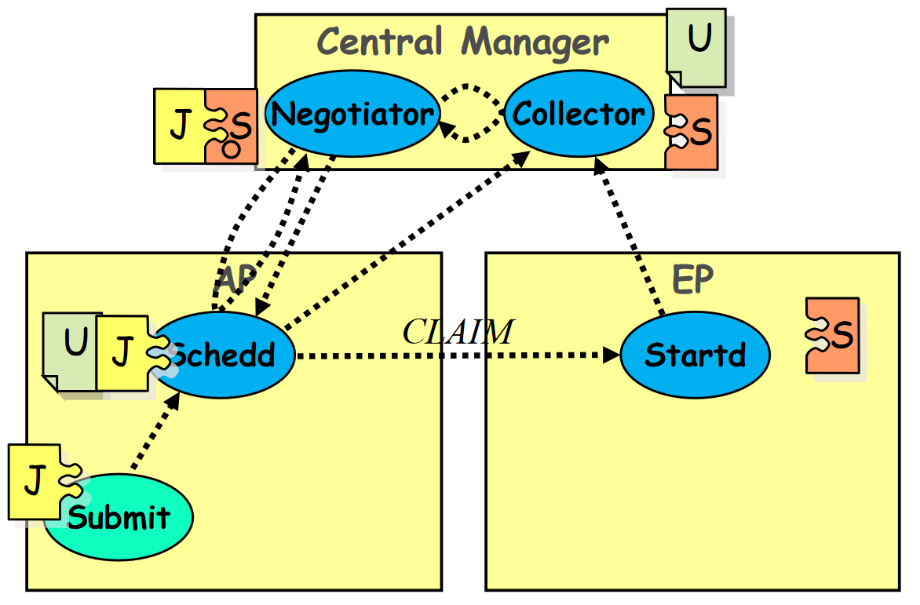

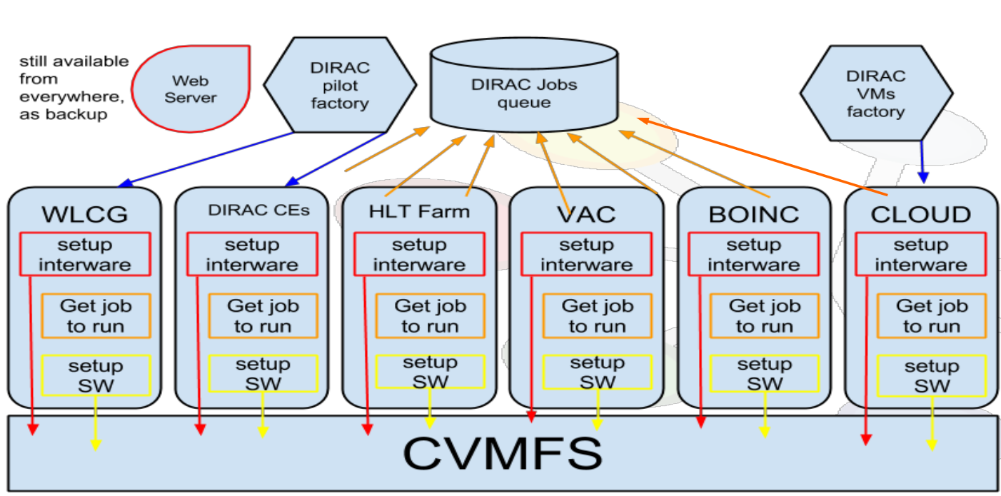
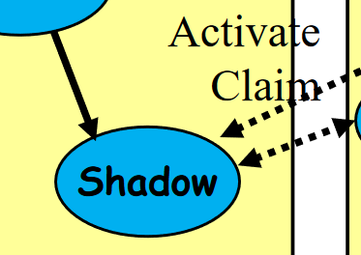

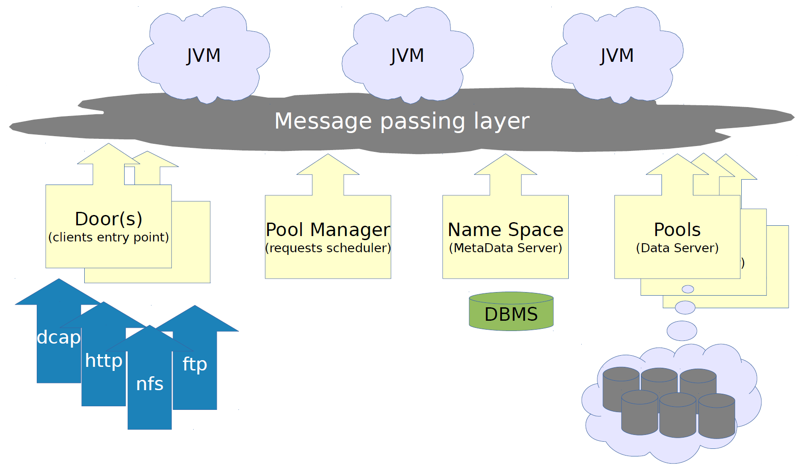

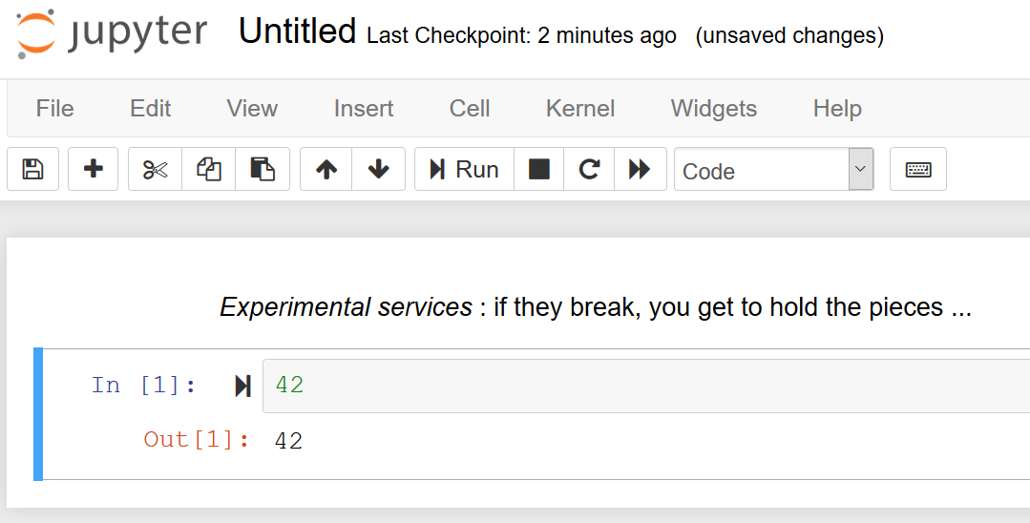

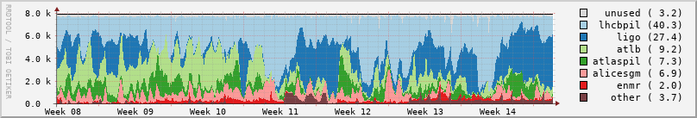
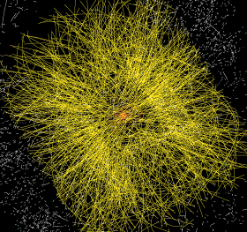
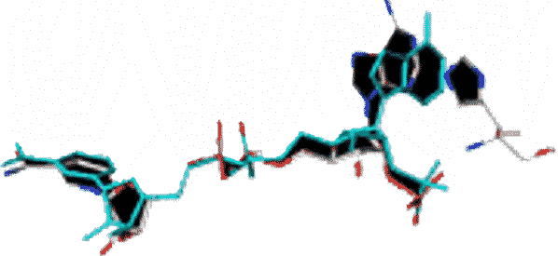
From a bunch of systems to a service
application software and (AppTainer, docker) container images
Occupancy: NDPF (DNI allocation), early 2023; other graphics: DIRAC Interware, HTCondor (UWMadison), Jupyter notebook: Nikhef Callysto service; dCache (DESY, dCache.org)

Slide 24
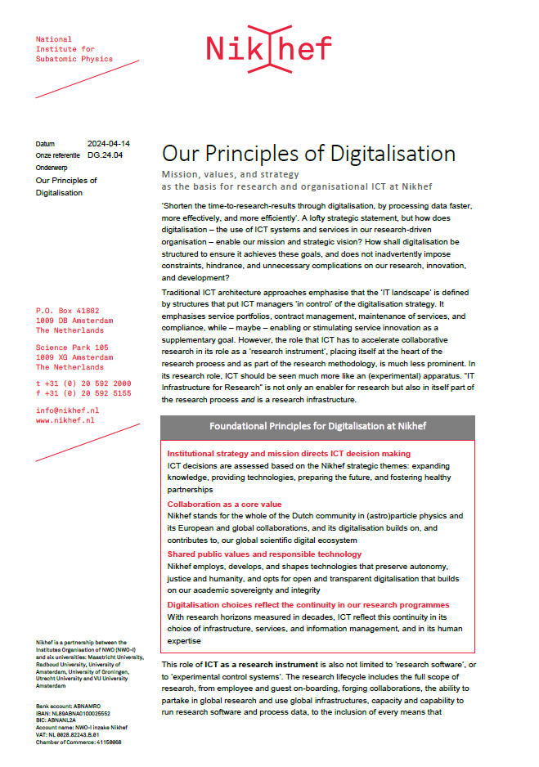
Services and service management
Infrastructure and services for research
driven by the strategy requirements
appropriate service levels and impact
balancing
stability, innovation, and engagement
Service classes
‘enterprise’ services
research computing services (local & DNI)
experimental services

Slide 25
Our Principles of Digitalisation
‘If they are many, they are not principles’, so we set only four:
Institutional strategy and mission directs ICT decision making
ICT decisions are assessed based on the Nikhef strategic themes
Collaboration as a core value
Nikhef stands for the whole of the Dutch community in (astro)particle physics and its European and global collaborations
Shared public values and responsible technology
Nikhef employs, develops, and shapes technologies that preserve autonomy, justice and humanity, that builds on our academic sovereignty and integrity
Digitalisation reflects the continuity in our research programmes
With research horizons measured in decades, ICT reflect this continuity in its choice of infrastructure, services, and information management, and in its human expertise

Slide 26
FitSM – Federated IT Service Management
Structuring service management with https://www.fitsm.eu/
(collaboration and federation-focused light-weight ISO20k/ITILv3 rendering)
production systems of
High Throughput Compute (HTC) and on-line Storage (HTS) services
system & network components supporting provisioning of public services
pre-production and systems for service portfolio development
Scope excludes by design experimental and research systems,
apart from Supplier Relationship Management and procurement

Slide 27
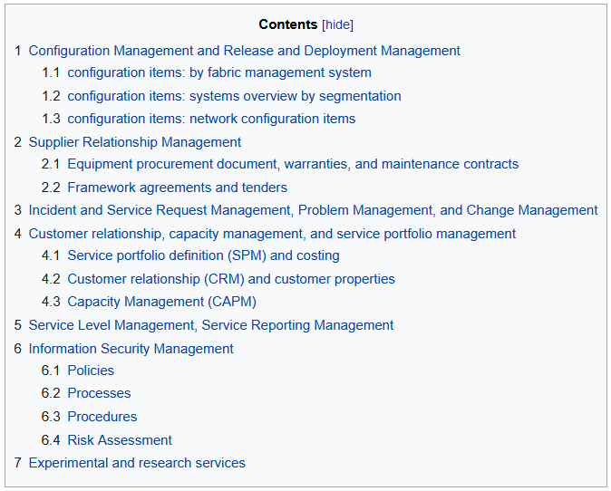
Coordinated service management
Single source of truth
Inventory and support contract insight
Configuration Management
  for systems management several used in parallel,
  which is not per-se an issue: Saltstack, Ansible
Facilitates our ISM
Technical and Organisational Measures
Methodological alignment with SURF DNI

Slide 28


































And … we live in a federated global world

Slide 29



Collaboration: an inherently-cross-domain issue ..
Example from the LHC Computing infrastructure WLCG
170 sites
~50 countries & regions
~20000 users
just how many interactions ??
AuthN & AuthZ, architecture and trust should
align with collaboration structures, and
be outward facing: open, scalable, & multi-domain
people photo: a small part of the CMS collaboration in 2017, Credit: CMS-PHO-PUBLIC-2017-004-3; site map: WLCG sites from Maarten Litmaath (CERN) 2021

Slide 30
IdM: ‘AARC’ & REFEDS compliant Trust & Identity AAI
Central identity management
designed to allow innovation based
on REFEDS & AARC models
‘our users are the validation’
production-quality
with rapid innovation cycle
Basis for all AAI (identity & access)
OpenLDAP as core
bespoke integration suite
SimpleSAMLphp IdP and SP proxy
Support SAML, OIDC, OIDfed,
and REFEDS MFA & RAF natively

Slide 31

Research Computing Services
https://www.nikhef.nl/pdp/doc/service-portfolio

Slide 32



Analysis cluster
https://kb.nikhef.nl/ct/

Slide 33



Can can analyze small things
in an executable
Jupyter paper

Slide 34

Including analyzing the infrastructure itself …

Slide 35



Research Engineering support and engagement
computing courses
and ‘Office Hours’ concept

Slide 36
Although users may send some rather confused questions …

Slide 37



A coherent collection
of emergent services
Nikhef Partnership facilities
Stoomboot: ~2000 cores and ~4 PByte dCache
Callysto: JupyterHub with $home and SSO login
eduVPN: securely access Callysto and your home
Mattermost’s ‘STBC-users’ channel to talk & ask
eVA, SURFdrive, and FileSender to collaborate
Global Services
WLCG, SURF DNI, and EGI: HTC compute, CVMFS, …
Experimental services: ShareMD, Commute, …
But do read https://www.nikhef.nl/pdp/doc/experimental-services before using experimental services ...
Stoomboot statistics: https://www.nikhef.nl/pdp/doc/stats/stbc-grisview-week, https://www.nikhef.nl/pdp/stats/stbc/intern/stbc_summ_plots

Slide 38




Experimental services
https://www.nikhef.nl/pdp/doc/experimental-services

Slide 39




Network monitoring: the SOC, MISP and WLCG SOC-WG
Nikhef SOC, H234b C06
WLCG SOC: David Crooks and Liviu Valsan, ISGC2019 proceedings,
PoS(ISGC2019)010

Slide 40
MISP Threat intel sharing (plus Shodan & ShadowServer)

Slide 41
When things go south …
Backup and BC/DR

Slide 42
But if something does go belly-up
we should know what to do

Slide 43
BCDR
The Nikhef XXXXXXXXXXXXXXXXXXX BCDR setup – foundational service capability more than 30km away from the primary site …

