Slide 1
Computing resources and research in the Nikhef context
February 2022
David Groep
Physics Data Processing

Slide 2
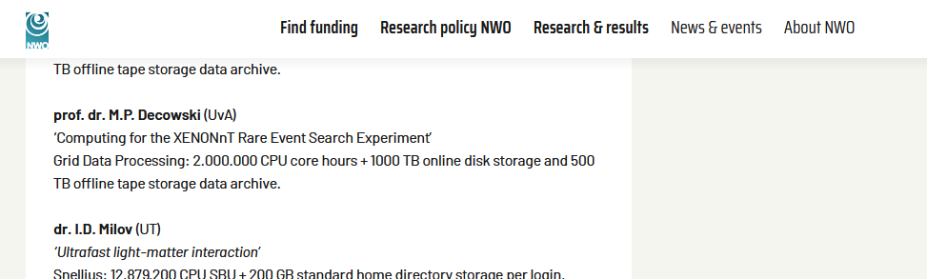
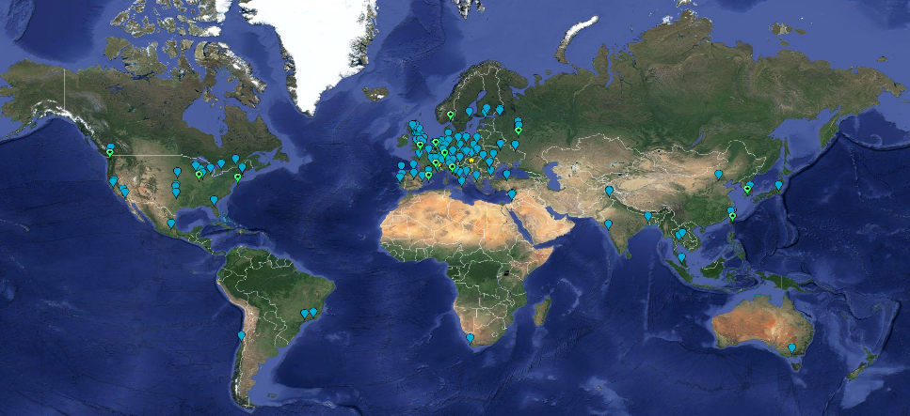
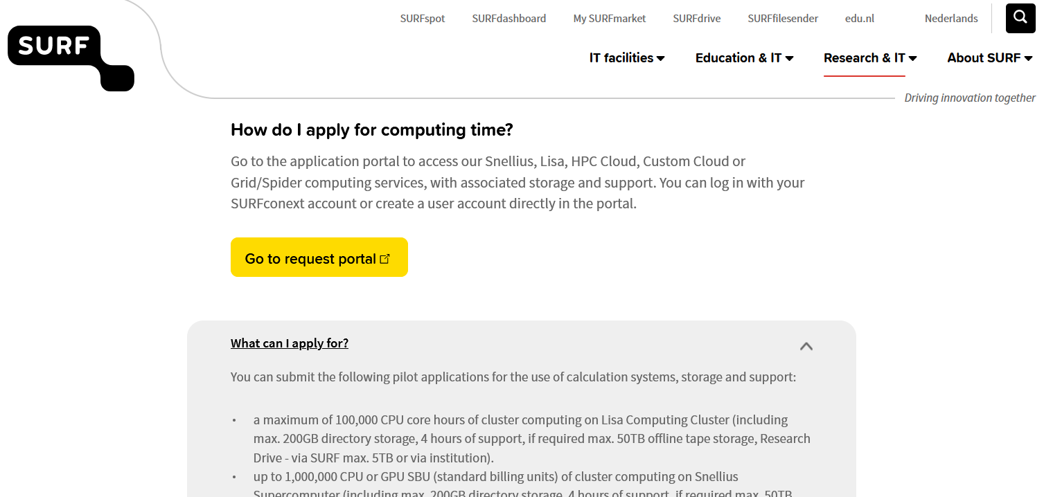

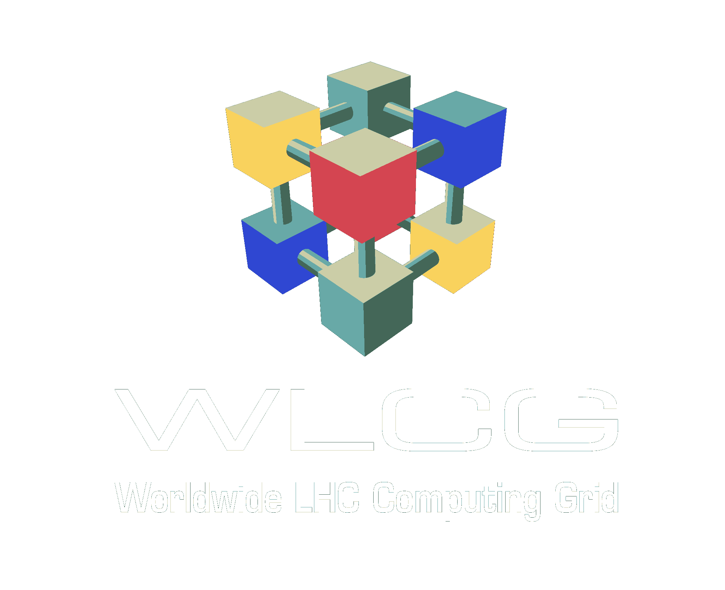
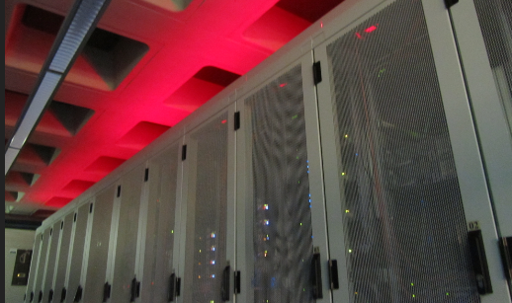
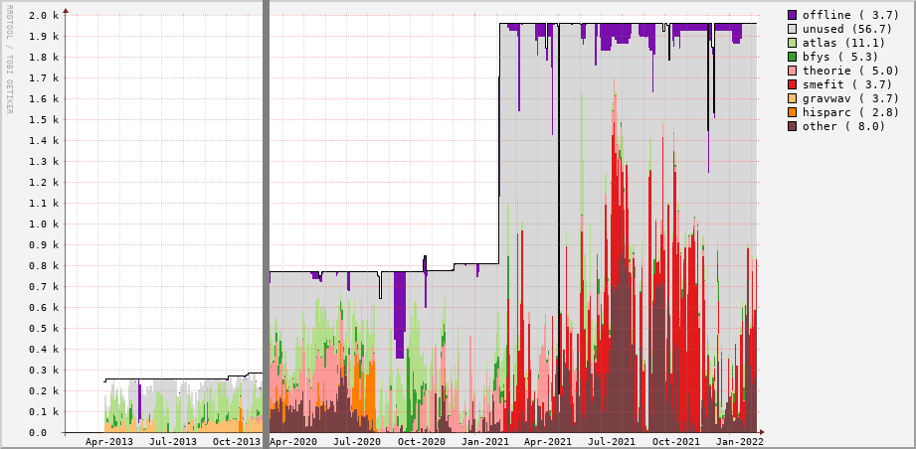
Nikhef and the federated e-Infrastructures resources
SURF + Nikhef national resources
global T1 resources through Nikhef and SURF
Nikhef-collaboration
specific ‘Stoomboot’
compute & data services
Images: CERN, SURF, Nikhef/D.Groep. Map sublayer: Google

Slide 3
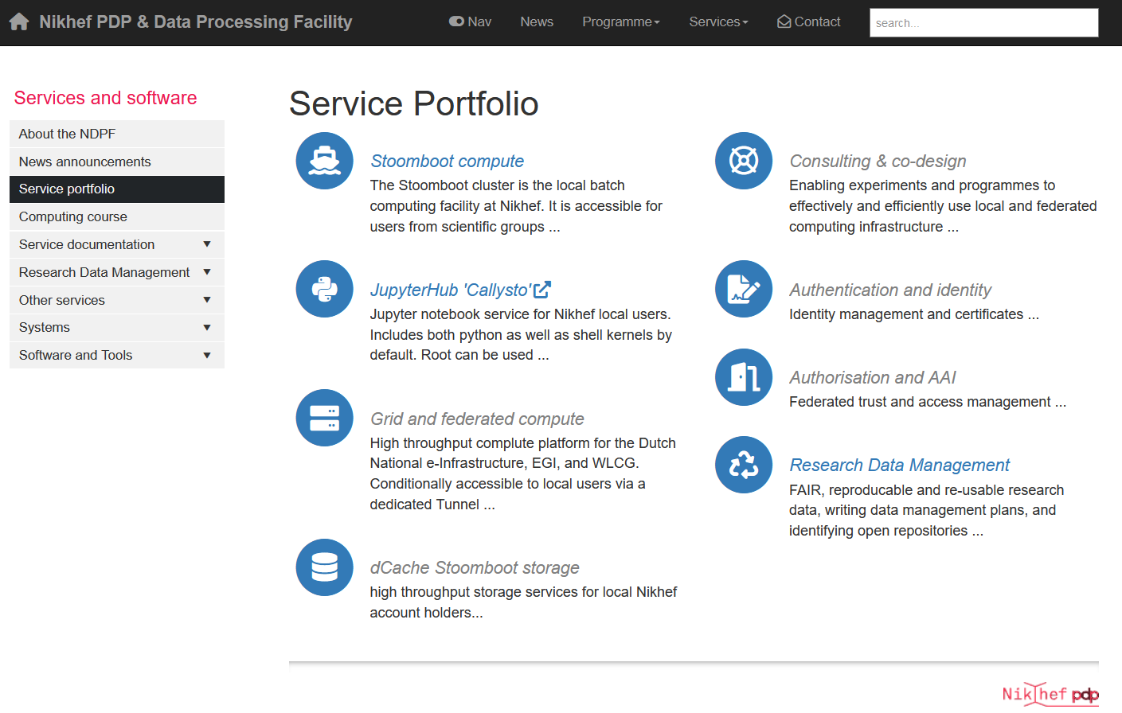
Nikhef PDP & the Nikhef Data Processing Facility “NDPF”
Specialised resource services
our ‘local’ analysis facility
federated ‘Grid’ services for the
Dutch National e-Infrastructure
wLCG ‘Tier-1’ (Nikhef+SURF)
Specialised people are important!
systems research engineering
team (“DevOps+”, ~ 6FTE)
linked to more generic ‘computing support’, but with advanced R&D role
our software and standards engineering teams cross-fertilise this work
link to research data management activities (@Nikhef: this is in PDP)

Slide 4
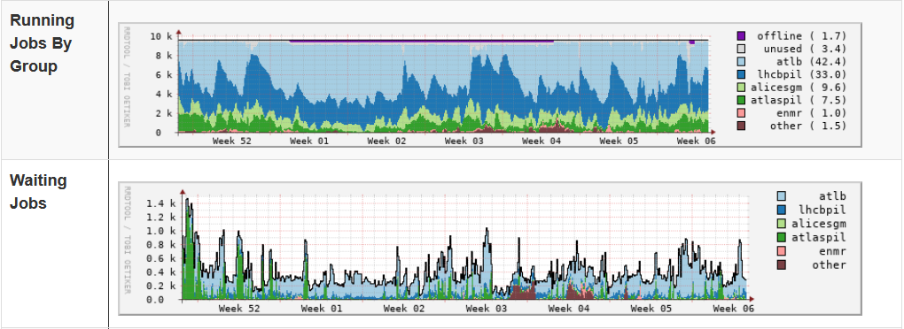
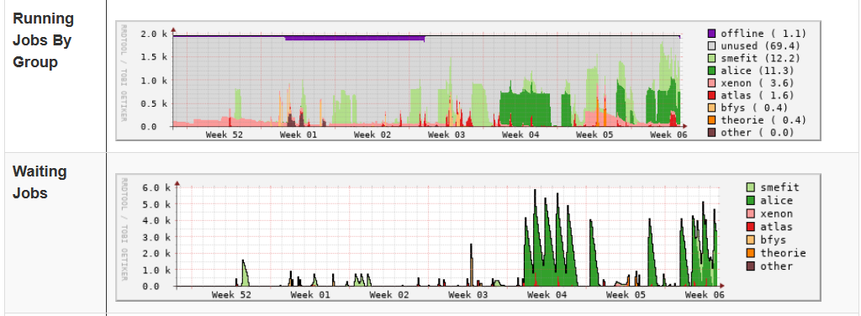
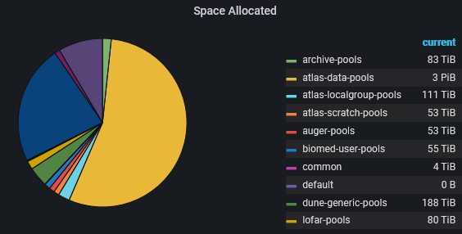
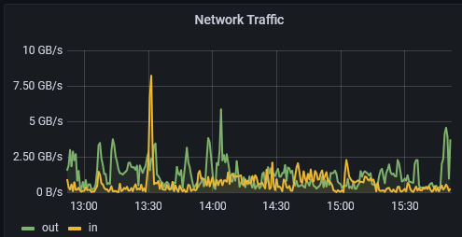
NDPF resources today
High Throughput Compute
Grid/DNI & Stoomboot
9500+1500 cores and some GPUs
Scalable distributed storage
~7 PB federated + 3 PB local
multiple storage qualities
Experimental facilities
nationalespeeltuin.nl
infrastructure innovation,
with SURF SOIL and vendors
Images: Nikhef NDPF Prometheus and GRIDview data, February 2022, https://www.nikhef.nl/pdp/stats/

Slide 5
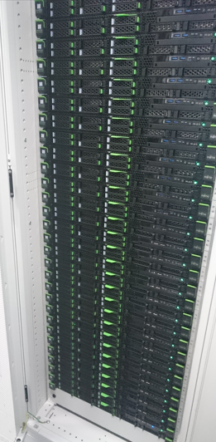
Stoomboot – our friendly local facility
A Nikhef collaboration ‘standard service’
for anyone with a Nikhef account,
i.e. registered users ‘with some plausible association’
resource priority depends on fair sharing for compute, and
shared for all Nikhef programmes (no experiment clusters)
HPC and federation expertise bundled in
joint DevOps team, the PDP research programme,
and (access and research) software development team
Fully connected to Nikhef’s research network structure
we postulate that an R&E institute has an R&E data network
with maybe some office enclaves, not the other way round!
Image: Nikhef NDPF “Chocolade” compute nodes, AMS/H234b

Slide 6
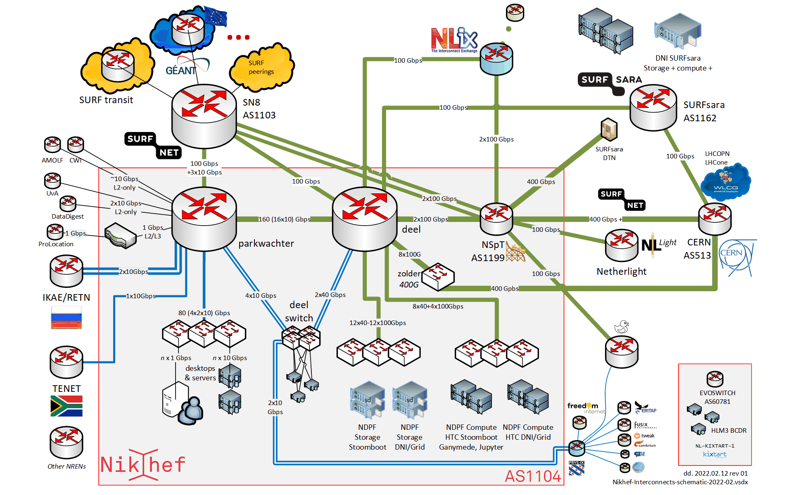
Nikhef network topology as of February 2022
Image: the Nikhef Autonomous System and its interconnects, D.L. Groep/2022

Slide 7
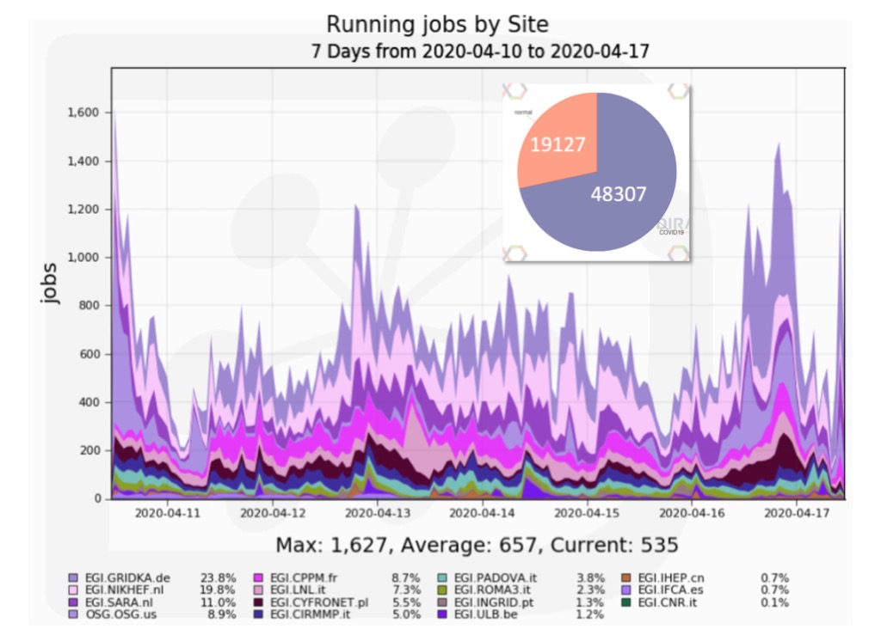

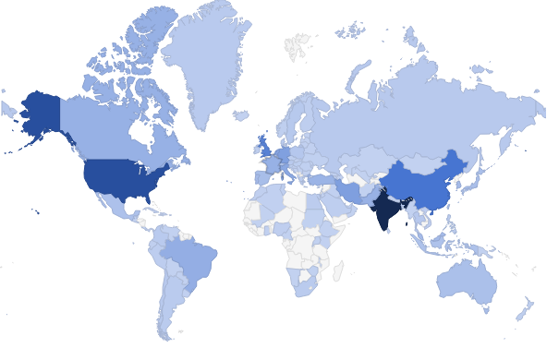
Resource access modes
Modelled around ‘free at point of use’
local resources are always there for those with ‘some reasonable link’ to Nikhef programme & collaboration
access to the DNI, at Nikhef and at SURF, follow community centric access model - one Dutch qualified applicant is enough to bring in a global community
application via SURF e-Infra portal (large requests via an NWO route)
positive effects of collaborative research more than warrant this model
image from: https://www.egi.eu/use-cases/research-infrastructures/wenmr-a-worldwide-e-infrastructure-for-nmr-60348-2/
Haddock User Map WeNMR portal - Alexandre Bonvin, Bijvoet Centrum voor Biomoleculair Onderzoek, Universiteit Utrecht

Slide 8
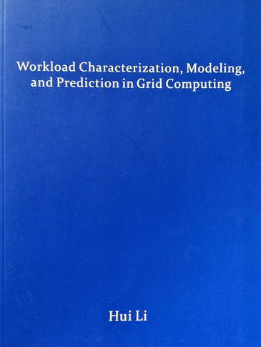
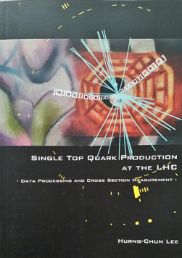
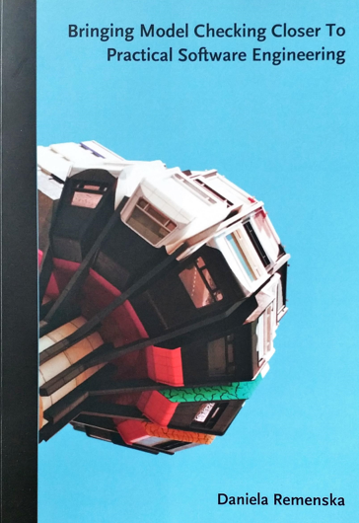
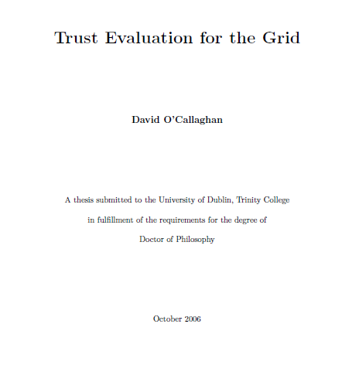
Beyond machines - collaborative computing research
the (Nikhef) e-infra, with its diverse user base and large global
applications, as a computer science and modelling proving ground
Some past computer science research PhD projects
Data intensive workflow scheduling research validated in ATLAS
(Hurng-Chun Lee, UvA – with ATLAS)
Estimated run time prediction in near-full occupancy scenarios
on Nikhef WLCG and DNI clusters (Hui Li, LIACS – with PDP)
Model checking for distributed scheduling systems, using
LHCb DIRAC as the object
(Daniela Remenska, VU CS – with PDP and LHCb)
Many international examples as well: Assurance models for federated infrastructures
(Daniela Pöhn and Jule Ziegler at LRZ); Trust modelling (David O’Callaghan, TCD)
Images: front covers PhD thesis from Nikhef and/or with key Nikhef PDP participation

Slide 9
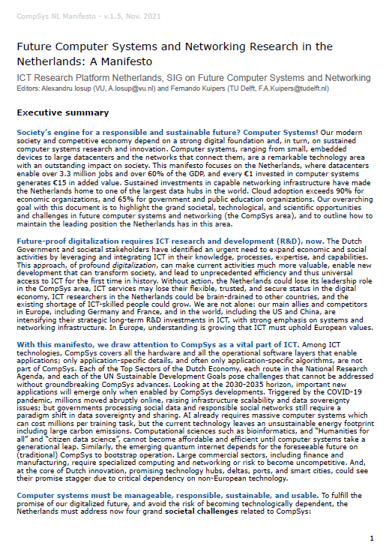
More is interesting, and much is needed
Opportunities abound:
LHCb has an open data policy for
joint associate collaborators (for ML &c)
projects (e.g. NWA NextGrasPP) ML & GPU co-design, QC
(with SURF and linked to e.g. CERN QTI)
we co-signed the CompSys NL manifesto for a good reason!
…
… where Nikhef facilities and our federated, global, e-Infra system, and our
systems-innovation lab ‘Speeltuin’, provides opportunity, a study object, and capacity
… and for educational purposes, we have often donated decommissioned hardware
which of course works just fine, but the energy-performance-rack space ratios
are no longer efficient for the DNI and WLCG use cases
Manifasto: https://bit.ly/ManifestoCompSysNL

