Slide 1
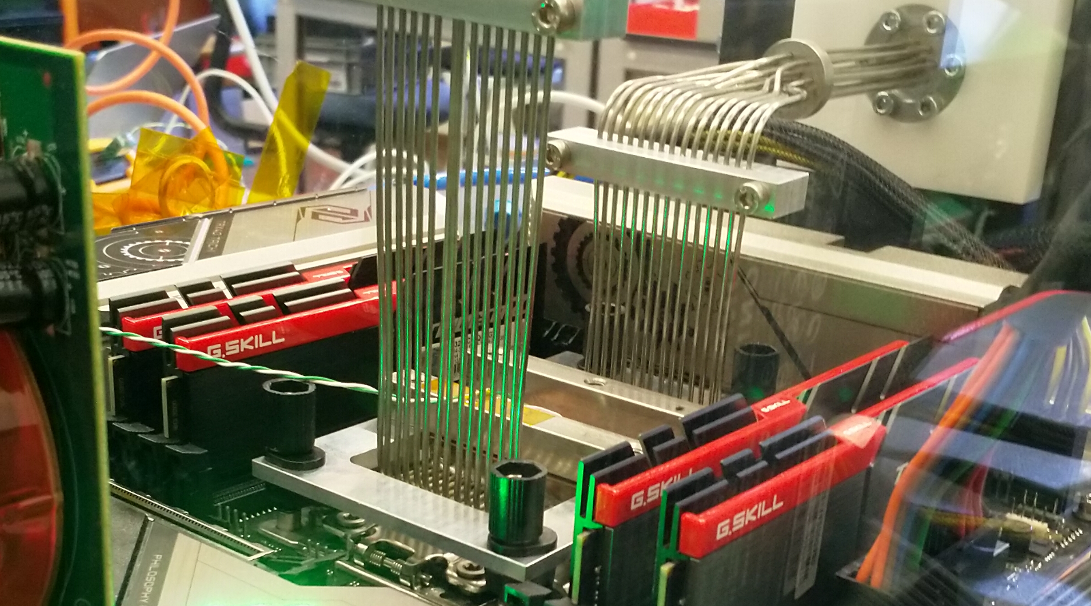
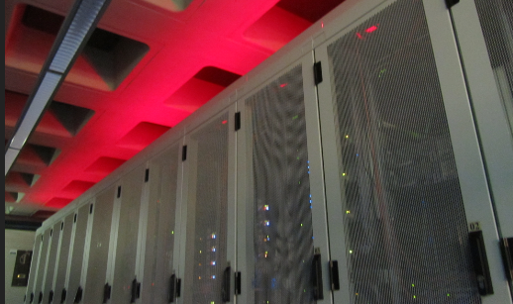
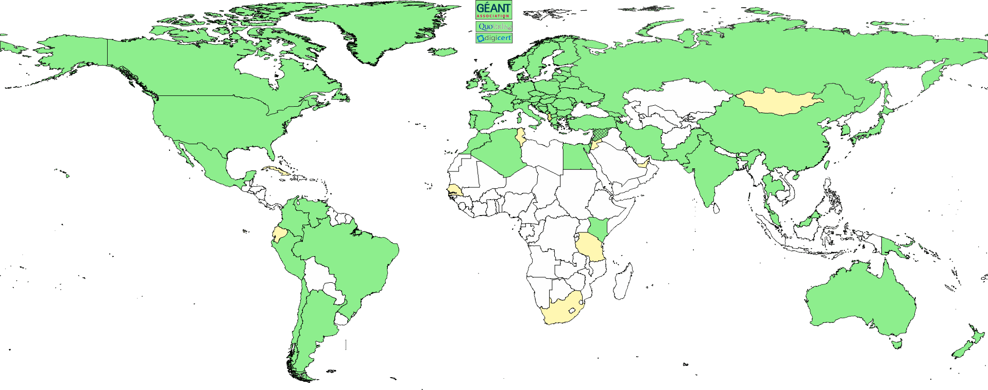
Physics Data Processing
Accelerating ‘time to science’ through computing and collaboration
Algorithmic design patterns and software
efficient software for (GPU) accelerators, new algorithms,
high-performance processors
data and processing pipelines
Infrastructure, network & systems co-design R&D
co-design & development
experimental technologies
research on IT infrastructure
building ‘research IT facilities’
Infrastructure for
trusted collaboration
managing the complexity of collaboration mechanisms
securing the infrastructure
of our open science ‘clouds’

Slide 2

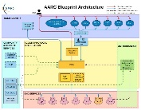
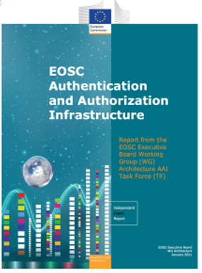
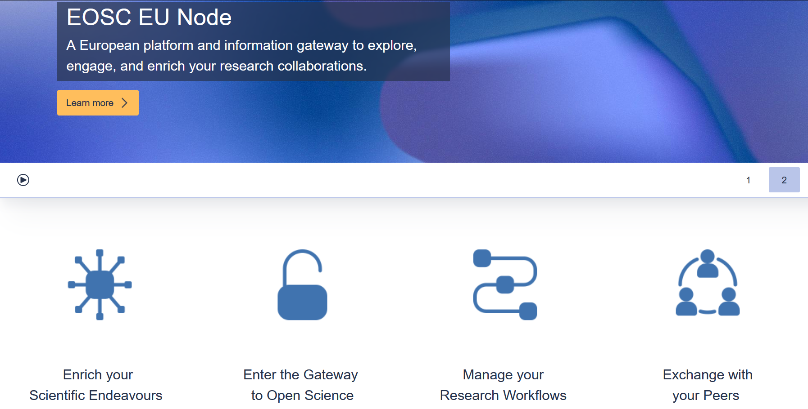
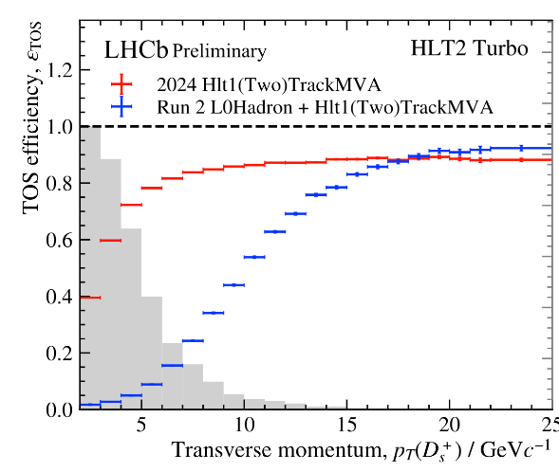

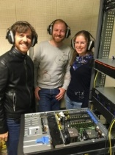

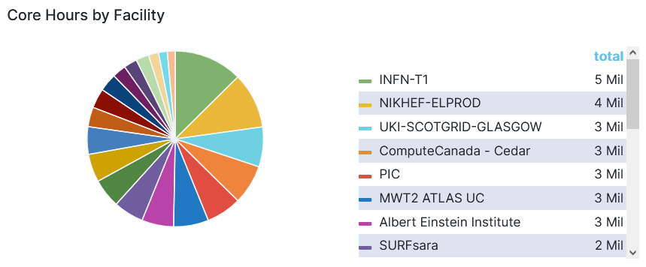
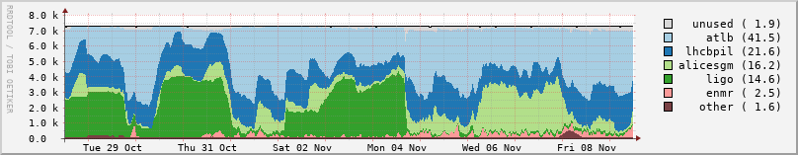
Pushing computing boundaries, some examples
From single GPU demo to 500 node LHCb HLT1
makes tracking info directly available for classification
Providing Security and
Risk Management for the European Open Science Cloud “EU Node” core services (procured EC service, delivered with )
Now we get much higher efficiency (blue → red points) for e.g. D(s)→KKπ charm physics
and next-gen trust & identity for LSRIs with
AARC TREE and eduGAIN security
IGWN GravWav jobs in 2024 (Q1-Q3)
unit: core-hours
Nikhef Data Processing Facility in our ederated Dutch e-Infrastructure:
WLCG Dutch Tier 1, Auger, KM3NeT
gravitational waves … but also
e.g. WeNMR structural biochemistry
Dutch federated infrastructure both
at Nikhef and SURF
Image sources: EOSC EU Node https://open-science-cloud.ec.europa.eu/; IGWN utilisation from OSG GRACIA https://gracc.opensciencegrid.org/ and https://edu.nl/tr79b; LHCb HLT1: Roel Aaij (Nikhef), Daniel Campora (Nikhef & UM), Dorothea vom Bruch (LPNHE), photo: LPNHE; Run3 to Run2 comparison: https://lbfence.cern.ch/alcm/public/figure/details/3837; EOSC AAI Architecture: publications office of the European Union; AARC blueprint: https://aarc-community.org/; DNI: https://www.nikhef.nl/pdp/doc/stats/

Slide 3
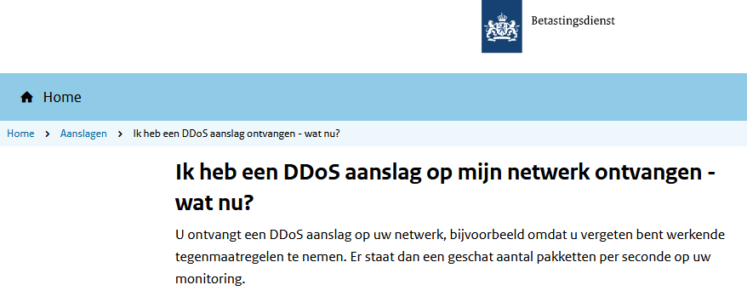
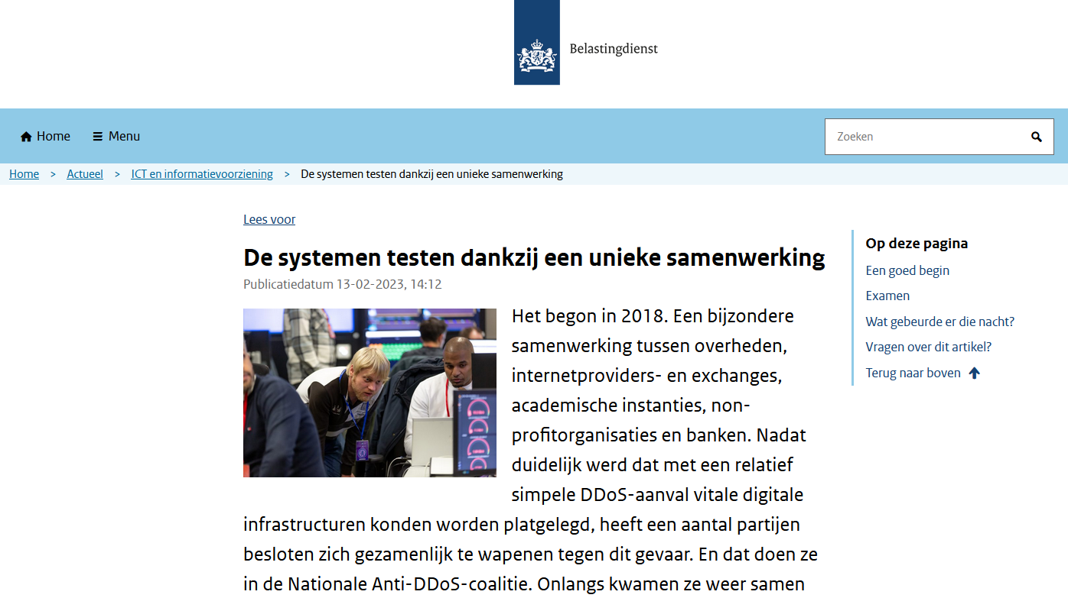
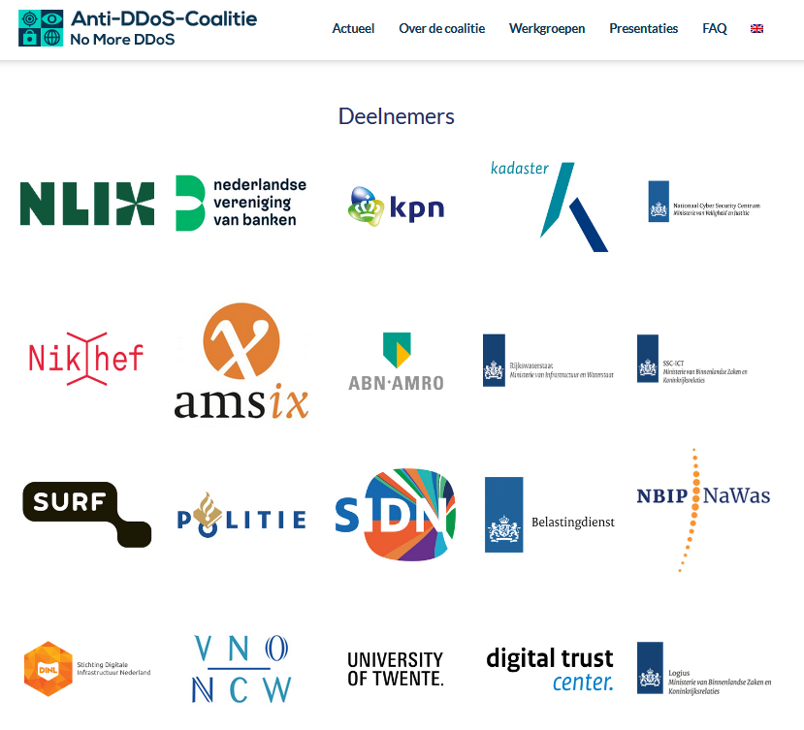
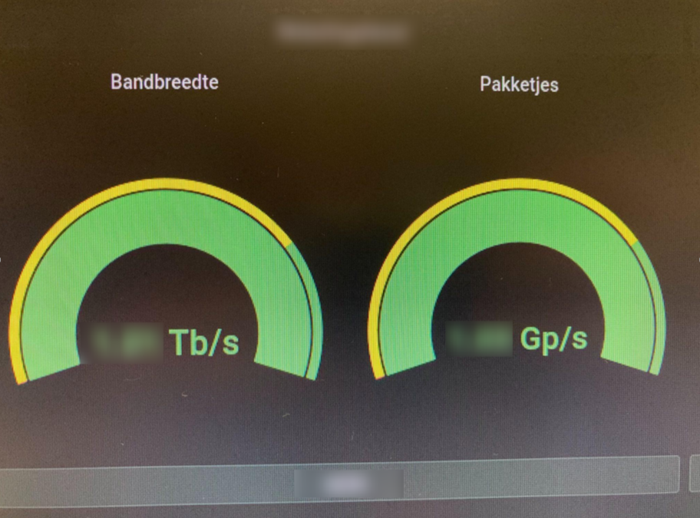
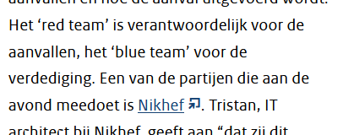
Our science data flows … are somebody else’s DDoS attack
Bandwidth for the HL-LHC, WLCG, and the trigger data streams can also ‘exercise’ our Dutch national critical infrastructure
Image sources: belastingdienst.nl, rws.nl, werkentegennederland.nl, https://www.nomoreddos.org/deelnemers/

Slide 4
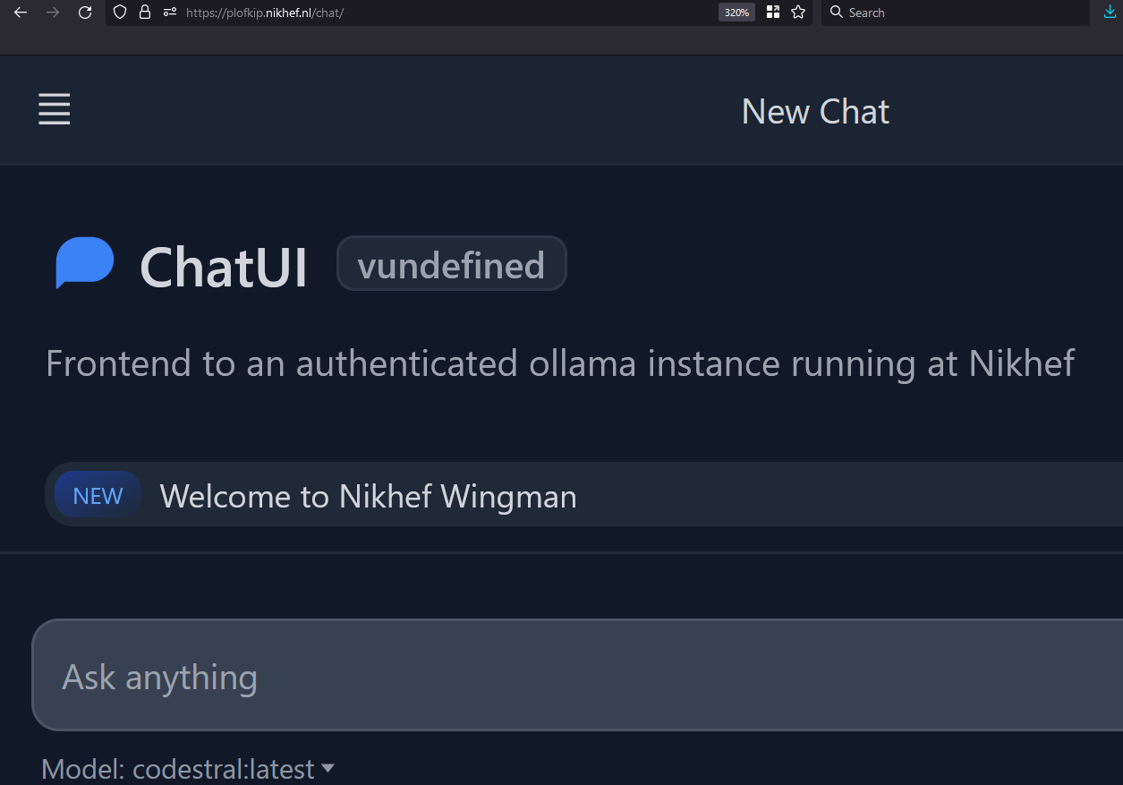
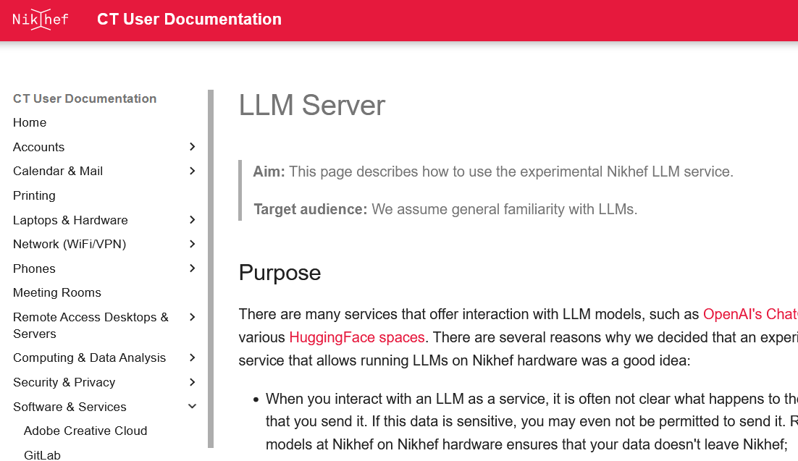
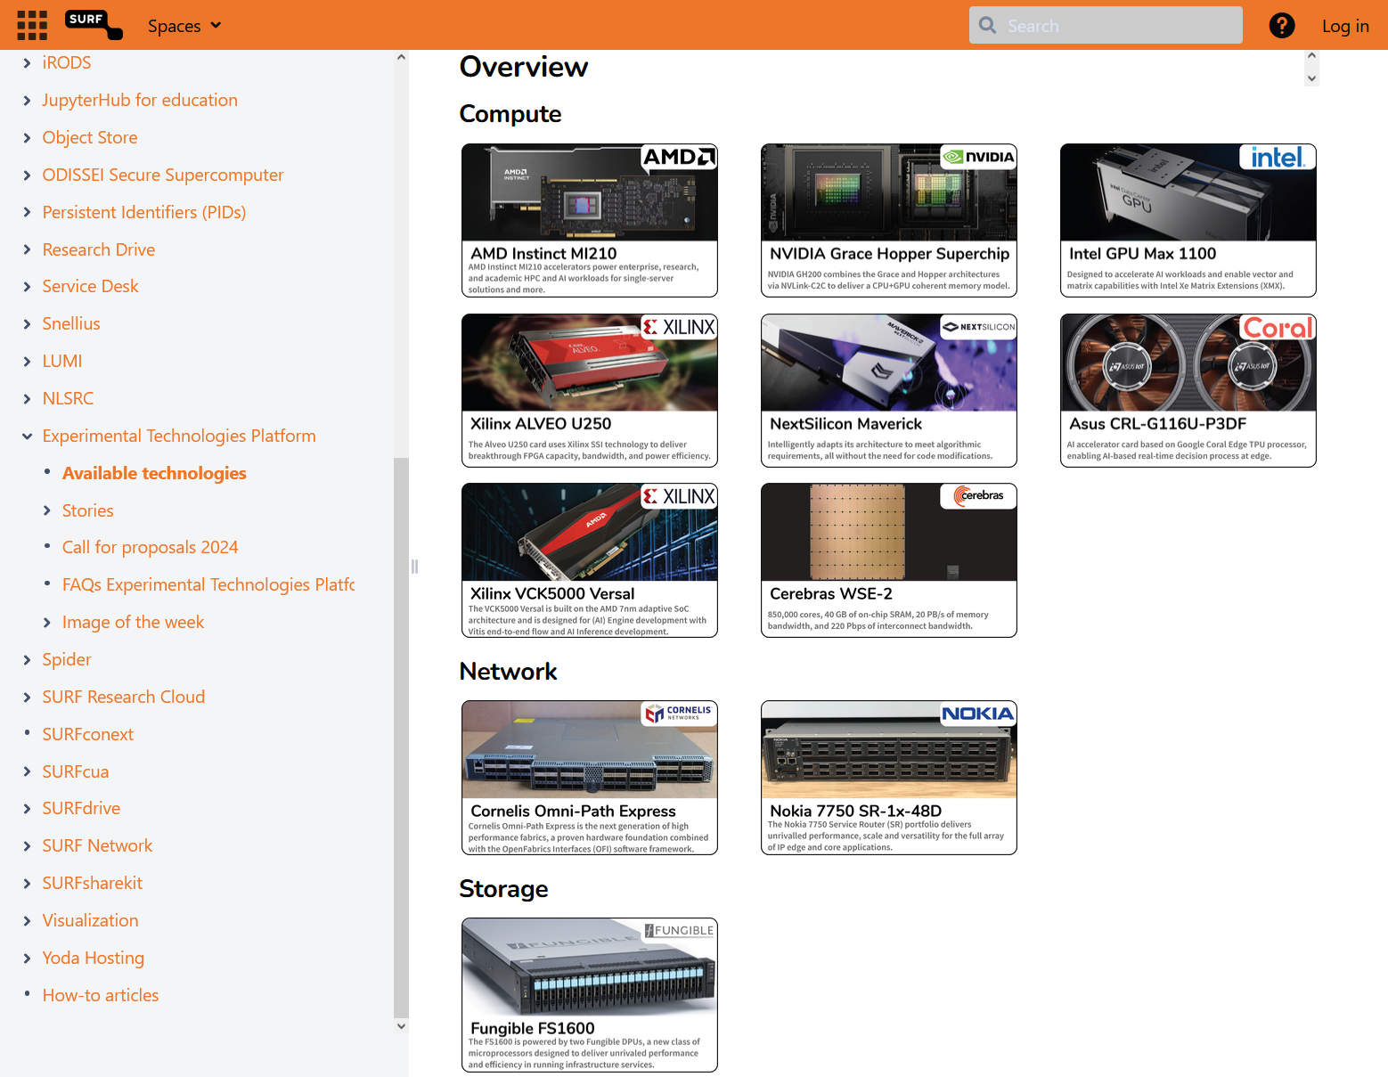
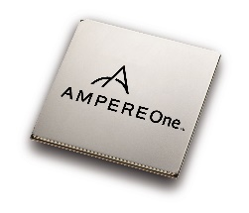
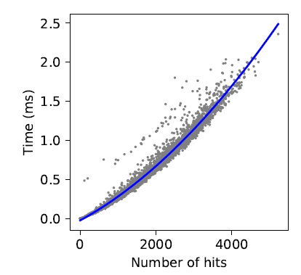


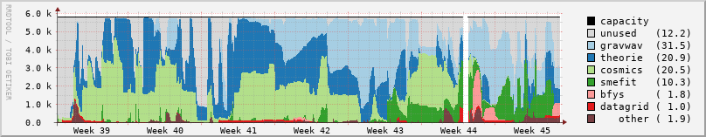
Jumping over our computing boundaries
Efficient and accelerated computing
accelerators, such as GPU- and hybrid-computing
– extending its scope to last trigger stage, to off‐line processing and to analysis
more machine learning, for tracking and physics event classification
efficient architectures: ARM systems (with our SURF Experimental Platform)
exploration of quantum computing, for future gains in algorithmic complexity
Networking, both physical link and collaborative networks
network bandwidths over 800 Gbps to CERN, and to more destinations
evolving and aligning global collaboration technologies (unified tokens):
authentication & authorization for WLCG, Gravitational Waves, SKA, DUNE,
… and the European Open Science Cloud
Open Science at scale, with data for today’s and tomorrow’s science
new forms of service delivery with Analysis Facilities and ‘data lakes’
practical Open Science for data-intensive systems (with 4TU.RD/TUDelft)
– with a new Institutional Data Repository using Djuhuty open source software,
linked to our local analysis facility, adding re-usable science software
LLM service: https://plofkip.nikhef.nl/chat, services: kb.nikhef.nl/ct, AmpereOne SURF ETP ARM experimental platform pauperbak.nikhef.nl; scatter plot shows compute time per event estimated for ATLAS at the HL-LHC with the current processing model (from: FASTER ENW-XL); Djehuty open source Data repository: archive.nikhef.nl, data.4tu.nl, Catharina Vaendel (Nikhef) and Roel Jansen et al. (TUDelft).

