Slide 1

Welcome to the joint
Nikhef-QuSoft workshop
Tuesday 14 September 2021
10.30 – 17.30, WCW room Z0.09

Slide 2
Welcome to today’s programme!
10.30 .. 12.45 Session 1
Introduction to the challenges of subatomic physics in HEP and GW
Introduction to Quantum Computing
Use case: the case from LHCb and tracking - followed by discussion
12.45 .. 14.00 Lunch in room Z0.10 opposite
14.00 .. 15.30 Session 2
State of the Art in Quantum Algorithms
Use case: gravitational waves, ‘template matching’, and discussion
15.30 .. 16.00 Tea also in room Z0.10
16.00 .. 16.45 Ideas Market: your lightning pitch, and some planning
16.45 .. 17.30 Drinks, food, networking: building lasting collaboration …
https://indico.nikhef.nl/e/qchepgw-0914 - https://go.nikhef.nl/qc-ws-14sept

Slide 3
Computing challenges in HEP and GW for the QC era
Nikhef-QuSoft workshop
David Groep, PDP
September 2021

Slide 4
‘We live and breathe in a quantum world’
What are basic
building blocks of matter and space-time?
How are structures
formed and
how do they evolve?
And … how can we measure this?
Image adapted from an original by: Kees Huyser, Nikhef

Slide 5
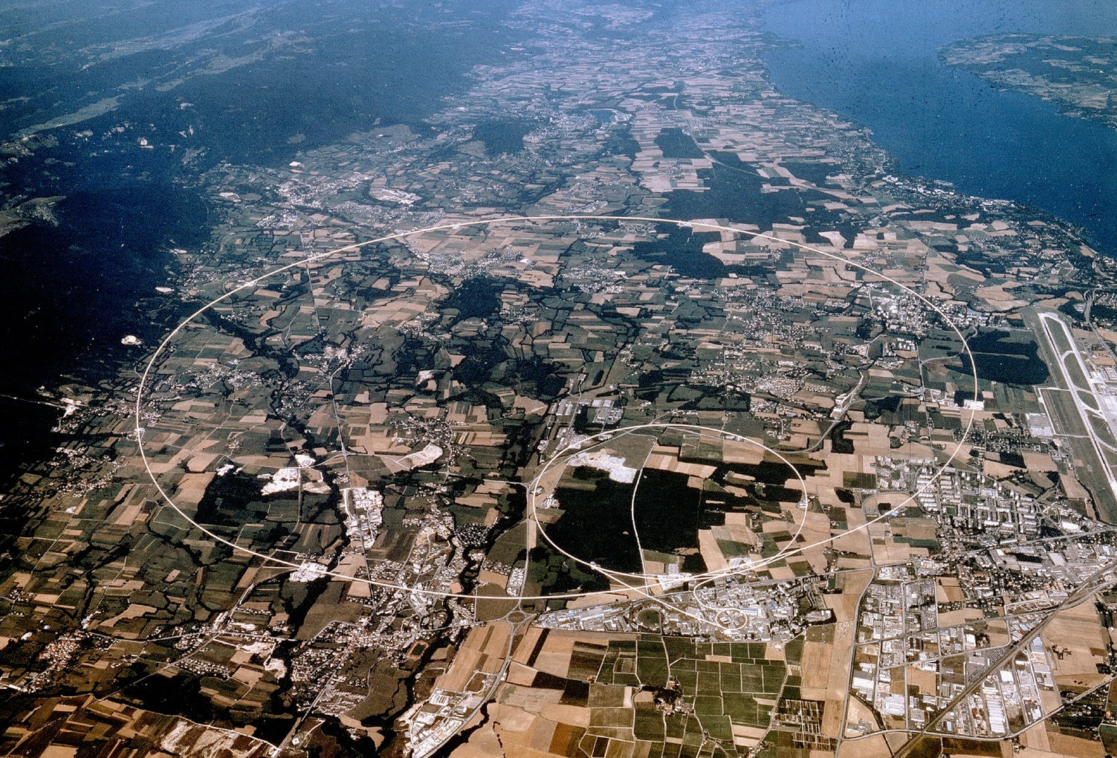
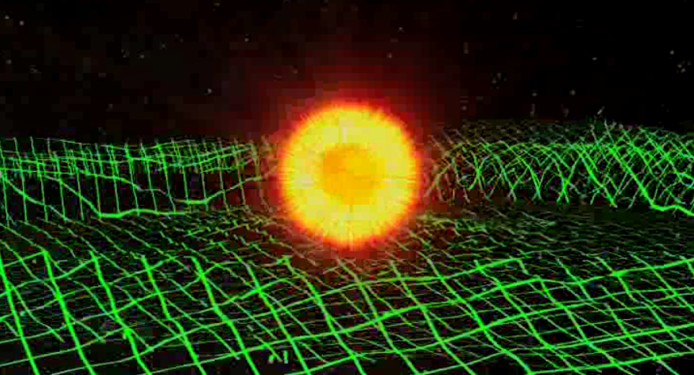
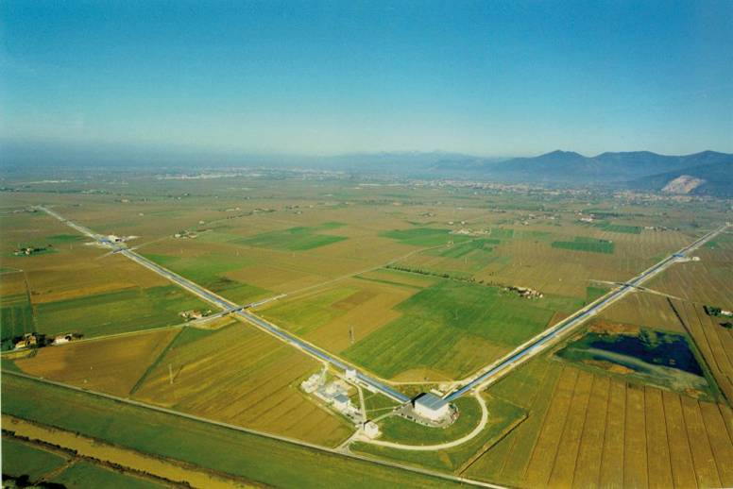
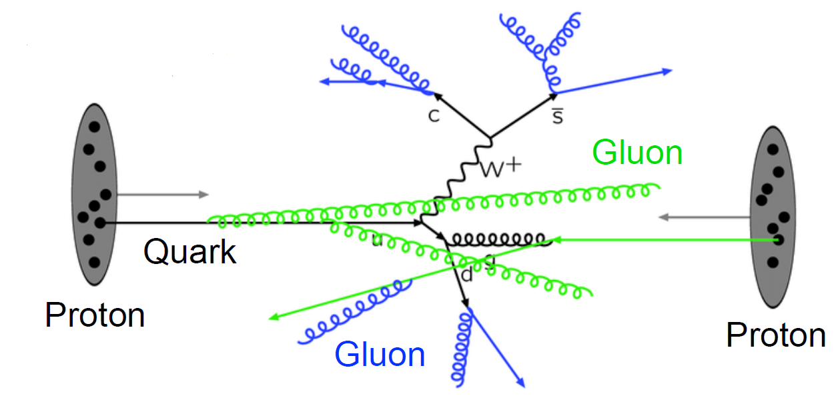
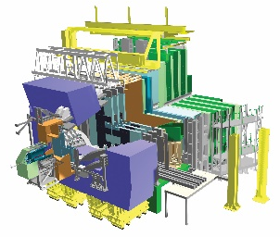


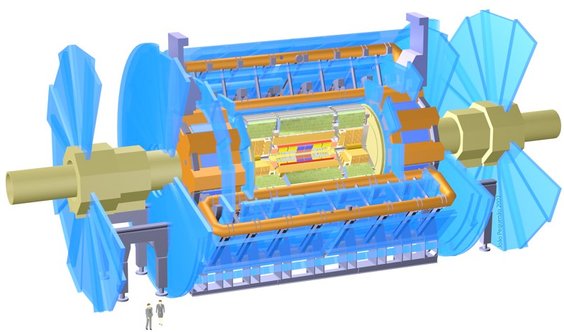
Virgo GW
detection
Collecting data
KM3NeT construction
LHC
@CERN
Images: Alice, ATLAS, and LHCb collaborations, CERN, Wikimedia, KM3NeT, Virgo collaboration

Slide 6
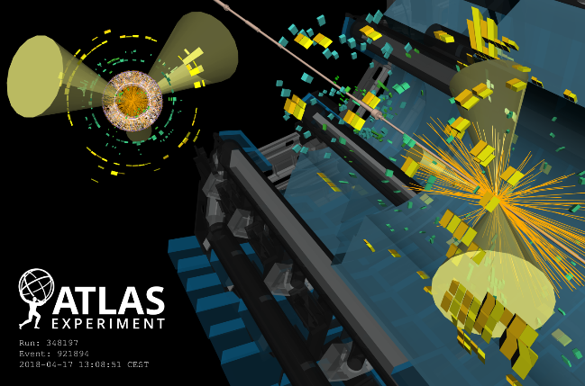
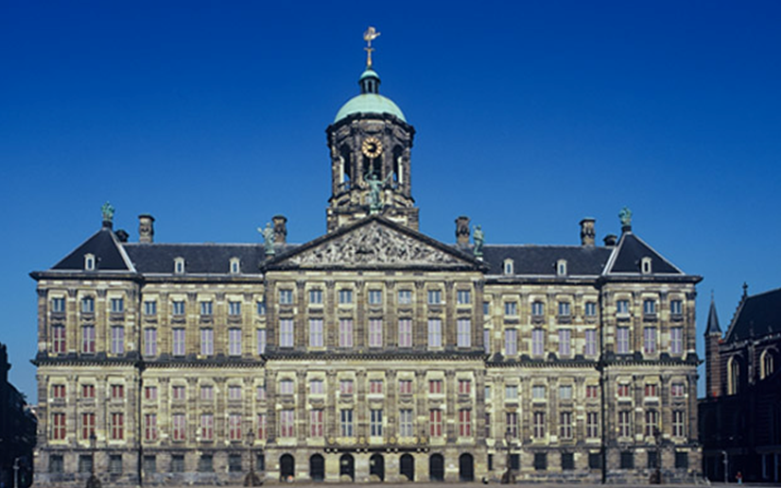
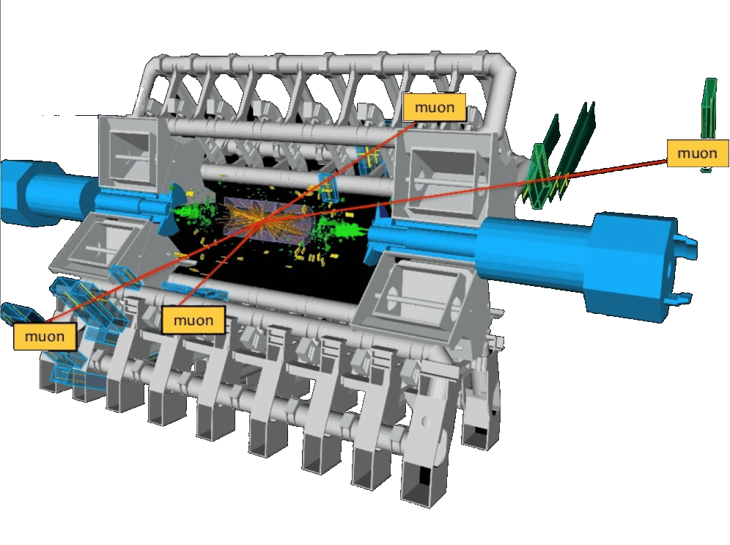
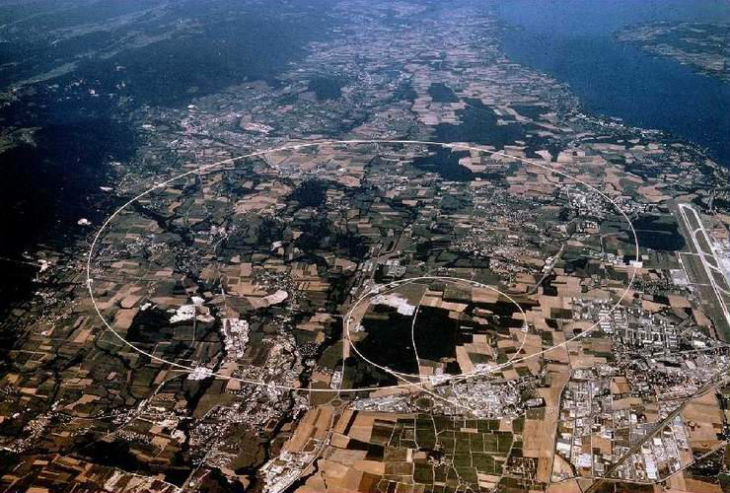
LHC data challenges
~ 50 PiB per year collected
180 institutions
~ 50 PiB/year
today from CERN
Images: ATLAS collaboration, CERN, Wikimedia

Slide 7
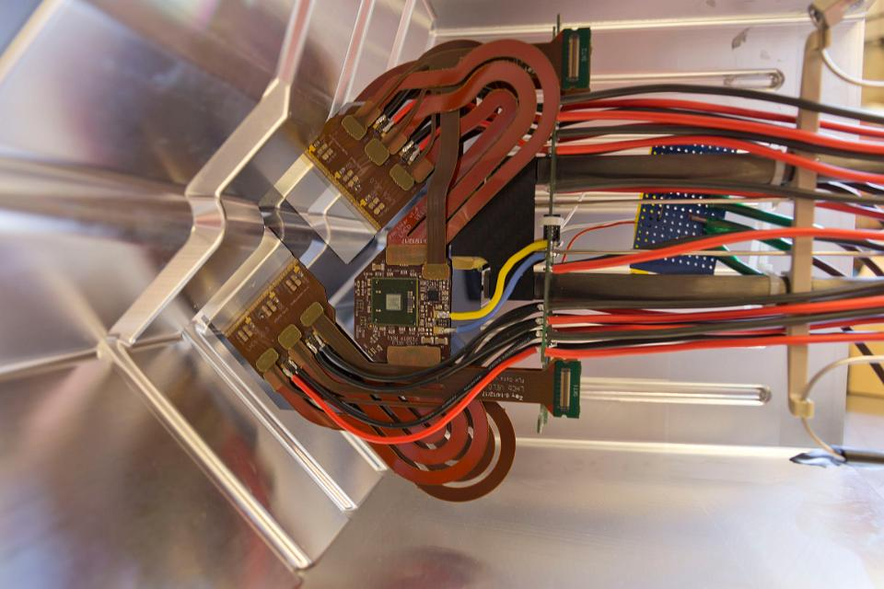
Combining the small and large
Velo Sensor In RF-box
Image: Nikhef, LHCb

Slide 8
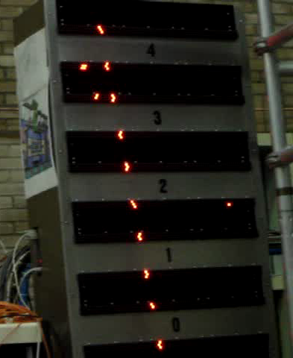
Tracking – a single particle is easy …
video ATLAS Muon chamber: Frank Linde, Nikhef
tracking image: P. Durante et al. , CERN (LHCb)

Slide 9
Like overlapping photo’s
Typically available event information:
~ 90M pixel: (x,y,z), (x,y,z,dE), (x,y,z,t,dE)
but these contain
‘overlapping exposures’:
today: ~ 35-40
HL-HLC: > 250
# frames: 40 million/sec …
(so you have just 25 ns)
Image from: 2016 J. Phys.: Conf. Ser. 706 022002, B. Schmidt, CERN
High pileup event with 78 reconstructed vertices taken in 2012 by CMS.
Multiplicity numbers from ATLAS: ATL-PHYS-PROC-2018-101, LHCP2018
Tracking image: D. Campora, LHCb, UM & Nikhef

Slide 10
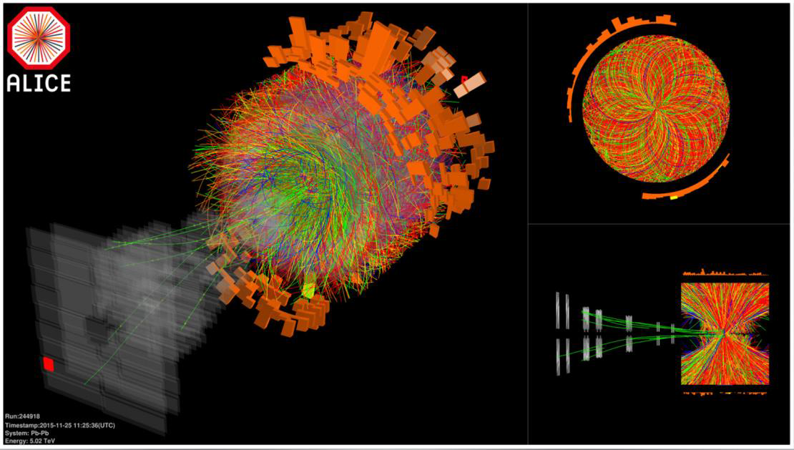
Dealing with both volume and complexity
Image: Alice collaboration @LHC

Slide 11
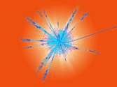

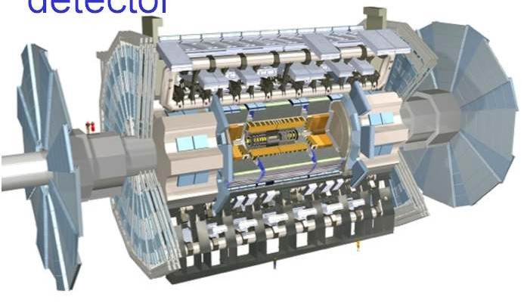
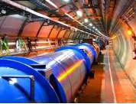
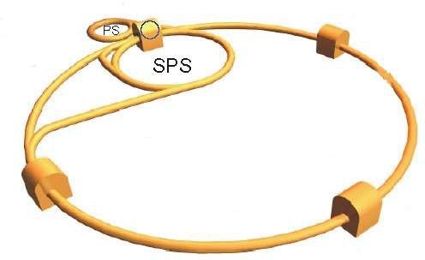
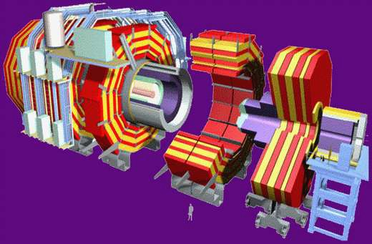
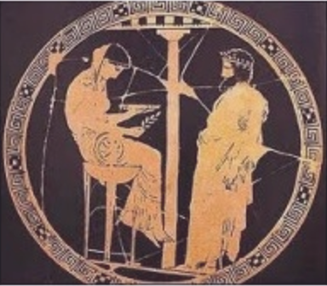
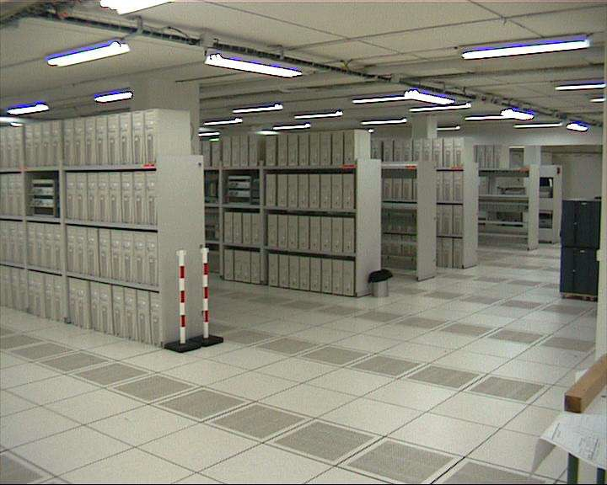


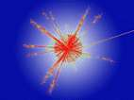
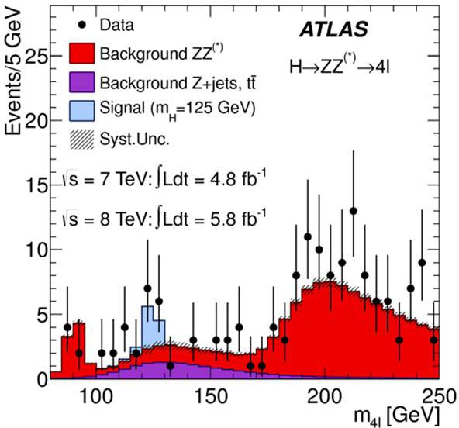
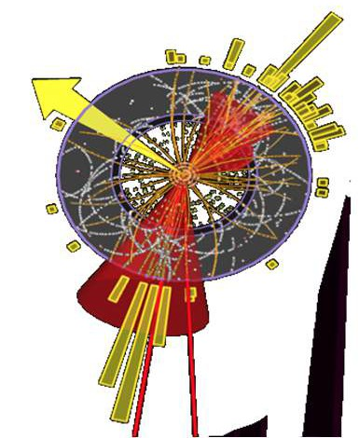
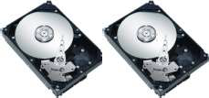
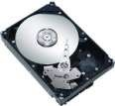
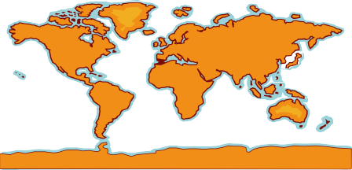

‘logical’ flow
Data flows at the LHC
Simulation of ATLAS detector
LHC data
24 Pbit/s
Filter and first selection
4 Experiments
200 Gbit/s
to the CERN computer center
P(m_{4l}|SM[m_{H}])
Create sub-samples
Physics results
Observed m
Analysis Event selection
Reconstruction
of ATLAS detector
4l
10 Tbit/s Distributed + local
100 Gbit/s 40 Gbit/s
Store on disk and tape
Export copies
10¹⁰ events/year
World-Wide Analysis
Graphic elements from: Edoardo Martelli, CERN, for SIG-NGN
Wouter Verkerke, Nikhef
H->ZZ-> 4l plot: ATLAS

Slide 12
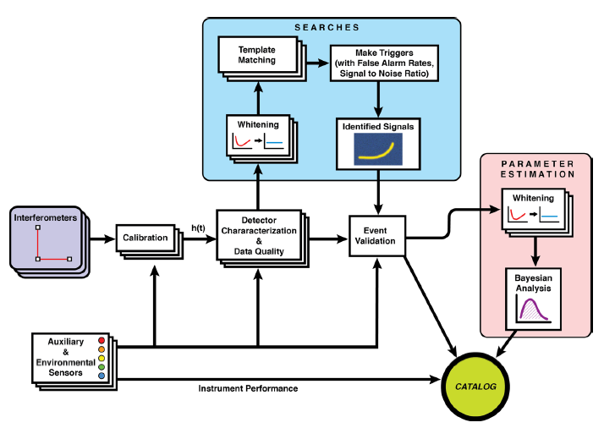
And there’s data from
gravitational wave events
Diagram from: B P Abbott et al. 2020 Class. Quantum Grav. 37 055002
Image: Virgo GW detector in Pisa

Slide 13
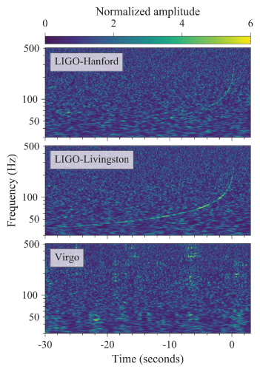
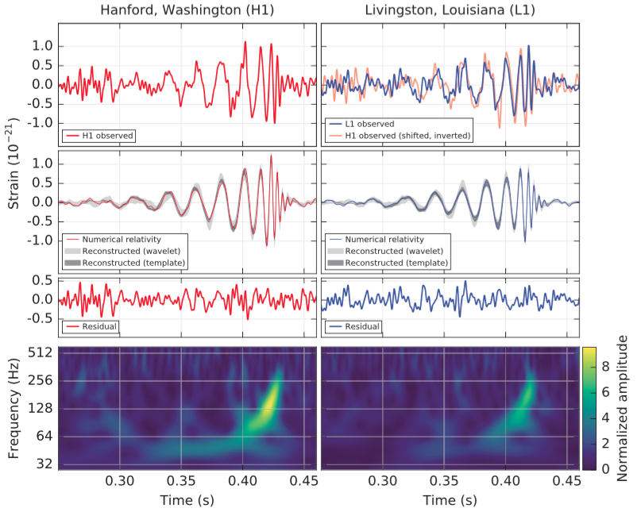
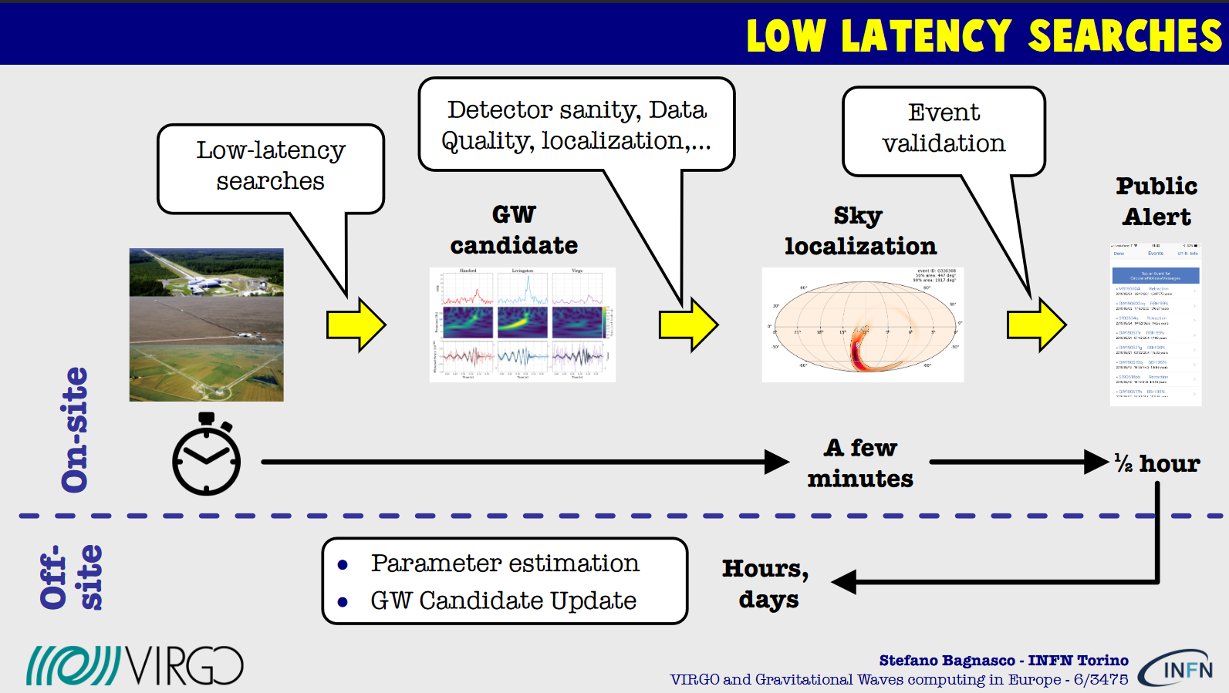
Thriving on fast Fourier transforms …
Image: GW150914 (source: LVC) PRL 116 061102
and GW170817. PRL 119 (16) 161101
Low-latency slide: Stefano Bagnasco, INFN Torino and Virgo

Slide 14
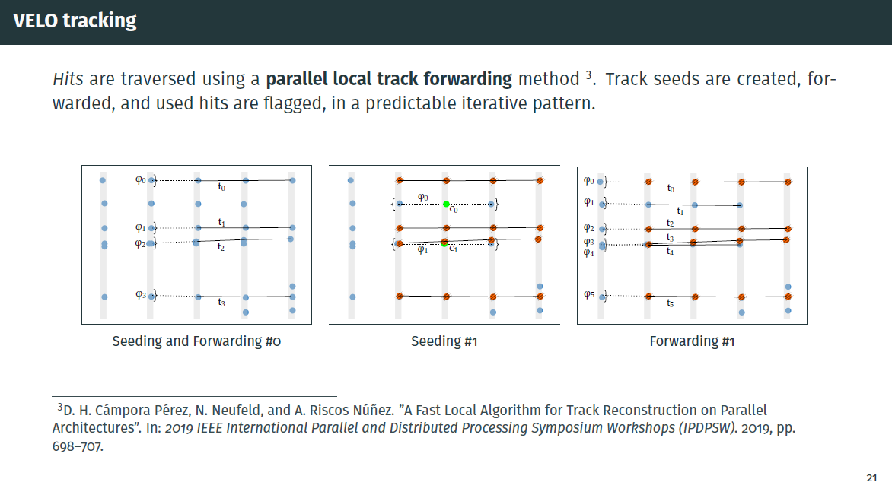
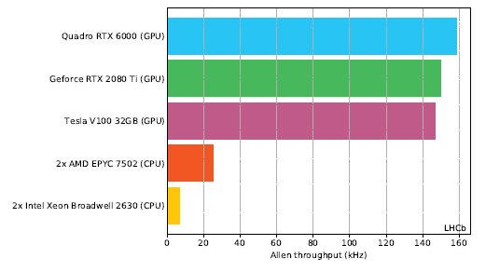
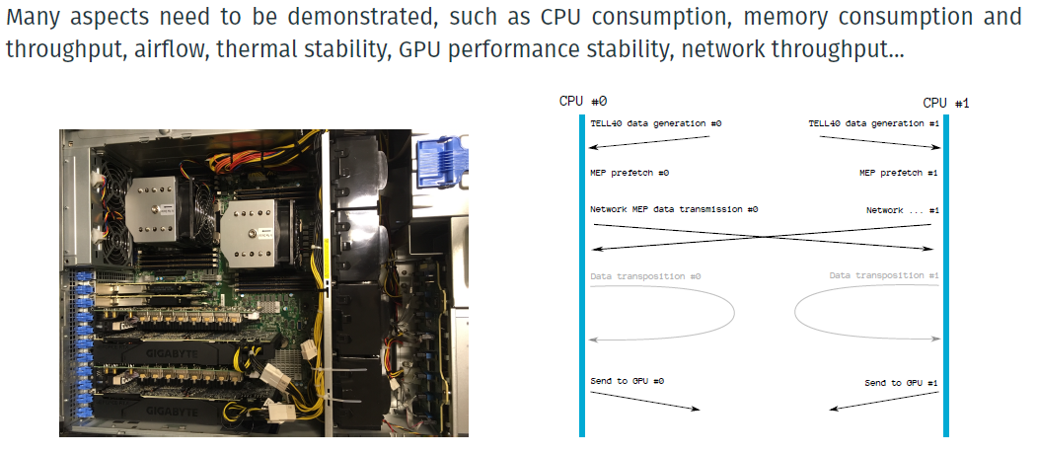
Parallelism and GPUs are already making a difference
Source: Daniel Cámpora, UM & Nikhef
and the LHCb Allen project

Slide 15

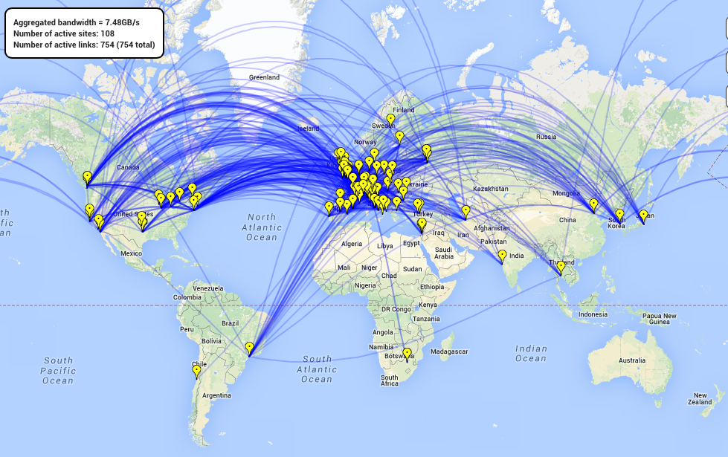
An additional way of dealing with volume
WLCG:
Worldwide LHC
Computing Grid
~ 180 institutions, with
13 ‘tier-1’ sites (NL-T1)
~ 60 countries/regions
~ 10 000 daily users
~ 600 000 cpu cores
>> 300 PiB mass storage
CERN
Tier 2s
Tier 1s
Image sources: CERN OpenLab/SDC, WLCG, Rocío Rama Ballesteros

Slide 16
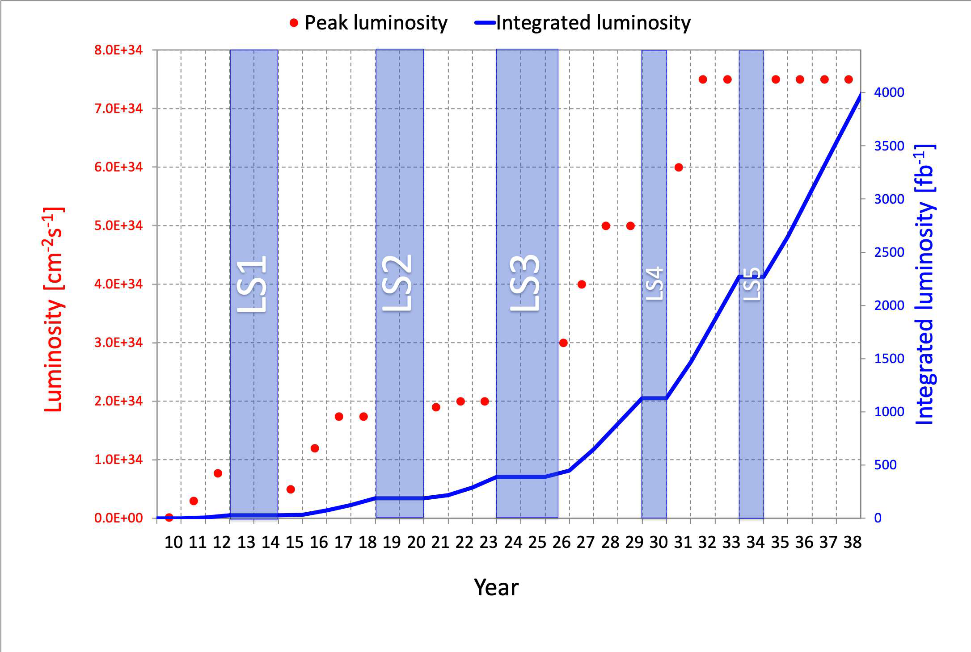
Facing scaling issues for 2030 and beyond
~ data rate

Slide 17
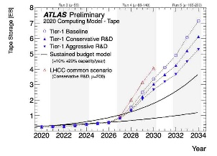
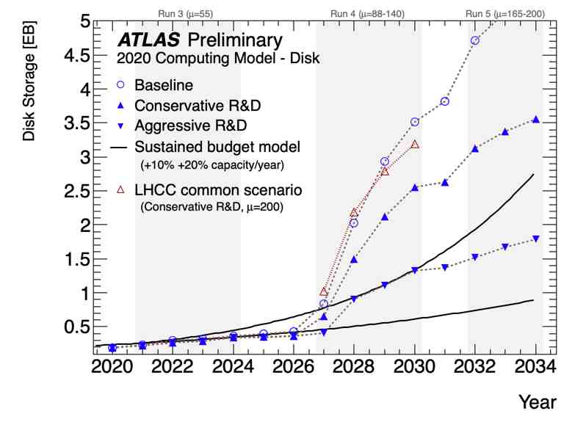
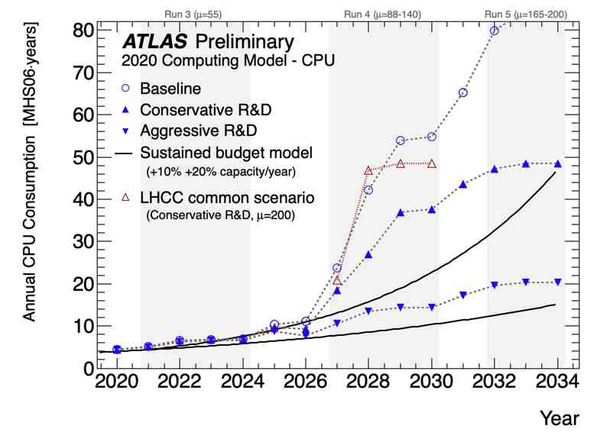
A sizeable amount of data …
Graphic: ATLAS collaboration
https://twiki.cern.ch/twiki/bin/view/AtlasPublic/ComputingandSoftwarePublicResults

Slide 18
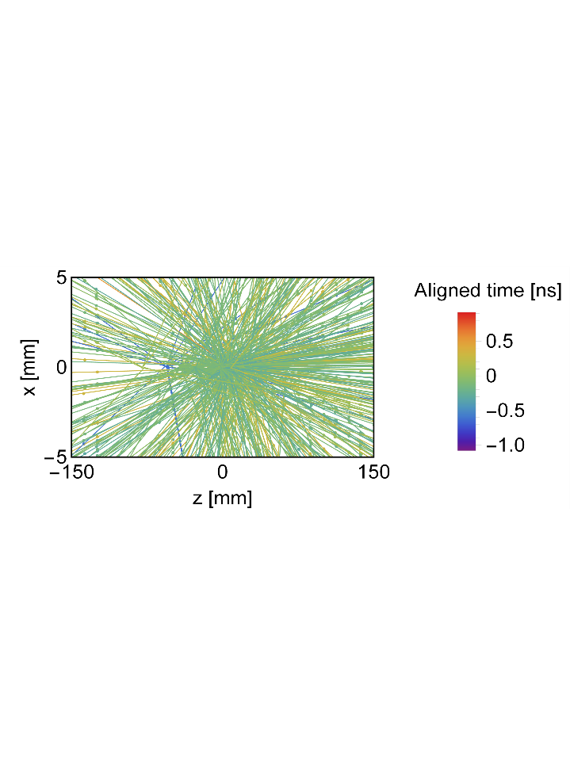
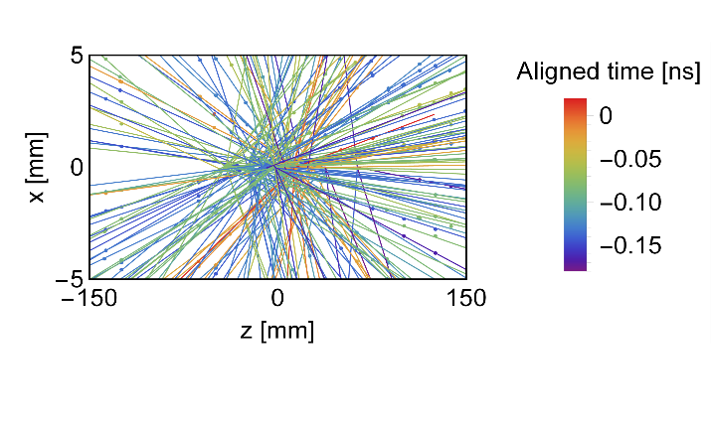
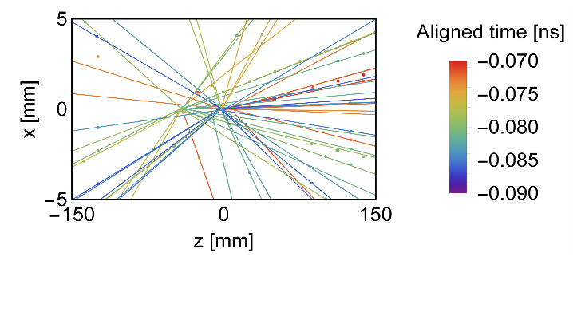
1 ps = 10⁻¹²s
Some cleverness can be done in hardware
2000 ps
adding additional parameters
to improve discriminating power
200 ps
20 ps
scheduled for ~2030 (LS4)
Images: LHCb Velo-3 4D tracking
Marcel Merk, UM & Nikhef

Slide 19
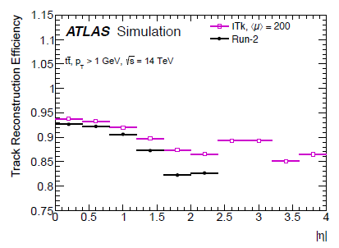
Also we can deal with some inefficiency, provided it’s quantifiable
efficiency can be determined comparing reconstruction of simulated data to theoretical input
all within limits of course:
we need ‘most’ valid events
to ‘survive’ reconstruction
and not get ‘fake’ data out …
Example of an efficiency plot: Liza Mijovic,
LHCP2018, ATL-PHYS-PROC-2018-101

Slide 20
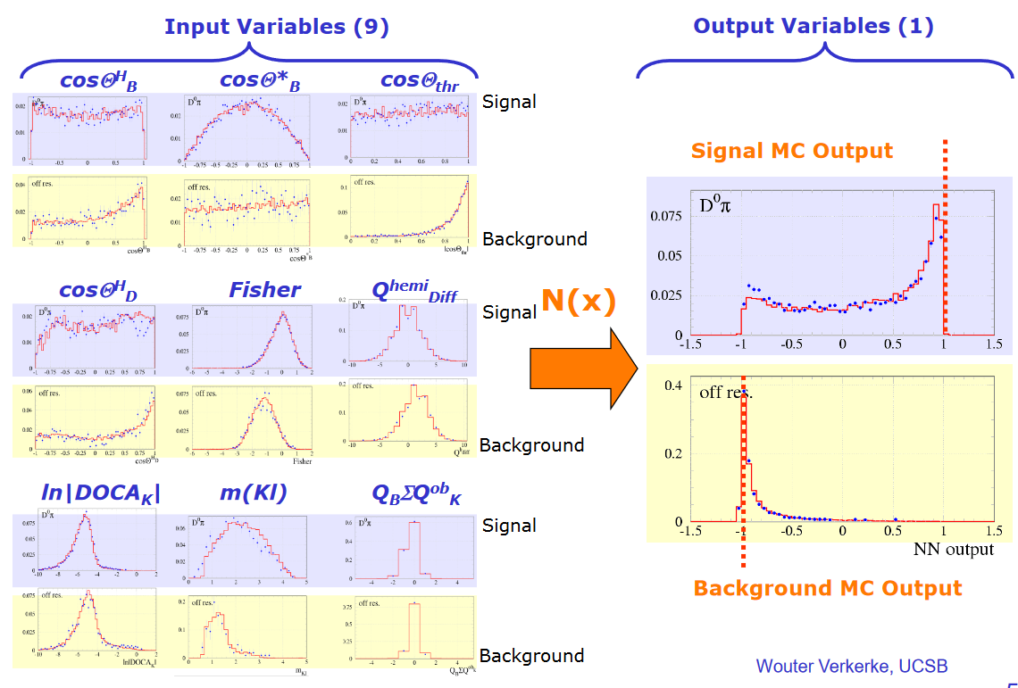
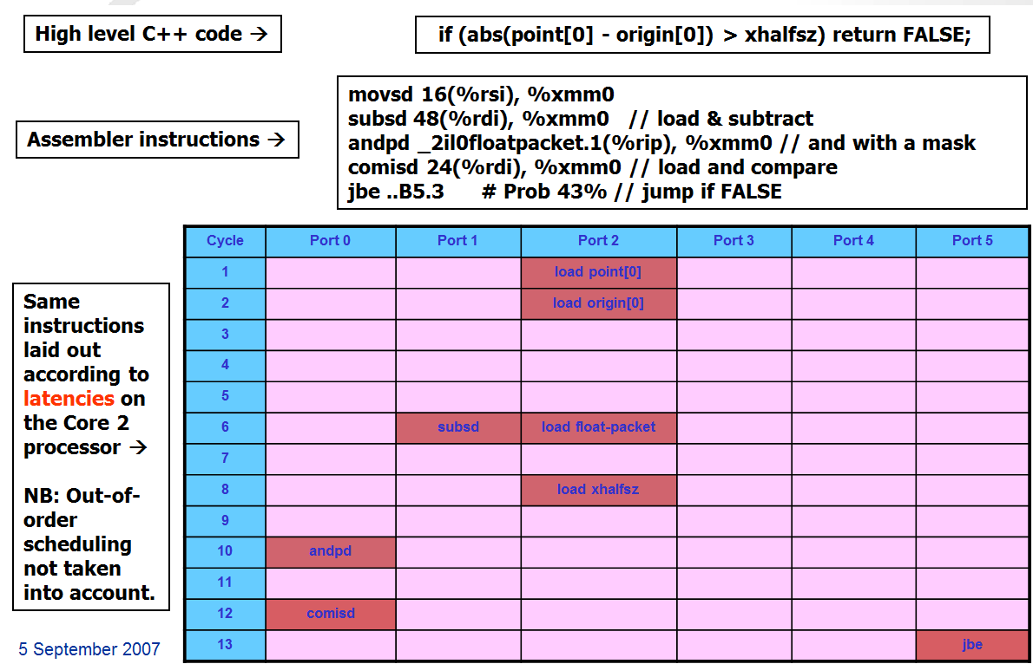
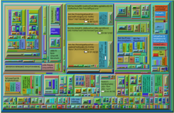
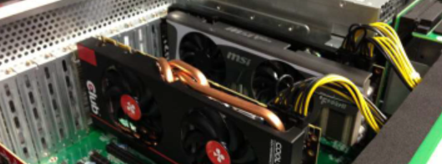
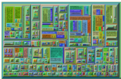
Time to get inspired
Improving parallelism
and pipelining
Accelerators: GPUs, DPUs
Machine Learning
(NNs, BDTs, …)
and we see very interesting ideas coming for QC …
2007 Core2 efficientcy: Sverre Jarp, CHEP2007
RECO improvements 2012-2015: Gerhard Raven, Nikhef
Learning: Wouter Verkerke Practical Statistics –part I
GPU node: plofkip.nikhef.nl

Slide 21
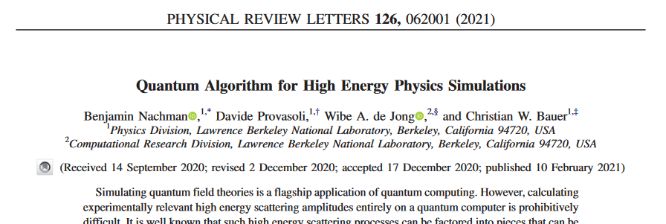
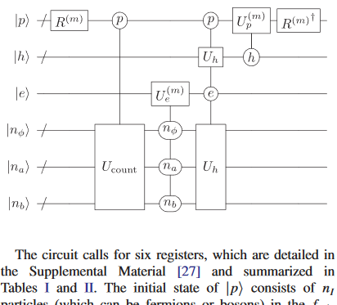
Get inspired by early work ... much of it on simulations
Mostly simulated,
with some early experimental results
Nachman et al., 10.1103/PhysRevLett.126.062001

Slide 22
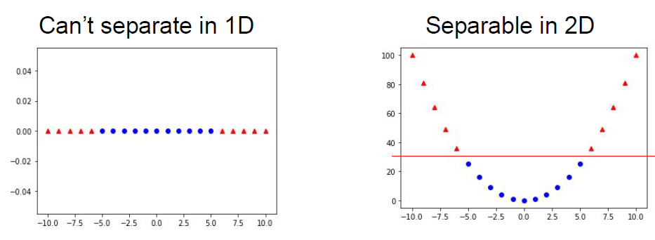



Distinguishing events
Support Vector Machines classify events
QSVM (in simulations) works quite well – comparable to best classic models
Images from: Jamie Heredge, et al. UMelbourne,
in vCHEP2021 https://indico.cern.ch/event/vchep2021
https://arxiv.org/abs/2103.12257

Slide 23




Optimizing algorithms (in this case for ‘parton shower’ sim)
From: W. Jang et al (UTokyo, ICEPP, and LBL)
vCHEP21: Quantum Circuit Optimization
AQCEL optimization protocol, arXiv:2102.10008

Slide 24
Many challenges in volume and complexity –
and quantum computing could help us here!
Current Nikhef focus for accelerator-based experiments at the LHC
track reconstruction
event classification
and in gravitational waves observation and analysis
time-to-frequency domain conversion, filtering of data
template matching (‘waveform fitting’) to understand GW sources
and possibly also ... solving the many differential equations

Slide 25
We start from here!

Slide 26
Background slides from vCHEP21

Slide 27


Slide 28


