Slide 1
Principles of Digitalisation
Mission, values, and strategy as the basis
for research and organisational ICT at Nikhef
David Groep, 2024

Slide 2
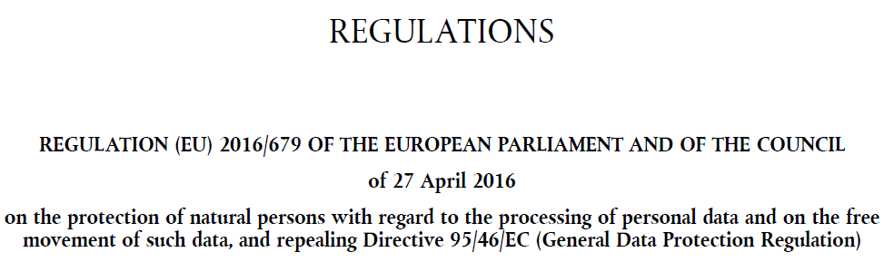
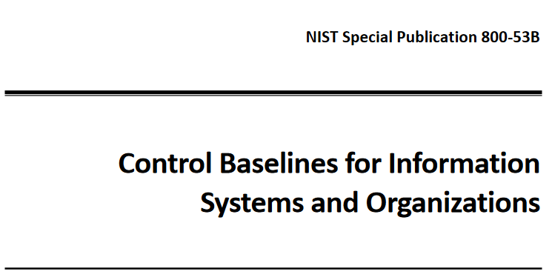
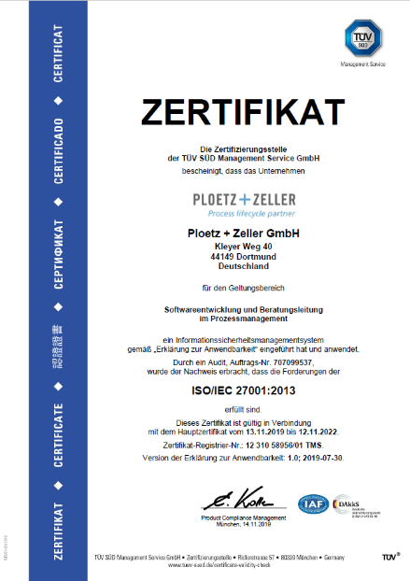
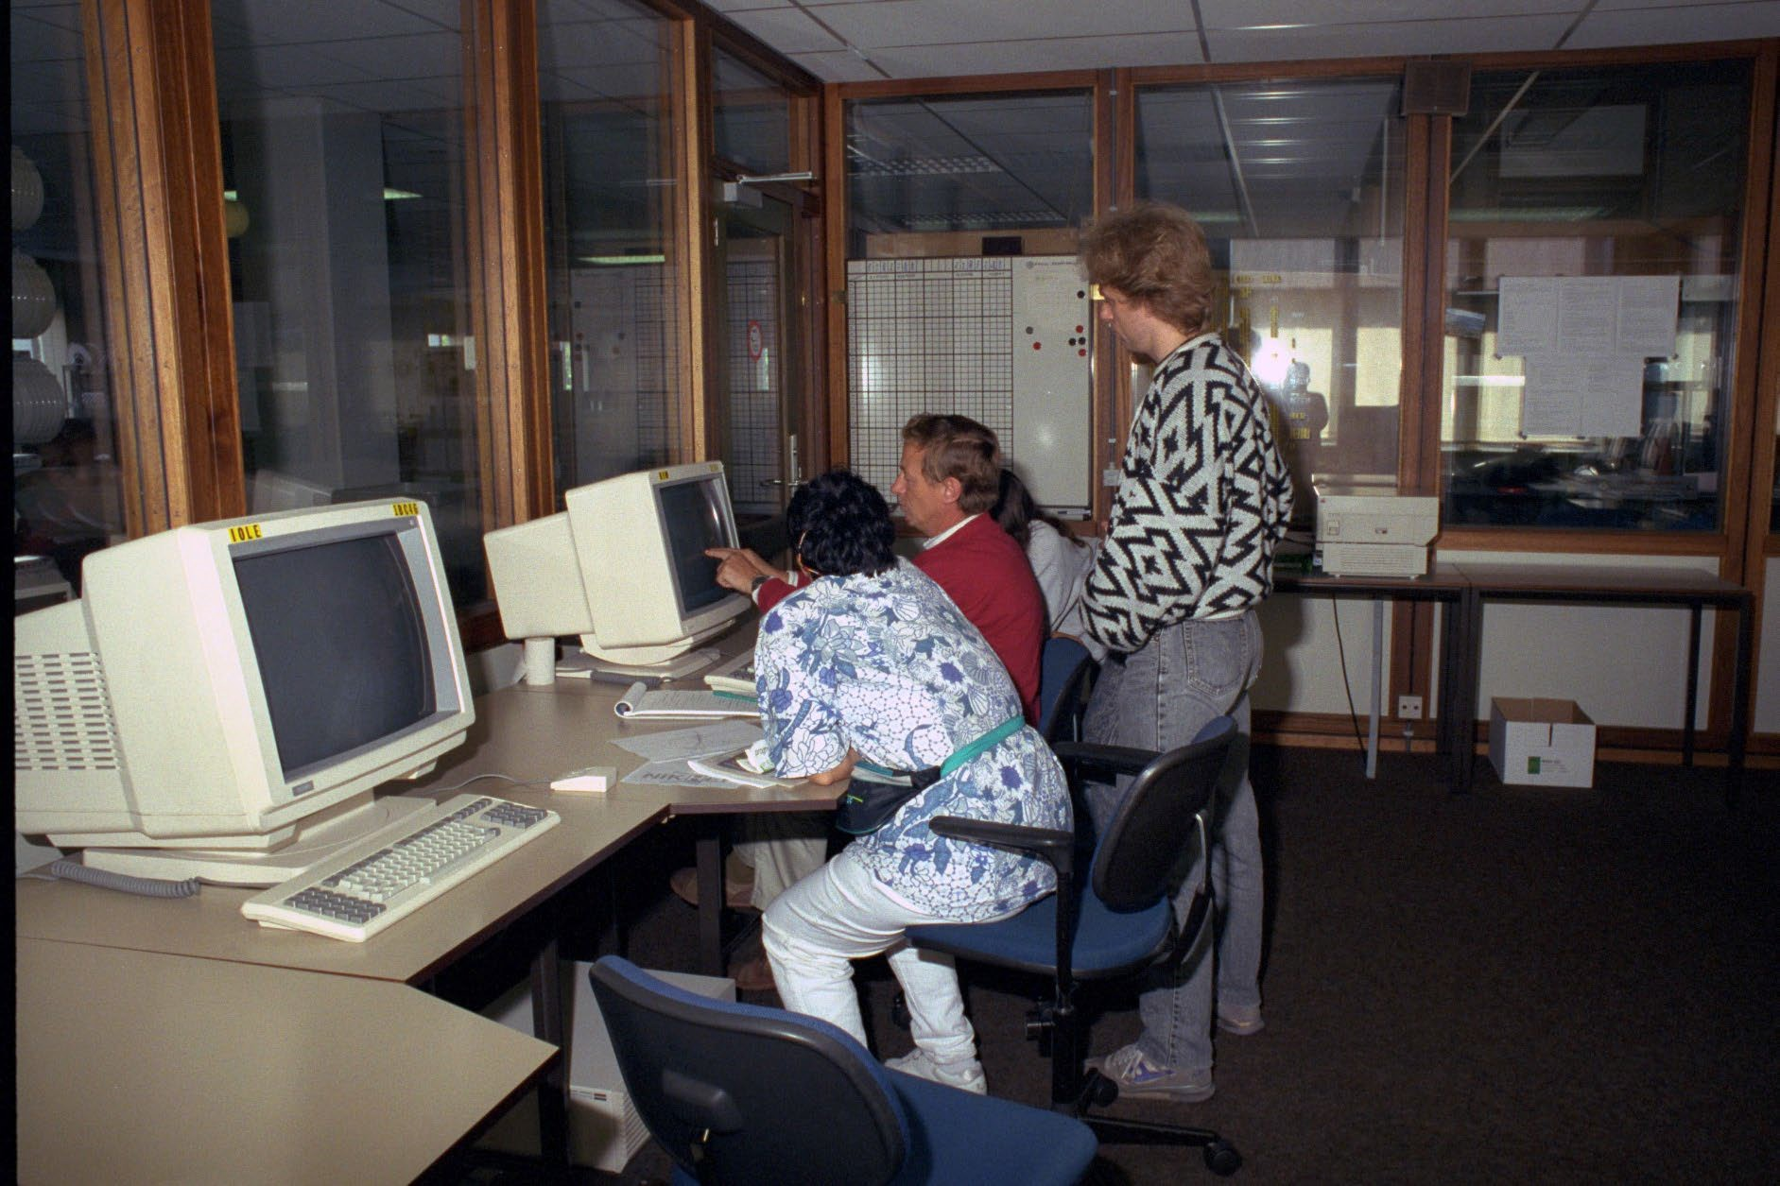
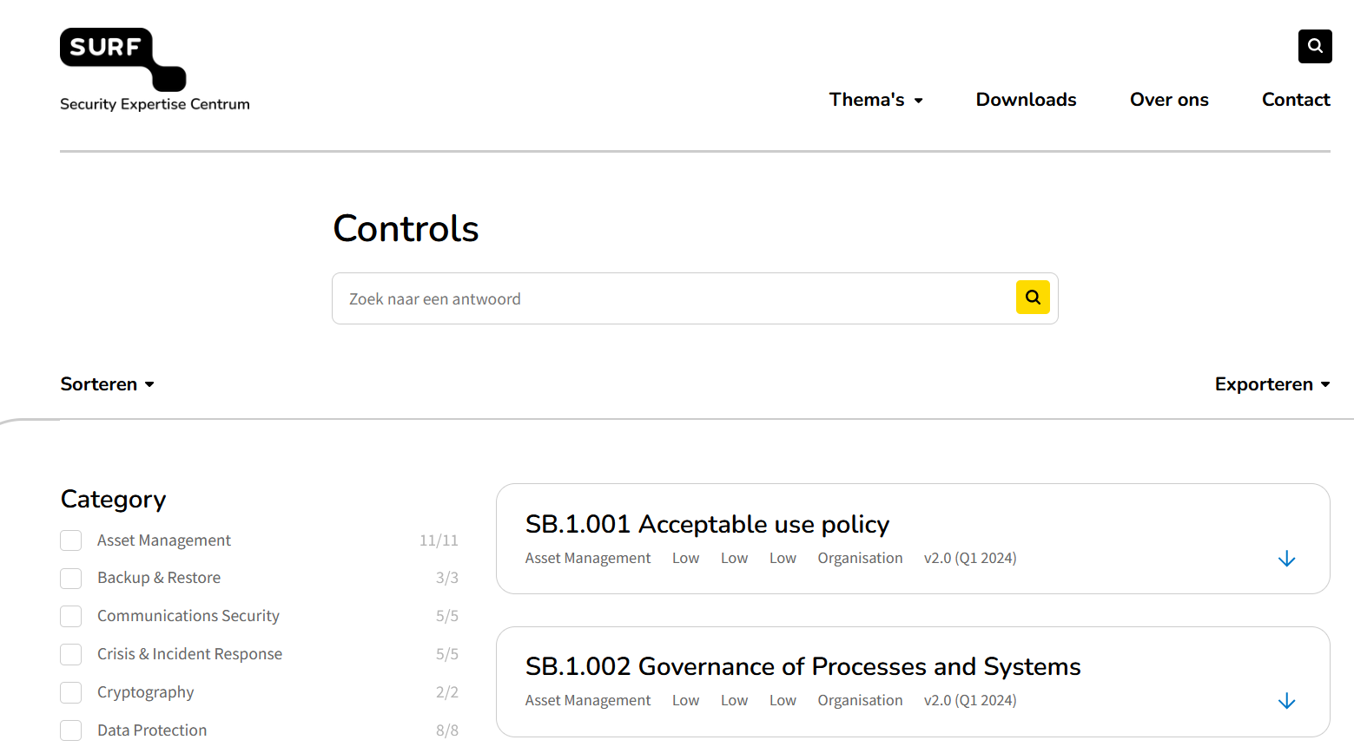
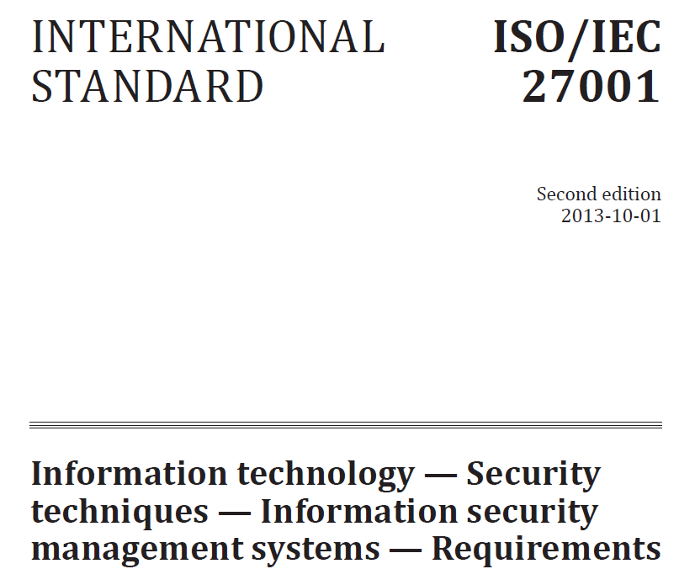
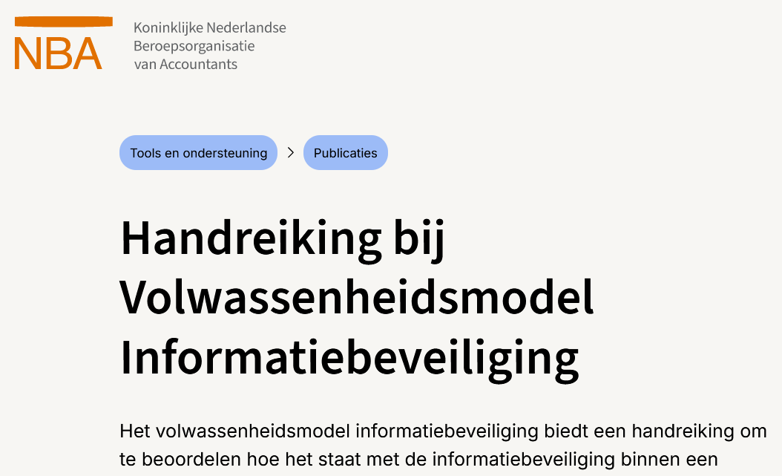
A changing landscape
Image sources: PZ0151 (https://commons.wikimedia.org/wiki/File:PundZ_ISO27001_2019_Z2.png),
and publications from NIST, European Union, NBA, ISO, SURF; left: Nikhef H137 in ~1990

Slide 3
Balancing goals:
primary mission, security risks, and administrative functions
No single element has primacy in determining digitisation strategy
Processes can’t all be defined ‘upfront’: science (as every organisation) has emergent needs
Computing is a research instrument, a topic of research, and a facilitator for other things
Computing is a continuum. From admin to science, from phone to HPC system, …
  legitimate request by users to have a consistent experience when dealing with computing & services
  security policy as such is not the most important: it’s a means to achieve the mission, and defining policies, processes, & procedures does not mean reality follows, nor does open science mean all data must be freely accessible
But ‘in pursuit of the goal, anything goes?’ is also not a foundation for trust
So: we balance risks – and academic research and education is by design a risk-seeking
‘with great power comes great responsibility’* – education and awareness are key
*) the sudo(8) initial user message

Slide 4

Nikhef’s mission
... to study the interactions and structure of all elementary particles and fields at the smallest distance scale and the highest attainable energy.
Two complementary approaches are followed:
Accelerator-based particle physics – Studying interactions in particle collision processes at particle accelerators, in particular at CERN;
Astroparticle physics – Studying interactions of particles and radiation emanating from the Universe.
Nikhef coordinates and leads the Dutch experimental activities in these fields. The research at Nikhef relies on the development of innovative technologies.
The knowledge and technology transfer to third parties, i.e., industry, civil society and general public, is an integral part of Nikhef’s mission.

Slide 5

The Four Areas of the Nikhef Strategy 2023-2028
Expanding knowledge
Nikhef’s main research effort is aimed at further expanding our understanding of the universe in terms of elementary particles and forces, through the interpretation of data, and confronting results with theory and vice versa.
Maintaining infrastructure
Much of Nikhef’s effort is put into upgrading and exploiting the current experiments and building new experiments. The technology departments at Nikhef are essential to make this happen.
Preparing the future
Nikhef is constantly innovating towards new technologies and designs of new facilities and projects to explore new scientific challenges and opportunities in the years to come.
Healthy partnership
Nikhef strives to be a vibrant, diverse and inclusive community in the (inter)national field of (astro)particle physics by ensuring a safe work environment and investing in people’s talents and expertise.

Slide 6
So what can ICT do that helps fulfil this mission?
Digitisation strategy
Shorten the time-to-research-results through digitalisation,
by processing data faster, more effectively, and more efficiently
So how does digitalisation – the use of ICT systems and services in
a research-driven organisation – enable our mission and strategic vision?
How shall digitalisation be structured to ensure it achieves these goals,
and does not inadvertently impose constraints, hindrance, and
unnecessary complications on our research, innovation, and development?

Slide 7

A new role for the IT Landscape
Traditional ‘IT Landscape’
service portfolio management, configuration management, supplier relationship management, service level management (if you’re lucky), information security management, … customer relationship management (who came up with that term) …
Image: “Bliss”, the default Windows XP wall paper. Photo by Charles O’Rear 1996, © Microsoft 2000

Slide 8
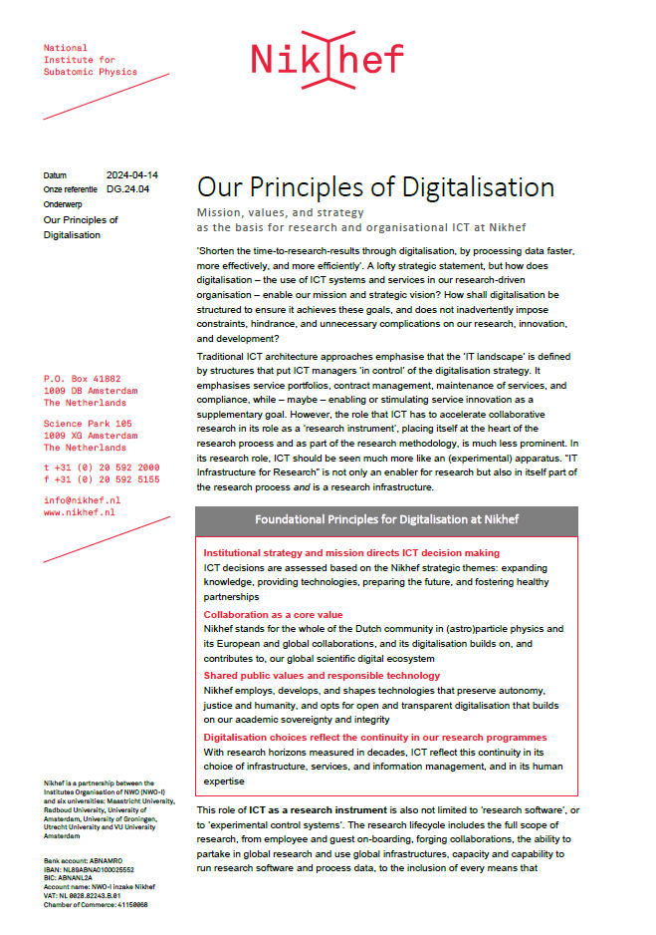
Rather than starting with an ICT architecture or landscape …
What actually drives our (ICT) choices?
How do they relate
to organisational values?
How do we position our ICT choices
in the scientific, societal,
and governance landscape?
Those questions deserve an answer ...
before drafting any policies, procedures,
or compliance requirements

Slide 9
Our Principles of Digitalisation
‘If they are many, they are not principles’, so we set only four:
Institutional strategy and mission directs ICT decision making
ICT decisions are assessed based on the Nikhef strategic themes
Collaboration as a core value
Nikhef stands for the whole of the Dutch community in (astro)particle physics and its European and global collaborations
Shared public values and responsible technology
Nikhef employs, develops, and shapes technologies that preserve autonomy, justice and humanity, that builds on our academic sovereignty and integrity
Digitalisation reflects the continuity in our research programmes
With research horizons measured in decades, ICT reflect this continuity in its choice of infrastructure, services, and information management, and in its human expertise

Slide 10
What this means for architecture and service management
The Principles do not define an architecture, but drive how we see and create one
Using our own principles to create ICT architecture!
Architecture becomes an emergent result of applying the Principles:
“made jointly and continuously by our computing and data experts and the users in the Nikhef community,”
“in line with their own and our collaborative assessment of how digitalisation can enhance Nikhef as an organisation,”
“and how therewith to best implement our mission.”
Human expertise (#4)
Academic sovereignty and integrity (#3)
European and global collaborations (#2)
Institutional strategy (#1):
expanding knowledge, preparing the future, fostering healthy partnerships

Slide 11
Example: redefining the concept of service management
IT Service Management (ISO20000, ITIL, FitSM) promote
a specific definition of service portfolio management:
“Product/service portfolio The product/service portfolio is the complete set of products and/or services that are managed by the organization, and it represents the organization’s commitments and investments across all its customers and market spaces. …”
[ITIL v4, chapter 5]
Concept of ‘services’ in collaborative research is entirely different:
coming from existing collaborations and infrastructures, many or most
services already exists and used extensively by research and collaborative administration;
they are an essential part of collaborative research: they should be embraced;
whether a ‘service’ is operated by a third party, our outside (local) ITSM control
is immaterial to the value of the service

Slide 12
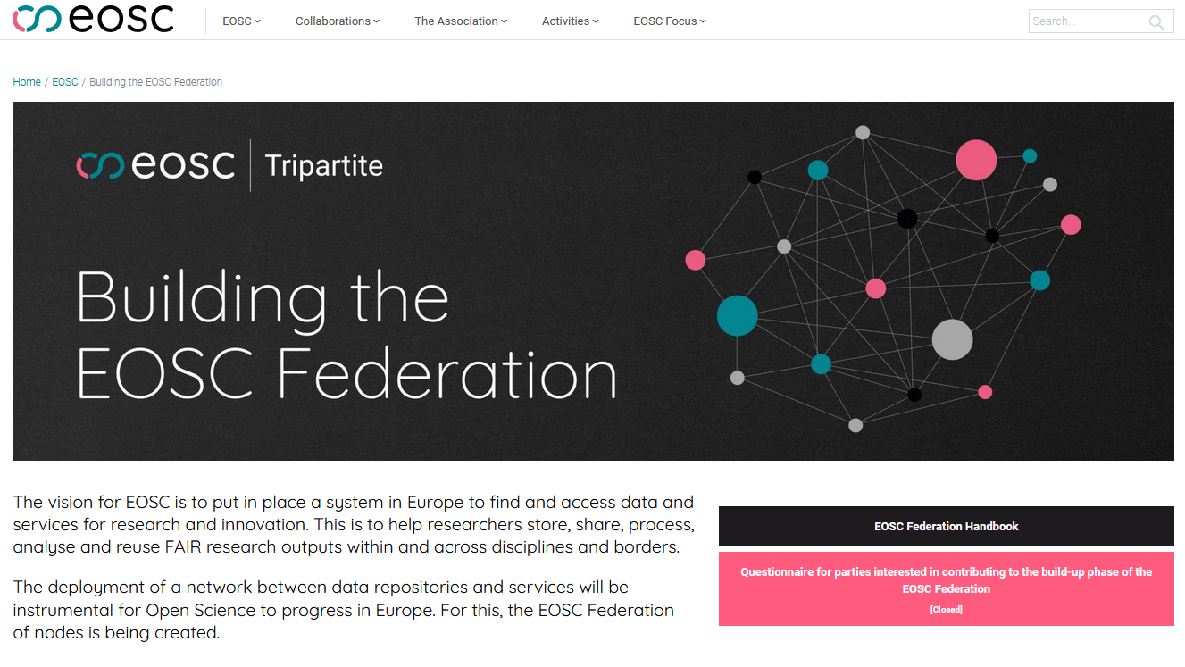
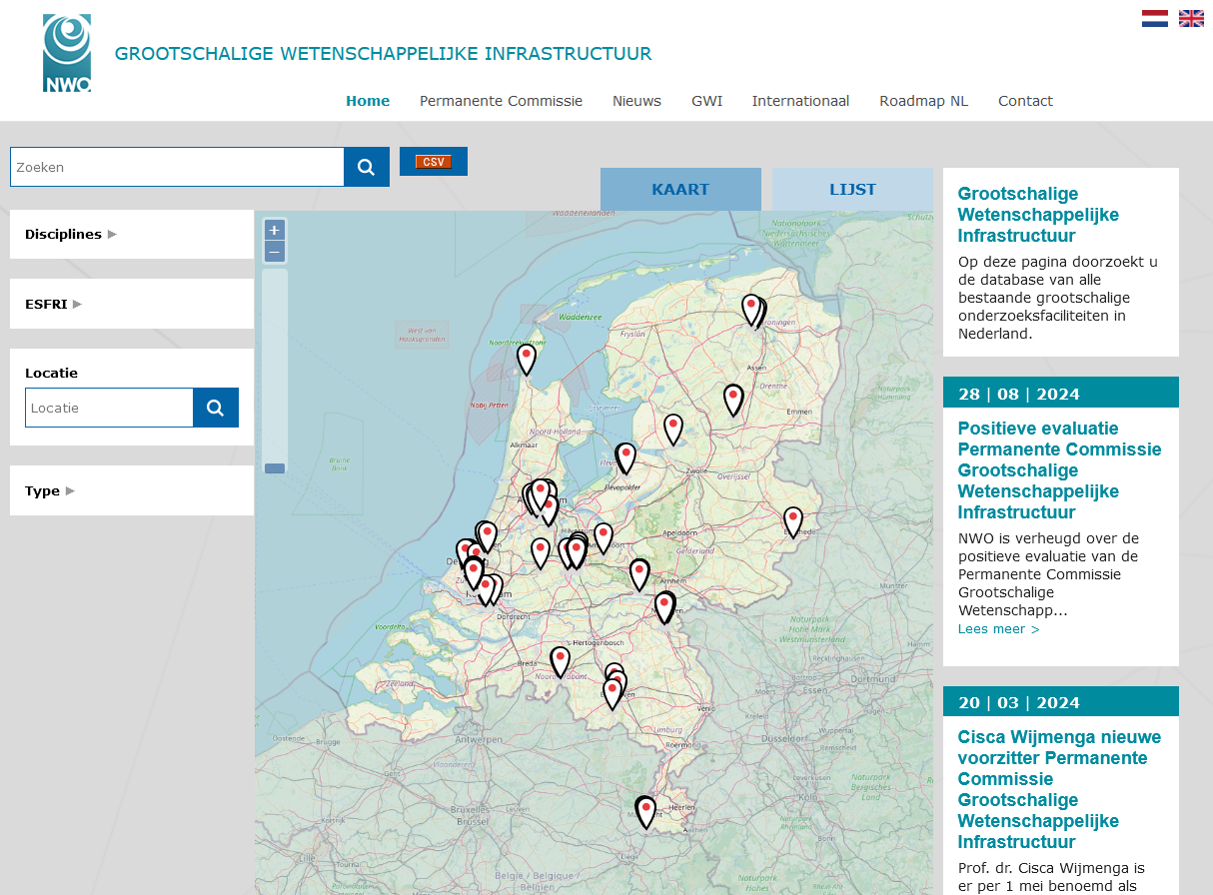
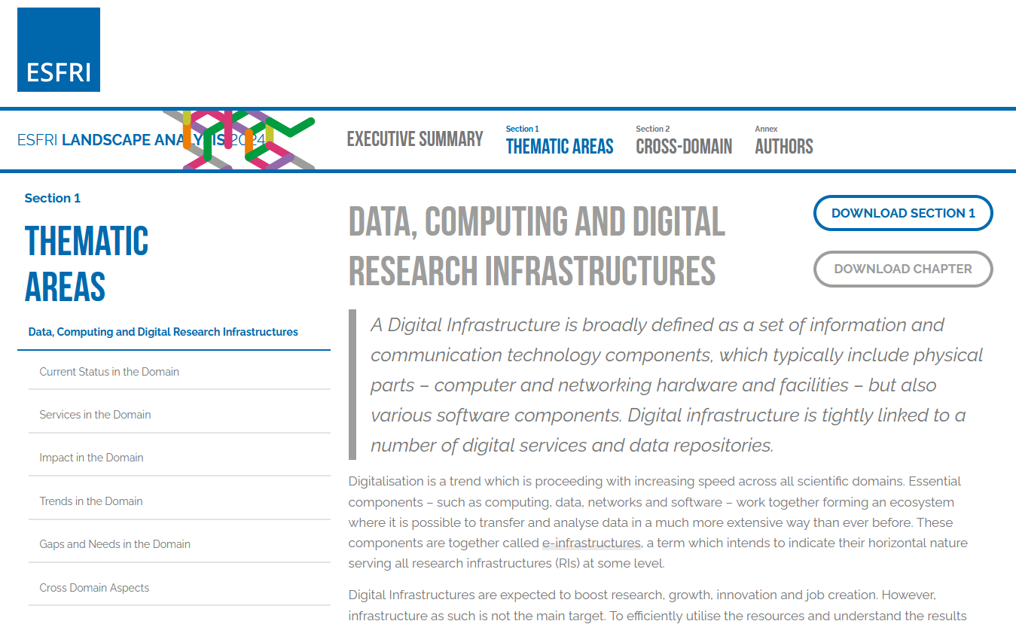
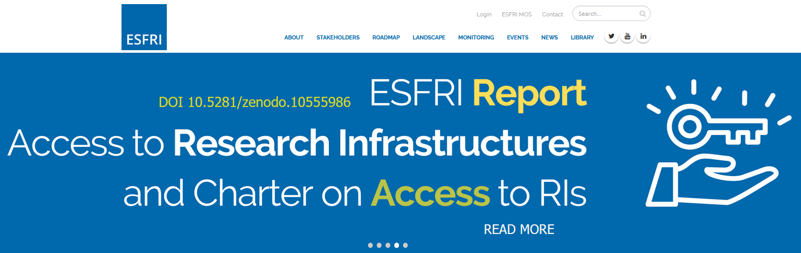
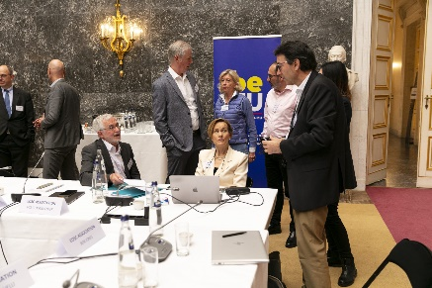
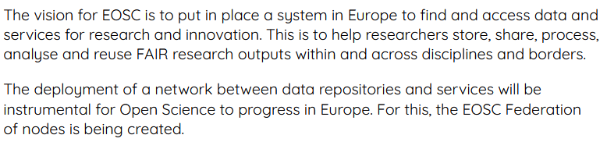
About ESFRIs, GWIs, the European Open Science Cloud
See e.g. https://www.onderzoeksfaciliteiten.nl/; https://www.esfri.eu/; https://landscape2024.esfri.eu/; https://eosc.eu/building-the-eosc-federation/

Slide 13
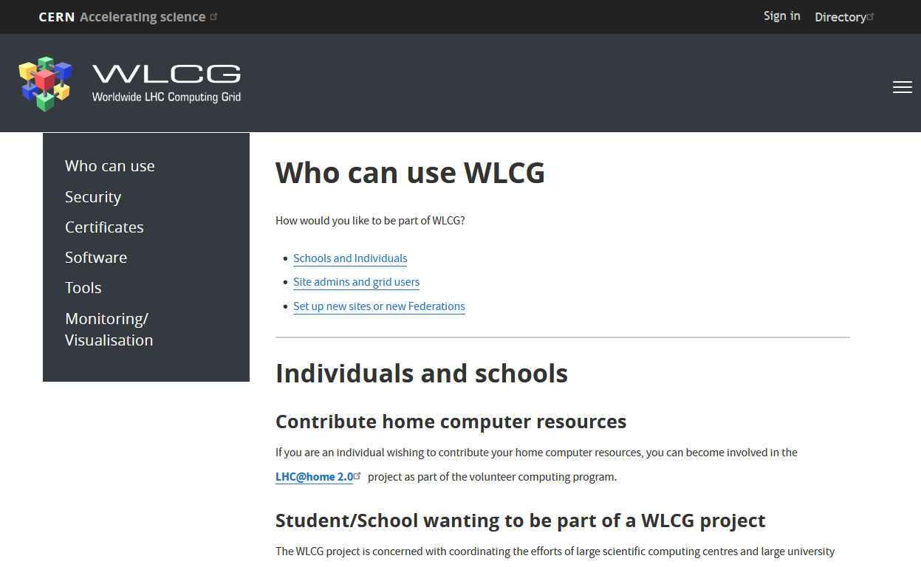
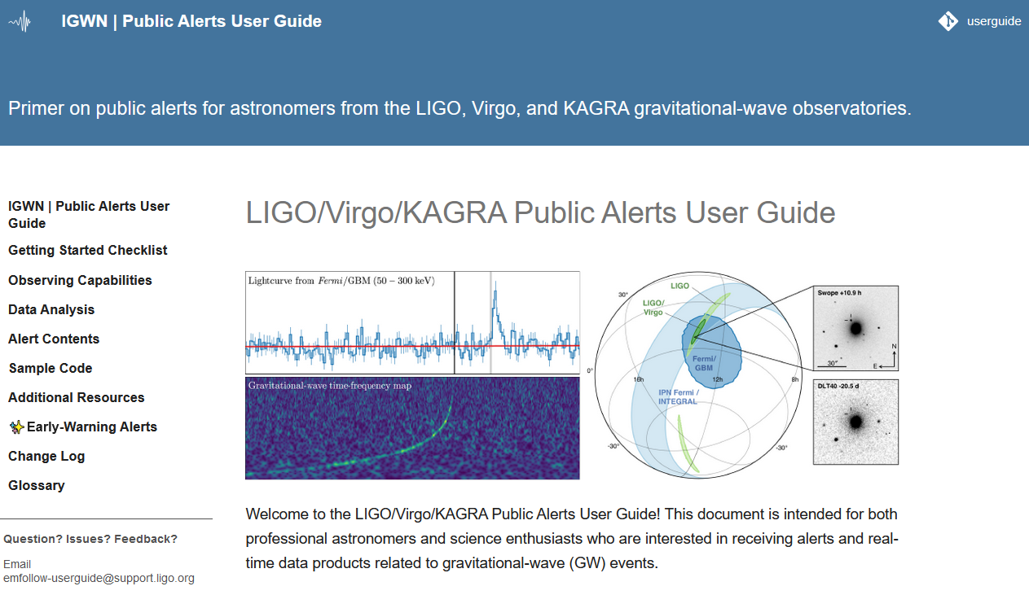

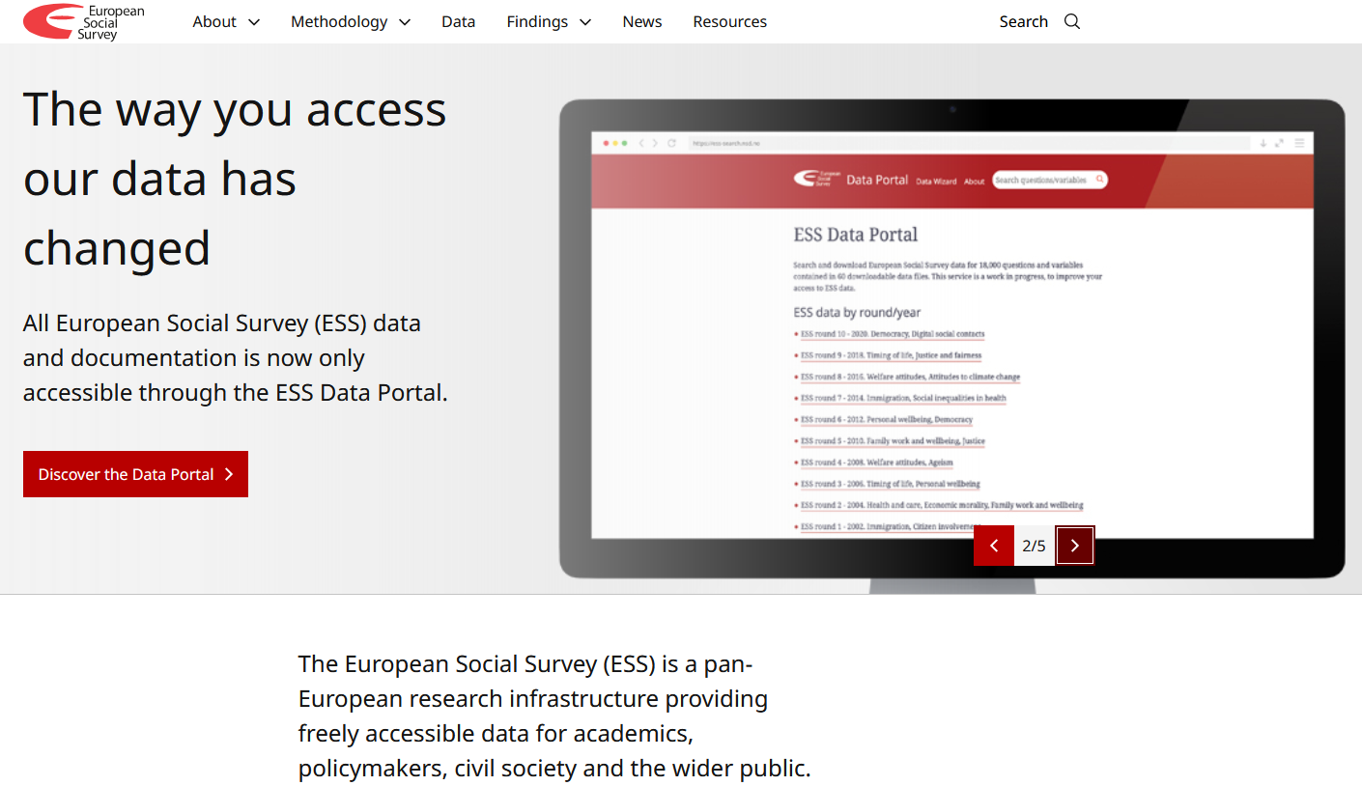

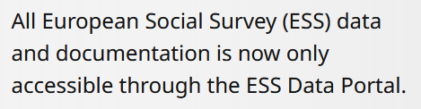
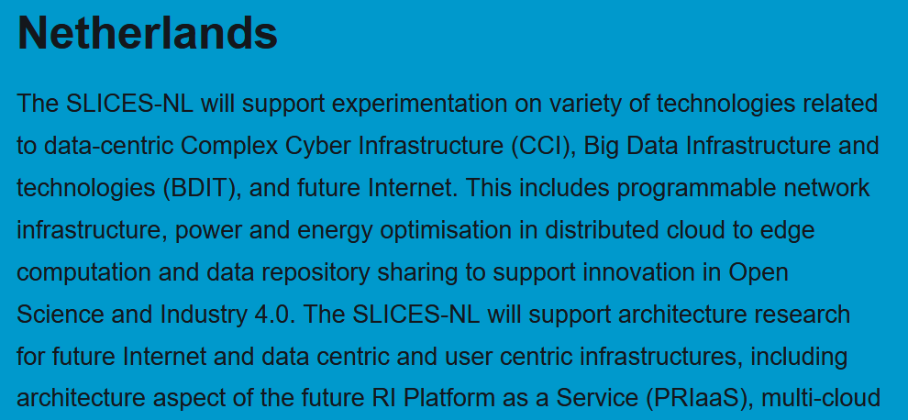
Research Infrastructures both users and providers … and ‘we’ are as well!
https://rtd.igwn.org/; https://www.europeansocialsurvey.org/; https://wlcg.web.cern.ch/;
https://www.slices-ri.eu/consortium-netherlands/

Slide 14
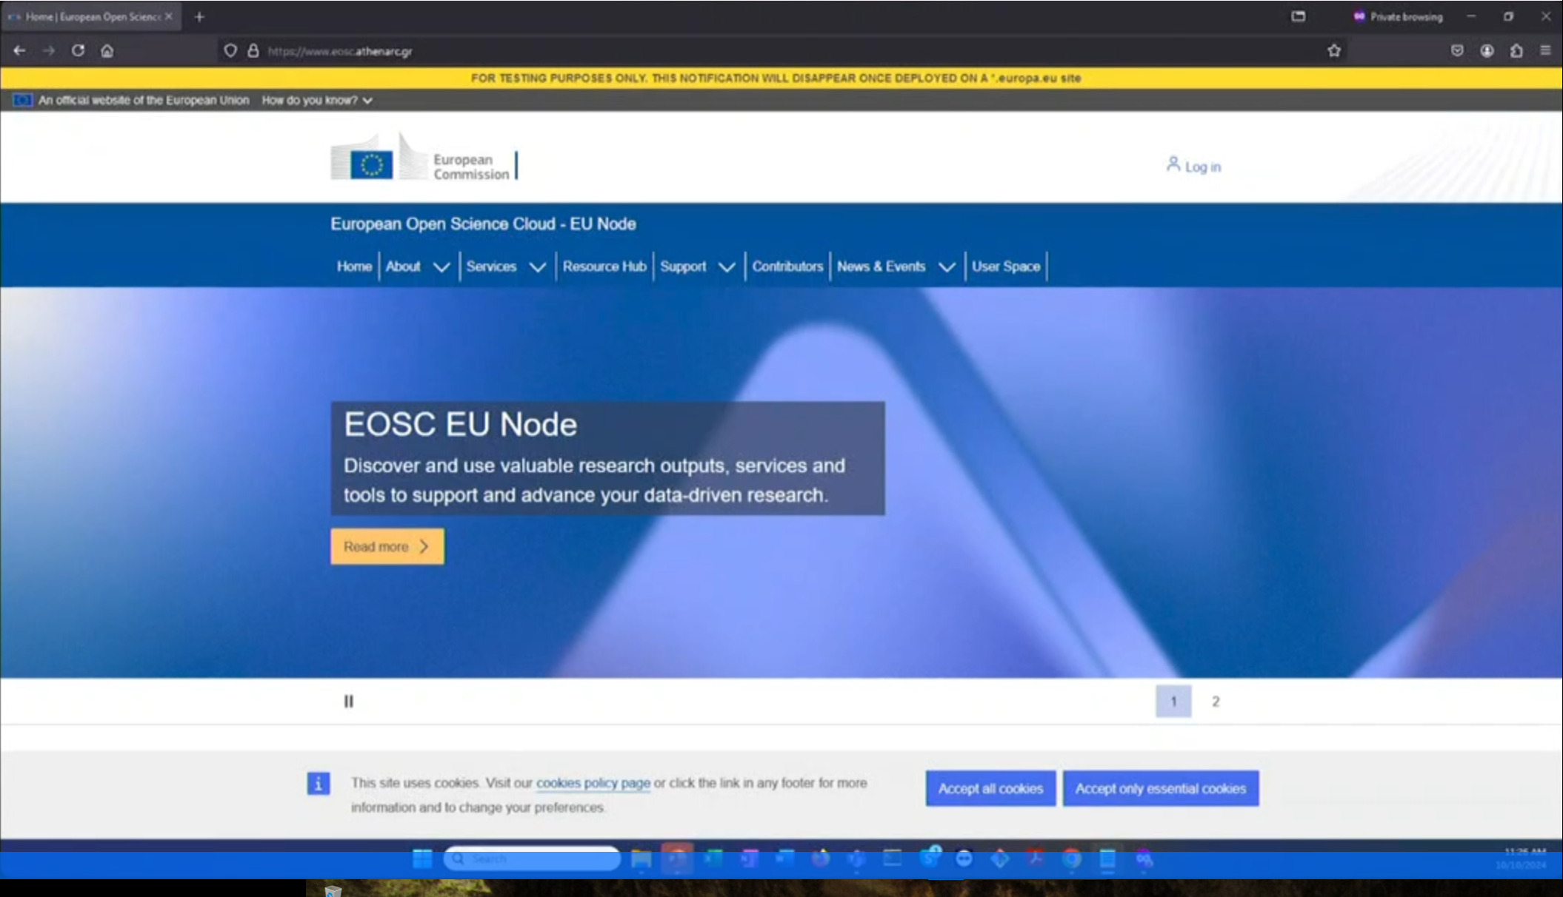
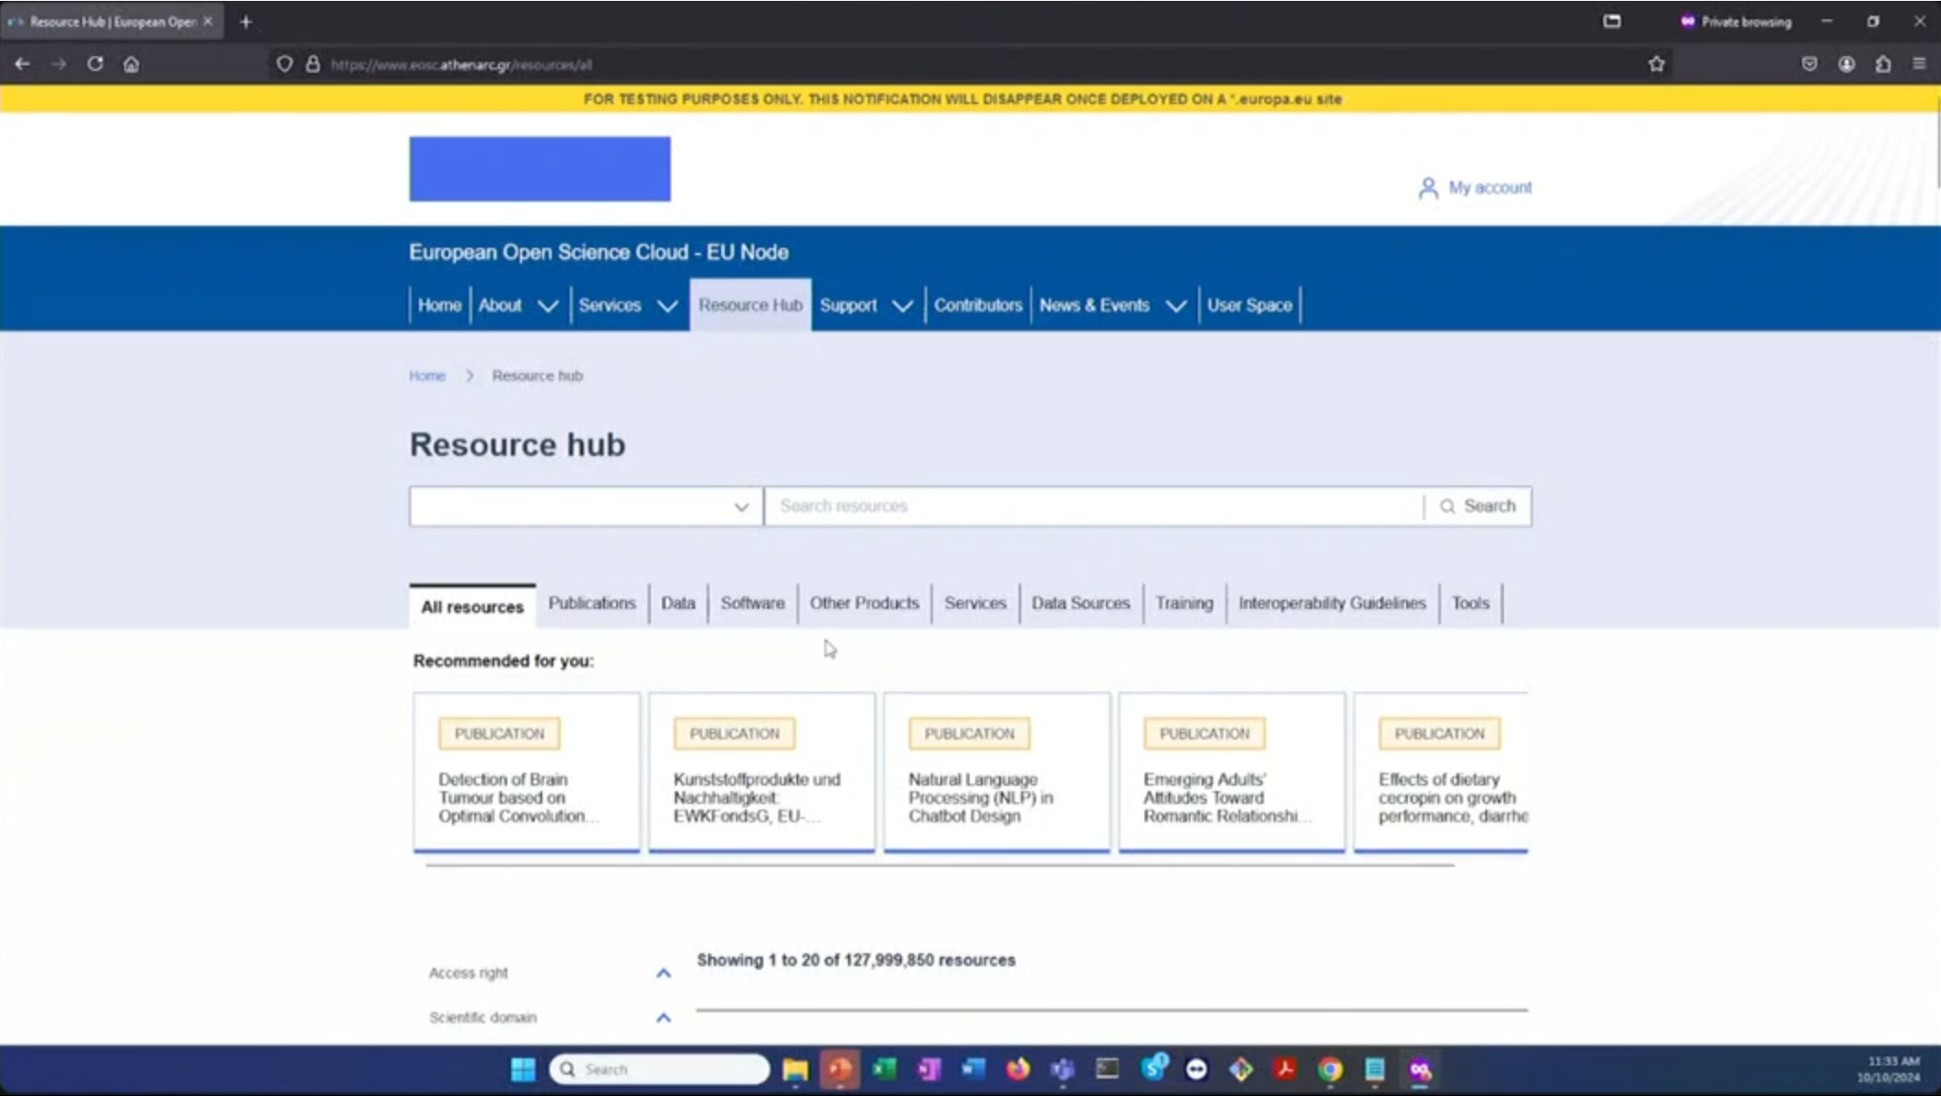
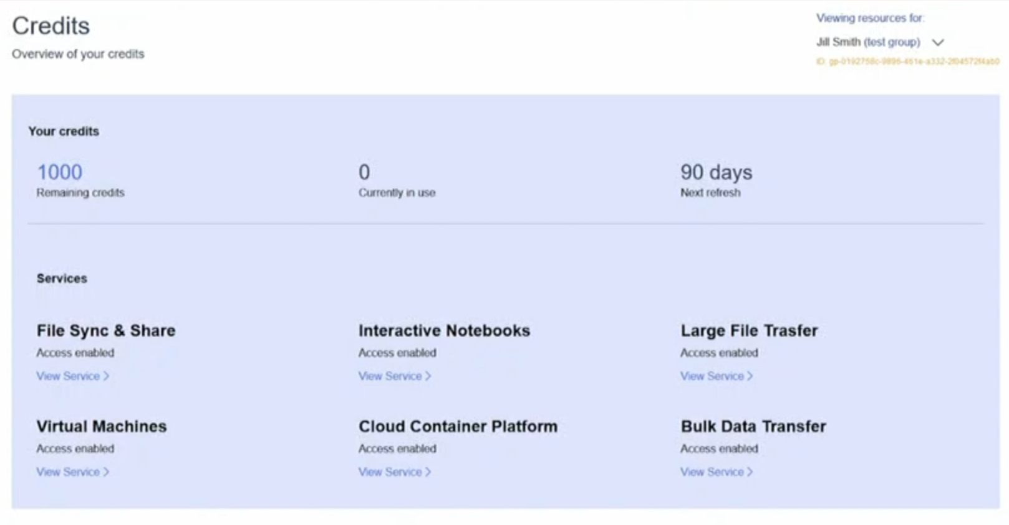
And some EOSC is coming ‘whether you want it or not’ …
https://webcast.ec.europa.eu/eu-node-technical-launch-event-24-10-10

Slide 15
Translating principles to actionable practice
Principles cheat sheet
Institutional strategy and mission directs ICT decision making
Collaboration as a core value
Shared public values and responsible technology
Digitalisation choices reflect the continuity in research programmes
The Foundational Principles
underpin everyday strategic decisions
and their practical implementation
strategic implementation choices
should be broadly consistent
evolving over time, like we evolve
the Nikhef strategy itself
implementation should be
consistent and fair,
and come through a transparent process
Practices are often a combination of the Principles, but let’s group them anyway

Slide 16
Institutional strategy and mission directs ICT decisions
“ICT decisions are assessed based on the Nikhef strategic themes: expanding knowledge, providing technologies, preparing the future, and fostering healthy partnerships”
ICT infrastructure and services are in themselves a research instrument,
similar to our detectors, for local users, and also for our collaborators
design decisions made in the architecture of infrastructure and networks
respect the primacy of our scientific mission
the concept of ‘bring your own device’ is taken as a given for digitalization
open, innovative, and scalable solutions are preferred over minimalistic offerings that may appear to have lower cost, but oft are soon inadequate
The approach to all IT risk management is based on subsidiarity and devolution, unless there are clear reasons to centralise risk acceptance
also provide a return to industry and civil society by co-creating future computing and networking infrastructure

Slide 17
Collaboration as a core value
“Nikhef stands for the whole of the Dutch community in APP & PP, and its collaborations, and its digitalisation builds on, and contributes to, our global scientific digital ecosystem”
development, operation, and sourcing is done in collaboration, and we engage with our partners long-term, prioritizing collaborative & federated solutions
access through federated trust and identity that allows granting access to our scientific collaborations, national or global R&E community, or the public at large
federation is multi-lateral by construction:
users must not be bound to a single supplier or single identity
what we develop is open and re-use friendly: we protect that openness
through OSI endorsed licensing, with ‘open source first, unless’ policy that
encourages open standards, longevity, and preservation of autonomy
that is essential for our long-term science goals
we collaborate with and contribute to the open source community

Slide 18
Shared public values and responsible technology
“Nikhef employs, develops, and shapes technologies that preserve autonomy, justice and humanity, and opts for open and transparent digitalisation that builds on our academic sovereignty and integrity”
self-assessment and peer review are part of our common heritage and as applicable to digitalisation as they are to research in general
public values as drivers for our choices made in the implementation of digitalisation not only in research services, but also in enterprise and back-office
in academia, everyone is already guided by our common integrity principles
honesty, scrupulousness, transparency, independence, and responsibility
academic freedom inextricably linked to digitization, since ICT infrastructures
(in the broadest sense, not limited to scientific computing aspects) fundamentally determines whether we can perform the research we set out to do
Netherlands Code of Conduct for Research Integrity 2018: https://www.nwo.nl/en/netherlands-code-conduct-research-integrity

Slide 19
Shared public values: preservation of autonomy
“employs, develops, and shapes technologies that preserve autonomy, justice and humanity”
practical autonomy: nature and longevity of our programmes means our needs will nearly always outlive any offering made to us by ‘closed’ commercial from outside our own communities (and those who share our long-term outlook)
for commercial services there always must be an exit-strategy, and moving services back to ‘in-house’ facilities and services must always be a viable option
expertise to assess services on technical merit must be retained at Nikhef, to be able to specify technical requirements and assess vendor-proposed solutions and deliveries on compliance
we pursue a multi-vendor model with standards-based interoperability and ability to migrate data between different vendors using open formats
We retain control over our own data

Slide 20
Shared public values: justice: trust and transparency
“employs, develops, and shapes technologies that preserve autonomy, justice and humanity”
we take care of data entrusted to us, both scientific data – where open access, FAIR data management, and open source software are key elements –
as well as any sensitive and personal data we process
acknowledge also ‘legitimate (or customary) expectation’ and the
‘intent’ of laws and regulations as significant elements in how to act justly
respect for the people whose data we process: be it personal data or
the result of their decades of scientific work
and this extends to whether, and how, we intervene with their devices and network behaviour for monitoring

Slide 21
Shared public values: humanity
“employs, develops, and shapes technologies that preserve autonomy, justice and humanity”
founded on research integrity and ethical norms rather than on enforced adherence to regulatory and contractual frameworks. Get adherence ‘bottom-up’, using positive incentives
digitalisation is there to support the people, and we do not a-priori block access to services, tools, or facilities that could help the user
not a `free-for-all’: with great freedom comes great responsibility
establish acceptable use aligned with our global collaborative consensus
we encourage learning from our mistakes together and allow people to make mistakes – as long as we are all open about having made those mistakes
encourage responsible disclosure
‘The best research is made in a climate where opposing ideas are welcome, questions explained and mistakes gauged’

Slide 22
Choices reflect the continuity in our research programmes
“With research horizons measured in decades, ICT reflect this continuity in its choice of infrastructure, services, and information management, and in its human expertise”
Today building the systems and collecting data we know we will use the next 30+ yrs
any products we procure or commercial services and software we use will change beyond recognition, be obsoleted by its supplier, or become extortive, and any supplier will either fail or no longer be innovative
Nikhef avoids sourcing that would lead to vendor lock-in and emphasises the use of open formats and protocols, unless services are just ephemeral
choices need a mechanism to adjust and evolve underlying technologies,
enabled by human expertise, organisational memory and continuity of staff

Slide 23
So our principles of science inspire our digitalisation
open access to our collaborative global infrastructures,
‘ICT infrastructure is a research instrument in itself’,
FAIR infrastructure,
mindful of programmatic research
rather than short-cycle or project-based approach

Slide 24
Our Principles of Digitalisation
Available from https://go.nikhef.nl/principles-of-digitalisation for reflection

Slide 25
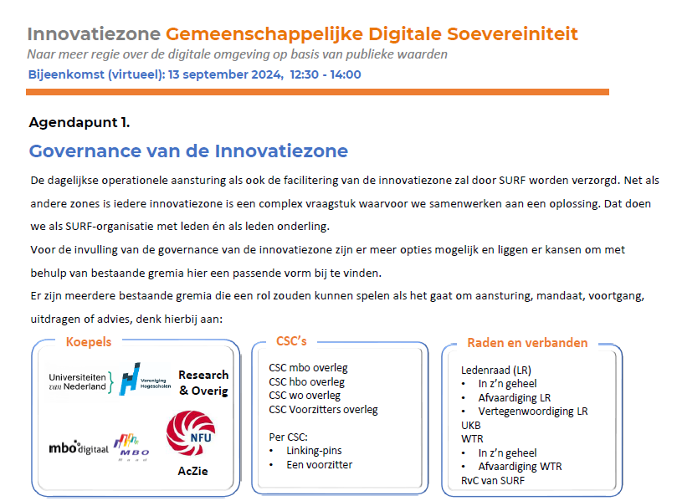
Collaborating on ICT infrastructure collaboration
Innovatiezone: Gemeenschappelijke Digitale Soevereiniteit
Bewustwording en kennis over alternatieven, creëren van draagvlak
en bereidheid om dit serieus te ontwikkelen;
Sturing op aanpassing van de
Sourcing strategieën (van alle leden),
acceptatie van Open Source;
Investering in AI
op basis van alternatieve ontwikkelingen;
Mandaat om hier binnen SURF al
pilots op te ondernemen; en
Breed communiceren over beschikbare alternatieven en geleerde lessen.

Slide 26
Yes, we can!

