Slide 1
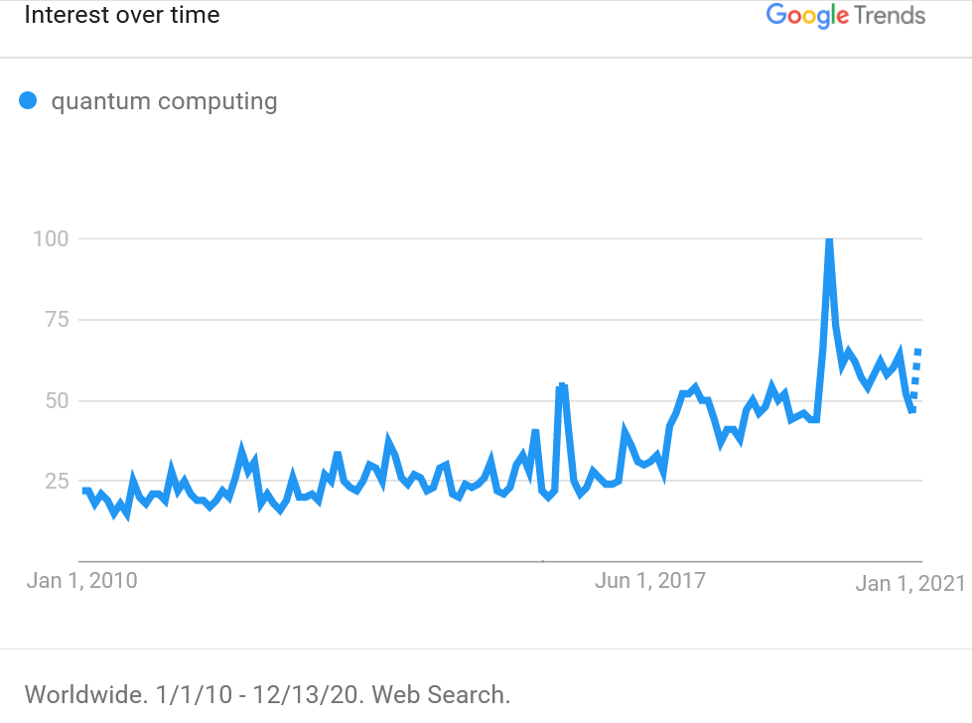
Quantum Computing both ready and not ready for us all at the very same time
Nikhef Jamboree 2020
David Groep
Physics Data Processing

Slide 2
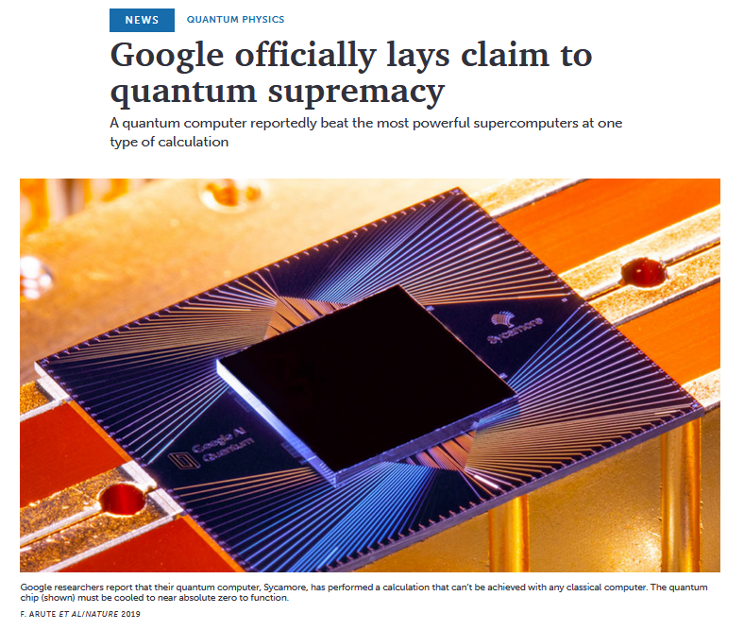
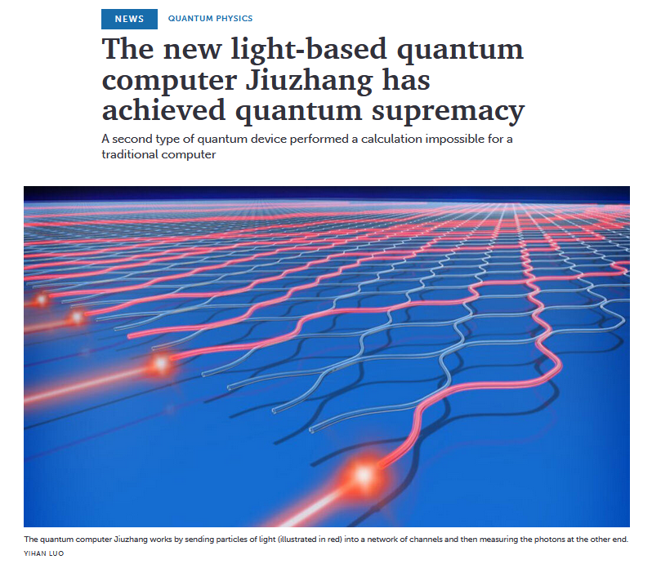
Screen captures: sciencenews.org

Slide 3
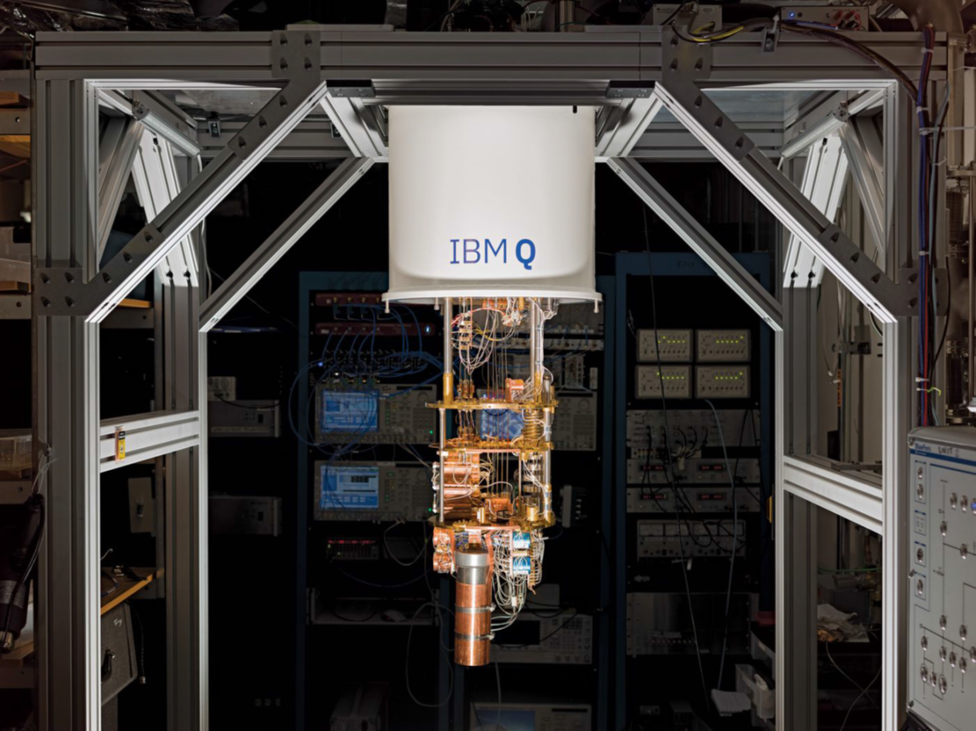
Image: IBM

Slide 4
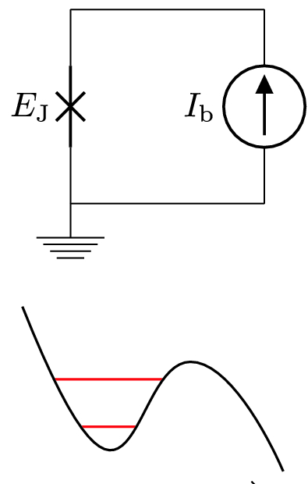


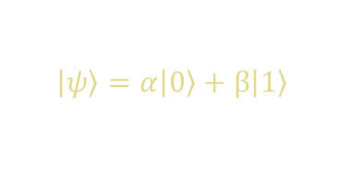
What’s in it … for the machine …
a classical bit can be either 0 or 1
typical implementation:
a charge in a MOS capacitor
a ‘qubit’ does have two basis states
|0⟩ typically a ground state and also
|1⟩ (maybe higher-energy) state
typical implementations: Josephson
junction, spin, photon polarization, a hole, …
and you can manipulate a qubit through
unitary transformation of its state (‘gates’)
although in fact there are only 2 free parameters
$$\left|\left.ψ\right\rangle \right.=α\left|\left.0\right\rangle \right.+β\left|\left.1\right\rangle \right.$$
$${|α|}^{2}+ {|β|}^{2}=1$$
and a rotation over $π$
is immaterial
image E_{J}: Anton Frisk Kockum & Franco Nori
Quantum Bits with Josephson Junctions https://link.springer.com/chapter/10.1007/978-3-030-20726-7_17

Slide 5

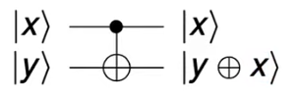
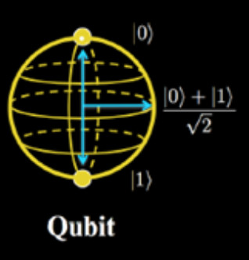


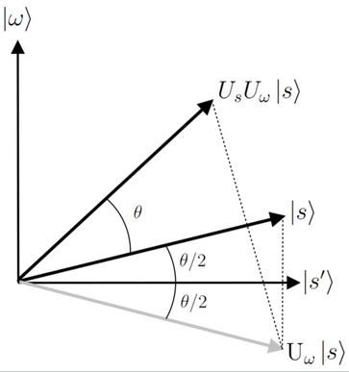

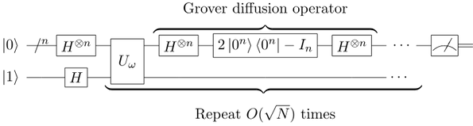
Things to do with a qubit when you’re bored
you can make it a superposition
you can entangle it
‘gate’
you can interfere with it
Image credits Bloch sphere: https://prateekvjoshi.com/
gates: wikipedia.org

Slide 6
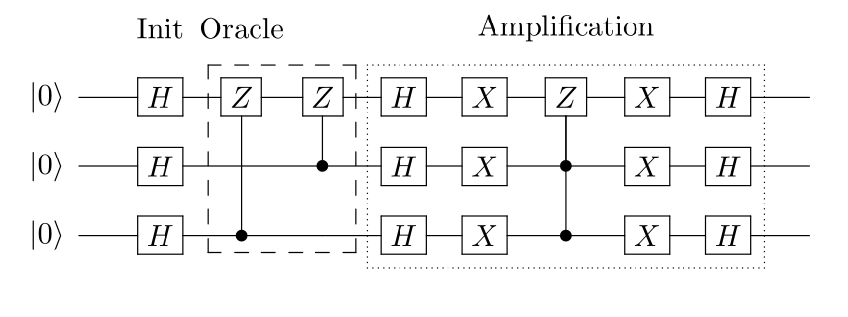
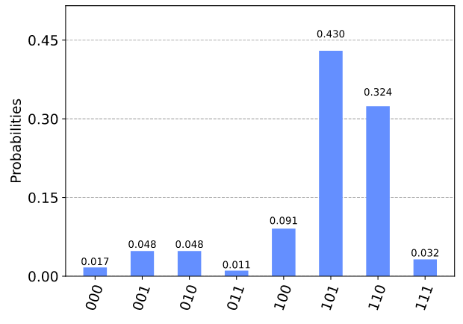

More fun with more qubits … and a bunch of gates
create maximal-
mix initial state
‘function’
acts on ABC
processing needed to determine ‘action of the oracle’ (function)
enhancing the real solution – suppressing FAKE answers
A
B
C
‘if A is |1⟩, only keep it there is either B xor C is |1⟩’
ABC
‘a general purpose Quantum Computer feels a bit
like programming an FPGA … that has a bad hair day’
images: https://qiskit.org/textbook/ch-algorithms/grover.html

Slide 7
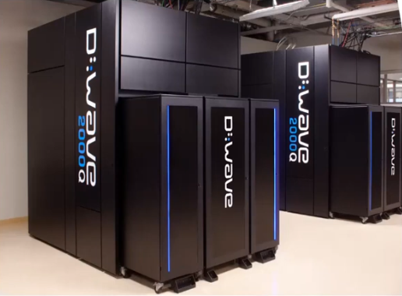
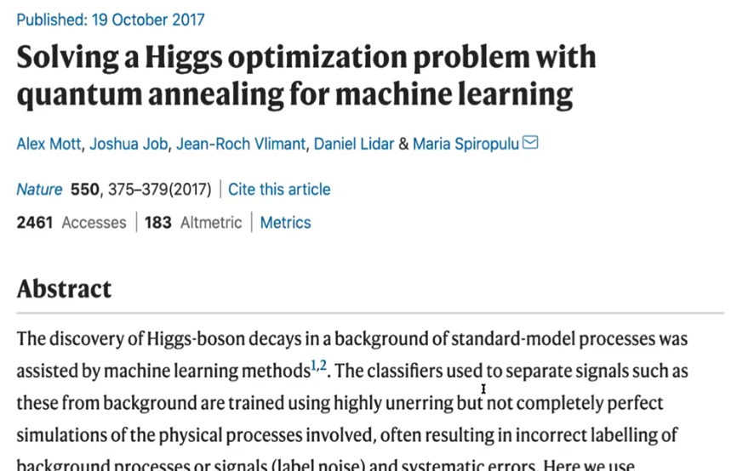
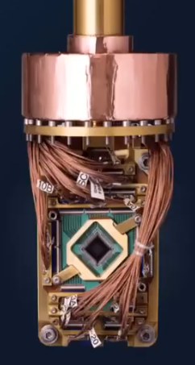
What’s in it … for us?
‘an annealing Quantum Computer can do one thing (minimization) well,
with lots of qubits, but is more like an ASIC …’
so can we also scale a general purpose QC like IBM’s to our problem sizes?
images D-Wave via: Elías F. Combarro, CERN QC lecture #5, https://indico.cern.ch/event/970903/

Slide 8
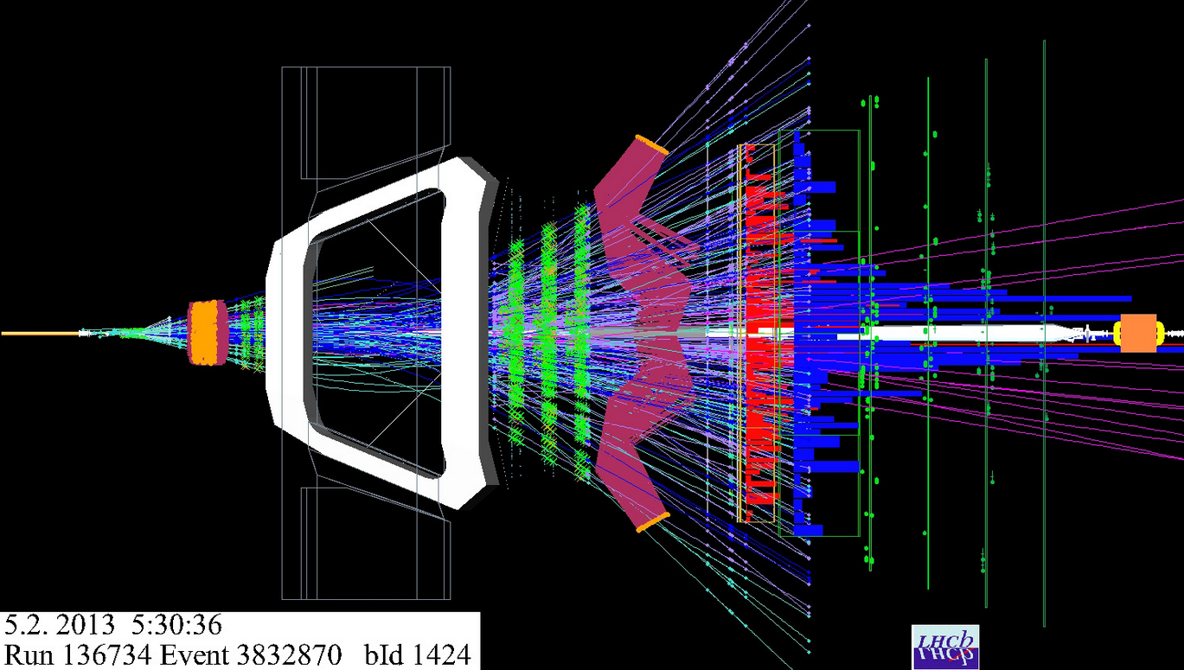
What’s in it … for us
‘just a few steps to take?’
work on potential algorithms
it’s a minimization challenge with many inputs
… but you need a lot of qubits
and a way to boost the desired result, and suppress fake news
quantify its efficiency
in finding the right tracks
and it would be jolly nice if
our quantum computer did not suffer from amnesia all the time
not suffer that many errors
now if we could only obtain quantum supremacy …
… to make sense of this, for example
so: don’t hold your breath,
it may take quite a while yet!

Slide 9
So now, be both convinced and confused …
… at the same time
go and watch the CERN QC lecture series by Elías F. Combarro at https://indico.cern.ch/event/970903/

Slide 10
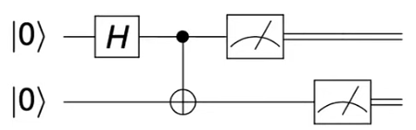
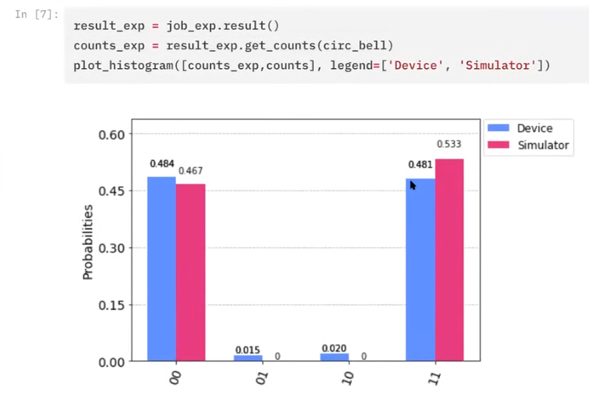
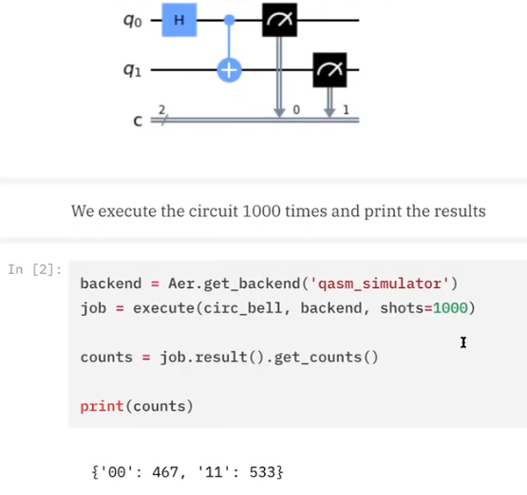
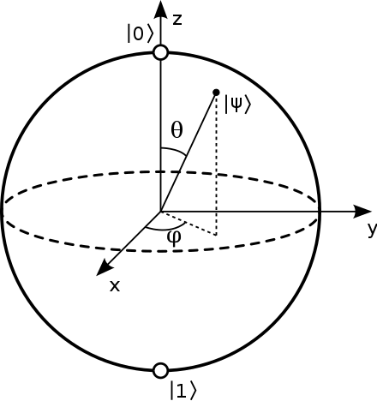
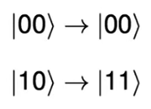
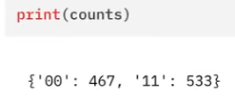

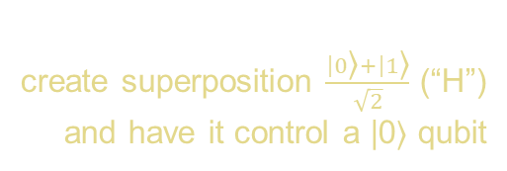
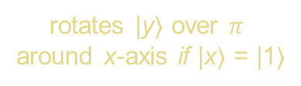
Nature always interferes slightly with our desires …
example gate:
a “controlled NOT”
create superposition $\frac{\left|0\right.\text{⟩}+\left|1\right.\text{⟩}}{\sqrt{2}}$ (“H”)
and have it control a |0⟩ qubit
x
y
what you expect:
(and what the simulator gives)
what you really get is:
rotates |y⟩ over $π$
around x-axis if |x⟩ = |1⟩
probabilistic, so measure, e.g.
1000 times in the simulator
result graphics from: Elías F. Combarro, CERN QC lecture #3, https://indico.cern.ch/event/970903/

Slide 11
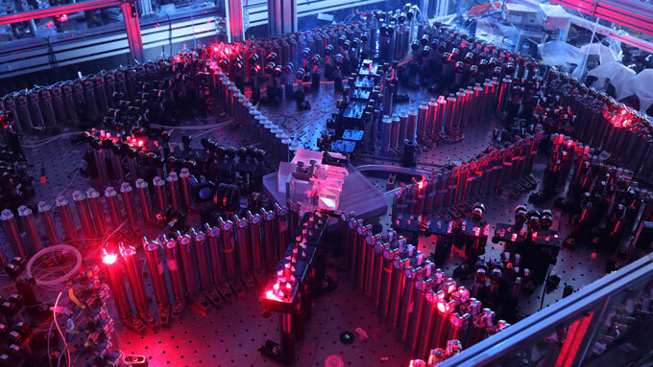
Image source: https://www.sciencenews.org/article/new-light-based-quantum-computer-jiuzhang-supremacy

