Slide 1
LHC Upgrade & the data Infrastructure
Roadmap ICT netwerk & informatie event
David Groep
Nikhef
April 2019

Slide 2
Nikhef – the National Institute for Subatomic Physics
The mission of the National Institute for Subatomic Physics Nikhef is to study the interactions and structure of all elementary particles and fields at the smallest distance scale and the highest attainable energy.
Two complementary approaches are followed:
Accelerator-based particle physics – Studying interactions in particle collision processes at particle accelerators, in particular at CERN;
Astroparticle physics – Studying interactions of particles and radiation emanating from the Universe.
Nikhef coordinates and leads the Dutch experimental activities in these fields. The research at Nikhef relies on the development of innovative technologies.
The knowledge and technology transfer to third parties, i.e., industry, civil society and general public, is an integral part of Nikhef’s mission.
Vaste wetenschappelijke staf | 80
Promovendi en postdocs | 125
Technische en engineering staf | 75
Ondersteunende staf | 25

Slide 3
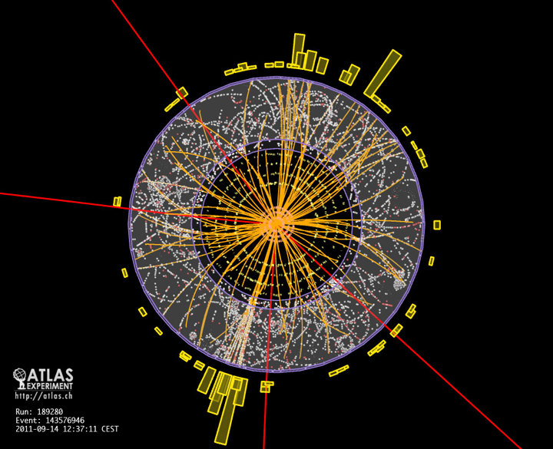
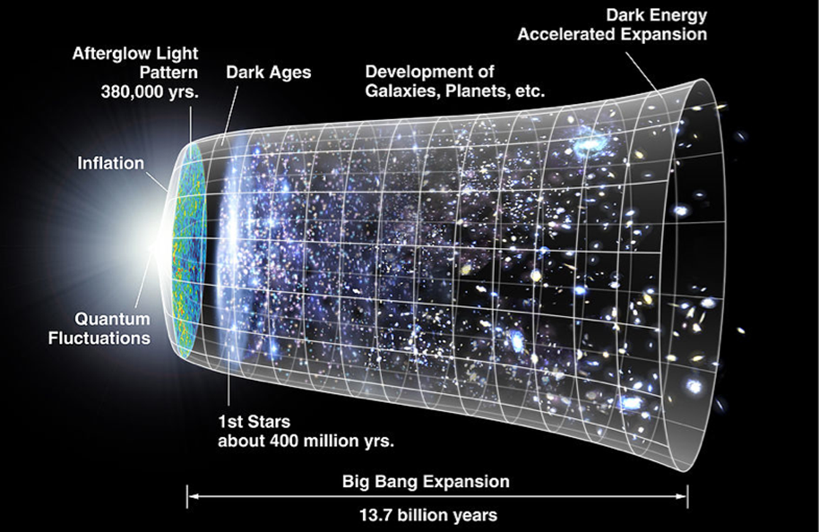
Complementary programmes
LHC increased luminosity –
can we see beyond the standard model?
Astroparticle physics –
gravitational waves, neutrinos,
cosmics rays and search for dark matter

Slide 4
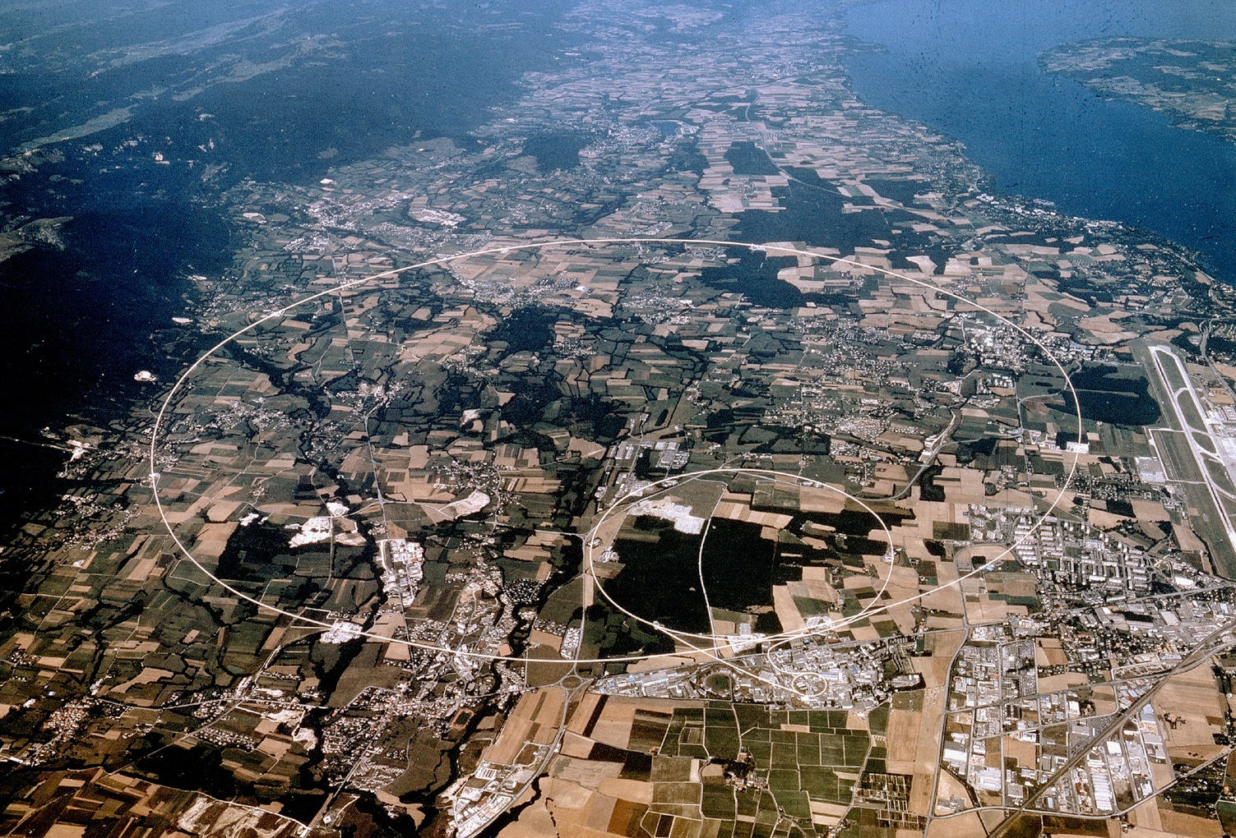





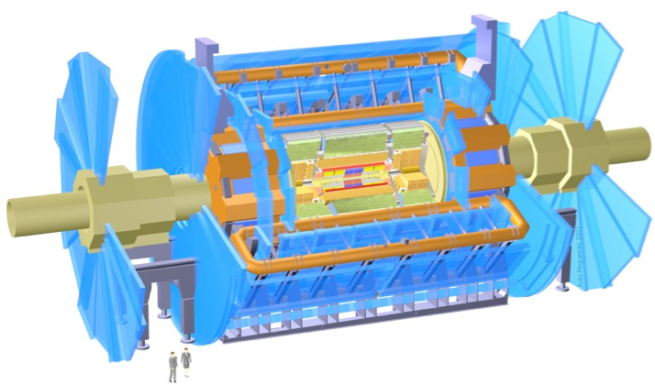

Nikhef at the LHC
ATLAS
Higgs physics
Beyond the standard model
LHCb
rare decays
matter vs anti-matter
Alice
quark-gluon plasma
matter phase transitions
LHCb
ALICE
ATLAS
Atlas
protons
Haarlemse Chemische Kring
4

Slide 5
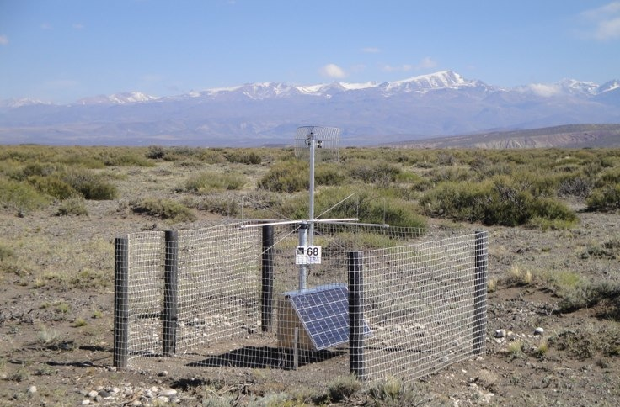
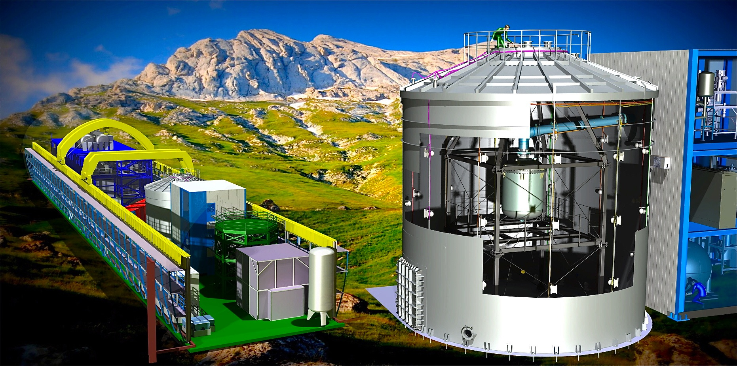
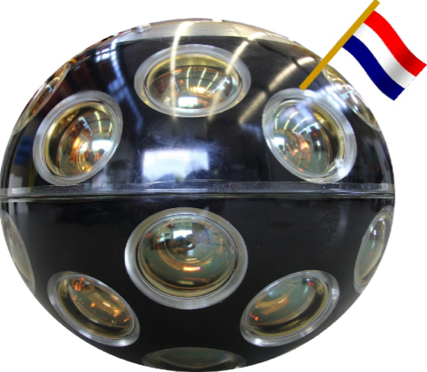
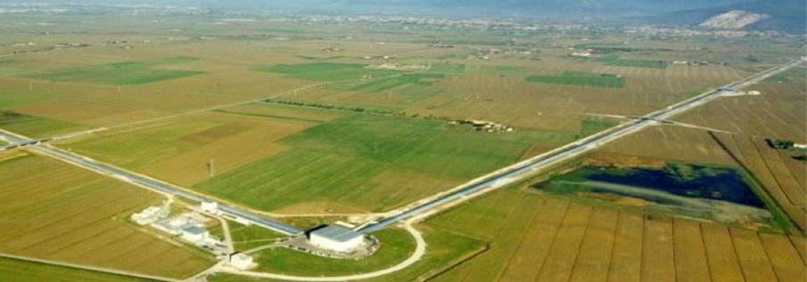
Astro-particle physics
Pierre Auger - cosmic rays
Xenon1T - Dark Matter
KM3NET
neutrino telescope
Virgo/LIGO, towards the Einstein Telescope
gravitational waves
Auger
ultra-high energy cosmic rays
Xenon
search for dark matter
Adv VIRGO - Gravitational Waves
KM3NeT - neutrino detection

Slide 6
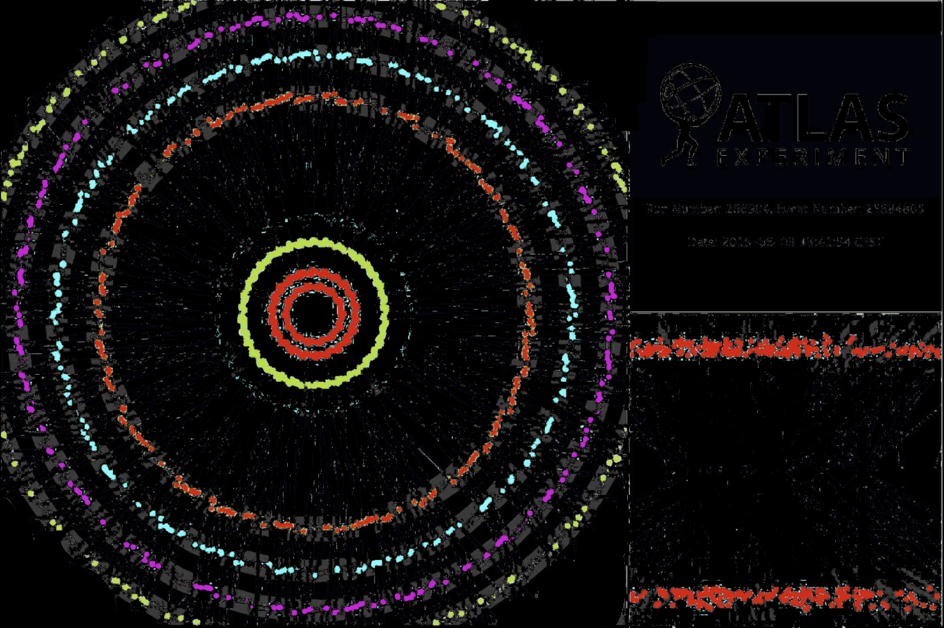
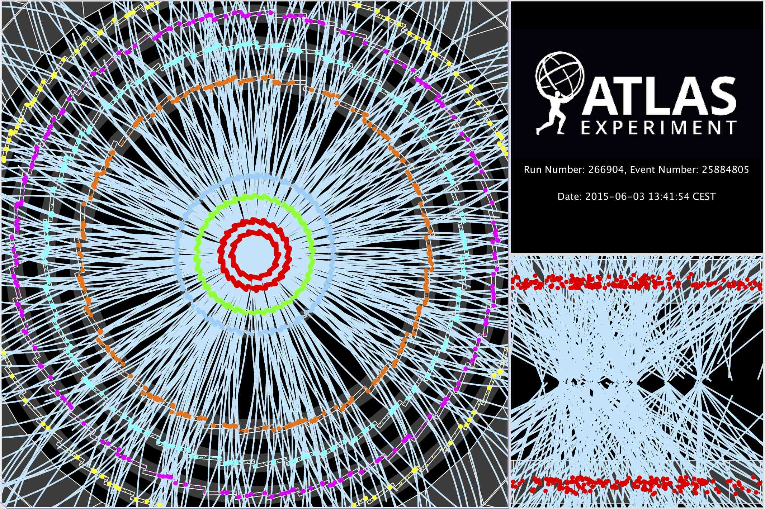
Computing: for the LHC and more
~ 10 seconds to a compute a single event at ATLAS for ‘jets’ containing ~30 colllisions
Display of a proton-proton collision event recorded by ATLAS on 3 June 2015, with the first LHC stable beams at a collision energy of 13 TeV
Event processing time: v19.0.1.1 as per Jovan Mitrevski and 2015 J. Phys.: Conf. Ser. 664 072034 (CHEP2015)

Slide 7
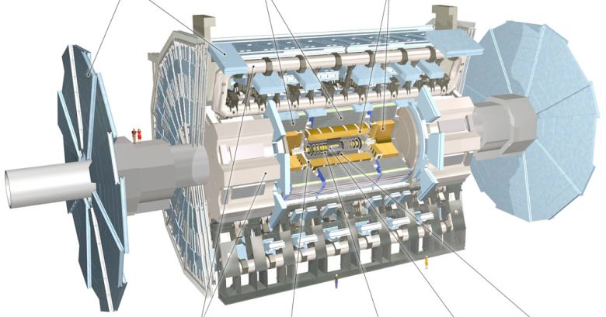
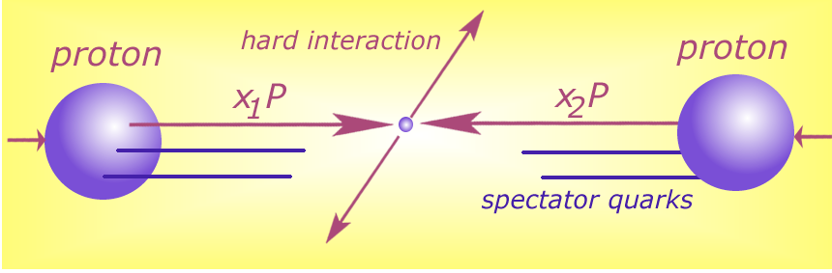





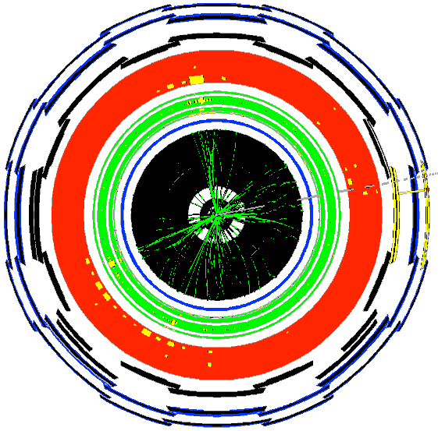

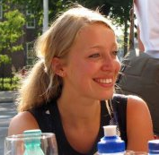

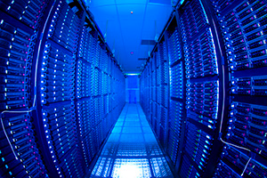


Data flow at the LHC
40 miljoen / seconde
Analysis of results by staff and PhD students
Filtering at source selects
~ 600 Hz, so ~ 1 GB/s data
Data distribution in
the national and global
e-Infrastructures

Slide 8
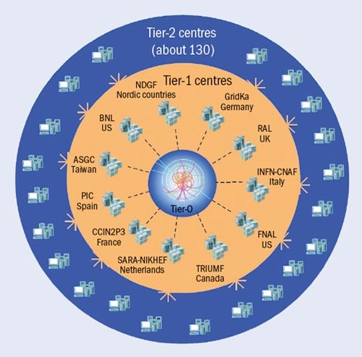
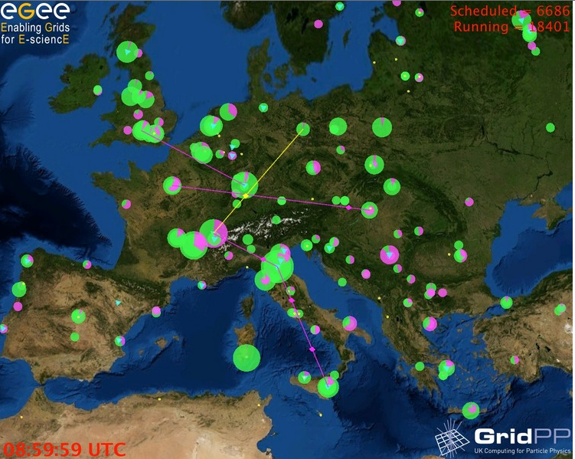
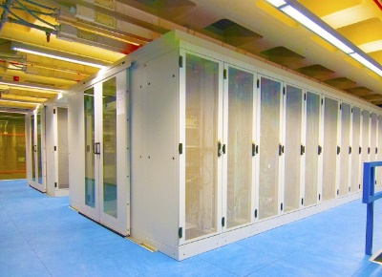
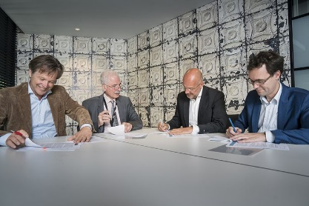
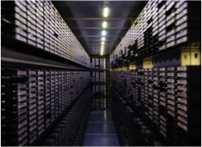
Computing – the Netherlands Tier-1
for the ‘Worldwide LHC Computing Grid (WLCG)’
the Dutch National e-Infrastructure provides the NL Tier-1 as a service to WLCG
–> the LHC NL Tier-1 is jointly operated by the DNI partners, and coordinated by SURF
but this did not just
happen by chance

Slide 9
Stronger together – BiG Grid
BiG Grid (2005, 2007-2012)
from data processing ‘project’ to
a national e-Infrastructure
all in this together: Nikhef, NWO, NBIC
solve common challenges
invest in both hardware and peopleware
Dutch National e-Infrastructure (2013-)
coordinated by SURF
national collaboration brings great results
ensure continuation of BiG Grid success
more effective and cost-efficient,
and of ensured quality
BiG Grid Mission:
To realise a national ‘world class’ ICT infrastructure for scientific research
such as particle physics, life sciences and other sciences, including a variety of hardware facilities to enable e-Science.

Slide 10

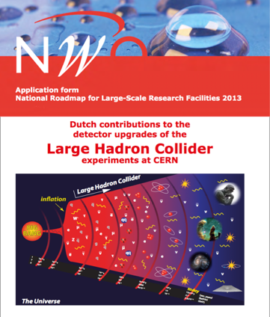
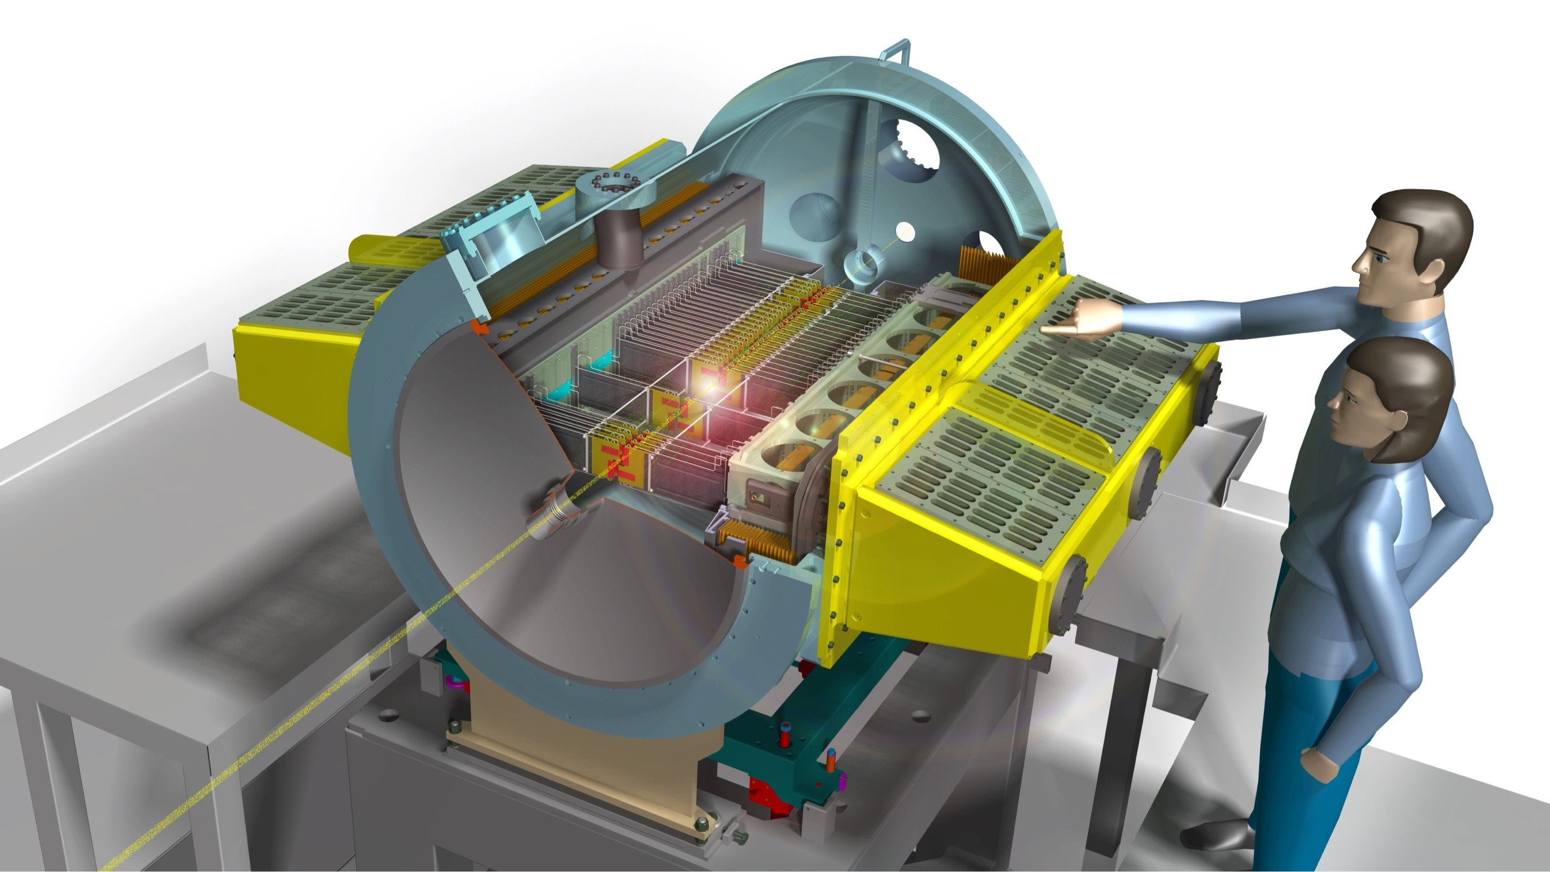
The LHC Detector Upgrades roadmap (2014)
National roadmap 2014: invest ~15.2M€ in
upgrade of the LHC detectors for
new discovery potential
enable the computing infrastructure to
analyse these new results
ATLAS: 5.2 M€
LHCb 4.0 M€
ALICE 2.3 M€
NL-Tier1 3.7 M€
(for 5 years)

Slide 11
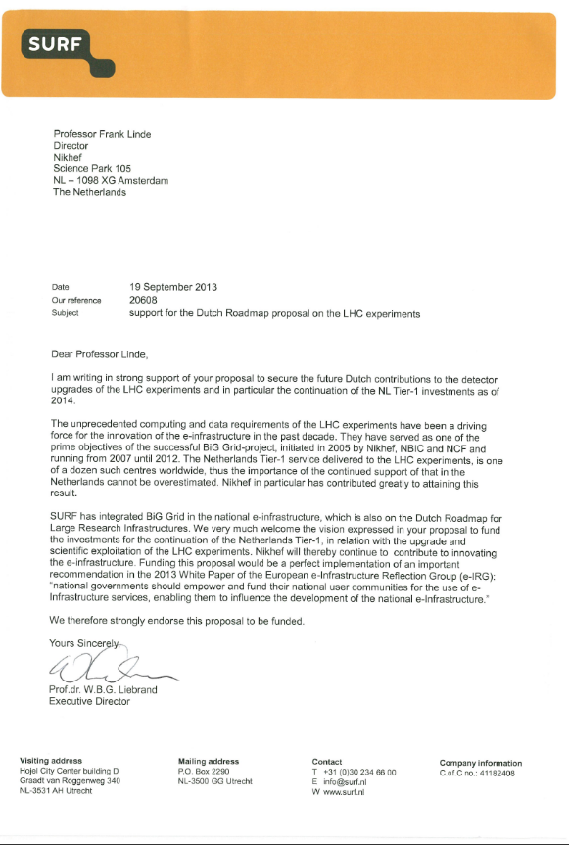
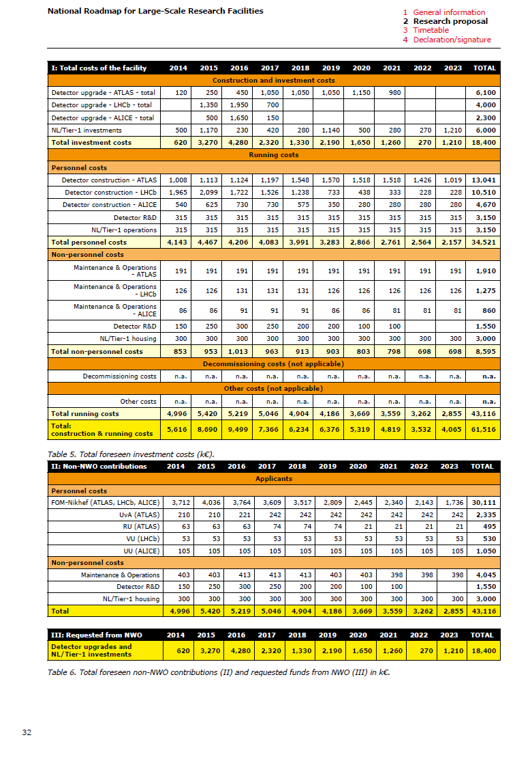
Computing is part of the infrastructure
Requested computing investment
6 M€ for 10 years (2014 - 2023)
CPU
Storage
Networking equipment
Commission reduced computing term to 5 years (and only 3,7 M€)
– but then: “We’ll be back”
Our own contribution:
Operations personnel (~ 4 fte/yr)
Housing (Nikhef datacenter)

Slide 12
computing is all in the national
e-Infrastructure – coordinated by SURF
The NL/Tier-1 is a joint venture of Nikhef and SURFsara, serving the three LHC experiments in which Nikhef participates (ATLAS, LHCb, and ALICE), and is fully integrated into the Dutch e-infrastructure, operated by the SURF foundation and partners, one of which is Nikhef.
SURFsara is the national computer centre and the flagship partner of the national e-infrastructure. The NL/Tier-1 profits from excellent high-speed optical links provided by notably SURFnet. Being the best-connected Tier-1 centre, it plays an important role in the WLCG high-bandwidth network connectivity between several other Tier-1s and CERN.
Expansion of the NL/Tier-1 to keep pace with the computing needs of the upgraded LHC facility depends on our success in securing new funding. In the new e-infrastructure model, it will be exclusively our own funding that provides the adequate compute and data capacity.
However, we will provide this capacity by participating in and through the national e-infrastructure, which allows us to benefit from economies of scale and profit from the joint operations and sharing of personnel. It allows us to focus on investments in capacity, while being assured of the long-term sustainable services by SURF and its subsidiaries.
Federation of resources across ‘the DNI’ very effective indeed

Slide 13
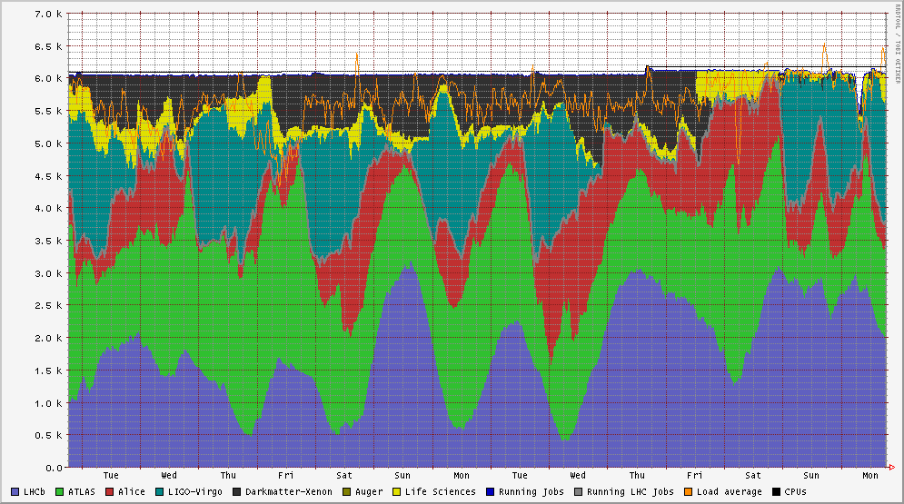
service-based approach: efficient and effective
Life Sciences, MinE, WeNMR
Services in the DNI
compute in many operational sites (SURFsara, Nikhef, RUG-CIT)
high-throughput storage at SURFsara and Nikhef,
long-term storage at SURFsara,
interconnected by SURFnet, and authentication by SURFcertificaten
Dark matter search
LIGO-Virgo
LHC Alice
LHC ATLAS
NDPF voview short 1 October 2018
LHCb

Slide 14
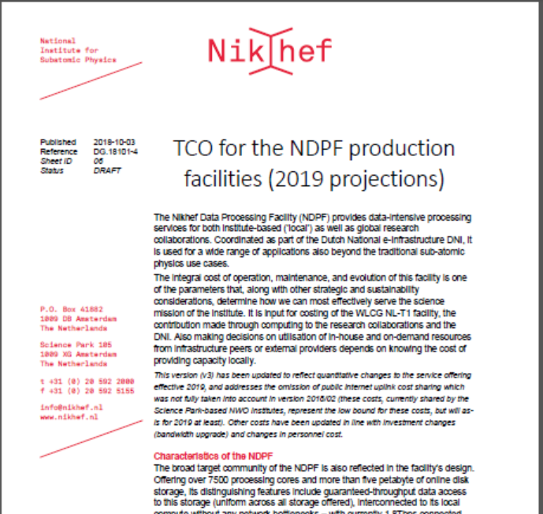
Joint infrastructure: a utilized service is a cost-effective service
Running the NL-T1 service is not ‘free’, also not on our national e-Infra
the funding from the LHC Upgrade roadmap
is invested via the ‘DNI’ Dutch National e-Infrastructure
used to support all aspects of the service:
compute, high-throughput storage, tape archive
cost at all operational partners remarkably similar
(if one is honest about total cost …)
with its high utilization DNI is far more efficient
than public commercial clouds at our required service level

Slide 15
Questions?

