Slide 1

Starting the
Natural & Engineering Sciences Thematic DCC
NES TDCC “2022” Roadmap
David Groep
September 2022
for the NES TDCC writing team
Anthony Brown, David Groep, Marta Teperek, Irene Debussy, Vera Sarkol, Wim Som de Cerff

Slide 2
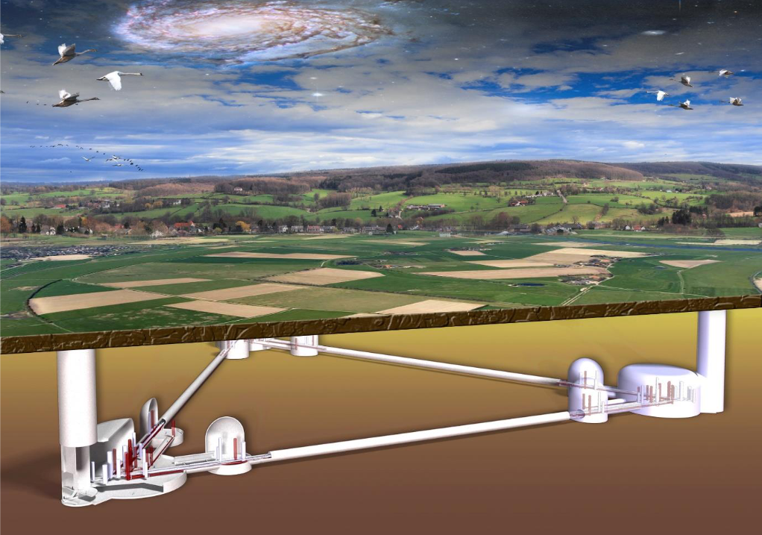
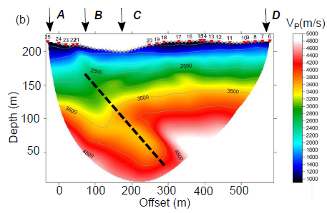
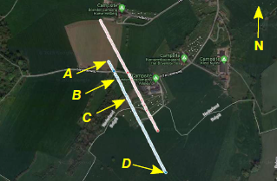
‘NES’: a heterogeneous domain with common challenges
Case study 1: Einstein Telescope seismic studies … (‘E-TEST’)
Data collected here is also useful for many others - outside of the ET planning - and
we build on existing competences from domains decidedly ‘non-GW’ … that span
many ‘local’ organisations (UM/Nikhef, KNMI, VU/Nikhef, UvA/Nikhef, Liege, Aachen, …)
ET impression: Marco Kraan (Nikhef) from “Terziet drilling campaign” https://www.nikhef.nl/wp-content/uploads/2019/10/Terziet-Drilling-Campaign-Final-NoC.pdf
Seismic data: S Koley (VU and Nikhef) Sensor networks to measure environmental noise at gravitational wave detector sites, ISBN 978-94028-2054-6

Slide 3
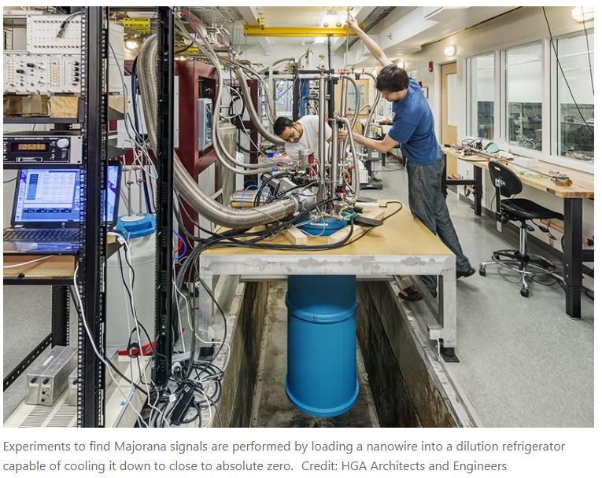
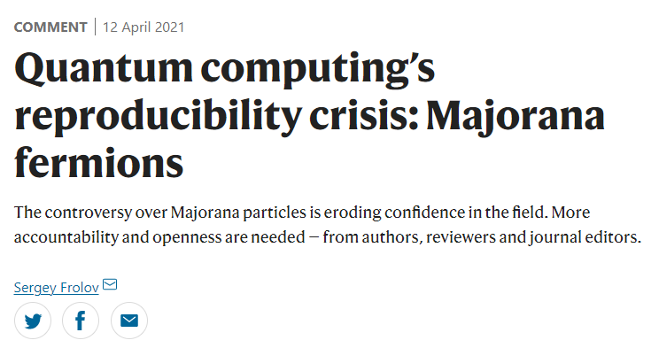
Opportunities for collaboration
Case study 2: quantum research: quantum mechanics, physics, materials science, electrical engineering to come together with best practices
https://www.nature.com/articles/d41586-021-00954-8
Slide and imagery: Marta Teperek, 4TU.RD and TUDelft

Slide 4
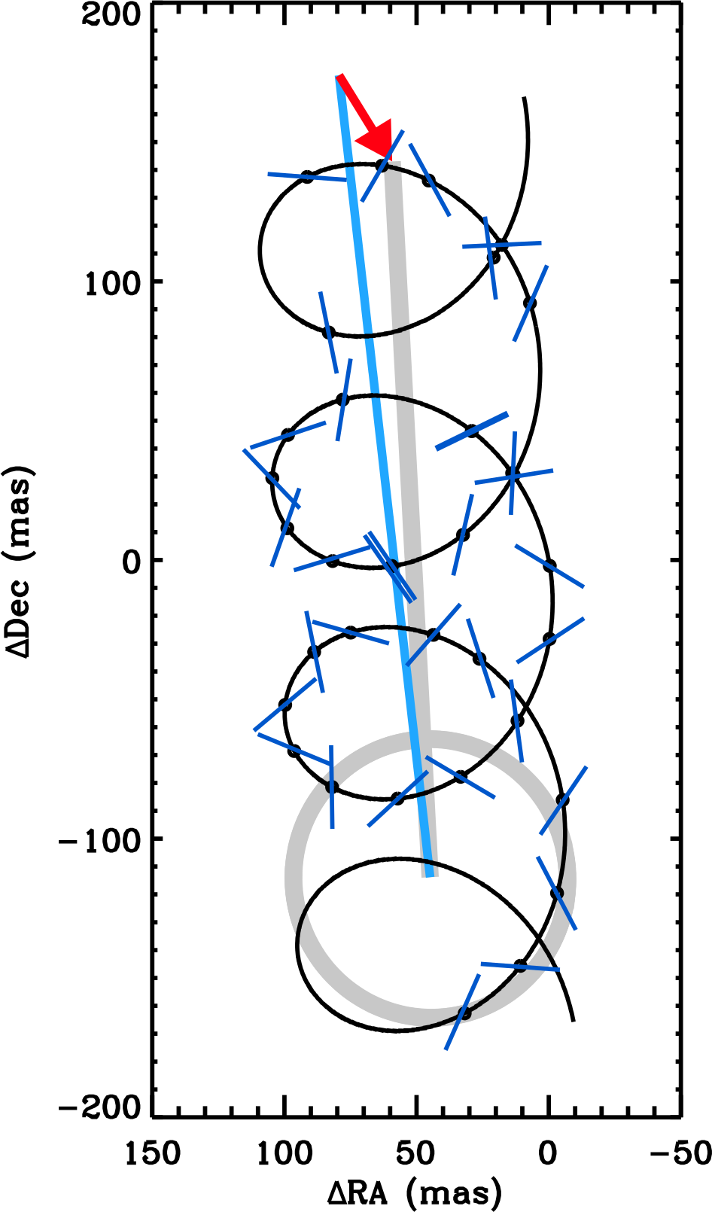
Opportunities for collaboration
Case study 3: Long term data and software archiving
Data such as from Gaia are scientifically useful ‘forever’; e.g. astronomical data from a century ago are being reprocessed and combined with Gaia data
Long term (10s to 100s of years) preservation of raw and processed data
  Including calibration data and models etc
Preserve the software needed to handle/process/interpret the data
Facilitate reprocessing of data in the future
  E.g. new insights into forward modelling the data, combination with new/other data
Exoplanet detection by combination Hipparcos and Gaia data (spanning 25 years) https://doi.org/10.1038/s41550-018-0561-6
See https://doi.org/10.1007/978-1-4614-3323-1_2 for more details on the Gaia example
Slide and imagery: Anthony Brown, Sterrewacht Leiden

Slide 5
The challenge for the NES TDCC
Connect research communities to existing infrastructures, tools, services and expertise
Foster a coherent ecosystem of digital services, data and software across the domain.
Stimulate collaboration and exchange of best practices across disciplines
Increase expertise among researchers so they can steer more initiatives in their own field
Provide continuous feedback to NWO on research support needs
to inform NWO’s (future) resources distribution on digital competence topics
Facilitate connections also between thematic DCCs for cross-disciplinary research

Slide 6
Luckily, the NES TDCC stands not alone
Local DCCs are essential to identify, connect and support the domain-specific needs,
and the TDCC can help to extend beyond institutional, and national, borders
there’s a rich ecosystem on infrastructure, software, data and expert groups surrounds us,
with SURF, the Netherlands eScience Center, LCRDM, NWO’s Open Science Fund, &c
there is inherent, structural, expertise in the Roadmap Facilities of the PC-GWI (you!)
strong international collaborations & forums (RDA, IVOA, ECFA, …) and the ESFRIs
we now have our new Open Science ‘Regieorgaan’ coordination body

Slide 7
Initial challenges within the NES domain
Fragmented landscape – insufficient connections
between research communities, existing infrastructures, tools, services & experts
Lack of interoperability of data and of workflows: especially the ‘I’ and ‘R’
& need to integrate workflows to put FAIR into practice and bring data to ‘life’
Insufficient training capacity on digital competences
Insufficient support long-term preservation & sustained maintenance of software
Insufficient computational reproducibility practices
(e.g. implementation of provenance standards and agreement on level of detail)
Lack of clarity and guidance about dealing with IP and legal issues
Insufficient collaboration between disciplines across the domain
which could facilitate the adoption of FAIR practices

Slide 8
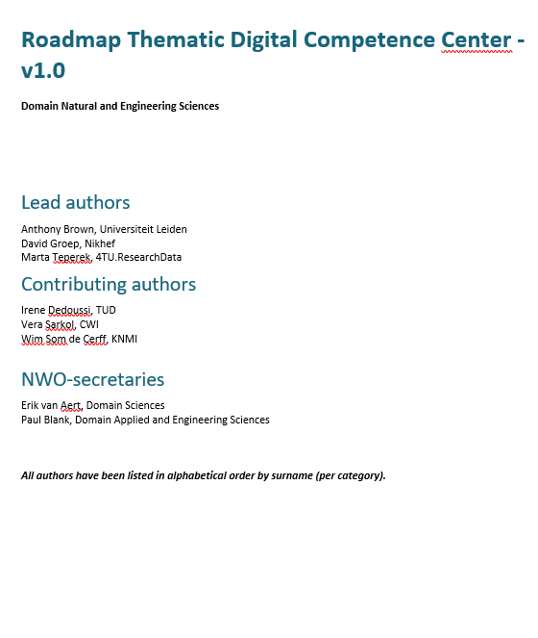
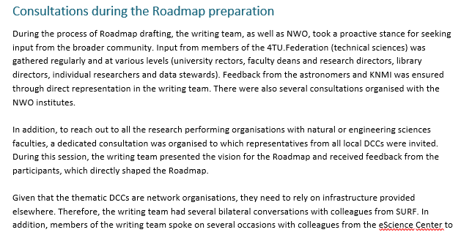
The NES Roadmap v1 is now ready!
Based on the extensive consultation process
PC-GWI, science deans, LDCCs,
Netherlands eScience Center, SURF, LCRDM, and you:
the national Roadmap Facility digital expert group, …
stakeholders* welcome
to shape programme and projects
anyone can use the output, join the
trainings, and use the network!
*) contribution can also be in-kind with your time investment!

Slide 9
Bottleneck ‘projects’
Community building
  the national expertise map and thematic survey
Creating a Training Hub
  leveraging existing communities and material
Facilitating long-term software preservation
  curation guidance, best practice licensing and publishing,
  models for sustaining research software
Support for metadata standards and vocabularies for FAIR data
  linking with RDA, promoting community standards to new users

Slide 10
Beyond the bottleneck ‘projects’
these will be complemented with more & targeted projects in years following
  identified by a domain-wide continuous consultation process
  in the NES TDCC governance board
support together a coherent work programme and foster collaboration
  by centrally defining that work programme, and calling for teams to work
  together on realizing the NES work programme
project calls will be to execute a specific part of the work programme
  in a collaborative way
  call process will be promoting collaboration

Slide 11
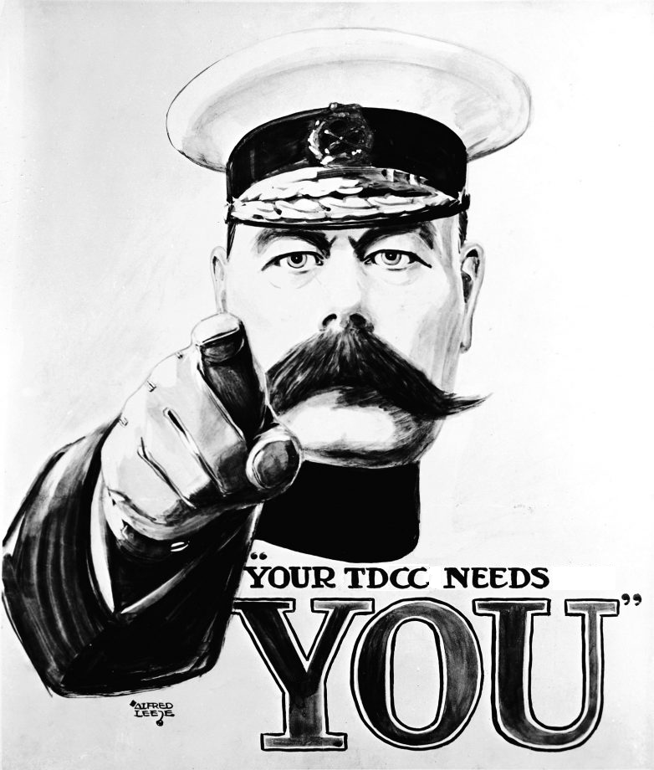
… the NES TDCC looks for your input and appreciates your participation!
all thanks should go to the writing team!
and any blame: please direct that to me
The NES TDCC writing team:
Anthony Brown, David Groep, Marta Teperek,
Irene Debussy, Vera Sarkol, Wim Som de Cerff
NWO support by Erik van Aert and Paul Blank

Slide 12
Supplementary material

Slide 13







Three domain-specific digital competence centres
Thematic (domain-specific) DCCs
National coordination per domain, international collaboration, brokering domain expertise, collections, tools, FAIR-standards, training
Cross-domain & large-scale IT infrastructure
Generic infra & expertise for data & software stewardship
Connecting to international
e-infrastructures
TDCC-SSH
TDCC-LSH
TDCC-NES
Local DCC
Local DCC
Supporting local needs within constraints of
local infrastructure, budgets & policy
Institutional & domain data stewards, data science centres
Image by: Ruben Kok, LSH TDCC and DTL

Slide 14

Building the NES TDCC – governance
Governance Board
composed of contributing members from all disciplines
Develops the consortium agreement
Determines the priorities and work programme
Ensures alignment with national digital research priorities and other thematic domains
Guides the evaluation of project proposals
Coordination Team
Supports the Board and implements the programme
Community Coordinator
Network Manager
Image by Marta Teperek, 4TU.RD and TUDelft

Slide 15
NES TDCC organisation: coordination team
Coordination Team
Network manager (Consortium Coordinator)
Community Coordinator
Represents the consortium
Drives governance and membership discussions
Structures the project portfolio and ensures alignment with the programme
Liaises with infrastructure, tool and resource providers
Oversees communication and online presence
Identifies and liaises with community members
Identifies community needs
Maps the infrastructure, existing resources and tools
Connects people from different disciplines and connecting them with infrastructure, resources and tools
Image by Marta Teperek, 4TU.RD and TUDelft

