Slide 1

Middleware Security
in Selected Grid Infrastructures (2010)
David Groep, Nikhef
with graphics by many others from publicly available sources ...

Slide 2
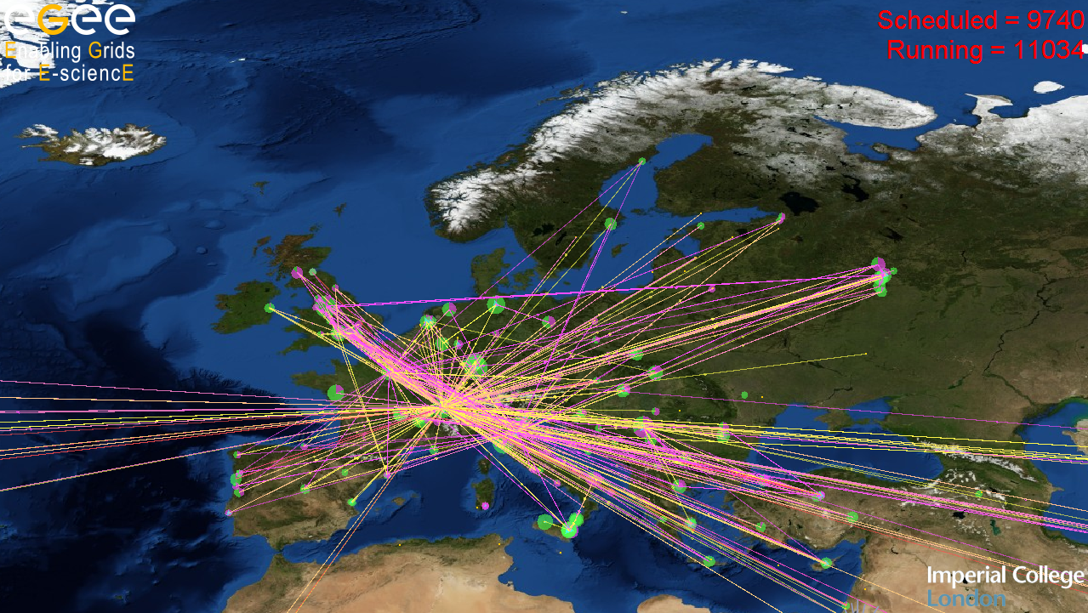
Grid Security Middleware
mechanisms for protecting the e-Infrastructure

Slide 3
What to expect?
What might be covered
What will not be covered
How to deal with AuthN
AuthZ frameworks
Access control in services
Unix credential mapping
Pilot jobs and late binding
Security interoperability
Storage access control
Data Security and Privacy
… with a slight EGEE & C + Unix bias, sorry …
How to write secure code
  Look at http://pages.cs.wisc.edu/~kupsch/
Current vulnerabilities
  They’re secret for a reason…
Most of the federation work
  Milan will tell you all
The latest WS-* *ML specs

Slide 4
A taxonomy of this middleware talk
glexec
Centralizing access control
Encrypted storage
To the Unix Domain
Late Job Binding
ACLs and banning
Long-running job renewal
Storage models
Compute Services
Community services
Middleware Authorization Frameworks
Authentication and
Identity Credentials
Community organisation
… with a slight EGEE & C + Unix bias, sorry …

Slide 5
Security Mechanism Foundations and scope
Trust infrastructures and PKI: verifying authenticity
Delegation and proxies
Getting practical about failures

Slide 6
Elements of Trust
Authentication
  Who are you?
  Who says so?
  How long ago was that statement made?
  Have you changed since then?
Authorization
  Why should I let you in?
  What are you allowed to do?
  By whom? Who said you could do that?
  And how long ago was that statement made?

Slide 7
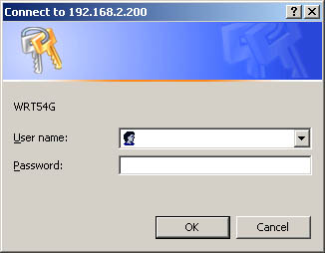
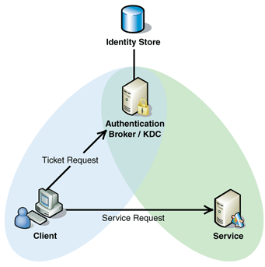
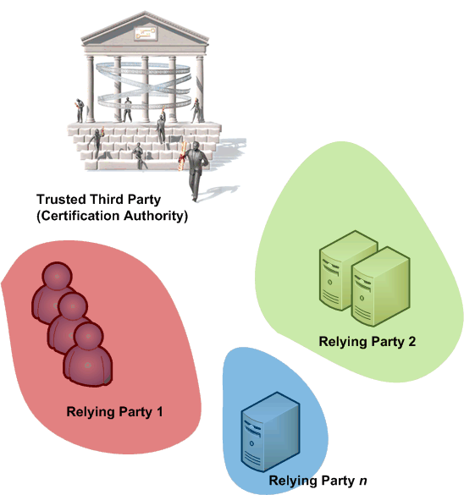
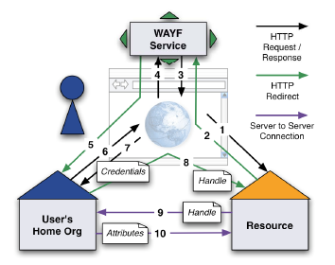
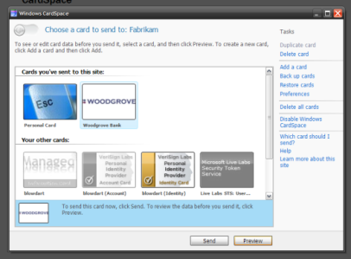
Authentication models
Direct user-to-site
  passwords, enterprise PKI, Kerberos
PKI with trusted third parties
Federated access
  Controlled & policy based
  Open or bi-lateral, e.g., OpenID
Identity meta-system
  Infocard type systems: will they materialize?
Next talk …

Slide 8
X.509: add identifiers to a public key
Authentic binding between
  Subject name
  A public key
  A validity period
  Zero or more extensions
  … that can contain identifiers
  … or policies
Signed by an issuer
  Yourself: self-signed cert
  Trusted third party, ‘CA’
Serial Number
Issuer, Algorithm, etc.
Valid from and valid until
Subject Distinguished Name
Extensions
basicConstraints: CA: TRUE or FALSE
keyUsage: …
subjectAlternativeName: …
…
…
Public Key Data (exponent, modulus)
Signature of the issuer (‘issuing CA’)

Slide 9
Verification steps
Check signature chain up to a trusted root
  OpenSSL (thus most middleware) root of trust must be self-signed
  Trust anchors
    ‘.0’ files in ‘PEM’ format, e.g. from IGTF as RPM, tgz or JKS
  Revocation
    Lists ‘.r0’ files in PEM format, retrieved by tools: fetch-crl
    OSCP not operationally deployed in grids
Check extensions
  basicConstraints and keyUsage, but others must be ‘sane’ as well
  ‘interesting’ errors in case other extensions are wrong, beware!
Check RP namespace constraints

Slide 10
Signing policy files
Constrain name space to specified subject names
For now, specific to Grids
  Recognised in
    Globus Toolkit C core, and Java in 4.2+
    gLite Trust Manager
    GridSite (recent versions only)
  Parsing is prone to many, many bugs!
  See OGF CAOPS-WG “RPDNC Policies” document
access_id_CA X509 '/C=NL/O=NIKHEF/CN=NIKHEF medium-security certification auth'
pos_rights globus CA:sign
cond_subjects globus '"/C=NL/O=NIKHEF/CN=NIKHEF medium-security certification auth"
"/O=dutchgrid/O=users/*" "/O=dutchgrid/O=hosts/*"
"/O=dutchgrid/O=robots/*"'

Slide 11
Building up: CA hierarchies
Root Certificate Authority
1 Jan 1999 until 31 Dec 2029
Root Certification Authority
Signature of Root Certification Auth
Root Certificate Authority
1 Jan 1999 until 31 Dec 2019
Subordinate Certification Authority 1
Root Certificate Authority
Signature of Root Certification Auth
1 Jan 1999 until 31 Dec 2049
Serial Number
Subordinate Certification Authority 2
Subordinate Certification Authority 1
Signature of Root Certification Auth
Valid from and valid until
Subject Distinguished Name
Extensions
basicConstraints: CA: TRUE or FALSE
Not all paths need to be equally trusted by
a relying party - i.e. a site, a user or a VO
keyUsage: …
subjectAlternativeName: …
…
…
Public Key Data (exponent, modulus)
Signature Subordinate Certification Auth1

Slide 12
Hierarchies in middleware
Namespace constrains aid in securing hierarchies
# EACL - AAACertificateServices
#
access_id_CA X509 '/C=GB/ST=Greater Manchester/L=Salford/O=Comodo CA Limited/CN=AAA Certificate Services'
pos_rights globus CA:sign
cond_subjects globus '"/C=GB/ST=Greater Manchester/L=Salford/O=Comodo CA Limited/CN=AAA Certificate Services" "/C=US/ST=UT/L=Salt Lake City/O=The USERTRUST Network/OU=http://www.usertrust.com/CN=UTN-USERFirst-Client Authentication and Email"'
# EACL - UTNAAAClient
#
access_id_CA X509 '/C=US/ST=UT/L=Salt Lake City/O=The USERTRUST Network/OU=http://www.usertrust.com/CN=UTN-USERFirst-Client Authentication and Email'
pos_rights globus CA:sign
cond_subjects globus '"/C=NL/O=TERENA/CN=TERENA eScience Personal CA"'
# EACL - TERENAeSciencePersonalCA
#
access_id_CA X509 '/C=NL/O=TERENA/CN=TERENA eScience Personal CA'
pos_rights globus CA:sign
cond_subjects globus '"/DC=org/DC=terena/DC=tcs/*"'

Slide 13
Hierarchies in middleware
Alternate ‘.namespaces’ format (e.g. VOMS)
##############################################################################
#NAMESPACES-VERSION: 1.0
#
# @(#)$Id: 75680d2e.namespaces,v 1.1 2010/01/29 09:46:36 pmacvsdg Exp $
# CA Hierarchy anchored at AAACertificateServices for
# the TCS eScience Personal CA
#
TO Issuer "/C=GB/ST=Greater Manchester/L=Salford/O=Comodo CA Limited/CN=AAA Certificate Services" \
PERMIT Subject "/C=US/ST=UT/L=Salt Lake City/O=The USERTRUST Network/OU=http://www.usertrust.com/CN=UTN-USERFirst-Client Authentication and Email"
TO Issuer "/C=US/ST=UT/L=Salt Lake City/O=The USERTRUST Network/OU=http://www.usertrust.com/CN=UTN-USERFirst-Client Authentication and Email" \
PERMIT Subject "/C=NL/O=TERENA/CN=TERENA eScience Personal CA"
TO Isser "/C=NL/O=TERENA/CN=TERENA eScience Personal CA" \
PERMIT Subject "/DC=org/DC=terena/DC=tcs/*"

Slide 14
Delegation – why break the recursion?
Mechanism to have someone, or some-thing
– a program – act on your behalf
  as yourself
  with a (sub)set of your rights
Essential for the grid model to work
GSI/PKI and recent SAML drafts define this
  GSI (PKI) through ‘proxy’ certificates (see RFC3820)
  SAML through Subject Confirmation,
  (linking to at least one key or name)

Slide 15
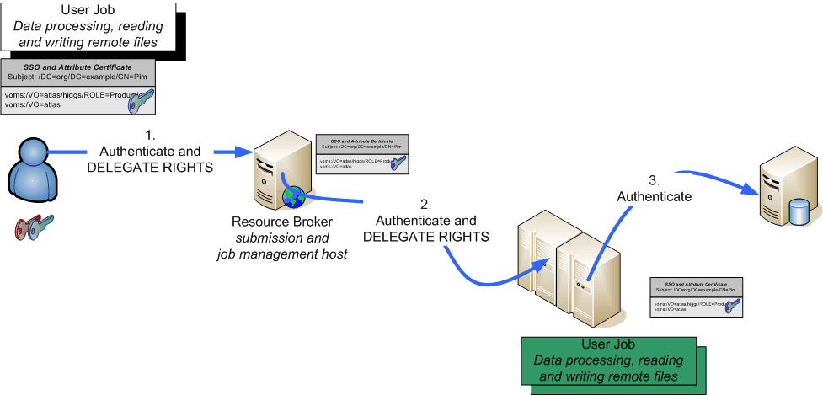
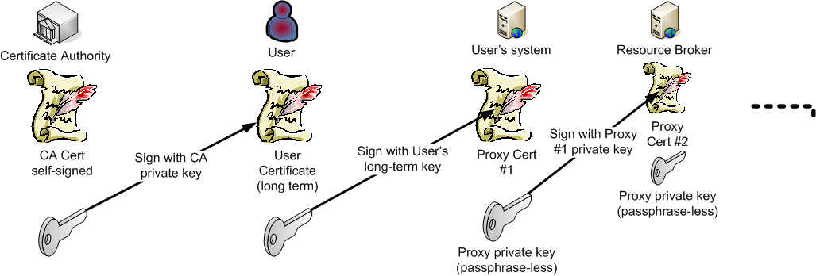
Daisy-chaining proxy delegation

Slide 16
Delegation, but to whom?
‘normal’ proxies form a chain
  Subject name of the proxy derived from issuer
  May contain path-length constraint
  May contain policy constraints
  And: legacy (pre-3820) proxies abound
But: use the name of the real end-entity for authZ!
Note that
in SAML, delegation can be to any NameID
in RFC3820 these are called ‘independent proxies’
“/DC=org/DC=example/CN=John Doe/CN=24623/CN=535431”
is likely a proxy for user
“/DC=org/DC=example/CN=John Doe”

Slide 17
Verifying authentication and X.509
‘Conventional’ PKI
  OpenSSL, Apache mod_ssl
  Java JCE providers, such as BouncyCastle
  Perl, Python usually wrappers around OpenSSL
With proxy support
  OpenSSL (but beware of outstanding issues!)
  Globus Toolkit (C, Java)
  GridSite
  ProxyVerify library
  TrustManager
Always ensure the proxy policies are implemented

Slide 18
Verification middleware options
Plain OpenSSL (C)
  On its own, it is not enough to verify a credential
  Need to add your validation routines for (proxy) credentials
  e.g. http://www.nikhef.nl/~janjust/proxy-verify/
  No single library available, though – re-implemented many times
GridSite (Andre McNab, C)
Globus Toolkit GSI utils (C) and Java tools
gLite Trust Manager (Java)
  based on BouncyCastle
Most of this is based on OpenSSL or BouncyCastle, but …

Slide 19
Trust anchor formats are diversifying
Java based software (e.g. Unicore)
  Java Key Store
  Supports keys over 2048 bits only since Java 1.4
NSS
  Increasingly deployed as alternative to OpenSSL
  E.g. by RedHat and its distribution of apache mod_nss
  Binary trust store format (‘key3.db’, ‘cert8.db’)
  Trust anchors can be qualified for purposes
  But not a ‘pluggable’ format …
OpenSSL
  Changed its format in v1 for no apparent reason

Slide 20
AuthN and AuthZ, a User View
Potential problems in AuthN and AuthZ
  Trust anchors inconsistent on client and server
  Certificates revoked
  CRL outdated
  Time on client and server is different
  Proxy has expired or has wrong attributes
  User not member of the (proper) VO
  …
Error messages usually incomprehensible
Which side it ‘at fault’ is unclear

Slide 21
In Real Life …
Error creating PKCS#7 structure
1688:error:0B080074:x509 certificate routines:X509_check_private_key:key values mismatch:x509_cmp.c:411:
1688:error:2107407F:PKCS7 routines:PKCS7_sign:private key does not match certificate:pk7_smime.c:76:
End of file reached
Error -12227
  For testing the connection and interpreting the diagnostics try, e.g., the connection verify utility
    http://www.nikhef.nl/grid/client-connect

Slide 22
User Community Models

Slide 23
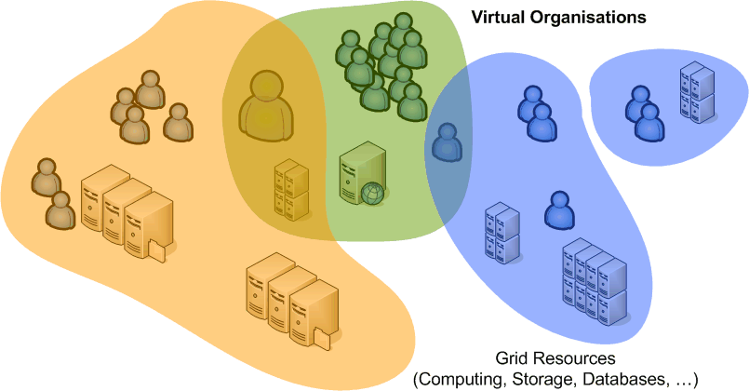
Authorization: VO representations
VO is a directory (database) with members, groups, roles
based on identifiers issues at the AuthN stage
Membership information is to be conveyed
to the resource providers
  configured statically, out of band
  in advance, by periodically pulling lists
  VO (LDAP) directories
  in VO-signed assertions pushed with the
  request: VOMS, Community AuthZ Service
  Push or pull assertions via SAML

Slide 24
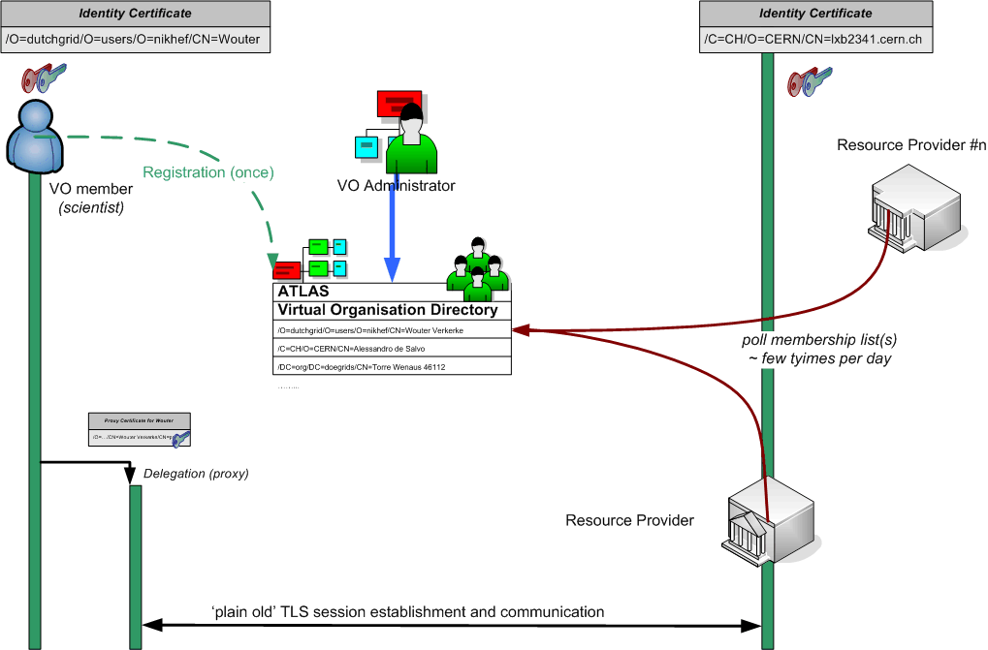
VO LDAP model

Slide 25
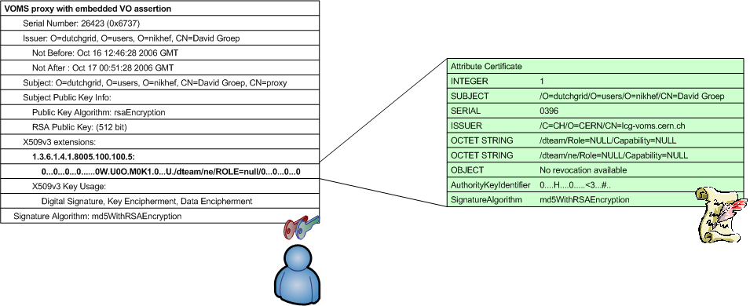
VOMS: X.509 as a container
Virtual Organisation Management System (VOMS)
developed by INFN for EU DataTAG and EGEE
used by VOs in EGEE, Open Science Grid, NAREGI, …
push-model signed VO membership tokens
  using the traditional X.509 ‘proxy’ certificate for trans-shipment
  fully backward-compatible with only-identity-based mechanisms

Slide 26
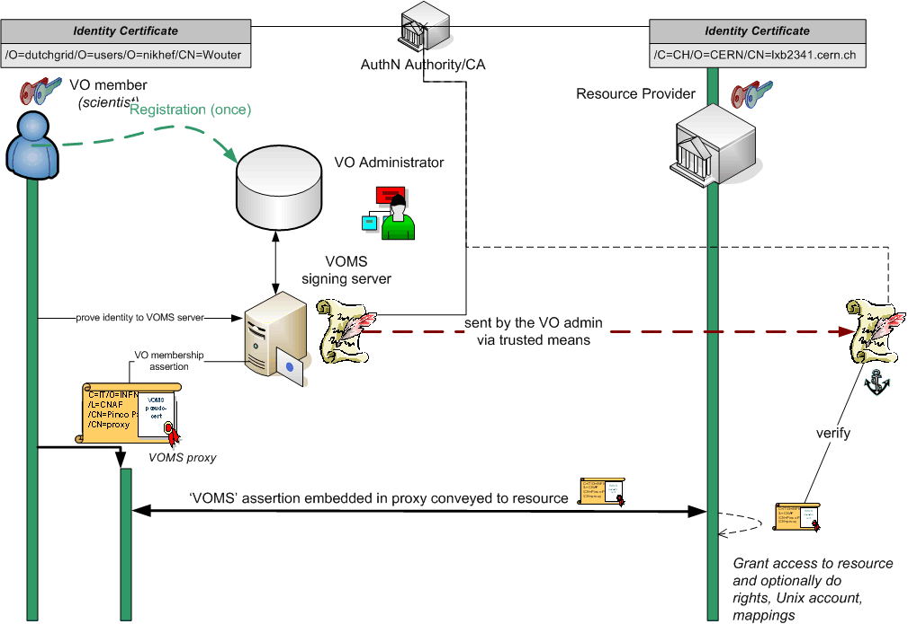
VOMS model

Slide 27
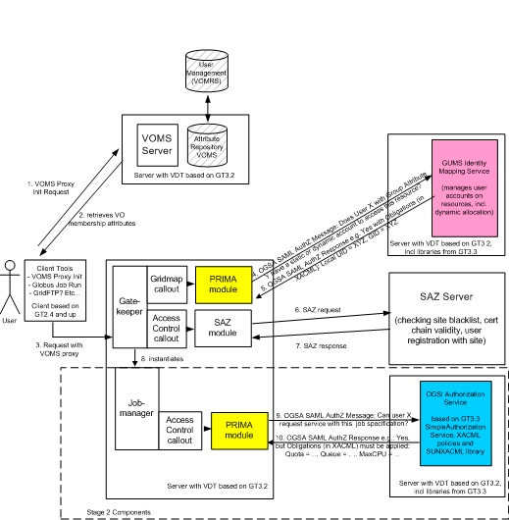
GUMS model
VO configuration replicated locally at the site
Here, pushed VOMS attributes are advisory only
synchronizes
Graphic: Gabriele Garzoglio, FNAL

Slide 28
Towards a multi-authority world (AAI)
Interlinking of technologies can be cone at various points
Authentication: linking (federations of) identity providers to the existing grid AuthN systems
  ‘Short-Lived Credential Services’ translation bridges
Populate VO databases with UHO Attributes
Equip resource providers to also inspect UHO attributes
Expressing VO attributes as function of UHO attributes
and most probably many other options as well …
Leads to assertions with multiple LoAs in the same decision
  thus all assertions should carry their LoA
  expressed in a way that’s recognisable
  and the LoA attested to by ‘third parties’ (i.e. the federation)

Slide 29
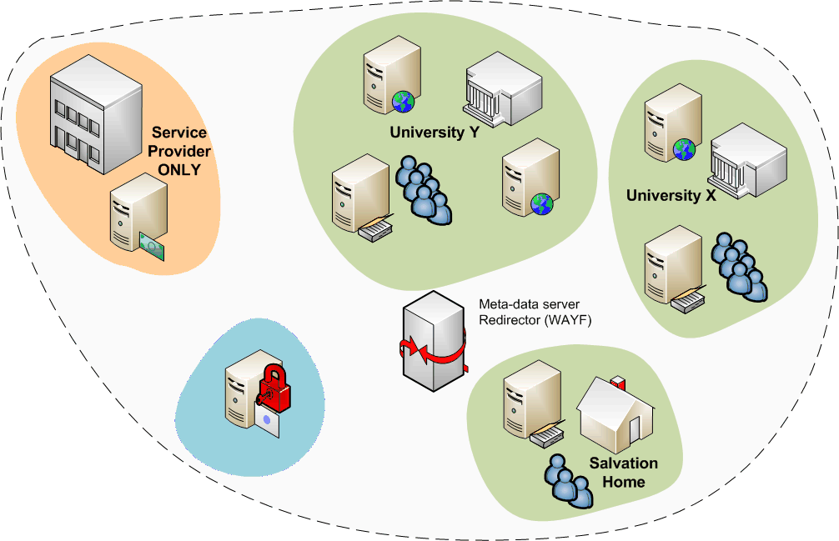
Federations
A common Authentication and Authorization Infrastructure
Allow access to common resources with a single credential
grid structure was not
too much different!

Slide 30
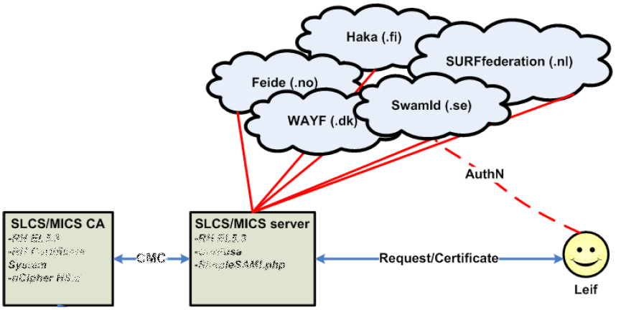
A Federated Grid CA
Use your federation ID
... to authenticate to a service
... that issues a certificate
... recognised by the Grid today
Implementations:
SWITCHaai SLCS
TERENA Grid CA Service
Outdated
Graphic from:
Jan Meijer, UNINETT

Slide 31
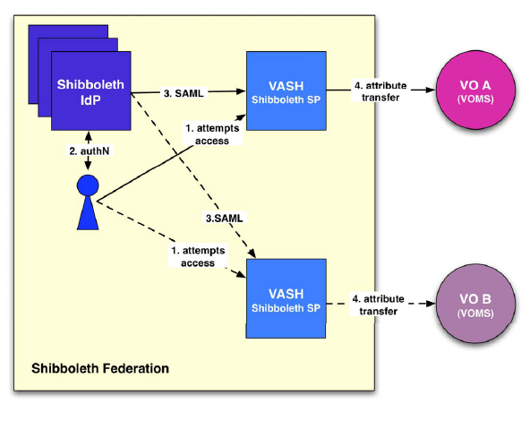
Attributes from multi-authority world
In ‘conventional’ grids, all attributes assigned by VO
But there are many more attributes
VASH: ‘VOMS Attributes
from Shibboleth’
  Populate VOMS with
  generic attributes
  Part of gLite (SWITCH)
http://www.switch.ch/grid/vash/
Graphic: Christoph Witzig, SWITCH

Slide 32
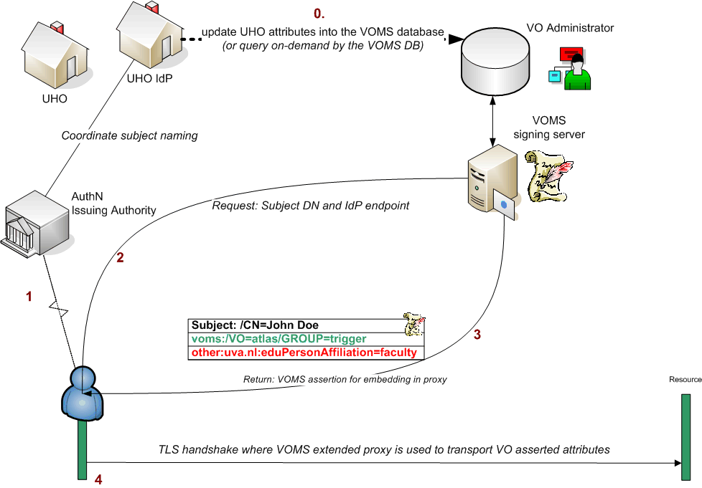
Putting home attributes in the VO
Characteristics
  The VO will know the source of the attributes
  Resource can make a decision on combined VO and UHO attributes
  but for the outside world, the VO now has asserted to the validity of the UHO attributes – over which the VO has hardly any control

Slide 33
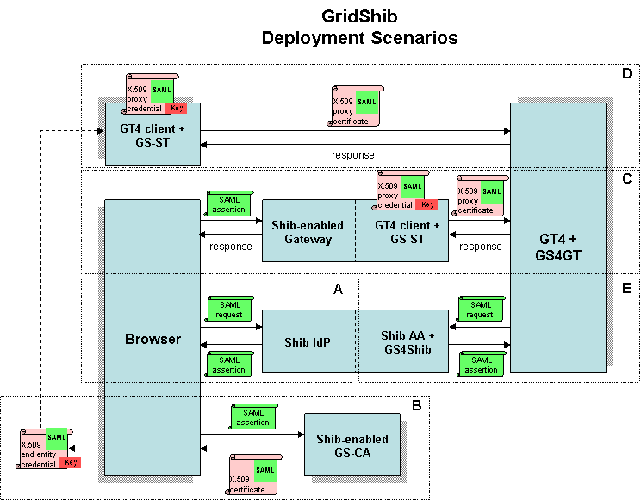
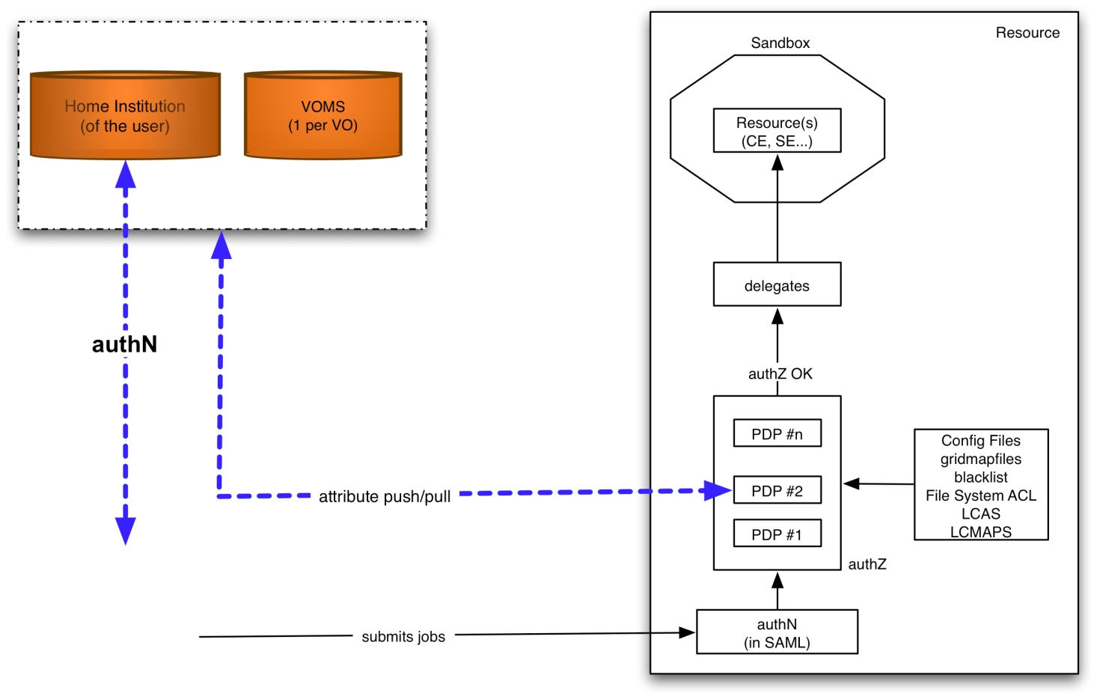

Attribute collection ‘at the resource’
graphic from:
Chistoph Witzig, SWITCH, GGF16, February 2006
Graphic: the GridShib project (NCSA)
http://gridshib.globus.org/docs/gridshib/deploy-scenarios.html
Characteristics
  The RP (at the decision point) knows the source of all attributes
  but has to combine these and make the ‘informed decision’
  is suddenly faced with a decision on quality from different assertions
  needs to push a kind of ‘session identifier’ to select a role at the target resource

Slide 34
Authorization Frameworks
Container versus service level
Logical authZ structure: PEP,PDP,PAP,PEP
Frameworks

Slide 35
A multi-authority world
Authorization elements (from OGSA 1.0)
Graphic: OGSA Working Group

Slide 36
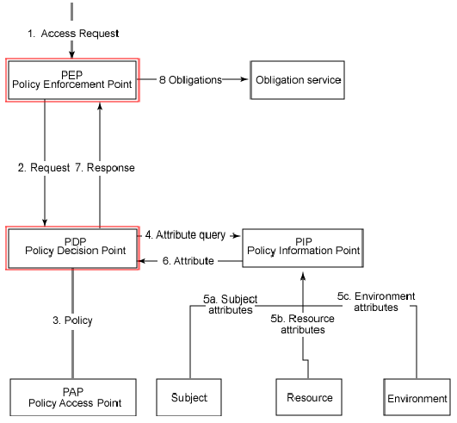
Logical Elements in authorization
“beware that translating
architecture to implementation
1:1 is a recipe for disaster ”

Slide 37
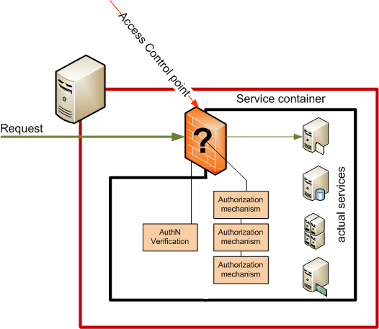
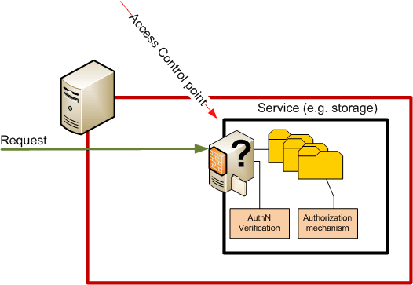
Control points
Container based
Service based
Single control point
Agnostic to service semantics
Many control points
Authorization can depend on
requested action and resource

Slide 38
Frameworks
(chain of) decision making modules controlling access
  Loosely or tightly coupled to a service or container
  Generic ‘library’, or tied into the service business logic
example: GT4/Java
Graphic: Frank Siebenlist, Globus and ANL

Slide 39
Some framework implementations
PRIMA-SAZ-GUMS-gPlazma suite
Globus Toolkit v4 Authorization Framework
Site Access Control ‘LCAS-LCMAPS’ suite
Argus (gLite)
GridSite & GACL
...
... and don’t forget ‘native’ service implementations
interop
interop

Slide 40
Different frameworks
Each framework has
  own calling semantics (but may interoperate at the back)
  its own form of logging and auditing
Most provide
  Validity checking of credentials
  Access control based on Subject DN and VOMS FQANs
  Subject DN banning capability
And some have specific features, e.g.,
  Capability to process arbitrary ‘XACML’ (composite) policies
  Calling out to obtain new user attributes
  Limiting the user executables, or proxy life time, ...

Slide 41
Access Control for Compute
Example: running compute jobs
Access control: gatekeepers, gLExec, ban lists, and GACL

Slide 42
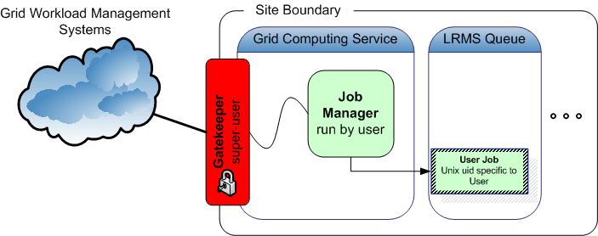
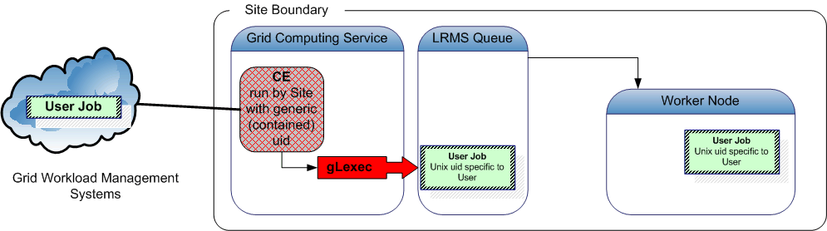
Job Submission Today
User submits his jobs to a resource through a ‘cloud’ of intermediaries
Direct binding of payload and submitted grid job
job contains all the user’s business
access control is done at the site’s edge
inside the site, the user job has a specific, site-local, system identity

Slide 43
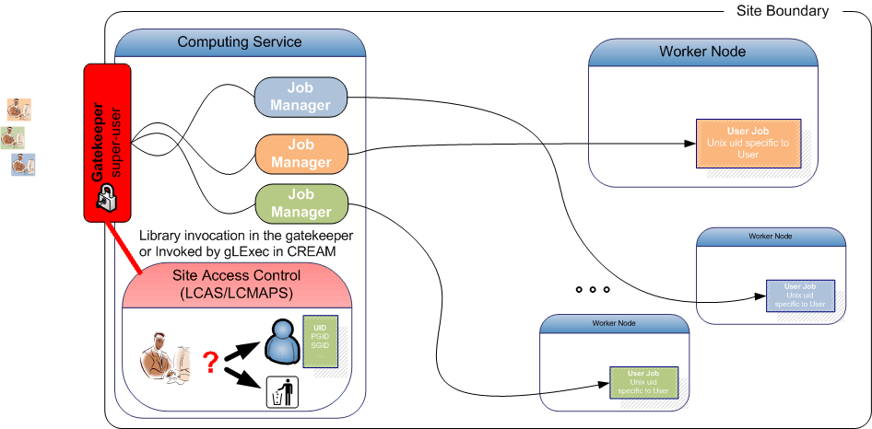
Access Control for Compute on Unix
System access needing assignment of Unix account
  Either locally on the node (grid-mapfile, LCMAPS)
  or through call-outs to GUMS (Prima), Argus PEP-C client, or SCAS

Slide 44
Example: LCAS in basic authorization
Pluggable authorization framework in C
  Independent modules (‘shared objects’) called based on simple ‘boolean-AND’ policy description
Decisions based on
  Allowed user or VOMS FQAN list
  Deny based on a separate ‘ban’ list with wildcards
  GACL policy
  Allowed-executable (‘RSL’ matching)
  Time slots
  L&B2-policy module
http://www.nikhef.nl/grid/lcaslcmaps/

Slide 45
LCAS example
/opt/glite/etc/lcas/lcas.db
# @(#)lcas.db
pluginname=lcas_userban.mod,pluginargs=ban_users.db
pluginname=lcas_voms.mod,pluginargs="-vomsdir/etc/grid-security/vomsdir/ ..."
/opt/glite/etc/lcas/ban_users.db
# @(#)ban_users.db
/DC=org/DC=example/CN=Sherlock Holmes
/DC=gov/DC=somelab/OU=CDF/CN=*
only DN c.q. FQAN used from ... /etc/grid-security/grid-mapfile
"/O=dutchgrid/O=users/O=nikhef/CN=David Groep" .pvier
"/O=dutchgrid/O=users/O=nikhef/CN=Oscar Koeroo" okoeroo "/C=AT/O=AustrianGrid/OU=UIBK/OU=OrgUnit/CN=Name Suppressed" .esr
"/vlemed/Role=NULL/Capability=NULL" .vlemed
"/vlemed" .vlemed
"/vo.gear.cern.ch/Role=NULL/Capability=NULL" .poola
"/vo.gear.cern.ch" .poola
"/vo.gear.cern.ch/Role=lcgadmin/Capability=NULL" .troi
"/vo.gear.cern.ch/Role=lcgadmin" .troi

Slide 46
Argus Policies and banning
Integrated policy with distributed mechanism
‘pushed’ policies can implement central banning
https://twiki.cern.ch/twiki/bin/view/EGEE/SimplifiedPolicyLanguage
resource ".*" {
obligation "http://glite.org/xacml/obligation/local-environment-map" {}
action ".*" {
rule deny {
subject = "CN=Alberto Forti,L=CNAF,OU=Personal Certificate,O=INFN,C=IT"
}
rule deny {
fqan = /dteam/test
}
rule deny {
pfqan = "/lsgrid/Role=pilot“
}
rule permit {
vo = “lsgrid"
}
}
}
https://twiki.cern.ch/twiki/bin/view/EGEE/AuthorizationFramework

Slide 47
gLite WMS access control: GACL
/opt/glite/etc/glite_wms_wmproxy.gacl
<gacl version="0.0.1">
<entry>
<voms>
<fqan>lofar/ROLE=admin</fqan>
</voms>
<allow><exec/></allow>
</entry>
...
<entry>
<voms>
<fqan>lsgrid</fqan>
</voms>
<allow><exec/></allow>
</entry>
<entry>
<person>
<dn>/DC=org/DC=example/O=HEP/O=PKU/OU=PHYS/CN=Some Person</dn>
</person>
<deny><exec/></deny>
</entry>
</gacl>
GridSite and LCAS can do GACL as well, though ...

Slide 48
GUMS access control
GUMS is a central-service only mapping service
Database with a ‘site’ dump of the VO membership
Tools to manipulate that database
e.g. banning a user or a VO
please hold for a central service based on LCAS-LCMAPS...
https://twiki.grid.iu.edu/bin/view/Security/GUMS--DevelopmentandAdditions
# an individual that is not a VO member
/DC=org/DC=doegrids/OU=People/CN=Jay Packard 335585,
# an invidual from any VO
/DC=org/DC=doegrids/OU=People/CN=Jay Packard 335585, .*
# or an individual from the Atlas production role
/DC=org/DC=doegrids/OU=People/CN=Jay Packard 335585, //atlas/usatlas/Role=production.*

Slide 49
But notably different
gLite WMS
  Uses GACL libraries directly and exclusively
Storage access control, e.g. DPM
  Has built-in native handing of groups via POSIX ACLs expressed as VOMS FQANs
Native GRAM, GSIssh, and GridFTP in GT <= 5.0
  Has only a static DN map file
  Unless configured to use LCAS-LCMAPS or PRIMA-GUMS
…

Slide 50
But basic yes-no does not get you far
If yes, what are you allowed to do?
  Credential mapping via obligations, e.g. unix account, to limit what a user can do and disambiguate users
  Intended side effects: allocating or creating accounts ... or virtual machines, or ...
  Limit access to specific (batch) queues, or specific systems
Additional software needed
  Handling ‘oblibations’ conveyed with a decision
  LCMAPS: account mappings, AFS tokens
  Argus: pluggable obligation handlers per application
    E.g. used by LCMAPS again when talking to an Argus service

Slide 51
To the Unix world
Credential mapping
Running jobs
Long-running jobs and MyProxy
Addressing late-binding with gLExec

Slide 52
Computing jobs in a multi-user Unix site

Slide 53
To the Unix world: Problem
C=IT/O=INFN
/L=CNAF
/CN=Pinco Palla
/CN=proxy
(X509, VOMS)
/dc=org/dc=example/CN=John Doe
grid identity
VOMS
pseudo-cert
translate
pvier001:x:43401:2029:PoolAccount VL-e P4 no.1:/home/pvier001:/bin/sh
Unix does not talk Grid, so
translation is needed between grid and local identity
this translation has to happen somewhere
something needs to do that

Slide 54
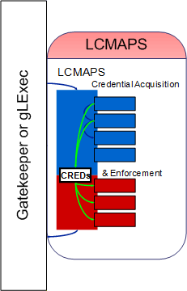
To the Unix world: LCMAPS
Two things need to happen
Figure out which account to use
  Acquisition
  collect attributes and obligations
  allocate or make an account
  obtain a mapping from a service
Make sure you get there
  Enforcement
  modify accounts if needed (LDAP)
  obtain AFS tokens for file acces
  change effective user id of process
  needs to be the last step
run as root
credential: …/CN=Pietje Puk
run as target user
uid: ppuk001
uidNumber: 96201

Slide 55
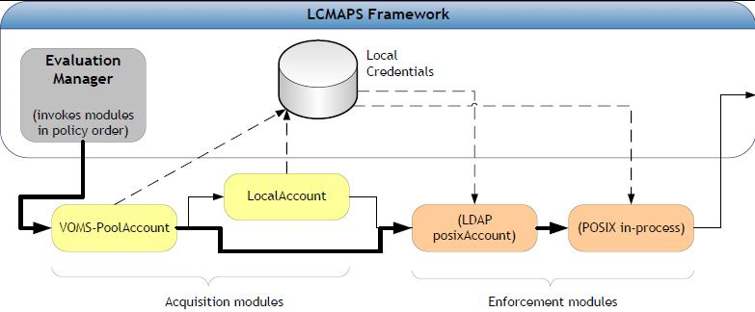
LCMAPS modules
Acquisition
(voms)local{account,group}, (voms)pool{account,group}, GUMS, verify-proxy, scas-client
Enforcement
posix_enf, ldap_enf, afs, jobRepository
http://www.nikhef.nl/grid/lcaslcmaps/

Slide 56
LCMAPS configuration example (local)
/opt/glite/etc/lcmaps/lcmaps-scas.db
# LCMAPS config file for glexec generated by YAIM
vomslocalgroup = "lcmaps_voms_localgroup.mod ...“
vomslocalaccount = "lcmaps_voms_localaccount.mod ...“
vomspoolaccount = "lcmaps_voms_poolaccount.mod ...“
localaccount = "lcmaps_localaccount.mod"
" -gridmapfile /etc/grid-security/grid-mapfile“
poolaccount = "lcmaps_poolaccount.mod"
" -override_inconsistency"
" -gridmapfile /etc/grid-security/grid-mapfile"
" -gridmapdir /share/gridmapdir"
good = "lcmaps_dummy_good.mod“
# Policies: DN-local -> VO-static -> VO-pool -> DN-pool
static_account_mapping:
localaccount -> good
voms_mapping:
vomslocalgroup -> vomslocalaccount
vomslocalaccount -> good | vomspoolaccount
classic_poolaccount:
poolaccount -> good
Policy sequence depends on the service!

Slide 57
Mapping, but where
Locally at the service end (the CE node)
  LCMAPS
  Globus ‘authz call-out’ loaded with LCMAPS
  Classic ‘gss_assist’ grid-mapfile
At a (central) mapping/authz service
  PRIMA + GUS
  LCMAPS + SCAS
  LCMAPS + Argus
  gPlazma + GUMS (some forms of storage)
  GT call-out talking to LCMAPS or Argus

Slide 58
Late binding
Pilot jobs
Impact on sites

Slide 59
Classic job submission models
In the submission models shown, submission of the
user job to the batch system is done
with the original job owner’s mapped (uid, gid) identity
grid-to-local identity mapping is done only on the front-end system (CE)
  batch system accounting provides per-user records
  inspection shows Unix process on worker nodes and in batch queue per-user

Slide 60
Late binding: pilot jobs
Job submission gets more and more intricate …
Late binding of jobs to job slots via pilot jobs
some users and communities develop and prefer to use
proprietary, VO-specific, scheduling & job management
  ‘visible’ job is a pilot: a small placeholder
  that downloads a real job
  first establishing an overlay network,
  subsequent scheduling and starting of jobs is faster
  it is not committed to any particular task on launch
  perhaps not even bound to a particular user!
this scheduling is orthogonal to the site-provided systems

Slide 61
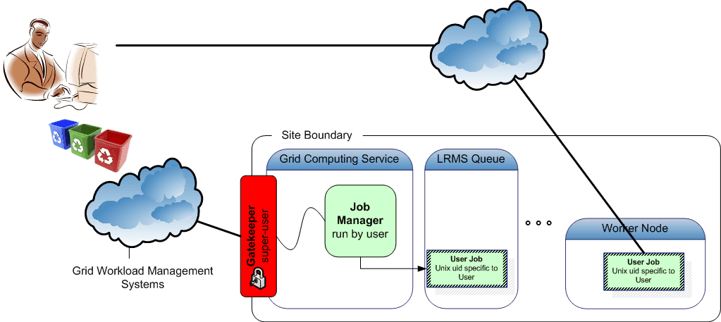
Every user a pilot

Slide 62
Pilot job incentives
Some Pros:
Worker node validation and matching to task properties
Intra-VO priorities can be reshuffled on the fly
without involving site administrators
Avoid jobs sitting in queues when they could run elsewhere
From: https://wlcg-tf.hep.ac.uk/wiki/Multi_User_Pilot_Jobs
For any kind of pilot job:
  Frameworks such as Condor glide-in, DIRAC, PANDA, … or Topos, are popular, because they are ‘easy’ (that’s why there are so many of them!)
  Single-user pilot jobs are no different than other jobs
  when you allow network connections to and from the WNs
  Of course:
  any framework used to distribute payload gives additional attack surface

Slide 63
Multi-user pilot jobs
All pilot jobs are submitted by a single (or a few) individuals from a user community (VO)
  Creating an overlay network of waiting pilot jobs
VO maintains a task queue to which people
(presumably from the VO) can submit their work
Users put their programs up on the task queue
Pilot jobs on the worker node looks for work from that task queue to get its payload
Pilot jobs can execute work for one or more users in sequence, until wall time is consumed

Slide 64
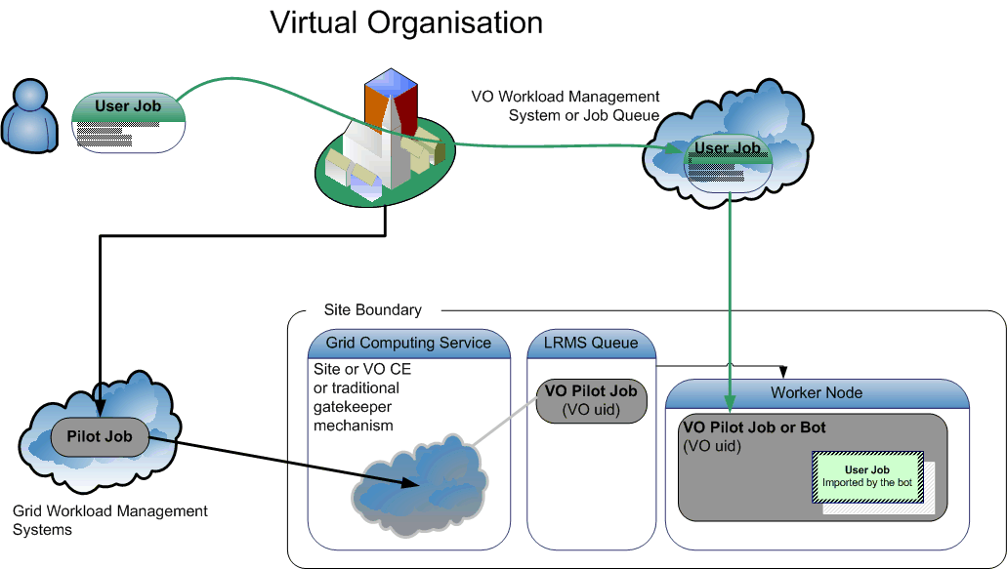
VO overlay networks: MUPJ

Slide 65
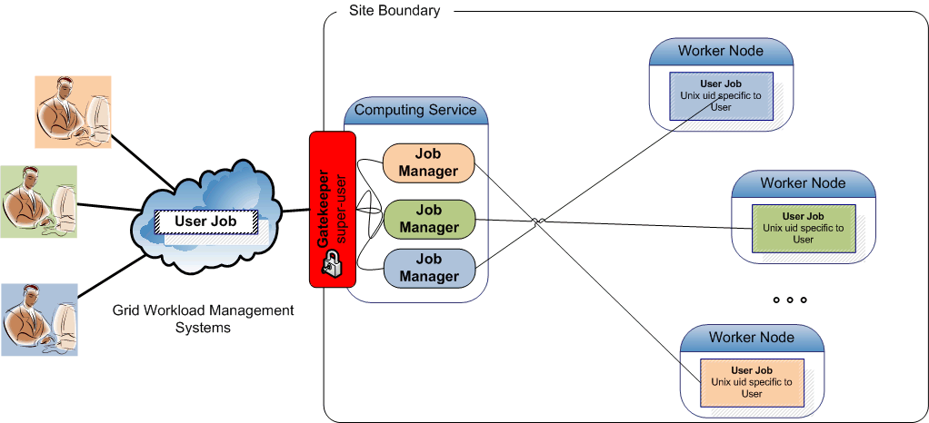
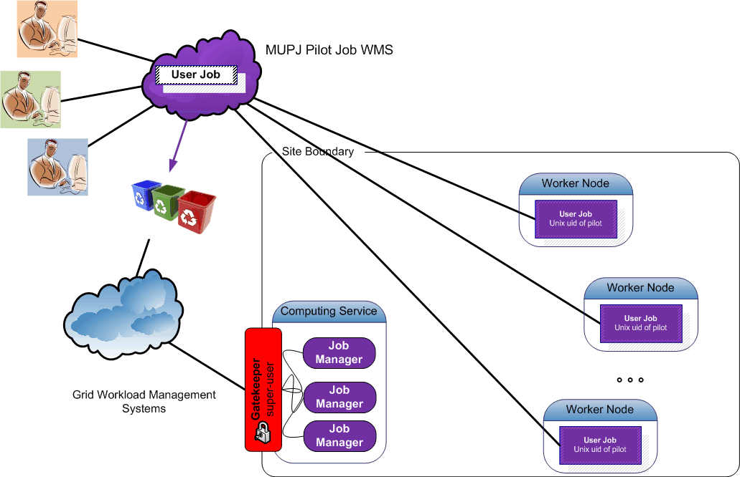
A resource view of MUPJs
Multi-user pilot jobs hiding in the classic model
Classic model

Slide 66
Pros and Cons of MUpilot jobs
In current ‘you only see the VO pilot submitter’ model:
Loss of control over scheduling/workload assignment, e.g.
  site admin cannot adjust share of specific user overloading e.g. the Storage Element (only the pilots are seen by the batch system) and might need to:
  ban entire VO instead of user from the SE and/or CE, or
  reduce the entire VO share
  Is that acceptable in case of a non-confirmed incident?
Traceability and incident handling issues
Advantages
you only see & need to configure a single user
It’s not complicated, and no software/config is needed
Extensive summary of technical issues (pros and cons):
https://wlcg-tf.hep.ac.uk/wiki/Multi_User_Pilot_Jobs

Slide 67
Traceability and compromises
Post-factum: in case of security incidents:
  Complete & confirmed compromise is simple: ban VO
  In case of suspicion: to ban or not to ban, that’s the question
    There is no ‘commensurate’ way to contain compromises
    Do you know which users are inside the VO?
    No: the list is largely private
    No: it takes a while for a VO to respond to ‘is this user known’?
    No: the VO will ban user only in case they think (s)he is malicious – that may be different from your view, or from the AIVD’s view, or ...
    So: the VO may or may not block
    The site is left in the cold: there is no ‘easy’ way out except blocking the entire VO, which then likely is not ‘acceptable’

Slide 68
Traceability and compromises
Protecting user payload, other users, and the pilot framework itself from malicious payloads
  To some extent a problem for the VO framework, not for the site
  Not clear which payload caused the problem: all of them are suspect
  User proxies (when used) can be stolen by rogue payloads
  … or the proxy of the pilot job submitter itself can be stolen
  Risk for other user to be held legally accountable
  Cross-infection of users by modifying key scripts and environment of the framework users at each site
Helps admins understand which user is causing a problem

Slide 69
Traceability and compromises
Ante-factum requirements
Sites may need proof of the identity of who was
(or is about to!) use the resources at any time,
in particular the identities involved in any ongoing incidents
Information supplied by the VO may be (legally) insufficient or too late
Privacy laws might hamper the flow of such information back and forth
  c.f. the German government’s censorship bill, with the list of domains that
  a DNS server must block, but which cannot be published by the enforcing ISP
  Or other government requirements or ‘requests’ that need to be cloaked

Slide 70
MUPJ security issues
With multi users use a common pilot job deployment Users, by design, will use the same account at the site
Accountability
no longer clear at the site who is responsible for activity
Integrity
a compromise of any user using the MUPJ framework ‘compromises’ the entire framework
the framework can’t protect itself against such compromise
unless you allow change of system uid/gid
Site access control policies are ignored
… and several more …

Slide 71
Recovering control
Policy
gLExec
Cooperative control

Slide 72
Recovering control: policy
Policy itself
  E.g. https://edms.cern.ch/document/855383
Collaboration with the VOs and frameworks
You cannot do without them!
  Vulnerability assessment of the framework software
  Work jointly to implement and honour controls
  Where relevant: ‘trust, but verify’
Provide middleware control mechanisms
  Supporting site requirements on honouring policy
  Support Vos in maintaining framework integrity
  Protect against ‘unfortunate’ user mistakes

Slide 73
Recovering control: mechanisms
Unix-level sandboxing
  POSIX user-id and group-id mechanisms for protection
  Enforced by the ‘job accepting elements’:
    Gatekeeper in EGEE (Globus and lcg-CE), TeraGrid and selected HPC sites
    Unicore TSI
    gLite CREAM-CE via sudo
VM sandboxing
  Not widely available yet
... a slight technical digression on (1) follows ...

Slide 74
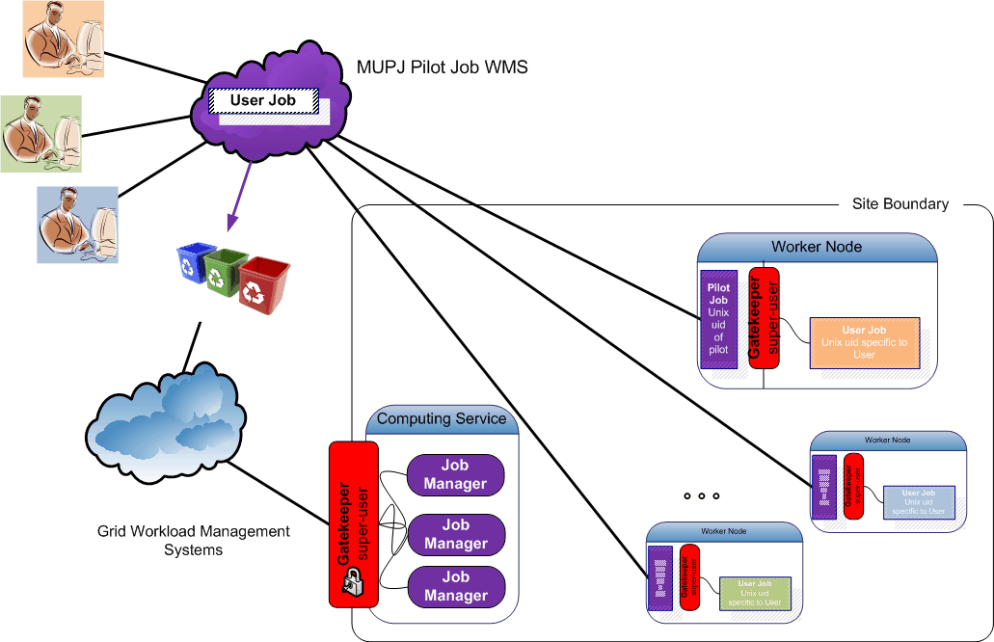
Pushing access control downwards
Making multi-user pilot jobs explicit with distributed
Site Access Control (SAC)
- on a cooperative basis -

Slide 75
Recovering Control
Make pilot job subject to normal site policies for jobs
VO submits a pilot job to the batch system
  the VO ‘pilot job’ submitter is responsible for the pilot behaviour
this might be a specific role in the VO, or a locally registered ‘special’ user at each site
  Pilot job obtains the true user job,
  and presents the user credentials and the job
  (executable name) to the site (glexec) to request a decision on a cooperative basis
Preventing ‘back-manipulation’ of the pilot job
  make sure user workload cannot manipulate the pilot
  project sensitive data in the pilot environment (proxy!)
by changing uid for target workload away from the pilot

Slide 76
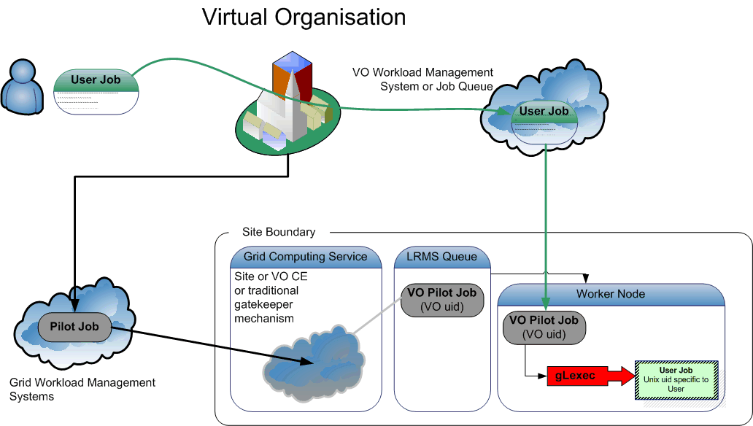
Recovering control: gLExec

Slide 77
What is gLExec?
gLExec
a thin layer
to change Unix domain credentials
based on grid identity and attribute information
you can think of it as
‘a replacement for the gatekeeper’
‘a griddy version of Apache’s suexec’
‘a program wrapper around LCAS, LCMAPS or GUMS’

Slide 78
What gLExec does …
User grid credential
(subject name, VOMS, …)
command to execute
current uid allowed to execute gLExec
cryptographically protected
by CA or VO AA certificate
gLExec
Authorization (‘LCAS’)
check white/blacklist
VOMS-based ACLs
is executable allowed?
…
Credential Acquisition
voms-poolaccount
localaccount
GUMS, …
‘do it’
LDAP account
posixAccount
AFS, …
LCMAPS
Execute command with arguments
as user (uid, pgid, sgids … )

Slide 79
Pieces of the solution
VO supplied pilot jobs must observe and honour
  the same policies the site uses for normal job execution
  (e.g. banned individual users)
Three pieces that go together:
glexec on the worker-node deployment
  the mechanism for pilot job
  to submit themselves and their payload to site policy control
  give ‘incontrovertible’ evidence of who is running on which node at any one time (in mapping mode)
    gives ability to identify individual for actions
    by asking the VO to present the associated delegation for each user
  VO should want this
    to keep user jobs from interfering with each other, or the pilot
    honouring site ban lists for individuals may help in not banning the entire VO in case of an incident

Slide 80
Pieces of the solution
glexec on the worker-node deployment
keep the pilot jobs to their word
  mainly: monitor for compromised pilot submitters credentials
  process or system call level auditing of the pilot jobs
  logging and log analysis
gLExec cannot to better than what the OS/batch system does
  ‘internal accounting should now be done by the VO’
    the regular site accounting mechanisms are via the batch system, and these will see the pilot job identity
    the site can easily show from those logs the usage by the pilot job
    accounting based glexec jobs requires a large and unknown effort
  time accrual and process tree remain intact across the invocation
    but, just like today, users can escape from both anyway!

Slide 81
But all pieces should go together
glexec on the worker-node deployment
way to keep the pilot jobs submitters to their word
  mainly: monitor for compromised pilot submitters credentials
  system-level auditing of the pilot jobs,
  but auditing data on the WN is useful for incident investigations only
‘internal accounting should be done by the VO’
  the regular site accounting mechanisms are via the batch system, and these will see the pilot job identity
  the site can easily show from those logs the usage by the pilot job
  making a site do accounting based glexec jobs is non-standard,
  and requires non-trivial effort

Slide 82
gLExec deployment modes
Identity Mapping Mode – ‘just like on the CE’
  have the VO query (and by policy honour) all site policies
  actually change uid based on the true user’s grid identity
  enforce per-user isolation and auditing using uids and gids
  requires gLExec to have setuid capability
Non-Privileged Mode – declare only
  have the VO query (and by policy honour) all site policies
  do not actually change uid: no isolation or auditing per user
  Pilot and framework remain vulnerable
  the gLExec invocation will be logged, with the user identity
  does not require setuid powers – job keeps running in pilot space
‘Empty Shell’ – do nothing but execute the command…

Slide 83
Installation
Actually only identity mapping mode really helps
  Otherwise
  back-compromise (and worm infections) remain possible
  attributing actions to users on WN is impossible
  (that needs a uid change)

Slide 84
Towards Central Control
Centralizing Authorization in the site
Available middleware: GUMS and SAZ, Argus, SCAS
Interoperability through common protocols

Slide 85
What Happens to Access Control?
So, as the workload binding get pushed deeper into the site,
access control by the site has to become layered as well …
… how does that affect site access control software
and its deployment ?

Slide 86
Site Access Control today
PRO already deployed
no need for external components, amenable to MPI
CON when used for MU pilot jobs, all jobs run with a single identity
end-user payload can back-compromise pilots, and cross-infect other jobs
incidents impact large community (everyone utilizing the MUPJ framework)

Slide 87
Centralizing decentralized SAC
Aim: support consistently
  policy management across services
  quick banning of bad users
  coordinated common user mappings (if not WN-local)
Different options to implement it …

Slide 88
Central SAC management options
Regular site management tools (CFengine, Quattor, etc)
  Addresses site-wide banning in a trivial and quick way
  Does not address coordination of mapping (except NFS for the gridmapdir)
GUMS (use the new interoperability version 2)
  database with users available at all times, but it is not ‘real-time’
  Extremely well stress tested
Argus (use at least v1.1 or above)
  Supports all common use cases, with resilience in mind
  in addition also grid-wide policy distribution and banning!
SCAS (transitional)
  service implementation of the LCAS/LCMAPS system
  Client can talk natively also to GUMS v2 and GT
All together can be used in composition to support more use cases
  e.g. add support for AFS token acquisition via LCMAPS, plain-text ban-lists shared with storage via LCAS, grid-wide banning via Argus, joint GACL support with the current WMS, …

Slide 89
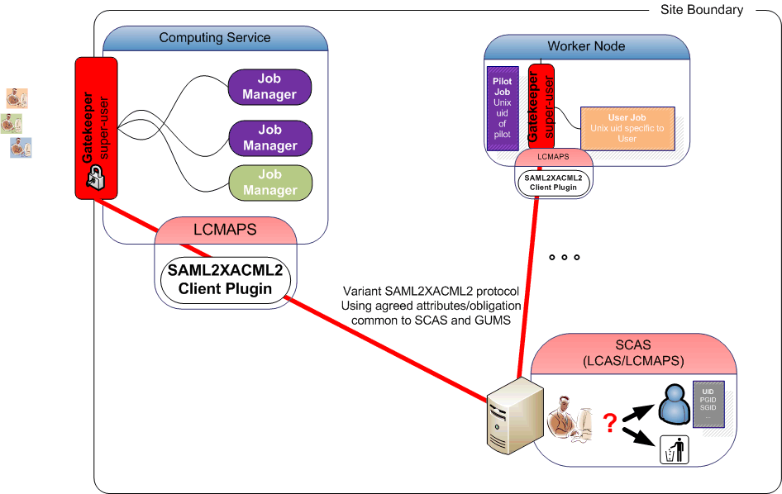
Centralizing access control in M/W
off-site
policy
site-central service
* of course, central policy and distributed
per-WN mapping also possible!
PRO single unique account mapping per user across whole farm, CE, and SE*
can do instant banning and access control in a single place
CON need remedy single point of failure (more boxes, failover, i.e. standard stuff)
credential validation is still done on the end-nodes for protocol reasons

Slide 90
Talking to an AuthZ Service: standards
Existing standards:
  XACML defines the XML-structures that are exchanged with the PDP to communicate the security context and the rendered authorization decision.
  SAML defines the on-the-wire messages that envelope XACML's PDP conversation.
The Authorization Interoperability profile augments those standards:
  standardize names, values and semantics for common-obligations and core-attributes such that our applications, PDP-implementations and policy do interoperate.
Graphic: Gabriele Garzoglio, FNAL
  Subject S requests to perform Action A on Resource R within Environment E
CE / SE / WN
XACML Request
Site Services
Gateway
PDP
PEP
XACML Response
Grid Site
  Decision Permit, but must fulfill Obligation O

Slide 91
Two Elements for interop
Common communications profile
  Agreed on use of SAML2-XACML2
  http://www.switch.ch/grid/support/documents/xacmlsaml.pdf
Common attributes and obligations profile
  List and semantics of attributes sent and obligations received between a ‘PEP’ and ‘PDP’
  Now at version 1.1
  http://cd-docdb.fnal.gov/cgi-bin/ShowDocument?docid=2952
  http://edms.cern.ch/document/929867

Slide 92
Aims of the authz-interop project
Provide interoperability within the authorization infrastructures of OSG, EGEE, Globus and Condor
See www.authz-interop.org
Through
Common communication protocol
Common attribute and obligation definition
Common semantics and
actual interoperation of production system
So that services can use either framework
and be used in both infrastructures

Slide 93
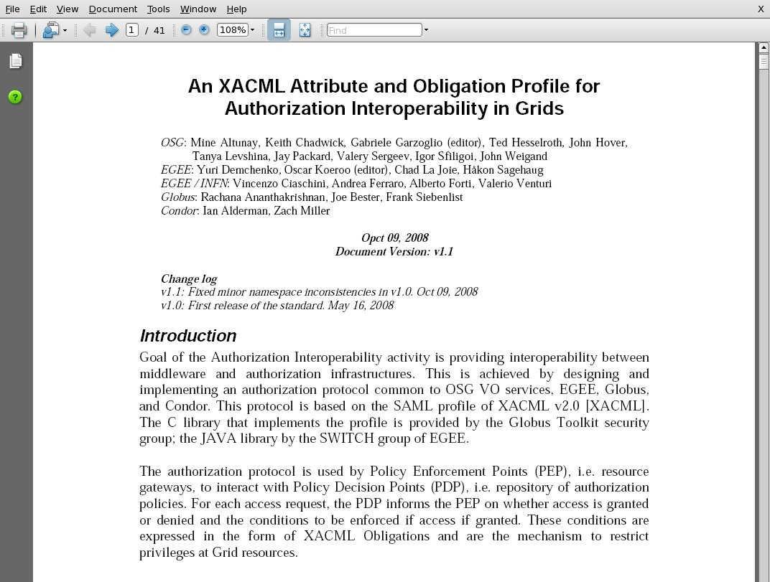
An XACML AuthZ Interop Profile
Authorization Interoperability Profile based on the SAML v2 profile of XACML v2
Result of a 1yr collaboration between OSG, EGEE, Globus, and Condor
Releases:
  v1.1 → 10/09/08 v1.0 → 05/16/08

Slide 94
Most Common Obligation Attributes
UIDGID
  UID (integer): Unix User ID local to the PEP
  GID (integer): Unix Group ID local to the PEP
Secondary GIDs
  GID (integer): Unix Group ID local to the PEP (Multi recurrence)
Username
  Username (string): Unix username or account name local to the PEP.
Path restriction
  RootPath (string): a sub-tree of the FS at the PEP
  HomePath (string): path to user home area (relative to RootPath)
Storage Priority
  Priority (integer): priority to access storage resources.
Access permissions
  Access-Permissions (string):
  “read-only”, “read-write”
see document for all attributes and obligations

Slide 95
What has been achieved now
All profiles written and implemented
Common libraries available in Java and C implementing the communications protocol
Common handlers for
Joint Interoperable Attribute and Obligations
Integrated in all relevant middleware in EGEE and OSG:
  Clients: lcg-CE (via LCMAPS scasclient), CREAM and gLExec (ditto),
  GT pre-WS gram (both prima and LCMAPS), GT GridFTP,
  GT4.2 WS-GRAM, dCache/SRM
  Servers: GUMS, SCAS, Argus (variant protocol)
Other (lower-prio) components in progress
  SAZ, RFT, GT WS native-AuthZ, Condor (& -G), BeStMan

Slide 96
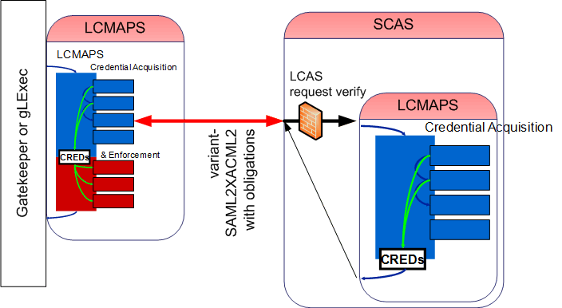
SCAS: LCMAPS in the distance
Application links LCMAPS dynamically or statically, or includes Prima client
Local side talks to SCAS using a variant-SAML2XACML2 protocol
- with agreed attribute names and obligation between EGEE/OSG
- remote service does acquisition and mappings
- both local, VOMS FAQN to uid and gids, etc.
Local LCMAPS (or application like gLExec) does the enforcement

Slide 97
Talking to SCAS
From the CE
  Connect to the SCAS using the CE host credential
  Provide the attributes & credentials of the service requester, the action (“submit job”) and target resource (CE) to SCAS
  Using common (EGEE+OSG+GT) attributes
  Get back: yes/no decision and uid/gid/sgid obligations
From the WN with gLExec
  Connect to SCAS using the credentials
  of the pilot job submitter
  An extra control to verify the invoker of gLExec
  is indeed an authorized pilot runner
  Provide the attributes & credentials of the service requester, the action (“run job now”) and target resource (CE) to SCAS
  Get back: yes/no decision and uid/gid/sgid obligations
The obligations are now coordinated between CE and WNs

Slide 98
SCAS Supported services & protocols
SCAS communicates based on a few standards and the joint “Authorization Interoperability” profile
  Supported by Globus, EGEE/gLite 3.x, VO Services/OSG, dCache
  Defined also common wire protocol
  Common naming of obligations such as uid/gid, rootPath
Compatible software
  Globus gatekeepers, lcg-CE
  gLExec (on WNs and on CREAM-CEs)
  dCache > 1.9.2-4
  GT GridFTP
  GT4.2 WS-GRAM, GRAM5 (to be tested)

Slide 99
GUMS and SAZ
VO
PDP
Grid
Site
Site Services
VO Services
GUMS
SAZ
VOMRS
synch
VOMS
synch
2
3
7
6
ID Mapping?
Yes / No +
UserName
Is Auth?
Yes / No
1
register
PEPs
4
SE
CE
WN
get voms-proxy
SRM
Gatekeeper
gLExec
gPlazma
Prima
Prima
5
Submit request
with voms-proxy
Pilot SU
Job
(UID/GID)
10
Access
Data
(UID/GID)
Submit
Pilot OR Job
(UID/GID)
Schedule
Pilot OR Job
8
8
Batch
System
Storage
Legend
9
AuthZ
Components
Not Officially
In OSG
VO Management
Services
graphic: Dave Dykstra, Fermi National Accelerator Laboratory, CHEP, March 2009

Slide 100
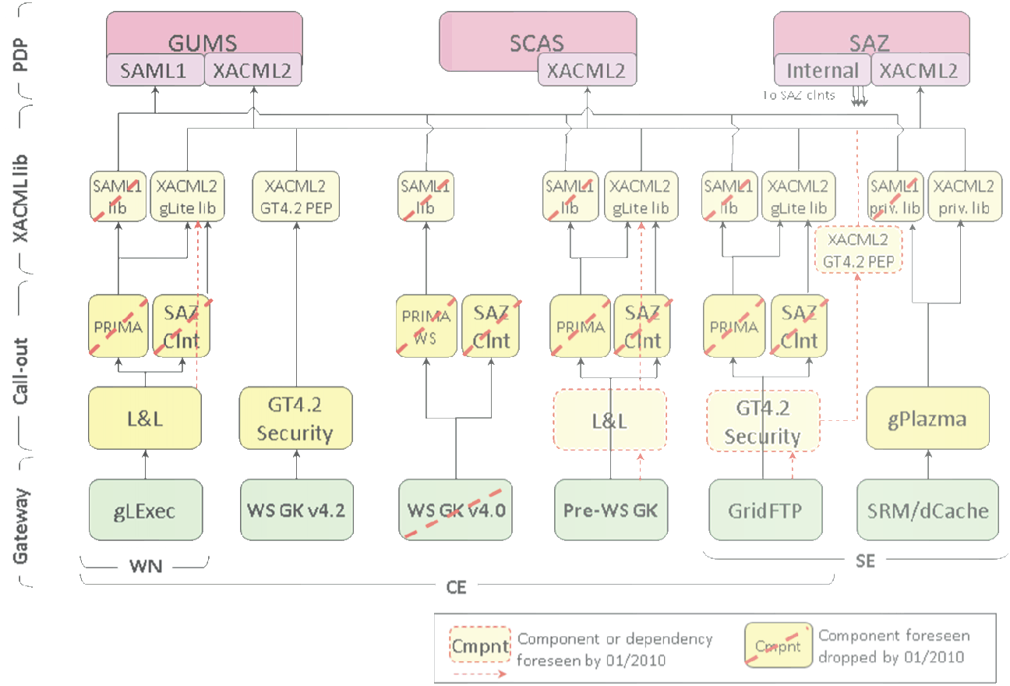
Interoperability achievements
graphic: Gabriele Garzoglio, FNAL

Slide 101
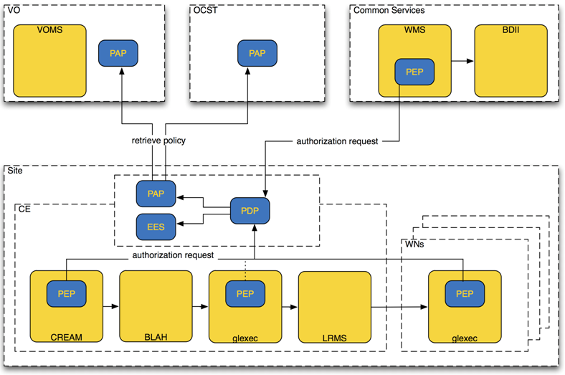
Argus service
graphic: MJRA1.4 (EGEE-II) gLite security architecture, Oct 2008, Christoph Witzig

Slide 102
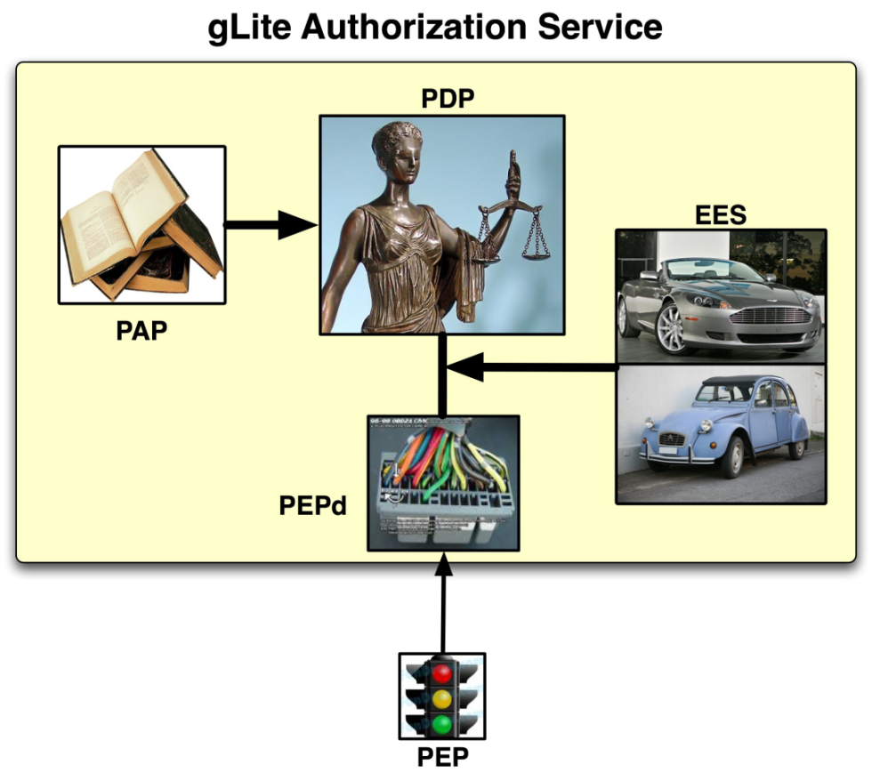
Argus services and daemons
Administration Point
Formulating rules through CLI and/or file-based input
Decision Point
Evaluating a request from a
client based on the rules
Enforcement Point
Thin client part and server part:
all complexity in server part
Runtime Execution Environment
Under which env. must I run?
(Unix UID, GID, …)
Graphic: Christoph Witzig, SWITCH and EGEE

Slide 103
Capabilities
Enables/eases various authorization tasks:
  Banning of users (VO, WMS, site, or grid wide)
Composition of policies – e.g.
CERN policy + experiment policy + CE policy
+ OCST policy + NGI policy=> Effective policy
Support for authorization based on more detailed information about the job, action, and execution environment
  Support for authorization based on attributes other than FQAN
  Support for multiple credential formats (not just X.509)
  Support for multiple types of execution environments
  Virtual machines, workspaces, …
https://twiki.cern.ch/twiki/bin/view/EGEE/AuthorizationFramework

Slide 104
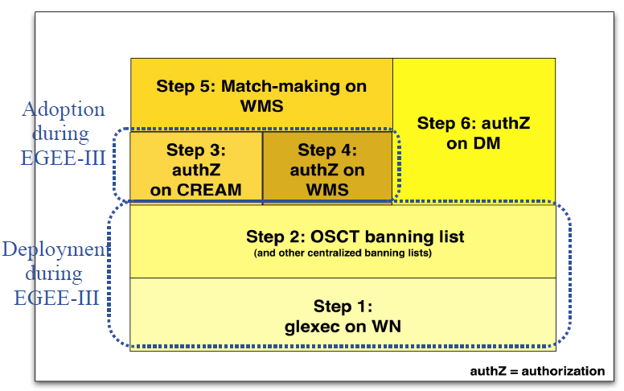
Introduction of the service in gLite
Focus is on computing services (again …)
  Initial introduction through gLExec on the WN
  As a new LCMAPS plug-in
  (used in conjunction with the others, esp. verify-proxy)
  With OSCT ban list
standards expressibility
  ‘PIP, PEP, PAP, PDP’, and SAML
  XACML policies and attributes
  But with a simplified language ☺
v1.1 released in Feb 2010
  Contains important fixes – use at least this one or better
Graphic: Christoph Witzig, SWITCH and EGEE

Slide 105
gLExec with Argus
‘just another call-out from LCMAPS’
/opt/glite/etc/lcmaps/lcmaps-argus.db
# LCMAPS config file for glexec generated by YAIM
# Plugin definitions:
posix_enf = "lcmaps_posix_enf.mod"
" -maxuid 1" " -maxpgid 1" " -maxsgid 32"
verifyproxy = "lcmaps_verify_proxy.mod"
" -certdir /etc/grid-security/certificates"
pepc = "lcmaps_c_pep.mod"
"--pep-daemon-endpoint-url https://mient.nikhef.nl:8154/authz"
"--resourcetype wn"
"--actiontype execute-now"
"--capath /etc/grid-security/certificates"
"--pep-certificate-mode implicit"
# LCMAPS Execution Policies:
argus:
verifyproxy -> pepc
pepc -> posix_enf

Slide 106
Argus Supported services & protocols
Argus communicates based on many of the well-known standard protocols
  Same common wire communications protocol as
  Globus, EGEE/gLite 3.x, VO Services/OSG, and SCAS
  Naming derived from but slightly different from the Joint Profile
  but will not yet work with AuthZ Interop attribute profile compliant apps
Compatible software
  gLExec (on WNs and on CREAM-CEs)
  All LCMAPS capable services via common PEP-C plugin
  GT4 pre-WS gatekeeper via dedicated GT4 authZ call-out
  Scale-out to WMS and storage services foreseen

Slide 107
Combining services
If you want, e.g.,
banning from Argus and mapping done locally?
  Configure Argus service to not run a pool-account map
  Then, chain a lcmaps_c_pep plugin and a voms-poolaccount in sequence, followed by posix_enf
# Policies
good_account_mapping:
verifyproxy -> pepc
pepc -> vomslocalgroup
vomslocalgroup -> vomslocalaccount | localaccount
vomslocalaccount -> posix_enf | vomspoolaccount
vomspoolaccount -> posix_enf
localaccount -> posix_enf | poolaccount
poolaccount -> posix_enf

Slide 108
Long Running Jobs
MyProxy
Renewal daemons
What About VOMS

Slide 109
MyProxy in EGEE
EGEE security based on proxy certificates
  often carrying VOMS attribute certificates
MyProxy used for several purposes:
  Solution for portals (P-GRADE, Genius)
    a common way of using MyProxy
  Long-running jobs and data transfers
    credential renewal
http://myproxy.ncsa.uiuc.edu/
Slides based on: Ludek Matyska and Daniel Kouril, CESNET

Slide 110
Long-running Jobs
Jobs require valid credentials
  e.g. to access GridFTP data repositories on the user‘s behalf
  these operations must be secured, using the users‘ credentials
Job's lifetime can easily exceed the lifetime of a proxy
  consider waiting in the queues, possible resubmissions, computation time, data transfers, etc.
  also VOMS certificates have limited lifetime
Impossible to submit a job with sufficiently long credentials
  the overall job lifetime not known in advance
  violation of the meaning of short-time proxies
  increased risk when the credential is stolen
  might be unacceptable for the end resources
How to provide jobs with a valid short-lived credential throughout their run?
Slides based on: Ludek Matyska and Daniel Kouril, CESNET

Slide 111
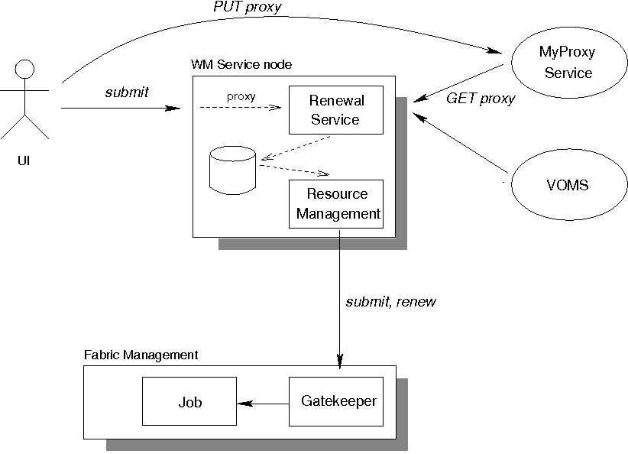
Proxy Renewal Service
Slides based on: Ludek Matyska and Daniel Kouril, CESNET

Slide 112
Proxy Renewal Service
Ensures that jobs always have a valid short-time proxy
Users have full control over their proxies and renewal
  Using the MyProxy repository
Support for VOMS
All operations are logged
  allows an audit
Stolen credentials can't be renewed easily
  the WMS credential are necessary for renewal
An older (still valid) proxy must be available for renewal
  reduces the risk when services are compromised
Developed in EU Datagrid, in production use in EGEE
Slides based on: Ludek Matyska and Daniel Kouril, CESNET

Slide 113
MyProxy and Trust Establishment
Relationship between MyProxy and its client is crucial
  clients must be authorized to access the repository
So far trust based on a static configuration
  each service and client must be listed
  regular expressions aren‘t sufficient
  a subject name of a service must be added on each change or addition
VOMS support introduced recently
  generated by needs of EGEE
  allows to specify VOMS attributes (roles, groups) instead of specifying identity
  requires adding service certificates to VOMS machinery
Slides based on: Ludek Matyska and Daniel Kouril, CESNET

Slide 114
Data Storage
Access Control semantics
Breakdown of the container model
Legacy forever: mapping grid storage onto Unix semantics
The DPM model

Slide 115
Storage: Access Control Lists
Catalogue level
  protects access to meta-data
  is only advisory for actual file access
  unless the storage system only accepts connections from a trusted agent that does itself do a catalogue lookup
SE level
  either natively (i.e. supported by both the SRM and transfer services)
SRM/transfer level
  SRM and GridFTp server need to lookup in local ACL store for each transfer
  need “all files owned by SRM” unless underlying FS supports ACLs
OS level?
  native POSIX-ACL support in OS would be needed
  Mapping would still be requires (as for job execution)

Slide 116
Grid ACL considerations
Semantics
  Posix semantics require that you traverse up the tree to find all constraints
  behaviour both costly and possibly undefined in a distributed context
  VMS and NTFS container semantics are self-contained
  taken as a basis for the ACL semantics in many grid services
ACL syntax & local semantics typically Posix-style

Slide 117
‘Container abstraction’ breakdown
database consistency
graphic: Ann Chervenak, ISI/USC, from presentation to the Design Team, Argonne, 2005

Slide 118
Embedded access control: dCache
voms-proxy-init
Proxy with VO
Membership | Role attributes
srmcp
DATA
SAML2XACML2
interop protocol
GUMS, SCAS, &c
SRM Server
DATA
GridFTP
Server
SRM-dCache
GridFTP
Callout
SAML response
User Authorization
Record
gPLAZMA
PRIMA SAML Client
Storage Authorization Service
Storage metadata
https/SOAP
SRM Callout
SAML query
Get storage authz for this username
gPLAZMALite Authorization Service
If authorized,
get username
gPLAZMALite grid-mapfile
GUMS
Identity Mapping
Service
dcache.kpwd
Graphic: Frank Wurthwein, CHEP2006 Mumbai

Slide 119
Legacy persists, though
dCache/gPlazma maps back to
  Unix username
  ‘root path’
Files stored
with Unix uid and gid
  Can have local access!
  But doing VOMS-based ACLs
  over simple Unix ACLs
  results in
  a combinatorial group explosion
SAML response
User Authorization
Record
Storage Authorization Service
Storage metadata
https/SOAP
SAML query
Get storage authz for this username
If authorized,
get username
GUMS
Identity Mapping
Service
Graphic: Frank Wurthwein, CHEP2006 Mumbai

Slide 120
Grid storage access control
Use ‘grid’ identity and attributes to define ACLs
With ‘POSIX’ semantics
  So traversal based, not object based
  Needs ‘good’ database schema to store ACLs&metadata
Example: DPM “Disk Pool Manager”
  See
  https://twiki.cern.ch/twiki/bin/view/EGEE/GliteDPM

Slide 121
DPM Architecture
Grid Client
Data Server
Name Server
RFIO Client
RFIO Daemon
Disk System
NS Daemon
NS Database
Gridftp Client
Gridftp Server
RFIO Client
Disk Pool Manager
DPM Daemon
Request Daemon
SRM Server
SRM Client
SRM Daemon
DPM Database
All disk-based (data) files owned by a generic ‘dpm’ user
Meta-data, locations, ownership, ACLs: all in a database
graphics: ‘ACLs in Light Weight Disk Pool Manager’ MWSG 2006, Jean Philippe Baud, CERN

Slide 122
Virtual Ids and VOMS integration
DNs are mapped to virtual UIDs: the virtual uid is created on the fly the first time the system receives a request for this DN (no pool account)
VOMS roles are mapped to virtual GIDs
A given user may have one DN and several roles, so a given user may be mapped to one UID and several GIDs
Currently only the primary role is used in LFC/DPM
Support for normal proxies and VOMS proxies
Administrative tools available to update the DB mapping table:
  To create VO groups in advance
  To keep same uid when DN changes
  To get same uid for a DN and a Kerberos principal
Slides and graphics: ‘ACLs in Light Weight Disk Pool Manager’ MWSG 2006, Jean Philippe Baud, CERN

Slide 123
DPNS mapping tables
CREATE TABLE Cns_groupinfo (
gid NUMBER(10),
groupname VARCHAR2(255));
CREATE TABLE Cns_userinfo (
userid NUMBER(10),
username VARCHAR2(255));
included in GridFTP through ‘dli’ plugin mechanism,
and in SRM through call-outs to dpns
Slides and graphics: ‘ACLs in Light Weight Disk Pool Manager’ MWSG 2006, Jean Philippe Baud, CERN

Slide 124
Access Control Lists
LFC and DPM support Posix ACLs based on Virtual Ids
  Access Control Lists on files and directories
  Default Access Control Lists on directories: they are inherited by the sub-directories and files under the directory
Example
  dpns-mkdir /dpm/cern.ch/home/dteam/jpb
  dpns-setacl -m d:u::7,d:g::7,d:o:5 /dpm/cern.ch/home/dteam/jpb
  dpns-getacl /dpm/cern.ch/home/dteam/jpb
  # file: /dpm/cern.ch/home/dteam/jpb
  # owner: /C=CH/O=CERN/OU=GRID/CN=Jean-Philippe Baud 7183
  # group: dteam
  user::rwx
  group::r-x #effective:r-x
  other::r-x
  default:user::rwx
  default:group::rwx
  default:other::r-x
Slides and graphics: ‘ACLs in Light Weight Disk Pool Manager’ MWSG 2006, Jean Philippe Baud, CERN

Slide 125
Specialised Middleware
Hydra distributed key store
SSSS

Slide 126
Encrypted Data Storage
Medical community as the principal user
large amount of images
privacy concerns vs. processing needs
ease of use (image production and application)
Strong security requirements
anonymity (patient data is separate)
fine grained access control (only selected individuals)
privacy (even storage administrator cannot read)
Described components are under development
Slides based on Akos Frohner, EGEE and CERN

Slide 127
Accessing medical images
image ID is located by AMGA
key is retrieved from the Hydra key servers (implicitly)
file is accessed by SRM (access control in DPM)
data is read and decrypted block-by-block
in memory only (GFAL and hydra-cli)---> useful for all
Still to be solved:
ACL synchronization among SEs
Hydra
KeyStore
Hydra
KeyStore
AMGA
metadata
Hydra
KeyStore
gridftp
2. keys
1. patient look-up
SRMv2
3. get TURL
GFAL
image
I/O
4. read
DICOM
DICOM-SE
Slides based on Akos Frohner, EGEE and CERN

Slide 128
Exporting Images
“wrapping” DICOM :
  anonymity: patient data is separated and stored in AMGA
  access control: ACL information on individual files in SE (DPM)
  privacy: per-file keys
    distributed among several Hydra key servers
    fine grained access control
Image is retrieved from DICOM and processed to be “exported” to the grid.
AMGA
metadata
Hydra
KeyStore
Hydra
KeyStore
Hydra
KeyStore
gridftp
patient data
keys
trigger
SRMv2
image
file ACL
I/O
DICOM
DICOM-SE
Slides based on Akos Frohner, EGEE and CERN

Slide 129
Hydra key store theory, and SSSS
Keys are split for security and reliability reasons using Shamir's Secrect Sharing Scheme (org.glite.security.ssss)
  standalone library and CLI
  modified Hydra service and Hydra client library/CLI
  the client contacts all services for key registration, retrieval and to change permissions
    there is no synchronization or transaction coordinator service
$ glite-ssss-split-passwd -q 5 3 secret
137c9547aba101ef 6ee7adbbaacac1ef 1256bcc160eda592 fdabc259cdfbacc9 3113be83f203d794
$ glite-ssss-join-passwd -q 137c9547aba101ef NULL \
1256bcc160eda592 NULL 3113be83f203d794
secret
Slides based on Akos Frohner, EGEE and CERN

Slide 130
Example: integration into DPM
lcg-cp -bD srmv2 srm://dpm.example.org:8446/srm/managerv2?
  SFN=/dpm/example.org/home/biomed/mdm/<ID> file:picture.enc
glite-eds-decrypt <ID> picture.enc picture
glite-eds-get -i <ID> rfio:////dpm/example.org/home/biomed/mdm/<ID> picture
  file is opened via gfal_open()
  decryption key is fetched for <ID>
  loop on gfal_read(), glite_eds_decrypt_block(), write()
'glite-eds-get' is a simple utility over the EDS library.
Slides based on Akos Frohner, EGEE and CERN

Slide 131
From Here?
Summary and last words

Slide 132
Summary
Security middleware is everywhere
  An integral part of almost any grid service
  And (but …) implemented in a myriad of ways
Most of the core capabilities are there
  VOMS based access, banning on VO or DN
  But methodology varies,
  and the documentation is not well read or disseminated
New frameworks will help you manage security at the site
  Deal with new usage patterns and novel risk surfaces
  We’re getting there with interop
  No reason to wait: regular site management can already help a lot
And (or: but): we’re far from done …

Slide 133
Questions?

