Slide 1
Middleware Security
in Selected Grid Infrastructures
David Groep, Nikhef

Slide 2
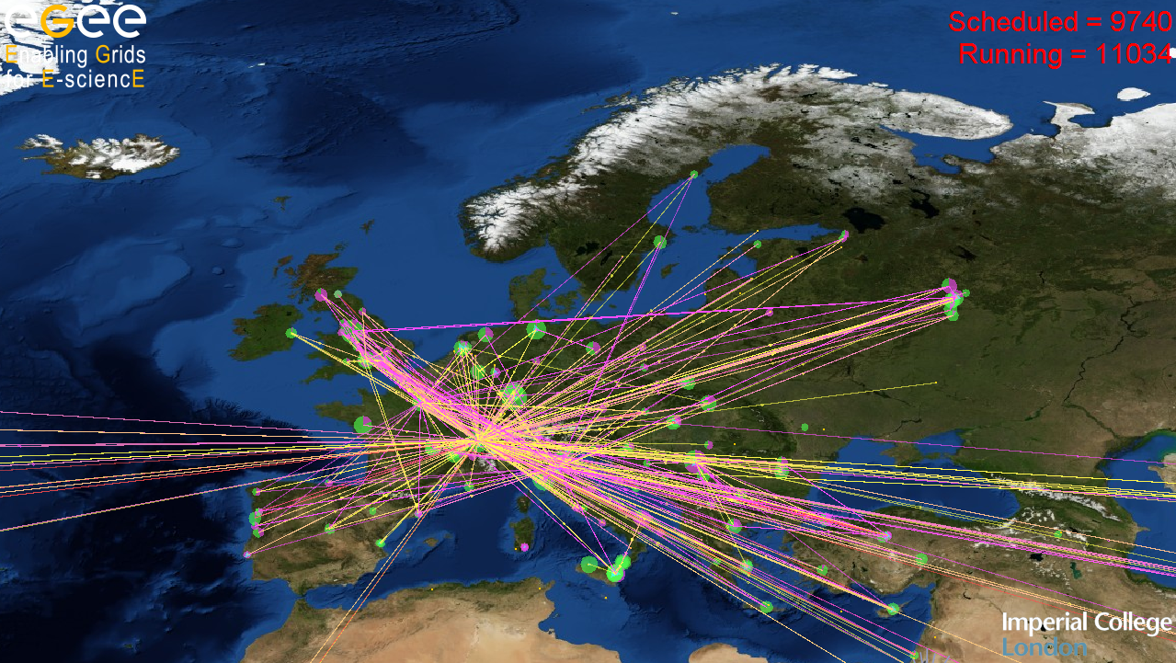
Grid Security Middleware
mechanisms for protecting the e-Infrastructure

Slide 3
What to expect?
What might be covered
What will not be covered
How to deal with AuthN
AuthZ frameworks
Access control in services
Unix credential mapping
Pilot jobs and late binding
Security interoperability
Storage access control
Data Security and Privacy
… with a slight EGEE & C/Unix bias (sorry)
How to write secure code
  Look at http://pages.cs.wisc.edu/~kupsch/
Current vulnerabilities
  They’re secret for a reason…
What might be there
in 2-3 years’ time
Most of the federation work
The latest WS-* *ML specs

Slide 4
Security Mechanism Foundations
Terminology: virtual organisation models
Authentication requirements
Delegation and proxies
Virtual Organisation membership

Slide 5
The Virtual Organisation, or ‘VO’
Grids organised around ‘virtual organisations’
A set of individuals or organisations, not under single hierarchical control, (temporarily) joining forces to solve a particular problem at hand, bringing to the collaboration a subset of their resources, sharing those at their discretion and each under their own conditions.
However, the term is used in different ways ...

Slide 6
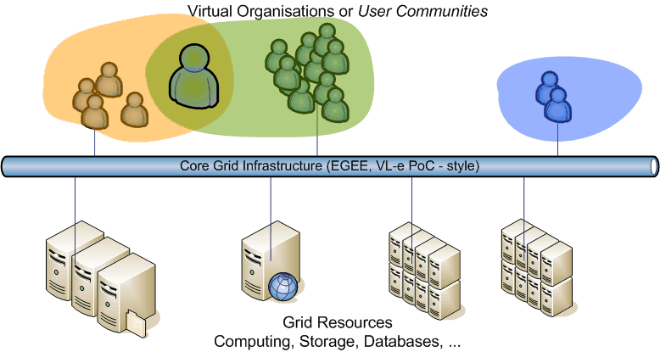
VOs on an e-Infrastructure
User communities ‘live’ on a persistent infrastructure
Communities can exist without their ‘own’ resources
... and resource centres can do without local users

Slide 7
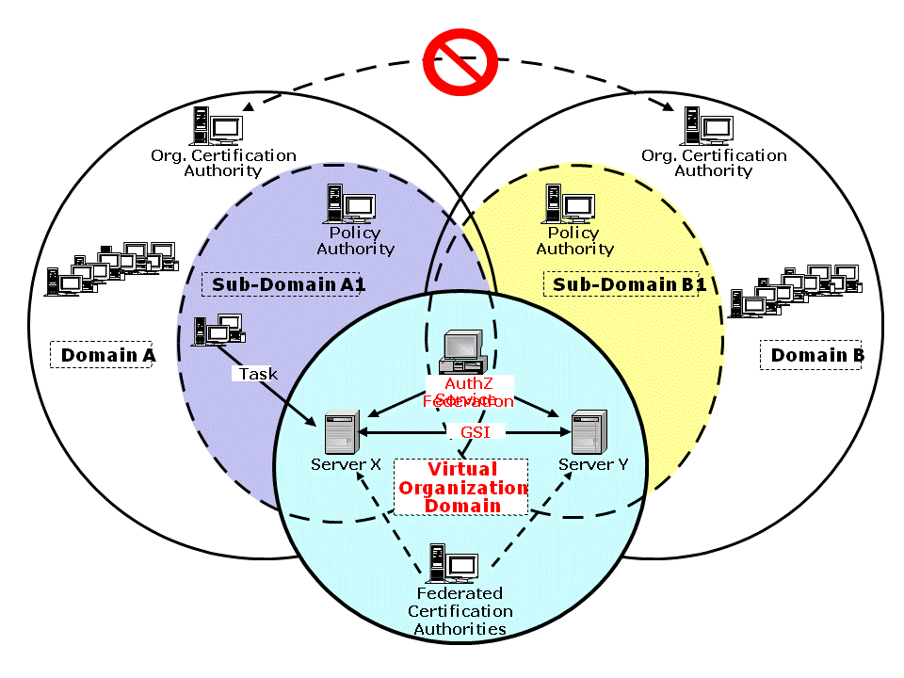
Trust
For the model to work parties have to trust each other
Organisational trust is hard; Grid’s user-resource scales better

Slide 8
Elements of Trust
Authentication
  Who are you?
  Who says so?
  How long ago was that statement made?
  Have you changed since then?
Authorization
  Why should I let you in?
  What are you allowed to do?
  By whom? Who said you could do that?
  And how long ago was that statement made?

Slide 9
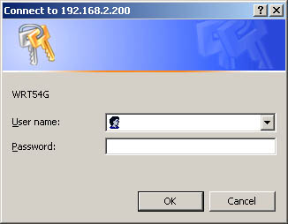
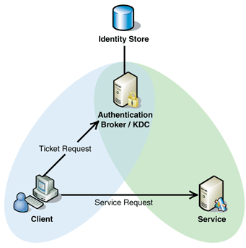
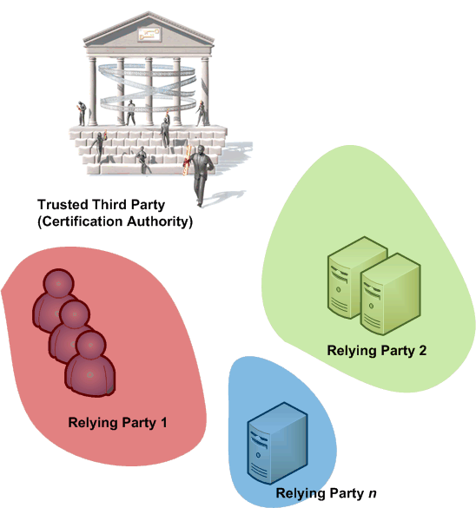
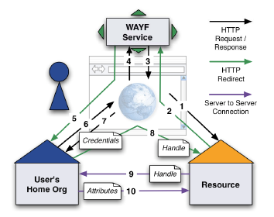
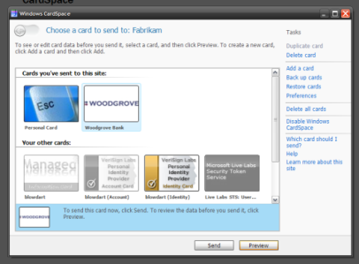
Authentication models
Direct user-to-site
  passwords, enterprise PKI, Kerberos
PKI with trusted third parties
Federated access
  Controlled & policy based
  Free-for-all, e.g., OpenID
Identity meta-system
  Infocard type systems

Slide 10
PKI (1): Asymmetric cryptography
Based on X.509 PKI:
John
Paul
every user/host/service has an X.509 certificate;
certificates are signed by trusted (by the local sites) CA’s;
every Grid transaction is mutually authenticated:
  John sends his certificate;
  Paul verifies signature in John’s certificate;
  Paul sends to John a challenge string;
  John encrypts the challenge string with his private key;
  John sends encrypted challenge to Paul
  Paul uses John’s public key to decrypt the challenge.
  Paul compares the decrypted string with the original challenge
  If they match, Paul verified John’s identity and John can not repudiate it.
John’s certificate
Verify CA signature
Random phrase
Encrypt with J.’ s private key
Encrypted phrase
Decrypt with J.’ s public key
Compare with original phrase

Slide 11
PKI (2): Communications
Securing the channel
  ‘Transport Layer Security’ (TLS, formerly SSL)
  Exchange a symmetric cipher through PK challenge
  Communications on channel authentic and encrypted
Securing the message
  Can be sent and forwarded over any medium
  Each and every message needs a signature
  Examples: XML-DSIG, XML-ENC, but also PGP…

Slide 12
X.509: add identifiers to a public key
Authentic binding between
  Subject name
  A public key
  A validity period
  Zero or more extensions
  … that can contain identifiers
  … or policies
Signed by an issuer
  Yourself: self-signed cert
  Trusted third party, ‘CA’
Serial Number
Issuer, Algorithm, etc.
Valid from and valid until
Subject Distinguished Name
Extensions
basicConstraints: CA: TRUE or FALSE
keyUsage: …
subjectAlternativeName: …
…
…
Public Key Data (exponent, modulus)
Signature of the issuer (‘issuing CA’)

Slide 13
Example certificate
Version: 3 (0x2)
Serial Number: 2113 (0x841)
Signature Algorithm: sha1WithRSAEncryption
Issuer: C=NL, O=NIKHEF, CN=NIKHEF medium-security certification auth
Validity Not Before: Oct 23 00:00:00 2008 GMT
Not After : Oct 23 07:35:37 2009 GMT
Subject: O=dutchgrid, O=users, O=nikhef, CN=David Groep
Subject Public Key Info:
Public Key Algorithm: rsaEncryption
RSA Public Key: (1024 bit)
Modulus (1024 bit):
00:f1:14:78:97:9b:38:84:69:e0:b7:df:d9:f2:31:
Exponent: 65537 (0x10001)
X509v3 extensions:
X509v3 Basic Constraints: critical
CA:FALSE
X509v3 Key Usage: critical
Digital Signature, Key Encipherment, Data Encipherment
X509v3 Extended Key Usage:
TLS Web Client Authentication, E-mail Protection
X509v3 CRL Distribution Points:
URI:http://ca.dutchgrid.nl/medium/cacrl.der
X509v3 Certificate Policies:
Policy: 1.3.6.1.4.1.10434.4.2.2.1.3.1
Policy: 1.2.840.113612.5.2.2.1
X509v3 Subject Alternative Name:
email:davidg@nikhef.nl
Signature Algorithm: sha1WithRSAEncryption
19:d3:82:19:af:96:7d:34:97:61:58:76:4f:a8:56:45:34:90:

Slide 14
Building up: CA hierarchies
Root Certificate Authority
1 Jan 1999 until 31 Dec 2029
Root Certification Authority
Signature of Root Certification Auth
Root Certificate Authority
1 Jan 1999 until 31 Dec 2019
Subordinate Certification Authority 1
Root Certificate Authority
Signature of Root Certification Auth
1 Jan 1999 until 31 Dec 2049
Serial Number
Subordinate Certification Authority 2
Subordinate Certification Authority 1
Signature of Root Certification Auth
Valid from and valid until
Subject Distinguished Name
Extensions
basicConstraints: CA: TRUE or FALSE
Not all paths need to be equally trusted by
a relying party - i.e. a site, a user or a VO
keyUsage: …
subjectAlternativeName: …
…
…
Public Key Data (exponent, modulus)
Signature Subordinate Certification Auth1

Slide 15
Signing policy files
Constrain name space to specified subject names
For now, specific to Grids – with talk in IETF
  Recognised in
    Globus Toolkit C core, and Java in 4.2+
    gLite Trust Manager
    GridSite (recent versions only)
  But still lacking in some places – need patches!
See OGF CAOPS-WG “RPDNC Policies” document
access_id_CA X509 '/C=NL/O=NIKHEF/CN=NIKHEF medium-security certification auth'
pos_rights globus CA:sign
cond_subjects globus '"/C=NL/O=NIKHEF/CN=NIKHEF medium-security certification auth"
"/O=dutchgrid/O=users/*" "/O=dutchgrid/O=hosts/*"
"/O=dutchgrid/O=robots/*"'

Slide 16
Verification steps
Check signature chain up to a trusted root
  In OpenSSL (and thus most grid middleware)
  the root of trust must be self-signed
Check basicConstraints and keyUsage
Check revocation of any certificates in the chain
  Using Certificate Revocation Lists (CRLs) when installed
  Download on-demand or OCSP not yet supported
Check RP namespace constraints

Slide 17
Needed for verification
Trust anchors
  ‘.0’ files in ‘PEM’ format, e.g. from IGTF
  download and update in RPM format with yum/apt
  Or install and refresh with tar balls or JKSs
Revocation lists
  ‘.r0’ files in PEM format, retrieved by tools: fetch-crl
RP namespace constraints
  ‘.signing_policy’ files, and ‘.namespaces’ files
Java JKS’s (used in Unicore) are of course different

Slide 18
Delegation and Virtual ORganisations
Proxy certificate verification
VO technologies: LDAP, VOMS-push, VOMS-pull, SAML
Towards a multi-authority world: interlinking federations

Slide 19
Delegation
Mechanism to have someone, or some-thing
– a program – act on your behalf
  as yourself
  with a (sub)set of your rights
Essential for the grid model to work
GSI/PKI and recent SAML drafts define this
  GSI (PKI) through ‘proxy’ certificates (see RFC3820)
  SAML through Subject Confirmation,
  (linking to at least one key or name)

Slide 20
Delegation, but to whom?
‘normal’ proxies form a chain
  Subject name of the proxy derived from issuer
  May contain path-length constraint
  May contain policy constraints
  And: legacy (pre-3820) proxies abound
But: use the name of the real end-entity for authZ!
Note that
in SAML, delegation can be to any NameID
in RFC3820 these are called ‘independent proxies’
“/DC=org/DC=example/CN=John Doe/CN=24623/CN=535431”
is likely a proxy for user
“/DC=org/DC=example/CN=John Doe”

Slide 21
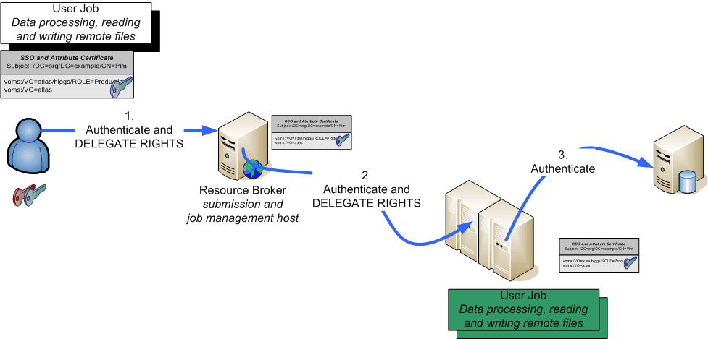
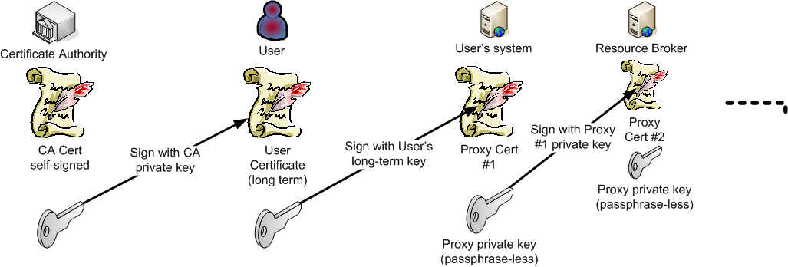
Daisy-chaining proxy delegation

Slide 22
Verifying authentication and X.509
‘Conventional’ PKI
  OpenSSL, Apache mod_ssl
  Java JCE providers, such as BouncyCastle
  Perl, Python usually wrappers around OpenSSL
With proxy support
  OpenSSL (but beware of outstanding issues!)
  Globus Toolkit (C, Java)
  GridSite
  ProxyVerify library
  TrustManager
Always ensure the proxy policies are implemented

Slide 23
Authorization: VO representations
VO is a directory (database) with members, groups, roles
based on identifiers issues at the AuthN stage
Membership information is to be conveyed
to the resource providers
  configured statically, out of band early days, i.e. < 2001
  in advance, by periodically pulling lists DEISA
  VO LDAP directories
  in VO-signed assertions pushed with the EGEE (+OSG pulls VOMS)
  request: VOMS, Community AuthZ Service
  Push&pull of assertions via SAML 2010 +

Slide 24
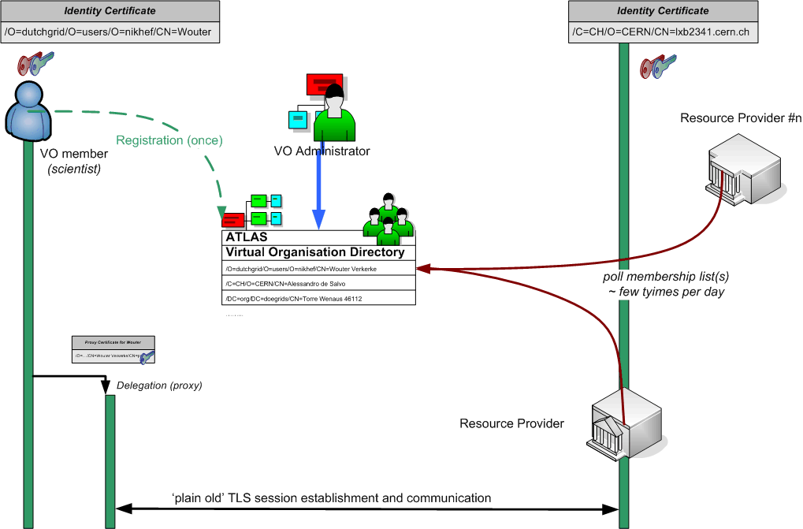
VO LDAP model

Slide 25
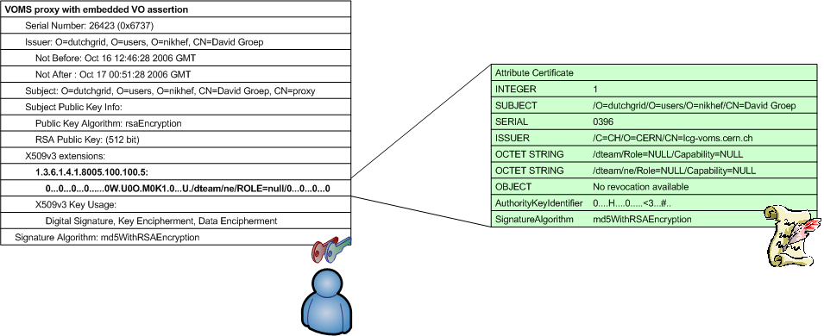
VOMS v1: X.509 as a container
Virtual Organisation Management System (VOMS)
developed by INFN for EU DataTAG and EGEE
used by VOs in EGEE, Open Science Grid, NAREGI, …
push-model signed VO membership tokens
  using the traditional X.509 ‘proxy’ certificate for trans-shipment
  fully backward-compatible with only-identity-based mechanisms

Slide 26
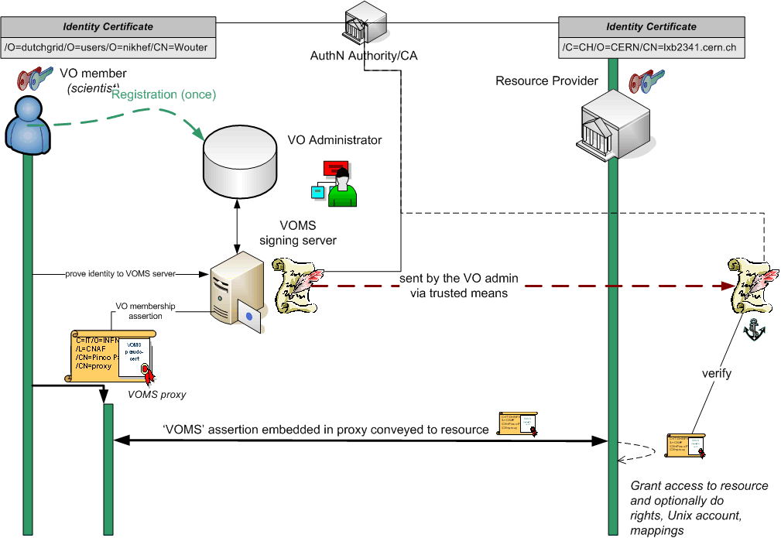
VOMS model

Slide 27
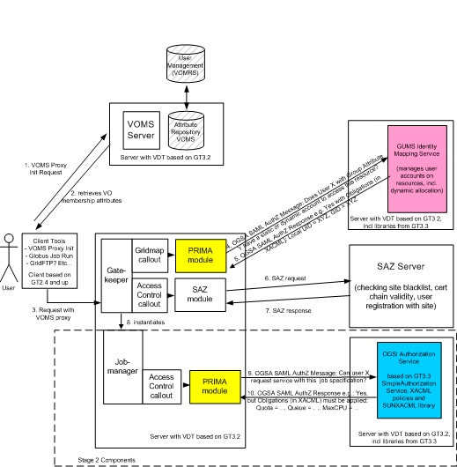
GUMS model
VO configuration replicated locally at the site
Here, pushed VOMS attributes are advisory only
synchronizes
Graphic: Gabriele Garzoglio, FNAL

Slide 28
Towards a multi-authority world (AAI)
Interlinking of technologies can be cone at various points
Authentication: linking (federations of) identity providers to the existing grid AuthN systems
  ‘Short-Lived Credential Services’ translation bridges
Populate VO databases with UHO Attributes
Equip resource providers to also inspect UHO attributes
Expressing VO attributes as function of UHO attributes
and most probably many other options as well …
Leads to assertions with multiple LoAs in the same decision
  thus all assertions should carry their LoA
  expressed in a way that’s recognisable
  and the LoA attested to by ‘third parties’ (i.e. the federation)

Slide 29
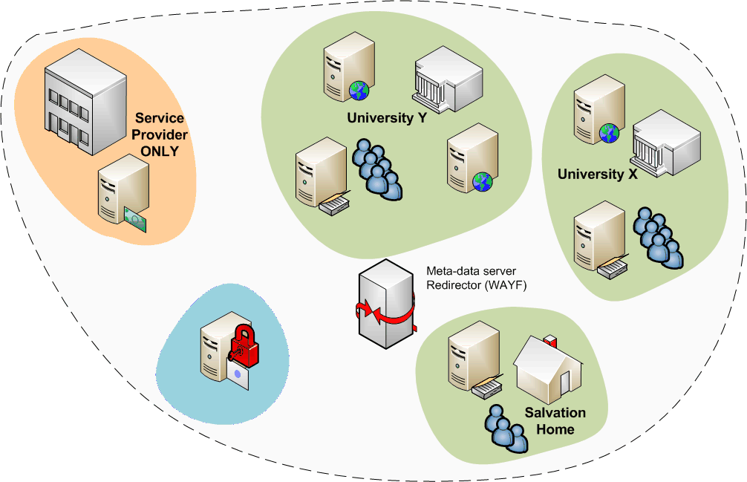
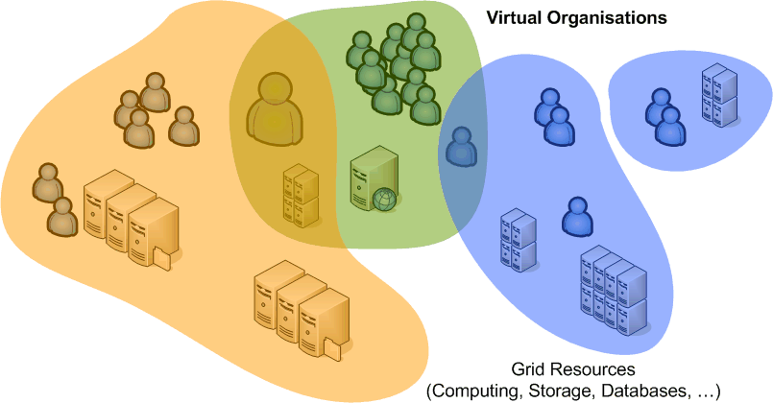
Federations
A common Authentication and Authorization Infrastructure
Allow access to common resources with a single credential
grid structure was not
too much different!

Slide 30
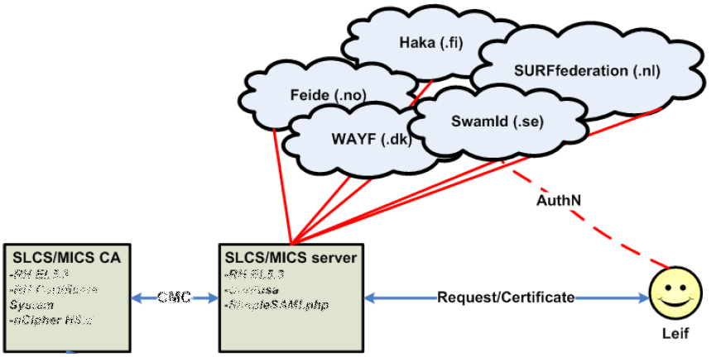
A Federated Grid CA
Use your federation ID
... to authenticate to a service
... that issues a certificate
... recognised by the Grid today
Implementations:
SWITCHaai SLCS
TERENA Grid CA Service
Graphic from:
Jan Meijer, UNINETT

Slide 31
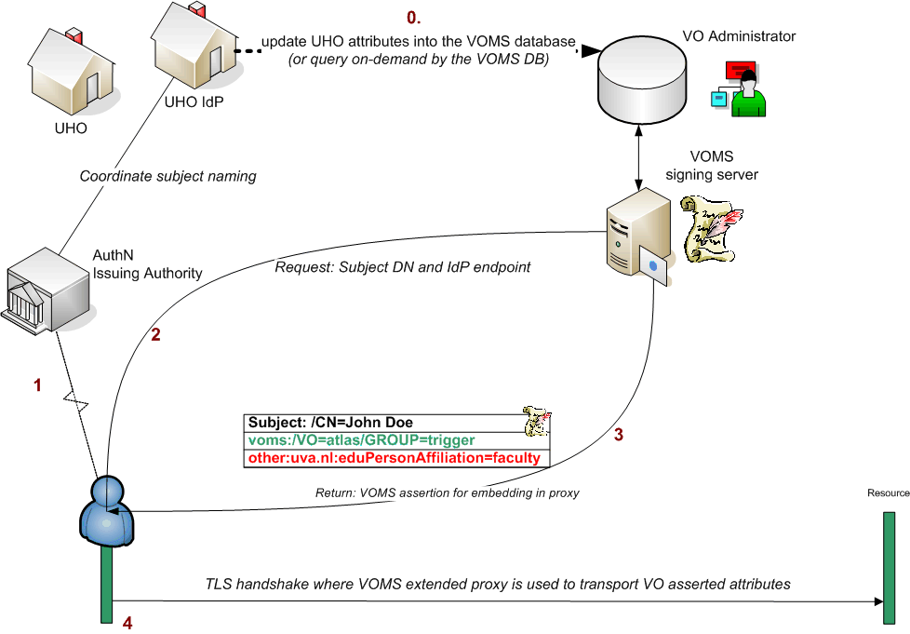
Putting home attributes in the VO
Characteristics
  The VO will know the source of the attributes
  Resource can make a decision on combined VO and UHO attributes
  but for the outside world, the VO now has asserted to the validity of the UHO attributes – over which the VO has hardly any control

Slide 32
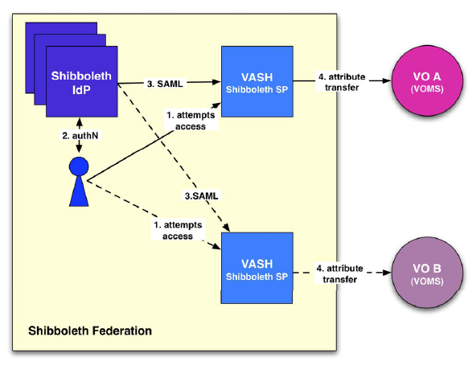
Attributes from multi-authority world
In ‘conventional’ grids, all attributes assigned by VO
But there are many more attributes
VASH: ‘VOMS Attributes
from Shibboleth’
  Populate VOMS with
  generic attributes
  Part of gLite (SWITCH)
http://www.switch.ch/grid/vash/

Slide 33
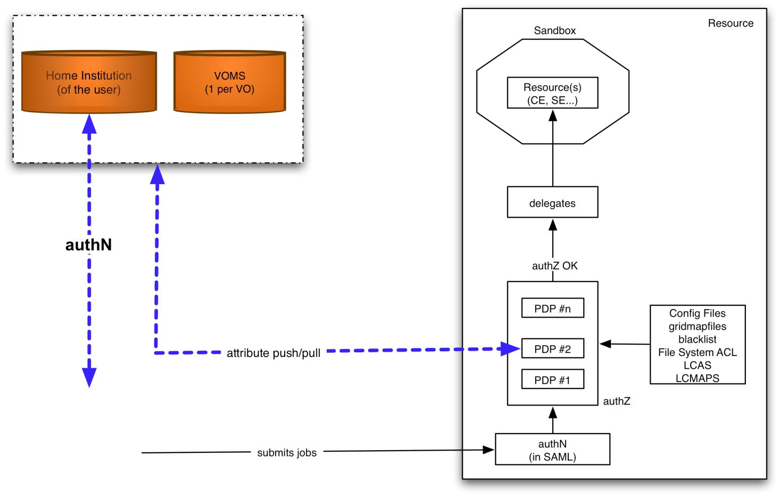

Attribute collection at the resource
graphic from: Chistoph Witzig, SWITCH, GGF16, February 2006
Characteristics
  The RP (at the decision point) knows the source of all attributes
  but has to combine these and make the ‘informed decision’
  is suddenly faced with a decision on quality from different assertions
  needs to push a kind of ‘session identifier’ to select a role at the target resource

Slide 34
Authorization Frameworks
Container versus service level
Logical authZ structure: PEP,PDP,PAP,PEP
Frameworks

Slide 35
A multi-authority world
Authorization elements (from OGSA 1.0)
Graphic: OGSA Working Group

Slide 36
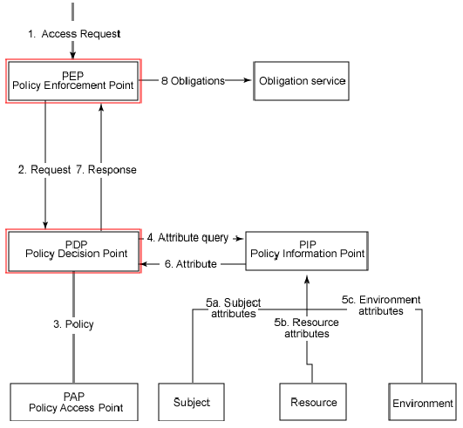
Logical Elements in authorization
“beware that translating
architecture to implementation
1:1 is a recipe for disaster ”

Slide 37
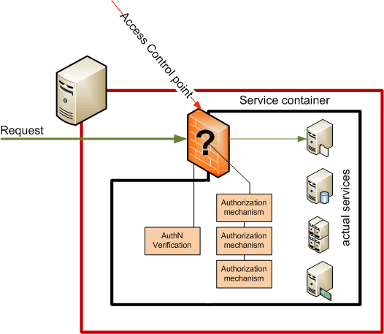
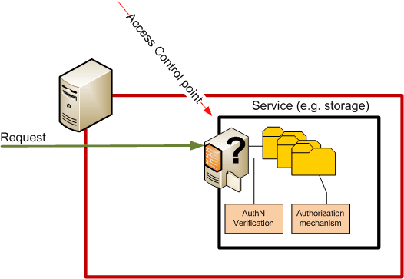
Control points
Container based
Service based
Single control point
Agnostic to service semantics
Many control points
Authorization can depend on
requested action and resource

Slide 38
Frameworks
(chain of) decision making modules controlling access
  Loosely or tightly coupled to a service or container
  Generic ‘library’, or tied into the service business logic
example: GT4
Graphic: Frank Siebenlist, Globus and ANL

Slide 39
Some framework implementations
Globus Toolkit v4 Authorization Framework
Site Access Control ‘LCAS-LCMAPS’ suite
PRIMA-SAZ-GUMS-gPlazma suite
GridSite & GACL
gLite Authorization Framework (v2), under construction
...
... but don’t forget ‘native’ service implementations
interop.
per 1/2009

Slide 40
Implementation example: LCAS
Enforcement point: service calls framework
Framework executes (PDP(s))
And renders a decision
gatekeeper.c
retval=lcas_get_fabric_authorization(user_cred_handle, lcas_lcmaps_request);
if (retval) {
failure(FAILED_AUTHORIZATION, "LCAS failed authorization.");
}
/opt/glite/etc/lcas/lcas.db
# LCAS database/plugin list
pluginname=lcas_userban.mod,pluginargs=ban_users.db
pluginname=lcas_voms.mod,pluginargs="-vomsdir/etc/grid-security/vomsdir/ ..."
/var/log/globus-gatekeeper.log
LCAS 2: LCAS authorization request
LCAS 0: lcas_userban.mod-plugin_confirm_authorization():
checking banned users in /opt/glite/etc/lcas/ban_users.db
LCAS 0: 2009-04-14.18:13:40 :
lcas_plugin_voms-plugin_confirm_authorization_from_x509():
voms plugin succeeded
LCAS 0: lcas.mod-lcas_run_va(): succeeded

Slide 41
Different frameworks
Each framework has
  own calling semantics (but may interoperate at the back)
  its own form of logging and auditing
Most provide
  Validity checking of credentials (all except ‘new’ gLite FW)
  Access control based on Subject DN and VOMS FQANs
  Subject DN banning capability
And some have specific features, e.g.,
  Capability to process arbitrary ‘XACML’ policies
  Calling out to obtain new user attributes
  Limiting the user executables, or proxy life time, ...

Slide 42
Different targets, different implementations
CA
proxy cert:
request
dn, cert, Pkey,
VOMS cred.
(short lifetime)
certificate:
dn, ca, Pkey
VOMS
certificate
user
delegation:
re-newal
VOMS cred:
cert+key
MyProxy
request
VO, group(s),
(long lifetime)
role(s)
delegation:
cert+key
proxy cert
proxy cert
(short lifetime)
proxy cert
proxy cert
proxy cert
auth
auth
auth
auth
auth
TrustManager
TrustManager
mod_ssl
GSI
GSI
authz
pre-process:
pre-process:
pre-process:
authz
WebServices Authz
parameters->
parameters->
parameters->
LCAS
dn,attrs,acl, req.op
obj.id + req. op.
obj.id + req. op.
obj.id + req. op.
dn,attrs,acl, req.op
->yes/no
->yes/no
map
map
dn -> DB role
authz
authz
authz
LCMAPS
obj.id -> acl
dn -> userid, krb ticket
dn,attrs,acl, req.op
GACL:
GACL:
->yes/no
obj.id -> acl
obj.id -> acl
doit
doit
dn,attrs,acl, req.op
dn,attrs,acl, req.op
->yes/no
->yes/no
doit
doit
doit
coarse grained
fine grained
fine grained
fine grained
coarse grained
Java
web
C

Slide 43
Which framework to use?
Unfortunately, this question has no clear answer ☹
Each service uses a particular framework
  If you want a service, have to use its chosen framework
Semantics are mostly different
However, there is progress!
There is interop if you use a central service
  Using an agreed ‘SAML2’ profile of ‘XACML2’ Req/Resp
  See the interop section later on
Let’s look at a few examples ...

Slide 44
Access Control for Compute
Example: running compute jobs
Access control: gatekeepers, gLExec, ban lists, and GACL

Slide 45
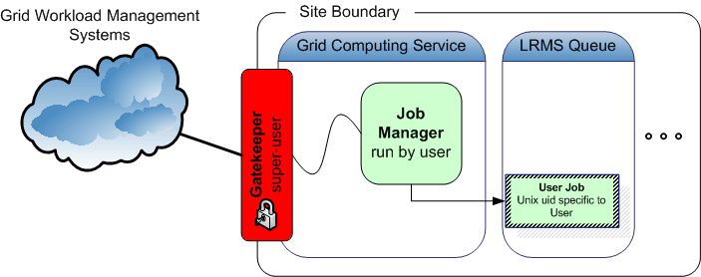
Job Submission Today
User submits his jobs to a resource through a ‘cloud’ of intermediaries
Direct binding of payload and submitted grid job
job contains all the user’s business
access control is done at the site’s edge
inside the site, the user job has a specific, site-local, system identity

Slide 46
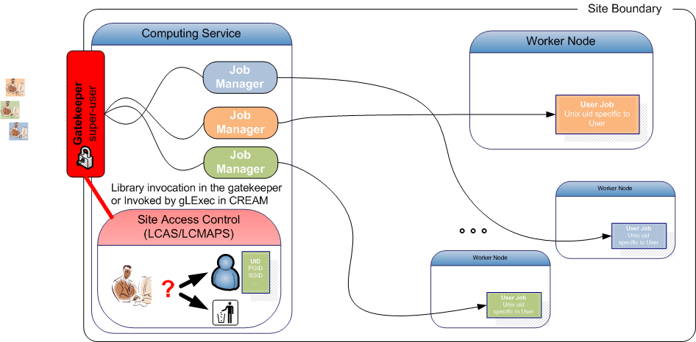
Access Control on the CE
System access, written in C, means LCAS-LCMAPS
Native or through ‘call-out hooks’ like in GT4

Slide 47
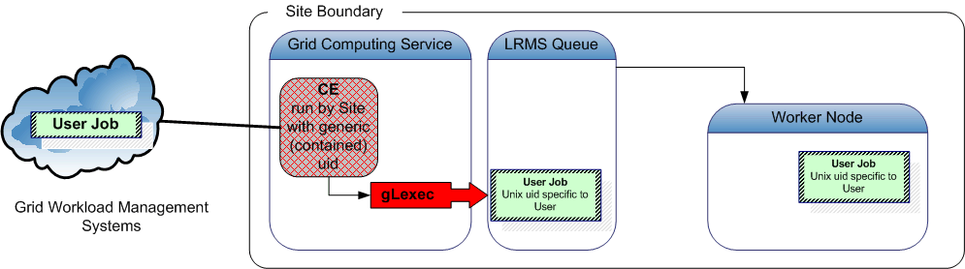

Similar services in C or using Unix
gLite ‘CREAM’ submission
  globus toolkit pre-WS GRAM in EGEE
  gLExec (via CREAM and in late-binding pilot scenarios)
  globus gridftp, gsi-openssh
  DPM (LCAS-only in new version!)
  SCAS (‘recursive’ invocation)

Slide 48
Decision attributes and obligations
Example: LCAS, the oldest - and simplest - one
Input attributes
  Submitting user certificate
  VOMS FQANs are known
  Target service is known
  Action, partially known (‘RSL’ or executable name)
Requested decisions
  Is access granted?
LCMAPS needed for obligations, i.e., the unix account

Slide 49
LCAS: basic authorization
Pluggable authorization framework in C
  Independent modules (‘shared objects’) called based on simple ‘boolean-AND’ policy description
Decisions based on
  Allowed user or VOMS FQAN list
  Deny based on a separate ‘ban’ list with wildcards
  GACL policy
  Allowed-executable (‘RSL’ matching)
  Time slots
  L&B2-policy module
http://www.nikhef.nl/grid/lcaslcmaps/

Slide 50
LCAS example
/opt/glite/etc/lcas/lcas.db
# @(#)lcas.db
pluginname=lcas_userban.mod,pluginargs=ban_users.db
pluginname=lcas_voms.mod,pluginargs="-vomsdir/etc/grid-security/vomsdir/ ..."
/opt/glite/etc/lcas/ban_users.db
# @(#)ban_users.db
/DC=org/DC=example/CN=Sherlock Holmes
/DC=gov/DC=somelab/OU=CDF/CN=*
only DN c.q. FQAN used from ... /etc/grid-security/grid-mapfile
"/O=dutchgrid/O=users/O=nikhef/CN=David Groep" .pvier
"/O=dutchgrid/O=users/O=nikhef/CN=Oscar Koeroo" okoeroo "/C=AT/O=AustrianGrid/OU=UIBK/OU=OrgUnit/CN=Name Suppressed" .esr
"/vlemed/Role=NULL/Capability=NULL" .vlemed
"/vlemed" .vlemed
"/vo.gear.cern.ch/Role=NULL/Capability=NULL" .poola
"/vo.gear.cern.ch" .poola
"/vo.gear.cern.ch/Role=lcgadmin/Capability=NULL" .troi
"/vo.gear.cern.ch/Role=lcgadmin" .troi

Slide 51
But notably different
gLite WMS
  Uses GACL libraries directly and exclusively
Storage access control, e.g. DPM
  Has built-in native handing of groups via POSIX ACLs expressed as VOMS FQANs
Native GT4 pre-WS-GRAM and GridFTP
  Has only a static DN map file
  Unless configured to use LCAS-LCMAPS or PRIMA-GUMS
…

Slide 52
gLite WMS access control: GACL
/opt/glite/etc/ glite_wms_wmproxy.gacl
<gacl version="0.0.1">
<entry>
<voms>
<fqan>lofar/ROLE=admin</fqan>
</voms>
<allow><exec/></allow>
</entry>
...
<entry>
<voms>
<fqan>lsgrid</fqan>
</voms>
<allow><exec/></allow>
</entry>
<entry>
<person>
<dn>/DC=org/DC=example/O=HEP/O=PKU/OU=PHYS/CN=Some Person</dn>
</person>
<deny><exec/></deny>
</entry>
</gacl>
GridSite and LCAS can do GACL as well, though ...

Slide 53
GUMS access control
GUMS is a central-service only mapping service
Database with a ‘site’ dump of the VO membership
Tools to manipulate that database
e.g. banning a user or a VO
please hold for a central service based on LCAS-LCMAPS...
https://twiki.grid.iu.edu/bin/view/Security/GUMS--DevelopmentandAdditions
# an individual that is not a VO member
/DC=org/DC=doegrids/OU=People/CN=Jay Packard 335585,
# an invidual from any VO
/DC=org/DC=doegrids/OU=People/CN=Jay Packard 335585, .*
# or an individual from the Atlas production role
/DC=org/DC=doegrids/OU=People/CN=Jay Packard 335585, //atlas/usatlas/Role=production.*

Slide 54
To the Unix world
Credential mapping
Running jobs
Long-running jobs and MyProxy
Addressing late-binding with gLExec

Slide 55
To the Unix world: Problem
C=IT/O=INFN
/L=CNAF
/CN=Pinco Palla
/CN=proxy
(X509, VOMS)
/dc=org/dc=example/CN=John Doe
grid identity
VOMS
pseudo-cert
translate
pvier001:x:43401:2029:PoolAccount VL-e P4 no.1:/home/pvier001:/bin/sh
Unix does not talk Grid, so
translation is needed between grid and local identity
this translation has to happen somewhere
something needs to do that

Slide 56
To the Unix world: LCMAPS
LCMAPS
Again a pluggable framework
  Separated in two phases, since
  #1 may require ‘root’ privileges,
  that a plug-in in #2 might drop
  Acquisition
  collect attributes and obligations
  Enforcement
  make all obligations honoured
  interact with local unix system
Modules are shared objects
Credential
Acquisition
Service (GK, GridFTP, …)
& Enforcement
CREDs
http://www.nikhef.nl/grid/lcaslcmaps/

Slide 57
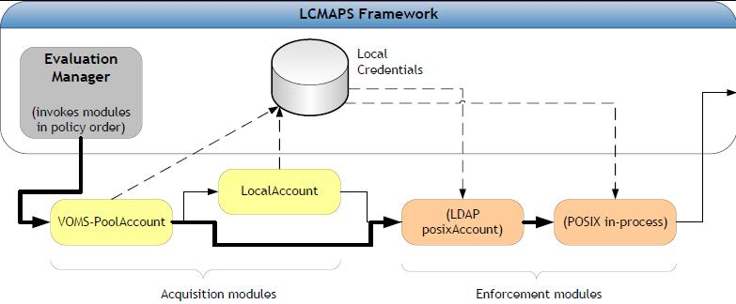
LCMAPS modules
Acquisition
(voms)local{account,group}, (voms)pool{account,group}, GUMS, verify-proxy, scas-client
Enforcement
posix_enf, ldap_enf, afs, jobRepository

Slide 58
LCMAPS configuration example
/opt/glite/etc/lcmaps/lcmaps-scas.db
# LCMAPS config file for glexec generated by YAIM
vomslocalgroup = "lcmaps_voms_localgroup.mod ...“
vomslocalaccount = "lcmaps_voms_localaccount.mod ...“
vomspoolaccount = "lcmaps_voms_poolaccount.mod ...“
localaccount = "lcmaps_localaccount.mod"
" -gridmapfile /etc/grid-security/grid-mapfile“
poolaccount = "lcmaps_poolaccount.mod"
" -override_inconsistency"
" -gridmapfile /etc/grid-security/grid-mapfile"
" -gridmapdir /share/gridmapdir"
good = "lcmaps_dummy_good.mod“
# Policies: DN-local -> VO-static -> VO-pool -> DN-pool
static_account_mapping:
localaccount -> good
voms_mapping:
vomslocalgroup -> vomslocalaccount
vomslocalaccount -> good | vomspoolaccount
classic_poolaccount:
poolaccount -> good
Policy sequence depends on the service!

Slide 59
Long Running Jobs
MyProxy
Renewal daemons
What About VOMS

Slide 60
MyProxy in EGEE
EGEE security based on proxy certificates
  often carrying VOMS attribute certificates
MyProxy used for several purposes:
  Solution for portals (P-GRADE, Genius)
    a common way of using MyProxy
  Long-running jobs and data transfers
    credential renewal
http://myproxy.ncsa.uiuc.edu/
Slides based on: Ludek Matyska and Daniel Kouril, CESNET

Slide 61
Long-running Jobs
Jobs require valid credentials
  e.g. to access GridFTP data repositories on the user‘s behalf
  these operations must be secured, using the users‘ credentials
Job's lifetime can easily exceed the lifetime of a proxy
  consider waiting in the queues, possible resubmissions, computation time, data transfers, etc.
  also VOMS certificates have limited lifetime
Impossible to submit a job with sufficiently long credentials
  the overall job lifetime not known in advance
  violation of the meaning of short-time proxies
  increased risk when the credential is stolen
  might be unacceptable for the end resources
How to provide jobs with a valid short-lived credential throughout their run?
Slides based on: Ludek Matyska and Daniel Kouril, CESNET

Slide 62
Proxy Renewal Service
Periodical renewal of credentials
  maintains a list of jobs' proxy certificates to be kept valid
  using MyProxy repository
    server specified by user in the job description
    uses the renewal mode
    authenticates using the WMS credential AND authorizes using the proxy being renewed
  Support for renewal of VOMS attributes
Part of the broker node (WMS)
  A proxy of a job is registered upon submission
  It is renewed whenever it is going to expire
    several attempts done until renewal succeeds
  After renewal a new proxy is pushed to the computing resource, where the job is running
  After the job completion the proxy is unregistered
Slides based on: Ludek Matyska and Daniel Kouril, CESNET

Slide 63
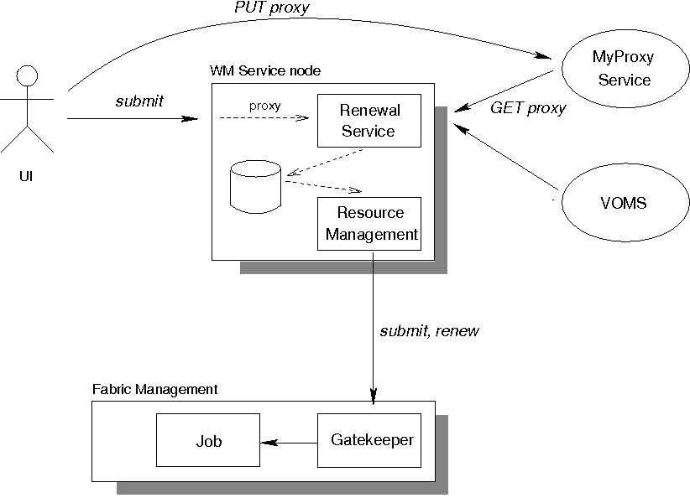
Proxy Renewal Service
Slides based on: Ludek Matyska and Daniel Kouril, CESNET

Slide 64
Proxy Renewal Service
Ensures that jobs always have a valid short-time proxy
Users have full control over their proxies and renewal
  Using the MyProxy repository
Support for VOMS
All operations are logged
  allows an audit
Stolen credentials can't be renewed easily
  the WMS credential are necessary for renewal
An older (still valid) proxy must be available for renewal
  reduces the risk when services are compromised
Developed in EU Datagrid, in production use in EGEE
Slides based on: Ludek Matyska and Daniel Kouril, CESNET

Slide 65
MyProxy and Trust Establishment
Relationship between MyProxy and its client is crucial
  clients must be authorized to access the repository
So far trust based on a static configuration
  each service and client must be listed
  regular expressions aren‘t sufficient
  a subject name of a service must be added on each change or addition
VOMS support introduced recently
  generated by needs of EGEE
  allows to specify VOMS attributes (roles, groups) instead of specifying identity
  requires adding service certificates to VOMS machinery
Slides based on: Ludek Matyska and Daniel Kouril, CESNET

Slide 66
Late binding
Pilot jobs
Impact on sites

Slide 67
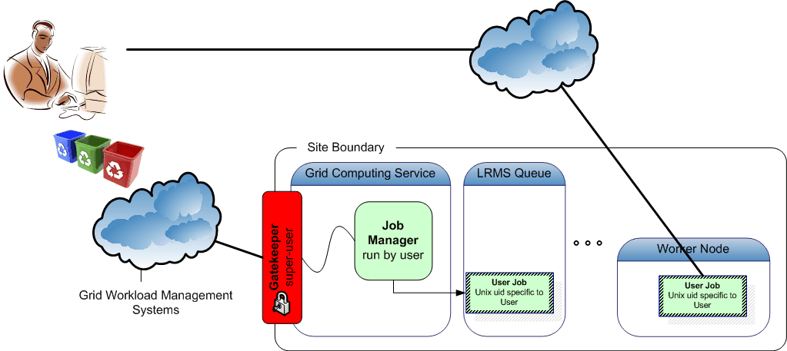
Binding Late
user’s system for
job management
job container binds to actual workload
Late binding of work load using ‘pilot jobs’
generic job containers are sent, which can verify the ‘surroundings’
retrieve payload from a repository ‘elsewhere’
if the repository is run by the user, on a per-user bases,
then it is likely that it’s the users’ payload – if communication is secure

Slide 68
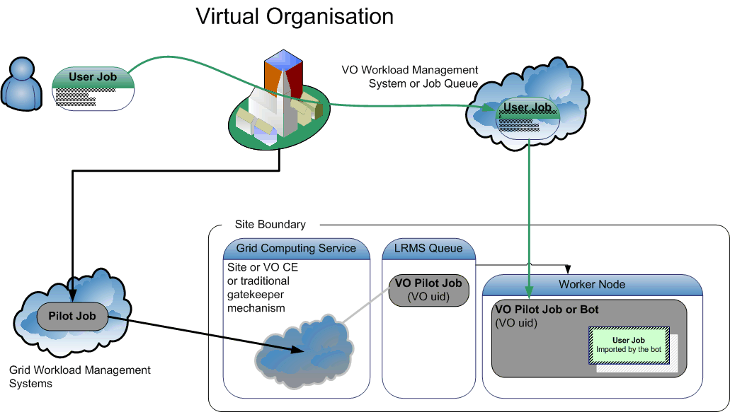
Multi-User Pilot Jobs
What if the user ‘outsources’ the running of the pilot jobs?
then whoever runs the pilot jobs, will run workload for multiple users
but the site only grants access to the ‘service provider’ (VO) …

Slide 69
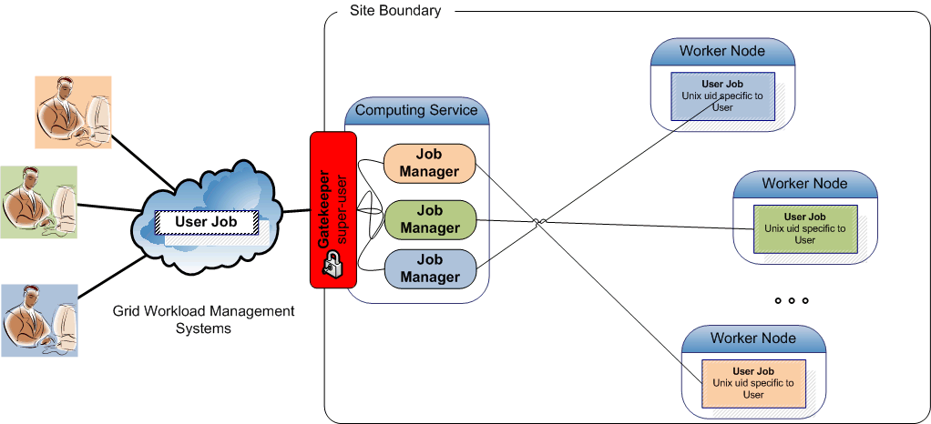
Pushing access control downwards
Classic model

Slide 70
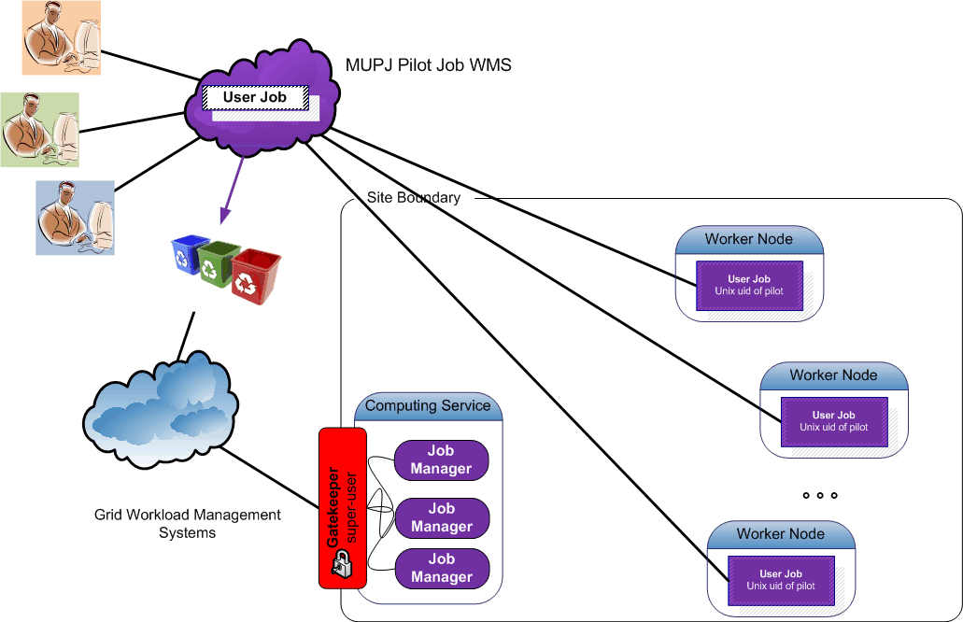
Pushing access control downwards
Multi-user pilot jobs hiding in the classic model

Slide 71
MUPJ security issues
With multi users use a common pilot job deployment Users, by design, will use the same account at the site
Accountability
no longer clear at the site who is responsible for activity
Integrity
a compromise of any user using the MUPJ framework ‘compromises’ the entire framework
the framework can’t protect itself against such compromise
unless you allow change of system uid/gid
Site access control policies are ignored
… and several more …

Slide 72
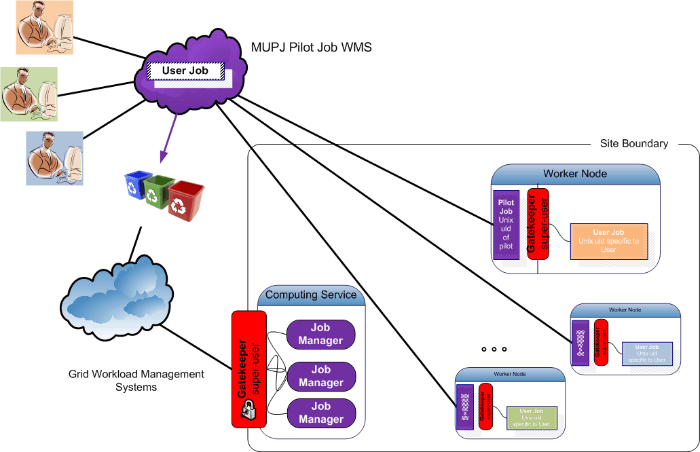
Pushing access control downwards
Making multi-user pilot jobs explicit with distributed
Site Access Control (SAC)
- on a cooperative basis -

Slide 73
Implementing distributed SAC
Component 1: gLExec
a thin layer
to change Unix domain credentials
based on grid identity and attribute information
you can think of it as:
‘a replacement for the gatekeeper’
‘a griddy version of Apache’s suexec’
‘a program wrapper around LCAS, LCMAPS or GUMS’

Slide 74
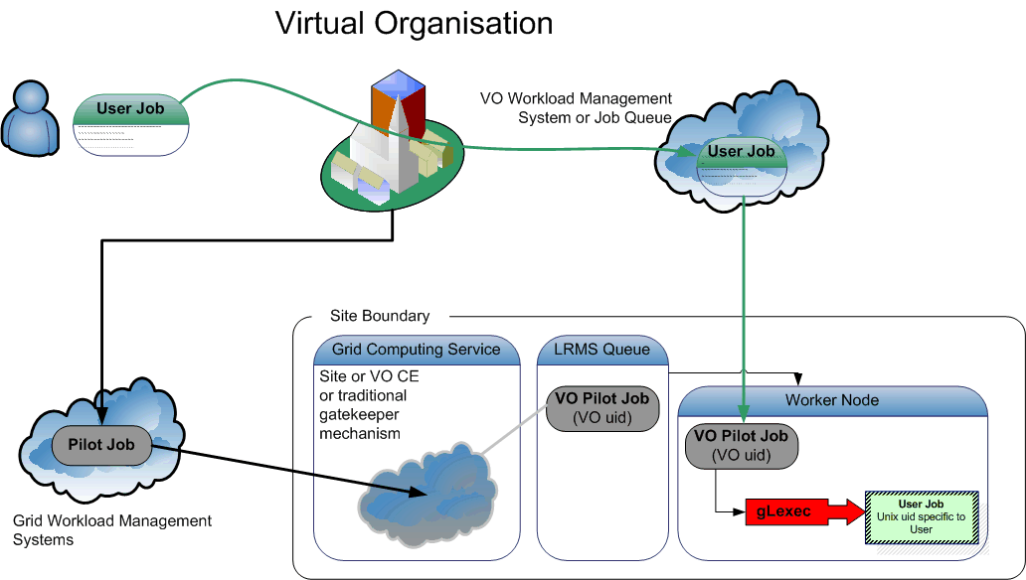
Pilot Jobs and gLExec
On success: gLExec will set the uid/gid to the new user’s job and execute it
On failure: gLExec returns with an error, and pilot job can terminate or obtain other user’s job

Slide 75
gLExec deployment modes
Identity Mapping Mode – ‘just like on the CE’
  have the VO query (and by policy honour) all site policies
  actually change uid based on the true user’s grid identity
  enforce per-user isolation and auditing using uids and gids
  requires gLExec to have setuid capability
Non-Privileged (‘Logging Only’) Mode – declare only
  have the VO query (and by policy honour) all site policies
  do not actually change uid: no isolation or auditing per user
  the gLExec invocation will be logged, with the user identity
  does not require setuid powers – job keeps running in pilot space
‘Empty Shell’ – do nothing but execute the command…

Slide 76
Identity change
Let’s assume you make it setuid. Fine. Where to map to:
To a shared set of common pool accounts
  Uid and gid mapping on CE corresponds to the WN
  Requires SCAS or shared state (gridmapdir) directory
  Clear view on who-does-what
To a per-WN set of pool accounts
  No site-wide configuration needed
  Only limited (and generic) set of pool uids on the WN
  Need only as many pool accounts as you have job slots
  Makes cleanup easier, ‘local’ to the node
Or something in between ... e.g. 1 pool for CE other for WN
But if it is not setuid, it cannot isolate & protect the pilot.

Slide 77
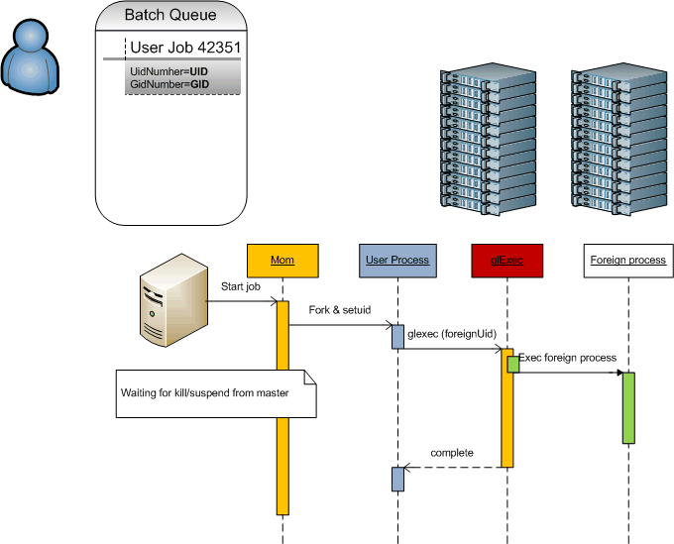
Batch system and OS compatibility
How does gLExec affect the basic functions of a batch system?
Job Submission
Job Suspend/Resume
Job Kill
CPU time accounting
  No change with respect
  to current behaviour of jobs
  Times are accumulated
  on wait and
  collated with the gLExec usage
by keeping the process tree,
gLExec is transparent for the
tested batch systems
tests based on work by Ulrich Schwickerath

Slide 78
But all pieces should go together
glexec on the worker-node deployment
way to keep the pilot jobs submitters to their word
  mainly: monitor for compromised pilot submitters credentials
  system-level auditing of the pilot jobs,
  but auditing data on the WN is useful for incident investigations only
‘internal accounting should be done by the VO’
  the regular site accounting mechanisms are via the batch system, and these will see the pilot job identity
  the site can easily show from those logs the usage by the pilot job
  making a site do accounting based glexec jobs is non-standard,
  and requires non-trivial effort

Slide 79
Towards Central Control
Centralizing Authorization in the site in gLite today
GUMS and SAZ: long time experience
Interoperability through common protocols

Slide 80
What Happens to Access Control?
So, as the workload binding get pushed deeper into the site,
access control by the site has to become layered as well …
… how does that affect site access control software
and its deployment ?

Slide 81
Site Access Control today
PRO already deployed
no need for external components, amenable to MPI
CON when used for MU pilot jobs, all jobs run with a single identity
end-user payload can back-compromise pilots, and cross-infect other jobs
incidents impact large community (everyone utilizing the MUPJ framework)

Slide 82
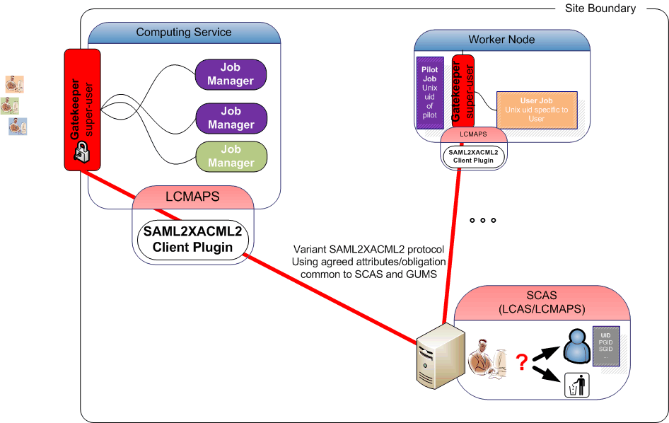
Site-central access control
* of course, central policy and distributed
per-WN mapping also possible!
PRO single unique account mapping per user across whole farm, CE, and SE*
can do instant banning and access control in a single place
protocol profile allows interop between SCAS and GUMS (but no others!)
CON replicated setup for redundancy needed for H/A needs more boxes
cannot yet do credential validation (formalistic issues with the protocol)

Slide 83
Centralizing decentralized SAC
Supporting consistent
policy management
mappings (if the are not WN-local)
banning
via the
Site Central Authorization Service SCAS
  network wrapper around LCAS and LCMAPS
  it’s a variant-SAML2XAML2 client-server
  it is itself access controlled

Slide 84
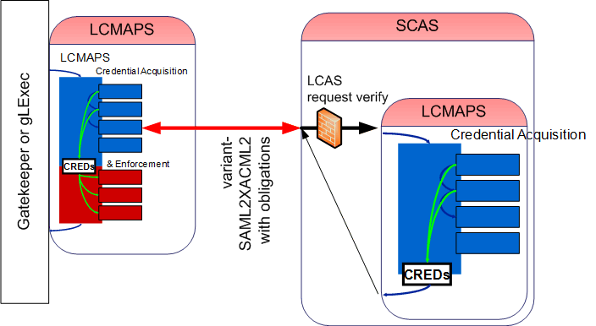
SCAS: LCMAPS in the distance
Application links LCMAPS dynamically or statically, or includes Prima client
Local side talks to SCAS using a variant-SAML2XACML2 protocol
- with agreed attribute names and obligation between EGEE/OSG
- remote service does acquisition and mappings
- both local, VOMS FAQN to uid and gids, etc.
Local LCMAPS (or application like gLExec) does the enforcement

Slide 85
Talking to SCAS
From the CE
  Connect to the SCAS using the CE host credential
  Provide the attributes & credentials of the service requester, the action (“submit job”) and target resource (CE) to SCAS
  Using common (EGEE+OSG+GT) attributes
  Get back: yes/no decision and uid/gid/sgid obligations
From the WN with gLExec
  Connect to SCAS using the credentials
  of the pilot job submitter
  An extra control to verify the invoker of gLExec
  is indeed an authorized pilot runner
  Provide the attributes & credentials of the service requester, the action (“run job now”) and target resource (CE) to SCAS
  Get back: yes/no decision and uid/gid/sgid obligations
The obligations are now coordinated between CE and WNs

Slide 86
Interoperability Now: inside the site
authz-interop.org
Harmonizing the internal semantics: XACML2-SAML2
Common protocol and common attributes
It works today!

Slide 87
EGEE scenario ‘today’
VO
PDP
Grid
Site
Site Services
VO Services
SCAS
VOMRS
synch
VOMS
2
Is Auth?
ID Map?
Yes / No
UID/GID
1
5
register
PEPs
3
SE
CE
WN
get voms-proxy
SRM
Gatekeeper
gLExec
gPlazma
SCAS Clnt.
SCAS Clnt.
4
Submit request
with voms-proxy
Pilot SU
Job
(UID/GID)
8
Access
Data
(UID/GID)
Submit
Pilot OR Job
(UID/GID)
Schedule
Pilot OR Job
6
6
Batch
System
Storage
Legend
7
AuthZ
Components
VO Management
Services

Slide 88
OSG Authorization Infrastructure
A Common Protocol
for OSG and EGEE
integrated with
the GT
VO
PDP
Grid
Site
Site Services
VO Services
GUMS
SAZ
VOMRS
synch
VOMS
synch
2
3
7
6
ID Mapping?
Yes / No +
UserName
Is Auth?
Yes / No
1
register
PEPs
4
SE
CE
WN
get voms-proxy
SRM
Gatekeeper
gLExec
gPlazma
Prima
Prima
5
Submit request
with voms-proxy
Pilot SU
Job
(UID/GID)
10
Access
Data
(UID/GID)
Submit
Pilot OR Job
(UID/GID)
Schedule
Pilot OR Job
8
8
Batch
System
Storage
Legend
9
AuthZ
Components
Not Officially
In OSG
VO Management
Services

Slide 89
What did we start with?
GUMS and PRIMA using proprietary SAML1 based protocol
SAZ (authorization service)
GT3, GT4 ‘authz callout’ for PRIMA by Markus Lorch
LCAS/LCMAPS
gLExec
gPlazma
Not only used GUMS and the ‘EGEE’ a different logical model of dealing with attributes and authorization (local VOMS dumps vs. VOMS attribute push)
Also, the services build in one ecosystem (e.g. ‘EGEE’) could not be used in the other (‘OSG’) → hacks and double work

Slide 90
Aims of the authz-interop project
Provide interoperability within the authorization infrastructures of OSG, EGEE, Globus and Condor
See www.authz-interop.org
Through
Common communication protocol
Common attribute and obligation definition
Common semantics and
actual interoperation of production system
So that services can use either framework
and be used in both infrastructures

Slide 91
Two Elements for interop
Common communications profile
  Agreed on use of SAML2-XACML2
  http://www.switch.ch/grid/support/documents/xacmlsaml.pdf
Common attributes and obligations profile
  List and semantics of attributes sent and obligations received between a ‘PEP’ and ‘PDP’
  Now at version 1.1
  http://cd-docdb.fnal.gov/cgi-bin/ShowDocument?docid=2952
  http://edms.cern.ch/document/929867

Slide 92
Profile in a nutshell
Existing standards:
  XACML defines the XML-structures that are exchanged with the PDP to communicate the security context and the rendered authorization decision.
  SAML defines the on-the-wire messages that envelope XACML's PDP conversation.
The Authorization Interoperability profile augments those standards:
  standardize names, values and semantics for common-obligations and core-attributes such that our applications, PDP-implementations and policy do interoperate.
  Subject S requests to perform Action A on Resource R within Environment E
CE / SE / WN
XACML Request
Site Services
Gateway
PDP
PEP
XACML Response
Grid Site
  Decision Permit, but must fulfill Obligation O

Slide 93
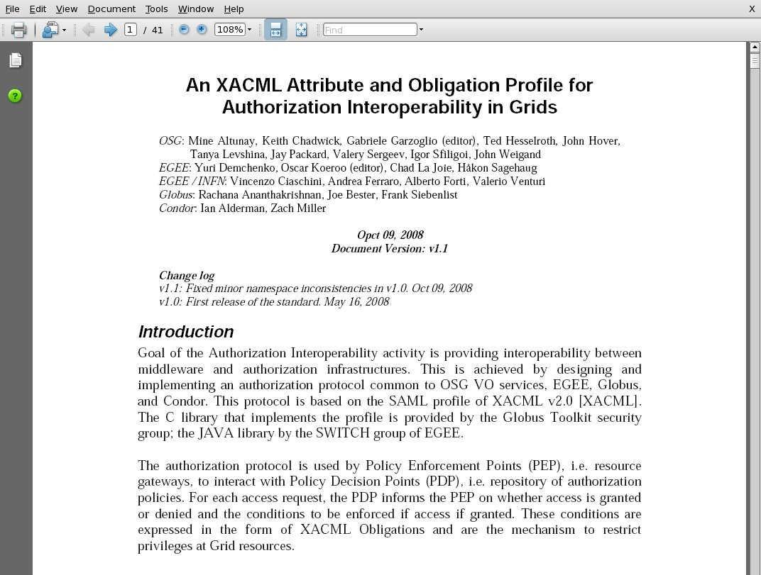
An XACML AuthZ Interop Profile
Authorization Interoperability Profile based on the SAML v2 profile of XACML v2
Result of a 1yr collaboration between OSG, EGEE, Globus, and Condor
Releases:
  v1.1 → 10/09/08 v1.0 → 05/16/08

Slide 94
Structure of the AuthZ Interop Profile
Namespace prefix: http://authz-interop.org/xacml
Request Attribute Identifiers
Subject: <ns-prefix>/subject/<subject-attr-name>
Action: <ns-prefix>/action/<action-attr-name>
Resource: <ns-prefix>/resource/<resource-attr-name>
Environment: <ns-prefix>/environment/<env-type>
Obligation Attribute Identifiers
ObligationId: <ns-prefix>/obligation/<obligation-name>
AttributeId: <ns-prefix>/attributes/<obligation-attr-name>

Slide 95
Most Common Request attributes
Subject (see profile doc for full list)
  Subject-X509-id
    String: OpenSSL DN notation
  Subject-VO
    String: “CMS”
  VOMS-FQAN
    String: “/CMS/VO-Admin”
Resource (see doc for full list)
  Resource-id (enum type)
    CE / SE / WN
  Resource X509 Service Certificate Subject
    resource-x509-id
  Host DNS Name
    Dns-host-name
Action
  Action-id (enum type)
    Queue / Execute-Now / Access (file)
  Res. Spec. Lang.
    RSL string
Environment
  PEP-PDP capability negot.
    PEP sends to PDP supported Obligations
    Enables upgrading of the PEPs and PDPs independently
  Pilot Job context (pull-WMS)
    Pilot job invoker identity
    Policy statement example: “User access to the WN execution environment can be granted only if the pilot job belongs to the same VO as the user VO”
see document for all attributes and obligations

Slide 96
Most Common Obligation Attributes
UIDGID
  UID (integer): Unix User ID local to the PEP
  GID (integer): Unix Group ID local to the PEP
Secondary GIDs
  GID (integer): Unix Group ID local to the PEP (Multi recurrence)
Username
  Username (string): Unix username or account name local to the PEP.
Path restriction
  RootPath (string): a sub-tree of the FS at the PEP
  HomePath (string): path to user home area (relative to RootPath)
Storage Priority
  Priority (integer): priority to access storage resources.
Access permissions
  Access-Permissions (string):
  “read-only”, “read-write”
see document for all attributes and obligations

Slide 97
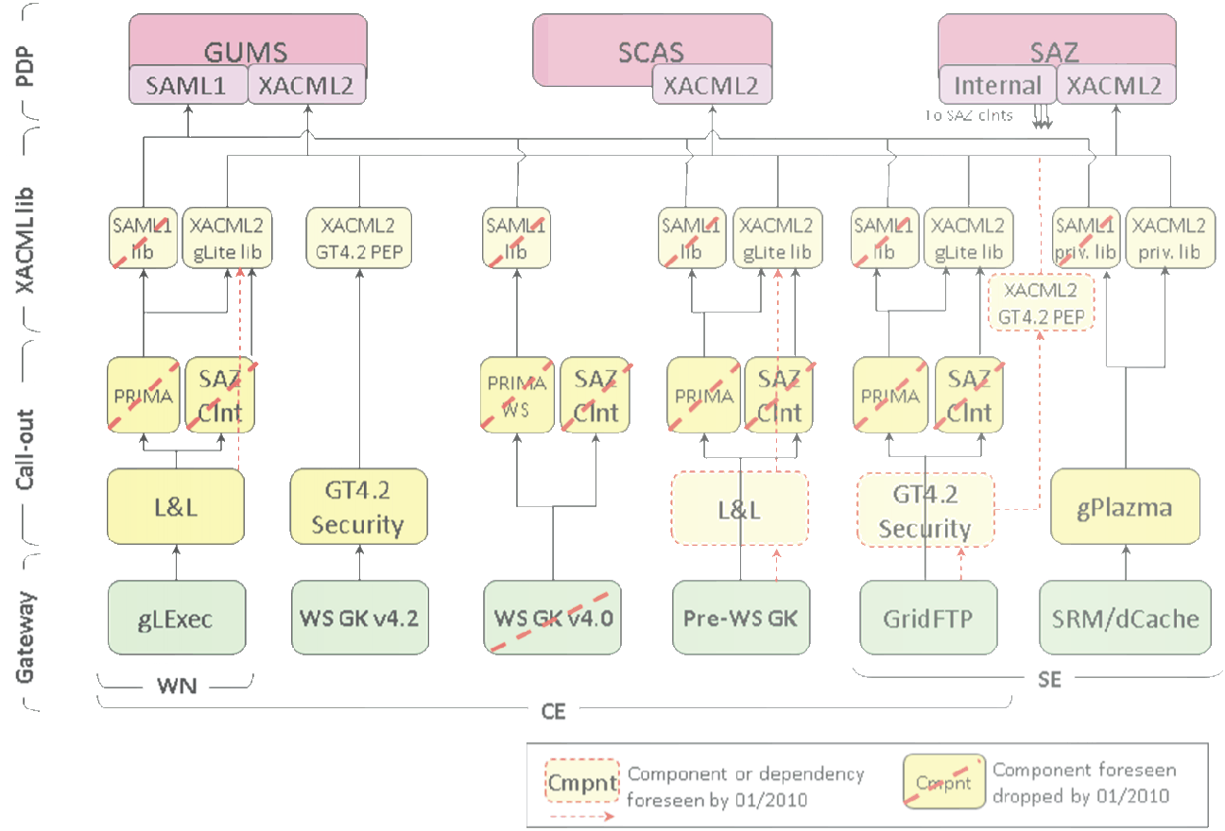
Full interoperability

Slide 98
What has been achieved now
All profiles written and implemented
Common libraries available in Java and C implementing the communications protocol
Common handlers for
Joint Interoperable Attribute and Obligations
Integrated in all relevant middleware in EGEE and OSG:
  Clients: lcg-CE (via LCMAPS scasclient), CREAM and gLExec (ditto),
  GT pre-WS gram (both prima and LCMAPS), GT GridFTP,
  GT4.2 WS-GRAM, dCache/SRM
  Servers: GUMS, SCAS
Other (lower-prio) components in progress
  SAZ, RFT, GT4.x native-AuthZ, Condor (& -G), BeStMan

Slide 99
OSG Integration Test Results
Component | Test | PDP Component
 |  | Old GUMS | New GUMS | SCAS
WS-Gatekeeper (Out of Scope) | Test call-out component | NO | YES | YES
 | Run job w/o Delegation or File Transfer | NO | YES | out of scope
 | Run job with Delegation and File Transfer | NO | YES | out of scope
SCAS / PRIMA cmd line tool (OOS) | AuthZ call via Legacy protocol call-out | YES | YES | NO
 | AuthZ call via XACML protocol call-out | NO | YES | YES
Pre-WS Gatekeeper (VTB-TESTED) | Run job. AuthZ via Legacy protocol | YES | YES | NO
 | Run job. AuthZ via XACML protocol | NO | YES | YES
GridFTP (VTB-TESTED) | Transfer file. AuthZ via Legacy protocol | YES | YES | NO
 | Transfer file. AuthZ via XACML protocol | NO | YES | YES
gLExec (REL. Jan 20) | Run pilot job. AuthZ via Legacy protocol | YES | YES | NO
 | Run pilot job. AuthZ via XACML protocol | NO | YES | YES
SRM/dCache gPlazma (REL. Jan 20) | Transfer file. AuthZ via Legacy protocol | YES | YES | NO
 | Transfer file. AuthZ via XACML protocol | NO | YES | YES

Slide 100
Latest news
dCache v1.9.2-4 has been released
Pre-release tests have been conducted successfully against GUMS and SCAS.
Will be the recommended release in a few months
Development of native authz XACML call-out module for GridFTP: tests with the Globus Toolkit call-out module for authorization speaking the interop protocol started

Slide 101
Participants
EGEE
VO Services (‘Privilege’) Project
Globus
Condor
VDT (OSG)
Joint development and definition effort 2007 until early 2009
In production phase as of mid 2008
Institutes:
ANL, BCCS, BNL, FNAL, INFN, Nikhef, Switch, UvA, UWMadison

Slide 102
Data Storage
Access Control semantics
Breakdown of the container model
Legacy forever: mapping grid storage onto Unix semantics
The DPM model

Slide 103
Storage: Access Control Lists
Catalogue level
  protects access to meta-data
  is only advisory for actual file access
  unless the storage system only accepts connections from a trusted agent that does itself do a catalogue lookup
SE level
  either natively (i.e. supported by both the SRM and transfer services)
SRM/transfer level
  SRM and GridFTp server need to lookup in local ACL store for each transfer
  need “all files owned by SRM” unless underlying FS supports ACLs
OS level?
  native POSIX-ACL support in OS would be needed
  Mapping would still be requires (as for job execution)

Slide 104
Grid ACL considerations
Semantics
  Posix semantics require that you traverse up the tree to find all constraints
  behaviour both costly and possibly undefined in a distributed context
  VMS and NTFS container semantics are self-contained
  taken as a basis for the ACL semantics in many grid services
ACL syntax & local semantics typically Posix-style

Slide 105
‘Container abstraction’ breakdown
database consistency
graphic: Ann Chervenak, ISI/USC, from presentation to the Design Team, Argonne, 2005

Slide 106
Embedded access control: dCache
voms-proxy-init
Proxy with VO
Membership | Role attributes
srmcp
DATA
SAML2XACML2
interop protocol
GUMS, SCAS, &c
SRM Server
DATA
GridFTP
Server
SRM-dCache
GridFTP
Callout
SAML response
User Authorization
Record
gPLAZMA
PRIMA SAML Client
Storage Authorization Service
Storage metadata
https/SOAP
SRM Callout
SAML query
Get storage authz for this username
gPLAZMALite Authorization Service
If authorized,
get username
gPLAZMALite grid-mapfile
GUMS
Identity Mapping
Service
dcache.kpwd
Graphic: Frank Wurthwein, CHEP2006 Mumbai

Slide 107
Legacy persists, though
dCache/gPlazma maps back to
  Unix username
  ‘root path’
Files stored
with Unix uid and gid
  Can have local access!
  But doing VOMS-based ACLs
  over simple Unix ACLs
  results in
  a combinatorial group explosion
SAML response
User Authorization
Record
Storage Authorization Service
Storage metadata
https/SOAP
SAML query
Get storage authz for this username
If authorized,
get username
GUMS
Identity Mapping
Service

Slide 108
Grid storage access control
Use ‘grid’ identity and attributes to define ACLs
With ‘POSIX’ semantics
  So traversal based, not object based
  Needs ‘good’ database schema to store ACLs&metadata
Example: DPM “Disk Pool Manager”
  See
  https://twiki.cern.ch/twiki/bin/view/EGEE/GliteDPM

Slide 109
DPM Architecture
Grid Client
Data Server
Name Server
RFIO Client
RFIO Daemon
Disk System
NS Daemon
NS Database
Gridftp Client
Gridftp Server
RFIO Client
Disk Pool Manager
DPM Daemon
Request Daemon
SRM Server
SRM Client
SRM Daemon
DPM Database
Slides and graphics: ‘ACLs in Light Weight Disk Pool Manager’ MWSG 2006, Jean Philippe Baud, CERN

Slide 110
DPM File Catalog Schema
File Metadata
User Metadata
Logical File Name (LFN)
GUID
System Metadata (Ownership,
Size, Checksum, ACL)
User Defined Metadata
File Replica
Symlinks
Storage File Name
Storage Host
Link Name
LFN acts as main key in Database. Has:
  Unique Identifier (GUID)
  Information on Physical Replicas
  Symbolic Links to it
  A small amount (one field) of user attached metadata
Slides and graphics: ‘ACLs in Light Weight Disk Pool Manager’ MWSG 2006, Jean Philippe Baud, CERN

Slide 111
Virtual Ids and VOMS integration
DNs are mapped to virtual UIDs: the virtual uid is created on the fly the first time the system receives a request for this DN (no pool account)
VOMS roles are mapped to virtual GIDs
A given user may have one DN and several roles, so a given user may be mapped to one UID and several GIDs
Currently only the primary role is used in LFC/DPM
Support for normal proxies and VOMS proxies
Administrative tools available to update the DB mapping table:
  To create VO groups in advance
  To keep same uid when DN changes
  To get same uid for a DN and a Kerberos principal
Slides and graphics: ‘ACLs in Light Weight Disk Pool Manager’ MWSG 2006, Jean Philippe Baud, CERN

Slide 112
DPNS mapping tables
CREATE TABLE Cns_groupinfo (
gid NUMBER(10),
groupname VARCHAR2(255));
CREATE TABLE Cns_userinfo (
userid NUMBER(10),
username VARCHAR2(255));
included in GridFTP through ‘dli’ plugin mechanism,
and in SRM through call-outs to dpns
Slides and graphics: ‘ACLs in Light Weight Disk Pool Manager’ MWSG 2006, Jean Philippe Baud, CERN

Slide 113
Access Control Lists
LFC and DPM support Posix ACLs based on Virtual Ids
  Access Control Lists on files and directories
  Default Access Control Lists on directories: they are inherited by the sub-directories and files under the directory
Example
  dpns-mkdir /dpm/cern.ch/home/dteam/jpb
  dpns-setacl -m d:u::7,d:g::7,d:o:5 /dpm/cern.ch/home/dteam/jpb
  dpns-getacl /dpm/cern.ch/home/dteam/jpb
  # file: /dpm/cern.ch/home/dteam/jpb
  # owner: /C=CH/O=CERN/OU=GRID/CN=Jean-Philippe Baud 7183
  # group: dteam
  user::rwx
  group::r-x #effective:r-x
  other::r-x
  default:user::rwx
  default:group::rwx
  default:other::r-x
Slides and graphics: ‘ACLs in Light Weight Disk Pool Manager’ MWSG 2006, Jean Philippe Baud, CERN

Slide 114
Specialised Middleware
Hydra distributed key store
SSSS

Slide 115
Encrypted Data Storage
Medical community as the principal user
large amount of images
privacy concerns vs. processing needs
ease of use (image production and application)
Strong security requirements
anonymity (patient data is separate)
fine grained access control (only selected individuals)
privacy (even storage administrator cannot read)
Described components are under development
Slides based on Akos Frohner, EGEE and CERN

Slide 116
Building Blocks
Hospitals:
  DICOM = Digital Image and COmmunication in Medicine
Grid: SE = SRM + gridftp + I/O
  and a client (application processing an image)
  Goal: data access at any location
gridftp
SRM
I/O
DICOM
SE
Slides based on Akos Frohner, EGEE and CERN

Slide 117
Exporting Images
“wrapping” DICOM :
  anonymity: patient data is separated and stored in AMGA
  access control: ACL information on individual files in SE (DPM)
  privacy: per-file keys
    distributed among several Hydra key servers
    fine grained access control
Image is retrieved from DICOM and processed to be “exported” to the grid.
AMGA
metadata
Hydra
KeyStore
Hydra
KeyStore
Hydra
KeyStore
gridftp
patient data
keys
trigger
SRMv2
image
file ACL
I/O
DICOM
DICOM-SE
Slides based on Akos Frohner, EGEE and CERN

Slide 118
Accessing Images
image ID is located by AMGA
key is retrieved from the Hydra key servers (implicitly)
file is accessed by SRM (access control in DPM)
data is read and decrypted block-by-block
in memory only (GFAL and hydra-cli)---> useful for all
Still to be solved:
ACL synchronization among SEs
Hydra
KeyStore
Hydra
KeyStore
AMGA
metadata
Hydra
KeyStore
gridftp
2. keys
1. patient look-up
SRMv2
3. get TURL
GFAL
image
I/O
4. read
DICOM
DICOM-SE
Slides based on Akos Frohner, EGEE and CERN

Slide 119
Hydra key store theory, and SSSS
Keys are split for security and reliability reasons using Shamir's Secrect Sharing Scheme (org.glite.security.ssss)
  standalone library and CLI
  modified Hydra service and Hydra client library/CLI
  the client contacts all services for key registration, retrieval and to change permissions
    there is no synchronization or transaction coordinator service
$ glite-ssss-split-passwd -q 5 3 secret
137c9547aba101ef 6ee7adbbaacac1ef 1256bcc160eda592 fdabc259cdfbacc9 3113be83f203d794
$ glite-ssss-join-passwd -q 137c9547aba101ef NULL \
1256bcc160eda592 NULL 3113be83f203d794
secret
Slides based on Akos Frohner, EGEE and CERN

Slide 120
Integration into DPM
lcg-cp -bD srmv2 srm://dpm.example.org:8446/srm/managerv2?
  SFN=/dpm/example.org/home/biomed/mdm/<ID> file:picture.enc
glite-eds-decrypt <ID> picture.enc picture
glite-eds-get -i <ID> rfio:////dpm/example.org/home/biomed/mdm/<ID> picture
  file is opened via gfal_open()
  decryption key is fetched for <ID>
  loop on gfal_read(), glite_eds_decrypt_block(), write()
'glite-eds-get' is a simple utility over the EDS library.
Slides based on Akos Frohner, EGEE and CERN

Slide 121
From Here?
Some pending issues
gLite Authorization Framework v2

Slide 122
Current issues
Different Services use different authorization mechanisms
  Some services even use internally more than one authorization framework
Site administrators do not have simple debugging tools to check and understand their authorization configuration
Site administrators must configure the authorization for each service at their site separately
  Consequence 1: At a site, there is no single point to ban users/groups of users for the entire site
  Consequence 2: many site administrators don’t know how to ban users
  Consequence 3: no central banning at the infrastructure level
Limited means of advertising specific policies
  Only GlueAccessControlBaseRules with VOMS FQANs or DNs
Inhomogeneous and limited monitoring

Slide 123
New gLite: AuthZ Framework (v2)
‘the only new gLite work item in EGEE-III’
Addressing the above list of short-comings
Service based (no embedded framework)
Limited to only authorization,
so you will still need credential validation outside of it!
Resistance to failure and simple means for scaling service
  Flexible deployment model, high availability options
Client component is very lightweight
  Small amount of code, few dependencies (especially on WN)
  Portability: support on other OS and languages easy
https://edms.cern.ch/document/944192/1

Slide 124
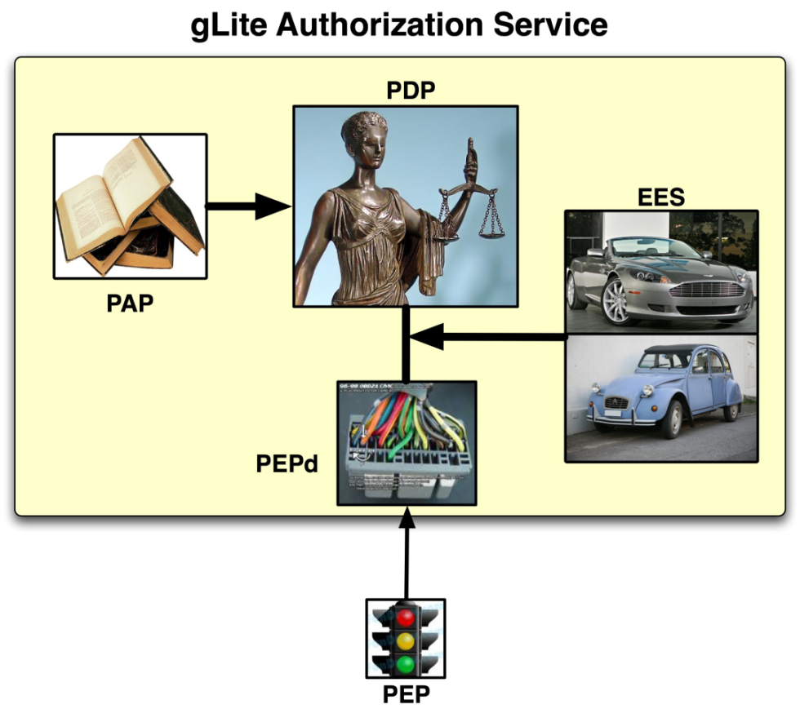
gLite Authorization Framework (v2)
Administration Point
Formulating rules through CLI and/or file-based input
Decision Point
Evaluating a request from a
client based on the rules
Enforcement Point
Thin client part and server part:
all complexity in server part
Runtime Execution Environment
Under which env. must I run?
(Unix UID, GID, …)
Graphic: Christoph Witzig, SWITCH and EGEE

Slide 125
Capabilities
Enables/eases various authorization tasks:
  Banning of users (VO, WMS, site, or grid wide)
Composition of policies – CERN policy + experiment policy + CE policy + OCST policy + NGI policy=> Effective policy
Support for authorization based on more detailed information about the job, action, and execution environment
  Support for authorization based on attributes other than FQAN
  Support for multiple credential formats (not just X.509)
  Support for multiple types of execution environments
  Virtual machines, workspaces, …
Nagios plug-ins provided for monitoring of service
https://twiki.cern.ch/twiki/bin/view/EGEE/AuthorizationFramework

Slide 126
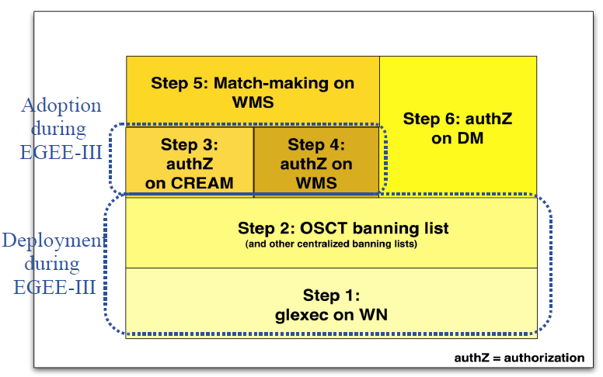
Introduction of the service in gLite
Focus is on computing services (again ☹)
  Initial introduction through gLExec on the WN
  As a new LCMAPS plug-in
  (used in conjunction with the others, esp. verify-proxy)
  With OSCT ban list
Has all the right buzzwords
  PIP, PEP, PAP, PDP, and SAML
  XACML policies and attributes
  But with a simplified language ☺
Testing well on its way!
Interop and general adoption unclear, though… ☹

Slide 127
Deployment plans
Expect service to enter certification in April
  Gradual deployment in the six self-contained steps
Initial focus on gLExec on WN and OSCT ban list
  Configuration option for gLExec
  Integration into CREAM and WMS for authorization
  Integration into data management
  Offers perspective to manage access to a site from one site-specific service
  Longer term option for inclusion into match-making
Feedback and volunteer sites
for trying service out are welcome

Slide 128
Summary
Security middleware is everywhere
  An integral part of almost any grid service
  Implemented in a myriad of ways
Most of the core capabilities are there
  VOMS based access, banning on VO or DN
  But methodology varies,
  and the documentation is not well read or disseminated
We’re getting there with interop
  authz-interop.org collaboration composed
  working mesh of interoperable security services
But we’re far from done …

Slide 129
Questions? Dinner?

