Slide 1
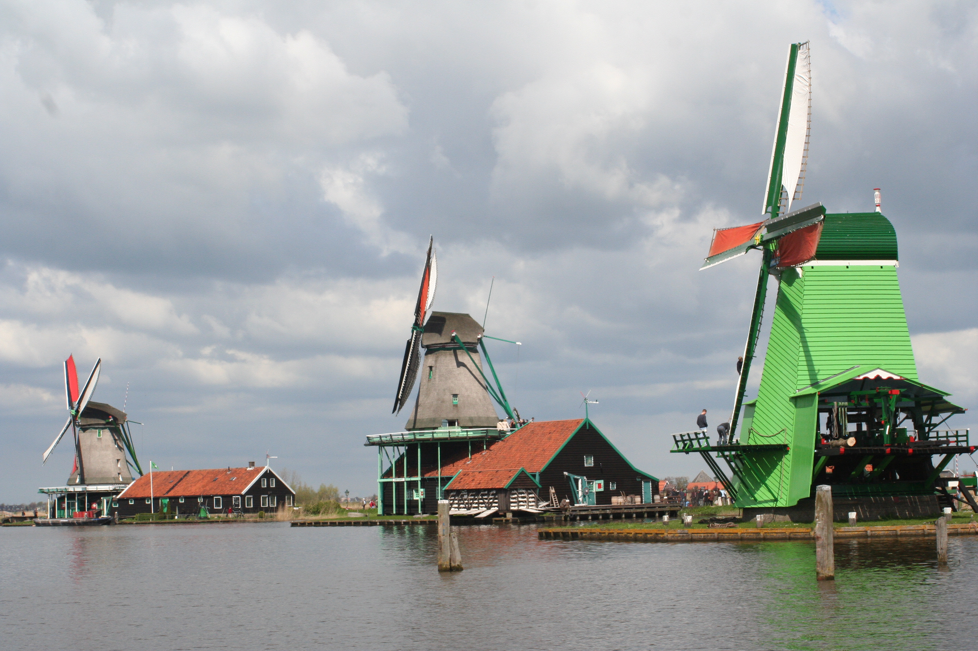

Welcome to the NL-T1 and the
Dutch National e-Infrastructure
LHCOPN-LHCOne workshop
October 2015
David Groep, Nikhef
Photo: Teun Spaans – WikiMedia commons CC-BY-SA

Slide 2
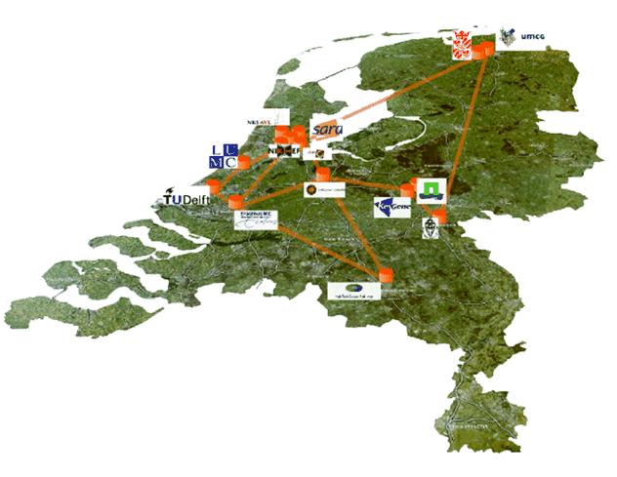



The Dutch National e-Infrastructure
operational partners
coordinated by

Slide 3
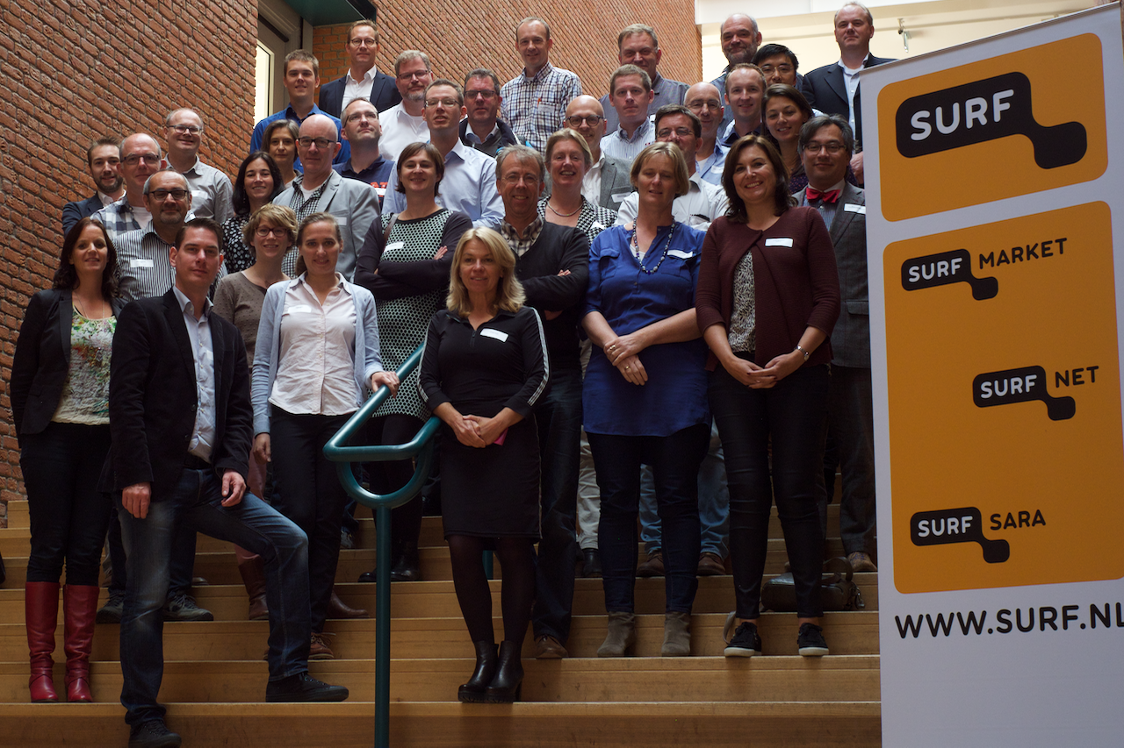

Slide 4
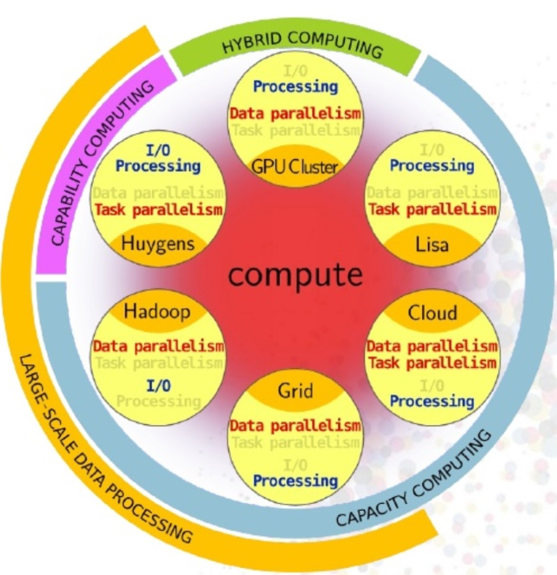
DNI data and compute services
Data Ingest Service
High-throughput
storage
Long-term archival
“Lisa” low-latency compute cluster
Carthesius T1 HPC
HTC IaaS data processing Cloud (several, est: 2016)
‘Grid’ data intensive processing platform
HPC Cloud (IaaS)
Hadoop
GPU
BeeHub
SURFdrive

Slide 5

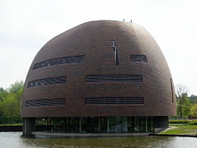
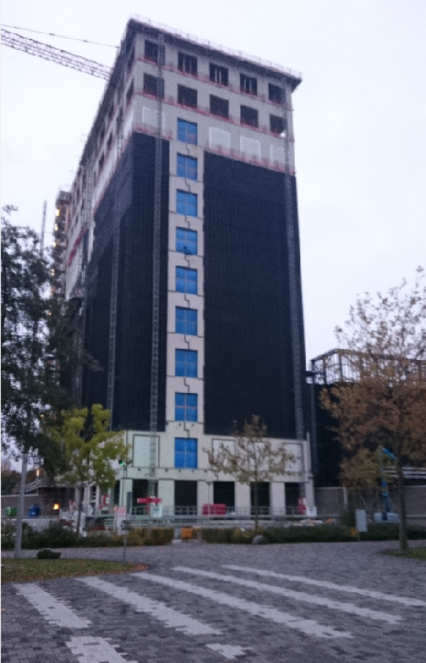
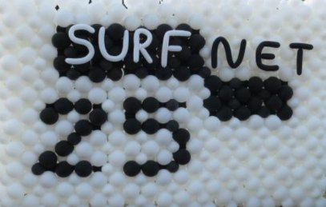
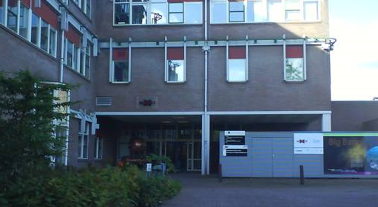
Connecting NL infrastructure

Slide 6

What do our users want? And if we Ask ?

Slide 7
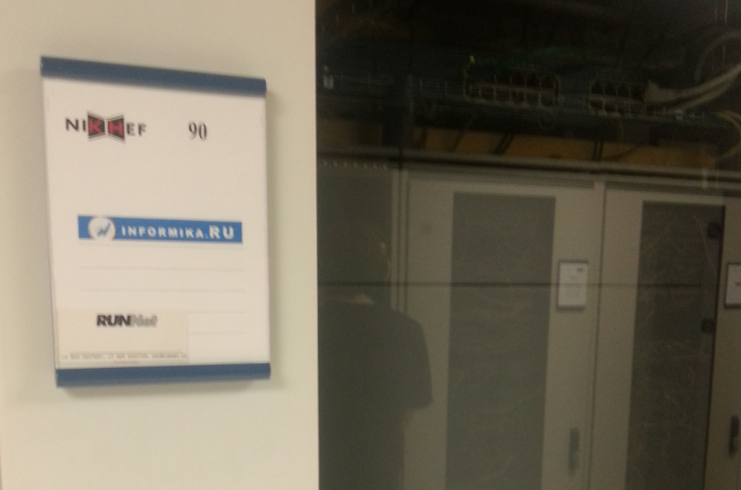
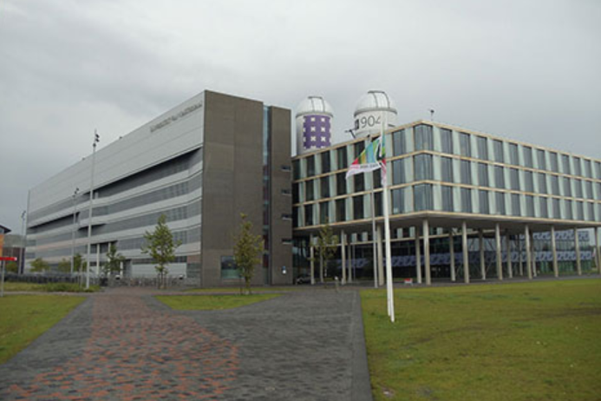
Beyond our ‘own’ infrastructure?
Increasing a meshed infrastructure appears:
institutional private peering, metro-area fiber
owned by e.g. universities
Re-use of trigger farms for analysis: new flows!
Dynamic commercial infrastructure: NHScienceCloud, green (or: cheap) computing

Slide 8

Wieringermeer, Noord Holland

Slide 9
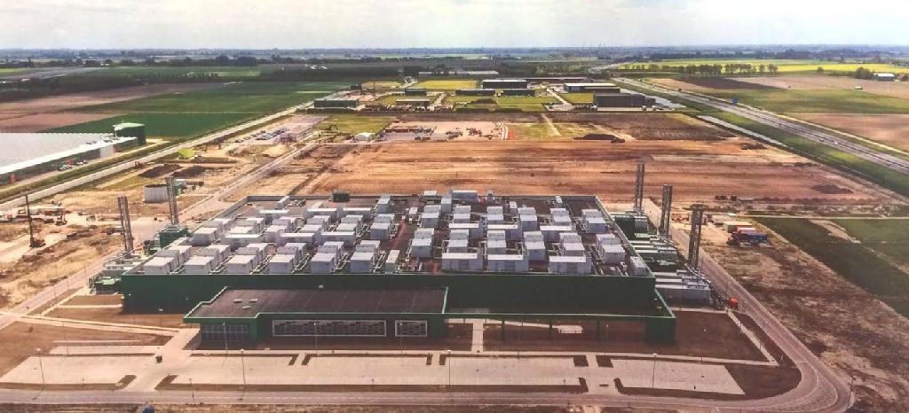
Wieringermeer, Noord Holland

Slide 10

But why not here, where it’s green?

Slide 11
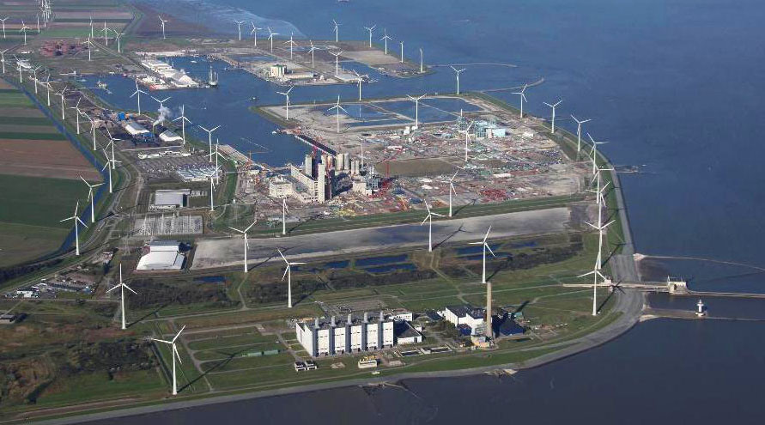
Or here, where it’s cheap?

Slide 12
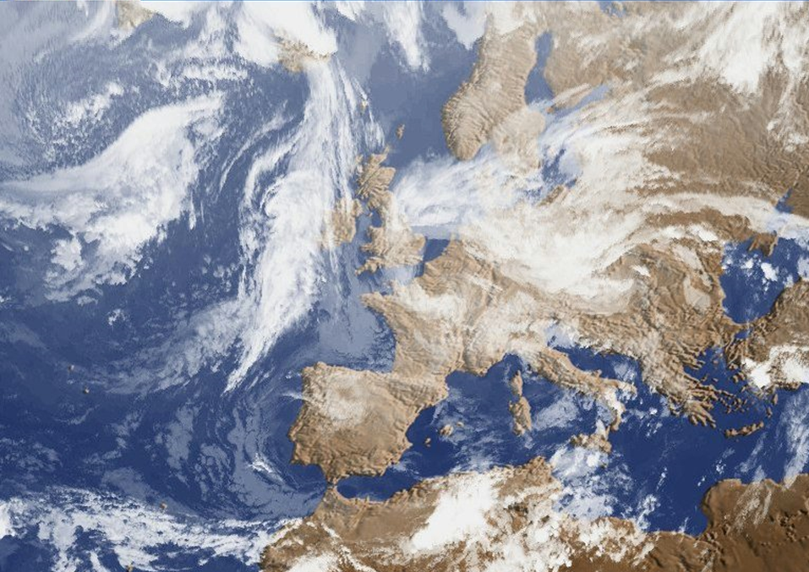
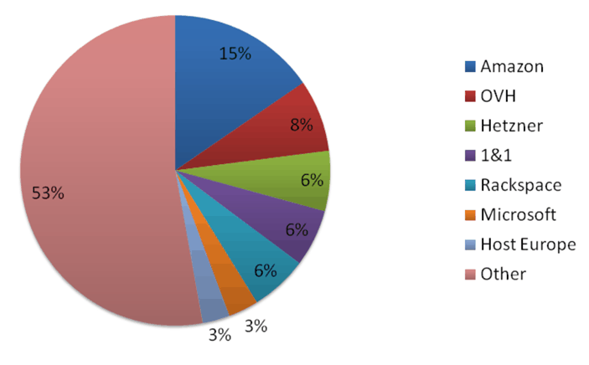
Cloud provider landscape in Europe
Source: the METISfiles Top 1000
http://www.themetisfiles.com/2014/11/leading-iaas-partners-of-european-saas-isvs/
Background imagery: MeteoFrance

Slide 13

Getting it to the end-user
photo: https://www.flickr.com/photos/leaflanguages/8359270512 (CC-0)

Slide 14
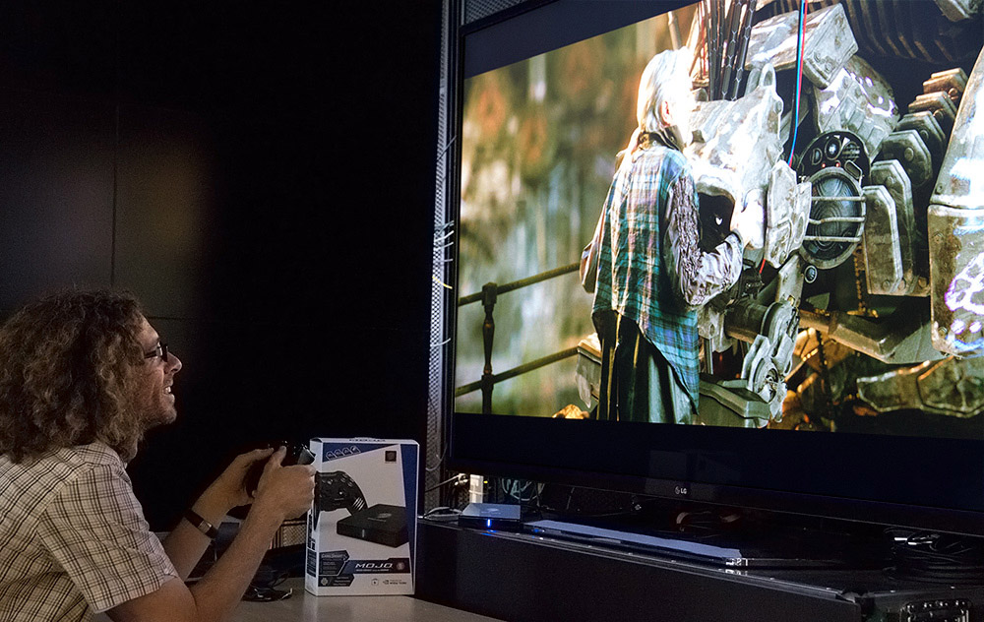
This is what they have at home …
4K displays
500+ Mbps to the home
but also 20+ms latency with DOCSIS
But:
do users know how to use networks?
… be it theirs, or our LHCOPN/One?
Image: UCSD Qualcomm Institute (ucsdnews.ucsd.edu)

Slide 15
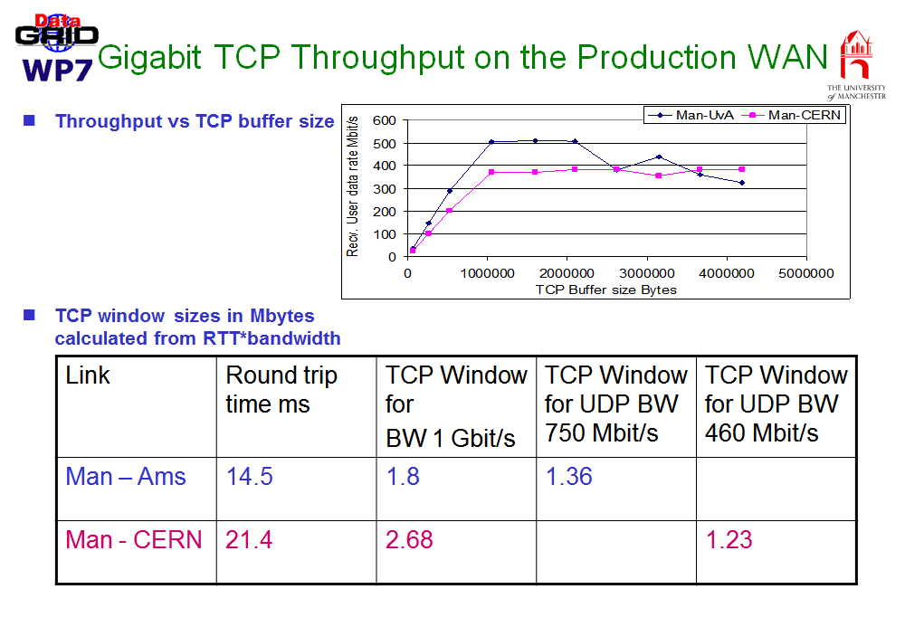
But what end-users need …
… may what we have by now forgotten …

Slide 16

Education!
get end-users to understand & comprehend enough to use our ‘goodies’
and make sure all LHCOne participants
also know what to do (and what not …)
… but let’s keep on dreaming: the users won’t!
Tableau: Murmellius Gymnasium, Alkmaar

