Slide 1
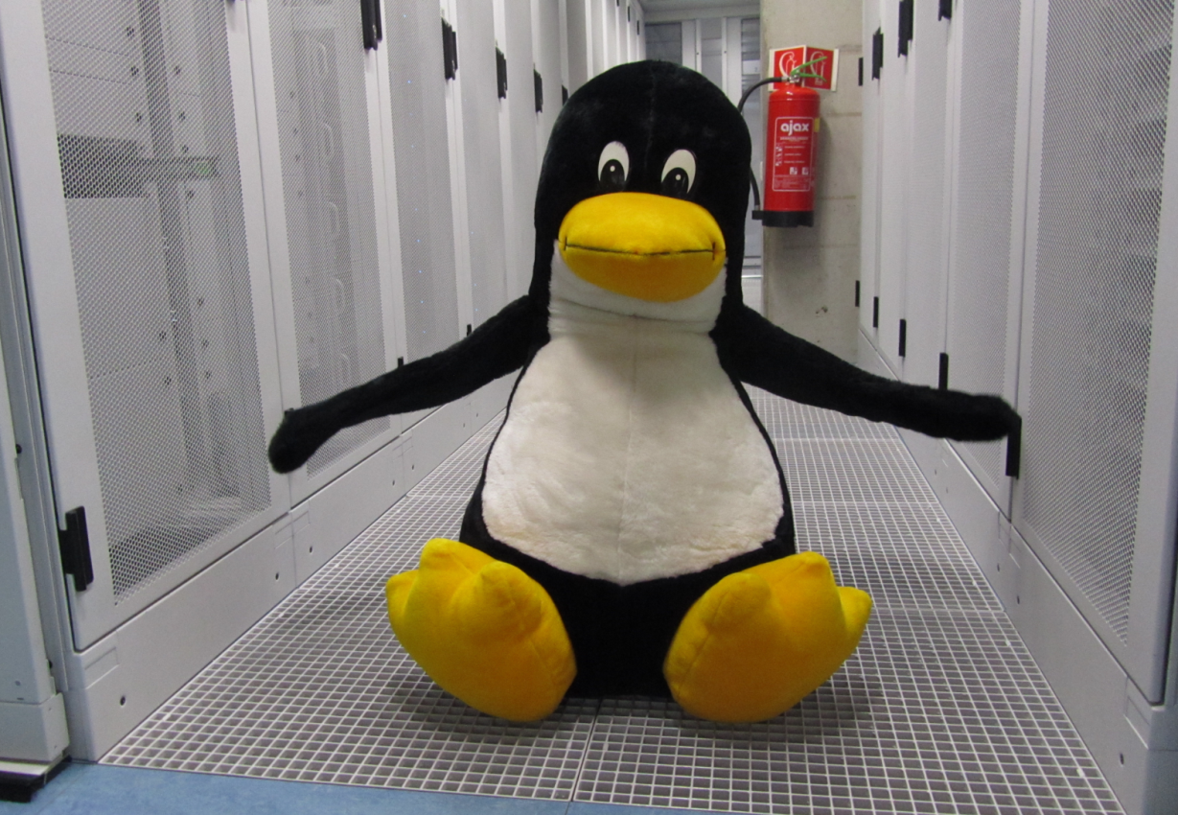
Physics Data Processing & ICT
Ready for more than Run 2
– Nikhef Jamboree 2014
Nikhef data centre
H234b on Open Day

Slide 2
User Support
CT-PDP roadshow, Helpdesk & Outreach (important, but no further mention)
Scaling R&D
Big data & access patterns,
multi-core, distributed computing, NG networking, configuration management, software engineering,
Scalable
Multi-Domain Security
site access control, community building, global federations, vulnerability analysis, operational security, pen testing,ethical hacking...
Physics ICT Services
Stoomboot, Grid Tunnel, xrootd federation & N2N, multi-core optimization, capacity planning, analysis data access & file systems
Local Infra Innovation
Nikhef SSO, eduGAIN services, CERN auto-login, TERENA Grid certificates, SURFdrive, 100G internet, Campus-wide WiFi, ...
Funding Acquisition & Policy Development Service
EU H2020 consortium building, SURF liaisons, NLeSC, EGI council, e-IRG

Slide 3
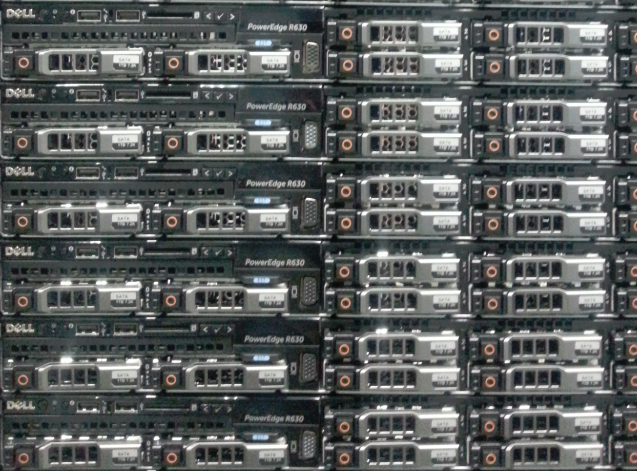
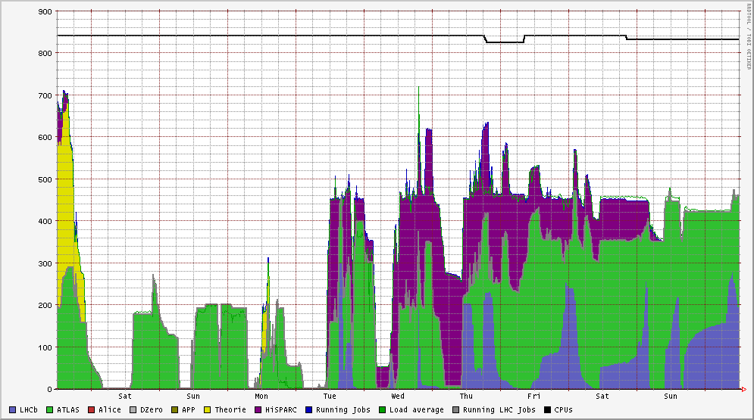
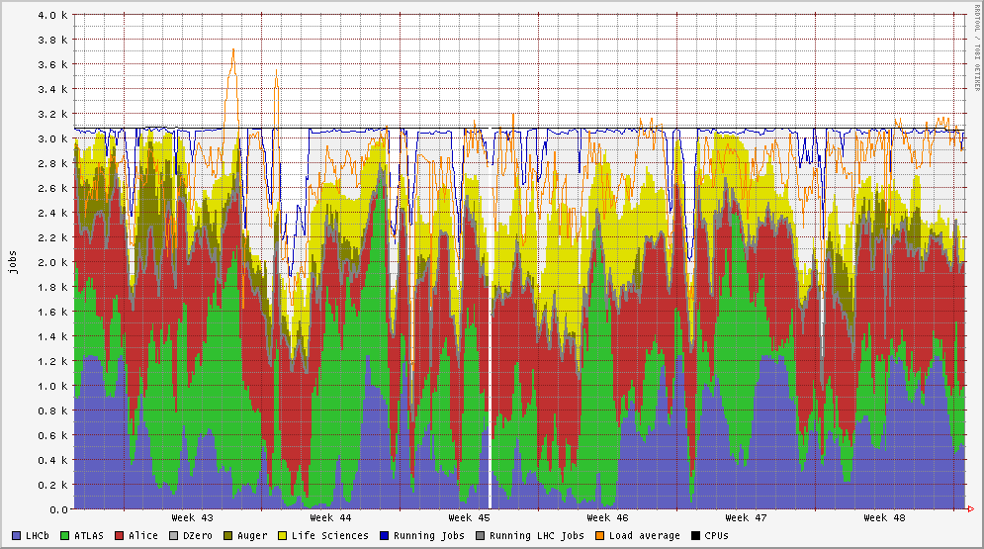

Bigger is Better!
840 cores @ stoomboot
3100 + 1416 ~ 4500 cores @NDPF
Dec 2014: ‘Marsepein’!
+59 Haswell-EP ‘v3’ systems
24 physical cores per box
12 cores per socket
192 Gbyte RAM per box
8 Tbyte disk per box
1416 additional cores
Making it flexible!
2015: Introduction of on-demand allocation
You should prepare also for odd-numbered core counts
Dennis van Dok, Tamas Balogh

Slide 4
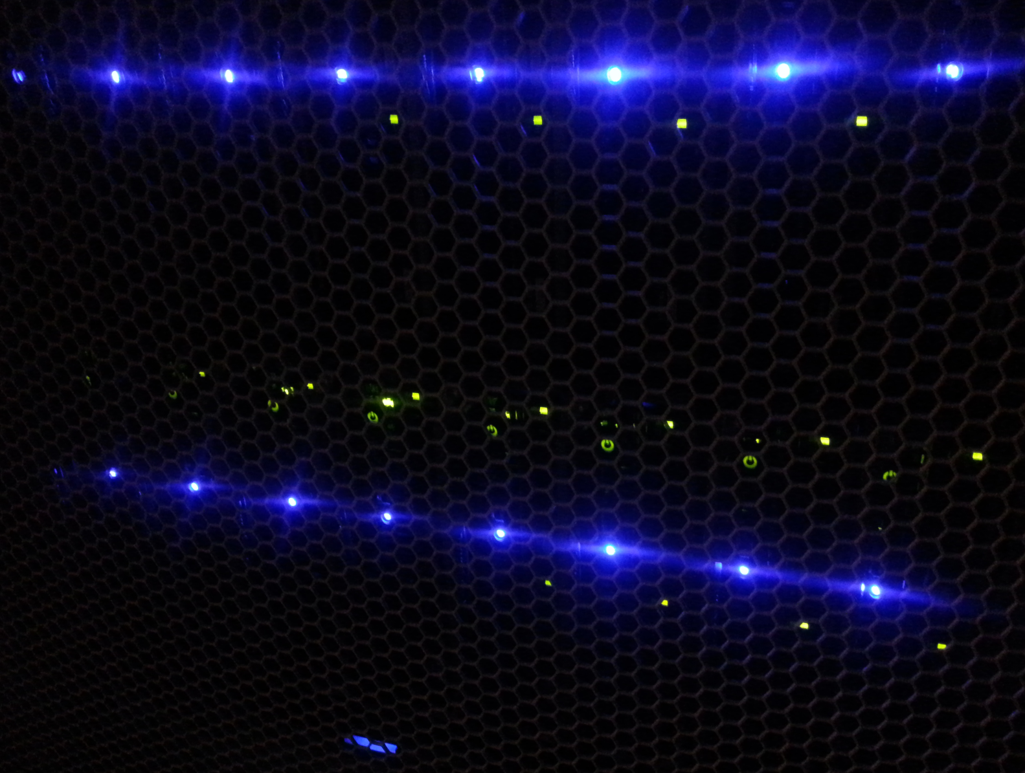
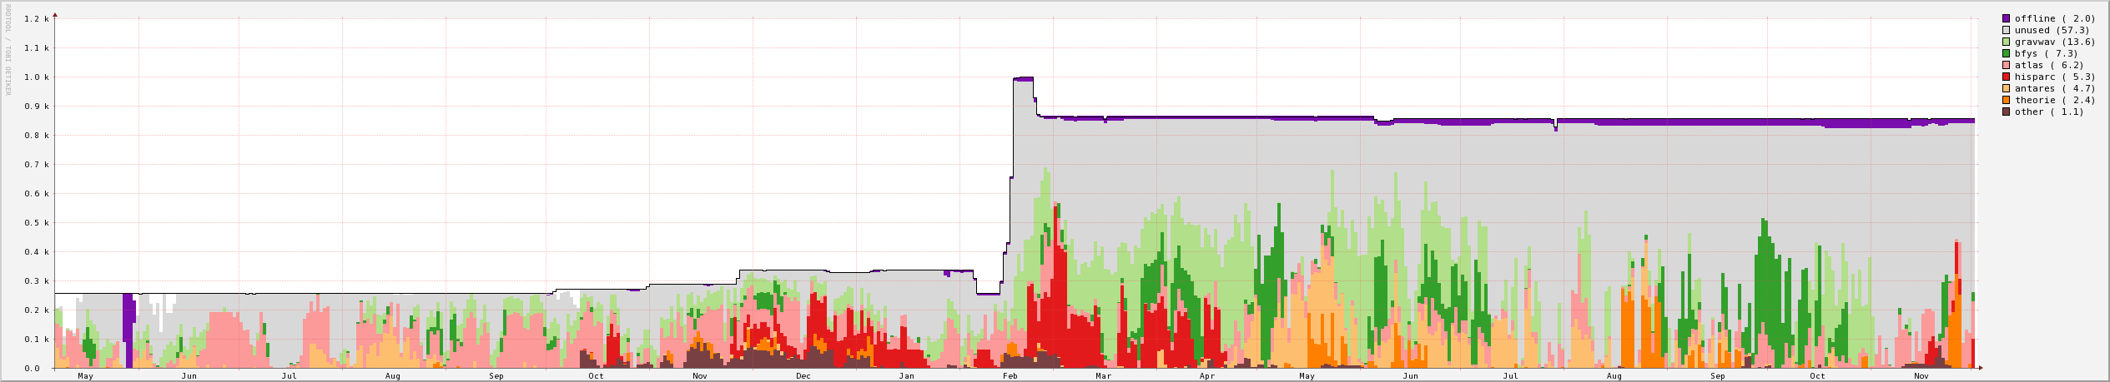
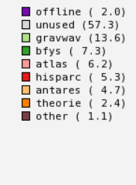
Scaling Stoomboot
~ 850 cores
February 2014: BiG Grid HTC Philips Research cluster brought back to Nikhef
~ 720 additional cores
rebuilt all systems to 32 GByte and 8 cores (4 GiB/core)
with the way currently HEP apps are written,
these 5-year old systems are great –
the codes don’t exploit newer processors anyway ☹

Slide 5
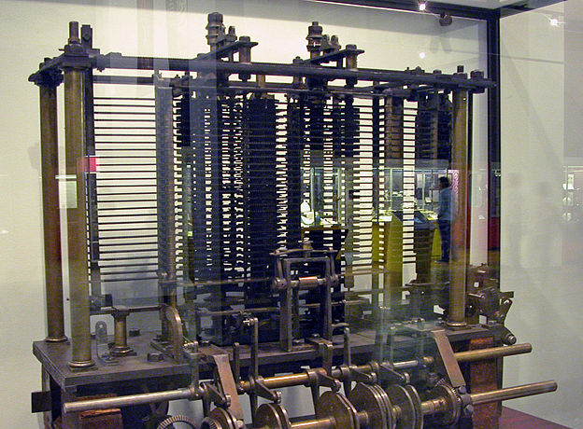
Why Ye Olde Processor does so ‘well’
‘we must do better for run 3 – we cannot afford not to – literally!
Data: NDPF and SURFsara benchmarks for Valentine, Sint Maarten, Carnaval, Knal, and GINA2014-I
Photograph: Charles Babbage Analytical Engine – London Science Musum. Photograph by Bruno Barral (ByB), CC-BY-SA

Slide 6
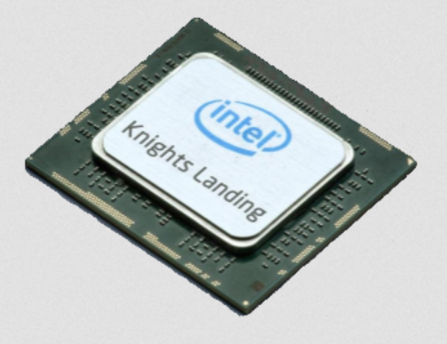
A Larger Cluster – also inside!
Prepare your algorithms for massive multi-processing
Use vectorisation techniques to exploit processor parallelism (Intel AVX2, and co-processing with Knights Corner & ~ Landing)
E.g.: never jump inside a loop – all invariants
should really stay outside or you lose!
Get to know a bit about CPU architecture – tell the compiler what you want – and use a compiler that understands you!
Talk to us about new CPU architectures – we usually have some
interesting systems for you (and us) to experiment with!
Jan Just Keijser, Wilco Baan Hofman, Tristan Suerink, DavidG
Notes:
Same holds for network by the way – we like it, just as we do now for Xenon …

Slide 7
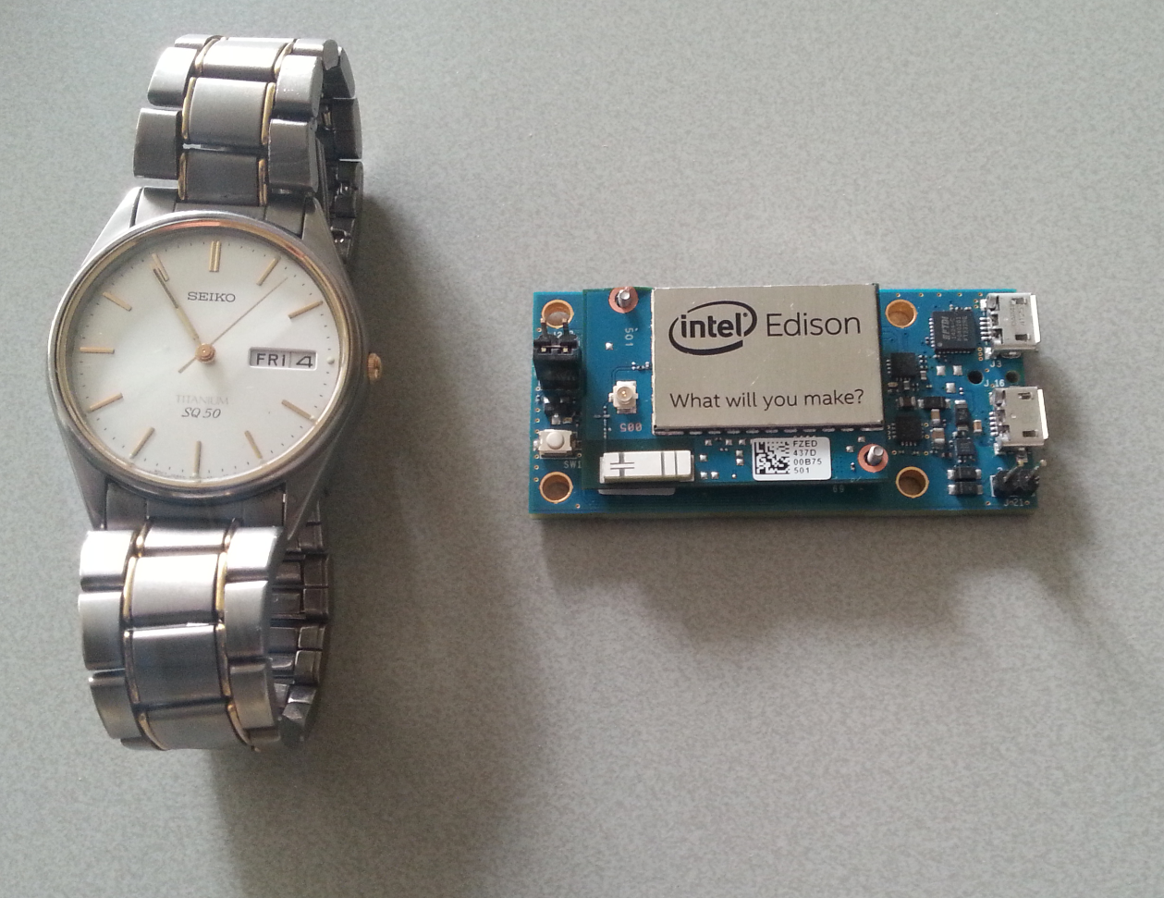
Intel Edison –
looking inside Jan Just found it to be a 64-bit Atom processor – at only 2W!

Slide 8
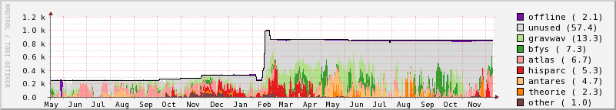

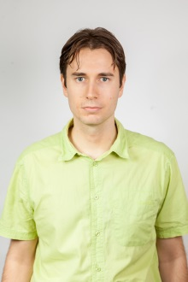
And Our Yearly STB Competition Winner Is …
are the 200 SLC5 cores still needed?
````
Years computed
Number jobs run
Reinier Jonker
rjonker (gravwav) 101.3
adelaat (hisparc) 37.5
Jleerdam (bfys) 27.6
kmelis (antares) 19.2
partois (theorie) 16.7
debkr (bfys) 16.0
mjongen (antares) 13.6
pbutti (atlas) 8.8
Manuelsr (bfys) 8.5
Gadatsch (atlas) 6.8
XXXXXX (atlas) 1.2M
XXXXXX (antares) 476k
XXXXXXX (atlas) 414k
XXXXXXX (atlas) 241k
XXXXX (atlas) 232k
XXXXXXX (gravwav) 221k
XXXXXXX (hisparc) 192k
XXXXXX (atlas) 163k
XXXXXX (atlas) 101k
XXXXXXXX(bfys) 69k
But: ‘More’ is not always ‘Better’ …
still ………………… ‘Computing is easy!’

Slide 9
.. and maybe even too easy here at Nikhef?
“ I did leave but here in Stockholm the infrastructure is not as nice as nikhef so for the very last results of Run I I am still using the setup at nikhef :-) "
Thanks, Priscilla!
That’s what we get out of our joint BiG Grid, NL-T1, SURFsara & STBC efforts
– and what can give you the ‘competitive edge’ when you use it wisely ☺

Slide 10
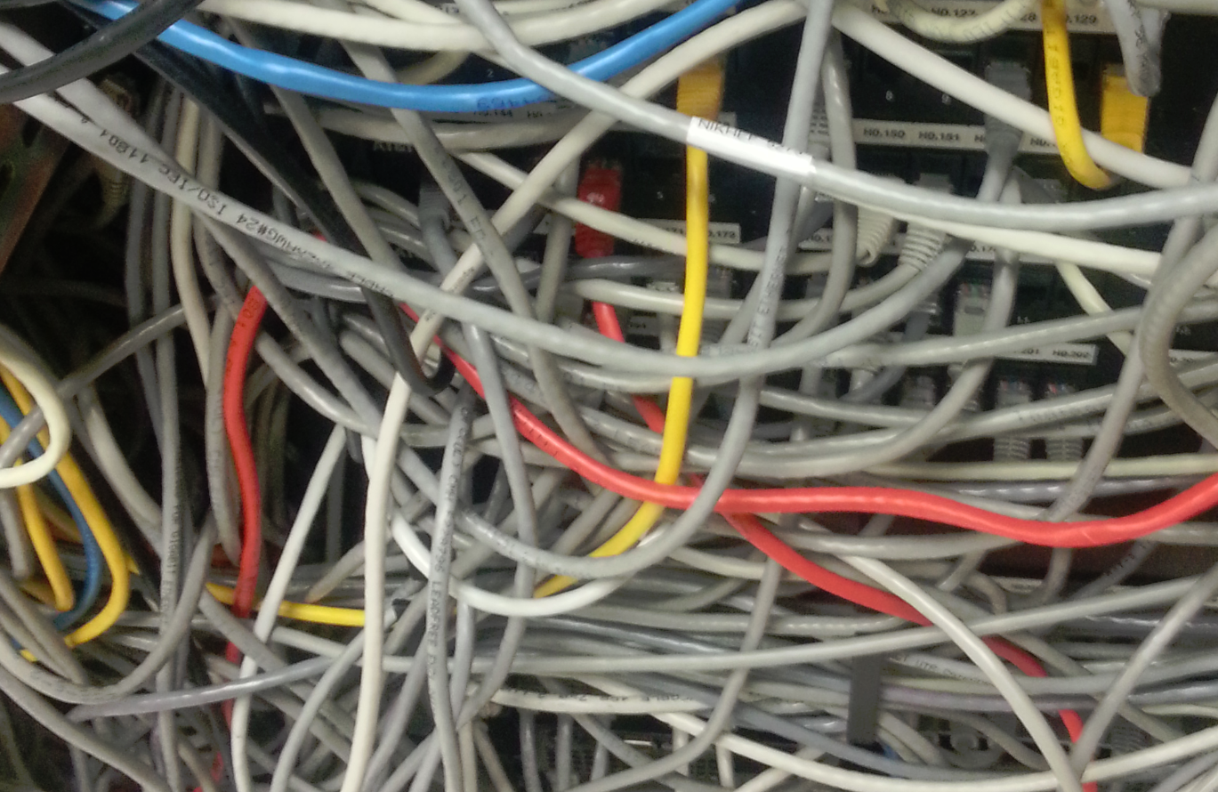
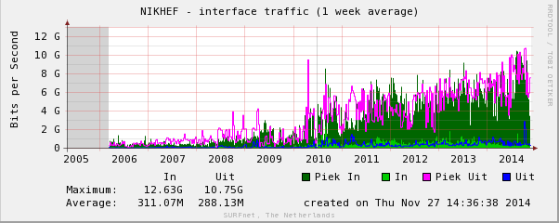
Getting the data in – and out: Networks!
Nikhef traffic exchanged with the rest of the world
Bandwidth use is independent of LHC running
What would happen when Run 2 really starts?
Internal 240Gb/s network nice – but data comes from anywhere
Not only for the LHC, but also e.g. for Xenon!

Slide 11



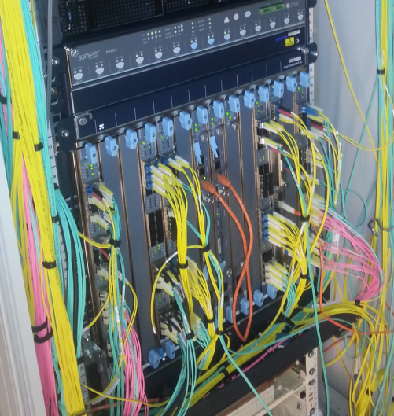
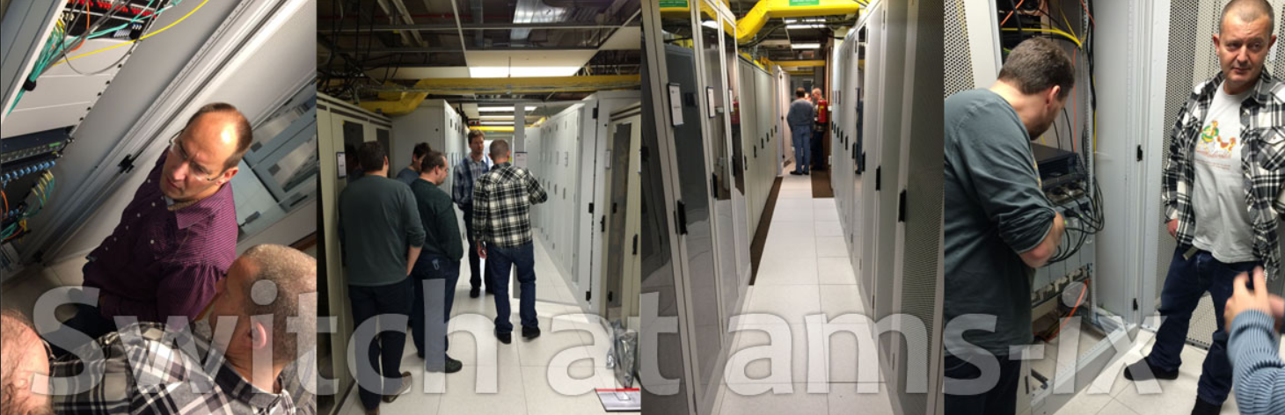
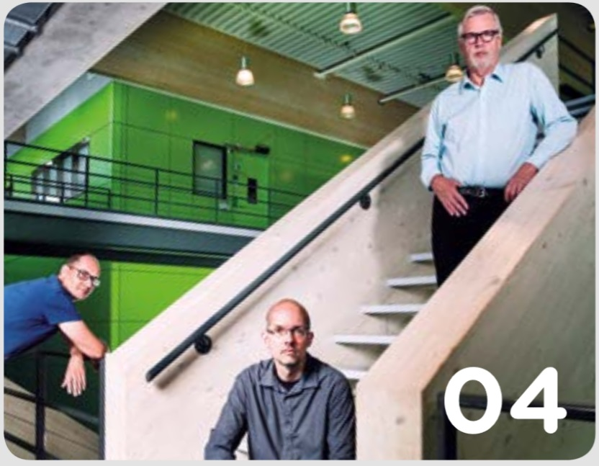
SURFnet Campus Challenge
Upgrade from 10 → 100 Gbps SURFnet
Upgrade 20 → 100 Gbps SURFsara
Transit LHCOPN for the Atlas Moscow T1
Our access to Run-2 data now: 40Gbps
and a whole lot more: storage, wireless, …
http://campus-challenge.amolf.nl/
Wim Heubers, Wilco Baan Hofman, Tristan Suerink, DavidG

Slide 12
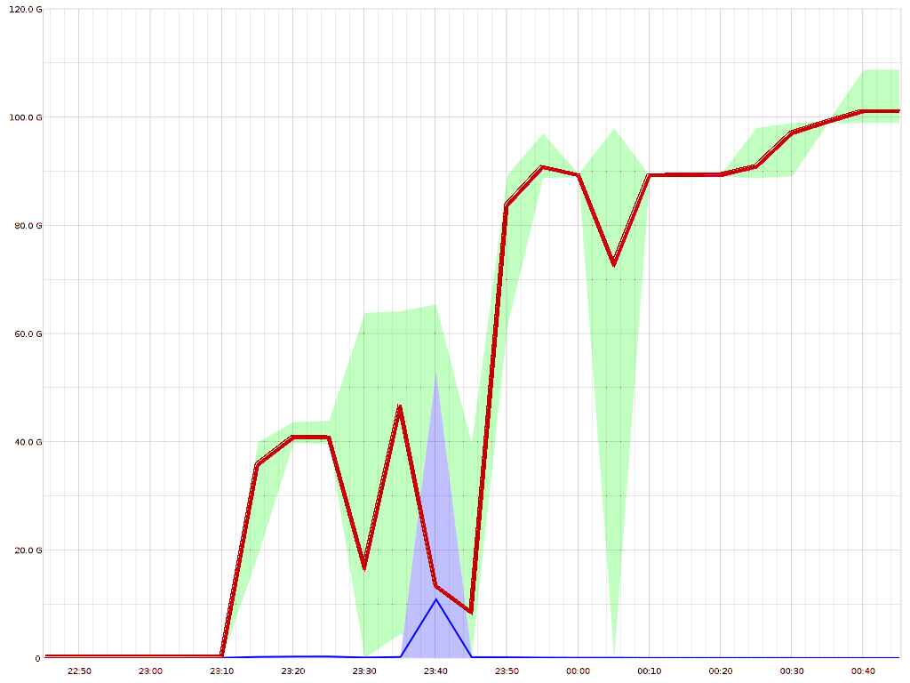
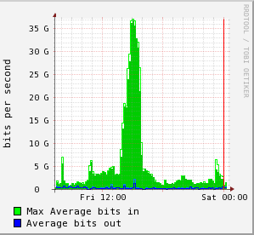
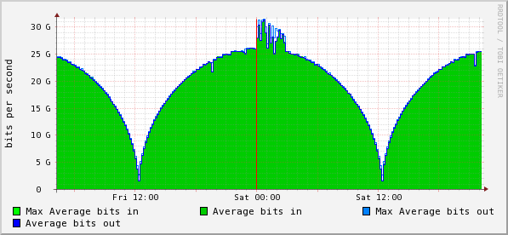
The 100G network came just in Time!
6-7 September 2014
100G tests end-to-end
UvA-SURFnet-Nikhef
October 2014
100G SURFsara commissioned,
and 10G to KIAE deployed
100Gbps
time line: 2hrs
November 2014: sustained 40G validation traffic
Nov 28
… and just in time for a
mere 300 Atlas analysis jobs
Tristan Suerink, DavidG

Slide 13
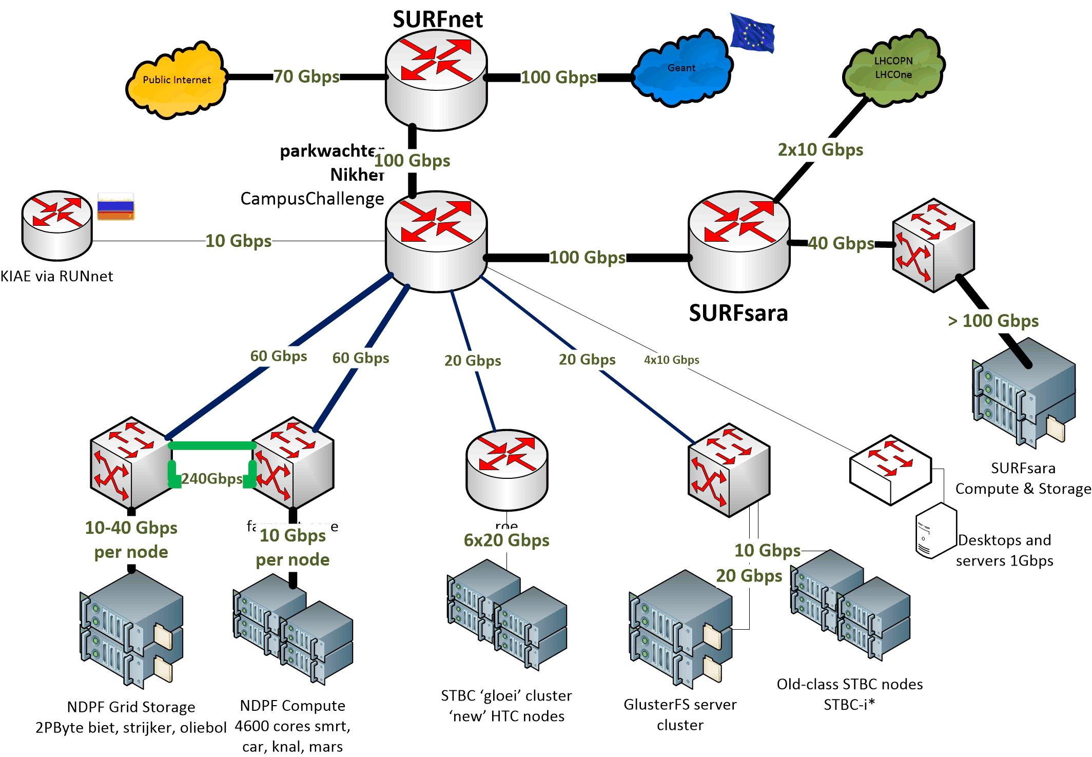

‘The Graph Nobody Wants To See™’

Slide 14
We need bandwidth …
… to get to data and more data!
Local capacity – just more and more of it?
  ~300 TB now, maybe 1 Petabyte in 2015 …
But how to access it? Over the network?
  GlusterFS failed us for now – it cannot sustain our 800+ nodes
  Move ‘resolution’ complexity to application?
  Try Atlas XRootd-federation, and e.g. gfal2fs!
  Use our own ‘grid’ storage ‘@tbn18’ – and connected to stbc
  – distributed, with better throughput and network
  Maybe we can try some new protocols and filesystems in 2015?
  – a local dCache? Lustre + ZFS? WebDAV fs?
  … and only now the world comes round to the CDN ‘Content Delivery Networks’ we already demonstrated in 2012 ☺

Slide 15
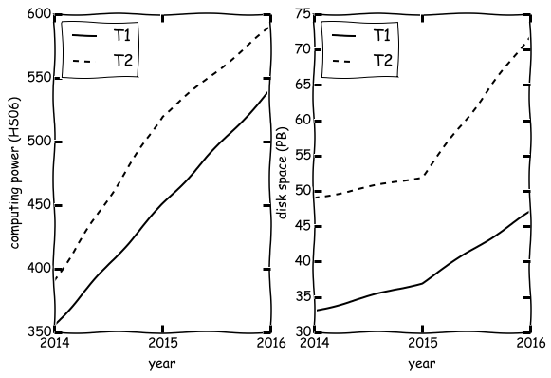
Capacity means planning ahead!
ATLAS global request for T1 + T2 capacity
‘Even if you cannot yet plan ahead for >2016 we can guestimate the trend for you – based on global projections. It also means we’ll need plenty of cash. And whether, and how, we get that is partially your choice!’

Slide 16



Small data – sharable data!
SURFdrive - sharing and collaborating on data within and outside the academic community
Use it – sync client, webdav, sharing. But: use it wisely!
  100GByte / user (so not for your root files, backups, or movies ;-)
  Once you use access it, keep using it (it’s a yearly fee per user, so once we paid you better use the 100G!)
  Secure, hosted and backed-up locally by a party we trust: SURFsara!
https://www.surfdrive.nl/

Slide 17
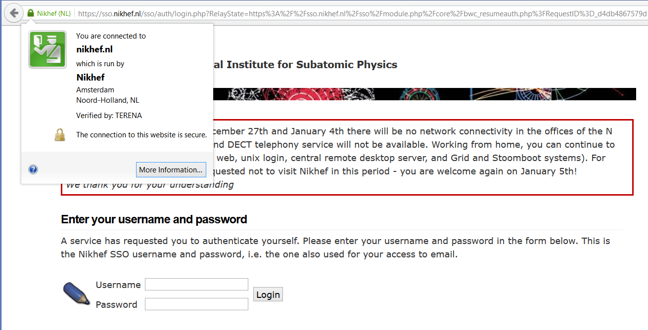
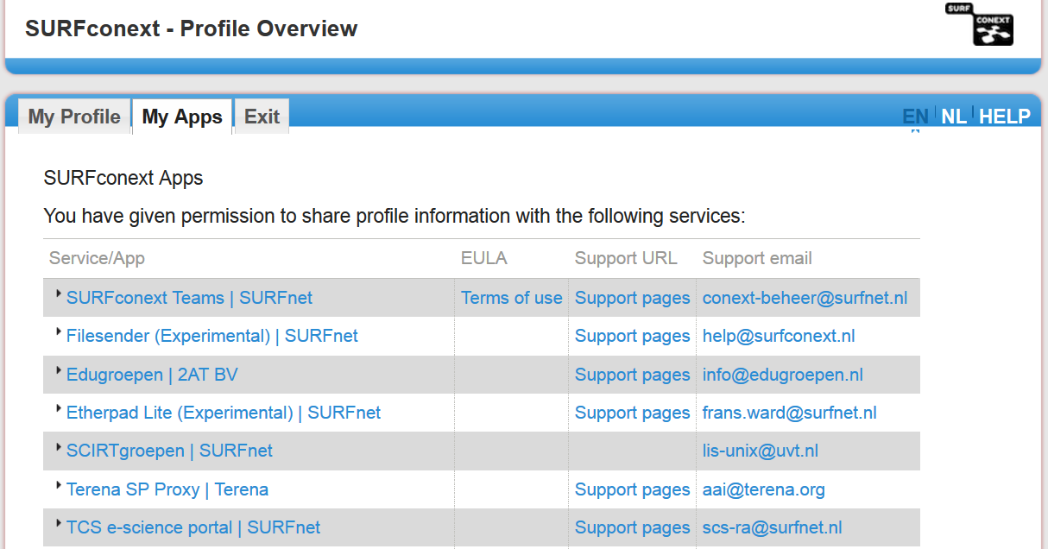
Access via SSO and federation

Slide 18
Scalable Multi-Domain Security
Linking user communities to trusted resources
Making access ‘simple’ for insiders
Software development for multi-domain authorization and site access control
But also: keep the miscreants out
– and there are unfortunately many attackers
Operational security
Security and federation policy

Slide 19
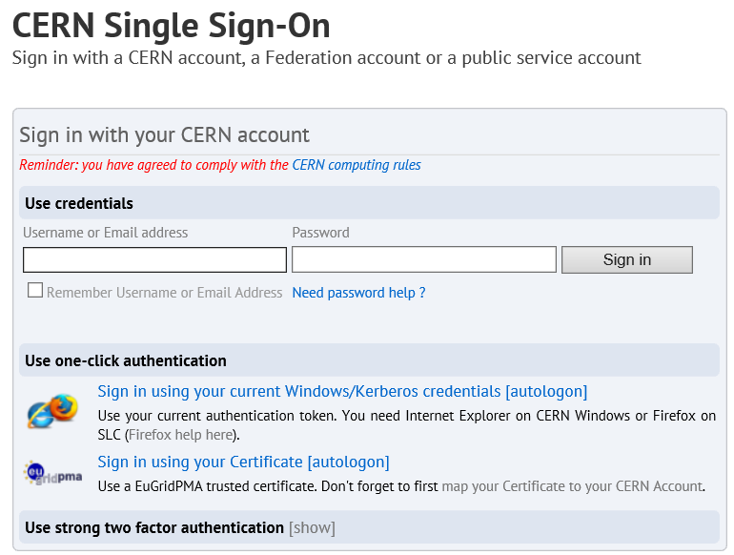
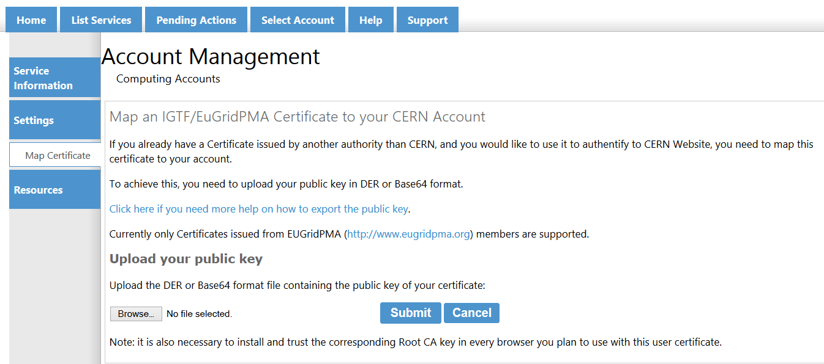
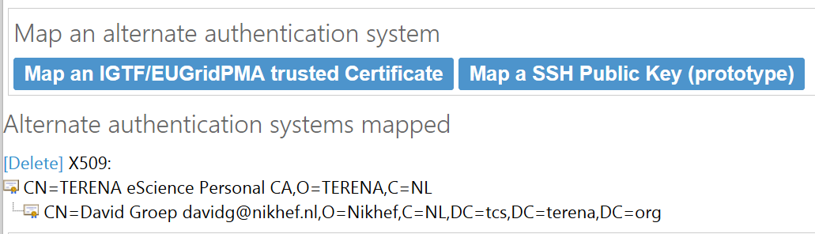
CERN with a (grid) CERT?
http://cern.ch/accountmap

Slide 20

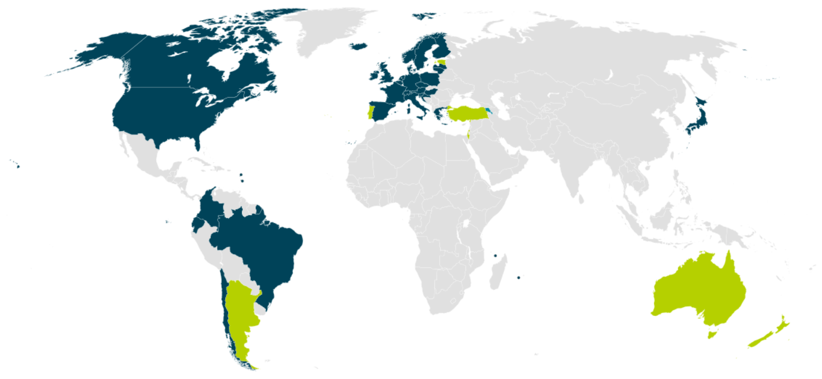

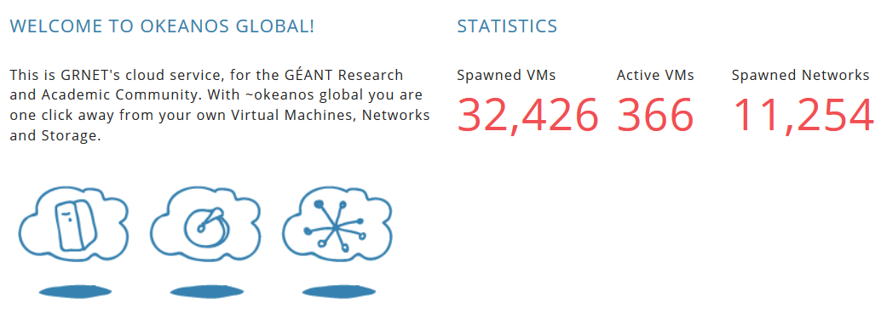
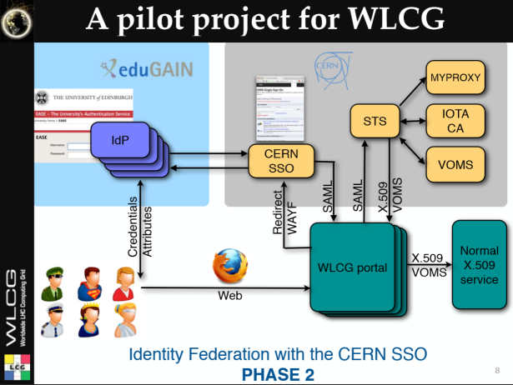
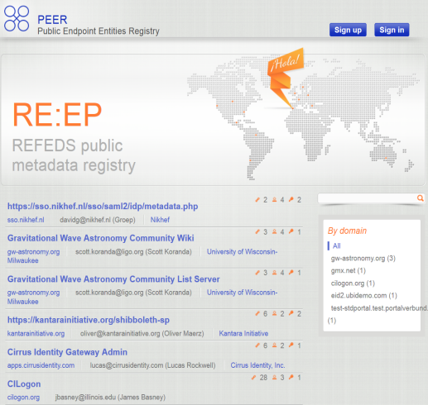

Towards global single sign-on: eduGAIN and the AARC initiative
‘free VMs 4 ALL’
wLCG FIM4R pilot
background: eduGAIN connected federations as of November 2014 – Brooke Schofield, TERENA

Slide 21
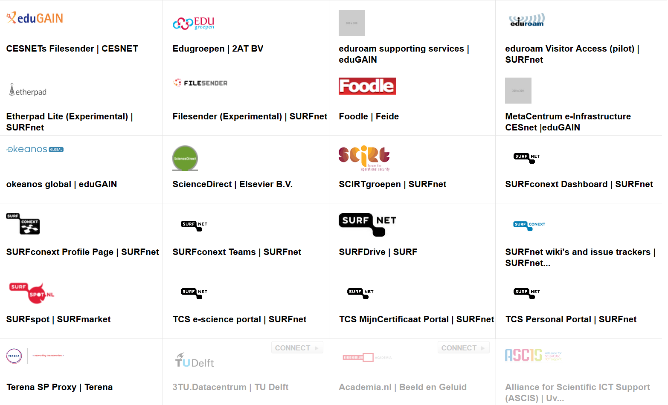
And the Federated Services we use (frequently)

Slide 22
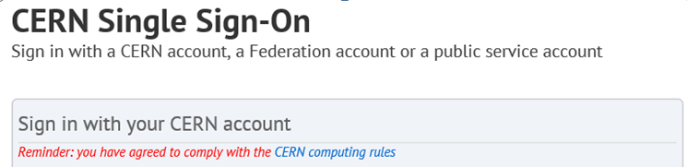

But what about this button?
eduGAIN: global confederation for research & education identity
  allowing users to authenticate and provide information about them to services like CERN Indico login, Okeanos Global, …
  Today works ‘sometimes’ and only for ‘low-value’ services …
  but envisions far easier access for R&E users (us!) – once it works
Nikhef, in collaboration with Geant (TERENA) and with support from the EU H2020 is in Authentication and Authorization for Research Collaborations (AARC)

Slide 23
Scalable Security exploiting a H2020 focus area
Nikhef joined four EU H2020 proposals to promote scalable security for us and the ERA
EGI ENGAGE – secure operation of the pan-European grid and more (security lead)
AARC – authentication and authorization for Research Collaborations (activity lead)
GLACE – supporting large scale data transport & compute with Globus Globus Online
VLDATA – DIRAC and SciBUS security
If awarded, enables us to get better collaboration support for more than just the LHC – but also for e.g. LIGO and also for smaller communities
8M€/30mo – 14PM ‘us’
3M€/24mo – 24PM ‘us’
3.5M€/24mo – 37PM ‘us’
19M€/24mo – 12PM ‘us’

Slide 24
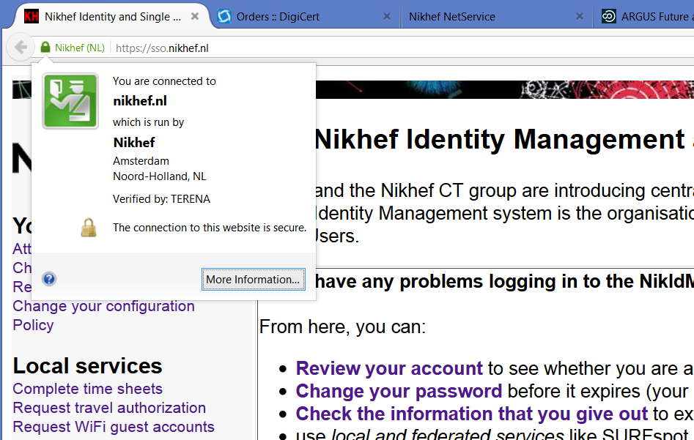
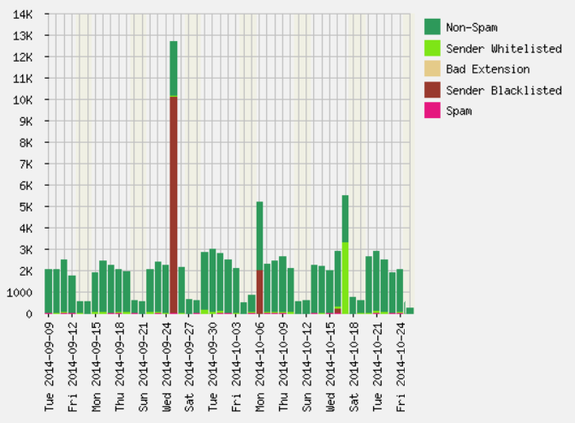
Security brought ‘home’ …
Infected systems
@Nikhef

Slide 25

Remember the CERN campaign
Training equally relevant @Nikhef!
phishing trials in .nl show up to 20% ‘success’ rate
Only a few (6-10 per year) are used for spam runs – so the rest are held in reserve? For what?
Our password aging helps against hoarded credentials
http://resource.wageningenur.nl/nl/organisatie/show/Een-op-de-vijf-WURers-trapt-in-phishing-mail.htm

Slide 26
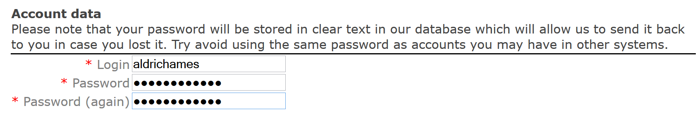
Read the notices and warnings
So please, do not use your Nikhef SSO password on any Indico system
So ALSO not on the new indico.nikhef.nl its unsafe and
we will have to expire your SSO password
immediately if you make them the same!
… but 40% of the current early users still did ☹

Slide 27
A Quick Test, anyone?
Which URL gets you the real PayPal?
https://www.paẏpal.com/nl/webapps/mpp/home
https://www.paypal.com/nl/cgi-bin/webscr?cmd=_home
https://www.paypal.com:nl/mpp/home@my-account.info/view
You want to ssh in to the 22nd WN in our ‘knal’ cluster
compute farm from within Nikhef – and type the
root password: is it OK?
ssh root@wn-knal-022.farm
Paypal example inspired by Romain Wartel, CERN

Slide 28

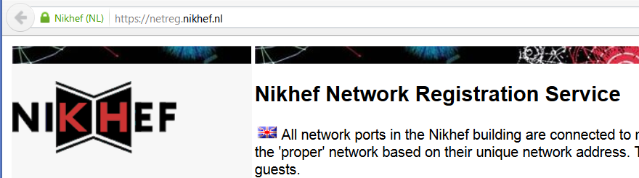
Towards making you trust Nikhef
During 2015 every web site where you type your Nikhef credentials gets a green
address bar “Nikhef (NL), verified by TERENA”
Like NetReg, where you from 2015 on will register all wired devices

Slide 29
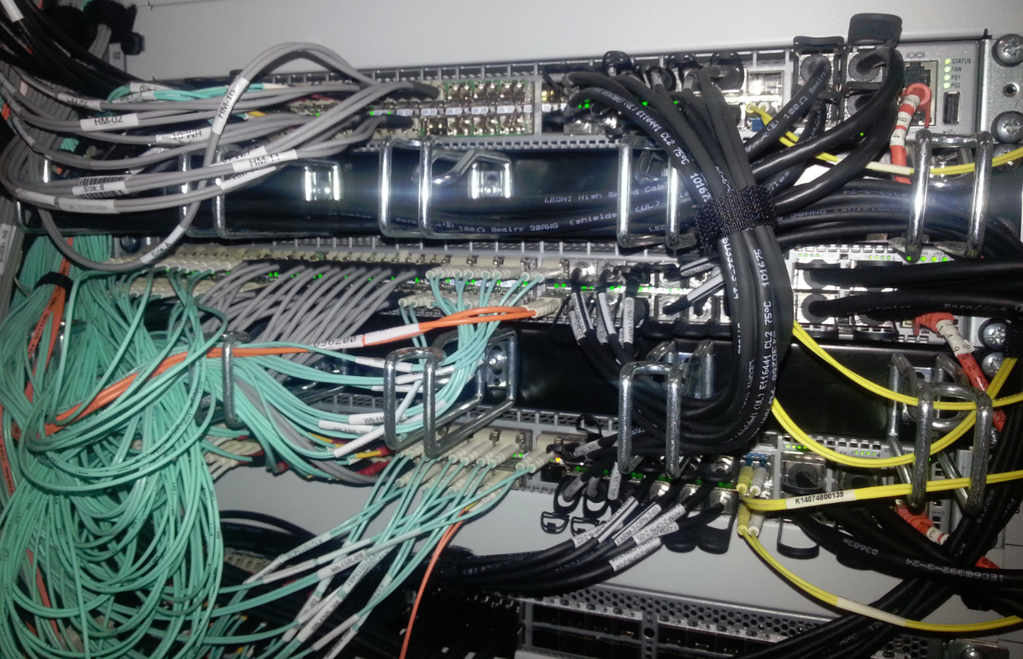
Lots of Stuff will be happening in 2015+
Scaling R&D – data access and efficient scheduling in the massive multi-core area, local and wide-area storage integration, exploiting vectorisation, ...
Scalable Multi-Domain Security – global inter-federation will bring ease of use (and quite some H2020 funding) – but please only for us, and not for the miscreants!
Most services shown come with the award-winning
Nikhef Best Effort™ Service Level
if it happens to work, talk to us so we can stress it and then
watch it die – before that happens to you by accident
We need you and real life situations to do proper R&D for
working at scale – both for hardware and software infrastructure
– but for security, don’t just DoS us at random …
In the background: the NDPF compute-storage interconnect at 240 GBps

Slide 30
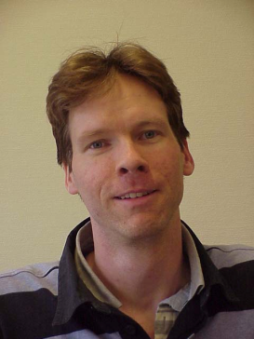
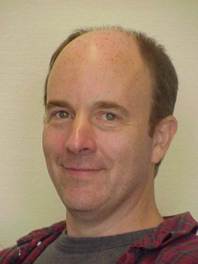
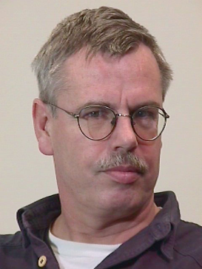
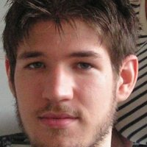
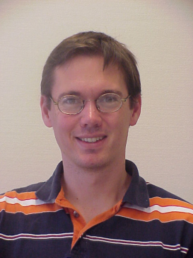
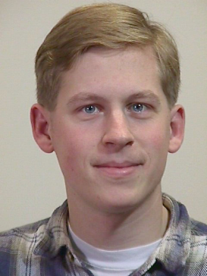
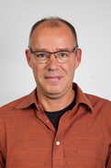
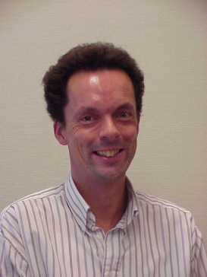
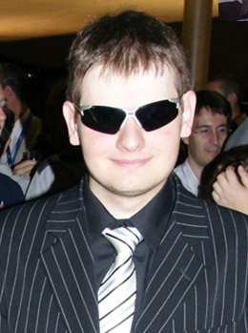
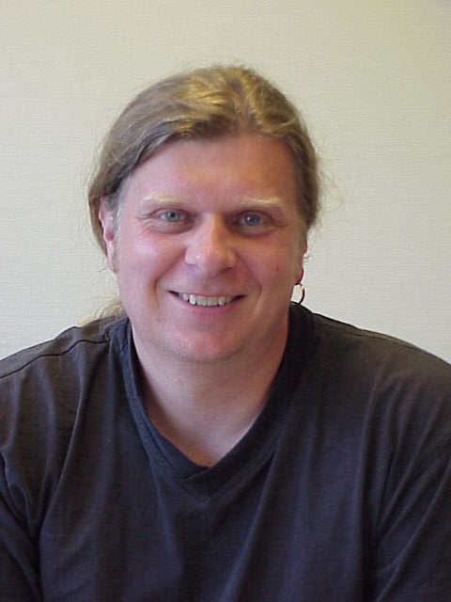

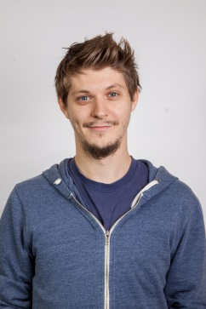

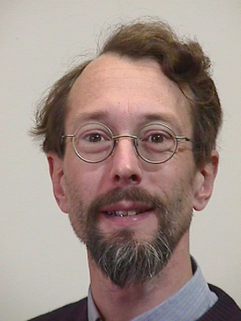



Computing Infrastructure
& Physics Data Processing
?
A lot
(or too much?)
to do!
So please be patient
if not everything happens
all at once …

Slide 31

  Q&A
  Panel

