Slide 1
Ensuring Availability
Security, Protection, Trust,
walking the line between paranoia and laisser-faire
in a highly connected world

Slide 2
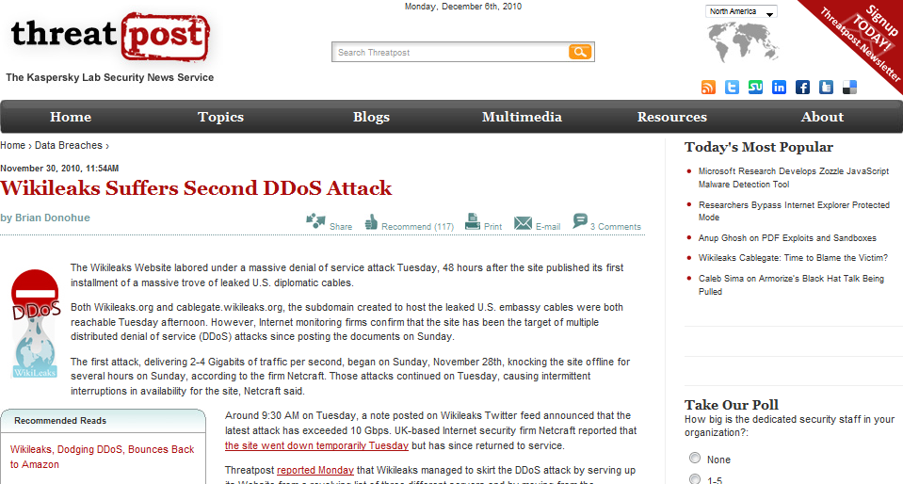


Slide 3
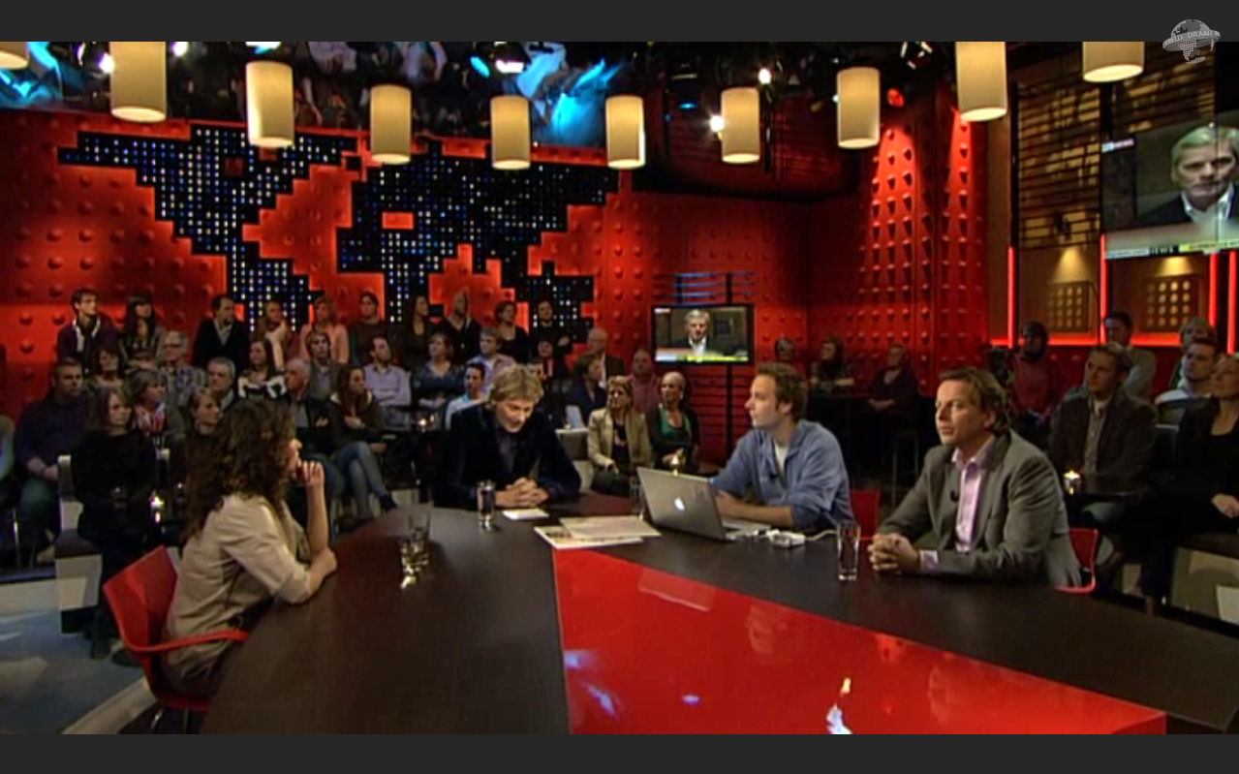

‘De wereld draait door’ – VARA, 8 december 2010 – http://dewerelddraaitdoor.vara.nl/

Slide 4
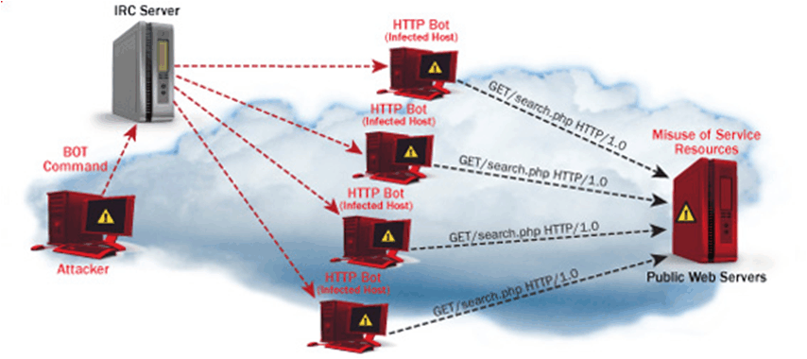
Distributed Denial of Service (DDoS)

Slide 5
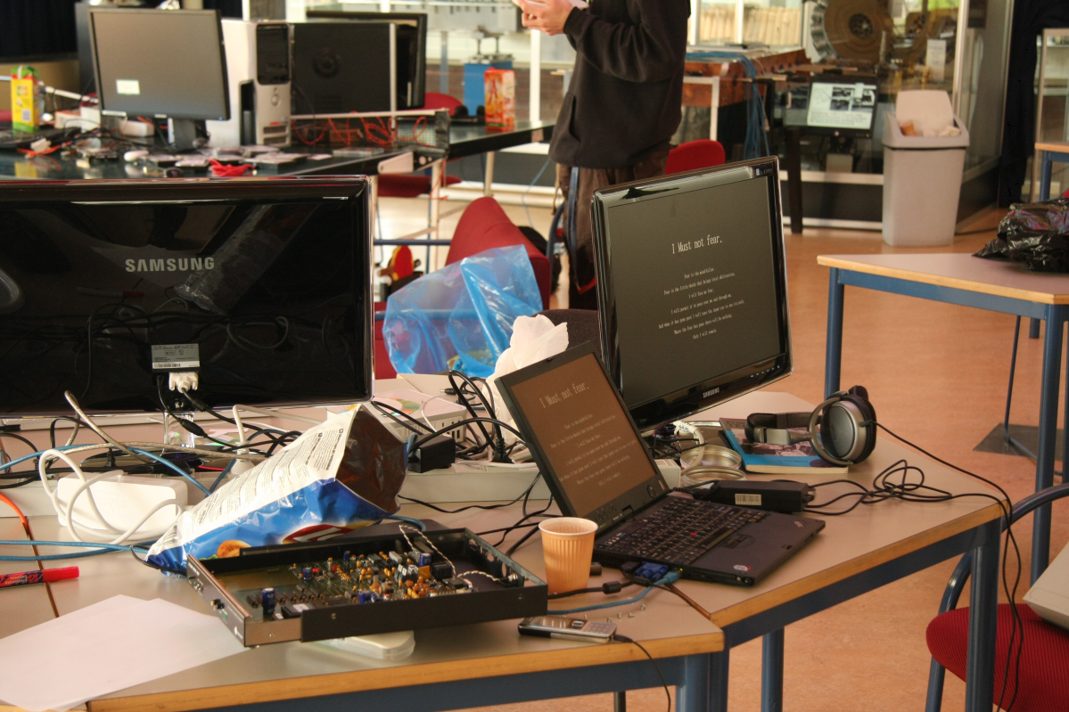


Slide 6
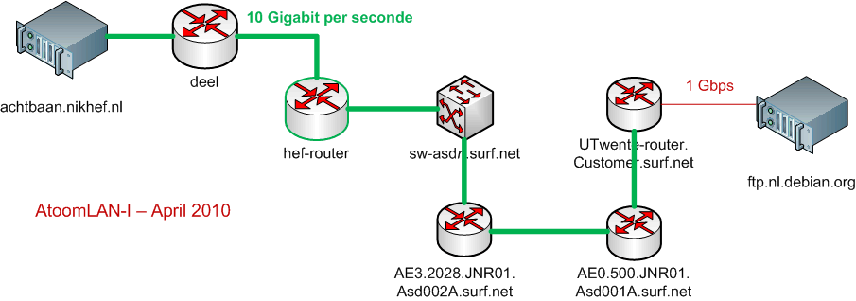
Just A Machine @Nikhef
Note
These were ‘white hat’ challenges performed as part of controlled network validation and scaling tests – so do not try this yourself!

Slide 7
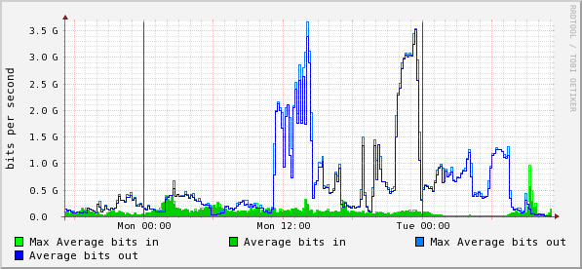
Stoomboot: data retrieval rate
stoomboot AWS price: 1.6MUS$ setup + 86.5 kUS$/month @400 TB/month

Slide 8
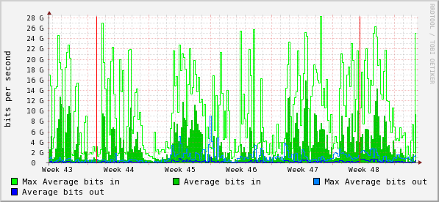
Compute-to-data-traffic NDPF/Grid
BiG Grid: network utilisation at the central Facilities @ Nikhef

Slide 9
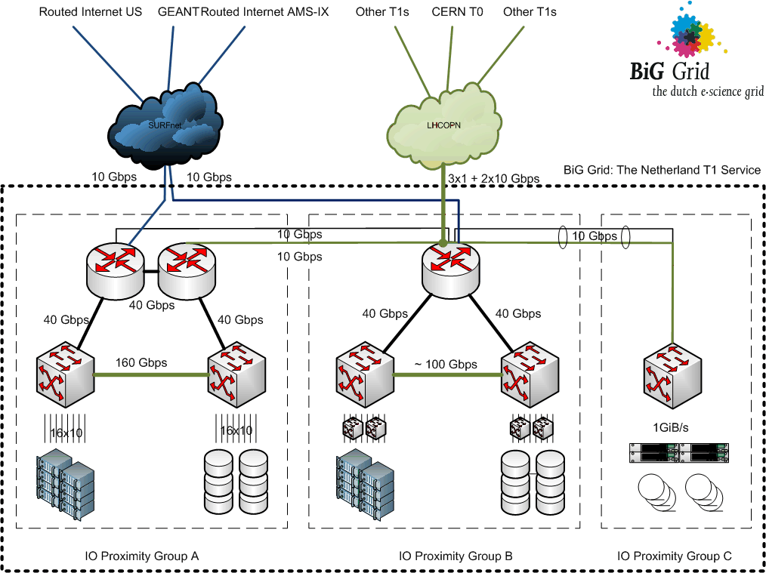

the Netherlands Tier 1 for wLCG is a service by BiG Grid,
the Dutch e-Science Grid

Slide 10
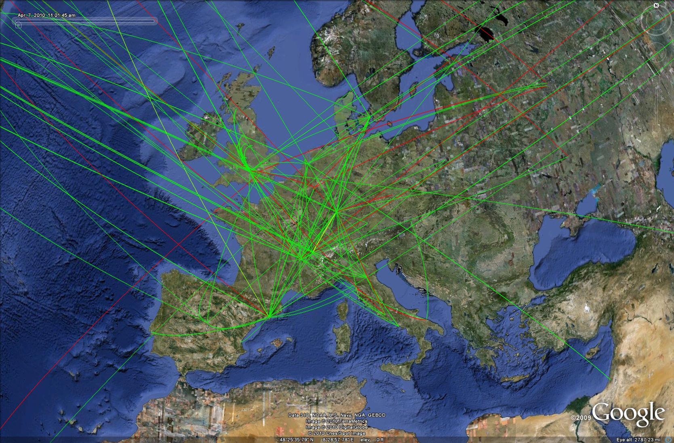

372 sites globally
10 – 40 Gbps network
296 000 CPU cores
140 000 TByte storage
Data source: gSTAT, December 2010, http://gstat.egi.eu/
Image source: wLCG, http://cern.ch/lcg/

Slide 11

Security and Availability
Need to stand up to analysis load
  Analysis is a denial-of-service attack!
  high-bandwidth infrastructure needed
  even then
  only sustainable with ‘right’ access pattern...
but for the rest of the world,
we are a potential threat – when abused
  cluster & network has monetary value in and of itself
  infected systems typically used in criminal contexts

Slide 12
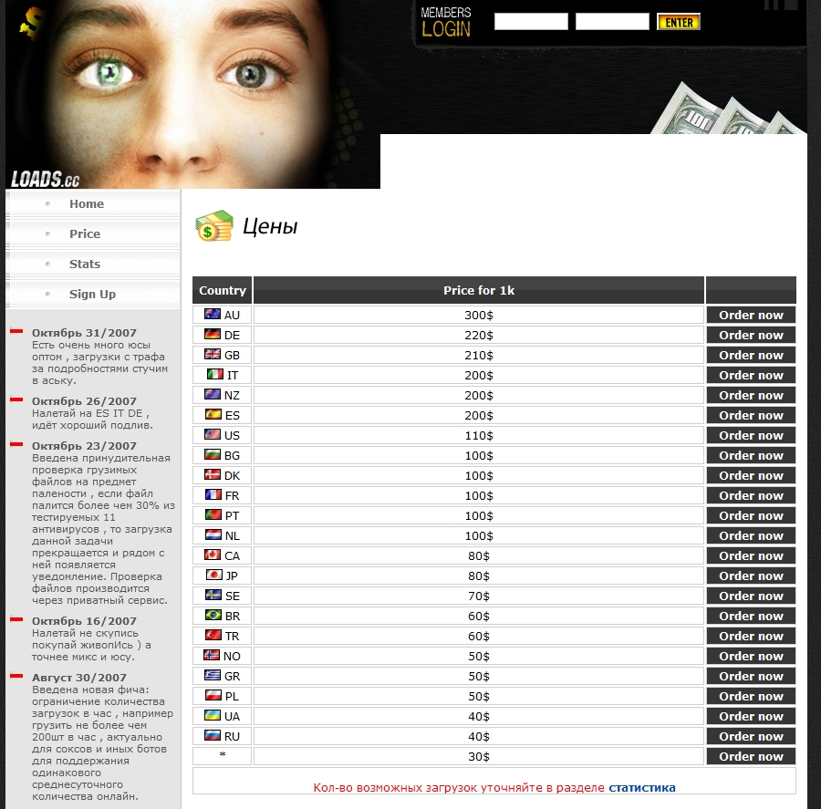

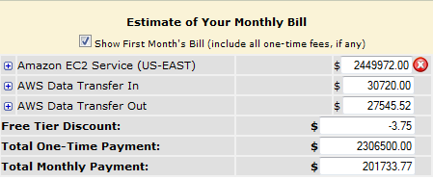
price in US$
per 1000 bots per hour
on an ADSL link
NDPF@AWS?
3-yr reserved
discounted rate ...
only compute,
not even storage!
setup * 2.3 MUS$
monthly 202 k US$
* every 3 years

Slide 13
need to secure our resources
allow you, the ‘right people’, in
whilst keeping out the ‘bad guys’
is about both security and availability

Slide 14
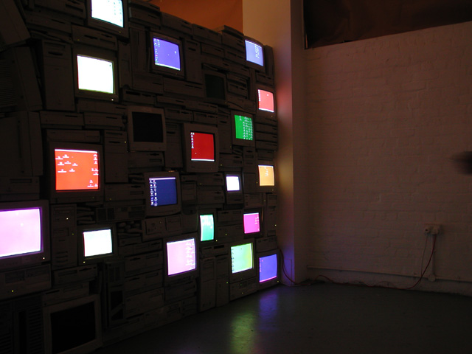
“Firewall” by Sandy Smith, www.computersforart.org

Slide 15
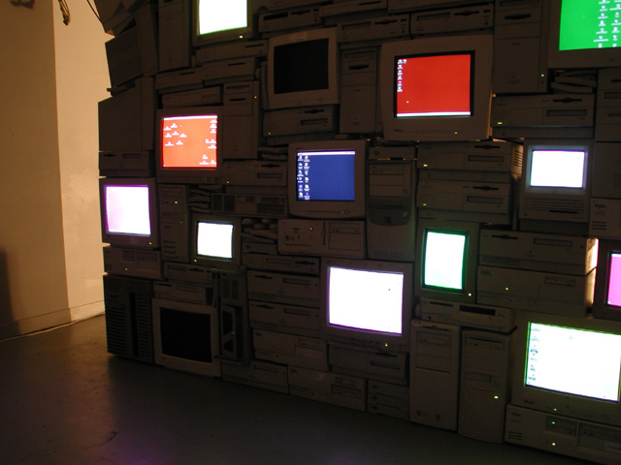
“Firewall” by Sandy Smith, www.computersforart.org

Slide 16
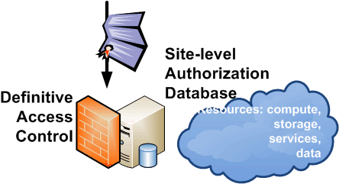
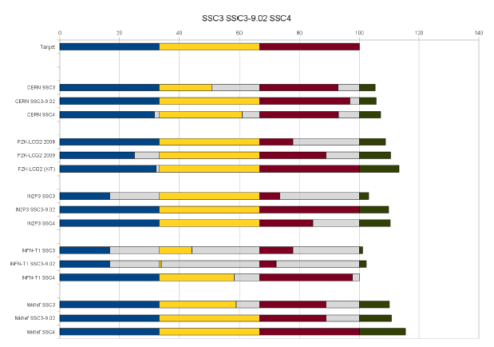
... keeping out the ‘bad guys’
Site Access Control
software development
white and blacklists
grid-aware security
vulnerability assessment
CSIRT: Incident Response
monitoring & forensics
communications
security exercises
grid-mw-security@nikhef.nl
LCG T1’s CSIRT response scores
2009 and 2010 compared
Sven Gabriel: Security Service Challenges

Slide 17
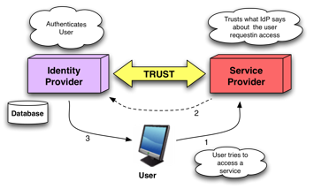
... the ‘right people’, ...

Slide 18
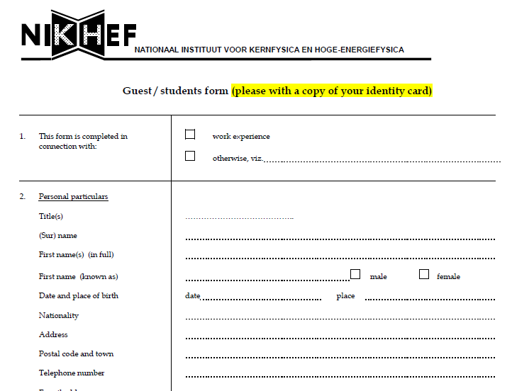
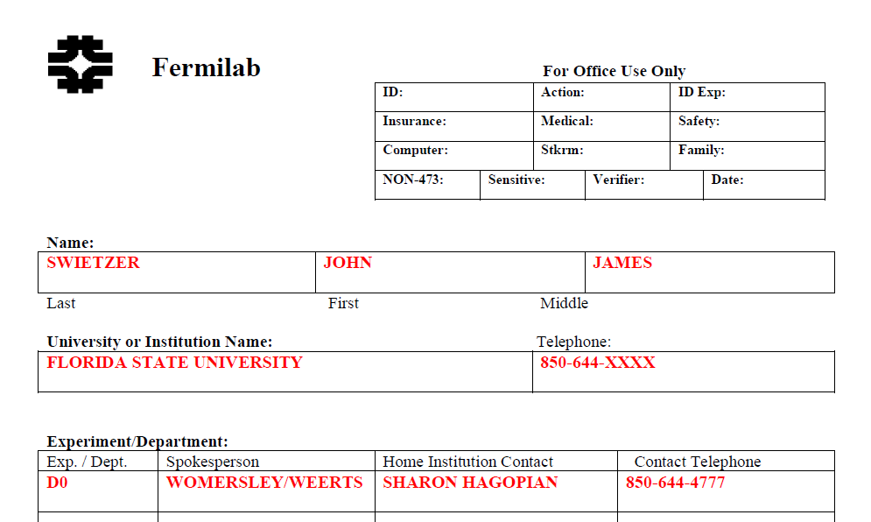
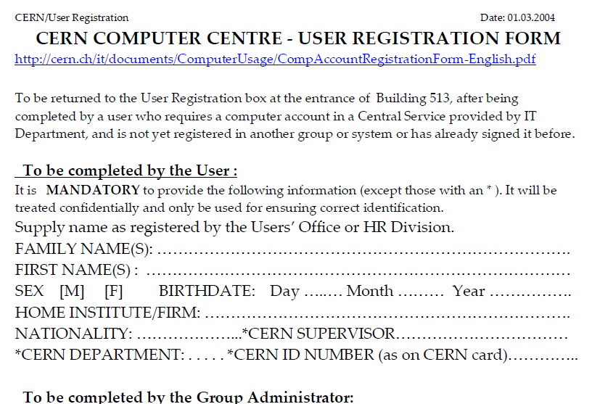
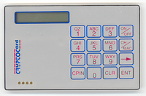
Before the Grid ...

Slide 19

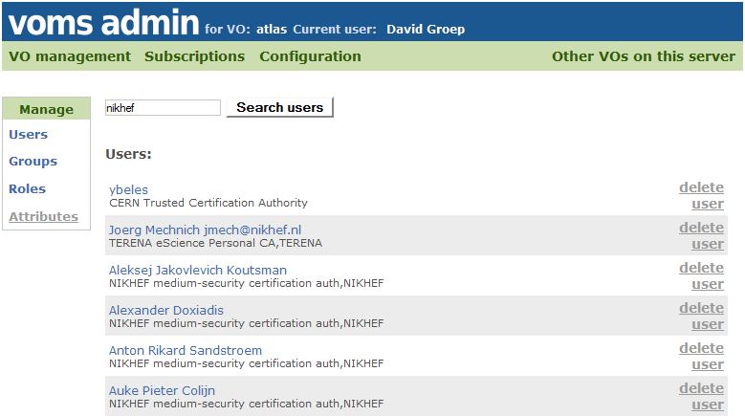
... the ‘right people’, ...

Slide 20

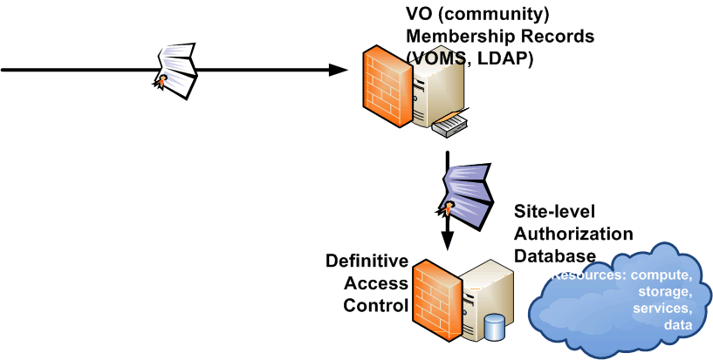
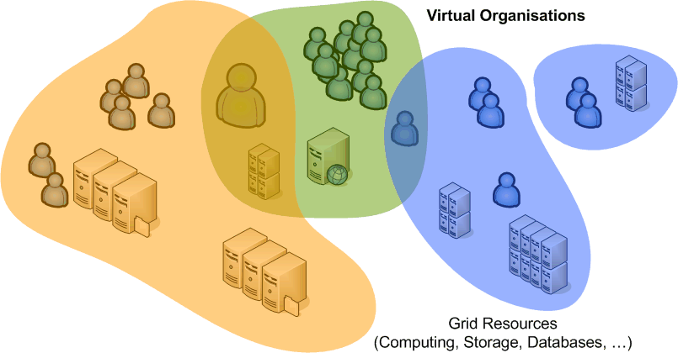
Grid Identity and Community

Slide 21
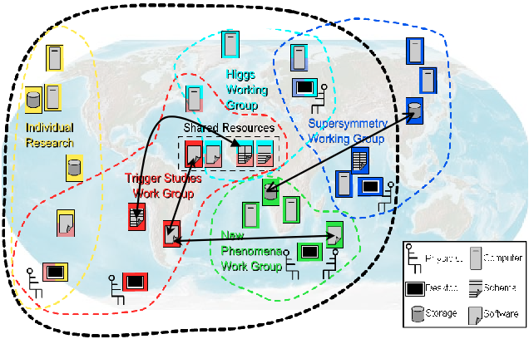
graphic: Open Grid Services Architecture, © Global Grid Forum 2005, GFD.30

Slide 22


allow you, ...
‘but we know who we are – we’re us!’
simple computer identities depend on the system involved
... but for the grid we need a global identity

Slide 23
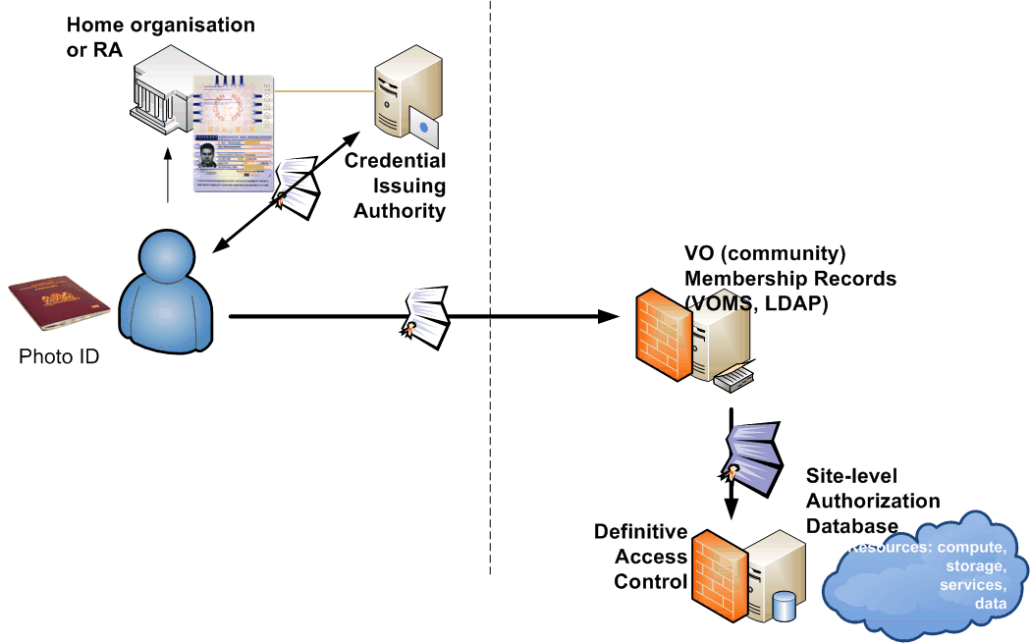
Your Global Identity
Authorization
based on the unique AuthN ID
grants or denies access
VO & Site joint security responsible
Authentication
each person globally unique name
forever persistent
traceable to a real person

Slide 24
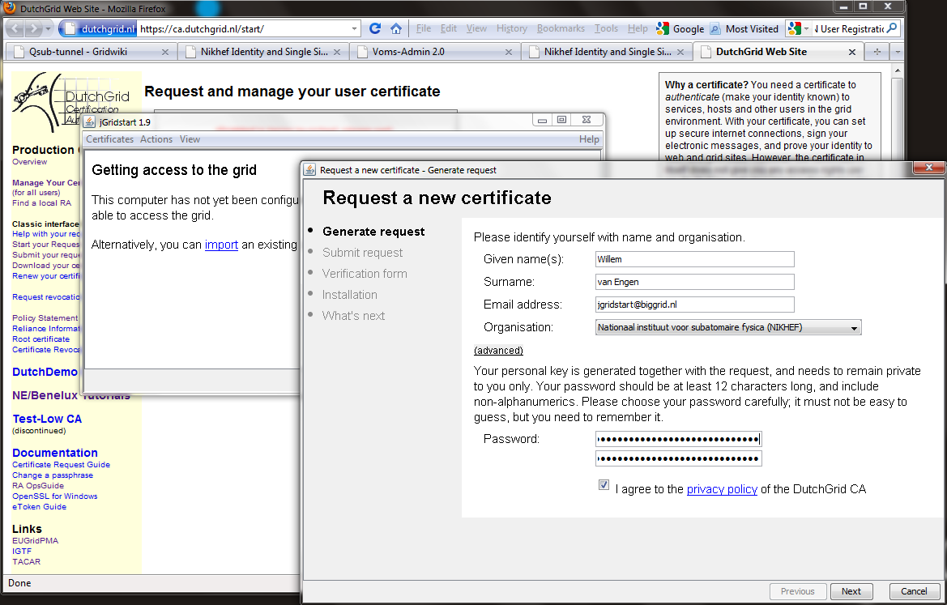

Slide 25
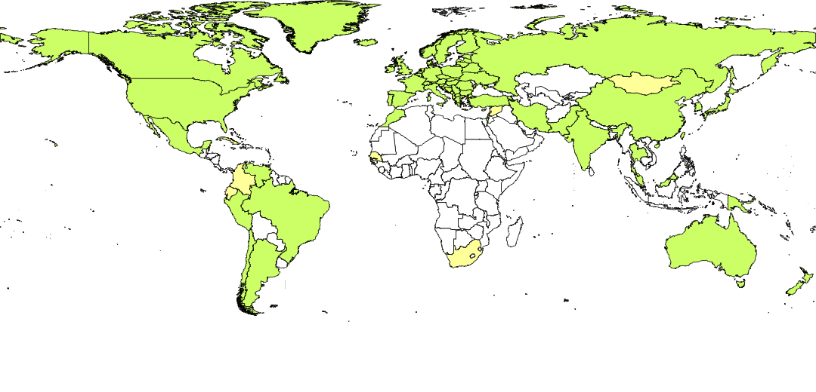



Where ever you are ... IGTF!
International Grid Trust Federation – http://www.igtf.net/
EUGridPMA – https://www.eugridpma.org/

Slide 26
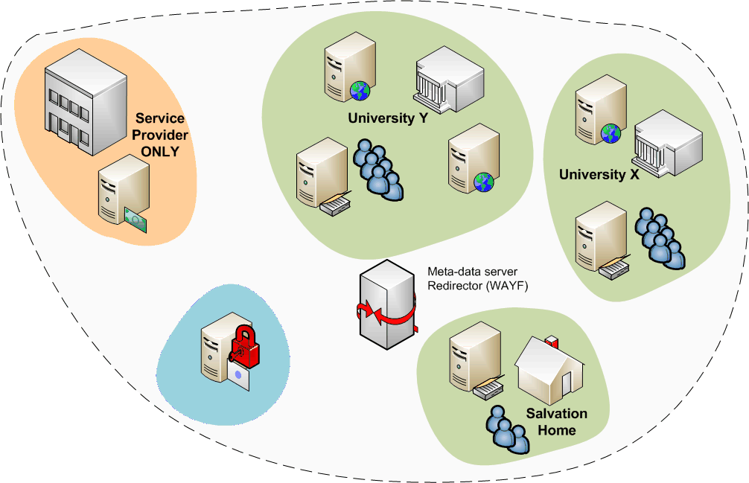

Federated Identity – we no longer run alone!
Single sign-on across academia and research
the no. 1 ICT request from the ESFRI projects
grid structure was not
too much different!

Slide 27
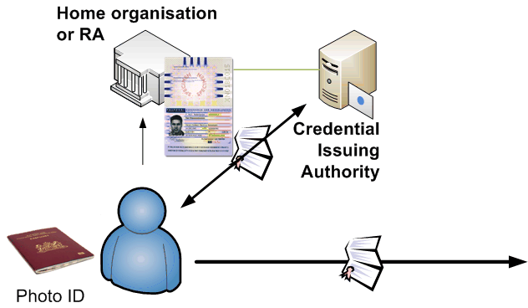
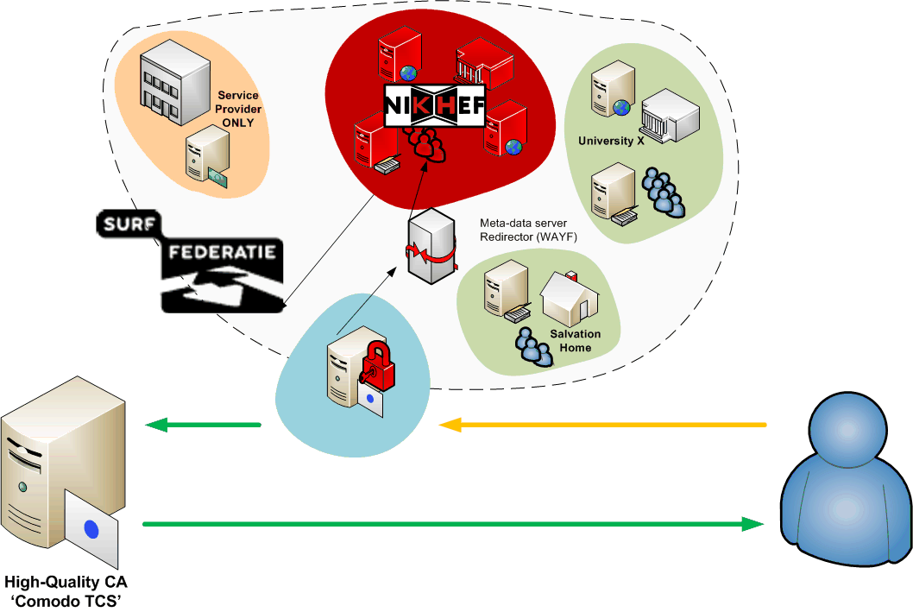

... and we keep running ...
web-SSO federations have matured
HR and ICT processes aligned
integration of ‘high-value grid’ &
web federation now becomes reality
Federation peers rely on and trust home institutes to manage their users
Trust has become global: accounts get high, global value

Slide 28

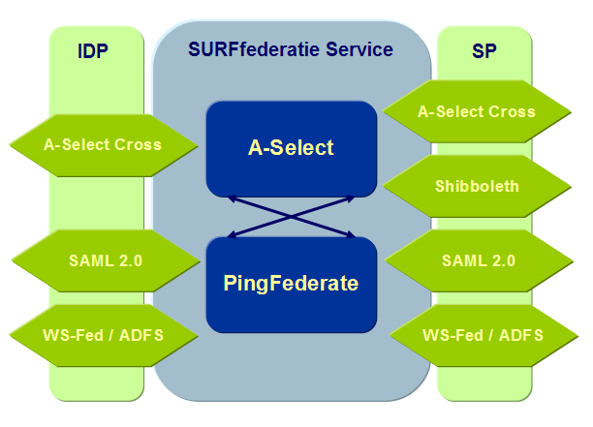




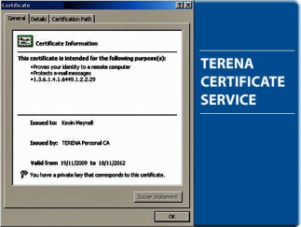

SSO for everything!

Slide 29
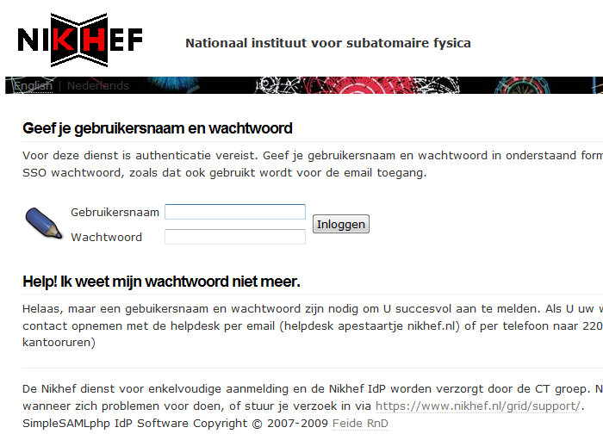
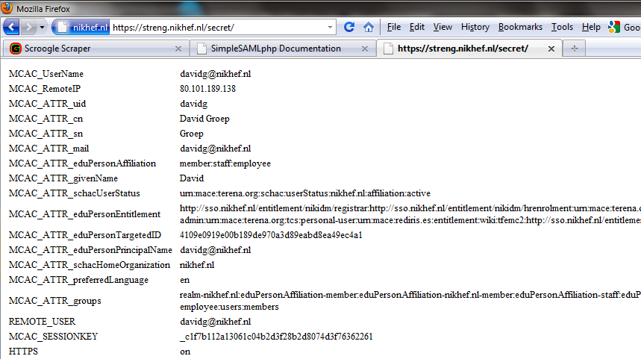
Your Very Own SSO service!
authentication without disclosing the password
Secure any http web page/site
SimpleSAMLphp
memcached (RPMforge/EL6)
a little bit of http config
access to all attributes
control any kind of web page
Secure PHP apps & services
SimpleSAMLphp
5 lines of PHP in any app
Access to all attributes and meta-data
example at http(s)://streng.nikhef.nl/secret/
http(s)://streng.nikhef.nl/test/

Slide 30
SSO for You
Access to new federated services
Same login for most services
  Desktops and login.nikhef.nl
  Email and spam filter settings
  Instant Grid certificates and access to wLCG
  Elsevier – Science Direct
  ... windows and more web applications planned as well
New applications require better controls
  account registration and expiration requirements
  needed to keep our infra secure and
  remain trustworthy for our global federation partners
https://sso.nikhef.nl/

Slide 31
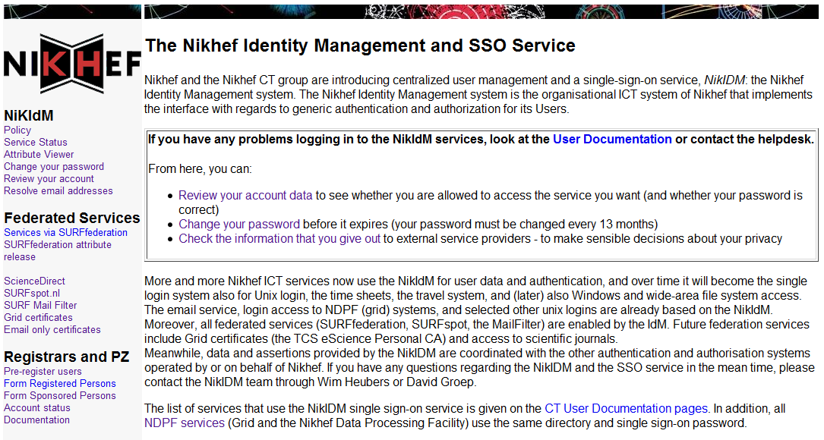
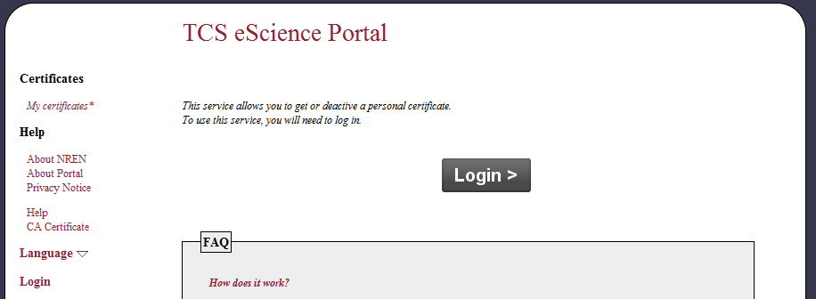
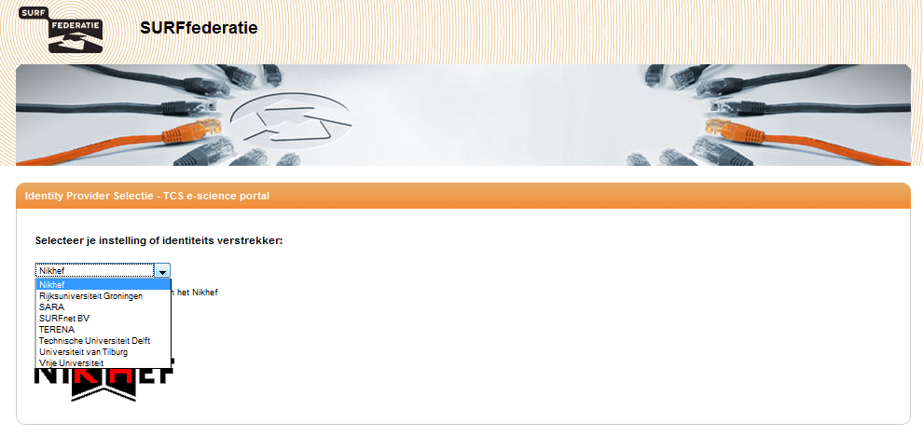
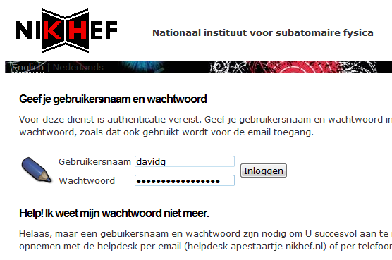
http://ca.dutchgrid.nl/tcs/ or https://sso.nikhef.nl/

Slide 32
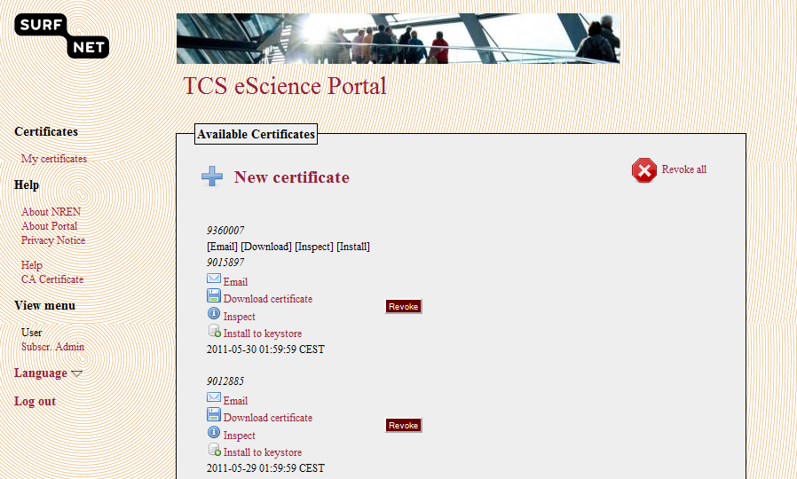
Your Certificate in 5 Clicks
... and in120 Seconds
for the longer-term future, we are working on completely hiding this ...
https://tcs-escience-portal.terena.org/ & https://www.terena.org/activities/tcs/

Slide 33
Security & Availability Take-Away
Yes: unfortunately – security is needed
Yes: we are an interesting target
... and we strive to become even more so!
@Nikhef we support development of security software and processes aiming at
user friendliness and still remain effective
allow you, the ‘right people’, in
whilst keeping out the ‘bad guys’

Slide 34
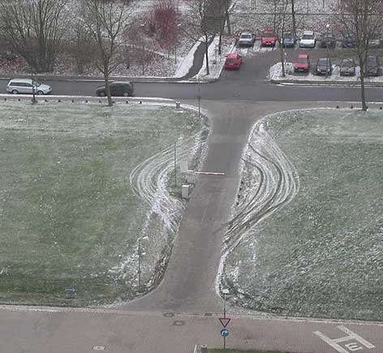
Image: MasterJM taken at Uni Bielefeld, DE
found at: http://www.schneier.com/blog/archives/2005/02/the_weakest_lin.html

