Slide 1
Welcome to Nikhef
Introduction to Nikhef,
Computing and Networking
David Groep
March 2024

Slide 2
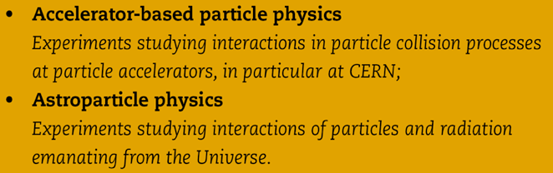
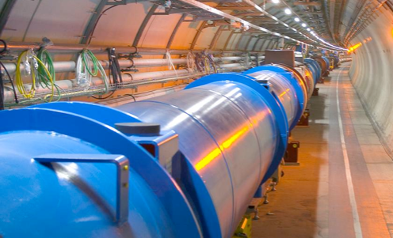
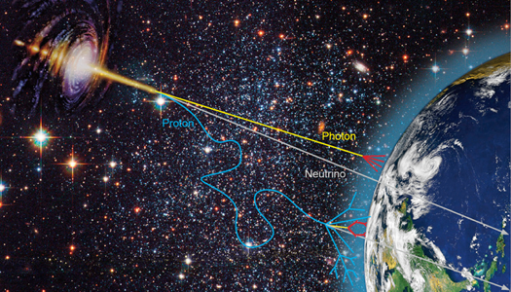


Verleggen van de grenzen van onze kennis
Phenomenology
Collider physics
Astroparticle physics
8 september 2015
Orientatie Nikhef
Notes:
not on slide but important: concentrates all NL HEP infrastructure
machine shop, designers, ICT

Slide 3
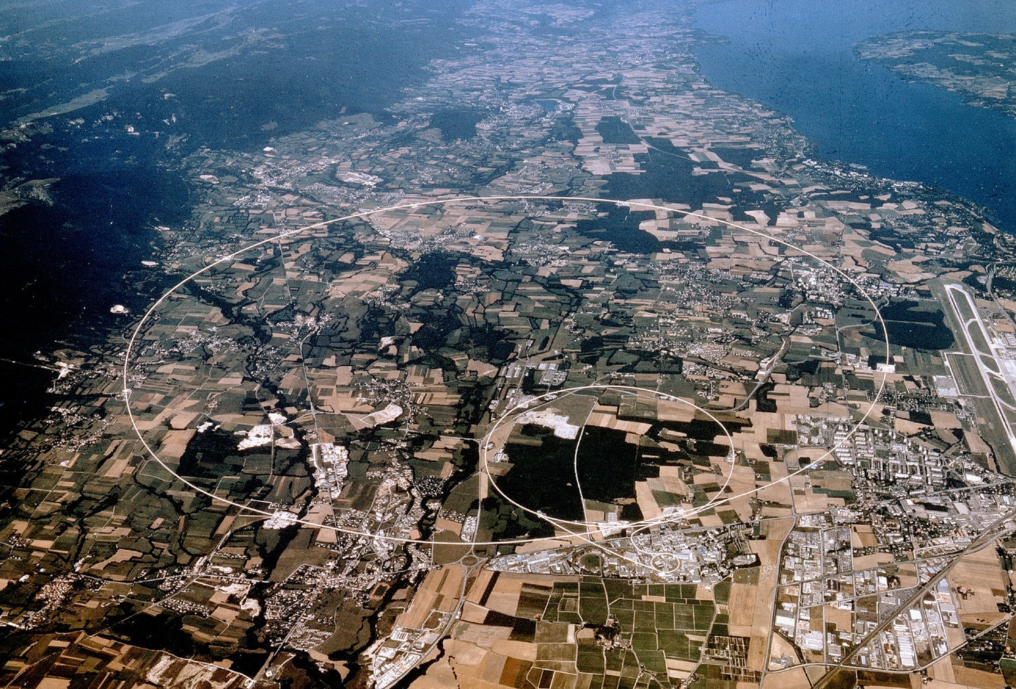


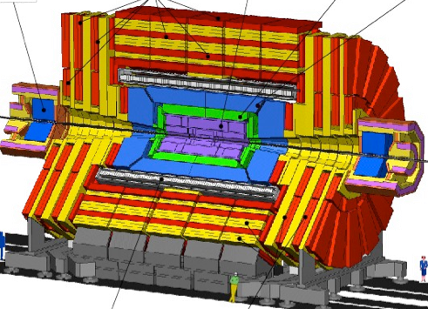




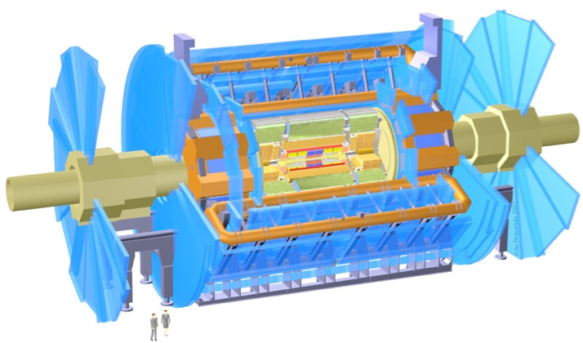

CMS
LHCb
ALICE
ATLAS
Atlas
protons
Haarlemse Chemische Kring
Imagery: CERN

Slide 4
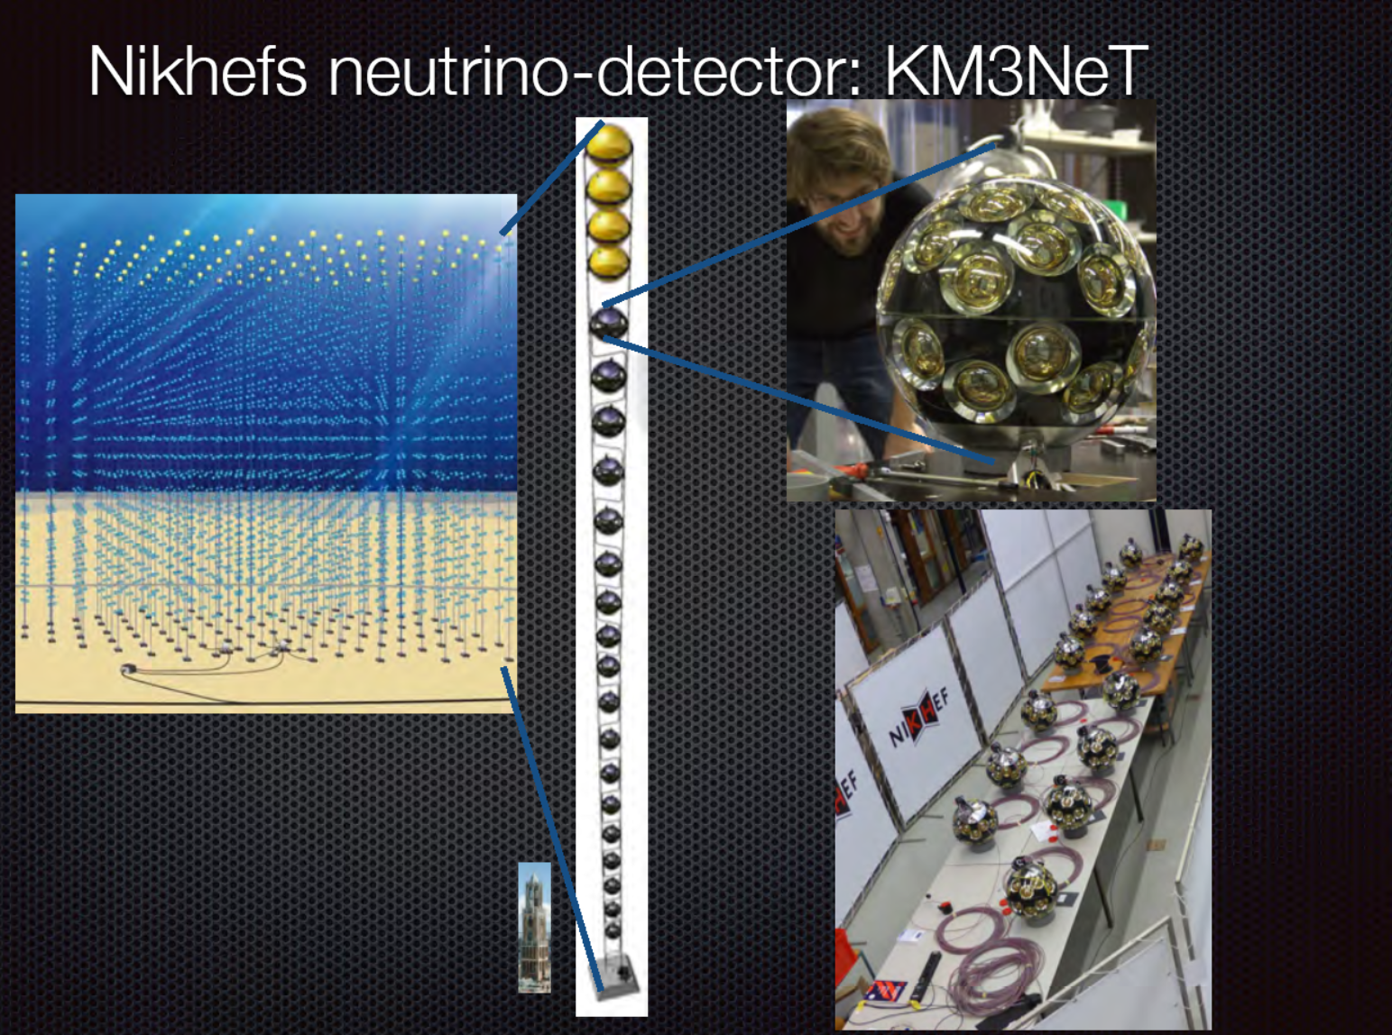

Slide 5
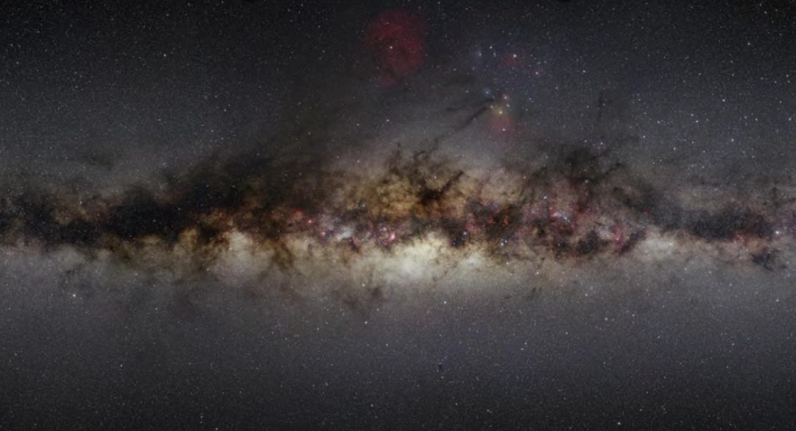
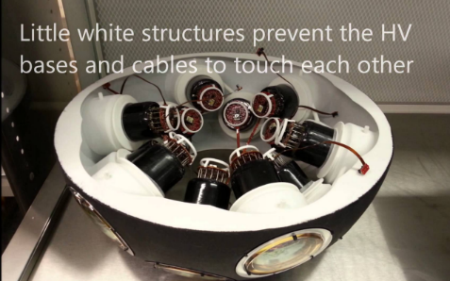
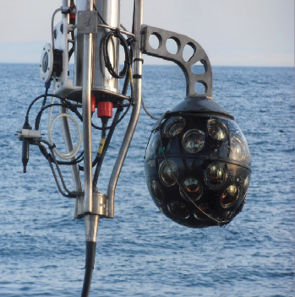
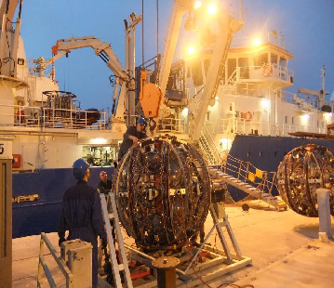
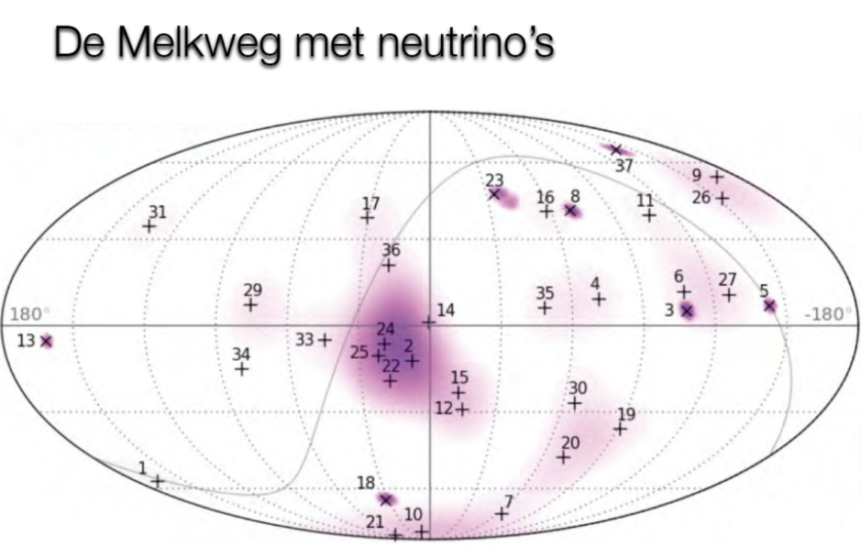
Imagery: Nikhef, NIOZ, KM3NET collaboration

Slide 6
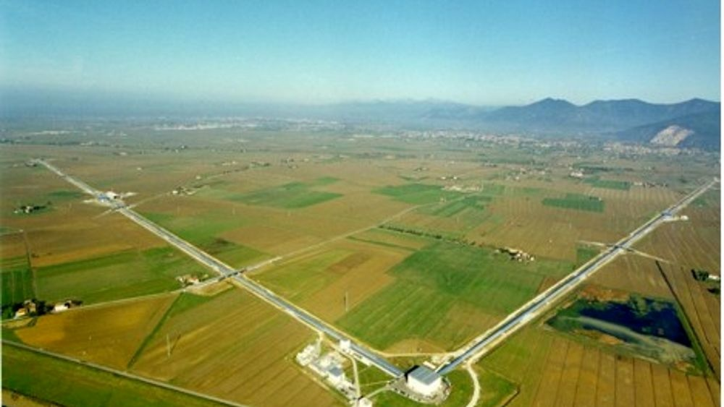
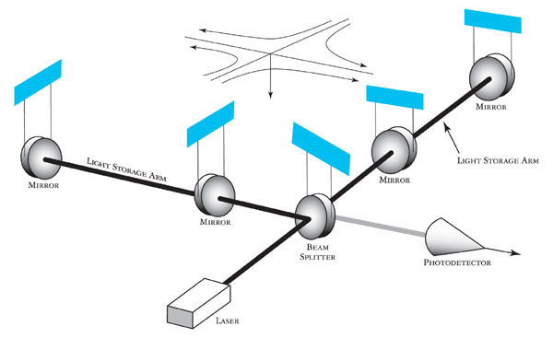
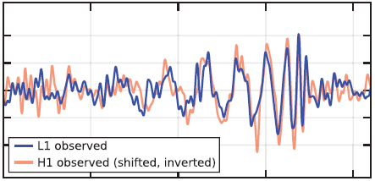

SLIDE OVER LIGO/VIRGO!!!
Imagery: gw-astronomy collaborations, LSC

Slide 7
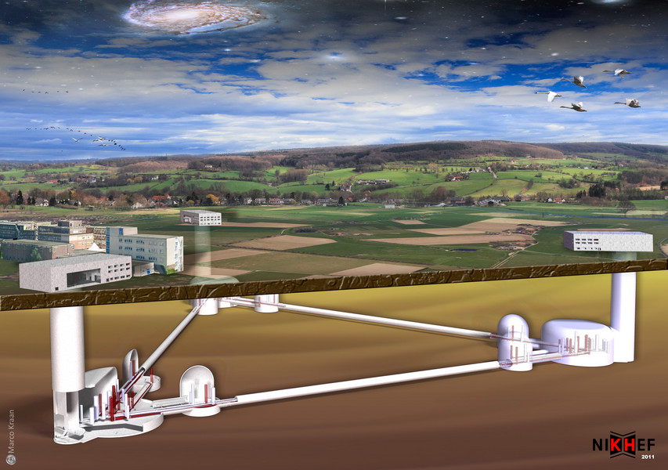
Einstein Telescope – projected onto Heuvelland Limburg, NL

Slide 8
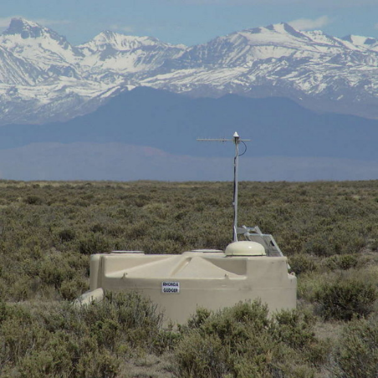
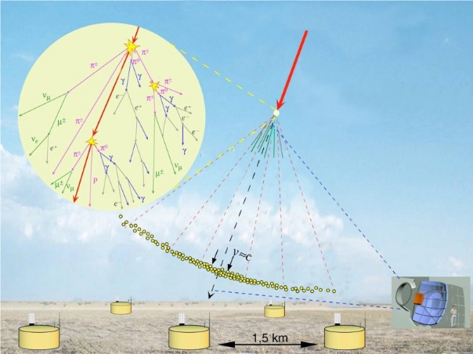
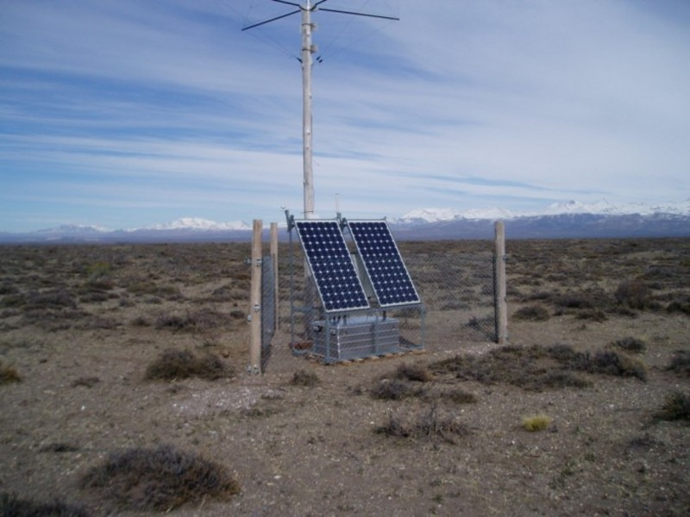
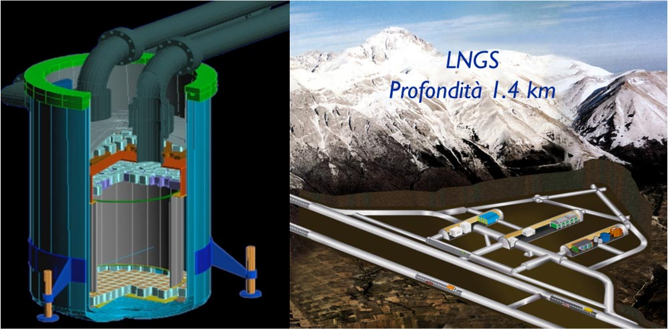
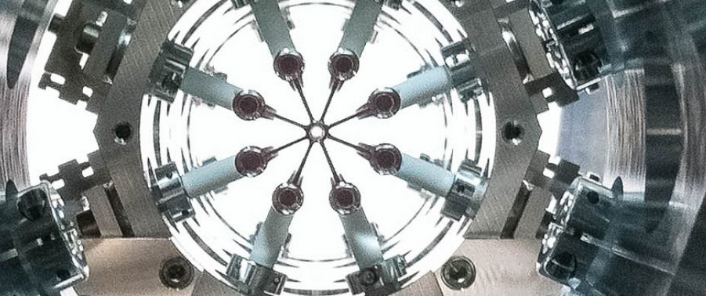
Image sources: LNGS/INFN, Xenon collaboration; Pierre Auger collaboration; Nikhef

Slide 9
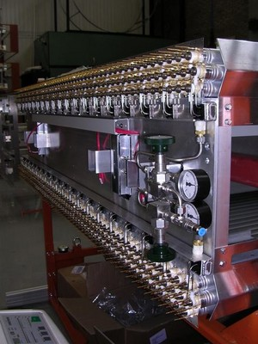
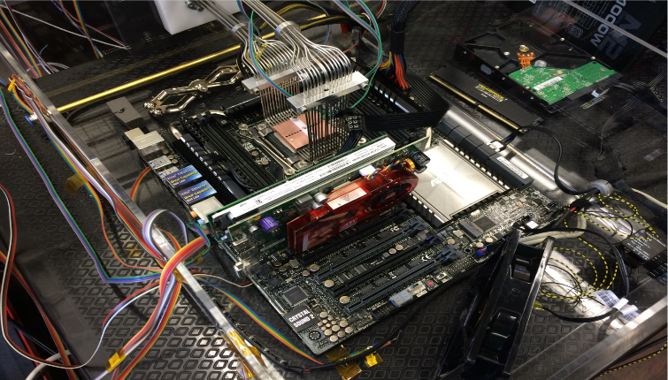
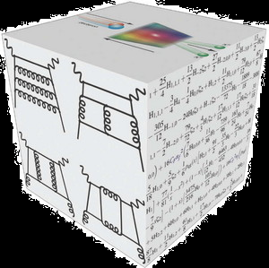
Nikhef collaboration – underpinning programmes
Theoretical Physics
Physics Data Processing
Detector R&D

Slide 10
PDP ‘Physics Data Processing’ activities and action lines
Scalable Computing
& Algorithms
algorithms for high-performance software
data organisation
accelerator throughput
rethinking code: at small scale and on large scales
Research Infrastructure
& Future Technologies
NDPF processing facility
National e-Infrastructure
coordinated by SURF
experimental next-gen systems engineering
cross-tier global networks
stressing & public/private collaborative design
Infrastructure for Secure Collaboration
authentication and authorization protocols
multi-domain federation
global trust and identity
access provisioning
operational security

Slide 11
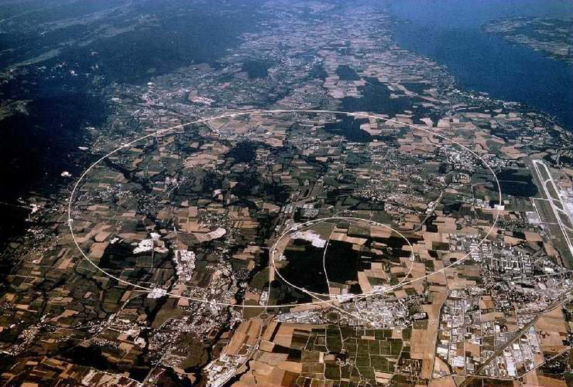
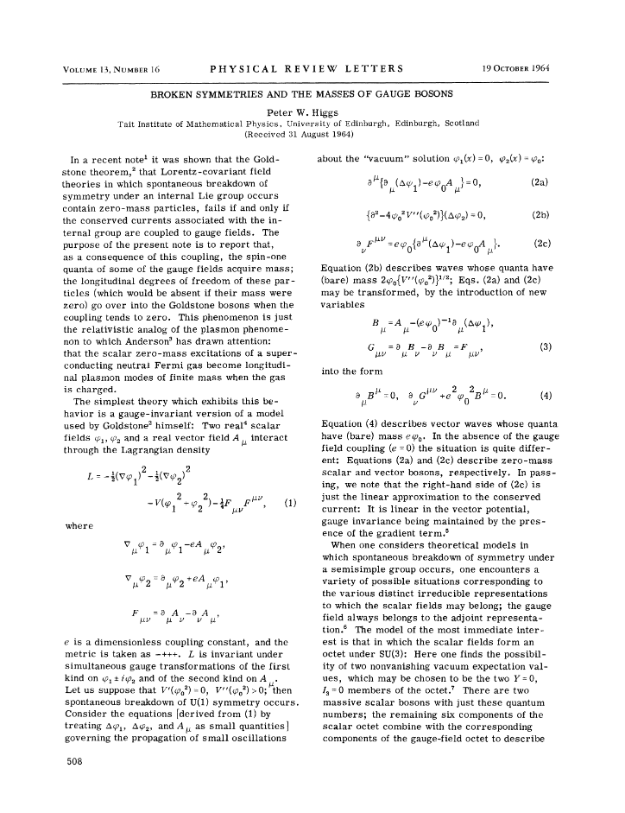
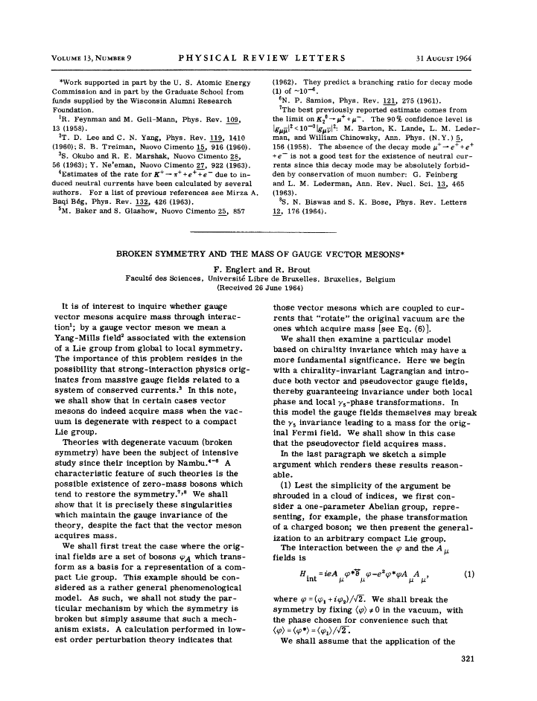
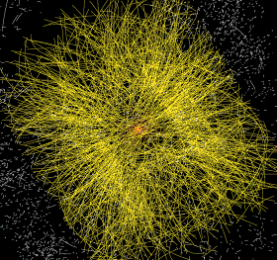
Data at the Large Hadron Collider at CERN
1964
~ 50 PiB/year
primary data
P. Higgs, Phys. Rev. Lett. 13, 508
16823 characters, 165kByte PDF

Slide 12
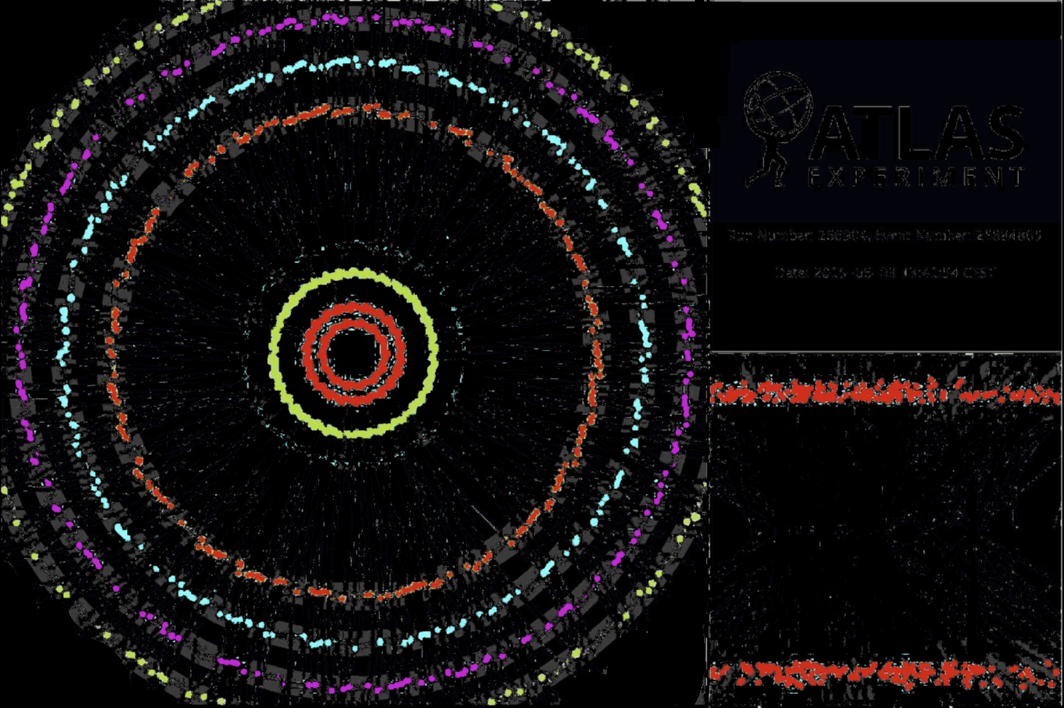
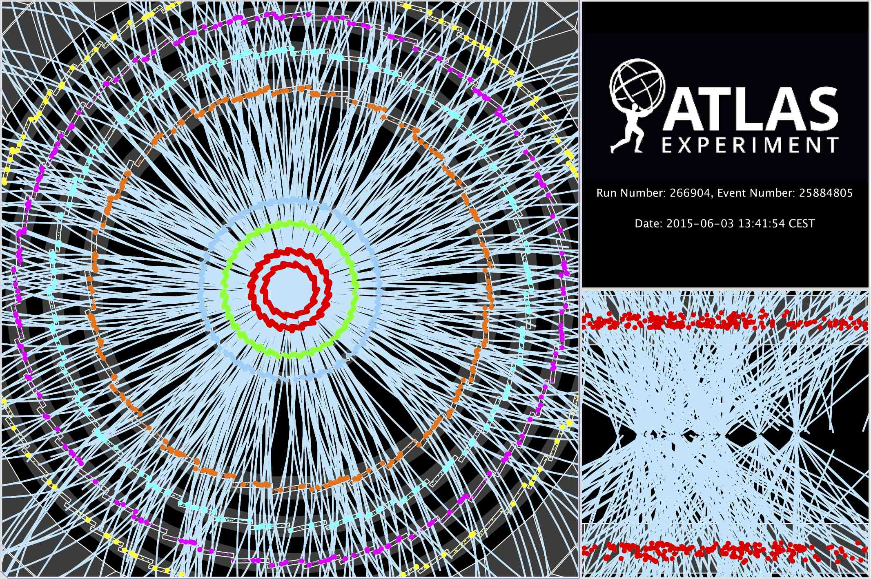

Computing on lots of data – 40 Mevents/sec
~ 10 seconds to compute
a single event at ATLAS
for ‘jets’ containing ~30 collisions
Display of a proton-proton collision event recorded by ATLAS on 3 June 2015, with the first LHC stable beams at a collision energy of 13 TeV;
Event processing time: v19.0.1.1 as per Jovan Mitrevski and 2015 J. Phys.: Conf. Ser. 664 072034 (CHEP2015)

Slide 13
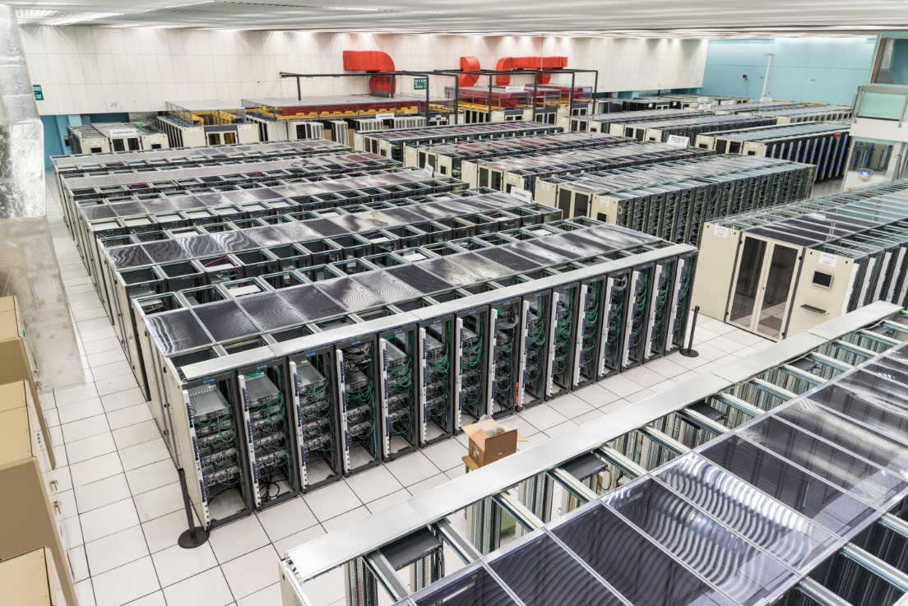
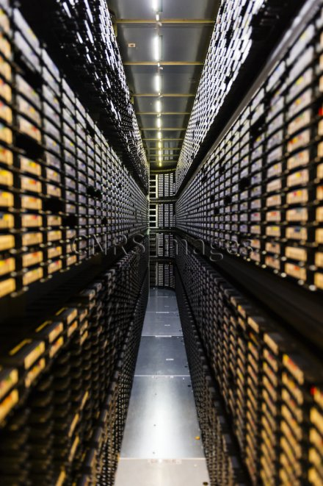
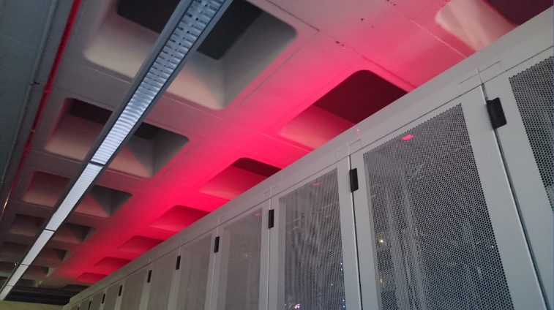
‘Big Science’ needs some computing …
CERN CC B513, image: https://cds.cern.ch/record/2127440; tape library: CC-IN2P3 with LHC and LSST data; cabinets: Nikhef H234b

Slide 14
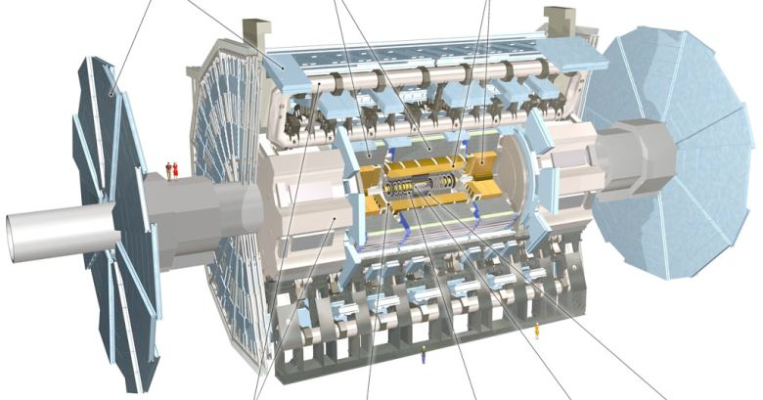

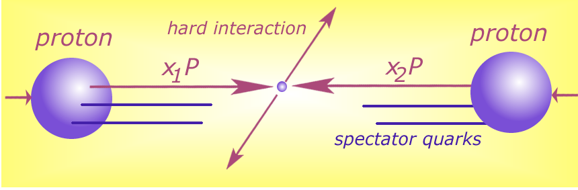

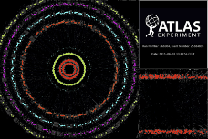


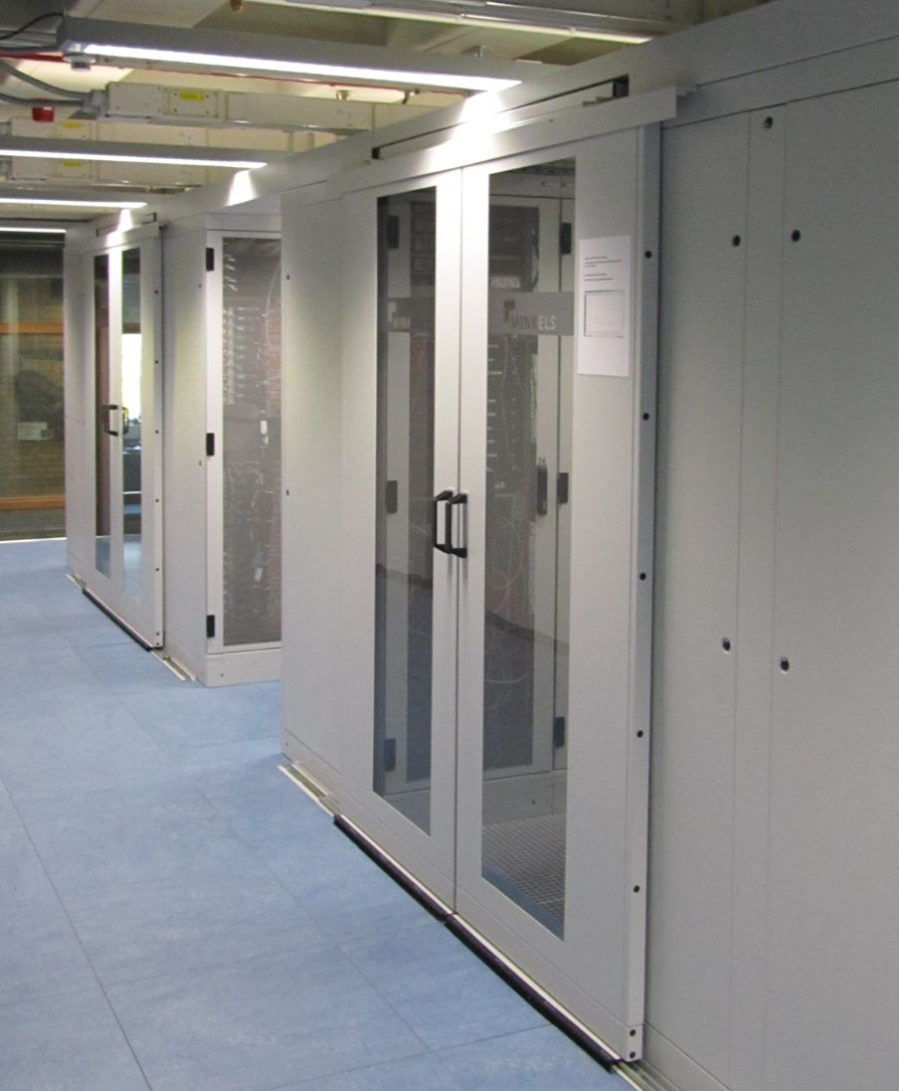






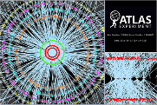

Detector to doctor workflow
40 million collisions / second
Physics analysis by (PhD) students, in papers & analysis notes
Trigger system selects
600 Hz ~ 1 GB/s data
Classify particles in collision and their physics properties:
- electrons
- muons
- jets consisting
of hadrons
- …
diagram adapted from Frank Linde; images: ATLAS collaboration, Nikhef. … and sorry for the GDPR-blur

Slide 15
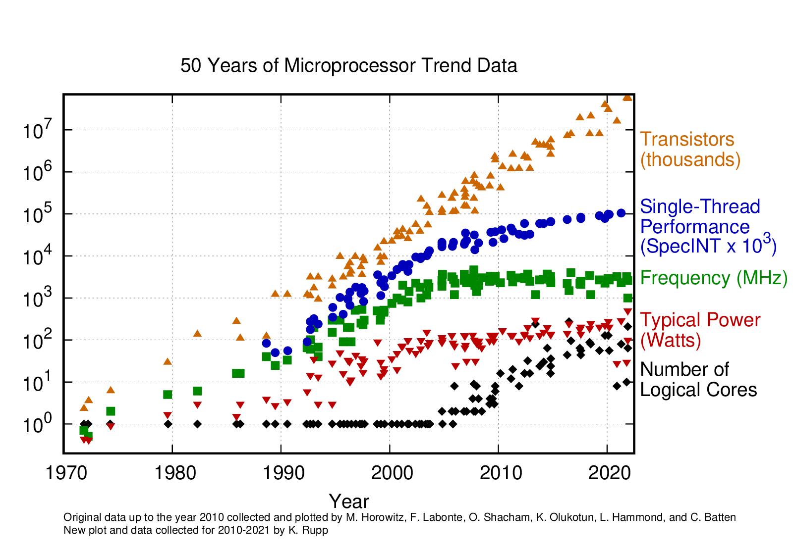
Single CPU scaling stopped around 2004
limitation is power, not circuit size
  and clock frequency is most ‘power-hungry’
  still some packages now @ TDP of 400W
multiple cores on the same die helped
  AMD EPYC Genoa (Zen 4) has 96 cores on die
  Intel Cascade Lake AP looked like a cludge
  but now Sapphire Rapids appears better again
CPU design-performance gains left
  predictive execution
  out-of-order execution
  on-die parallelism (multi-core)
  pre-fetching and multi-tier caching
  execution unit sharing (‘SMT’)
  but at increased risk for security/integrity
Image: K Rupp, https://github.com/karlrupp/microprocessor-trend-data

Slide 16
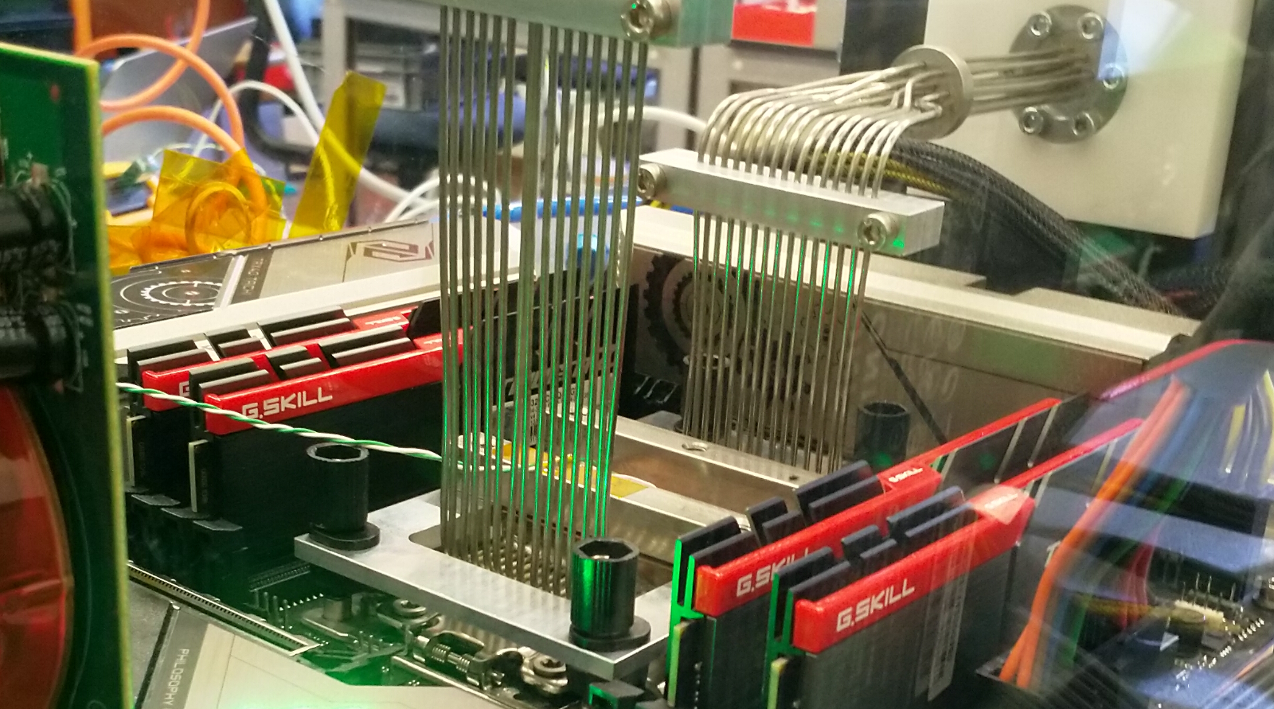
Fix the thing that didn’t scale well, CPU frequency??
LCO2 cooling of an AMD Ryzen Threadripper 3970X [56.38 °C] at 4600.1MHz processor (~1.5x nominal speed) sustained,
using the Nikhef LCO2 test bench system (https://hwbot.org/submission/4539341) - (Krista de Roo en Tristan Suerink)

Slide 17
… since you then need this around it …
Nikhef 2PA LCO2 cooling setup. Image from Bart Verlaat, Auke-Pieter Colijn CO2 Cooling Developments for HEP Detectors https://doi.org/10.22323/1.095.0031
proceed to clusters

Slide 18
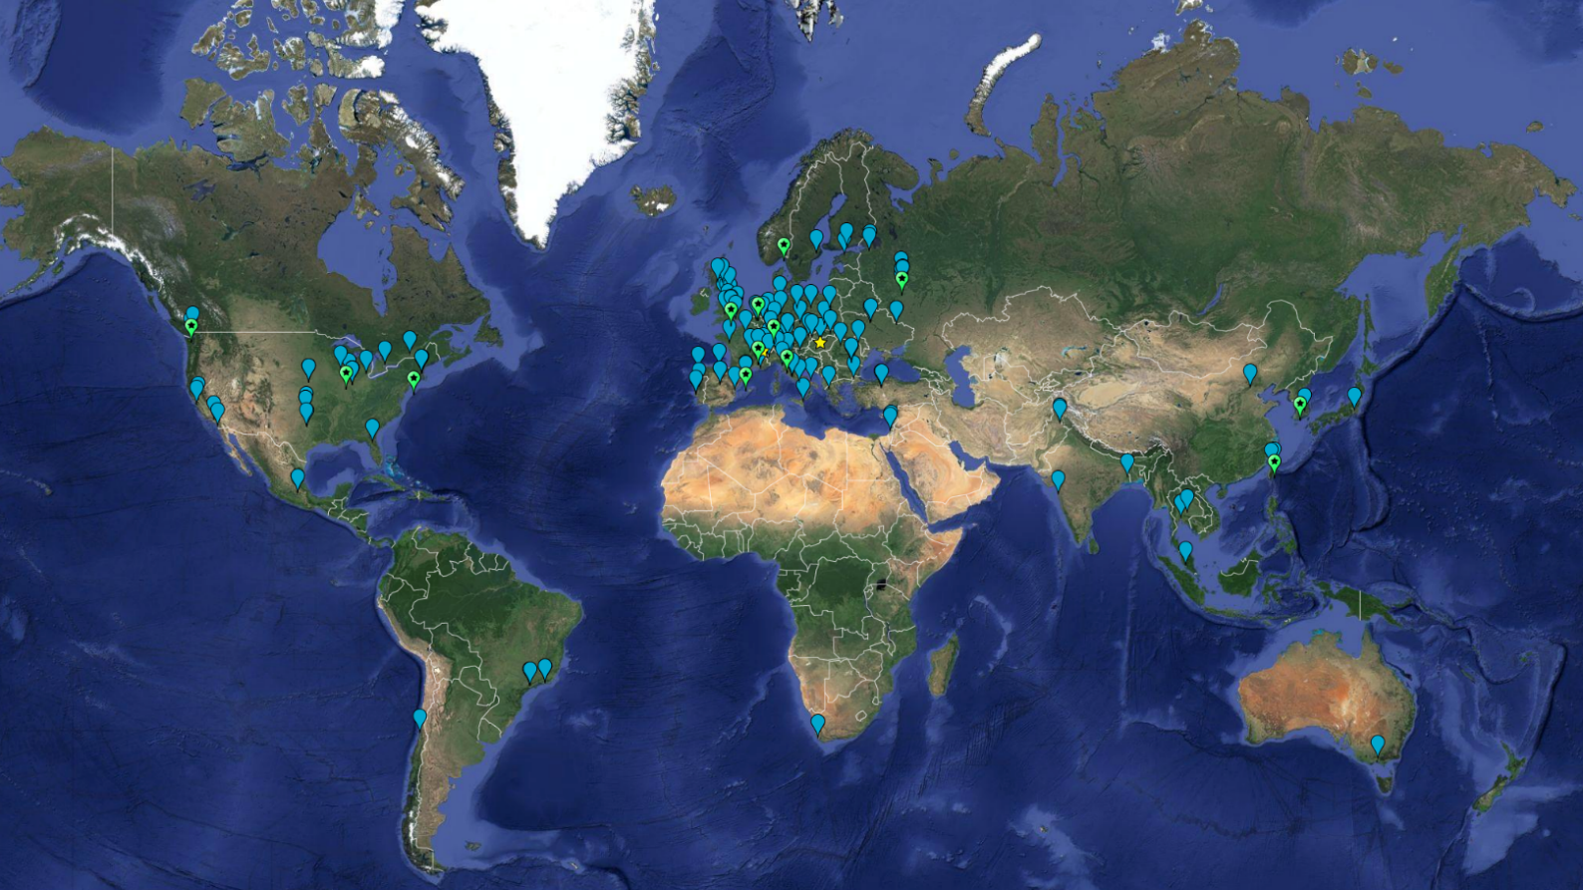
With 20 000+ users, you need something global: WLCG!
~ 1.4 million CPU cores
~ 1500 Petabyte
disk + archival
170+ institutes
40+ countries
13 ‘Tier-1 sites’
NL-T1:
SURF & Nikhef
e-Infrastructures
EGI
PRACE-RI
EuroHPC
OpenScienceGrid
XSEDE (ACCESS)
Earth background: Google Earth; Data and compute animation: STFC RAL for WLCG and EGI.eu; Data: https://home.cern/science/computing/grid
For the LHC Computing Grid: wlcg.web.cern.ch, for EGI: www.egi.eu; ACCESS (XSEDE): https://access-ci.org/, for the NL-T1 and FuSE: fuse-infra.nl, https://www.surf.nl/en/research-it

Slide 19

Global distribution of computing and data placement
WLCG and EGI Advanced Computing for Research

Slide 20

More of more than one …
@Nikhef
> 1 user group
> 1 organization
> 1 system
> 1 site

Slide 21
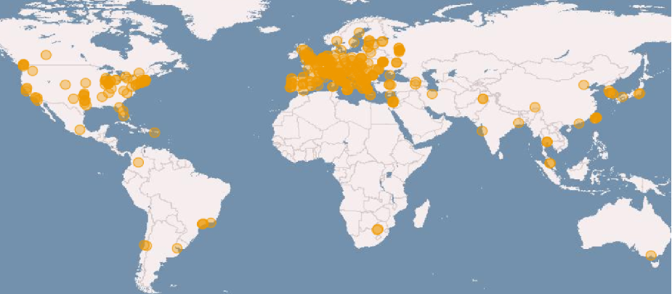
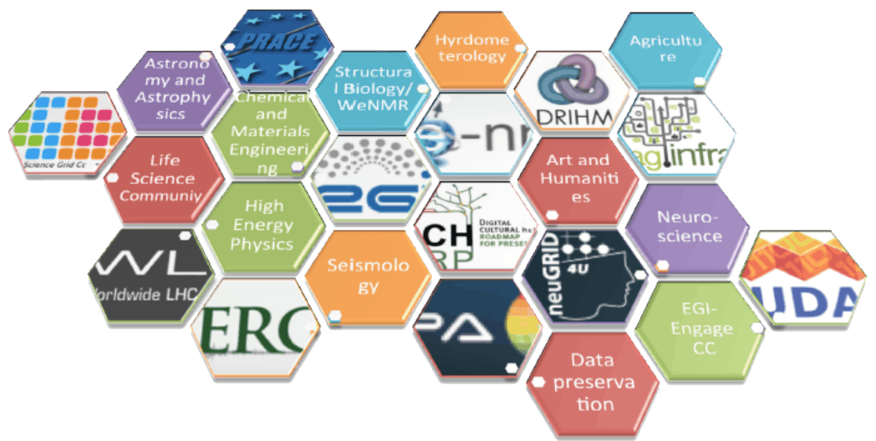
e-Infrastructures: EGI, EUDAT, GEANT, PRACE, …
imagery: EGI.eu

Slide 22
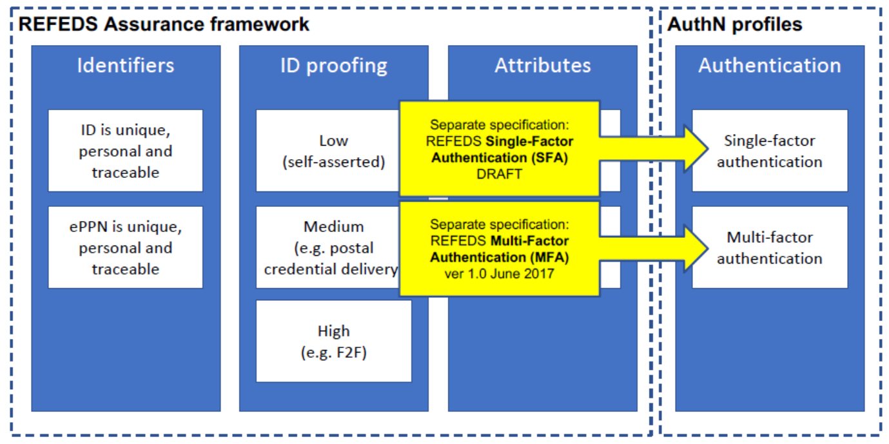

Policy-bridged global federations for research computing
Auth 2
Authority 1
Auth n
Auth 3
charter
guidelines
acceptance process
3 regional areas (for scalability): EMEA, Americas, Asia Pacific
~ 90 Identity Providers (some leveraging a R&E federation)
~ 10 international major relying parties
~ 60 countries / economic areas / international treaty orgs
> 1000 relying service provider collaborations
relying
party n
relying
party 1
Image: Interoperable Global Trust Federation IGTF, https://igtf.net/; REFEDS Assurance Framework RAF: http://refeds.org/assurance, https://refeds.org/profile/mfa

Slide 23
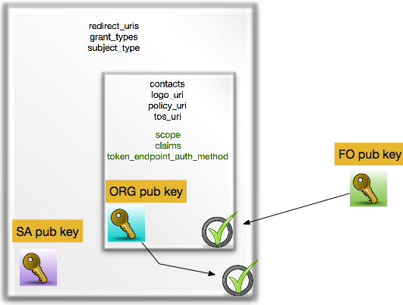
OpenID Connect Federation
OIDC endpoints + trust policy data for registration can be federated in a meta-data feed
makes OIDC ‘federatable’ (plain oidc is single OP)
as for PKIX, can be technical or policy bridge
delegated metadata
makes ‘OIDC-fed’ scale
in webscale scenarios
Image: Roland Hedberg, University of Umeå
OpenID Connect Fedrration:
https://openid.net/specs/openid-connect-federation-1_0.html

Slide 24
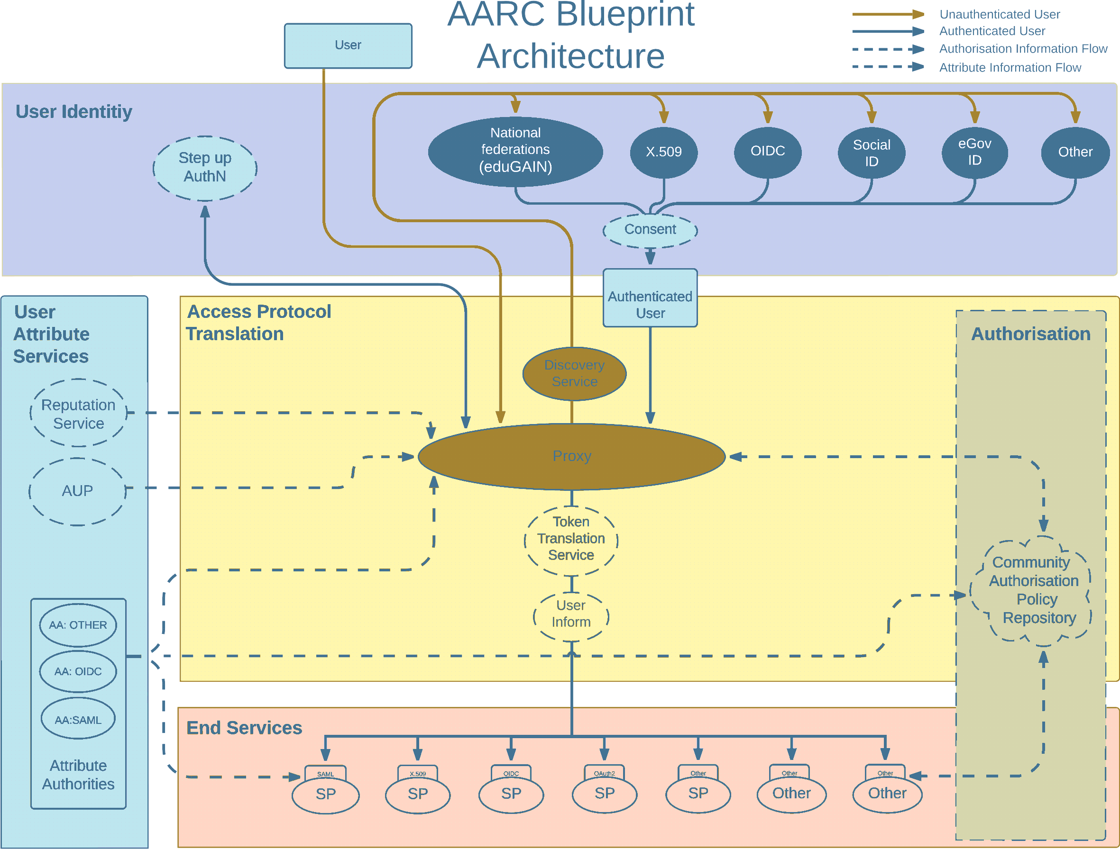
Most trust flows from the (research) community
AARC Blueprint Architecture (2019) AARC-G045 https://aarc-community.org/guidelines/aarc-g045/; stacked proxies: EOSC AAI Architecture
EOSC Authentication and Authorization Infrastructure (AAI), ISBN 978-92-76-28113-9, http://doi.org/10.2777/8702

Slide 25
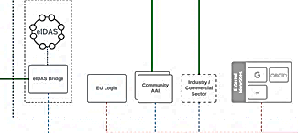
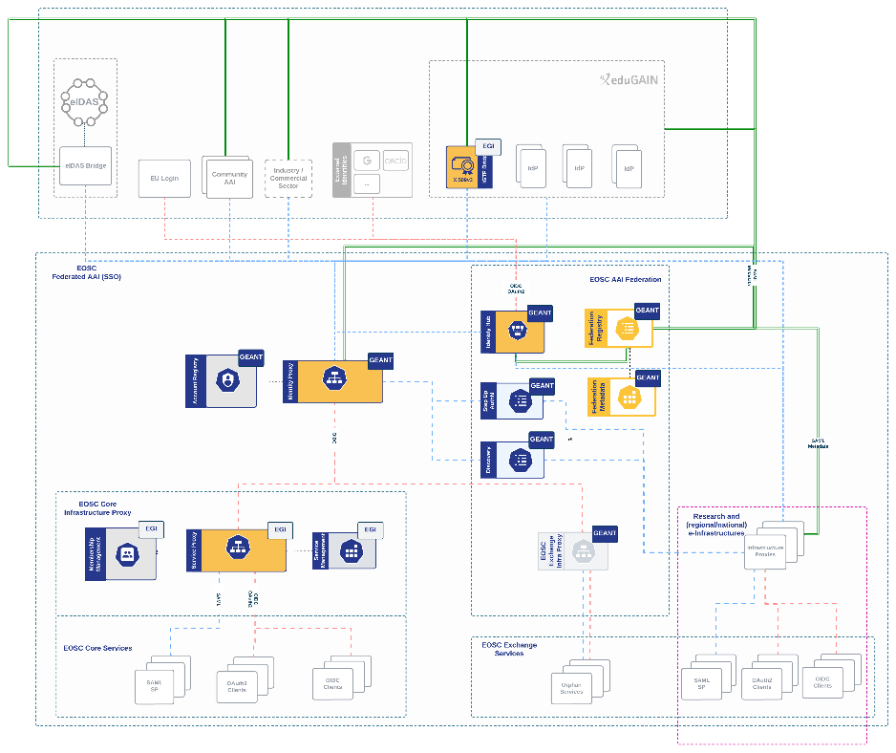
EOSC AAI Federation
Identity assurance brings the true value: authenticators are aplenty, and ‘MFA’
far less interesting than vetted identities.
But HEI home IdPs seem reluctant to provide it …
user identity comes ‘with the user’ from outside,
mediated by the research community, ORCID,
or from the home member state involved
Image: EOSC AAI for the EOSC Core and Exchange Federation for the EOSC European
Node by Christos Kanellopoulos, Nicolas Liampotis, David Groep (June 2023)

Slide 26
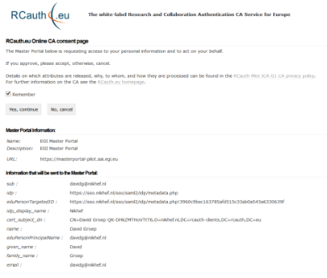
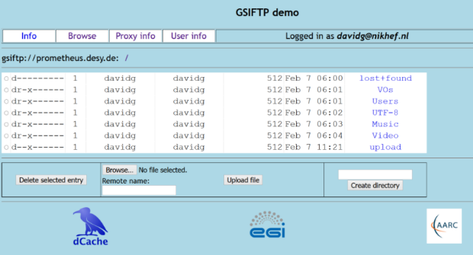






Bridges: token translation example ‘SAML’ to PKIX
user facing
hidden back-end
Community Science Portal
IGTF accredited
PKIX Authority
Infrastructure Master
Portal Credential Store
User Home Org
or Infrastructure IdP
REFEDS R&S
Sirtfi Trust
see also https://rcdemo.nikhef.nl/
Policy Filtering WAYF to eduGAIN
Built on CILogon and MyProxy, see www.cilogon.org
Notes:
VO portal can be anything even a simple shell
Certs stored only for 11 days
Master portal can add attributes via VOMS (or others in the future)

Slide 27




With a single, yet fully compliant, ‘Heath Robinson’ CA

Slide 28

A single-site locally-highly-available RCauth at Nikhef Amsterdam
Most ‘fault-prone’ components are
  Intel NUC (single power supply)
  HSM (can lock itself down, and the USB connection is prone to oxidation)
  DS front-end servers (physical hardware, albeit with redundant disks and powersupplies)
private
semi-redundant
switch
Eliminated SPOFs first
using ‘local HA’

Slide 29


Since we do not like SPOFs …
Distributed High Availability setup
across the 3 sites
design for minimal effort
readily-available techniques
  L3 VPN (OpenVPN) or L2 VPC
  Linux HAProxy
STFC (OXF)
Nikhef (AMS)
work supported by the EOSC Hub and EOSC Future Horizon Europe projects
GRNET (ATH)

Slide 30
A transparent multi-site setup is needed for the user
User
connects to HA proxy at {wayf,pilot-ica-g1}.rcauth.eu
HA proxy sends users to “closest” working service
primarily forward to its own DS when available
HA proxy
HA proxy
VPC or VPN interconnect
Straightforward proven solution is IP anycast
wherever the user is, the service is at
2a07:8504:01a0::1
or for legacy IP users at 145.116.216.1
HA proxy
If a HA loses its
backend DS, can still
route to another DS
over VPC/VPN backend
selected imagery: Mischa Sallé, Jens Jensen, Nicolas Liampotis

Slide 31


Getting 2a07:8504:1a0::/48 out there
route maps: bgp.tools for 2a07:8504:1a0::/48 – IPv4 for 145.116.216.0/24 is similar – imagery from November 2022

Slide 32

And you get reasonable load balancing in Europe for free
map: RIPE NCC RIPE Atlas - 500 probes, distributed across Europe (https://atlas.ripe.net/measurements/50949024/)

Slide 33


Many parties, shared security challenges
Challenges
IdP appears outside
the service’s security mandate
Lack of contact or lack of trust in the IdP
which to the SP is an unknown party
IdP fails to inform other affected SPs, for
fear of leaking data, of reputation,
or just lack of interest and knowledge
No established channels of communication, esp. not to federations themselves!

Slide 34









Exercises – communications and actions
parties involved in response challenge

Slide 35


SSC monitoring

Slide 36

More than one: Nikhef Science Data Centre (‘234b’)

Slide 37

Physical farms: selecting the ‘worker nodes’
For HTC applications
– like WLCG, IGWN,
but also SKA, WeNMR – typically
balanced features for node throughput
(CPU, storage, memory bandwidth, network)
single-socket multicore systems are fine,
typical: 64-128 cores per system
network: 2x25Gbps
(+ ‘out of band’ management like IPMI)
memory: 8 GiB/core
local disk: 4TB NVME PCIe Gen4 x4
+ space (physical + power) to add GPU
Image: Cluster ‘Lotenfeest’ at the Nikhef NDPF, acquired March 2020. Lenovo SR655 with AMD EPYC 7702P 64-Core single-socket

Slide 38



NDPF ‘WLCG and Dutch National Infra’ cluster
Running jobs:
period: March 2021 .. October 2022
# jobs
Waiting jobs (Week 40, 2022)
# jobs
drainage event on Sept 27 are nodes being moved to the LIGO-VIRGO specific cluster; Source: NDPF Statistics overview, https://www.nikhef.nl/pdp/doc/stats/
‘other’ waiting jobs are almost all for the Auger experiment - GRISview images: Jeff Templon for NDPF and STBC

Slide 39


Global high throughput computing needs moving of data
source: https://monit-grafana.cern.ch/d/000000420/fts-transfers-30-day ; data: November 2020 ; CERN FTS instance WLCG: daily transfer volume ATLAS+LHCb

Slide 40

Typical data traffic to and from the processing cluster
Source: Nikhef cricket graphs period June 2021 – October 2022 – aggregated (research) traffic to external peers from deelqfx – https://cricket.nikhef.nl/

Slide 41

LHCone
LHCone (“LHC Open Network Environment”) – visualization by Bill Johnston, ESnet version: October 2022 – updated with new AS1104 links

Slide 42



Slide 43

Just one random
(smallish)
autonomous
system
AS1104

Slide 44




Exercising the network – sensor data and events
1.02 Bpps
400 Gbps and 593 Mpps –
connected to CERN via SURF
Image: ballenbak.nikhef.nl, Tristan Suerink

Slide 45



Innovation on infrastructure
Image: Minister of Economic Affairs M. Adriaansens launched the Innovation Hub with Nikhef, SURF, Nokia and NL-ix, January 2023. Composite image from https://www.surf.nl/nieuws/minister-adriaansens-lanceert-testomgeving-voor-supersnelle-netwerktechnologie

Slide 46





Our science data flows are somebody else’s DDoS attack
Image sources: belastingdienst.nl, rws.nl, nu.nl, werkentegennederland.nl

Slide 47

But what about some other digital competences?
We have the network (physical and in terms of expertise)
for processing and analysis, but other elements are missing
accessible analysis preservation for
our on-prem experiments and R&D projects
longer-term ‘local’ re-use in programmatic research
complexity of managing ongoing large analyses
data and software of non-collaboration-based outputs
Now preparing for analysis preservation and RDM
through managed ‘snapshots’ as part of the analysis pipelines
linking Stoomboot dCache to a new institutional Research Data Management

Slide 48




Power usage and efficient data centres
Nikhef scientific data centre (the ‘glass box’) designed for 400kW total use + cooling in 47 racks
De snelste CPU/GPU is voor ons niet altijd de beste (sorry gamers & miners!), want 5 jaar energie en beheer zijn even kostbaar als de server zelf
WKO: Warmte Koude Opslag
21% van het vermogen is nodig om te koelen, maar:
we mogen 3500GJoule/jaar (~112 kWjaar, ~982 000 kWh)
aan studenten tegenover leveren om ze warm te houden !

Slide 49
Let’s go on tour!

