Slide 1
Nikhef, its science and ICT programme, and the NikhefHousing data centre
Federated computing ecosystems for science
Connecting the Netherlands to the world
David Groep
2025

Slide 2

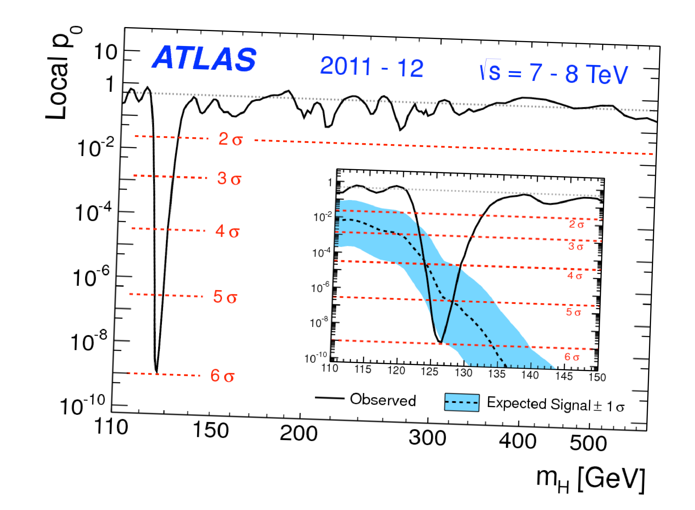
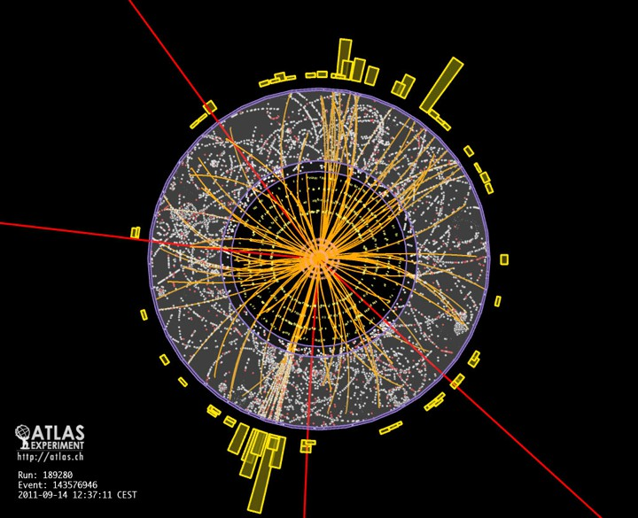
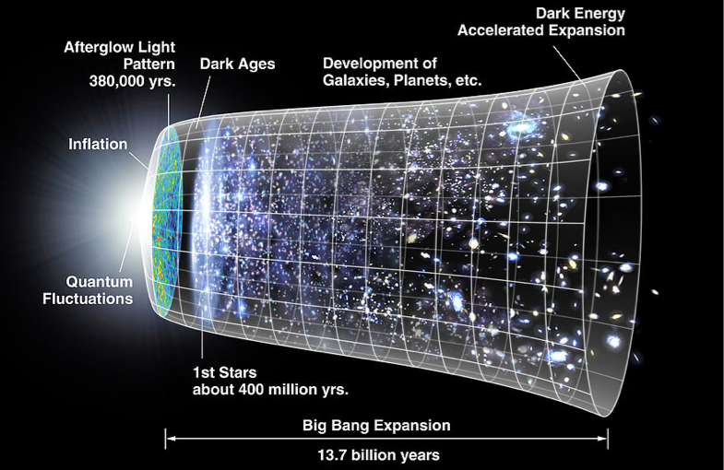
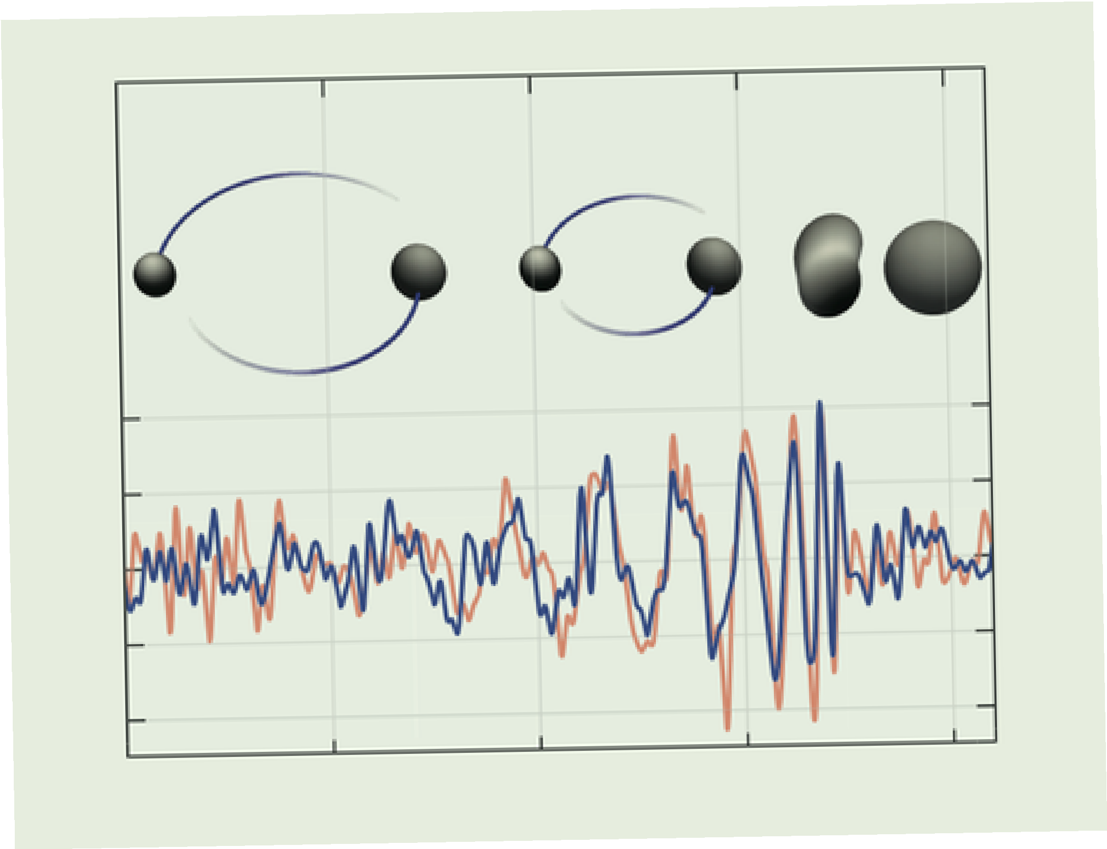
Welcome to Nikhef the Dutch
National Institute for Sub-atomic Physics
Discovery of Higgs particle
We probe our world, made of particles and fields,
with collider physics, primarily at CERN
astroparticle physics:
particles, radiation, and ripples coming from the universe
Discovery of Gravitational Waves
images: atlas.cern.ch, CERN, LIGO-Virgo Collaboration

Slide 3
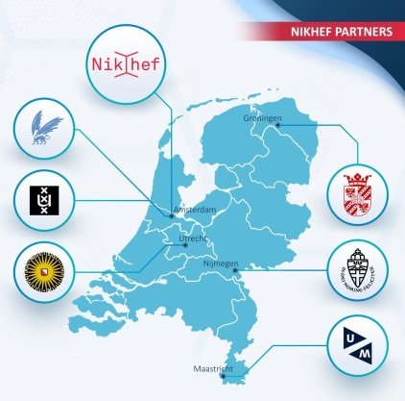

The Nikhef Partnership
In itself a collaborative ecosystem
university partners co-lead
(most) research programmes
aligned with a joint national strategy
Permanent Staff | 96
PhD candidates | 125
Postdocs | 43
Technical/engineer | 88
Support | 33

Slide 4
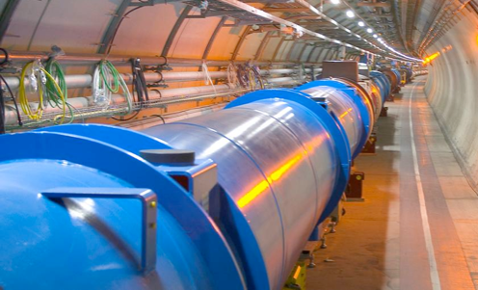
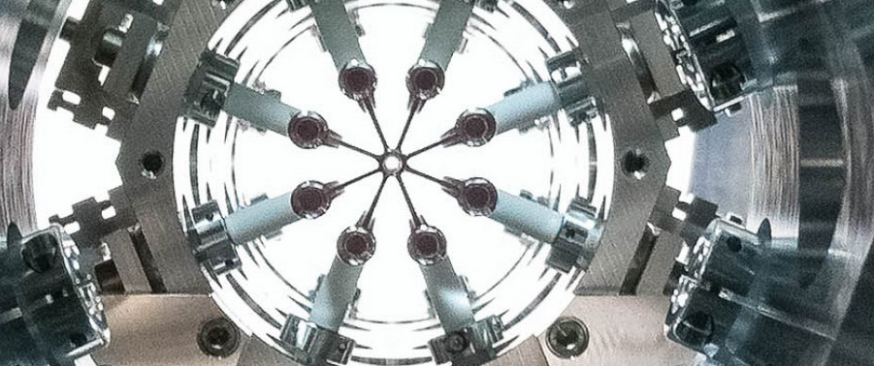
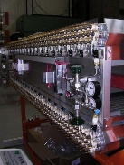
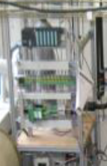
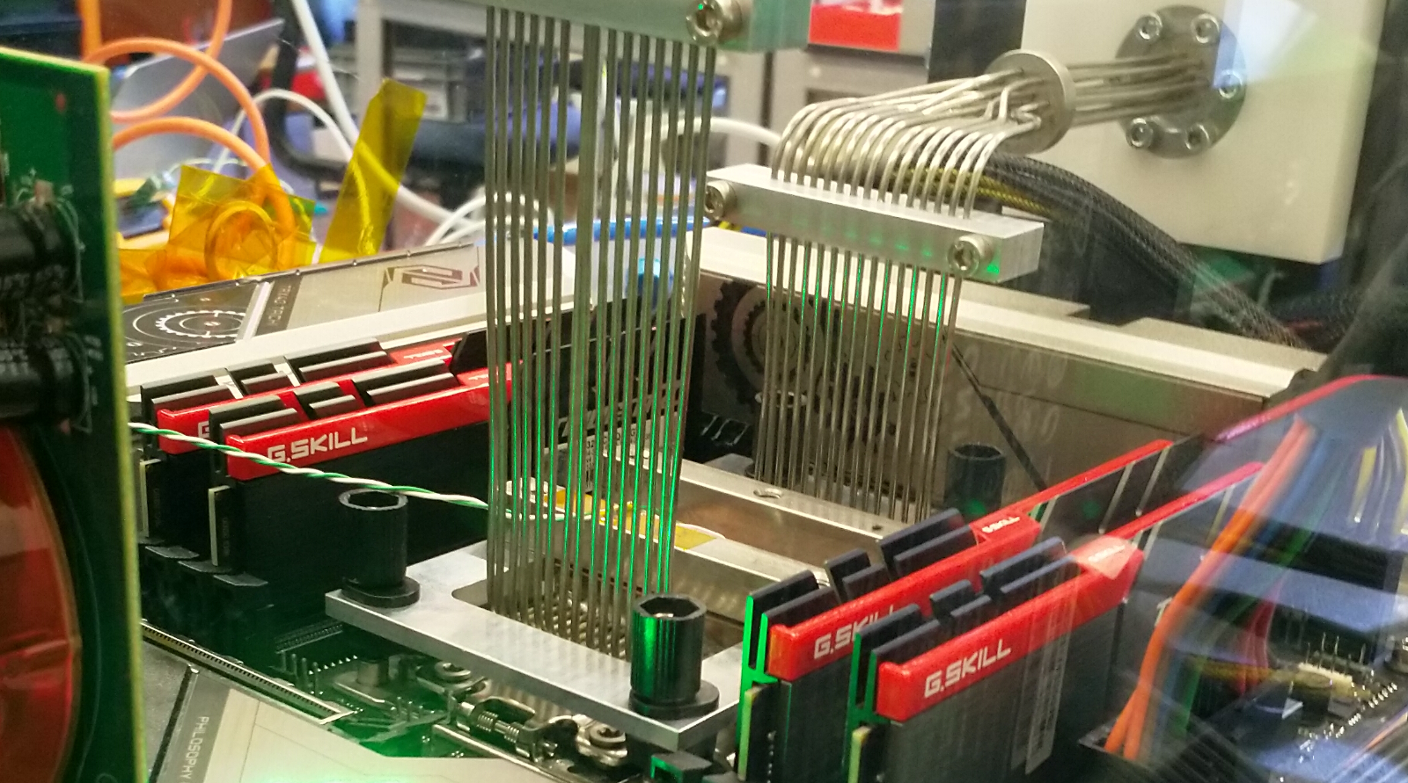
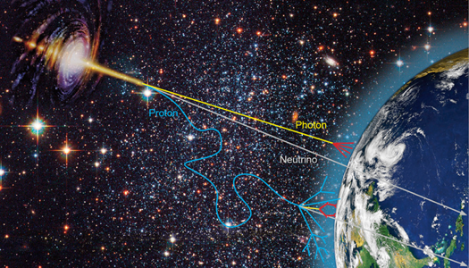
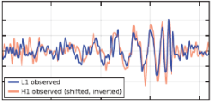


Nikhef Scientific Programmes
Atlas
LHCb
Alice
eEDM
Detector R&D
Physics
Data Processing
Particle physics
Technology R&D
Neutrinos
Gravitational
waves
Cosmic Rays
Dark Matter
Theoretical
Physics
Astroparticle physics
Phenomenology
Notes:
not on slide but important: concentrates all NL HEP infrastructure
machine shop, designers, ICT

Slide 5
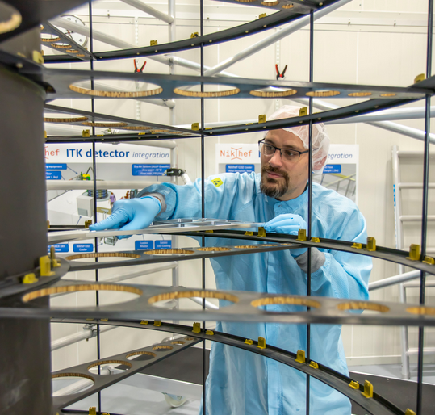
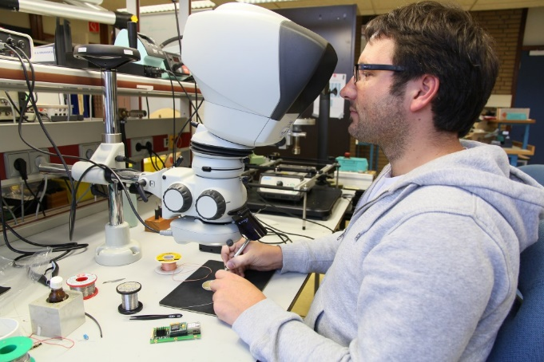
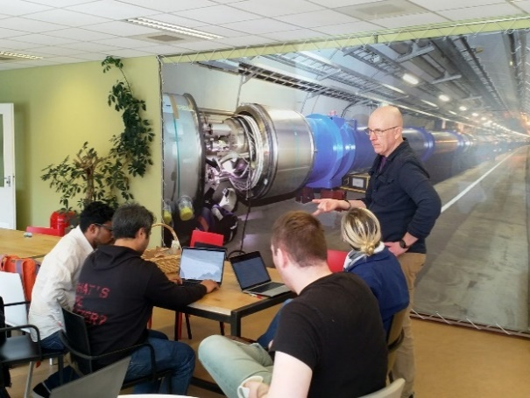
Technical Engineering and technology transfer
`The research at Nikhef relies on the development of innovative technologies. The knowledge and technology transfer to third parties, i.e., industry, civil society and general public, is an integral part of Nikhef’s mission.’
Mechanical Technology
Electronics Technology
Computing Technology
pictures from Nikhef’s ‘Dimensions’ magazine and Computing Office Hours; https://www.nikhef.nl/en/nikhef-mission/

Slide 6
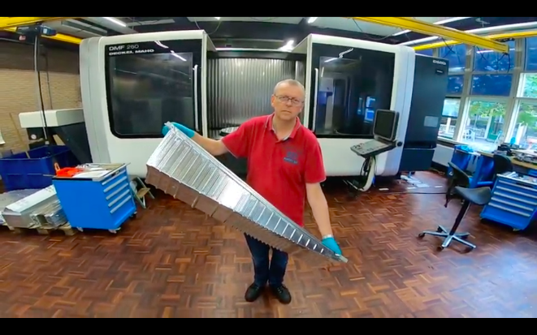
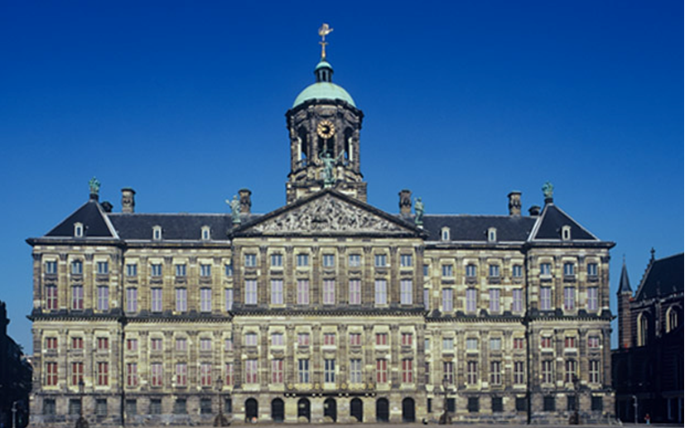
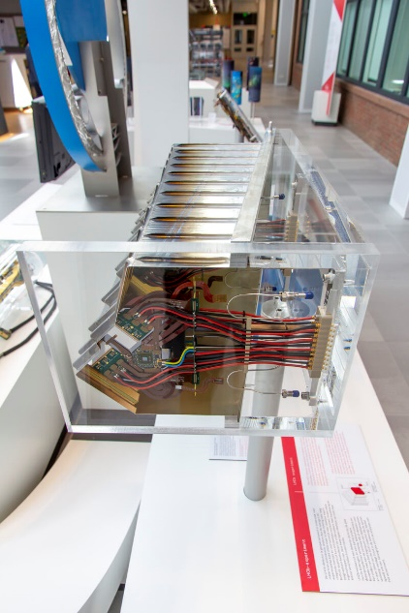
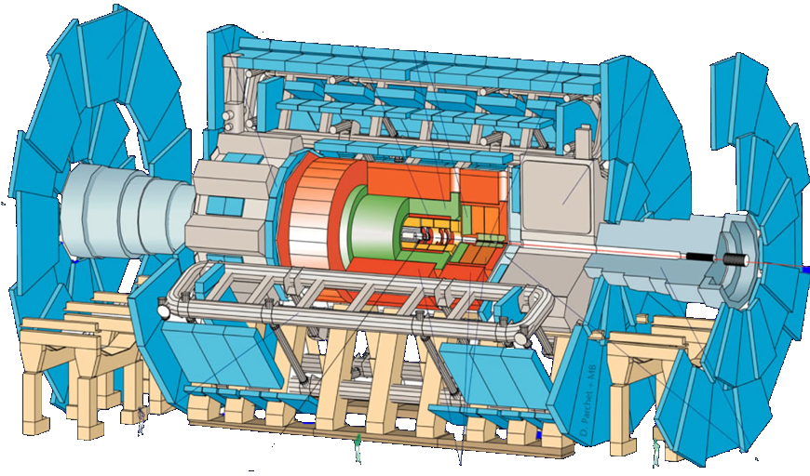
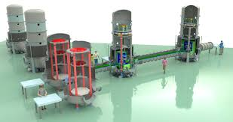
Infrastructure-intensive science
ATLAS at CERN
~ 150 Institutes
~1800 Physicists
Slide materials from: Stan Bentvelsen, 2016, ATLAS collaboration, CERN; LHCb VELO and RF box at Nikhef and ET Pathfinder visualisation: Marco Kraan, Nikhef

Slide 7
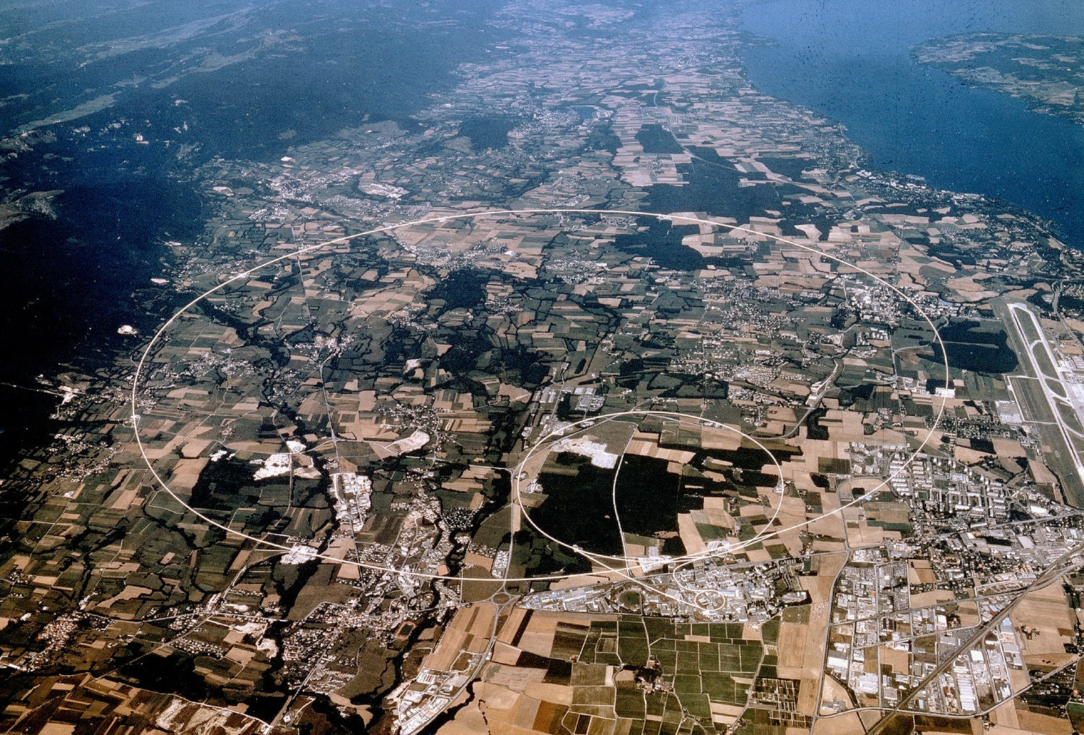
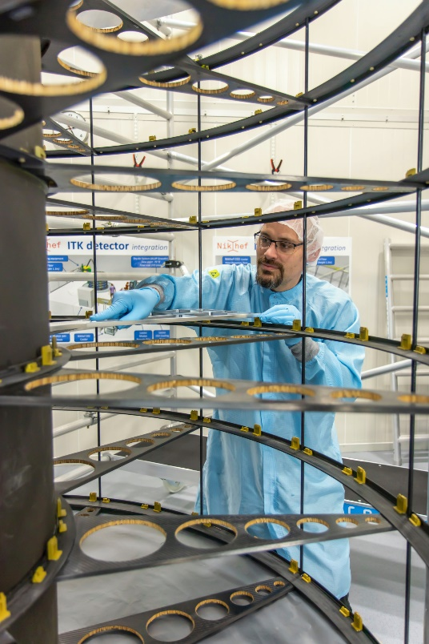





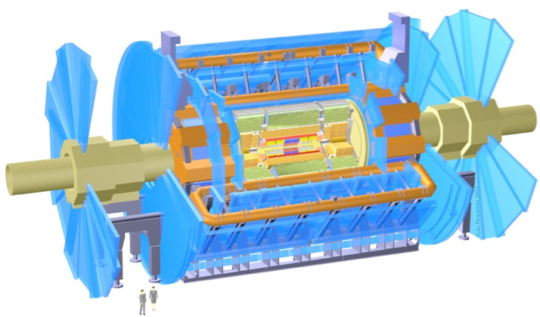
Nikhef at CERN – LHCb, Atlas, Alice
CMS
LHCb
ALICE
ATLAS
Imagery: CERN, European Organisation for Nuclear Research, and Marco Kraan, Nikhef

Slide 8
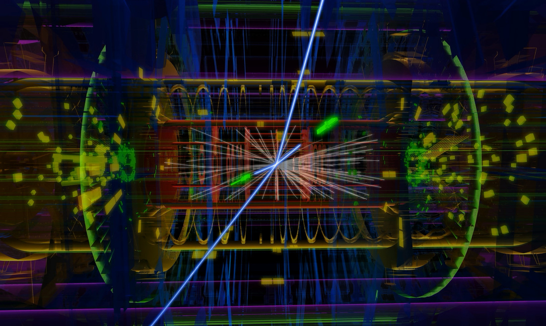
Atlas: up to 40 Tbyte/day of fresh raw data
Image source: CERN, Atlas collaboration; ATLAS approx. 140M active channels, mean event size ROD 1.6 MByte

Slide 9
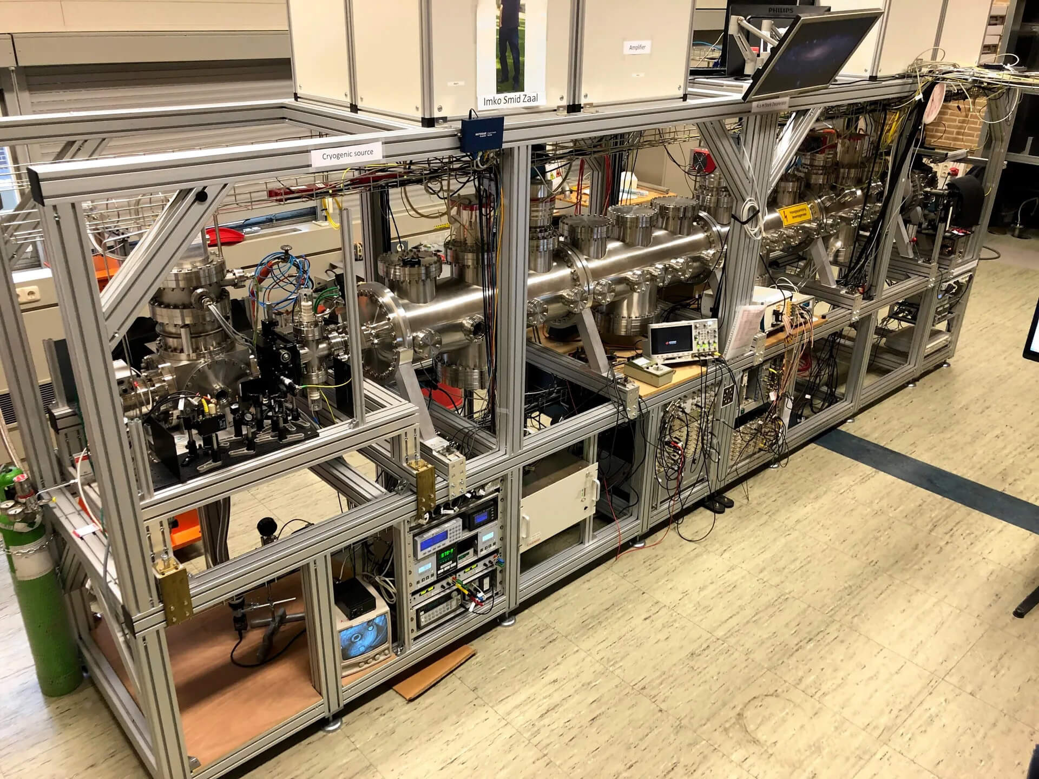
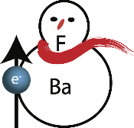
And decelerate for ultra-high-precision measurements
https://www.eedm.nl/ Nikhef and Rijksuniversiteit Groningen, images: Steven Hoekstra

Slide 10
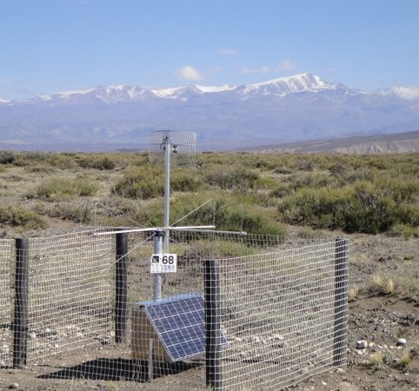
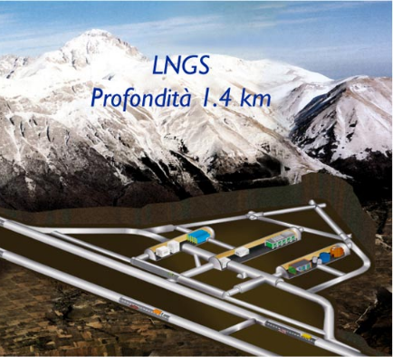
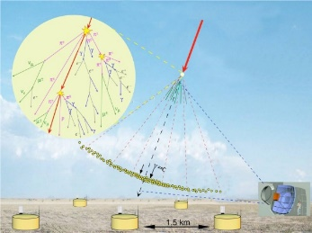
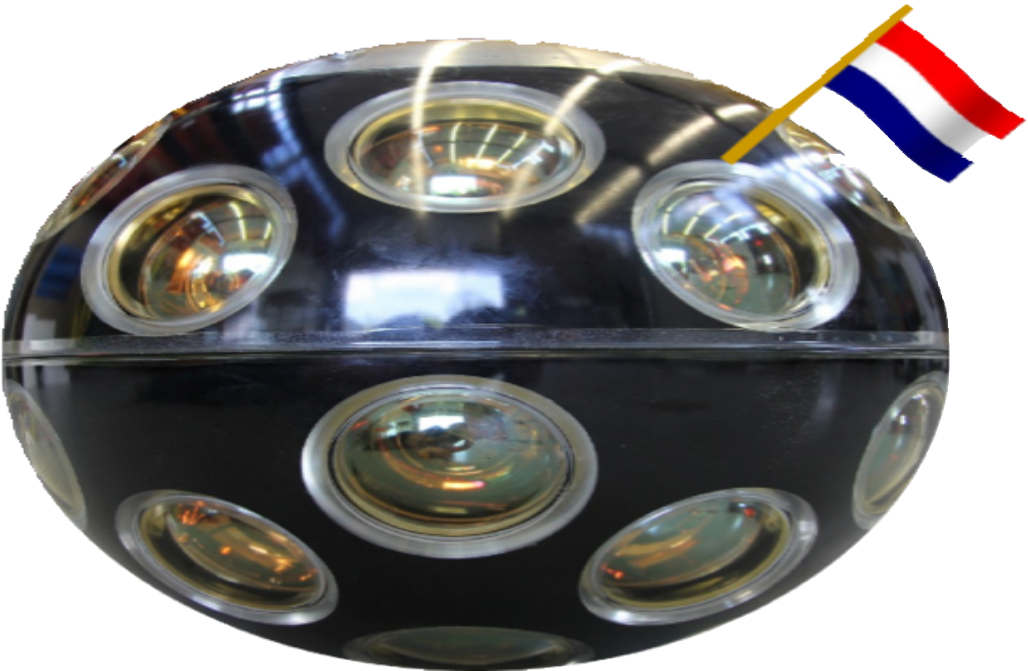
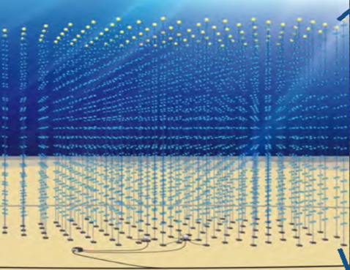
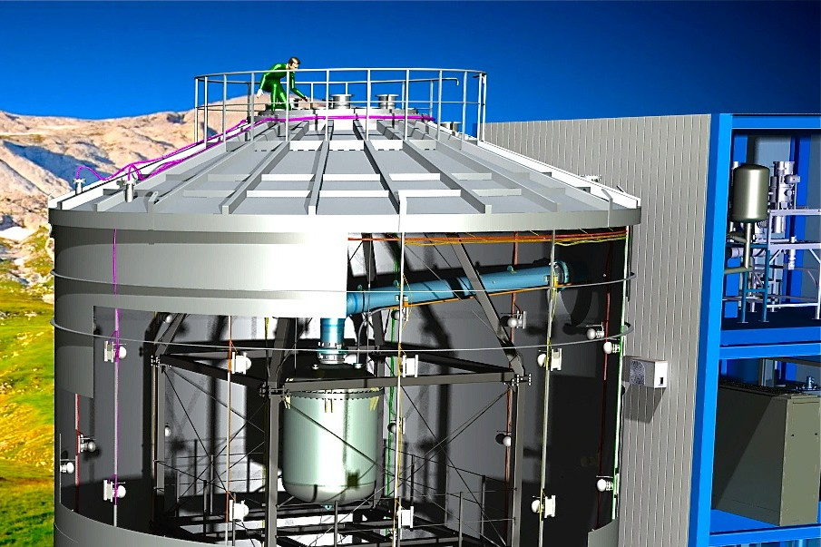
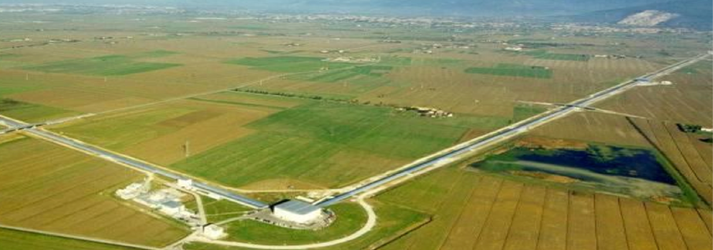
The astro-particle physics programmes Nikhef
Pierre Auger - UHECR
XENONnT - Dark Matter
Gravitational Waves
KM3NeT - neutrino telescope
Slide: Stan Bentvelsen, Nikhef SEP 2023, KM3NeT collaboration, Virgo Collaboration, Xenon-nT collaboration, Pierre-Auger collaboration

Slide 11
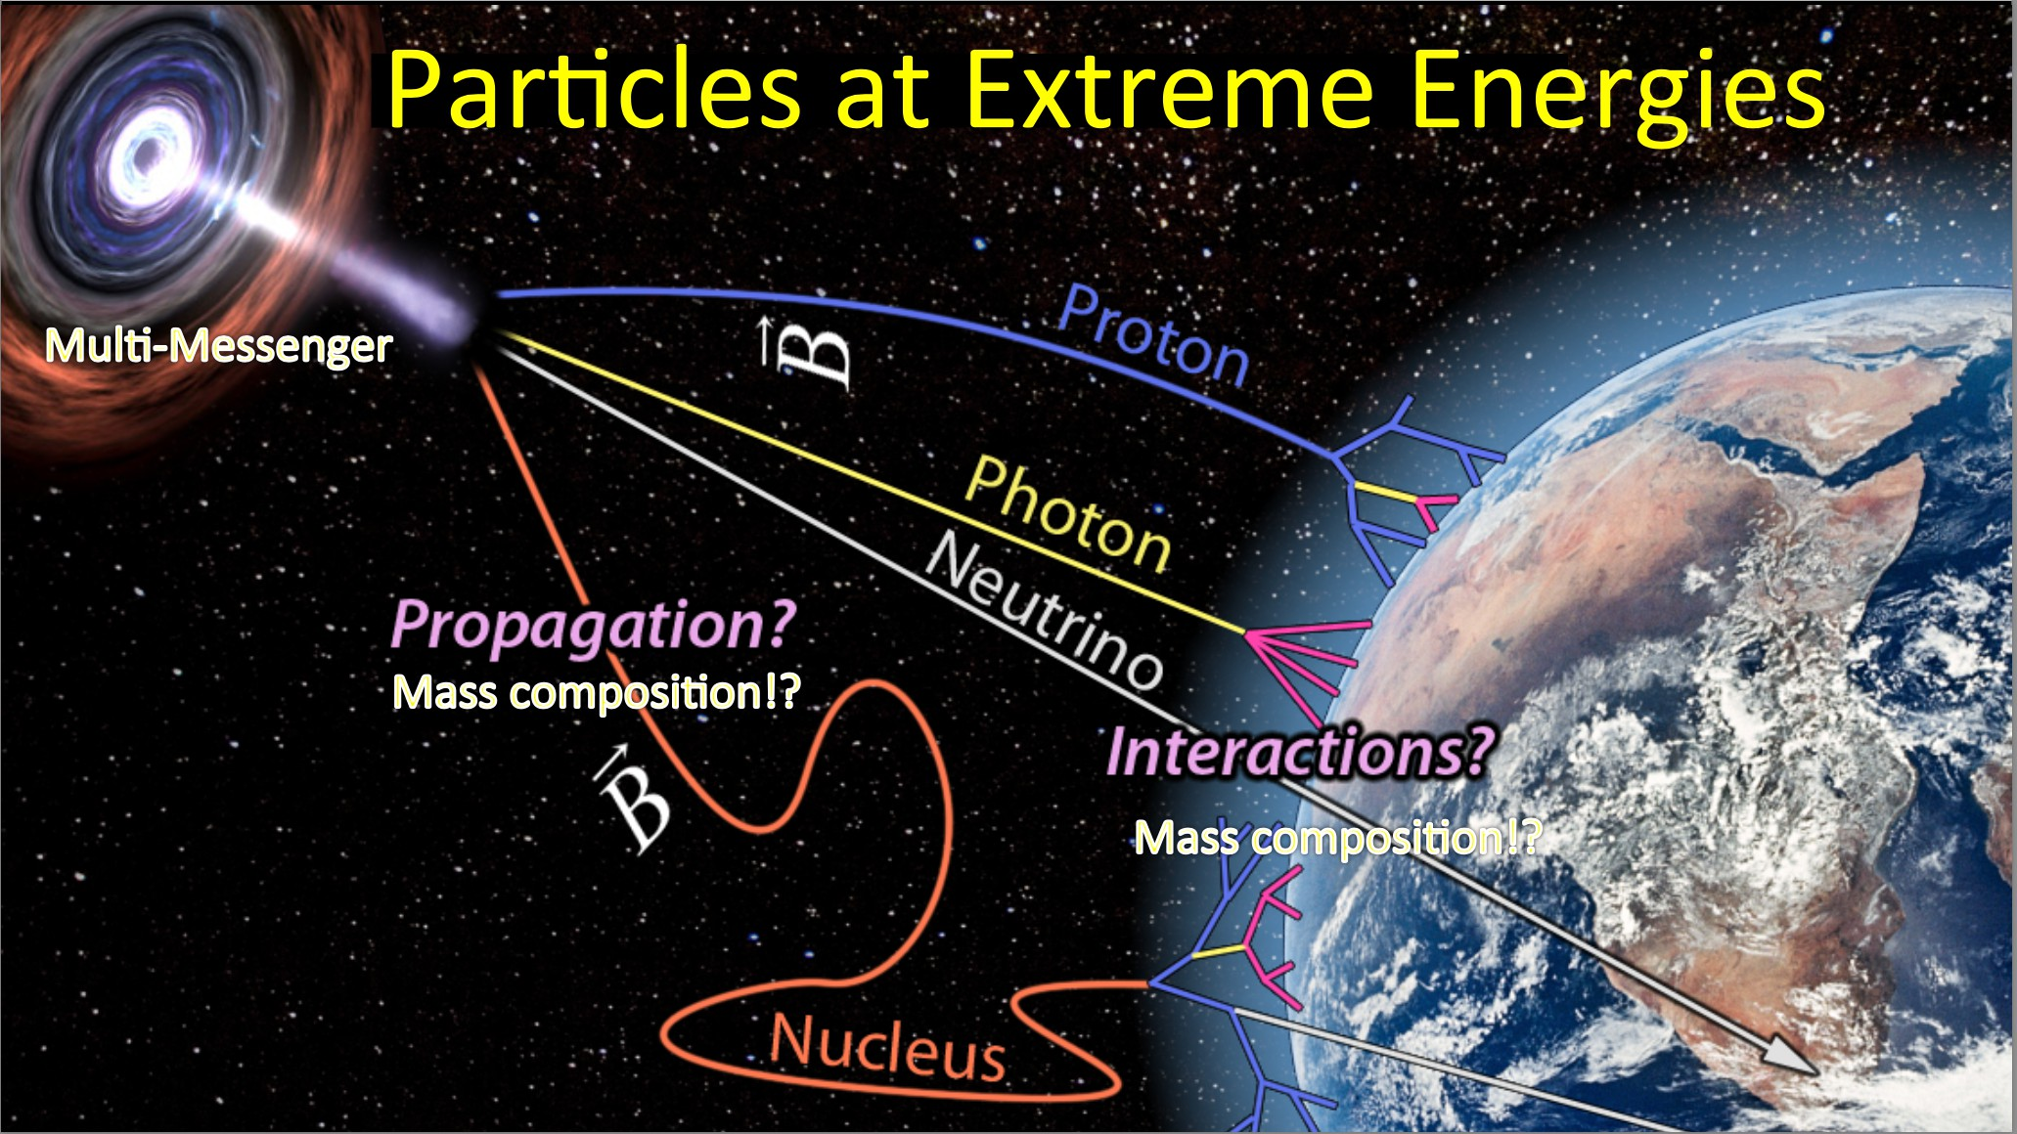

Imagery: Stan Bentvelsen, 2016

Slide 12
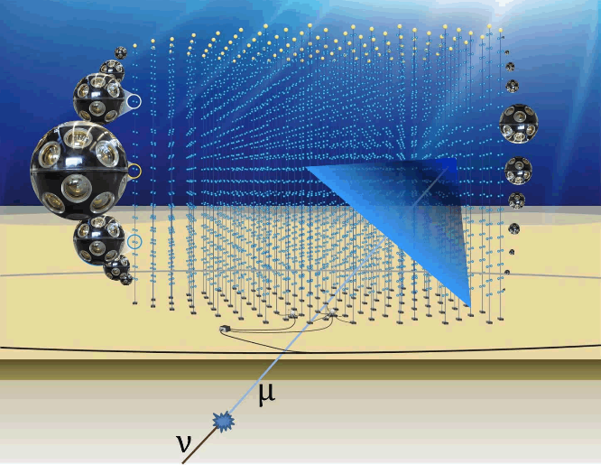
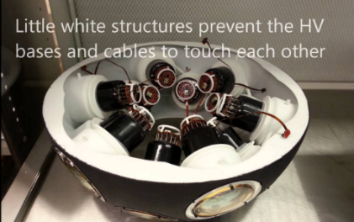
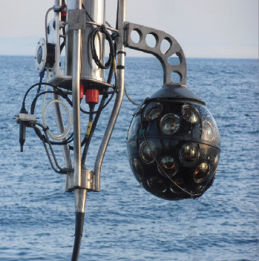
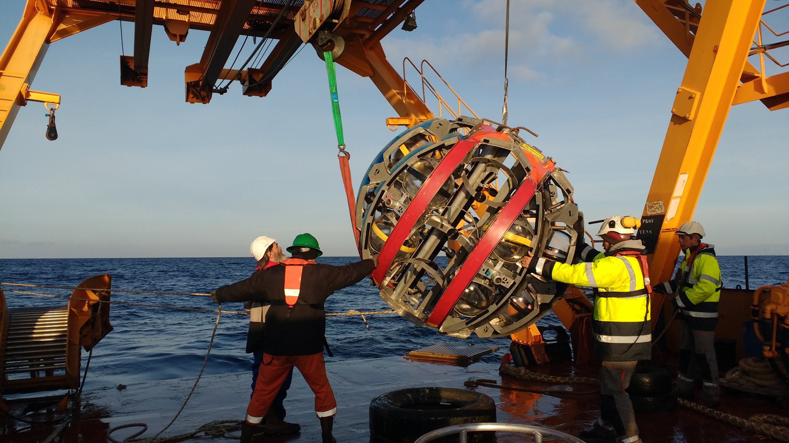
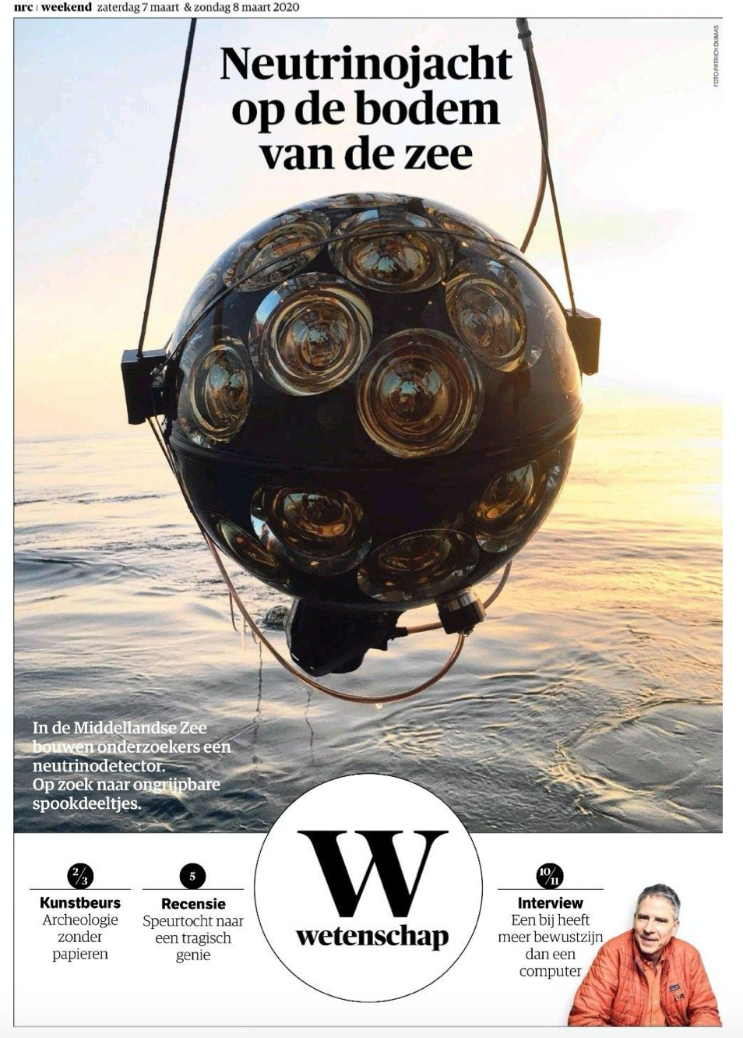
Image sources:
Nikhef, NIOZ,
KM3NET collaboration, NRC Handelsblad

Slide 13
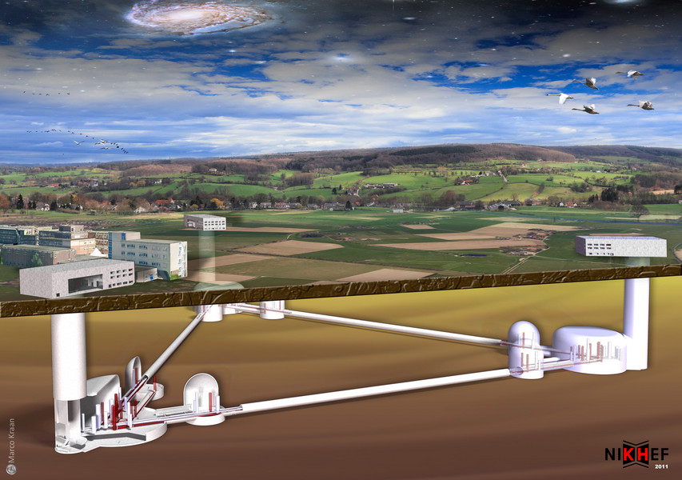
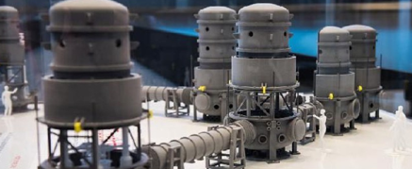
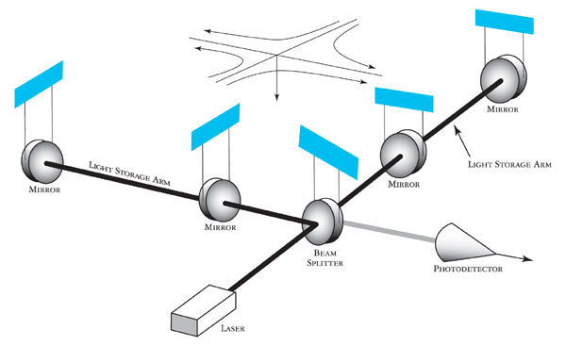

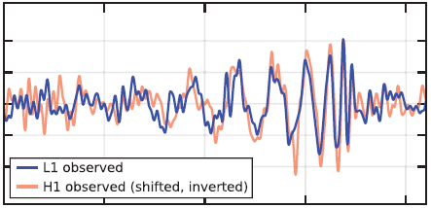

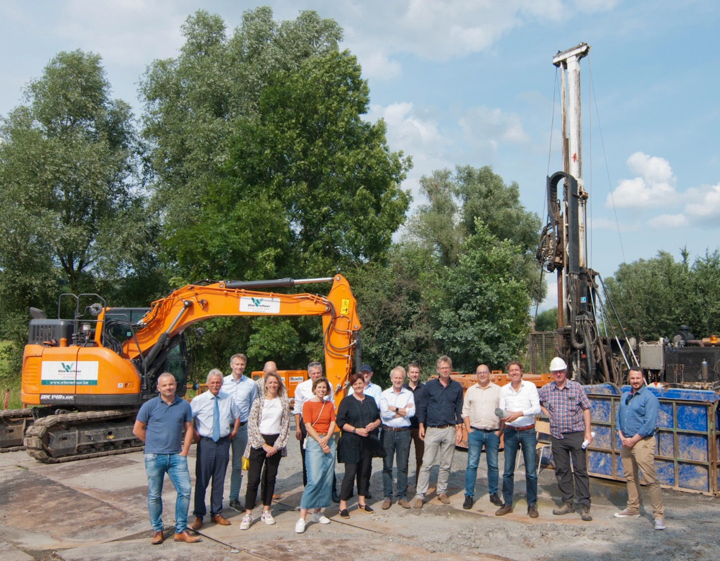
www.et-emr.eu
Einstein Telescope projected in
the Euregio Maas Rijn,
images: Marco Kraan;
ET Pathfinder at UM, Maastricht, NL
GW150914 event:
gw-astronomy collaborations, LIGO

Slide 14

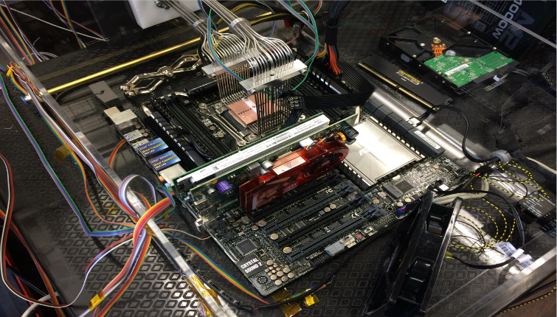
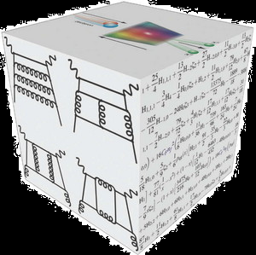
Enabling Research Programmes – next gen infrastructure
Theoretical Physics
Detector R&D
Physics Data Processing

Slide 15

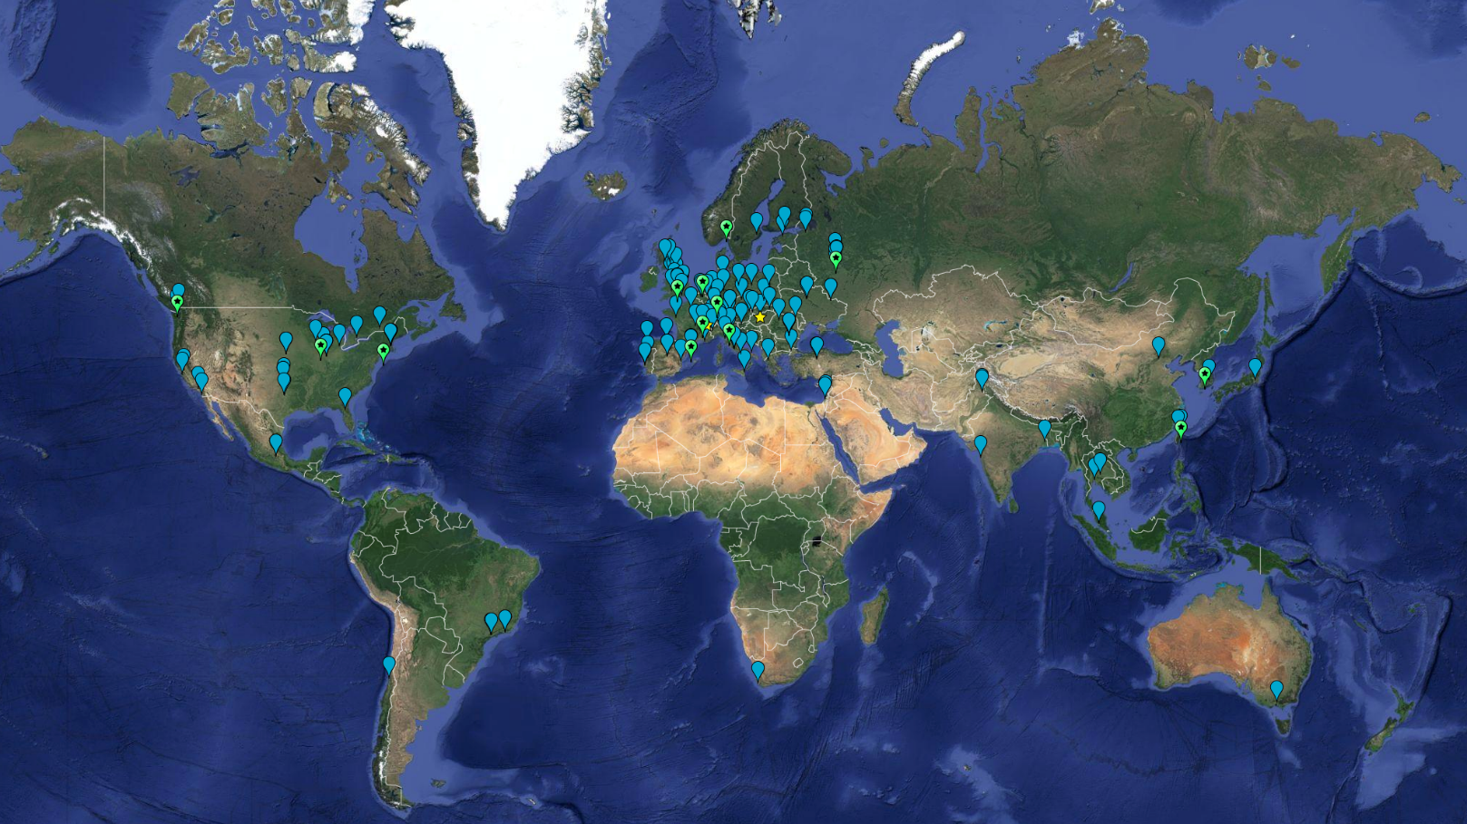

LHC Computing – a global infrastructure
> 2 million CPU cores
> 2000 Petabyte
disk + archival
170+ data centres
42+ countries
13 ‘Tier-1 sites’
NL-T1 jointly by
SURF & Nikhef
built on many ‘generic’
e-Infrastructures
EGI, GEANT, EuroHPC
OpenScienceGrid
NSF ACCESS-CI, ESnet, KEK, CalculCanada, …
Earth background: Google Earth
Data and compute animation: STFC RAL for WLCG and EGI.eu
Data: https://home.cern/science/computing/grid

Slide 16
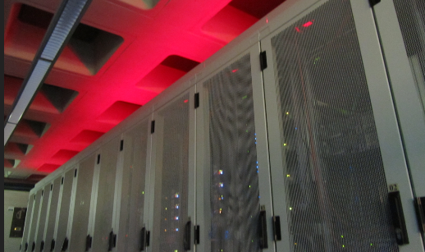
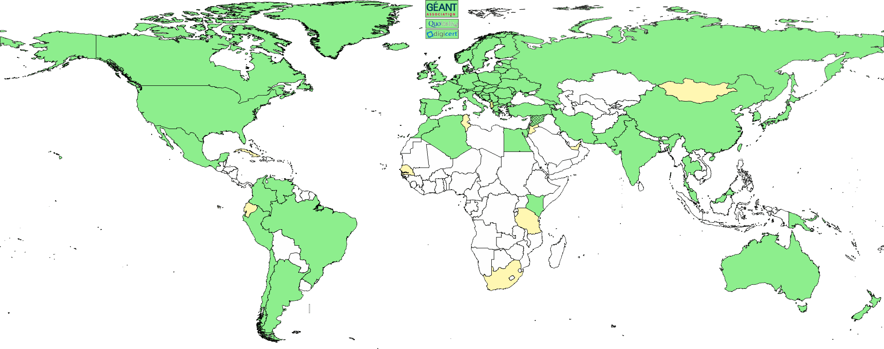
Infrastructure research for research infrastructures at Nikhef
Algorithmic design patterns and software
scientific software (GPU) acceleration, new algorithms,
high-performance processors
software design patterns for workflow & data orchestration, and (energy) efficiency
Infrastructure, network & systems co-design R&D
building ‘research IT facilities’
co-design & development
big data science innovation
research on IT infrastructure
Infrastructure for
trusted collaboration
trust and identity for
enabling communities
managing complexity of collaboration mechanisms
securing the infrastructure
of our open science cloud

Slide 17
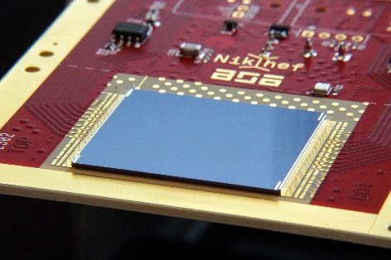
Algorithms and detectors go hand in hand
Reducing complexity is both in hardware and algorithms
If we ‘do nothing’, the HL-LHC intensity will result in hundreds of overlapping ‘images’ that are impossible to disentangle:
improve timing resolution to 10-50ps (more ‘frames’ per collision)
accelerated algorithms and dedicated GPU kernels, also ‘off-line’
From: FASTER (LHCb images) and R.Geertsema LHCP2022; right: TimePIX4 (also used at e.g. M4i)

Slide 18
Data Processing infrastructure – the Dutch SURF example
Cumulative cores per community
Multi-domain e-Infrastructure
ENMR: structural biochemistry
Project MinE: ALS (health)
Xenon: direct DM searches
TROPOMI: earth observation
DUNE:
long baseline neutrinos
LIGO-Virgo:
Gravitational waves
Alice, ATLAS, LHCb
LHC (NL) experiments
#CPU cores in GINA facility (5.5k)
day (arbitrary 2 weeks)
Graphic: GINA DNI compute service coordinated by SURF
Notes:
De nationale e-Infra is een plaats waar veel communities samen schaalvoordeel kunnen halen. Het combineren van domeinen krijgt de utilisatie naar ~95%, zodat de infrastructuur extreme efficient is. Ook voor energiegebruik, trouwens …
(dit plaatje kan nog vervangen worden door eentje van GINA)

Slide 19





Coordinated e-Infrastructure: the SURF cooperative
SURF nationally aligns and supports computing for
members (RPOs and education) and research council
networking (the physical ones) with global links
HPC and HTC facilities, data storage
federation services: trust, identity, and security
Coordinates joint infrastructure, initiatives, and projects
nationally with members and the LSRIs
in Europe with GEANT, EGI, EUDAT, EuroHPC and ESFRIs,
globally with collaborations like WLCG, SKA, IGWN, Internet2
‘digital competences’: FAIR data … and beyond
technology innovation, digital autonomy, policy, and ‘futuring’
Images: EGI accounting (https://accounting.egi.eu/) for NL, all federated communities, 2020-2022; Yoda: Utrecht University and SURF, https://www.uu.nl/en/news/new-yoda-website-launched-and-collaboration-with-surf; SRAM: SURF Wiki; ; RI Commons and Common IT Rersources: Magchiel Bijsterbosch, SURF
Notes:
infrastructure is a prerequisite for keeping data ‘alive’
and it’s all about collaboration and doing that in national infrastructure ‘coordinated by SURF’ is the most effective way of preventing lock-in (to cloud vendors, countries, or … again publishers! – think of Mendelay, PURE, &c …)
DNI national federated HTC infrastructure
Yoda
T2 network
DCC network

Slide 20












Scalable HPC: from local “Tier-2” to European “Tier-0”
Nikhef “Stoomboot”
Analysis Facility
You need local expertise
to enable exploitation
of European and
global resources
…
SURF National Infrastructure
foundation as well as stepping stone
Photos: Nikhef NDPF, DelftBlue/TUDelft, SURF Data Repository, Snellius, SURF @ DigitalRealty
Steamship: Michael on Unsplash (https://unsplash.com/photos/944sDSMQ778), Tile: Nationaal Museum van Wereldculturen
Notes:
** KEY SLIDE
** ook EOSC expliciet noemen
de flow van instellingen naar T1 T0 vereist deelname instellingen – ook in volgende slide
HPC strategie
- opschaling T2T1T0
- Nederland goede positive, maar HPC is nodig, en kost wel geld …
- daar moeten ‘we’ iets van vinden
- en keuzes maken

Slide 21






e-Infrastructure for research is an ecosystem:
hardware, software, services, and … people
Images: ATLAS Rucio volume, (from rucio.cern.ch); optical network: NDPF ‘deel’; User meeting Stoomboot Office Hours (both Nikhef)); Snellius opening visit; HPDC service page (both SURF)
Notes:
** Alle dingen in verhouding tot elkaar
** de “mensen” komen terug in de DCC slides
Message: Infrastructure is more than the computing or storage hardware, although we do need capacity as well of course. What makes it ‘ICT infrastructure for research’ includes also the network that connects us to our peers and the world, the software that makes it work together, it needs design and architecture to turn disparate pieces of iron into a service, and you need the experts to embed ICT into the research process – which is much more than a ‘helpdesk’, but a joint adventure into research computing.

Slide 22









Sharing more than resources:
data, software, research pipelines, expertise
Thematic Digital Competence Centres -
beyond data stewards and ‘dead’ data for open science
Thematic (domain-specific) DCCs
National coordination per domain, international collaboration, brokering domain expertise, collections, tools, FAIR-standards, training
Cross-domain & large-scale IT infrastructure
Generic infra & expertise for data & software stewardship
Connecting to international
e-infrastructures
TDCC-SSH
TDCC-LSH
TDCC-NES
Local DCC
Local DCC
Supporting local needs within constraints of
local infrastructure, budgets & policy
Institutional & domain data stewards, data science centres
Image by: Ruben Kok, LSH TDCC and DTL
Software and infrastructure essential to bring ‘dead’ data to life!
TDCC Roadmaps: https://www.nwo.nl/en/roadmaps-three-thematic-dccs-digital-competence-centres
Notes:
MENSEN, mensen
TDCCs: software and infrastructure to bring data to life
alleen maar NPOS, en ‘dode’ data, is niet genoeg:
ook nog HPC/HTC resources nodig – en het network om data te versturen
+ ook nog open science sharing van expertise en best practices
+ ook nog infra & software

Slide 23



Sharing expertise: thematic digital competence centres
an example from the Natural and Engineering Sciences domain
Case study: Einstein Telescope seismic studies in EUregio Meuse-Rhine in the E-TEST project
Data collected here is also useful for many other domains outside of the ET planning …
ET impression: Marco Kraan (Nikhef) from “Terziet drilling campaign” https://www.nikhef.nl/wp-content/uploads/2019/10/Terziet-Drilling-Campaign-Final-NoC.pdf
Seismic data: S Koley (VU and Nikhef) Sensor networks to measure environmental noise at gravitational wave detector sites, ISBN 978-94028-2054-6; map image: etest-emr.eu project site
Notes:
** doel slide (kan evt/ weg) is samenwerking uitdieken tussen instellingen
TDCC Natural and Engineering Sciences roadmap – voor levende data is een ‘institutional repository’ niet genoeg: dan vind niemand het terug. Om data vruchtbaar te laten zijn moet de samenwerking vanuit het domein komen, en daarbij ook instellingsoverstijgend ondersteund worden. De rol van SURF tussen de instellingen (en in b.v. de EOSC) helpt om dit mogelijk te maken. De TDCCs (hoewel nu even gedreven door NWO) hebben ook die samenwerking met SURF, en het eScience Center, nodig om de data, met software en infrastructuur, ‘tot leven te wekken’.

Slide 24



Looking at ICT as a research instrument, like our detectors
‘ICT infrastructure for research – distinct from the office and enterprise service’
research data today has joint challenges,
and hence shared e-Infrastructure!
and needs a different governance compared to enterprise IT
2003
2007
2015
2021+
vl-e.nl; biggrid.nl; fuse-infra.nll; surf.nl; https://go.nikhef.nl/principles-of-digitalisation
Notes:
** KEY MESSAGE SLIDE
** cofinanciering kan ook door/via domeinen, ingebed en gecoordineerd in een SURF context
** PWC rapport: instellingen hebben tot 17% minder investeringen gedaan (“verborgen kosten”) sinds 2010-2021!
(gat van 2011 heft decennium lang issues opgeleverd
Domein sturing en persistent infrastructuur
De {T,L}DCCs laten zien dat de vraag naar infrastructuur alleen maar zal toenemen – en in veel gebieden is nu duidelijker waar de noden zitten. Maar ‘open science’ en het ook effectief maken van re-use kosten serieus geld, wat niet va nature hoort bij het onderzoek zelf. De individuele instellingen zijn hier ook geen goede plaats voor, want naarmate er meer data en data herbruik komt (de re-processing zal, b.v. voor gegevensbescherming, vaak bij de datalocatie zelf moeten zijn) eet dit gestaag alle resources op. Er komt immers alleen data bij, totdat al je resources in maintenance gaan zitten.
Dit zie je al als dilemma bij research software, waar ‘succesvolle’ developers gestaag al hun tijd aan maintenance zien op gaan.
De behoefte aan processing and computing moet dus meegroeien met de cumulatieve resultaten. Het voorbeeld van de WLCG RRBs, en de SKAO planning, en de e-infra paragraaf van de ESFRIs, geven de input vanuit de domeinen waar beter bekend is wat (misschien) er nodig is. Maar de implementatie kan veel beter gedeeld, zoals GINA/DNI al liet zien, of het SURF Data Repository.
Maar de cyclus van BiG Grid, LHCUpgrade, FuSE, … op projectbasis, met de kortetermijn ideeen van NWO, gaat neit werken. Daar laat SURF veel beter zien hoe het kan, maar dan moet daar ook wel een beter passend instrument bij…
nu nog experimenteren met (L/T)DCCs -- daarna structuur vnuit de domeinen/ESFRIs/GWIs – en dan maar aan de leden vertellen dat het dus _zo_ moet.
Infra is er voor de wetenschap, en dat doet SURF … maar: die 20MEur Uitvoeringsplan/Apers is niet genoeg …
FuSE blijft steeds weer terugkomen, zoals al aan die evaluatie commissie verteld
Wat te doen met data? Langduring ontsluiten/beschikbaar houden is duur

Slide 25







Riding the infrastructure innovation chain … together!
Computing Sciences
Research
Operational Research
(near-term, NextGen storage,
800G+ network, QC & simulators)
Operational innovation (procurement, systems vendor co-engineering)
involving non-CS research domains
Images: SLICES-RI, CompSysNL, UM & SURF QC, SURF SOIL BDRI,
NationaleSpeeltuin.nl @Nikhef
Notes:
In de innovatieketen is SURF een stabiele continue factor. De betrokkenheid van SURF in het hele traject, b.v. vanuit SLICES-NL en samenwerking met CS groepen, via het innovatieprogramma voor (efficient en effectief) gebruik van faciliteiten en het onderzoek naar matching tussen technologie en applicaties, tot aan het operationeel onderzoek zodat SURF en haar partners _zelf_ de expterside hebben om infrastructure te bouwen. Niets zou erger zijn dan zelfs de kennis over wat je wilt te moeten inhuren. Doordat SURF dit, met haar partners, wel kan, krijgt Nederland een unieke positive.
Daarvoor is het wel van belang dat ICT alsresearch instrument gezien wordt, en NIET als facilitair of een veredeld ERP system.
De erkenning van ICT als essentieel als onderzoeksinstrument is nog lang niet voltooid – nog te veel instellen in Nederland zien ICT (en dus ook hun representative richting SURF) als een kostenpost. Dit is een structuurprobleem waarook de instellingen (en hun CSCs) aan zullen moeten wennen.
matching de infra op research – samenwerking tussen infra expertise bij SURF en domein expertise
co-innovatie is sterk punt SURF: SOIL, BDSI (‘nationale speeltuin’), maar ook op diensten (Yoda), en ‘stressen’ van next-gen infra research (Quantum simulators, QC – short term & long term)

Slide 26


SURF Experimental Technologies Platform
https://servicedesk.surf.nl/wiki/display/WIKI/Experimental+Technologies+Platform and https://www.surf.nl/en/etp - contact Raymond Oonk at SURF for more info

Slide 27

It’s all about networking – of all kinds, and globally
Graphic: Bill Johnston, ESnet, for LHCone
Notes:
** netwerken voor data – Nederland sterk, moeten we wel blijven – ZEEKABELS
Historisch sterk in netwerken en verbondenheid: Netherlight, optical networks, connectivity-oriented network hubs
Nederland heeft ook hier een unieke positie!
En de bundeling van e-Infra (network, compute, storage, services) in een gezamenlijk ecosystem is behoorlijk uniek in de wereld – maar dan moeten we die positive wel ‘uitnutten’ ☺

Slide 28



And since speed does matter …
Image: Minister of Economic Affairs M. Adriaansens launched the Innovation Hub with Nikhef, SURF, Nokia and NL-ix, January 2023. Composite image from https://www.surf.nl/nieuws/minister-adriaansens-lanceert-testomgeving-voor-supersnelle-netwerktechnologie

Slide 29




1.02 Bpps
800 Gbps and 593 Mpps –
connected to CERN
ballenbak.nikhef.nl
Image: Tristan Suerink
Notes:
800+ Gbps voor HL-LHC – zowel de LHCone mesh en de SURF-Nikhef-CERN dark fiber optical link AMS-GVA
LHCb QC computing met SURF, QuSoft, Nikhef, UM, UvA
FuSE – joint growth en CPU+GPU+storage … + algorithms
1Bpps packets systeem – nationale kritieke infra tests … en remote trigger voor rare decays in kleine pakketjes
wat weer met het onderzoek naar DPU computing
onder SURF innovatie linked (Fungible, 6.5MIOPS/node world record)

Slide 30





Our science data flows are somebody else’s DDoS attack
Image sources: belastingdienst.nl, rws.nl, nu.nl, werkentegennederland.nl

Slide 31
How did we get here?
A collaborating ‘ecosystem’
for science and innovation

Slide 32

Once upon a time … a green fields approach?
Watergraafsmeer and volkstuinencomplex Frankendael, 1974, starting the construction of the WCW. Image: Beeldbank Amsterdam, gemeente Amsterdam

Slide 33

The Nikhef data centre – at the end of the 1980s
Gould, Sun, and DEC systems,
taking several racks each
500 m2 floor area
Raised floor: +60cm
walls are ‘movable’
to accommodate expansion
Nikhef room H1.37 – terminal stations on the raised data floor of the computer room (H1.40, behind the glass-panel walls)

Slide 34



Collaborative Research Infrastructures: all about networking!
be it human or computer networks …
See https://personalpages.manchester.ac.uk/staff/m.dodge/cybergeography/atlas/historical.html for more historic maps ; right-hand image: SURFnet2, 1990
first email to MCVAX at CWI from https://www.cwi.nl/en/news/cwi-celebrates-25-years-of-open-internet-in-europe-in-november/ (Piet Beertema, CWI, 1988)

Slide 35


‘IBR-LAN’ at Nikhef – connecting local and global networks
International Backbone Router Local Area Network “IBR-LAN” at Nikhef, room H1.40 as seen in 1996. Right: H1.39 with nikhefh.nikhef.nl racks and early DAS-2 system

Slide 36

1990’s: Computers got smaller and there was space left…
What happens if you welcome two other networks on your floor?
Image: AmsIX at Nikhef H140 in 2007 – foto Beeldbank Amsterdam https://archief.amsterdam/beeldbank/detail/a95bc475-8fcc-d0d1-37f9-b077ba3729db/media/

Slide 37



A growing internet!
AMS-IX traffic Nov 2, 2024; https://stats.ams-ix.net/ https://www.ams-ix.net/ams/colocations
AMS-IX topology, 2002

Slide 38

Just one of
the many
autonomous
systems ...
AS1104

Slide 39







Connect each other … and scientific data and instruments
dashed lines: traffic is routed via ancillary facilities of SURF and GEANT first (currently: AMS9 at WCW) SKA Meerkat traffic via TENET

Slide 40

What happens inside a data centre …
‘Connectivity’ housing and
‘hosting’ are different things:
        NikhefHousing (H140) has connectivity parties only, and does not host any content
        what you see on the 1st floor tour is network equipment:
        shipping data, but not keeping anything
        2nd floor has our science data centre
And no single connectivity data centre is a single point of failure: Internet protocols are engineered to re-route traffic

Slide 41


Today’s data centre at Nikhef
‘NikhefHousing’ data centre
from the first 2 racks in a corner
to now ~500 racks
many different connectivity parties
396 networks present in PeeringDB
connectivity-focus, not hosting
Nikhef ‘science’ data centre H234b
47 racks and ~350 kW
hosts Nikhef, CERN, gravitational waves, and SURF research data
strengthens connectivity at,
and uses NikhefHousing
Connected networks: see https://www.peeringdb.com/fac/18

Slide 42

Data centre installation management, ever growing
active/free cooling chillers
installed on the roof in 2009
data floor: ~400 racks
evolving hot-isle/cold-isle configuration
electricity generator sets
2003, 2009, 2021
aquifer thermal energy storage (ATES) system installed 2010
Image: Floris Bieshaar, Nikhef

Slide 43



Power in … and power out …
Three generators
A-Feed 1250 kVA (pictured under load while testing)
B-Feed 1700 kVA
C-Feed 1250 KVA added with the current expansion
Separate redundant UPS for each
Heat re-use:
aquifer thermal energy storage
re-use heat to warm our building (pretty warm)
AND feed more heat to student housing opposite
nominal ‘PUE’ ~ 1.21
Generator image source: Floris Bieshaar. MacGillevrylaan sketch: Science Park Amsterdam

Slide 44

Because, even if we can …
LCO2 cooling of an AMD Ryzen Threadripper 3970X [56.38 °C] at 4600.1MHz processor (~1.25x nominal speed) sustained over all cores simultaneously, using the Nikhef LCO2 test bench system (https://hwbot.org/submission/4539341) - (Krista de Roo en Tristan Suerink)
Notes:
Leuk, maar niet de oplossing voor ons ICT samenwerkingsprobleem!

Slide 45
… it is not always the most scalable solution!
7m
Nikhef 2PA LCO2 cooling setup. Image from Bart Verlaat, Auke-Pieter Colijn CO2 Cooling Developments for HEP Detectors https://doi.org/10.22323/1.095.0031

Slide 46
Thanks, and enjoy Nikhef

Slide 47
Tour
hereafter:
NikhefHousing ‘the backside of the internet’
with Anton Mors, Floris Bieshaar, & me

