Slide 1
Welcome to Nikhef
Introduction to Nikhef and
the NikhefHousing Data Centre
David Groep
May 2024

Slide 2
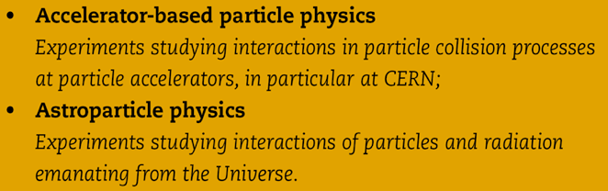
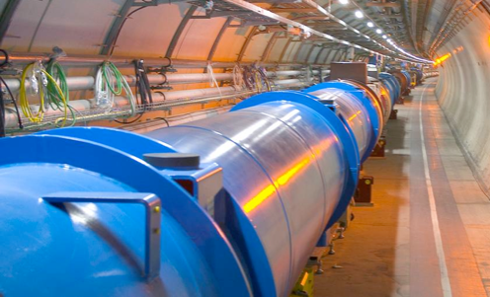
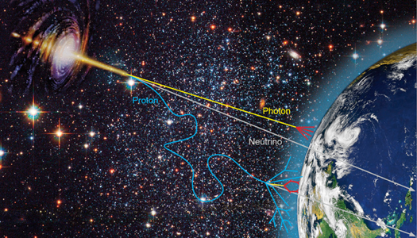
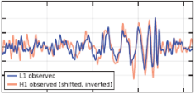
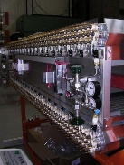
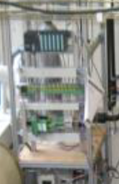

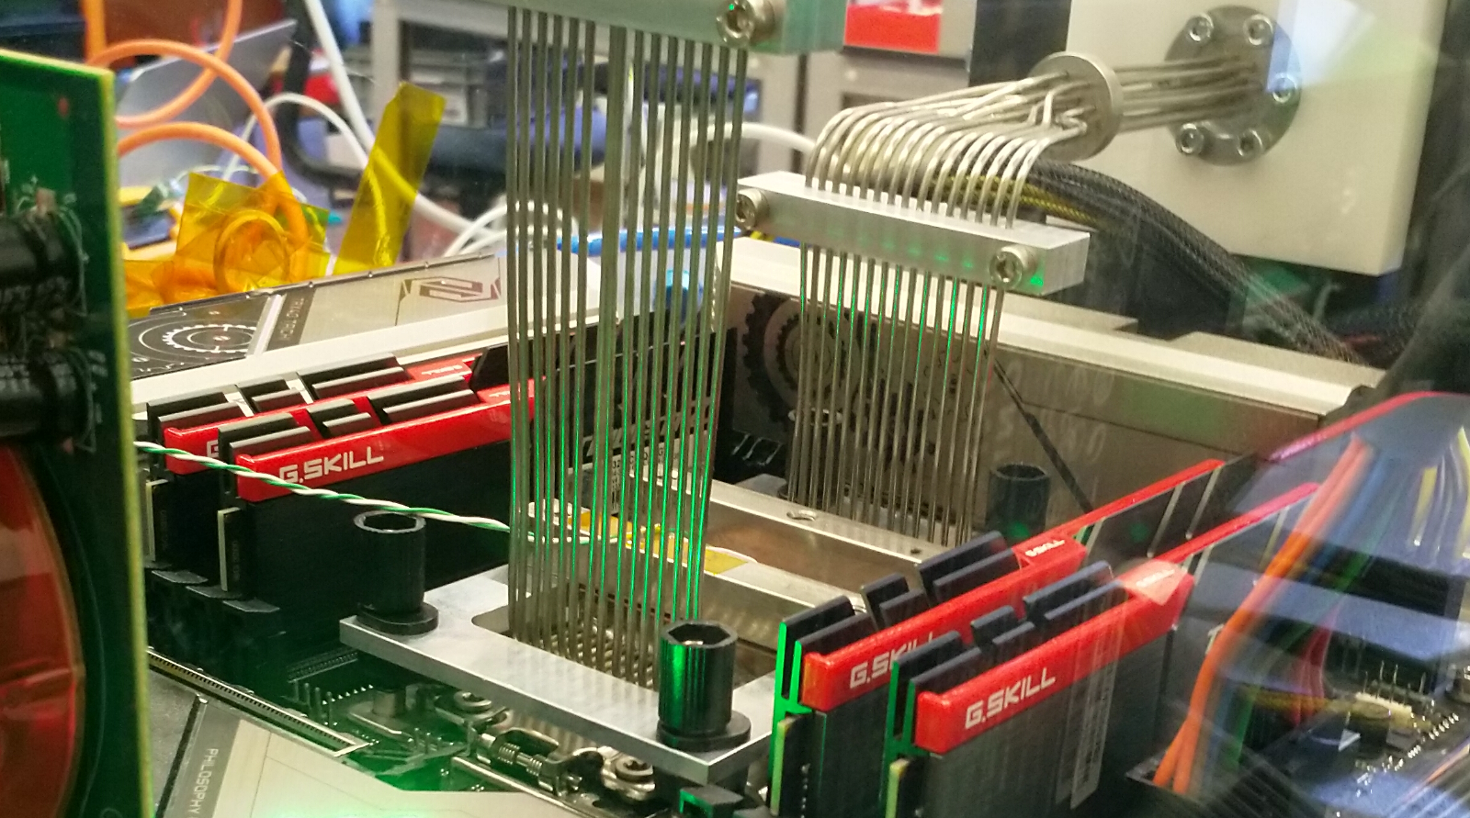

Our world, made of particles and fields
Collider physics
Astroparticle physics
Phenomenology
Technology R&D
Notes:
not on slide but important: concentrates all NL HEP infrastructure
machine shop, designers, ICT

Slide 3
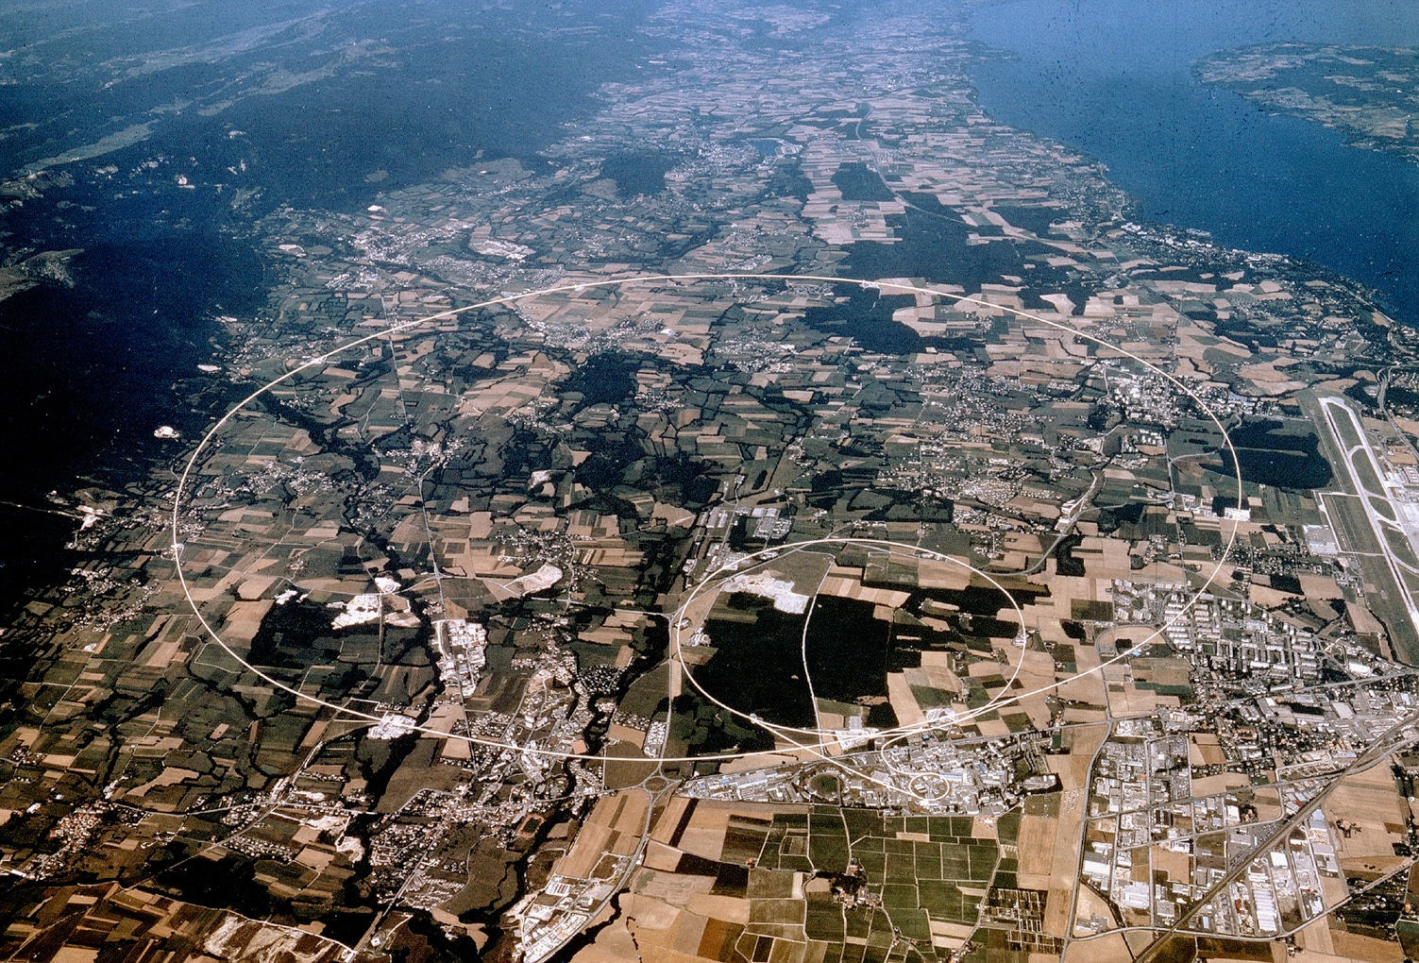


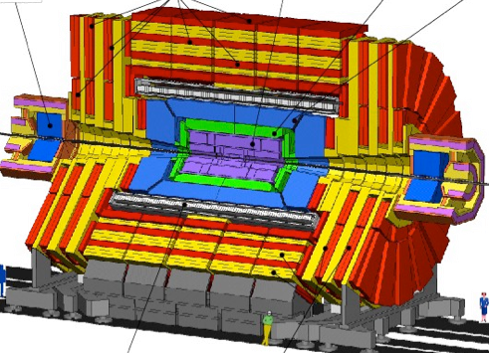


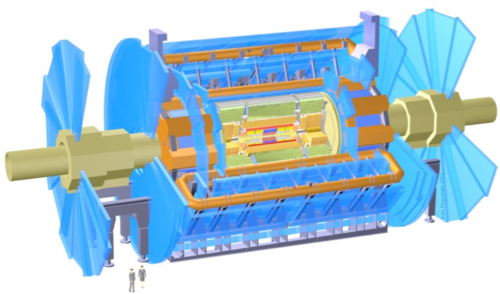


CERN – Europe’s laboratory for high-energy physics
CMS
LHCb
ALICE
ATLAS
Atlas
Imagery: CERN, European Organisation for Nuclear Research

Slide 4
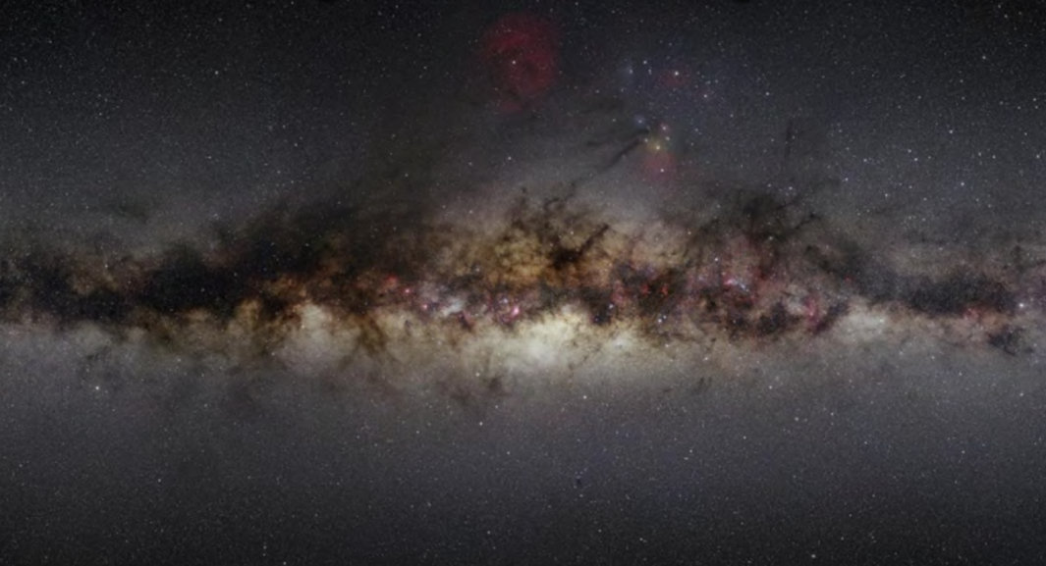
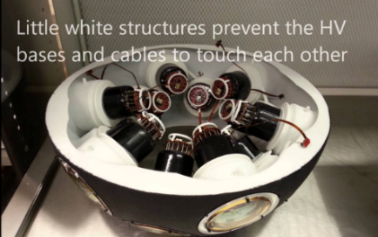
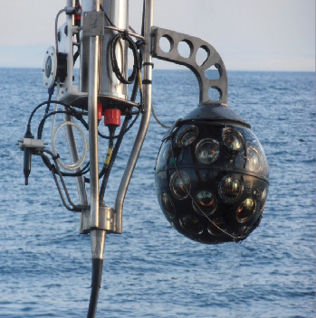
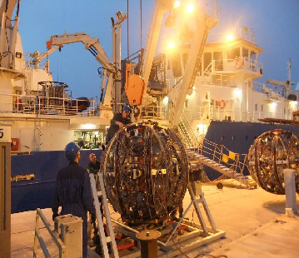
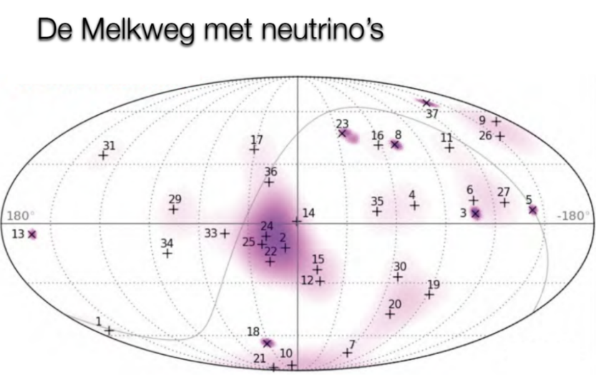
Image sources:
Nikhef, NIOZ,
KM3NET collaboration

Slide 5
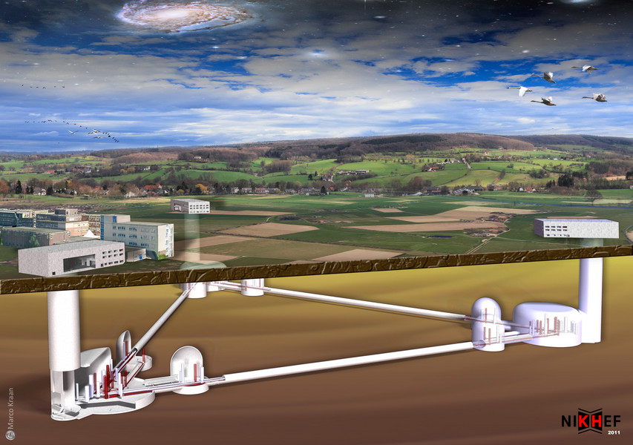
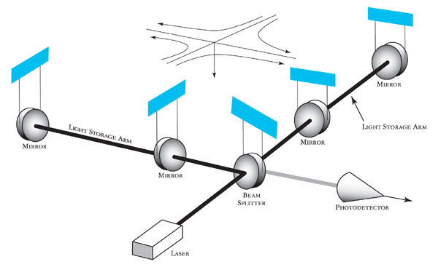
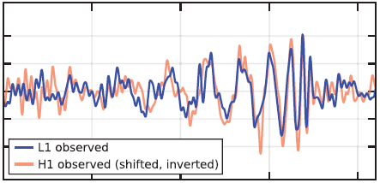

www.et-emr.eu!
Einstein Telescope projected in the
EMR region, image: Marco Kraan
GW150914 event:
gw-astronomy collaborations, LIGO

Slide 6
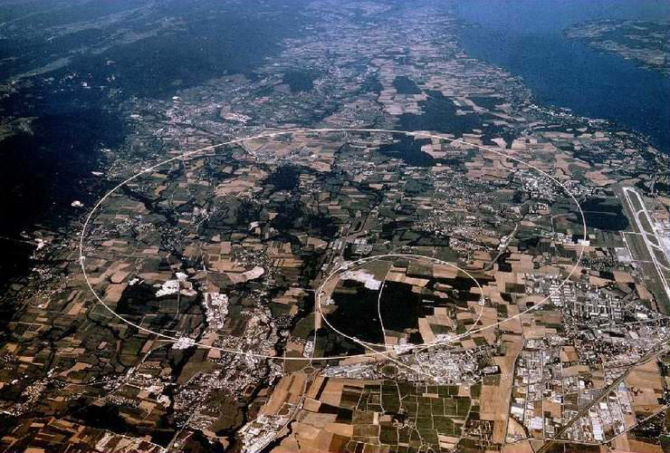
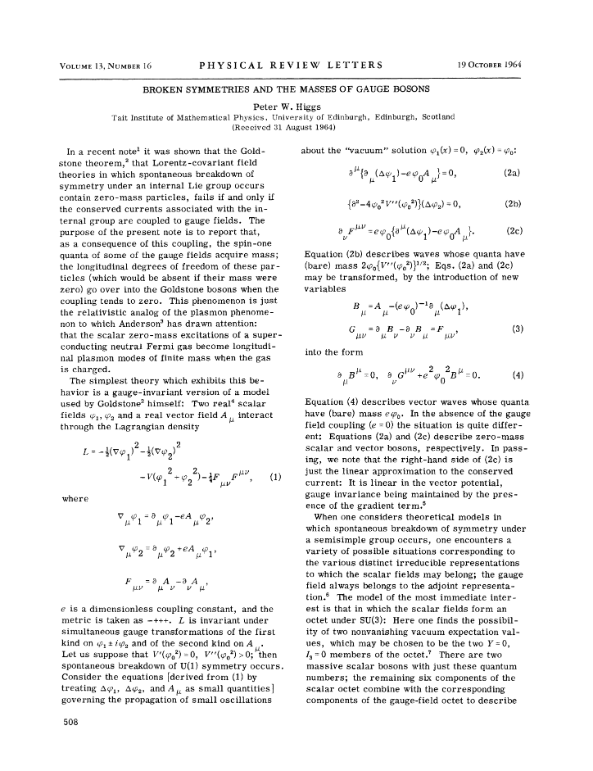
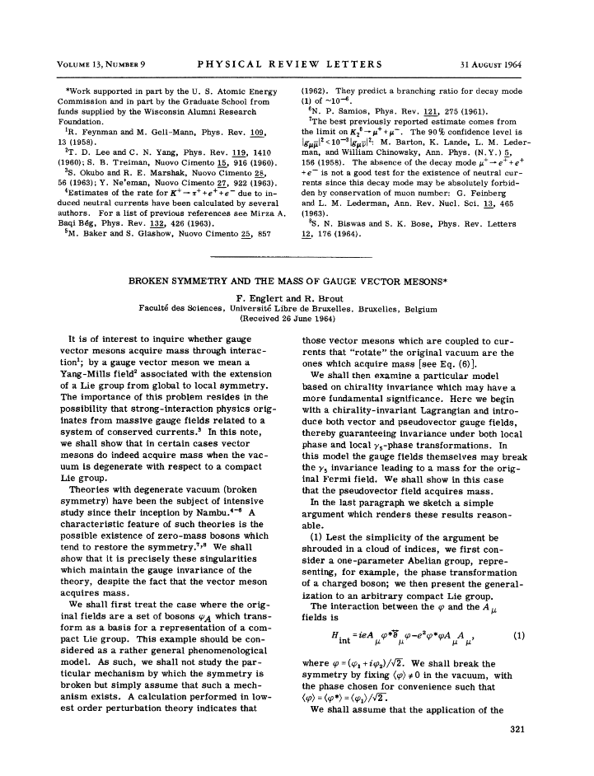
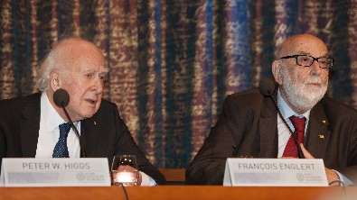
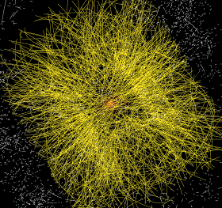
Data at the Large Hadron Collider at CERN
1964
~ 50 PiB/year
primary data
P. Higgs, Phys. Rev. Lett. 13, 508
16823 characters, 165kByte PDF
Peter Higgs and Francois Englert at the 2013 Nobel prize press conference, Stockholm. Photo: Bengt Nyman, https://www.flickr.com/photos/97469566@N00

Slide 7
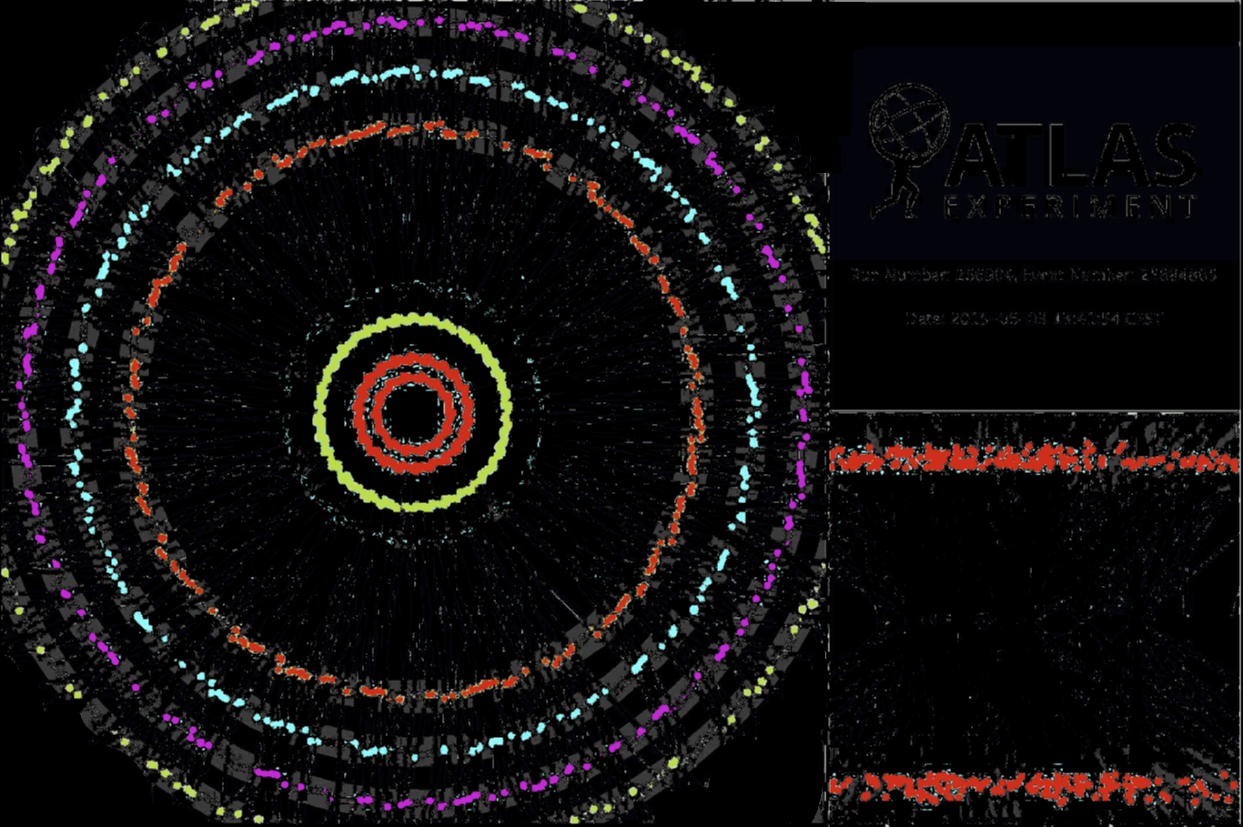
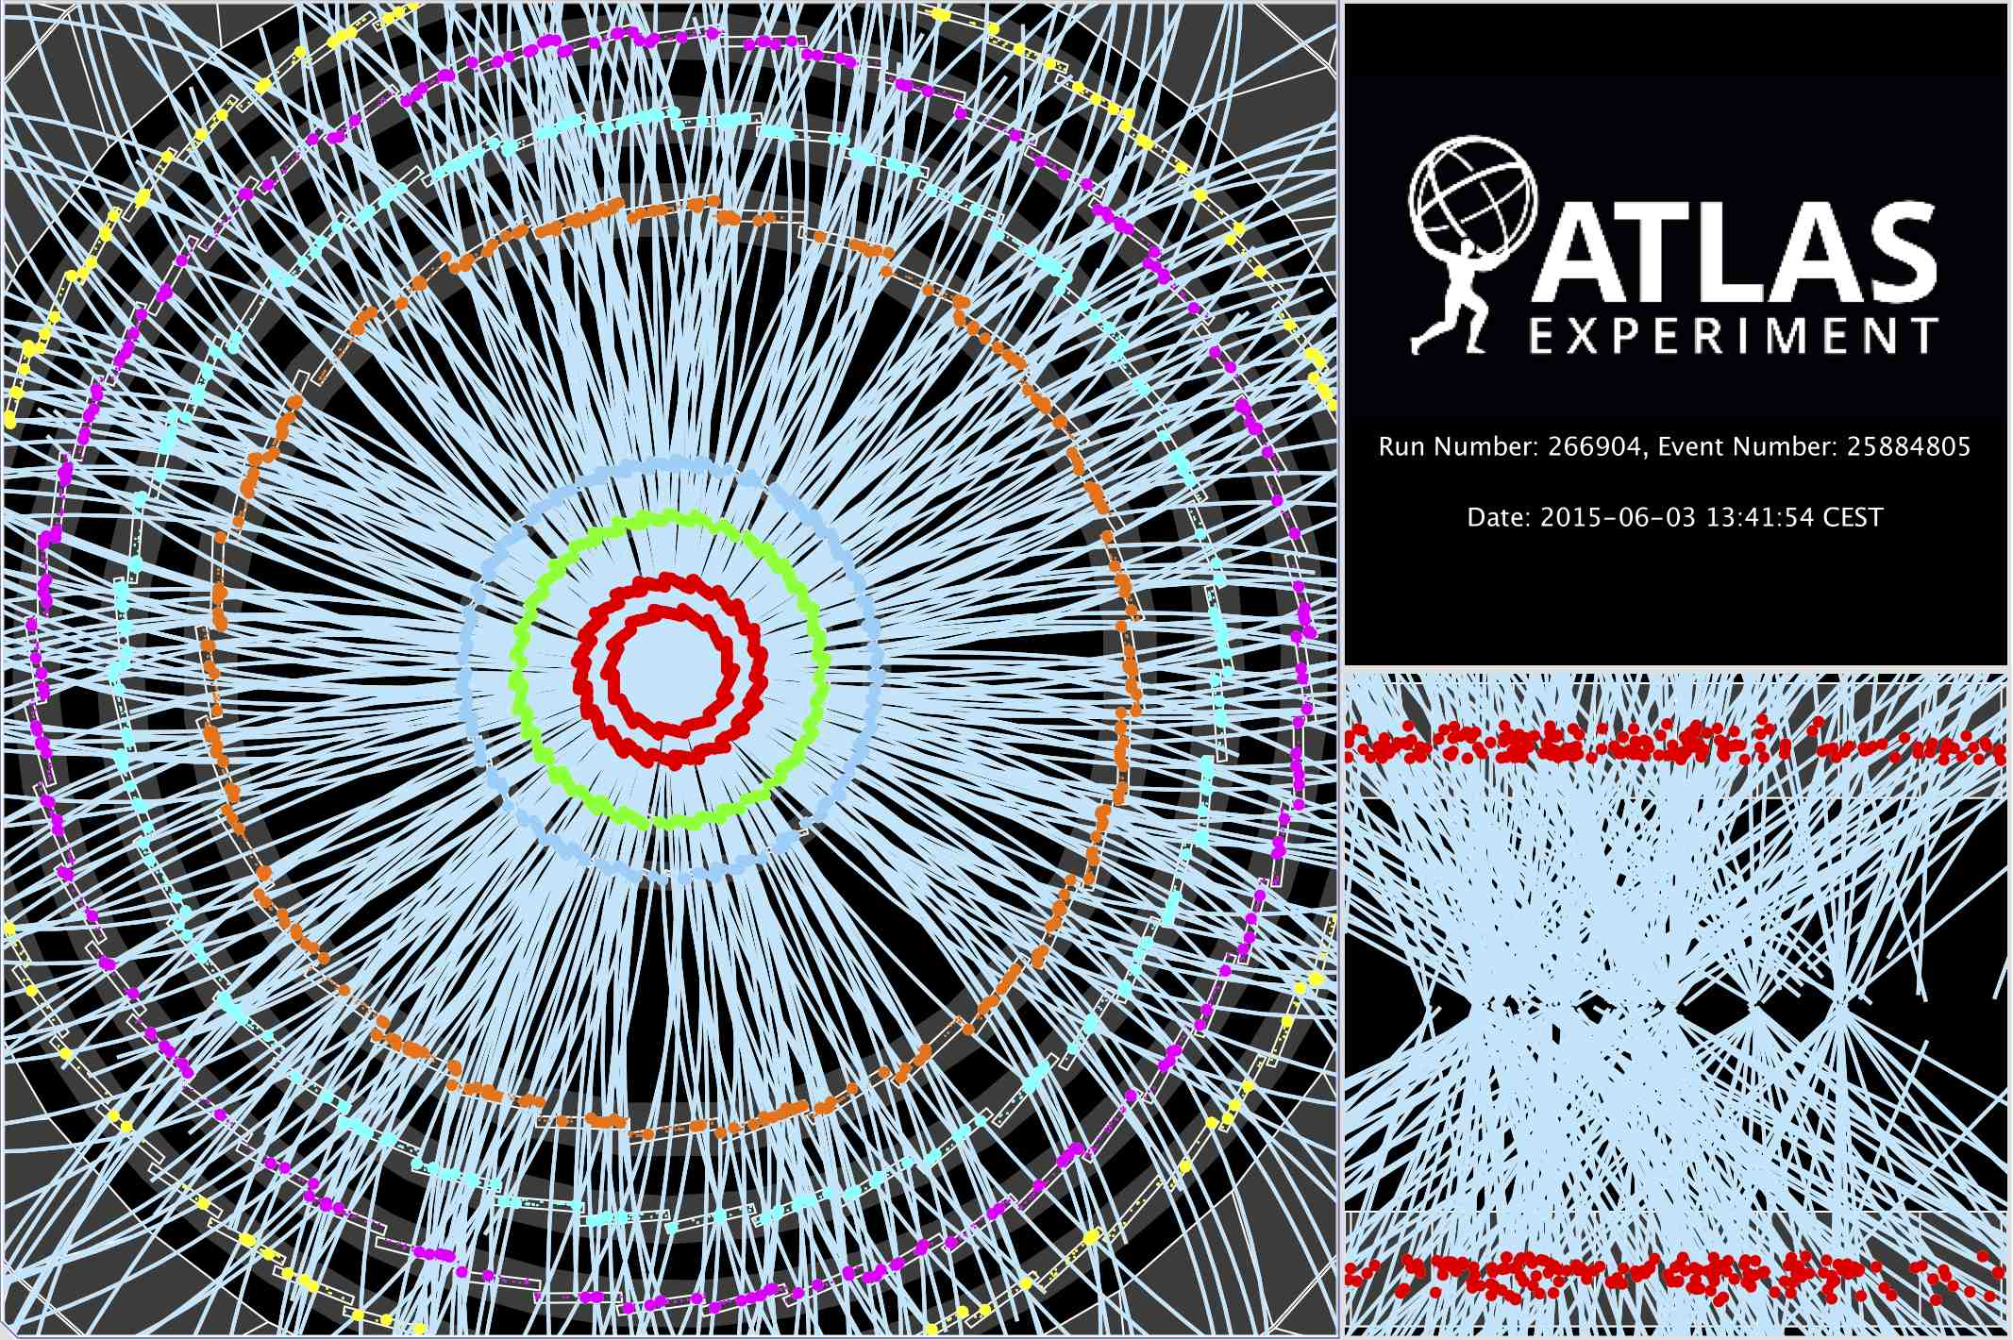

Computing on lots of data – 40 Mevents/sec
~ 10 seconds to compute
a single event at ATLAS
for ‘jets’ containing ~30 collisions
Display of a proton-proton collision event recorded by ATLAS on 3 June 2015, with the first LHC stable beams at a collision energy of 13 TeV;
Event processing time: v19.0.1.1 as per Jovan Mitrevski and 2015 J. Phys.: Conf. Ser. 664 072034 (CHEP2015)

Slide 8
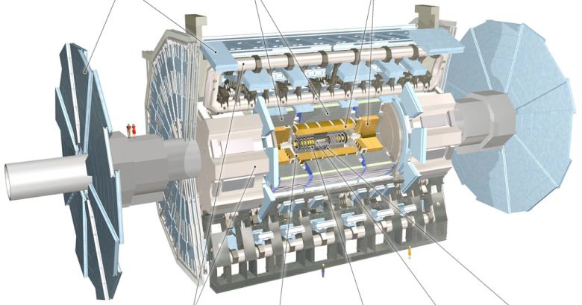

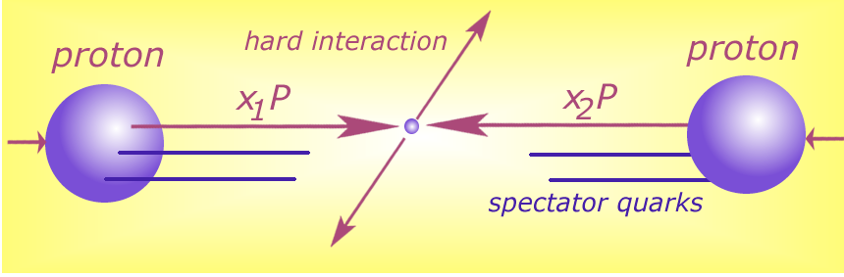




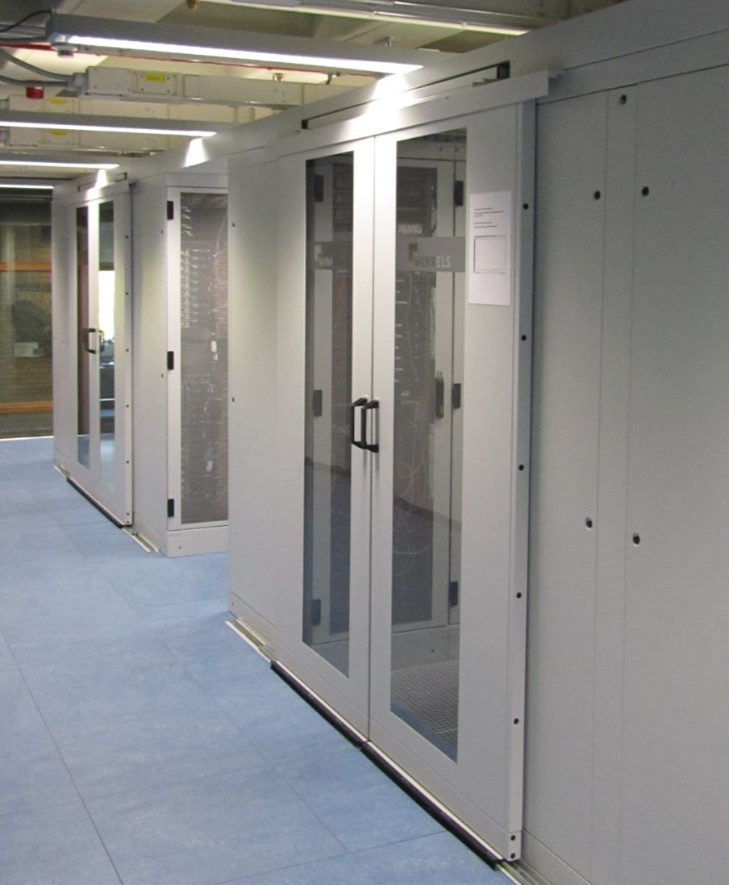






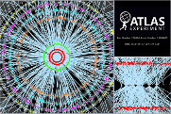

Detector to doctor workflow
40 million collisions / second
Physics analysis by (PhD) students, in papers & analysis notes
Trigger system selects
600 Hz ~ 1 GB/s data
Classify particles in collision and their physics properties:
- electrons
- muons
- jets consisting
of hadrons
- …
diagram adapted from Frank Linde; images: ATLAS collaboration, Nikhef. … and sorry for the GDPR-blur

Slide 9
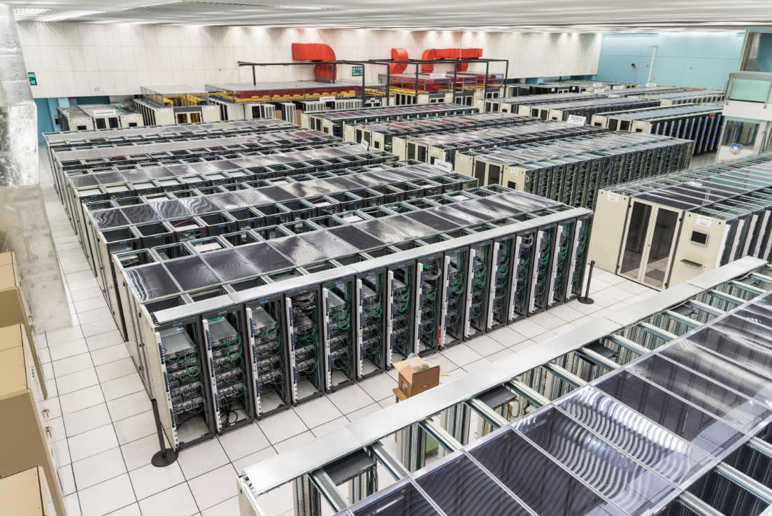
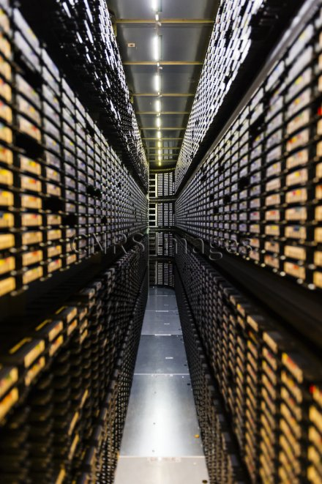
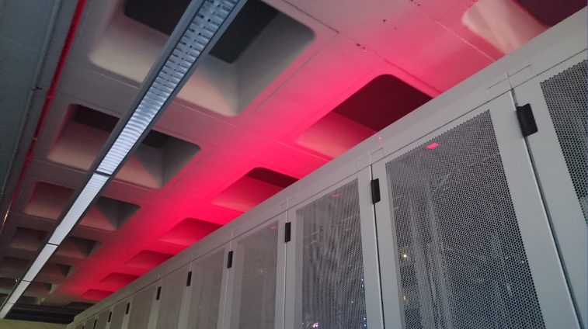
‘Big Science’ needs some computing …
CERN CC B513, image: https://cds.cern.ch/record/2127440; tape library: CC-IN2P3 with LHC and LSST data; cabinets: Nikhef H234b

Slide 10
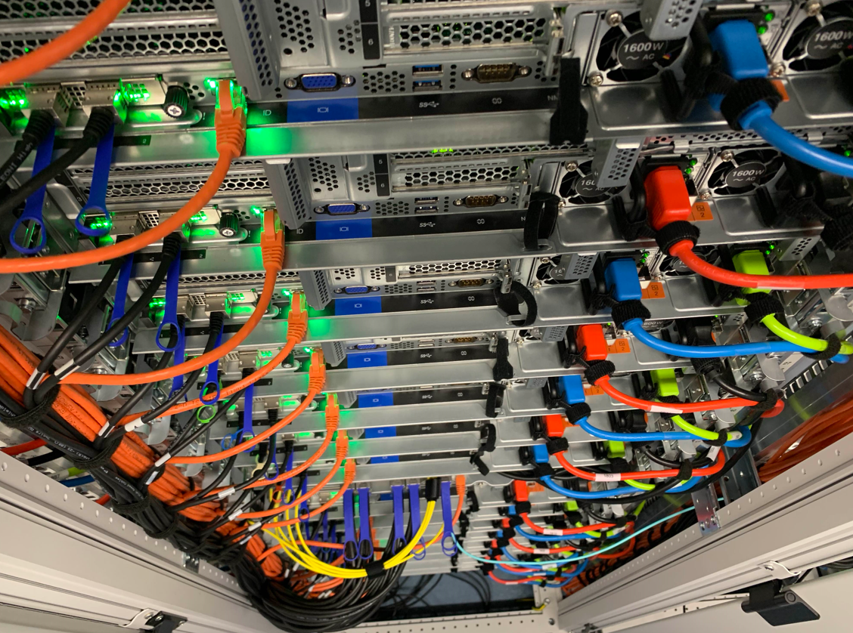
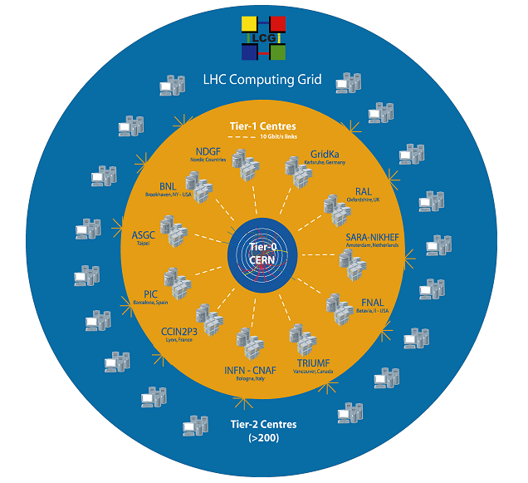
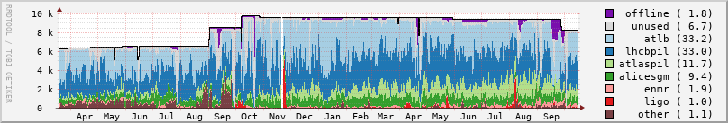
WLCG and Dutch National Infrastructure
11 global Tier-1 centres for CERN’s LHC
‘NL-T1’ part of the Dutch National Infrastructure
coordinated by SURF
located at SURF and Nikhef
shared across research domains:
GWIs, WIs, and other instruments
# jobs
Source: NDPF Statistics overview, https://www.nikhef.nl/pdp/doc/stats/ GRISview images: Jeff Templon period: March 2021 .. October 2022; cluster nodes: ‘Lotenfeest’

Slide 11
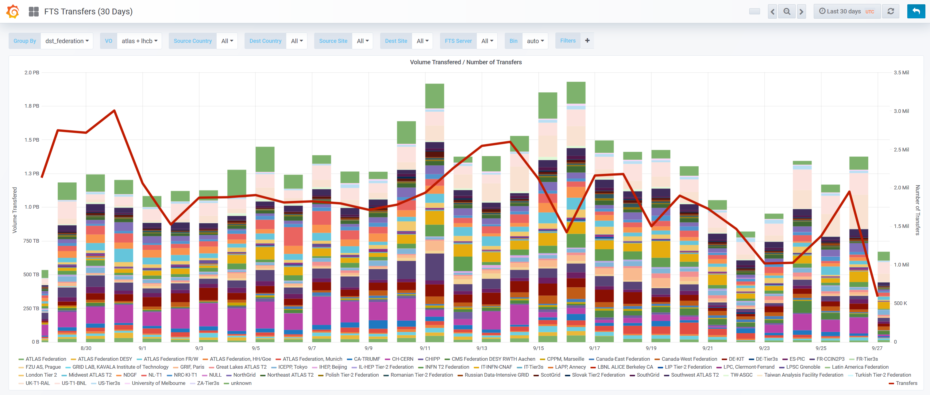



Distributing data via the network
2.6M
source: https://monit-grafana.cern.ch/d/000000420/fts-transfers-30-day

Slide 12
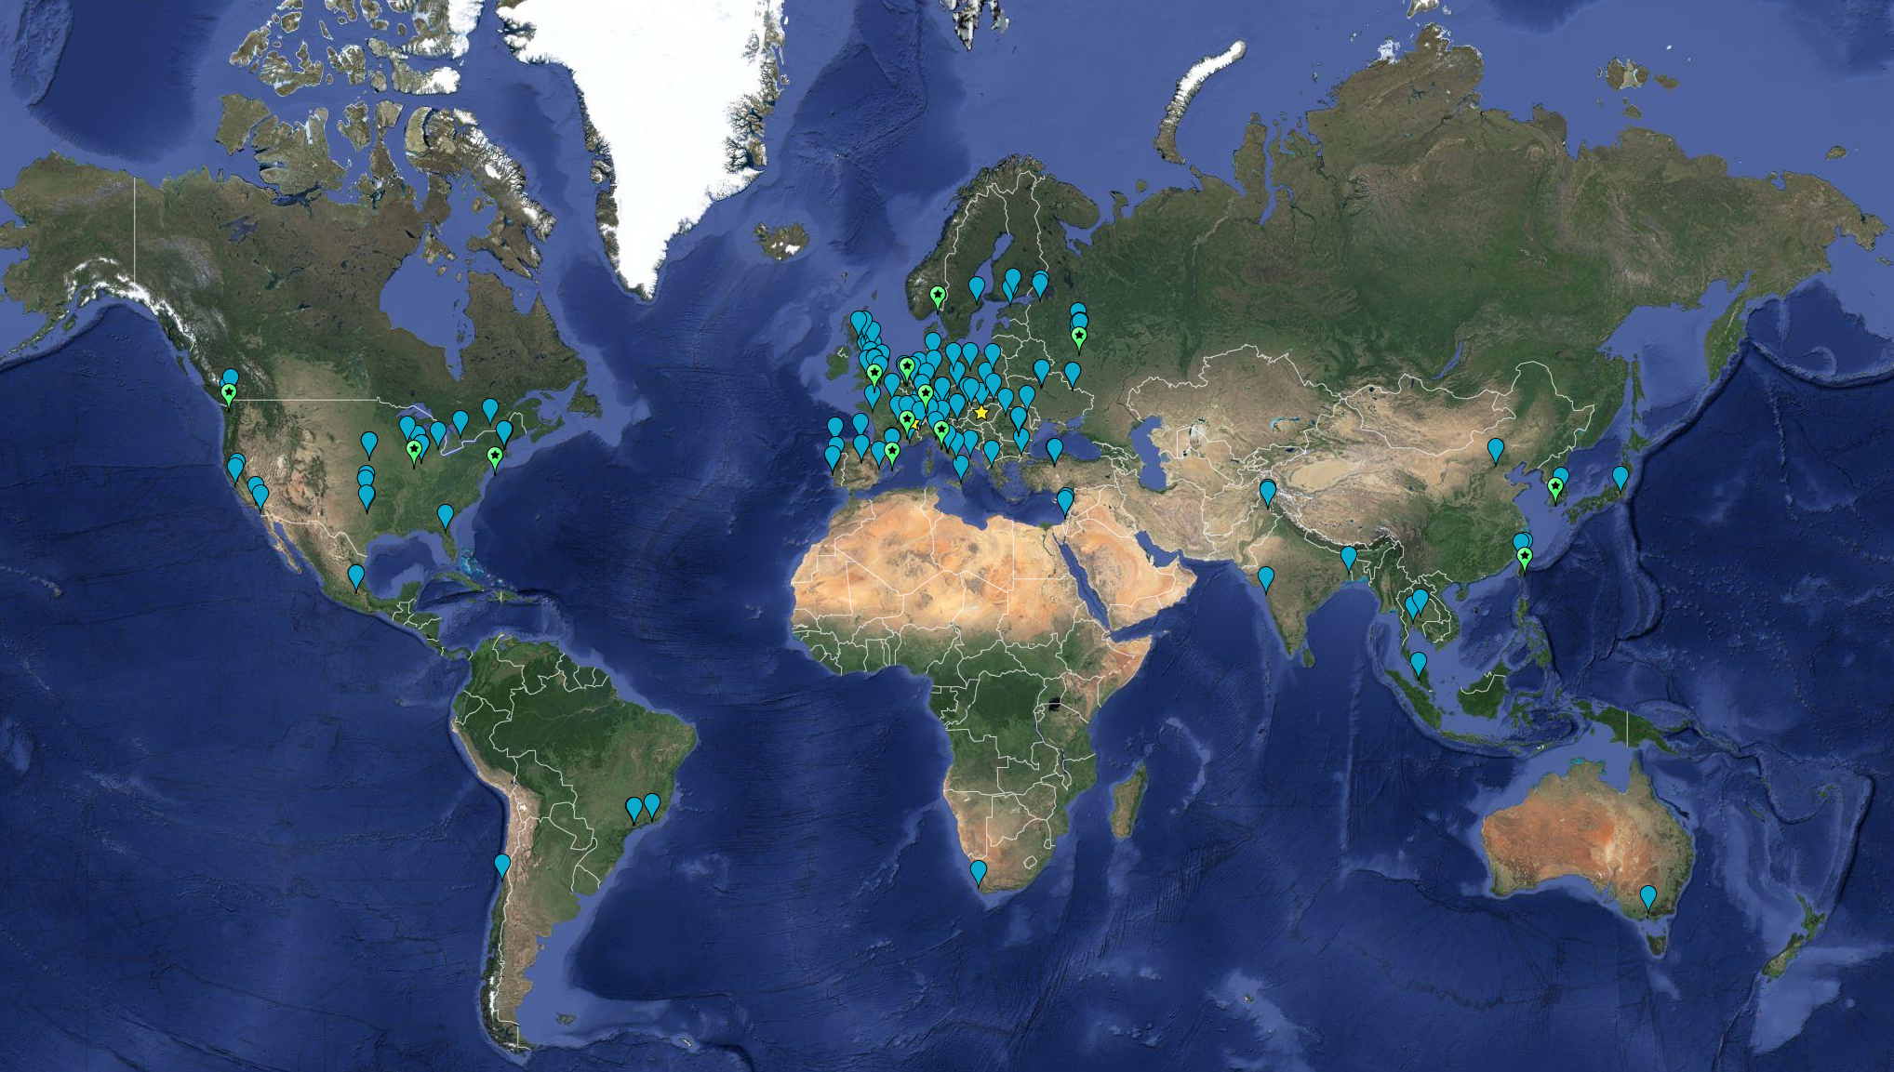



Globally distributed computing: federated services
> 170 institutes in
> 42 countries & economies
no single administrative control
Computing ~ 2,000,000 cores
On-line disks > 400 PB
Archival > 600 PB

Slide 13
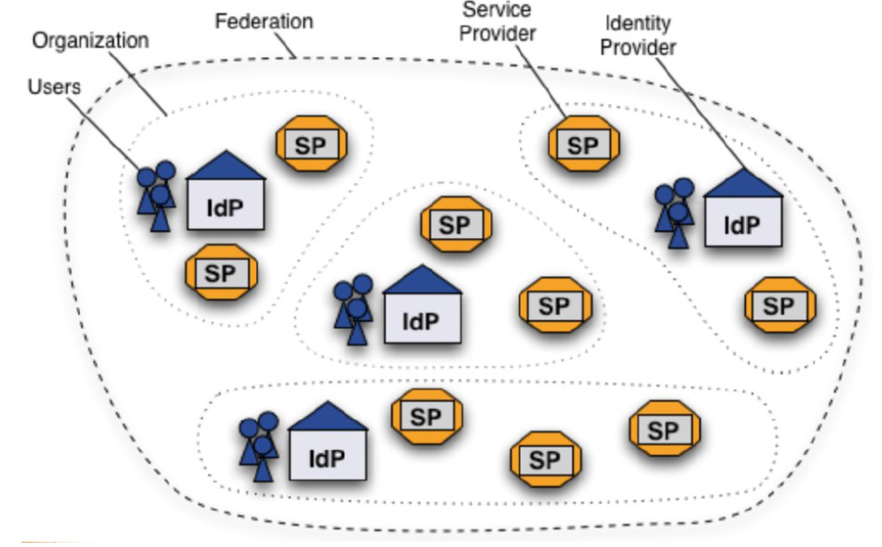
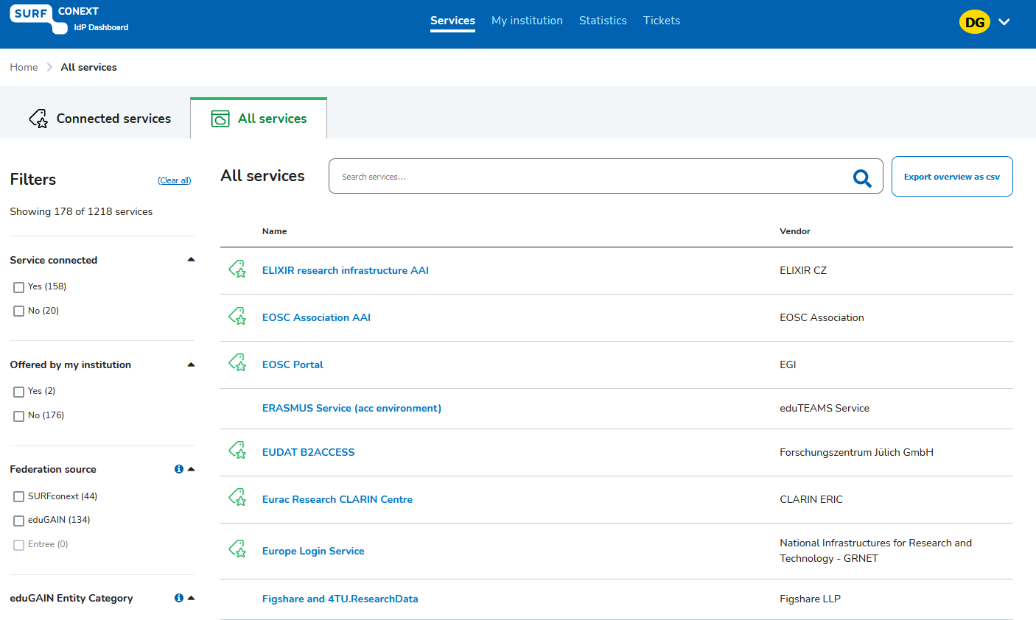

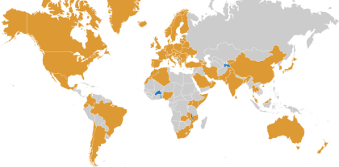
… to a global service federation for research and education
Images: SURFconext IdP dashboard by SURF, showing some services tagged with REFEDS R&S; eduGAIN map: GEANT, https://technical.edugain.org/status

Slide 14
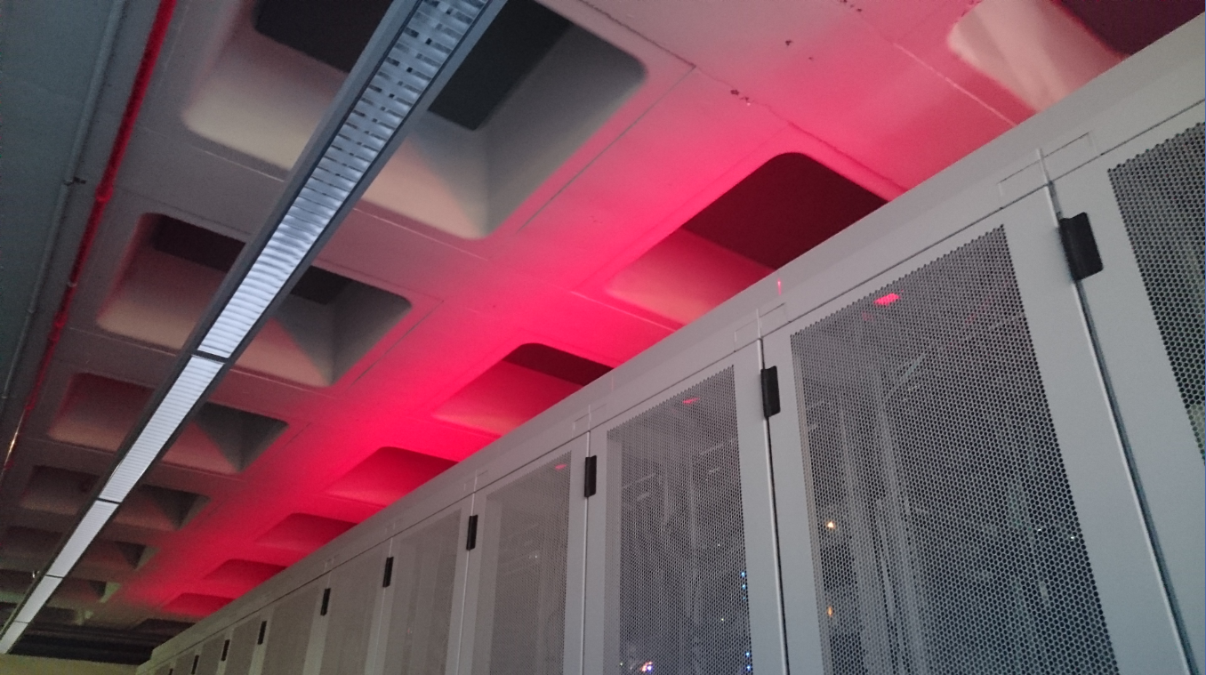
Data Centre: Housing, Connectivity, Compute, Data

Slide 15
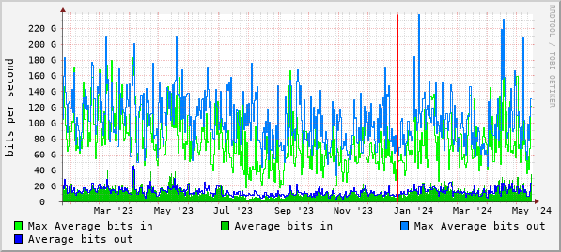
Typical data traffic to and from our processing cluster
Source: Nikhef cricket graphs period January 2023 – May 2024 – aggregated (research) traffic to external peers from deelqfx – https://cricket.nikhef.nl/

Slide 16
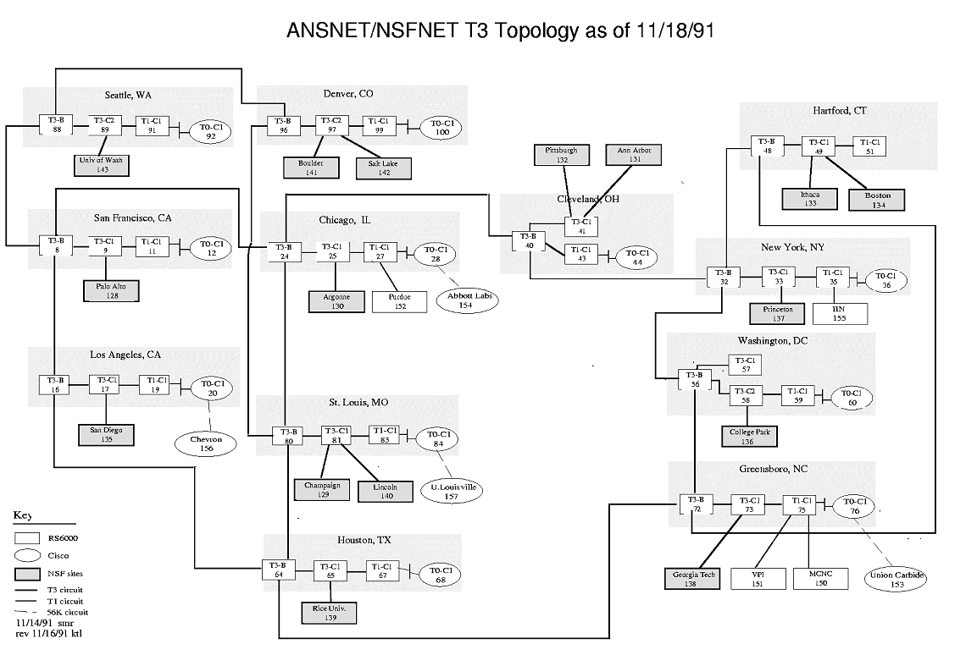
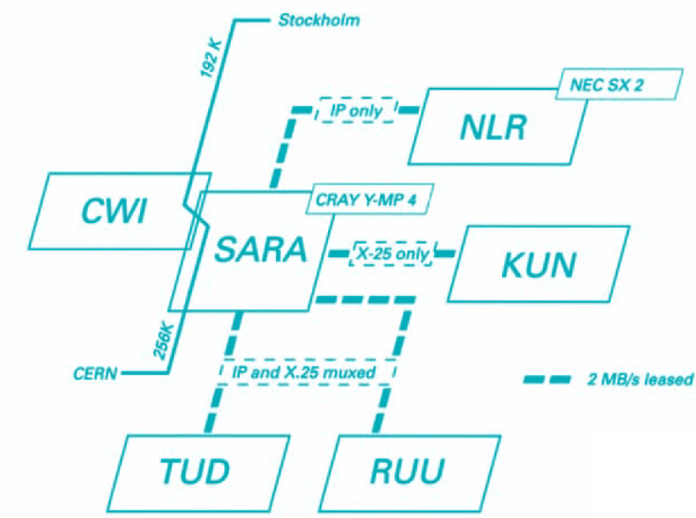
Getting to CERN from the Netherlands
See https://personalpages.manchester.ac.uk/staff/m.dodge/cybergeography/atlas/historical.html for more historic maps ; right-hand image: SURFnet2, 1990

Slide 17
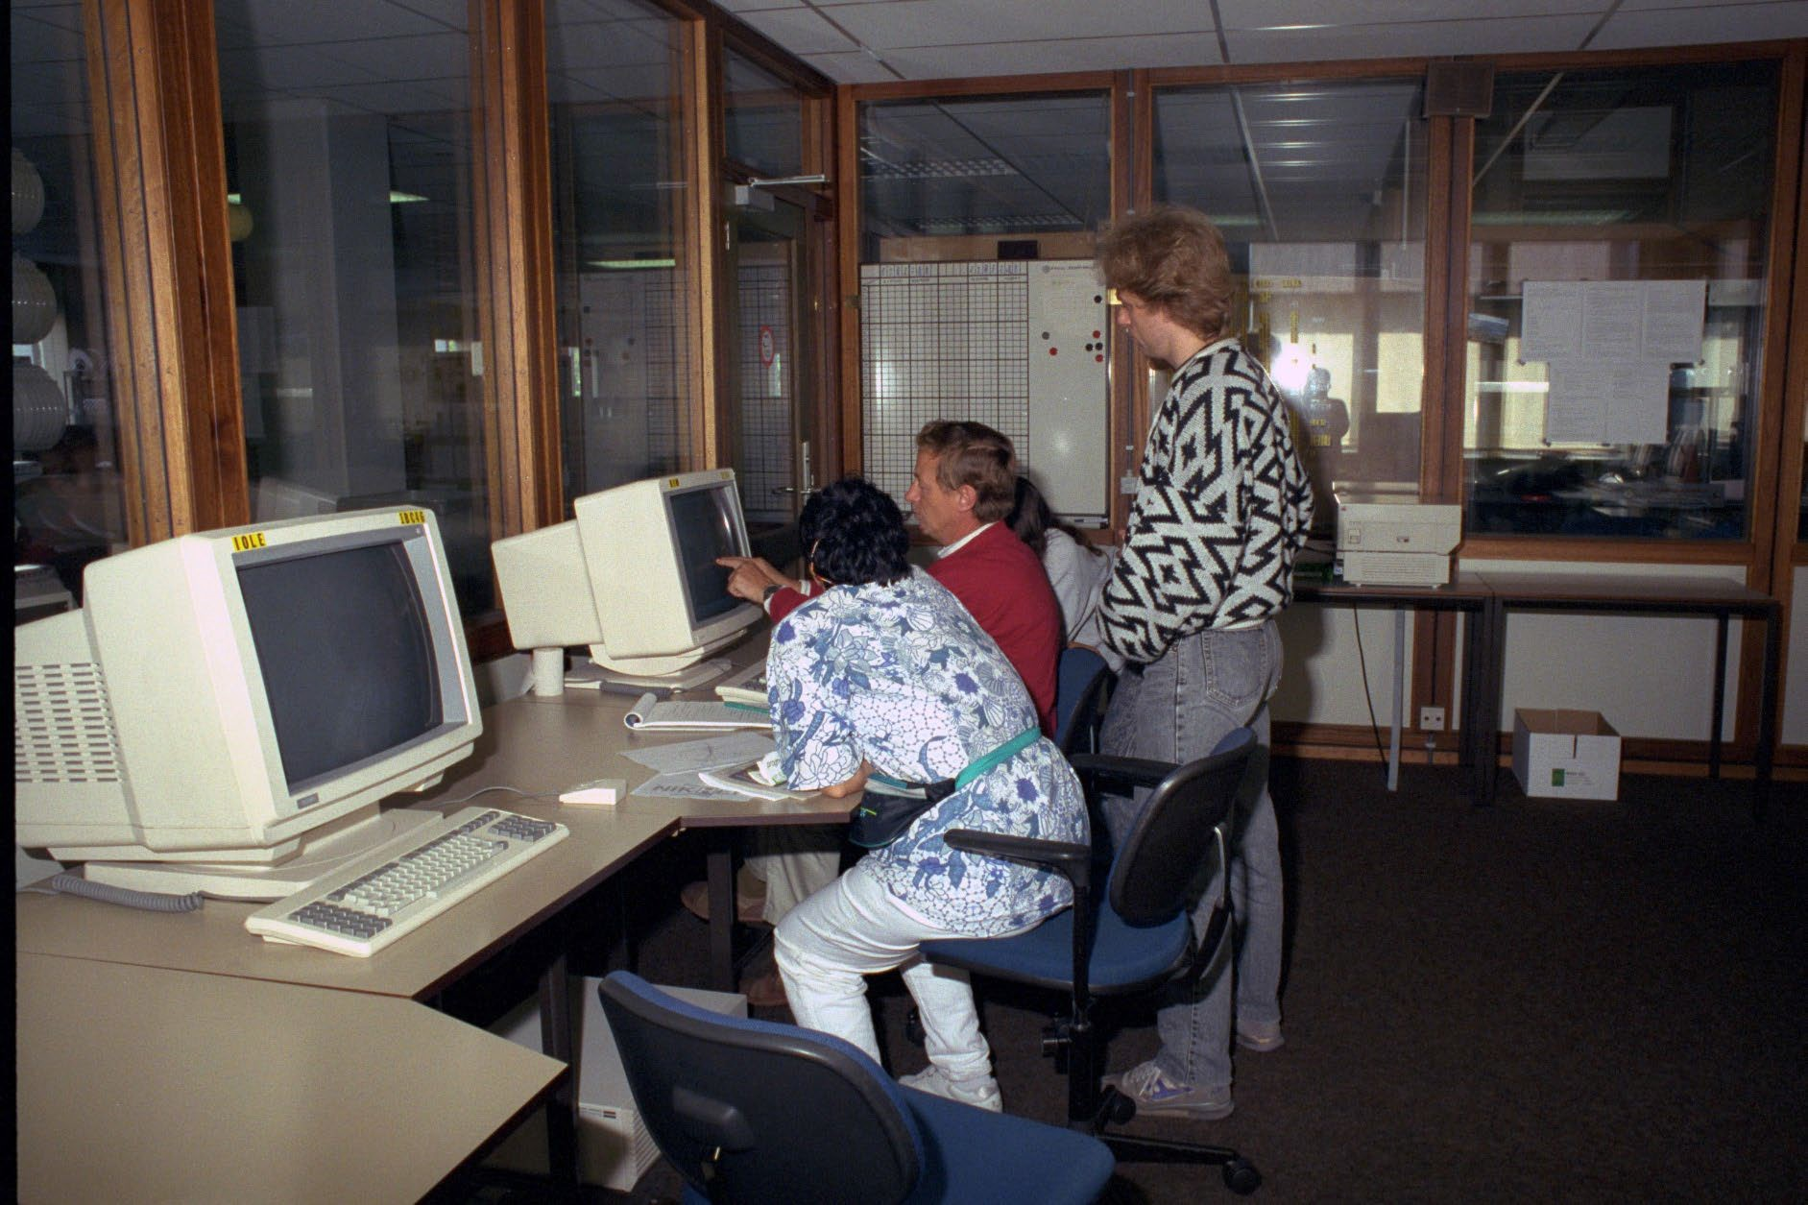
The Nikhef data centre – at the end of the 1980s
Gould, Sun, and DEC systems,
taking several racks each
500 m2 floor area
Raised floor: +60cm
walls are ‘movable’
to accommodate expansion
Nikhef room H1.37 – terminal stations on the raised data floor of the computer room (H1.40, behind the glass-panel walls)

Slide 18
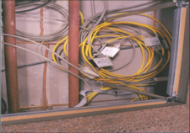
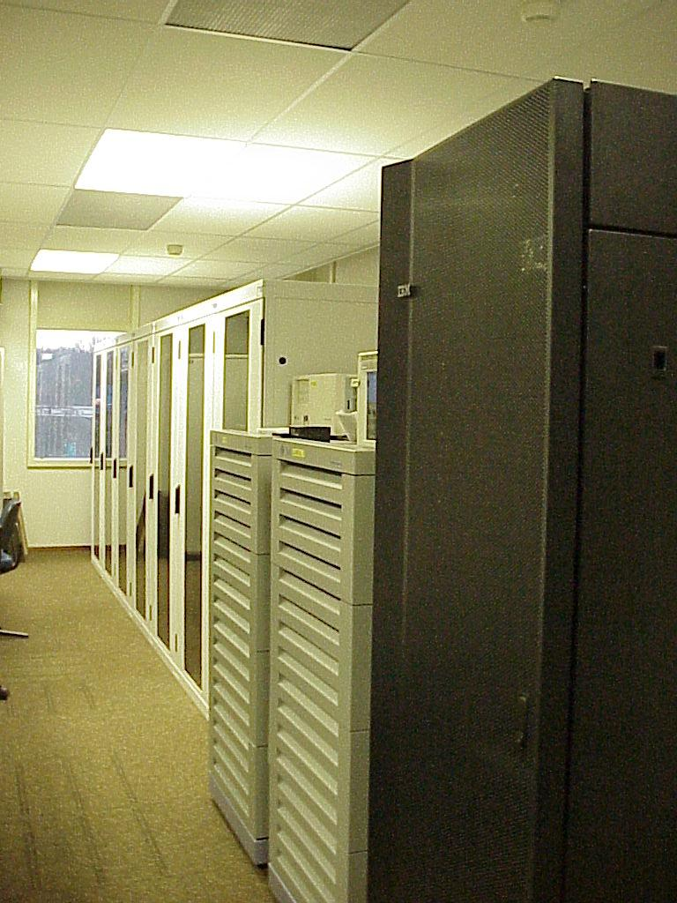
IBR-LAN at Nikhef
International Backbone Router Local Area Network “IBR-LAN” at Nikhef, room H1.40 as seen in 1996. Right: H1.39 with nikhefh.nikhef.nl racks and early DAS-2 system

Slide 19
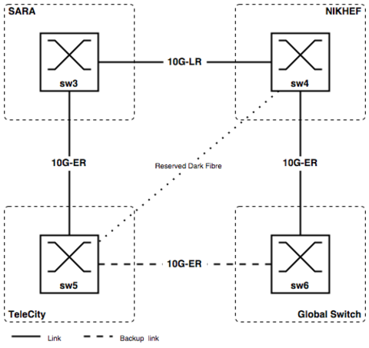
A growing internet!
AMS-IX topology, 2002

Slide 20
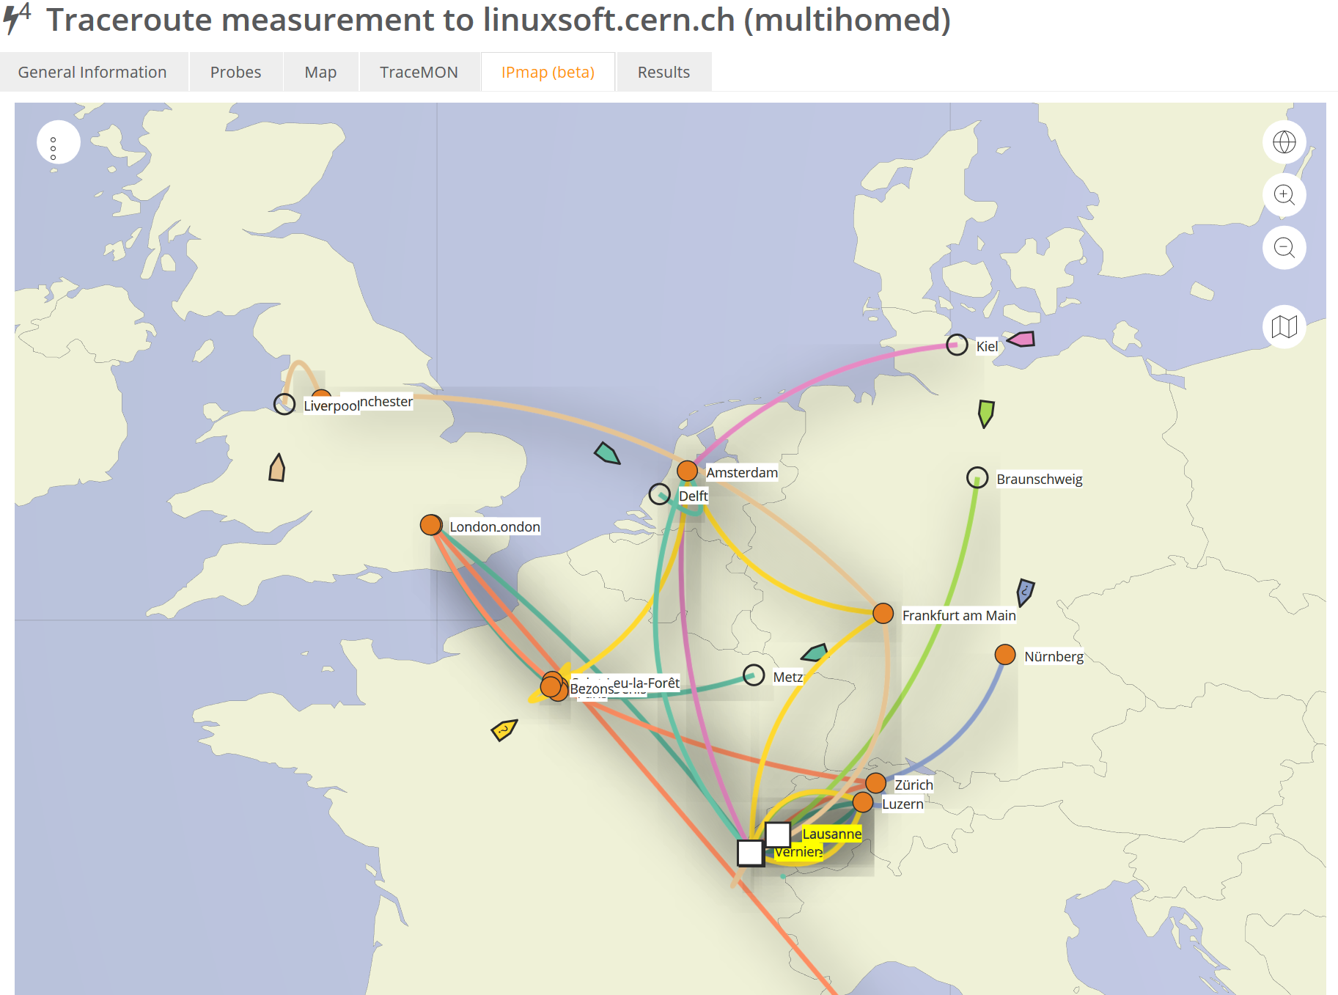

Getting
to CERN
Data: TraceMON IPmap from RIPE NCC Atlas atlas.ripe.net measurement 9249079

Slide 21
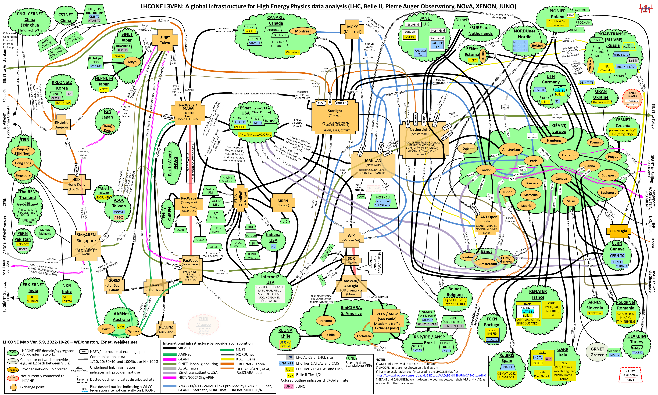
LHCone
LHCone (“LHC Open Network Environment”) – visualization by Bill Johnston, ESnet version: October 2022 – updated with new AS1104 links

Slide 22

What happens inside a data centre …
‘Connectivity’ housing and
‘hosting’ are different things:
        NikhefHousing (H140) has connectivity parties only, and does not host any content
        what you see on the 1st floor tour is network equipment:
        shipping data, but not keeping anything
        2nd floor has our science data centre
And no single connectivity data centre is a single point of failure: Internet protocols are engineered to re-route traffic

Slide 23


Today’s data centre at Nikhef
Nikhef ‘science’ data centre H234b
47 racks and ~350 kW
hosts Nikhef, CERN, gravitational waves, and SURF research data
strengthens connectivity at NikhefHousing
‘NikhefHousing’ data centre
from once just 2 racks in a spare space
to now > ~400 racks
many different connectivity parties
connectivity only, but not hosting

Slide 24

Data centre installation management
three 400kW active/free cooling chillers installed in 2009
data floor: grown to ~400 racks
additional electricity generator set added in 2009
Aquifer Thermal Energy Storage (ATES) system in 2010
Image: Floris Bieshaar, Nikhef

Slide 25



Power in … and energy out …
Three generators
A-Feed 1250 kVA (pictured under load while testing)
B-Feed 1700 kVA
C-Feed 1250 KVA added with the current expansion
Separate redundant UPS for each
Heat re-use:
aquifer thermal energy storage
re-use heat to warm our building (pretty warm)
AND feed more heat to student housing opposite
nominal ‘PUE’ ~ 1.21
Generator image source: Floris Bieshaar. MacGillevrylaan sketch: Science Park Amsterdam

Slide 26

Just one of
the many
autonomous
systems ...
AS1104

Slide 27



Some are faster than …
Image: Minister of Economic Affairs M. Adriaansens launched the Innovation Hub with Nikhef, SURF, Nokia and NL-ix, January 2023. Composite image from https://www.surf.nl/nieuws/minister-adriaansens-lanceert-testomgeving-voor-supersnelle-netwerktechnologie

Slide 28




Exercising the network – sensor data and events
1.02 Bpps
800 Gbps and >593 Mpps –
connected to CERN via SURF
Image: ballenbak.nikhef.nl, Tristan Suerink

Slide 29





Our science data flows are somebody else’s DDoS attack
Image sources: belastingdienst.nl, rws.nl, nu.nl, werkentegennederland.nl

Slide 30
Thanks, and enjoy Nikhef

