Slide 1
Welcome to Nikhef
Introduction to Nikhef and
the NikhefHousing Data Centre
David Groep
May 2024

Slide 2
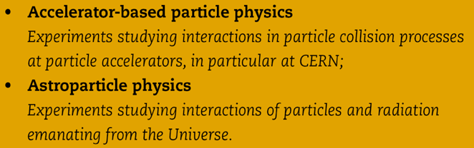
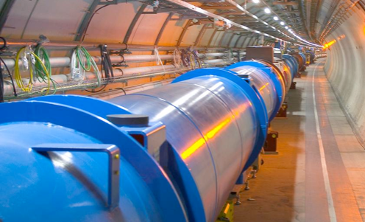
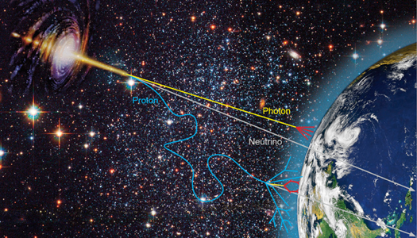
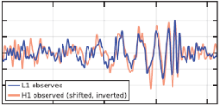
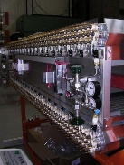
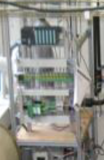

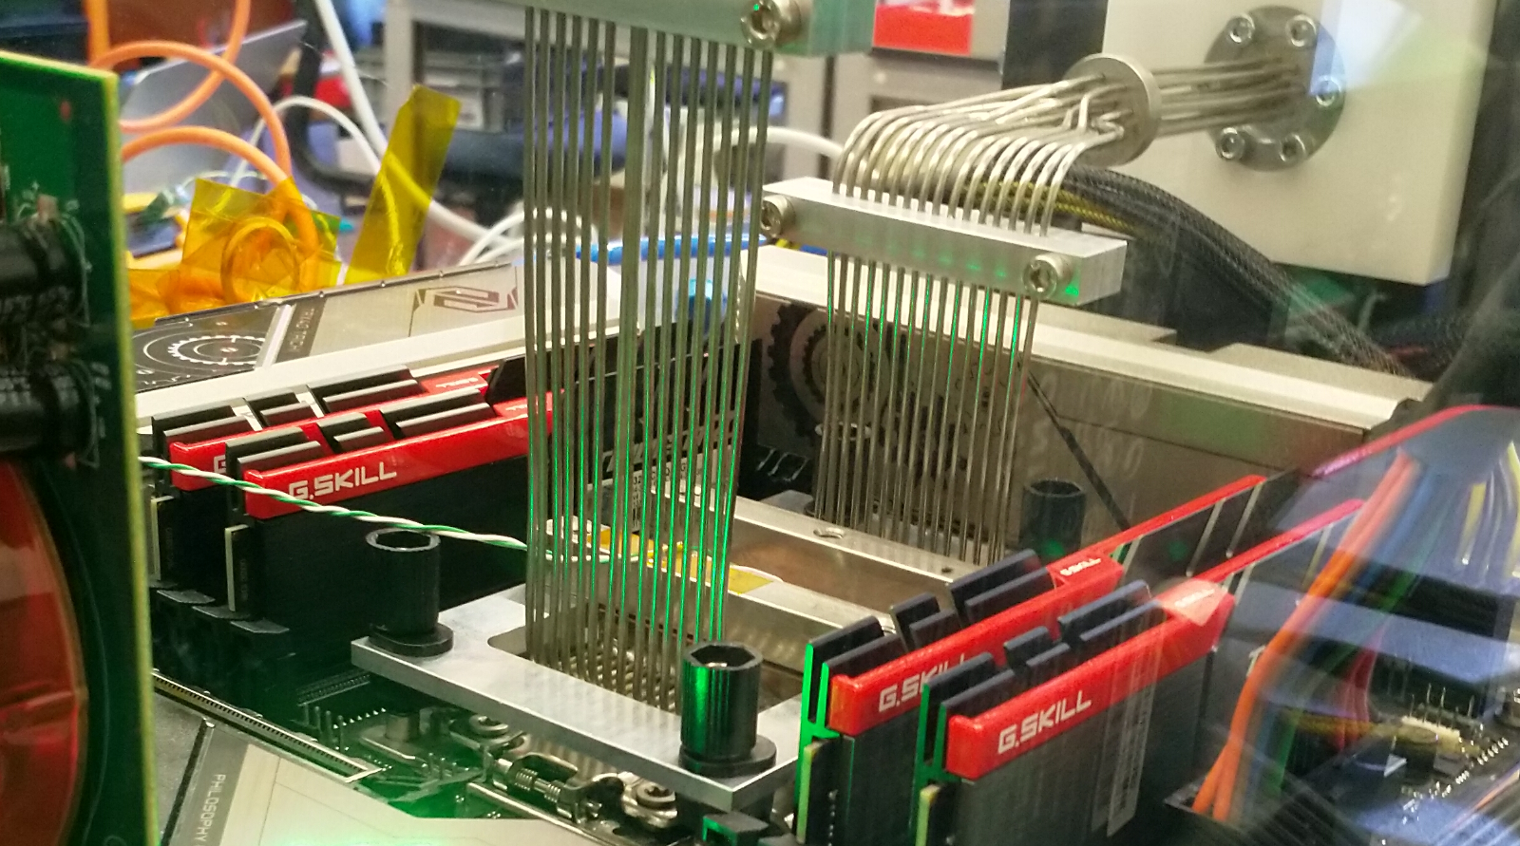

Our world, made of particles and fields
Collider physics
Astroparticle physics
Phenomenology
Technology R&D
Notes:
not on slide but important: concentrates all NL HEP infrastructure
machine shop, designers, ICT

Slide 3
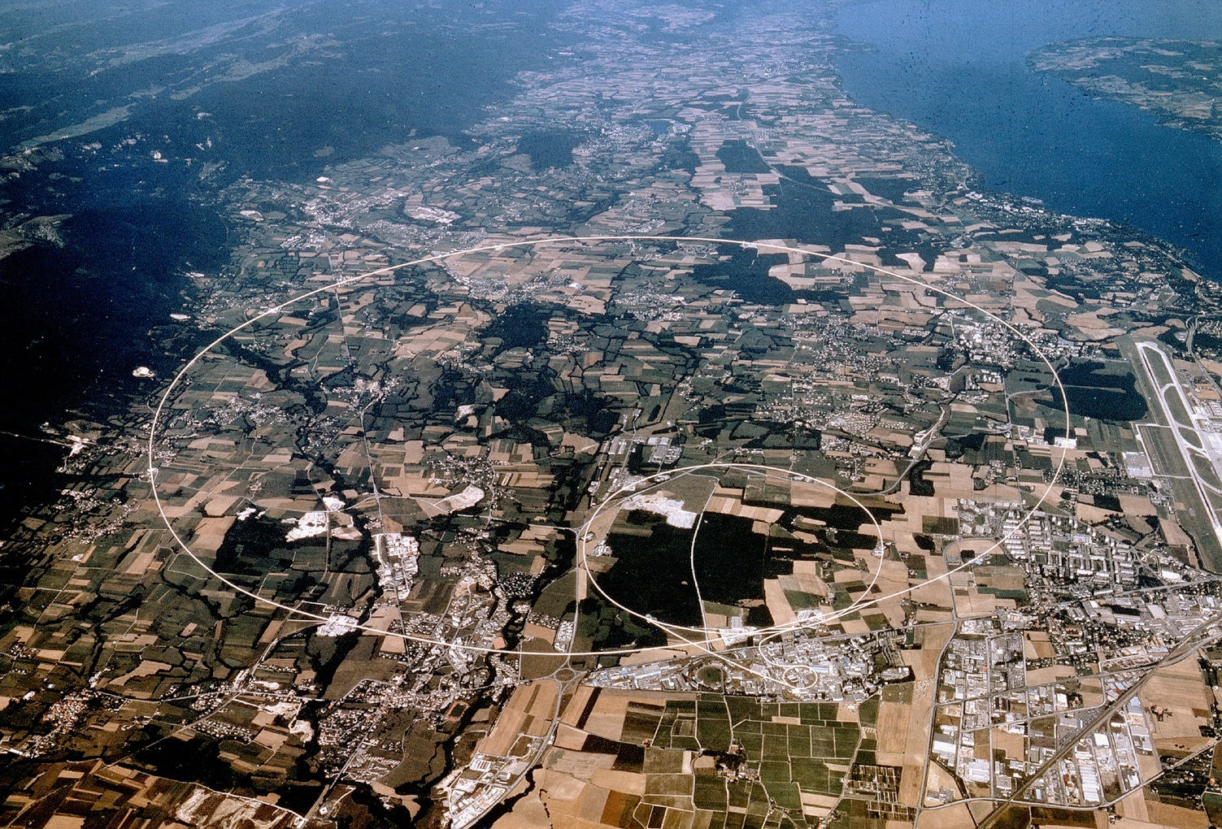


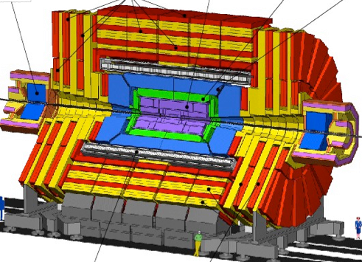


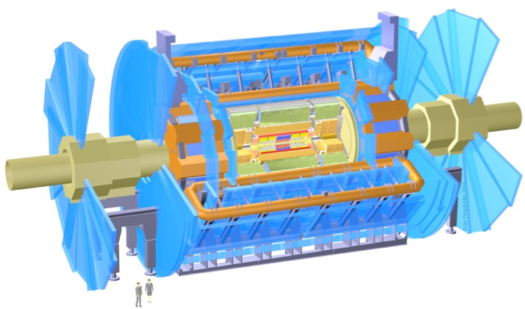


CERN – Europe’s laboratory for high-energy physics
CMS
LHCb
ALICE
ATLAS
Atlas
Imagery: CERN, European Organisation for Nuclear Research

Slide 4
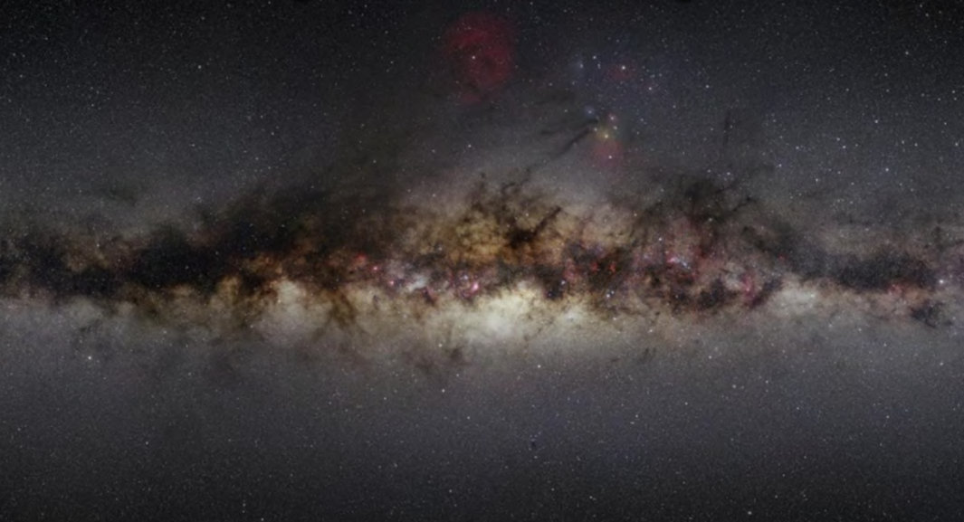
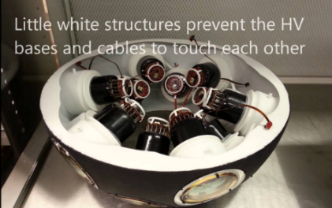
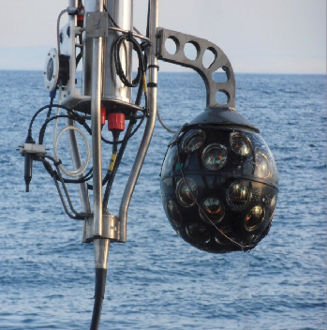
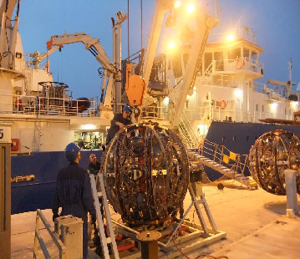
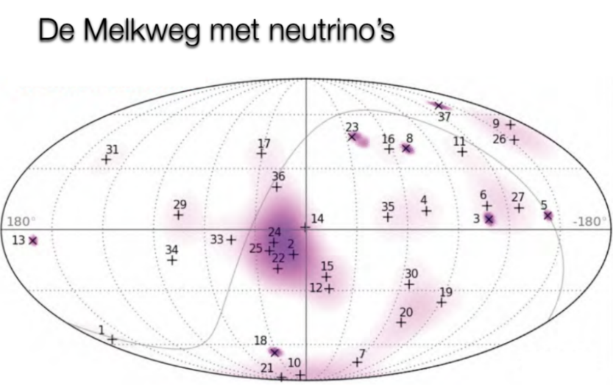
Image sources:
Nikhef, NIOZ,
KM3NET collaboration

Slide 5
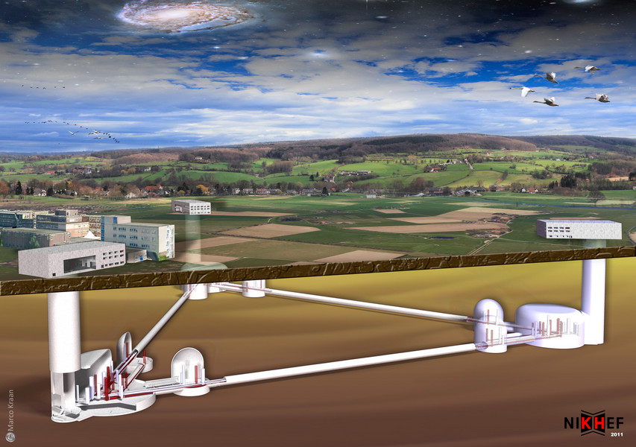
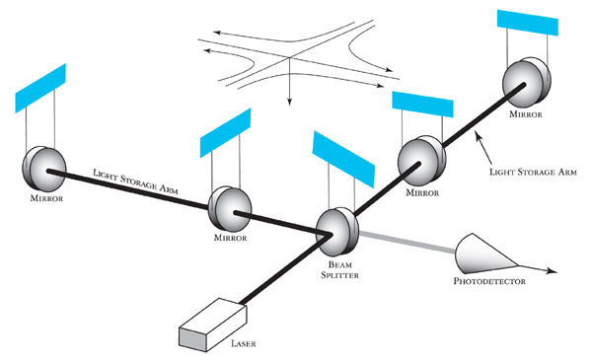
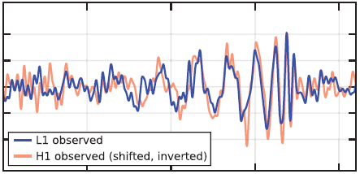

www.et-emr.eu!
Einstein Telescope projected in the
EMR region, image: Marco Kraan
GW150914 event:
gw-astronomy collaborations, LIGO

Slide 6
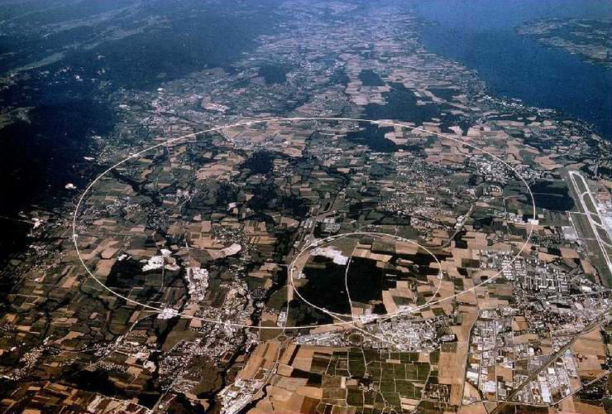
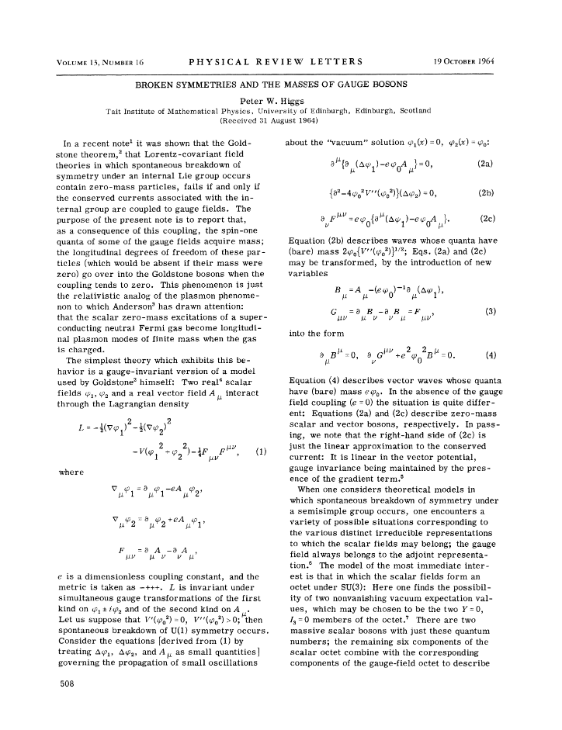
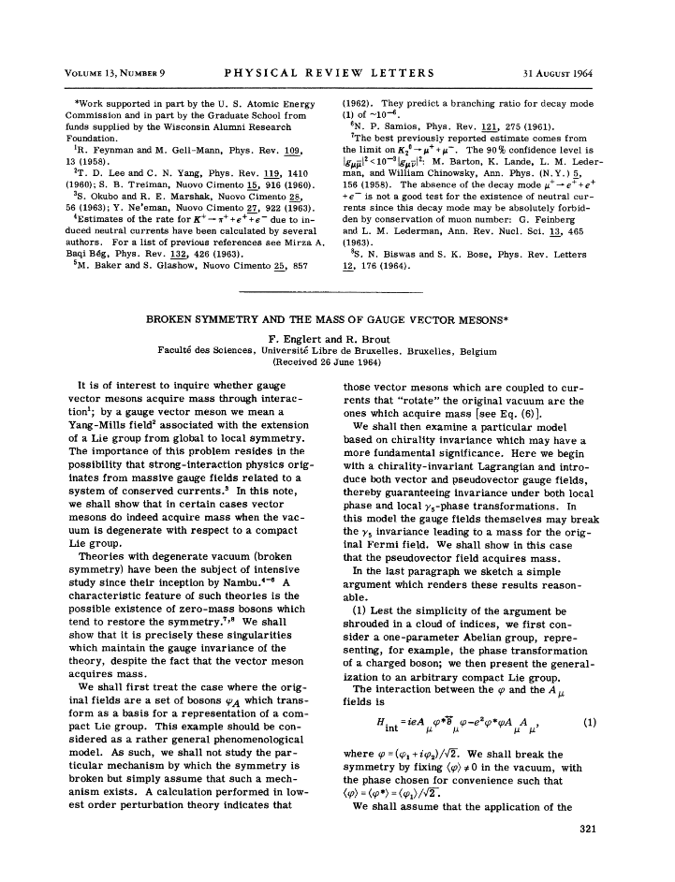

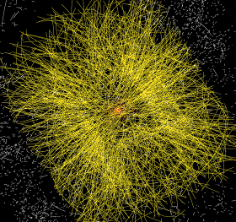
Data at the Large Hadron Collider at CERN
1964
~ 50 PiB/year
primary data
P. Higgs, Phys. Rev. Lett. 13, 508
16823 characters, 165kByte PDF
Peter Higgs and Francois Englert at the 2013 Nobel prize press conference, Stockholm. Photo: Bengt Nyman, https://www.flickr.com/photos/97469566@N00

Slide 7
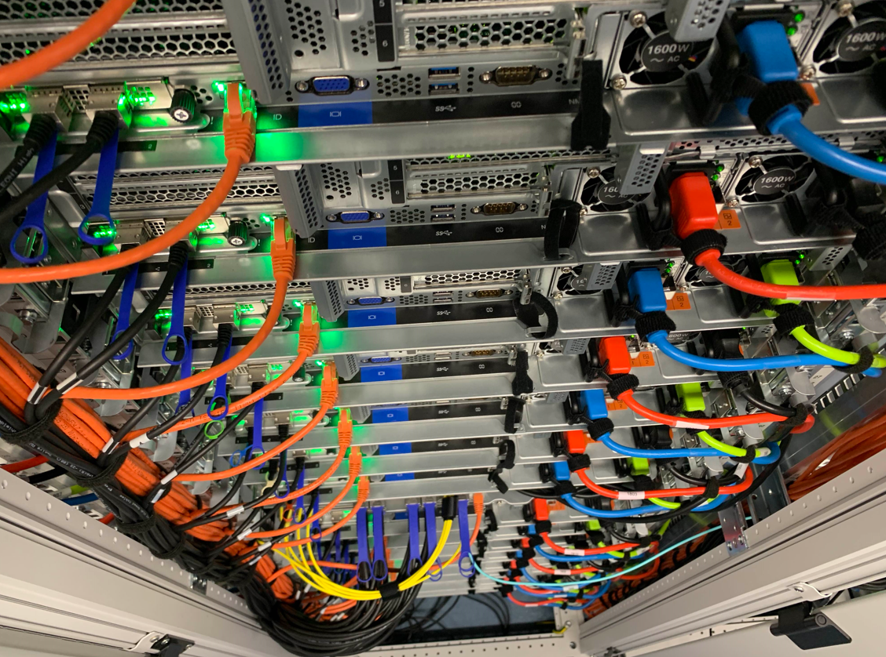
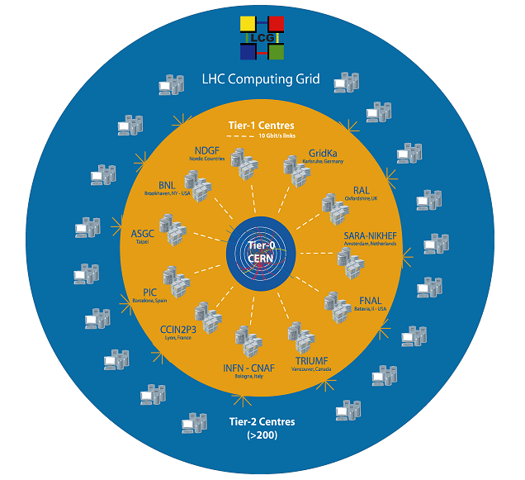
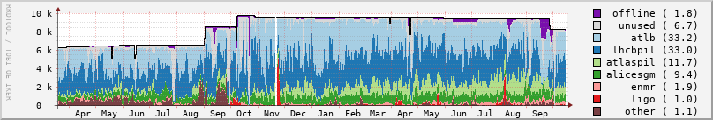
WLCG and Dutch National Infrastructure
11 global Tier-1 centres for CERN’s LHC
‘NL-T1’ part of the Dutch National Infrastructure
coordinated by SURF
located at SURF and Nikhef
shared across research domains:
GWIs, WIs, and other instruments
# jobs
Source: NDPF Statistics overview, https://www.nikhef.nl/pdp/doc/stats/ GRISview images: Jeff Templon period: March 2021 .. October 2022; cluster nodes: ‘Lotenfeest’

Slide 8
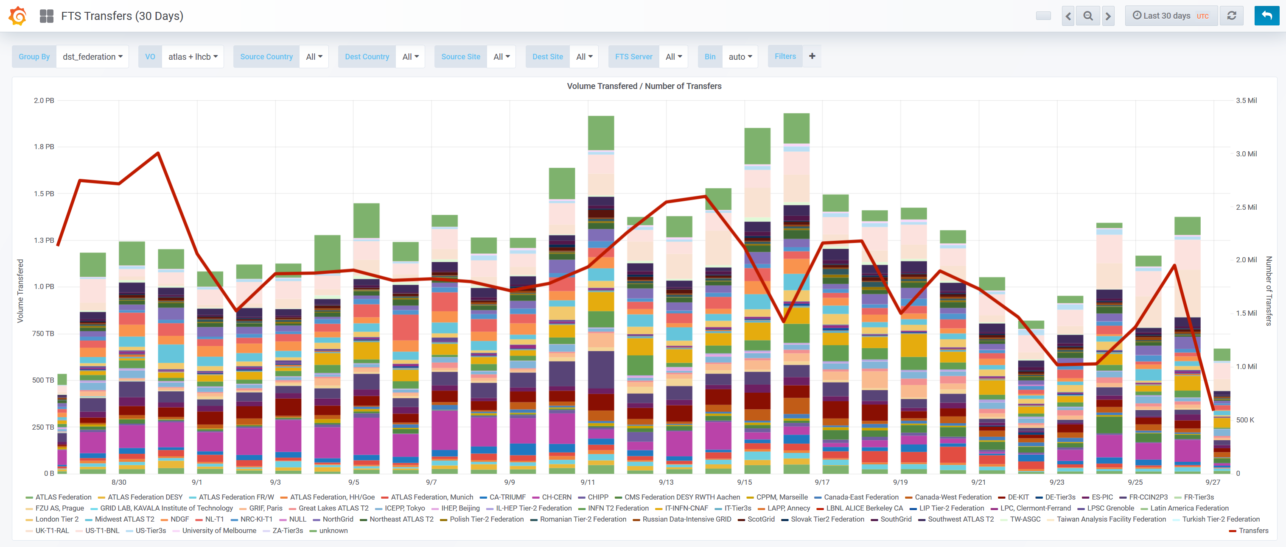

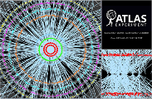

Distributing data via the network
2.6M
source: https://monit-grafana.cern.ch/d/000000420/fts-transfers-30-day

Slide 9
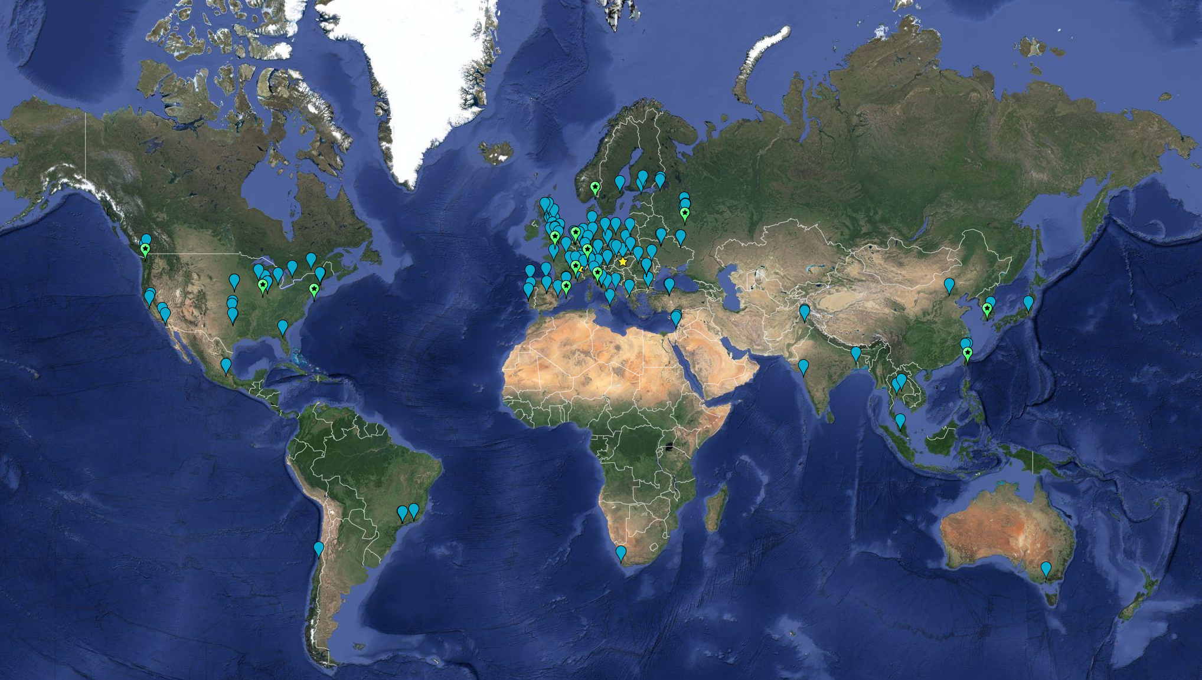



Globally distributed computing: federated services
> 170 institutes in
> 42 countries & economies
no single administrative control
Computing ~ 2,000,000 cores
On-line disks > 400 PB
Archival > 600 PB

Slide 10
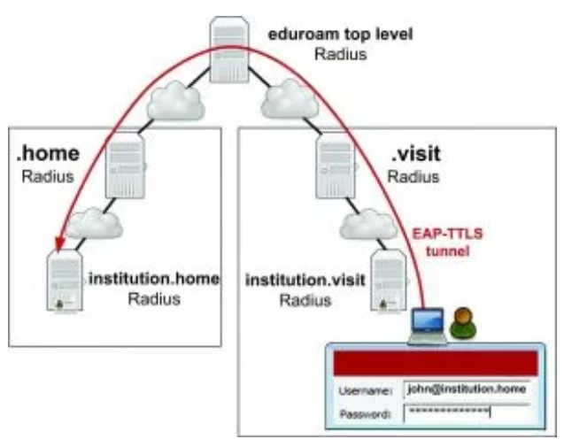

From a simple federation: eduroam global WiFi …
Service-specific “WiFi” federation
trust between organisations, globally
local organization grants access
based on your home credentials
There are now multiple such federations,
such as govroam
eduroam: Klaas Wieringa et al., image from https://eduroam.org/how/, GEANT ; RADIUS: RC2865 https://www.rfc-editor.org/rfc/rfc2865; see also freeradius.org

Slide 11
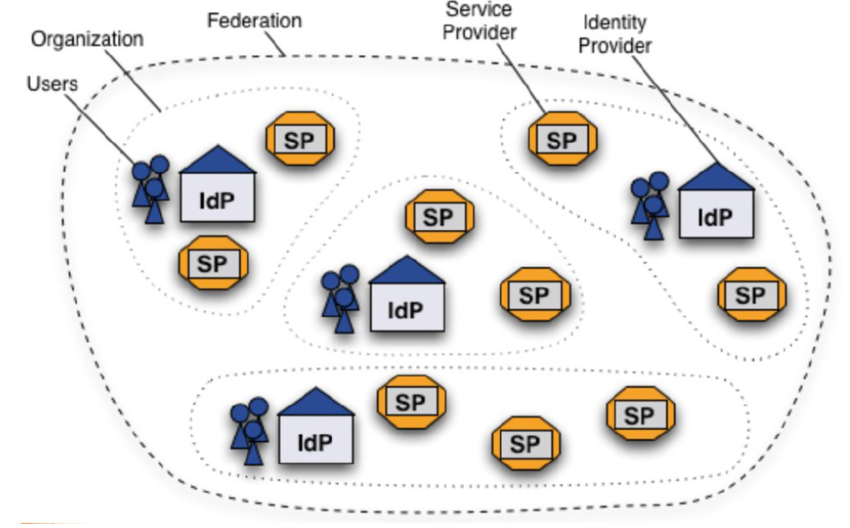
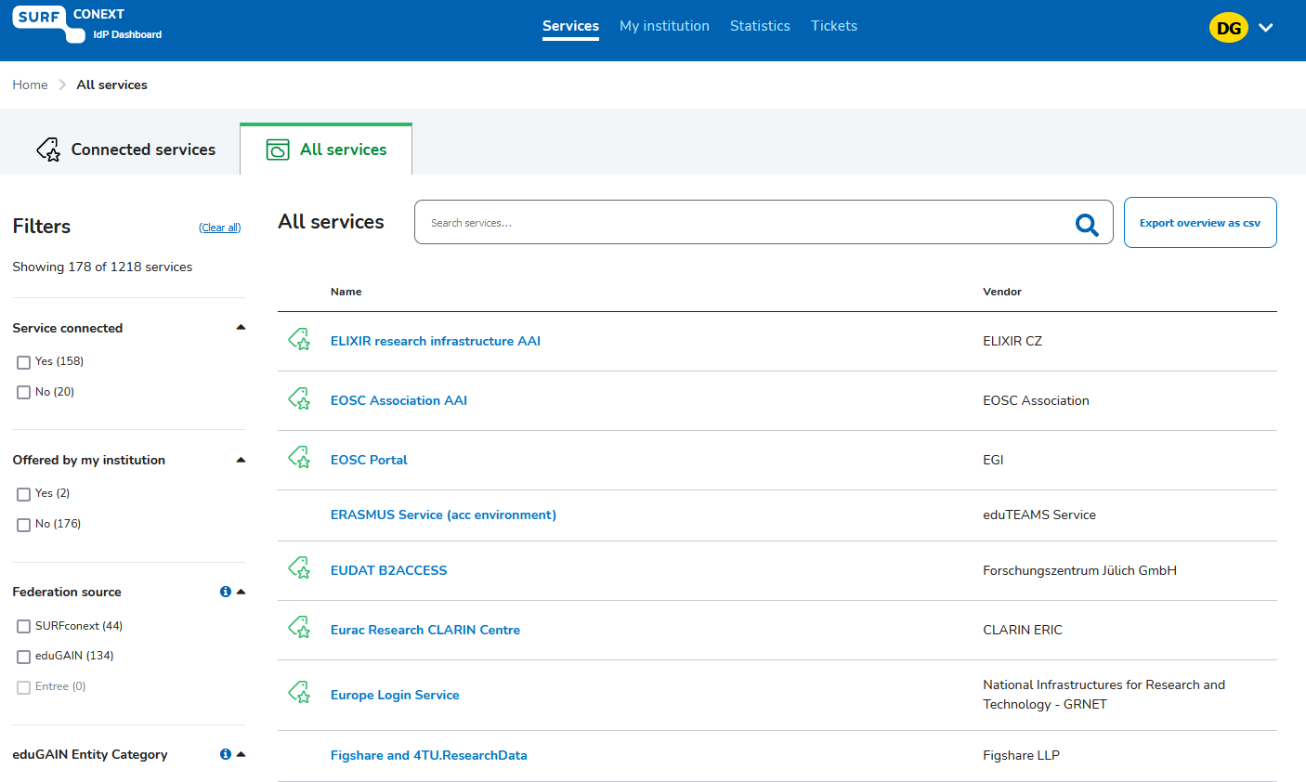

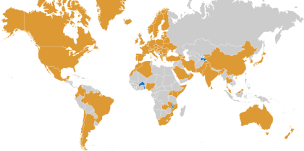
… to a global service federation for research and education
Images: SURFconext IdP dashboard by SURF, showing some services tagged with REFEDS R&S; eduGAIN map: GEANT, https://technical.edugain.org/status

Slide 12
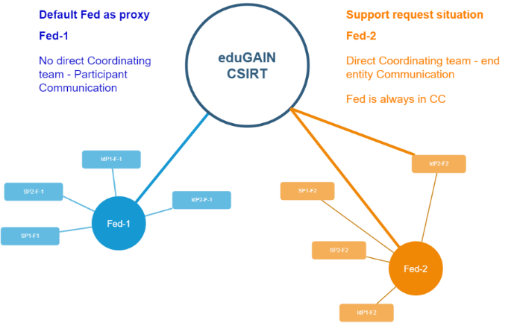
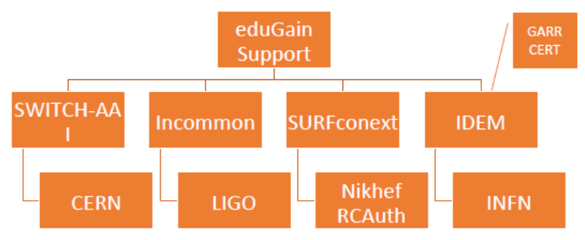

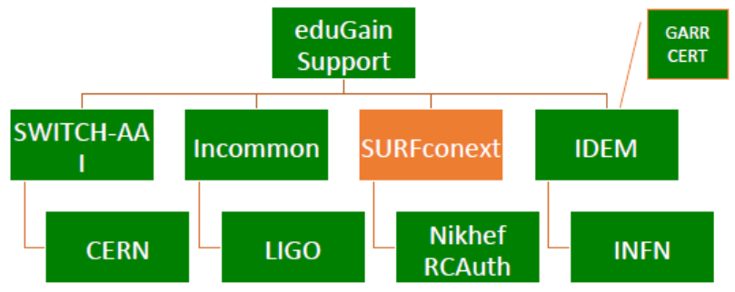



When something happens to it: federated incident response
Joint operational trust baseline for the global R&E federations
Supplemented by sectoral policy guidance
focus on infrastructure and data integrity, confidentiality, availability
|
|CSIRT
images: AARC Sirtfi v1 exercise (Hannah Short), eduGAIN security TTX (Sven Gabriel, eduGAIN CSIRT); joint with GN5-1 EnCo

Slide 13
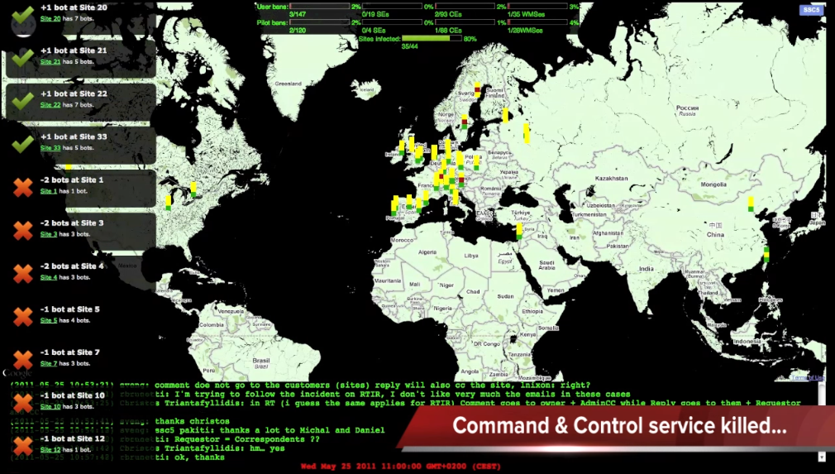
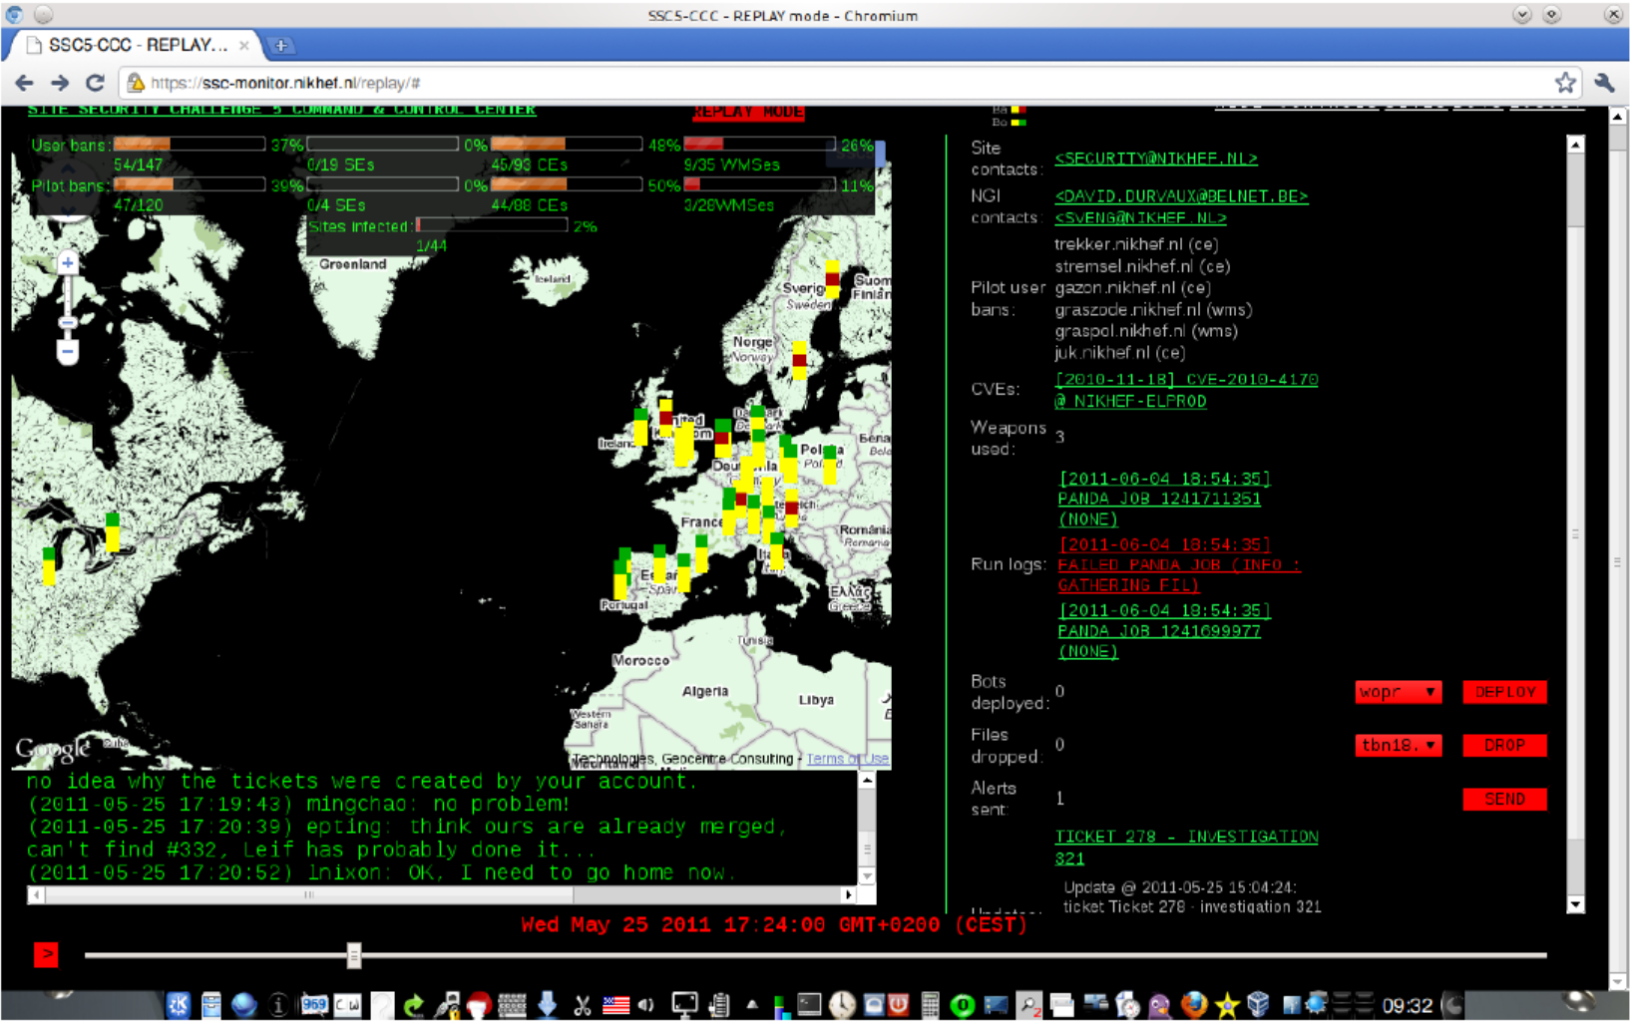
Security Service Challenges: exercise finding & removing malware and spyware in global collaboration
Screenshots: Oscar Koeroo et al., Nikhef, for EGI SSC5

Slide 14
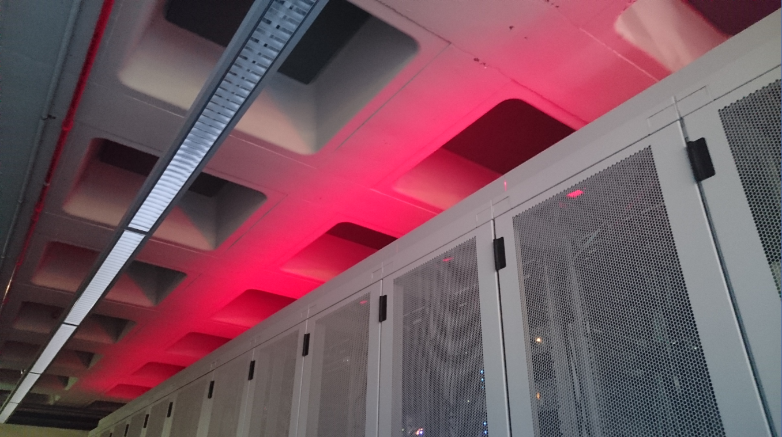
Data Centres – housing and connectivity

Slide 15
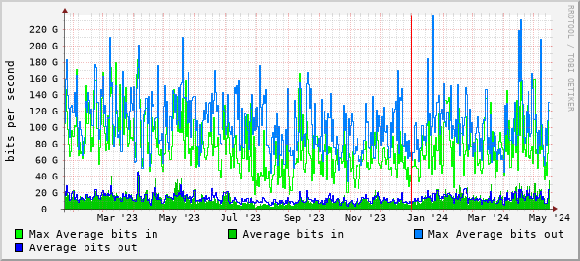
Typical data traffic to and from our processing cluster
Source: Nikhef cricket graphs period January 2023 – May 2024 – aggregated (research) traffic to external peers from deelqfx – https://cricket.nikhef.nl/

Slide 16
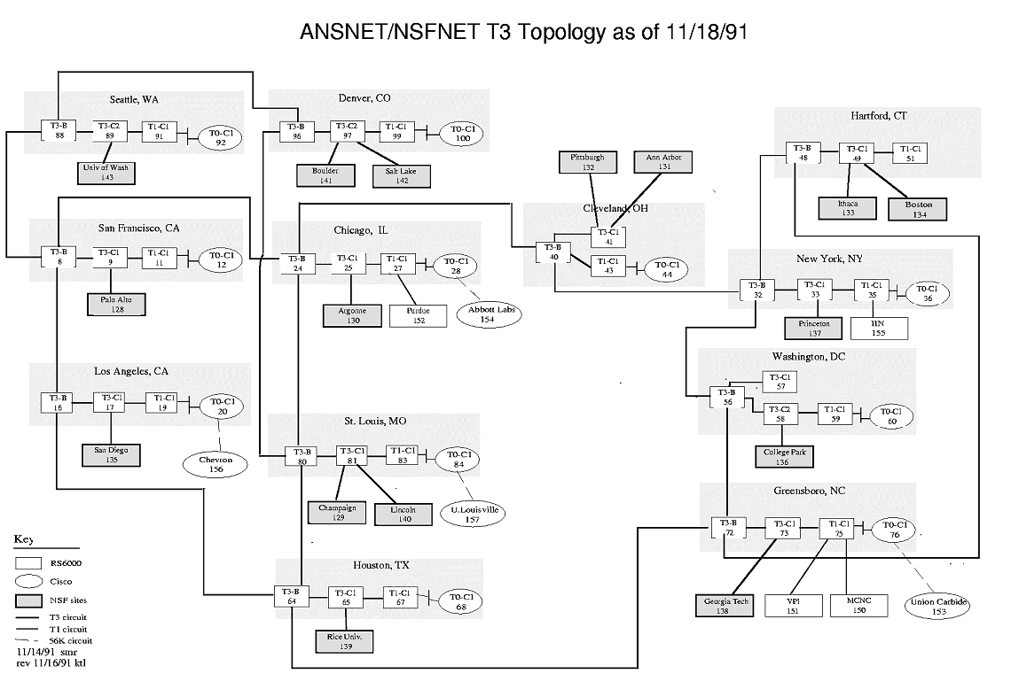
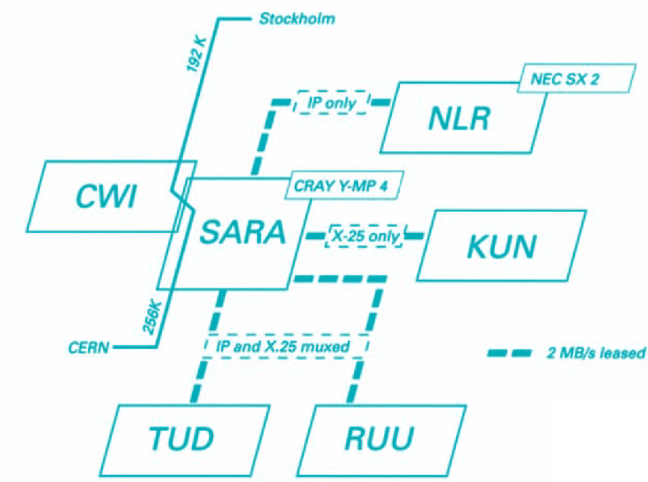
Getting to CERN from the Netherlands
See https://personalpages.manchester.ac.uk/staff/m.dodge/cybergeography/atlas/historical.html for more historic maps ; right-hand image: SURFnet2, 1990

Slide 17
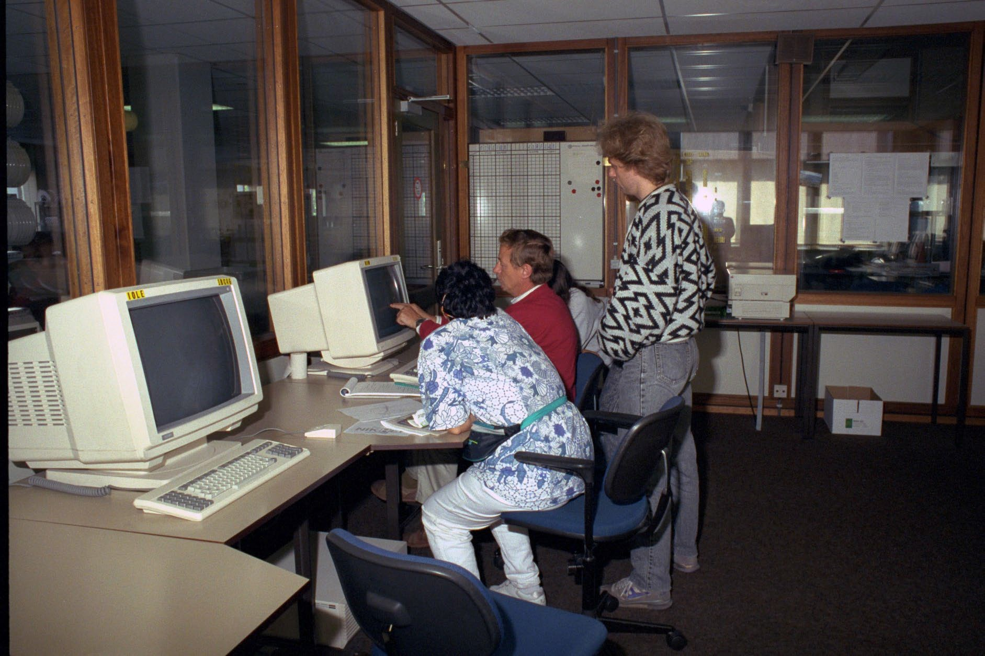
The Nikhef data centre – at the end of the 1980s
Gould, Sun, and DEC systems,
taking several racks each
500 m2 floor area
Raised floor: +60cm
walls are ‘movable’
to accommodate expansion
Nikhef room H1.37 – terminal station on the raised data floor of the computer room (H1.40, behind the glass-panel walls)

Slide 18
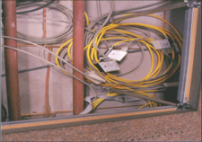
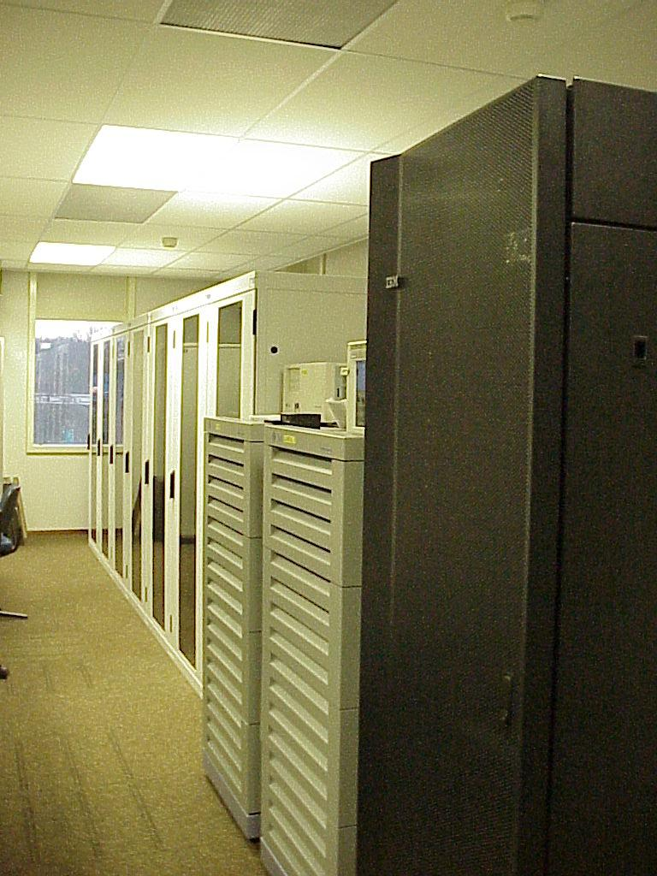
IBR-LAN at Nikhef
International Backbone Router Local Area Network “IBR-LAN” at Nikhef, room H1.40 as seen in 1996. Right: H1.39 with nikhefh.nikhef.nl racks and early DAS-2 system

Slide 19
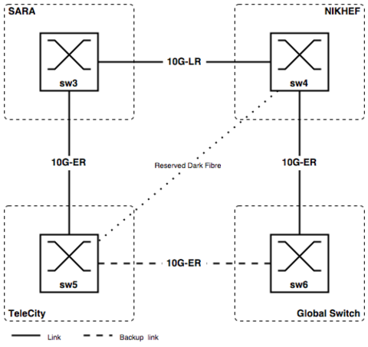
A growing internet!
AMS-IX topology, 2002

Slide 20
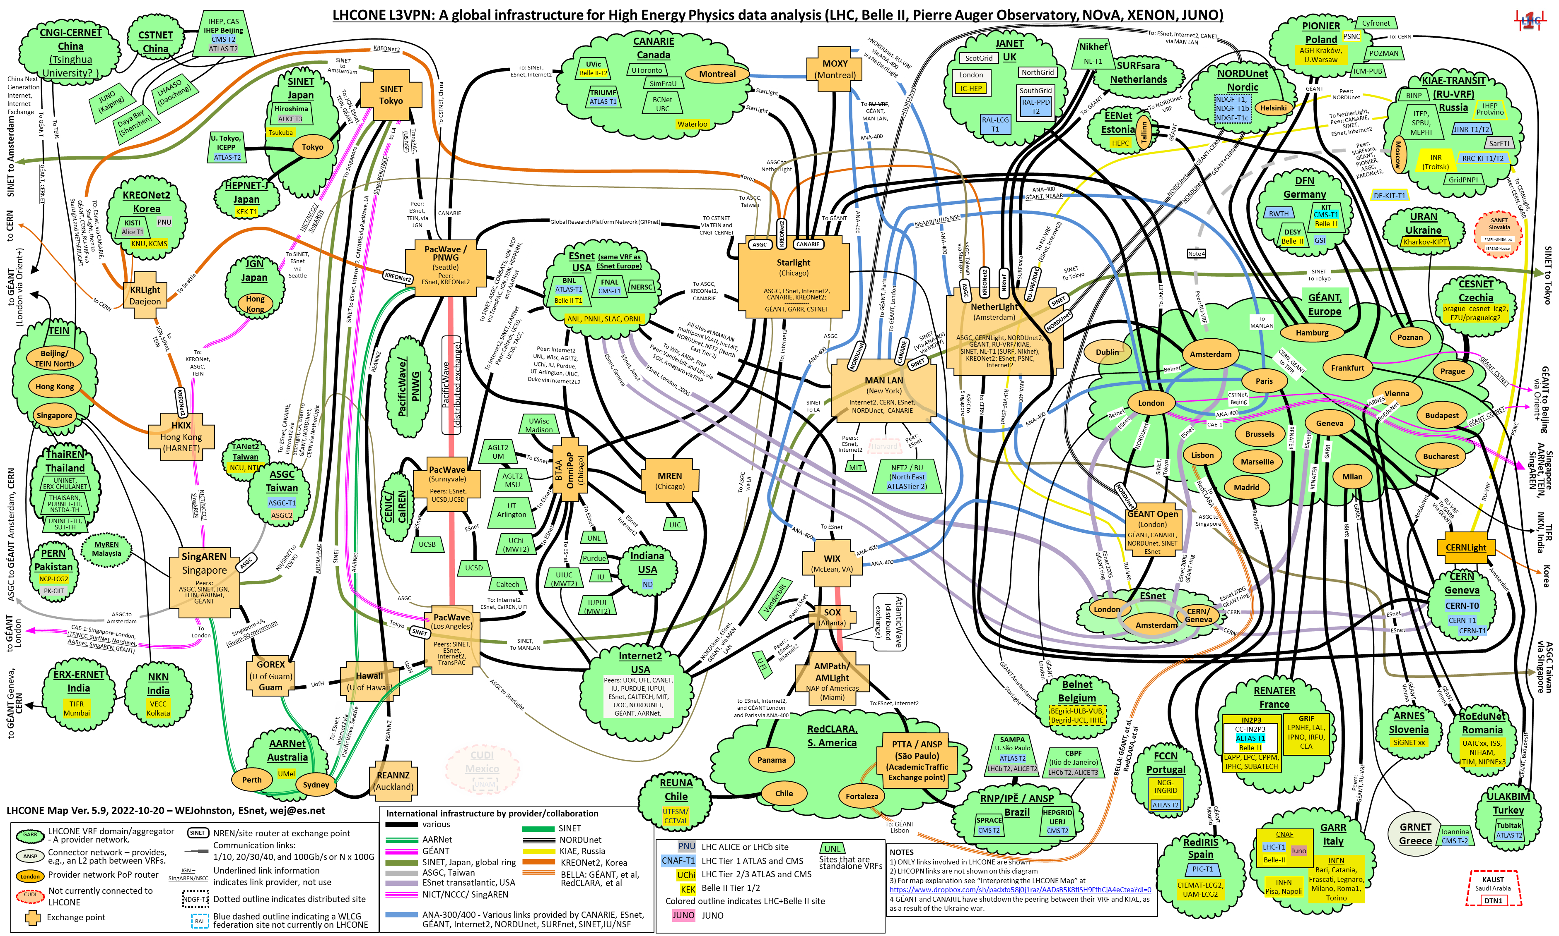
LHCone
LHCone (“LHC Open Network Environment”) – visualization by Bill Johnston, ESnet version: October 2022 – updated with new AS1104 links

Slide 21
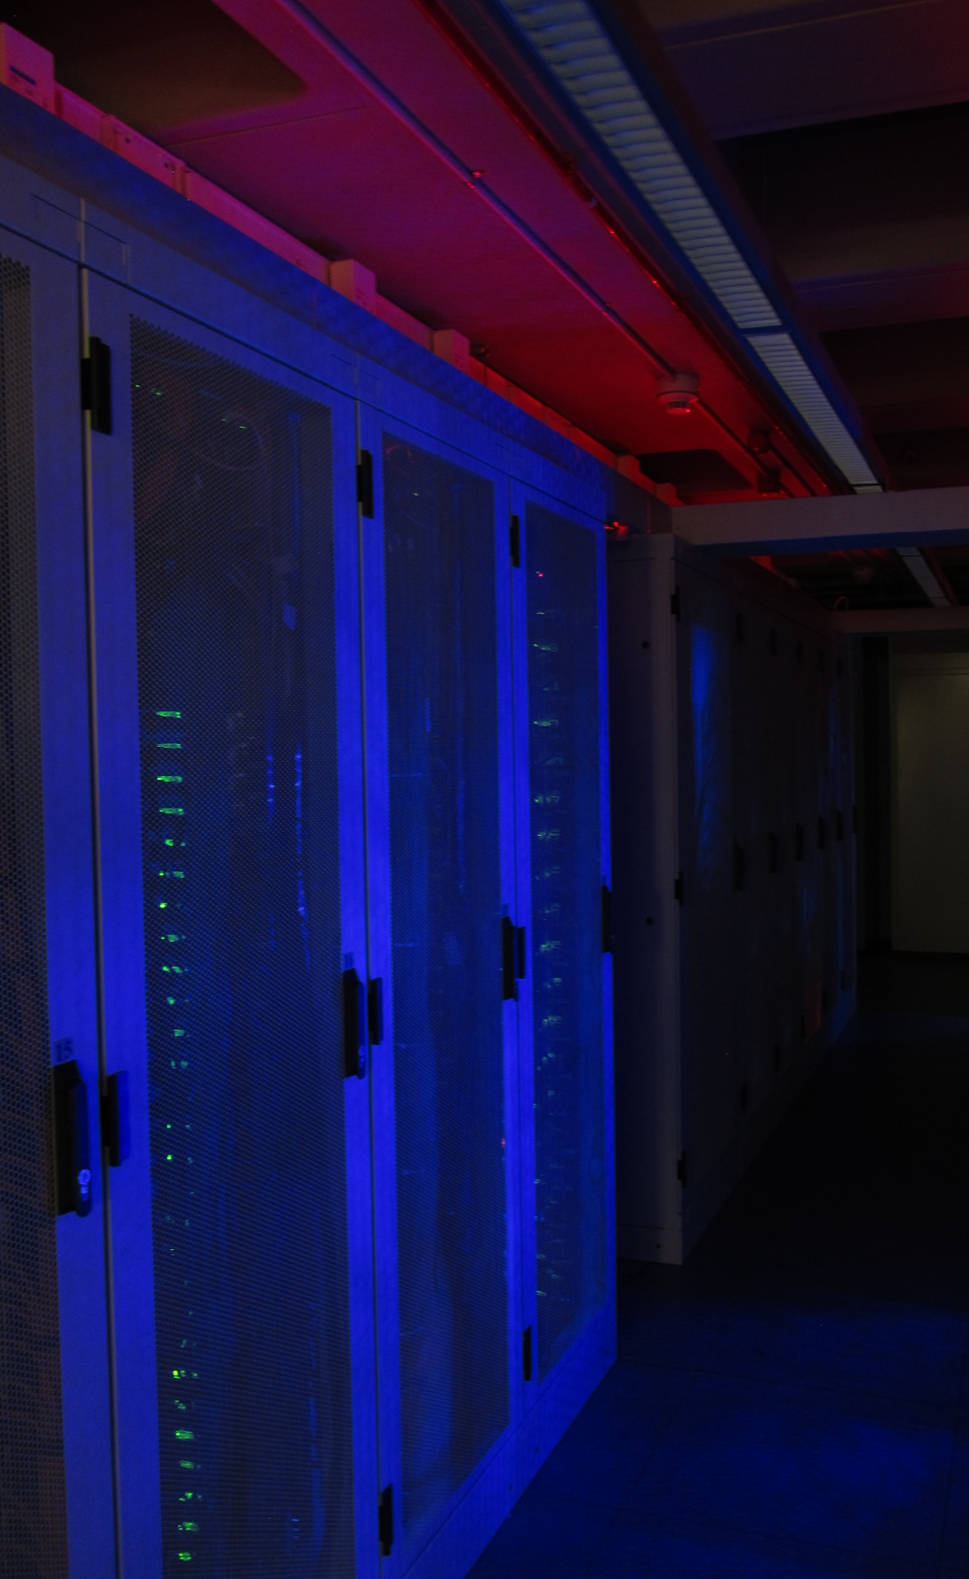
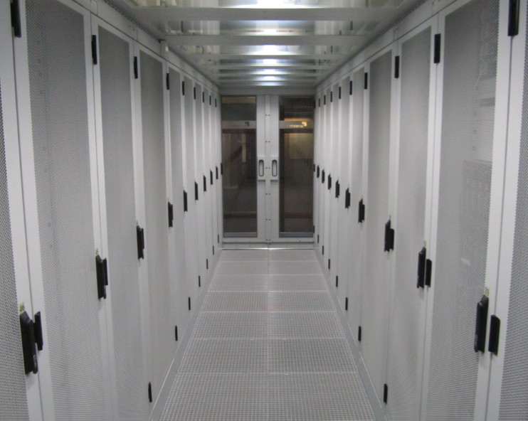
Today’s data centre at Nikhef
Nikhef ‘science’ data centre H234b
47 racks and ~350 kW
hosts Nikhef, CERN, GW, and SURF research data
strengthens connectivity at NikhefHousing
‘NikhefHousing’ data centre
from once just 2 racks in a spare space
to now > ~400 racks
many different connectivity parties
connectivity only, but not hosting

Slide 22
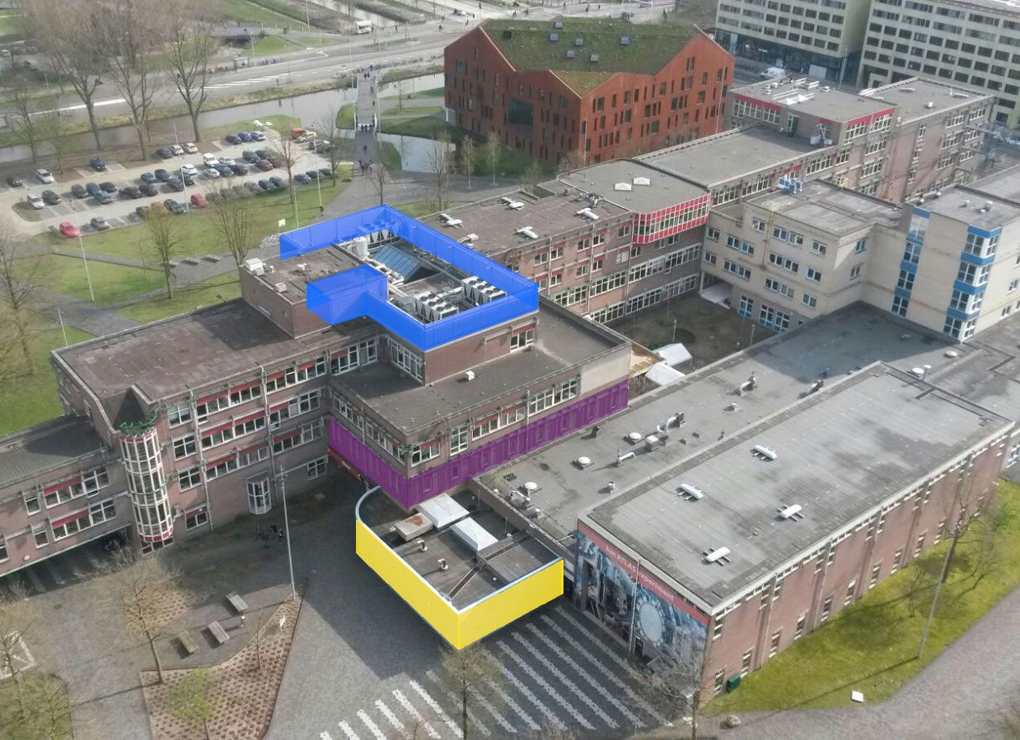
Data centre installation management
three 400kW active/free cooling chillers installed in 2009
data floor: grown to ~400 racks
additional electricity generator set added in 2009
Aquifer Thermal Energy Storage (ATES) system in 2010
Image: Floris Bieshaar, Nikhef

Slide 23
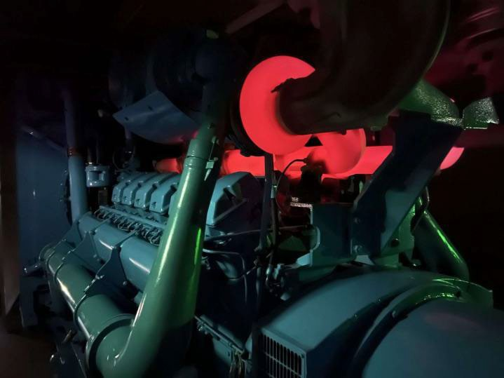


Power in … and energy out …
Three generators
A-Feed 1250 kVA (pictured under load while testing)
B-Feed 1700 kVA
C-Feed 1250 KVA added with the current expansion
Separate redundant UPS for each
Heat re-use:
aquifer thermal energy storage
re-use heat to warm our building (pretty warm)
AND feed more heat to student housing opposite
nominal ‘PUE’ ~ 1.21
Generator image source: Floris Bieshaar. MacGillevrylaan sketch: Science Park Amsterdam

Slide 24

What happens inside a data centre …
Yet ‘connectivity’ housing and
‘hosting’ are also quite different
        NikhefHousing (H140) has connectivity parties only, and does not host any content
        what you will be seeing on tour is network equipment,
        shipping data, but not keeping anything
        (H234b has our science data, only)
No single connectivity data centre is a single point of failure: Internet protocols are engineered to re-route traffic

Slide 25



But some are faster than …
Image: Minister of Economic Affairs M. Adriaansens launched the Innovation Hub with Nikhef, SURF, Nokia and NL-ix, January 2023. Composite image from https://www.surf.nl/nieuws/minister-adriaansens-lanceert-testomgeving-voor-supersnelle-netwerktechnologie

Slide 26





Our science data flows are somebody else’s DDoS attack
Image sources: belastingdienst.nl, rws.nl, nu.nl, werkentegennederland.nl

Slide 27
Thanks, and enjoy Nikhef

Slide 28


Getting
to CERN
Data: TraceMON IPmap from RIPE NCC Atlas atlas.ripe.net measurement 9249079

