Slide 1

In Grid We Trust
New authentication mechanisms and their
impact on trust relationships at the home organisation
ISGC 2011
David Groep

Slide 2
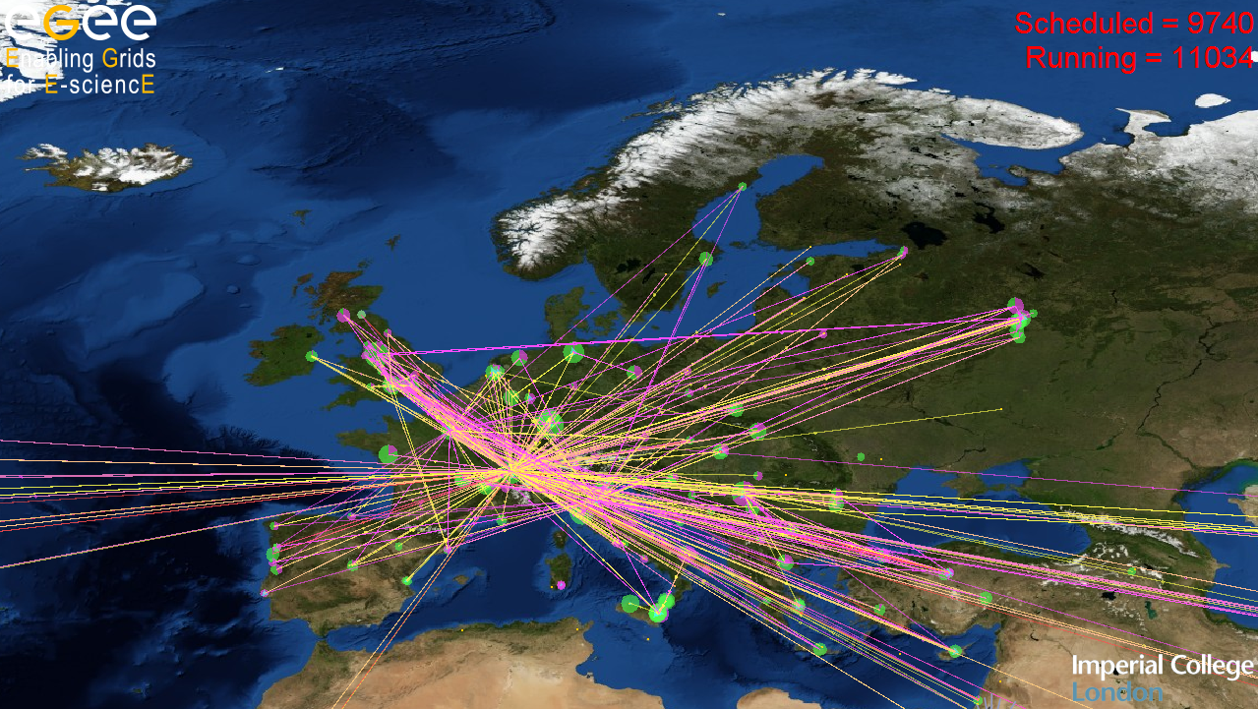
In Grid ... where many participants have no a-priori relationship

Slide 3
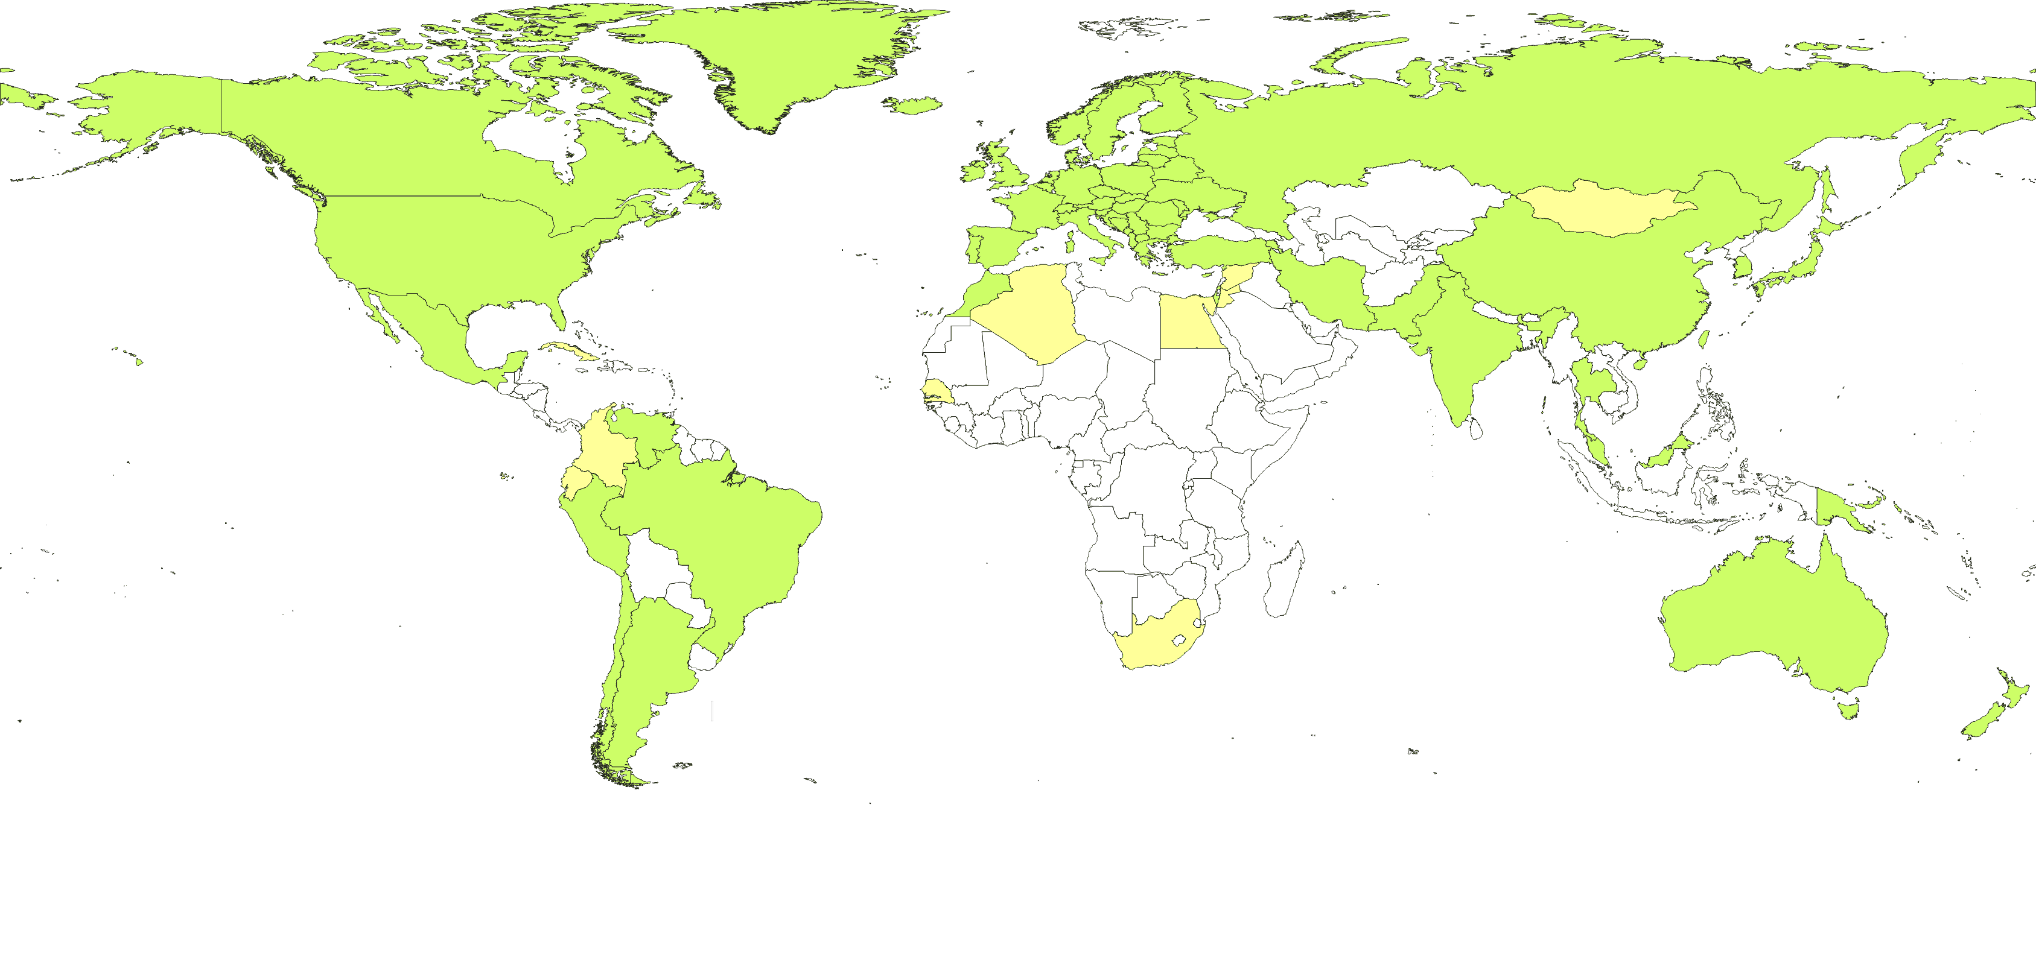


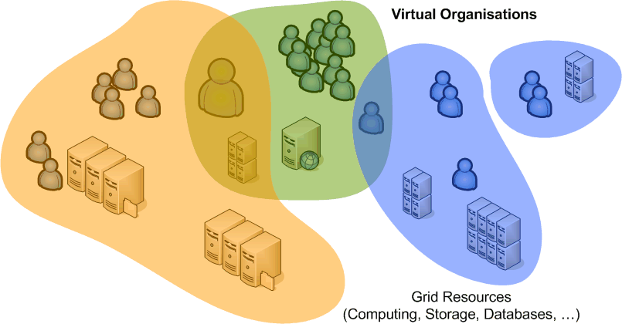

... we trust in identity and attributes delivered from many sources

Slide 4
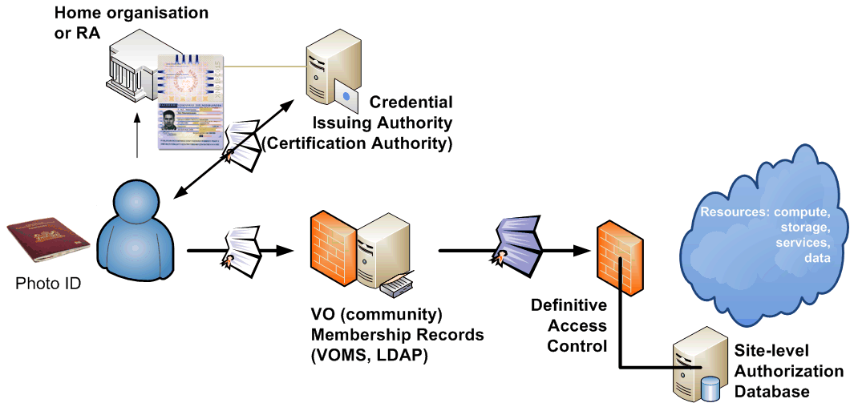
Trusting and trustable parties
focus: - persistent unique ID
- traceability assurance

Slide 5
AP Structure and Elements of Trust
Identity Vetting (‘people ware’ LoA)
Operational Requirements (‘what and how LoA’)
Site security controls (‘implementation LoA’)
Publication and disclosure (‘gaining trust’)
Auditing (‘sustaining trust’)
Privacy and confidentiality (‘securing trust’)
Compromise and Disaster Recovery (‘recovering trust’)
User responsibilities
  this one deserves more attention in home organisation context, since direct & continuous contact with users can be maintained

Slide 6

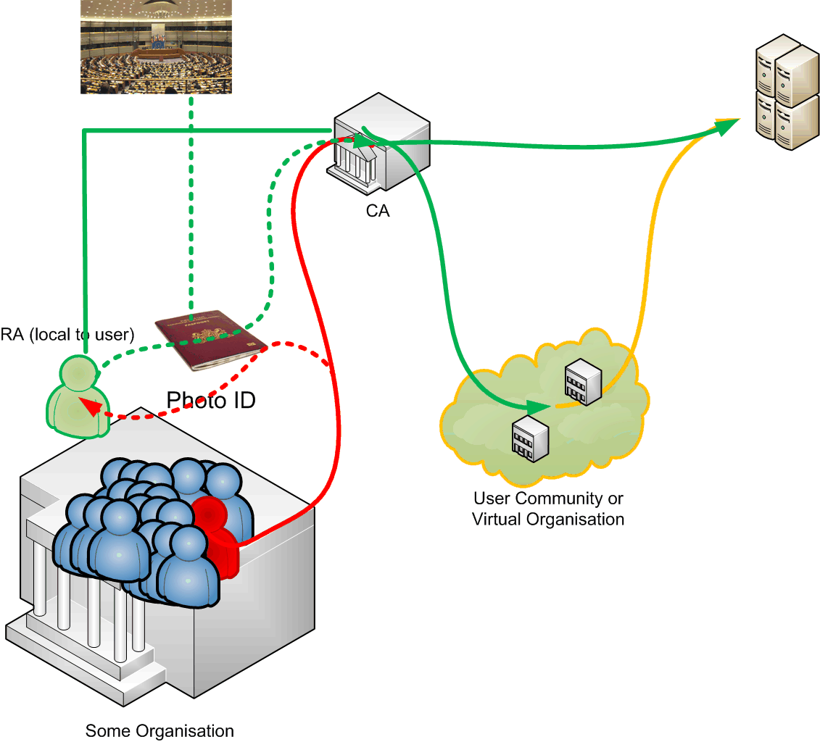
Trust Relations in Classic CAs

Slide 7
Classic Authentication Profile
Example: Classic Authority using Secured Infrastructure
Aimed at long-lived identity assertions
Identity vetting procedures
  Based on (national) photo ID’s, face-to-face verification of applicants via distributed network of Registration Authorities or ‘Trusted’ Registrars
  Periodic rekeying once every year, using fresh key material
  Appropriate representation of the person’s real name in the credential
  validate all rekeying against pre-existing credential identifiers
Secured operations
  dedicated rooms with monitored access, vault, and audit trails
  off-line signing key or HSM-backed on-line systems (FIPS 140.2 lvl 2)
Response to incidents
  Timely (<24hrs) revocation of compromised credentials
  must issue an up-to-date list of revoked credentials
Audit log retention and periodic re-assessment
https://www.eugridpma.org/guidelines/classic/

Slide 8
Policies supporting trust
Classic AP’s ‘traditional ID vetting’
  done by CA explicitly according to own practices
  face-to-face after or at time of making request
What does that bring?
  pro – easy to describe
  con – complicated for user and introduces delay
  but even then
  in risk analysis for the end-to-end trust chain, ID is only a small element as verified in the ‘classic’ AP

Slide 9

We, the Grid, trust
Vetting in classic CAs gives ‘warm and fuzzy feeling’
  is easy to describe in a stand-alone document
  which may be false
  but is certainly fuzzy
But grid is no longer alone: many others need trust
  many other services inside and off-campus need ‘trusted identity’ in some way
  relative lower value of many off-campus services previously
  did not require a lot of complexity in assurance level or trust

Slide 10
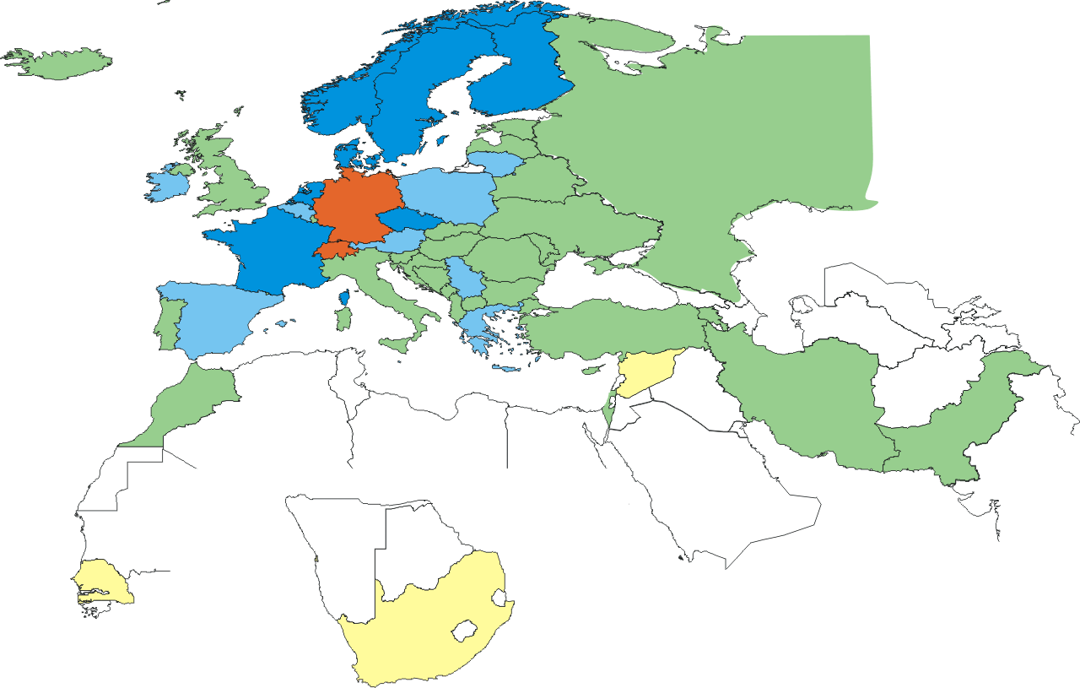
A new wave of federated CAs
new trusted identity sources have emerged
  R&E federations have been established
  hosting more and higher-valued services
  broad and increasing user base
we now leverage these for access to e-Infra resources

Slide 11
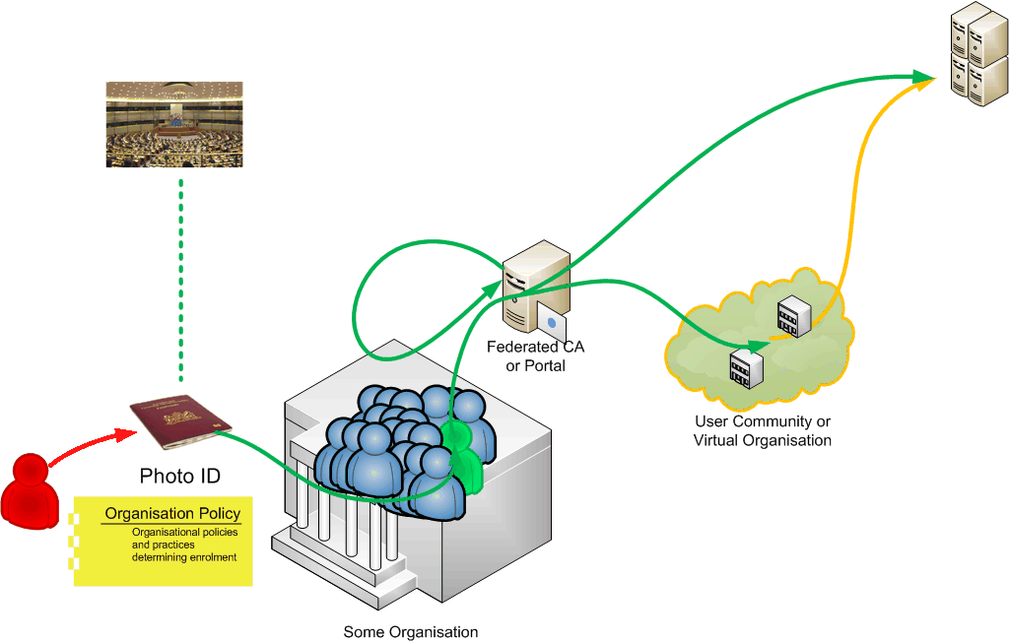
Trust Relations in a
Federated CA (MICS) model

Slide 12
New CA models
Broader base for users brings challenges
‘warm and fuzzy’ trust has a scaling limit
there will necessarily be some indirection
but federated IdP’s are ‘closer’ to the user
  more trustworthy and more close to any changes
  IdP’s are further away from the ‘grid’, and thus less warm and fuzzy
this applies to ID attributes and other value-added attributes ... and should apply to the VO as well!

Slide 13
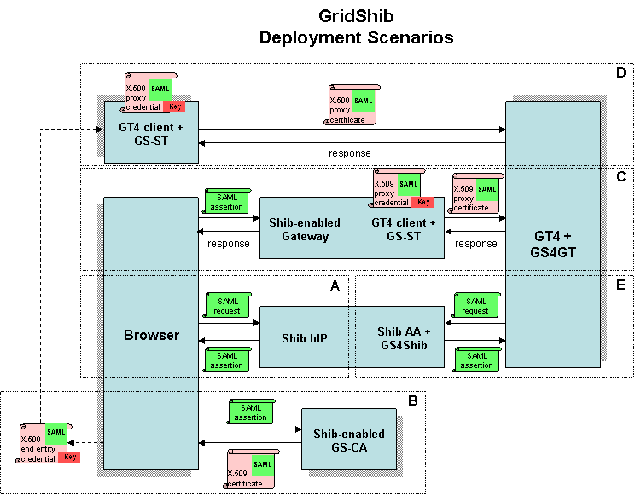

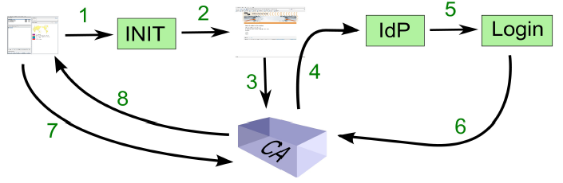

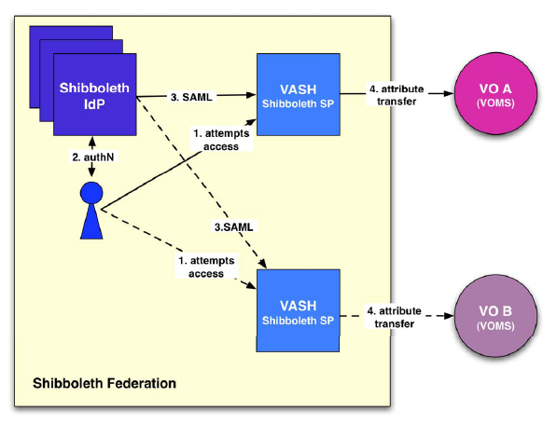

New e-Infrastructure scenarios
GridShib
graphic: Jim Basney, NCSA
Delegation options
‘hidden’ federated CAs
Security Token Service
semi-explicit instant CA
VASH
graphic: Christoph Witzig,
SWITCH
IMDI Browser (delegated corpus browsing)
graphic: Mischa Salle, Nikhef

Slide 14
Basic federation policies
Requirements (example from SURFfederatie)
Give accurate organisational contact details
End-user guidance document per organisation
  netiquette, compliance with law, no damage to third parties
  guidance should be ‘appropriately enforced’
federation systems appropriately secured
data complete and up to date, set of required attributes
disclose procedures and practices on request
Enforcement and sanctions
Suspension from the federation (nothing worse)
Indemnify other participants from damages

Slide 15
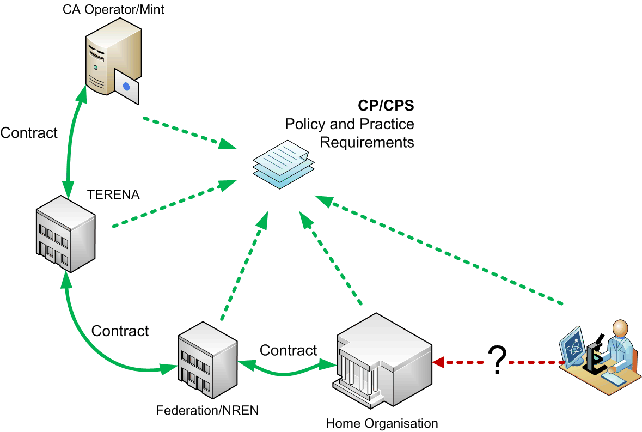
Contract supported trust
‘We the Grid’ should now trust what the IdP says, and rely on that trust without
‘warm and fuzzy’ recourse
graphic: after Jan Meijer, UNINETT

Slide 16
In Grid We Trust
IGTF global trust features are not ‘default’ in many federations
  persistent unique naming
  higher-assurance level identity vetting
Responsibilities have to be defined
  these now rely on the IdPs –
  these are now ‘quality IdPs’ in well-recognised federations
  contract mechanisms tie down responsibility
  how can an organisation set up a trusted IdM & IdP?

Slide 17

Elements of institutional IdM
 | Ad Hoc | Focused | Standard | Integrated
Single log-on
Authorization
Source systems
Policies
Documented processes
IdP systems for federation
Quality Assurance
Process implementation
Security / Auditing
Source: SURFnet Identity Management Maturity Scan http://www.surfnet.nl/
IGI Group http://www.igi.nl/

Slide 18
At a random mid-size org ...
To be trustworthy, each IdP in a federation should address the basic requirements for trusted identity and attributes
Basically, this is
  addressing the topics listed in the AP by the IGTF
  user education and validation
  organisational ‘culture’
and a bit of policy and technical expertise ...

Slide 19
Organisational elements
ICT
  trustworthy IdP implies that users are familiar with the IdP, and use it for everyday work (so no separate login or system)
  when rolled out, gives usability advantages (less helpdesk calls) and better security enforcement (single kill switch)
  many services can be linked to SSO services (usually via LDAP)
HR
  source of ‘validated’ ID attributes (registry)
  likely has existing practices to comply with privacy, data retention & protection, and legal issues
Management
  buy-in to endorse policy and guarantee continuity

Slide 20
Join a federation with integrated IdM
For mid-size org needed effort not very high
  once there is common intent and purpose can be done within ~ 6 months (not full-time), using OSS tooling
Work items
  ensure buy-in
  write up a draft policy (using the AP template)
  set up (LDAP-capable) directory service
  demonstrate some quick goodies: desktop login,
  link to no-policy test federation using simpleSAMLphp
  review the policy ☺
  join the full federation and give goodies to users

Slide 21
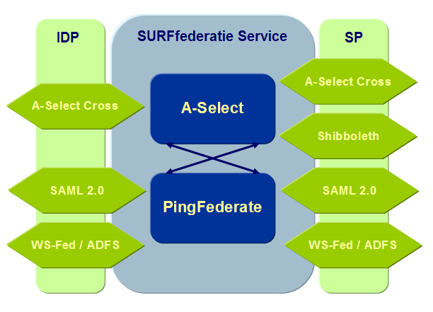




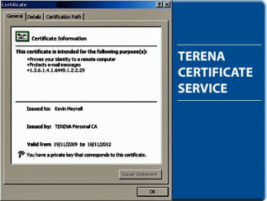


Federation services as incentive and driving force for users
and organisational systems such as email as incentive for both
ICT (less support load, better controls) and users (single password)

Slide 22
The harder bits
Goodies gain momentum, then take the next step
  convert ‘critical’ systems, such a email, self-services (travel request, budgetting, timesheets, ...)
  implement your account & password expiration
  policy in automated processes
  if that was not yet standing procedure (test first!)
  give reasonable grace period, say, 13 months
  start disabling services that are not SSO enabled

Slide 23
So: What About the Policy?
Used IGTF Authentication Profile template
Missing elements related to user management
  need for data protection and attribute release policies
  additional user obligations (e.g. password changing)
  expiration controls
  differentiate between suspension and expiration
  you cannot ‘delete’ users (must keep the key identifier)
In section 3 (identity vetting) added ‘hardship clause’
– helps ease pain of policy faults by limited override
Also Grid AUP and Site Ops Policy have useful elements
Be prepared to disclose the policy – publicly, AFAIAC!

Slide 24
Side effects of linking the IdM
Organisational interest in proper registration as a side-effect of the IdM introduction
  ICT services are typically the main thing people (grad students, guests, visiting researchers) need – so they want to have these and will go a long way to pester people. Alongside with a room key
  Other services (registration in a phone directory, a web picture galery, room allocation system, insurance) for the applicant have lower priority
  By linking the systems, overall quality improved:
    guests/students pester IT for an account, who redirects to HR. The applicant will keep on top of it and helps ensure consistency
    HR wants a complete registration, e.g. for insurance purposes,
    and has an interest in processing the application

Slide 25
Some lessons learnt
Policy document – you really must have one
  as high level as possible (no frequent change), but ...
  enough to assess compliance with popular services
  (in federation and elsewhere)
Separate out your documents
  practices and implementation from policy
  attribute listing for data protection purposes in separate document – however, will need re-approval
Explain intent, not only practices, to help desk

Slide 26
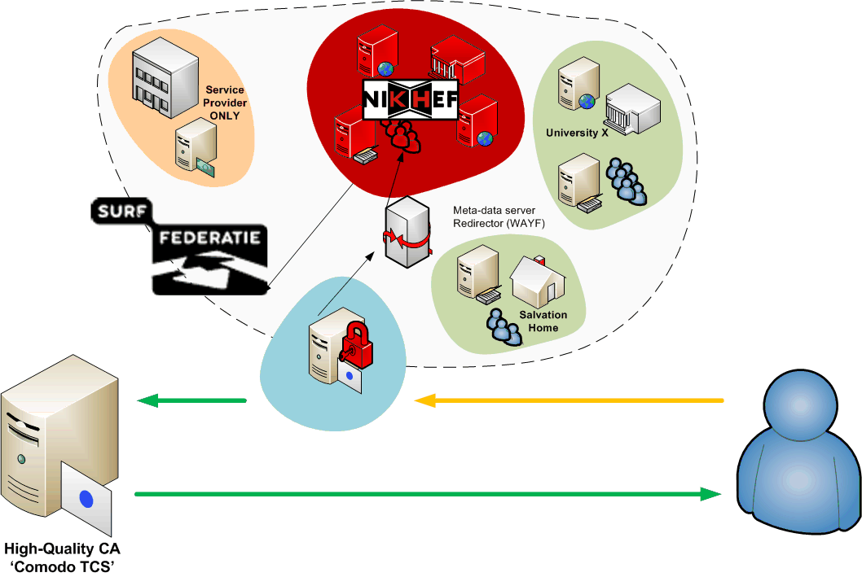
... so from now on ...
web-SSO federations have matured
integration of ‘high-value grid’ &
web federation now becomes reality
large, complex orgs: integration with existing ERP system
mid-size: try it yourself, with policy templates and SSO tools
Significant benefits for grid & more
federation peers and CAs rely on and trust home institutes to manage their users properly
so that in Grid we may trust

