Slide 1

IT Security for complex infrastructures
EGI-CSIRT Security Training Workshop
David Groep
ISGC 2026 Taipei
March 2026

Slide 2

Remember the days when computing was safe & simple
An IBM Portable PC in use by early 1985

Slide 3
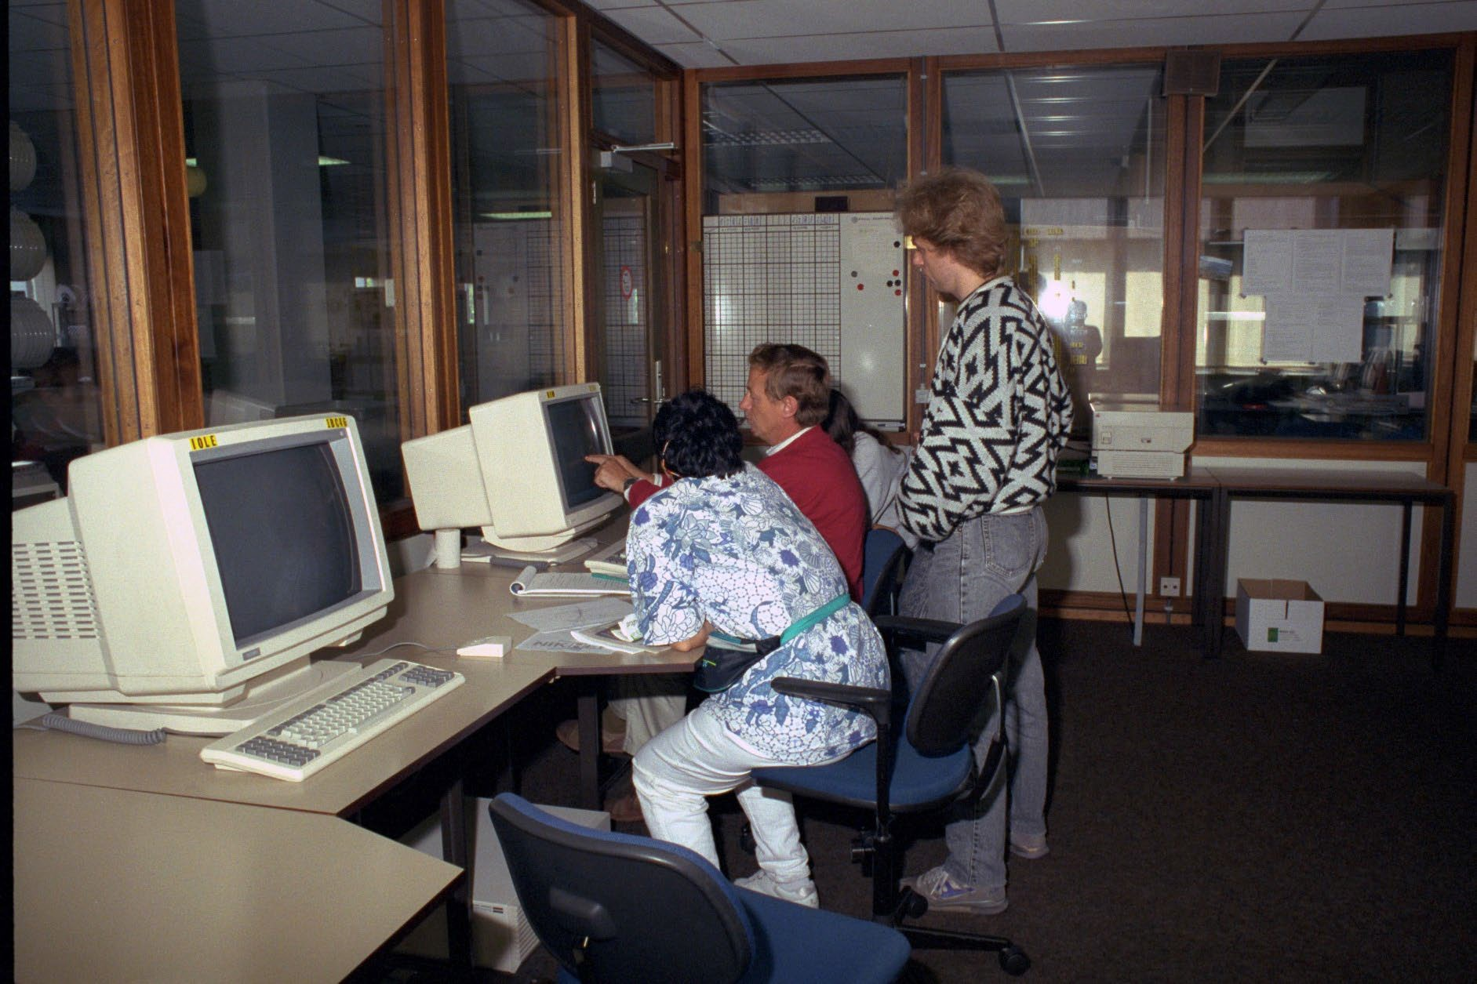
… and then they got networked …
Nikhef user room H1.37 – terminal stations in the early 1990’s – image source: Nikhef

Slide 4
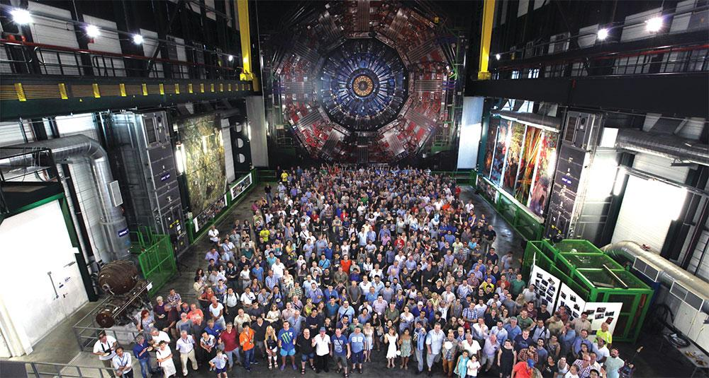
Today we have more people, more computing, more …
a small part of the CMS collaboration in 2017, photo credit CERN on behalf the CMS collaboration, CMS-PHO-PUBLIC-2017-004-3

Slide 5
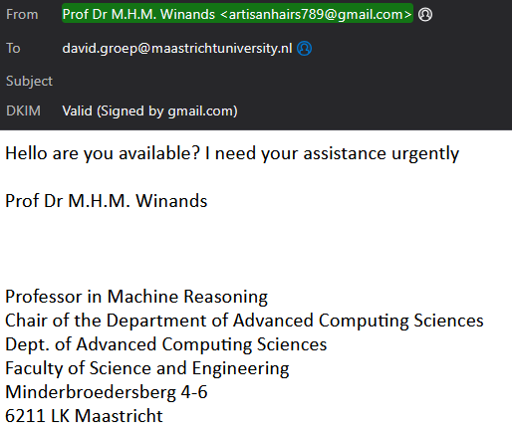

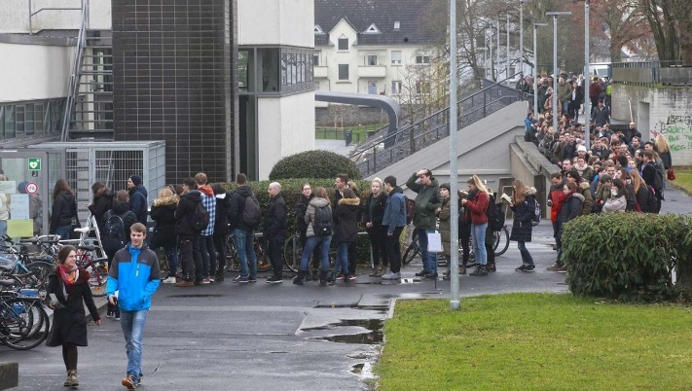
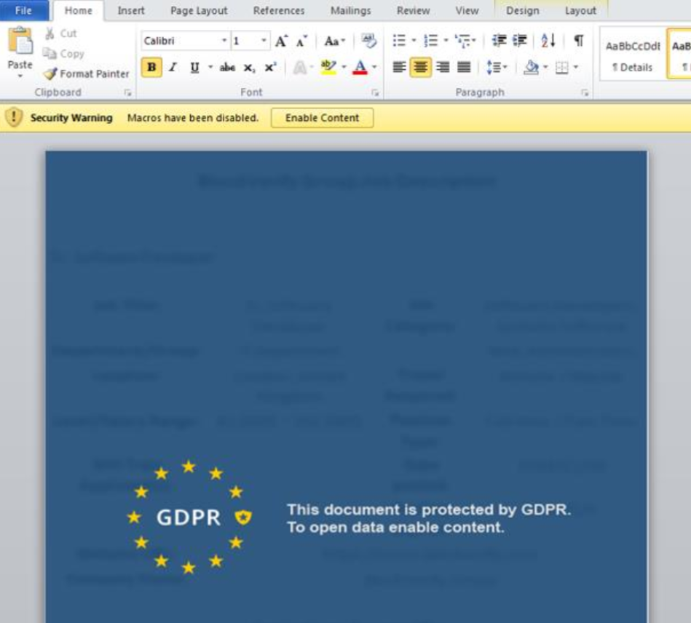
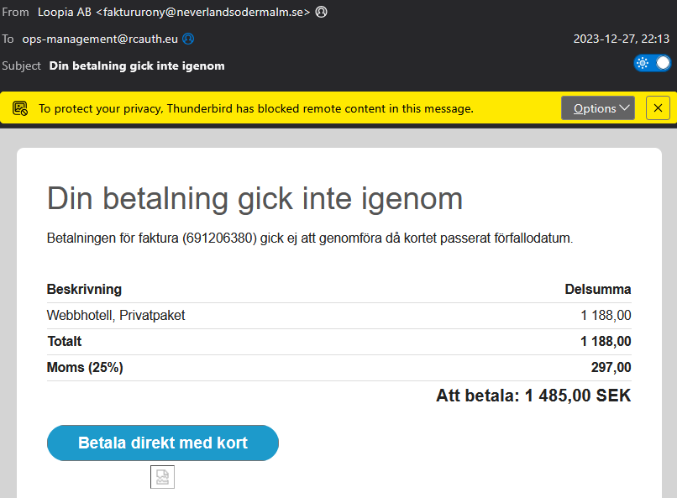
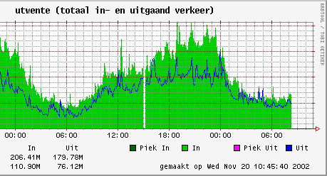
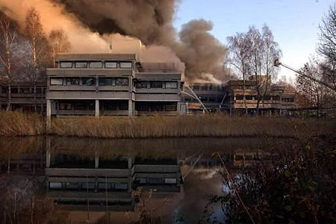
… and many more risks
Thanks to: https://labs.f-secure.com/assets/BlogFiles/f-secureLABS-tlp-white-lazarus-threat-intel-report2.pdf, uni-Giessen, Universiteit Maastricht, SURFnet, … and a bunch of phishers

Slide 6
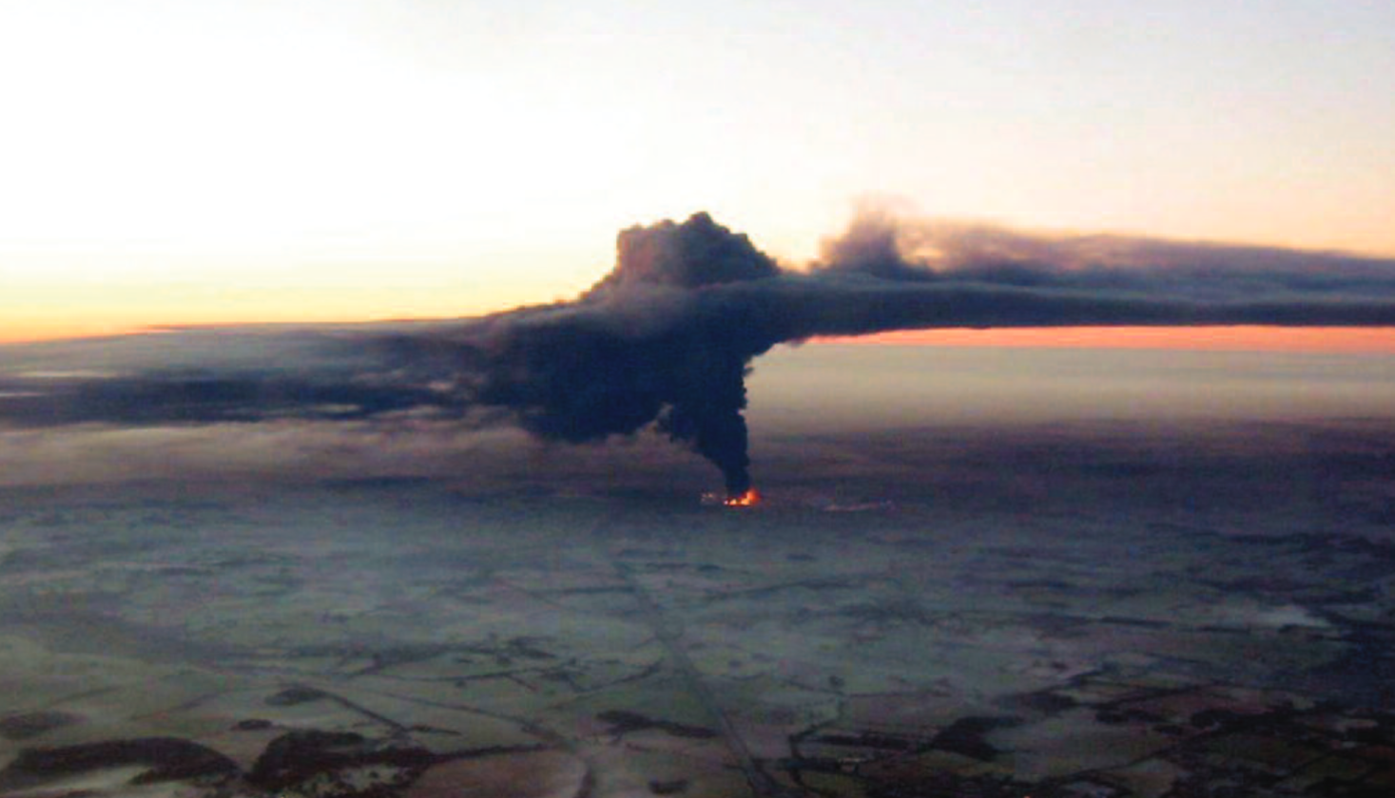
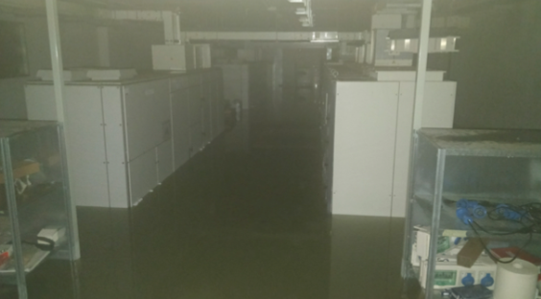
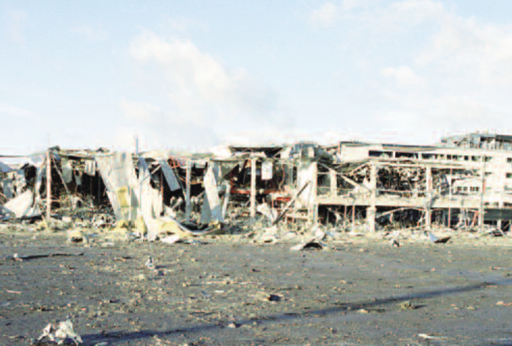
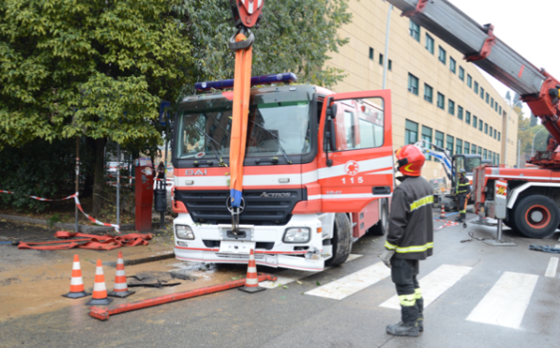
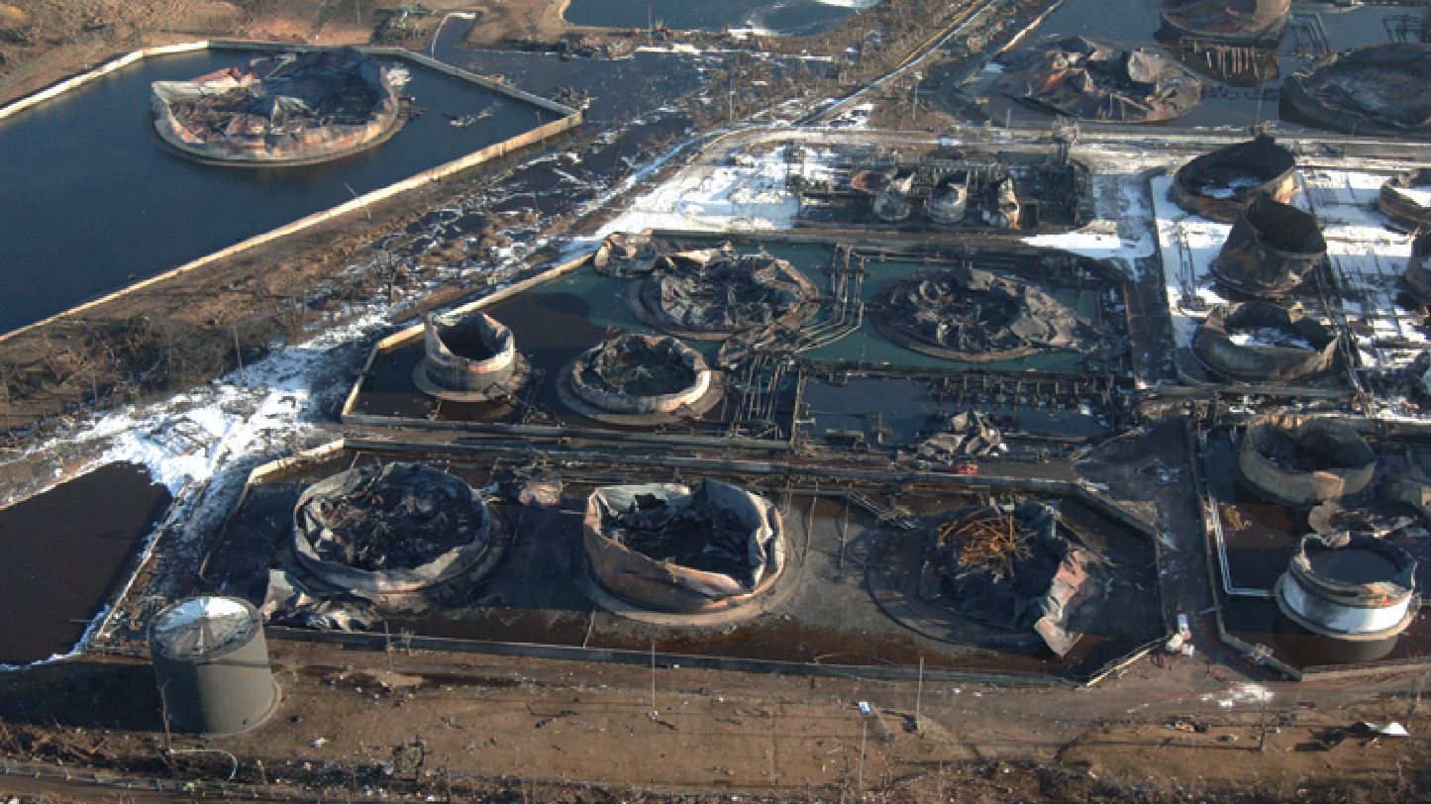
And not all risks are criminal, but still infrastructure risks
A big thank-you to Luca and his team at CNAF
for the talk and sharing lessons learnt
you may need some investment in BC/DR – and Northgate Plc. indeed did & managed to pay on time
CHEP2018 [EPJ Web of Conferences 214, 09008 (2019) https://doi.org/10.1051/epjconf/201921409008], imagery: HSE, https://www.hse.gov.uk/comah/buncefield/

Slide 7
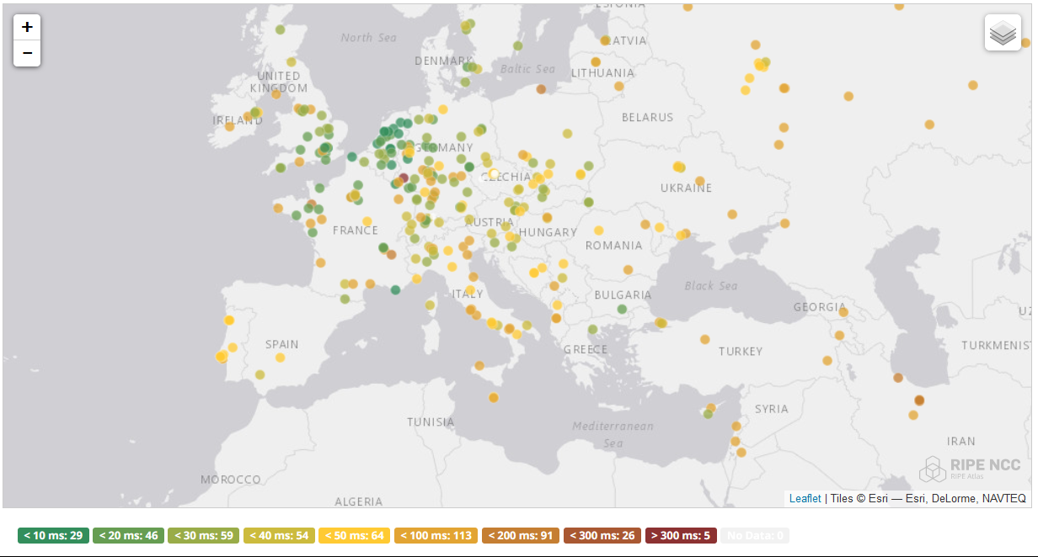
And while CDNs and Cloud may be part of a solution …
RCauth.eu: anycasted identity token translation service distributed across Nikhef, GRNET, and RAL
map: RIPE NCC RIPE Atlas - 500 probes, distributed across Europe (https://atlas.ripe.net/measurements/50949024/)

Slide 8
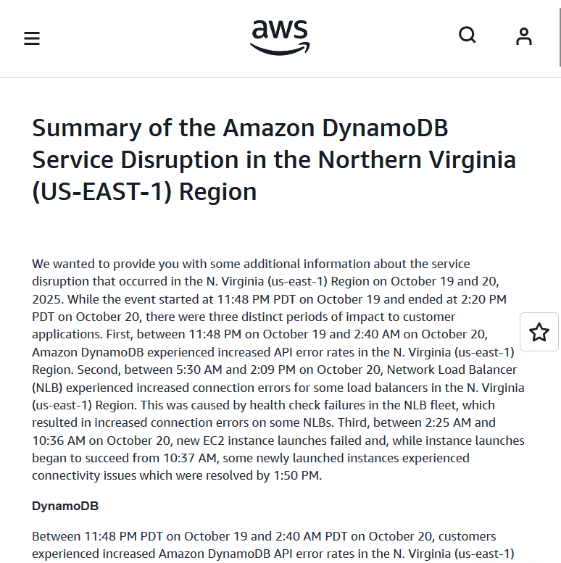
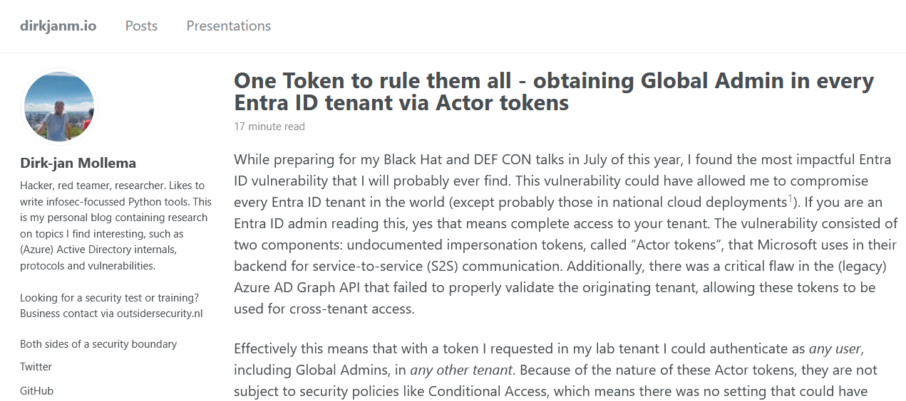
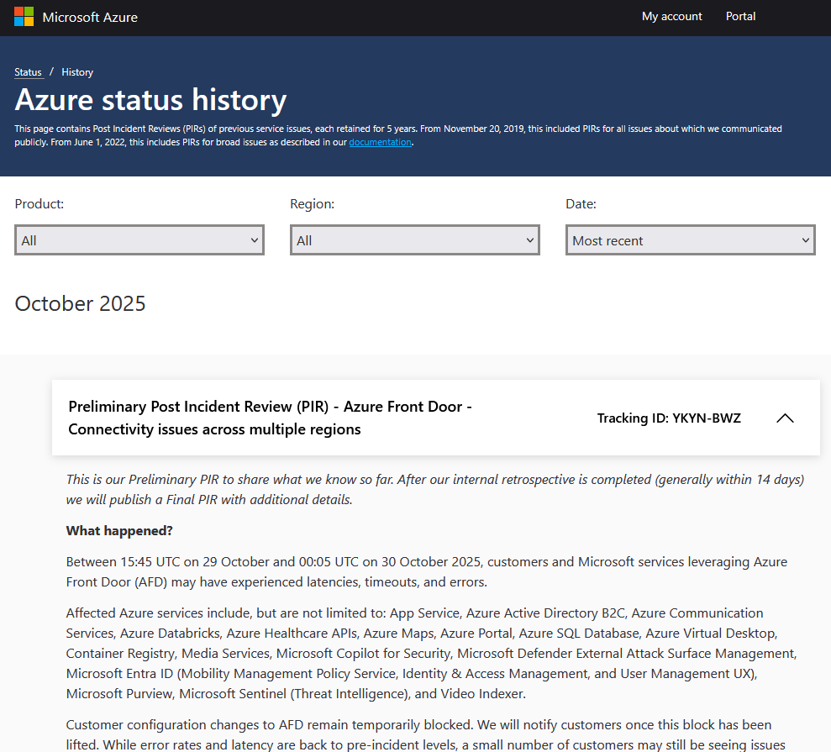
But abstractions are leaky and dependencies unfathomable …
One month worth of *aaS events
https://aws.amazon.com/message/101925/, https://azure.status.microsoft/en-us/status/history/, https://dirkjanm.io/obtaining-global-admin-in-every-entra-id-tenant-with-actor-tokens/

Slide 9
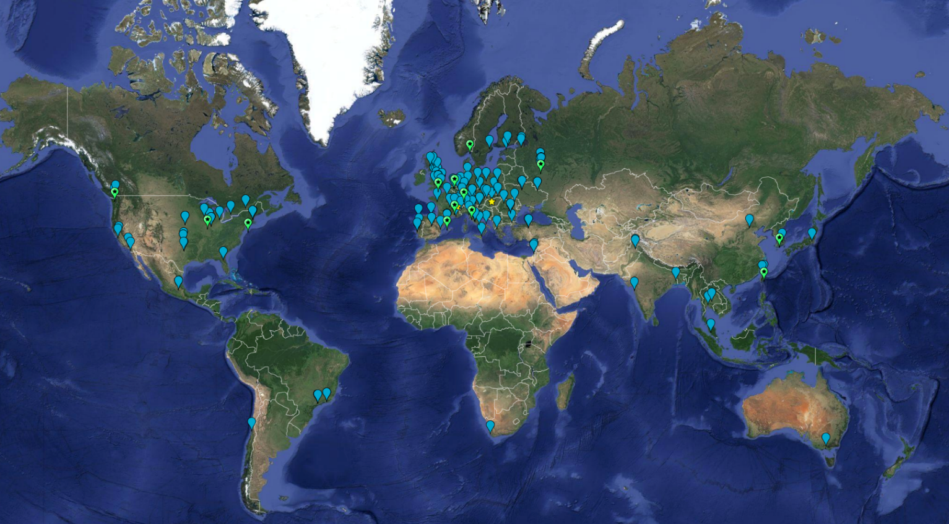
Distributed research computing, collaborating for decades
Worldwide LHC
Computing Grid (~ 2024)
~ 1.4 million CPU cores
~ 1500 Petabyte
disk + archival
170+ institutes
42+ countries
13 ‘Tier-1 sites’
some multi-community:
NL-T1 @ SURF & Nikhef
Finding mechanisms to collaborate
beyond the canonical ~150 people (“Dunbar’s number”)
but what we built, may be unique for
our ‘high-trust’ research community … or an example for others
Earth background: Google Earth; Data and compute animation: STFC RAL for WLCG and EGI.eu; Data: https://home.cern/science/computing/grid ;
LHC Computing Grid: wlcg.web.cern.ch, EGI: www.egi.eu; ACCESS CI: https://access-ci.org/, NL-T1 and FuSE: fuse-infra.nl, https://www.surf.nl/en/research-it

Slide 10
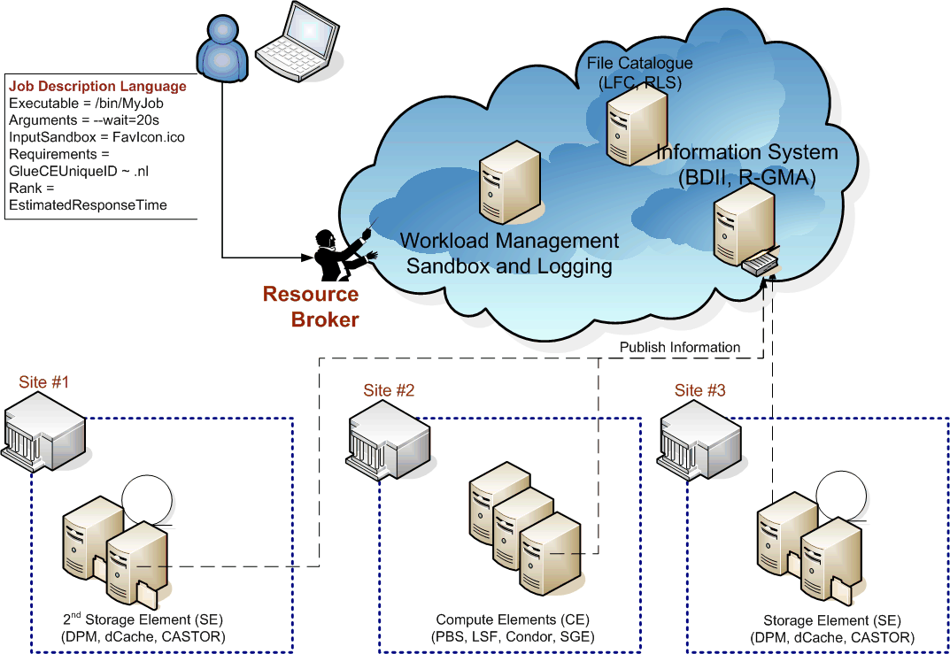
Beyond the enterprise egg shell …
Interoperable cloud? Compare OGF’s OCCI WG GFD.221 (https://www.ogf.org/documents/GFD.221.pdf) with e.g. Amazon S3 API or the OwnCloud CS3 interfaces

Slide 11
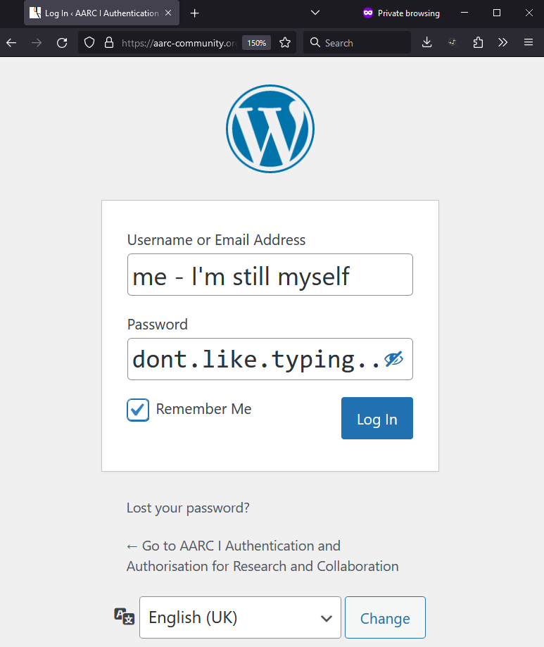
When you are asked to login again…~12 000 x 170+ times?
Authentication
demonstrating ‘you are you’
authenticator
‘you’ remains same ‘you’
vetted identity
‘you’ can be pseudonymous
‘you’ can be a vetted person

Slide 12
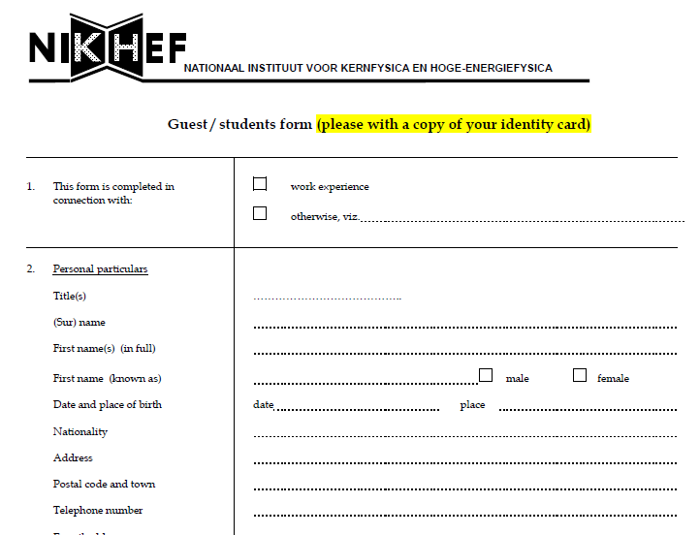
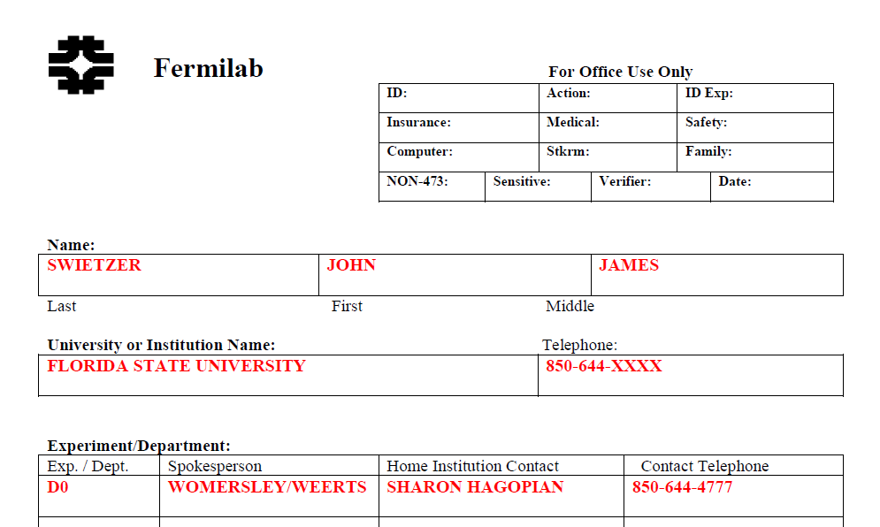
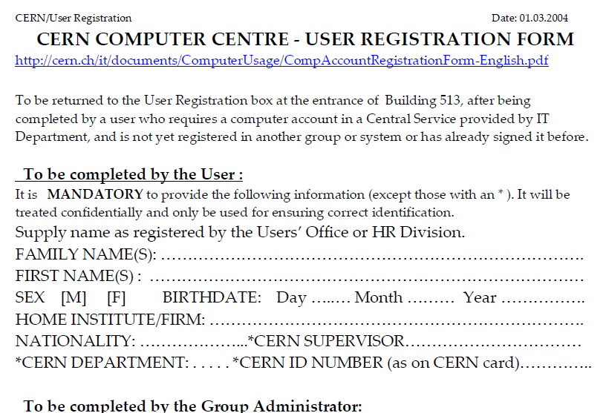
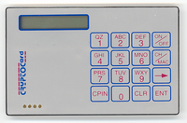
Self-asserted or ‘pseudonymous’ often not enough
state of EU DataGrid and
HEP computing in ~2000

Slide 13
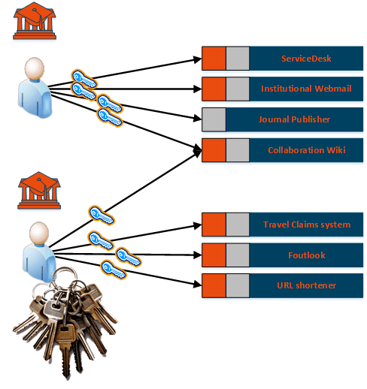
Scaling credentials: per service per user
Many start with credentials dedicated
to each service where you need access
In a multi-organizational system becomes
O(n_{services}) * O(n_{users})
usually creates a strong link to authorization:
different accounts for different roles, multiplying the number of credentials per user
Image imspired by AARC NA2 training module “Authentication and Authorisation 101” – keychain image created by generative AI

Slide 14
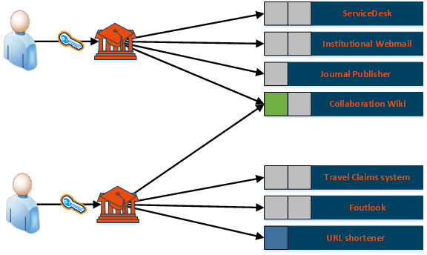
Can we scale better with an ‘federated’
Authentication and Authorisation Infrastructure (‘AAI’)
with one service provided to
several organisations
in a common federation
we will get to authorisation in a bit …

Slide 15
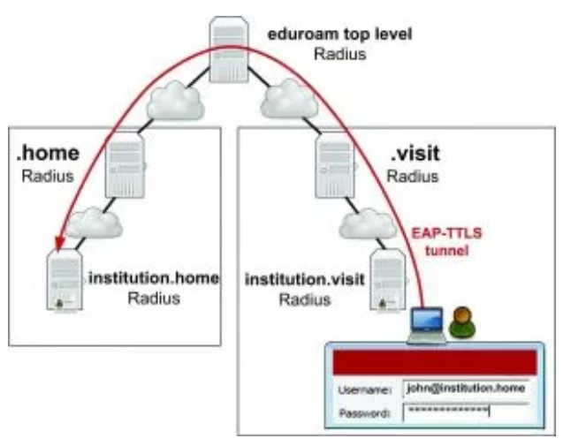

The R&E federation that was there first …
service-specific trust
between organisations
hierarchical server path, based on
a network-specific secure exchange
sending your credentials back
to only your home institution
found via <anon@domain.name>
eduroam image from https://eduroam.org/how/, GEANT ; RADIUS: RC2865 https://www.rfc-editor.org/rfc/rfc2865; see also freeradius.org

Slide 16
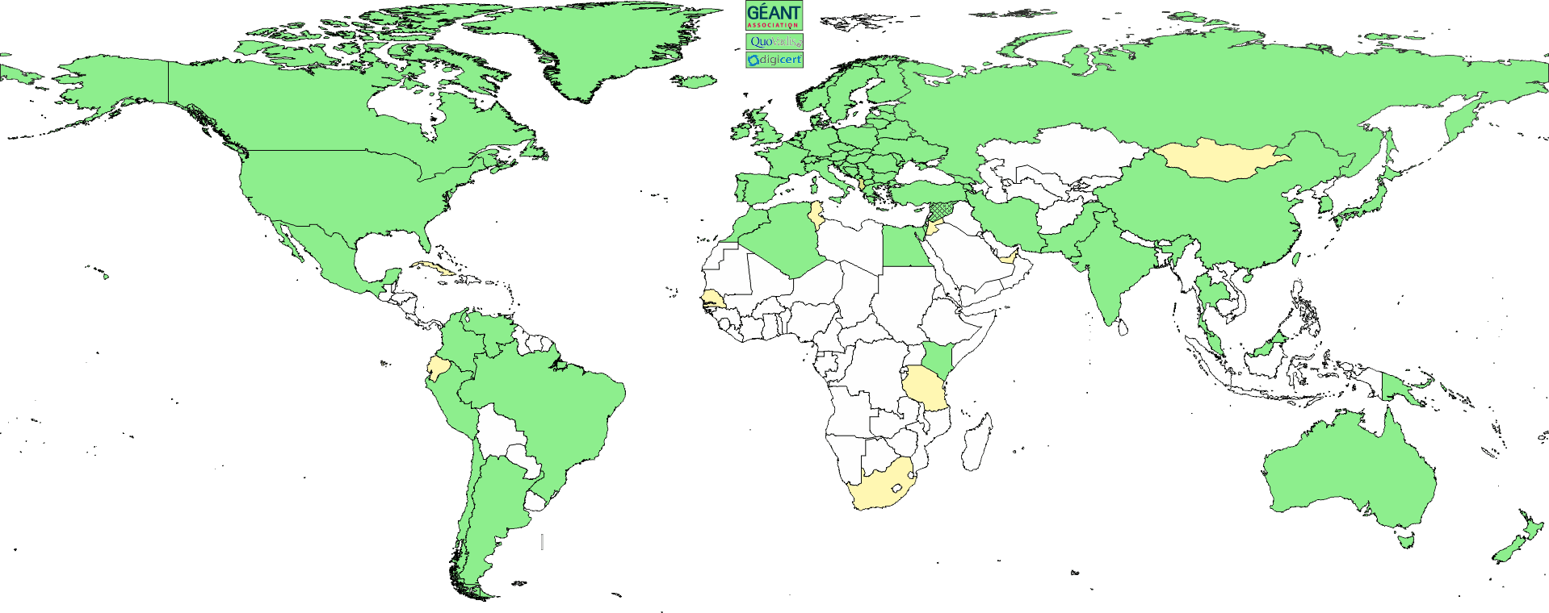
Interoperable Global Trust Federation IGTF
3 regional chapters: EMEA, Americas, AP
~ 90 Identity Providers (some leveraging a R&E federation)
~ 10 international major relying parties
~ 60 countries / economic areas / extra-territorial orgs
> 1000 relying service provider collaborations
www.igtf.net

Slide 17

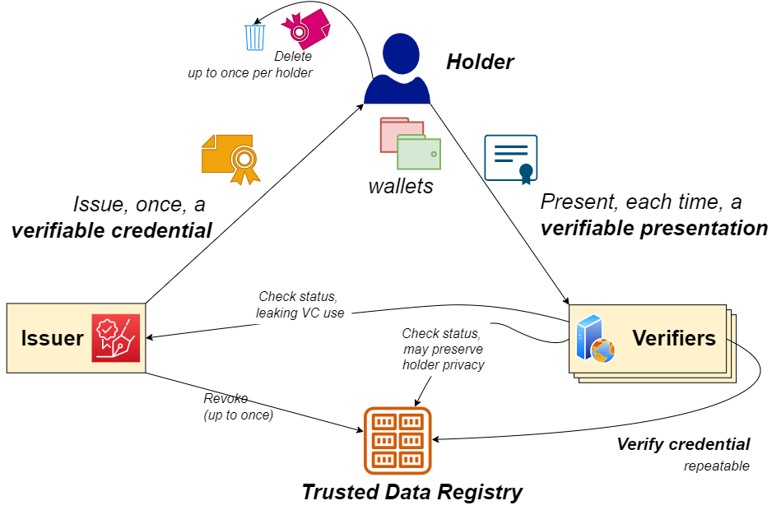

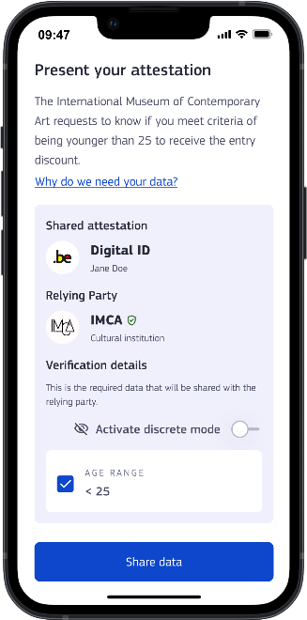
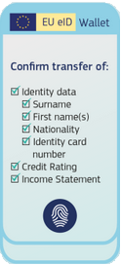
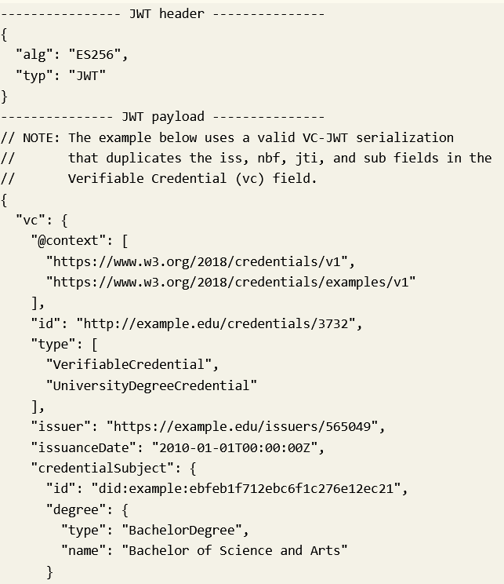
Identity wallets by the user, are another: conceptually similar
the user as a
credential Holder
Flow diagram inspired by: Lifecycle Details (5.1), Verifiable Credentials Data Model v1.1, W3C Recommendation 03 March 2022, https://www.w3.org/TR/vc-data-model/
EU eID Wallet from https://commission.europa.eu/strategy-and-policy/priorities-2019-2024/europe-fit-digital-age/european-digital-identity_en
Appimage: European Commission, at https://ec.europa.eu/digital-building-blocks/sites/display/EUDIGITALIDENTITYWALLET/Security+and+Privacy

Slide 18
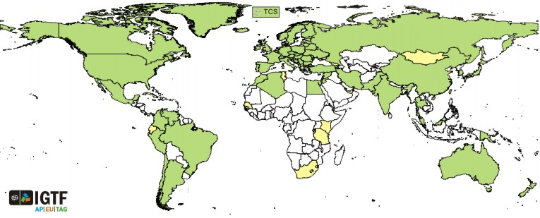
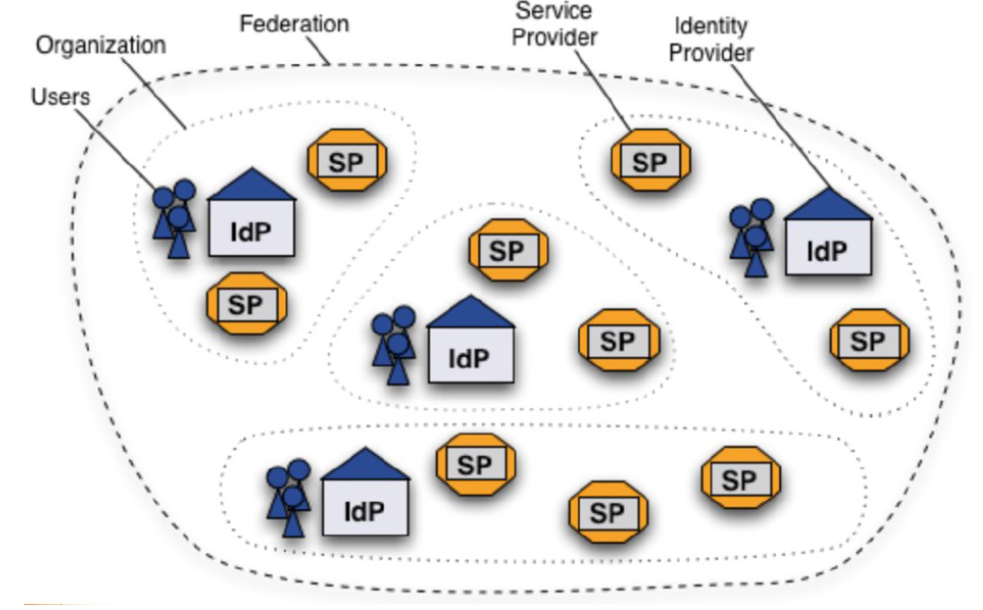

We progressed a lot since 2003 with identity federation
For eduGAIN federation the IdPs provide authentication from the home organisation, for the user-centric PKIX IGTF trust fabric, the CAs do.
Then Service providers perform authorization,
… maybe using attributes provided by the IdP. But do they get them??
Right-hand image: Shibboleth IdP federation, Lukas Hammerle, SWITCH (CH), user-centric PKI credentials: Interoperable Global Trust Federation, https://igtf.net/

Slide 19
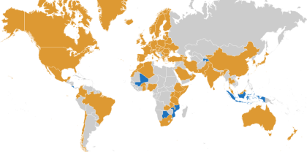
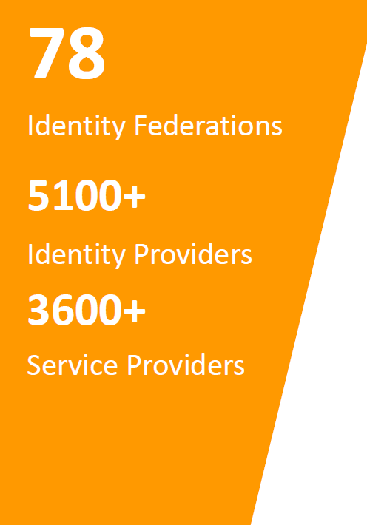
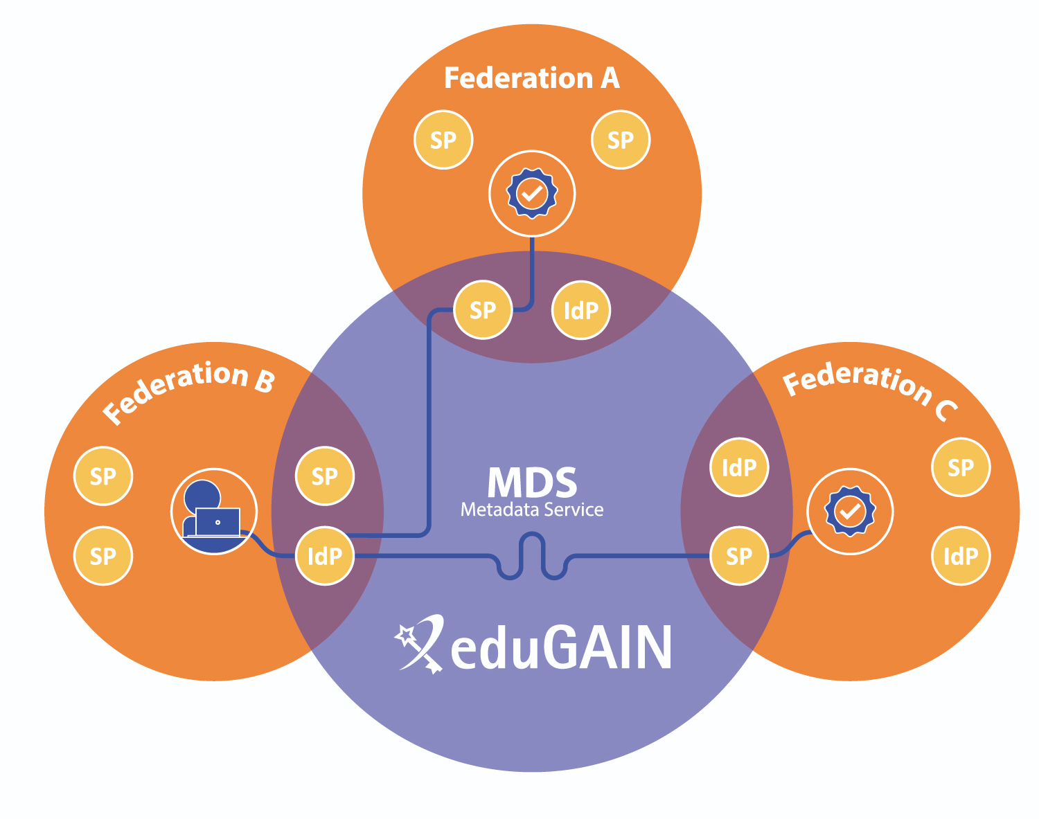
eduGAIN image: Davide Vaghetti, GARR for GN*-*, https://technical.edugain.org/

Slide 20
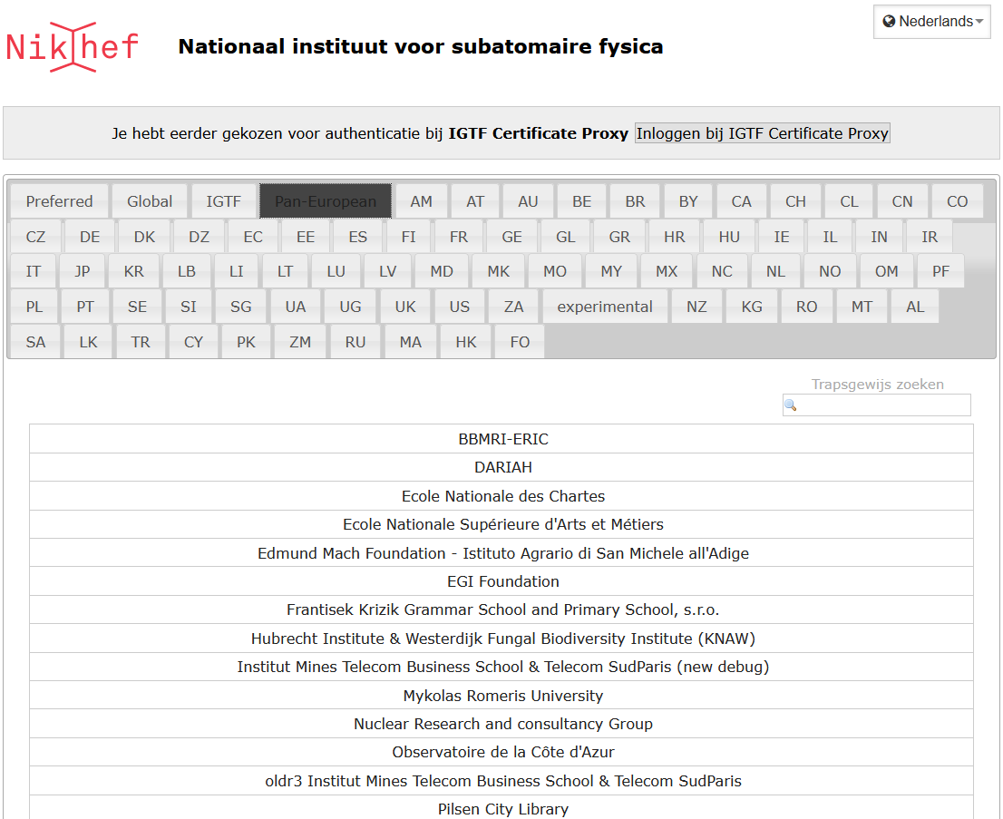
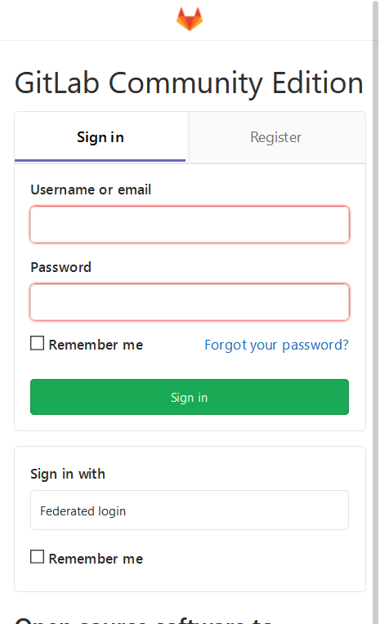
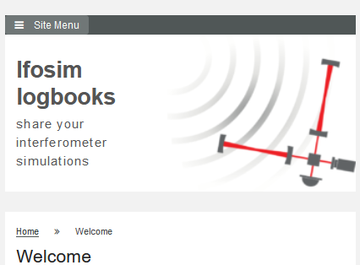

Federated Access
Federated Success!
Login to GW’s ifosim.org, to gitlab, or … via the service proxy
with any eduGAIN IdP
for user authentication
https://gitlab.nikhef.nl/
https://logbooks.ifosim.org/
https://wayf.nikhef.nl/
ifosim federated AAI integration implementation by Mischa Sallé; per-country WAYF selection is a bespoke Nikhef WAYF feature

Slide 21
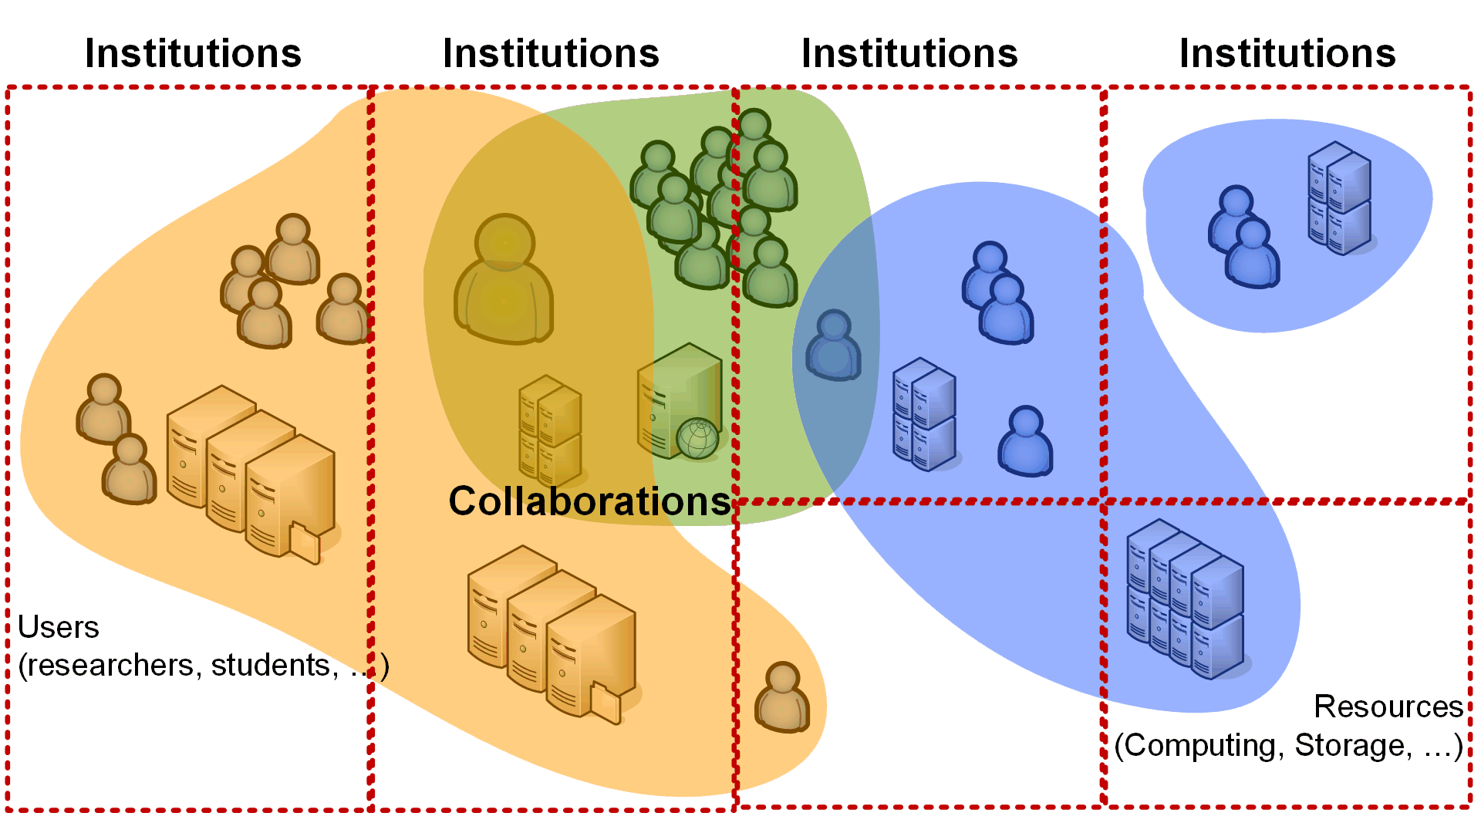
Since collaborations and institutions slice in different ways
… security must bridge domains …

Slide 22
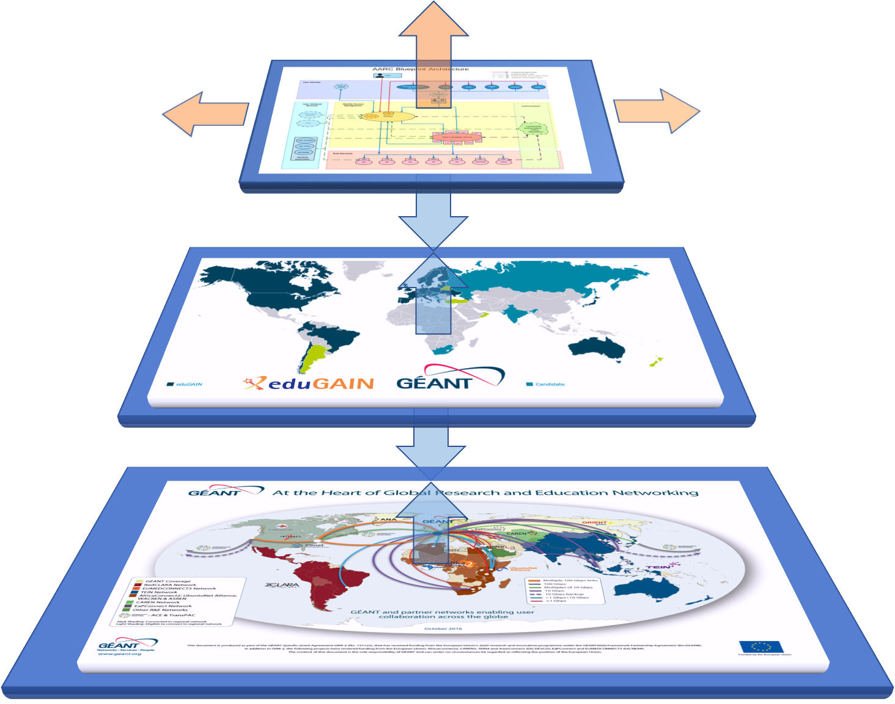

Adding a layer in the architecture for research collaboration
Bridging collaboration
and authorisation layer
to identity federation
Authentication
(academic, or govID, or ...)
Network layer(s)

Slide 23
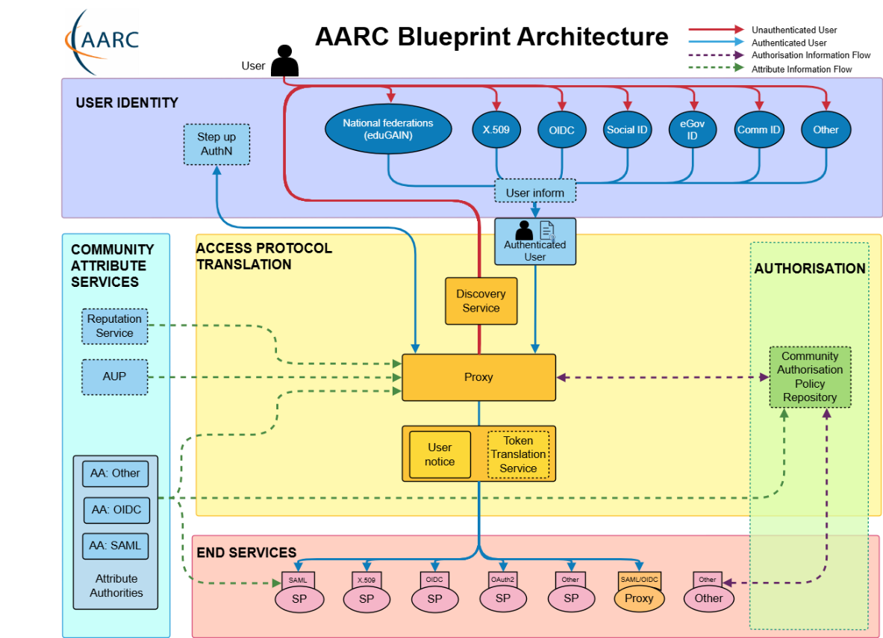
AARC Blueprint – making the bridge a first-class citizen
Facilitating the bridges
with interoperable building blocks for ‘AAI infrastructure’ architects
that are
technology-agnostic
have multiple implementations
come with policy templates &
good practice guides ☺
AARC BPA 2019 ‘Community First’
https://aarc-community.org/guidelines/aarc-g045/

Slide 24
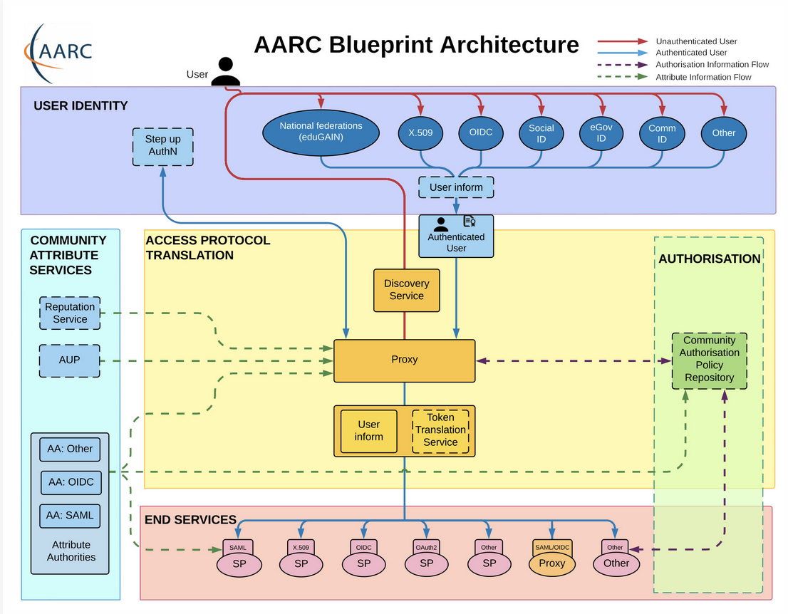
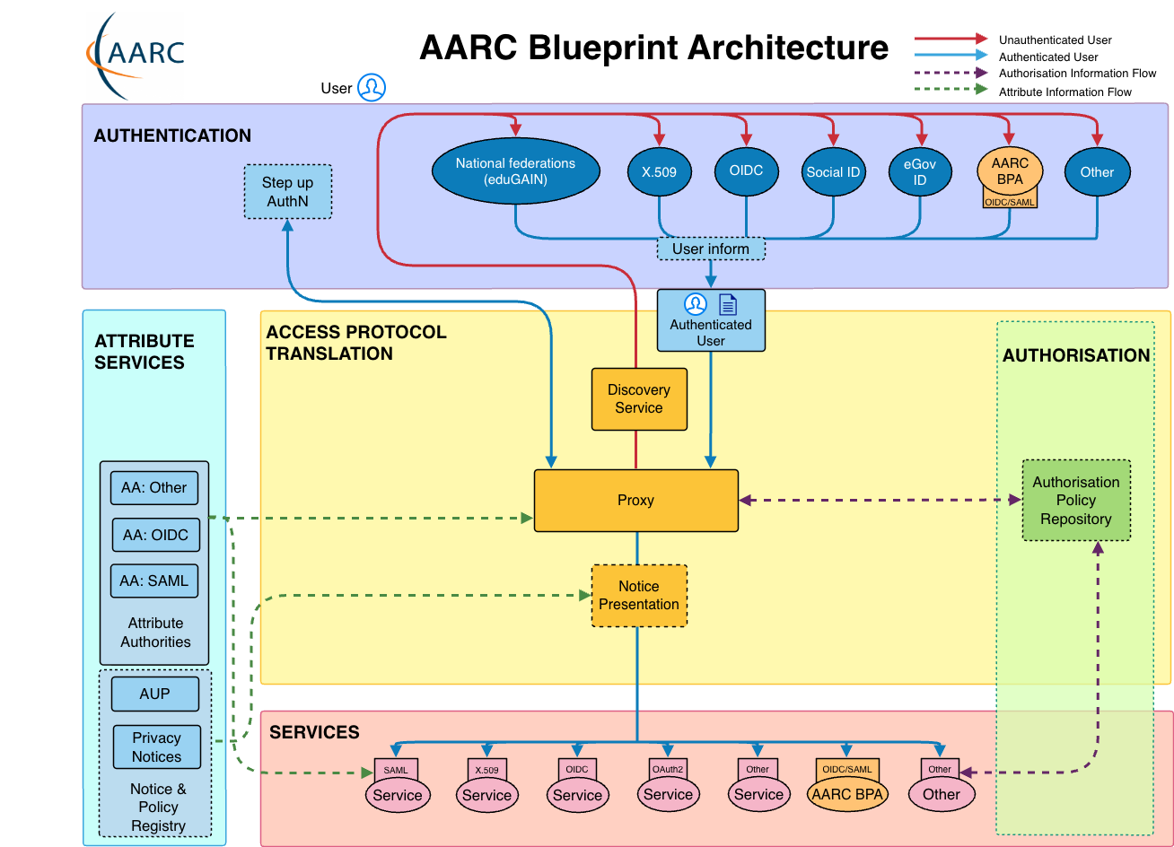
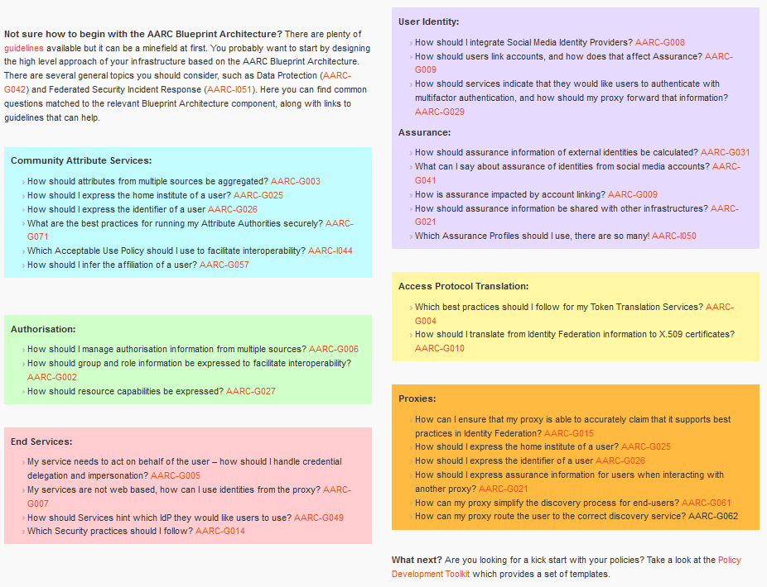
More than just nice colours
https://aarc-community.org/guidelines/

Slide 25
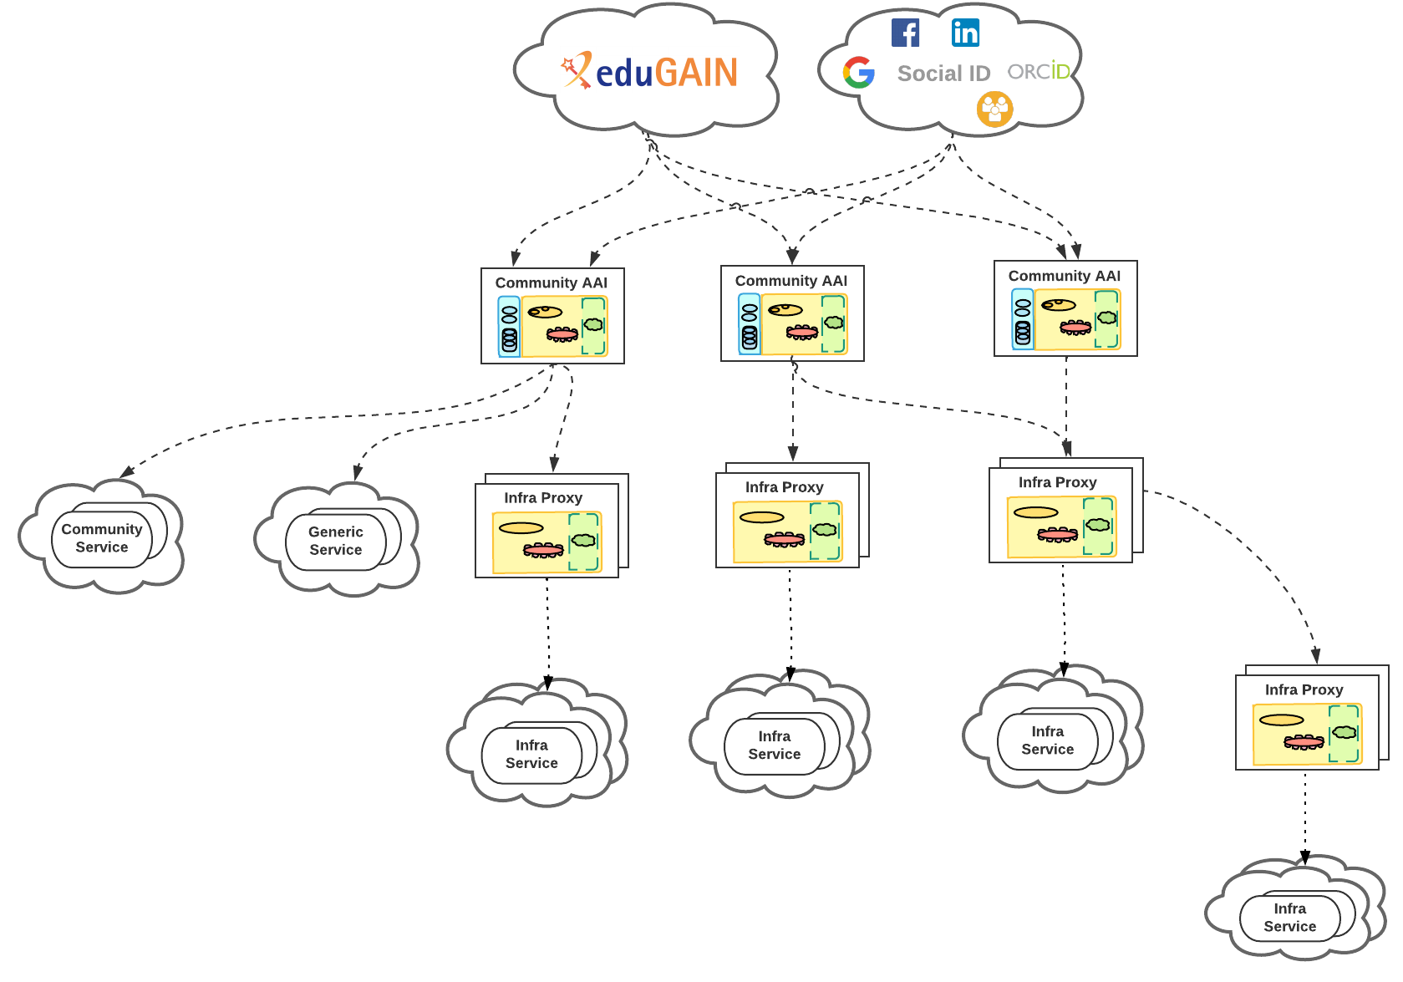
and with proliferation comes complexity ☹

Slide 26
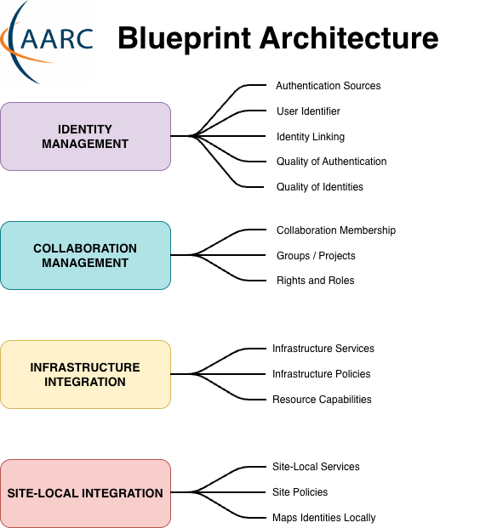
AARC Blueprint Architecture 2025: Functional Capabilities
What has changed since AARC-BPA-2019?
Added Identity Management capability:
  Groups identity-related functions such as unique identifier assignment, identity assurance, authentication assurance, and identity linking
Community AAI → Collaboration Management
Added Site-local Integration capability:
  Enables integration of federated users into local environments
Notes:
Identity Capability - Encompasses the authentication and identity lifecycle management of users. It integrates with external Identity Providers and supports identity enrollment and linking across multiple authentication sources. This capability draws primarily from the User Identity layer and parts of the Attribute Services layer.
Collaboration Management Capability - Enables the management of collaborations, including user membership in groups/projects, assignment of roles, and user access to services within the scope of their collaboration. It builds upon identity information and facilitates collaboration-driven authorisation logic. This capability spans the Attribute Services layer and the Authorisation layer.
Infrastructure Integration Capability - Provides protocol mediation and centralised access control enforcement, ensuring interoperability between the User Identity and End Services layers. It translates identity assertions, enriches identities with infrastructure-specific attributes (e.g. resource capabilities, infrastructure roles), and manages access requests. This capability includes the Access Protocol Translation layer and parts of the Authorisation layer.
Site-local Integration Capability - Connect multiple services at one site to ensure that federated identities and access policies can be effectively integrated at the site level. It includes services from the End Services layer and any site-local proxies that mediate between the infrastructure and local services. These proxies enforce site-specific policies, such as attribute transformation or access filtering, enabling integration of federated users into local environments. From the perspective of the infrastructure, site-local proxies are treated equivalently to individual services.

Slide 27
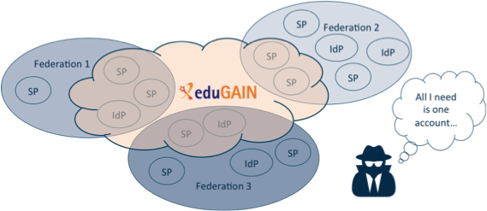
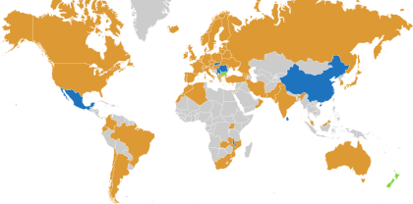













Now what have we built?!
full of valuable resources
(data, network, services)
We have federation and single sign-on …
… but can we share security information when needed?
… timely and confidentially, protecting everyone’s reputation?
left: eduGAIN interfederation extent in 2020; logos on the right from the European e-Infrastructures and ESFRIs; center graphic: AARC collaboration

Slide 28





The need to ‘decorate’ the arrows with trust
Each side of each arrow has
independent parties
we allow them to do part of the work
we would otherwise do
to make it easier and faster for users
to perform their research
but we relinquish some control
beyond our organisation, our own policies, our own jurisdiction
Why would we trust them to do that?

Slide 29





Policy and agreements enable action in times of crisis
https://aarc-community.org/guidelines; https://wise-community.org/; https://igtf.net/; https://wiki.eugridpma.org/

Slide 30


But even a simple Who are you? is not always simple …
IGTF interoperable global trust federation
Kantara IAF
industry identity assurance
eIDAS
government ID
REFEDS R&E federation
REFEDS Assurance Framework and IGTF Profiles are ‘simpler’:
as academia is a higher-trust environment, it can leverage
pre-established trust, self-assessment, and peer review
Source: https://aarc-community.org/guidelines/aarc-i050, Ian Neilson et al.
See https://refeds.org/assurance - join and interoperate on MFA+ and vetting

Slide 31


Developing the Trust framework, guidelines and best practice for BPA proxies and interaction with research services
minimise the number of divergent policies
empower identity providers, service providers, user communities to rely on interoperable policies
The Evolved AARC TREE Policy Development Kit version 2:
a simpler, deployment-oriented
Policy, Process, and Procedure Development Kit
comprehensive re-use of existing components to reduce complexity
input from national research infrastructures and EOSC nodes,
but not only in Europe but e.g. also Australia
leverage the works we co-created with WISE, REFEDS and EOSC
https://aarc-community.org/policies/policy-development-kit/

Slide 32

Building a trust framework: policy and procedural aspects of complex IT infrastructure
AARC-I082
https://aarc-community.org/guidelines/aarc-i082/

Slide 33
More importantly:
AARC Guidelines series as a pathways to policy sustainability and impact
AARC-I082 Trust framework for proxies and Snctfi research services landscape analysis and structure
AARC-G083 Guidance for Notice Management by Proxies reducing user frustration by streamlining
AARC-G084 Security Operational Baseline trusted and secure infrastructure and incident response
AARC-I085 eID Assurance Model Assessment investigates capabilities for leveraging national eID
AARC-I086 Membership Management Policy Development at light-weight and infrastructure-level
AARC-I088 Policy Development Kit an interactive resource for jumpstarting collaboration
Cross-cutting guidelines
AARC-G080 Blueprint Architecture 2025 as the conceptual foundation
AARC-G081 Recommendations for Token Lifetimes balancing usage patterns and security
Adoption stimuli through the Policy Development Kit version 2 for
AARC-G071 ‘Attribute Authority and Proxy Operations’, AARC-I044 ‘Baseline AUP implementation’
AARC-I051 and SIRTFI federated incident response, REFEDS DPCoCo v2, AARC-G042 ‘DPIA’ for research collaborations, REFEDS Assurance Framework
https://aarc-community.org/guidelines/; PDK: https://aarc-community.org/policy/policy-development-kit/

Slide 34

Practices we already have, practices we need to harmonise
AARC-G071
Authentication and identity sources
NIST SP800-63
FIPS140
ISO 27001
IGTF AP Profiles
REFEDS MFA
REFEDS Assurance Framework
so … what about standards
for the operation of this ‘proxy’ thing?
Service provider operations
ISO27k
NIS2
ITSRM2
https://aarc-community.org/guidelines/aarc-g071/
while for identity sources and for services there is extensive normalisation, our AARC BPA ‘proxy’ did not yet …

Slide 35


Information Security: Security Operational Baseline
AARC-G084
Service Security Policy was re-used widely, in EGI, AARC,
WLCG, but naturally diverged over time
- with national implementations and specialisations
- included in EOSC Interoperability Framework as
‘Security Operational Baseline’
So the new AARC PDK converges on a common Baseline
- included in the EOSC AAI WG Federation 2025 requirements
- with guidance and FAQ
AARC-G084 https://doi.org/10.5281/zenodo.7396724

Slide 36
The 12 points of AARC-G084
AARC-G084
comply with the SIRTFI security incident response framework for structured and coordinated incident response [ref to SIRTFI]
ensure that your Users agree to an Acceptable Use Policy (AUP) or Terms of Use, and that there is a means to contact each User.
promptly inform Users and other affected parties if action is taken to protect their Service, or the Infrastructure, by controlling access to their Service, and do so only for administrative, operational or security purposes.
honour the confidentiality requirements of information gained as a result of your Service’s participation in the Infrastructure.
respect the legal and contractual rights of Users and others with regard to the personal data processed, and only use access personal data for administrative, operational, accounting, monitoring or security purposes.
retain system generated information (logs) in order to allow the reconstruction of a coherent and complete view of activity as part of a security incident (the ‘who, what, where, when’, and ‘to whom’), for a minimum period of 180 days, to be used during the investigation of a security incident.
follow, as a minimum, generally accepted IT security best practices and governance, such as pro-actively applying secure configurations and security updates, and taking appropriate action in relation to security vulnerability notifications, and agree to participate in drills or simulation exercises
to test Infrastructure resilience as a whole.
operate services and infrastructure in a manner which is not detrimental to the security of the Infrastructure nor to any of its Participants or Users.
collaborate in a timely fashion with others, specifically those with which there is a direct trust relationship, in the reporting and resolution of security events or incidents related to their participation in the infrastructure and those affecting the infrastructure as a whole.
honour the obligations on security collaboration and log retention (clauses 1, 6, and 9 above) for the period of 180 days after their Service is retired from the Infrastructure, including the retention of logs when physical or virtual environments are decommissioned.
not hold Users or other Infrastructure participants liable for any loss or damage incurred as a result of the delivery or use of the Service in the Infrastructure, except to the extent specified by law or any licence or service level agreement.
maintain an agreement with representatives for individual service components and suppliers that ensures that engagement of such parties does not result in violation of this Security Baseline

Slide 37


FAQ and implementation guidance
AARC-G084

Slide 38



WISE AUP: actionable policy across infrastructures
Purpose binding
ensure use is as intended for access grant
Terms and Conditions
research data access conditions, permits, grant conditions
WISE Baseline AUP
common 10 commandments that
allow seamless cross-sectoral user movement
Service level agreements
promises and recourse
Privacy notice references
for access personal data policies
https://wise-community.org/wise-baseline-aup/

Slide 39



Bringing it together: the Policy Development Kit
AARC TREE D2.2
AARC PDK
PDK v2 has guidelines and explanations, hints, and accessible recommendations
https://aarc-community.org/policies/policy-development-kit/

Slide 40







Providers manage complexity for research communities
communities sourcing
‘well-operated’ community platforms
(SRAM)
and a few more …
through their scale gets
federations to trust our
AARC ‘middle boxes’
Notes:
Simplicification in AARC TREE – somebody can run these complex things for you …!
Hosted multi-tenant services as a way of simplifying control
and Snctfi compliance checks helps you as a community to select a good provider

Slide 41


Since be it research information, research cloud, or open science …
Thanks to Eileen Waegemaekers, Maarten Hoogerwerf, image by denkschets.nl during an ORI event. Right: RDA GORC-WG, https://www.rd-alliance.org/groups/gorc-international-model-wg/

Slide 42
Infrastructure as a composite set of connected services
IT Service Management (ISO20000, ITIL, FitSM) promote
a specific definition of service portfolio management:
“Product/service portfolio The product/service portfolio is the complete set of products and/or services that are managed by the organization, and it represents the organization’s commitments and investments across all its customers and market spaces. …” [ITIL v4, chapter 5]
Concept of ‘services’ in collaborative research is quite different:
coming from existing collaborations and infrastructures, many or most services
already pre-exists and used extensively by research and collaborative administration;
these ‘outsiders’ are an essential aspects: they should be embraced, as they support
the primary mission of the organization (e.g. research & education);
whether a ‘service’ is operated by a third party, or outside our local ITSM control,
is immaterial to the value of the service

Slide 43



Example: an overlay network of containers …
‘alien containers’ HPC integration - container computing, using curated application images
Image sources: NDPF JupyterHub service “Callysto”; SLATE: Service Layer At The Edge – Rob Gartner (UChicago), Shawn KcMee (UMich) et al. – slateci.io

Slide 44

‘ScienceDMZ’
Accessible from the outside world
with predicable performance
and data access for research
‘where research services,
data, and researchers meet’
latency hiding through caching
security zoning/segmentation
protects specific data sets
outside any ‘enterprise’ perimeter since any stateful device will be disruptive
Image and ‘ScienceDMZ’ concept promulgated by ESnet (see fasterdata.es.net) – image: Eli Dart

Slide 45

Just one random autonomous system, AS1104



AS1104 state as of Oct 2024

Slide 46

LHCone
LHCone (“LHC Open Network Environment”) – visualization by Bill Johnston, ESnet version: October 2022 – updated with new AS1104 links

Slide 47




Exercising the network, for sensor data and events
1.02 Bpps
400 Gbps and 593 Mpps –
connected to CERN via SURF
Image: ballenbak.nikhef.nl, Tristan Suerink, 2022

Slide 48

with packets being more destructive than bandwidth …
https://wiki.nikhef.nl/grid/2Bpps_Machine - in preparation for the 2025 National ‘Resilience Exercise’

Slide 49



And some traffic is triggered by researchers scaling up
‘accidentally’ from a laptop to a cluster without too much thought
A researcher doing mass creation of containers, rebuilding their python ‘virtual env’ for each job, running on >> 4000 cores
[root@wn-pep-002 ~]# top
top - 09:40:47 up 71 days, 12:17, 2 users, load average: 110.38, 101.43, 106.3
Tasks: 700 total, 7 running, 666 sleeping, 0 stopped, 27 zombie
%Cpu(s): 17.0 us, 2.0 sy, 0.0 ni, 81.0 id, 0.0 wa, 0.0 hi, 0.0 si, 0.0 st
KiB Mem : 39462902+total, 23514457+free, 10406320 used, 14907812+buff/cache
KiB Swap: 67108860 total, 66841340 free, 267520 used. 37964784+avail Mem
PID USER PR NI VIRT RES SHR S %CPU %MEM TIME+ COMMAND
82661 ligo000 20 0 5618756 396356 924 R 360.0 0.1 5:14.43 mksquashfs
72615 ligo000 20 0 5626336 248516 816 R 90.0 0.1 5:44.11 mksquashfs
83257 ligo000 20 0 5611608 219300 852 S 90.0 0.1 1:17.66 mksquashfs
...
Pulling the python packages at line rate and downloading public python repositories ultimately will flood SURFnet (though neither CloudFlare or I mind ☺)
June 28th, 2023, data from Nikhef NDPF stats & cricket (top),
SURFnet asd001b-jnx-01 to asd001b-jnx-04 (left),
AMS-IX SFlow https://stats.ams-ix.net/sflow/index.html (bottom)

Slide 50






Research data traffic looks like … a DDoS to others ☺
Image sources: belastingdienst.nl, rws.nl, nu.nl

Slide 51



‘open’ does not mean ‘insecure’
system logging
LogStash
650 GByte/day ingest; 400Gbps+ monitoring through
optical taps and mirroring; MISP intel from CERN, SURF, and private intel sources
Nikhef SOC design/management by Daniel Geerts, Sil Westerveld, Jouke Roorda.
WLCG SOC WG model: Liviu Valsan (CERN) and David Crooks (STFC RAL)

Slide 52



‘Sirtfi’ – what makes federated security different?
Organisations probably do ‘something reasonable’ for their own security ... but may not realise the implications for others
Sirtfi targets coordinated response in a federated context:
Enable communication and coordination
in managing federated security incidents
Relevant event data is available to help
collaborating incident responders
Security protections are applied to federated transactions
Clarifies security incident response by an IdP or SP, and organisation can self-asserts in federation meta-data
Operational Security
Incident Response
Traceability
User Rules & Conditions
https://refeds.org/sirtfi

Slide 53









A federated community security challenge
Can we coordinate our collective R&E response?
‘challenges’ based on the Sirtfi contact model
Security Incident Response Trust Framework for
Federated Identity
parties involved in response challenge
Report-outs see https://wiki.geant.org/display/AARC/Sirtfi+Communications+Challenges%2C+AARC2-TNA3.1

Slide 54




Response across IdP-SP Proxies: the limits of Sirtfi version 1
Srtfi v1
|
|CSIRT
joint work with GN5 EnCo
and eduGAIN CSIRT

Slide 55


The eduGAIN Security Handbook
https://edugain.org/edugain-security/references/ eduGAIN Security activities supported by the GN4-3 and GN5-1 Trust and Identity activities

Slide 56


Sharing threat intel – working with our community
AARC I-051 Guide to federated incident response
https://aarc-community.org/guidelines/aarc-i051/
WLCG SOC WG, Research SOC (US), MISP by Circl.lu (https://www.circl.lu/services/misp-malware-information-sharing-platform/)

Slide 57



A single site sees only so much …
many ‘false warnings’ when industry-standard (e.g. standard Suricata) rules are used. You need R&E specific ones!
NikhefSOC setup: Jouke Roorda, Daniel Geerts, Sil Westerveld
based on evolved WLCG SOC concepts

Slide 58


And remember to engage users – also an intel source!

Slide 59




A question of when, not if – hence we run security challenges
Communication:
Endpoints valid?
Form/Content OK ?
Containment
Ban ”malicious” users
Find/Stop malicious processes
Find submission IP
Forensics
Basic Forensics on binary
Network traffic

Slide 60


Federation security table-top exercises
What your role play brings you ☺
real time pressure to contain incidents
true gratitude for protecting your peers
collective recovery
exploring some gruelling conflicts of interest!
eduGAIN TTX – role play scenario from the ISGC Security Workshop 2024, 2025

Slide 61



‘Global’ cross-domain services and catalogues are coming
https://webcast.ec.europa.eu/eu-node-technical-launch-event-24-10-10

Slide 62



And security should be a mandatory corner stone
EOSC AAI Architecture 2025 - Implementation of the EOSC AAI Federation; https://doi.org/10.5281/zenodo.15388270

Slide 63











At all scales: bringing it together for a smaller set-up
FSE CSLab –
a computing sciences field lab at the
UM Dept of Advanced Computing Sciences
ScienceDMZ concept
Independent up-links separate concerns
Implementing security good practices:
ITSRM risk assessment,
WISE Baseline AUP,
AARC Security Baseline,
TrustedCI Transformative Twelve and OT22, microsegmentation, central logging & IdM, …
Now for a bunch of 1200+ unruly students ☺

Slide 64





And next to services, there is always policy to allow action…

Slide 65


So what do you do??

Slide 66


This work has also been co-supported by projects that have received funding from
the European Union’s Horizon research and innovation programmes under
Grant Agreements GN5-1, GN5-2, EGI-ACE/EGI-Engage, EOSC Future, AARC/2, AARC TREE
This work is supported by SURF under the Innovation Programme, part of the NWO and SURF Execution Plan Digital Infrastructures for Research and other sources

