Slide 1

The IGTF IOTA Profile
towards differentiated assurance levels – but for whom?
David Groep, Nikhef and NL-NGI for EGI global task O-E-15
This work is supported by EGI-InSPIRE under NA2 and SA1.2
davidg@nikhef.nl, orcid.org/0000-0003-1026-6606

Slide 2
Broad outline
diverse infrastructures: the use cases for IOTA
  Differentiated and Collaborative Assurance Risk Profile
IGTF Federation Charter and structure
assurance levels
  NIST/Kantara vs. Classic, MICS, SLCS .. and IOTA
differentiated collaborative assurance
IOTA Profile: a really different level!
  What You See Is What You Get (and no more)
caveats for IOTA
questions RPs should be asking themselves

Slide 3
Times are a’changeging
More diverse services
  portal services, data-only, IaaS clouds
  more closely integrated: directly exposed to users
Can we simplify the user experience
and reduce duplicate efforts
… and still stay reasonably secure?
We have
(well-)managed AAI federations in many countries are now well established
infrastructures with defined (and at times adhered-to) procedures
but that are quite differently structured

Slide 4
Differentiated assurance
EGI: VO Portal Policy
  4 levels of ‘impact’ -> 4 levels of identity assurance
  Inspired by portals (science gateways), but not limited thereto
  EGI SPG: https://documents.egi.eu/document/80
Actions vs assurance level
  Click-only portals – anonymous, but rate limited
  Parameter portals – email reg, rate limited
  Data storage – ‘LoA-1’, unqualified
  federated, site-specific agreements for write access
  Arbitrary executables – traceable and persistent ID

Slide 5
Redistributing risk
‘risk envelope’
Subject (ID/LoA) based
Defined identity assurance level
Includes Community-given LoA
For given actions, resources, and acceptable residual risk,
required ID assurance is a given
Action (app) based
More constraint actions can
lower need for identity LoA
(J)SPG VO Portal policy
did just that: 4 levels of actions
Resource (value) based
e.g. access to wireless network does not pose huge risks,
so can live with a lower identity LoA (eduroam)

Slide 6
Trust Element Distribution (Classic, MICS, SLCS)
Technical elements
integrity of the roots of trust
integrity of issuance process
process incident response
revocation capabilities
key management
credential management
incident response
Identity elements
identifier management
re-binding and revocation
binding to entities
traceability of entities
emergency communications
regular communications
‘rich’ attribute assertions
correlating identifiers
access control
IGTF Classic elements
RP, Community elements
Verifiability & Response, mitigation, recovery

Slide 7
Parties to assurance level
Identity assertions
  IGTF: Classic, MICS – SLCS – experimental
Community (attribute) assertions
  Largely unexplored, AAOps Guidelines take a step
  EGI VO registration policy (relatively weak)
  PRACE site registration procedures (status is mixed)
Resource providers
  In EGI usually don’t vet the user
  This is more common in other infra’s
    PRACE: per-site additional vetting possible
    XSEDE: centrally vetted

Slide 8
Collaborative assurance
Cater for those use cases where
  the RPs (VOs) already collect identity data
  this RP (VO) data is authoritative and provides traceability
  the ‘identity’ component of the credential is not used
through an AP where the authority provides only
  persistent, non-reused identifiers
  traceability only at time of issuance
  naming be real or pseudonymous (discussion on going!)
  good security for issuance processes and systems
and where the RP will have to take care of
  subscribers changing name often (in case traceability at issuing authority is lost)
  all ‘named’ identity vetting, naming and contact details

Slide 9
The IGTF
a small diversion if needed

Slide 10
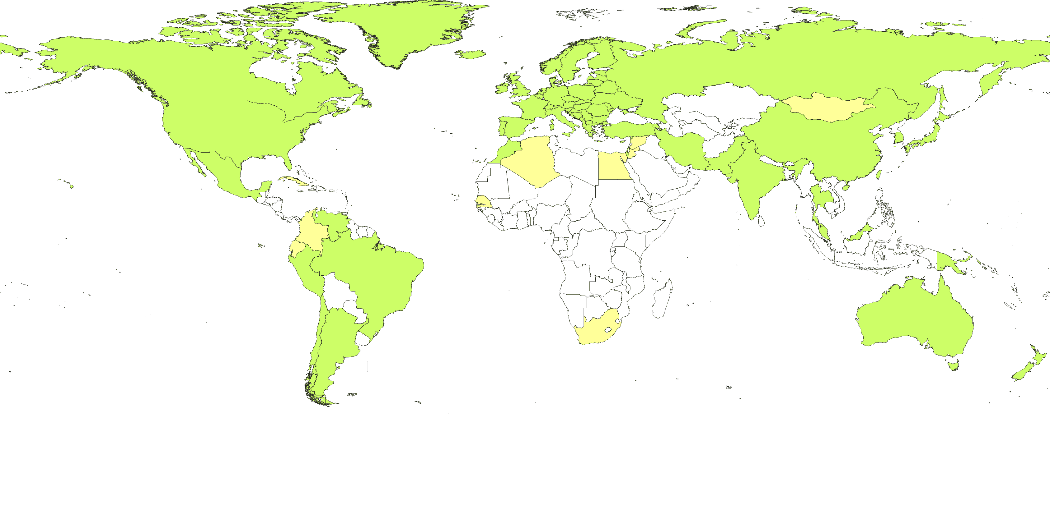



Global Trust
86 accredited authorities from 53 countries and economic regions

Slide 11
IGTF Structure of Trust
Common criteria and model
  globally unique and persistent identifier provisioning
  not fully normative, but based on minimum requirements
Trust is technology agnostic
  technology and assurance ‘profiles’ in the same trust fabric
  ‘classic’ traditional public key infrastructure
  ‘MICS’ dynamic ID provisioning leveraging federations
  ‘SLCS’ on-demand short-lived token generation
  a basis for ‘arbitrary token’ services
  new profiles

Slide 12
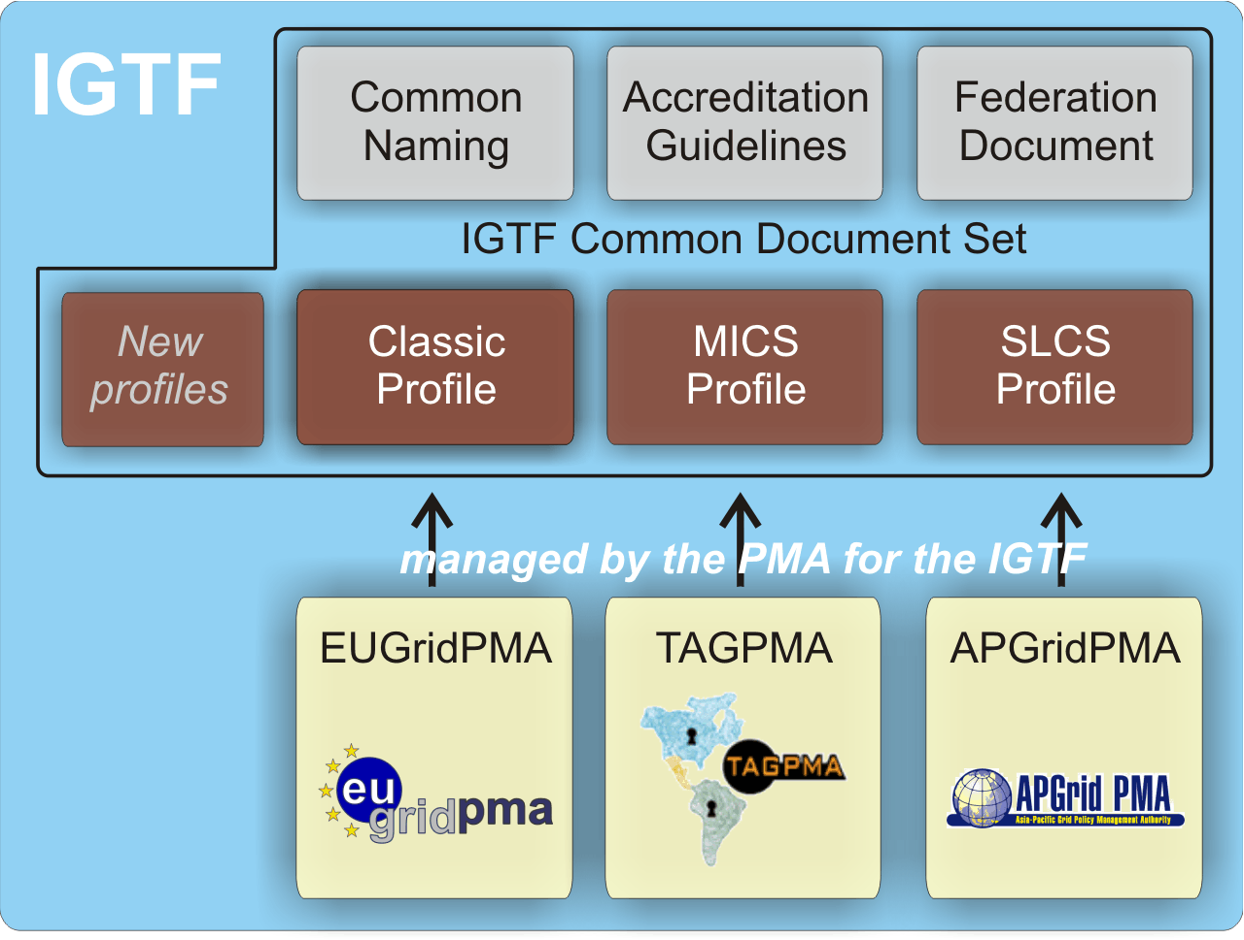
IGTF Common Criteria

Slide 13
Assurance levels in the IGTF
Technical and operational controls
Authorities come in two basic flavours
  off-line (only used in ‘traditional’ PKI): human controls and air-gap security provide protection against attacks
  on-line infrastructure (federation-backed, SLCS and classic): valuable security material is network connected need compensatory controls:
    secure hardware, compliant to FIPS 140-2 level 3
    additional layered network security
Technical requirements apply to any attribute source
  such as community registries like ‘VOMS’

Slide 14
Vetting Assurance Levels
Identity controls and vetting
long-term traceable assurance (classic, MICS)
  based on in-person checking of (nationally defined) official identity documents
  recorded identity persists beyond the moment of issuance
  assertions can live for a long time (over a year) to facilitate long-term use
  but compromise may happen, so is revocable
momentary assurance (SLCS)
  traceability to a physical person for at least one year
  may use any vetting mechanism that assures that traceability
  but assertions are limited in time to 24 hours (unless revocable, in which case: 11 days)
https://www.eugridpma.org/guidelines/{classic,mics,slcs}

Slide 15
Collaborative assurance
… back on track

Slide 16
Assurance levels
Trust in the identity assertions
by resource and service providers is key
Until now, our e-Infrastructure used a single ‘level’
  there are well-known ‘government’ standards for LoA
  (US: OMB M-04-04 & NIST SP800-63)
  but 95/46/EC and 1999/93/EC are not of much use to us
  and the Nice treaty states that identity is a national matter …
  there is rough but not 1:1 correspondence between balanced needs of the providers and users and the NIST LoA levels

Slide 17
IGTF Assurance Levels
Type and classification of e-Infrastructure services
drives the level of assurance required
Security and assurance level set to be commensurate
  not overly high for ‘commodity’ resources
  not too low, as providers otherwise start implementing additional controls on top of and over the common criteria
  defined in collaboration with resource providers
  using transparency and a peer review processes
  leveraging our own community organisation mechanisms

Slide 18
Redistributing responsibilities
Subject (ID) based
Effective LoA is retained
For given actions, resources, and acceptable residual risk,
required ID assurance is a given
can shift ‘line’ in identity trust level
Action (app) based
More constraint actions can
lower need for identity LoA
(J)SPG VO Portal policy
did just that: 4 levels of actions
Resource (value) based
e.g. access to wireless network does not pose huge risks,
so can live with a lower identity LoA (eduroam)

Slide 19
Who does What?
EGI: very heterogeneous (many VO communities, many providers, limited control)
  VOs and sites to answer you with “who did what when where” can take ages or will not work
  User-orig delegation & classic ID vetting (IGTF Classic, MICS, SLCS) give you tracability and ID
PRACE T1s:
  all data is (“should be”) in central LDAP, ought to have no need for using IGTF ID for finding user
CERN HR (wLCG):
  association to existing ID, existing User has all data

Slide 20
PRACE vetting based on slides from Vincent
… back on track

Slide 21
The PRACE security model
Authentication
  X.509 certificates (EUGridPMA, IGTF)
    Services using X.509 authentication : GSI-SSH, UNICORE, GridFTP, GRAM, web services
  SSO (MyProxy server)
Authorization
  LDAP used as an authorization database
  Fine grained management
    Attributes associated to projects (groups of persons)
    Attributes associated to accounts
Accounting
  Distributed database (DART for access)
  Accounting records compliant to OGF Usage Record format

Slide 22





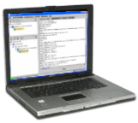



User registration in PRACE (1/2)
user
DB
user
DB
site A
site B
allowed
User
Review DB
Project attributes
LDAP
authz
user
DB
site C
a) PRACE Project Administration
b) Federated User Administration
c) Authorized Access to Resources

Slide 23
User registration in PRACE (2/2)
User registration is done by each partner for users from their country or by assignment. User is only registered once for all sites.
Rules are not very explicit for Tier-1 sites. It is assumed that sites have a contract with the user that they register and that they have a clear evidence on how to trace the user.

Slide 24
Information collected by sites and published in LDAP
First name, last name
Email
Telephone number
Certificate subject DN
Nationality
Login details, group memberships, organization (« Home site ») …

Slide 25
Why do we need this information ?
Site local policies require a clear traceability (no anonymous access on the execution sites).
Some sites need this information to initiate a local authorization procedure which can lead in the worse cases to access refusal.

Slide 26
This profile may be accepted by PRACE if we are convinced that for every internal registered user we have enough information to trace that user.
(the next two slides quote parts form the profile which make clear why we need the above requirement)
Users from other infrastructures can only be accepted if that infrastructure has the same requirement for traceability of the user and can provide us with this information if asked for (in agreed situations).

Slide 27
IOTA Profile
… back on track
Linking a generic ID
to pre-existing user data

Slide 28
IOTA AP Trust difference
Provide only (opaque) identifiers, nothing more
Easier to obtain for users, but must be complemented by RP for traceability and integrity
who should have that data already
…3,4
LoA 2: 1, 2-factor vetting, verified traceability, externally audited as matter of course
2
MICS, Classic: identified naming, traceability, longer-term,
limited auditing
Vetting
LoA
scale
SLCS: identified naming, point-in-time traceability, time-limited
RP task
IOTA AP: unique identification, no identity , limited traceability
* somewhat
my personal
view …
sorry for bias
1
LoA 1: verified email address with mail-back
LoA 0: ‘like conventional unsigned email’

Slide 29
Moving the bar towards differentiated assurance
http://wiki.eugridpma.org/Main/IOTASecuredInfraAP
IOTA AP assurance level is different, and rest
must be taken up by somebody else
Consider questions about
  Real names and pseudonyms
  Enrolling users in a community
  Keeping audit records in the VO
  Auditability and tracing
  Incident response
As a new profile next to classic, MICS, SLCS
Identity elements
identifier management
re-binding and revocation
binding to entities
traceability of entities
emergency communications
regular communications
‘rich’ attribute assertions
correlating identifiers
access control

Slide 30
IOTA Profile
http://wiki.eugridpma.org/Main/IOTASecuredInfraAP

Slide 31
Profile Structure
General items (from the federation level)
subject names must be globally unique
persistent for the life time of the authority
Architectural model
It’s about people and robots, not servers or services
Naming of IOTA subjects must be distinct
  ‘migration’ of named does not work since it itself was not vetted
  If every eligible entity name was any vetted, then it can be done
Supposedly backed by federation (InCommon, UKAMF, or maybe even all of eduGAIN?)

Slide 32
IdM Relationships
subscriber identity is maintained by the credential issuing authority or by third parties [read: federation] trusted by the authority for the purposes of identifier assignment.
Any such third parties must have a documented and verifiable relationship with the issuing authority, and through this relationship the issuing authority must have documented, verifiable and auditable means to ensure the requirements of this authentication profile are met [this auditing does not implicitly extend to actual IDs, see later]

Slide 33
Explicit caveat!
Credentials issued by authorities operating under this Authentication Profile should be used primarily in conjunction with vetting and authentication data collected by the relying parties, such that there is less need for collecting data that would otherwise duplicate efforts already performed by such relying parties.
Authorities are not required to collect more data than are necessary for fulfilling the uniqueness requirements. Credentials issued by authorities under this profile may not provide sufficient information to independently trace individual subscribers, and should be used in conjunction with complementary identification and vetting processes.

Slide 34
Naming
opaque unique identifier OR name chosen by the requestor and obtained from (a list proposed by) the IdP on which the issuer will enforce uniqueness.
The set of subject name elements included must:
identify the identity management system
contain sufficient information […] allows unique identification of the vetted entity in this identity management system;
with a verified element in the credential [not: subject] that allows direct contact to the subject (e.g. an email address(1)), correct at time of issuance;
subjectAlternativeName contains emailAddress

Slide 35
Records and tracability
the authority must retain sufficient information, or have sufficient information retained on its behalf, such that the persistency of name binding can be guaranteed.
The authority may rely in good faith [not: audited and verified] on identity management systems by third parties, provided such third parties retain the necessary records.

Slide 36
Traceability
At credential issuing time [not: for the validity of the credential], the authority must reasonably demonstrate how it can verify identity information and trace this information back to a physical person (or for non-human credentials to a named group).
At the time of issuance, the authority may rely in good faith on any identity management system by a third party with which it has entered into an agreement […]

Slide 37
Revocation
… Any entity can request revocation if they can sufficiently demonstrate compromise or exposure of the associated private key material, or if they can demonstrate that any data contained in the credential is incorrect.
Managers of identity management systems involved in issuing credentials may [not: should or must] request revocation of credentials if their stored identity data changes or when traceability to the person is lost.
Individual holders of a credential must request revocation if the private key pertaining to the credential is lost or has been compromised, or if the data in the credential are no longer valid.

Slide 38
Security and Incident Response
systems of the authority or at third parties with which the authority has entered into an agreement for identity management should [not: must] be highly secure and trustworthy systems, [...]
The authority must not knowingly continue to rely on data from third parties that provide inaccurate or fraudulent information.
It is strongly recommended that any third party on which the issuing authority relies has an incident response capability and is willing to participate in resolving such incidents. [but notably in InCommon this is not part of the agreement – and some org intentionally don’t want to]

Slide 39
Auditing
Each authority must accept being audited by another accredited authority to verify its compliance with the rules and procedures specified in its CP/CPS document.
The authority should perform internal operational audits of its staff and of interfaces between components and systems. These audits should be performanced at least once per year to verify its compliance with the rules and procedures specified in its CP/CPS document. Audit results shall be made available to the accrediting body upon request. A list of authority and site identity management personnel should be maintained and verified at least once per year.
The auditing does not necessarily extend to identity vetting systems operated by third parties and used for credential issuance.

Slide 40
Accreditation process
There are lots of ‘should’s and recommendation in the list – these get evaluated by the accrediting PMA
We expect ‘managed’ federations to be used: national NREN-run federations like those in eduGAIN. Then you effectively get a lot more!
InCommon is also managed, but their basic membership level suffers from the ‘don’t-ask-any-questions’ encourage programme
– there are hardly any requirements in there ☹, lots of orgs don’t bother to (tell they) do it right

Slide 41
IOTA Identity Providers
Who can provide IOTA?
  CILogon InCommon Basic (not OpenID)
  UK NES SARoNGS
  In future maybe a new SP serving eduGAIN IdPs
  the eduGAIN federation template looks strong enough
  and better than InCommon w.r.t incident response
Who can actually use it?
  XSEDE is willing to accept at least InCommon Basic
  UK NGS might accept SARoNGS
  … you get the idea ;-) but this ought to start changing

Slide 42
IOTA Technical Deployment
Distribution and use considerations

Slide 43
Technical trust remains
loosing technical trust would make
any authentication infrastructure useless
so integrity of the issuer has to be retained
  just like for the AA Operations Guidelines
  similar to the classic, mics and slcs profiles
  both issuing system and ID management secure
  retention of records for incident response
When contracting back-end (university) IdPs
the requirements must apply to them as well

Slide 44
From IGTF to RP
IGTF Distribution is not monolithic
  Authorities comes in ‘bundles’ for each profile
  RPs select one or more ‘profiles’ as sufficient
  and may add their own authorities as well
  e.g: “EGI policy on trusted authorities” accepts Classic, MICS and SLCS
  And there is no ‘IGTF all’ distribution – on purpose!
With more diverse profiles (and LoAs)
RPs will make more diverse choices
For your interest: EGI SPG policy on Approval of Certification Authorities, https://documents.egi.eu/document/83

Slide 45
At the site: do not mix assurance levels
  In software, it is unclear how to distinguish users on resources that are part of two RP infrastructures (one with and one without IOTA)
  You CANNOT distinguish by VO, for example!
Remember the PRACE warning …
This specifically affects wLCG – EGI/OSG/NorduGrid
For a Resource Provider that participates in multiple infrastructures, the minimum acceptable LoA should be the lowest one that the resource provider is willing to accept for all its users and infrastructures”
So if you participate in a controlled infra with managed user database, and one which has more ‘open’ reg procedures,
you should stay at classic & mics (& slcs if you’re happy) …

Slide 46
RP considerations
… still in the form of a Questionnaire, sorry

Slide 47
IOTA Questions for RPs
FIRST: do a risk assessment!
Do the RPs/RCs need the ‘real name’ of the person the certificate subject?
  Is it enough to be able to ask another entity to give you the name (e.g. the VO, community, other site or central LDAP)?
  What assurance level do you expect from this 3rd party?
  Do you need this information up-front (before or at use time)?
  Do you need this information at end (e.g. for accounting)?
  or It is sufficient to be able to ask an entity to contact the user on your behalf (like a privacy service)?
  Should pseudonyms be clearly identifiable (e.g. if they look like a name they should be the real name)?
  The email use case will not work: since emailAddress must be embedded in the SAN, but the mail will be pseudonymous as well

Slide 48
IOTA AP
Vetting assurance level and responsibility
  If you require identification of real users, and given that the name may be a pseudonym and is weakly verified, do you (RP, community) have the mechanisms in place to strongly identify the real user?
  Should we enforce obfuscated naming for all subjects?
  How will you (RP, VO) deal with ‘identity spoofing’?
  How do you currently enrol users in the community? Do you use or rely on the commonName of the subject for adding people to your databases (or get a ‘warm fuzzy’ feeling in association with e.g. unsigned email)?
Tracability by the VO
  Are you set up to provide traceability for your users?
  Do you have means and procedures for incident response and mitigation?

Slide 49
Auditability, traceability
Access to the user information by RPs
  Do you insist that the collection of this data is verifiable?
  Should the chain of processes be documented?
  Should the chain of processes be audited periodically (expensive!)?
  Should the chain be auditable? Or contract/sanction-based?
  A user may and will have many credentials and changing names: does this pose issues?
  Do you expect e.g. the community to provide a real name up-front with every access request (e.g. in a VOMS generic attribute)?
Do the RPs (RCs) need to be able to independently trace the user without involving the user community?
  Can a registration mechanism, retrievable or callable by the RP, satisfy this requirement (e.g. like the EGEE CIC portal having an ability to send email to the owner of a DN)
Do the RPs need to be able to trace without involving the CA?
  Which are the ‘emergency cases’ where they expect CA involvement in tracing or contacting subscribers?

Slide 50
Incident response
Do RPs/RCs expect the CA to be involved in incident response?
  What is an incident where you expect CA involvement?
  What is the level of involvement?
  Do you see a classification of incidents?
  If there are up-stream IdPs, are you ‘happy’ with just the CA response even if upstream does not participate?
  Do you expect more than pure credential revocation in case of demonstrable credential compromise?
  Do you see the CA more than a fall back to point to in case LEA comes after you?
  Do you expect/prefer suspension possibilities? Do you have this capability at the RP level (through authorization)?
Can you get by with just your own response capability?

