Slide 1
InterNetworking – made physical
ICTRecht visit
2018-11-30

Slide 2

On Needles and Haystacks
Zachte botsingen 10⁸
W±→ e±ν 15
Z⁰→ e⁺e⁻ 1
Top-anti-top quarks 1
bb →μ+X 10³
QCD jets, p_{T}>150 GeV 10²
Higgs deeltje: ~ 1 per dag
event rates from LHC Run 1
Selectie interessante gebeurtenissen uit ‘achtergrond’ van 1 op 10¹³ gebeurtenissen
- dit is equivalent met zoeken van
1 persoon op 1000 wereldpopulaties
oftewel één speld in 20 miljoen hooibergen

Slide 3
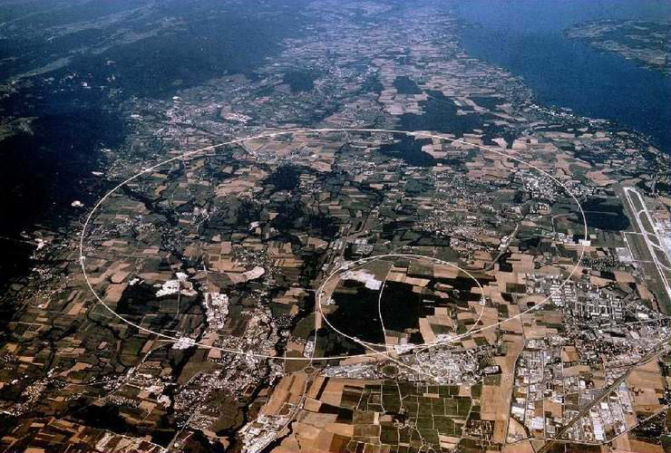
Netwerk: from 9600bps to 1.2Tbps
~ 50 PiB/year data
from CERN to WLCG

Slide 4
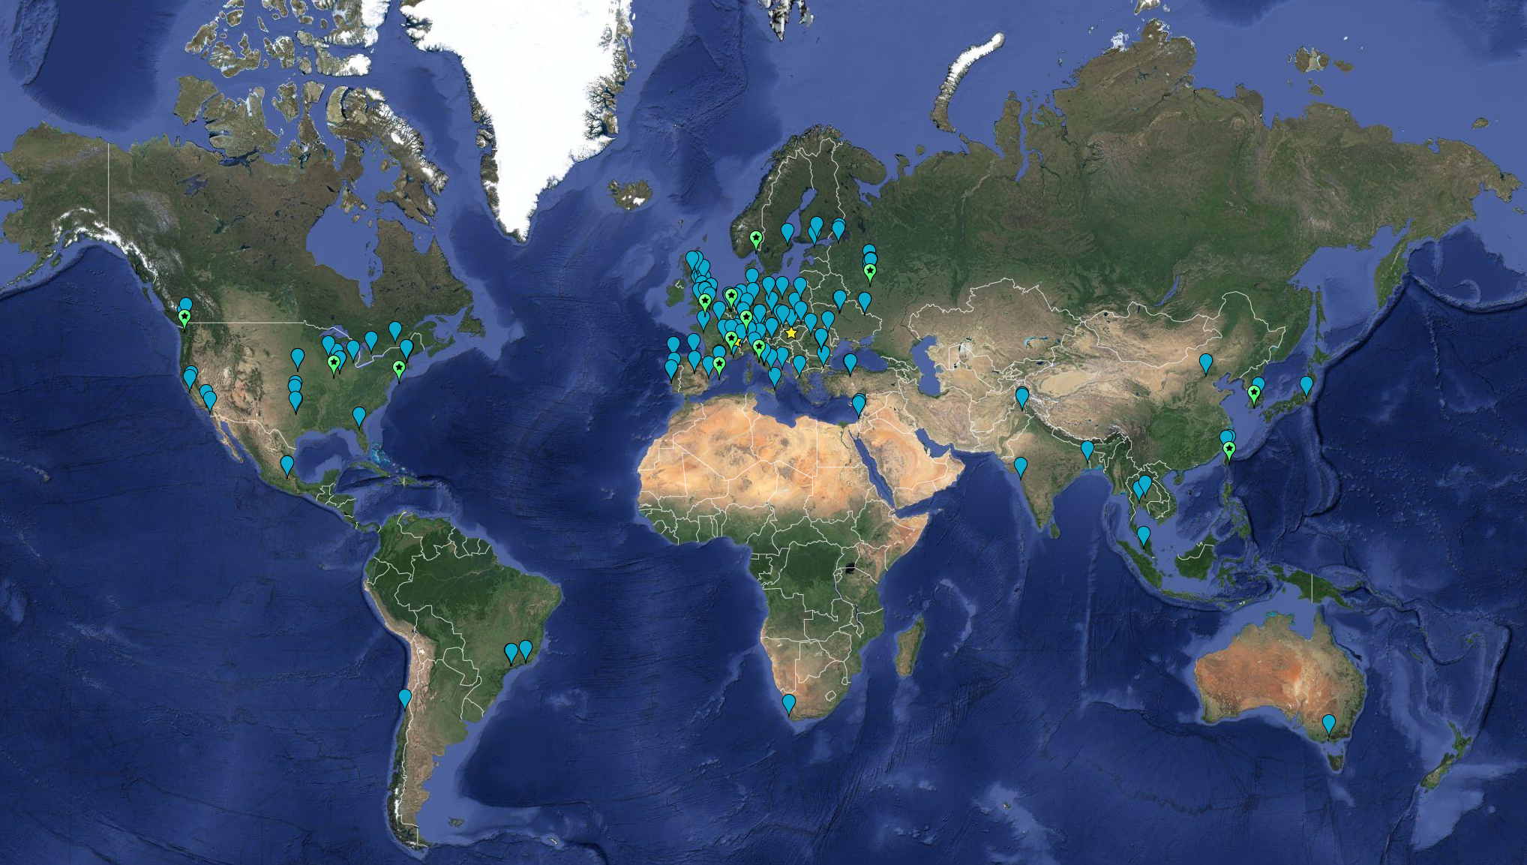


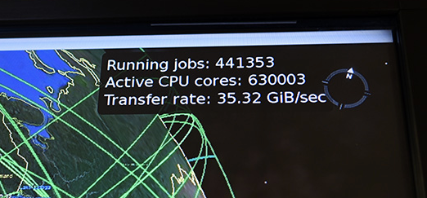

… globally distributed
meer dan 170 instituten in
42 landen en economiën
CPU: ~ 350,000 modern rekenkernen
Disk 310 PB
Tape 390 PB

Slide 5
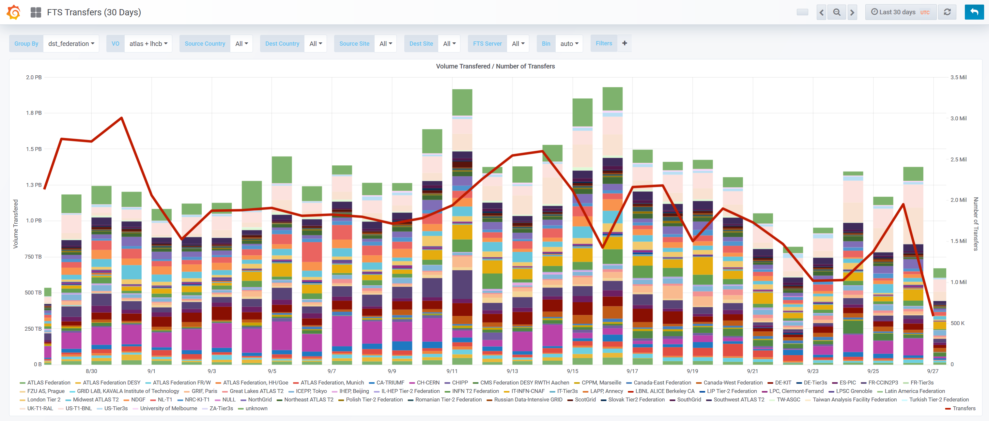
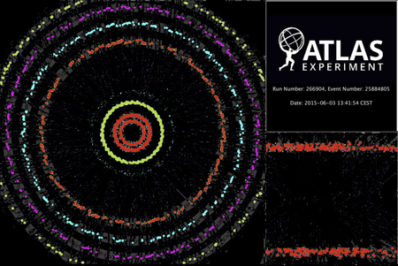
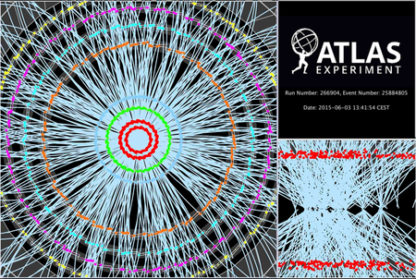

Data verdelen over de wereld T0>T1s
2.6M
source: https://monit-grafana.cern.ch/d/000000420/fts-transfers-30-day on September 27, 2018

Slide 6
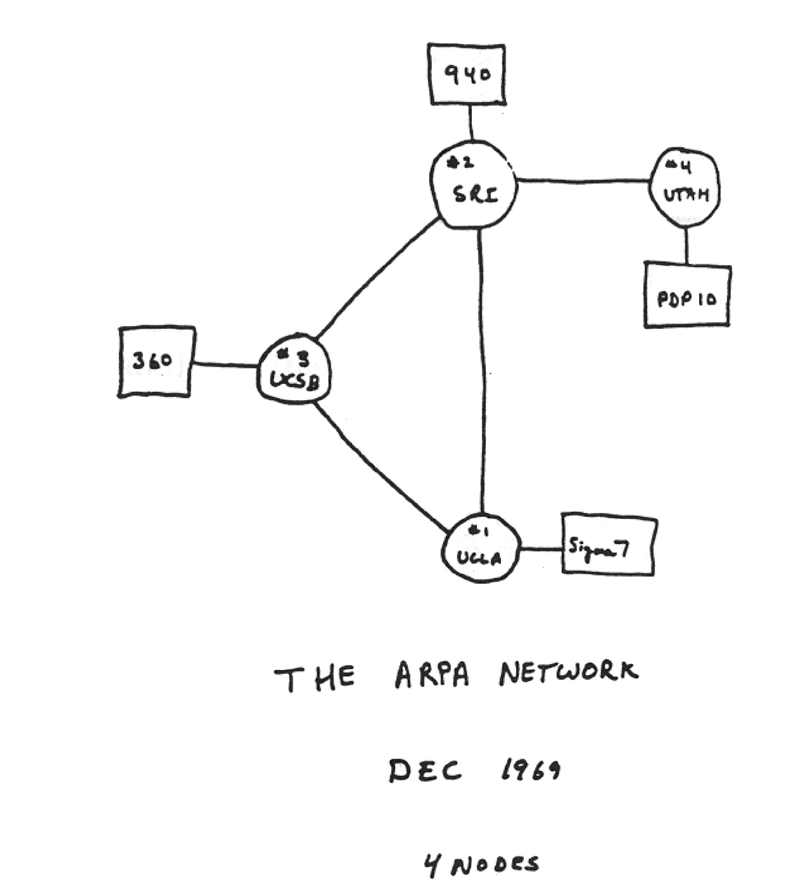
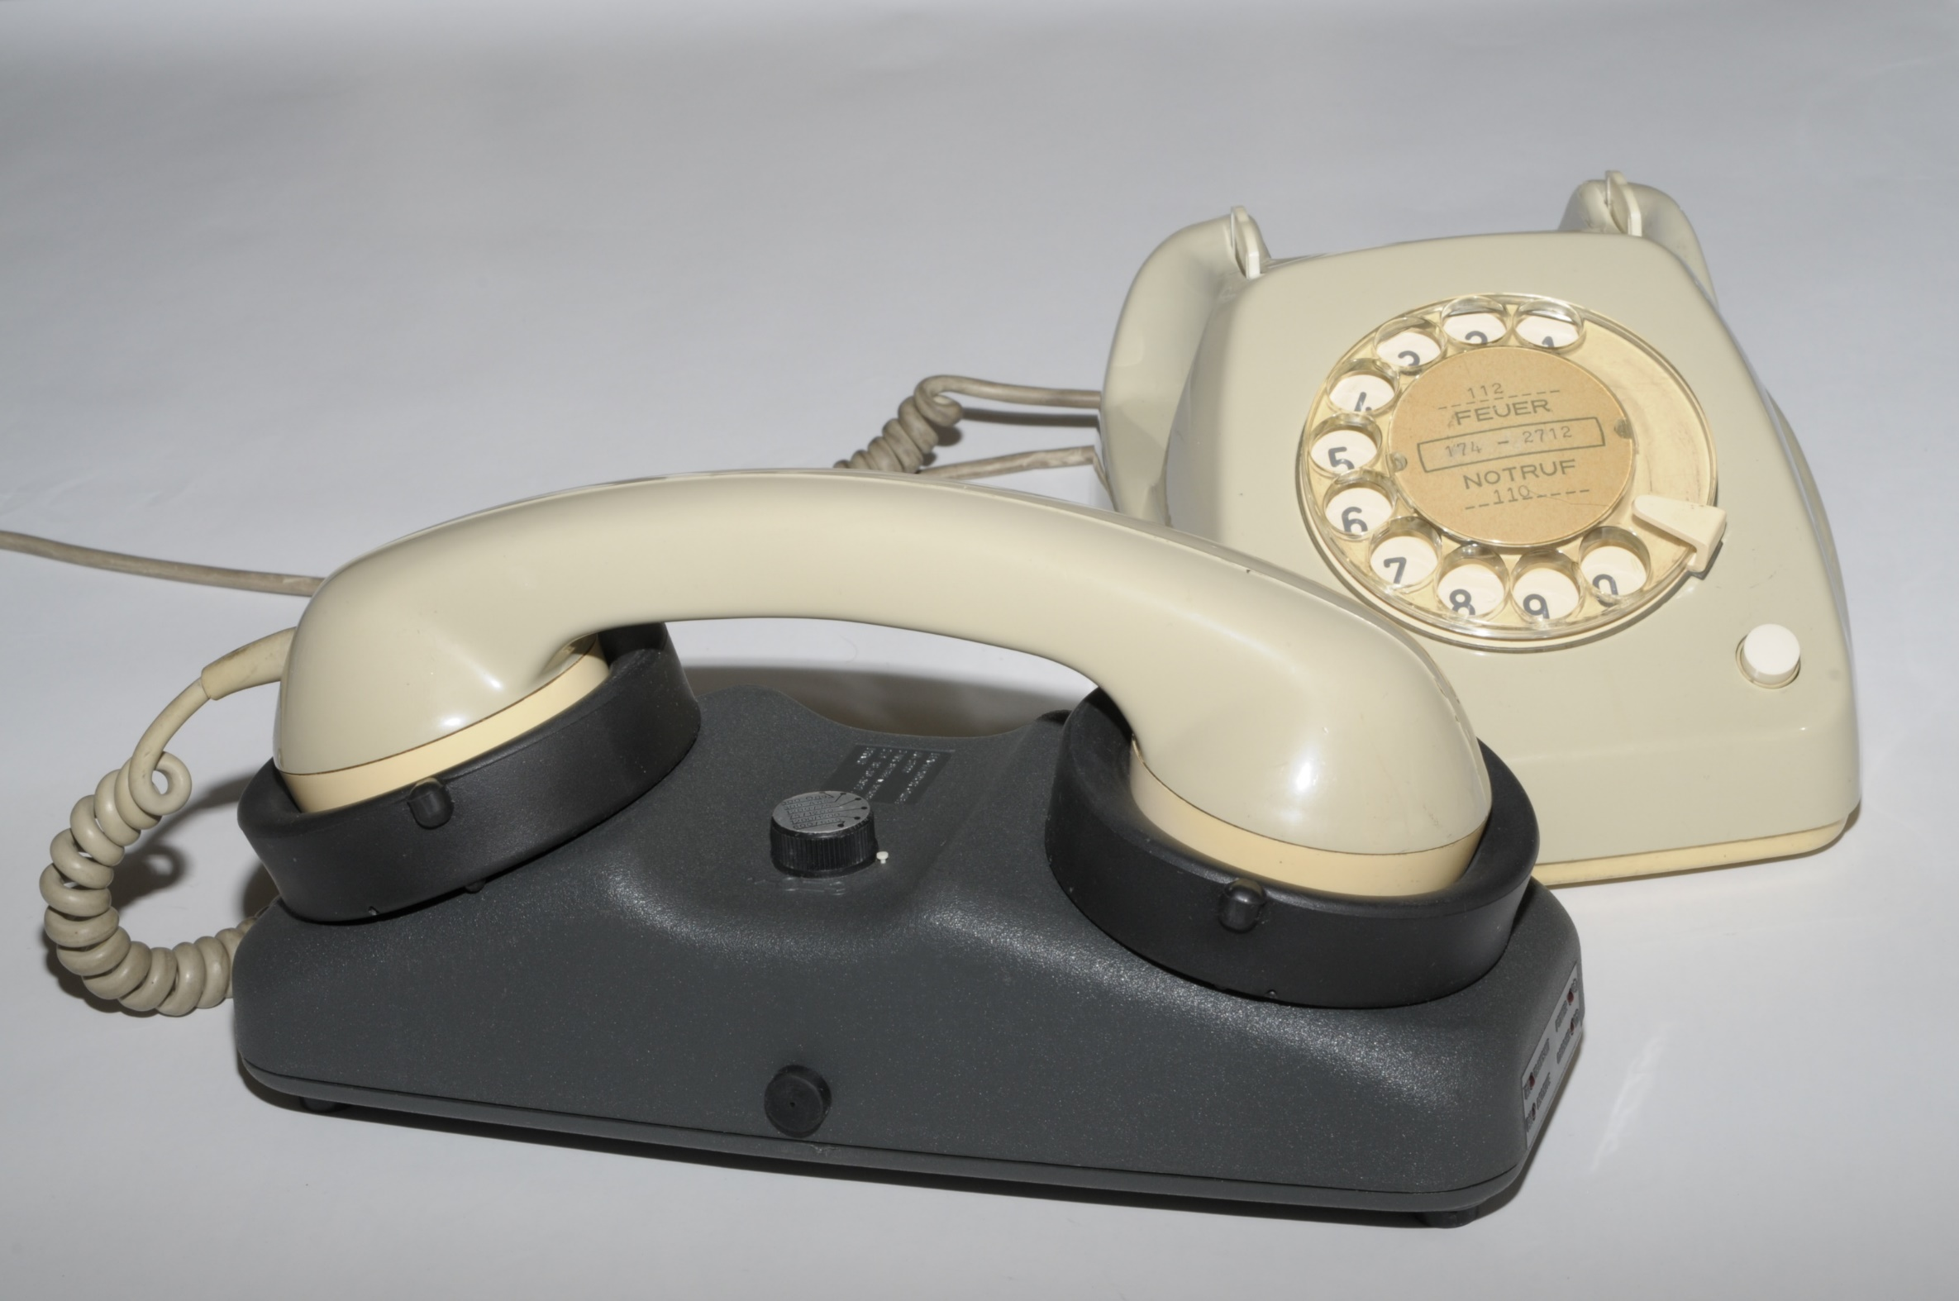
‘Ye olde compatibilitye’
Image source: Alex McKenzie and "Casting the Net", page 56. See https://personalpages.manchester.ac.uk/staff/m.dodge/cybergeography/atlas/arpanet2.gif ; acoustocoupler: Wikimedia

Slide 7
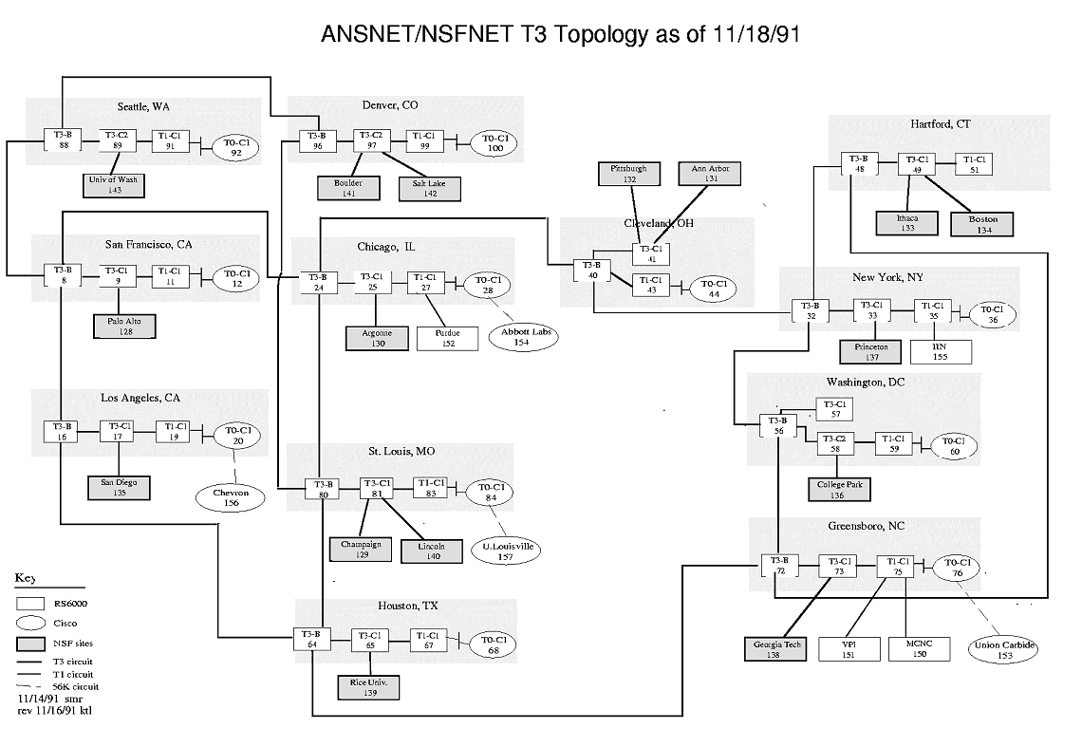

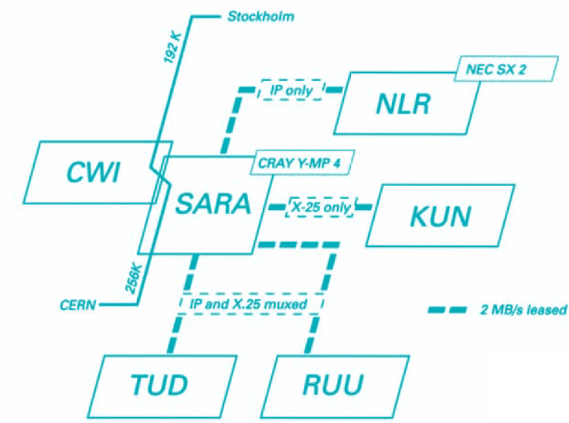
NSFnet and early SURFnet
SURFnet 2, 1990
See https://personalpages.manchester.ac.uk/staff/m.dodge/cybergeography/atlas/historical.html for more historic maps

Slide 8
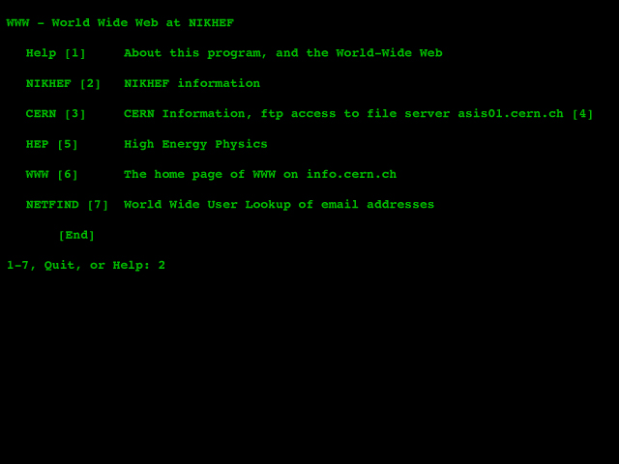
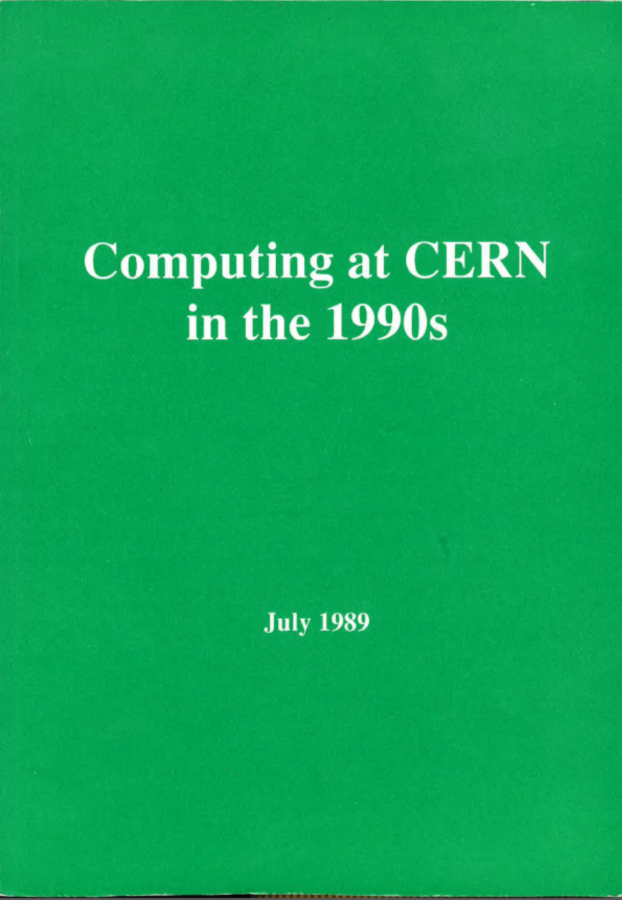
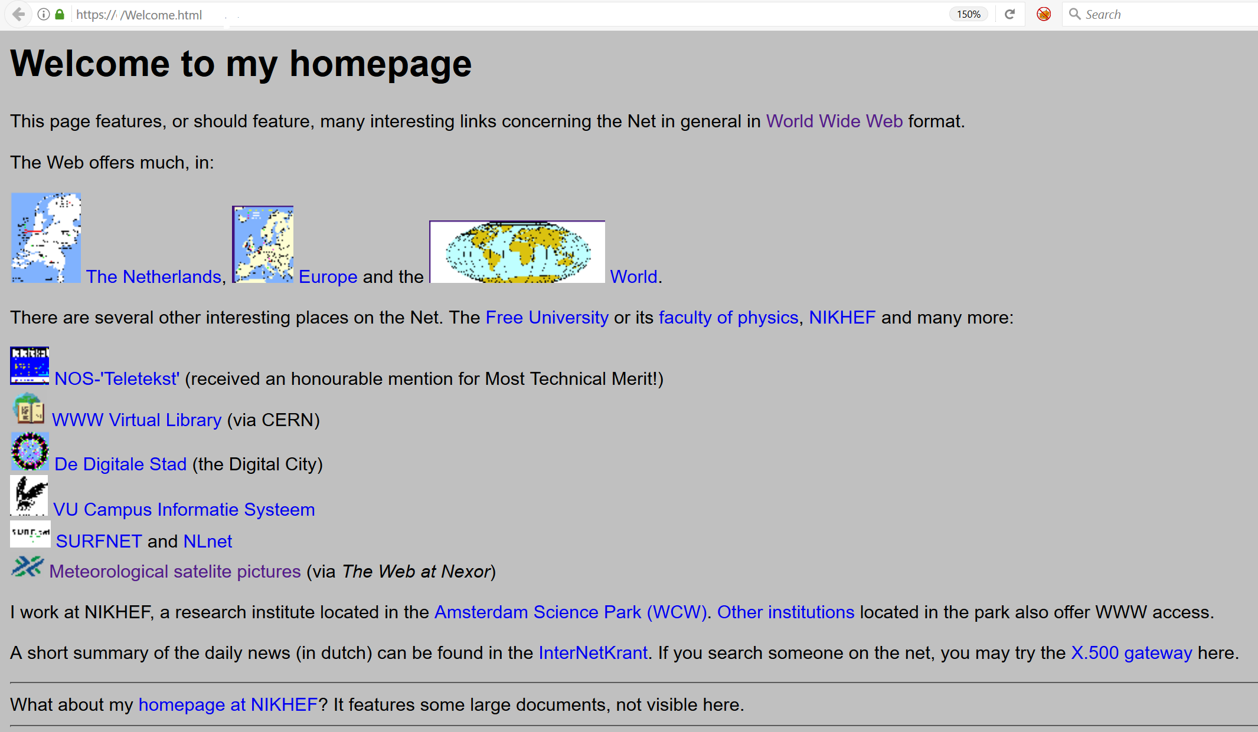
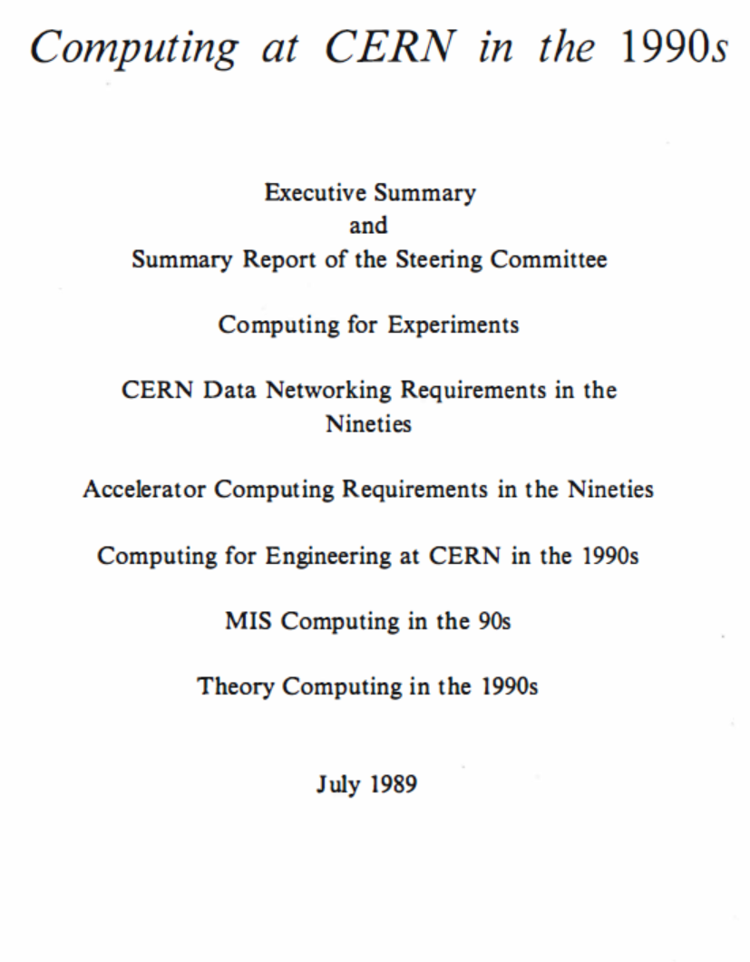
Collaboration & remote analysis
Sources:
nic.nikhef.nl, trivia.nat.vu.nl:8000, and
cds.cern.ch/record/206085/

Slide 9
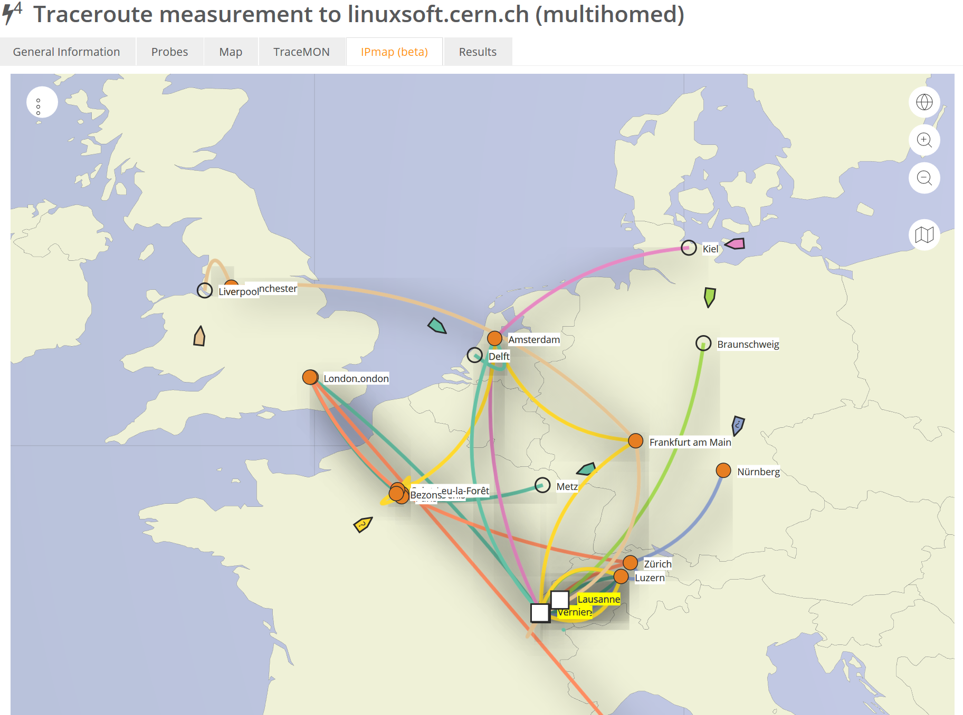

how would you get to CERN?
Data: TraceMON IPmap
from RIPE NCC Atlas
atlas.ripe.net
measurement 9249079

Slide 10
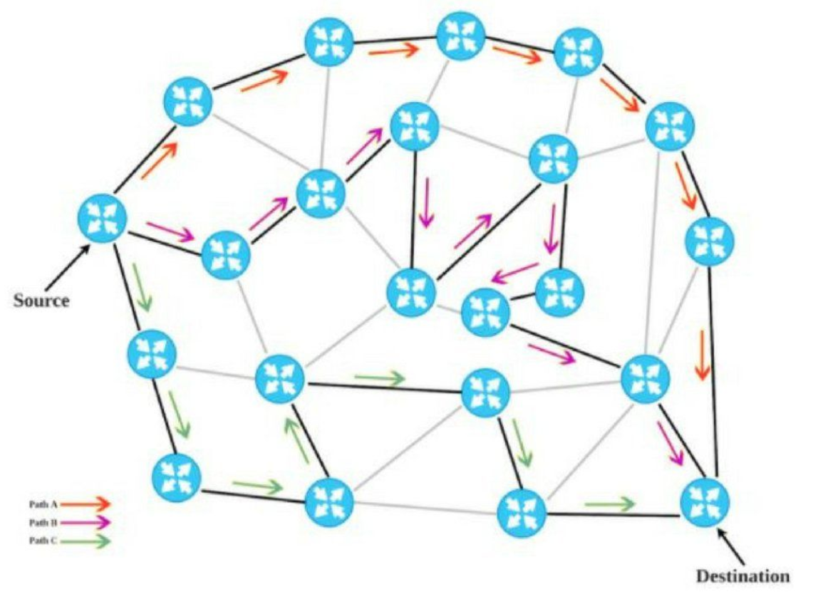


BGP, and Policy Based Routing
Ik ben AortaNet, AS6830,
(maar stiekem toch LibertyGlobal)
Ik ben CERN, AS513, en …
ik wil m’n pakketje kwijt …
188.184.38.9
Ik ben LibertyGlobal, AS9141,
en breng je wel ergens heen
Ik ben KPN, AS286,
en breng je wel ergens heen
Ik ben Sunrise CH, AS6730,
en breng je wel ergens heen
Ik ben ook GEANT, AS20965,
en breng je naar AS1103 en 1104
Ik ben SURFsara, AS1162,
en breng je direct naar AS1104!
Ik ben SURFnet, AS1103,
en breng je naar AS1104
Ik ben GEANT, AS21320,
en breng je naar AS1103 en 1104
Ik ben Nikhef, AS1104
en ik heb schijfruimte voor je
Ik ben SURFnet, AS1103,
en breng je naar AS1104
194.171.96.128/25
“segment routing”
image by David Penaloza, CISCO

Slide 11
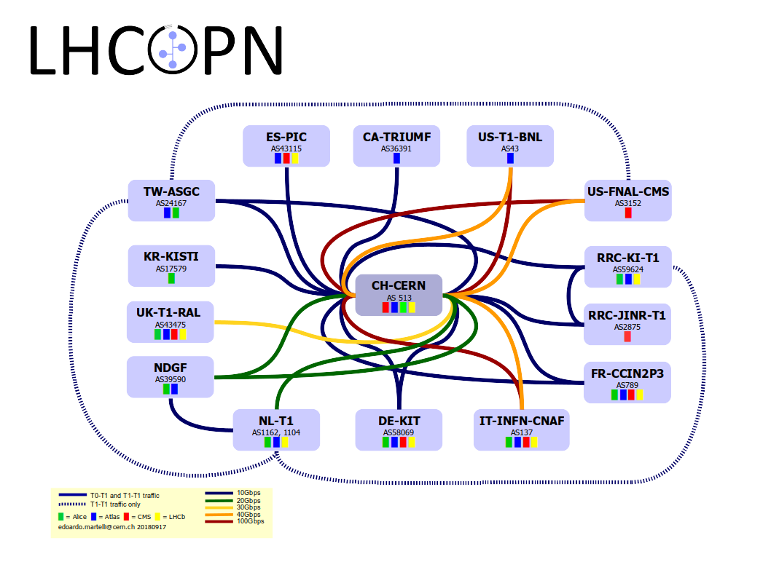
LHC ‘Optical Private Network’

Slide 12
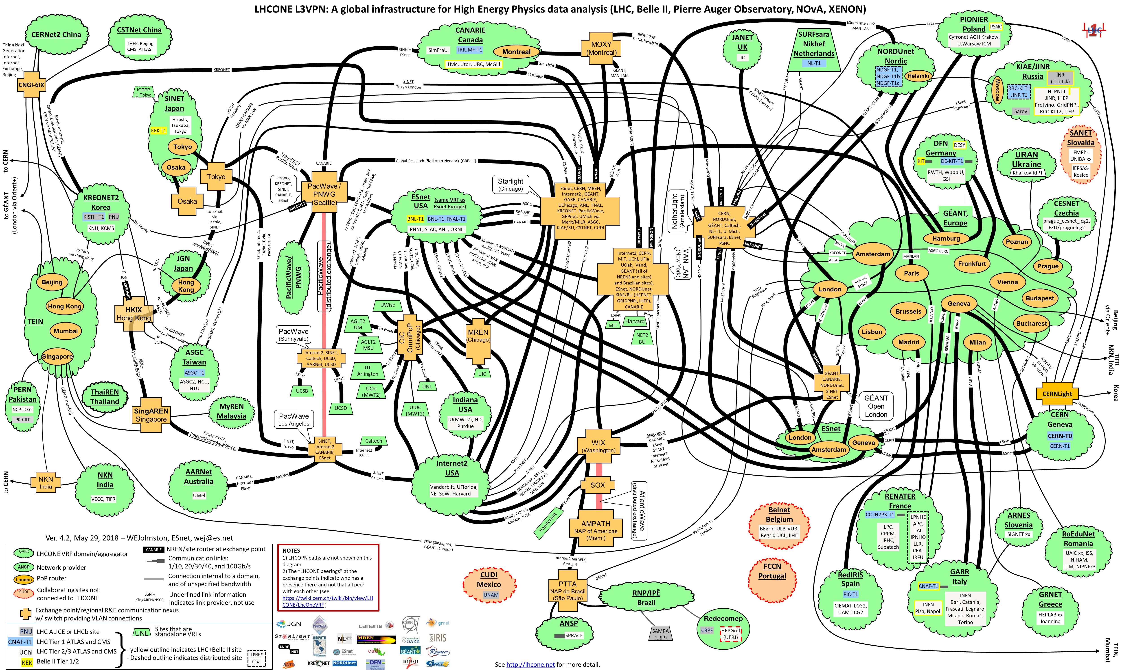
‘LHC Open Network Environment’

Slide 13
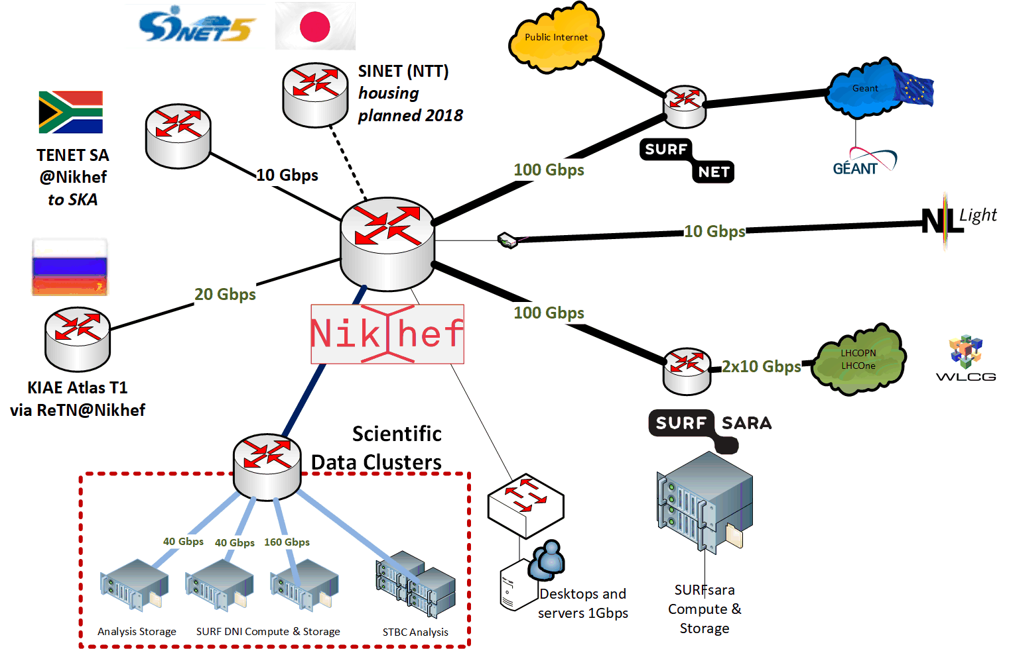
Direct peering infra for ‘big data’

Slide 14
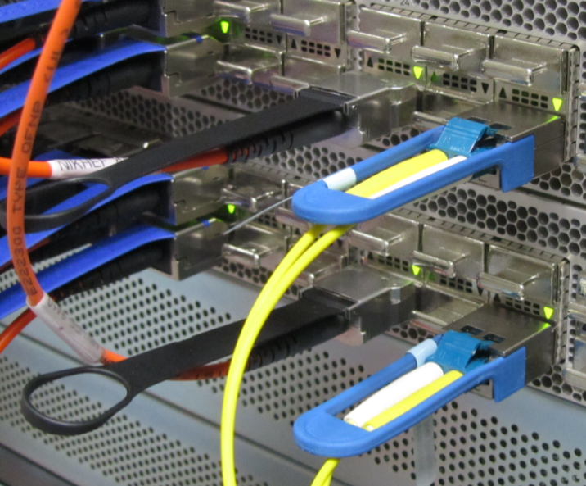
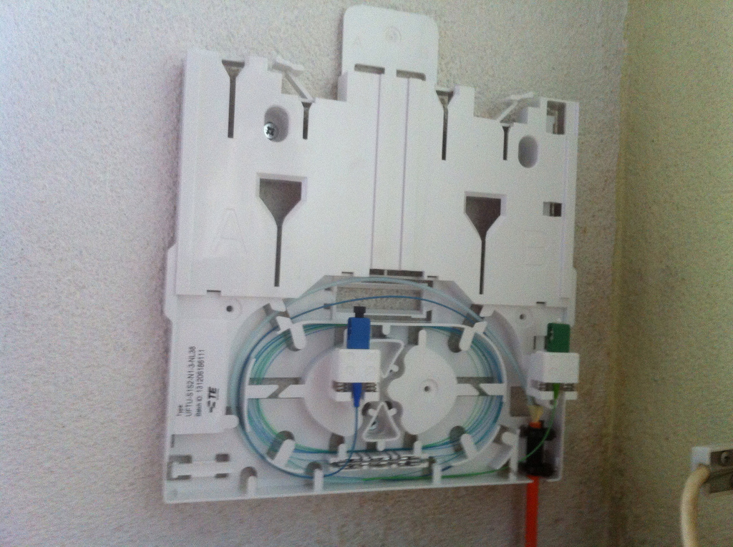
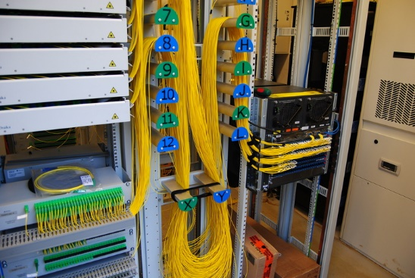
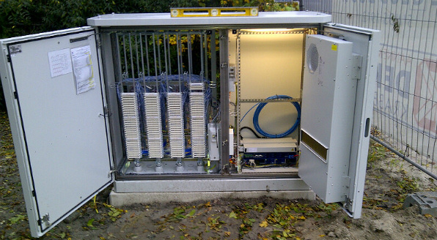
From 100 Gbps upwards …
Thuis ‘FttH’
~1Gbps BX
single strand, SC
Nikhef
Data Processing
Facility
router ‘deel’
een KPN FttH
PoP in de wijk
100-1000Mbps
vergelijk:
VDSL BR straatkast
voor als je nog
op xDSL koper zit
20-180 Mbps

Slide 15
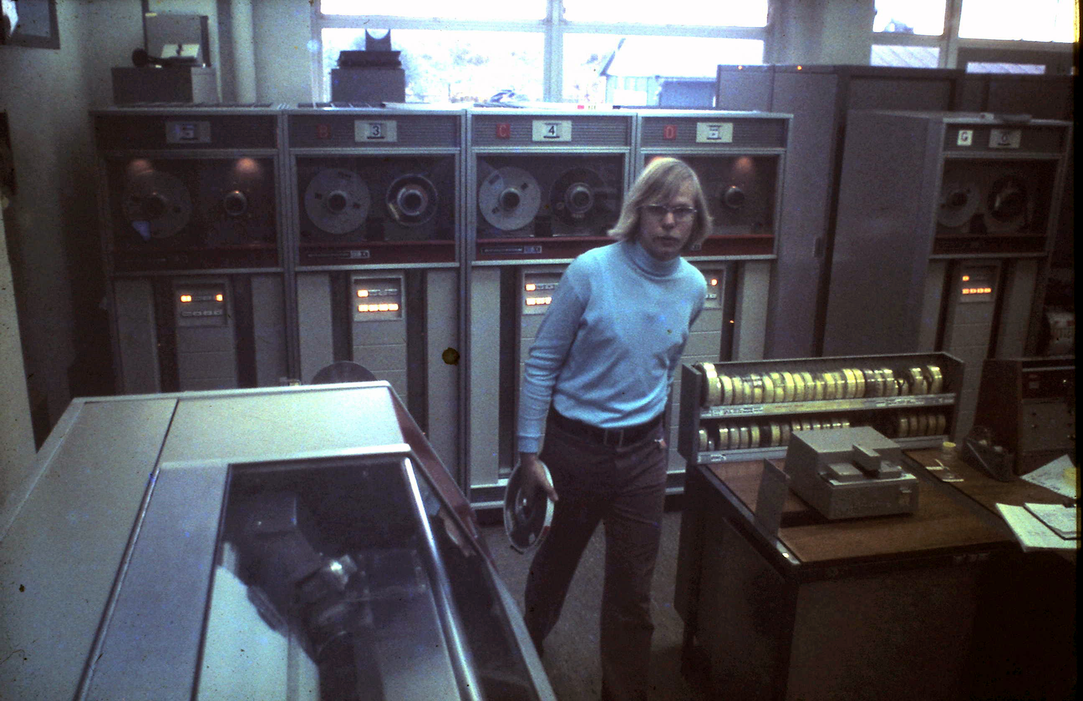
From the 80’s to ’18
this is how H1.40 could have looked …
it is actually the Nikhef-K computer room
on the Oosterringdijk

Slide 16
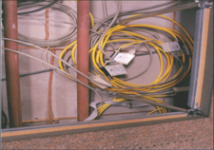
IBR LAN @Nikhef: the first exchange
1996, Nikhef H1.40

Slide 17
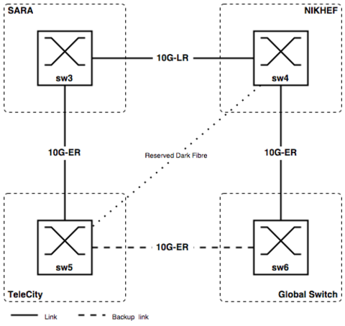
AMS-IX in ~2002

Slide 18
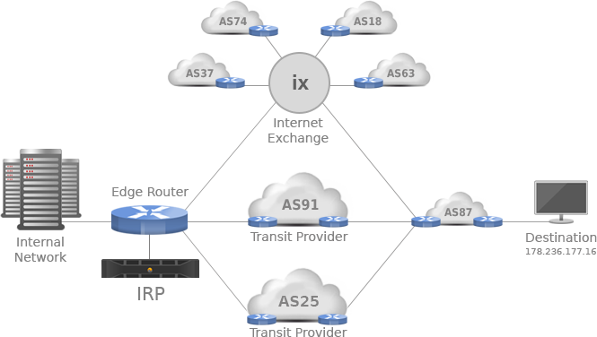
Beyond IX-es: direct transit

Slide 19
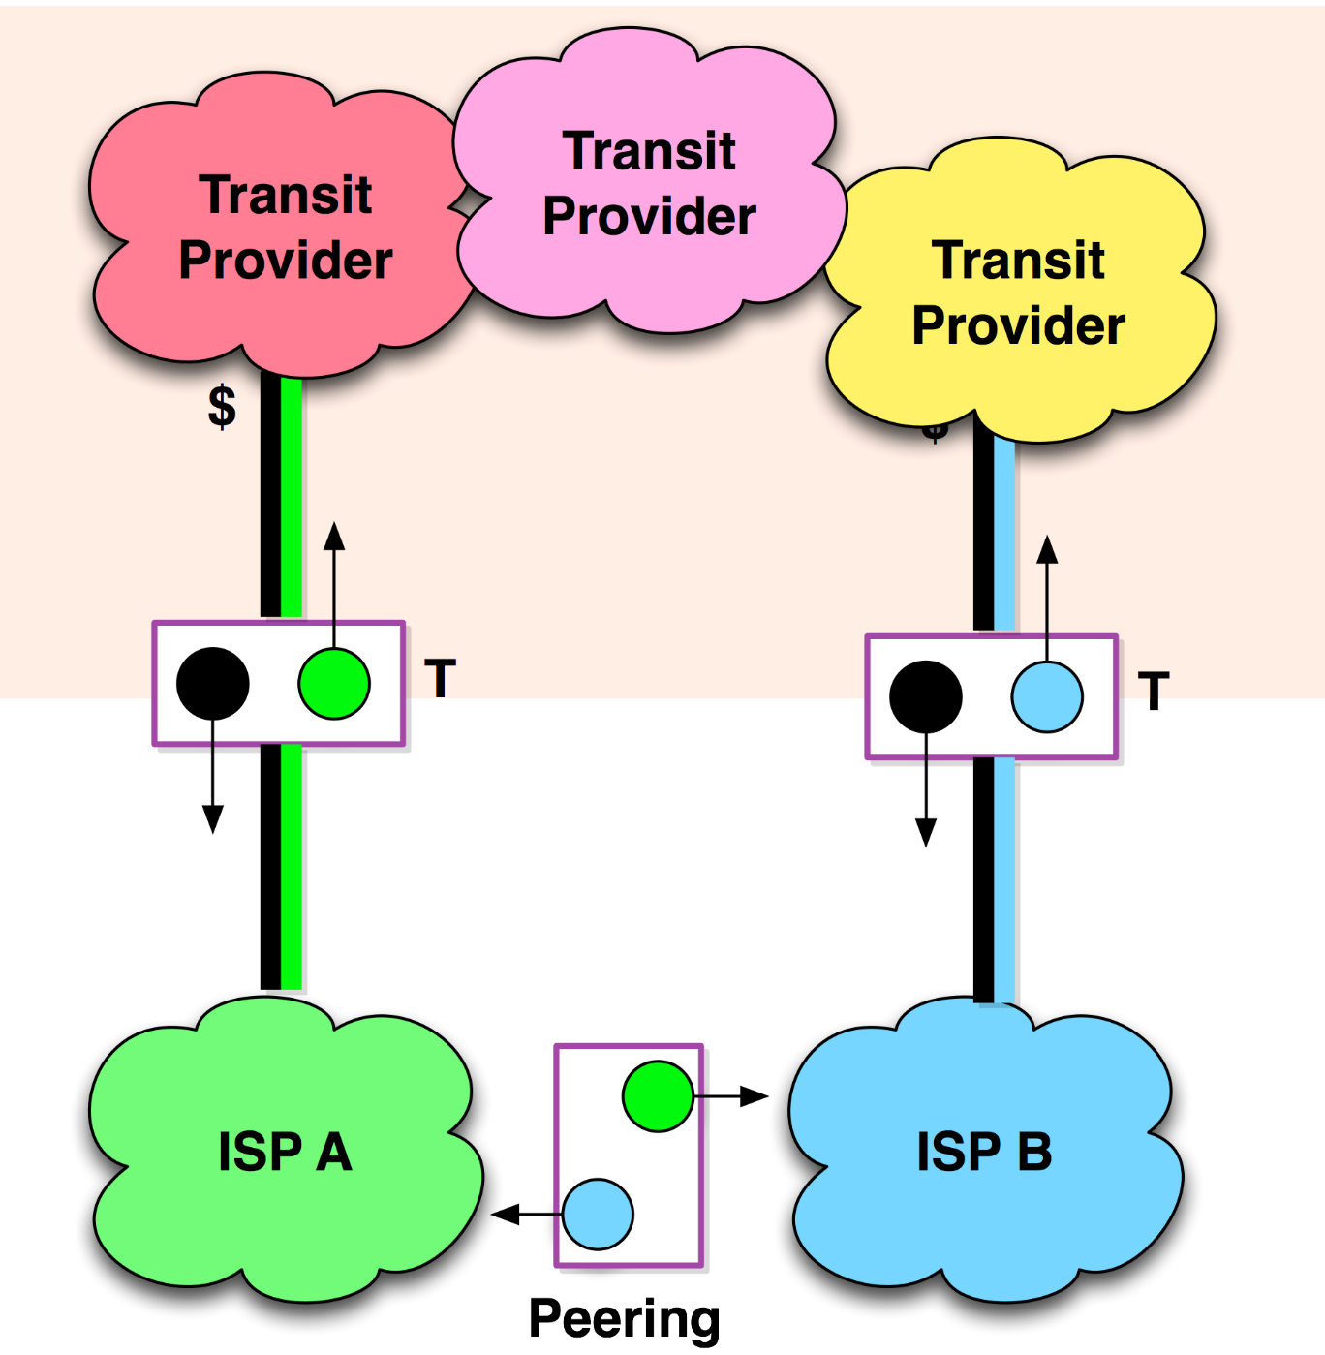

and private direct peering
Network Data Centres and Housing
the more ISPs are located together,
the easier private peerings become
parties ‘pay their own way’ to the housing location, and have their own equipment – so it’s not ‘free’
peerings can be settlement-free or paid
model takes traffic away from IX-es
For a quick summary on peering, see e.g. http://drpeering.net/core/ch4-Internet-Peering.html

Slide 20
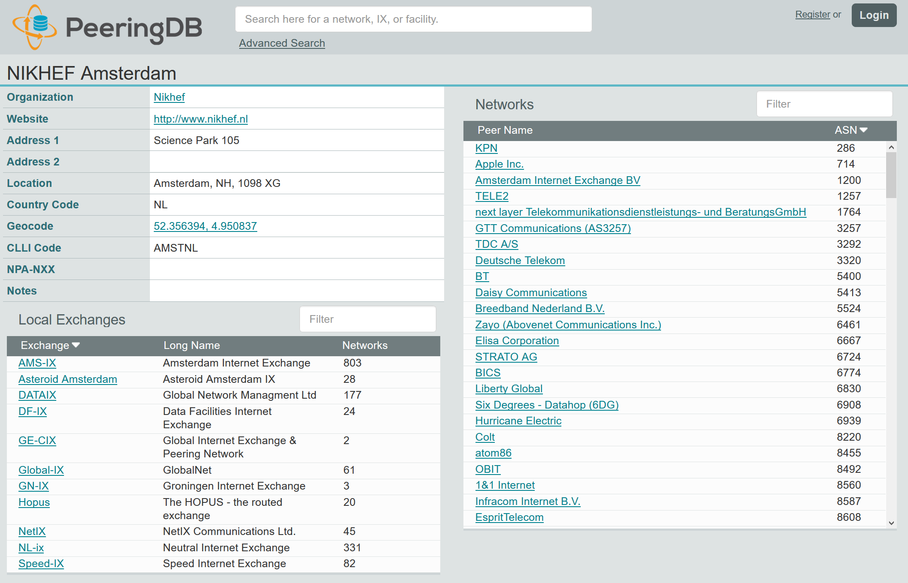
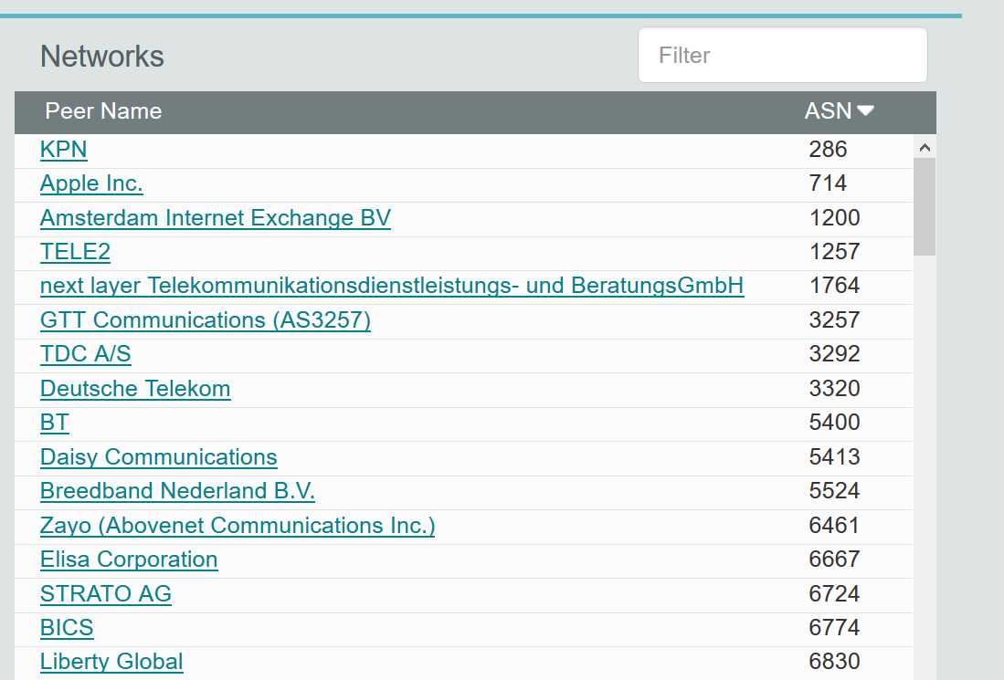
Friends … the more the merrier

Slide 21
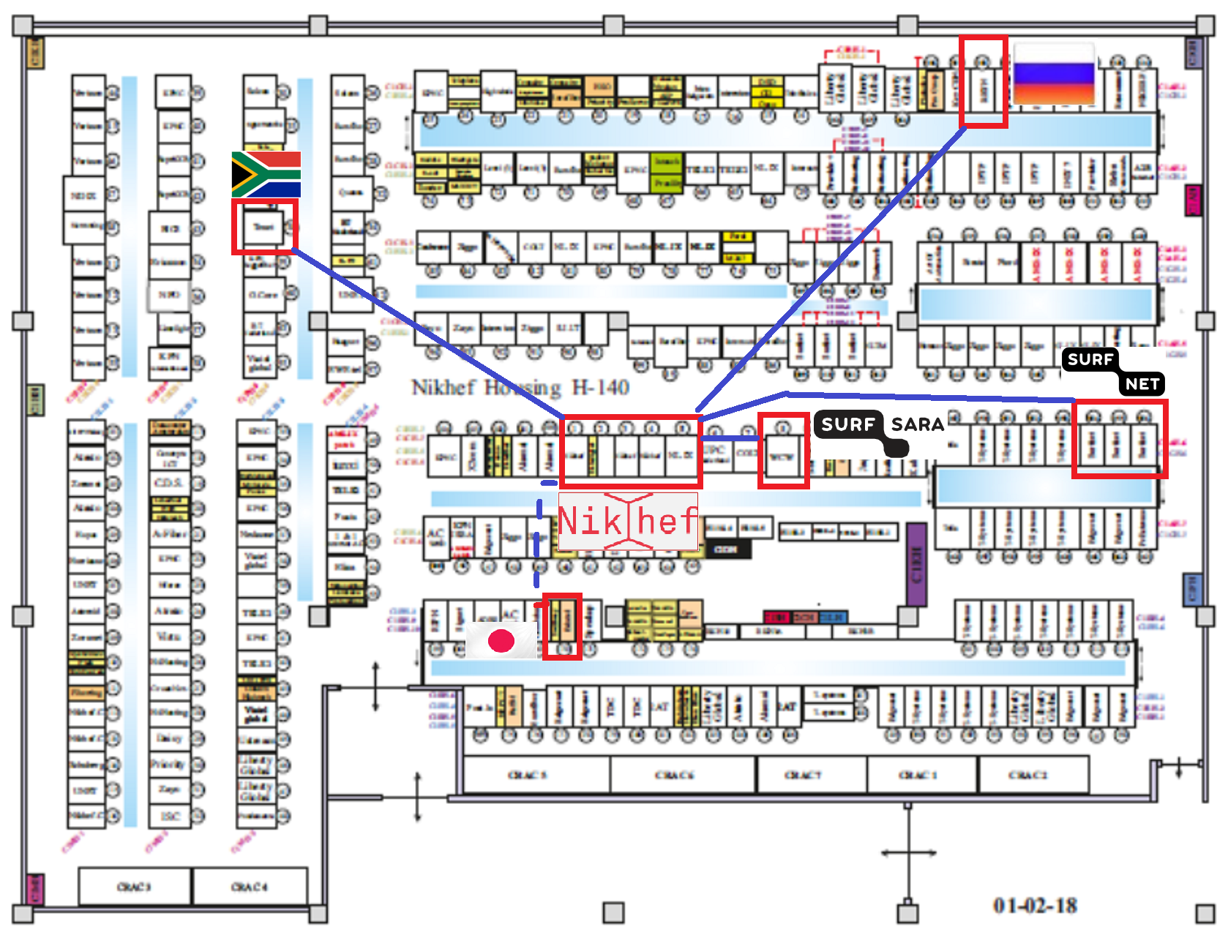
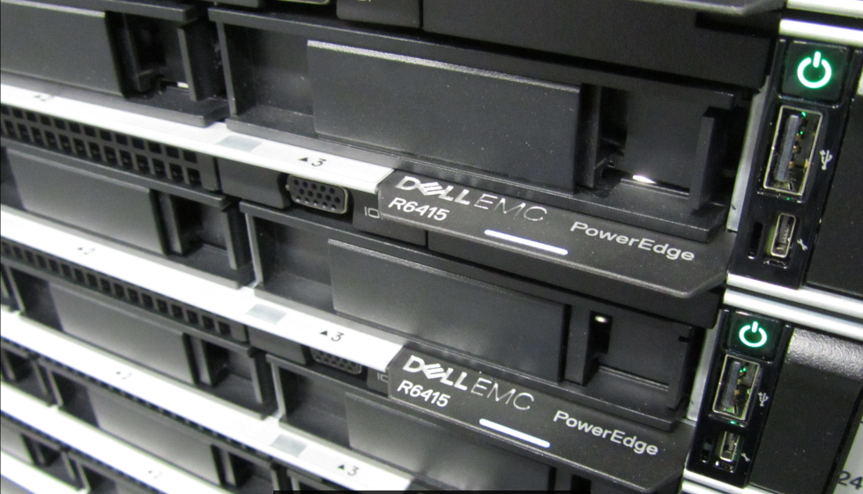
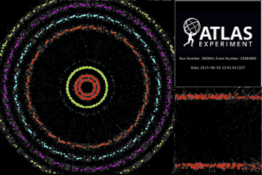
Touching the networks

Slide 22
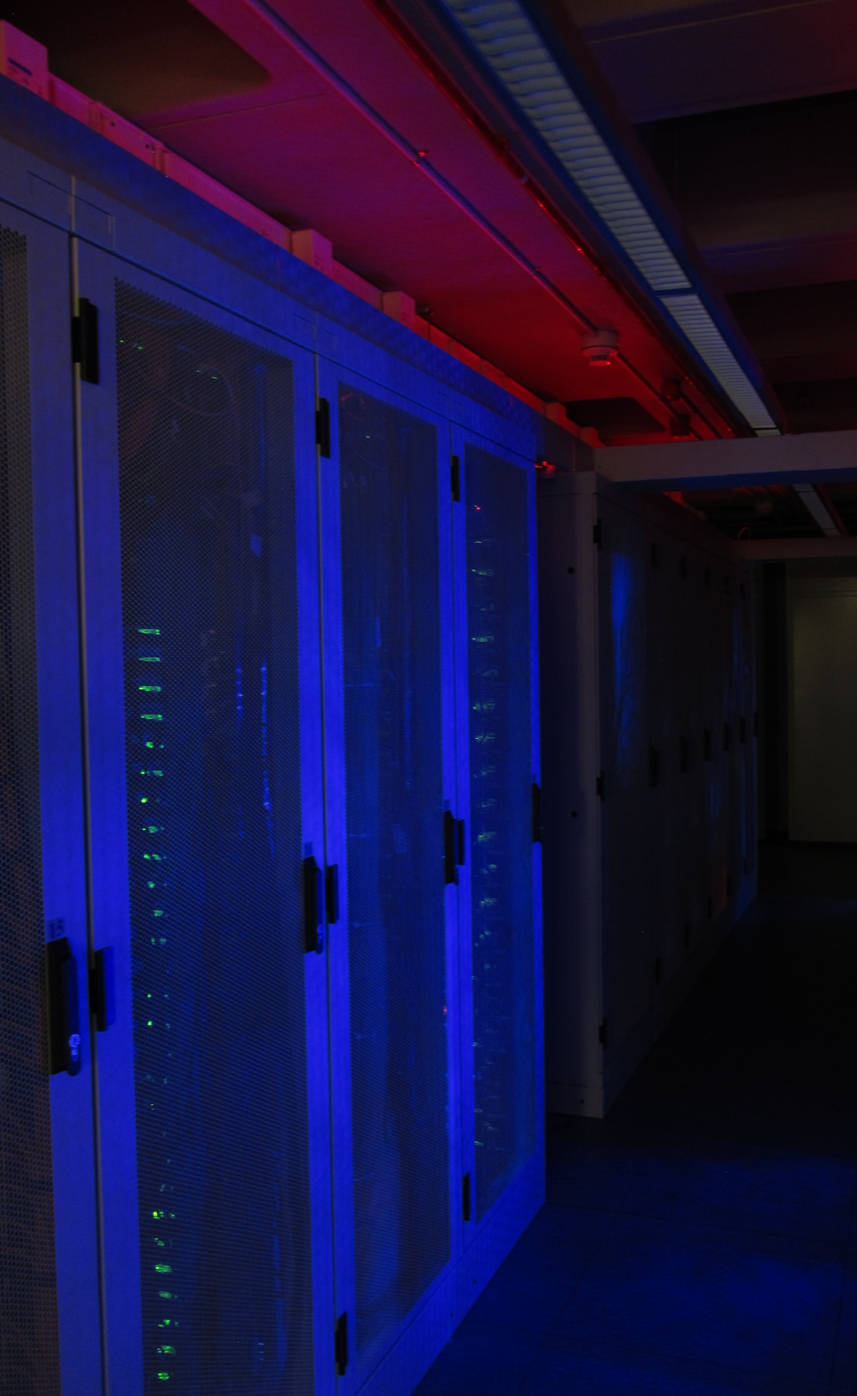
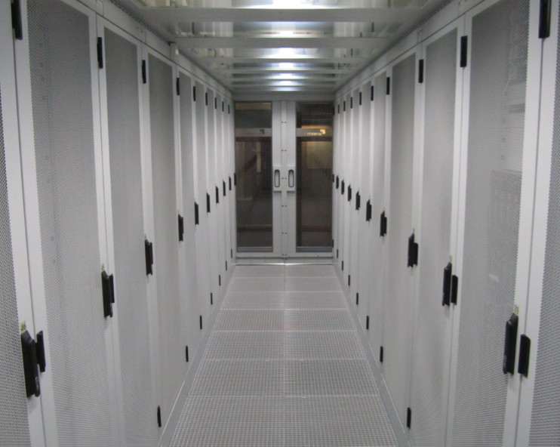
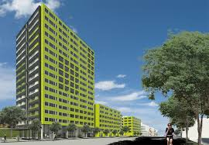
Some quick housing facts
~180 networks, 33 carriers
2.5 MW redundant power, A+B feed
Data Processing Facility (400 kW)
high-power ~9kW/rack, 24 C
in Housing location ~4kW/rack, ~18 C
look for energy optimization methods …
~21% additional power needed for cooling
but: with 3500 GJoule/yr of STES capacity
(~112 kW-yr) linked to student housing

Slide 23
then return for discussion and Q&A on your choice of topics routing neutrality, DDoS, or open discussion
first the tour
– please form two groups (but you will see everything)

Slide 24
Discussion options
‘Back-office’ of net neutrality: peering wars and settlement
Why do DDoS attacks keep persisting?
How would carriers help, and why don’t they do it?
… and if you’re still not tired of GDPR:
would (or should) an ISP be classified as a data processor?

Slide 25
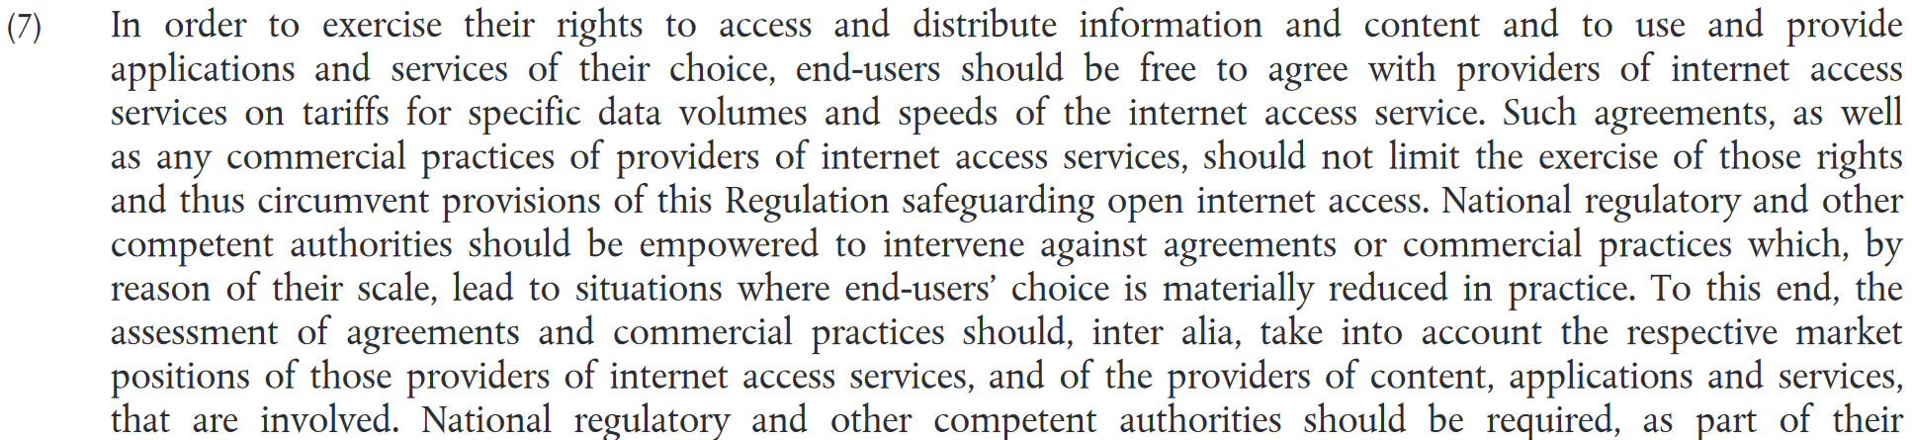
Net neutrality and peering policy
From the recitals in Regulation (EU) 2015/2120

Slide 26

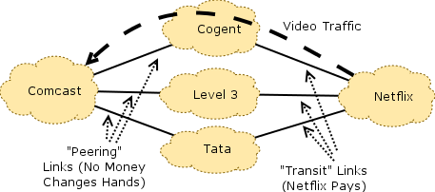




In the US: ‘traffic wars’
All major providers claim they’re a ‘Tier-1 carrier’
refuse settlement-free peering with equally large (or larger) partners to pressure them for money:
  Cogent – Google
  Comcast – Cogent
  Hurricane Electric – Cogent
  AT&T – Comcast
Yet all have their own back-haul networks …
See e.g.
http://www.dslreports.com/forum/r31868626-Speed-Experiencing-site-slowdowns-Comcast-and-Cogent-are-at-it-again
https://qz.com/256586/the-inside-story-of-how-netflix-came-to-pay-comcast-for-internet-traffic/

Slide 27
yet Europe is not entirely immune
E.g. Liberty Global:
even if its own ‘Ziggo’ customers want to view your content
and themselves already pay for that via their subscription,
… Liberty Global still wants you as a content provider
to pay up as well!
(getting payed twice for the traffic is quite profitable …)
https://www.libertyglobal.com/operations/business-services/global-peering-principles/
https://www.libertyglobal.com/pdf/countries/Settled-Peering-Policy-March-2015.pdf

Slide 28
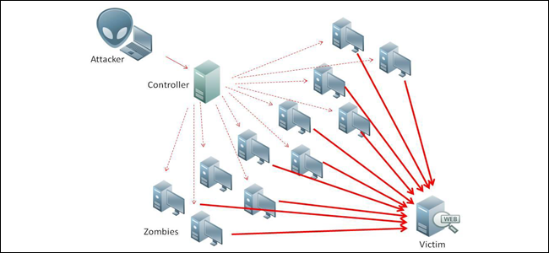
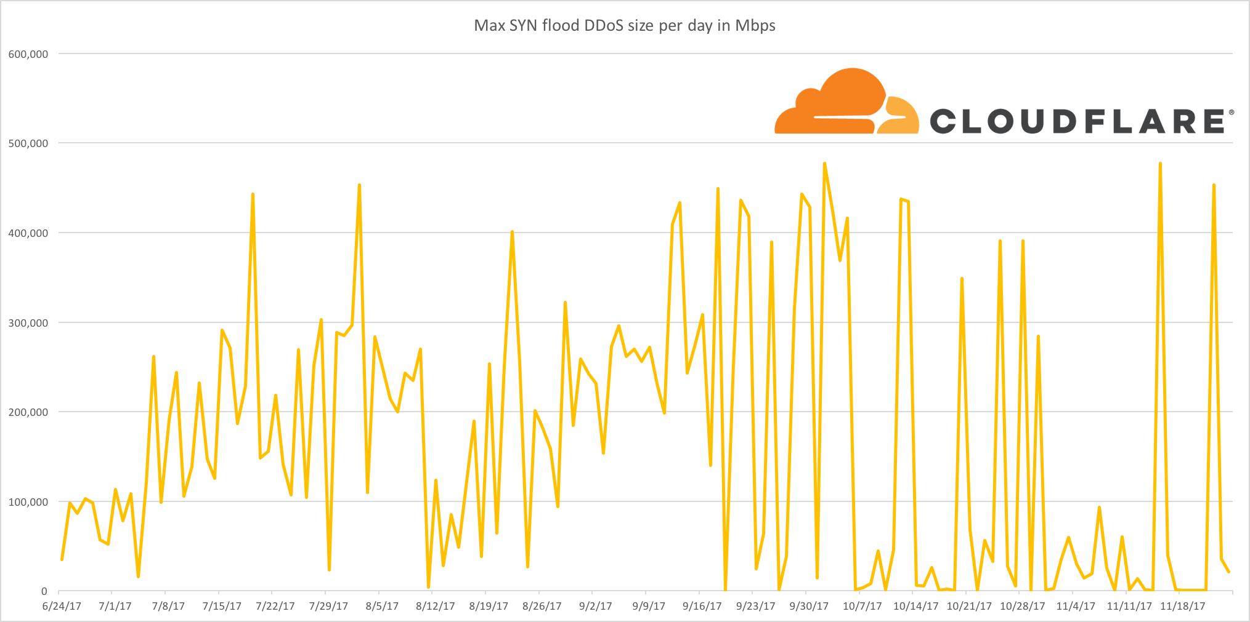
‘Did you order your DDoS today?’
Traffic graph source: https://blog.cloudflare.com/the-new-ddos-landscape/

Slide 29
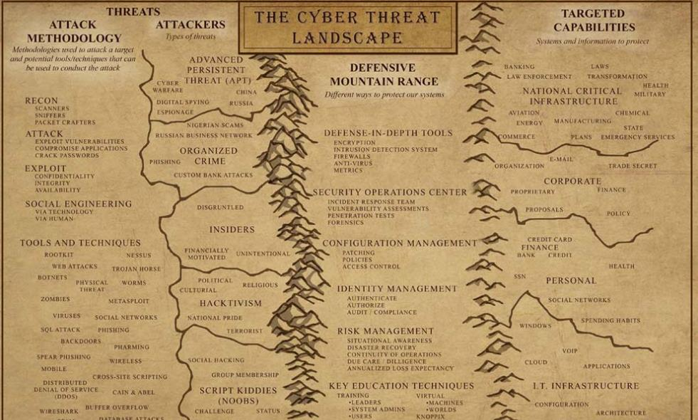
Some common DDoS reasons
Organised groups
Extortion
Anti-competitive
practices (inside and outside)
Hacktivism
APTs
Individuals also very common
attacking your game opponent
attacking your school
to get your exam deferred
From Cyber Warfare: Techniques, Tactics and Tools for Security Practitioners; Jason Andress, Steve Winterfeld

Slide 30
‘Styn’ is clearly a student …
INSERT INTO `users` VALUES
(102199,'Styn','john1968', '¤¤¤¤¤¤@¤¤¤¤¤¤.¤¤¤¤¤',0,1,1422654207,0,0,'');
from home with Ziggo as the ISP, and one in a while using a Vodafone mobile browser
INSERT INTO `checkip` (`id`, `ip`, `user`) VALUES (87,'¤¤.75.183.125','Styn');
INSERT INTO `checkip` (`id`, `ip`, `user`) VALUES (138,'¤¤.217.77.43','Styn');
and 95 attacks ordered, against a Dutch ROC, and later a Dutch university:
INSERT INTO `logs` VALUES (14071,'Styn','¤¤¤.97.64.171',80,95,'¤¤¤¤',...);
but meanwhile also on some Ziggo addresses – assumed his game opponents in a dorm
data thanks to a nice data leak of the LizardSquad DDoS-for-hire service in 2015 ☺

Slide 31
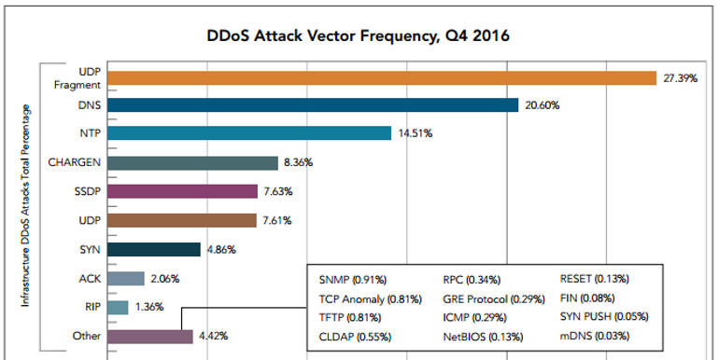
DDoS usage of IP protocols

Slide 32
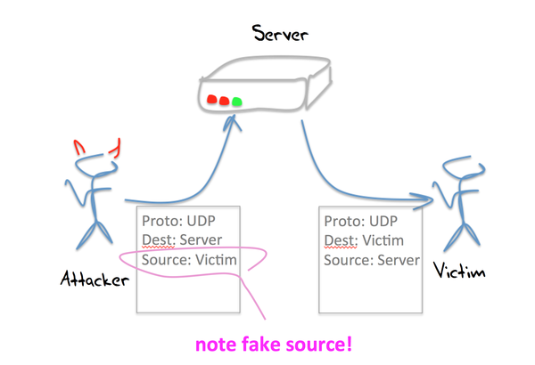
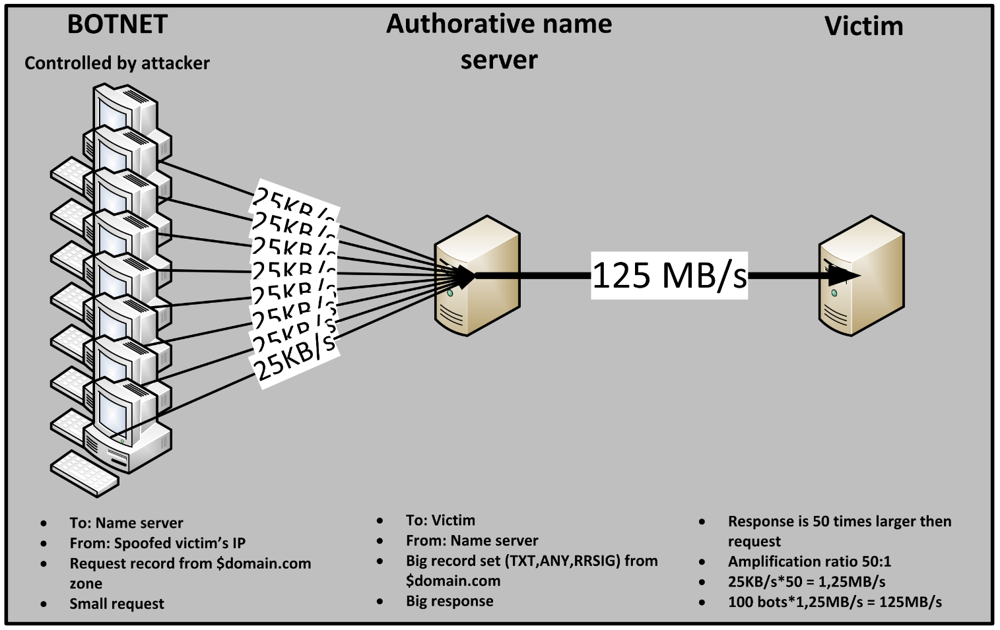
Reflection & amplification attacks
Image source top-left : https://labs.ripe.net/Members/gih/ntp-for-evil
NLNet labs: https://www.nlnetlabs.nl/downloads/publications/report-rrl-dekoning-rozekrans.pdf

Slide 33
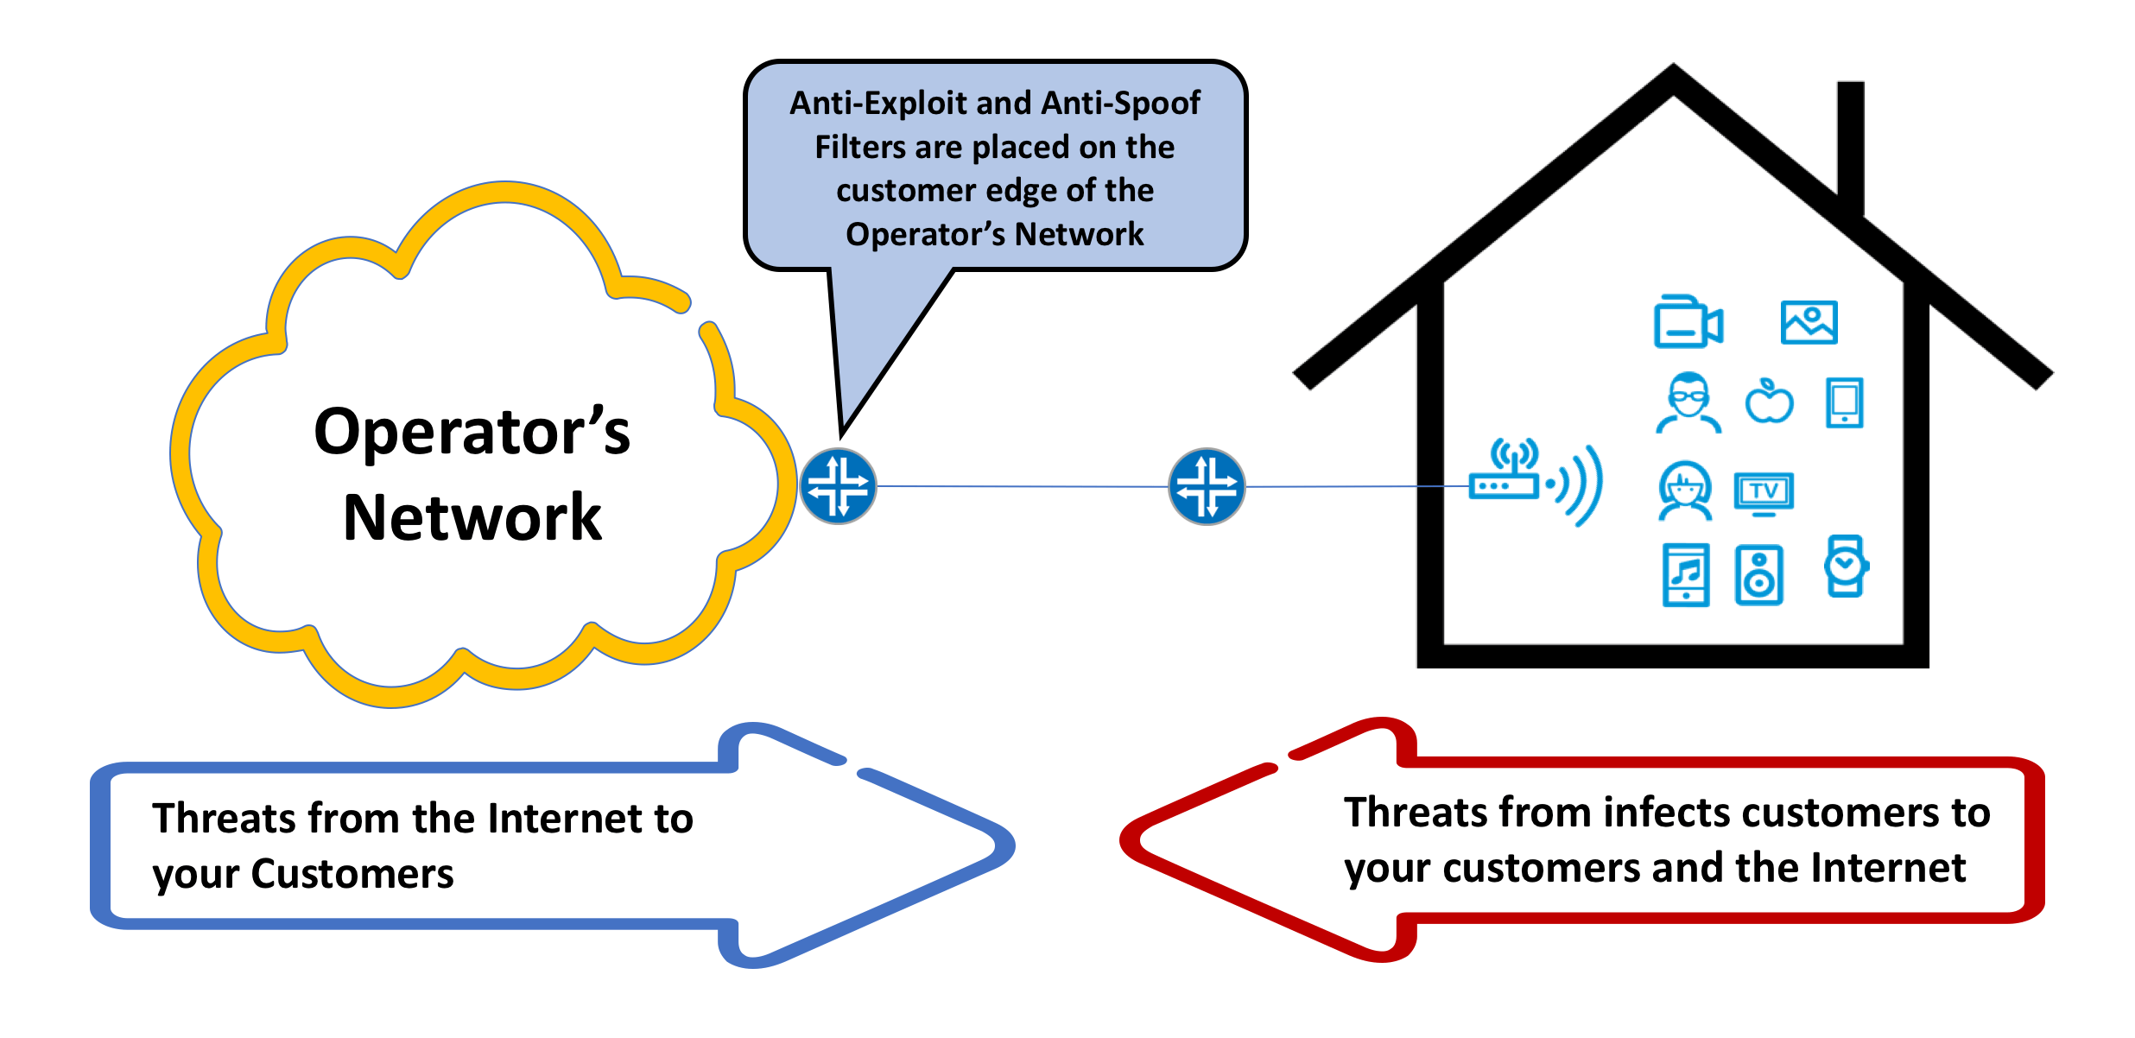
‘BCP-38’
Read up on Barry Greene’s pages at SENKI: http://www.senki.org/exploitable-port-filtering/

Slide 34
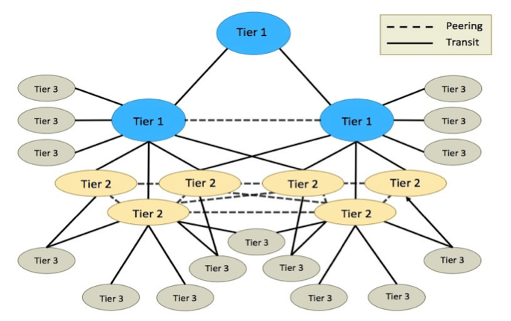
At the T1’s it’s too late …

Slide 35
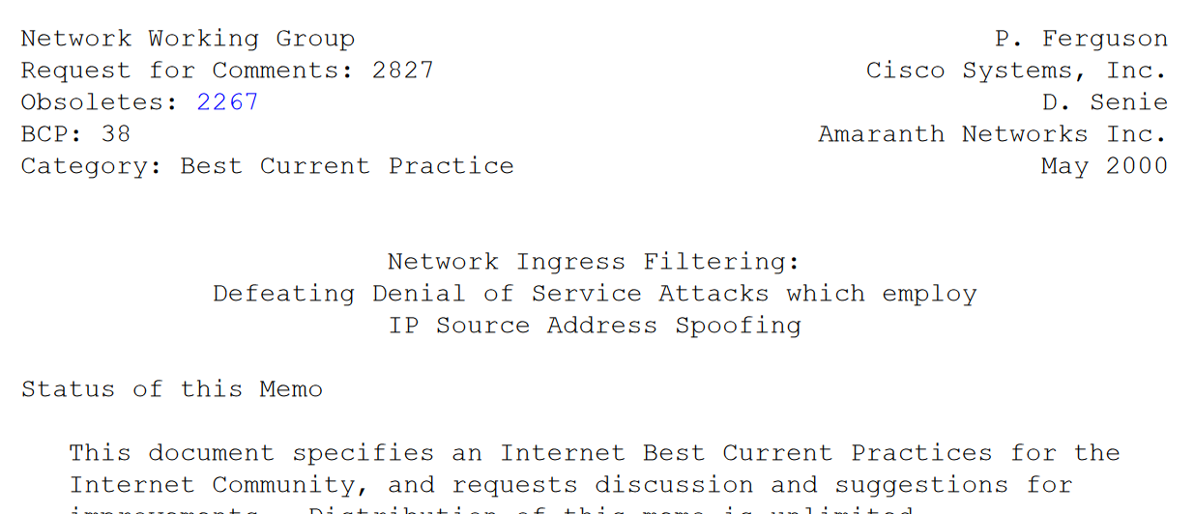
And why DDoS persists …
but ‘de cost gaet voor de baet uyt’ or ‘the tragedy of the commons’
Should we consider ISPs an accomplice for sending traffic not ‘their own’?
Should we do the same for IP prefix hijacking?
Or is it the responsibility of the IoT device’s owner? Or its manufacturer?

Slide 37
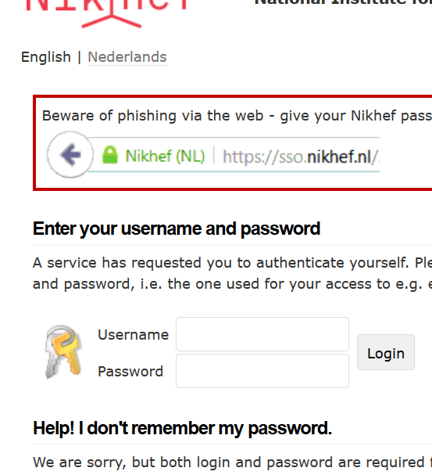
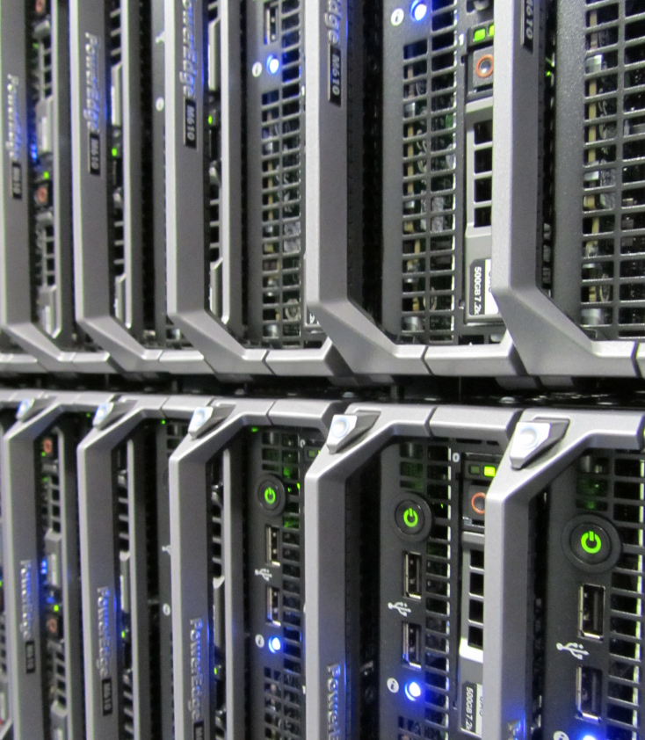
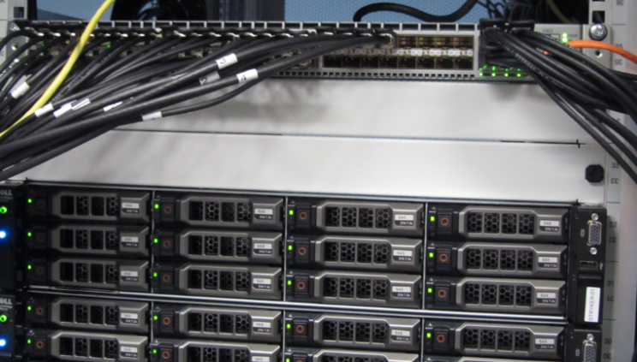



IT Infrastructures for Research
High Throughput
Compute
Secure Collaboration
parallel data storage
we houden bij wie er mag rekenen, welk experiment wat gebruikt, en of onze rekenkracht goed gebruikt wordt …
… en we niet misbruikt worden om het internet aan te vallen!
de ~5 petabyte gegevens bij ons moeten we ook in één dag kunnen lezen, anders staan die 7000 rekenkernen te wachten … die lezen
ieder ~10MB per seconde!
7000 rekenkernen
(is ~300 servers) staan
dag en nacht te rekenen aan onderzoeksdata

Slide 38


SURF and Netherlight
Imagery: https://www.glif.is/publications/maps/

Slide 39

Global Lambda Integrated Facility
Imagery: https://www.glif.is/publications/maps/

Slide 40














The LHC Analysis Chain
40 miljoen / seconde
Analyse van botsingen door promovendi
Trigger systeem
selecteert 600 Hz
~ 1 GB/s data
Classificatie van deeltjes in de botsingen:
electronen
muonen
jets van hadronen
…
diagram: from Frank Linde; images: ATLAS collaboration, Nikhef. And sorry for the AVG-blur

Slide 41

Overal rekenen … ‘high-troughput’
In Nederland:
De National
e-Infrastructuur
gecoordineerd
door SURF
www.surf.nl
Europees
HTC Platform
door EGI
www.egi.eu
Imagery: GridPP Job Monitor
by STFC Rutherford Appleton Lab

Slide 42

Verdeel en heers: we moeten wel
~ 4 GHz
~ 140W
8-10 instructies per tick
Graphic: Herb Sutter
The Free Lunch Is Over: A Fundamental Turn Toward Concurrency in Software

Slide 43

Zo hou je een rekencluster vol:
WeNMR
Xenon
LIGO & Virgo
Alice
ATLAS
NDPF voview short 1 October 2018
LHCb

Slide 44


Verdeel en heers
DotHill (HGST): 480 TByte gross capacity/4RU
Kengetallen van opslag
capaciteit (‘terabytes’)
bandbreedte (‘megabyte per seconde’)
aantal ‘opdrachten’ per seconds (“IOPS”)
5 Petabyte lezen in 1 dag?
Dat is dus 61 GByte per seconde!
(en dus ~500 Gbps)
Daarom kan onze data niet op een USB stick
– en doet je ‘thuis NAS’ oplossing het ook niet
… hoe leuk ik mijn eigen opslagdoosje ook vind
van slechts 15 Watt met 16Terabyte voor € 915 …

Slide 45
Interception, exchanges, and peers
Full mesh: no single predicable path for traffic
Exchange point probably does not get you traffic you want
Exfiltration at ‘the interesting’ edge more feasible:
  traffic goes to the target
  maybe fewer eyes on the equipment: attacks are easier
  maybe your target does not have means to re-route?

