Slide 1
Infrastructure for Collaboration
trust, Security, and operations
in ICT Infrastructures for Research
at the Nikhef Physics Data Processing group
David Groep
January 2019
KPN subset

Slide 2
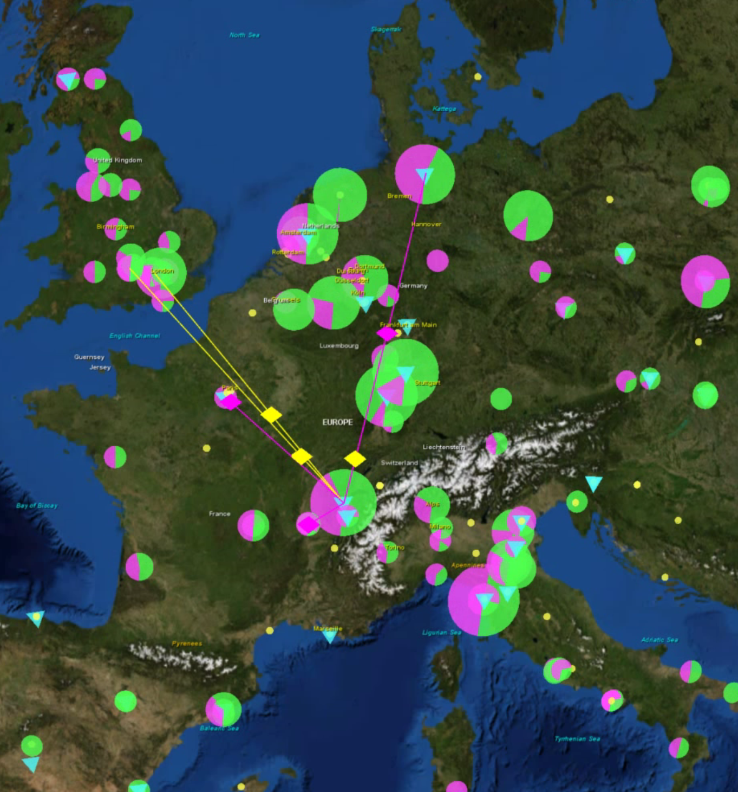
Security: Infrastructure
for Collaboration
global policy and
best practice harmonization
access control middleware
for multi-domain services
operational security:
response and forensics
training and communications

Slide 3
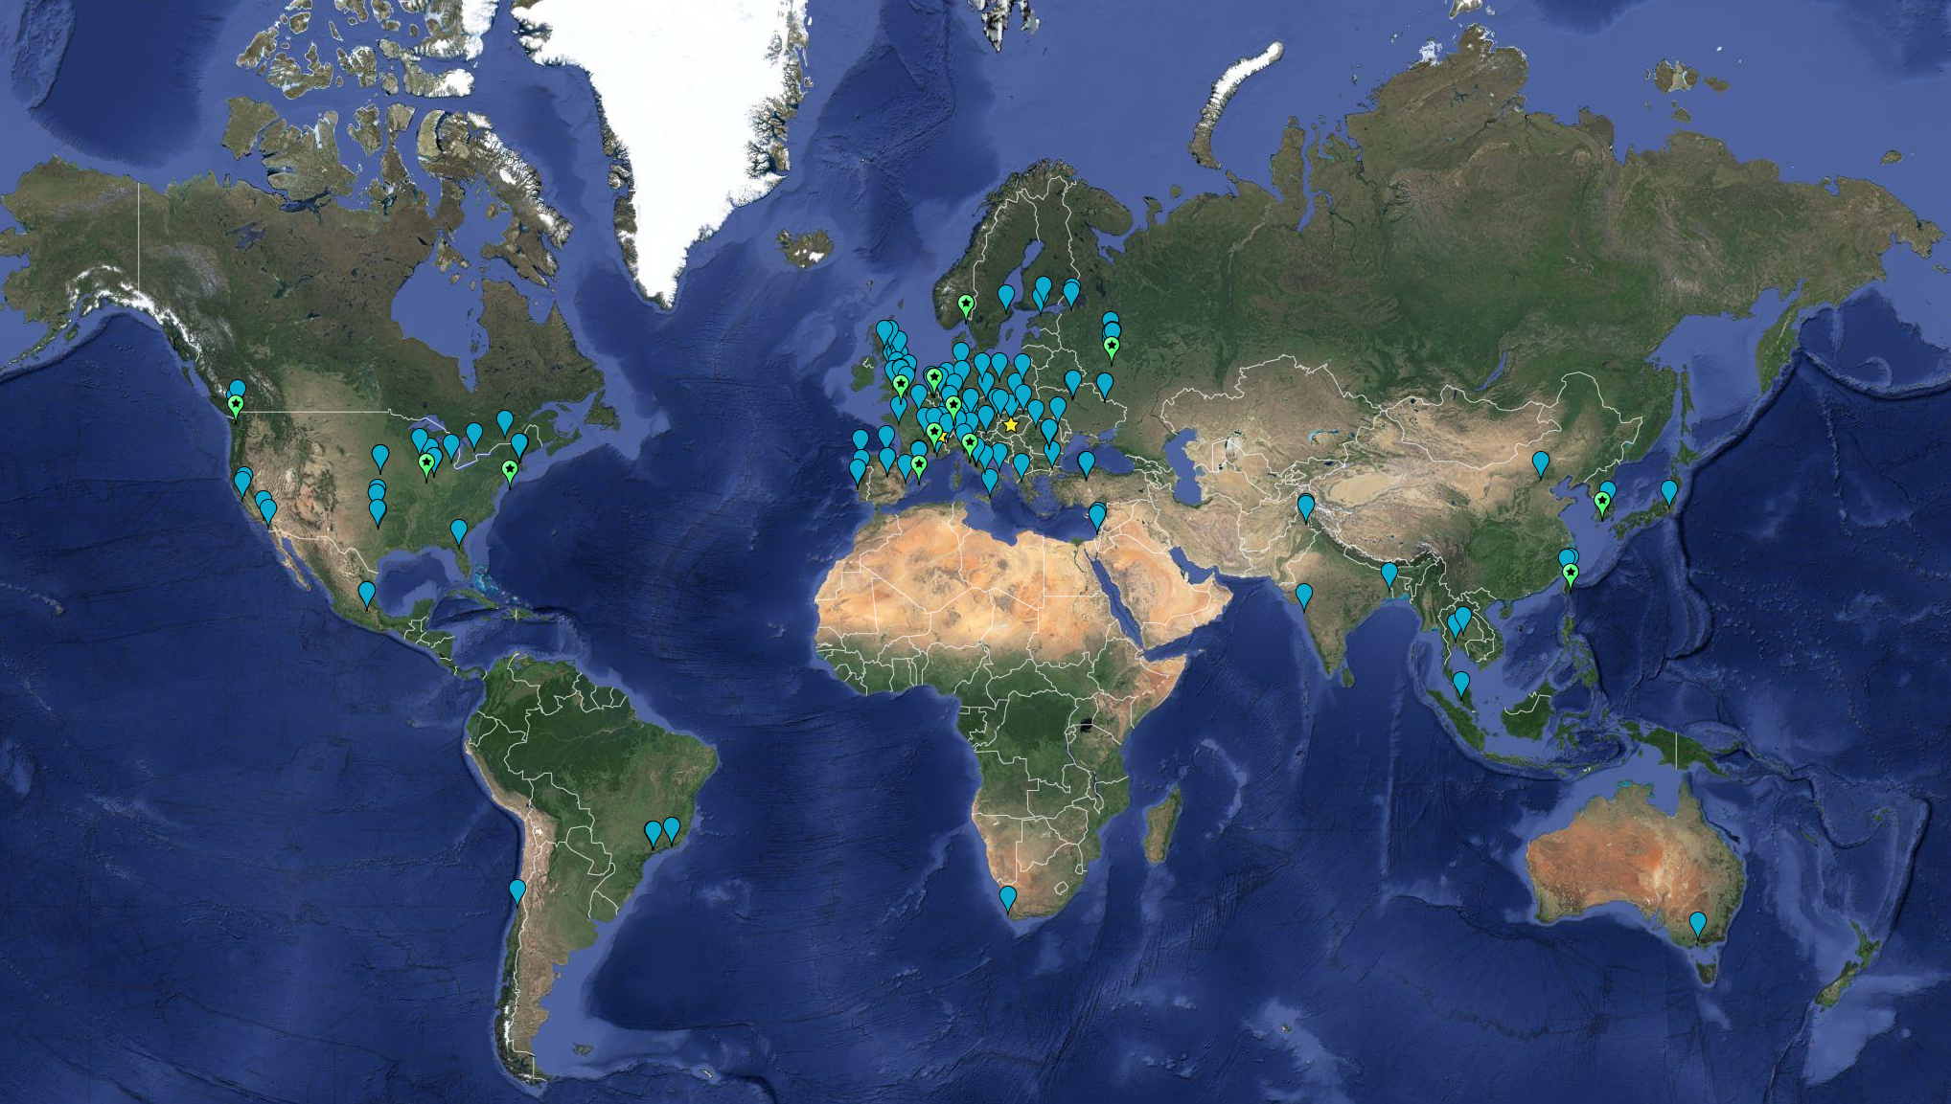


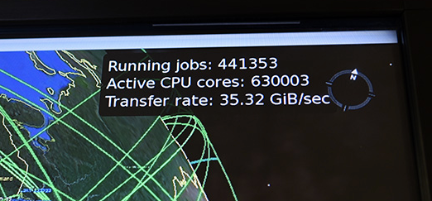

LCG – a global collaboration
meer dan 170 instituten in
42 landen en economiën
CPU: ~ 350,000 modern rekenkernen
Disk 310 PB
Tape 390 PB

Slide 4
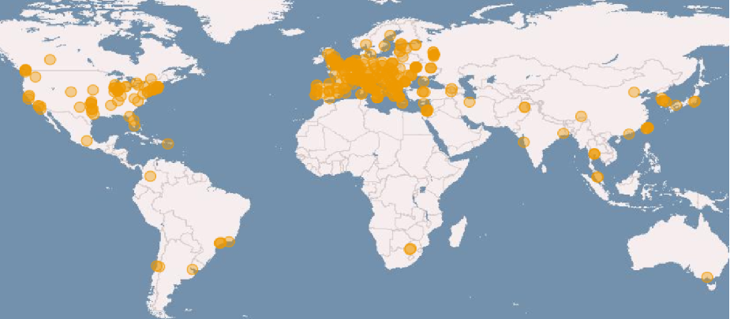
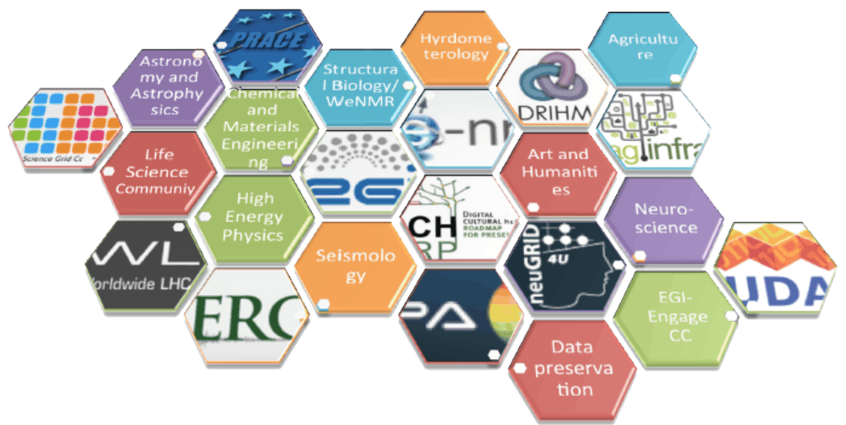
e-Infrastructures: EGI, EUDAT, GEANT, PRACE, …
imagery: EGI.eu

Slide 5
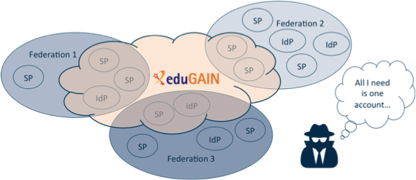
eduGAIN statistics
Federations 59
Entities 5284
Identity providers 2965
Service providers 2319
Data: edugain.org, January 2019
All I need …
A loose federation, but with some big advantages
we see more than just the network
incidents spread through the communities whose structure we already know
recognized need and willingness to collaborate and share data
Imagery by GEANT and Hannah Short, CERN

Slide 6
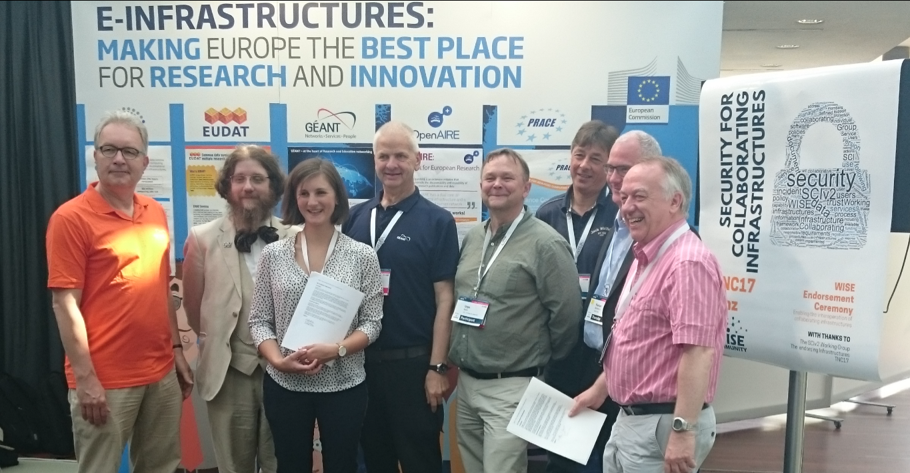

Trust and global policy
A single policy cannot apply
different risk scenarios for participants,
different risk appreciation,
distinct legal contexts, …
But one can ‘map’ policies and align policy structures
“enable interoperation of collaborating Infrastructures in managing cross-infrastructure operational security risks.”
which is the role of SCI: Security for Collaboration among Infrastructures

Slide 7
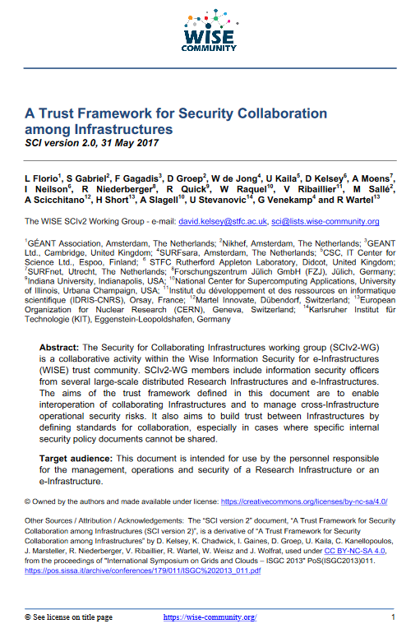
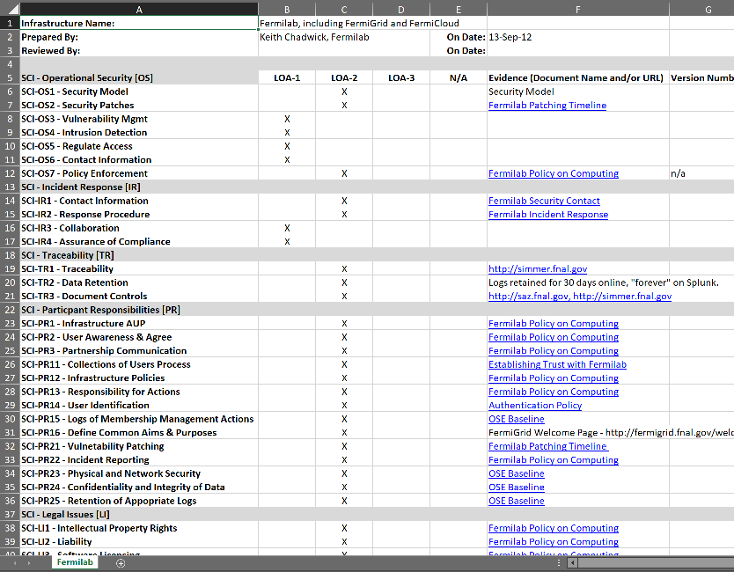
SCI v2 – peer assessment and trust
Interoperation areas
Operational Security
Incident Response
Traceability
Participant Responsibilities
  Individual users
  Collections of users (communities)
  Service providers
Data Protection
Alongside: assessment maturity model
using peer-reviewed self-assessment

Slide 8
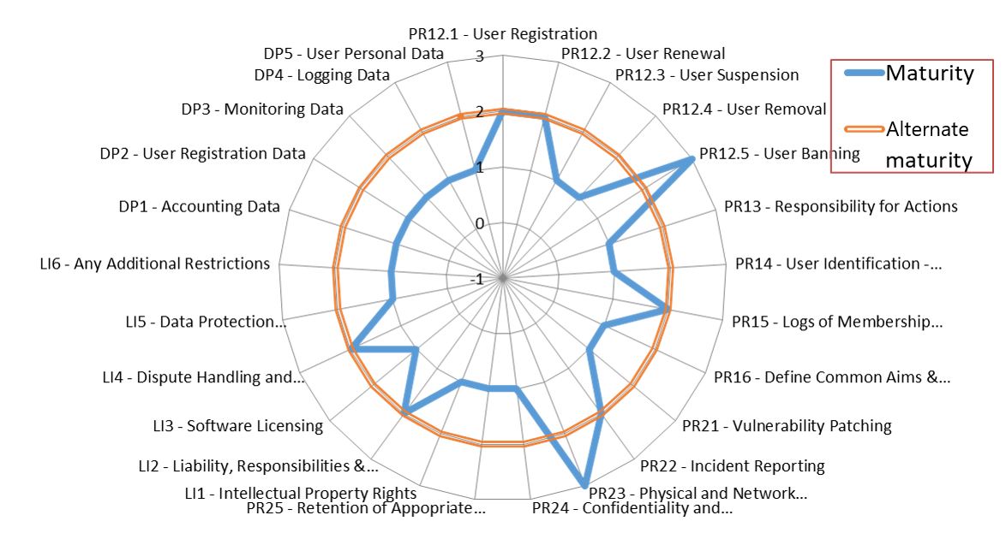
Example SCI Assessment

Slide 9
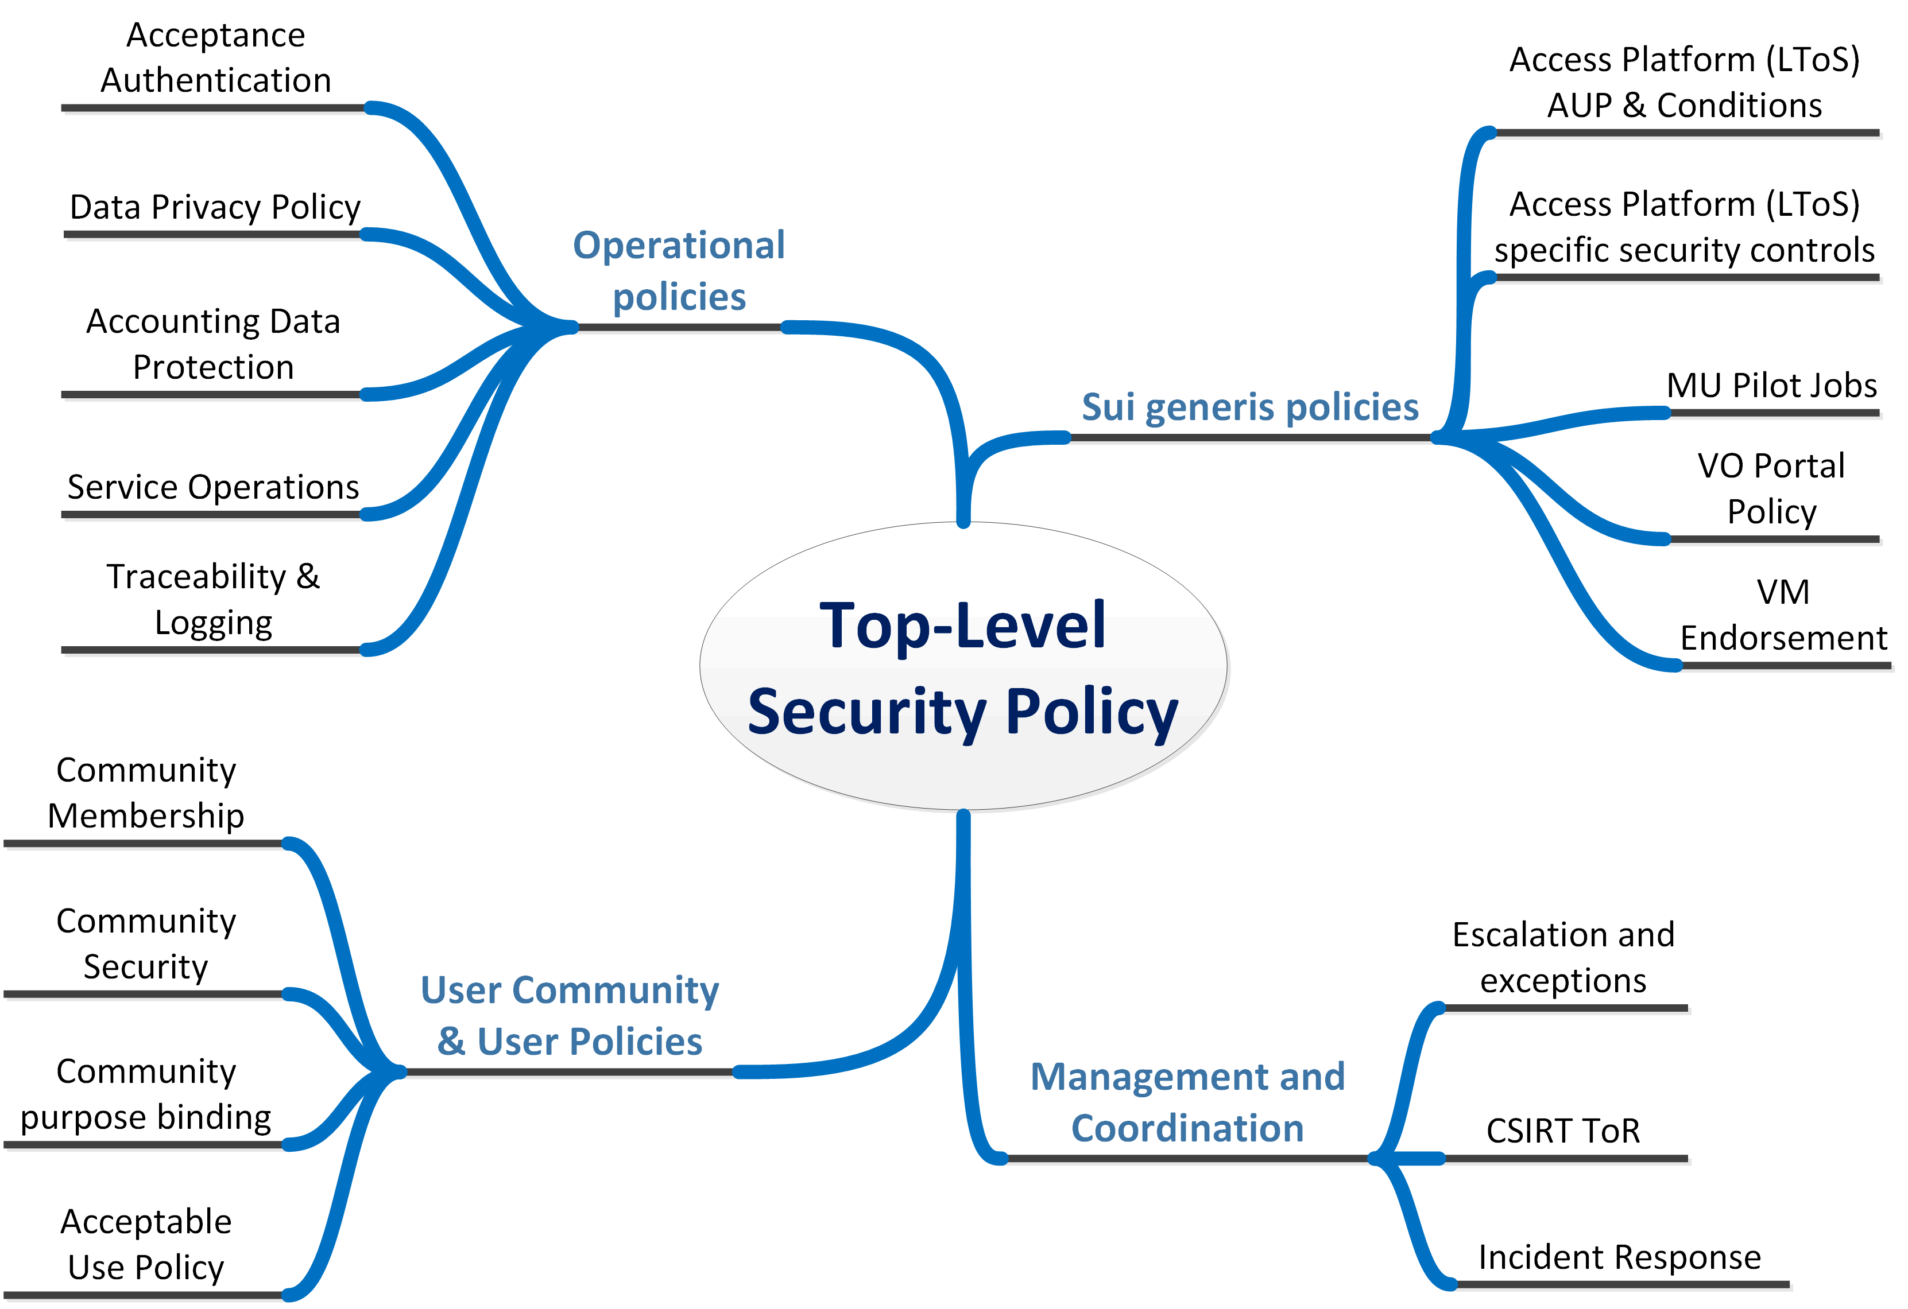

A Policy structure for EGI and WLCG

Slide 10
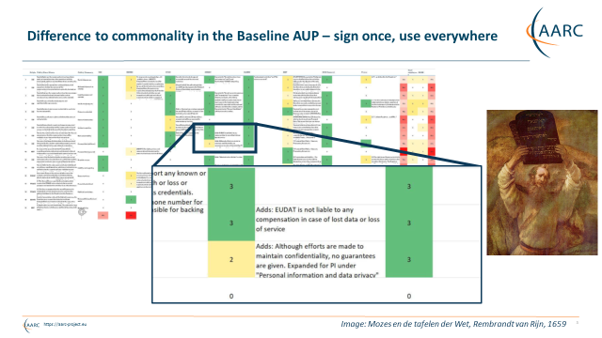
Where more alignment is useful …

Slide 11
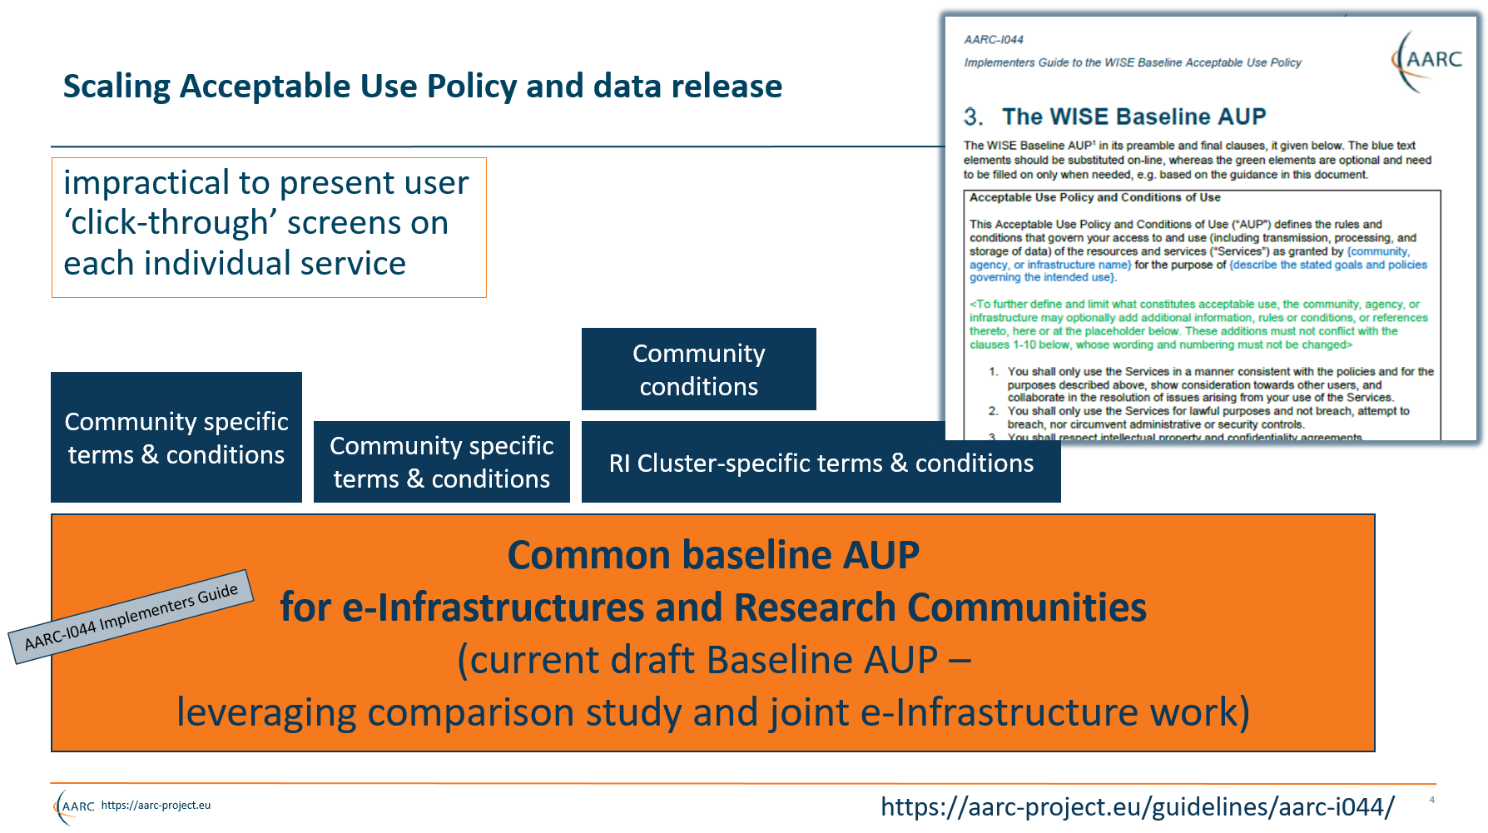

Slide 12
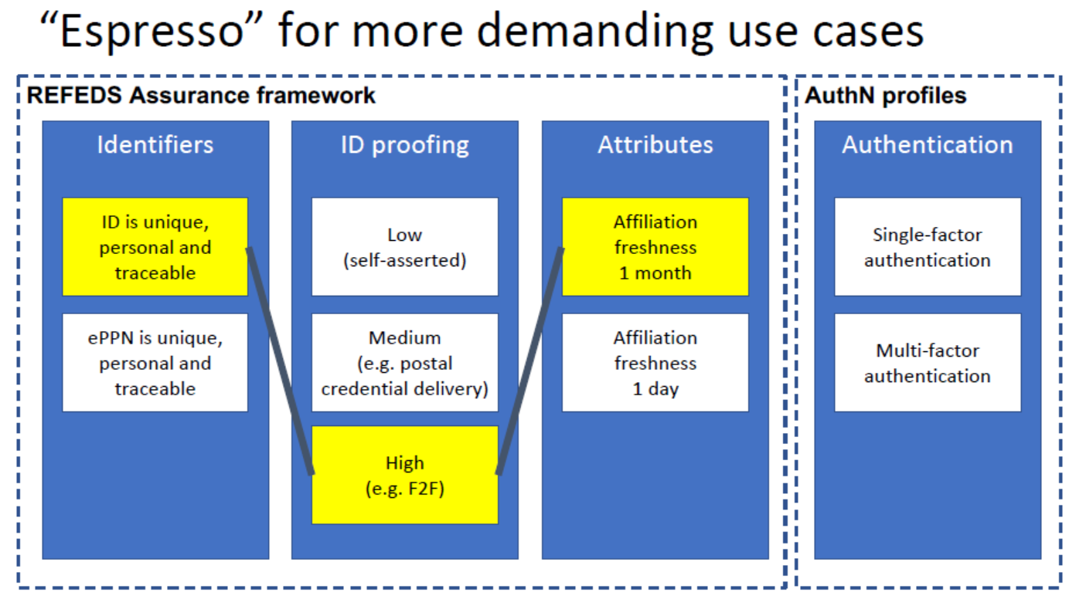

Global users? – global trust!
Electronic identity assurance remains a scalability challenge … globally
many frameworks: Kantara, NIST, REFEDS, IGTF, eIDAS, TDIF, …
many components: uniqueness, ID proofing, ‘freshness’, authenticator
Infrastructures for Research:
feasible assurance matching
risk profile of service classes
‘Cappucino’, ‘Birch’, ‘Dogwood’, …
intentionally opaque naming
and no ‘levels’

Slide 13
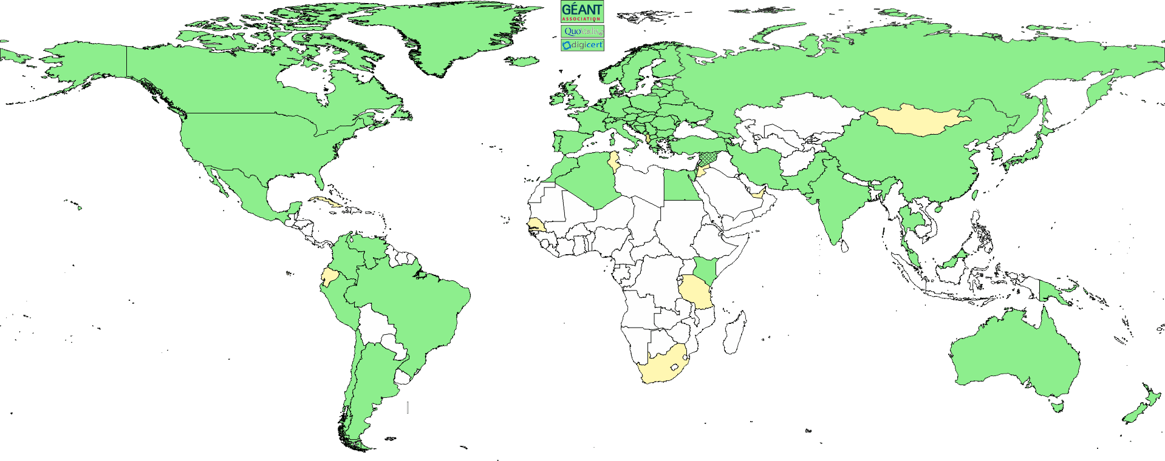
Interoperable Global Trust Federation IGTF
3 regional chapters: EMEA, Americas, AP
~ 90 Identity Providers (some leveraging a R&E federation)
~ 10 international major relying parties
~ 60 countries / economic areas / extra-territorial orgs
> 1000 relying service provider collaborations
www.igtf.net

Slide 14
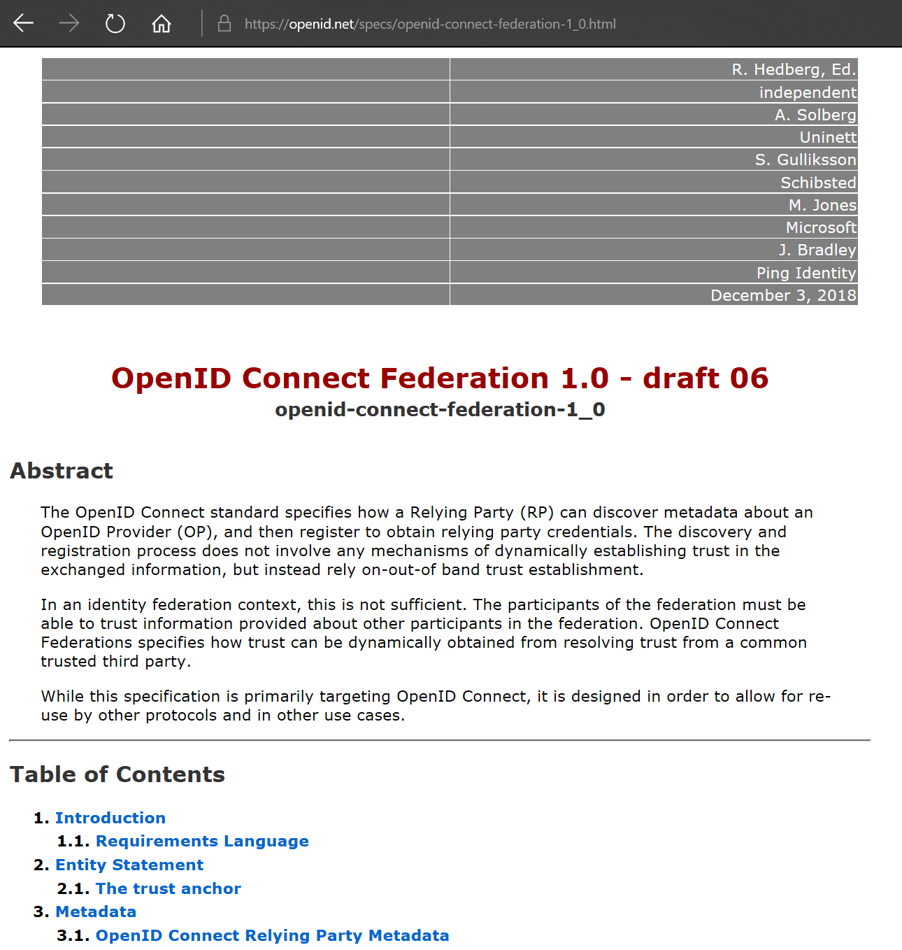
OIDC Fed – trust is technology agnostic
OpenID Connect Federation:
multilateral trust beyond GAFA
see: openid.net → Specs & Dev info
Roland Hedberg, et al., with Mischa Sallé

Slide 15
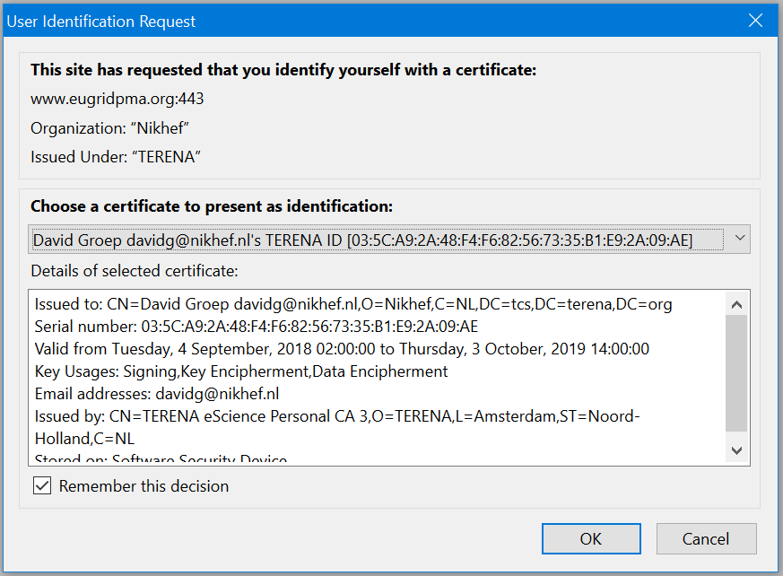
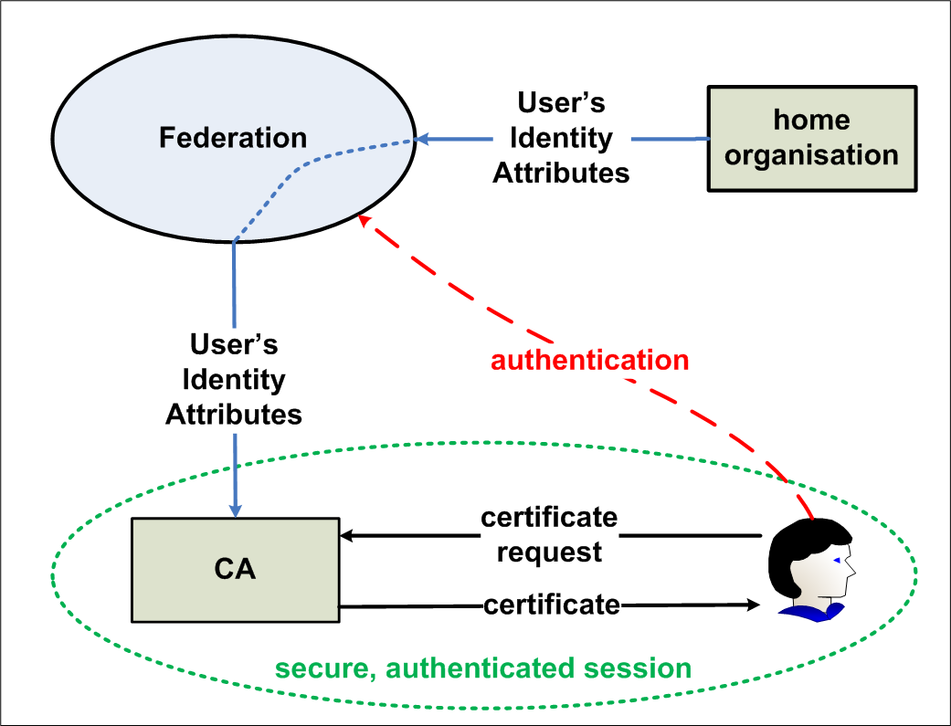
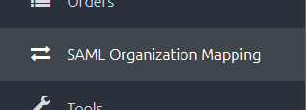
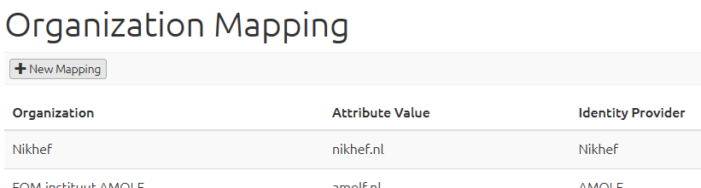
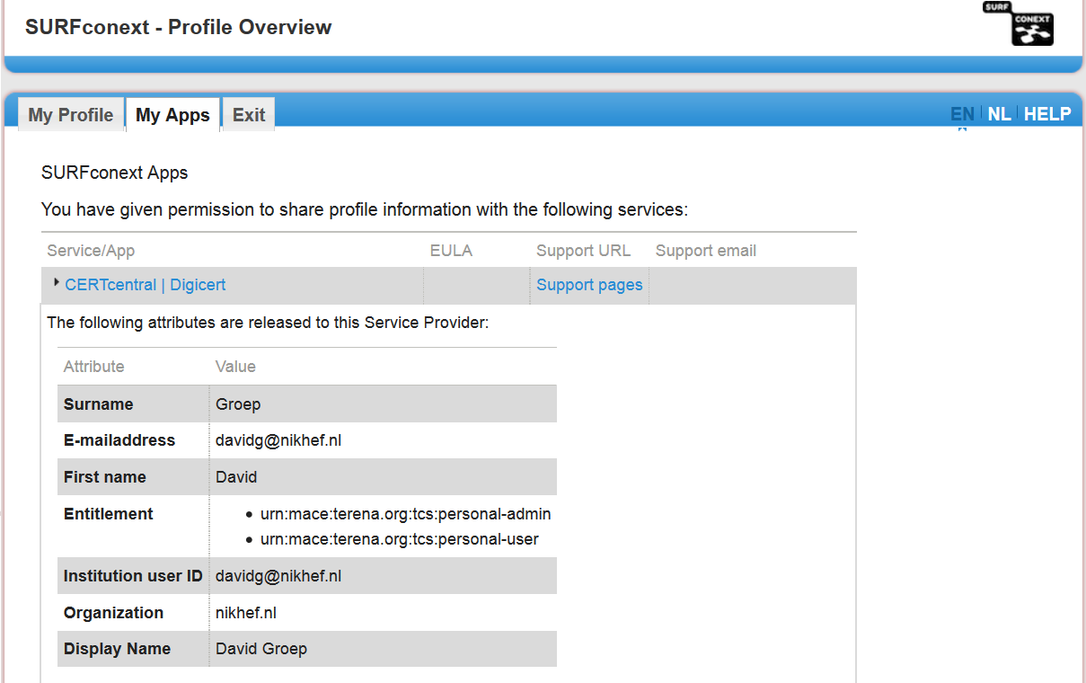
Bridges and Token Translation Services
GEANT Trusted Certificate Service
DigiCert acts as a SAML Service provider to eduGAIN
and eligible authenticated users can obtain their
own certificate for access and delegation to services

Slide 16
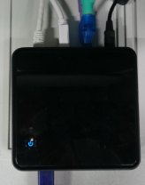












RCauth.eu – bridging trust technology
user login flow: Access Portal → Community Infrastructure → RCauth service → federated AAI
credential flow: authentication federation, Policy Filter, OpenID Connect, gateway credential provisioning
R&S
delegation
server
filtering
WAYF
science gateways
AARC Master Portal or
Infrastructure Solution

Slide 17
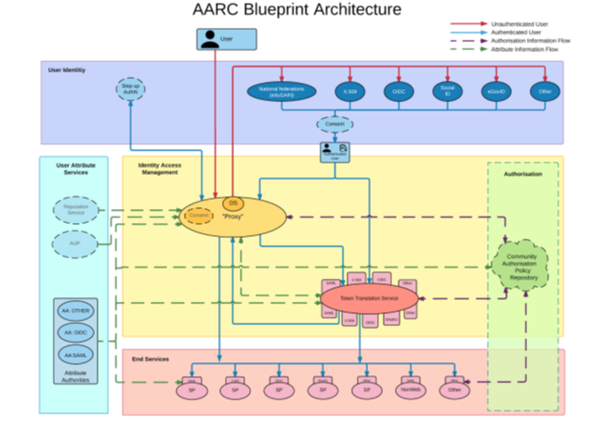

AARC BPA – coherency by proxying
https://aarc-project.eu/architecture/

Slide 18
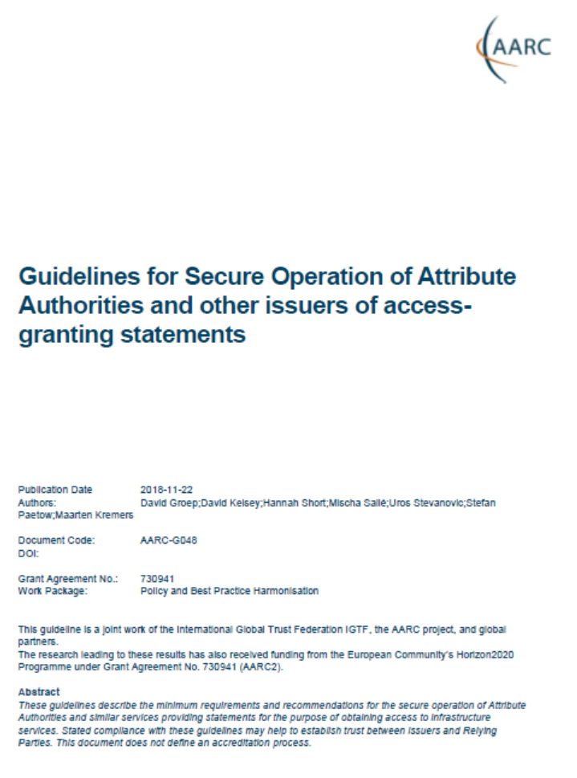
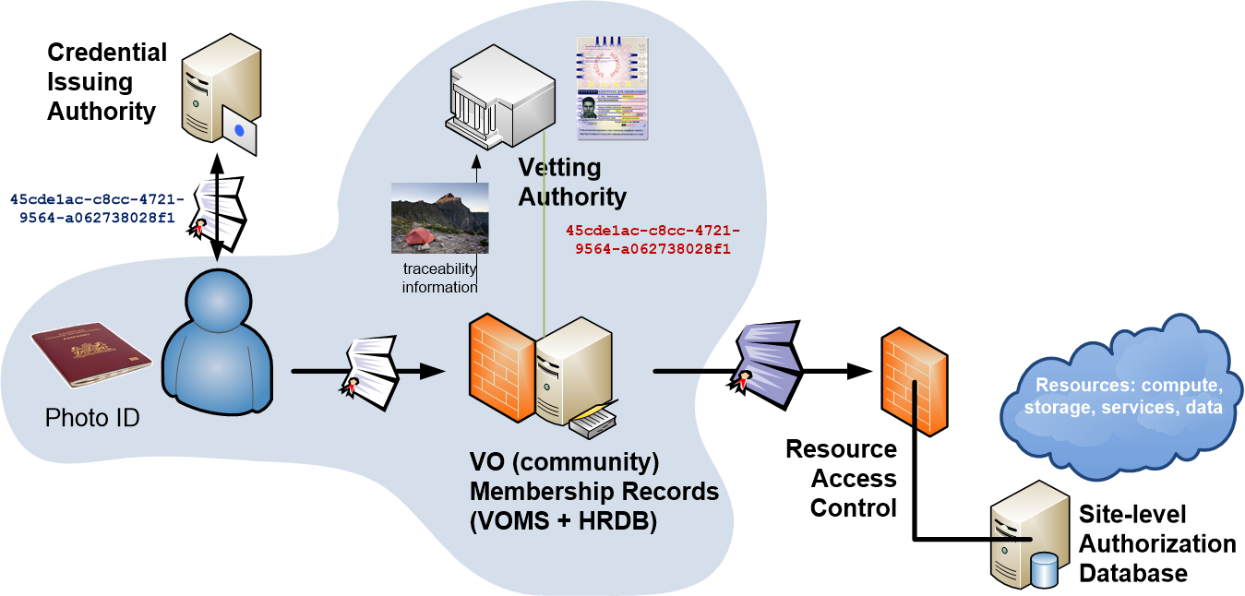
Beyond AuthN: collaborative assurance
Assurance elements may come from distinct sources
Community Attribute Authority needs
operational security equivalent to an authentication source

Slide 19
Communities taking responsibility
Communities and infrastructures thus hold a lot of (personal) data:
this is personal data resulting from use of the infrastructure
each of the communities (or infrastructure ‘on their behalf’) has legitimate interest in processing that data:
resource allocation, accounting, communicating with members, &c
each entity in the e-Infrastructure (and EOSC-HUB) is its own controller
Adherence to common policy suite facilitates data sharing
distributed incident response is explicitly allowed (and used) anyway
facilitate global sharing through the Code of Conduct (art. 40)
until EDBP is up to speed, we’re essentially a ‘BCR’ like structure

Slide 20
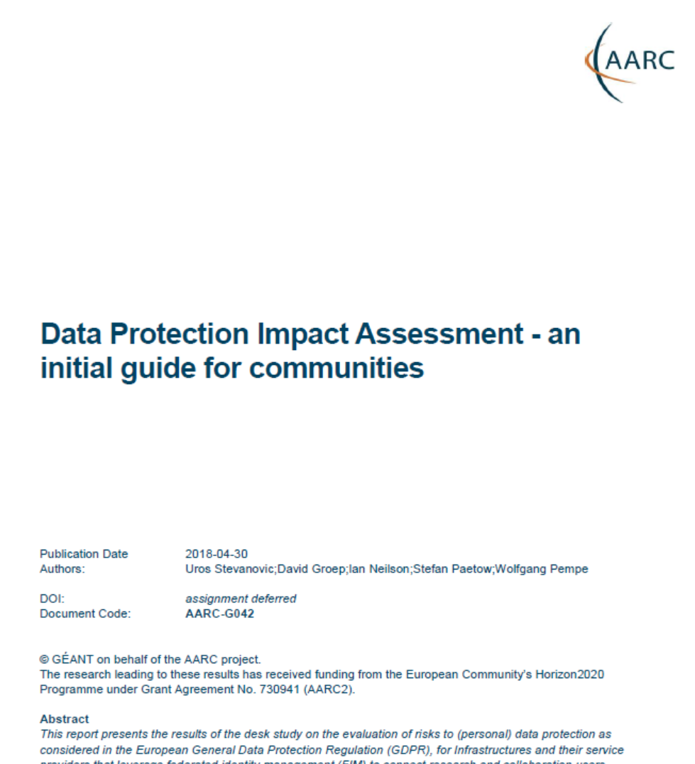
Data Protection and sharing
Large discrepancy between
practice, perception, and actual risk:
communities themselves don’t see need to
protect infrastructure AAI (accounting) data
– tend to forego basic guidance
misunderstanding issue, over-stating risk,
falling victim to FUD law firms with “GDPR”
even ‘simplified’ documents - like the
GEANT Data Protection Code of Conduct
– considered too complex to be understood
https://aarc-project.eu/guidelines/aarc-g042/

Slide 21

This is one solution …
UCE message sent on May 17th to Ian Neilson, and millions more …

Slide 22
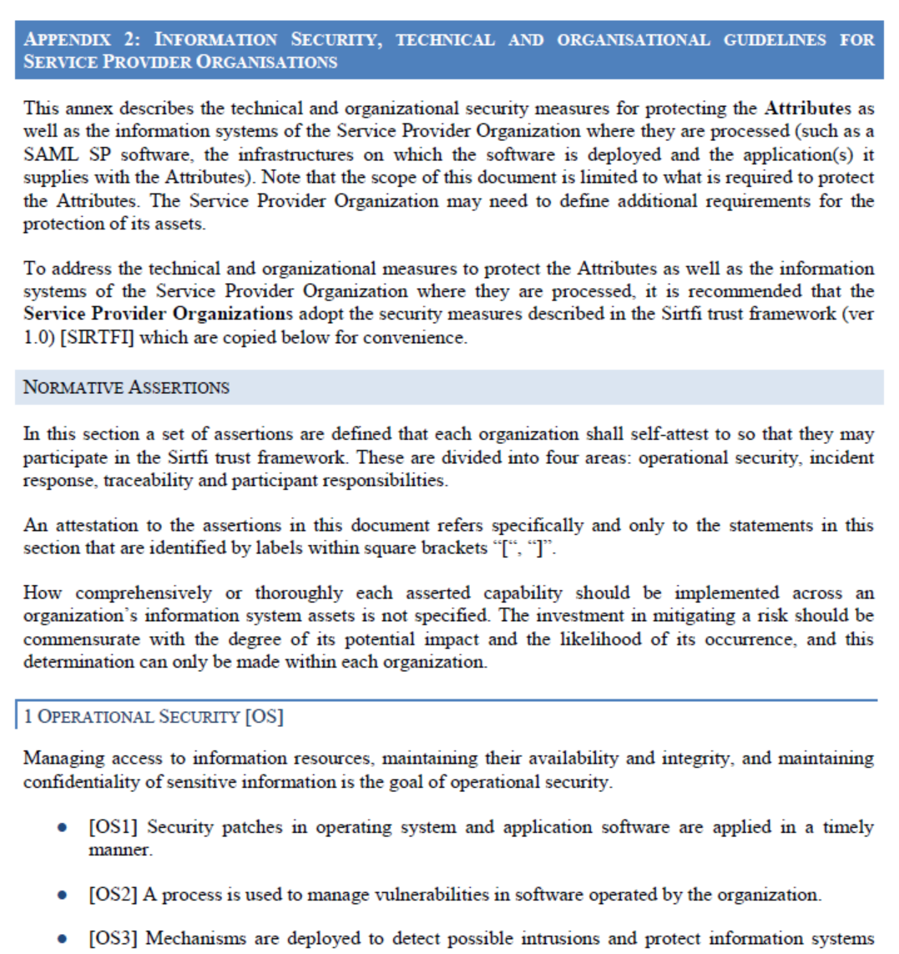
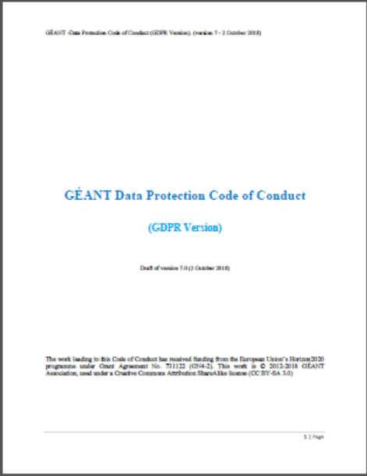
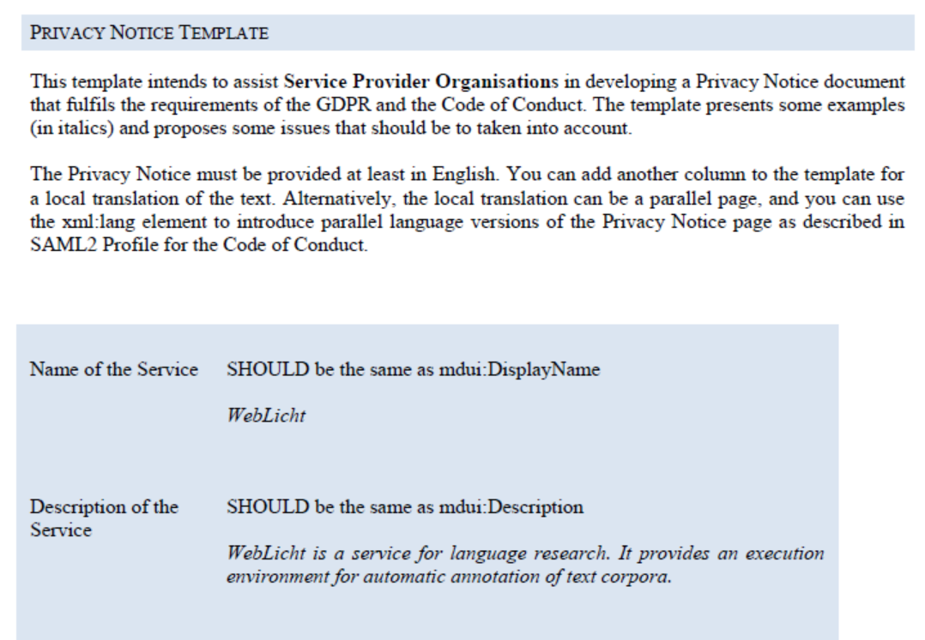
Models for data protection for federation
BCR-like: put in place a set of policies that bind all participants (“SCI”)
Code of Conduct
‘model clauses’ and contracts do not scale and thus don’t work

Slide 23
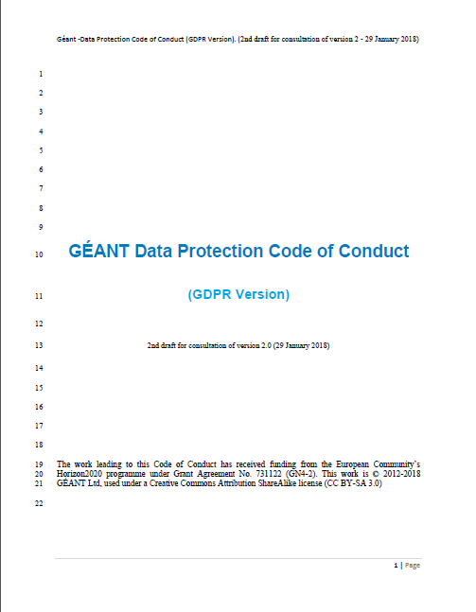
GEANT Data Protection Code of Conduct v2
Works admirably for our distributed infrastructure
must be specific (can do that: it even includes Sirtfi!)
applies for global transfers (great!)
must be approved by a DPA (EDPB can’t do it yet)
needs a monitoring body (a challenge for us)
Learn SP’s commitment
GEANT Data protection Code of Conduct
Commit to
HO
SP
Learn SP’s commitment
Commit to
HO
SP
HO
Learn SP’s commitment
Commit to
SP
https://wiki.refeds.org/display/CODE/Code+of+Conduct+ver+2.0+project
GEANT4-2 work by Mikael Linden, CSC and by Patrick van Eecke, UAntwerpen & DLA Piper

Slide 24
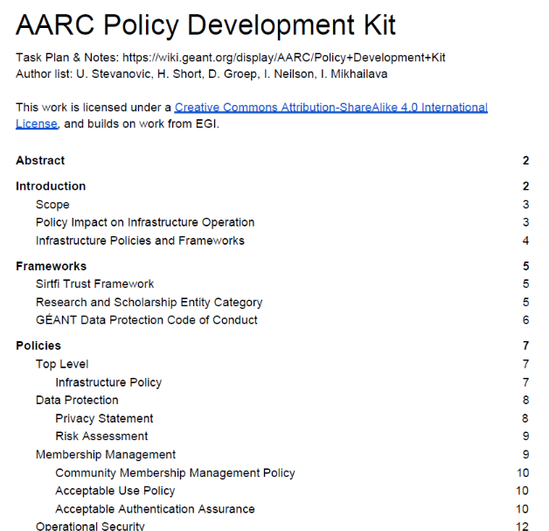



Policy Development Kit
Supporting our communities in joining the federation
shows best examples from the e-Infrastructures
comprehensive coverage
enables Sirtfi and Snctfi compatibility
includes a self-paced training module

Slide 25
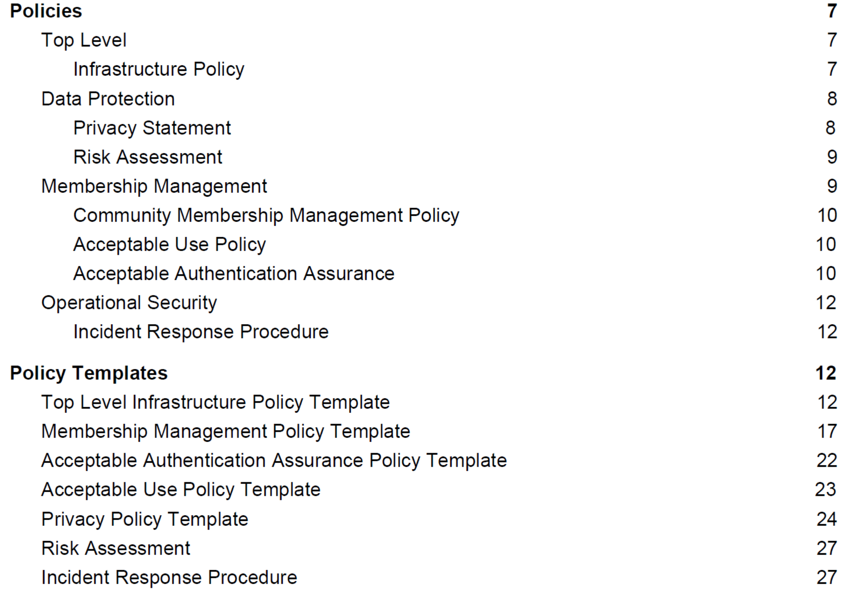
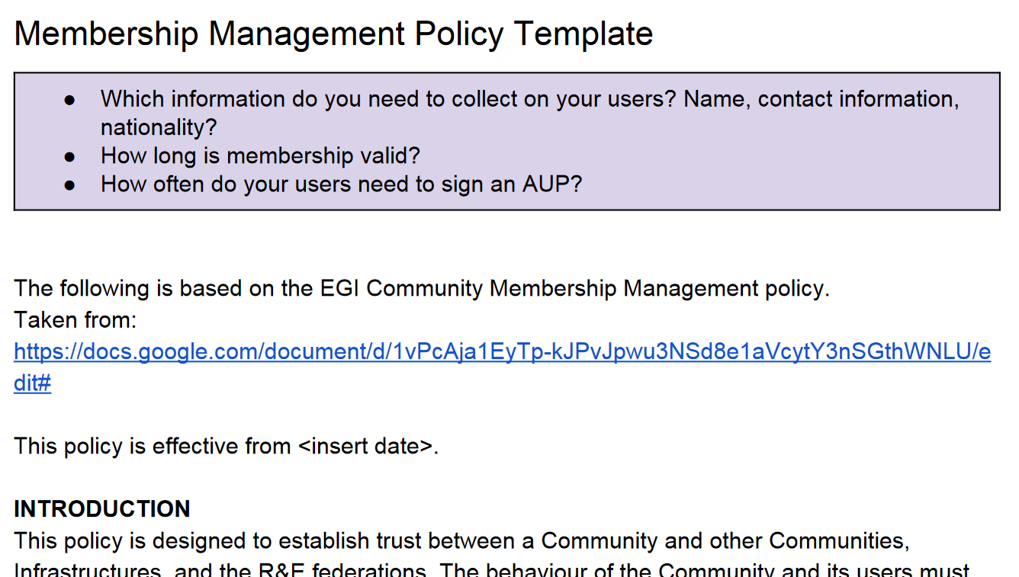
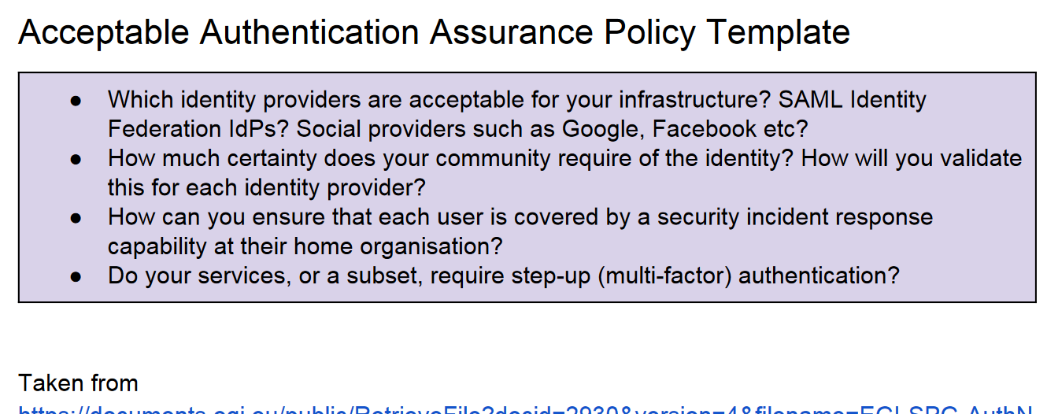
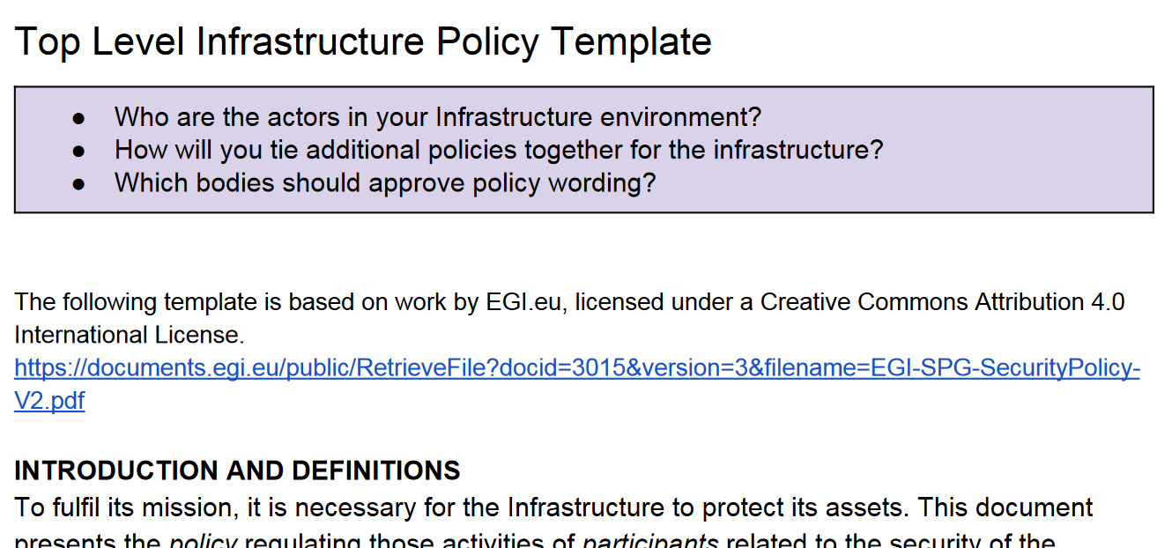
Policy Development Kit Templates
ENGAGE

Slide 26
Implementing it: Resource & Service access
Site Access Control
Delegation and support for
secure brokering:
OAuth2 and RFC3820
Traceability and Isolation
SaToSa proxies for
communities & COManage
Distributed policy and Argus

Slide 27
Proxies and provisioning
COManage and OpenStack and CTA and SCZ and …
gLExec JIT provisioning from a pool with LCMAPS and the EES
embedding authZ decisions, local or global
Coordinated policy management with SAML-XACML
emergency suspension with Argus
towards operational security

Slide 28
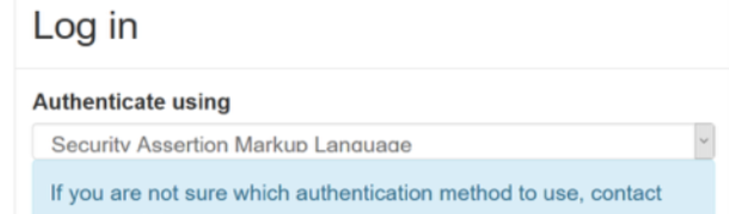
Provisioning proxy: SSH & OpenStack
Proxy Membership Management service
pre-provisioning of account
access rights linked to groups and roles
At Nikhef COmanage
ssh via ldap
OpenStack
…
and VOMS
unix, batch, web portals
co-development with the AARC project

Slide 29
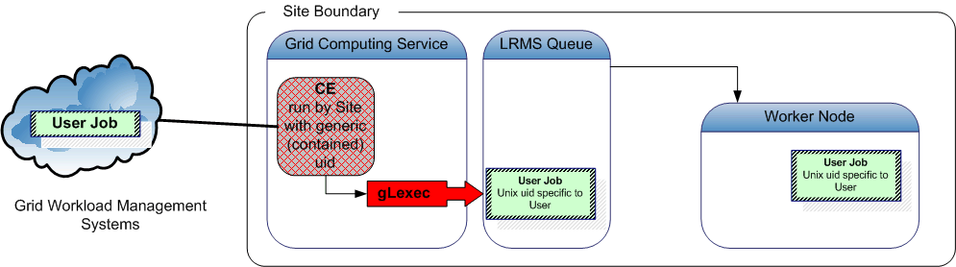
user containment and isolation
Nikhef’s Site Access Control suite for federated login to Unix systems
federated identity (with directory or principal name) + community membership
/dc=org/dc=example/CN=John Doe
voms:/atlas.cern.ch/Group=adc/Role=lcgadmin
/dc=org
/dc=example
/CN=John Doe/
/CN=proxy
VOMS
Attribute
Certificate
pvier001:x:43401:2029:PoolAccount VL-e P4 no.1:/home/pvier001:/bin/sh
first poolaccount implementation by Andrew McNab, Manchester

Slide 30
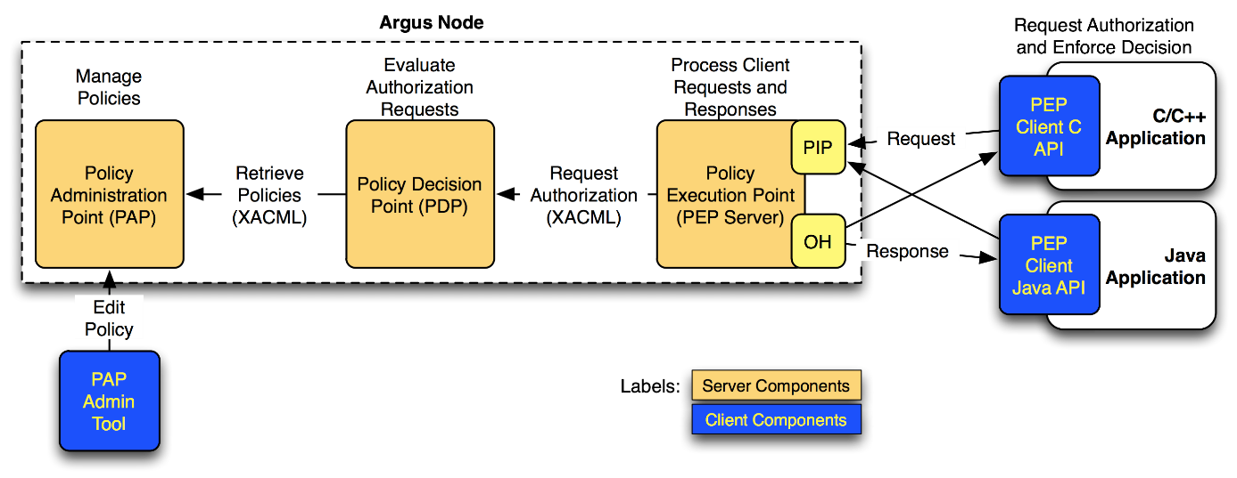
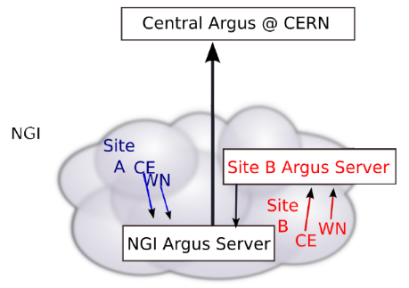

Federated Authorisation: local and global
Hierarchical distributed policy
chaining
Policy Adminstration Points
service-local
Policy Information Points and obligation handling
(“you shall be ua1242”,
“you shall have role dept_mngr”)
https://github.com/argus-authz
https://argus-documentation.readthedocs.io/

Slide 31
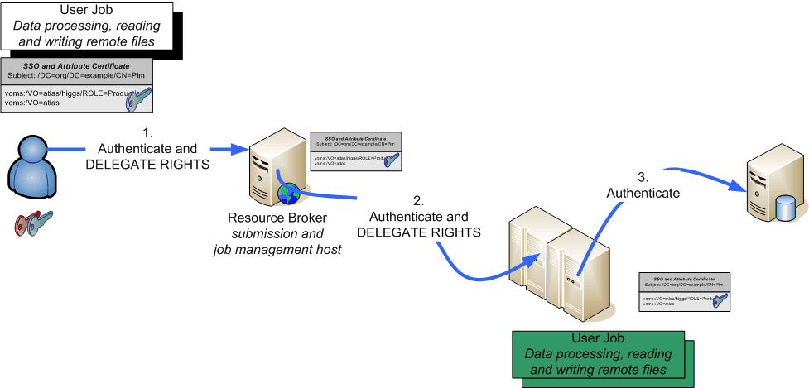
Secure Non-web remains a challenge
Use cases
deep delegation of rights
non-interactive workflows
long-running tasks
Solutions exist in PKIX (RFC3820 ‘proxy’ certificates)
in OAuth2 (access vs. refresh tokens)
but
… SAML ECP never caught on securely for us
… OAuth2 very new our federated use cases
... and PKIX is not loved by end-users ☹

Slide 32
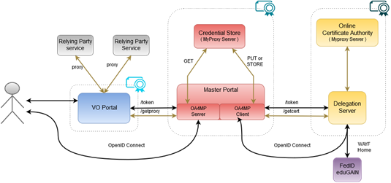
Science Gateway and the Master Portal
Credential management service
registered portal can
obtain user credentials
via OAuth2 (refresh) flow
act on behalf of user
to execute workflows
complements user-managed translation solutions
https://rcauth.eu/
https://github.com/rcauth-eu/aarc-master-portal
https://wiki.nikhef.nl/grid/AARC_Pilot_-_RCAuth.eu

Slide 33
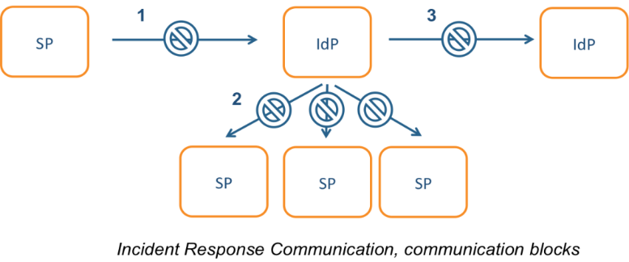
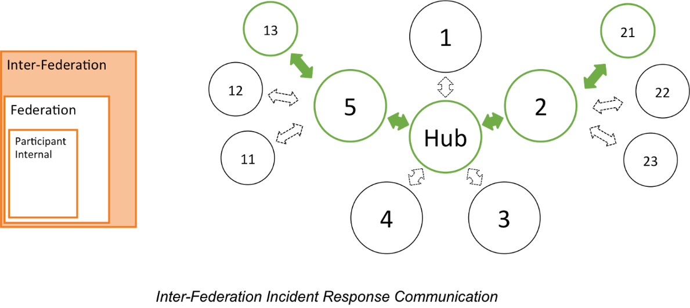
Many parties, shared security challenges
Challenges
IdP appears outside
the service’s security mandate
Lack of contact or lack of trust in the IdP
which to the SP is an unknown party
IdP fails to inform other affected SPs, for
fear of leaking data, of reputation,
or just lack of interest and knowledge
No established channels of communication, esp. not to federations themselves!

Slide 34
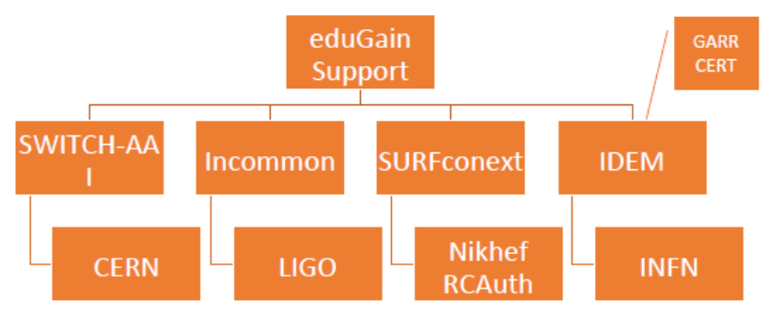
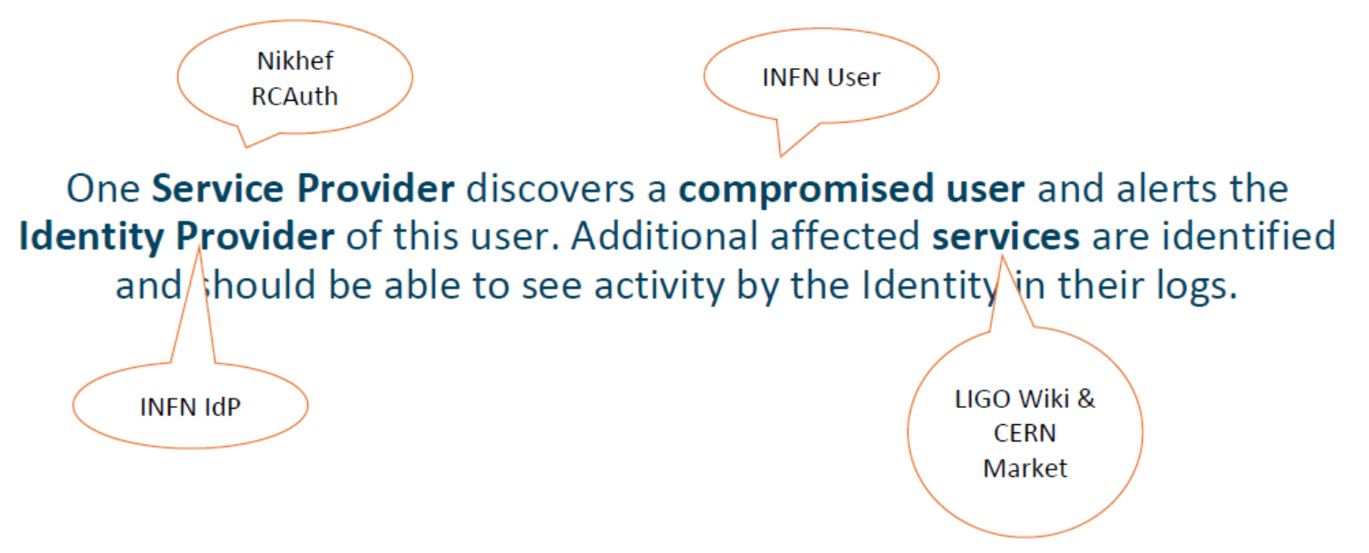



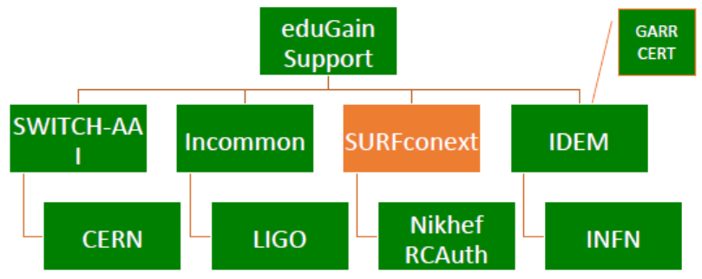



Exercises – communications and actions
parties involved in response challenge

Slide 35

EGi CSIRT capabilities – Nikhef OpSec Team
Nikhef provides the Security Officer for EGI
vulnerability mitigation monitoring
training and communications
traceability exercises
(“Security Service Challenges”)
incident handling
emergency suspensions of service providers
liaison with industry trust groups:
TF-CSIRT/TI, FIRST, OPS-T, …

Slide 36
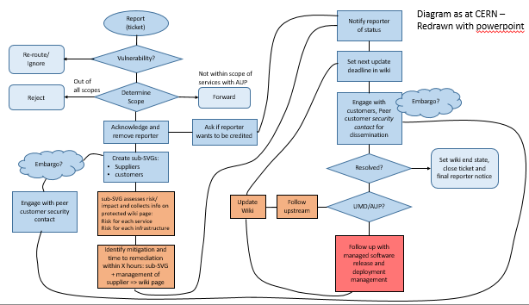
vulnerability analysis plus advisories
Most of the software we use originates outside, some comes from peers
access control and containerization software has elevated privileges
automated tools find only a fraction of the ‘real issues’
Middleware Security Team
code inspection and review
impact assessment and risk
advisory communications
black-box and white-box pen-testing

Slide 37
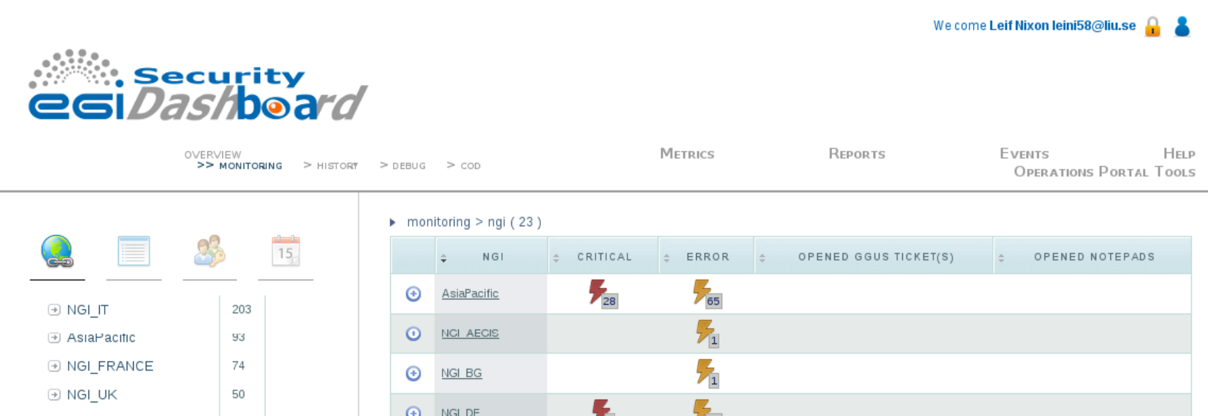
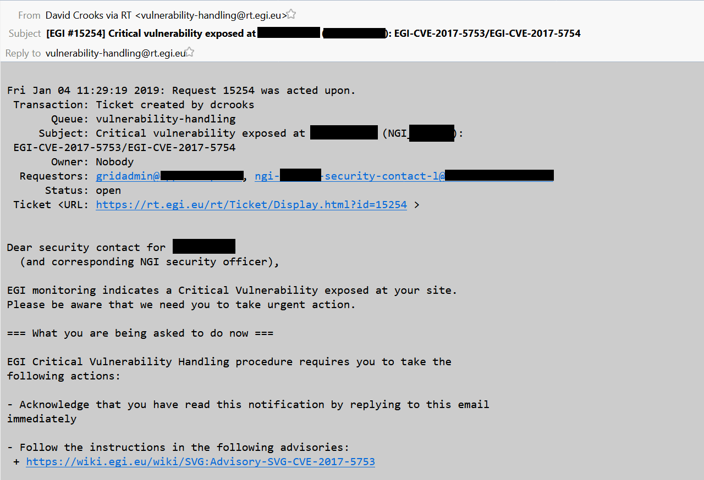
Vulnerability mitigation in EGI and WLCG
for consistent security in federation:
policy allows continuous vulnerability monitoring
monitoring data itself protected:
access for service provider and CSIRT
Data: EGI-CSIRT

Slide 38
Proactive monitoring – Pakiti and EGI CSIRT
Data: EGI-CSIRT/Sven Gabriel

Slide 39
EGi CSIRT – incident response
Typical incidents in the federated e-Infrastructure are the usual
phished accounts
jumping via compromised accounts and ssh keys
weak credentials (even for service administrators ☹)
new: insecure virtual appliances and bad orchestration scripts
Miscreant activities
mostly: cryptocurrency mining
which we also see from legit users lacking a moral compass…
a bit of spamming and DDoSing

Slide 40
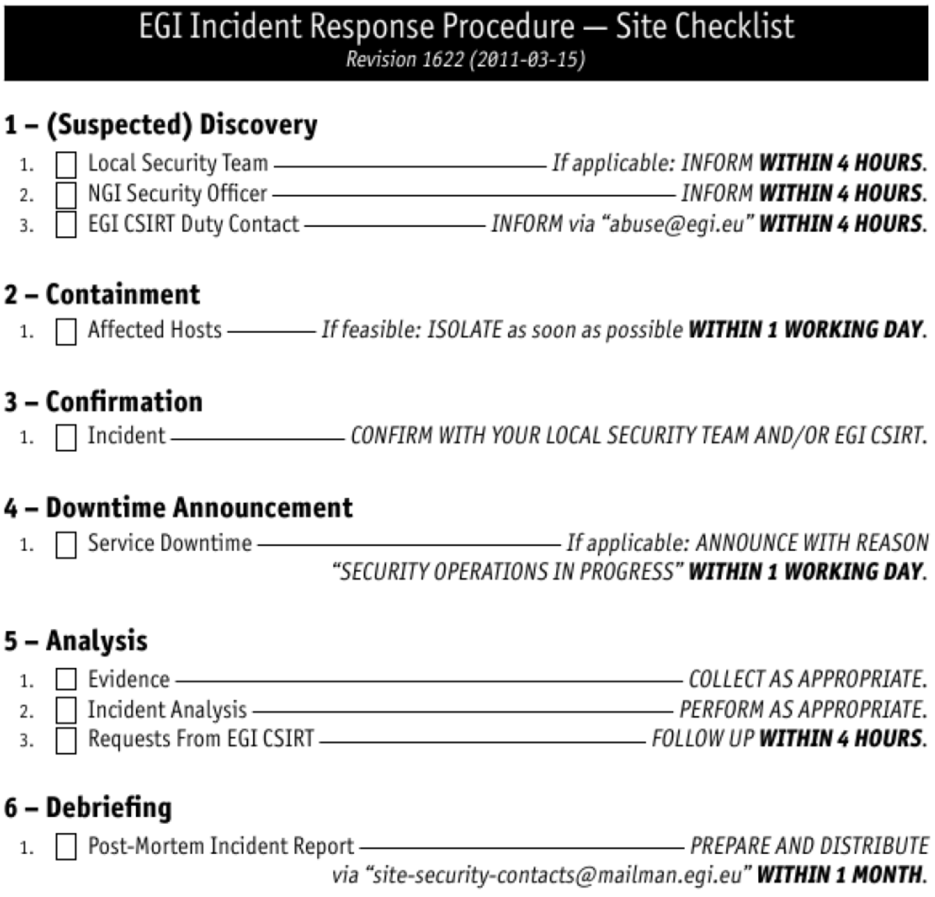
Service provider response checklist
EGI CSIRT acts as expert-centre for service providers that lack local security expertise:
standard processes & procedures
communications templates
advanced forensics

Slide 41
Training in a distributed federation
Developed a framework to automate
distribution of ‘fake incidents’ across infrastructure and monitor response
automated service access and ‘job submission’
challenging test mimicking real malware (including process hiding, use of encryption and TOR, P2P C2 control, and torrent payload transfer)
but of course not weaponized …
monitoring of intervention and suspension of suspect credentials
report-out and information sharing part of the challenge

Slide 42


SSC monitoring

Slide 43

Feedback to service providers
Communication:
Endpoints valid?
Form/Content OK ?
Containment
Ban ”malicious” users
Find/Stop malicious processes
Find submission IP
Forensics
Basic Forensics on binary
Network traffic

Slide 44

Data sharing is ‘part of the deal’
If good citizenship and preventing data leaks was no justification enough,
GDPR recital 49 recognizes the CSIRT role explicitly
Legitimate interest 6.1(f) as usual basis
appropriate safeguards within EEA in place
For global sharing with trusted peers
DP CoCo v2 (with Sirtfi embedded)
an ‘SCI’ policy framework: very BCR-like
NIS Directive (EU) 2016/1148 promotes it
despite some uncertainty under 49(1)§2’s
need to inform the DPA post-hoc
SMEs not supposed to be burdened by BCR
EDBP Guidelines 2/2018 note 40:
suggests compelling legitimate interest
see e.g. Andrew Cormack in https://script-ed.org/article/incident-response-protecting-individual-rights-under-the-general-data-protection-regulation/

Slide 45
Closer to a trusted e-Infrastructure
Policy
WISE and SCI
Trust
IGTF
Software
AARC Blueprint
Proxies
Community membership management
Site Access Contol & provisioning
Training
Response
Peer reviewed self-assessment
Snctfi
Common policy:
AUP, Assurance
Policy Dev Kit
Vulnerability handling
Communication
SSC and
‘fake’ incidents
Global authentication
Sirtfi
Proxies and persistent electronic identifiers
EGI CSIRT processes
Procedures and templates
information sharing!

Slide 46
with special thanks to our (project) co-funders: SURF and the European Commission via H2020 for AARC/2,
EOSC-HUB, GEANT4-3, ESCAPE, AENEAS, and their precursors DataGrid, EGEE, EMI, IGE, InSPIRE/ENGAGE;
and our I4C peers: CERN, CESNET, EGI.eu , FZJ, GEANT, GRNET, KIT, RAL STFC, SURFsara, SURFnet

