Slide 1
Showing Real Big Data
Towards visualisation of data transfers
with ‘Big Data’ analytics techniques
HvA induction session February 2016
David Groep, Nikhef

Slide 2
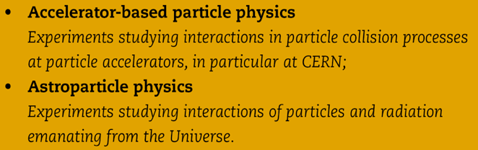
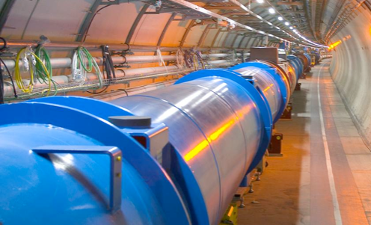
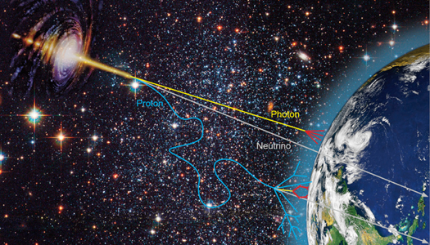


Nationaal instituut voor subatomaire fysica
Verleggen van de grenzen van onze kennis
Phenomenology
Collider physics
Astroparticle physics
8 september 2015
Orientatie Nikhef
Notes:
not on slide but important: concentrates all NL HEP infrastructure
machine shop, designers, ICT

Slide 3
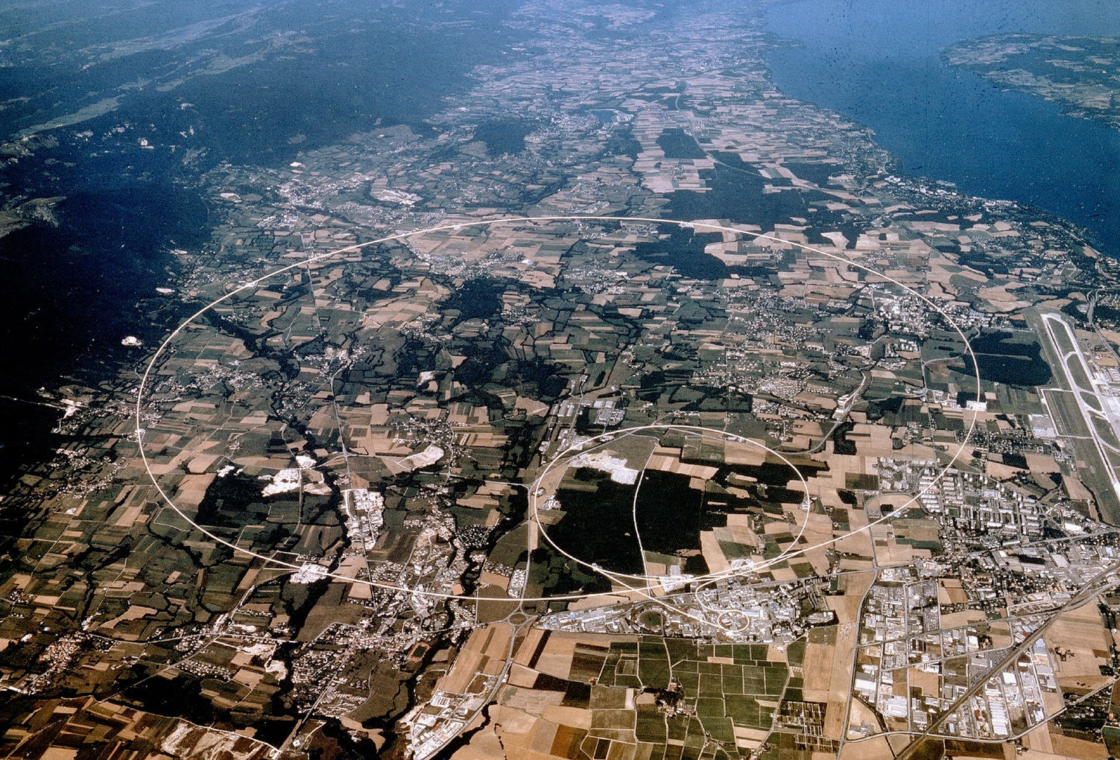


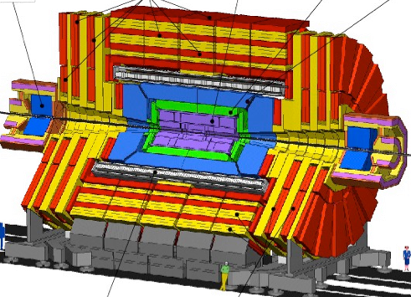




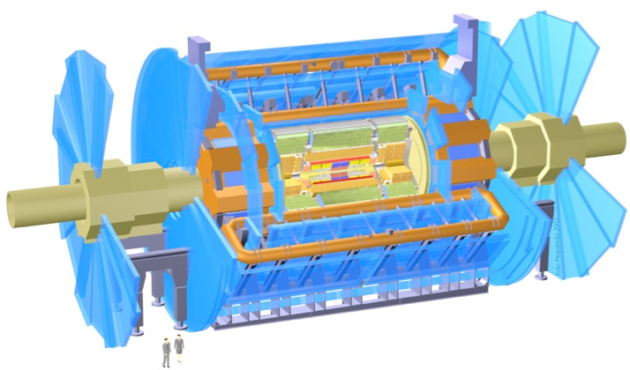

CMS
LHCb
ALICE
ATLAS
Atlas
protons
Haarlemse Chemische Kring

Slide 4
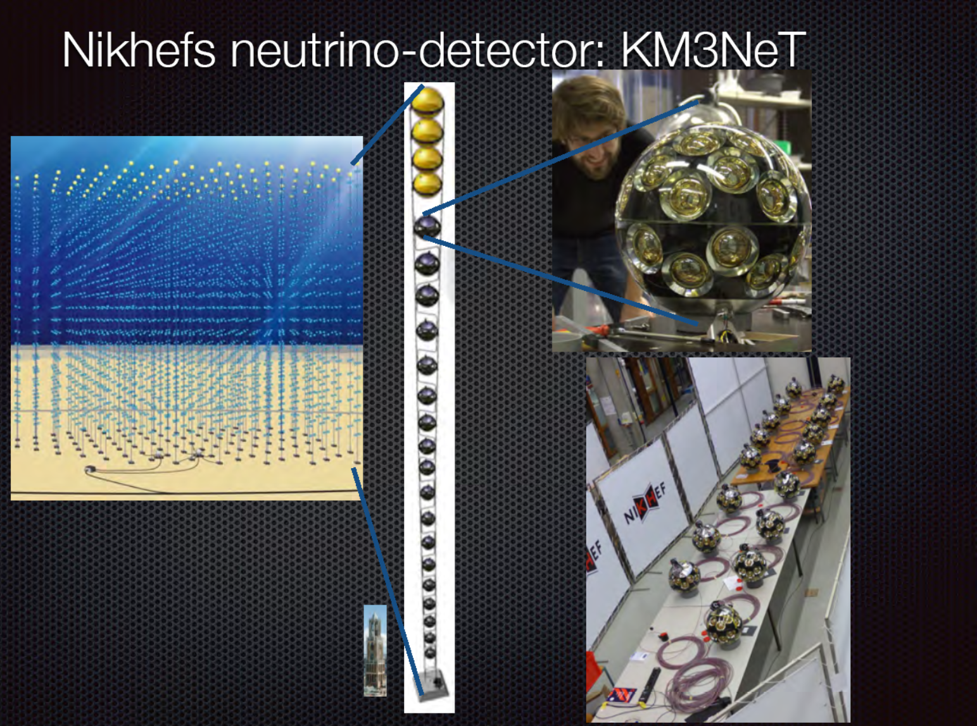

Slide 5

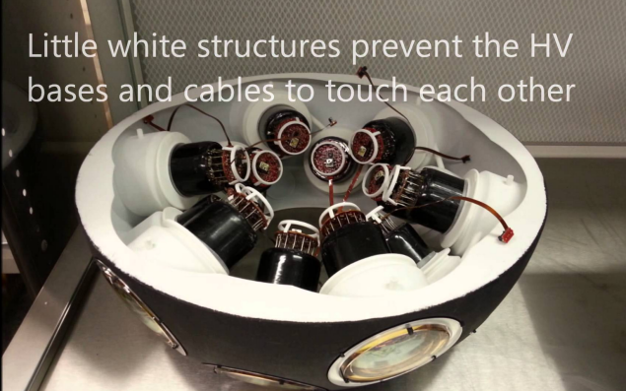
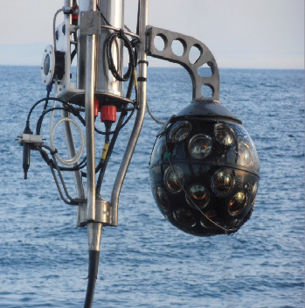
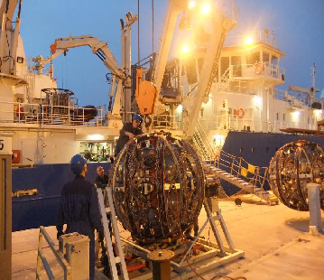
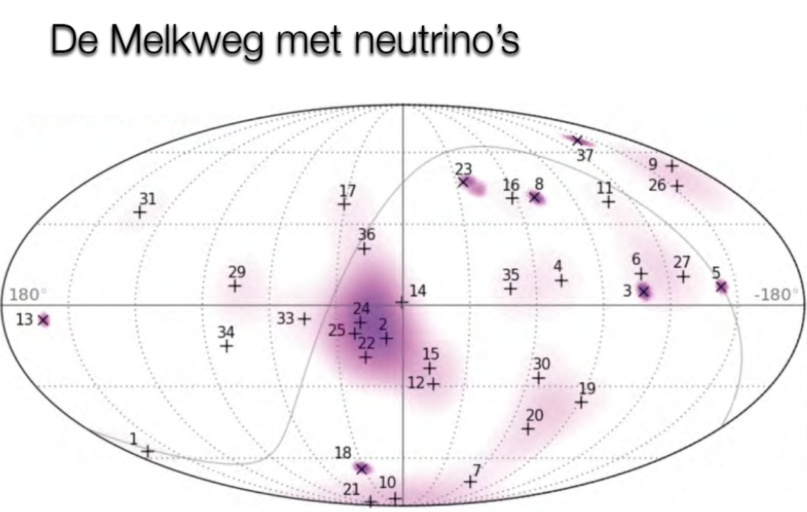

Slide 6
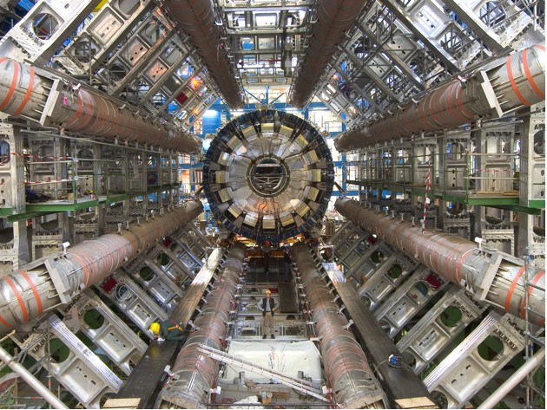

Slide 7
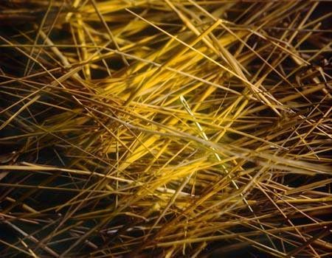
Kans Higgs deeltje:
1 op de 1.000.000.000.000 bostingen
- Dit is equivalent met zoeken van 1 persoon op 1000 wereldpopulaties
- Oftewel één naald in 20 miljoen hooibergen

Slide 8
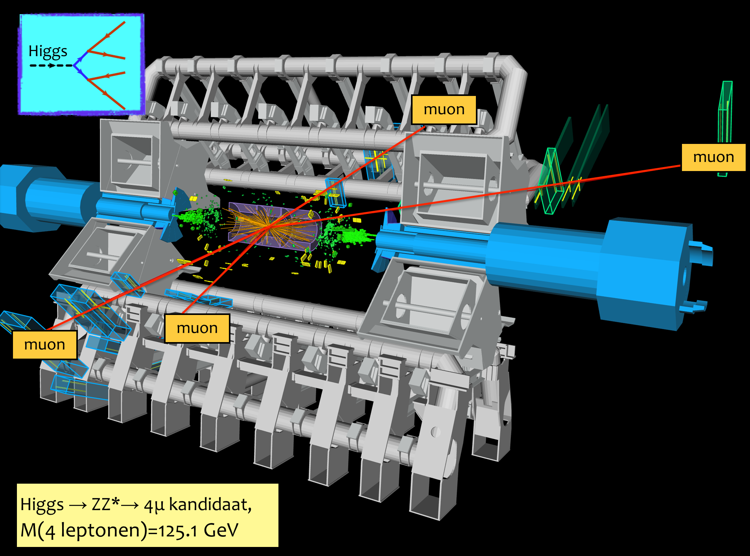

Slide 9
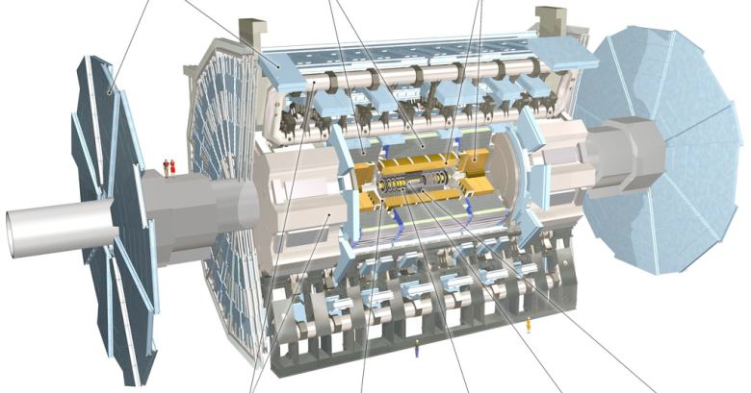
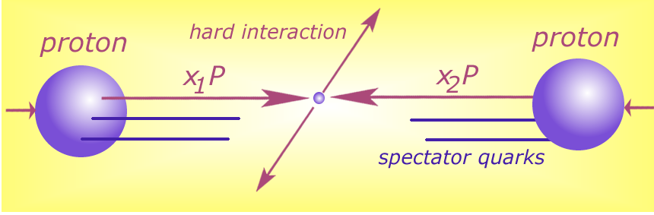





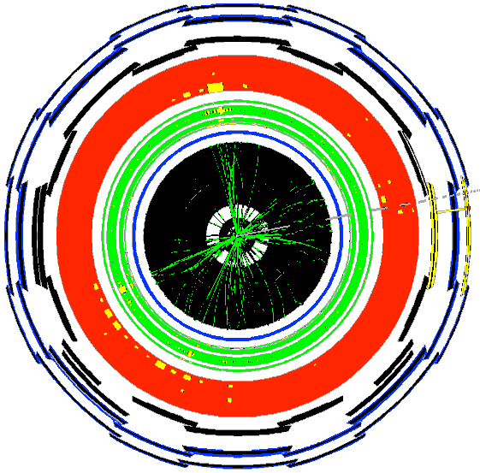




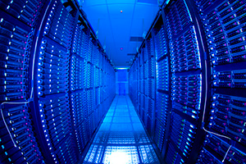


Detector to doctor ...
40 miljoen / seconde
Analyse van botsingen door promovendi
Trigger systeem selecteert 600 Hz
~ 1 GB/s data
and processing
Data distributie met
GRID computers
Collisions characterised by event signature:
  - electronen
  - muonen
  - jets
  -...

Slide 10
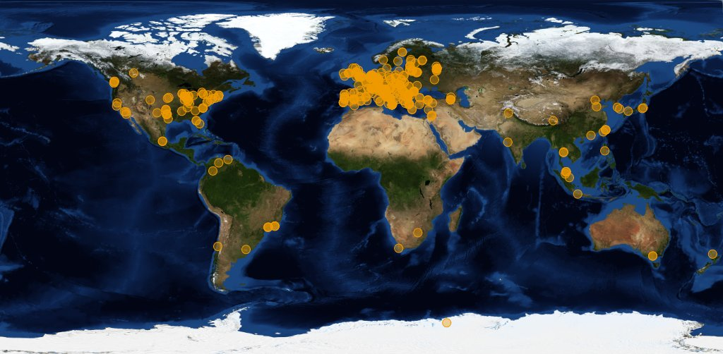




Image source: joint CERN (wLCG) and EGI
Organisations participating in the global collaboration of e-Infrastructures
Even just for wLCG, supporting the CERN LHC programme
More than 200 independent institutes with end-users
More than 50 countries & regions
More than 300 service centres
Handful regional ‘service coordination organisations’
300 000 CPU cores, 200+PByte storage
One independent ‘policy-bridge’ PKI

Slide 11
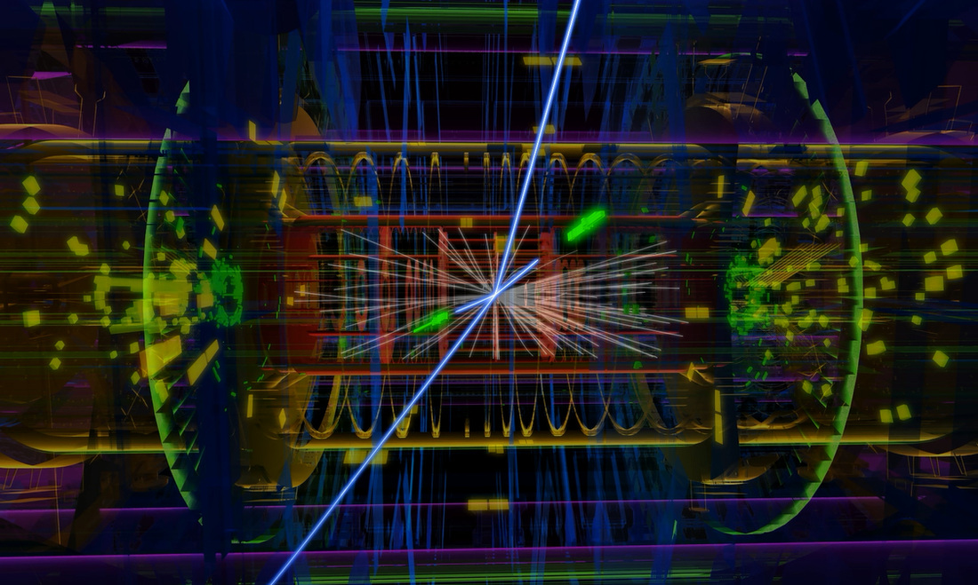
Atlas: ~50 TByte/day raw data to tape; 1000 TByte/day processed data transfers
Image source: CERN, Atlas

Slide 12




GridKa
IN2P3
TRIUMF
ASCC
Fermilab

Slide 13
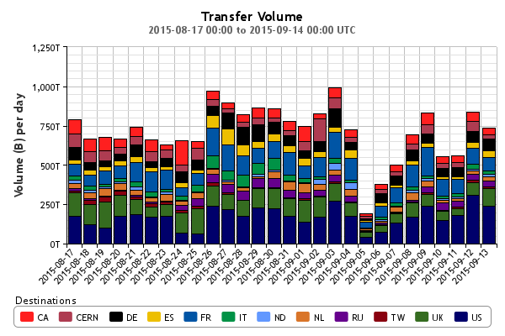
Big ‘as in Large’ Data
Atlas only
http://dashb-atlas-ddm.cern.ch/ddm2

Slide 14
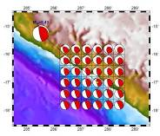


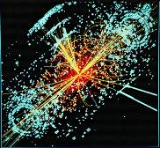

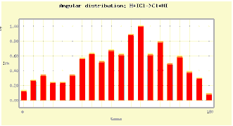
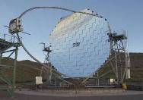

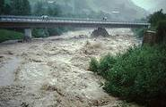
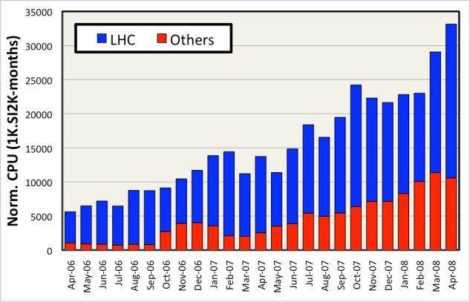
Shared e-Infrastructure
>270 communities
from many different domains
  Astronomy & Astrophysics
  Civil Protection
  Computational Chemistry
  Comp. Fluid Dynamics
  Computer Science/Tools
  Condensed Matter Physics
  Earth Sciences
  Fusion
  High Energy Physics
  Life Sciences
  …
Applications have moved from
testing to routine and daily usage
~80-95% efficiency

Slide 15
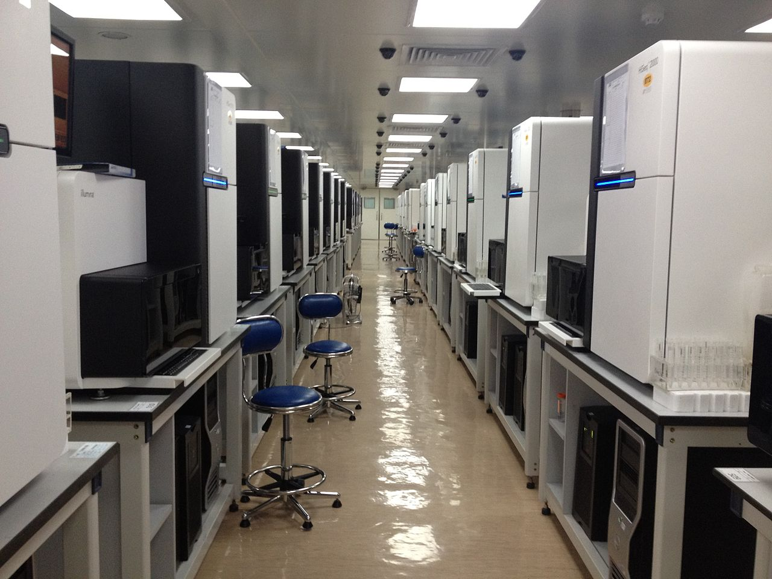
Global data flows
~150GByte, 12hrs
per (human) genome
per sequencer
But 1000+ sequencers…
50TByte from ‎Shenzhen to
NL is (still) done by rucksack
Genome sequencing at the Beijing Genomics Institute BGI
Photo: Scotted400, CC-BY-3.0

Slide 16
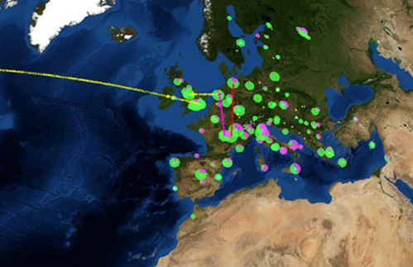
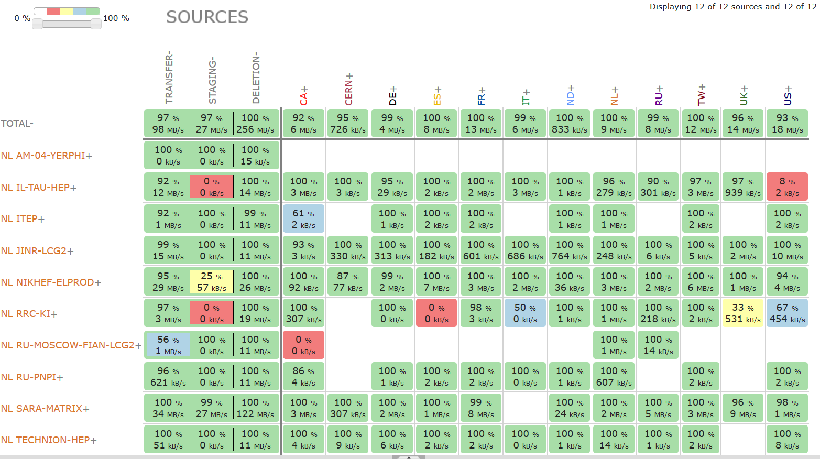
Distributed analysis – ‘Atlas neighbours’
http://dashb-atlas-ddm.cern.ch/ddm2

Slide 17
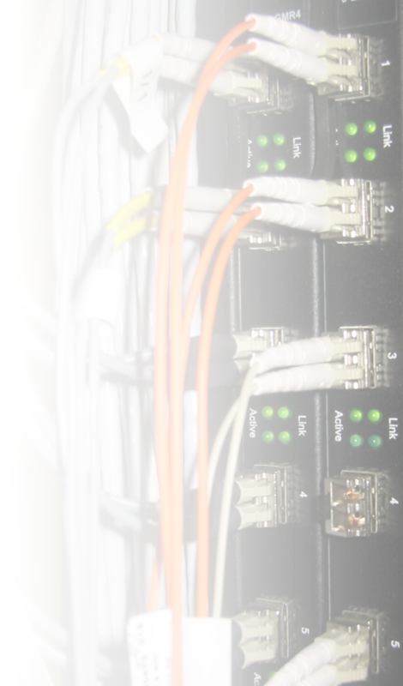


There’s always a network close to you
Doubling Time
(months)
Optical Fibre
(bits per second)
Gilder’s Law
(32X in 4 yrs)
9 12 18
Data Storage
(bits per sq. inch)
Storage Law
(16X in 4yrs)
Performance per Dollar Spent
Chip capacity
(# transistors)
Moore’s Law
(5X in 4yrs)
0 1 2 3 4 5
Number of Years
SURFnet pioneered ‘lambda’ and hybrid networks in the world
and likely contributed to the creation of
a market for ‘dark fibre’ in the Netherlands
There’s always fibre within 2 miles from you – where ever you are!
(it’s just that last mile to your home that’s missing
– and the business model of your telecom provider…)

Slide 18
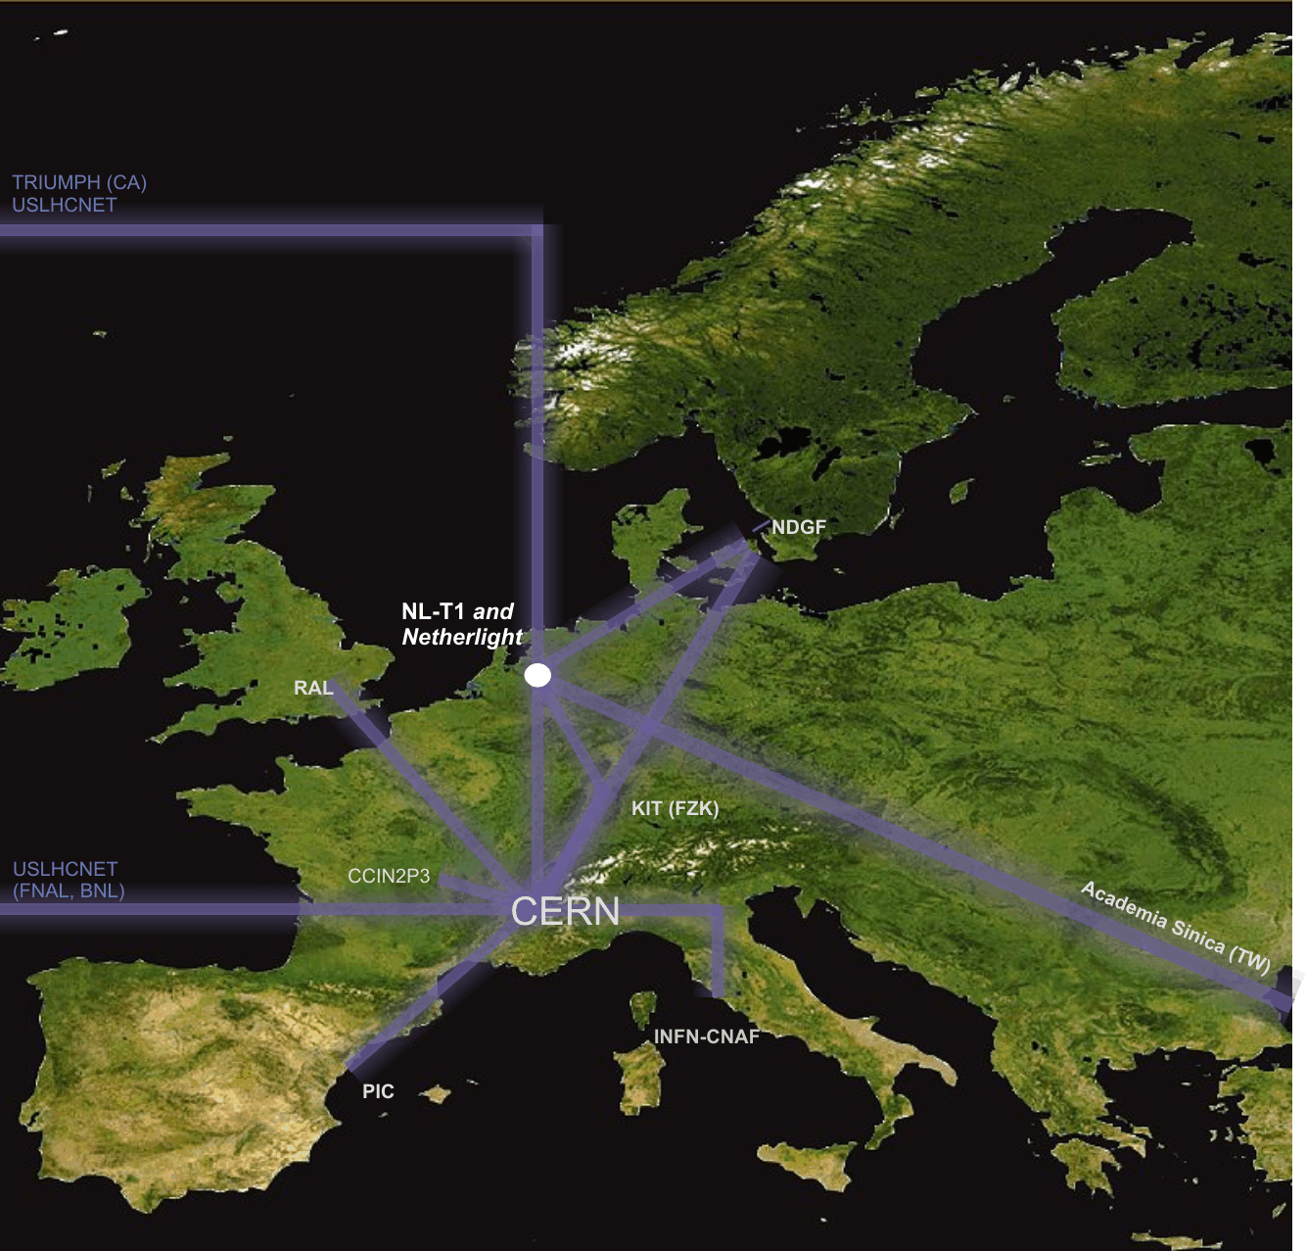
Interconnecting the Grid – the LHCOPN/LHCOne network
LHC Optical Private Network
10 – 40 Gbps dedicated
global networks
Scaled to T0-T1 data transfers
(nominally 300 Mbyte/s/T1 systained)

Slide 19
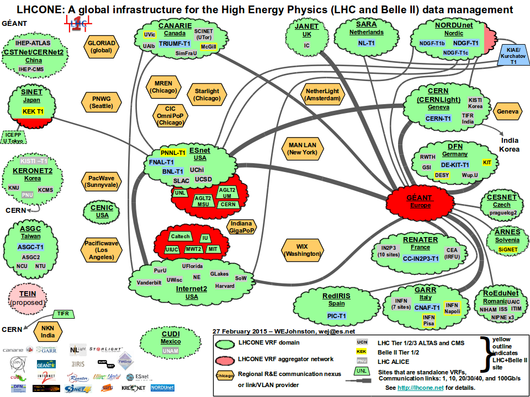
LHC OPN and LHCOne

Slide 20
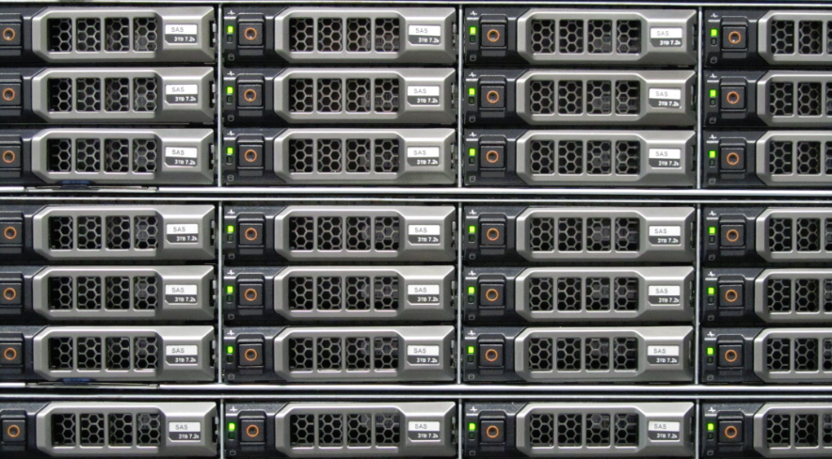
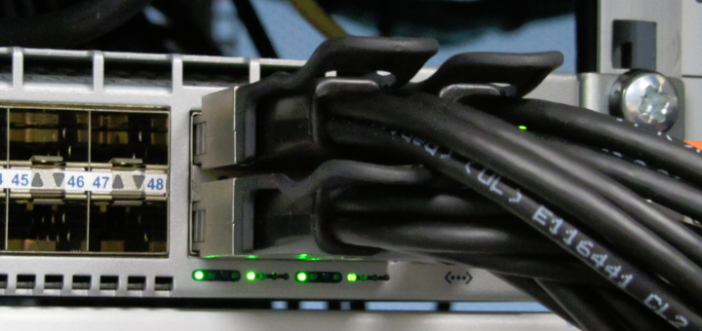
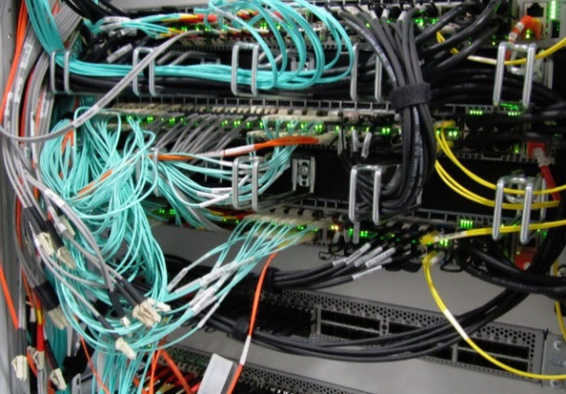
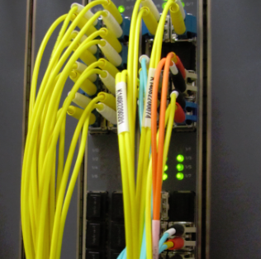

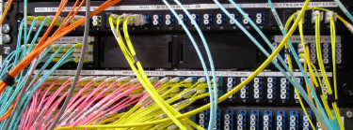
The Flow of Data at Nikhef
10 – 40 Gbps per server
240 Gbps interconnect
44 disk servers
~3 PiB (~3000 TByte)
2 control & DB nodes
Peerings: SURFnet, SURFsara,
Kurchatov, AMOLF, CWI,
LHCOPN, LHCOne via SARA
>200 Gbps uplinks

Slide 21
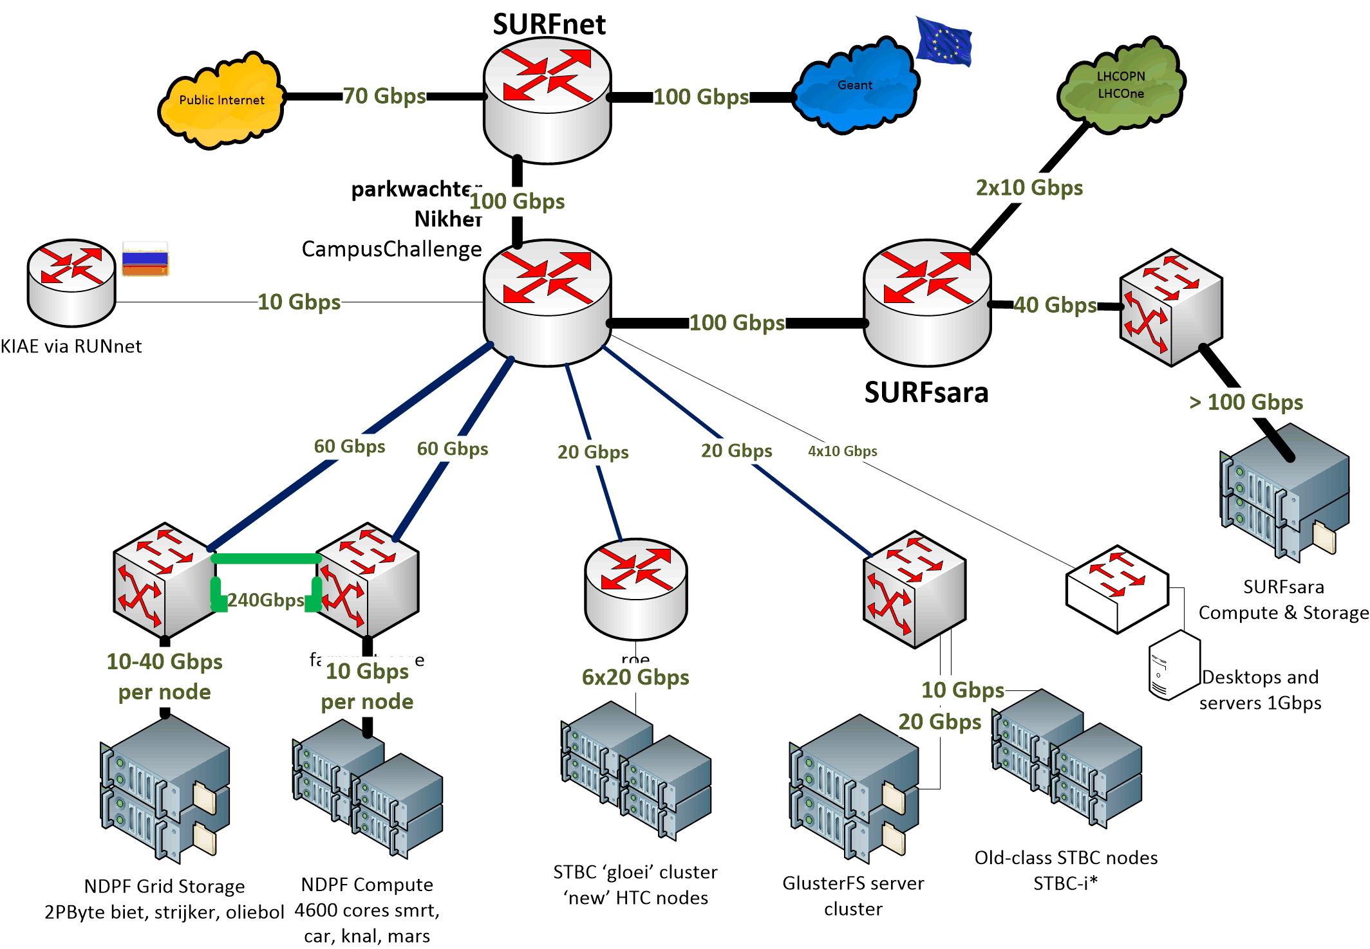

Nikhef Data Processing network

Slide 22
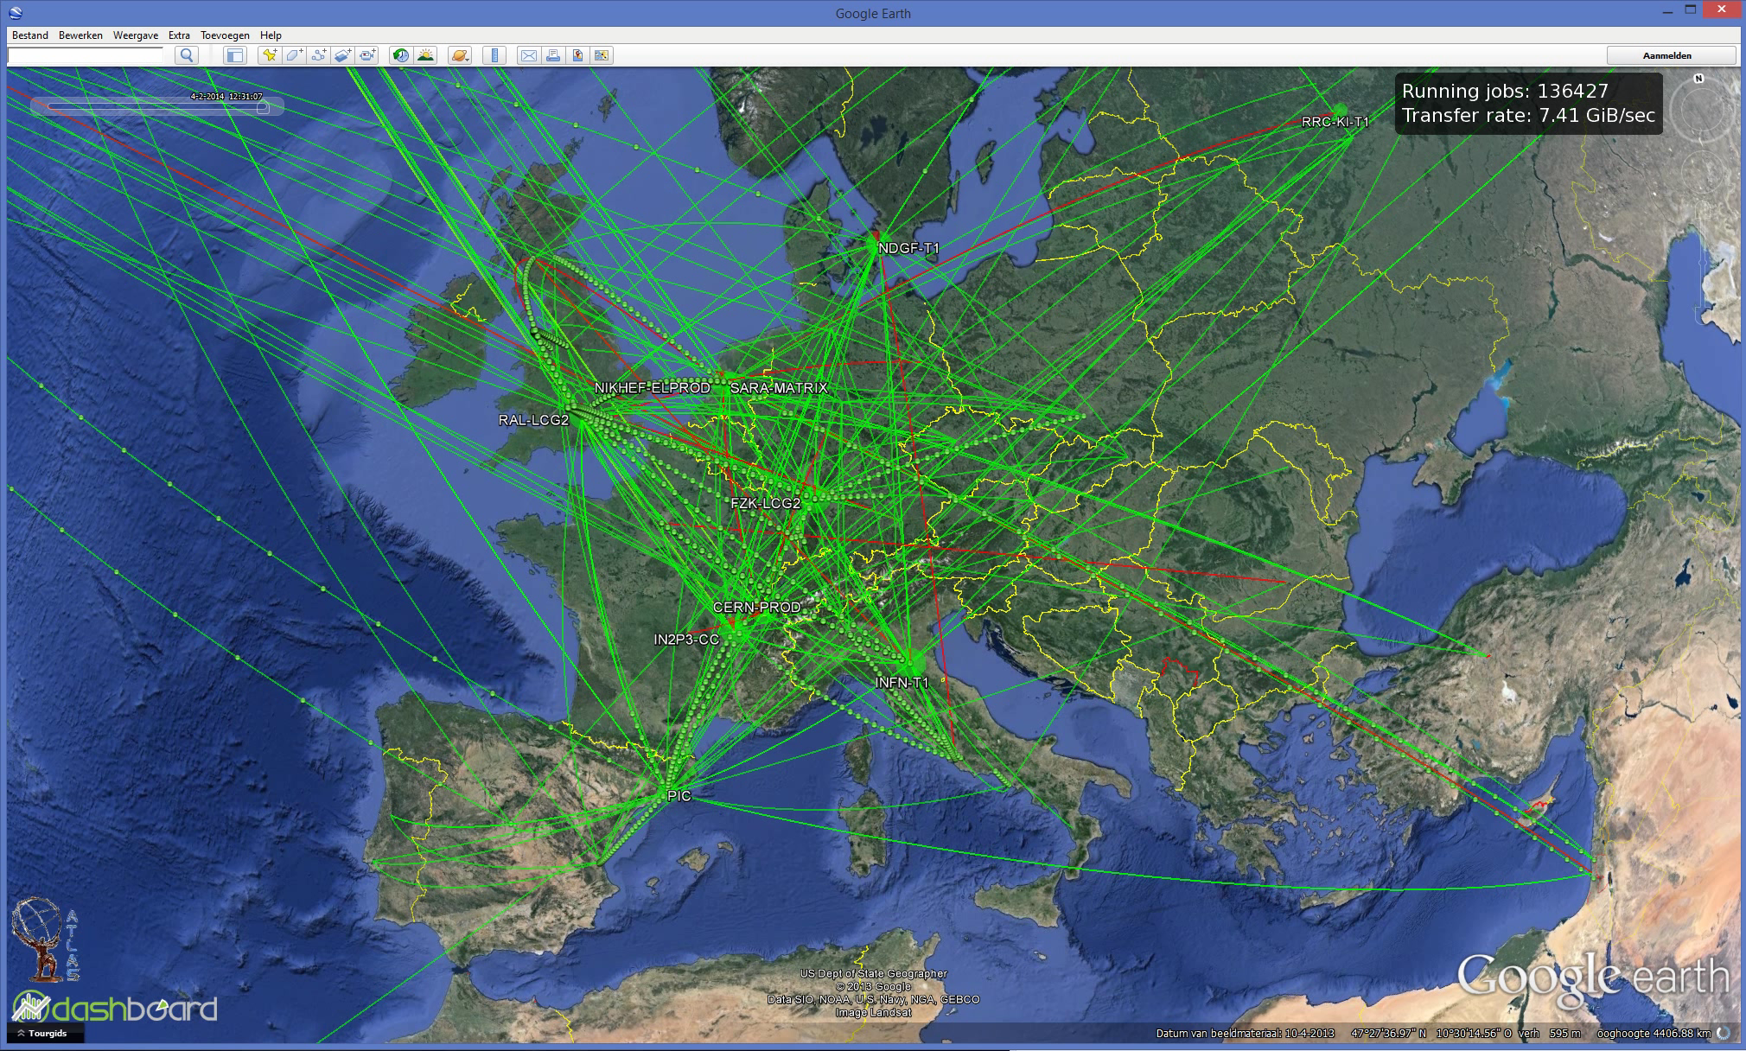
Data Flows in the LHC Computing Grid

Slide 23
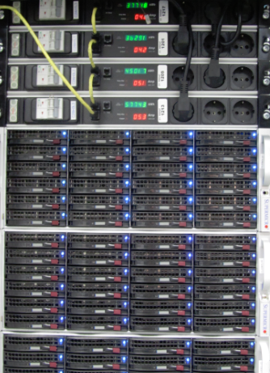
But that’s only a small subset
LCG “FTS” visualisation sees but part of the data
only shows the centrally managed data transfers
sees only traffic from Atlas, CMS, and LHCb
cannot show the quality, nor bandwidth used
But each of our nodes sees all
its transfers
server logging is in itself data
we collect it all

Slide 24
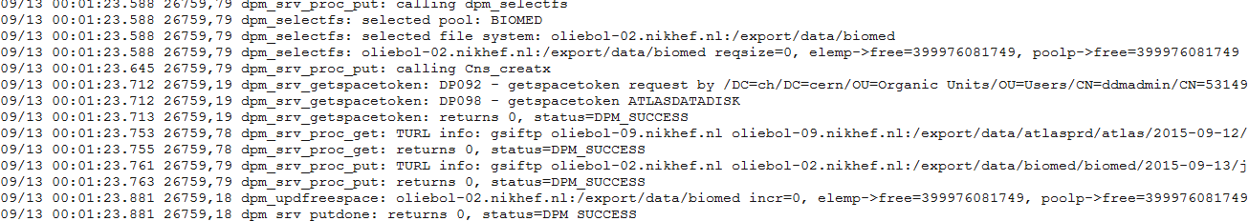
One day worth of logs … ~12GB/day
tbn18.nikhef.nl:/var/log/
631M dpm/log.1
1.1G dpns/log.1
639M srmv2.2/log.1
plus 44 disk server nodes @250 Mbyte/day
And then our storage manager is still ‘decent’ …

Slide 25
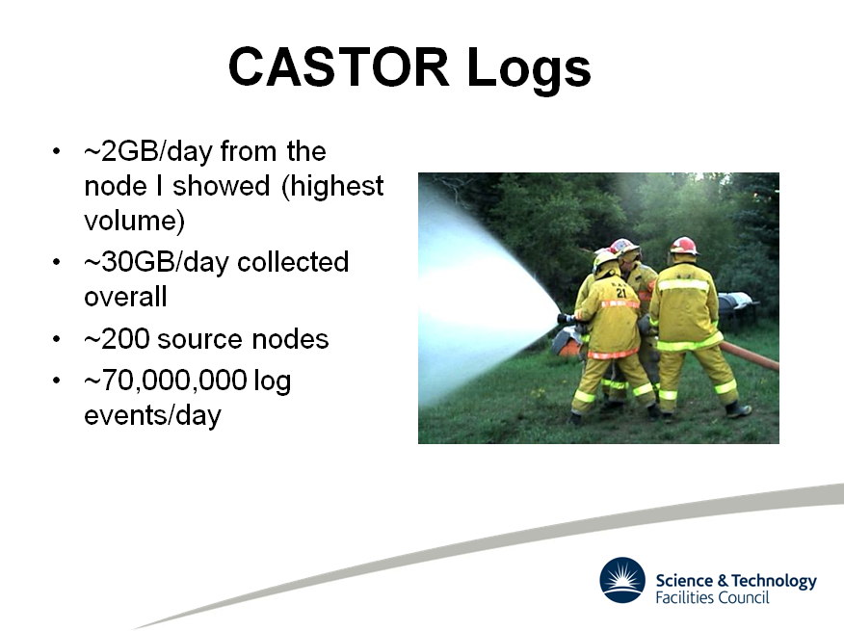
Slide by Rob Appleyard, RTFC RAL – at ISGC 2015

Slide 26
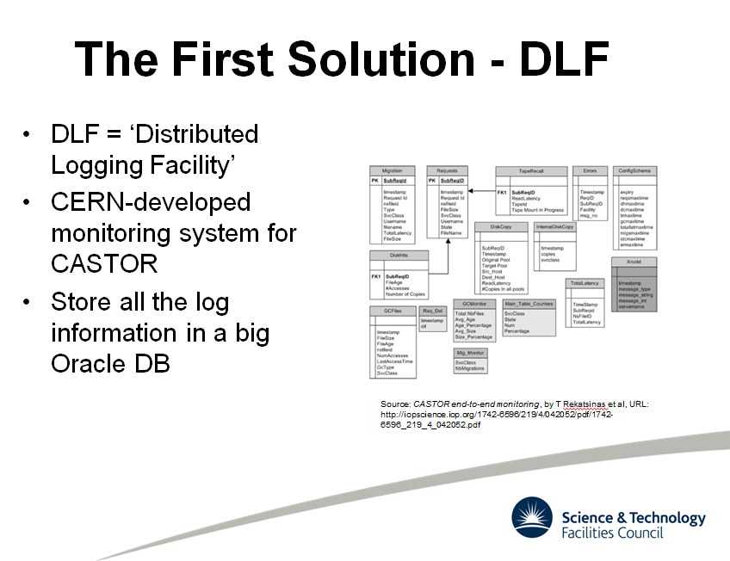
Slide by Rob Appleyard, RTFC RAL – at ISGC 2015

Slide 27
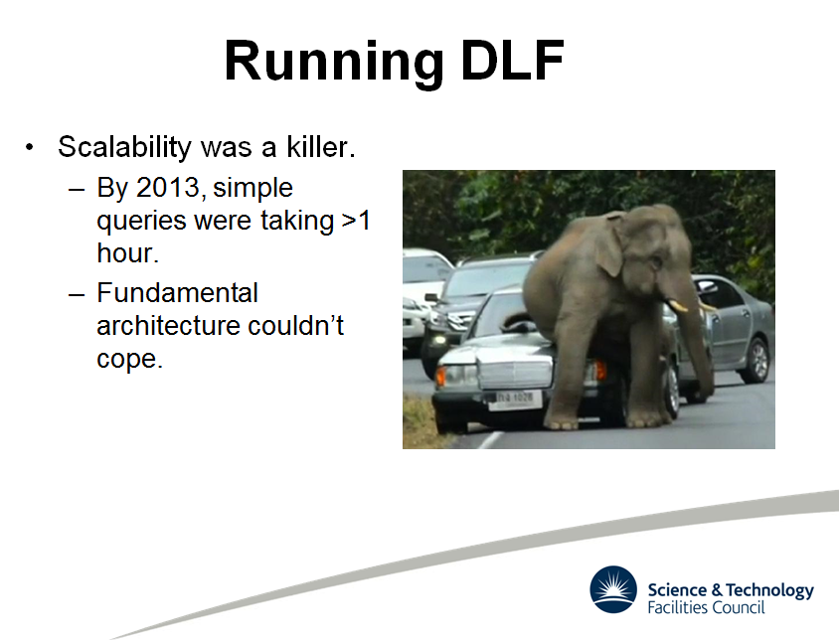
Slide by Rob Appleyard, RTFC RAL – at ISGC 2015

Slide 28
Big Data Analytics for log analysis
Analysis of log data is typical ‘big data’ problem
  CERN tried Hadoop (‘map-reduce’)
  RAL went with … ELK*
For logs specifically, it’s mostly efficient search
  ElasticSearch (www.elastic.co)
  LogStash (collect and parse logs, import to ES)
  Kibana – analysis based on Apache Lucene + graphing
Integrated into a single ‘stack’: ELK
*Appleyard et al., http://pos.sissa.it/archive/conferences/239/027/ISGC2015_027.pdf

Slide 29
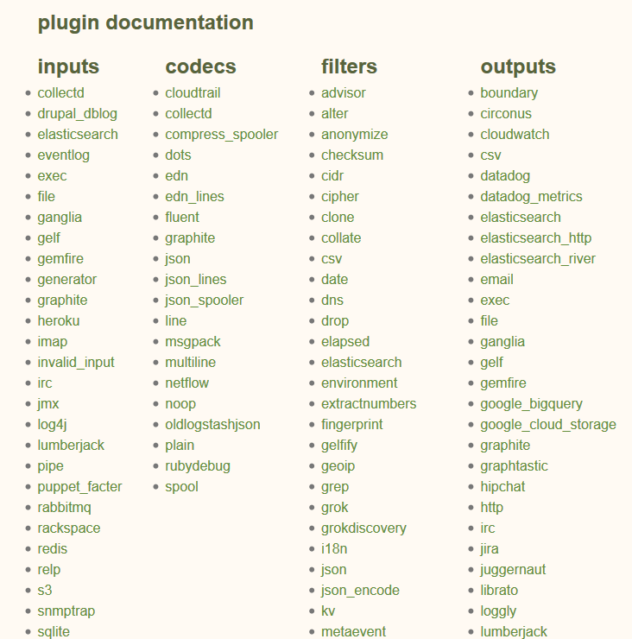
LogStash
Data arrives in format A…
…process B occurs…
…data out in format C
e.g. convert syslog into json

Slide 30
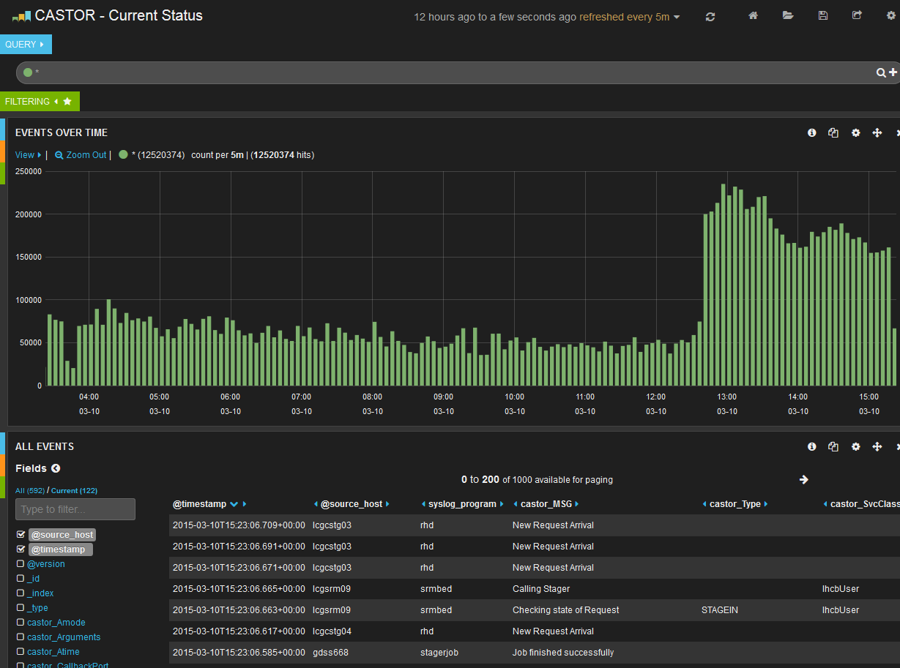
Analyse ‘by hand’: Kibana & Lucene
Graphic from Rob Appleyard, RTFC RAL – at ISGC 2015

Slide 31
Challenges ahead!
At the start
  44+ difference data sources, 240 Gbps of traffic
  150+ different storage partners, 55 countries/regions
  public internet plus the LHCOPN/LHCOne
  5000+ users, working 24x7
… and ‘grep’ for a tool … ☹
And phase I added
setup of a big data analytics cluster (ELK)
merge diverse data sources into a single system
define queries and find some global anomalies ☺

Slide 32
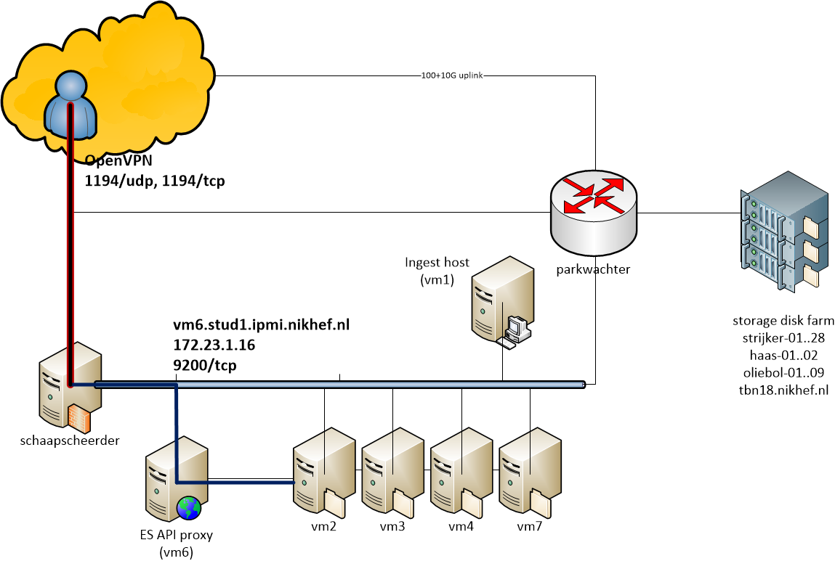
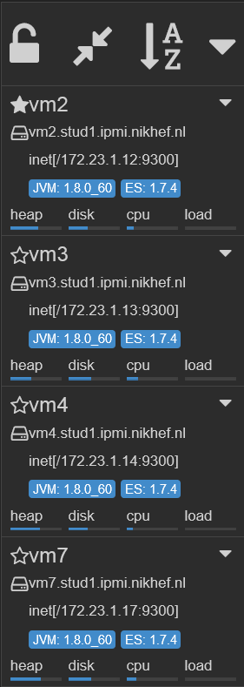
ELK Cluster and Interface

Slide 33
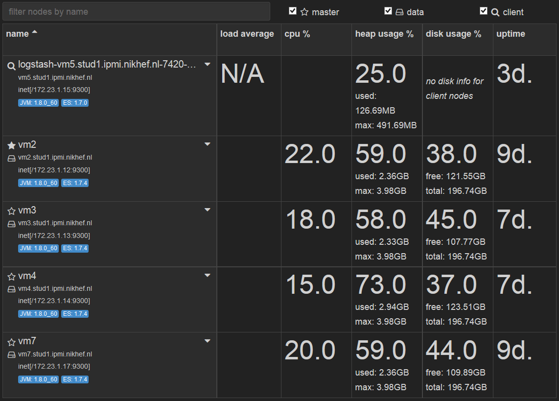
Filled with data

Slide 34


Filling it up: from 0 to ~ 500 million
16 M records/day
Graphics courtesy Jouke Roorda, Olivier Verbeek, Rens Visser

Slide 35


Data flows: a user at UC Irvine
reading a data set from Nikhef,
with some background from CERN
and KIT Karlsruhe
Graphics courtesy Jouke Roorda, Olivier Verbeek, Rens Visser

Slide 36
Building upon phase I …
Phase II
How can global data flows be presented?
Can one conceive visualisations for the general public?
for users? or for both?
Identifying troublesome inter-peer links (and local disk servers) via analytics techniques
Identifying ‘hot’ (interesting) data by analysing usage
Pro-active security incident detection:
are there users ‘behaving strangely’?

Slide 37
Phase II: plenty to do!
…
What’s the way to explain WLCG data flows to the world?
which systems (or group of systems) uses the most bandwidth (in and out separately)
which systems (or group of systems) generates the most connections?
what does the spectrum of transfers look like? mostly big, mostly small, ... ?
what does the time distribution of transfers look like (bandwidth and also number)?

Slide 38


Queries and responses
Graphics courtesy Jouke Roorda, Olivier Verbeek, Rens Visser

Slide 39
Access services
https://wiki.nikhef.nl/grid/HvABigDataVisualisation
OpenVPN configuration
Access to full ES search API
Please limit yourself to query methods
Do not redistribute or copy records with PII
Kindly observe the Nikhef AUP as well –
and report any incidents to security@nikhef.nl

Slide 40

Your call!
Questions?
Code sample: Jouke Roorda, PDP-sample-app

