Slide 1
Showing Real Big Data
Towards visualisation of data transfers
with ‘Big Data’ analytics techniques
HvA induction session september 2015
David Groep, Nikhef

Slide 2


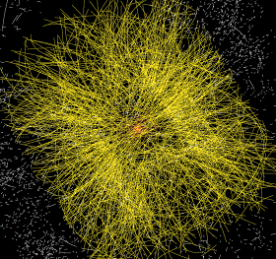
Balloon
(30 Km)
CD stack with
1 year LHC data!
(~ 20 Km)
Signal/Background 10⁻⁹
Data volume
  (high rate) X
  (large number of channels) X
  (4 experiments)
  ➔ 30+ PetaBytes of new data each year
Compute power
  (event complexity) X
  (number of events) X
  (thousands of users)
  ➔ 60’000 of (today's) fastest CPUs
Concorde
(15 Km)
Mt. Blanc
(4.8 Km)

Slide 3
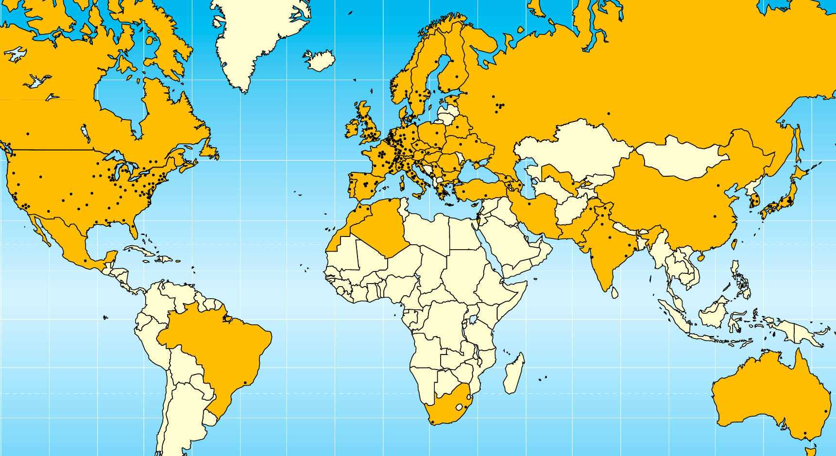

Today –
LHC Collaboration
20+ years est. life span
24/7 global operations
~ 4000 person-years of
science software investment
~ 5 000 physicists
~ 150 institutes
55+ countries, economic regions

Slide 4
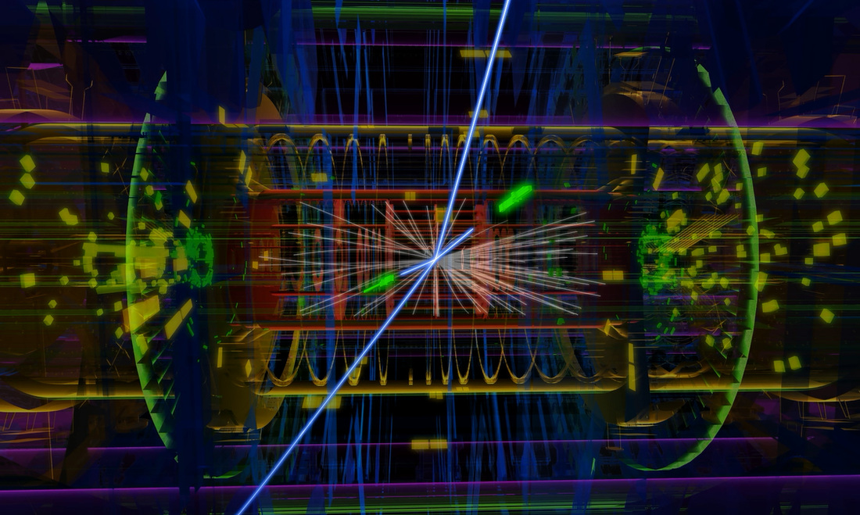
Atlas: ~50 TByte/day raw data to tape; 1000 TByte/day processed data transfers
Image source: CERN, Atlas

Slide 5




GridKa
IN2P3
TRIUMF
ASCC
Fermilab

Slide 6
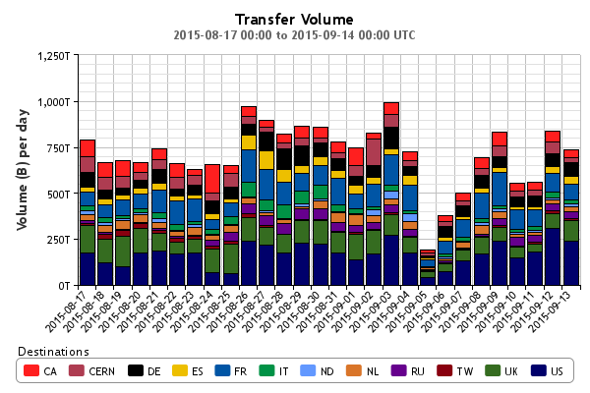
Big ‘as in Large’ Data
Atlas only
http://dashb-atlas-ddm.cern.ch/ddm2

Slide 7
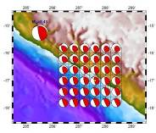


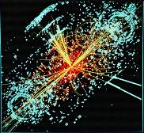

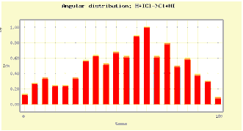
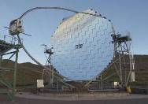

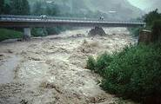
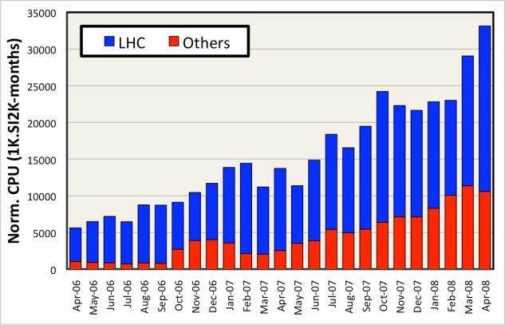
Shared e-Infrastructure
>270 communities
from many different domains
  Astronomy & Astrophysics
  Civil Protection
  Computational Chemistry
  Comp. Fluid Dynamics
  Computer Science/Tools
  Condensed Matter Physics
  Earth Sciences
  Fusion
  High Energy Physics
  Life Sciences
  …
Applications have moved from
testing to routine and daily usage
~80-95% efficiency

Slide 8
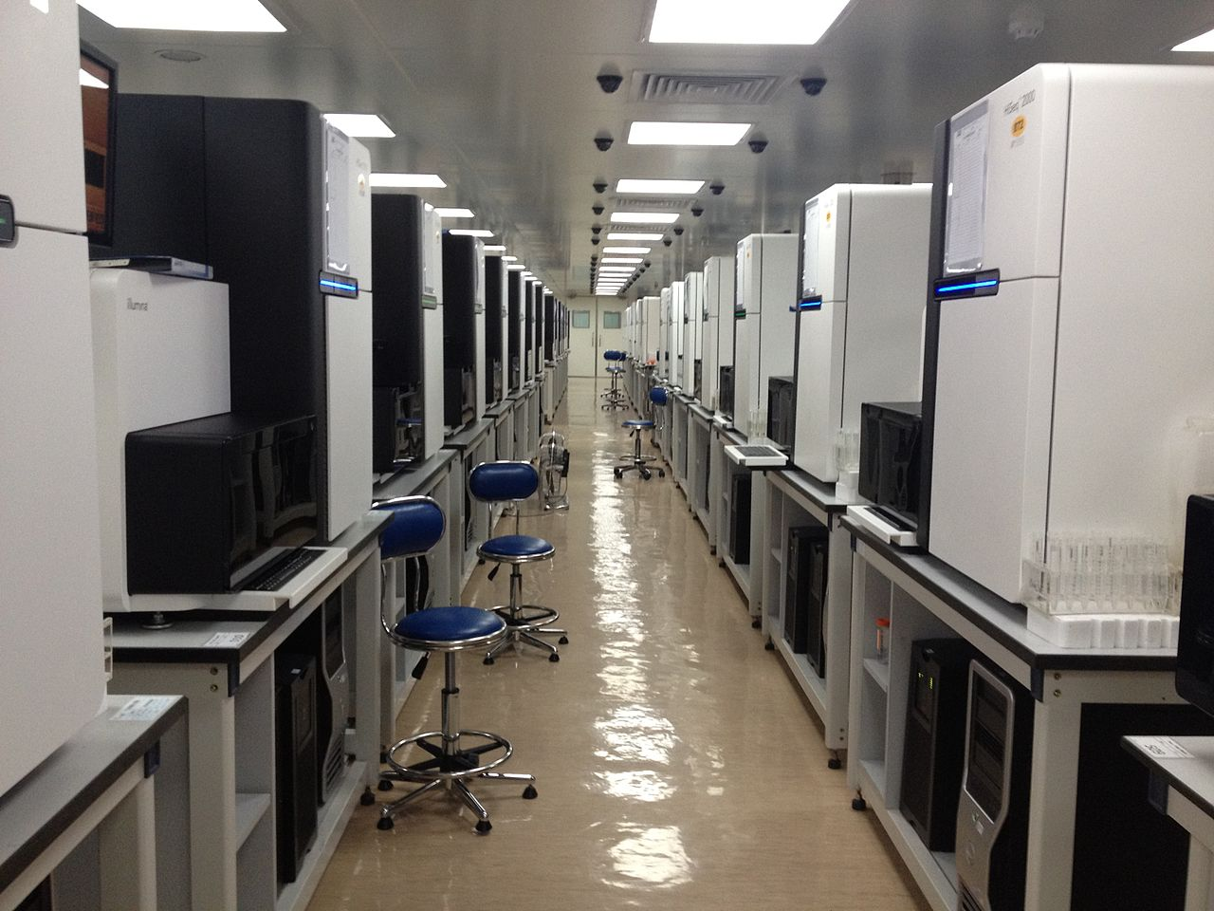
Global data flows
~150GByte, 12hrs
per (human) genome
per sequencer
But 1000+ sequencers…
50TByte from ‎Shenzhen to
NL is (still) done by rucksack
Genome sequencing at the Beijing Genomics Institute BGI
Photo: Scotted400, CC-BY-3.0

Slide 9
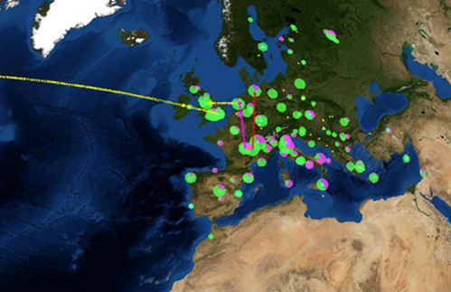
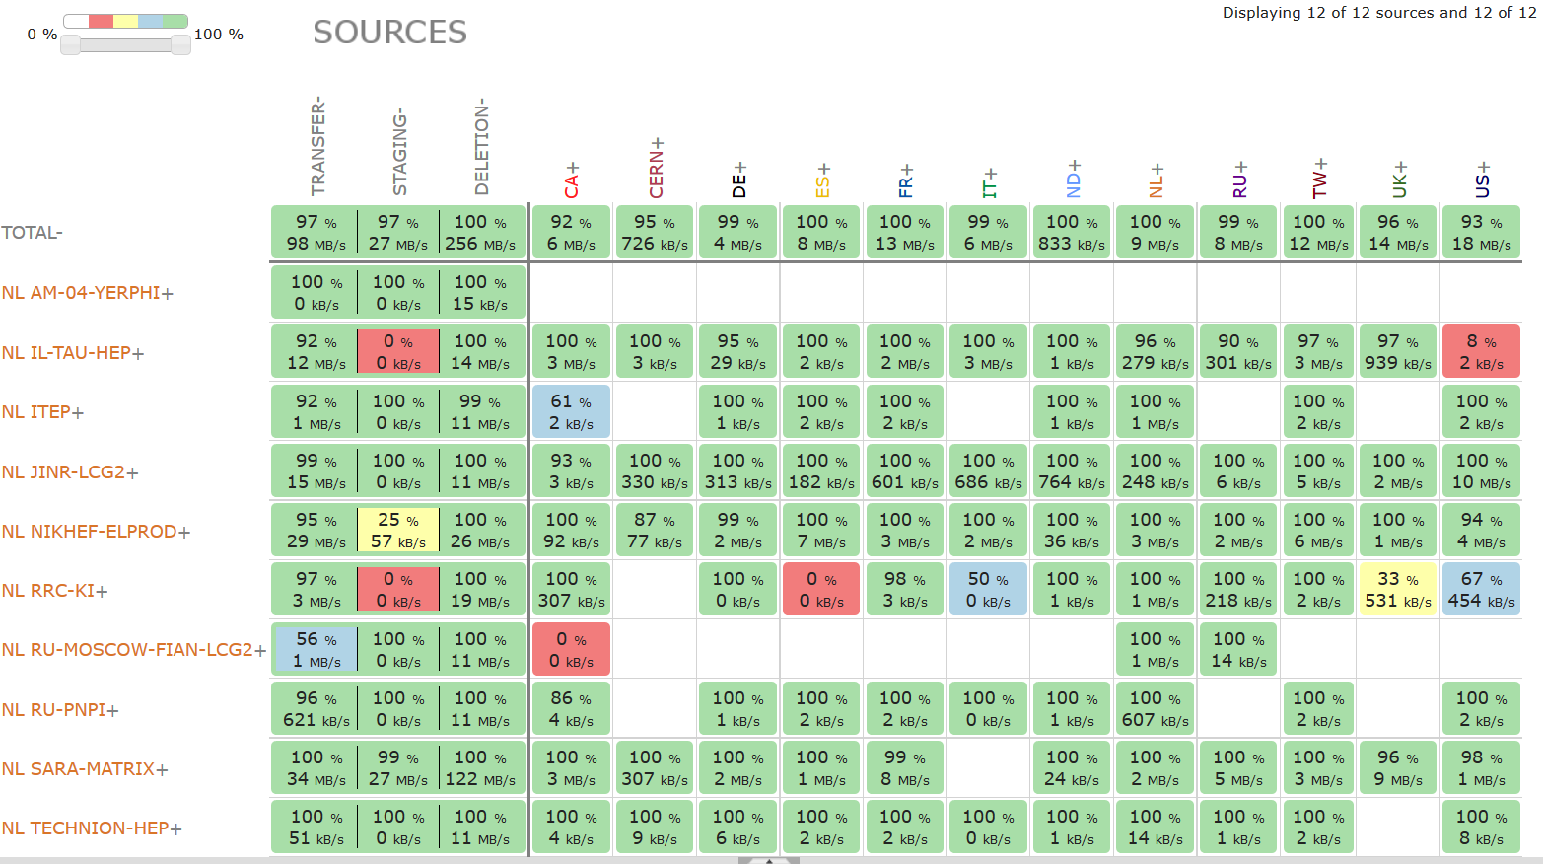
Distributed analysis – ‘Atlas neighbours’
http://dashb-atlas-ddm.cern.ch/ddm2

Slide 10
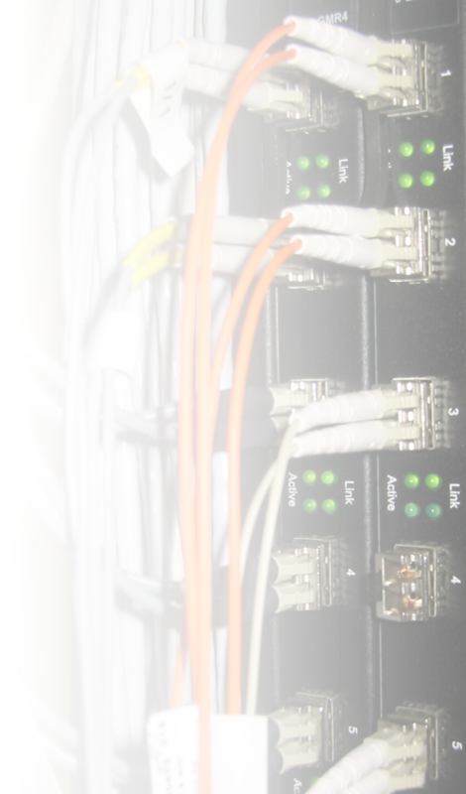


There’s always a network close to you
Doubling Time
(months)
Optical Fibre
(bits per second)
Gilder’s Law
(32X in 4 yrs)
9 12 18
Data Storage
(bits per sq. inch)
Storage Law
(16X in 4yrs)
Performance per Dollar Spent
Chip capacity
(# transistors)
Moore’s Law
(5X in 4yrs)
0 1 2 3 4 5
Number of Years
SURFnet pioneered ‘lambda’ and hybrid networks in the world
and likely contributed to the creation of
a market for ‘dark fibre’ in the Netherlands
There’s always fibre within 2 miles from you – where ever you are!
(it’s just that last mile to your home that’s missing
– and the business model of your telecom provider…)

Slide 11
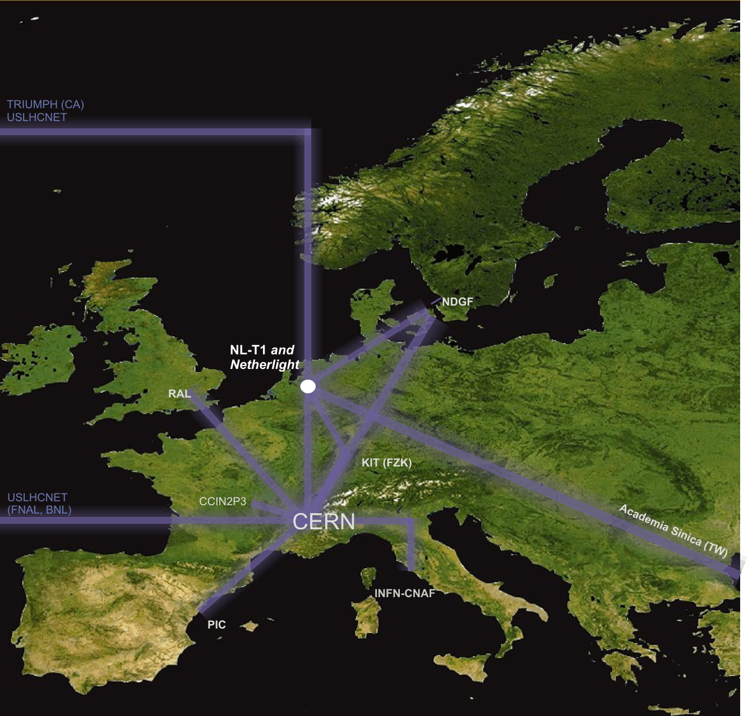
Interconnecting the Grid – the LHCOPN/LHCOne network
LHC Optical Private Network
10 – 40 Gbps dedicated
global networks
Scaled to T0-T1 data transfers
(nominally 300 Mbyte/s/T1 systained)

Slide 12
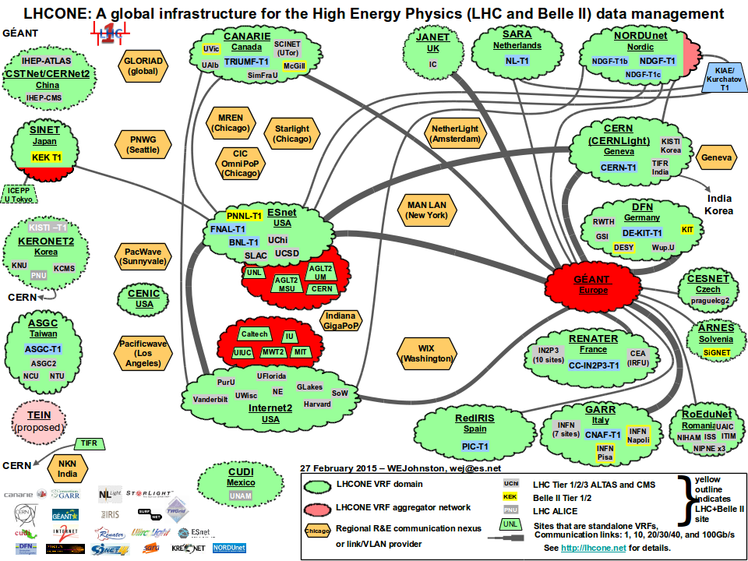
LHC OPN and LHCOne

Slide 13
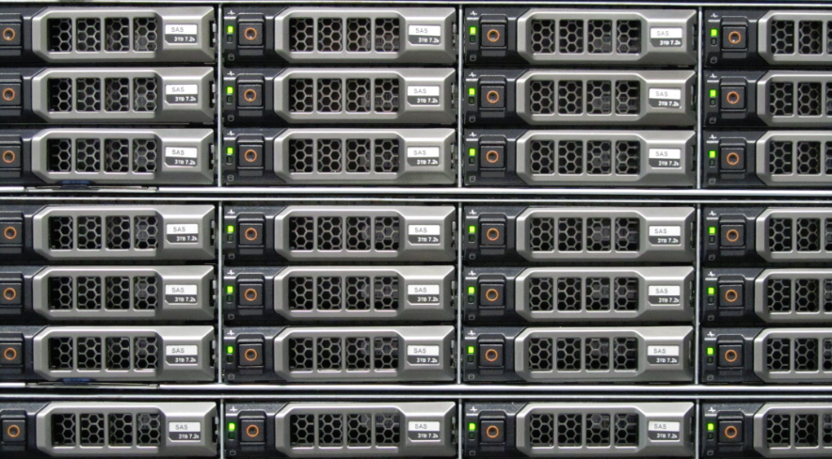
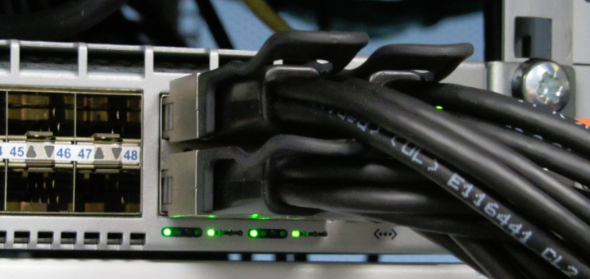
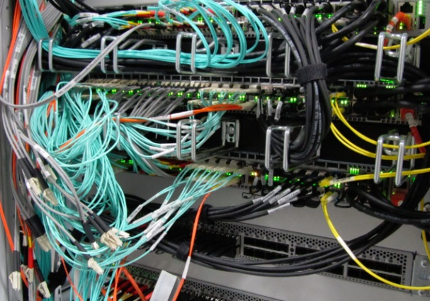
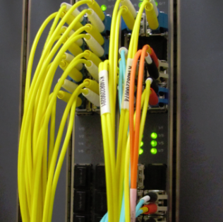

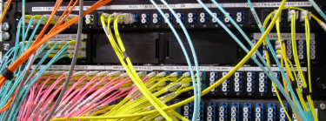
The Flow of Data at Nikhef
10 – 40 Gbps per server
240 Gbps interconnect
44 disk servers
~3 PiB (~3000 TByte)
2 control & DB nodes
Peerings: SURFnet, SURFsara,
Kurchatov, AMOLF, CWI,
LHCOPN, LHCOne via SARA
>200 Gbps uplinks

Slide 14
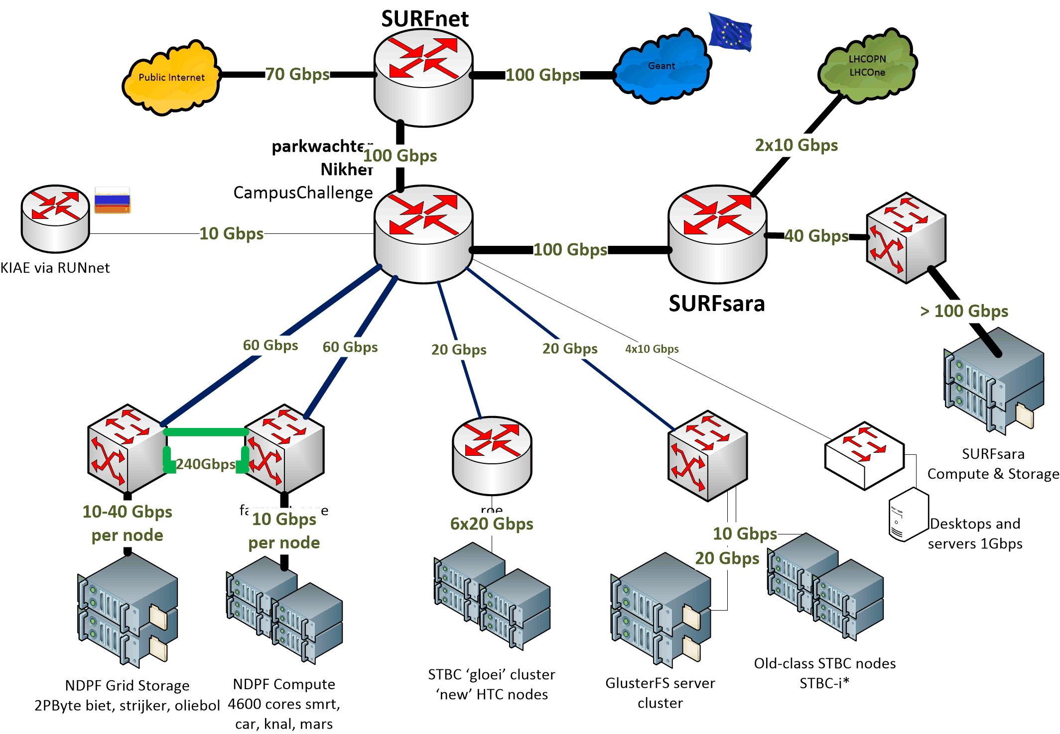

Nikhef Data Processing network

Slide 15
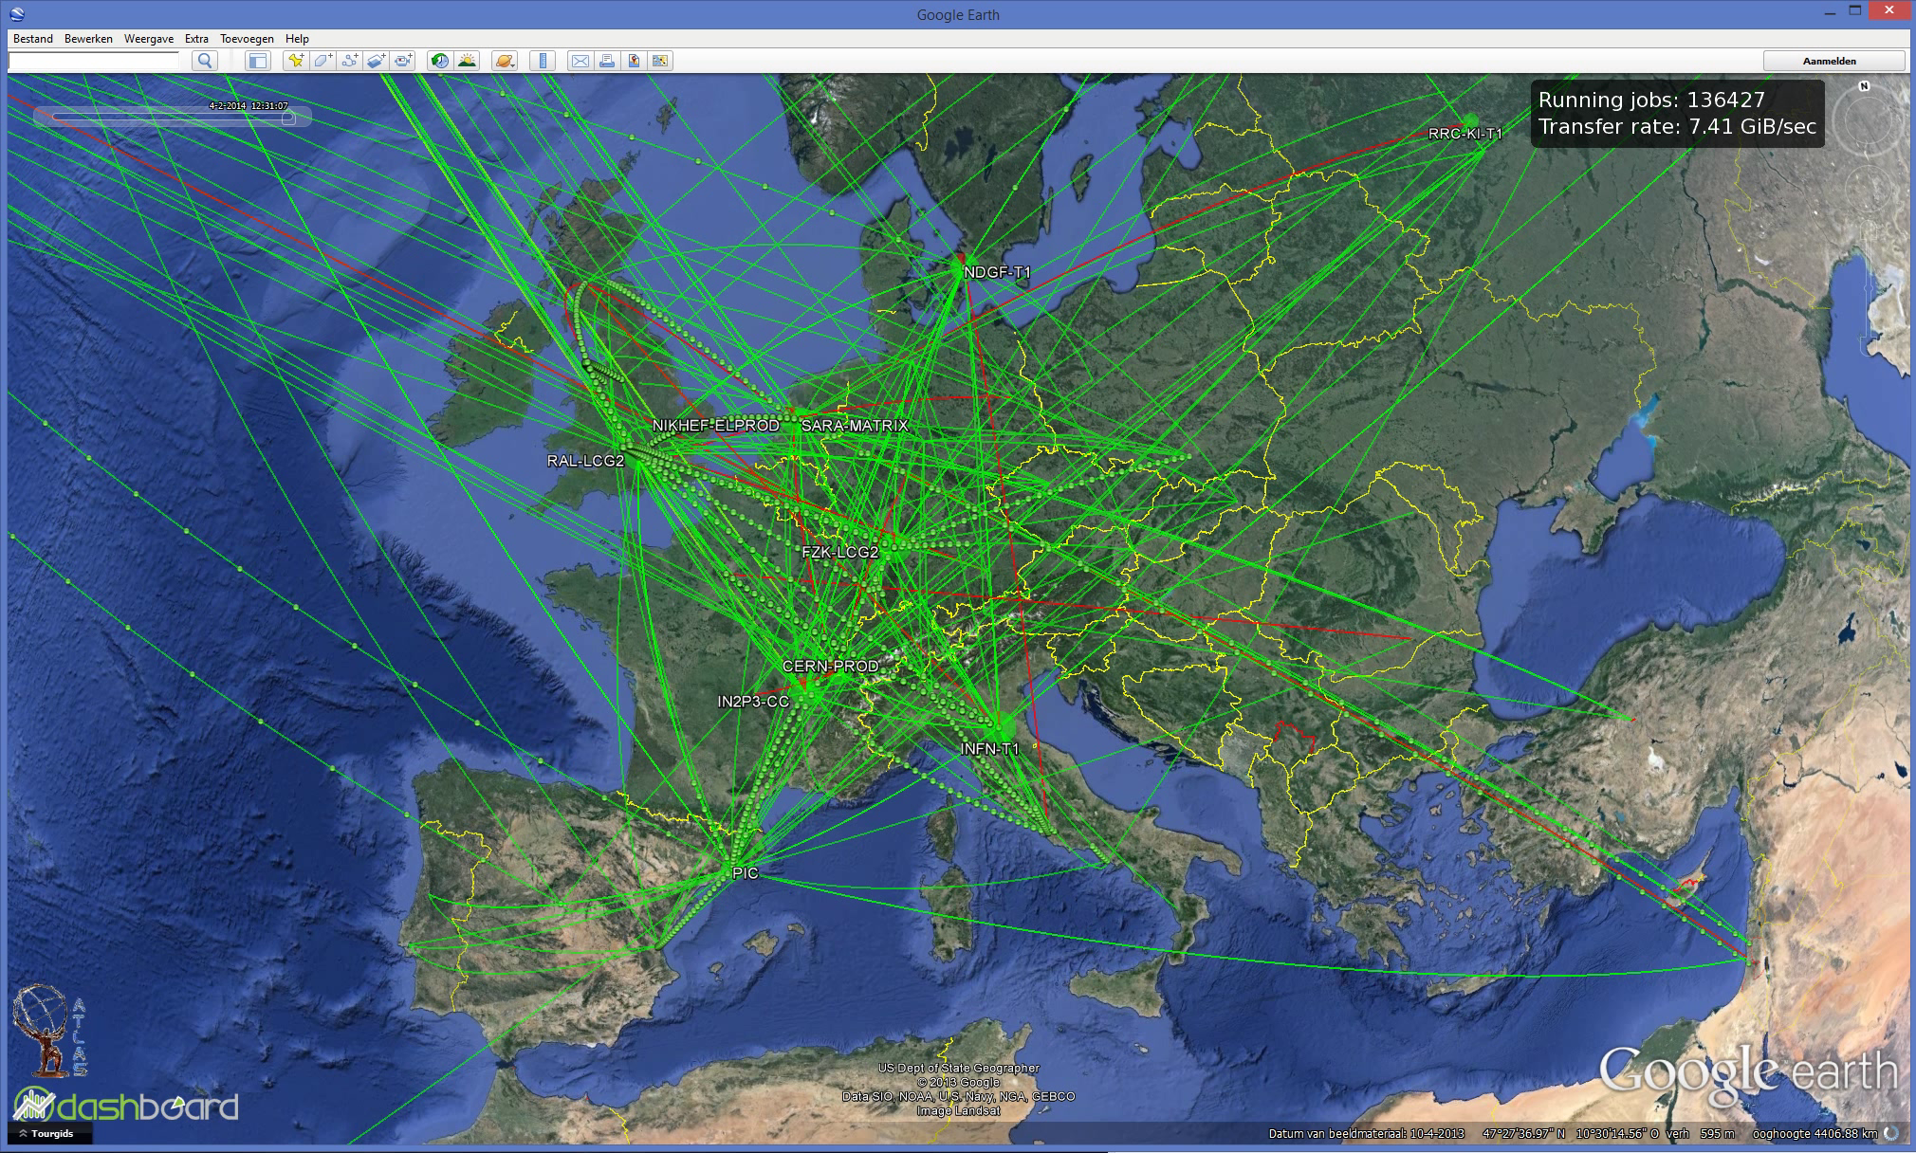
Data Flows in the LHC Computing Grid

Slide 16
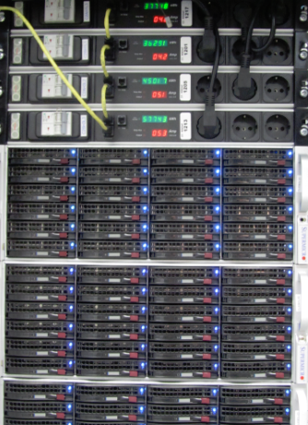
But that’s only a small subset
LCG “FTS” visualisation sees but part of the data
only shows the centrally managed data transfers
sees only traffic from Atlas, CMS, and LHCb
cannot show the quality, nor bandwidth used
But each of our nodes sees all
its transfers
server logging is in itself data
we collect it all

Slide 17
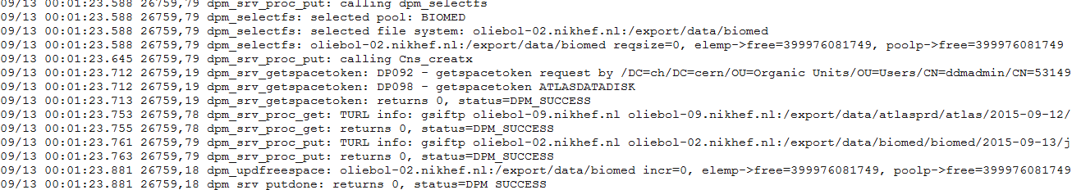
One day worth of logs … ~12GB/day
tbn18.nikhef.nl:/var/log/
631M dpm/log.1
1.1G dpns/log.1
639M srmv2.2/log.1
plus 44 disk server nodes @250 Mbyte/day
And then our storage manager is still ‘decent’ …

Slide 18
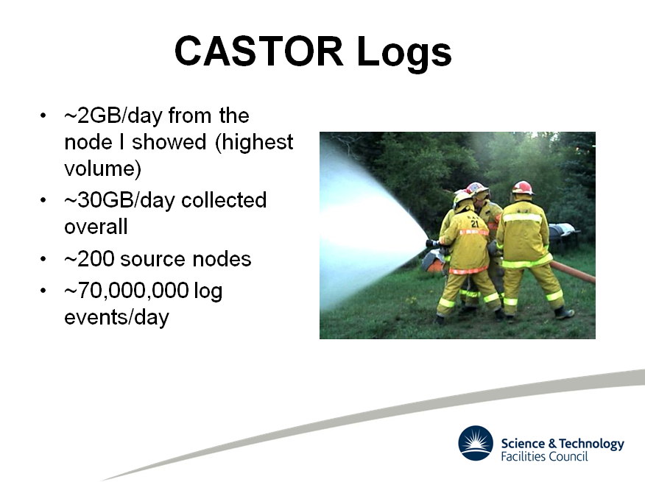
Slide by Rob Appleyard, RTFC RAL – at ISGC 2015

Slide 19
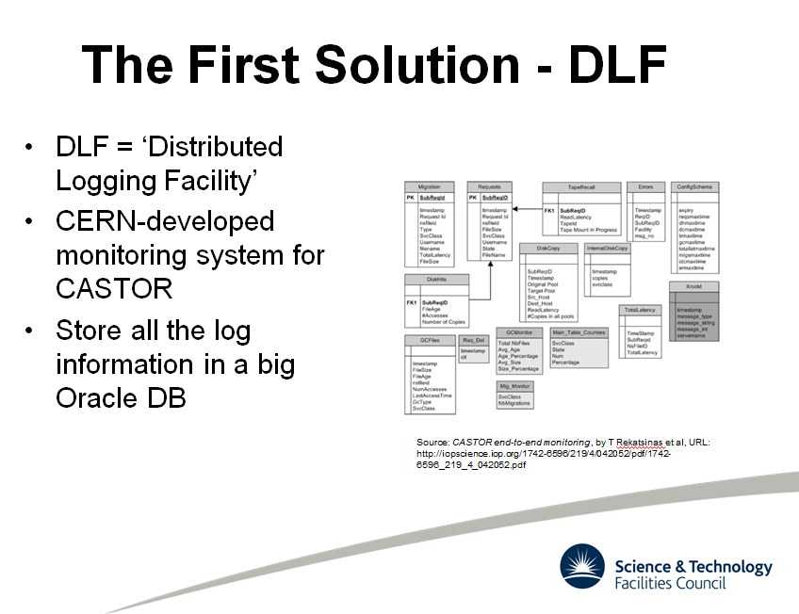
Slide by Rob Appleyard, RTFC RAL – at ISGC 2015

Slide 20
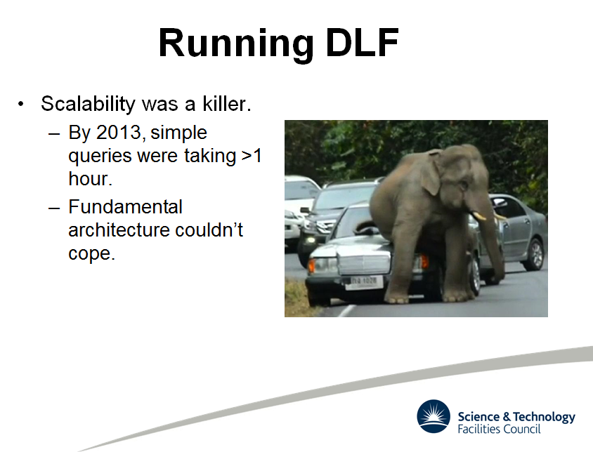
Slide by Rob Appleyard, RTFC RAL – at ISGC 2015

Slide 21
Big Data Analytics for log analysis
Analysis of log data is typical ‘big data’ problem
  CERN tried Hadoop (‘map-reduce’)
  RAL went with … ELK*
For logs specifically, it’s mostly efficient search
  ElasticSearch (www.elastic.co)
  LogStash (collect and parse logs, import to ES)
  Kibana – analysis based on Apache Lucene + graphing
Integrated into a single ‘stack’: ELK
*Appleyard et al., http://pos.sissa.it/archive/conferences/239/027/ISGC2015_027.pdf

Slide 22
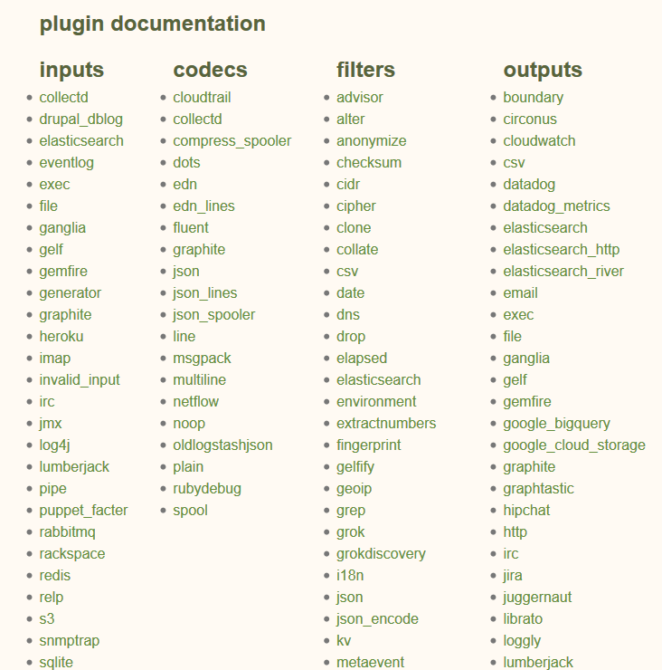
LogStash
Data arrives in format A…
…process B occurs…
…data out in format C
e.g. convert syslog into json

Slide 23
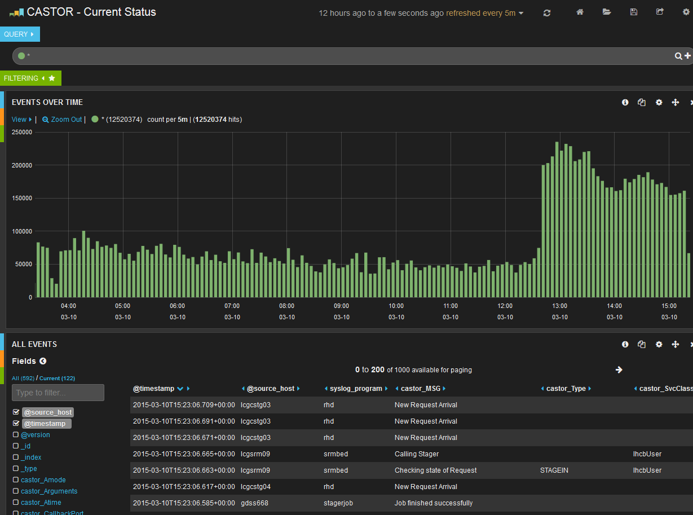
Analyse, for now with Kibana/Lucene
Graphic from Rob Appleyard, RTFC RAL – at ISGC 2015

Slide 24
Challenges ahead!
For now, we have
  44+ difference data sources, 240 Gbps of traffic
  150+ different storage partners, 55 countries/regions
  public internet plus the LHCOPN/LHCOne
  5000+ users, working 24x7
… and ‘grep’ for a tool … ☹
Phase I:
setup of a big data analytics cluster (ELK)
merge diverse data sources into a single system
define queries and find some global anomalies ☺

Slide 25
Building upon phase I
As an (optional) addition/extension to phase I
Discuss if ELK indeed the right tool for this: can it cope with the volume? It the ElasticSearch API suitable for defining new visualisations?
Add additional data sources: are simple transfer logs enough? Does data flow correlate with computing, and can we see that by adding sources and defining (lucene) queries?
And in phase II (>Feb 2016)
How can global data flows be presented?
Can one conceive visualisations for the general public?
for users? or for both?

