Slide 1

Grid Technologies for AAI*
in Selected Grid Infrastructures and using a Subset of the available technologies (2010)
David Groep, Nikhef
with graphics by many others from publicly available sources ...
based on the ISGC2010 Security Middleware presentation

Slide 2
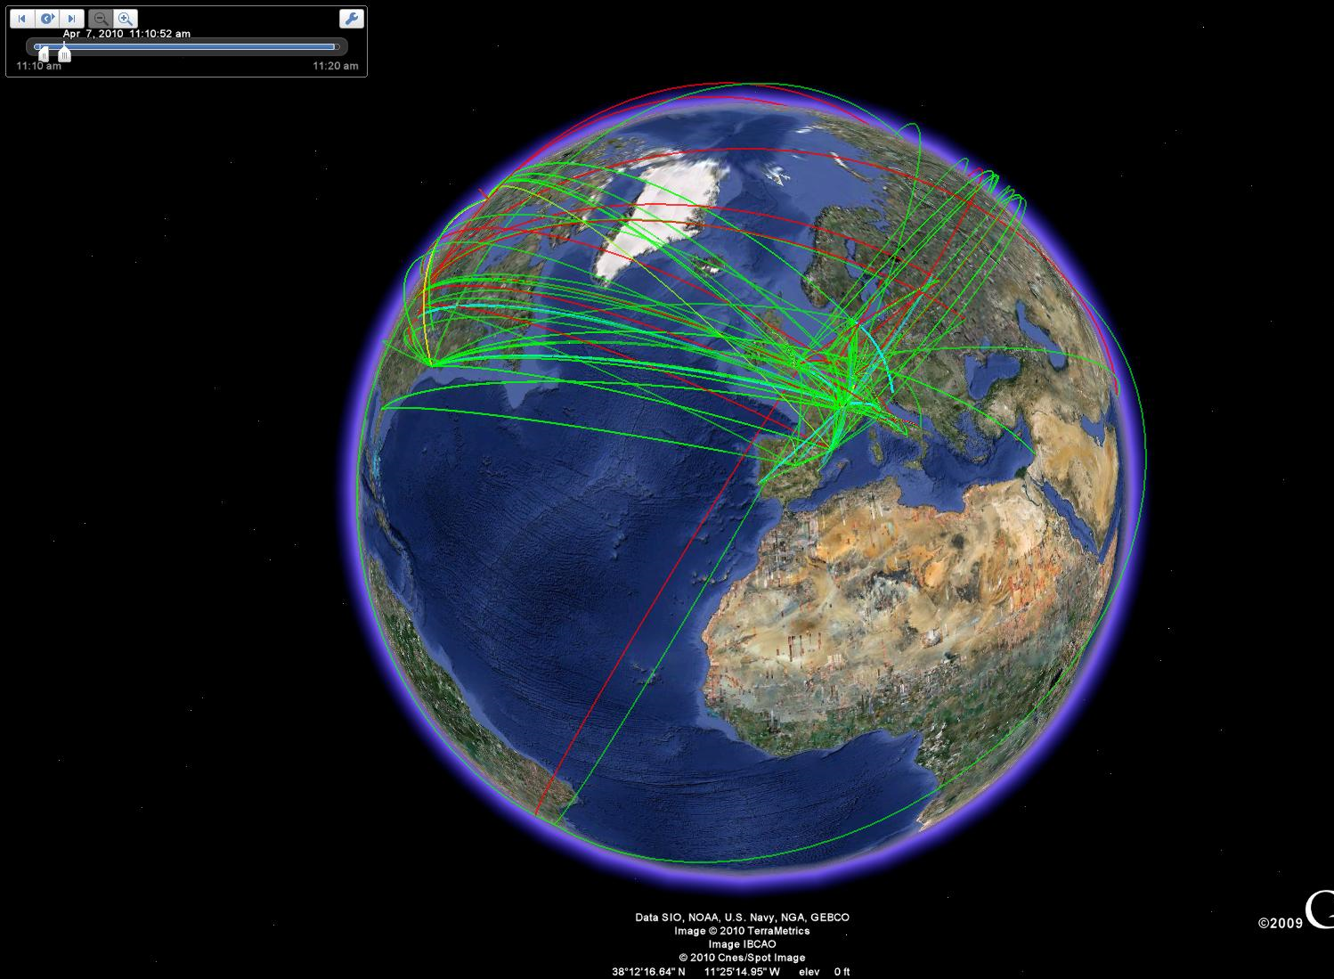
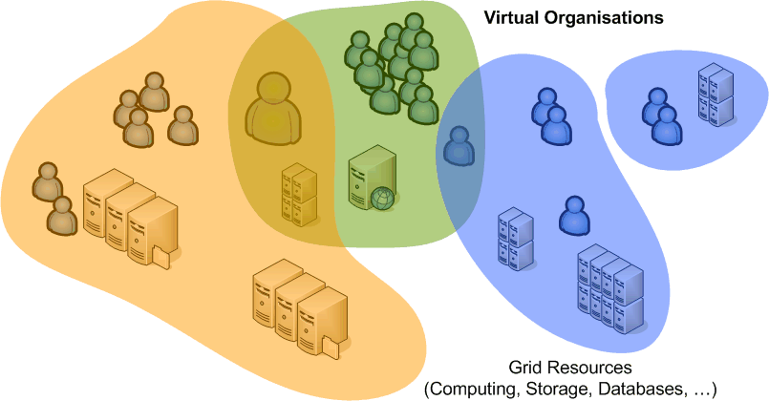
Grid is global
based around (dynamic)
user communities
not around their home organisations
that may live long or be over quickly
deal with compute, data, visualisation, services, and more
and can consist of staff, students, technicians, …

Slide 3
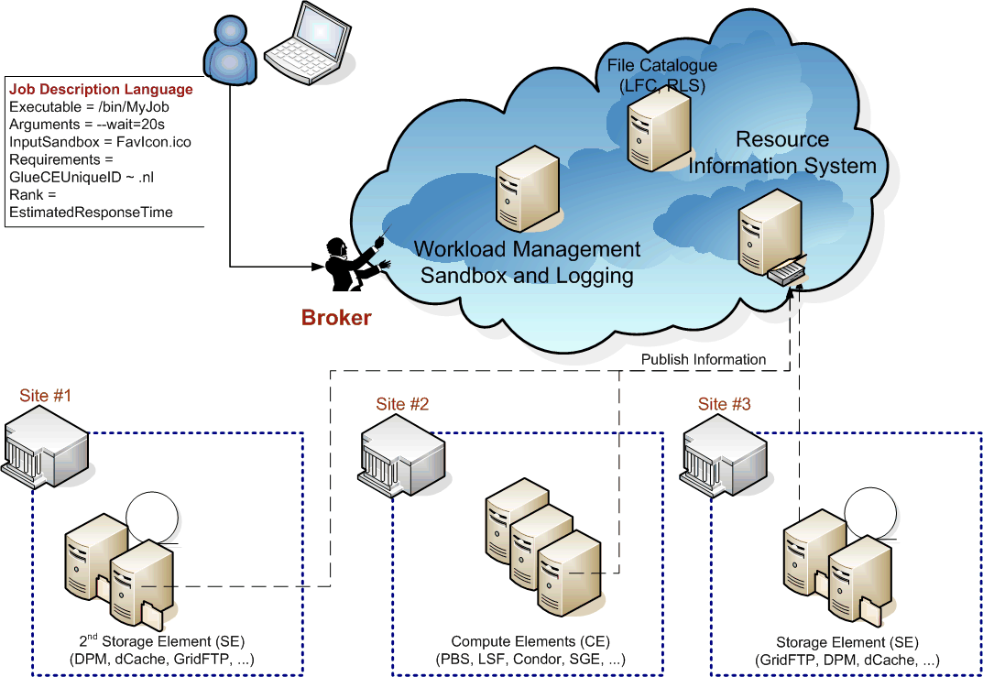
A Typical Grid Scenario

Slide 4
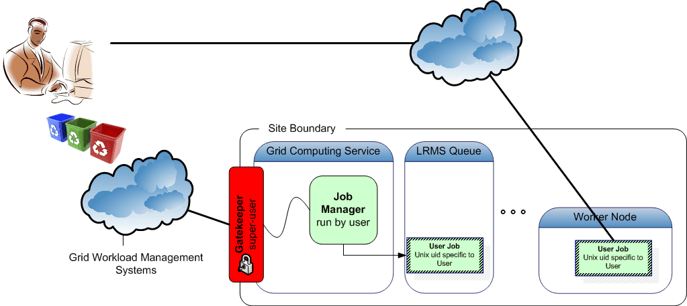
Non-interactive, autonomous work

Slide 5
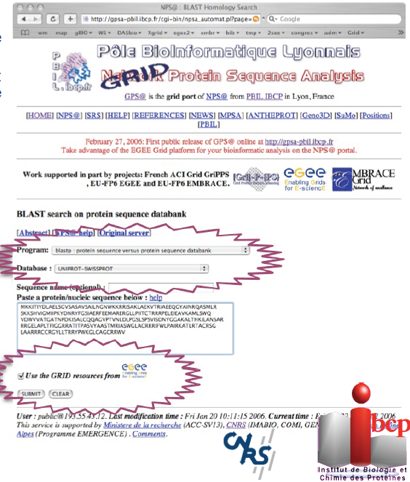
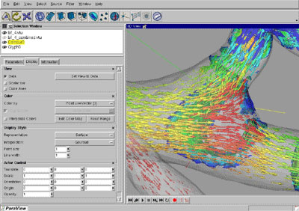
Or via portals
Flexible portals acting on behalf of the user,
work-flow portals with canned applications
turn-around: min-hours

Slide 6
What drove the Grid AAI model
Accommodate multiple sources for assertions
  AuthN vs. AuthZ is a logical implementable separation
Accommodate delegation (disconnected operation)
  Entities act on behalf of a user
  Service providers do not know (or cannot fully trust) each other
  Commensurate impact of resource compromise
    compromise of small resource should have limited impact
Accommodate individual, independent researchers
  collaboration without necessity to involve bureaucracy
Inspire enough trust for resource providers to relinquish per-user local registration and allow direct access to their systems
Has to work now (and has had to work since 2002!)

Slide 7
‘Grid’ Security Mechanism Foundations and scope
Authentication (vs. Authorization)
Obtaining trustworthy unique, persistent ID
Delegation and proxies

Slide 8
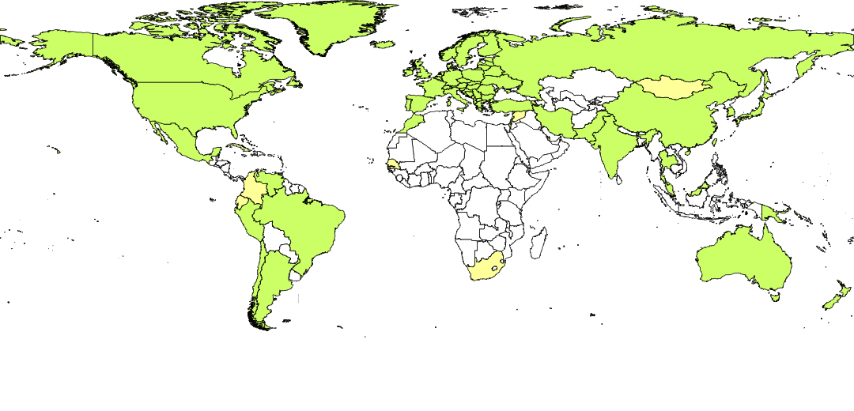
A coordinated trust fabric: IGTF
A ‘policy bridge’ infrastructure for authentication
Today there are 86 accredited authorities
From 54 countries or economic regions
Direct relying party (customer!) representation & influence
from countries … and major cross-national organisations
  EGI
  DEISA
  wLCG
  TERENA
  PRAGMA (APGridPMA)
  Teragrid (TAGPMA)
  Open Science Grid (TAGPMA)

Slide 9
Authentication Policy Guidelines
IGTF established a single trust fabric, incorporating authorities using different techniques
Common Elements
Unique Subject Naming
Identifier Association
Publication & IPR
Contact and
incident response
Auditability
Profiles
Classic PKI
  Real-time vetting
  (F2F or TTP)
  13 months life time
SLCS
  Existing IdM databases
  100k – 1Ms life time
MICS
  IdM Federation with F2F
  managed, revocable, identity
  13 months max
https://www.eugridpma.org/guidelines/

Slide 10
Relying Party Defined Namespace Constraints
Constrain name space to specified subject names
For now unique to Grids – but generic in concept
  Allows trust in a policy-based bridge PKI infrastructure
  Ensures a true globally unique, non re-used and persistent ID can be constructed
  .. a key requirement for multi-domain grids
  See OGF CAOPS-WG “RPDNC Policies” document
TO Issuer "/C=GB/ST=Greater Manchester/L=Salford/O=Comodo CA Limited/CN=AAA Certificate Services" \
PERMIT Subject "/C=US/ST=UT/L=Salt Lake City/O=The USERTRUST Network/OU=http://www.usertrust.com/CN=UTN-USERFirst-Client Authentication and Email"
TO Issuer "/C=US/ST=UT/L=Salt Lake City/O=The USERTRUST Network/OU=http://www.usertrust.com/CN=UTN-USERFirst-Client Authentication and Email" \
PERMIT Subject "/C=NL/O=TERENA/CN=TERENA eScience Personal CA"
TO Isser "/C=NL/O=TERENA/CN=TERENA eScience Personal CA" \
PERMIT Subject "/DC=org/DC=terena/DC=tcs/*"

Slide 11
Hiding PKI internals from the User
PKI is a great transport technology …
… but a no-go for most users
How to hide the PKI internals?
  do away with multiple ID checks by leveraging federations (TERENA TCS, SWITCHaai, DFNaai)
  hide credential management in client tools (jGridstart)
  use offer credential management as a service (MyProxy)
user does not see PKI that drives the infrastructure

Slide 12
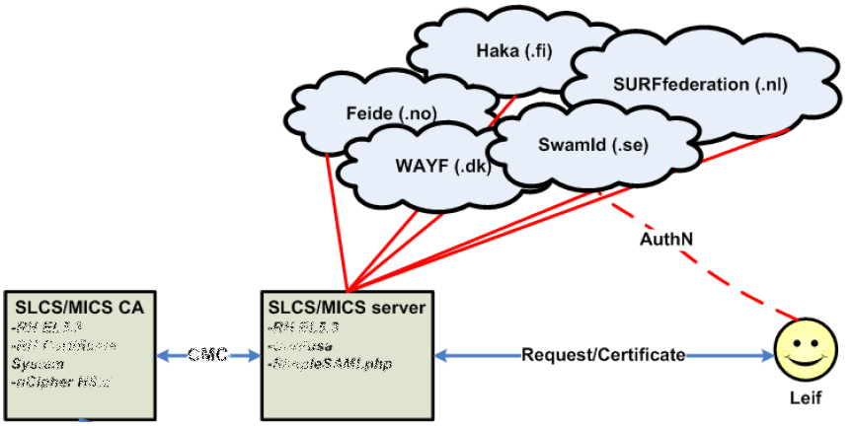
A Federated PKI
Implementations:
DFN Grid CA
SWITCHaai SLCS
TERENA eScience Personal CA
CI Logon (Q4 2010)
ARCS CA (end 2010)
Use your federation ID
... to authenticate to a service
... that issues a certificate
... recognised by the Grid today
Outdated
Graphic from:
Jan Meijer, UNINETT

Slide 13
Automated Tasks, Services, and brokering
Delegation
RFC3820

Slide 14

Distributed Services in Grid
Example
file transfer services using managed third-party copy via the SRM protocol
3. Register
(via RRS)
Replica
Catalog
Replica
Manager
SRM-Client
SRM-Client
Users
1.DATA
Creation
2. SRM-PUT
Network transfer
of DATA
SRM-Client
4.SRM-COPY
Tier0 to Tier1
7.SRM-COPY
Tier1 to
Tier2
Retrieve data
for analysis
10.SRM-GET
8.SRM-PUT
SRM
Network transfer
of DATA
SRM
5.SRM-GET
SRM
Network transfer
Network transfer
CASTOR
cache
dCache
Tier2
Storage
archive files
archive files
stage files
Tier 2
Center
CERN
Tier 0
FNAL
Tier 1
SRM graphic: Timur Perelmutov and Don Petravick, Fermilab, US
Example
automatic workload distribution across many sites in a Grid

Slide 15
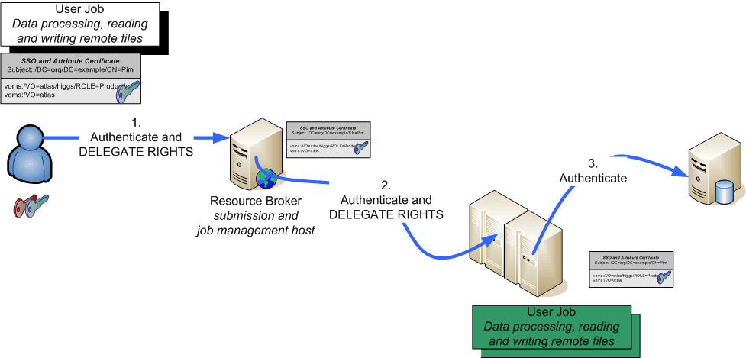
Delegating rights and privileges

Slide 16
Delegation – why break the recursion?
Mechanism to have someone, or some-thing – a program –
act on your behalf
  as yourself
  with a (sub)set of your rights
Essential for the grid model to work
  since the grid is highly dynamic and
  resources do not necessarily know about each other
  only the user (and VO) can ‘grasp’ the current view of their grid
GSI-PKI (and now finally some recent SAML) define
  GSI (PKI) through ‘proxy’ certificates (see RFC3820)
  SAML through Subject Confirmation, linking to at least one key or name

Slide 17
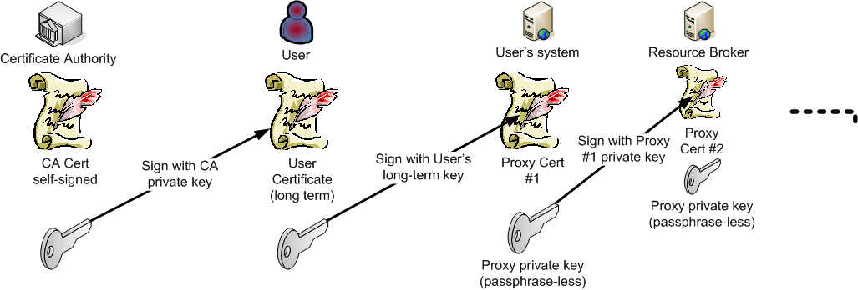
Delegation, but to whom?
RFC3820 – dynamic delegation via ‘proxy certs’
  Subject name of the proxy derived from issuer
  Contains policy constraints on delegation
AuthZ based on end-entity + embedded attributes&policies
with SAML, delegation can be to any NameID
in RFC3820, these are called ‘independent proxies’
“/DC=org/DC=example/CN=John Doe/CN=24623/CN=535431”
is a proxy for user
“/DC=org/DC=example/CN=John Doe”

Slide 18
Verifying authentication and X.509
‘Conventional’ PKI engines in *nix domain
  OpenSSL, Apache mod_ssl, nss
  Java JCE providers, such as BouncyCastle
  Perl, Python usually wrappers around OpenSSL
With proxy support
  OpenSSL (0.9.8+)
  Globus Toolkit (C, Java)
  gLite proxyVerify library (LCMAPS)
  gLite TrustManager on Java’s BouncyCastle
  GridSite
and always ensure proxy policies are implemented & enforced

Slide 19
User Community Models
Community organisation
Proxies and delegation with attributes: VOMS
Authorization with VOMS: autonomous, GUMS
Towards a multi-authority world

Slide 20
Authorization: VO representations
VO*: directory (database) of members, groups, roles, attributes
based on identifiers issues at the AuthN stage
Membership information is to be conveyed
to the resource providers
  configured statically, out of band
  in advance, by periodically pulling lists
  VO (LDAP) directories
  in VO-signed assertions pushed with the
  request: VOMS, Community AuthZ Service
  Push or pull assertions via SAML
* this is the ‘EGI’ or e-Infrastructure sense of VO, representing users.
Other definitions at times include resources providers, in a more vertically oriented ‘silo’ model

Slide 21
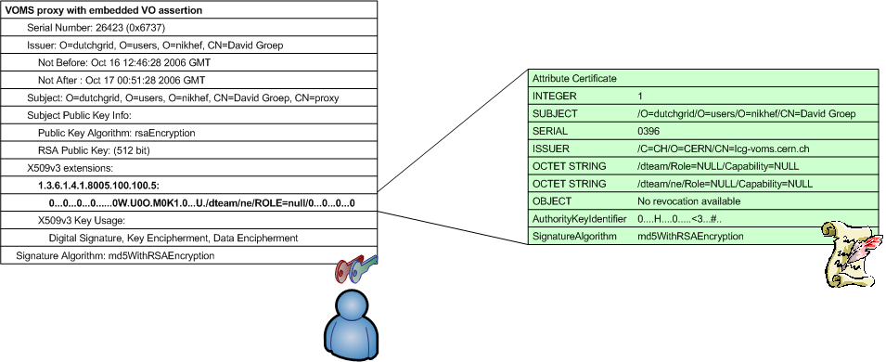
VOMS: the ‘proxy’ as a container
Virtual Organisation Management System (VOMS)
developed by INFN for EU DataTAG and EGEE
used by VOs in EGI, Open Science Grid, NAREGI, …
push-model signed VO membership tokens
  using the traditional X.509 ‘proxy’ certificate for trans-shipment
  fully backward-compatible with only-identity-based mechanisms

Slide 22
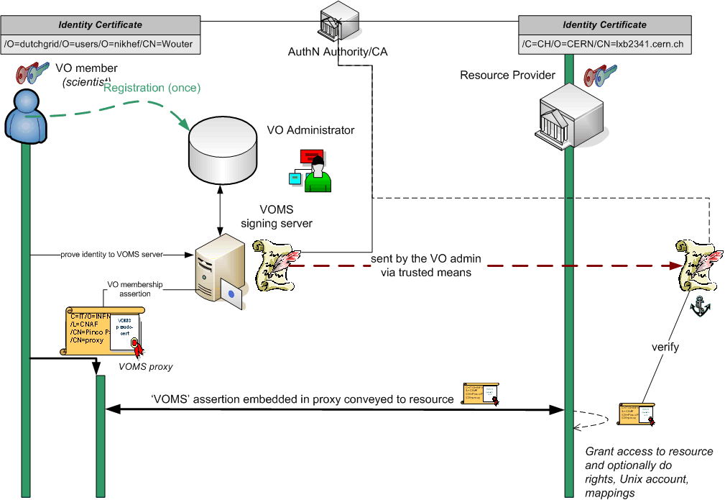
VOMS model

Slide 23
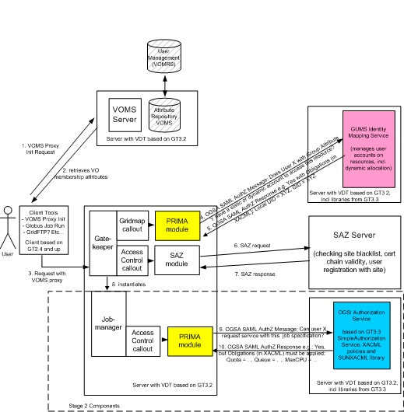
GUMS model
VO configuration replicated locally at the site
Here, pushed VOMS attributes are advisory only
synchronizes
Graphic: Gabriele Garzoglio, FNAL

Slide 24
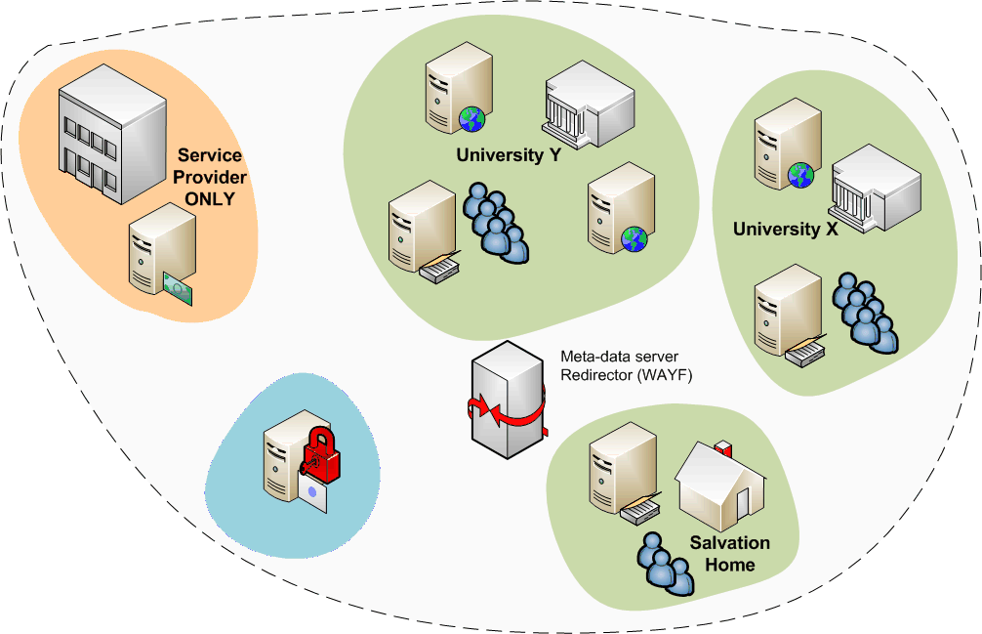
Attributes from many sources
In ‘conventional’ grids, all attributes assigned by VO
but there are many more attributes, and
some of these may be very useful for grid
grid structure was not
too much different!

Slide 25
Towards a multi-authority world (AAI)
Interlinking of technologies can be done at various points
Authentication: linking (federations of) identity providers to the existing grid AuthN systems
  ‘Short-Lived Credential Services’ translation bridges
Populate VO databases with UHO Attributes
Equip resource providers to also inspect UHO attributes
Expressing VO attributes as function of UHO attributes
and most probably many other options as well …
Leads to assertions with multiple LoAs in the same decision
  thus all assertions should carry their LoA
  expressed in a way that’s recognisable
  and the LoA attested to by ‘third parties’ (e.g. the federation)

Slide 26
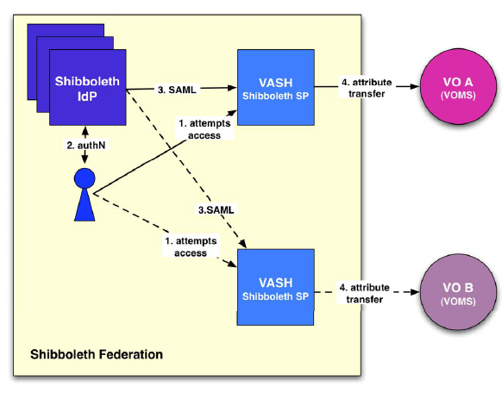
Attributes from multi-authority world
Linking two worlds example –
VASH: ‘VOMS Attributes
from Shibboleth’
  Populate VOMS with
  generic attributes
  Part of gLite (SWITCH)
http://www.switch.ch/grid/vash/
Graphic: Christoph Witzig, SWITCH

Slide 27
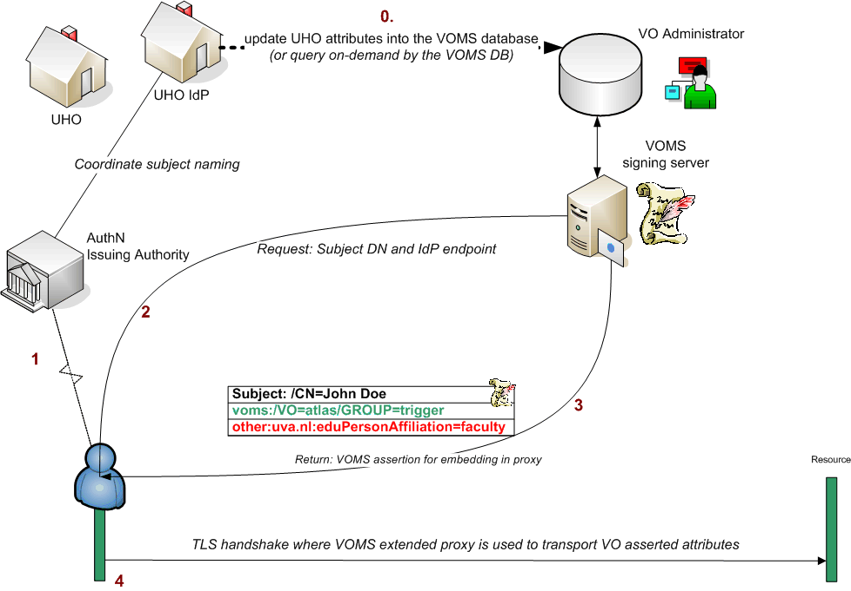
Putting home attributes in the VO
Characteristics
  The VO will know the source of the attributes
  Resource can make a decision on combined VO and UHO attributes
  but for the outside world, the VO now has asserted to the validity of the UHO attributes – over which the VO has hardly any control

Slide 28
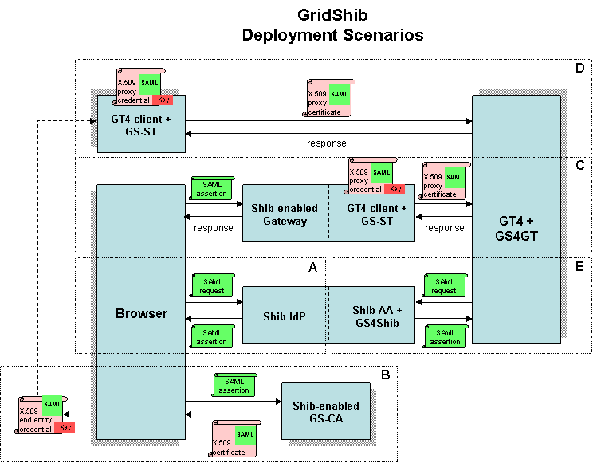
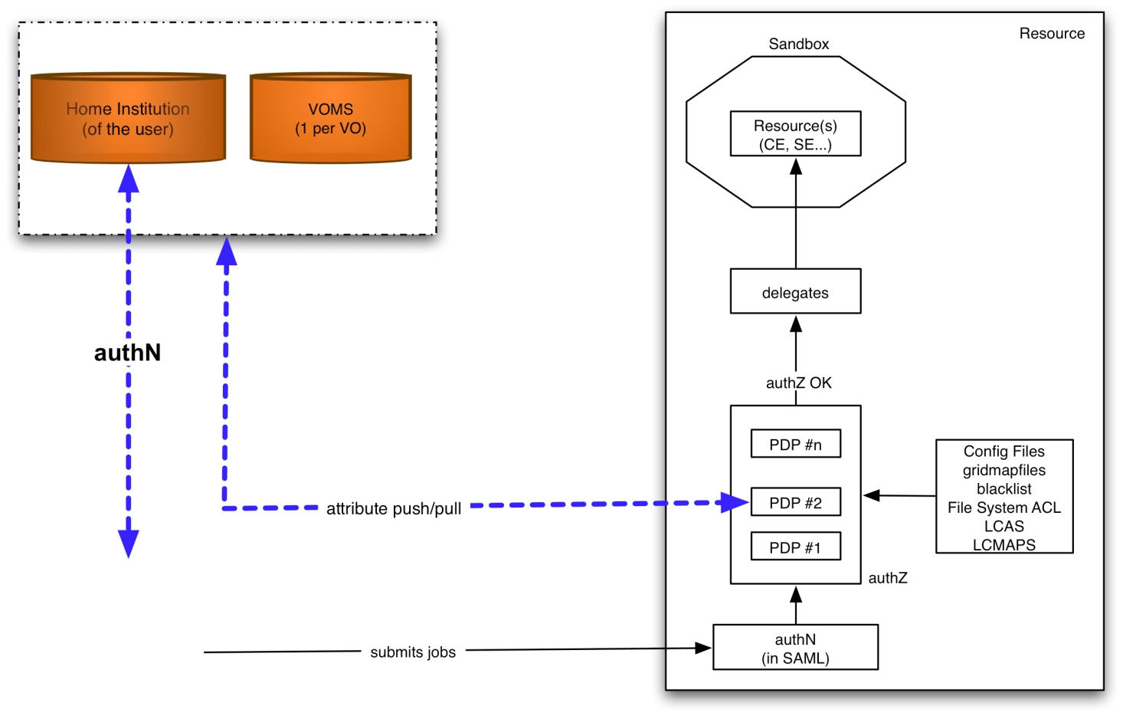
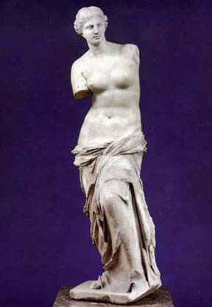
Attribute collection ‘at the resource’
graphic from:
Chistoph Witzig, SWITCH, GGF16, February 2006
Graphic: the GridShib project (NCSA)
http://gridshib.globus.org/docs/gridshib/deploy-scenarios.html
Characteristics
  The RP (at the decision point) knows the source of all attributes
  but has to combine these and make the ‘informed decision’
  is suddenly faced with a decision on quality from different assertions
  needs to push a kind of ‘session identifier’ to select a role at the target resource

Slide 29
Access Control for Compute
Example: running compute jobs
The Meaning of Attributes: Unix domain mapping

Slide 30
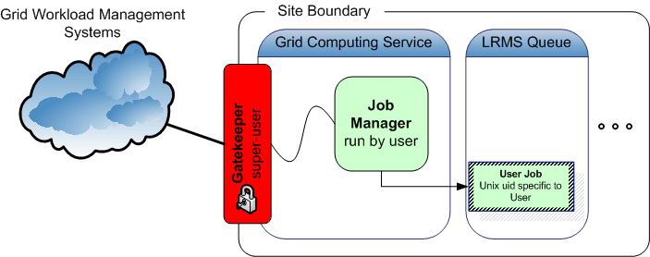
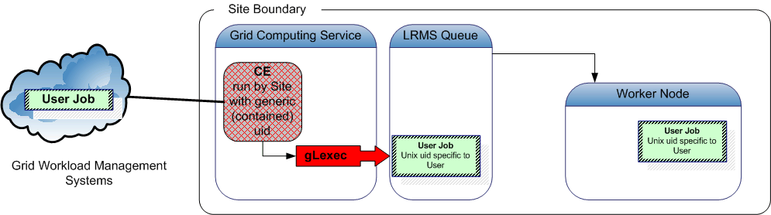
Job Submission Today
User submits his jobs to a resource through a ‘cloud’ of intermediaries
Direct binding of payload and submitted grid job
job contains all the user’s business
access control is done at the site’s edge
inside the site, the user job should get a specific, site-local, system identity

Slide 31
But basic yes-no does not get you far
If yes, what are you allowed to do?
  Credential mapping via obligations, e.g. unix account, to limit what a user can do and disambiguate users
  Intended side effects: allocating or creating accounts ... or virtual machines, or ...
  Limit access to specific (batch) queues, or specific systems
Additional software needed
  Interpreting policy and constraints
  Handling ‘obligations’ conveyed with a decision
  e.g.
  LCMAPS: account mappings, AFS tokens, Argus call-out
  Argus: pluggable obligation handlers per application
    and interpret (pre-provisioned) policies applicable to a transaction/credential

Slide 32
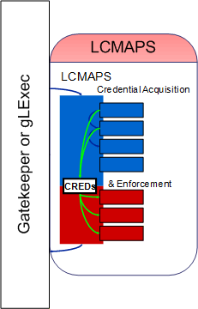
To the Unix world: Problem
C=IT/O=INFN
/L=CNAF
/CN=Pinco Palla
/CN=proxy
VOMS + other attributes
Identity
VOMS
pseudo-cert
translate
pvier001:x:43401:2029:PoolAccount VL-e P4 no.1:/home/pvier001:/bin/sh
run as root
credential: …/CN=Pietje Puk
Unix does not talk Grid, so
translation is needed between
grid and local identity
translation has to happen somewhere
something needs to do that
run as target user
uid: ppuk001
uidNumber: 96201

Slide 33
What does this all mean?
Attribute interpretation is much more than mere mapping
  what do the attributes mean, and do all VOs mean similar things with the same kinds of attributes?
  Is the order in which the attributes are presented important?
  Can the same bag of attributes (or same priority) be used for both compute and data access?
  How do changing attributes reflect access rights on persistent storage, if the VO evolves its attribute set?
Is there a driving use case by RPs (VO, sites) for an attribute?
  only then makes harmonization any sense…
Let RPs (co-)define requirements, not only IdPs, CAs, or VOs!
  attributes and policies needed, and the meaning of attributes
  levels of assurance

Slide 34
Access Control inside –
Example: Data Storage
Access Control semantics
Legacy forever: mapping grid storage onto Unix semantics
Native storage control: the DPM model

Slide 35
Storage: Access Control Lists
Catalogue level
  protects access to meta-data
  is only advisory for actual file access
  unless the storage system only accepts connections from a trusted agent that does itself do a catalogue lookup
SE level
  either natively (i.e. supported by both the SRM and transfer services)
SRM/transfer level
  SRM and GridFTp server need to lookup in local ACL store for each transfer
  need “all files owned by SRM” unless underlying FS supports ACLs
OS level?
  native POSIX-ACL support in OS would be needed
  Mapping would still be requires (as for job execution)

Slide 36
Grid ACL considerations
Semantics
  Posix semantics require that you traverse up the tree to find all constraints
  behaviour both costly and possibly undefined in a distributed context
  VMS and NTFS container semantics are self-contained
  taken as a basis for the ACL semantics in many grid services
ACL syntax & local semantics typically Posix-style –
this is what many end-users are accustomed to

Slide 37
Access control on top of Unix: dCache
voms-proxy-init
Proxy with VO
Membership | Role attributes
as an example only …
srmcp
DATA
SAML2XACML2
interop protocol
GUMS, SCAS, &c
SRM Server
DATA
GridFTP
Server
SRM-dCache
GridFTP
Callout
SAML response
User Authorization
Record
gPLAZMA
PRIMA SAML Client
Storage Authorization Service
Storage metadata
https/SOAP
SRM Callout
SAML query
Get storage authz for this username
gPLAZMALite Authorization Service
If authorized,
get username
gPLAZMALite grid-mapfile
GUMS
Identity Mapping
Service
dcache.kpwd
Graphic: Frank Wurthwein, CHEP2006 Mumbai

Slide 38
Grid storage access control: the native way
Use ‘grid’ identity and attributes to define ACLs
With ‘POSIX’ semantics
  So traversal based, not object based
  Needs ‘good’ database schema to store ACLs&metadata
Example: DPM “Disk Pool Manager”
  See
  https://twiki.cern.ch/twiki/bin/view/EGEE/GliteDPM

Slide 39
DPM Architecture
Grid Client
Data Server
Name Server
RFIO Client
RFIO Daemon
Disk System
NS Daemon
NS Database
Gridftp Client
Gridftp Server
RFIO Client
Disk Pool Manager
DPM Daemon
Request Daemon
SRM Server
SRM Client
SRM Daemon
DPM Database
All disk-based (data) files owned by a generic ‘dpm’ user
Meta-data, locations, ownership, ACLs: all in a database
graphics: ‘ACLs in Light Weight Disk Pool Manager’ MWSG 2006, Jean Philippe Baud, CERN

Slide 40
Virtual Ids and VOMS integration
DNs are mapped to virtual UIDs: the virtual uid is created on the fly the first time the system receives a request for this DN (no pool account)
VOMS roles are mapped to virtual GIDs
A given user may have one DN and several roles, so a given user may be mapped to one UID and several GIDs
Currently only the primary role is used in LFC/DPM
Support for normal proxies and VOMS proxies
Administrative tools available to update the DB mapping table:
  To create VO groups in advance
  To keep same uid when DN changes
  To get same uid for a DN and a Kerberos principal
Slides and graphics: ‘ACLs in Light Weight Disk Pool Manager’ MWSG 2006, Jean Philippe Baud, CERN

Slide 41
Access Control Lists
LFC and DPM support Posix ACLs based on Virtual Ids
  Access Control Lists on files and directories
  Default Access Control Lists on directories: they are inherited by the sub-directories and files under the directory
Example
  dpns-mkdir /dpm/cern.ch/home/dteam/jpb
  dpns-setacl -m d:u::7,d:g::7,d:o:5 /dpm/cern.ch/home/dteam/jpb
  dpns-getacl /dpm/cern.ch/home/dteam/jpb
  # file: /dpm/cern.ch/home/dteam/jpb
  # owner: /C=CH/O=CERN/OU=GRID/CN=Jean-Philippe Baud 7183
  # group: dteam
  user::rwx
  group::r-x #effective:r-x
  other::r-x
  default:user::rwx
  default:group::rwx
  default:other::r-x
Slides and graphics: ‘ACLs in Light Weight Disk Pool Manager’ MWSG 2006, Jean Philippe Baud, CERN

Slide 42
Authorization Frameworks
Policy from multiple sources
Frameworks

Slide 43
A multi-authority world
Authorization elements (from OGSA 1.0)
Graphic: OGSA Working Group

Slide 44
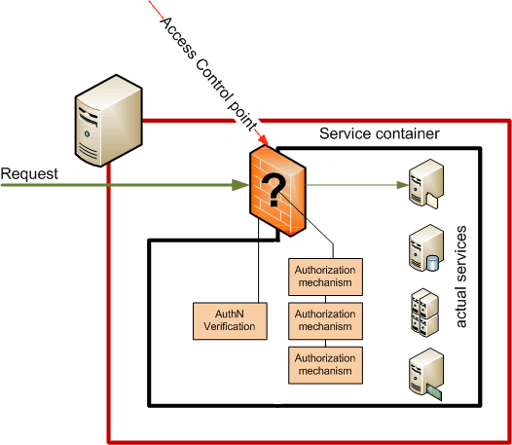
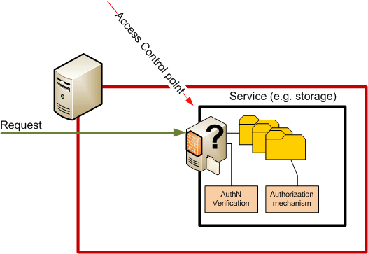
Control points
Container based
In-service based
Single control point
Agnostic to service semantics
Many control points
Authorization can depend on
requested action and resource

Slide 45
Frameworks
(chain of) decision making modules controlling access
  Loosely or tightly coupled to a service or container
  Generic ‘library’, or tied into the service business logic
example: GT4/Java
Graphic: Frank Siebenlist, Globus and ANL

Slide 46
Example framework implementations
PRIMA-SAZ-GUMS-gPlazma suite
Globus Toolkit Authorization Framework
Site Access Control ‘LCAS-LCMAPS’ suite
gLite Argus
GridSite & GACL
...
... and don’t forget ‘native’ service implementations
interop
interop

Slide 47
Different frameworks
Each framework has
  own calling semantics (but may/will interoperate at the back)
  its own form of logging and auditing
Most provide
  Validity checking of credentials
  Access control based on Subject DN and VOMS FQANs
  Subject DN banning capability
And some have specific features, e.g.,
  Capability to process arbitrary ‘XACML’ (composite) policies
  Calling out to obtain new user attributes
  Limiting the user executables, or proxy life time, ...
  allow embedding inside the application business logic

Slide 48
Access Control Management Systems
Centralizing Authorization in the site
Available middleware: GUMS and SAZ, Argus, ...
Interoperability through common protocols

Slide 49
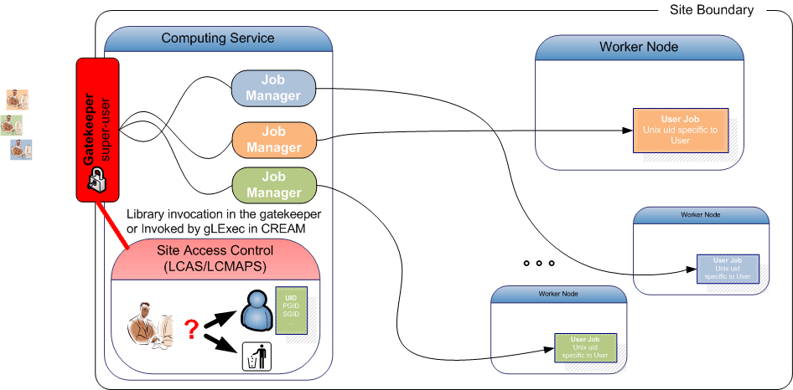
Embedded controls: CE, dCache, ...
voms-proxy-init
Proxy with VO
Membership | Role attributes
SAML2XACML2
interop protocol
GUMS, SCAS, &c
srmcp
DATA
SRM Server
DATA
GridFTP
Server
SRM-dCache
GridFTP
Callout
SAML response
User Authorization
Record
gPLAZMA
PRIMA SAML Client
https/SOAP
Storage Authorization Service
Storage metadata
SRM Callout
SAML query
Get storage authz for this username
gPLAZMALite Authorization Service
If authorized,
get username
gPLAZMALite grid-mapfile
GUMS
Identity Mapping
Service
dcache.kpwd
Graphic: Frank Wurthwein, CHEP2006 Mumbai

Slide 50
Access Control at the Service
Most prevalent solution today …
Pros:
services independent and have no common failure mode
quick and easy to develop and deploy
Con:
no single ‘Big Red Button’
difficult auditing…
risk of inconsistency

Slide 51
Centralizing decentralized Access Control
Aim: support consistently
  policy management across services
  quick banning of bad users
  coordinated common user mappings (if not WN-local)
Different options to implement it …
Regular site management tools (CFengine, Quattor, etc)
  Addresses site-wide banning in a trivial and quick way
  but appears ‘out of band’ and works only for managed installations
One of the ‘central authorization services’
  these can be department-central, site-central, but even grid-wide or global!
  some to choose from in Grid: Argus, GUMS, …
  like ‘inverse’ IdP, centrally processing assertions for AuthZ instead of making …

Slide 52
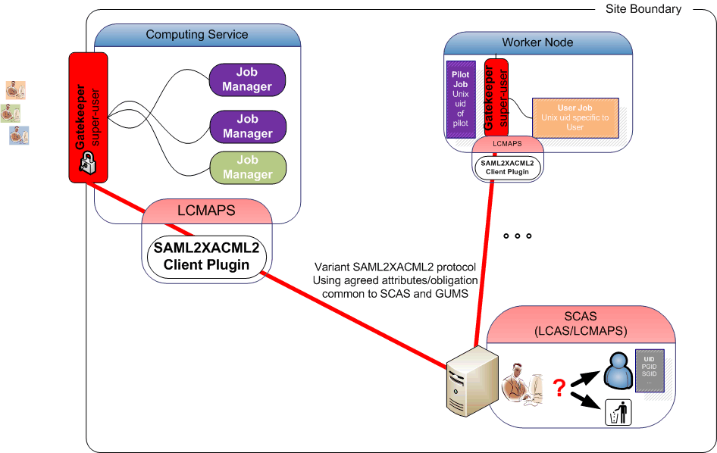
Centralizing access control in M/W
off-site
policy
site-central service
* of course, central policy and distributed
per-WN mapping also possible!

Slide 53
Key Elements for interop
Common communications profile
  Agreed on use of SAML2-XACML2
  http://www.switch.ch/grid/support/documents/xacmlsaml.pdf
Common attributes and obligations profile
  List and semantics of attributes sent and obligations received between a ‘PEP’ and ‘PDP’
  Now at version 1.1
  http://cd-docdb.fnal.gov/cgi-bin/ShowDocument?docid=2952
  http://edms.cern.ch/document/929867
Graphic: Gabriele Garzoglio, FNAL
  Subject S requests to perform Action A on Resource R within Environment E
CE / SE / WN
XACML Request
Site Services
Gateway
PDP
PEP
XACML Response
Grid Site
  Decision Permit, but must fulfill Obligation O
EGI-TF10 NREN-Grids workshop
Sept. 2009
53

Slide 54
GUMS and SAZ
VO
PDP
Grid
Site
Site Services
VO Services
GUMS
SAZ
VOMRS
synch
VOMS
synch
2
3
7
6
ID Mapping?
Yes / No +
UserName
Is Auth?
Yes / No
1
register
PEPs
4
SE
CE
WN
get voms-proxy
SRM
Gatekeeper
gLExec
gPlazma
Prima
Prima
5
Submit request
with voms-proxy
Pilot SU
Job
(UID/GID)
10
Access
Data
(UID/GID)
Submit
Pilot OR Job
(UID/GID)
Schedule
Pilot OR Job
8
8
Batch
System
Storage
Legend
9
AuthZ
Components
Not Officially
In OSG
VO Management
Services
graphic: Dave Dykstra, Fermi National Accelerator Laboratory, CHEP, March 2009

Slide 55
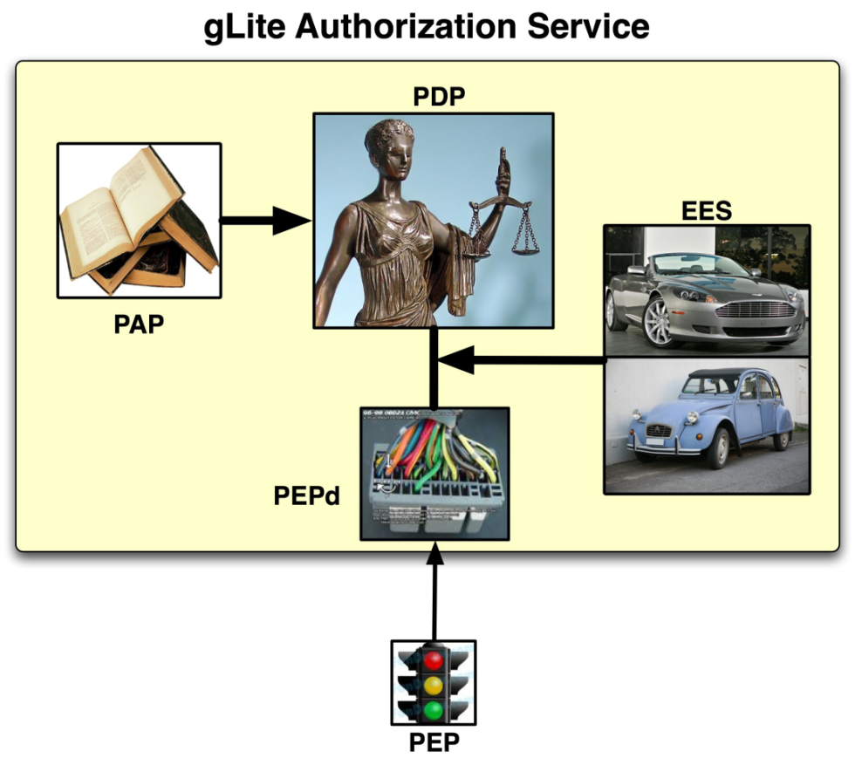
Argus services and daemons
Administration Point
Formulating rules through CLI and/or file-based input
Decision Point
Evaluating a request from a
client based on the rules
Enforcement Point
Thin client part and server part:
all complexity in server part
Runtime Execution Environment
Under which env. must I run?
(Unix UID, GID, …)
Graphic: Christoph Witzig, SWITCH and EGEE

Slide 56
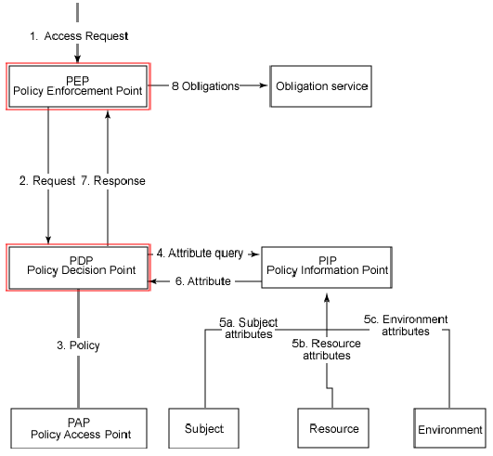
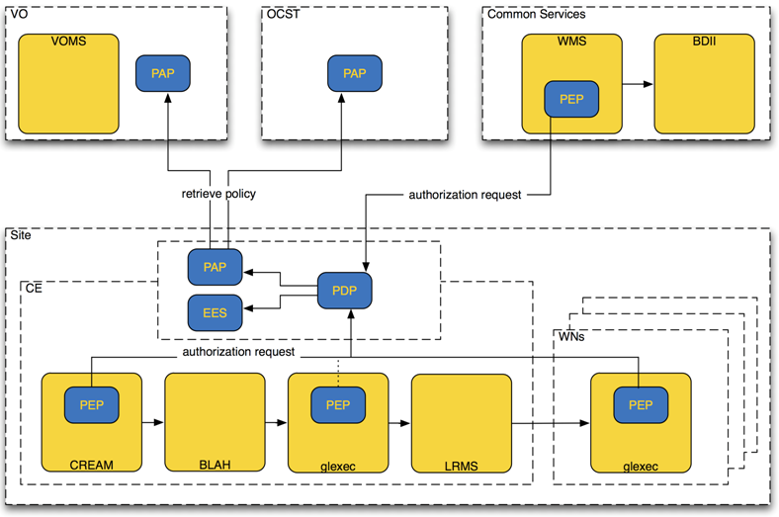
Argus service
graphic: MJRA1.4 (EGEE-II) gLite security architecture, Oct 2008, Christoph Witzig

Slide 57
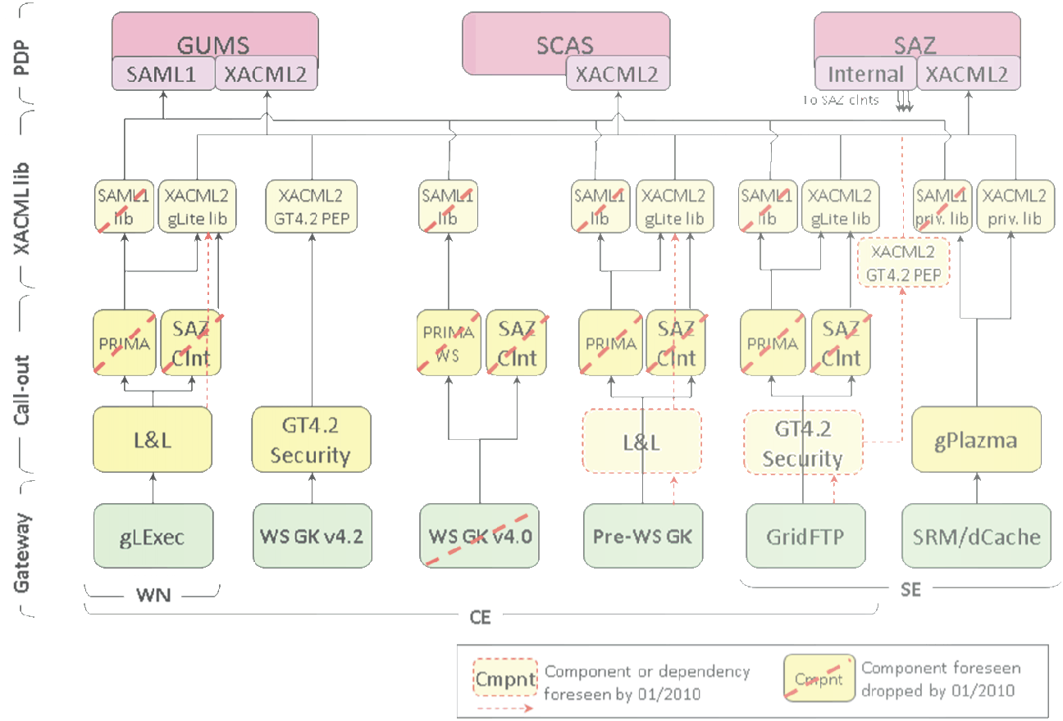
Interoperability achievements
graphic: Gabriele Garzoglio, FNAL

Slide 58
Capabilities (Argus as an example)
Enables/eases various authorization tasks:
  Banning of users (VO, WMS, site, or grid wide)
Composition of policies – e.g.
CERN policy + experiment policy + CE policy
+ OCST policy + NGI policy=> Effective policy
Support for authorization based on more detailed information about the job, action, and execution environment
  Support for authorization based on attributes other than FQAN
  Support for multiple credential formats (not just X.509)
  Support for multiple types of execution environments
  Virtual machines, workspaces, …
https://twiki.cern.ch/twiki/bin/view/EGEE/AuthorizationFramework

Slide 59
Specialised Middleware
Hydra distributed key store
SSSS

Slide 60
Accessing medical images
image ID is located by AMGA
key is retrieved from the Hydra key servers (implicitly)
file is accessed by SRM (access control in DPM)
data is read and decrypted block-by-block
in memory only (GFAL and hydra-cli)---> useful for all
Still to be solved:
ACL synchronization among SEs
Hydra
KeyStore
Hydra
KeyStore
AMGA
metadata
Hydra
KeyStore
gridftp
2. keys
1. patient look-up
SRMv2
3. get TURL
GFAL
image
I/O
4. read
DICOM
DICOM-SE
Slides based on Akos Frohner, EGEE and CERN

Slide 61
Exporting Images
“wrapping” DICOM :
  anonymity: patient data is separated and stored in AMGA
  access control: ACL information on individual files in SE (DPM)
  privacy: per-file keys
    distributed among several Hydra key servers
    fine grained access control
Image is retrieved from DICOM and processed to be “exported” to the grid.
AMGA
metadata
Hydra
KeyStore
Hydra
KeyStore
Hydra
KeyStore
gridftp
patient data
keys
trigger
SRMv2
image
file ACL
I/O
DICOM
DICOM-SE
Slides based on Akos Frohner, EGEE and CERN

Slide 62
Hydra key store theory, and SSSS
Keys are split for security and reliability reasons using Shamir's Secrect Sharing Scheme (org.glite.security.ssss)
  standalone library and CLI
  modified Hydra service and Hydra client library/CLI
  the client contacts all services for key registration, retrieval and to change permissions
    there is no synchronization or transaction coordinator service
$ glite-ssss-split-passwd -q 5 3 secret
137c9547aba101ef 6ee7adbbaacac1ef 1256bcc160eda592 fdabc259cdfbacc9 3113be83f203d794
$ glite-ssss-join-passwd -q 137c9547aba101ef NULL \
1256bcc160eda592 NULL 3113be83f203d794
secret
Slides based on Akos Frohner, EGEE and CERN

Slide 63
Example: integration into DPM
lcg-cp -bD srmv2 srm://dpm.example.org:8446/srm/managerv2?
  SFN=/dpm/example.org/home/biomed/mdm/<ID> file:picture.enc
glite-eds-decrypt <ID> picture.enc picture
glite-eds-get -i <ID> rfio:////dpm/example.org/home/biomed/mdm/<ID> picture
  file is opened via gfal_open()
  decryption key is fetched for <ID>
  loop on gfal_read(), glite_eds_decrypt_block(), write()
'glite-eds-get' is a simple utility over the EDS library.
Slides based on Akos Frohner, EGEE and CERN

Slide 64
From Here?
Summary and last words

Slide 65
What Grid AAI does for you today
Accommodates multiple sources for assertions
  AuthN vs. AuthZ separated, with multiple VO membership off same ID
  With the ‘PKI bits’ being cleverly hidden from the user
Accommodate delegation (disconnected operation)
  Entities act on behalf of a user
  services like MyProxy and SLCS make it transparent
  even for portals and long-running jobs
Accommodate individual, independent researchers
  even though federations will aid 99% percent, full coverage will be rare
EGI demonstrates that the mechanisms and associated policies and standards convinced 300+ resource providers grid is trustworthy enough
Users actually see a single interface (VO), and no longer need to register at 100s different sites and fill in 100+ AUP statements … since 2002!

Slide 66
Questions?
Having left out a lot of things ... are there any

