Slide 1

Grid Security, an introduction
Introduction to security issues
in grid infrastructures and
cross-domain user collaborations
David Groep, Nikhef

Slide 2
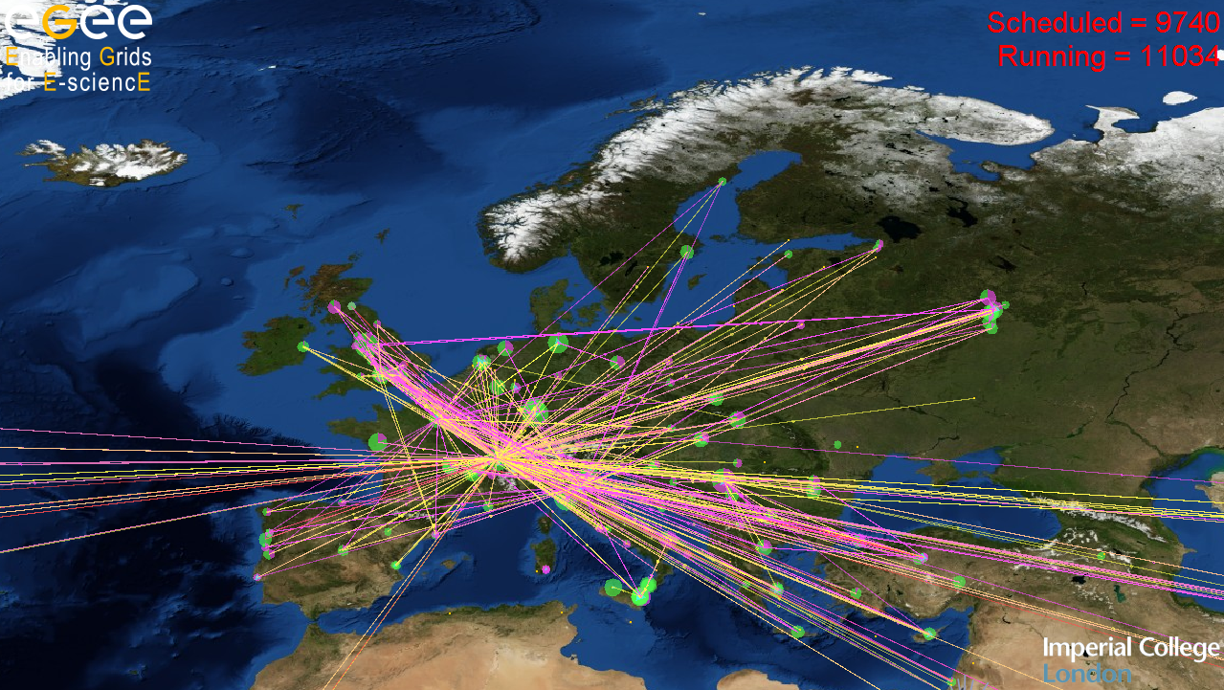
Grid Security
dealing with user-centric collaborations

Slide 3
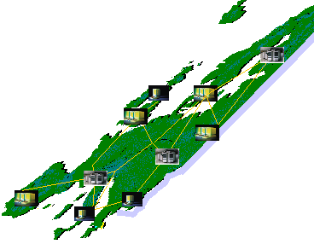

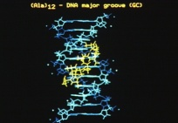
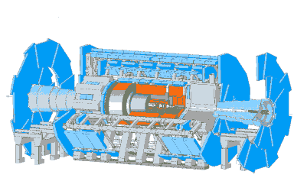
Grid from 10 000 feet
Researchers perform their activities regardless geographical location, interact with colleagues, share and access data
Scientific instruments, libraries and experiments provide huge amounts of data
The GRID: networked data processing centres and ”middleware” software as the “glue” of resources.
based on: Federico.Carminati@cern.ch

Slide 4
Grid: following research collaborations
Some things that may make a grid a bit ‘special’
compared to other distributed computing efforts
collaboration of individuals from different organisations
  most of the scientific grid communities today consist of people
  literally ‘scattered’ over many home organisations … internationally
delegation – programs and services acting on your behalf – are an integral part of the architecture
  unattended operation
  resource brokering
  integrating compute, data access, and databases in the same task

Slide 5
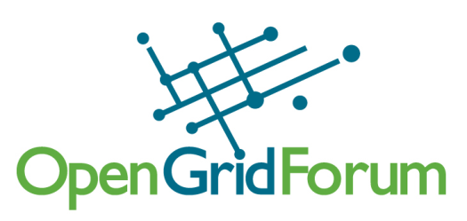
But ... what is Grid?
The word ‘grid’ has been used in many ways
  cluster computing
  cycle scavenging
  cross-domain resource sharing
  …
A clear definition for the grid?
Coordinates resources not subject to centralised control
Using standard, open and generic protocols & interfaces
Provides non-trivial qualities of collective service
www.ogf.org
Definition from Ian Foster in Grid Today, July 22, 2002; Vol. 1 No. 6,
see http://www-fp.mcs.anl.gov/~foster/Articles/WhatIstheGrid.pdf

Slide 6
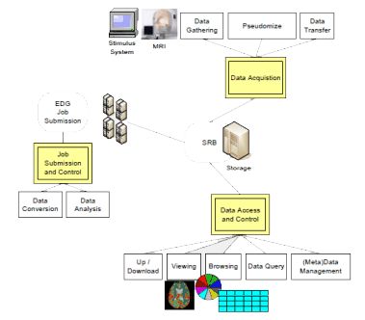
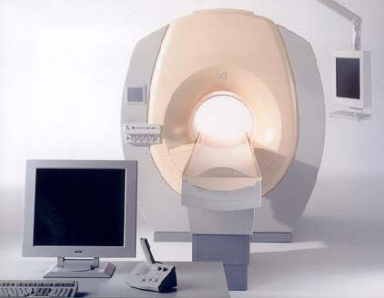
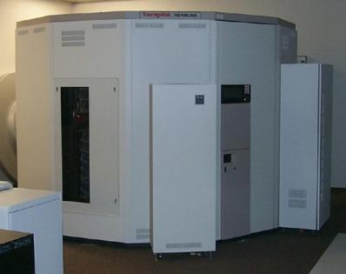
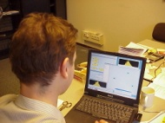

Example: a biomedical imaging project
On functional MRI studies run from a ‘standardized’ workflow
People and systems involved (the ‘vlemed’ VO)
  medical doctors and the fMRI apparatus: AMC hospital
  data storage service: SARA Compute and Network services
  Compute services: Nikhef, Philips Research, SARA
  algorithm developers: University of Amsterdam
  Medical doctors and analysts (MD): AMC
?
SP1.3 Medical Imaging
simplified user scenario

Slide 7
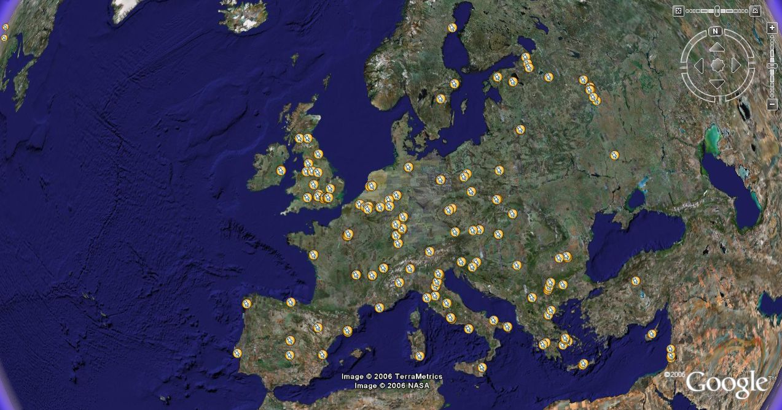

Typical use case: WISDOM
Wide-area In-Silico Docking On Malaria
people and organisations
  Bio-informaticians and grid development: IN2P3 (FR)
  Service systems (brokers) provided by: RAL (UK), NIKHEF (NL)
  algorithms, and results analysed by: SCAI (DE)
  Compute resources: provided by over 45 independent organisations in ~15 countries, whose primary mission is usually HE Physics!
  VO management hosted by CERN (CERN),
  and the VO itself is managed by Vincent Breton (FR)
Science done:
over 46 million ligands virtually docked on the malaria
(and H5N1/avian flu) viruses in less than 1 month

Slide 8
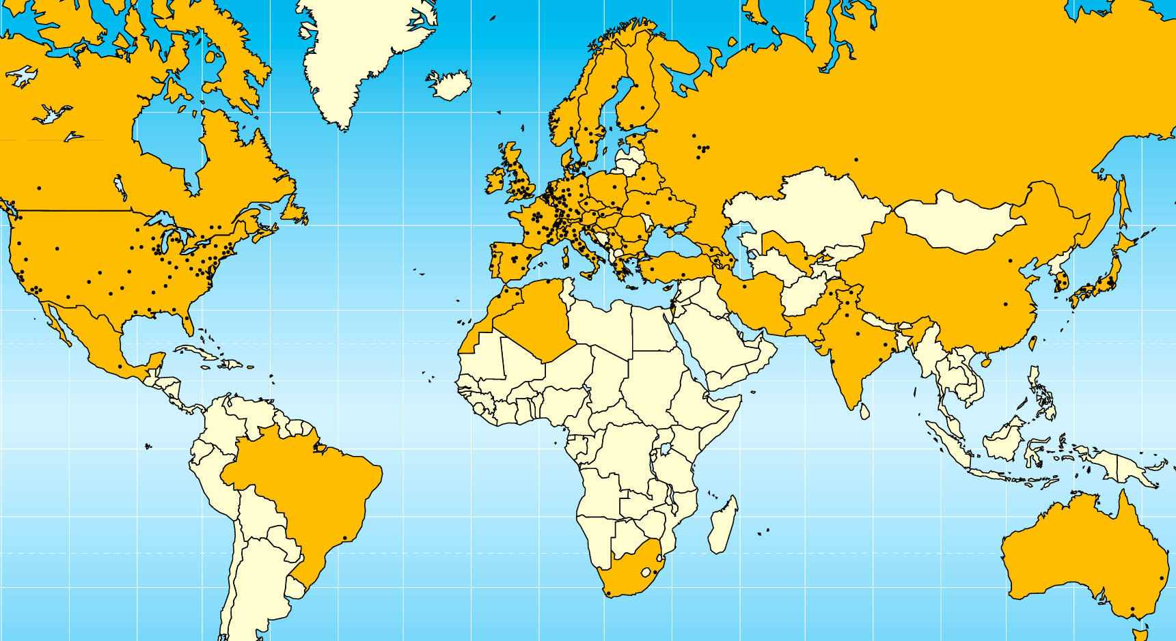

wLCG: implementing LHC computing
20 years est. life span
24/7 global operations
~ 4000 person-years of
science software investment
~ 5 000 physicists
~ 150 institutes
53 countries/economic regions

Slide 9
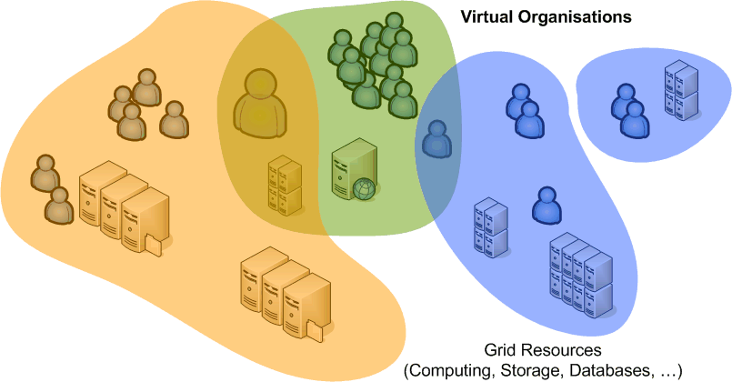
Virtual Organisation
A set of individuals or organisations, not under single hierarchical control, (temporarily) joining forces to solve a particular problem at hand, bringing to the collaboration a subset of their resources, sharing those
at their discretion and each under their own conditions.
User driven
Users are usually a member
of more than one community
Any “large” VO will have an internal structure,
with groups, subgroups, and various roles

Slide 10
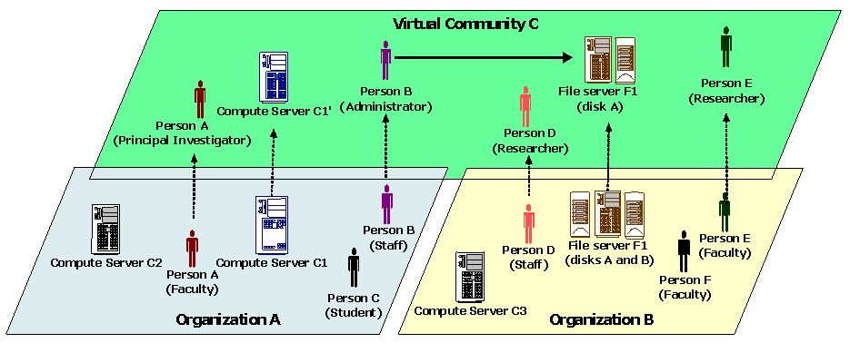
Virtual vs. Organic structure
Virtual communities (“virtual organisations”) are many
An person will typically be part of many communities
  has different roles in different VOs (distinct from organisational role)
  all at the same time, at the same set of resources, with SSO
graphic: OGSA Architecture 1.0, OGF GFD-I.030

Slide 11
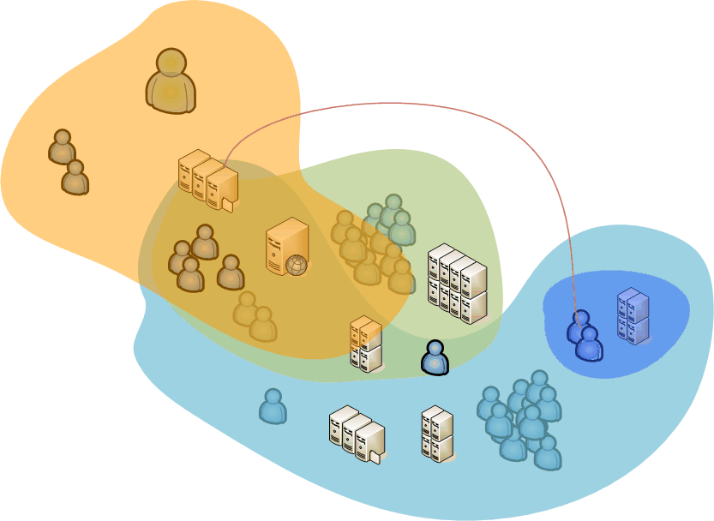
Before and parallel to the Grid ...
Each user in a collaboration gets individual access to many or most of the ICT resources
of all participating groups
  Shared group accounts
  Individual accounts with the same name (and password)
  Permissive password sharing
Characteristics
  Gets more access than needed
  No centralized management
  Easy ‘hopping’ between sites, also for attackers ... !

Slide 12
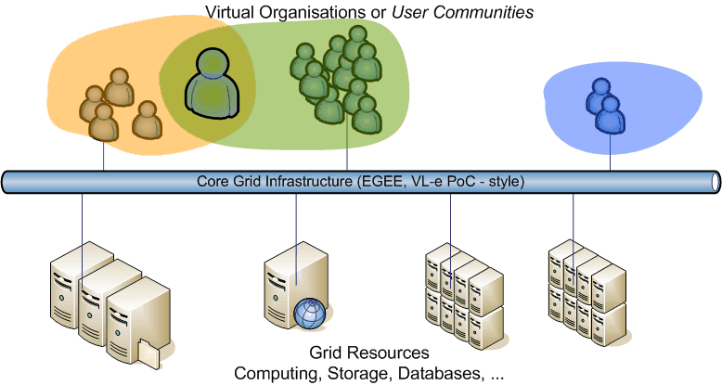
Grid ‘VOs’: structuring communities on a sustainable infrastructure
Virtual Organisations as groupings of users
  E-infrastructures (EGI, BiG Grid) provide persistent infrastructure
  with a “bus-like” view for VOs: essentially user communities
Communities can exist
without their ‘own’ resources
... and resource centres can do
without local users

Slide 13
Grid Security Mechanisms
Granting Access
Policy framework
Authentication
Authorization and Virtual Organisation membership

Slide 14
Access and Allocation
But: why grant access to a user or community?
  Joint research programme
  Joint funding in projects
  Economic models,
  either virtual ‘pot money’ or proper billing & settlement
Not too different from ‘conventional’ models
  ‘Get an account because we work together’
  Allocations on supercomputers or large clusters
  Pay-per-use infrastructure (AWS EC2 & S3, etc...)

Slide 15
Trust relationships
For the VO model to work, parties need a trust relationship
  the alternative: every user would need to register at every resource!
  need to provide a ‘sign-on’ for users that works across VOs
Org. Certification
Org. Certification
Authority
Authority
Policy
Policy
Authority
Authority
Sub-Domain A1
Sub-Domain B1
Domain A
Domain B
Task
GSI
Server X
Server Y

Slide 16
Elements of Trust
Authentication
  Who are you?
  Who says so?
Authorization
  Why should I let you in? What are you allowed to do?
  By whom? Who said you could do that?
  Community management and registration
Accounting (billing and settlement)
Incident Response
Compliance

Slide 17
Grid Security Policy ecosystem
A User and VO directed policy implementation
Incident
Response
Certification
Authorities
Audit
Requirements
Site & VO
Policies
Grid Security Policy
Grid & VO
AUPs
User Registration
& VO Management
Application Development
& Network Admin Guide
Site Oper.
Procedures

Slide 18
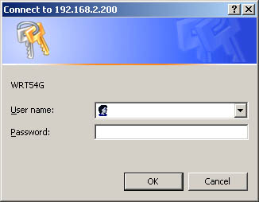
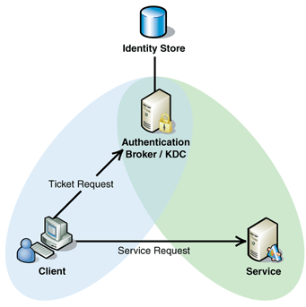
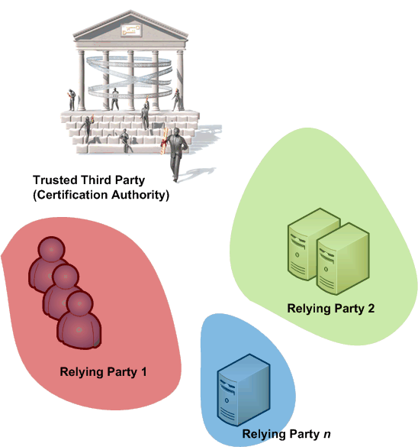
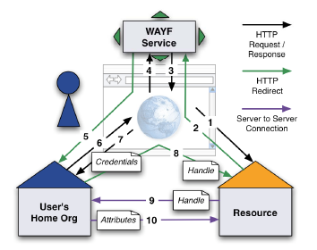
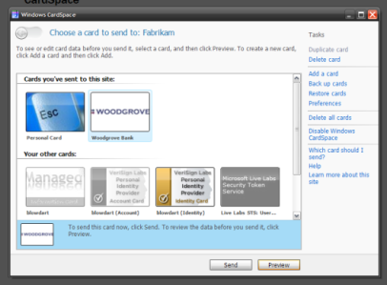
Authentication models
Direct user-to-site
  passwords, enterprise PKI, Kerberos
  Usually with implicit authZ
PKI with trusted third parties
Federated access
  Controlled & policy based
  ‘Free-for-all’, e.g., OpenID
Identity meta-systems
  Infocard type systems

Slide 19
Typical application domains
Web access and direct user interactions
  Moving towards WebSSO & federations
  Or use client PKI where users
  already have certificates
Task delegation (compute, data management)
  PKI ‘Trusted Third Party’ based
  Augmented with ‘proxy’ (RFC3820) delegation

Slide 20
Grid authentication
With emergence of production grids: need for providing cross-national trust
Driven by resource owner – ‘relying party’ – needs
independent of users and Vos, who have a conflict of interest
National PKI?
  in general uptake of 1999/93/EC and e-Identification is (too) slow
Various commercial providers?
  Main commercial drive: secure web servers based on PKI
  Comodo, Verisign, Global Sign, Thawte, Verisign, SwissPost, …
  primary market is server authentication, not end-user identities
  use of commercial CAs solves the ‘pop-up’ problem
  ... so for (web) servers a pop-up free service is actually needed
Grass-roots CAs?
  usually project specific, and without documented policies
  unsuitable for the ‘production’ infrastructure

Slide 21
Building a grid authentication infrastructures
Grid research/academic PKIs
  started off with pre-existing CAs, and some new ones
  ‘reasonable’ assurance based on documented procedures
  single assurance level inspired by grid-relying party** requirements
  using a threshold model: minimum requirements
Grid CA coordination driven by 2000 need to solve
cross-national authentication issues right now
  separation of AuthN and AuthZ allowed progress in the area
  the policies convinced enough resource providers
  to ‘trust’ the AuthN assertions
  there were and are individuals all over Europe (and the world) that need access to these resource providers

Slide 22
Federation Model for Grid Authentication
CA 2
CA 1
authentication
profiles
relying
party n
CA n
distribution
CA 3
acceptance
process
relying
party 1
Federation of independent CAs
  common minimum requirements (in various flavours)
  trust domain as required by users and relying parties
  where relying party is (an assembly of) resource providers
  defined and peer-reviewed acceptance process
No single top
  leverage of national efforts and complementarities
  Allow paced regional development, organisation and customisation

Slide 23
Guidelines: common elements in the IGTF
Coordinated namespace
  Subject names refer to a unique entity (person, host)
  Usable as a basis for authorization decisions
  This name uniqueness is essential for all authentication profiles!
Trust anchor repository
  Coordinated distribution for all trust anchors in the federation
  Trusted, redundant, sources for download, verifiable via TACAR
Concerns, risk assessment, and incident handling
  Guaranteed point of contact
  Forum to raise issues and concerns
Documented processes of federation and authorities
  Detailed policy and practice statement
  Auditing by federation peers

Slide 24
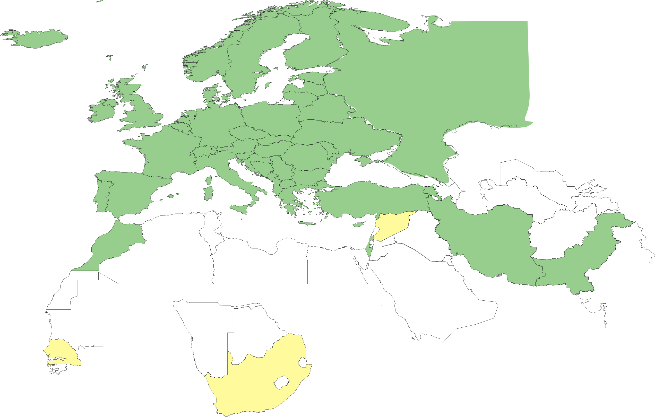
Geographical coverage
Green: EMEA countries with an Accredited Authority
23 of 25 EU member states (all except LU, MT)
+ AM, BY, CH, HR, IL, IR, IS, MA, MD, MK, NO, PK, RS, RU, TR, …
More Authorities in other continents:
Most North- and Latin-American countries
13+ countries and economic regions in the Asia-Pacific region

Slide 25
Authorization and Virtual ORganisations
Grouping users
VO management technologies
Delegation and access scenarios

Slide 26
Authorization: VO representations
VO is a directory (database) with members, groups, roles
Based on identifiers issues at the authentication stage
Membership information is then to be conveyed
to the resource providers
  configured statically, out of band
  in advance, by periodically pulling membership lists
  LDAP directories, replicated databases (GUMS)
  in VO-signed assertions pushed with the request:
  VOMS, Community AuthZ Service
Except for the CA provided DN, the VO is all the site will see
  Since VO is user-centric, it has a potential conflict of interest for identity

Slide 27
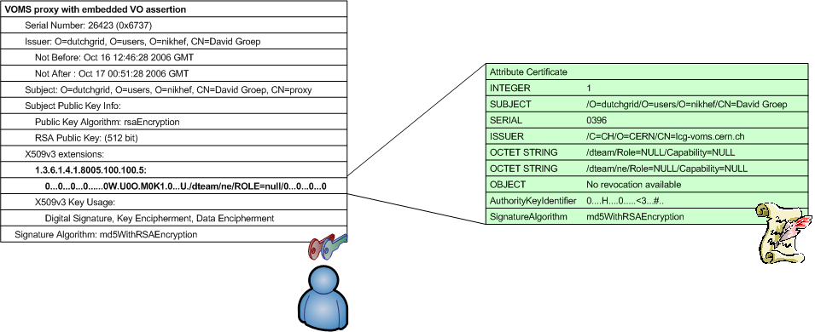
VOMS: VO attributes in a X.509 container
Virtual Organisation Management System (VOMS)
developed by INFN for EU DataTAG and EGEE
used by VOs in EGEE, Open Science Grid, NAREGI, …
push-model signed VO membership tokens
  using the traditional X.509 ‘proxy’ certificate for trans-shipment
  fully backward-compatible with only-identity-based mechanisms

Slide 28
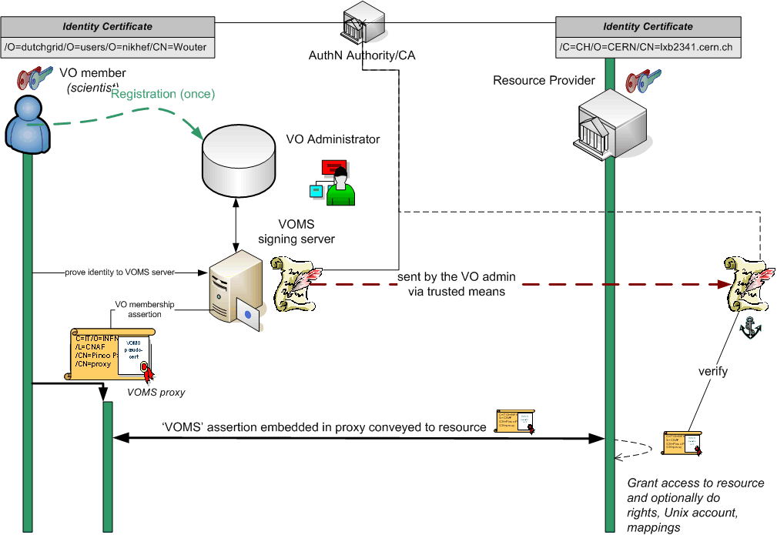
VOMS model

Slide 29
Delegation
Mechanism to have someone, or some-thing – a program –
act on your behalf
  as yourself
  with a (sub)set of your rights
Matches model of brokering and
non-interactive (automated) operations
GSI (PKI) and recent SAML drafts define this
  GSI (PKI) through ‘proxy’ certificates (see RFC3820)
  SAML through Subject Confirmation,
  (linking to at least one key or name)

Slide 30
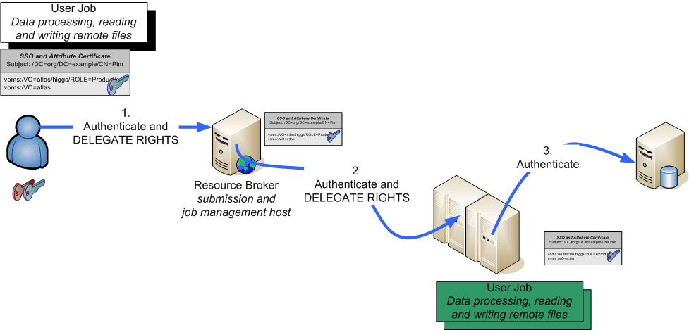
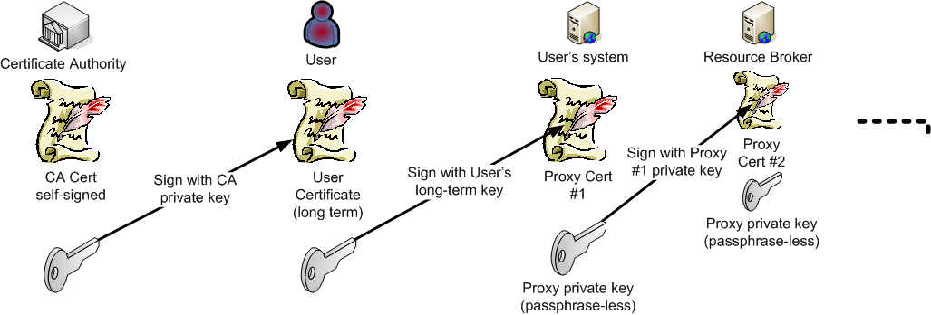
Daisy-chaining proxy delegation

Slide 31
Delegation to whom?
‘proxies certificates’ (RFC3820) form a chain
  Subject name of the proxy derived from issuer
  May contain path-length constraint
  May contain policy constraints
  Securely traceable to end-entity and CA
  SSL/TLS model remains unaltered
Uses name of the real end-entity for authZ
“/DC=org/DC=example/CN=John Doe/CN=24623/CN=535431”
is likely a proxy for user
“/DC=org/DC=example/CN=John Doe”

Slide 32
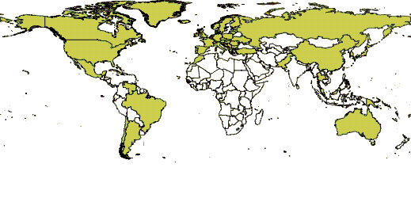
Acceptable Credentials on the Grid
‘Let’s not make the SSH mistake again’
‘All Credentials Have A Life Time’
  Long lived credentials must be revocable
  Short lived (< 100ks) credentials may be left to expire
So we get
X.509 identity certificates: <= 1 year
Proxy credentials: between 12 and ~24 hours
VOMS attributes: ~ 24 hours
Proxies in a managed credential store: 1Ms, ~11 days
‘limited delegation’ proxies prevents creeper-reaper-type exploits

Slide 33
Some Pros and Cons of PKI for Grid
Pro
User-based model fits structure of
‘grass roots’ scientific collaboration
Trust rooted in limited number of authorities, O(n), not O (n²)
Defined assurance level, irrespective of state of user’s home organisation (especially important internationally)
Con
End-user key management too complicated
Independent revocation and credential management
Users ‘forget’ procedures & practices, if grid not ‘daily work’

Slide 34
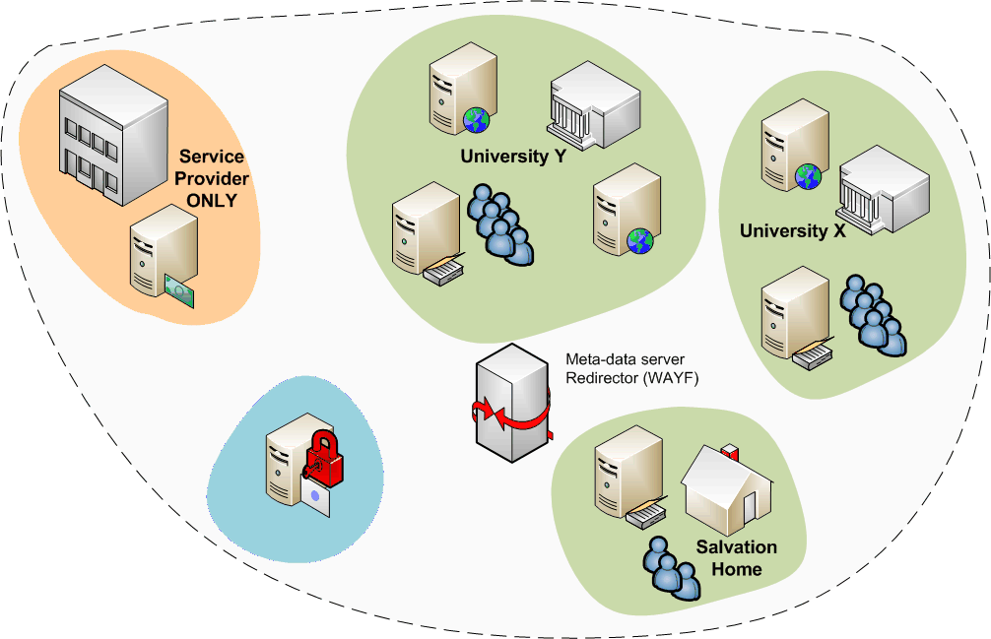
For end-users: federated credentials
PKI is virtually impossible to understand for end-users
A common Authentication and Authorization Infrastructure
Allow access to common resources with a single credential
grid structure was not
too much different!

Slide 35
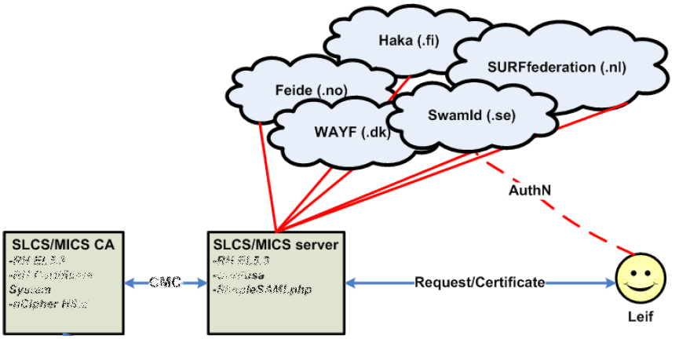
Linking federations to Grid AuthN
Use your federation ID
... to authenticate to a service
... that issues a certificate
... recognised by the Grid today
Implementations:
SWITCHaai SLCS
DFN SLCS
TERENA eScience Personal CA
model example, not actual implementation!
Graphic from:
Jan Meijer, UNINETT

Slide 36
Towards a multi-authority world (AAI)
Interlinking of technologies can be cone at various points
Authentication: linking (federations of) identity providers to the existing grid AuthN systems
  ‘Short-Lived Credential Services’ translation bridges
Populate VO databases with UHO Attributes
Equip resource providers to also inspect UHO attributes
Expressing VO attributes as function of UHO attributes
and most probably many other options as well …
Leads to assertions with multiple LoAs in the same decision
  thus all assertions should carry their LoA
  expressed in a way that’s recognisable
  and the LoA attested to by ‘third parties’ (i.e. the federation)

Slide 37
Access Control at the Site
Example: running compute jobs
Tracing users and actions
Storage

Slide 38
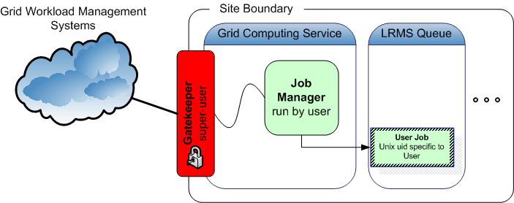
Accessing (compute) resources
User submits his jobs to a resource through a ‘cloud’ of intermediaries
Direct binding of payload and submitted grid job
job contains all the user’s business
access control is done at the site’s edge
inside the site, the user job has a specific, site-local, system identity

Slide 39
To the Unix world
C=IT/O=INFN
/L=CNAF
/CN=Pinco Palla
/CN=proxy
(X509, VOMS)
/dc=org/dc=example/CN=John Doe
grid identity
VOMS
pseudo-cert
translate
enmr001:x:43401:2029:PoolAccount eNMR 001:/home/enmr001:/bin/sh
Unix does not talk Grid, so
translation is needed between grid and local identity
this translation has to happen somewhere
  On entry at the Gatekeeper
  When running tasks or accessing files

Slide 40
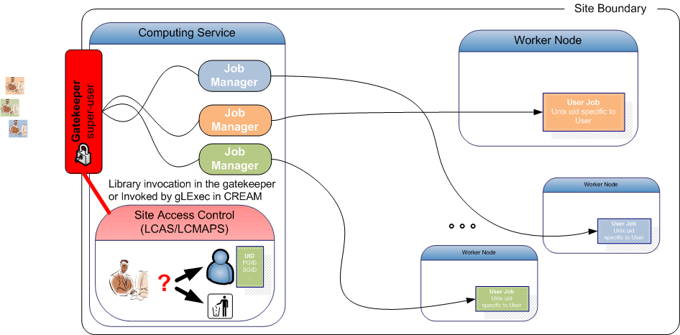
Access Control on the CE
System access (authorization: LCAS, mapping: LCMAPS)
Embedded or though ‘call-out hooks’ in Grid middleware

Slide 41
Access Control
Granting access: grid-mapfile
...
"/O=dutchgrid/O=users/O=nikhef/CN=David Groep" .dans
"/O=dutchgrid/O=users/O=nikhef/CN=Sven Gabriel" .dteam
"/O=dutchgrid/O=users/O=wageningen-universiteit/CN=Anonymised User" .lsg
"/O=dutchgrid/O=users/O=wageningen-universiteit/CN=Anonymised User" .lsg
"/alice/Role=lcgadmin" .alisgm
"/alice" .alice
"/atlas/Role=lcgadmin" .atlsm
"/atlas/Role=production" .atlb
"/atlas/Role=pilot" .atlpi
"/atlas/nl" .atlnl
"/atlas" .atlas
Denying access: ban_users.db
# This file contains the user subject DNs that are BANNED from this fabric
#
"/C=UK/O=eScience/OU=Cambridge/L=UCS/CN=anonymised user"
# from [UPDATE 5] Security incident - XXXXCERT-20080805, 04.Sept. 11:52
"/O=Grid/O=NorduGrid/OU=somesite.se/CN=Olof Palme"
"/O=Grid/O=NorduGrid/OU=somesite.se/CN=Alfred Nobel"
# 16-Jan-2009 banned compromised DN
"/C=CN/O=HEP/O=PKU/OU=PHYS/CN=Mao Zhedong"
# 23-Feb-2009 Security Service Challenge
# SG let Arjen in again after 18.Mar 2009
"/O=dutchgrid/O=users/O=nikhef/CN=Arnold Johan van Rijn"

Slide 42
What does the site owner see?
Batch system
stro.nikhef.nl:
Req'd Req'd Elap
Job ID Username Queue Jobname SessID NDS TSK Memory Time S Time
-------------------- -------- -------- ---------- ------ ----- --- ------ ----- - -----
3223967.stro.nikhef. atlb021 atlas STDIN 32473 1 -- -- 66:00 R -- wn-val-046
3227086.stro.nikhef. atlb021 atlas STDIN 22038 1 -- -- 66:00 R -- wn-val-004
3227691.stro.nikhef. atlb019 atlas STDIN 11290 1 -- -- 66:00 R -- wn-lui1-028
3228887.stro.nikhef. atlb021 atlas STDIN 1562 1 -- -- 66:00 R -- wn-val-091
3235888.stro.nikhef. lhcbpi01 lhcb STDIN 23903 1 -- -- 33:00 R 32:11 wn-lui2-014
3236232.stro.nikhef. atlb019 atlas STDIN 26115 1 -- -- 66:00 R 32:10 wn-bull-011
Gatekeeper audit log
PID: 13507 -- Requested service: jobmanager-pbs
PID: 13507 -- Authorized as local user: atlb019
PID: 13507 -- Authorized as local uid: 70019
PID: 13507 -- and local gid: 2036
PID: 13507 -- "/C=CA/O=Grid/OU=westgrid.ca/CN=Anony Mous" mapped to atlb019 (70019/2036)
PID: 13507 -- GATEKEEPER_JM_ID 2009-11-16.12:51:40.0000013507.0000000000 for
/C=CA/O=Grid/OU=westgrid.ca/CN=Anony Mous on 142.90.256.257
PID: 13507 -- Child 13576 started

Slide 43
Tracing the job
JobManager log
gmtime=20091116115140Z;uniqid=19095.1258344261;ug=70019:2036 2036;
jobid=3243289.stro.nikhef.nl; tag=https://gazon.nikhef.nl:20082/19095/1258344261/;
dry=no;jobtype=single;count=1;
exec=https://condorg.triumf.ca:20014/home/atlasprod/Panda/pyfactory/20091105/runpilot3-wrapper.sh;
args=;
dir=/home/atlb019//gram_scratch_pCHATpWQJY;log=/home/atlb019/gram_job_mgr_13576.log;
Batch system syslog entry
Nov 16 11:51:40 gazon jobmanager-pbs[19374]: qsub success (atlb019:atlb)
/home/atlb019/.globus/job/gazon.nikhef.nl/19095.1258344261/scheduler_pbs_job_script:
3243289.stro.nikhef.nl
As well as regular entries created by the batch system(s) and any auditing data

Slide 44
Storage: Virtual Ids or Unix domain?
Mapping to Unix credentials
  Lacks expression of VO attributes and rights
  Allows joint native and grid use of storage systems
Grid storage systems with grid meta-layer access control
  No need to allocate Unix-level resources or mappings
  Expresses both VO and site-level policies and ACLs
  Access must be via grid-aware mechanisms
Example: Disk Pool Manager DPM:
  mapped to ‘virtual UIDs’: created on the fly first time system sees DN
  VOMS roles are mapped to virtual GIDs
  User can have one DN and several roles,
  so may be mapped to one UID and several GIDs

Slide 45
Example Access Control Lists
LFC and DPM support Posix ACLs based on Virtual Ids
  Access Control Lists on files and directories
  Default Access Control Lists on directories: they are inherited by the sub-directories and files under the directory
Example
  dpns-mkdir /dpm/cern.ch/home/dteam/jpb
  dpns-setacl -m d:u::7,d:g::7,d:o:5 /dpm/cern.ch/home/dteam/jpb
  dpns-getacl /dpm/cern.ch/home/dteam/jpb
  # file: /dpm/cern.ch/home/dteam/jpb
  # owner: /C=CH/O=CERN/OU=GRID/CN=Jean-Philippe Baud 7183
  # group: dteam
  user::rwx
  group::r-x #effective:r-x
  other::r-x
  default:user::rwx
  default:group::rwx
  default:other::r-x

Slide 46
Handling E2E incidents in this system
Detection and coordination
  Globally unique identifiers (subject DNs, VO names)
  Policy ecosystem guidelines for auditing, log retention,
  and information exchange between participants
  Periodically tested through SSCs
Revocation
which, e.g., ssh keys don’t have, but federated access does
  At the identity level, the Grid implements working revocation and CRL support for the PKI
  At the authorization level: VO-level banning, site bans
Recovery
  De-facto, the only transparent recovery is by revocation of identity
  Subject name (DN) is persistent for the user across incidents,
  so no re-registration needed

Slide 47
Summary

Slide 48
Summary
Grid and the VO make collaboration explicit at systems level
  Structure of researchers themselves drives VO structure
  This discloses the ‘interconnected vulnerabilities’ & incidents issue
Threats in distributed computing exist irrespective of Grid
  Multiple accounts across organisations, usually ill-managed
  Shared or semi-public group accounts or shared storage
  Grid middleware gives some additional handles ...
  ... but also exposes new risk surfaces
We have yet to see a grid-specific incident
  Many ‘traditional’ incidents propagate along research collaborations
  Using non-grid attack vectors, and without ‘grid’ controls to help
Notes:
‘We have yet to see grid incident’:
- The structures set up for handling cross-site grid incidents do actually help to coordinate incident response, since the ‘griddy’ OSCT structure is driven by the research collaboration patterns

