Slide 1
Dreaming of a CS lab
The DACS FSE Computing Sciences Lab as a Fieldlab Demonstarator
Concepts, capabilities, connections
David Groep,
January 2025

Slide 2
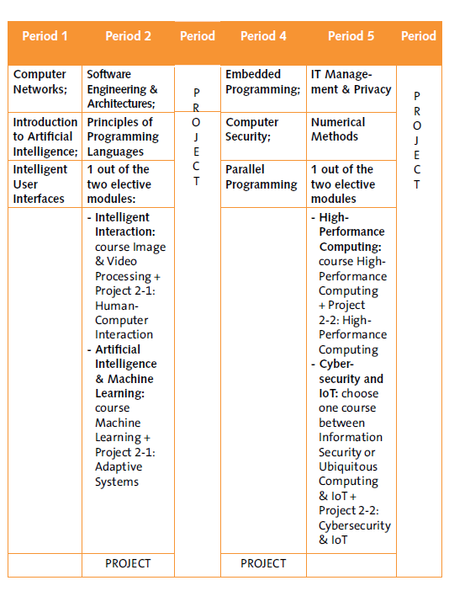
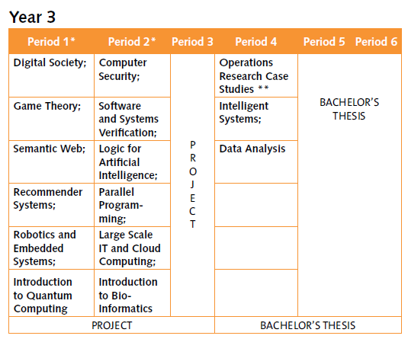
Why the CS lab?
Initially triggered by ‘basic’ short-term needs
new Bachelor Computer Science,
with strong engineering component (esp. in Y2 & Y3)
Large-scale IT and robotics, also in DSAI Year-3
But with wide use for {master, PhD} thesis work and
cross-discipline and cross-organisation research as well:
HPC simulation and modelling , ML models, LLM applications, and collaborating with research output ‘as a service’
science and engineering beyond DACS:
ET pathfinder & LHCb for GWFP, the MSP programme, …
data science in other faculties: need for ‘student sandboxes’
large multi-modal 4D imaging (e.g. for NWO ENW XL FASTER with Ron Heeren), and EU Horizon and Euregio collaborations
https://curriculum.maastrichtuniversity.nl/sites/default/files/dacs_-_study_guide_2024-2025.pdf

Slide 3
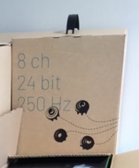
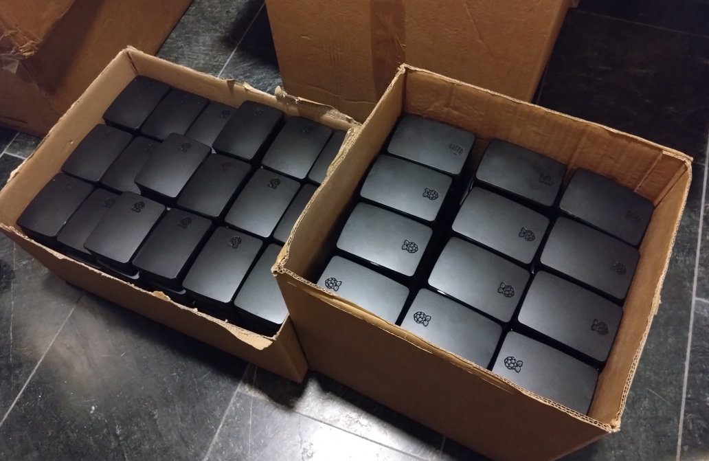
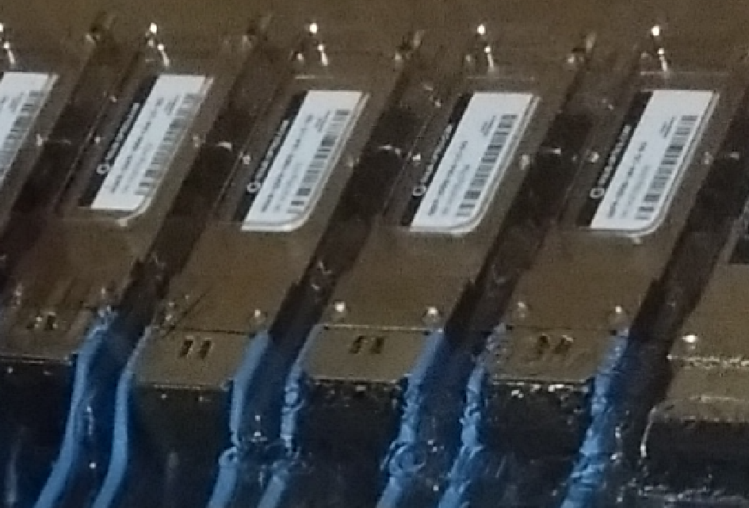
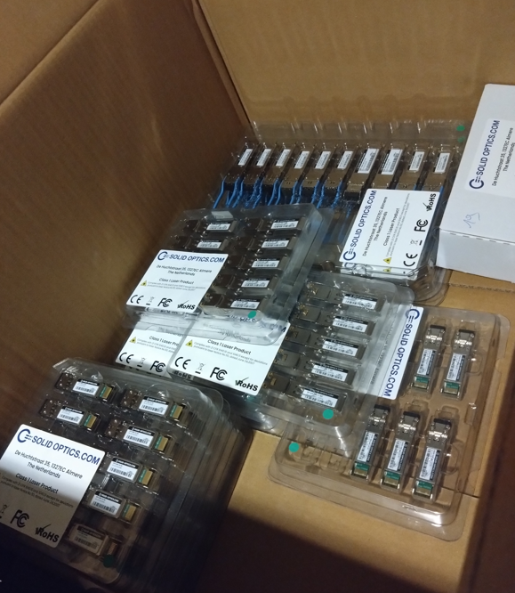
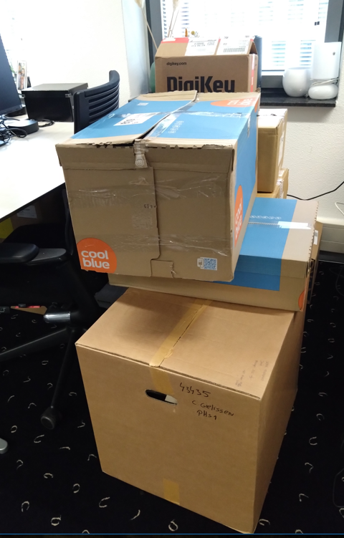
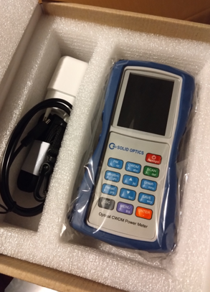
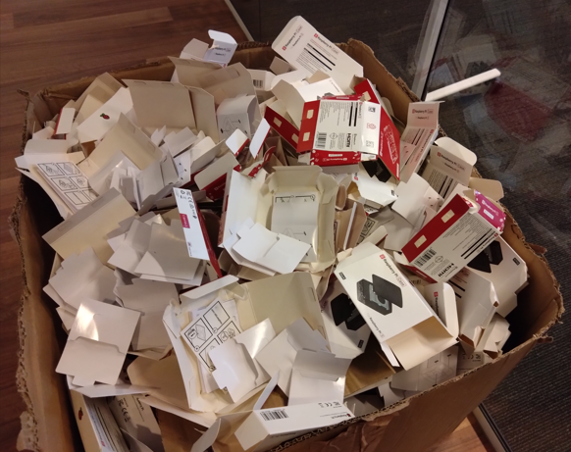
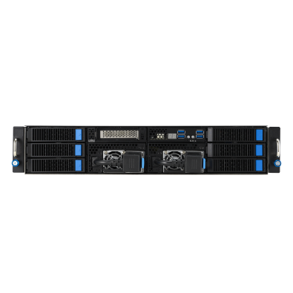
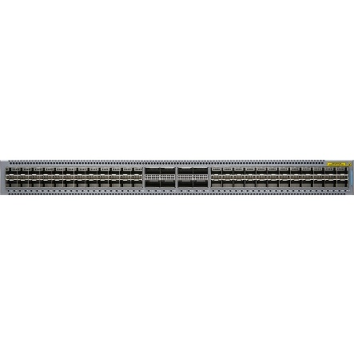
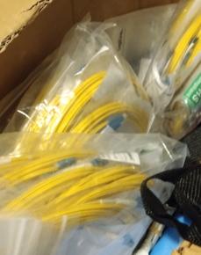
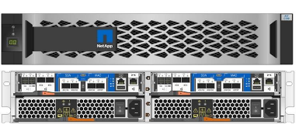
Suddenly … CSlab
And then there was Sectorplan 1
… whose funds needed to be spent in 2024

Slide 4
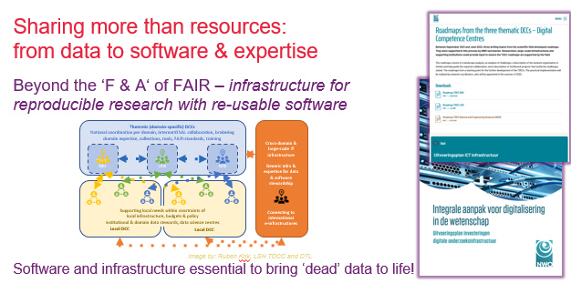
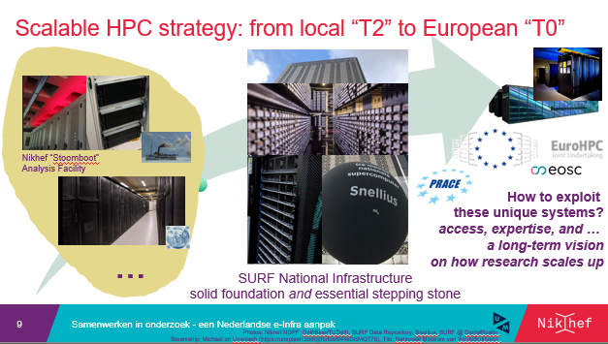
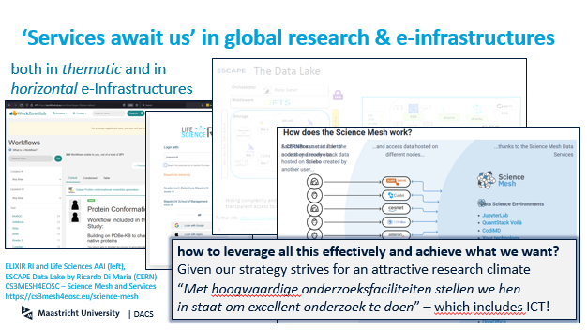
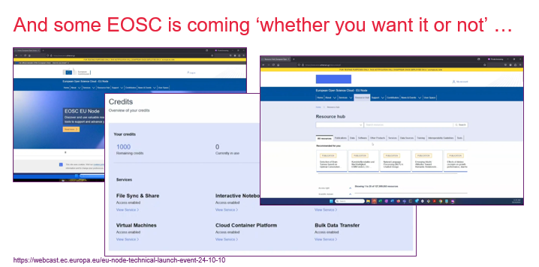
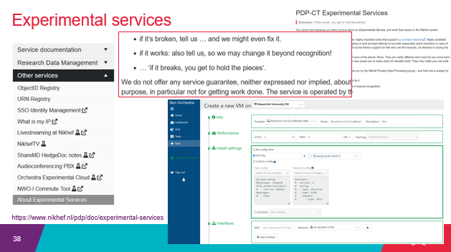
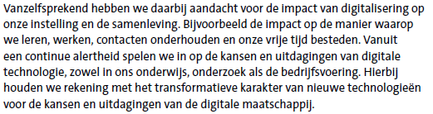
‘Wereldwijd verbonden vanuit een stevige basis in onze Euregio’
Research and education are inherently collaborative, and ‘services exist’
and are being used .. whether we know about them or not:
European Open Science Cloud, ‘ESFRI’ research infrastructures, Erasmus Without Papers, EU Identity Wallets, SURF-NWO Rekentijd & Snellius, EOSC EU Node ‘free VMs for faculty’
Images: UM Strategic Programme 2022-2026, SURF ETP
slide captures: www.nikhef.nl/~davidg/p/ for UM-CI office & LsIT course

Slide 5
Translating ‘wereldwijd verbonden’ education & research as a technical systems and network design
‘we can use existing services from outside’: AAI interoperability, network connectivity and bandwidth, devolution of responsibility and subsidiarity of concern
‘we can contribute in collaborations in education and research’: we can offer services, support pan-European student mobility in our programme, and provide innovative
lab environments that attract students and make our programmes unique
‘we teach and train our students to understand, design, build, study, work with,
and experiment with interconnected services and systems that are globally connected’
Of course we should do that in a safe, scalable, and transparent way,
and at the same time build and use our own science and engineering R&E concepts in an agile way
With a view towards the future … a decadal vision of common reference platform model,
usable for DACS & FSE, ET, … for FASTER 4D-imaging, … for SBE, FASoS, and UM-wide?

Slide 6
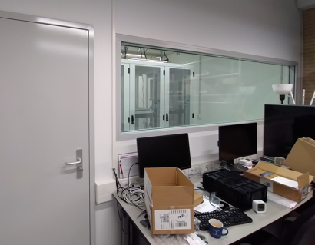
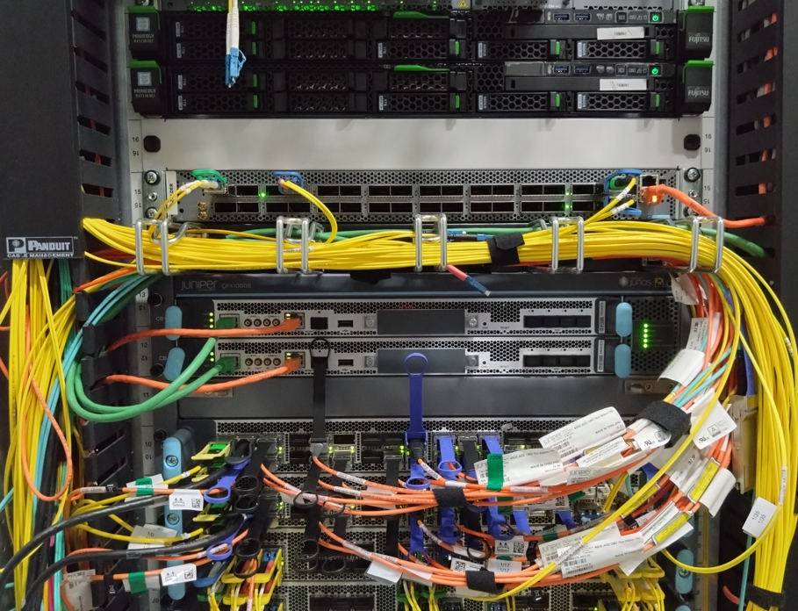
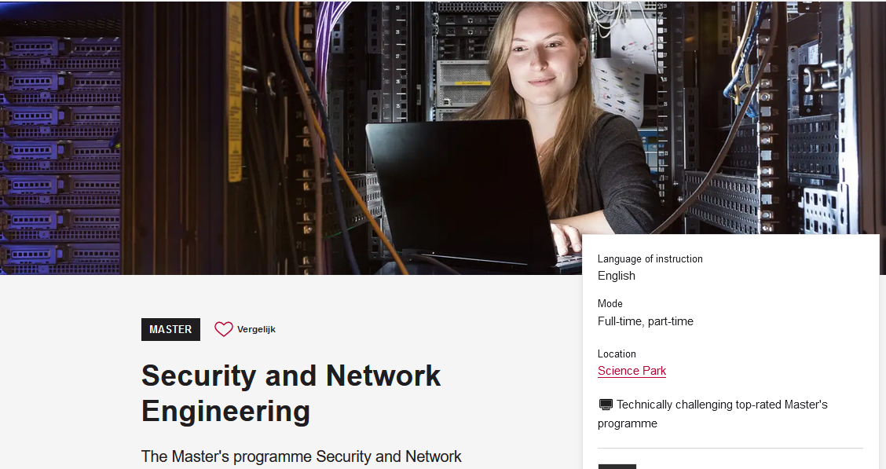
Technical inspiration
DACS CS-Lab concept for today focusses on systems and networks
  those act a foundation for more specific lab settings: robotics, XR, security
  focus on education labs, but equally applicable to research networks
design around micro-segmented networks and inter-subnet controls
  so you could build multiple labs on a partly-shared infrastructure
  leveraging the ESnet (US DoE) ‘ScienceDMZ’ concept, and
  on the UvA Security and Network Engineering master lab
  ( ‘every student a machine on the public internet
  and they are entirely responsible for this box’)
  with inspiration from SURF Experimental Technologies
  Platform and Nikhef open innovation lab
for CS and engineering education (extensible to research), and
not targeting enterprise services, nor for now sensitive data services

Slide 7
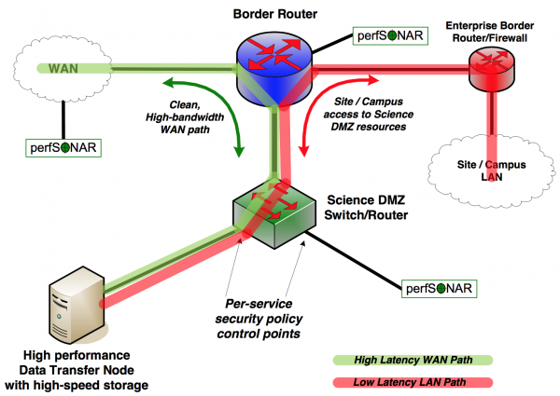
‘ScienceDMZ’
Predicable performance
and data access for research
‘where research services,
data, and researchers meet’
lossless transfers and latency hiding
elements horizontally scalable
security zoning/segmentation
protects services and data
outside enterprise perimeter
for a different type of traffic: science data transfers rather than eyeball networks
Image and ‘ScienceDMZ’ concept promulgated by ESnet (see fasterdata.es.net)

Slide 8
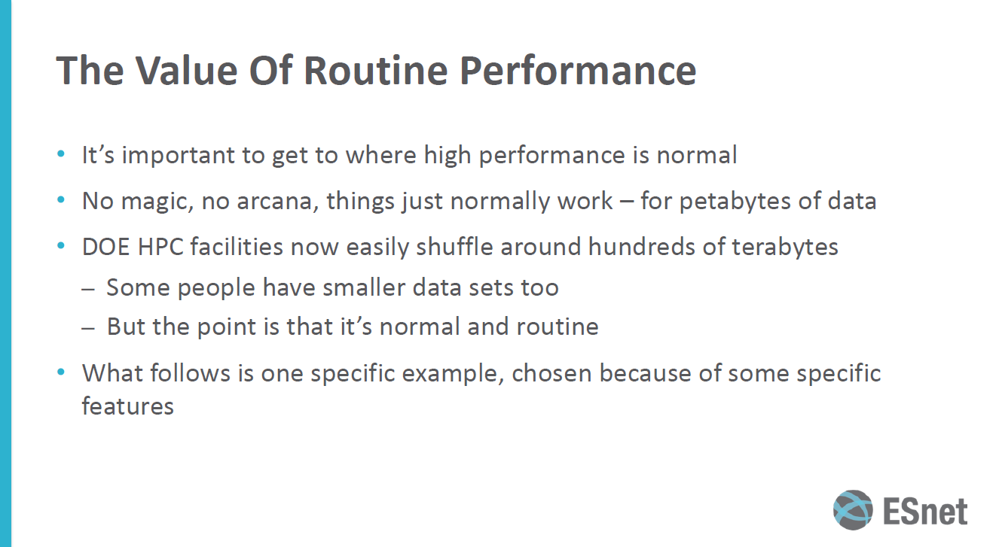
From Eli Dart (ESnet), “The Strategic Future of the Science DMZ”, TNC23, https://indico.geant.org/event/2/contributions/186/attachments/168/

Slide 9
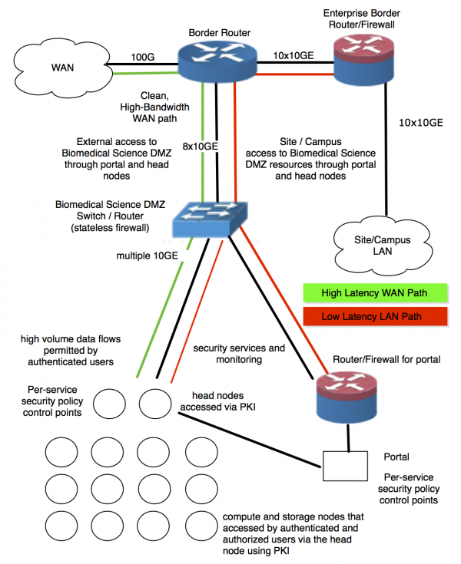
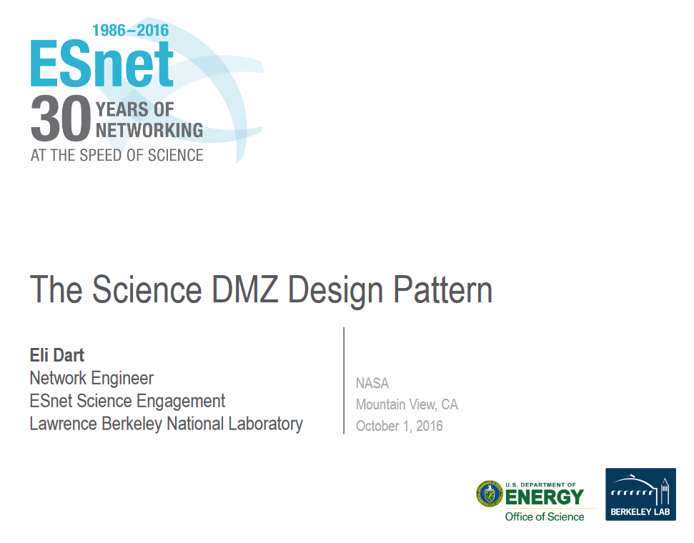
Labs as a design pattern …
Left: components in a medical sciences DMZ
from https://crd.lbl.gov/news-and-publications/news/2017/esnets-science-dmz-design-could-help-transfer-protect-medical-research-data/

Slide 10
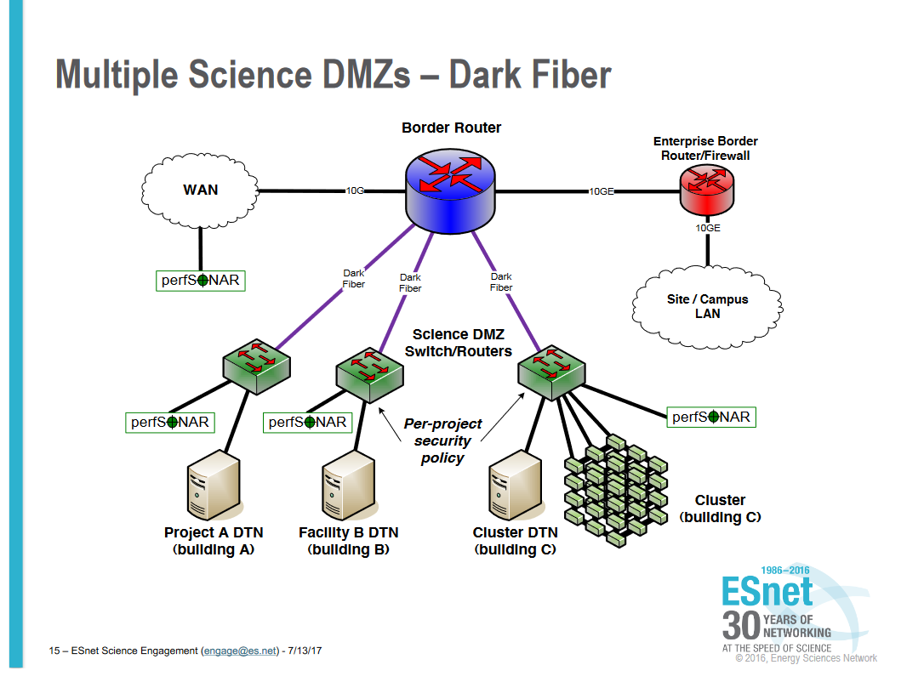
And once you have multiple FieldLabs
Slides: Eli Dart, ESnet (2017)
https://smd-prod.s3.amazonaws.com/science-red/s3fs-public/atoms/files/3-2-Science%20DMZ%20Design%20Pattern%20-%20ESNet%20-%20Eli%20Dart.pdf

Slide 11
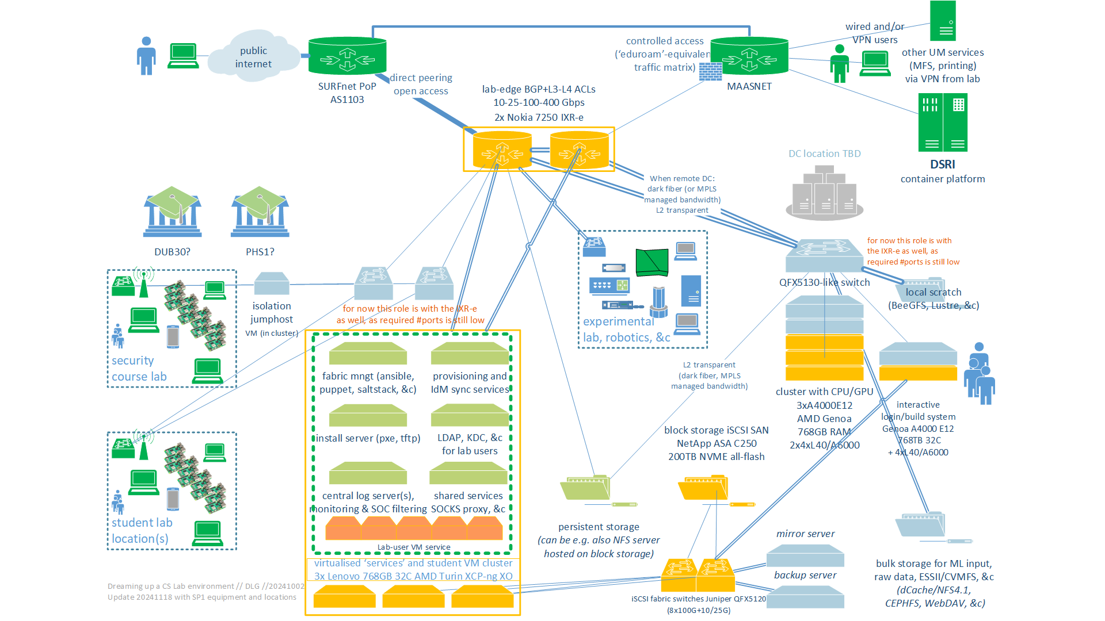
Dreaming up a CS lab environment in a ScienceDMZ
SOLL and IST (yellow, green) state
of the CSlab foundation

Slide 12
CS Lab – the 2024 foundation (<20 December 2024)
Virtualised base infrastructure: fabric management, logging, IAM bridging (to SURF SRAM or locally with a SAML SP), proxy and gateway services for sub-labs, ~300+ student sandbox VMs, XCP-ng & XenOrchestra managed with SAML or OIDC auth
  3x SR635v3 (each: 786GB RAM, 2x25G data network, 2x25G iSCSI, 64 logical cores 9355P)
Storage back-end service: block storage for VMs (supporting NFSv4 via VM with linux)
  NetApp C250 with 200 TByte net NVME all-flash capacity, 4x100G iSCSI
HPC starter cluster: AI/ML courses, reasoning, HPC modelling, interactive & batch
  4x ASUS ESC4000A (each: 3.25GHz 64 logical core EPYC 9355P, 768 GB RAM, 2x16TB NVME, 2x25G data network), 3 of these systems have 4 Nvidia L40 GPUs each (so 12 GPUs in total)
  one node as the ‘interactive’ validation and compilation node (scheduling will be in a VM)
Network: access gateway for standard edge connectivity (BGP, MPLS, 802.1q, EVPN, L3/L4 ingress and egress ACLs and policers) and iSCSI SAN fabric switches (25/100G)
  pair of Nokia 7250 IXR-e, each: 2xQSFP28 100G, 8xSFP28 25G, 24xSFP+ 10G (or 1G)
  pair of Juniper QFX 5120’s, each: 8xQSFP28 100G, 28xSFP28 25/10/1G

Slide 13
A lab for fieldlabs
It is also a technology lab & computing sciences engineering innovation lab
networking from commonly used protocols like evpn-vpls/mpls
to high-speed udp science data transport or alternative tcp stacks,
or segment routing and connecting to LHCone at 400Gbps to 1.6Tbps?
storage, compute, acceleration, cluster computing, virtualisation, orchestration, automation, AuthN & AuthZ infrastructures and IAM, …
power usage, application efficiency, divergence of 2019/424 to actual usage?
‘Lab’ aspect need not to stop at layer-7
ITSRM, SMS & FitSM/20k, … to federated services and Tier-2/1/0 scaleout
red-teaming in resilience exercises with SURF/NMDDoS – or for ourselves?

Slide 14
A collaborative demonstrator
The Fieldlab & ScienceDMZ concepts are readily generalizable
both a technology lab (networking, computing, storage, IoT, security)
as well as a infrastructure and systems lab for SMS and ITSRM concepts
So let’s try and use this for an integrated approach already now for the CSLab
linked to current and evolving ICT at UM as a whole
ITSRM for the CSLab in line with UM IT security risk management
look at this also as a playground for new ITSM ideas and experiments
– this is a ‘harmless’ lab with forgiving users and local flexibility ☺

Slide 15
The most important ingredients …
Creativity
Flexibility
Desire to experiment
CSLab equipment was selected for the usual HA design, but
can, may, and should be used also for experiments
a common playground for students, researchers, and ICT engineers
diversity in equipment, components, client devices, IoT stuff, and tools
is intentional for experimentation
Other labs may have a different scope and purpose, but all share the top-3 elements!

Slide 16
Getting more hands-on
… as we have to start making choices soon
for mounting, numbering, labelling, port speeds, filters, and much more

Slide 17
Collaboration … because it’s absolutely needed
In our interactions with ‘the world’, UM must appear as a coherent whole
Network circuit provisioning to SURF
Internet number resources (AS, IPv6 and IPv4 space) from SN-LIR (1xAS,/47 v6, /18 v4)
L1 and L2 network transport across campus building locations
RFC1918 number resources coordination
(so users can have access to both UM and lab even when both VPN and lab are up)
Housing and secured access, racking and stacking, power feeds and PDUs
jumphost to the lab OoBM network (may be virtual, UM internal VPN access only)
during commissioning (to prevent having to sit in DEB1 all the time ☺)
Collaboration services like SURF SRAM also needs UM central coordination
Incident response coordination & Sirtfi
even though DACS can initiate and prepare SURF staff for the requests,
SURF really wants these to come from our institutional contact persons

Slide 18
Collaboration … because it’s just better together
IAM for linking lab services to UM identity
an experiment: CSLab end-users shall not have any lab-specific re-usable credentials, but use only SAML, OIDC, or Wallet VCs to authenticate, or ssh pubkeys for login/access
release of attributes and provisioning interfaces for some lab services
like: which students are in which course,
and hence need to be granted access to which parts of the lab?
prevent duplication of SMS supporting assets
that the CSLab would need to set up but can be usefully shared:
protected GitLab for the CMDB, Jira/Confluence-like service, …

Slide 19
Collaboration … because we’re all human
coordinated cable numbering in shared DC facilities like DEB1
alignment on e.g. 802.1q identifiers because it prevents confusion in human communication (CSlab needs ~50 out of 4093 for its segmentation)
joint access to documentation and SMS information
work out a way for things sent to the UM central helpdesk to bounce misdirected questions back to the lab
periodic technical meetings & chat, since working together is nice,
… and because we all forget to ask for the right stuff sometimes!

Slide 20
More discussion time …

Slide 21
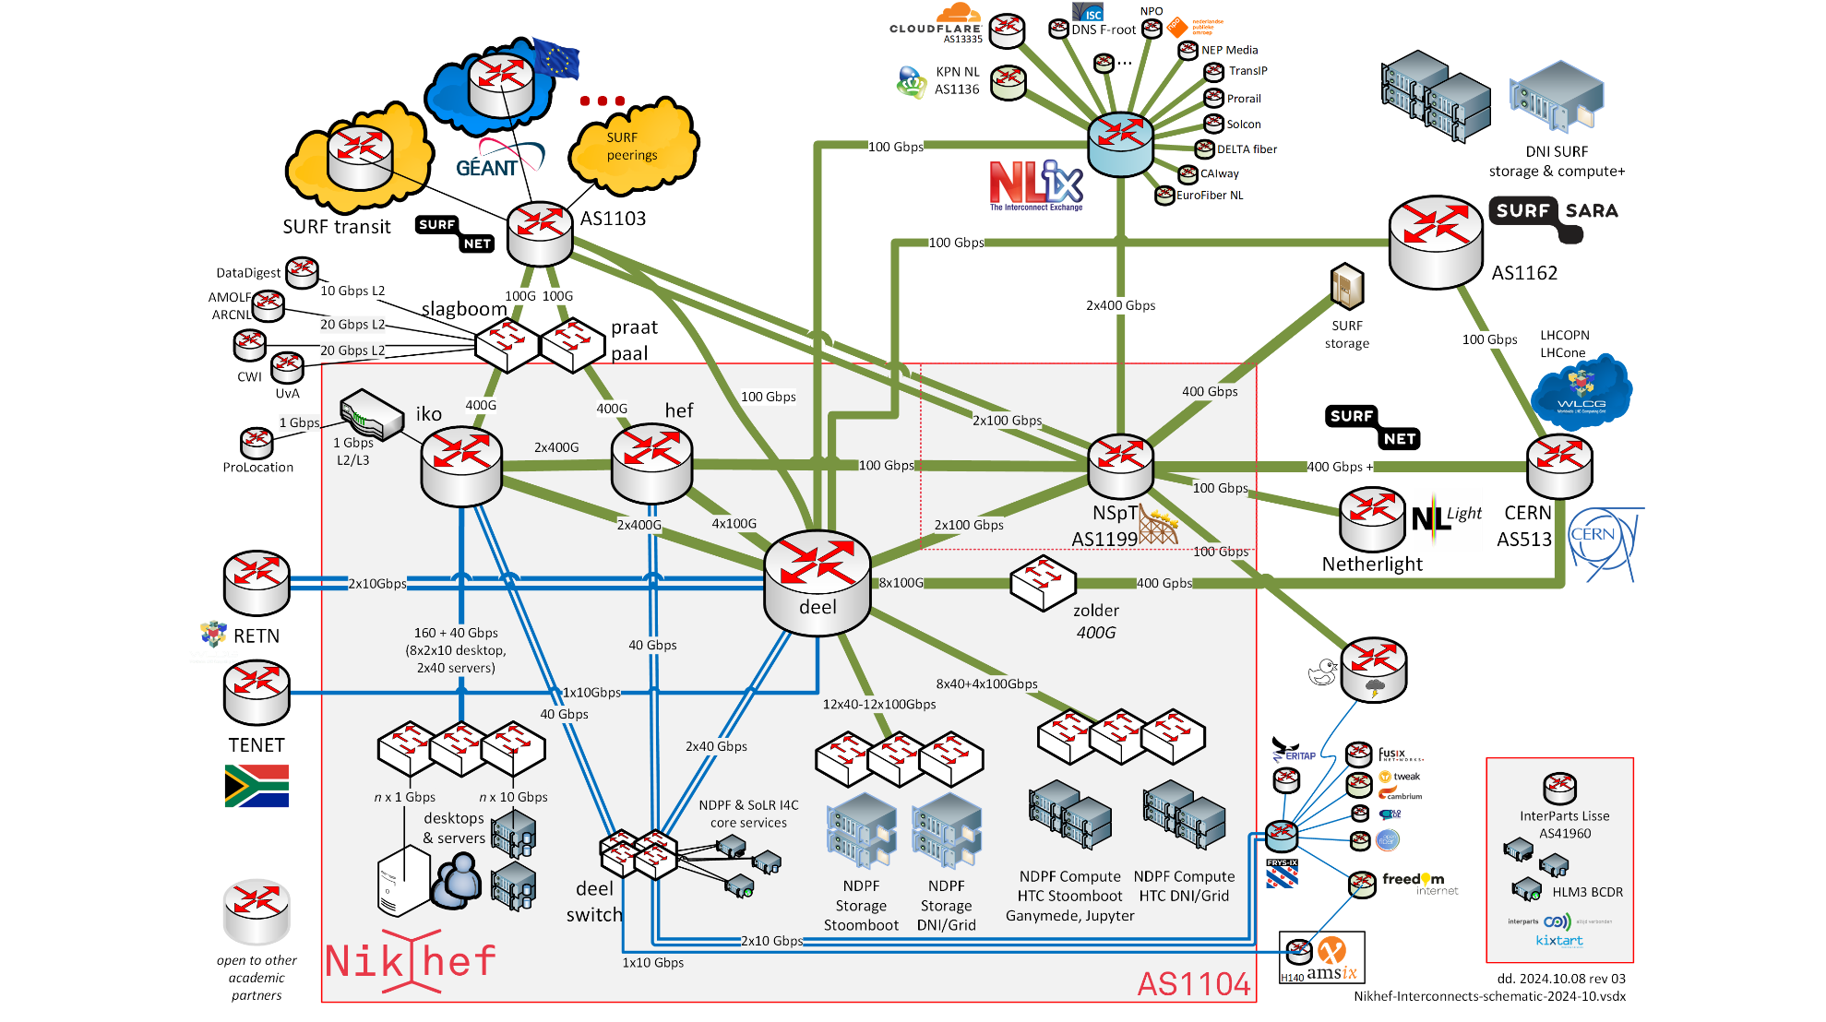
AS1104
https://www.nikhef.nl/pdp/doc/facility

Slide 22
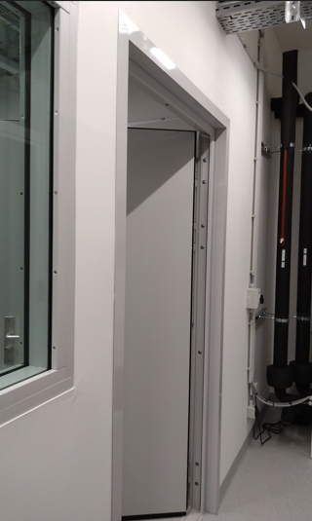
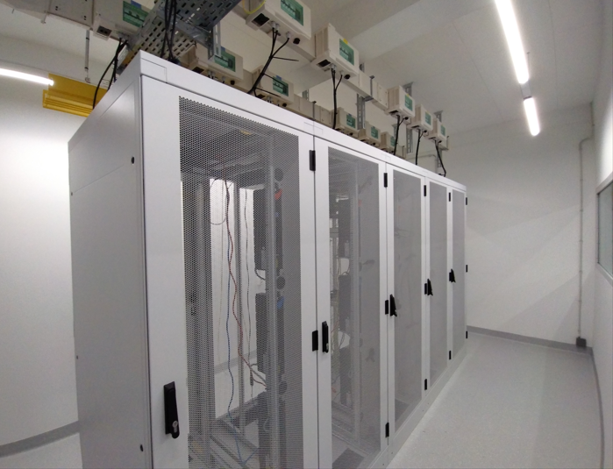
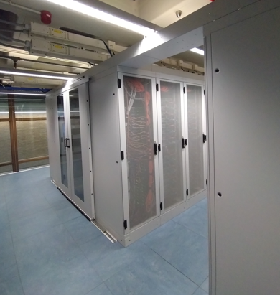
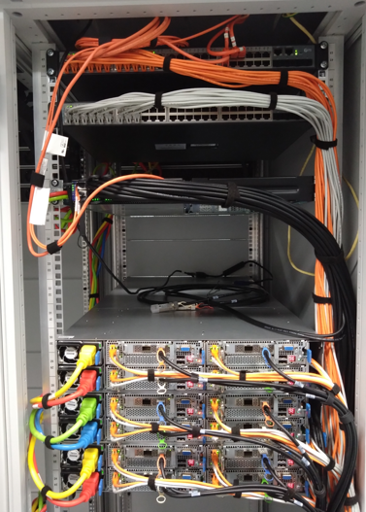
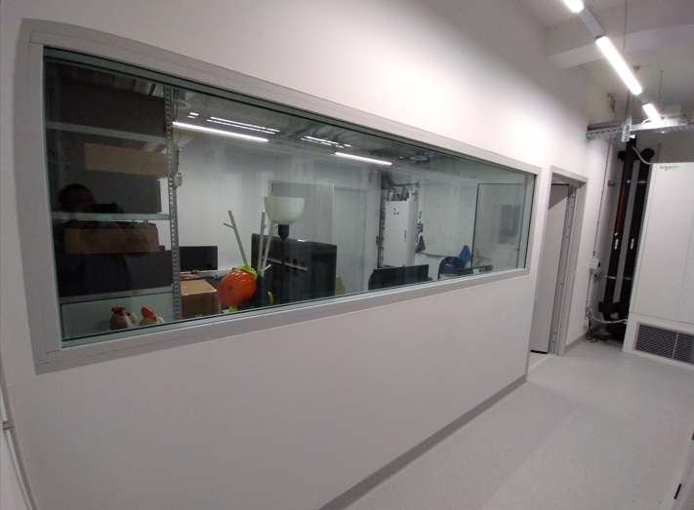
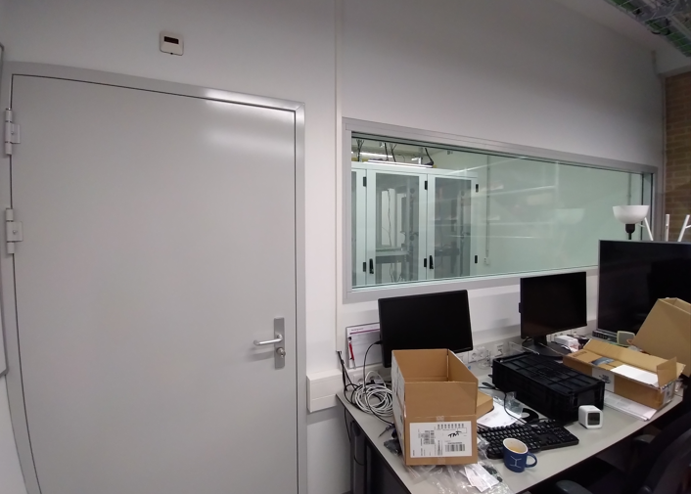
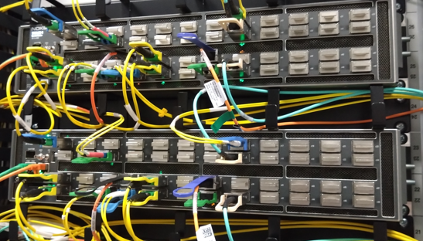
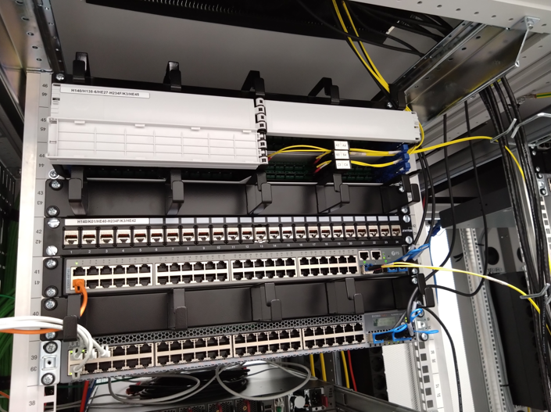
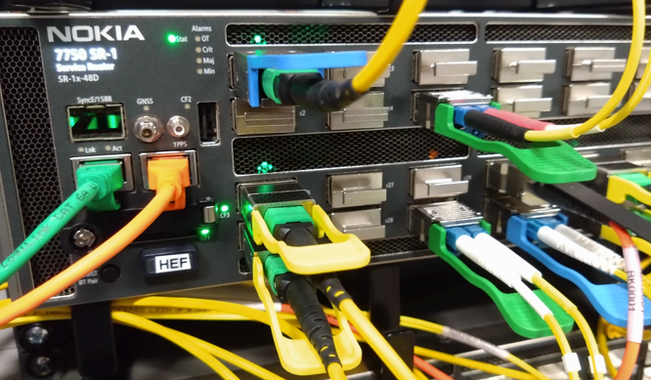
Labs and more labs!
Nikhef SP105: H234b (L) and H234f (R)

