Slide 1
Introducing Identity Management in a mid-size research organisation
From use cases to policy … the good, the bad and the ugly
David Groep, Nikhef, Physics Data Processing Programme
Outline
A few words about Nikhef
Co-driving ID management adoption with research use cases
Policy principles, document templates & structures
The good, the bad and the ugly
On sharing and engagement

Slide 2
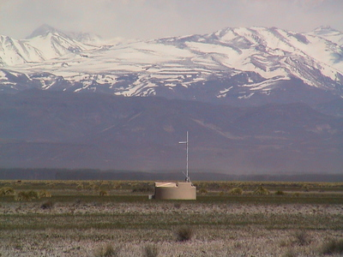
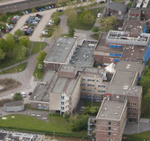





About us, Nikhef
~ 260 employees
60 scientific staff
100 PhD & postdocs
80 engineers
20 support staff
+ many guests and students
… part of stichting FOM + 4 Universities
(for employment administration)
And many national, European and global collaborations
listing only some ICT related ones here
…
National e-Infrastructure for Research

Slide 3


‘Why bother with policy?’
Key ingredients when we started
PDP Research use cases ⇨ for our directorate
Easier access to distributed e-Infrastructure
via TCS eScience Personal (wLCG, EGI)
Tempting access to federated services (LIGO/Virgo)
IT department use cases ⇨ for CT management
Automate account clean-up: life cycle management
Had to setup new mail service anyway, and …
… users started requesting single password (beyond YP)

Slide 4
Other key ingredient: cost
Being a mid-size organisation allowed us to introduce ‘proper’ IdM at very low cost as a joint op between the Nikhef research-IT (PDP) team and IT services group
All expertise existed in-house –
mostly thanks to previous Grid & e-Infra work
  Experience and good templates for policy
  Existing central directory services for ‘Grid’ side
  In-house expertise key technologies, if ~1-2 people
Basic linkage to HRM systems had been done previously for a ‘facebook’ web gallery
Flexible HR department (by good local proxy)
But: introducing Identity Management does not save you money!

Slide 5
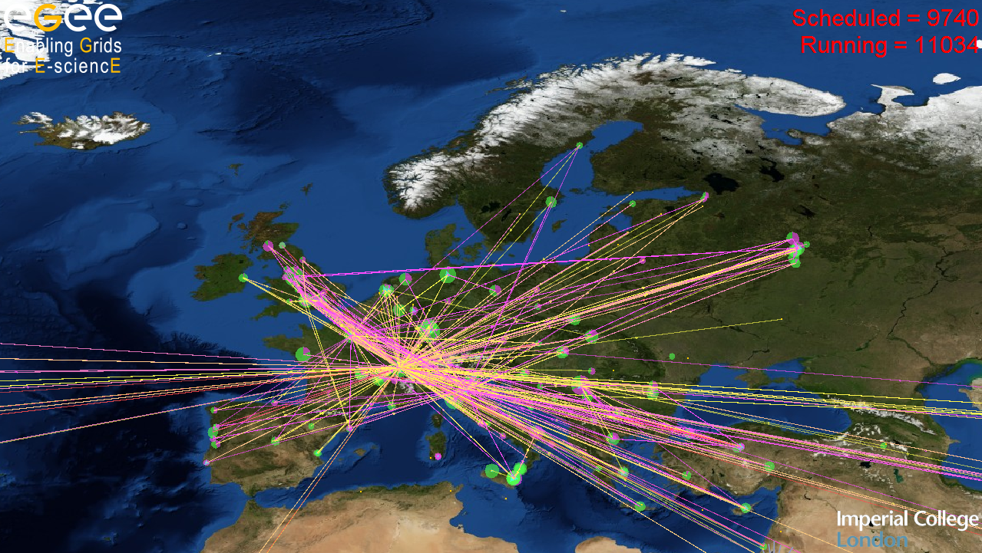
Nothing new
Nobody actually wants to read policy, so
tell in the exec-summary what
target audience ‘wants’
For directorate, we promoted
  Near-instant TCS certificates for wLCG
  SURFspot (always a big selling point for federation, but not policy)
  Elsevier/Scopus &c
Convincing our CT group was fairly trivial
  Auto-cleanup of accounts is a big plus –
  we lost 66% of our ‘users’ within a year ☺
  SSO/LDAP integration for mail service (biggest head-ache till then)
For ‘DIY admins’: ask how they deal with users in 10yrs
Graphic courtesy GridPP and EGEE: Real Time Monitor - rtm.hep.ph.ic.ac.uk

Slide 6
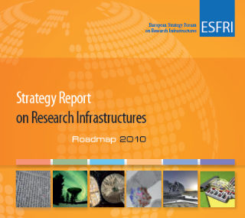
It’s the future anyway
ESFRI clusters and FIM4R should give you
science use cases for IdM policy
Towards a single European R&E AAI space
  “Deployment and promotion of a pan-European identity federation for researchers, educators and students, in compliance with existing identity inter-federation efforts...”
Technology space is messy, but having good-quality
IdM is a prerequisite in all cases
  Look at CERN WebSSO multiple-choice page:
  To get on there, you need demonstrable policies
  But makes both users and the Relying party happy

Slide 7
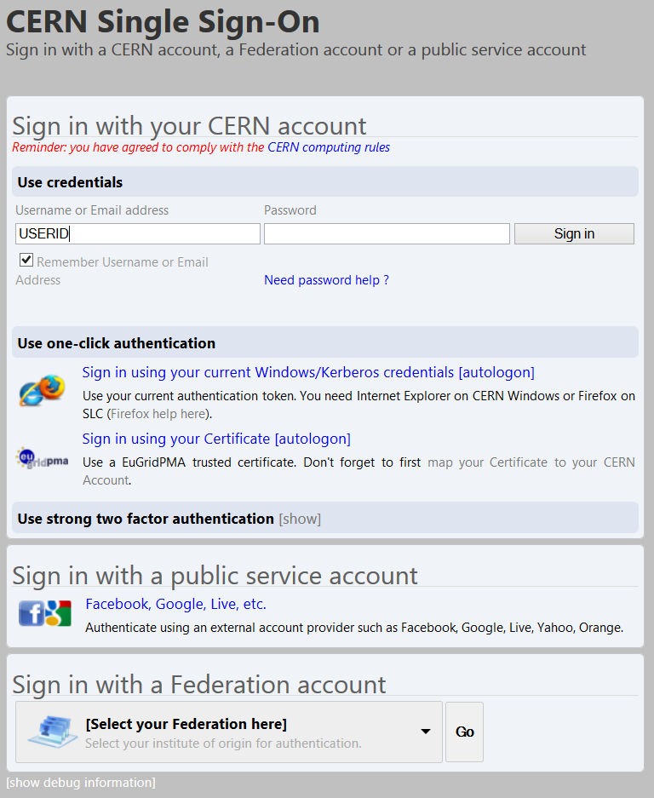
Service access and authorization depends on authentication strength and identity quality
Good quality (TCS-equivalent) identity
gives you access to all services
Unfortunately, beyond WebSSO
it’s a technology ‘nightmare’
By CERN IT/IS
www.cern.ch/it

Slide 8



How to ‘sell’ a policy
You don’t! Policy is not optional, so don’t even suggest anywhere you can work without one
  Set up as joint effort of physics computing and IT services
  and got fairly quick directorate buy-in
  Stating we had to comply with TCS CP/CPS helped
  The ‘IdM maturity scan’ (SURFnet sponsored) helped
  … that’s external pressure working for you ☺
  Writing one quickly – and not requesting effort
  up-front – helped
  … could have been a draft to show where we were going

Slide 9



Writing it all up
Use a template – there are many out there
  Not too technology specific (e.g. RFC3647 is great, but too much PKI specific; NIST SP800 series too detailed)
  Pick one which addresses federation concerns, and borrow from
  e.g. REFEDS federation policy best practice approach [2], the
  Identity Federation Policy template document (TNC2013) [3], &c…
  And modify if there are missing elements
We picked the Open Grid Forum
“Requirements for Authentication Service Profiles” [1]
  Technology agnostic, compact, and ‘familiar’ to us in the IGTF
  Good list of ‘things to address’ (added just small things on
  end-user obligations, which in the IGTF are dealt with elsewhere)
[1] http://redmine.ogf.org/dmsf_files/29
[2] https://refeds.terena.org/index.php/Federation_Policy_Best_Practise_Approach
[3] Marina Vermezovic et al., https://tnc2013.terena.org/getfile/701

Slide 10
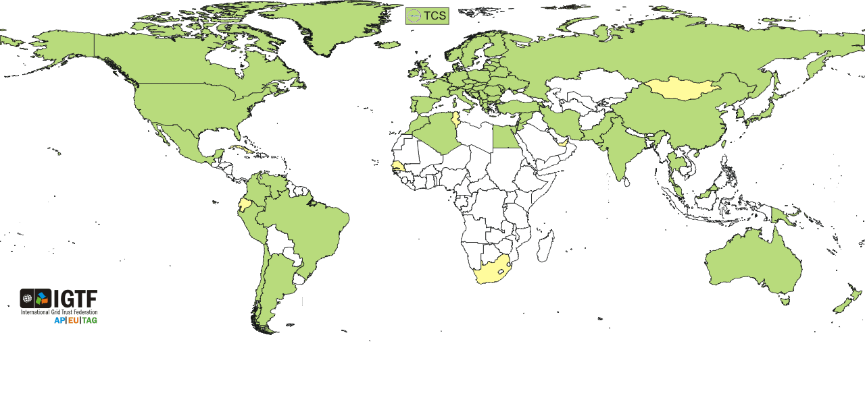



Borrowing from the IGTF
www.igtf.net
Global policy profile, based on ‘minimum requirements’,
geared towards IdM for scattered, lone end-users

Slide 11
Policy elements (from OGF template)
Authentication Service management
General architecture of the Service
Identity [vetting, attributes, roles, life cycle management]
Operational Requirements
Facility Security
Publication and Repository Responsibilities
Liability, Financial Reponsibilities, and Audits
Privacy and Confidentiality
Compromise and Disaster Recovery
Added: Subscriber (‘users’) Obligations and Compliance
https://sso.nikhef.nl/policy/Nikhef-IdM-Policy-v1.0.pdf

Slide 12
The Good …
Make sure the policy follows working process, don’t force reasonable processes to change
  Spend time to understand processes elsewhere
  Fix only ‘worst bits’ of process inconsistent with requirements
  Introducing IdM policy is not an excuse for re-organisation:
  keep processes and data where they are
Write to support exceptions: we have a hardship clause
Follow organisational culture
  Our basic premise: allow and promote use, preserve user privacy,
  unless it causes harm to Nikhef (like undue operational costs, non-compliance with external providers, legal hassle)
  and do no harm towards our IdM consumers

Slide 13
example of its implementation
So ‘Following existing processes’ reflects in Sec. 3 “Identity”
  We defined all categories of account we identified in the old system
  Users (those entities having registration data and vetting)
  Generic Accounts (entities without independent registration data)
  Automated system entities
Vetting processes defined only for users
  Thus: only Users get federated privileges
  Actual F2F ID vetting done by HR dept only (‘WBP-safe’ ;-)
  accounts with lower LoA (‘affiliate’) can be vetted by any (registered) employee: ‘sponsor’, as long as registration data are kept
Registration is ‘easy’, but access to services controlled
Complete account life cycle is defined, also for incidents

Slide 14
Good, cheap, or quick: pick any two
Take your calender time – it took us ~ 2 years
one year for establishment,
plus one year for graceful roll-over
  Awareness (TCS): early 2005, impetus early 2008
  Initial maturity scan in Oct 2008 → still low
  Took ~ 9mo calendar-time to get organisation aligned
  Ready for prime time in December 2009
  New IdM evaluated and audited Jan 2010
  Graceful roll-over period complete January 2011
Actual effort (policy + implementation) small: 2–3 PM
  … but effort spent by few ‘expensive’ (=overcommitted) experts

Slide 15
… the bad …
Training helpdesk personnel is never sufficient
  you will be spending time dealing with exceptions,
  or otherwise with frustrated users
Be prepared to ‘educate’ upstream providers
“no, I don’t need to know everyone’s pay grade nor a passport no.
to determine if they’re an employee”
Having a policy means there will be violations
  Make sure the policy empowers you to take action
  Be prepared to spend time on taking these actions
You will have stay vigilant against the ‘DIY admins’

Slide 16
… and the ugly
Do not hurry too much – we made that mistake
  Policy tends to become immutable,
  whilst practices may and will change
  Take the advice of RFC3647 to heart
  and take the time and split Policy and Practice statements
  we did not, and really ought to update the policy again
  and the policy SHOULD only have RFC2119 language in it, nothing else
We really should have spent time doing RBAC
but did not since most tooling was attribute-based
It took us one more year to get a new AUP
  since it involved monitoring capabilities, needed OR approval – and a works council is technically clueless

Slide 17
Getting there: share!
If you are inclined to ‘duplicate’ the process
Find at least one research (read: business critical) case
  to make it authoritative you’ll need some top-down support
Don’t ‘over-do’ the policy
Get involved in an IdM/policy community
– having or breeding in-house experts helps
  Go to SURF & SURFnet groups & network events …
  TERENA taskforces TF-EMC2 and TNC
  Go to the EuroCAMP meetings
  Listen in to FIM4R workshops and REFEDS
  Talk, share, engage, ask & discuss!

Slide 18
Questions?

