Slide 1



About Nikhef
Physics
Data Processing
BiG Grid & NL T1
a national e-Infra!
FOM-ICT Meet-up, January 2015

Slide 2
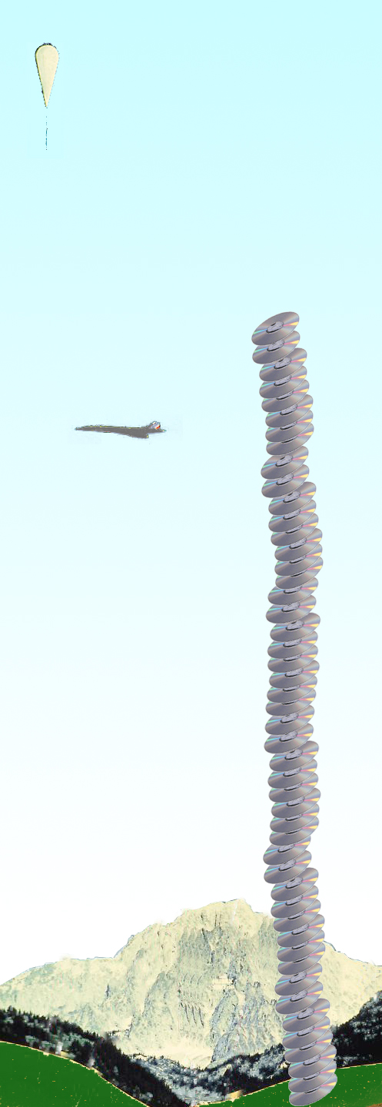
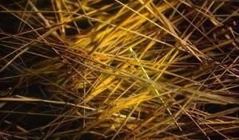
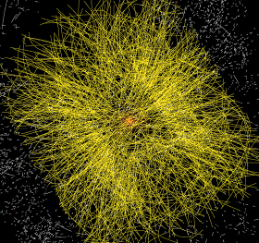
Balloon
(30 Km)
Data from the LHC
CD stack with
1 year LHC data!
(~ 20 Km)
Signal/Background 10⁻⁹
Data volume
  (high rate) X
  (large number of channels) X
  (4 experiments)
  ➔ 20 PetaBytes of new data each year
Compute power
  (event complexity) X
  (number of events) X
  (thousands of users)
  ➔ 60’000 of (today's) fastest CPUs
Concorde
(15 Km)
Mt. Blanc
(4.8 Km)

Slide 3
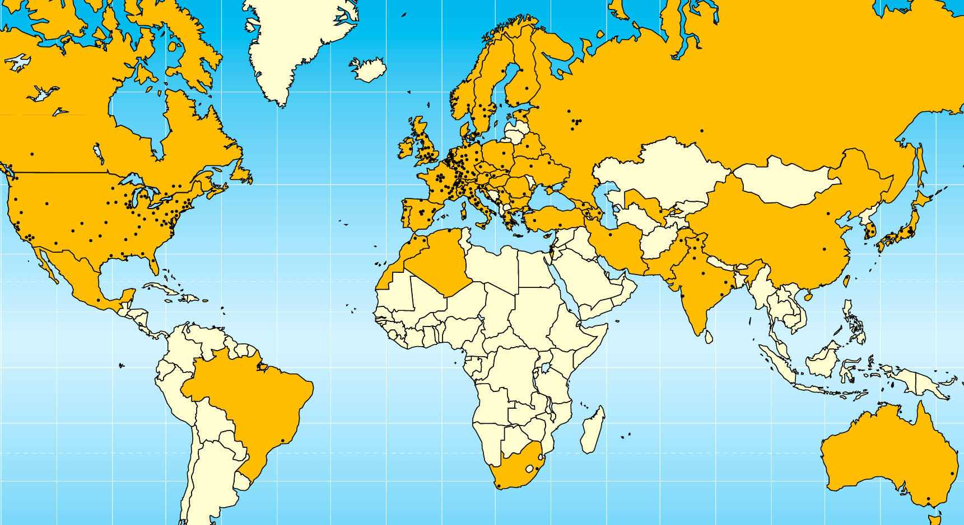

Today –
LHC Collaboration
20 years est. life span
24/7 global operations
~ 4000 person-years of
science software investment
~ 5 000 physicists
~ 150 institutes
53 countries, economic regions

Slide 4
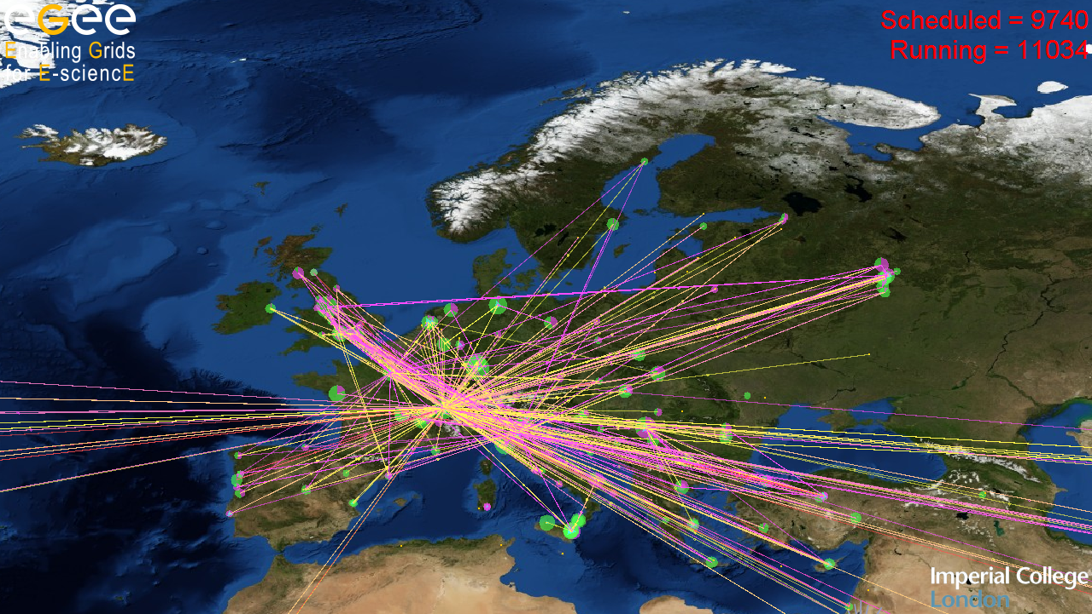
Grid – the global e-Infrastructure

Slide 5
Why would we need it?
Enhanced Science needs more and more computations and
Collected data in science and industry grows exponentially
The Bible | 5 | MByte
X-ray image | 5 | MByte/image
Functional MRI | 1 | GByte/day
Bio-informatics databases | 500 | GByte each
Refereed journal papers | 1 | TByte/yr
Satellite world imagery | 5 | TByte/yr
US LoC contents | 20 | TByte
Internet Archive 1996-2002 | 100 | TByte
LOFAR expected 2010 | ~ 1 | PByte
Particle Physics Today: LHC | 20 | PByte/yr
1 Petabyte = 1 000 000 000 Megabyte

Slide 6
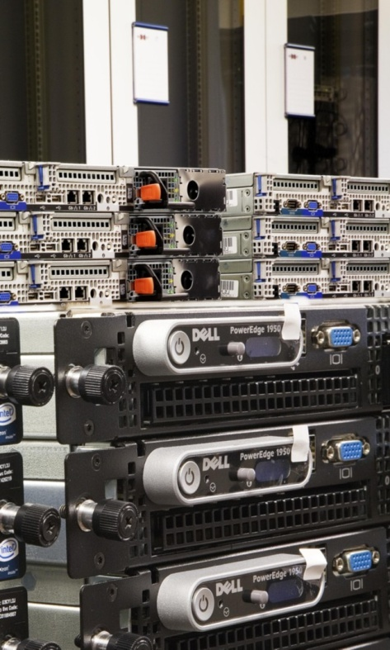
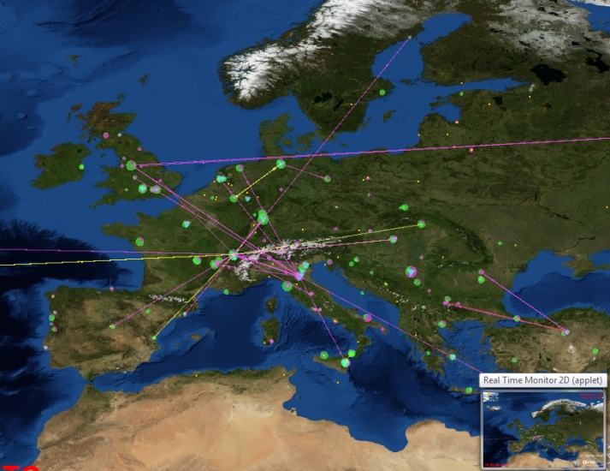

Grids in Science
The Grid is ‘more of everything’
as science struggles to deal
with ever increasing complexity
more than one place on earth
more than one computer
more than one science!
more than …

Slide 7

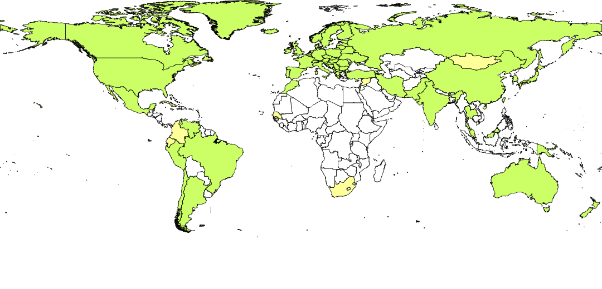
Trust Infrastructure and Security
Why would I trust you? How do I know who you are?
‘digital signatures and certificates be used as digital identities’
But they need to become ubiquitous
With high quality – since they are used to protect high-value assets
Persistent and globally unique
For the Grid a truly global identity is needed
–– so we built the International Grid Trust Federation
  over 80 member Authorities
  Including, e.g., the TCS
And it works in a global federation,
with harmonized requirements, driven by actual relying parties

Slide 8
Nikhef, the Netherlands and the World

Slide 9
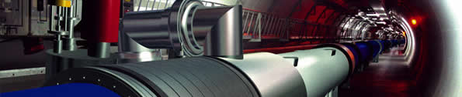
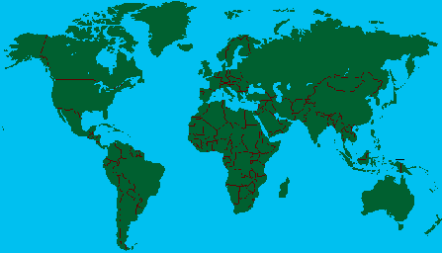
LCG Services
Tier-0 – the accelerator centre
Data acquisition & initial processing
Long-term data curation
Distribution of data → Tier-1 centres
Tier-1 – “online” to the data acquisition process → high availability
Managed Mass Storage –
→ grid-enabled data service
Data-heavy analysis
National, regional support
Canada – Triumf (Vancouver)
France – IN2P3 (Lyon)
Germany – Forschunszentrum Karlsruhe
Italy – CNAF (Bologna)
Netherlands – NIKHEF/SARA (Amsterdam)
Nordic countries – distributed Tier-1
Spain – PIC (Barcelona)
Taiwan – Academia SInica (Taipei)
UK – CLRC (Oxford)
US – FermiLab (Illinois)
– Brookhaven (NY)
Tier-2 – ~120 centres in ~35 countries
End-user (physicist, research group) analysis – where the discoveries are made
Simulation

Slide 10




GridKa
IN2P3
TRIUMF
ASCC
Fermilab

Slide 11



BiG Grid, the Dutch e-Science Grid
Started @Nikhef in 1999 Nikhef with WTCW VL
  2001: European DataGrid and EGEE projects
  joint with SARA (and KNMI)
Started BiG Grid in 2005/2007 to consolidate e-Science infrastructure & production support
Initiative lead by the science domains
  NCF and its scientific user base
  NBIC, Netherlands BioInformatics Center
  Nikhef, who you know by now ☺
With SARA as main operational partner
    Resulting in SURFsara today as coordinating a national e-Infra!

Slide 12
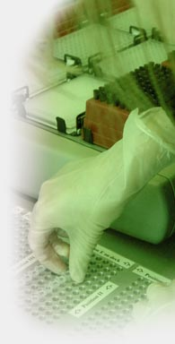
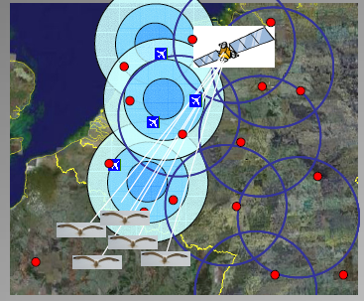
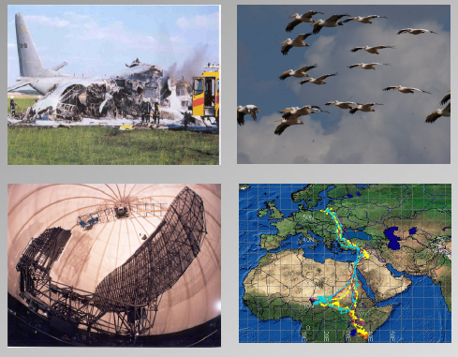
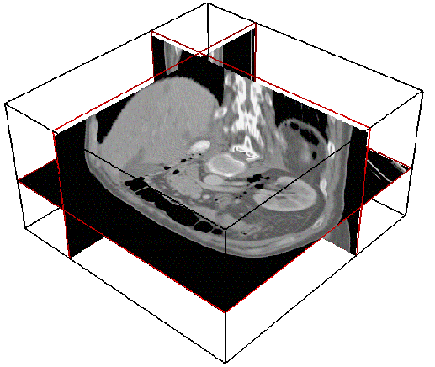
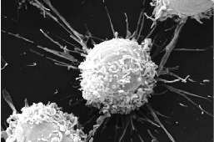
Virtual Laboratory and e-Science
Image sources: VL-e Consortium Partners
Data integration for
genomics, proteomics, etc.
analysis
Timo Breit et al.
Swammerdam
Institute of
Life Sciences
Medical Imaging and fMRI
Silvia Olabarriaga et al.
AMC and UvA IvI
Avian Alert and FlySafe
Willem Bouten et al.
UvA Institute for Biodiversity Ecosystem Dynamics, IBED
Bram Koster et al.
LUMC
Microscopic Imaging group
Molecular Cell Biology and 3D Electron Microscopy

Slide 13
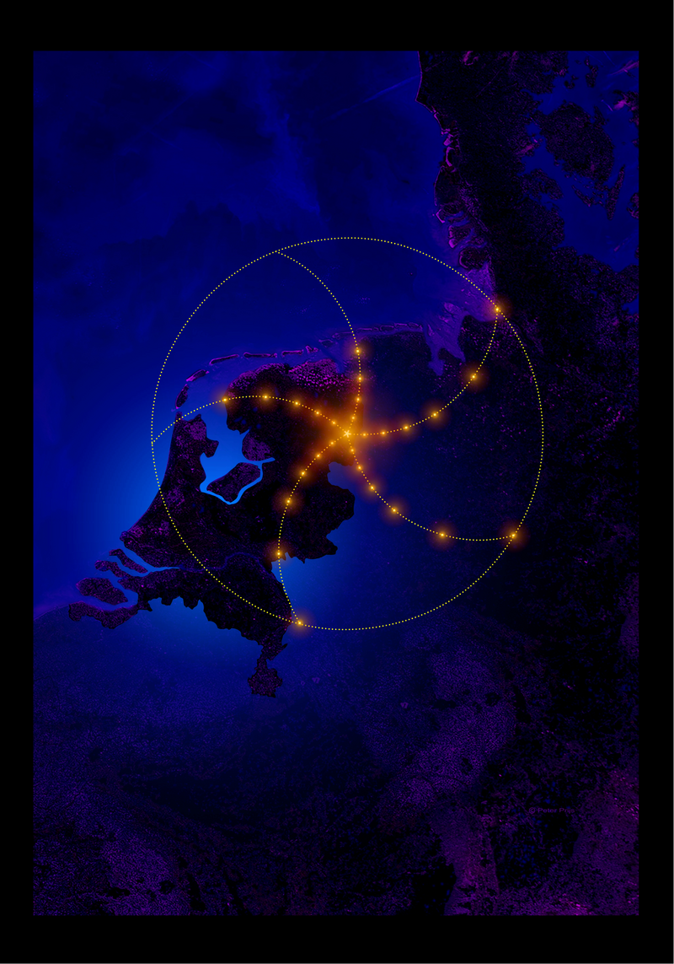
BiG Grid community: LOFAR
Status: Service challenges are ongoing, in which detector-to-archive tests are done
By now 7+PByte of data in the Long Term Archive – more than there is LHC data in .nl

Slide 14
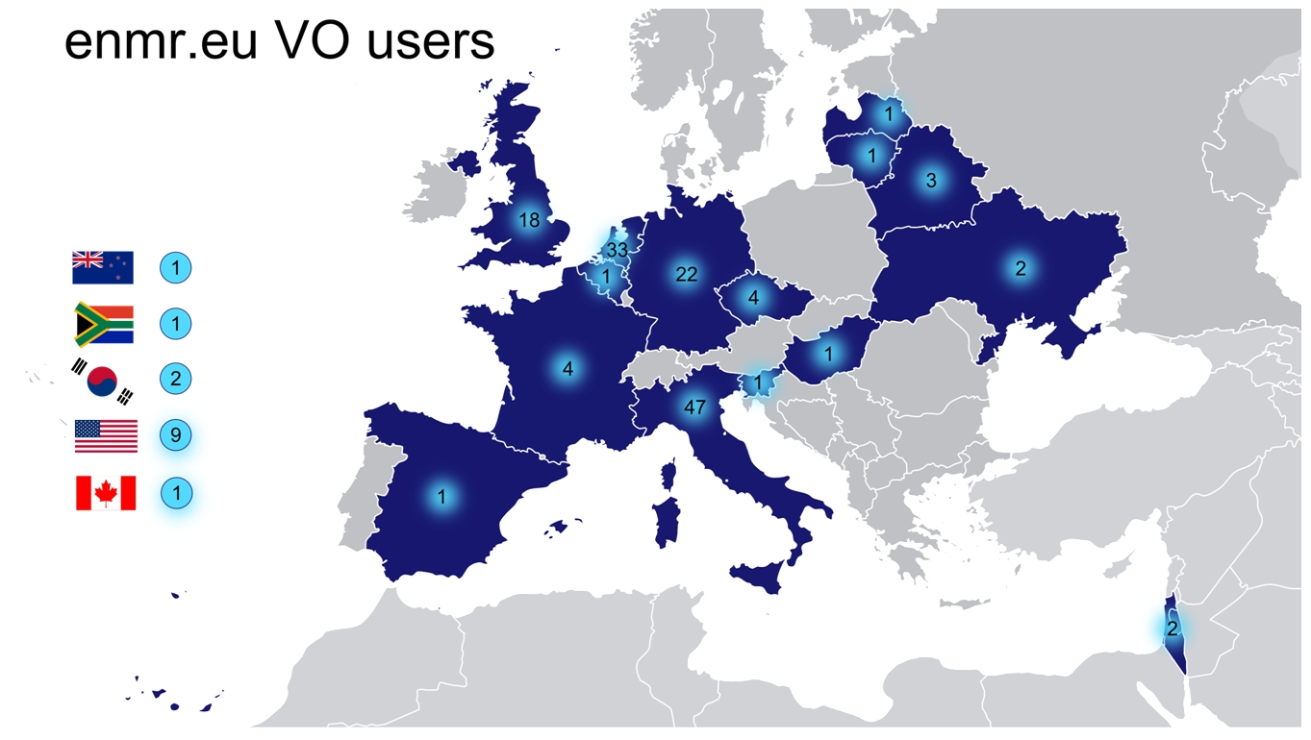
BiG Grid community: WeNMR
Status:
> 90% of their jobs run on National e-Infra and EGI
Happily running jobs at Nikhef, SARA, and RUG-CIT

Slide 15
BiG Grid community: Social Sciences
  DANS: Data Archiving and Network Services
  Grid backend for FEDORA
  Fixity service
VKS: Virtual Knowledge Studio
  Pilot project to process Wikipedia history file
CLARIN: Common LANguages Resources and technology Infrastructure
  ESFRI, with FP7 preparatory phase programme
  Several Dutch linguistics institutes involved

Slide 16
More than one community…
National e-Infra (Grid & more) supports
  ~ 40 communities on HTC Grid,
  of which 25 are active,
    HEP (atlas, LHCb, alice, auger, dzero)
    WeNMR, biomed,
Over 300 resource requests per year
  2015 est: 500+
  Many HPC Cloud and LSGrid

Slide 17
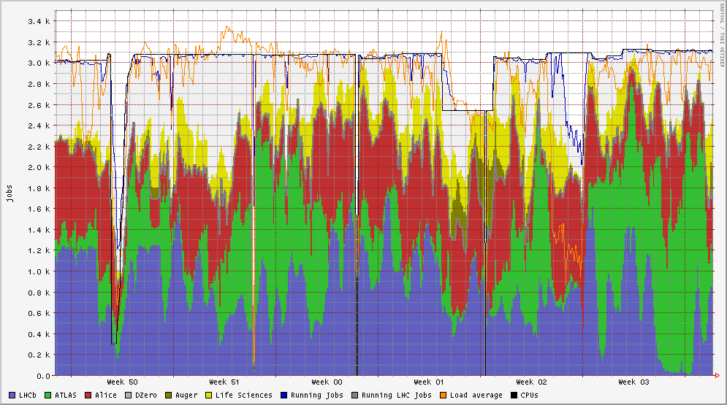
Facilities in NL
utilization
compute ~95+%
remaining space:
  HEP started real
  data taking in
  November 2009
  LOFAR has no more storage (not CPU) than LHC!
 | Nikhef | SARA | RUG-CIT | LSG
CPUs | 4500+ cores | 4000+ cores | 200+ cores | ~250 cores
Disk Store | 2500 TB | 5000 TB disk 12 PB tape | 200TB | 200 TB

Slide 18
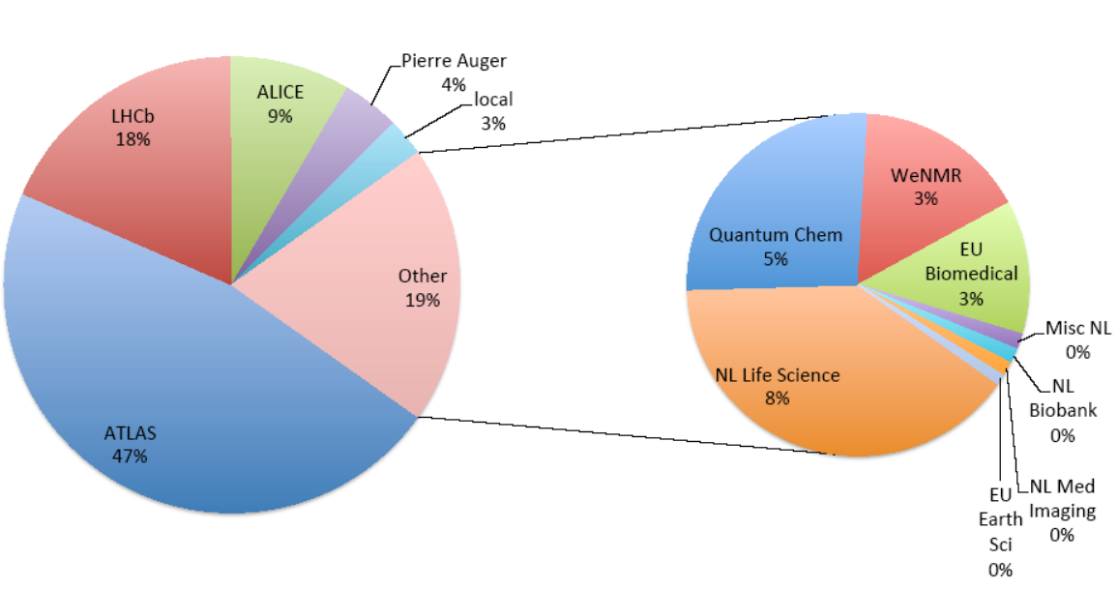
Many user communities
HTC Grid Computing service (“Vak N”)

Slide 19
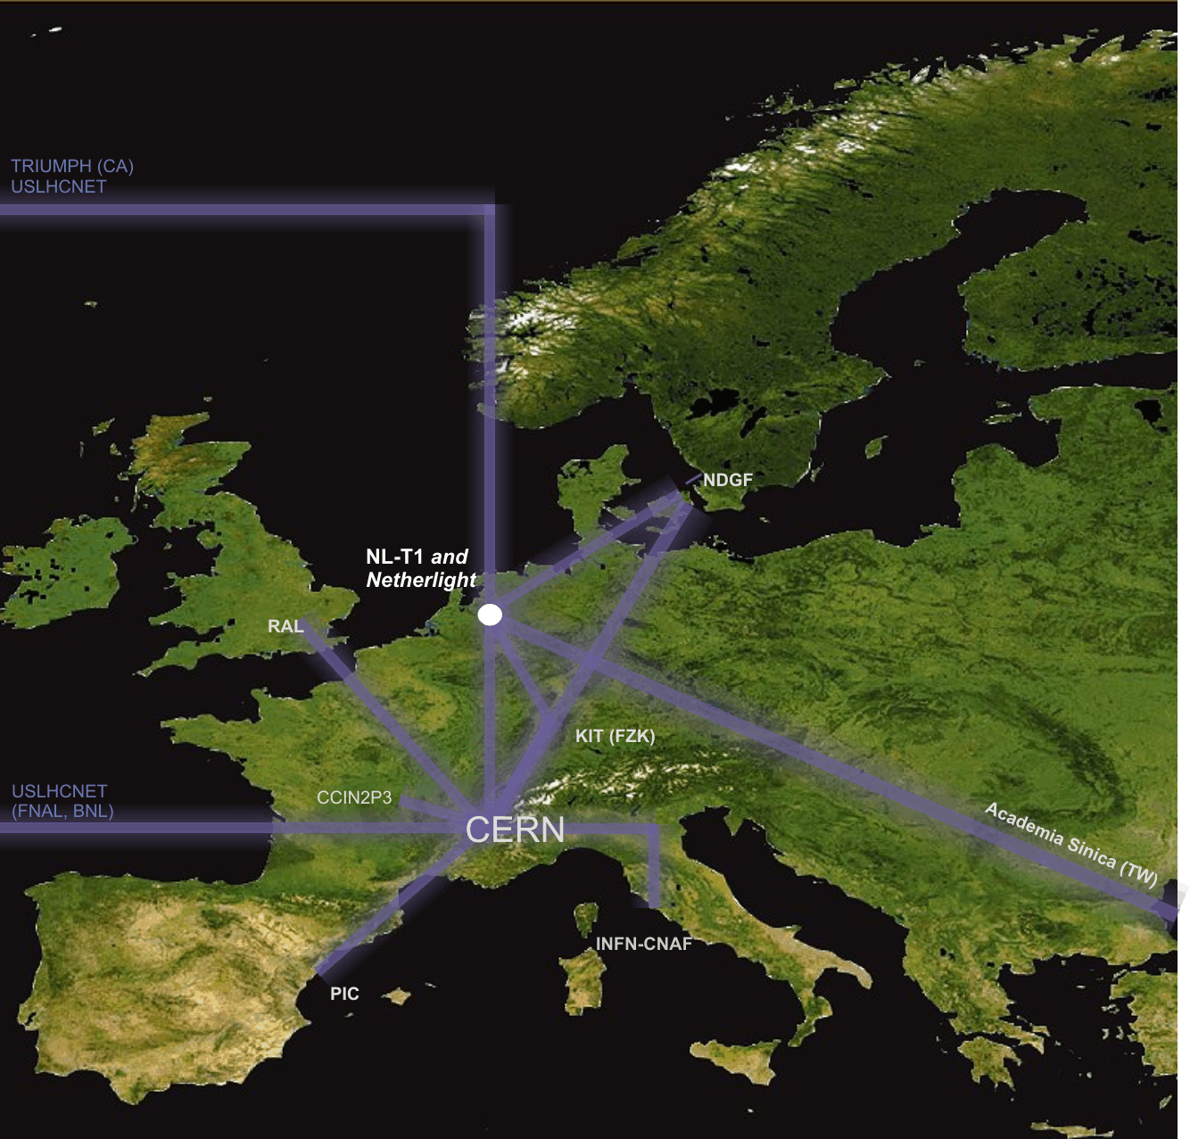
Interconnecting the Grid – the LHCOPN/LHCOne network
LHC Optical Private Network
10 – 40 Gbps dedicated
global networks
Scaled to T0-T1 data transfers
(nominally 300 Mbyte/s/T1 systained)

Slide 20
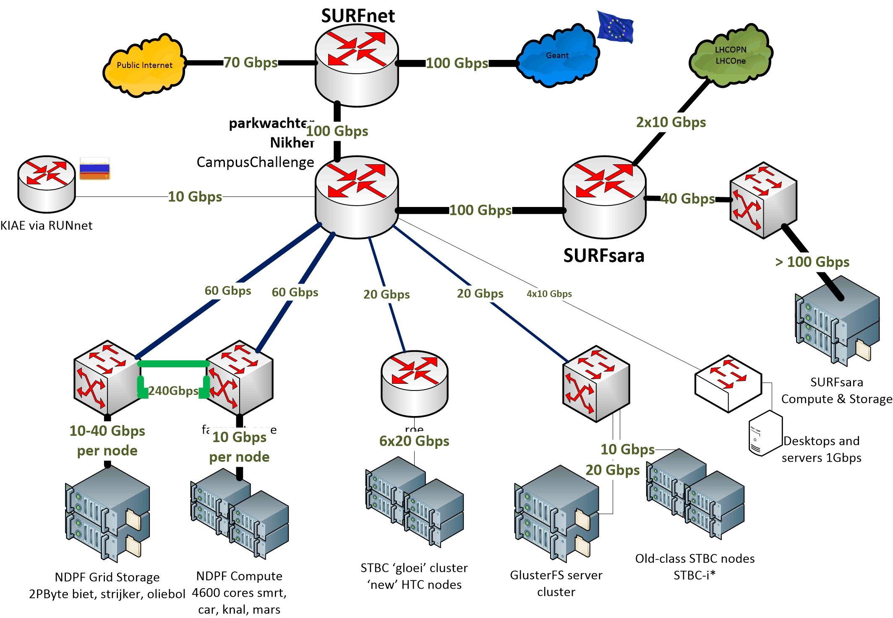

Nikhef Data Processing network

Slide 21


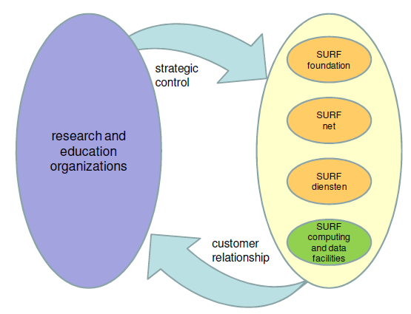
e-Infrastructure in Nederland
http://www.ictregie.nl/publicaties/nl_08-NROI-258_Advies_ICT_infrastructuur_vdef.pdf

Slide 22
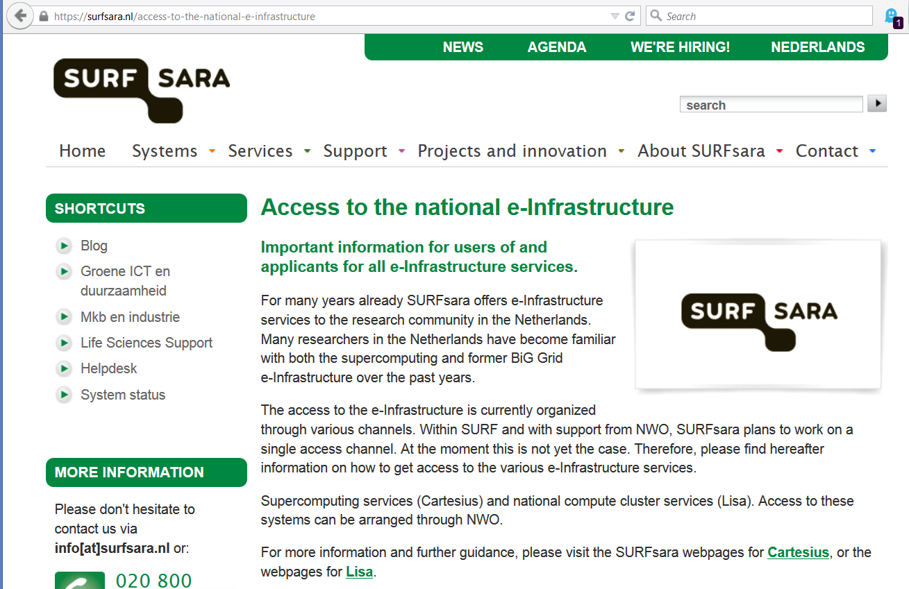
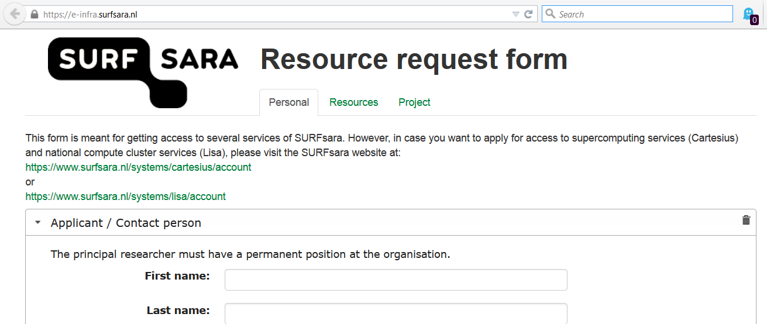
National e-Infra coordinated by SURFsara
HTC Grid
Hadoop
HPC Cloud
Visualization
GPGPU&KnightsCorner
Mass Storage
BeeHub
NoSQL
BigMem 2TB+
CVMFS Hosting
…

