Slide 1
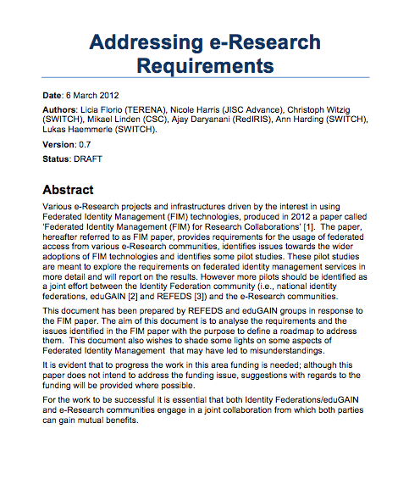
FIM4r v 2
… thanks to Hannah for slide content …

Slide 2
2012 Requirements
User friendliness (high)
Browser & non-browser federated access (high).
Bridging communities (medium).
Multiple technologies with translators including dynamic issue of credentials (medium).
Implementations based on open standards and sustainable with compatible licenses (high).
Different Levels of Assurance with provenance (high).
Authorisation under community and/or facility control (high).
Well defined semantically harmonised attributes(medium).
Flexible and scalable IdP attribute release policy(medium).
Attributes must be able to cross national borders(high).
Attribute aggregation for authorisation(medium).
Privacy and data protection to be addressed with community-wide individual identities(medium)
https://cdsweb.cern.ch/record/1442597/files/CERN-OPEN-2012-006.pdf
2

Slide 3
2012 Recommendations
Recommendations to the research communities
  Conduct Risk Analysis
  Run Pilot Studies coordinated by experts
Recommendations to the technology providers
  Separation of Authorization and Authentication
  Credentials revocation
  Attribute delegation to the research community
  Standardise efforts in Levels of Security/Assurance
Recommendations to funding agencies
  Fund FIM technologies that are focused on solving the described needs of the research communities
3

Slide 4
Progress Discussion
Significant progress made
  AARC I & II
  We are here having rational discussions between RCs, Fed Ops, eduGAIN etc!
  Many successes
Some requirements remain, for others we have found work-arounds, some are new

Slide 5
FIM4R Document Plans – Proposal
Editorial board
Rep from each community/infrastructure
Define survey Questions
Community/Infrastructure input
Statement on own progress and challenges
Write summary of progress since FIM4Rv1
Complete survey
Combine contributions from communities/infrastructures

Slide 6
FIM4R Document Plans - Proposal
Output?
  Whitepaper
  Include targeted recommendations to players, e.g.
    Funding agencies
    SPs
    IdPs
    Federation Operators
    …
When?
  Don’t want to be too slow and need to be aware of calls for funding
Where?
  Previous published by CERN (and others?) could repeat
  Proceedings TNC 18?

