Slide 1
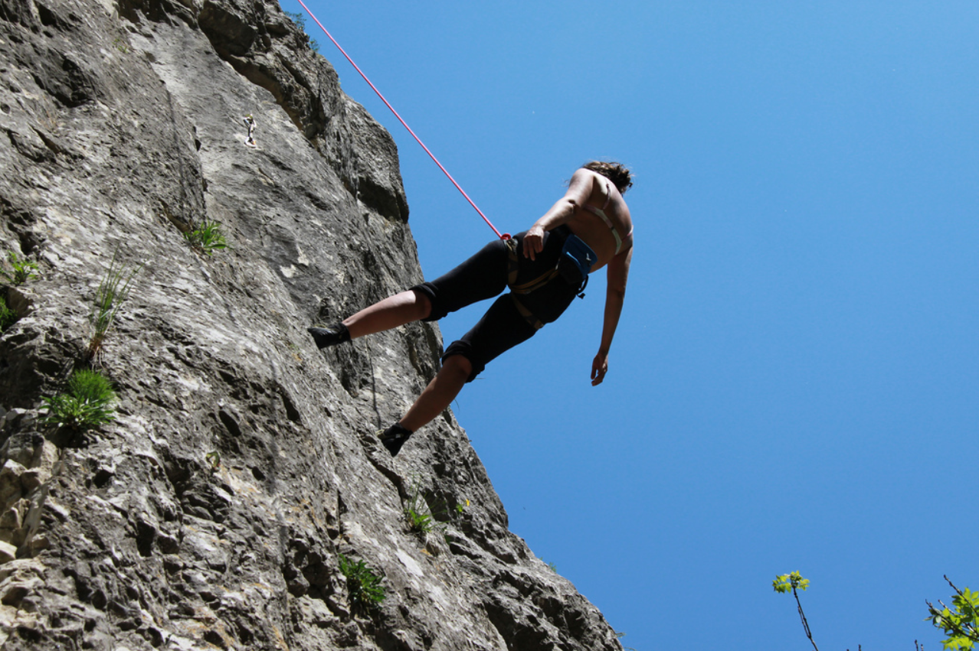
Building Interoperable
Global Trust
v20151201-04
bridging technology and
policy divides
David Groep
EWTI 2015
Image by Cristian Bortes, May 2011, CC-BY - https://flic.kr/p/9Uvwng

Slide 2
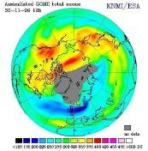
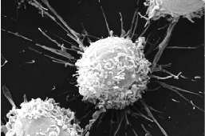
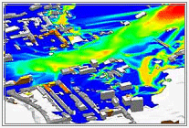

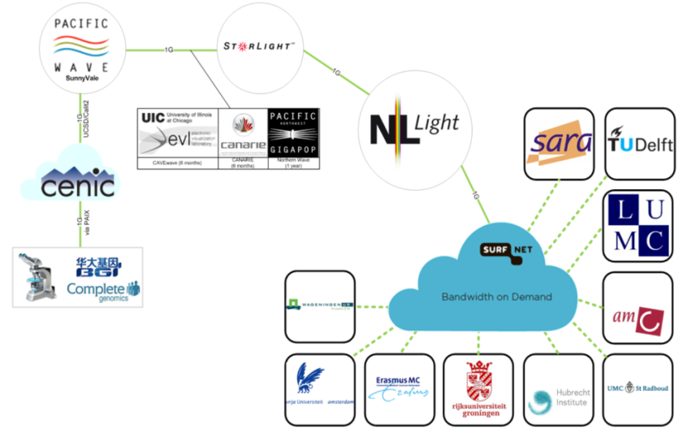
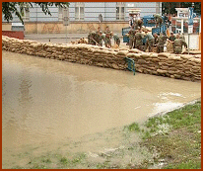
Research as a global distributed enterprise
Climate modelling
Aerospace
air flow and stress
Slide: Nicole Gregoire, SURFnet for EYR3, CC-BY
Flood prediction &
disaster mitigation
Global data flows for genomics

Slide 3
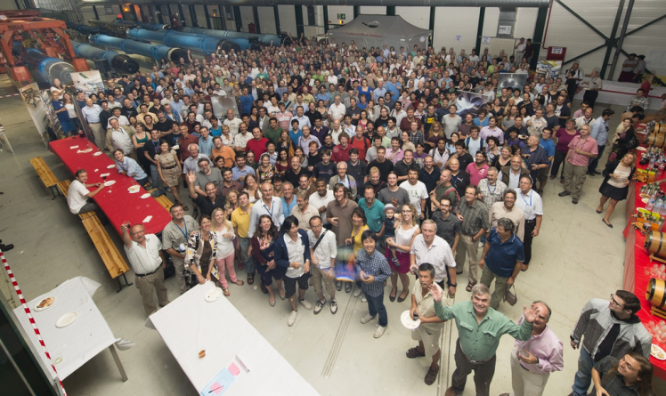

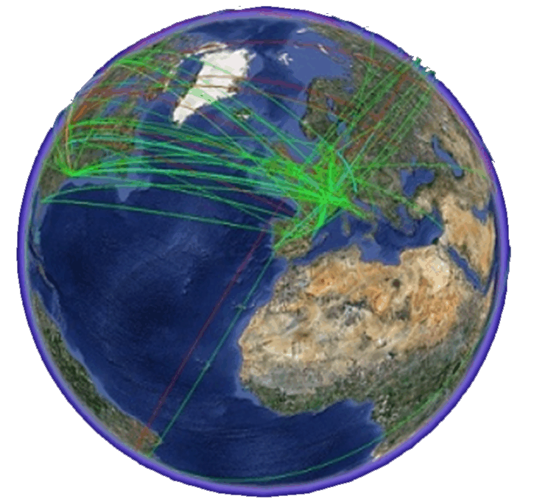
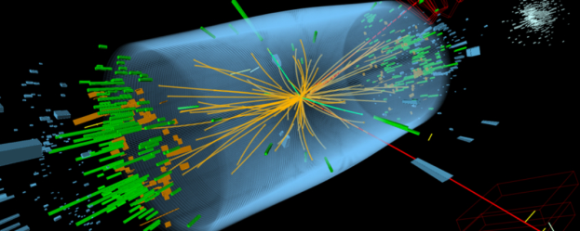


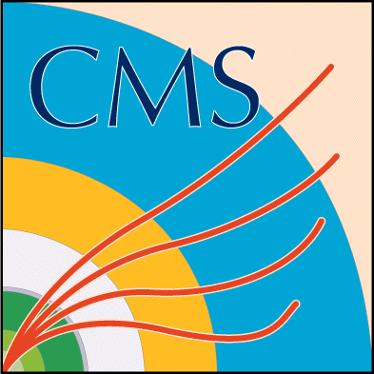

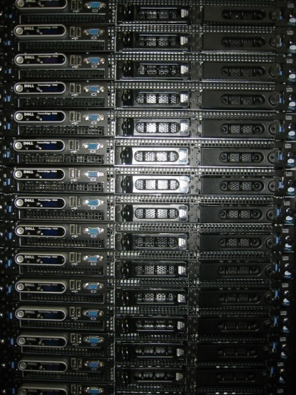
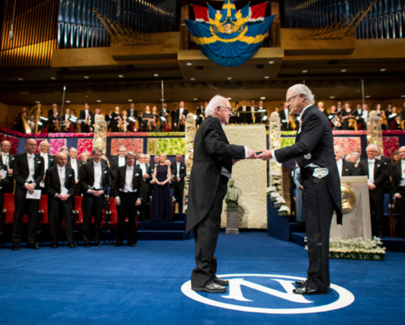
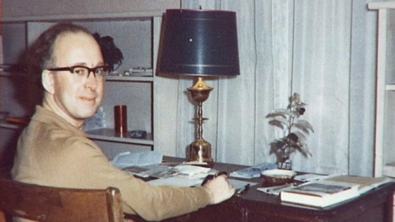
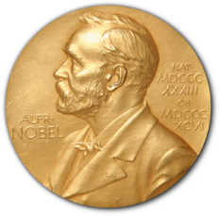
The intended outcome …
2x3000 physicists
>10k technical staff
150 institutes
50 countries/areas
2 people
2-3 people

Slide 4
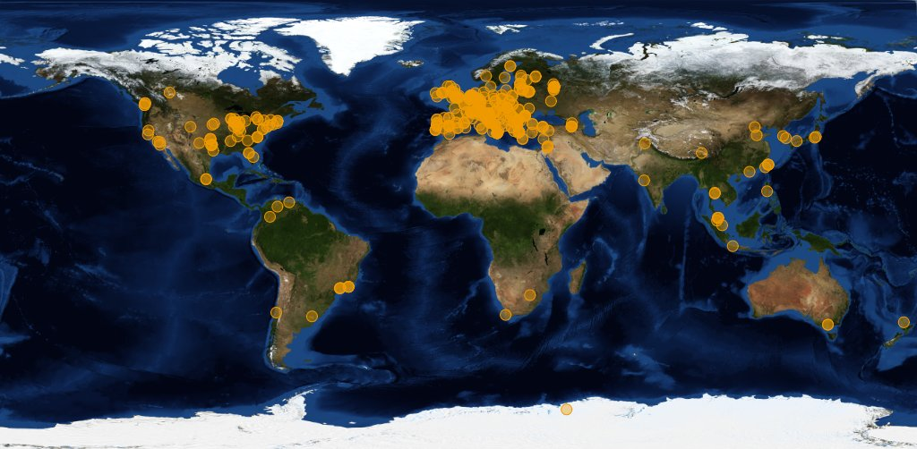



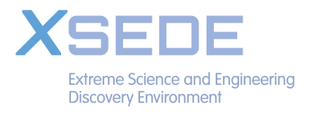
Image source: joint CERN (wLCG) and EGI
Organisations participating in the global collaboration of e-Infrastructures
Even just for wLCG, supporting the CERN LHC programme
More than 200 independent institutes with end-users
More than 50 countries & regions
More than 300 service centres
Handful regional ‘service coordination organisations’
300 000 CPU cores, 200+PByte storage
One independent ‘policy-bridge’ PKI

Slide 5
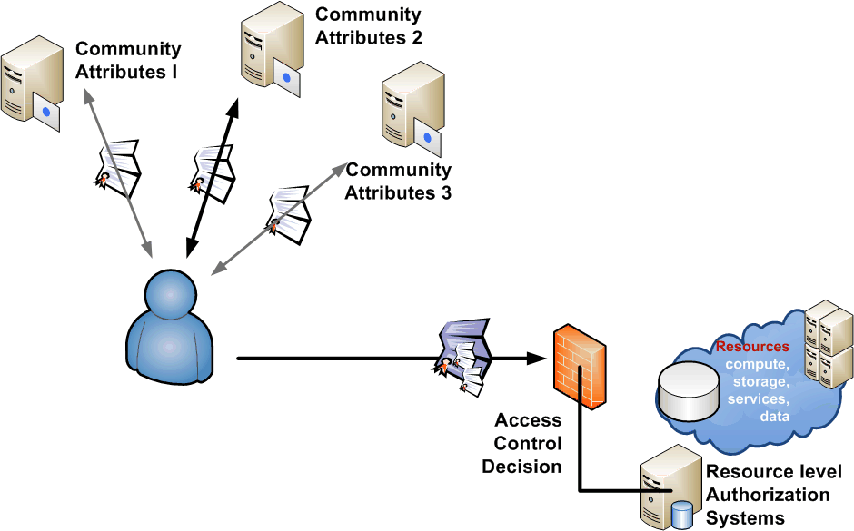
Community characteristics
More than one administrative organisation
More than one service provider
participates in a single transaction
More than one user
collaboration by design
More than one authority
influences effective policy
Single interoperating instance
at a global level

Slide 6
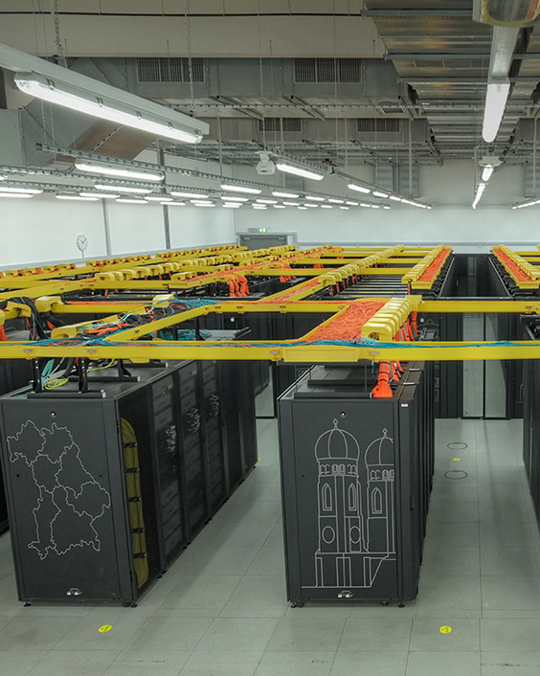
Building Sustainable Trust
Single Organisation
managerial control over all assets
Collaborative Community
distributed responsibility
loose controls
varying jurisdictions
left: the SuperMUC, LRZ, Garching bei München – which is actually also part of the R&E e-Infrastructure …

Slide 7

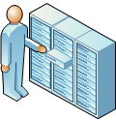

Identifying participants – classifying risks
Subject
Action
Resource
ID & Vetting Attributes
Identifier
Other
Attributes
P
Single organisation responsible for entire risk envelope

Slide 8

Identifying participants – classifying risks
Subject
Action
Resource
ID & Vetting Attributes
Subject
Action
Resource
Identifier
Identifier
ID & Vetting Attributes
P
Other
Attributes
Subject
Action
Resource
Other
Attributes
P
Identifier
ID & Vetting Attributes
P
Other
Attributes
Subject
Action
Resource
Identifier
ID & Vetting Attributes
P
Other
Attributes
Single organisation responsible for entire risk envelope
Multiple ‘monolithic’ organisations in equivalent roles interwork

Slide 9


Identifying participants – classifying risks
Subject
Action
Resource
ID & Vetting Attributes
Identifier
Other
Attributes
P
residual risk
Single organisation responsible for entire risk envelope
Multiple ‘monolithic’ organisations in equivalent roles interwork
Independent administrative domains collaborate in distinct roles

Slide 10
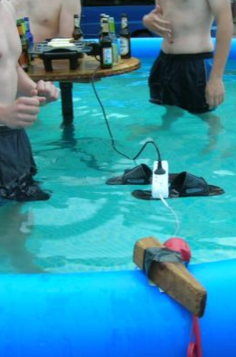
Relying Parties as a Defining Element
Service providers (‘relying parties’) absorb almost all of the residual risk – as they host and manage resources under threat
They trust others for a particular purpose
Sources of ‘subject authority’ should
align with RP interests to be useful
RP must have policy controls to
compose sources of authority
RP must be equipped with
effective controls to mitigate risks
source: NorthWood LAN party 7 - http://www.linuxno.de/

Slide 11
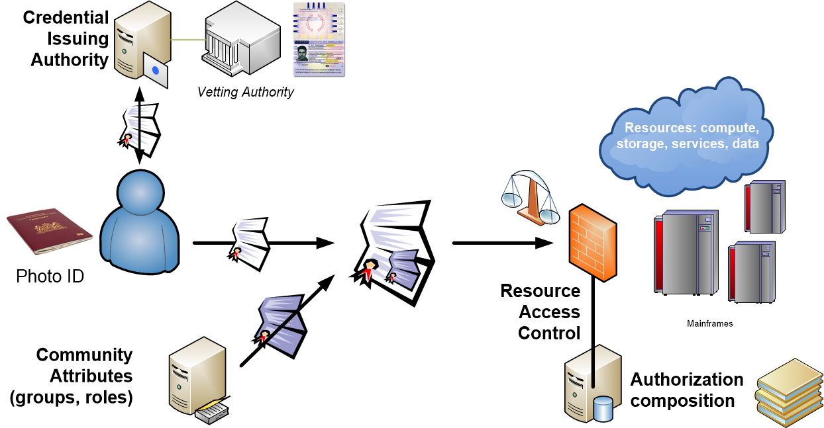
Multi-authority access control with PKI in e-Infrastructures using composable policy
RFC3820 facilitates composition, brokering and non-web single sign-on SSO
RFC3820+
RFC3281+
‘VOMS’ profile
VOMS Attribute Certificate Format, https://redmine.ogf.org/dmsf_files/10489

Slide 12
Why a dedicated trust fabric for eScience?
Specific assurances required for e-Infrastructures
globally unique, non-reassigned identifiers
identify end-users as well as networked services
active participation in incident response at last resort
Issues for e-Infra compared to current browser trust
‘actual’ relying party – end users – are not even encouraged to make trust decisions autonomously - it’s e.g. impossible to consistently remove an individual trust anchor from NSS default set
decisions (necessarily) consensus-based, but consensus in a group far larger and with divergent interests from specific cross-enterprise RPs
public browser trust almost exclusively DNS focused
Not all RPs nor all risks are equal, so ultimately one gets differentiated LoA even in a single federation
‘non-alignment’

Slide 13
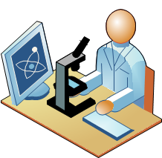
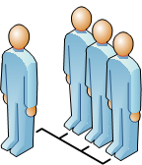



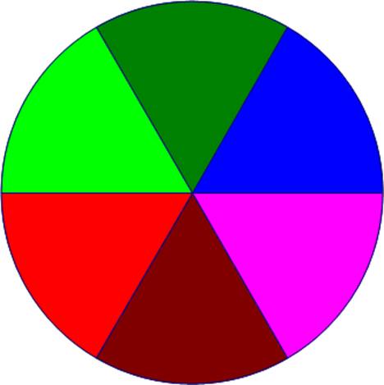
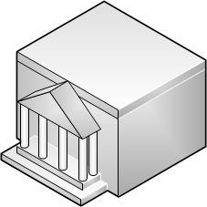




Empowering the Relying Party
User Identity
Community Attributes
Community
Resource SLA
Trusted
Third
Parties
Aggregated
Policy
Decision
Trust
Policy
AuthZ
Service
Resource Policy
Resource Attributes
graphic inspired by OGF OGSA-AuthZ WG, 2005

Slide 14
Establishing PKI interworking: AP EU TAG
European resource provider collaboration established first
CA Coordination Group for e-Infrastructures in 2000
  Leveraged on purpose existing PKI CAs where available
  Global research needs resulted in the 2003 ‘Tokyo Accord’
With start of production e-Infrastructures in 2004
  EUGridPMA: national (e-infra) identity services
  plus major e-Infrastructures & TERENA
  APGrid and PRAGMA establish APGridPMA
  Canada, Latin America and USA establish TAGPMA
bringing together resource providers, communities, IdPs
  agree on global, shared minimum requirements and assurance levels
  inspired and coordinated by the needs of relying parties, who
  frequently co-support some of the identity management operations

Slide 15
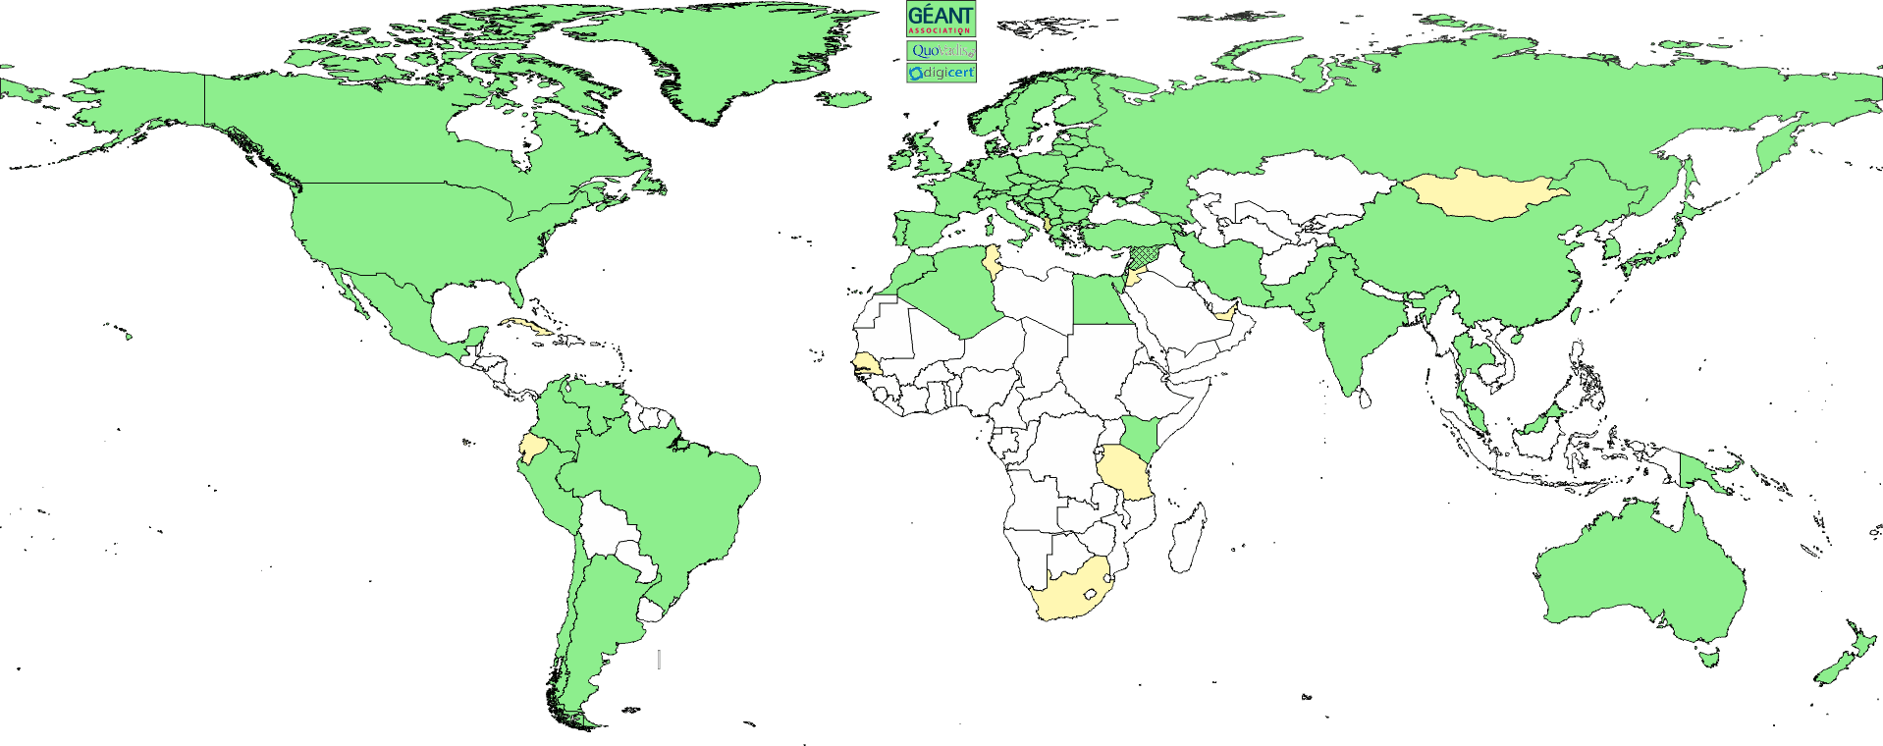
Interoperable Global Trust Federation
www.igtf.net
3 regional chapters: EMEA, Americas, AP
~ 90 Identity Providers (some leveraging a R&E federation)
~ 10 international major relying parties
~ 60 countries / economic areas / extra-territorial orgs
> 1000 relying service provider collaborations

Slide 16
Minimum requirements: assurance profiles
Federation minimum requirements (APs) reflect specific
operational and security needs of resource providers
  differentiated LoA support:
  classic direct-vetting subscriber services
  identity services leveraging (R&E) federations with ID vetting
  ‘LoA1+’ Identifier-Only Trust Assurance
  – if relying party has other ways to vet its users, allow for
  lower-assurance identifiers, thus enabling more federations as ID source
‘research-inspired’ trust verification process: self-audits,
peer-review, transparent open policies and processes
  ‘meet or exceed’ required minimum standards
www.igtf.net/ap/loa

Slide 17
Assurance Profiles – declaration of consistency towards Relying Parties
Vetting and assurance – for identity and attributes
  vetting rules and data quality
  expiration and renewal
  revocation and incident containment
Operational requirements for identity providers
  operating environment and site security
  staff qualification and control
Publication and audits
  openness of policy, practices and meta-data
  review and auditing
Privacy and confidentiality guarantees
Compromise, disaster recovery and business continuity

Slide 18
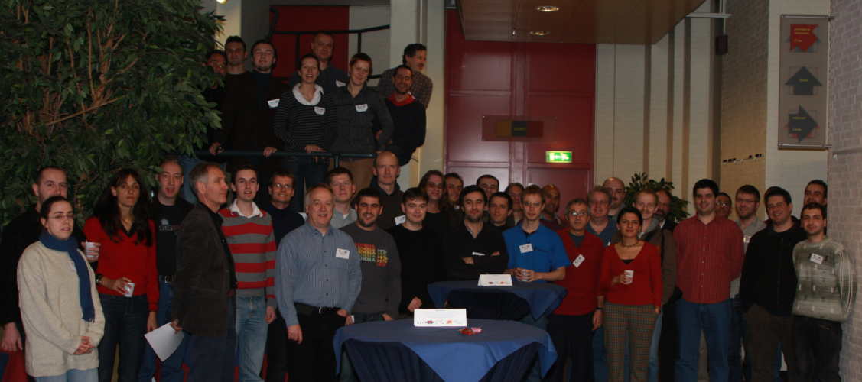
Engendering trust through transparent processes and procedures
IGTF itself works on peer review process
Supported by self-assessments shared with the peer group
Depending on the RP risk assessment,
for identified use cases this is actually sufficient LoA
Especially when there are complementary
sources of assurance: community attributes, ‘reputation’, …
Image: EUGridPMA Plenary Meeting, Amsterdam 2009

Slide 19
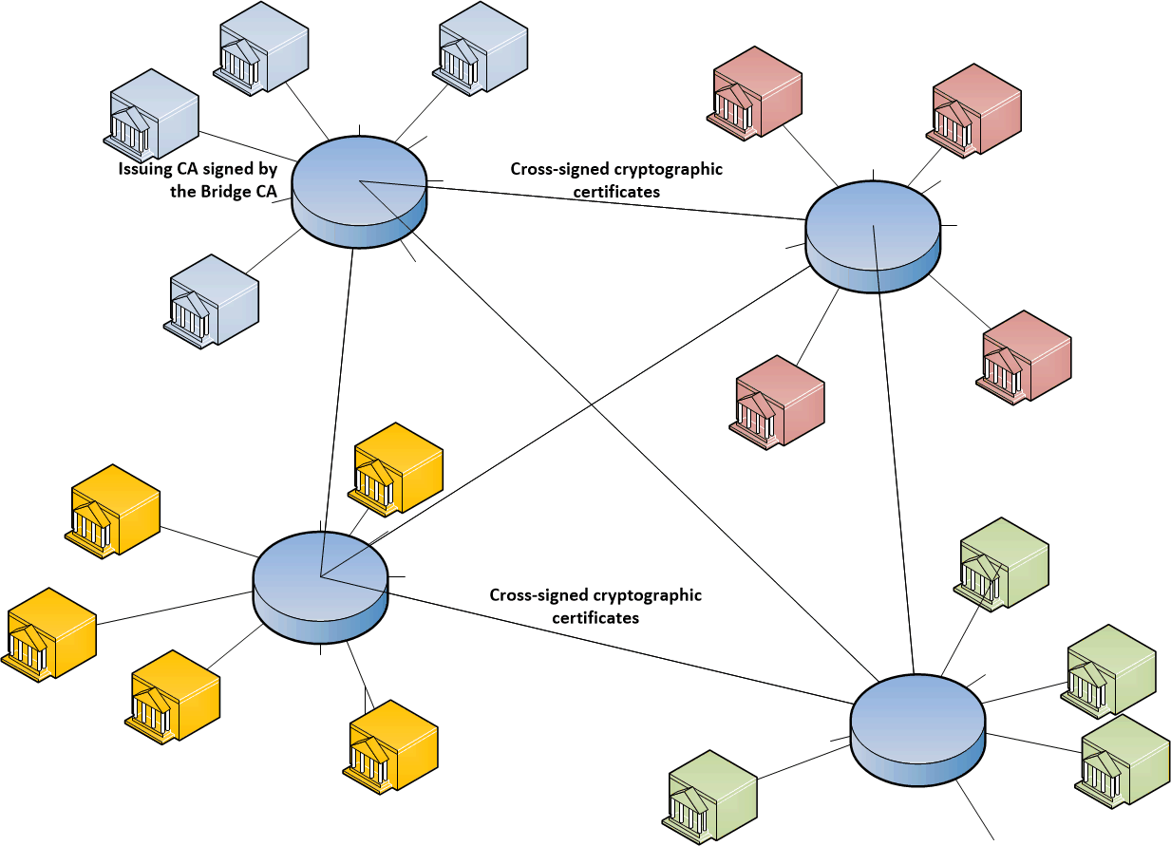
Cryptographic PKI bridging
Organisations typically act as both CA (IdP) and Relying Party
Technically
path discovery support
permissible ‘naming’ defined
in the cross-signing certs
policy mapping is done
in the bridges only
Bridges take care of policy
responsibility for their
trusting connected CAs and RPs

Slide 20
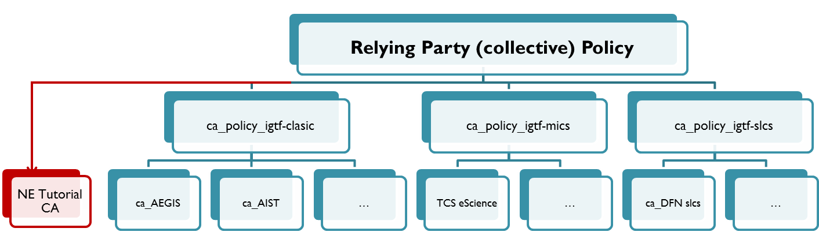
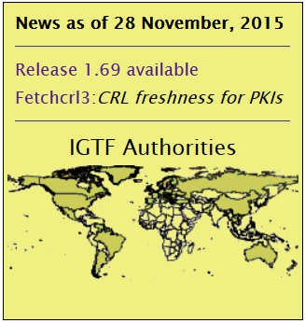
Rendering a PKI federation as a Policy Bridge
Once role separation is recognised, federation is simple
composable - and removable - assurance-tagged trust anchor lists
mechanism to distribute trust-anchor (meta) data via the federation
provide controls that permit the RP – under its own policy – to trust only those elements that match its risk profile
  based on assurance profiles expressed as accreditation trust marks
  based on relying party defined namespace constraints to set trust scope and global uniqueness of identifiers in the federation
  permit subject-based policy decisions (on name, issuer, attributes)
https://dl.igtf.net/distribution/current, https://www.ogf.org/documents/GFD.189.pdf
Notes:
Policy bridges are not new: public browser trust uses esentailyl the same model, except that trust is fored upon the RP (=end-user in that case)
Minimum requirements model used by IGTF allows for a ‘many-to-one’ mapping in importing ‘foreign’ federations. The RP-first model does not require mutual bridgeing – it’s like a single-sided cross-signing cert.

Slide 21
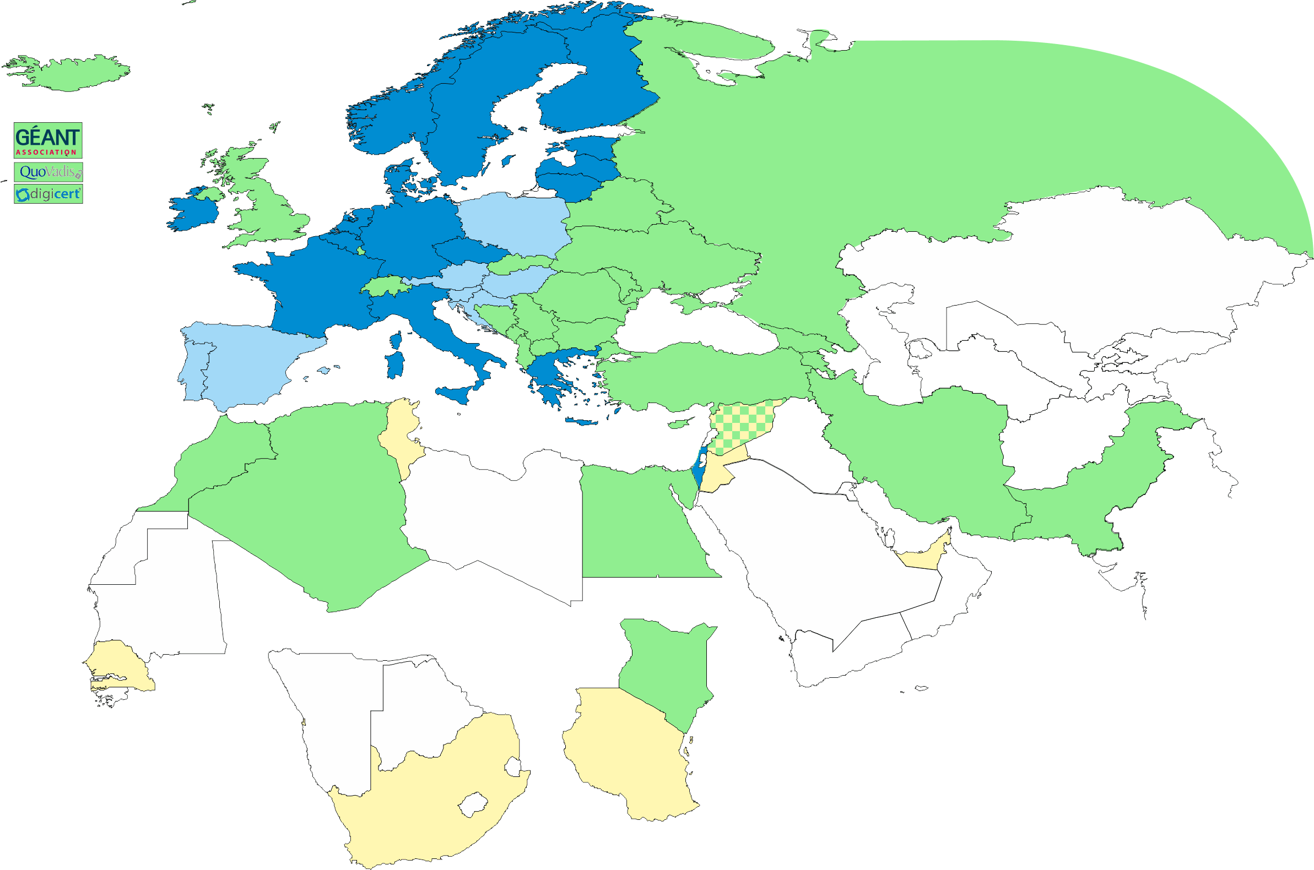
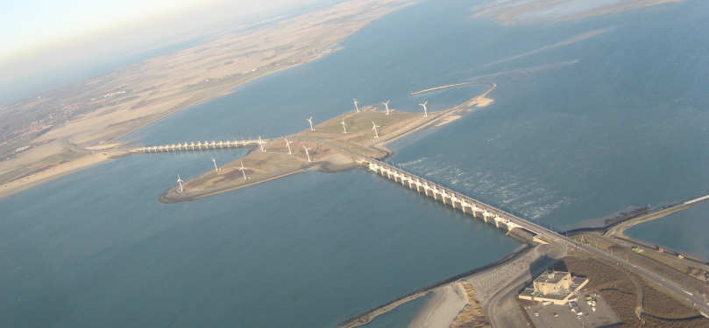
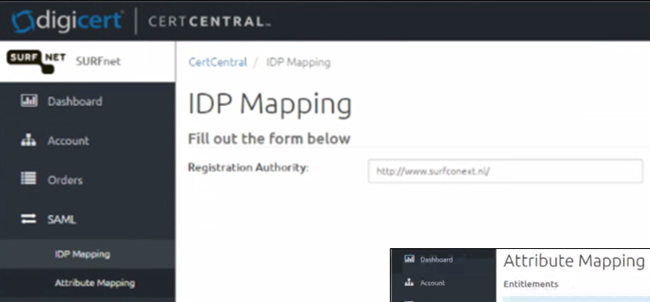
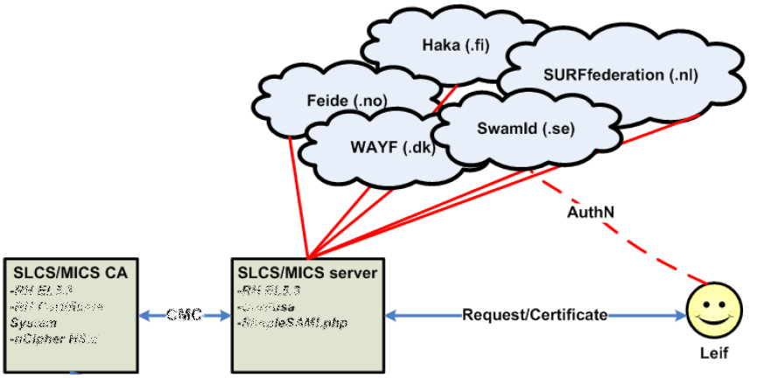
Collaboration is based on Bridging Trust!
Policy bridges are fairly common … in various technologies and scenarios …
Bridging bridged trust fabrics
GEANT TCS
DFN AAI SLCS
CILogon Basic, Silver
‘and trust is technology agnostic’
SLCS/MICS graphic: Jan Meijer, UNINETT
Image: Bryan Tong Minh, CC-BY-SA
Oosterscheldekering, Rijkswaterstaat, NL

Slide 22



www.igtf.net
Interoperable Global
Trust Federation
davidg@nikhef.nl
Dutch National Institute
for Subatomic Physics
Image: Bryan Tong Minh, CC-BY-SA
Oosterscheldekering, Rijkswaterstaat, NL
except where otherwise noted on images
logos owned by respective trademark holders and used as citations only

