Slide 1
EUGridPMA
Status and Current Trends and some IGTF & AARC topics
April 2019
APGridPMA Taipei
David Groep, Nikhef & EUGridPMA

Slide 2
Recent EUGridPMA topics
PMA membership and evolution of authorities
Towards TCS G4
Infrastructure Policy Alignment & AARC
post- AARC activities and the role of the IGTF and PMAs
See also the EUGridPMA45 summary: https://www.eugridpma.org/meetings/2019-01/

Slide 3
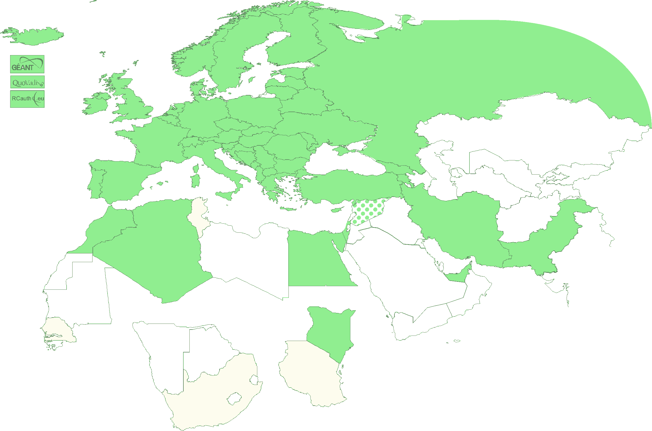
Authority coverage in EMEA
Europe: AT, CY, CZ, DE, DK, ES, FI, FR, GR, HR, HU, IT, NL, PL, PT, RO, SE, SI, SK, UK; AM, GE, IS, MD, ME, MK, NO, RS, RU, TR, UA and
the GEANT TCS
and EGI catch-all
Middle East: AE, IR, PK
Africa: DZ, EG, MA, KE
Multinational:
CERN, RCauth.eu,
QuoVadis (BM)
47+4

Slide 4
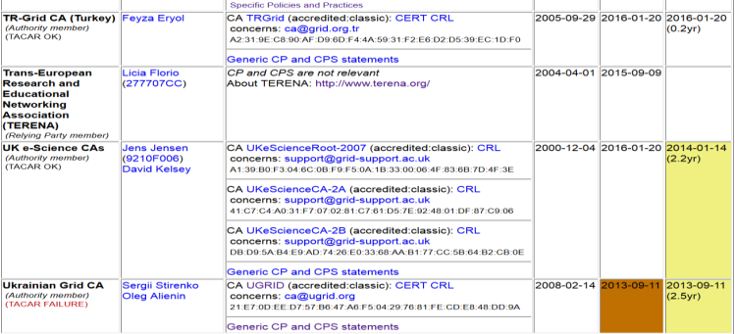
Membership and other changes
Responsiveness challenges for some members
  PLEASE take care to renew your trust anchors in time, as well as your CRLs
  EG-EUN now temporarily withdrawn for availability reasons
Identity providers: both reduction and growth
  RCauth.eu distributed operations (GRNET, STFC, Nikhef)
  using a shared key (and some smart border-guard-proof distribution)
  governance board + PMA + technical team
Self-audit review
  Cosmin Nistor as review coordinator
  Self-audits progressing
  on schedule for most CAs

Slide 5
TGC G4 R/E-Infrastructure requirements
Current ‘grid’ products actually use more widely
it’s the proper profile for unique user authentication (as opposed to email/document signing)
robots deserve more exposure (automated emails from CSIRT teams, mailing lists, etc) – like their original role envisioned
Naming of the products should probably not be ‘Grid’ ☺
Some thing will change (for better or for worse)
Hard to keep the propaganda people from changing /DC=org/DC=terena
Requests for new products: QC for Europe maybe?, better ECC promotion
push for more standard automation (can we evolve ACME to OV? Standard suggests so!)
CABForum keeps doing strange things (and is getting biased …)
MS Outlook also does weird things (mandatory encryption/signing separation)
Some things must stay the same
no GÉANT in the issuer or subject name (stay with 7-bit ASCII)
Namespace and subject DN construction
No cyclic issuer graphs, no third-party public trusted root mesh

Slide 6
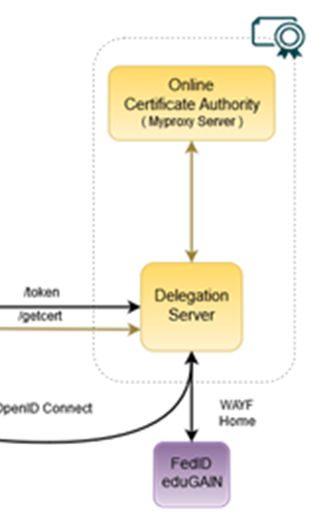
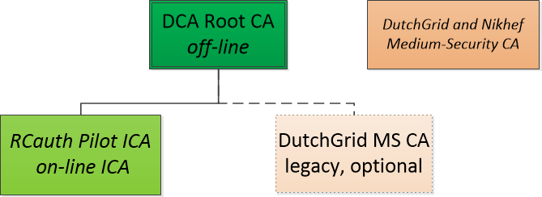
RCauth.eu – a white-label IOTA CA in Europe
Cover as much as R&E Federated Europe as possible
Scoped to research and collaborative use cases
In a scalable and sustainable deployment model
Following the AARC pilot
operates as a ‘production-compatible’ pilot service
which will operate for as long as necessary and useful
is supported by the Dutch National e-Infrastructure & Nikhef
… to support multiple applications and communities:
EGI CheckIn, B2ACCESS, and WaTTS instances
Project MinE
ELIXIR, and the Life Sciences AAI

Slide 7
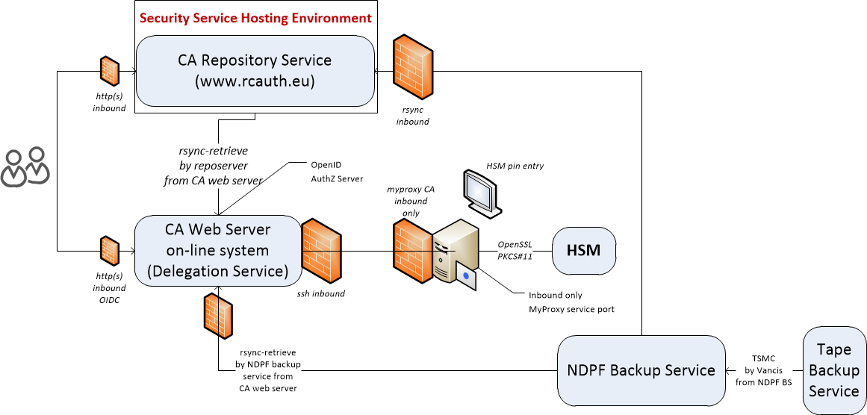
RCauth.eu: Logical set-up

Slide 8
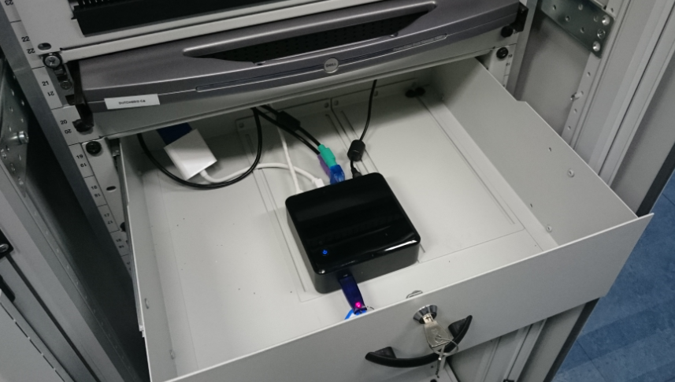
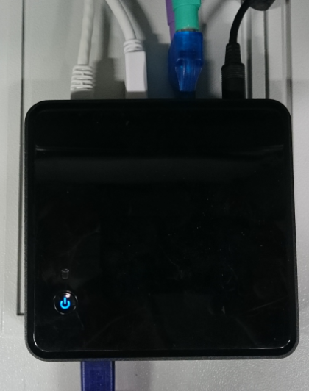
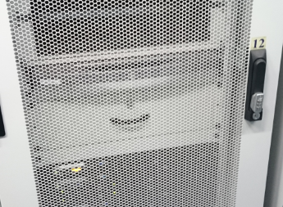
More pretty pictures

Slide 9
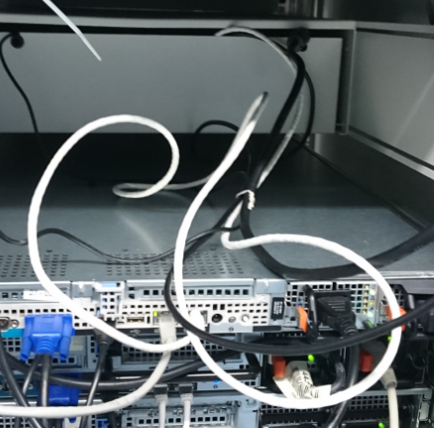
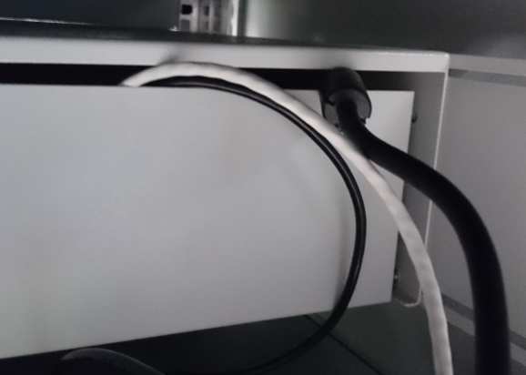
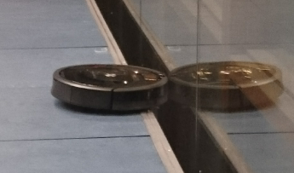
Slightly more ugly pictures …

Slide 10
RCauth.eu Governance
Governance Board
RCauth PMA
Ops Coordination Team
Representatives (and one alternate) from
each Materially Contributing Stakeholder
EGI.eu, EUDAT (ETFC), GÉANT, Nikhef (SURF)
Individuals drawn from the wide community […]
experts in the field of identity management
for research and collaboration,
PKI technology and identity bridging
STFC
GRNET
Nikhef
Operations people from each of the hosting partners with a (copy of) the RCauth.eu signing key,
and those partners otherwise involved in OPS

Slide 11
What do they manage? Two options!
Most consistent external view – closest internal coordination and trust
  Single RCauth.eu signing key
  Securely distributed to each operational partner
  Fully owned and managed by the PMA
  Requires partners to accept stringent controls by the PMA to ensure trust
  Fully transparent to users and external RPs
Most distributed and resilient view – with global user and RP impact on usability
  Each partner gets a different RCauth.eu signing key
  These will show up as independent ICAs in the IGTF distribution
  Same Subject DN namespace, but different issuer names in parallel and simultaneously
  Partners can join and leave, validity of ICA controlled through the CRL of upstream root
  Allows PMA to control a leaving party without such party’s co-operation and without special measures
  Floods IGTF distribution with multiple ICAs, and persistently exposes CA internal to VOMS and RPs

Slide 12


Assurance and trust frameworks
REFEDS RAF is there: Cappucino and Espresso
Identity Assurance Profiles for Infrastructure risk scenarios https://igtf.net/ap/loa/
Includes also
BIRCH - good quality (federated) identity,
DOGWOOD - identifier-only with traceability (R&S+Sirtfi+a few bits)

Slide 13
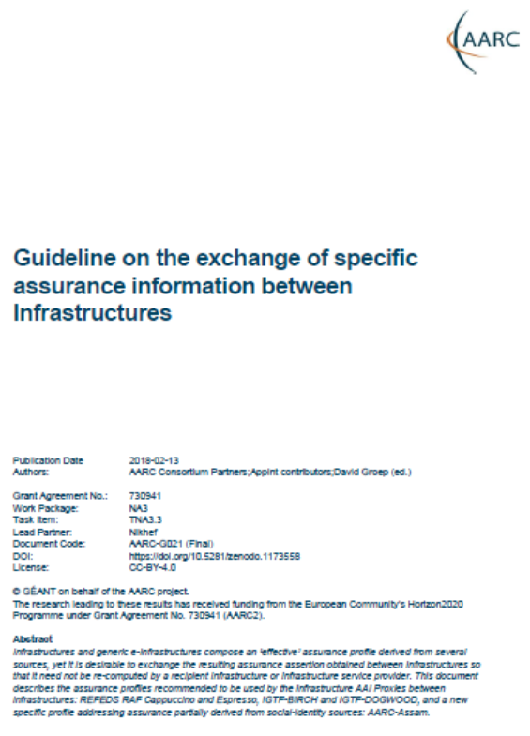
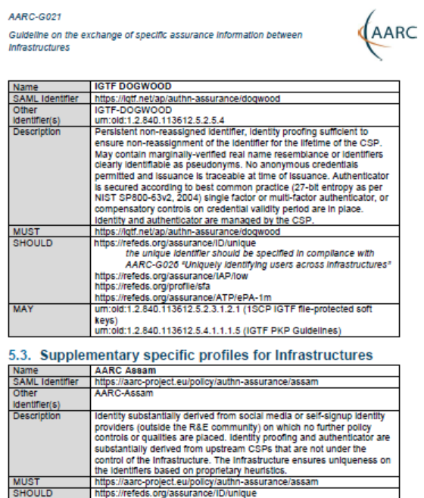
Re-usable Assurance between Infrastructures
BPA (community) proxy constructs identity based on multiple sources: home organisation, attributes, linked identities, authenticators
– and process these with (community-specific) heuristics
resulting assurance level may be different from one in home organization – and may depend on intelligence (components) that are
not ‘passable’ to the next (infrastructure) proxy
luckily: number of proxies in an exchange limited, and there’s explicit trust
AARC-G021
each BPA IdP-SP proxy should convey its ‘established assurance’
use a limited number of profiles targeted
at Infrastructure and Services risk levels (not in IdP capabilities)
re-use existing profiles as much as reasonable
AARC-G021: https://doi.org/10.5281/zenodo.1173558

Slide 14
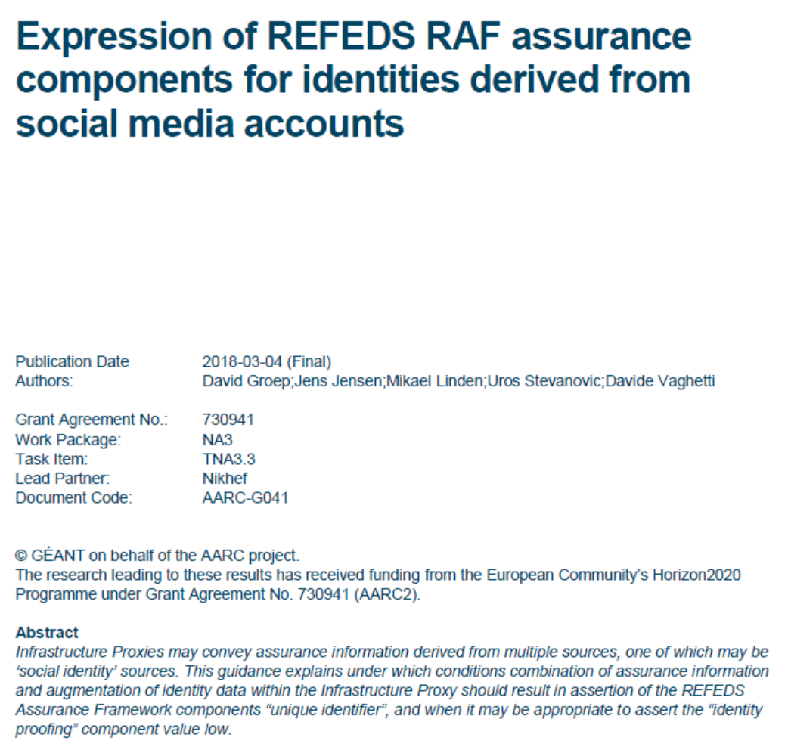
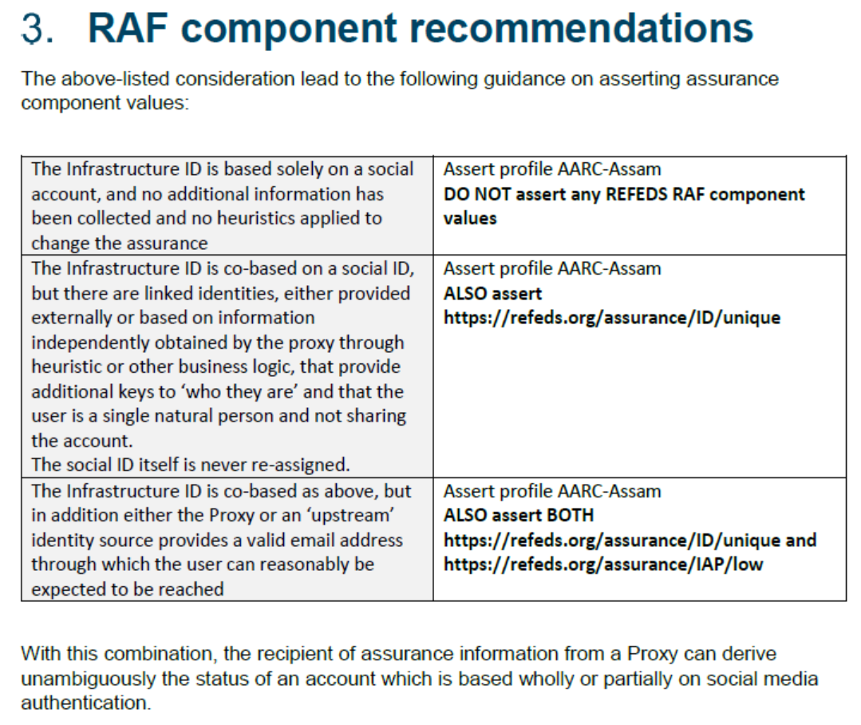
Specific assurance information BETWEEN Infrastructures
from REFEDS Assurance Framework: Cappuccino, Espresso
from IGTF Assurance Profiles: BIRCH, DOGWOOD (https://iana.org/assignments/loa-profiles)
from the AARC JRA1 use case analysis: Assam – derived from a user-held social identity
Can be extended to social ID
between the e-Infrastructures
from assessment:
this level is below DOGWOOD
unless specifically augmented by
an Infrastructure proxy and registry
AARC-G041
https://aarc-project.eu/guidelines/aarc-g041/

Slide 15
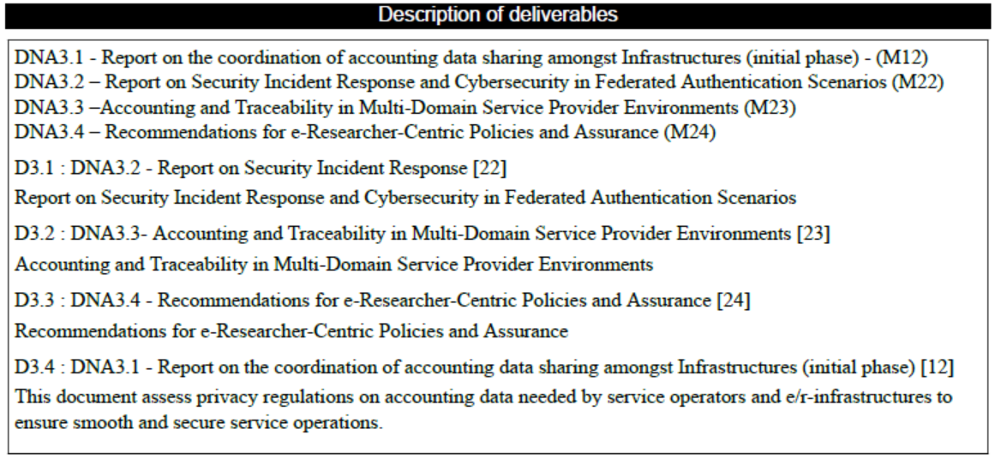
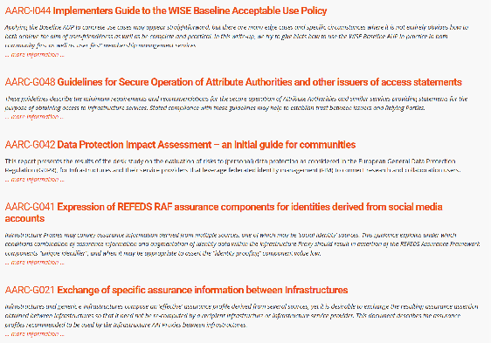
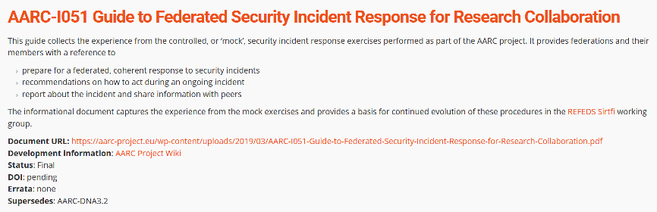
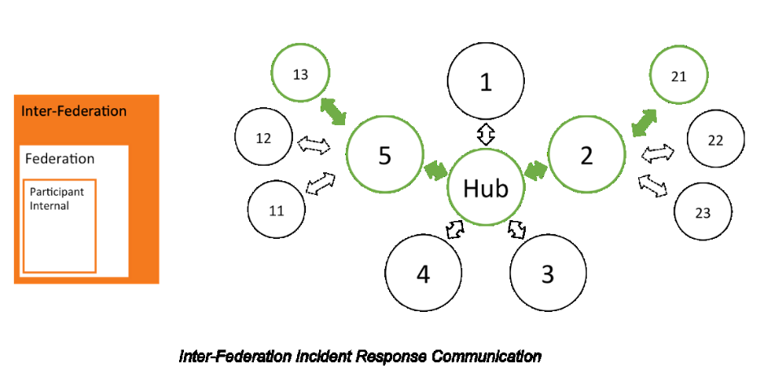
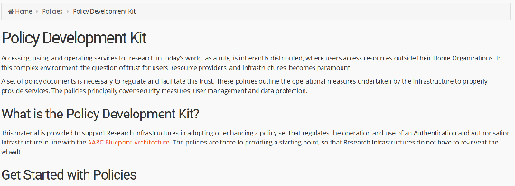
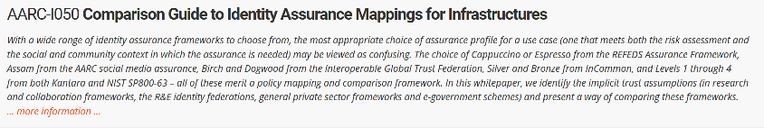
More guidance from AARC
and the AARC-G051 incident response process

Slide 16
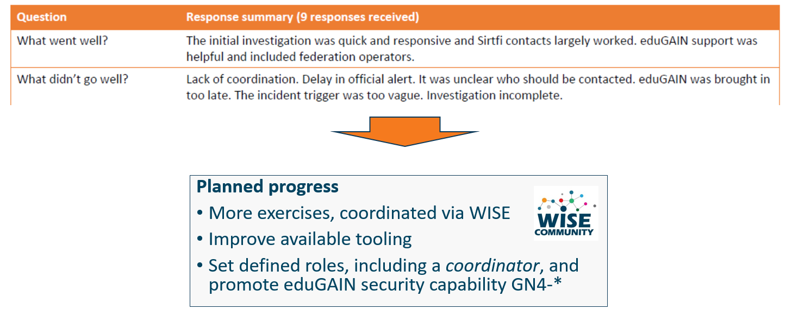
Communications Challenges
Based on Sirtfi incident role play of AARC in eduGAIN:
testing communications channels identified as high-prio target
Initial model might be along the IGTF RAT CC challenges – can be extended later

Slide 17
Proper OpSec needs to be exercized!
Like the IGTF RAT Communications Challenges, and TF-CSIRT processes, opsec really needs to be exercised often and in-depth to ensure readiness
Logical candidates that could all run the test against IdPs, CAs, SPs, RPs …
… and ‘legitimately’ claim an interest in their results
eduGAIN
IGTF
GEANT.org
EOSC-HUB ops, or EGI CSIRT
each of the e-Infrastructures XSEDE, EGI, EUDAT, PRACE, HPCI, …
every research infra with an interest: WLCG, LSAAI, BBMRI, ELIXIR, …
any institution (or person) with access to https://mds.edugain.org/
so soon: all the email in the world will be about Sirtfi Incident Response tests??

Slide 18
Frequency of challenges and tests - examples
Trusted Introducer and TF-CSIRT
2-3 Reaction Tests per year
supported by web click infrastructure, but requires (team) authentication
SURFcert challenges
annual response challenges, just reply to email to a (traceable) ticket
IGTF RAT Communications Challenges
every 1-2 years
in parallel with continuous operational monitoring
yet we already listed 14 entities that have a real interest in running tests,
5000+ entities can claim the same

Slide 19
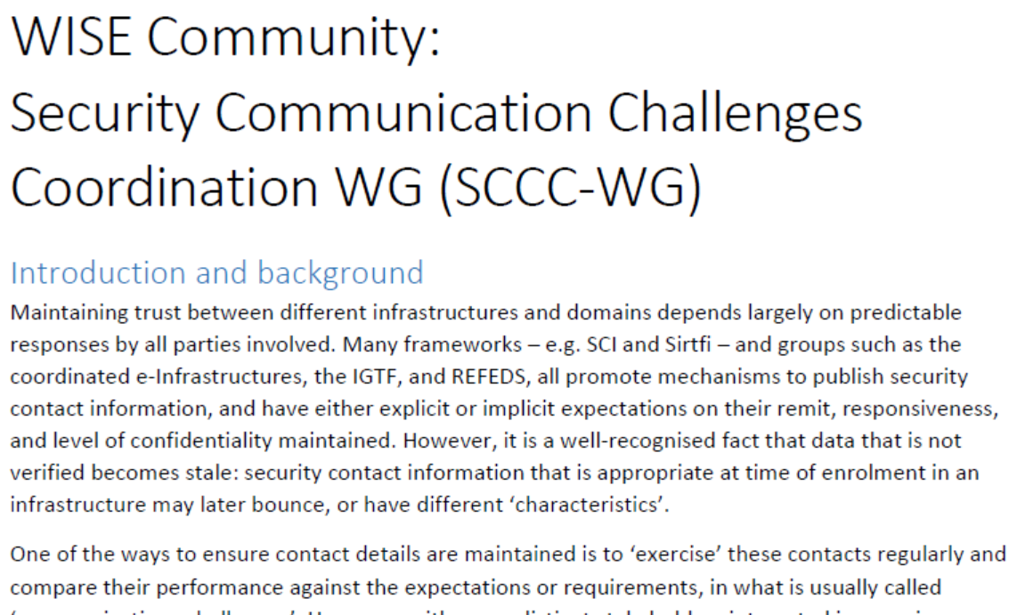
WISE SCCC-WG proposal – participate!
Proposed working group to WISE SC – see wise-community.org and join!

Slide 20
EUGridPMA/IGTF and the AARC

Slide 21
Beyond AARC – how can the good work continue and thrive?
EOSC-HUB: mainly WP4.4 “ISM”, WP5.1 “AAI”, and WP13 “Virtual Access” for RCauth
GN4-3: T5.1.4 – eduGAIN security operations and readiness
GN4-3: T5.4 – enabling communities
Without specific funding but endorsed by funded infrastructures & projects:
IGTF
Collaboration Agreement GN4-* and EOSC-HUB
WISE
AEGIS
REFEDS
FIM4R
Complementary sources: national e-Infrastructures, domain funding, ESFRIs and EOSC projects

Slide 22
Finding a home – some proposals
Sirtfi
already in a REFEDS WG (Sirtfi+)
‘response model’ to the extent it involves federations can go here as well
actual incident response plus readiness challenges on federated ID side go with
new eduGAIN security capability
Communications challenges for security that involve also the Infrastructures
WISE, specifically the new SCCC WG
needs some love and care from all Infrastructures
Infrastructure-specific challenges remain infrastructure, but coordinated through SCCC
like the IGTF RAT CC

Slide 23
Finding a home – some proposals
SCI Assessment
WISE SCI WG, with assessment in the IGTF
support through EOSC-HUB WP4.4 and GN4-3T5.4
but obviously also from PRACE, XSEDE, GridPP, SURF, &c
Assurance Profiles – from federations to Infrastructures, and between R/E infrastructures
the ‘feasible’ assurance and alignment with IdPs and federations belongs in REFEDS RAF
assurance requirements of, and exchange of assurance between, infrastructures: in IGTF
AUP and Terms of Use
the home is WISE SCI, but it needs care and nourishment from EOSCHUB and GN4-3
extends beyond just WP4.4/T5.4 and involves e.g. also eduTEAMS, CheckIn, B2ACCESS

Slide 24
Finding a home – some proposals
Data Protection and GDPR – service centric policy support
we should lean heavily on AndrewC and the TF-DPR, but more is needed
risk-assessment methodology for infrastructures and communities
consultancy role for new communities to enable use of the infrastructures -> mailing list?
joint GN4-3 + EOSC-HUB + WLCG effort, homed (for lack of anything else) in AEGIS?
Tuning the policy development kit
the WISE SCI WG can coordinate, but the effort should come from somewhere
again GN4-3 + EOSC-HUB (EGI, EUDAT) seem the natural choice, with input from PRACE
other sources have been very successful as well: HDF, GridPP, SURF
For the rest and new things needed, leverage GN-EOSCH collaboration agreement & AEGIS?
one-on-one consulting with communities highly appreciated also beyond AEGIS,
but must be and be seen as neutral (maybe a FIM4R or WISE WG? or RDA?)

Slide 25
From now on …
Coherency of vision and an umbrella for Collaborative policy work will be more challenging
Exploit personal overlap in the various groups (and cross-membership of lists)
Provide a forum for cross-fertilization through continued joint workshops
EUGridPMA increasingly hosts such joint meetings

Slide 26
Upcoming PMA events
EUGridPMA 46, in conjunction with EOSChub-WP4.4 and GN4’s EnCo Policy
Utrecht, NL May 20-22, 2019
TNC19 & REFEDS June 16-20 2019, Tallinn, EE
EUGridPMA 47 end of September (23-25?), location tbd

