Slide 1
EUGridPMA
Status and Current Trends and some IGTF topics
March 2018
APGridPMA ISGC Meeting
David Groep, Nikhef & EUGridPMA

Slide 2
Recent EUGridPMA topics
PMA membership and reviews
Infrastructure Policy Alignment & Snctfi
Up Next:
AAI for research and collaboration
  Policy and technology Bridging using infrastructure proxies
  Bridging trust: assurance, security, and uniqueness in RCauth
OIDC Federation at the IGTF for Research and e-Infrastructures
See also the EUGridPMA42 summary: https://www.eugridpma.org/meetings/2018-01/

Slide 3
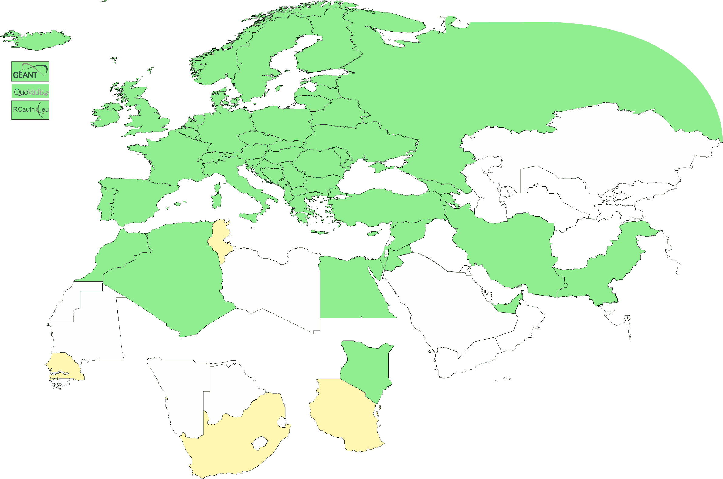
Geographical coverage of the EUGridPMA
26 of 28 EU member states (all except LU, MT)
+ AE, AM, CH, DZ, EG, GE, IR, IS, JO, MA, MD, ME, MK, NO, KE, PK, RS,
RU, SY, TR, UA,
CERN (int),
TCS (EU),
RCauth.eu (EU/NL),
QV (BM)
47+4
Active progress
ZA

Slide 4
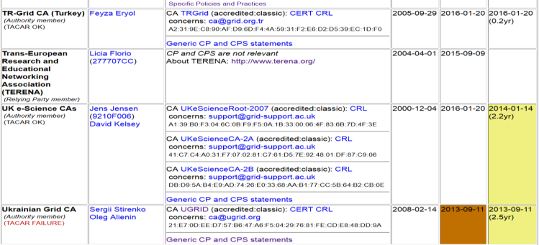
Membership and other changes
Responsiveness challenges for some members
  PLEASE take care to renew your trust anchors in time, as well as your CRLs
Identity providers: both reduction and growth
  Grid-FR now hosted within French government PKI infrastructure
  RCauth.eu distributed operations (GRNET, STFC, Nikhef)
Self-audit review
  Cosmin Nistor as review coordinator
  Self-audits progressing
  on schedule for most CAs

Slide 5
Upcoming events
EUGridPMA 43,
Karlsruhe May 23 – 25, 2018
I2GS, TAGPMA May 6-10 (incl 10th!), San Diego, CA, USA
TNC18 and REFEDS June 10, 11-14, Trondheim, NO
PEARC18 July 22-26, Pittsburg, PA, USA
TechEx Oct 15-18, Orlando, FL, USA

Slide 6
AAI in a wider context
IGTF traditionally well-linked to research and e-Infrastructures
support for research use cases
user-centric authentication based on a ‘bottom-up’ approach
In Europe, the AARC project supports evolution of ‘traditional’ R&E federations towards this research and collaboration use
common Blueprint Architecture promoting SP-IdP Proxies
harmonised policy supporting production use of federations (Sirtfi and “R&S”, non-reassigned identifiers and assurance)
help communities express ‘common’ qualities through Snctfi
allow newer technologies (OIDC) on the Infrastructure side

Slide 7
Assurance and trust frameworks
Identity Assurance Profiles for Infrastructure risk scenarios https://igtf.net/ap/loa/
BIRCH - good quality (federated) identity,
DOGWOOD - identifier-only with traceability (R&S+Sirtfi+a few bits)
RFC 6711 Registry: https://iana.org/assignments/loa-profiles
technology-specific ‘trust anchor’ distribution services
Supporting research and e-Infrastructure use cases
technology bridges: TCS, RCauth.eu, IGTF-eduGAIN bridge, …
behind Infrastructure Proxies OIDC gains prominence: OIDC Fed for RP pilot
Policy framework for Relying Parties (‘SP-IdPs-Proxies’)
Snctfi - Community Trust Framework in Federated Infras
https://igtf.net/snctfi
Policy Development Kit

Slide 8
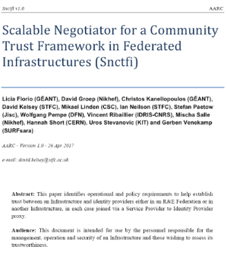
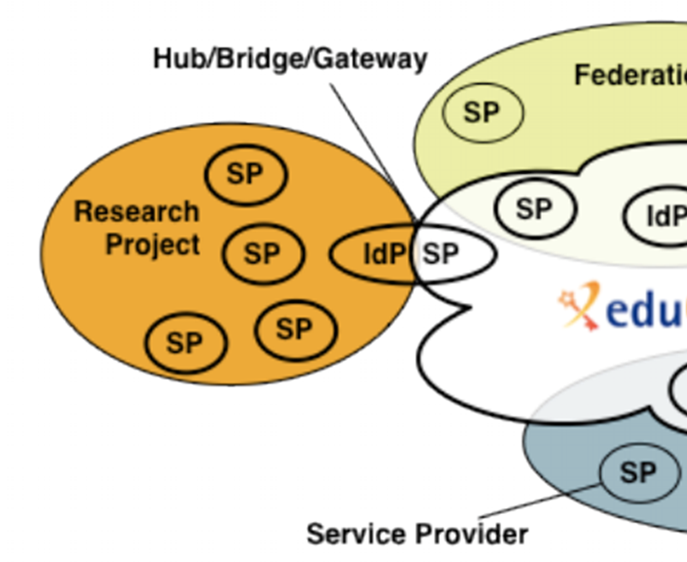
Snctfi: aiding Infrastructures achieve policy coherency
✓
allow SP-IdP-Proxies to assert ‘qualities’, based on assessable trust
✓
Develop recommendations for an Infrastructure’s coherent policy set
Snctfi
Scalable Negotiator for a Community Trust Framework in Federated Infrastructures
Complements Sirtfi with requirements on internal consistent policy sets for Infrastructures
Aids Infrastructures assert existing categories R&S, Sirtfi, CoCo
Support communities and infrastructures with
a policy kit and Acceptable Use Policy alignment
Graphics inset: Ann Harding and Lukas Hammerle, GEANT and SWITCH
https://igtf.net/snctfi

Slide 9
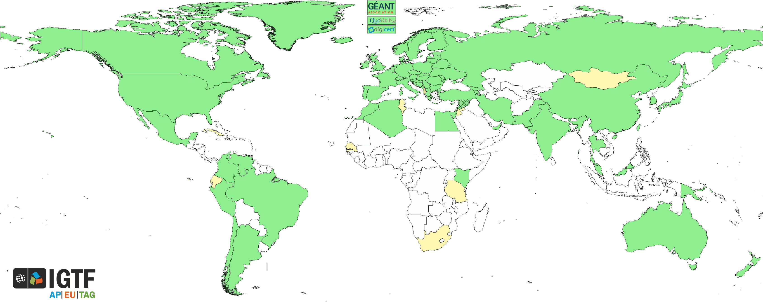
Trust for global e-Science infrastructures
“establish common policies and guidelines that enable interoperable, global trust relations between providers of e-Infrastructures and cyber-infrastructures, identity providers,
and relying parties”
EGI
PRACE
GEANT WLCG
XSEDE
OSG
HPCI
PRAGMA
RedCLARA
. . .

