Slide 1
EUGridPMA
Status and Current Trends and some IGTF topics
October 2017
APGridPMA Autumn Meeting
David Groep, Nikhef & EUGridPMA

Slide 2
EUGridPMA Topics
EUGridPMA (membership) status
AAI developments in the world: FIM4R, Sirtfi, Snctfi, and AARC2
Meshing authentication: IGTF-to-eduGAIN bridge & RCauth.eu
New directions: OIDCfed, maintenance of the RA network, and more
Beyond AuthN: Assurance Assessment Matrix for CO Registries
IPv6, SHA-1 collisions, and more
See also the EUGridPMA41 summary: https://www.eugridpma.org/meetings/2017-09/

Slide 3
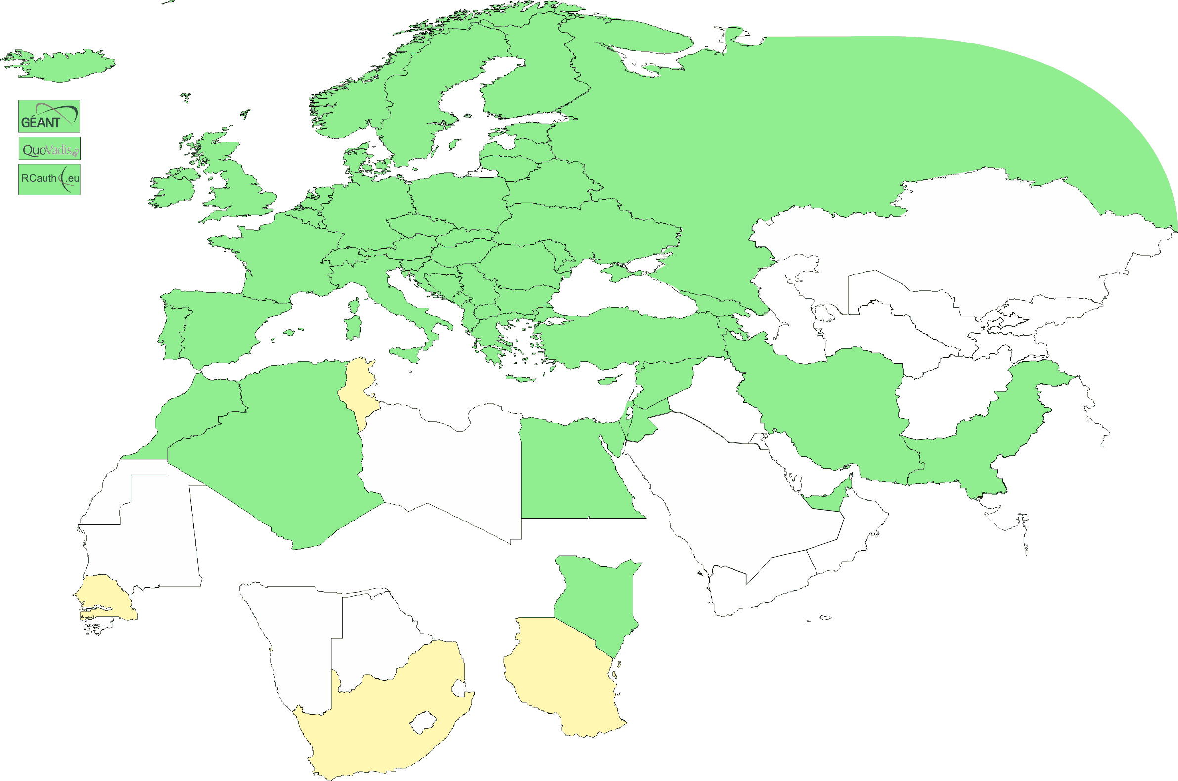
Geographical coverage of the EUGridPMA
26 of 28 EU member states (all except LU, MT)
+ AE, AM, CH, DZ, EG, GE, IR, IS, JO, MA, MD, ME, MK, NO, KE, PK, RS,
RU, SY, TR, UA,
CERN (int),
TCS (EU),
RCauth.eu (EU/NL),
QV (BM)
47+4
Active progress
AE, ZA

Slide 4
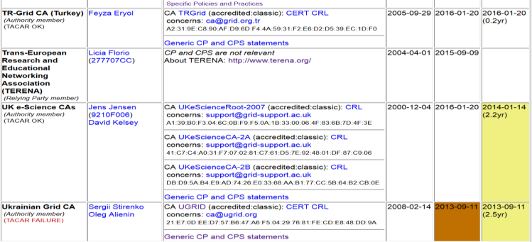
Membership and other changes
Responsiveness challenges for some members
  JUNET discontinued, HIAST – remains suspended
  PLEASE take care to renew your trust anchors in time,
  as well as your CRLs (applies globally, e.g. for SDG-G2 and CNIC)
Identity providers: both reduction and growth
  New CA for e-Infras: RCauth.eu IOTA CA (“for those who cannot use TCS”)
  New CA for UAE: DarkMatter (phase 2 of 2)
  Upcoming in UK: Adding a BIRCH CA based
  on “Moonshot” (Assent) and explicit sign-up
Self-audit review
  Cosmin Nistor as review coordinator
  Self-audits progressing
  on schedule for most CAs

Slide 5
AAI in a wider context
IGTF traditionally well-linked to research and e-Infrastructures
support for research use cases
user-centric authentication based on a ‘bottom-up’ approach
In Europe, the AARC project supports evolution of ‘traditional’ R&E federations towards this research and collaboration use
common Blueprint Architecture promoting SP-IdP Proxies
harmonised policy supporting production use of federations (Sirtfi and “R&S”, non-reassigned identifiers and baseline LoA)
help communities express ‘common’ qualities through Snctfi

Slide 6
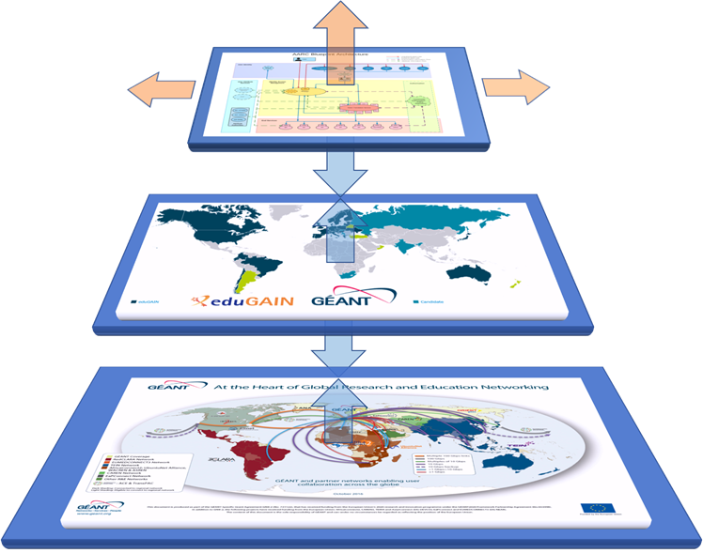
AARC Blueprint Architecture - Enabling an ecosystem of solution on top of eduGAIN
A Blueprint Architecture for authentication and authorization
  A set of architectural and policy building blocks on top of eduGAIN
eduGAIN and the Identity Federations
  A solid foundation for federated access in Research and Education

Slide 7

AARC Blueprint Architecture
https://aarc-project.eu/architecture/

Slide 8
AARC Blueprint Architecture
  Guidelines and support documents
  Best practices for managing authorisation
  Expressing group membership and role information
  Scalable attribute aggregation
  Implementation of token TTS
  Credential delegation
  Non-web access
  Social media IdPs
  Use cases for account linking
  Use cases for LoA elevation via step-up authentication
https://aarc-project.eu/architecture/

Slide 9
AARC Blueprint Architecture
  Policy recommendations & frameworks
  Security Incident Response Trust Framework for Federated Identity – Sirtfi
  Scalable Negotiator for a Community Trust Framework in Federated Infrastructures – Snctfi
  Recommendations on Minimal Assurance Level Relevant for Low-risk Research Use Cases
  Differentiated LoA recommendations for policy and practices of identity and attribute providers
  Recommendations and template policies for the processing of personal data by participants in the pan-European AAI
https://aarc-project.eu/policies/

Slide 10
What the IGTF can do (for authN services)
Inspired and aligned with community and e-Infrastructure needs
Differentiated assurance with both a solid and transparent level
Assessment model via peer-reviewed self-assessment
Promotion of alignment within Infrastructures – maintenance of Snctfi
And our ‘conventional’ capabilities of providing a quality authentication source:
User-centric authentication – independent of user’s home organization
Ability to transfer registrations across authorities and countries
(with the Registration Practice Statement)
guidance on trust and trustworthy operations for AuthN and Attributes

Slide 11
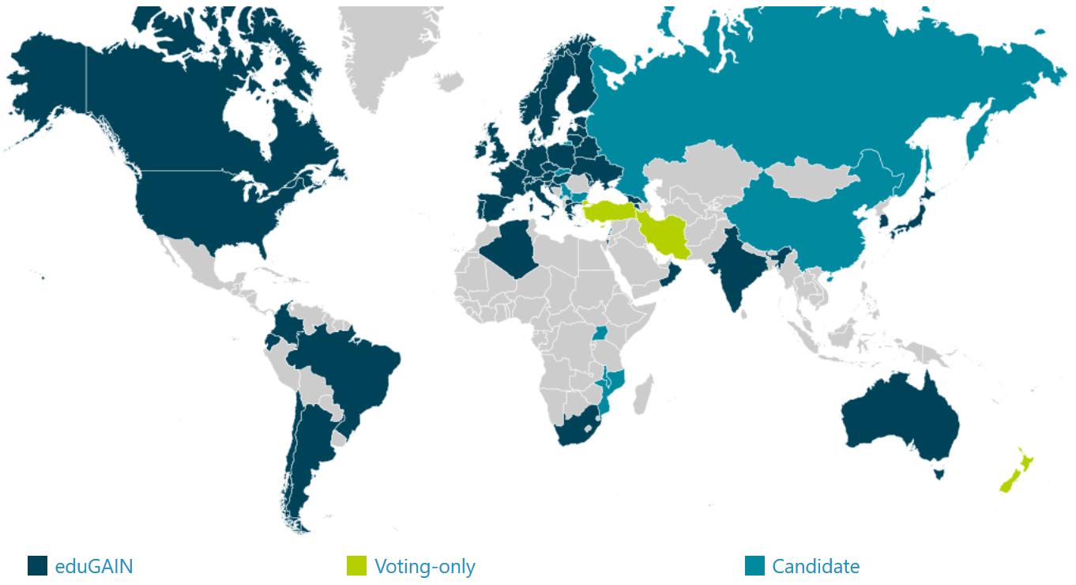




eduGAIN … and Infrastructure Proxies
40 NRENS (≈ countries)
4254 entities
(of which 2533 IdPs, i.e.,
authentication providers)
EGI CheckIn
B2ACCESS
CILogon
ORCID
…
eduGAIN (status Sept 2017)
organisation-centric, and with much national autonomy in policy & practice
where it reaches the users and a ‘link’ is made, provides great ease of use
in most organisations, research is not the primary use case (yet) for the ‘IdP’

Slide 12
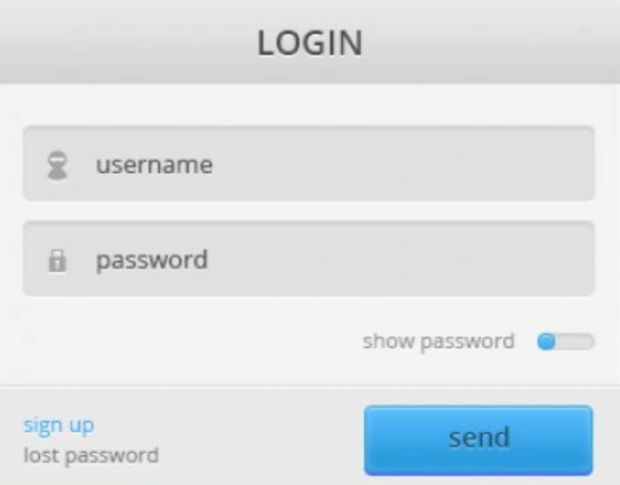



Turtles all the way down … and up!
…

Slide 13
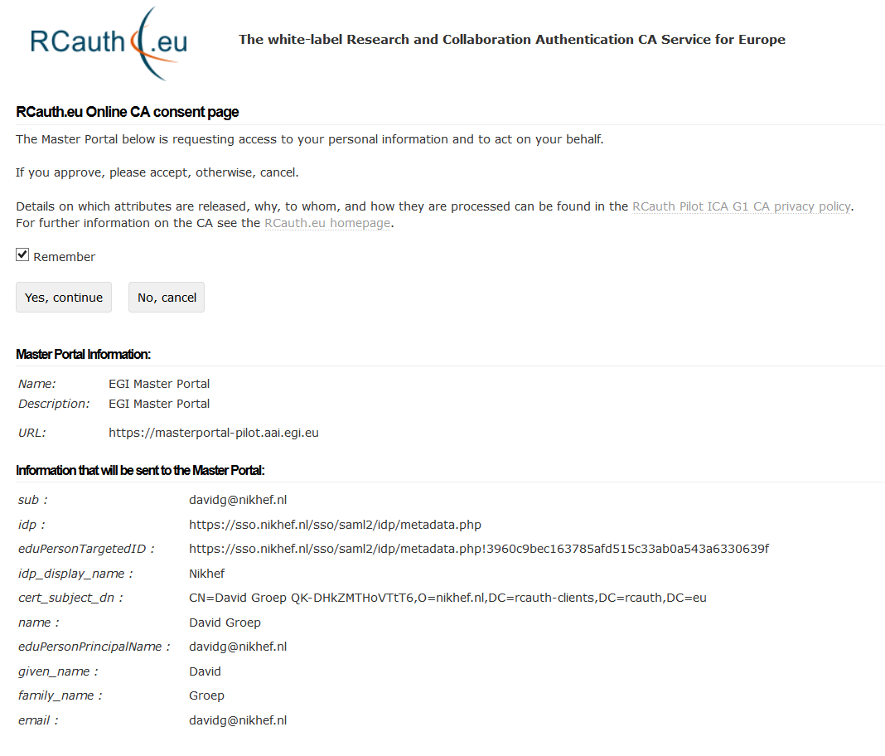
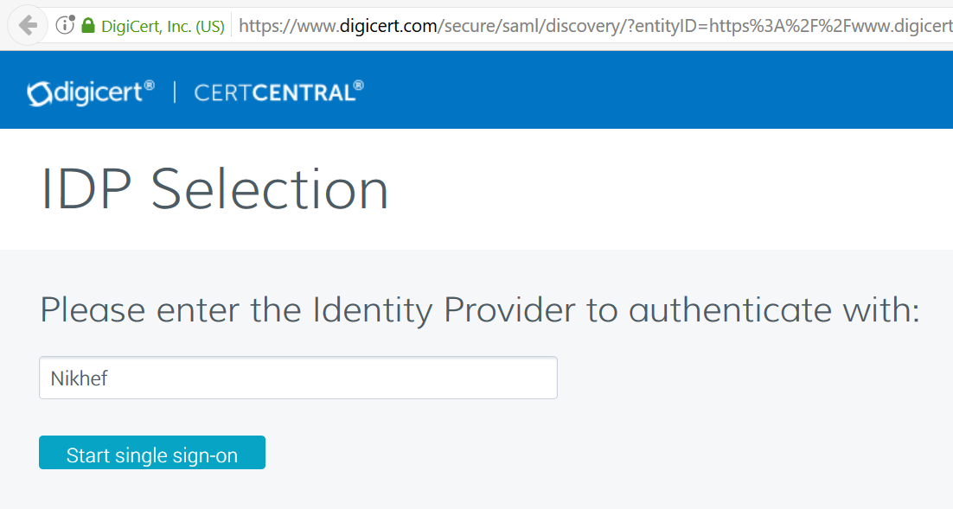
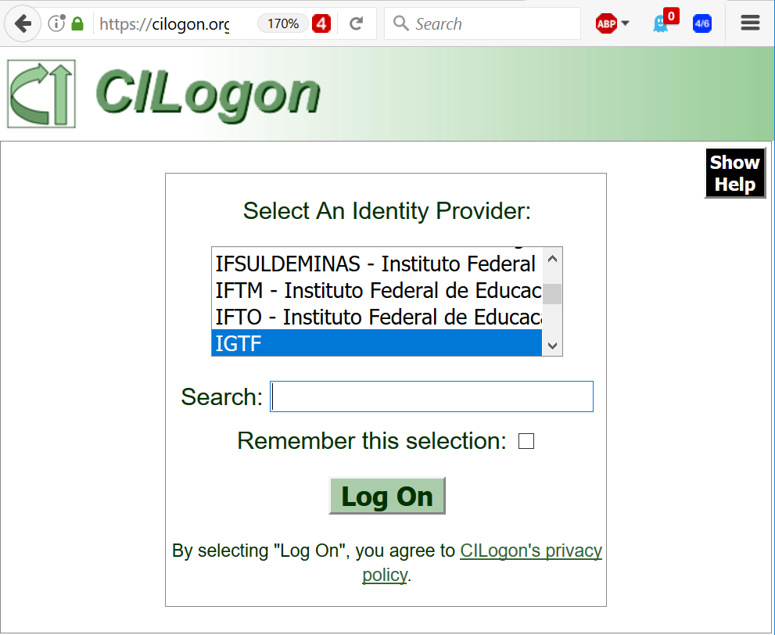
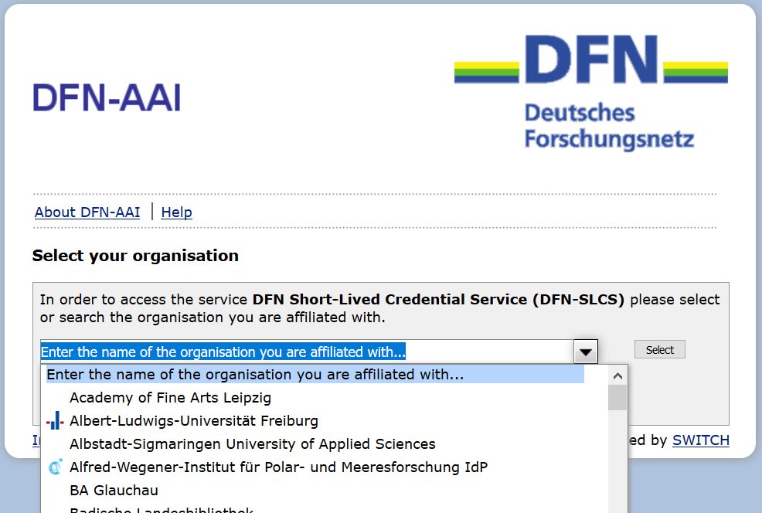
TCS – CILogon – DFN SLCS – RCauth.eu

Slide 14
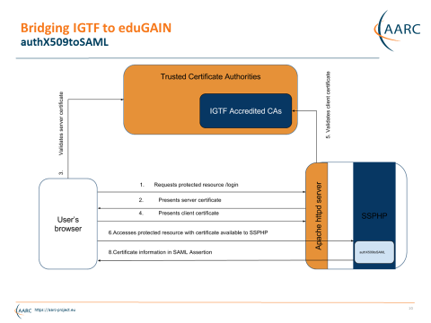
IGTF to eduGAIN bridge
https://edugain-proxy.igtf.net/
Work by Ioannis Kakavas and Nicolas Liampotis (GRNET) for the AARC project

Slide 15
Guidance we have and use
Assurance Profile – now being registered with IANA RFC6711
https://www.igtf.net/ap/
Assessment support
http://wiki.eugridpma.org/Main/AssuranceAssessment
‘Back-office’ template practices
https://www.eugridpma.org/documentation/rps/

Slide 16
Registration Networks
Although the process is labour-intensive and relatively slow, for some user categories the prevalent ‘user-held’ credential is the only one that ‘works’:
non-academic users (SMEs, industrial R&S)
users in a place without an eduGAIN federation
users in a place that does not do unique ID
users in an organization that does not release attributes
users in an organization that does not provide assurance
…

Slide 17
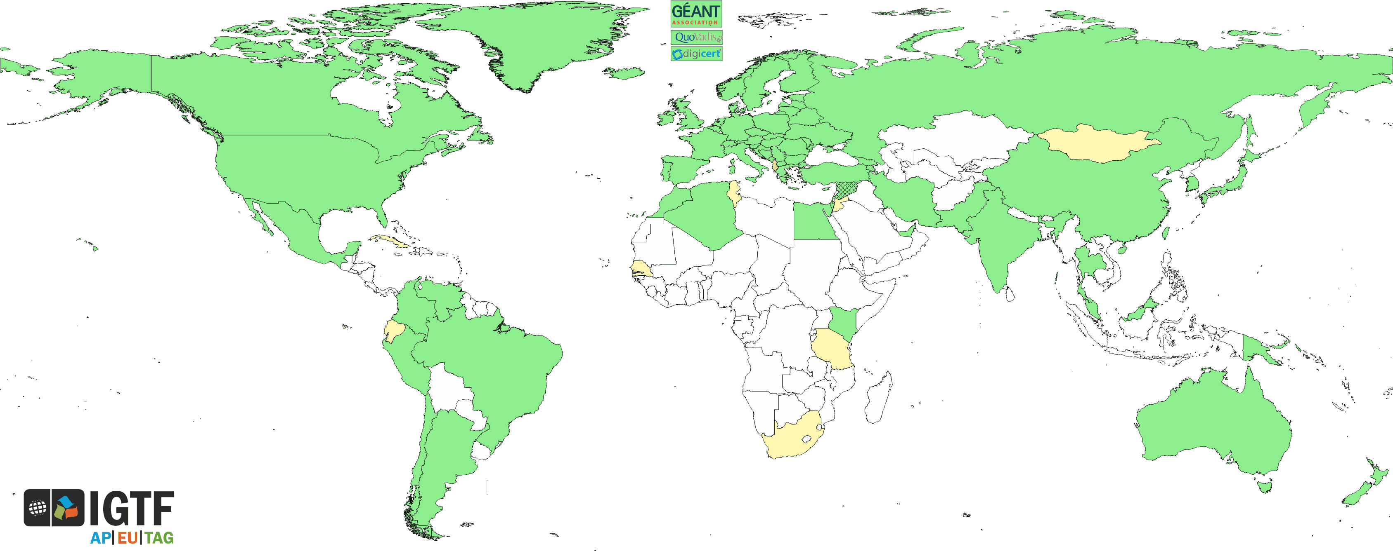
Are we the ‘high-quality IdP of last resort’?
Most useful asset is our RA network!

Slide 18
Assurance Assessment Support

Slide 19
IOTA in the EGI context
EGI – by design - supports loose and flexible user collaboration
300+ communities
Many established ‘bottom-up’ with fairly light-weight processes
Membership management policy* is deliberately light-weight
Most VO managers rely on naming in credentials to enroll colleagues
Only a few VOs are ‘special’
LHC VOs: enrolment is based on the users’ entry in a special (CERN-managed) HR database, based on a separate face-to-face vetting process and eligibility checks, including government photo ID + institutional attestations
Only properly registered and active people can be listed in VOMS

Slide 20
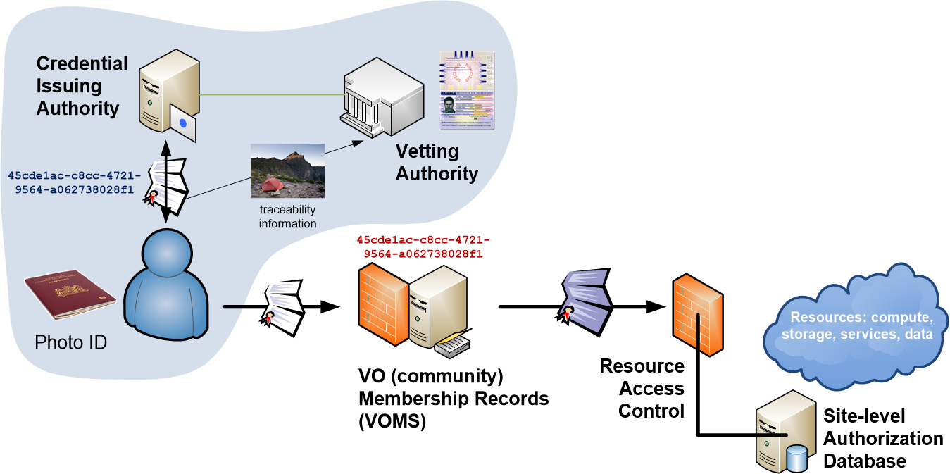
Distributed Responsibilities I:
Trusted Third Party

Slide 21
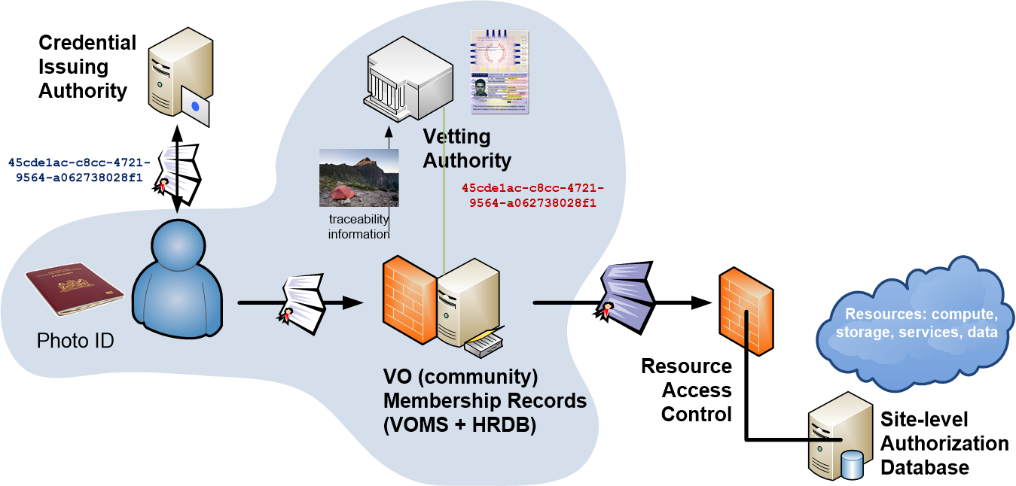
Distributed Responsibilities II:
Collaborative Assurance & Traceability

Slide 22
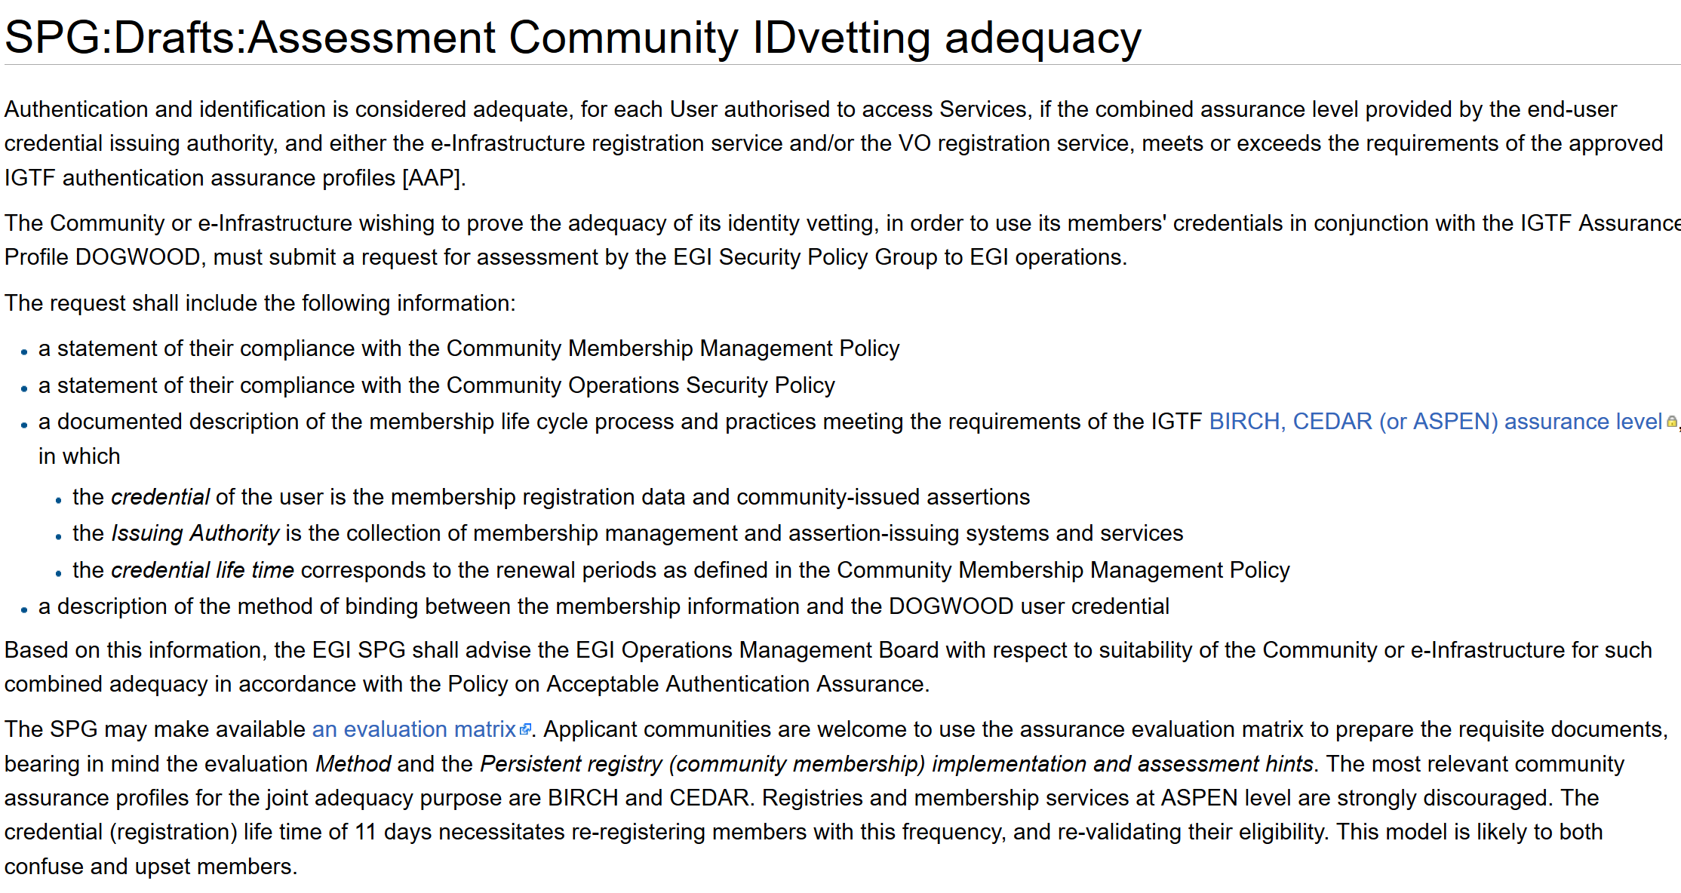
Developing an assessment framework

Slide 23
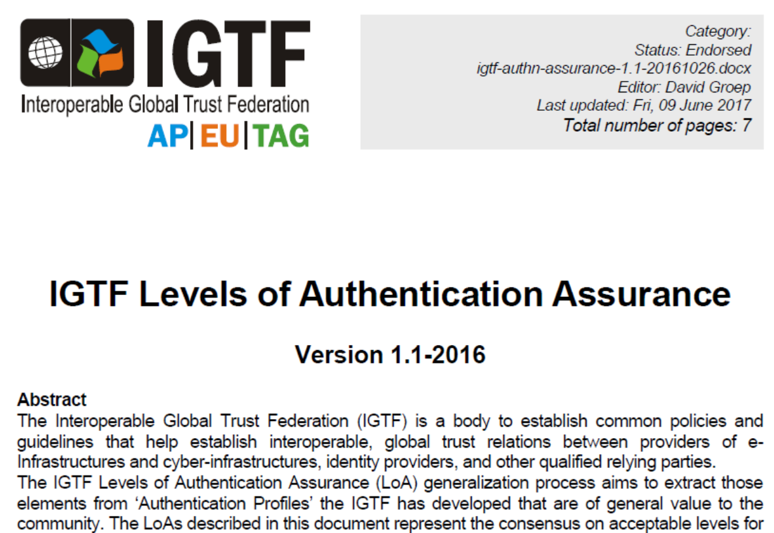
The need for guidance

Slide 24
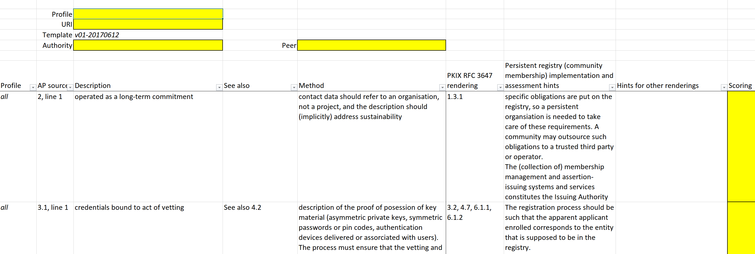
Assessment Matrix
Mapping for PKIX/RFC3647 is trivial
How to apply out BIRCH/CEDAR guidance to community registries?
Relevant for COmanage & VOMS communities,
but maybe wider?
https://wiki.eugridpma.org/Main/AssuranceAssessment

Slide 25
New Technologies, Same Trust

Slide 26
Changes from within and without
Diversification of technology
PKIX works technology-wise, but new users not accustomed to it
SAML R&E federations move quite slowly because of installed-base
New communities and infrastructures like
Oauth2 & OIDC because of industry support
and the end-of-service announcement for the Globus Toolkit stirred the community in some countries and regions as well

Slide 27
On Trust
‘the key factor the IGTF has is not PKIX itself, but the global trust fabric supporting research and e-Infrastructures’
We should retain full PKIX support for many years to come
the Infrastructures will not move away quickly, and EGI, OSG, XSEDE, WLCG, have committed to support GSI and tools
Using the IGTF as a ‘research federation’ registration vehicle in eduGAIN (SAML) is likely not cost-effective – we better push for research support in eduGAIN via existing groups
There is no OIDC federation, but a large need for OAuth in the Infrastructures – and here we can and should play a role!

Slide 28
OIDC Federation Task Force
The IGTF decides to set up a task force to push OIDC Federation next to its current trust anchor distribution. This group will
further identify objectives
scope the needs and requirements for Infrastructure OIDC Fed
verify compatibility of the IGTF Assurance Profile framework
for technology-agnosticity with OpenID providers
test a OIDCFed scenario
e.g. starting with the WLCG use case as a concrete implementation
assess the structure and needed meta-data in the trust anchor distribution, how to address RPDNC, and how it links with dynamic client registration through ‘.well-known’
liaise with other OIDC Fed efforts and Roland Hedberg

Slide 29
Joining OIDC Fed
Group wiki page
https://wiki.eugridpma.org/Main/OIDCFed
Mailing list
oidcfed@igtf.net
Current members
JimB, Jens, DavidG, DaveK, Derek, Eric Yen, Sang-Un, Scott Rea, and Roland Hedberg

Slide 30
Faits Divers: IPV6!

Slide 31
IPv6 status
New continuous v6 CRL monitor
http://cvmfs-6.ndgf.org/ipv6/overview.php
43 CAs offer working v6 CRL (it’s not going up any more ☹)
  but: also 1-2 CAs that give AAAA record but the GET fails …
  Still many endpoints support only legacy IP
  the ClouldFlare cache solution is trivial, so please either …
  dl.igtf.net can act as v6 source-of-last-resort for RPs that need it

Slide 32
Upcoming meetings
For more details,
see https://www.eugridpma.org/meetings/,
but meanwhile:

Slide 33
Upcoming events
EUGridPMA 42, Prague January 22 – 24, 2018

