Slide 1
EUGridPMA Status and Current Trends and some IGTF topics October 2016 TAGPMA24 meeting David Groep, Nikhef & EUGridPMA

Slide 2
EUGridPMA Topics
EUGridPMA (membership) status
New & coming CAs: RCauth.eu/AARC CILogon-like TTS; DarkMatter
GFD.225 OGF Certificate Profile and OGF News
Model implementations for video-supported vetting
Guidelines on Trusted Credential Stores & (finally) on-line CAs
Dissemination and impact
Related activities: Sirtfi & REFEDS Assurance WG
Misc. updated for the IGTF infrastructure
See the IGTF All Hands summary: https://www.eugridpma.org/meetings/2016-09/

Slide 3
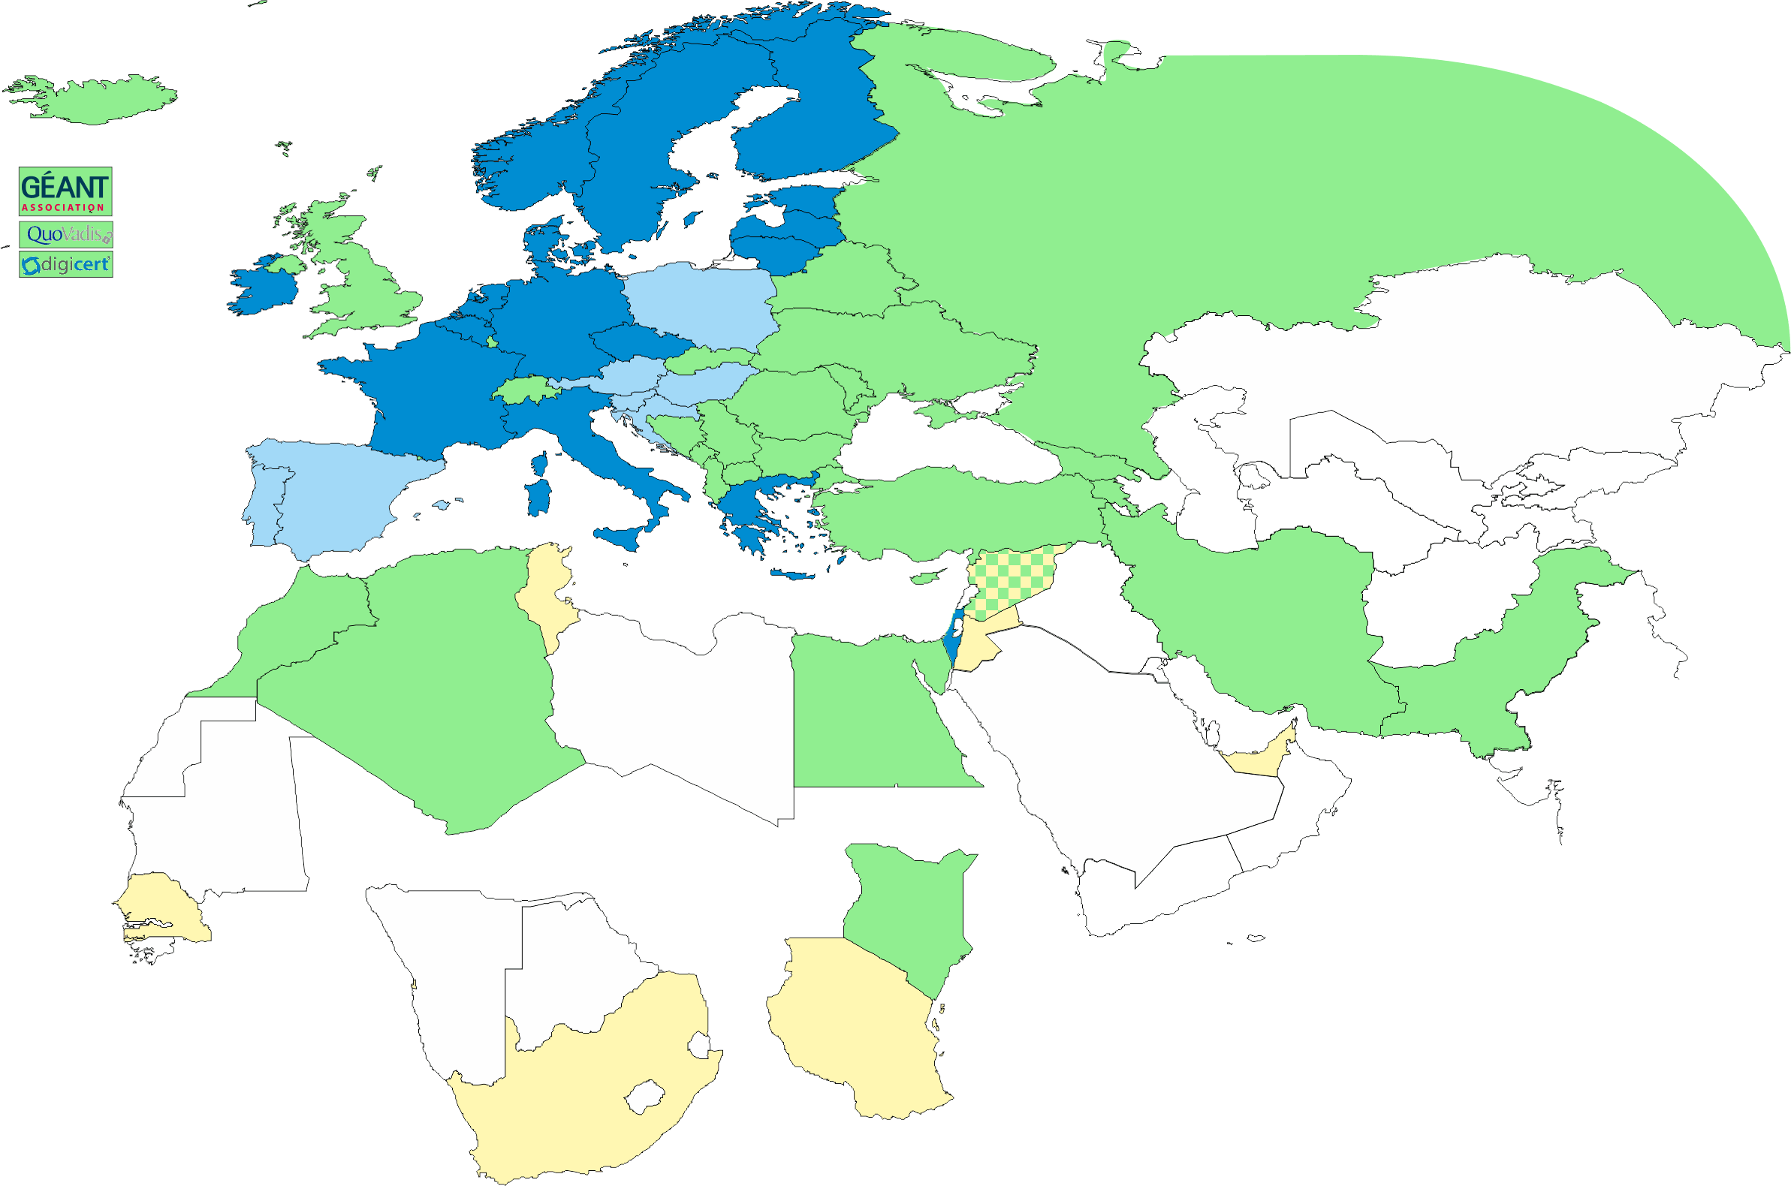
Geographical coverage of the EUGridPMA
26 of 28 EU member states (all except LU, MT)
+ AM, CH, DZ, EG, GE, IR, IS, JO, MA, MD, ME, MK, NO, KE, PK, RS, RU, SY, TR, UA, CERN (int), TCS (EU), QV (BM)
47+4
In progress
ZA, TZ, AE

Slide 4
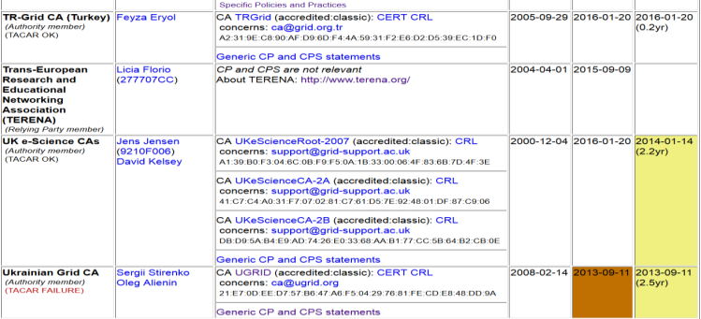
Membership and other changes
Responsiveness challenges for some members
JUNET CA – suspended
HIAST CA – temporarily withdrawn for operational reasons
Identity providers: both reduction and growth
New CA in Kenya (by the NREN KENET) classic on-line CA
New CA from CERN: IOTA (scoped) CA
New CA for e-Infras: RCauth.eu IOTA CA (“for those who cannot use TCS”)
Upcoming CA for UAE: DarkMatter
Self-audit review
Cosmin Nistor as review coordinator
Self-audits progressing on schedule for most CAs

Slide 5
RCauth.eu white-label CA for the AARC CILogon-like TTS Pilot
Ability to serve a large pan-European user base without national restrictions
without having to rely on specific national participation exclusively for this service
serving the needs of cross-national user communities that have a large but sparsely distributed user base
Use existing resources and e-Infrastructure services
without the needs for security model changes at the resource centre or national level
Allow integration of this system in science gateways & portals with minimal effort
only light-weight industry-standard protocols, limit security expertise (and exposure)
Permit the use of the VOMS community membership service
attributes for group and role management in attribute certificates
also for portals and science gateways access the e-Infrastructure
Concentrate service elements that require significant operational expertise
not burden research communities with the need to care for security-sensitive service components
keep a secure credential management model
coordinate compliance and accreditation – and help meet EU privacy stuff in just one place to ease adoption
Optional elements: ability to obtain CLI tokens (via ssh agent or even U/P); implicit AuthZ

Slide 6
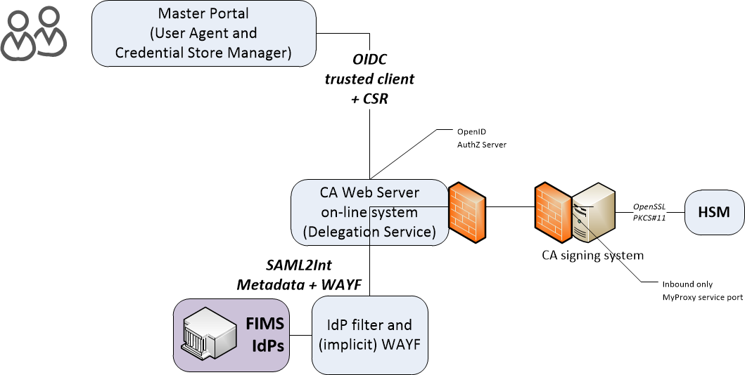
Enrolment and issuance [4.2]
Users could enroll directly, but are in practice using a Master Portal/Credential Manager
The credential manager is explicitly trusted by the RCauth CA service
exchange of OIDC client secret to authenticate
‘need to know’: (master) portals will hold user credentials, and we need to protect users per the PKP Guidelines
CA web server checks the incoming assertions from the IdP filter
Uses CILogon/OAuth4MP software based on the Shibboleth SAML implementation over server-side TLS
Connected for now to the SURFconext WAYF
… and yes, we check the SAML signature ;-)
When moving to wider support of eduGAIN
WAYF IdP filter check the incoming SAML2Int
Use multi-domain WAYF over server-side TLS
Based on SimpleSAMLphp implemenation with custom filters
… and yes, also here we’ll check the SAML signature
FIMS IdPs: leverage existing infrastructures

Slide 7
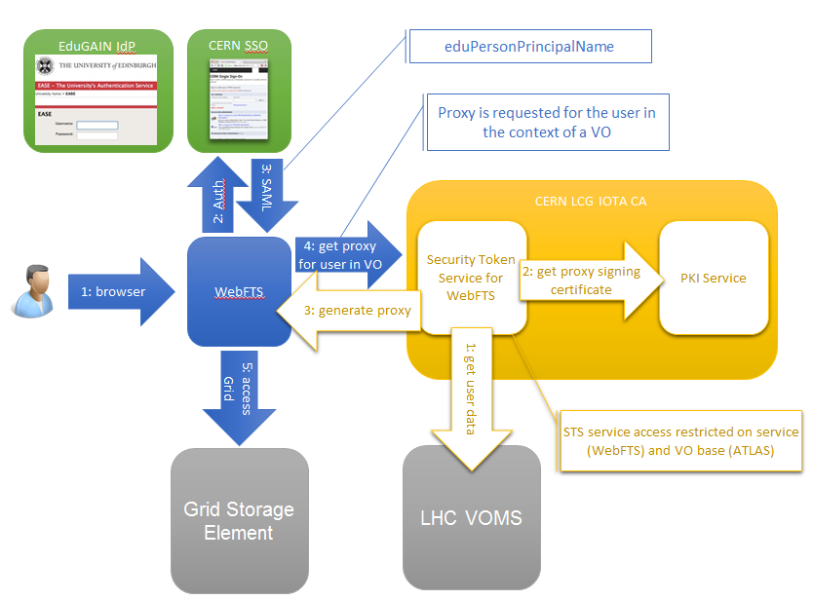
CERN LCG IOTA CA
Specific Identifier Only Trust Assurance CA – adds ‘VO membership’ constraints internally to fit with current state of e-Infrastructures and wLCG sites*
* http://lcg-ca.web.cern.ch/lcg-ca/doc/WLCG-CERN-IOTA-statement-MB.pdf

Slide 8
Broader issues from the IGTF ALL HANDS meeting

Slide 9
GFD.!(225)
Now ‘really’ almost done – Jens also picked the last nits:
About to be published soon now … and Jens is now anyway the OGF VP of Standards …
But the number has been taken by another spec right now ☹
Also there the reviews should probably check compliance
https://www.overleaf.com/646373kvfmwn

Slide 10
Video-supported vetting
“[Vetting] should be based on a face-to-face meeting and should be confirmed via photo-identification and/or similar valid official documents.” (BIRCH and CEDAR APs)
Many support explicit F2F only, yet designate RAs in different ways
Video-supported and notary-public postal mail & video: BR, TR
Government records: some TCS subscribers (universities with access to these databases)
Kantara LoA 2: some TCS countries (SE) for some of their applicants

Slide 11
Evolution of guidance
Closing soon …
“The aim should be to stay within the 'bandwidth of trust' described in the current text: between the (possibly worthless) notary-public attestations, and the more trusted real in-person hand-shake vetting.”
“If appropriate compensatory controls are in place and we can protect same-person continuity (non-reassignment) as well as traceability, it should be viable. Compensatory controls have some 'hard' requirements in the model process described in the Wiki:”
http://wiki.eugridpma.org/Main/VettingModelGuidelines
It is important that this be described and reviewed in each case, so the proposal is that "The following is also considered to be an acceptable process for implementing method 2 - if so acceptably documented in the CP/CPS and endorsed by the accrediting PMA”

Slide 12
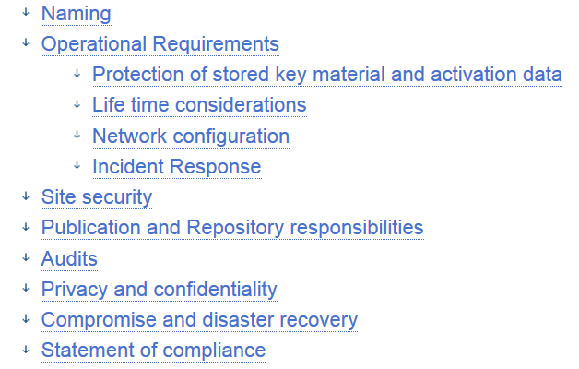
Trusted Credential Stores
In easing access to e-Infrastructures incrasingly credential management systems appear: UnityIDM, MyProxy hosting, AARC’s Master Portals, …
Issuing Authorities promoting PKP guidelines (e.g. RCauth.eu) need framework to assess explicitly-connected portals
Guidance on what constitutes an ‘acceptable’ credential store
Guidance for operators on ‘community best practice’
https://wiki.eugridpma.org/Main/CredStoreOperationsGuideline

Slide 13
Sirtfi and R&E federation assurance
Federation 2
SP
Federation 1
SP
IdP
IdP
SP
SP
SP
SP
SP
All I need is one identity…
IdP
Federation 3
SP
IdP
SP

SP
IdP
Clearly an inviting vector of attack… luckily, this was noticed several years ago!

Slide 14
Find out more on Sirtfi
https://refeds.org/sirtfi

Slide 15
More R&E developments on assurance
REFEDS Assurance WG
Baseline comes out of Mikael’s AARC work
Permit IdPs to assert individual elements (‘wireframe doc’)
https://docs.google.com/document/d/15v65wJvRwTSQKViep_gGuEvxLl3UJbaOX5o9eLtsyBI/edit
EGI ad-hoc assurance evolution
Use cases identified for several levels – needs alignment
There is a noted difference between ‘open guest IdPs’ and controlled university IdPs, but these cannot be identified now
UKAMS publishes UnitedID to edugain: ‘edugain’ is not enough
But hardly any need for >>BIRCH LoA (only some biomed cases)

Slide 16
IPv6 status
New continuous v6 CRL monitor http://cvmfs-6.ndgf.org/ipv6/overview.php
43 CAs offer working v6 CRL
but: also 2-4 CAs that give AAAA record but the GET fails …
Still 52 broken endpoints support only legacy IP
dl.igtf.net can act as v6 source-of-last-resort
fetch-crlv3 v3.0.10+ has an explicit mode to force-enable IPv6 also for older perl versions
Added option "--inet6glue" and "inet6glue" config setting to load the Net::INET6Glue perl module (if it is available) to use IPv6 connections in LWP to download CRLs

Slide 17
Dissemination and outreach
‘We do have a story to tell, but in practice we're not telling it’
Worthwhile topics in the short term would be:
the new assurance level specification - Jens
the onboarding of new CAs, like Darkmatter and RCauth
new use cases and RIs that use the LoA levels
At least Jens, IanN, and Jules are willing to help with (some of) these efforts. Other concrete actions for volunteers pick-up:
white paper on the assurance model (or more)
create a Wikipedia entry for IGTF (it's only mentioned now in a lemma on federation written by Rainer Hoerbe)
and we should update the IGTF entry on the REFEDS Wiki

Slide 18
Other IGTF related topics
Redundancy of operations and ROBAB proof-ness
Web site updates and infrastructure

Slide 19
Upcoming meetings
For more details, see https://www.eugridpma.org/meetings/, but meanwhile:

Slide 20
Upcoming events
REFEDS, CERN, Geneva November 28
EUGridPMA 39, Florence Jan 30 – Feb 1, 2017
APGridPMA, Taipei March 6 (tbc) 2017
EUGridPMA 40, Ljubljana May 8 – 10, 2017

