Slide 1
EUGridPMA
Status and Current Trends and some IGTF topics
March 2016
Taipei, TW
David Groep, Nikhef & EUGridPMA

Slide 2
EUGridPMA Topics
EUGridPMA (membership) status
New and updated CAs
IOTA CAs
IPv6 readiness and fetch-crl
Disaster Recovery WG
RATCC
AARC CILogon for Europe
Also see the Bratislava summary at
https://www.eugridpma.org/meetings/2016-01/

Slide 3
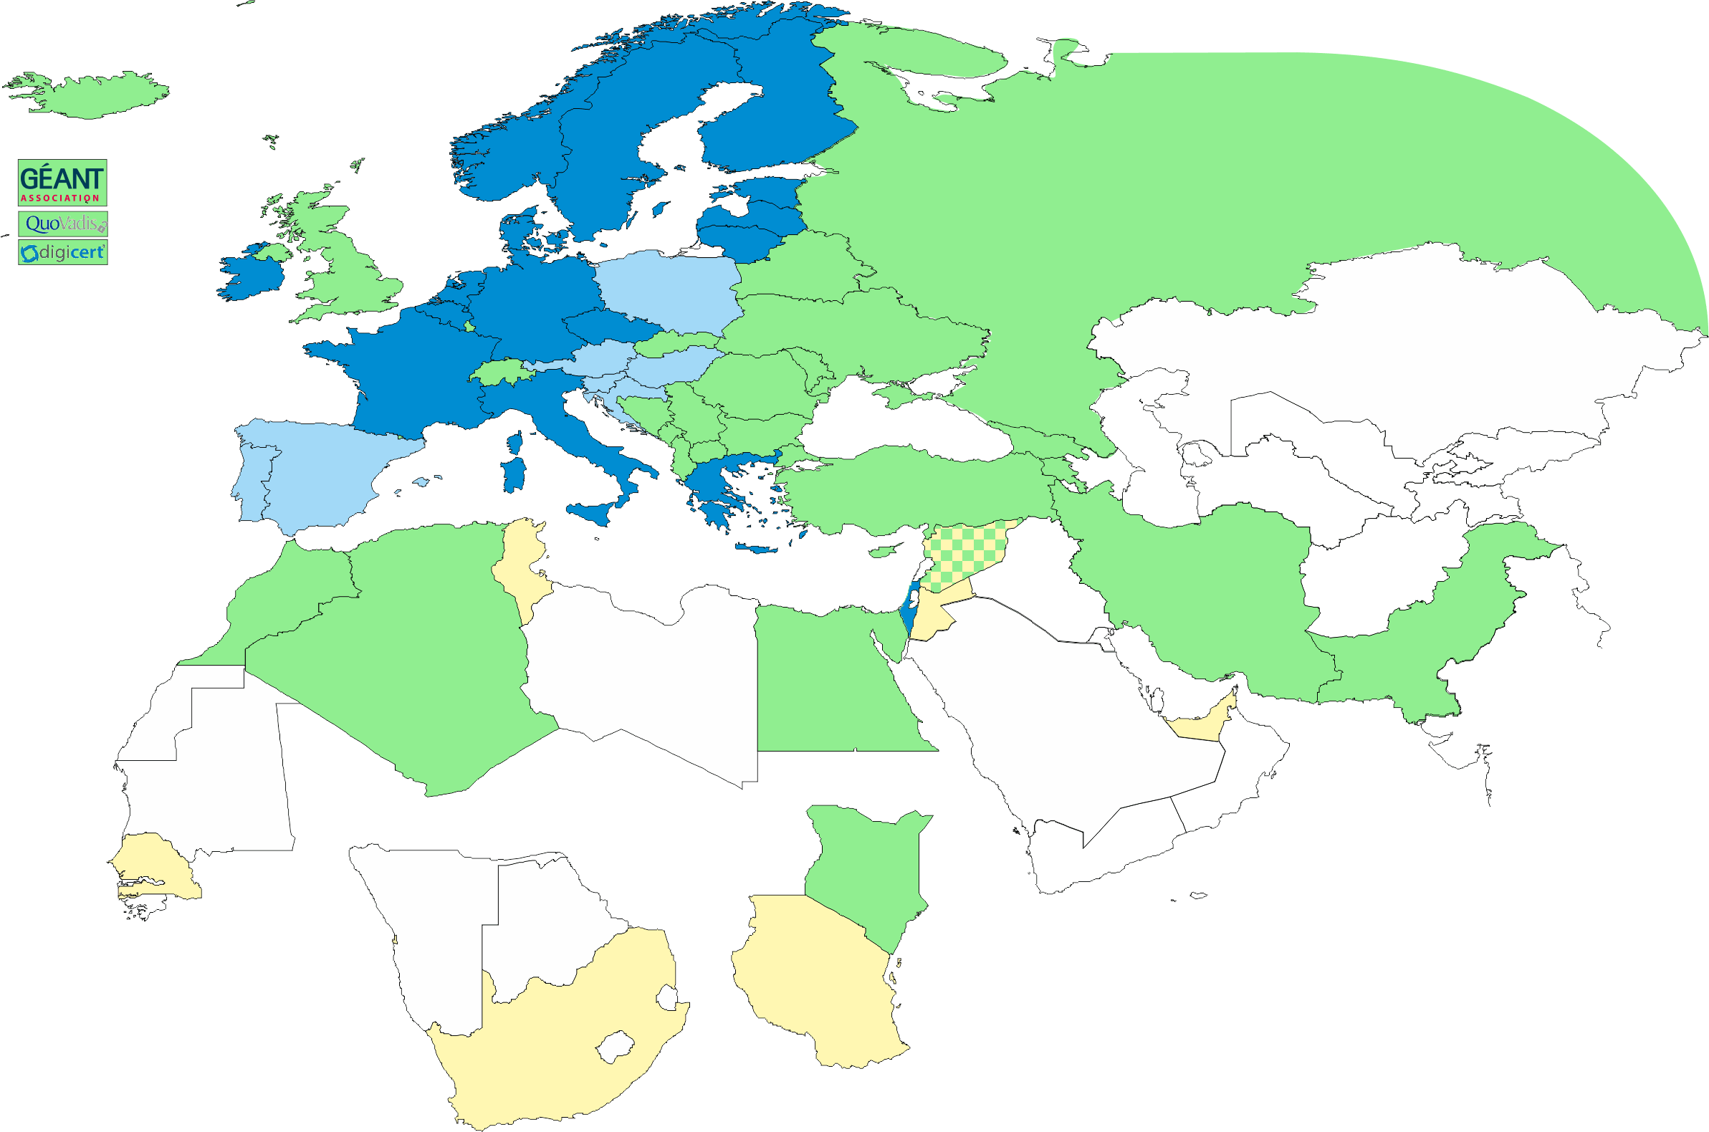
Geographical coverage of the EUGridPMA
26 of 28 EU member states (all except LU, MT)
+ AM, CH, DZ, EG, GE, IL, IR, IS, JO, MA, MD, ME, MK, NO, PK,
RS, RU, SY, TR, UA, CERN (int) + TCS (EU)
Pending or in progress
ZA, TZ, AE

Slide 4
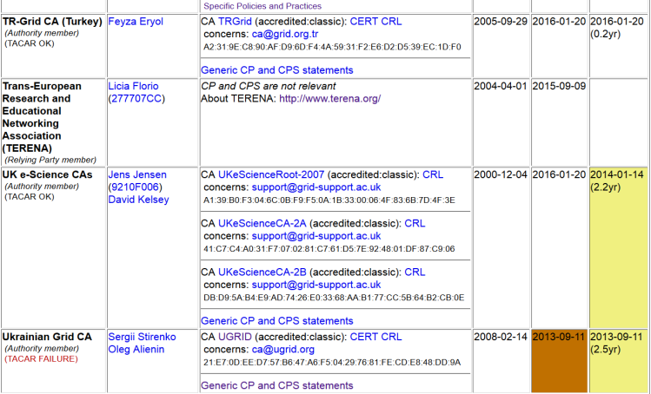
Membership and other changes
Responsiveness challenges for some members
  JUNET CA – suspended
  HIAST CA – temporarily withdrawn for operational reasons
Identity providers: both reduction and growth
  New CA in Kenya (by the NREN KENET) classic on-line CA
  New CA from CERN: IOTA (scoped) CA
  In progress: RCauth.eu IOTA CA
Self-audit review
  Cosmin Nistor replaced Kaspars as
  review process coordinator
  Self-audits progressing on schedule
  for most CAs

Slide 5
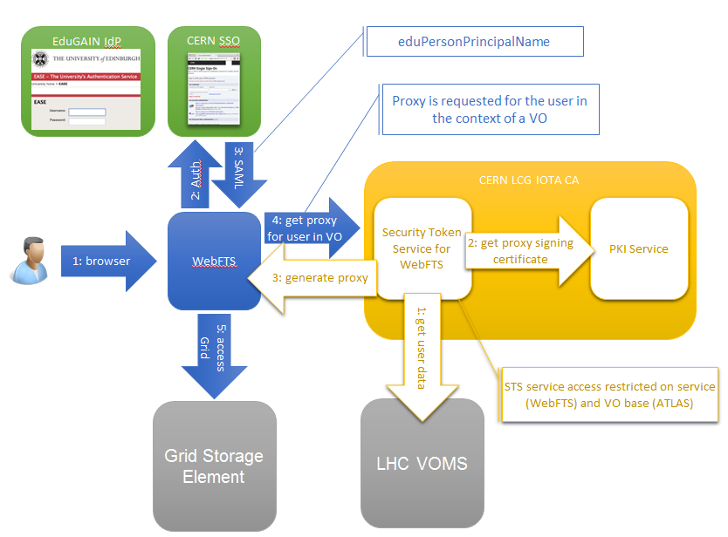
CERN LCG IOTA CA
Specific Identifier Only Trust Assurance CA – adds ‘VO membership’ constraints internally to fit with current state of e-Infrastructures and wLCG sites*
* http://lcg-ca.web.cern.ch/lcg-ca/doc/WLCG-CERN-IOTA-statement-MB.pdf

Slide 6
We have also documented on-line CA Guidance now
The on-line CA guidelines document available at
https://wiki.eugridpma.org/Main/GuidelinesForOnLineCAs
Codifies current requirements from Classic AP and current best practice – and permits more explicitly the key generation ceremony
Follows AP structure:
Operational requirements
Network controls
Key generation
Key storage
Key Activation
Key Deactivation
Key End of Life
Procedural Controls
Site Security
Publication and repository responsibilities
Audits
Compromise and disaster recovery

Slide 7
Which one to pick if you want it ‘just done’
On-line CA architectures must ensure that only legitimate traffic related to certificate issuing operations will ever reach the on-line CA issuing system. This can be ensured in various ways:
(A) an authentication/request server, suitably protected and connected to the public network, and a separate signing system, connected to the front-end via a private link, that only processes approved signing requests and logs all certificate issuance;
(B) an authentication/request server containing also the HSM hardware, connected to a dedicated network that only carries traffic destined for the CA and is actively monitored for intrusions and is protected via a packet-inspecting stateful firewall;
where it is noted that model A type designs are more readily secured and usually need less components and effort to maintain and operate and therefore preferred.

Slide 8
Best practice now documented
“To further protect the issuing CA and permit revocation thereof, it is strongly advised that all on-line issuing CAs be a subordinate of an off-line root or higher-level CA, where the off-line root may have a long-lived (one year or longer) CRL.”
“Any on-line CA shall have a disaster recovery and business continuity plan. For CAs where the key material has been generated inside the HSM, this plan should include regular tests of the capability to recover the key in the HSM from archival material.”
And a bit more, just read the doc …

Slide 9
IPv6 status
FZU runs a continuous v6 CRL monitor
http://www.particle.cz/farm/admin/IPv6EuGridPMACrlChecker/
23 CAs offer working v6 CRL
  but there are also 4 CAs that give an AAAA record but where the GET fails …
  Still 71 endpoints to go (but they go in bulk)
  dist.eugridpma.info can act as v6 source-of-last-resort
fetch-crlv3 v3.0.10+ has an explicit mode to force-enable IPv6 also for older perl versions
  Added option "--inet6glue" and "inet6glue" config setting to load the Net::INET6Glue perl module (if it is available) to use IPv6 connections in LWP to download CRLs

Slide 10
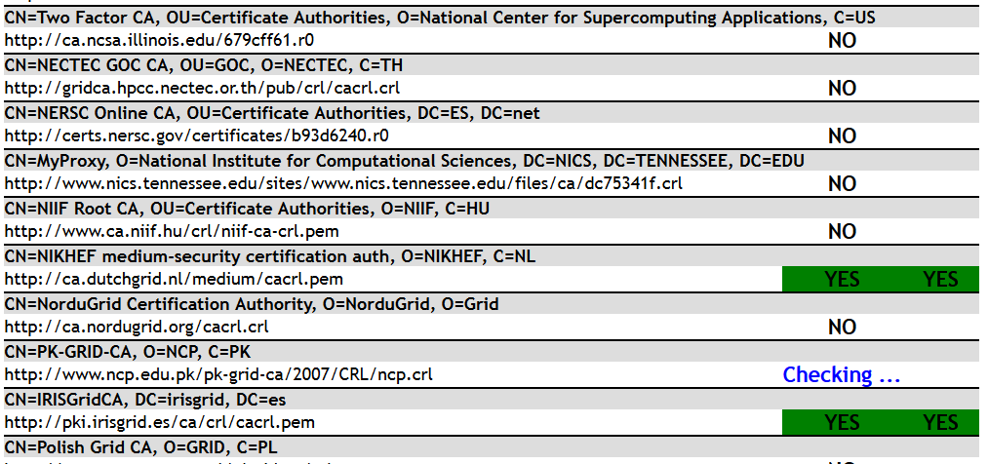
http://www.particle.cz/farm/admin/IPv6EuGridPMACrlChecker/
… and moving to a new place …

Slide 11
Disaster Recovery WG
Need for disaster recovery and business continuity reference text for CP/CPS section (and plans).
various risks from (power) instability, earthquakes, to the sudden appearance in a CA managers' path of city buses that subsequently continue to run over said CA manager.
not a large body of good reference texts for such a disaster recovery section in the CP/CPS. Some CAs do have it included, and periodically test the viability of the plans (such as CESNET), in others it is an ongoing concern of the operators (such as in the UK).
set up a task force to come up with good reference texts and methods for disaster recovery.
The group initially consists of Shahin, Jan Chvojka, Ursula, and Jens.

Slide 12
Upcoming meetings

Slide 13
IGTF+ Meeting Agenda
EUGridPMA 37: Ankara – May 9-11 2016
TNC2016 + REFEDS: 13+14-16 June 2016, Prague
EUGridPMA 38**, 19-21 Sept 2016, Geneva
EUGridPMA 39, Jan 2017, Florence
EUGridPMA 40, May 2017, Ljubljana
** pick this for the IGTF All Hands?

